Slide 1
对话系统的来龙去脉
机器智能前沿论坛
清华大学
智能技术与系统国家重点实验室
朱小燕
2017.11.4

Slide 2
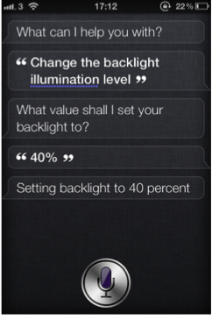
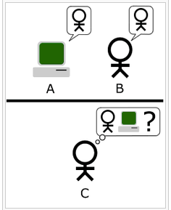
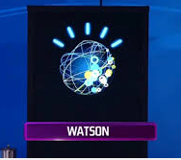
Question Answering or Dialogue Systems
IBM Watson：在Jeopardy！问答节目中击败人类冠军选手
起源于Turing Test；
AI领域最难和最基本的问题之一
苹果Siri：智能语音助手
Notes:
A： computer
B：人
C：测试者

Slide 3
1966 - ELIZA
第一个聊天机器人
在临床治疗中模仿心理医生
1964-1966 由Joel Weizenbaum在MIT编码完成
Weizenbaum对ELIZA的表现感到吃惊，随后写了《 Computer Power and Human Reason 》这本书，表达他对人工智能既爱又恨的纠结情感。
  Weizenbaum J. ELIZA—a computer program for the study of natural language communication between man and machine[J]. Communications of the ACM, 1966, 9(1): 36-45.
  Weizenbaum J. Contextual understanding by computers[J]. Communications of the ACM, 1967, 10(8): 474-480.

Slide 4
1966 – ELIZA(Cont.)
关键词匹配+规则
  若输入中含有“mother”一词，则ELIZA返回“Tell me more about your family”
若没有匹配上，则随机返回一些固定的句子
  “Very interesting. Please go on.”
  “Can you think of a special example?”
替换用户输入句子的某些词语生成回复
  my → your
  here→ there

Slide 5
1994 – A.L.I.C.E
ALICE: Artificial Linguistic Internet Computer Entity
目的
  娱乐，与人聊天
启发式模式匹配规则
两部分组成
  聊天引擎
  语言模型
    语言模型以AIML(Artificial Intelligence Mark-up Language)文件存储

Slide 6
1994 – A.L.I.C.E(Cont.)
2000年、2001年以及2004年3次获得Loebner奖
Loebner奖
  聊天机器人竞赛，始于1990年，每年一次，现代图灵测试，2013年结束
缺点
  不保留会话历史记录
  不能真实理解用户说的话
  仅根据系统现有的内容做出回应

Slide 7
Types of QA Systems
Information extraction (IE):
  Pre-defined templates are questions
  Filled template are answers
  e.g. TIPSTER, MUC
Information retrieval (IR)
  Queries are questions
  List of documents are answers
  QA is close to passage retrieval
  Well established methodologies (i.e. Text Retrieval Conferences TREC)
Data base based QA
  Translate question to relational DB query; e.g. LUNAR, FRED
Notes:
Established完善成长的

Slide 8
可交互系统
Conversational System
学术研究
认知智能表现的窗口
应用推广
智能人机协同的入口

Slide 9
BOTs
问答
一问一答
对话
有问有答，包含上下文逻辑
交互
融合更多种类环境/上下文信息，作出不同决策或推荐

Slide 10
动机
本课题组研究开始于2005年
原始目标：挑战搜索引擎
新一代搜索引擎现状
  Google目标是60%以上结果是内容直接返回，据说已经达到50%了

Slide 11





Search with Key Words
Key Words
URL
Information
Refine Key Words
Inspect
Notes:
研究从关键词检索开始，发现问题，用户能够的到信息，但是，要付出很多劳动，还有很多时候是失败。
引发思考，到来新一代搜索引擎：语义搜索

Slide 12













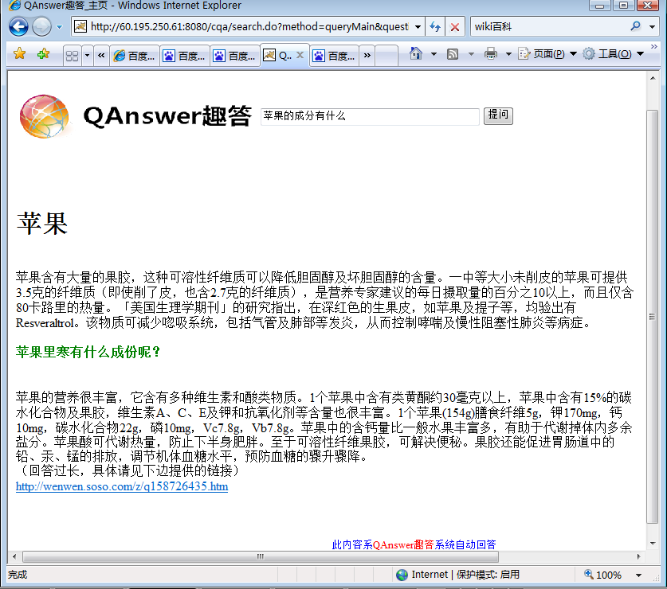













How to cure my cold?
How to say “I love you” in Chinese?
“我爱你”
吃点感冒药，好好休息 …
I want to
buy G10
电池很好，显示不行，。。。
Here is answers!!!
Beijing
weather?
http://www.qanswers.net/cqa
晴 24℃ 湿度: 34% …
Smart Agent
美国第44届总统 …
Smart Agent
Who is
Obama？
Notes:
我们最终的目的是使得任何人，在任何地点，用最自然的方式，高效快速地得到信息。
We hope people can access internet with one agent not several vertical search engines,
Get answer directly, don’t need to click url many time to reach the answer,
Don’t need to select best answer from many similar answers.
we are developing a Q&A based internet information acquisition platform called QAnswer.
Currently, search engines, such as Google, all push the task of data mining back to users. The process of a web search is an interactive process repeating as shown in the picture: the user has to analyze pages to find the information needed and, often, requires better keywords to repeat the search.
We hope search engine be able to provide direct answers. Such a system is possible as demonstrated in our QUANTA system as shown in the picture.
sophisticated and tidy answers复杂、整洁的答案

Slide 13
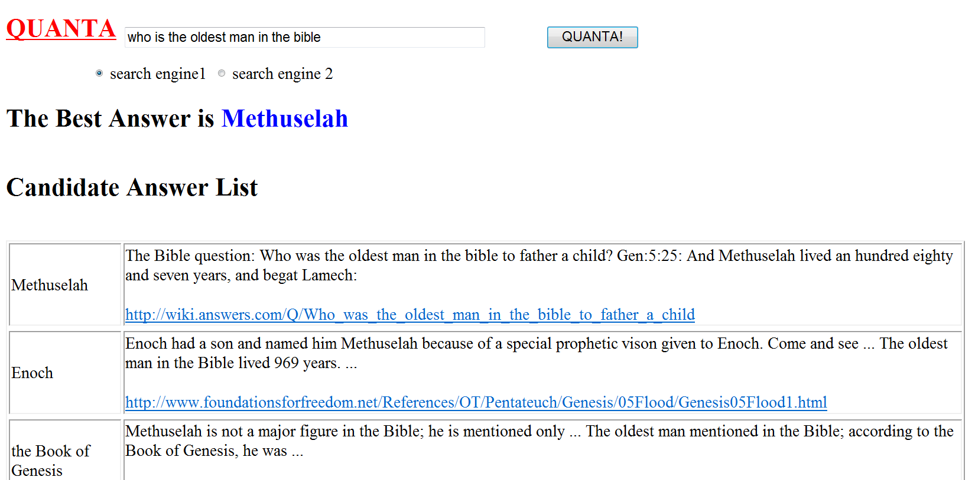
Retrieval-based QA: Factoid QA
Factoid question (www) answering engine,
  TREC, from 1992-2008,
  Our research started in 2005
  QUANTA, getting information from internet
Who is the oldest man in the bible ?
Notes:
下边就我们自己的研发经历，再回顾一下QA系统，随着大环境，包括各种技术，数据，网络，计算机等等方面的发展，所发生的变化。
当然，也包括了我们自己的心得
第一个阶段，当然还是延续最原始的QA，回答事实性问题，因为，那是国际评测TREC的内容，也是当时，国际上衡量技术的标准
我们开发的系统，主要是依赖于通用搜索引擎，当时是Google。
不谦虚地说，到2009年时，基本上达到了上线，也就是说，Google能找到的，并在返回前列，（前 200）中的信息我们都能够挖掘出来，返回给用户。
实际上我们是做了一个重排序。

Slide 14
Information Distance
D_{max}(x,y|c)
d_{max}(x,y|c)
d_{max}(x,y)
D_{min}(x,y)
d_{min}(x,y)
D_{max}(x,y)
Information Distance
D_{max}(x₁,x_{2,…})
Kolmogorov Complexity
Notes:
This is the sketch map of Information distance theory. Based on the Kolmogorov complexity theory, information distance family consists of various distance measures, and we have done a lot of work on this.

Slide 15
Retrieval-based QA
Data set：
Jimmy Lin’s factoid data
 | First answer | MRR
QUANTA | 69.7% | 0.77
Start | 28% | 0.28
BrainBoost | 44% | 0.51
Ask | 42% | 0.48
Google | 41% | 0.49
MSN | 38% | 0.44
Publications: SIGKDD2007 （finalist）, JCST
Notes:
这篇论文进入了finalist，

Slide 16
转变
受到加拿大政府的资助（2009），开始中文信息处理
Google 离开中国（2010）
信息含量有瓶颈
  互联网不是万能的，课查询到的内容上限约70%
  解决方案：借助人类储备了上千年的知识

Slide 17
Community QA （from 2010）
Question Retrieval (similarity)
Answer Selection (quality, relevance)
  Social features
  Abundant training data
Social media data used as a kind of knowledge
Notes:
Abundant丰富的

Slide 18
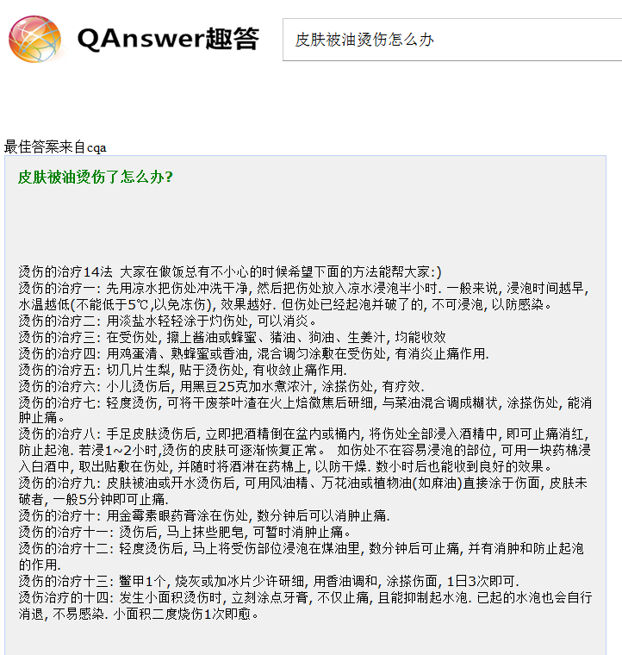
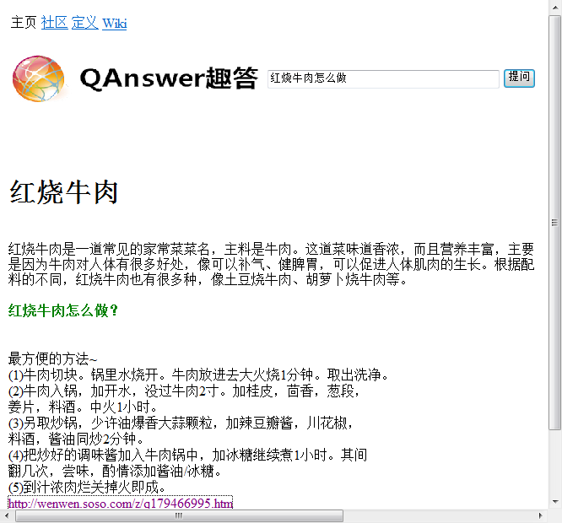
QAnswer(趣答)Ver.1.0
http://www.qanswers.net/cqa
Complex question (why, how) answering engine
Notes:
随后我们就发现，70%是上限，而且，事实性问题不是大众所关心的，怎么做也就是做个玩具。
因此，我们将问题类型从事实性转向复杂问题，即why，how问题，并且加入了中文内容，开发了“趣答”系统，主要数据来源是社区问答平台

Slide 19
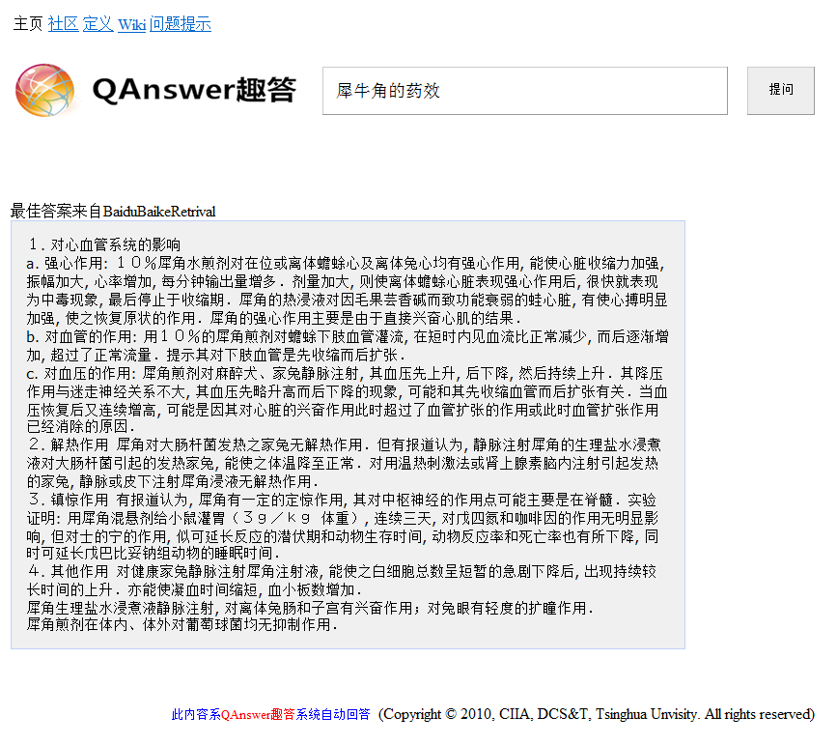
QAnswer(趣答)Ver.2.0
Web service: From a toy to a tool
Data from cQA portals, encyclopedia, commentary websites, forums, ……
The precision is around 70%
Licensed to 科大讯飞, in 2012
Notes:
进一步，有综合了其他的一些资源，有了现在的版本，得到了业界的认可。

Slide 20
再转变
依旧是个玩具
如果要做真实的信息服务，需要真正的知识体系支撑
开放域知识图谱研究（2011-2013）
  不是大学能够承担的工作
集中于垂直领域人机交互/信息服务系统（2013-至今）

Slide 21





Future Kitchen
-- Act Planning
制作秘籍
将西兰花洗净并切成小块
将牛肉放入清水中大火煮5分钟
……
将处理好的羊肉放入锅中小火炖30分钟
……
翻炒杏鲍菇至金黄色，装盘
将炖好的羊肉盛入碗中，放少许香菜
订制一本秘籍，
制作一桌菜品
冰箱里有西蓝花，还需购买牛肉。
各种需补充食材
有三个采购渠道
供您选择
后天聚餐
8人，爱吃辣的
预算600元
大数据菜谱
优鲜网：
牛腩肉：38元/600g
草鱼肉片：12元/300g
羊腿肉片：33元/500g
一键下单
这份食谱如何？
冬天吃清炖羊肉更
加健康噢！
聚餐食谱
凉拌蕨根粉
五香牛肉
水煮鱼片
清炖羊肉
干锅杏鲍菇
蒜蓉西兰花
酸辣汤
该淘米了！
聚餐食谱
凉拌蕨根粉
大拌菜
五香牛肉
水煮鱼片
清炖羊肉
干锅杏鲍菇
蒜蓉西兰花
酸辣汤
嗯不错！
我丈夫不爱吃蕨根粉
帮我换个凉菜吧
生鲜网：
牛腩肉：32元/550g
草鱼肉片：15元/350g
羊腿肉片：32元/500g
一键下单
换成大拌菜了
还有别的要求吗？
有什么忌口？
将牛肉先炖上
炒西兰花先放油
很好！
就是它啦！
爱吃网：
牛腩肉：30元/500g
草鱼肉片：18元/300g
羊腿肉片：28元/450g
一键下单
酸辣汤到时间了！
订制菜谱
采购食材
协助制作
A conversation system with a conversational agent
Notes:
这是一个美的未来厨房的系统设计的例子，也是一个上个星期（2017.3.8）刚刚发布的概念产品。
机器人（agent）可以根据主人来客的人数，人员成分，时间，季节等等因素，利用组合优化的方法推荐菜单。
然后，根据家里已有的素材，提供实品店或者电商等渠道所需要的采购单子，或直接推荐电商的采购界面，直至下单步骤之前（下单一个功能应该是人完成的，以免发生错误）
同时，agent还有义务根据菜单，为主人制定制作计划，例如操作的顺序，以及，根据制作秘籍通过语音交互，指导主人完成菜品制作
这是一个我们协助完成的项目，与斯伦贝谢的复杂不确定性推理还有一定程度的区别。
这也是一个AI的分支，抱歉没有特别的关注，
厨房kitchen
The scenario is in kitchen
There is a bot in the kitchen, who will help the master to do anything happened or maybe concerned with kitchen.
The master that is the user of the system comes into to the kitichen.
She tell the bot that some guests will come for the dinner in the week end.
And ask the bot recommend menu for the dinner party.
She have to tell the bot how many and what kind of people will come.
Then bot will make a menu according to some constrains such as characters of the guests, season, Cooking materials which are already in home.
Menu could be changed with conversation.
After determining the menu, we will go to shopping area, there will be several plans and system will content to e-commercial company directly,
At the day of the party, bot will help for the cooking.
Tell you the recipe, the schedule of the special dish
Remind or warning during the cooking

Slide 22
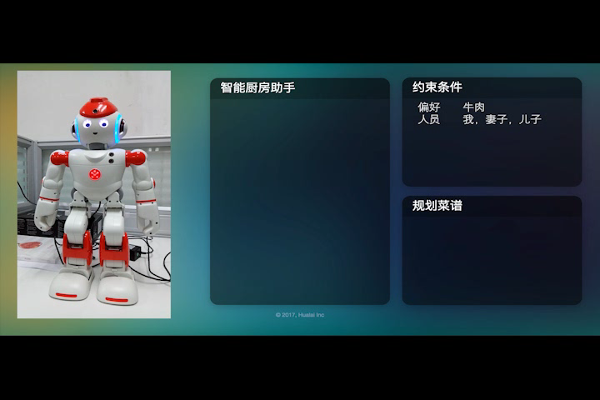
Demo

Slide 23
石油公司斯伦贝谢拥有同样的图片
User
needs
……
Oil deliver
Notes:
When I show the above picture in Schlumberger, they told me they have totally same picture

Slide 24
QA / Dialogue System
Semantic parser based
  For vertical domain
  For open domain
Deep learning based
  For open domain
  For vertical domain
Notes:
？？？？？？？

Slide 25
Approaches
End to End
NLU
Pattern based
NN based
……
……
NLG
Pattern based
NN based
DM
State Machine
Bayesian Networks
Neural Networks
Input
Output
Knowledge
Base
Notes:
前边写的都是传统的，NN模型，在之前的句子对学习模型是最主要的，争取下次上课是讲一些内容

Slide 26
Key Problems
Dialogue Act （DA）analysis (intent)
Dialogue management
  Predict next DA
Generation
  DA+slot-values → text
  Sequence→sequence （KB；PR+constraints）
End-2-end dialogue systems
  Neural dialogue
  Deep reinforcement learning
Knowledge
Notes:
PR后验正则化

Slide 27
NLU
Natural language understanding

Slide 28
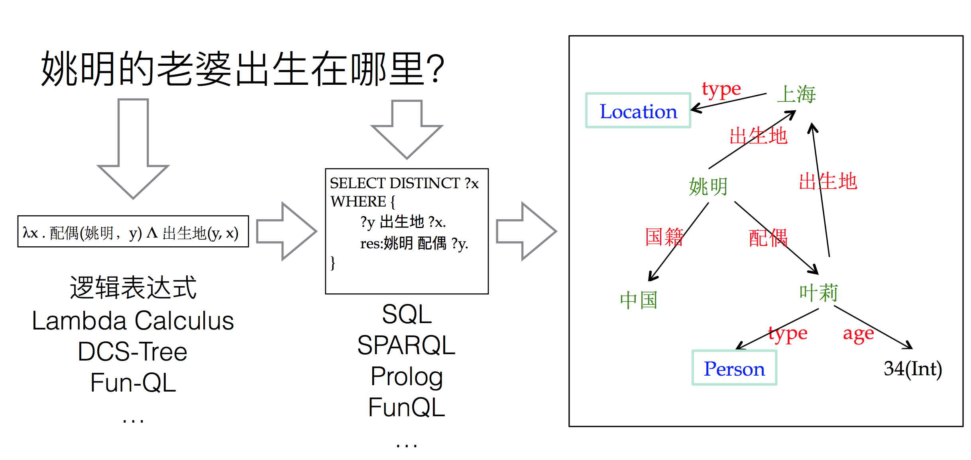
Semantic parser based （1）
Notes:
Distinct有区别的，明显的

Slide 29
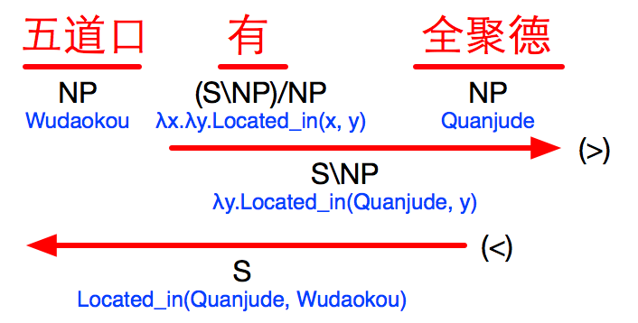
Semantic parser based （2）
Semantic parser
问题：如何设计构建规则库？
  如何利用机器学习的方法？
  如何引入/融入知识？
  如何能够在线学习？
X/Y : f Y : a ⇒ X : fa (>)
Y : a X\Y : f ⇒ X : fa (<)
X/Y : f Y/Z : g ⇒ X/Z : λz.f(gz) (>B)
Y\Z : g X\Y : f ⇒ X\Z : λz.f(gz) (<B)
Notes:
小i：传统的正则表达式，一个一个写，例泰康，将知识写到正则表达式里边
五道口，全聚德的关系
FAQ中的到的知识没有很好地挖掘和利用上
用上下文文法是永远也写不完的
如何引用知识库的概念，尽量在设计阶段使得模型更加鲁棒，
我们学的是句法，使用过程中语义模型进行动态评价，在RL学习支持下，调节和完善模型，
我们是将逻辑写成模板。
地点和餐馆的关系

Slide 30
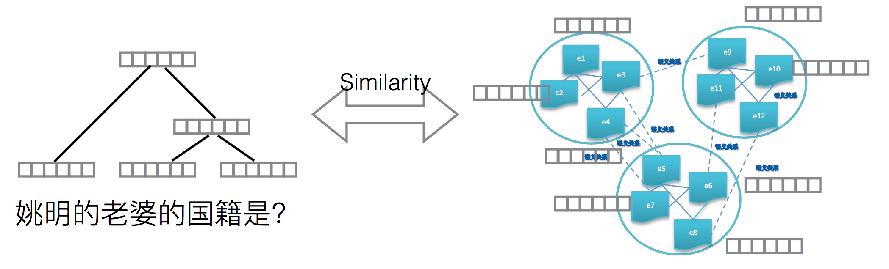
Deep Learning

Slide 31
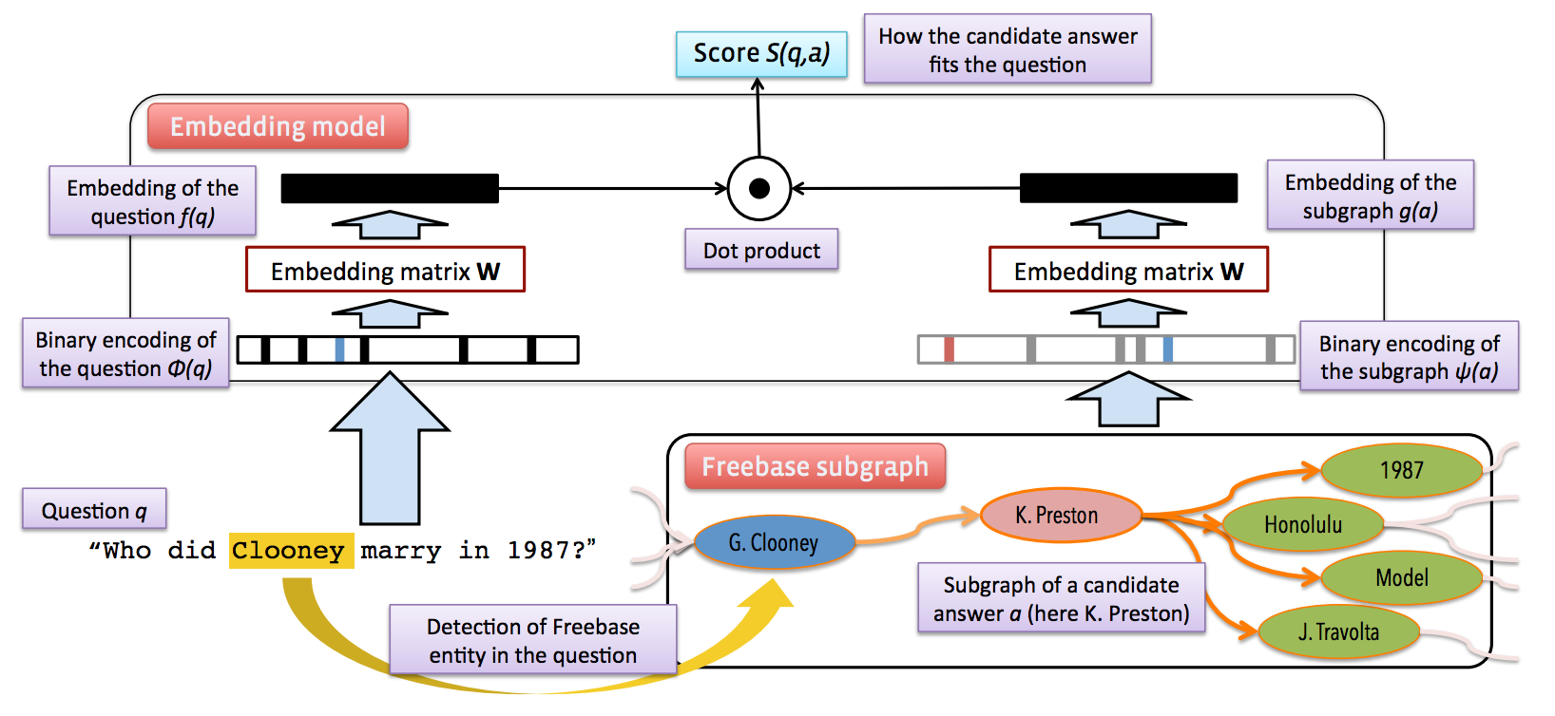
Deep Learning
Bordes et al. Question Answering with Subgraph Embedding, In Proceedings of EMNLP 2014

Slide 32
End to end system
Sequence to sequence
  Query/question to answer
Core: similar query/question selection
  Output is the corresponding answer
Applications
  E.g. system focuses on FAQ data
Large amount of data are needed
It works well, but with some problems
Notes:
correspondent相对应的

Slide 33
A Sentence Interaction Network for Dialogue Act Classification
Biao Liu, Minlie Huang, et al.
ACL 2016
Notes:
Good afternoon, I’m Liu Biao from Tsinghua University.
I’m glad to be here to present our work “A Sentence Interaction Network for Modeling Dependence between Sentences”.

Slide 34
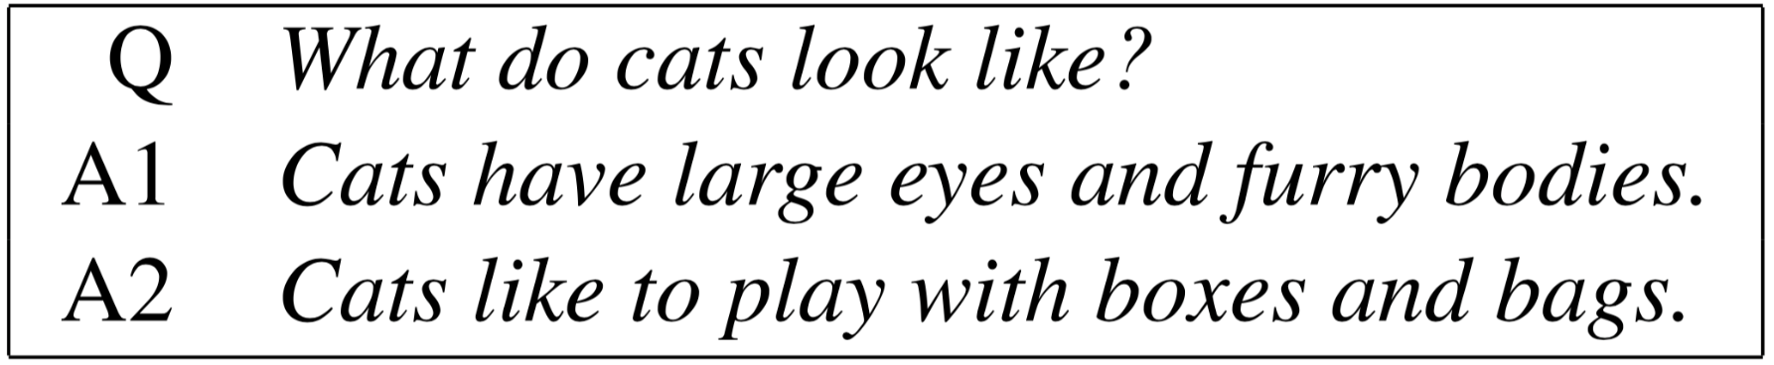
Motivation
The semantic relations between sentences is crucial for some NLP tasks.
  Answer Selection
Notes:
In this work, we are trying to model the semantic relations between sentences which are quite crucial for many NLP tasks.
For instance, as you can see in this slide.
Given a question, “what do cats look like?”,
and a set of possible answers, we want to find out the best answer to the question.
In such tasks, we have to discover the interactions between two sentences in order to reliably model their semantic relations.

Slide 35
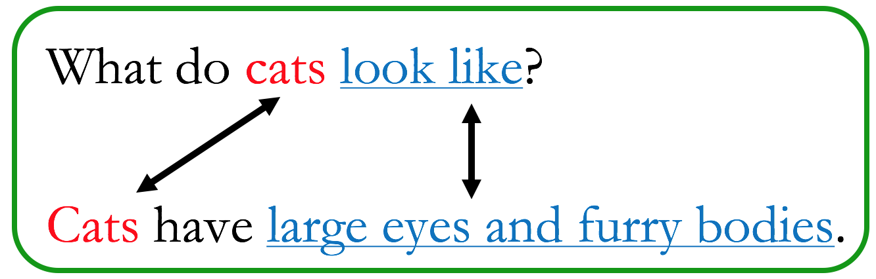
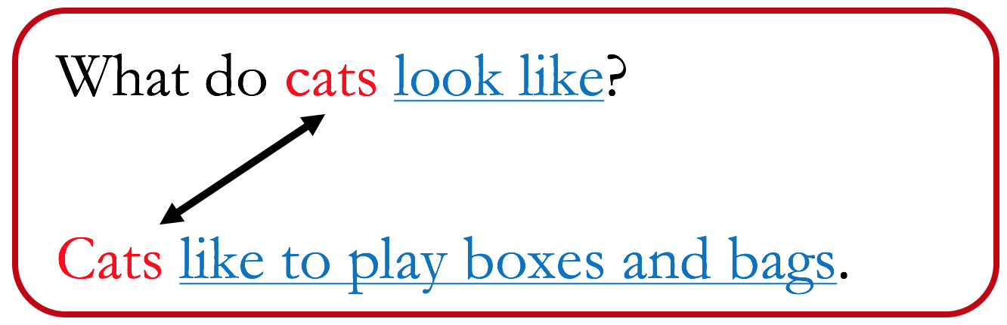
Motivation
Sentence interactions can be viewed as semantic matching.
Notes:
So, how do we describe sentence interactions?
Basically, it can be viewed as some sort of semantic matching.
Here, for the first question-answer pair in the green box, we know they are both talking about cats and cats’ appearance.
There exist a good match between them.
But for the second one in the red box, they do not match as well as the first one.

Slide 36
Ideas
A simple solution
  The semantic matching information is lost during sentence embedding.
Question
Question Vector
Classifier
Answer
Answer Vector
Х
Notes:
To model the semantic relations between two sentences,
a simple idea is to first project the two sentences into two feature vectors,
And then use these two vectors as features for classification.
The main drawback of this method is that we have lost all the matching information during sentence embedding.
As a result, the classifier won’t be able to discover the semantic relations between the two sentences.

Slide 37
Ideas
Our solution
  To introduce information of another sentence during sentence embedding.
Question
Question Vector
Classifier
Answer
Answer Vector
Notes:
So, in this work, we are trying to introduce information of another sentence during sentence embedding, as you can see in this figure.
This architecture can preserve semantic matching information in the sentence vector,
And help the classifier to capture the sentence interactions.

Slide 38
Applications
Answer Selection
  To select correct answers from a set of candidates for a given question.
Dialogue Act Analysis
  To identify the dialogue act of a sentence in a dialogue.
Notes:
We conducted experiments on two tasks: Answer Selection and Dialogue Act Analysis.

Slide 39
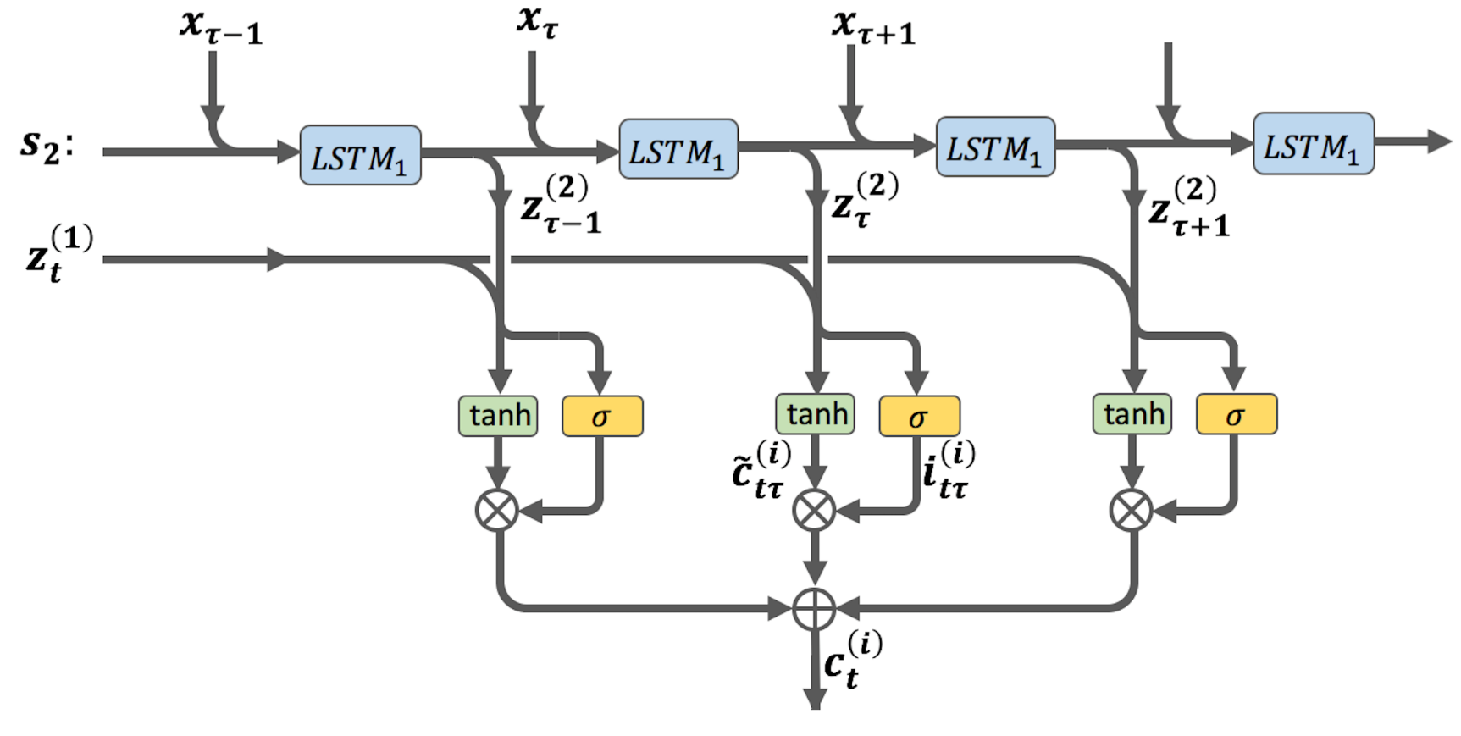
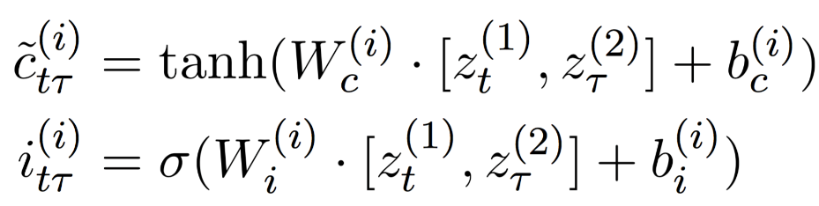
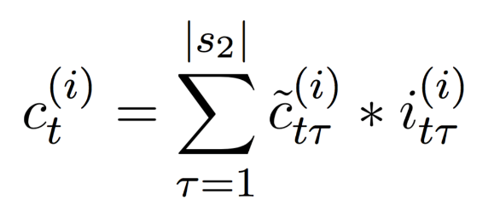
Method（2）
Modeling with interactions
Notes:
Step 2, we construct some information flows from one sentence to another.
This figure shows information flows from the second sentence to the t-th word in the first sentence.
These information flows represent the interactions between two sentences.
Specifically, for the t-th word in the first sentence, and every word in the second sentence,
We calculate a candidate interaction state and an input gate based on their hidden vector obtained in Step 1,
And multiply them element-wise to obtain an interaction state for the word pair.
By summing over the second sentence, we obtain the interaction state for the t-th word in the first sentence.
And this state contains all interaction information from the first sentence to this word.
There are also information flow from the first sentence to the second sentence,
And is symmetrical to the this figure.

Slide 40
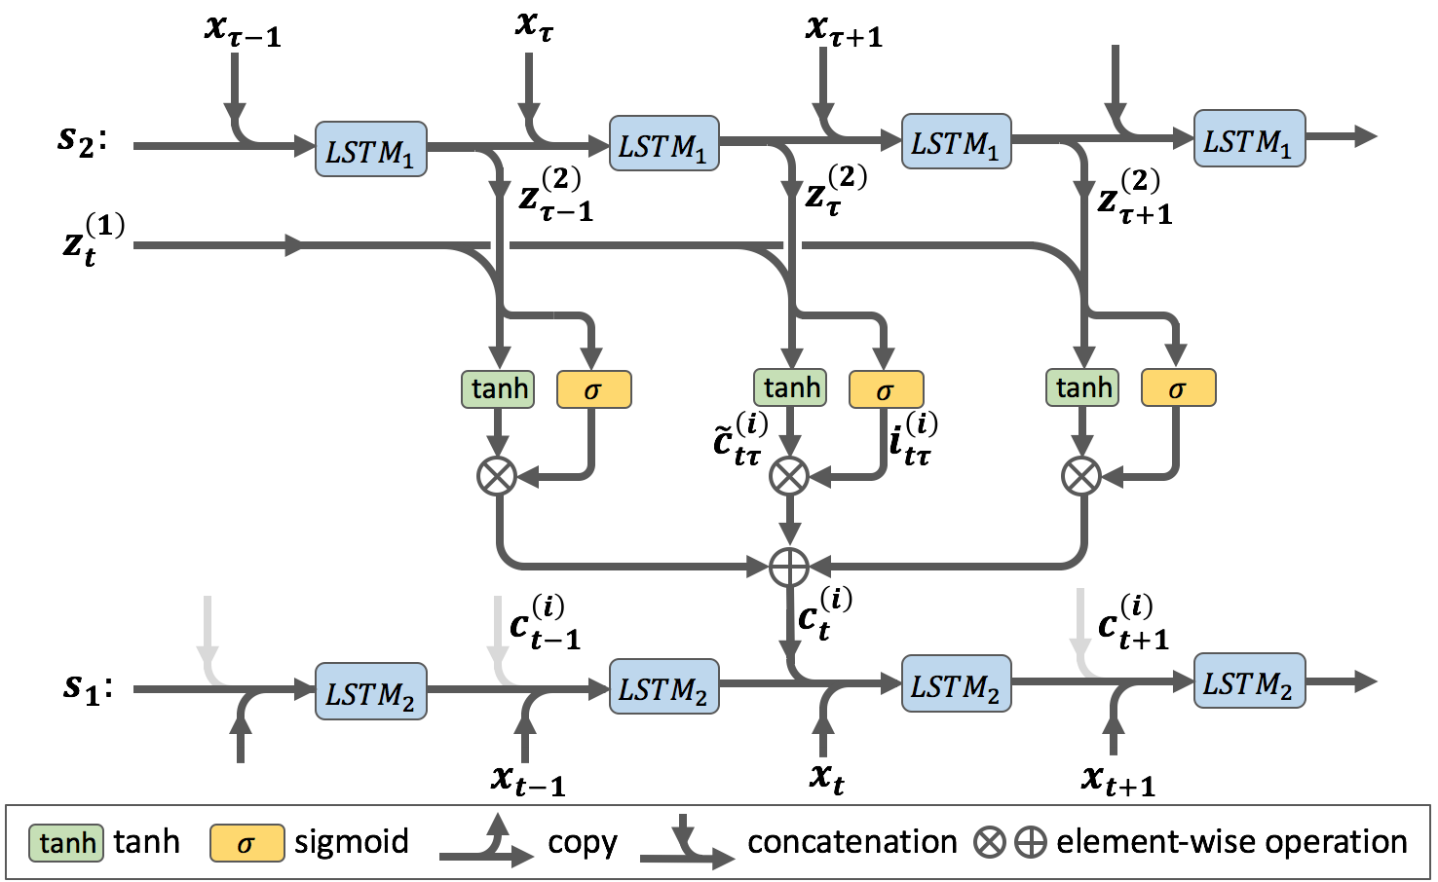
Answer Selection
Final model: sentence embedding with interactions.
Notes:
Step 3: we input the word vector and the interaction state together into another LSTM.
Since the information of the second 2 can pass to sentence 1 through the interaction states,
The semantic matching information will be encoded in the hidden vectors output by this LSTM.
So, if we input these vectors into a classifier, the sentence interactions will be properly modeled

Slide 41
Method
Sentence Interaction Network, SIN
Notes:
Our model is called Sentence Interaction Network.

Slide 42
Method
SIN (Sentence Interaction Network)
  Interactions between words are properly modeled, but those between phrases are not.
SIN with Convolution (SIN-CONV)
  Add a convolution layer to model phrases.
  Feed phrase vectors into SIN.
Notes:
Since SIN takes hidden vectors of words as input to calculate interaction states,
It is powerful to describe the interactions between words, but not so powerful for phrase interactions.
In order to model the interactions between phrases,
We can add a convolution layer on the word vector,
The convolution layer will take several words as input, and output a phrase vector.
And then, the phrase vectors can be input into SIN the same as word vectors.
We call SIN with convolution layers as SIN-CONV

Slide 43
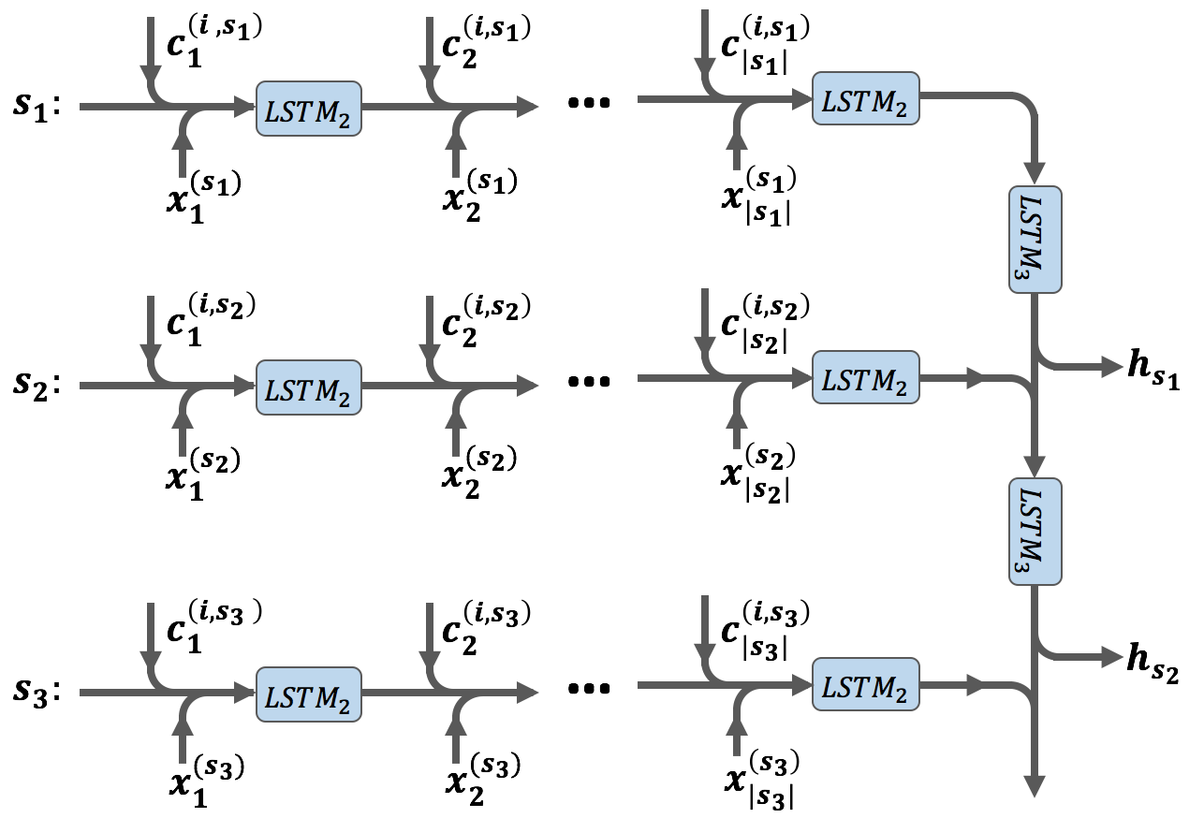
Dialogue Act Analysis
Model for Dialogue Act Analysis
Notes:
In order to apply SIN model to dialogue act analysis, we have to make some simple modifications.
We use the previous sentence to calculate the interaction states for the current sentence,
And after generating all sentence vectors, we join them together with LSTM in order to model long-range dependencies.
The hidden vectors of the last LSTM is fed into a soft-max layer for dialog act classification.

Slide 44
NLG
Natural Language Generation/Answer Generation
  Task oriented
  Chatbots

Slide 45
NLG
Natural Language Generation/Answer Generation
  Task oriented
  Chatbots

Slide 46
Context-aware Natural Language Generation for Spoken Dialogue Systems
Hao Zhou, Minlie Huang and Xiaoyan Zhu，
coling 2016
Notes:
主要目的，生成更自然的答复，不是简单地模板里边套单词，比较生硬
近年来，语音交互方式的在移动终端的崛起使得问答系统正在受到越来越多的关注。语言生成模型的任务是将答案的逻辑表达式转换为自然语言的形式传达给用户，是问答系统中直接与用户交互的一环，其表现对问答系统的评价有重要的影响。大多数基于规则和模板的传统方法生成的回复单一而又生硬，缺乏自然语言的多变与灵活性，并且设计回复规则和模板需要耗费大量人力。近年来随着人工神经网络的发展与网络上可获取的标注数据的增多，产生了数据驱动的方法：通过标注的数据训练一个神经网络，从而使其可以自动生成符合人类语言习惯的回答语句。而已有的任务导向的数据驱动方法在生成回复时仅利用了答案的逻辑表达式来生成回复，对于不同提问方式和语言习惯的用户，其无法针对性的生成恰当的回复。
提出了一种基于上下文信息的应用于垂直领域问答系统的语言生成模型（CA-LSTM）。相比于传统的基于规则和模板的方法，该模型使用了端到端的 LSTM 循环神经网络可以从训练语料中自动学习出回复句式，省去了人工设计规则和模板的工作量，并且通过对生成词语概率分布的随机采样可以生成出多变的句式，解决了传统方法回复单一的问题。同时，相比于已有的数据驱动的神经网络方法，本文将上下文信息引入到任务驱动的语言生成模型中：使用编码-解码（Encoder-Decoder）框架，可以根据用户不同的提问方式产生不同的回答；引入了注意力机制（Attention Mechanism）针对问题中的关键词语产生不同的回答；学习回复句式向量更精确的生成不同的回复句式。在 BLEU-4评分以及人工评分中取得了显著的性能提升。

Slide 47
Motivation
Problem: Given a DA , generate a natural language response
  假设问题：我想吃火锅
  Dialogue Act (DA): Recommend(Area=五道口，type=火锅)
  Response: 好，给您推荐一个五道口附近的火锅店吧
Common methods
  Template-based or rule-based methods
  Data-driven methods
Notes:
RE是什么意思

Slide 48
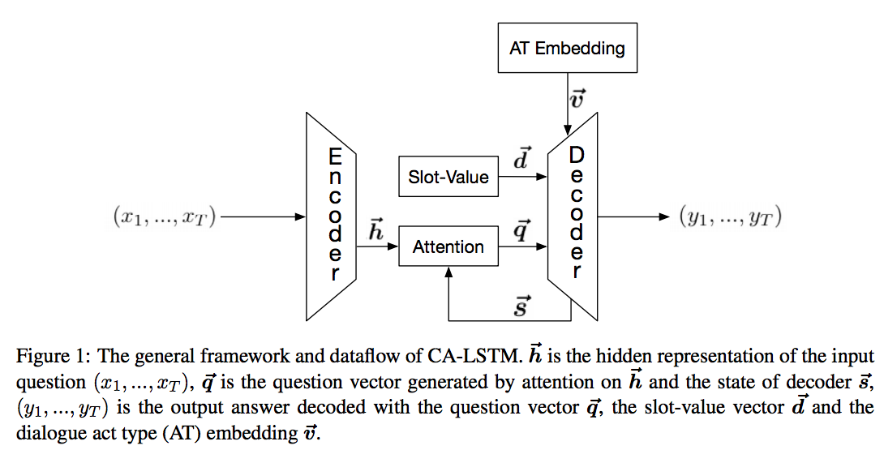
Our Proposal
Framework
  The Context-Aware LSTM (CA-LSTM) is built on the general encoder-decoder framework for sequence-to-sequence learning.
Notes:
下边主要介绍解码部分

Slide 49
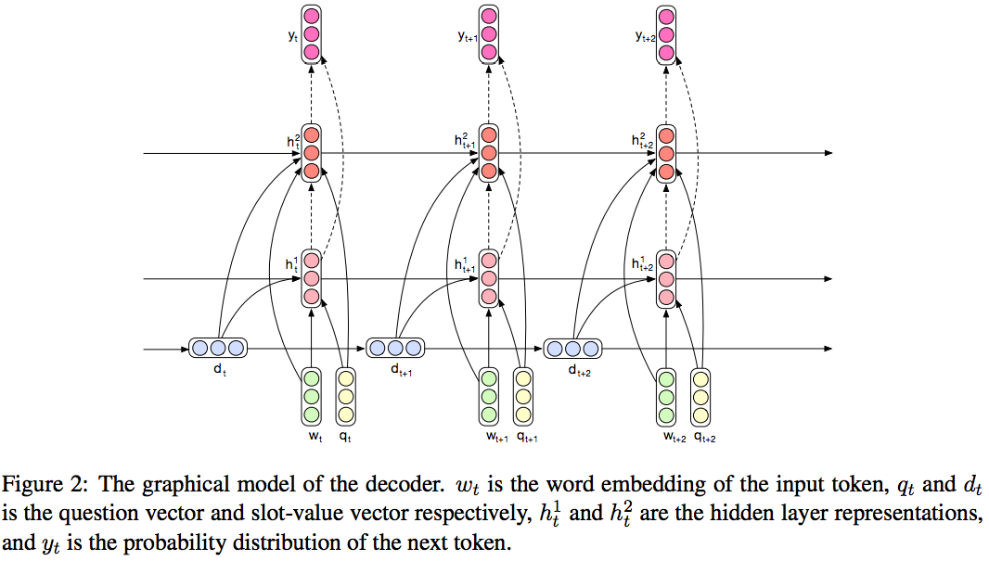
Our Proposal
Context-aware Decoding
  The decoder is based on the RNN language model (RNNLM), which takes the word embedding of a token as the input at every time step and outputs the probability distribution of the next token conditioned on the hidden layer representations.
Notes:
系统回复的解码神经网络Decoder的结构如图3所示。我们使用了双层的 长短期记忆网络（LSTM）将上一个step输出的词向量w，回复句式向量v ，答案信息向量 d 以及经过注意力机制的问题向量 q 作为输入，进行解码，对输出向量进行 softmax 就可以得到预测词的概率分布。

Slide 50
Our Proposal
Framework
  The Context-Aware LSTM (CA-LSTM) is built on the general encoder-decoder framework for sequence-to-sequence learning.

Slide 51
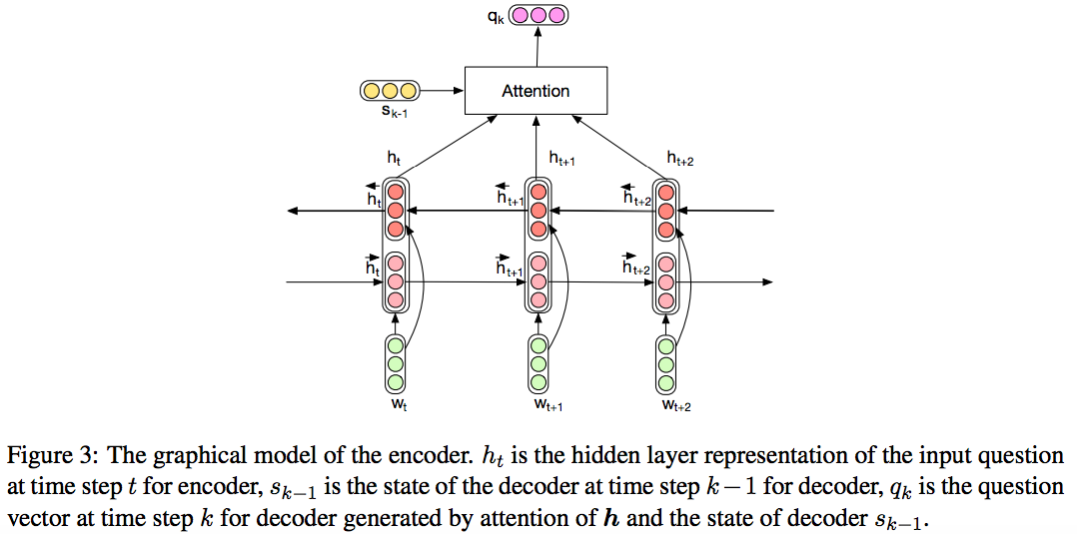
Our Proposal
Attention-based Encoding
  The encoder is built on a Bidirectional-LSTM architecture. And the attention mechanism is applied to generate question vector according to the hidden layer representation and the state of the decoder.
Notes:
用户问题的编码神经网络Encoder的结构如图2所示。我们使用了双向的长短期记忆网络（LSTM）将问题中每一个词的词向量作为网络输入，输出整个句子的隐向量表示 h，然后再与解码神经网络Decoder的状态向量 s 一起通过注意力机制，得到经过注意力机制的用户问题向量 q。

Slide 52
Our Proposal
Framework
  The Context-Aware LSTM (CA-LSTM) is built on the general encoder-decoder framework for sequence-to-sequence learning.
Notes:
AT: act type

Slide 53
NLG
Natural Language Generation/Answer Generation
  Task oriented
  Chatbots

Slide 54
聊天机器人的类别
聊天机器人可以从应用场景的角度分以下几个类别
  客服：自动回答客户对于产品或者服务的问题
  娱乐：陪伴及消遣娱乐
  教育：创造交互式的对话环境来辅助用户学习
  个人助理：生活服务，智能搜索

Slide 55
Chatting Machine
Semantics
Logic
Consistency
Interactiveness
Content
Quality
Persona
Proactive
Emotion
Notes:
Persona：人物角色
Proactive：主动的，主动性

Slide 56
Chatting Machines
User：最幸福的人不是拿到了最好的东西，而是学会去珍惜手上已经拥有的人。
Machine: 是的，所以我也要珍惜自己的幸福
User: 时间啊，你这把杀猪刀。。。
Machine: 我是被杀的
User: 怕孤獨，又捨不下自己的小自由。
Machine: 我想去流浪，但没有人陪我去。

Slide 57
Emotional Chatting Machine
POST
About 23000 tweets for training the classifier,
Each labeled with an emotion category
Response 1
Each post/response pair is labeled with emotion to train a deep learning algorithm
Emotional
Chatting
Machine
Response 2
Emotion
Classifier
Response 3
Like, Happiness,
Sadness, Anger, Disgussness, other
Hao Zhou, Minlie Huang, Tianyang Zhang, Xiaoyan Zhu, Bing Liu Emotional Chatting Machine: Emotional Conversation Generation with Internal and External Memory. arXiv:1704.01074
Notes:
训练过程

Slide 58
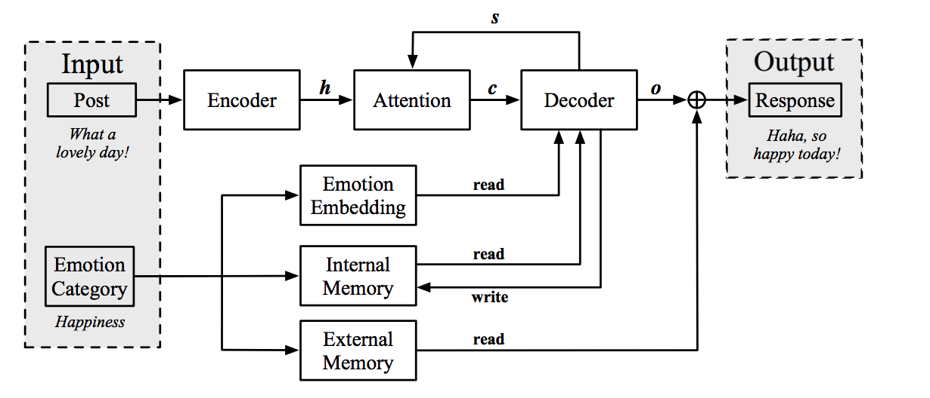
Emotional Chatting Machine
Emotion category embedding: High level abstraction of emotions
Emotion internal state: Capturing the change of emotion state during decoding
Emotion external memory: Treating emotion/generic words differentially

Slide 59
Emotional Chatting Machine~~Examples
情绪 | post:早上的天气不错啊！哈哈哈哈哈哈
other | 今天是个好天气。
喜欢 | 今天的天气不错啊！
悲伤 | 天气好，心情不好。
厌恶 | 这是哪里啊？求解释
愤怒 | 怎么了？什么情况？
快乐 | 今天的天气真好啊！
情绪 | post:送一个这样的蛋糕，给你美丽的闺蜜吧！
other | 这是蛋糕蛋糕吗？
喜欢 | 好漂亮的蛋糕啊！
悲伤 | 为什么我觉得很恶心
厌恶 | 这样的蛋糕你忍心吗？
愤怒 | 有没有想开网店的？
快乐 | 哈哈，好可爱的蛋糕！
情绪 | post:为了解决抄作业的不好习惯，高数老师这回要出绝招了！
other | 这老师是要逆天吗？
喜欢 | 这老师太有才了！
悲伤 | 这样的老师伤不起啊
厌恶 | 这老师也太狠了点吧
愤怒 | 这老师是要逆天啊！
快乐 | 哈哈，这老师太有才了
情绪 | post:承诺，就是一个骗子说给一个傻子听的。
other | 承诺就是一个承诺
喜欢 | 承诺是一个专一的傻子
悲伤 | 我就是一个悲伤的傻子
厌恶 | 一个骗子说给一个傻子听
愤怒 | 不管你信不信，反正我信了！
快乐 | 我就是一个开心的傻子
Notes:
这两页有什么区别？

Slide 60
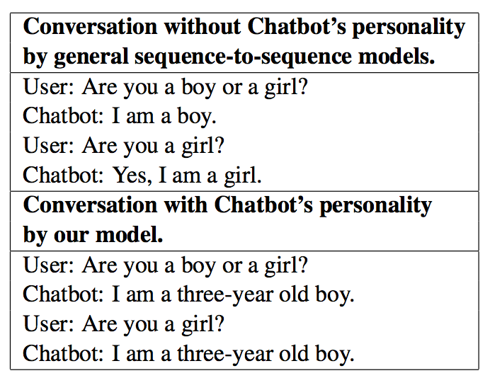
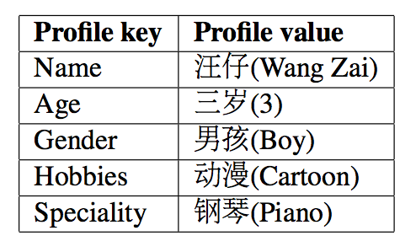
Endowing a Chatting Machine with Personality
Generating coherent conversation w.r.t. identity/personality

Slide 61
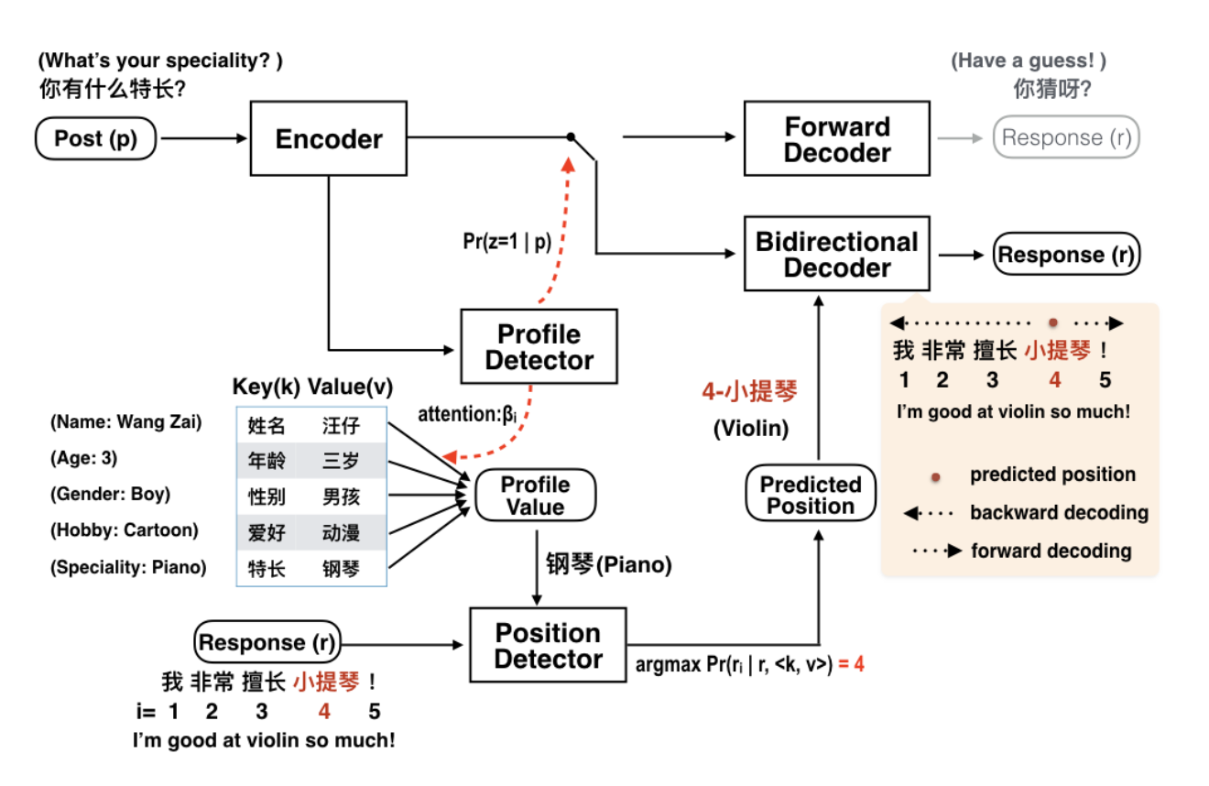
Endowing a Chatting Machine with Personality
Encoder
Profile
detector
Position
detector
Decoder

Slide 62
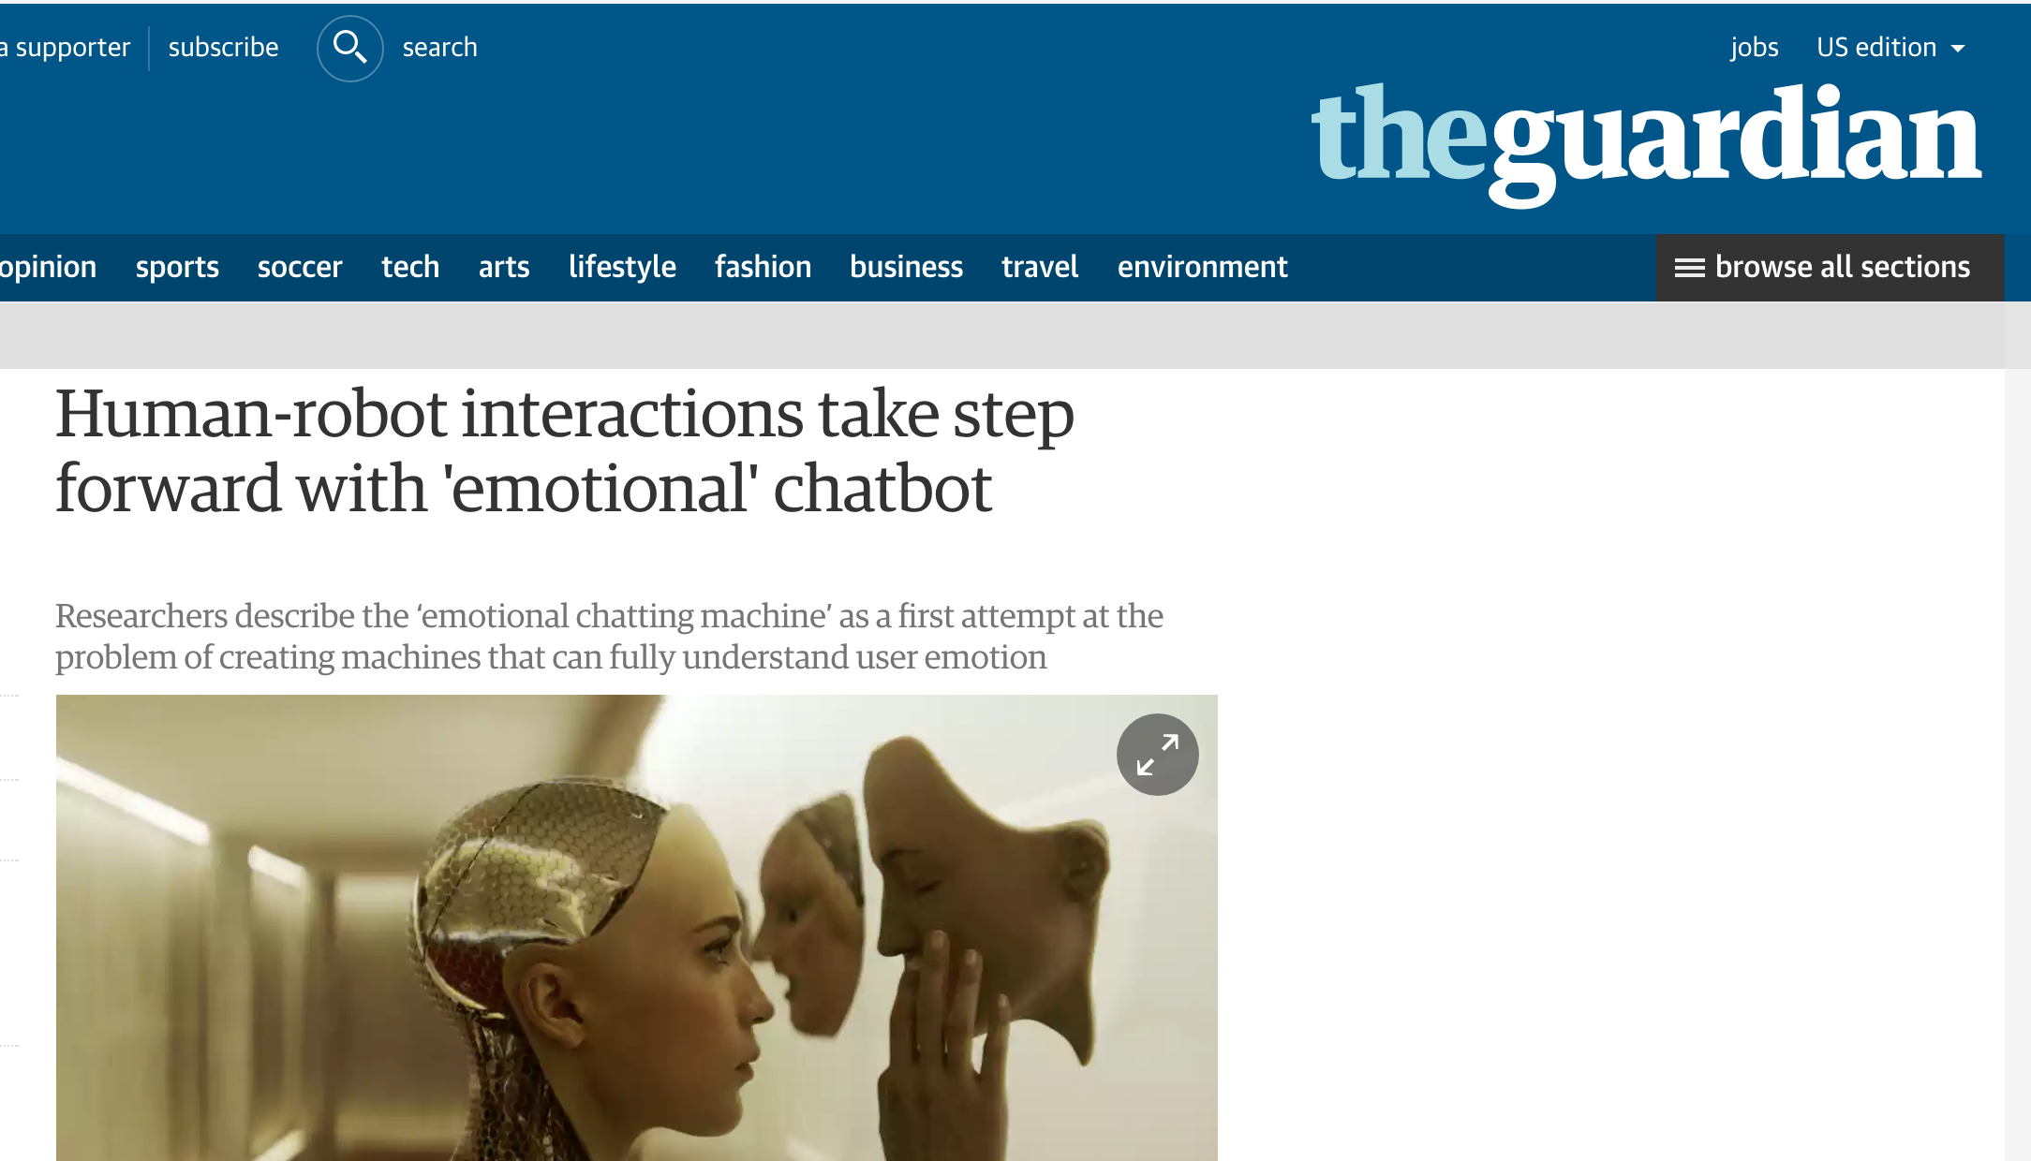
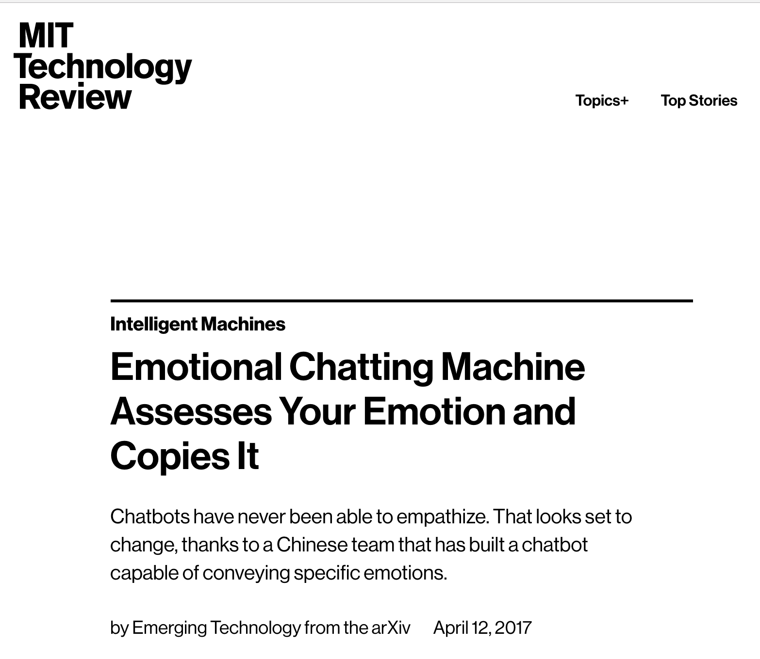
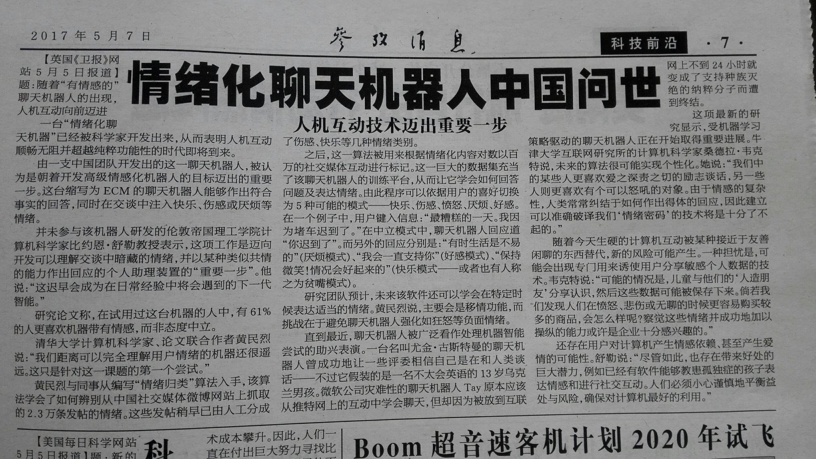
Emotional Chatting Machine
Prof Björn Schuller, a computer scientist at Imperial College London who was not involved in the latest advance, described the work as “an important step” towards personal assistants that could read the emotional undercurrent of a conversation and respond with something akin to empathy.
“This will be the next generation of intelligence to be met in daily experience, sooner rather than later,” he said.
Notes:
MIT Technology Review：the most influential technology media in the world;
英文卫报：the most mass media in europe, the professor Schuller is one of the most famous researchers in affective computing.

Slide 63
国际评测
2017年参加国际评测NTCIR-13短文本聊天生成（Short Text Conversation ）比赛中，与搜狗的联合团队，基于深度学习的生成结果获得第一名（国内外共22个队参加）。

Slide 64
DM
Dialogue Management
  Task oriented

Slide 65
Task-oriented Dialogue Management

Slide 66
Motivation
Dialog management (DM) is a central module of task-oriented dialog system
Local utterance and global dialogue semantics
Interpretability
RNN: no sufficient memory

Slide 67
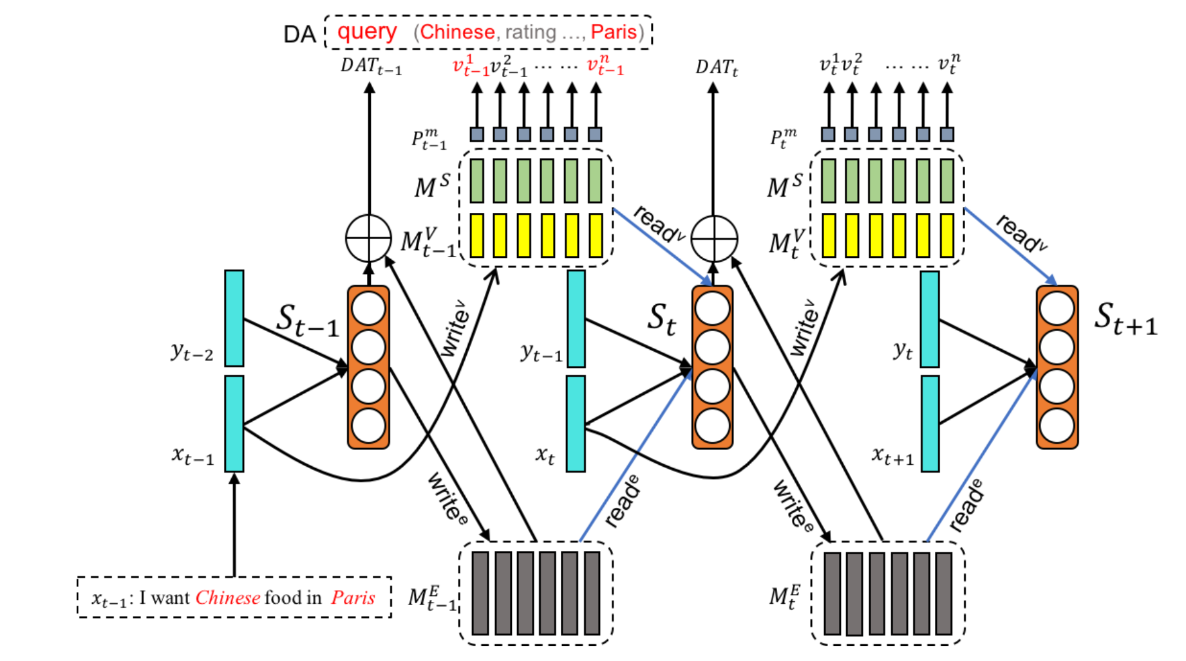
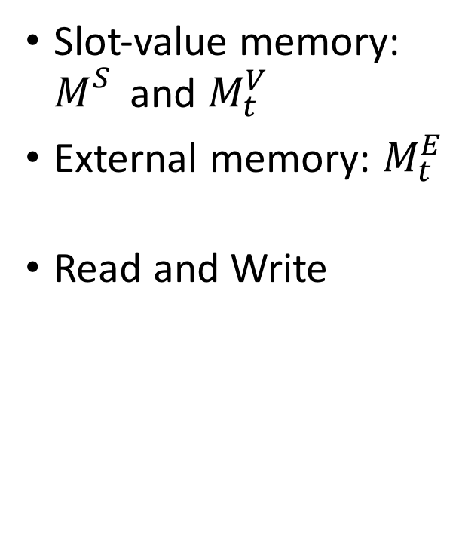
Model Design
Notes:
图的各个部分功能
模型引入了两个memory结构，提升模型在对话任务上的性能。
1）slot-value memory，由M^S和M^V两部分组成，每个都由很多列组成，每列对应一个slot。其中M^S保存slot的信息，M^V保存对话进行过程中每个slot对应的value的信息。
2）external memory，保存其他的一些对话历史信息，也由多列vector组成。
对话过程中，模型会对这两部分进行读写操作，并根据这些信息生成系统的动作。
确认

Slide 68
Knowledge
Knowledge representation
Inference

Slide 69
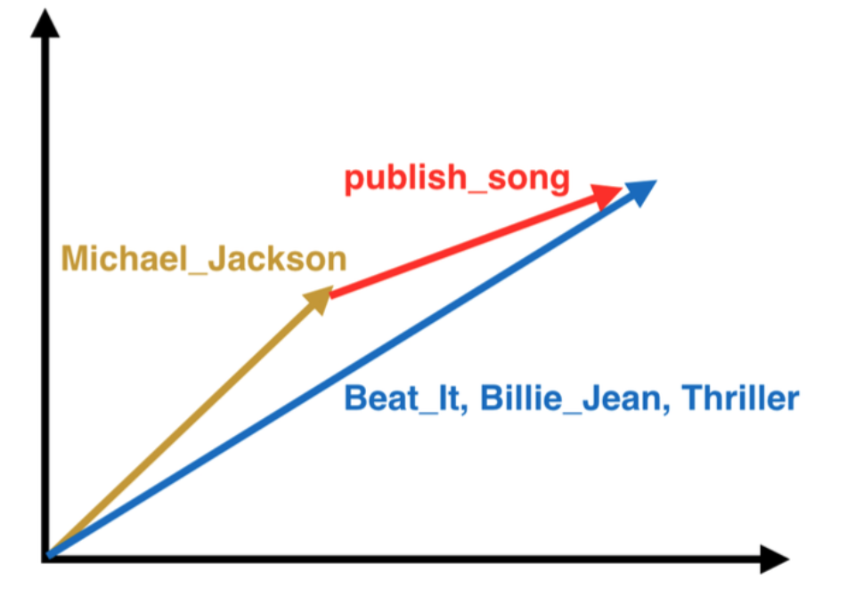

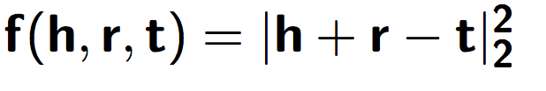
知识表示
基于流型的知识表示
ManifoldE：基于流型的知识嵌入方法（IJCAI 2016）
TransG：产生式知识嵌入方法（ACL 2016）
SSP: 融合语义的知识表示方法（AAAI 2017）
基本模型
< MichaelJackson, publishSong , BeatIt >
< MichaelJackson, publishSong , BillieJean >
< MichaelJackson, publishSong , Thriller >

Slide 70
结论与问题
结论
  BOTs在人工智能落地的实施中，起到了重要的作用
问题
  研究层面：知识表示是否可以另辟蹊径？
  开发层面：没有足够数据时，如何基于机器学习方法构建系统？RL如何发挥作用？如何使得模型有更好的鲁棒性和可移植性？
  实施层面：问答（客服）引擎如何能够在企业内部真正打通整个产品链，甚至于企业管理链条，打造真正的智能信息管理，知识管理平台？

Slide 71
谢谢！

