Slide 1


深度学习与知识获取
MIFS 2017
机器智能前沿论坛
刘知远
清华大学自然语言处理实验室
liuzy@tsinghua.edu.cn

Slide 2

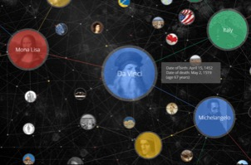
研究对象
网络结构
用户及其关系和行为
媒体信息
文本、视频、语音等信息
知识图谱
结构化的世界知识
面临挑战
信息多源异构，难以建立语义关联

Slide 3

基于符号的表示方案
star
[0, 0, 0, 0, 0, 0, 0, 0, 1, 0, 0, 0, 0, …]
sun
[0, 0, 0, 0, 0, 0, 0, 1, 0, 0, 0, 0, 0, …]
sim(star, sun) = 0

Slide 4
分布式表示方案
Distributed Representation
对象均被表示成稠密、实值、低维向量

Slide 5
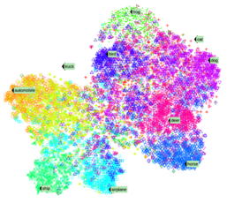
分布式表示的优势
解决大数据NLP的数据稀疏问题
实现跨领域、跨对象的知识迁移
提供多任务学习的统一底层表示
知识
语义分析
文档
句法分析
句子
词法分析
词汇
统一语义空间

Slide 6
社会计算研究对象
网络结构
用户及其关系和行为
媒体信息
文本、视频、语音等信息
知识图谱
结构化的世界知识

Slide 7
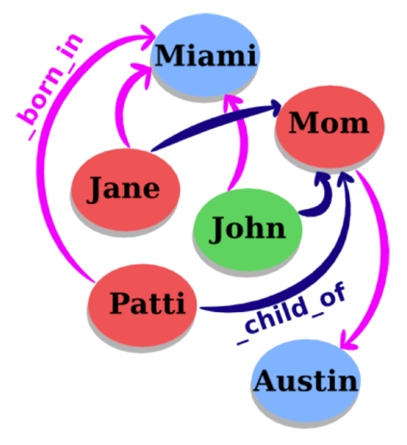
知识图谱实体与关系
知识图谱包括实体与关系
  节点代表实体
  连边代表关系
事实可以用三元组表示
  (head, relation, tail)
代表知识图谱
  WordNet: 语言知识
  Freebase: 世界知识

Slide 8
知识表示的挑战
知识图谱的典型表示方案
  基于符号表示的三元组（RDF）
  无法有效计算实体间的语义关系
解决方案：将知识映射到低维向量空间

Slide 9
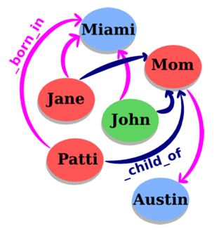
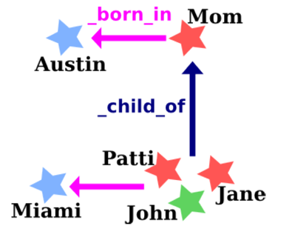
TransE: 将关系表示为平移
对每个事实 (head, relation, tail)，将其中的relation作为从head到tail的平移操作

Slide 10
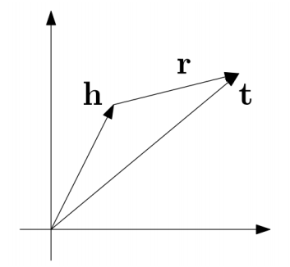
TransE: 将关系表示为平移
对每个事实 (head, relation, tail)，将relation作为从head到tail的平移操作
优化目标: h + r = t

Slide 11

评价任务：链接预测
WALL-E
_has_genre
?

Slide 12
评价任务：链接预测
WALL-E
_has_genre
Animation
Computer animation
Comedy film
Adventure film
Science Fiction
Fantasy
Stop motion
Satire
Drama
Connecting

Slide 13
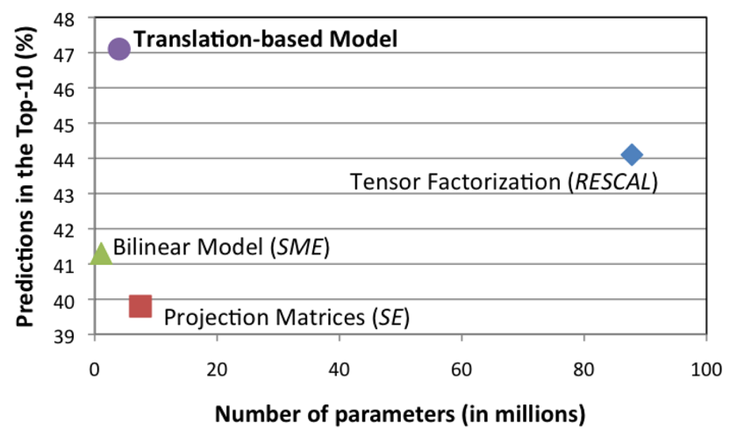
链接预测性能比较
Freebase15K

Slide 14
TransE样例
Entity | Tsinghua_University | A.C._Milan
1 | University_of_Victoria | Inter_Milan
2 | St._Stephen's_College,_Delhi | Celtic_F.C.
3 | University_of_Ottawa | FC_Barcelona
4 | University_of_British_Columbia | Genoa_C.F.C.
5 | Peking_University | Udinese_Calcio
6 | Utrecht_University | Real_Madrid_C.F.
7 | Dalhousie_University | FC_Bayern_Munich
8 | Brasenose_College,_Oxford | Bolton_Wanderers_F.C.
9 | Cardiff_University | Borussia_Dortmund
10 | Memorial_University_of_Newfoundland | Hertha_BSC_Berlin

Slide 15
TransE样例
Entity | China | Barack_Obama | Apple
1 | Japan | George_W._Bush | Onion
2 | Taiwan | Nancy_Pelosi | Strawberries
3 | South_Korea | John_Kerry | Avocado
4 | Argentina | Hillary_Rodham_Clinton | Pear
5 | North_Korea | Al_Gore | Cabbage
6 | Hungary | George_H._W._Bush | Broccoli
7 | Israel | John_McCain | Egg
8 | Australia | Colin_Powell | Cheese
9 | Iceland | Bill_Clinton | Bread
10 | Hong_Kong | Charles_B._Rangel | Tomato

Slide 16
TransE样例
Relation | /people/person/nationality | /location/location/contains
1 | /people/person/places_lived | /base/aareas/schema/administrative_area/administrative_children
2 | /people/person/place_of_birth | /location/country/administrative_divisions
3 | /people/person/spouse_s | /location/country/first_level_divisions
4 | /base/popstra/celebrity/vacations_in | /location/country/capital
5 | /government/politician/government_positions_held | /award/award_nominee/award_nominations
6 | /people/deceased_person/place_of_death | /location/administrative_division/capital
7 | /olympics/olympic_athlete/country | /location/us_county/county_seat
8 | /olympics/olympic_athlete/medals_won | /base/aareas/schema/administrative_area/capital
9 | /music/artist/origin | /location/us_county/hud_county_place
10 | /people/person/employment_history | /award/award_winner/awards_won

Slide 17
TransE样例
Head | China | Barack_Obama
Relation | /location/location/adjoin | /education/education/institution
1 | Japan | Harvard_College
2 | Taiwan | Massachusetts_Institute_of_Technology
3 | Israel | American_University
4 | South_Korea | University_of_Michigan
5 | Argentina | Columbia_University
6 | France | Princeton_University
7 | Philippines | Emory_University
8 | Hungary | Vanderbilt_University
9 | North_Korea | University_of_Notre_Dame
10 | Hong_Kong | Texas_A&M_University

Slide 18
TransE样例
Head | Stanford_University | Apple | Titanic
Relation | /education/educational_institution/students_graduates | /food/food/nutrients | /film/film/genre
1 | Steven_Spielberg | Lipid | War_film
2 | Ron_Howard | Protein | Period_piece
3 | Stan_Lee | Valine | Drama
4 | Barack_Obama | Tyrosine | History
5 | Milton_Friedman | Serine | Biography
6 | Walter_F._Parkes | Iron | Film_adaptation
7 | Michael_Cimino | Cystine | Adventure_Film
8 | Gale_Anne_Hurd | Pantothenic_acid | Action_Film
9 | Bryan_Singer | Vitamin_A | Political_drama
10 | Aaron_Sorkin | Sugar | Costume_drama

Slide 19
知识表示与关系抽取
融合文本与知识进行关系抽取
利用关系路径进行关系抽取
利用远程监督多实例进行关系抽取

Slide 20
融合文本与知识进行关系抽取
基于知识图谱的关系预测
基于文本信息的关系预测
r ~ t-h
Founder
Bill Gates
Microsoft
Bill Gates
was the co-founder and CEO of
Microsoft

Slide 21
利用CNN进行文本关系抽取
Daojian Zeng, Kang Liu, Siwei Lai, Guangyou Zhou, and Jun Zhao. Relation classification via convolutional deep neural network. In Proceedings of COLING.
Daojian Zeng,Kang Liu,Yubo Chen,and Jun Zhao. Distant supervision for relation extraction via piecewise convolutional neural networks. In Proceedings of EMNLP.

Slide 22
融合文本与知识进行关系抽取

Slide 23
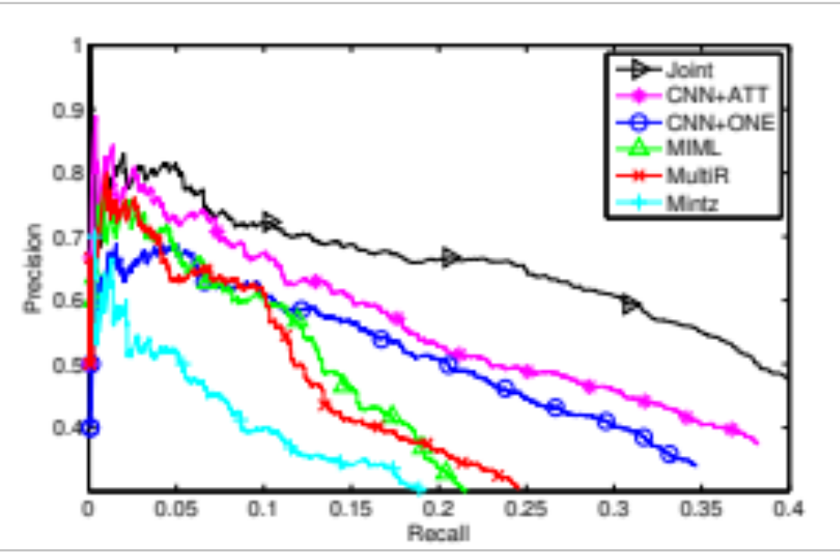
关系抽取结果

Slide 24
知识表示与关系抽取
融合文本与知识进行关系抽取
利用关系路径进行关系抽取
利用远程监督多实例进行关系抽取

Slide 25
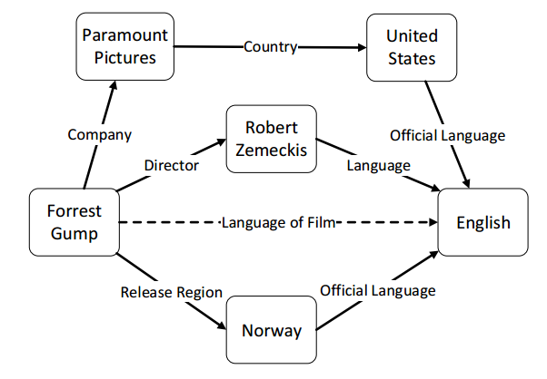
利用关系路径进行关系抽取

Slide 26
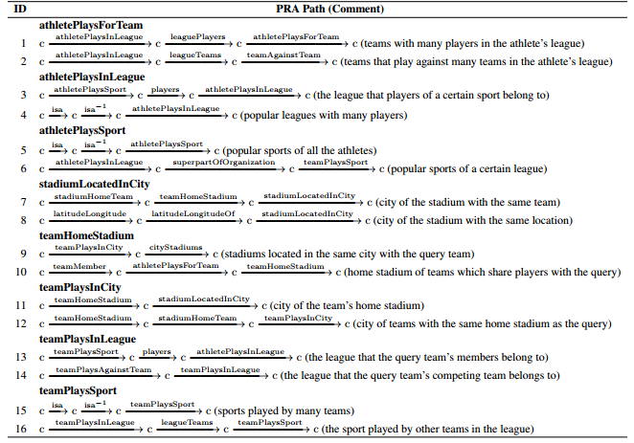
利用关系路径进行关系抽取
Path Ranking Algorithm
Lao, et al. (2011). Random walk inference and learning in a large scale knowledge base. EMNLP.

Slide 27
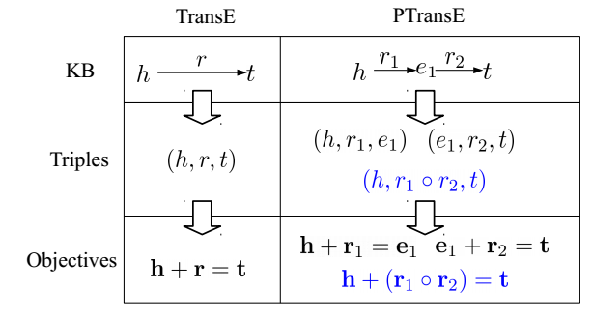
PTransE：考虑关系路径的TransE
Lin, et al. (2015). Modeling Relation Paths for Representation Learning of Knowledge Bases. EMNLP.

Slide 28
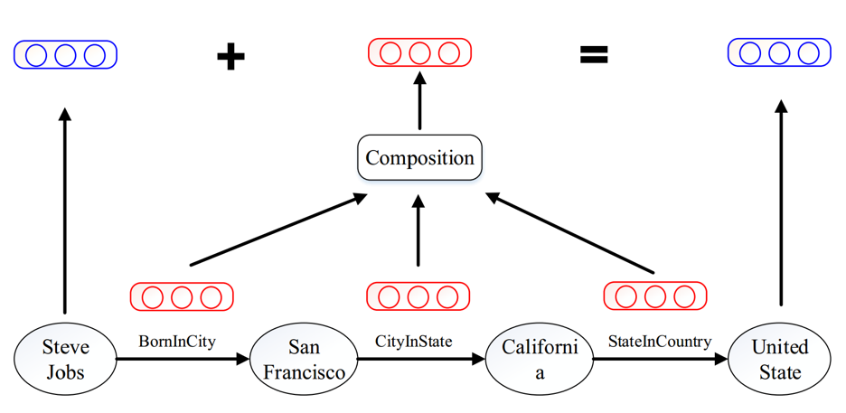
Path-based TransE

Slide 29
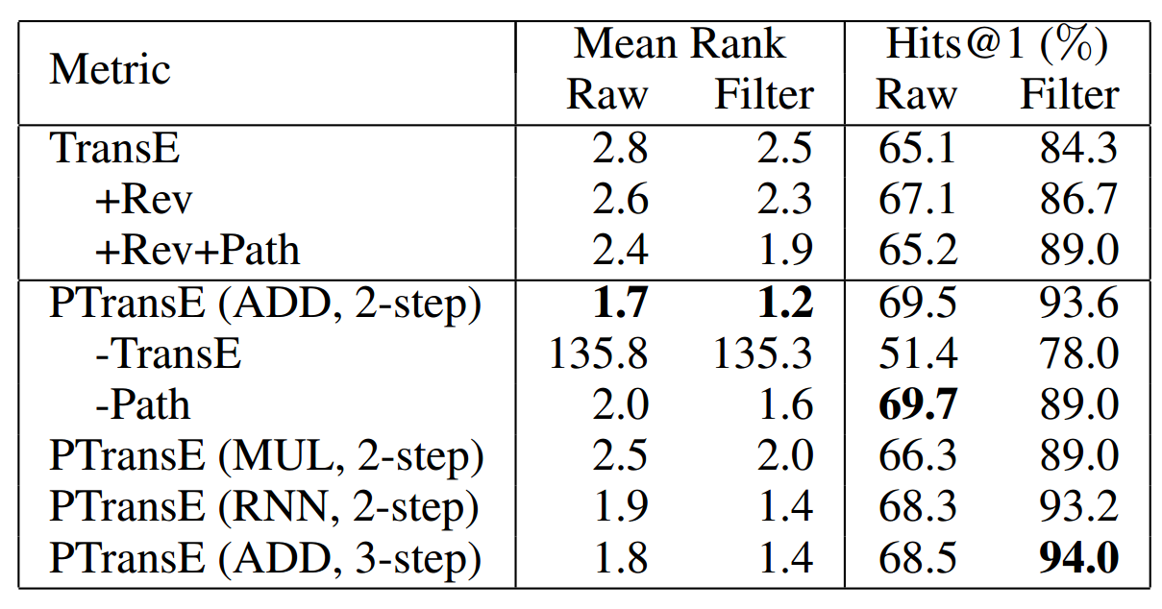
关系抽取结果
+10%

Slide 30
PTransE样例
Relation1 | /people/person/place_of_birth
Relation2 | /location/administrative_division/country
1 | /people/person/nationality
2 | /people/person/places_lived./people/place_lived/location
3 | /people/person/place_of_birth
4 | /music/artist/origin
5 | /olympics/olympic_athlete_affiliation/country
6 | /government/politician/government_positions_held
7 | /base/popstra/vacation_choice/location
8 | /people/deceased_person/place_of_death
9 | /government/political_appointer/appointees
10 | /location/administrative_division/country

Slide 31
PTransE样例
Relation1 | /location/location/contains
Relation2 | /location/location/contains
1 | /location/location/contains
2 | /location/country/second_level_divisions
3 | /location/country/administrative_divisions
4 | /location/administrative_division/capital
5 | /base/locations/continents/countries_within
6 | /base/aareas/schema/administrative_area/administrative_children
7 | /location/us_county/hud_county_place
8 | /location/country/capital
9 | /location/country/first_level_divisions
10 | /travel/travel_destination/tourist_attractions

Slide 32
知识表示与关系抽取
融合文本与知识进行关系抽取
利用关系路径进行关系抽取
利用远程监督多实例进行关系抽取

Slide 33
远程监督关系抽取的多实例问题
Founder
Bill Gates
Microsoft
Bill Gates
was the co-founder and CEO of
Microsoft
Bill Gates
announced to retire from
Microsoft
Bill Gates
and Paul Allen co-founded the IT giant
Microsoft

Slide 34
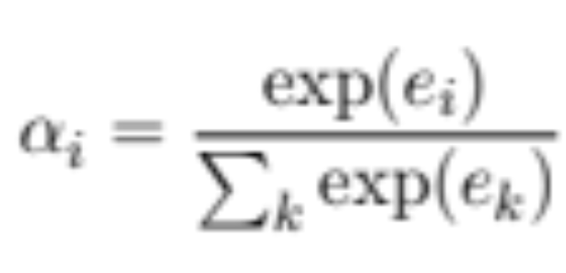
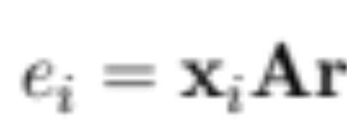
Sentence-Level Attention
Lin, et al. (2016). Neural Relation Extraction with Selective Attention over Instances. ACL.

Slide 35
关系抽取评测结果

Slide 36
关系抽取评测结果
Zeng, et al. (2015). Distant Supervision for Relation Extraction via Piecewise Convolutional Neural Networks. EMNLP.

Slide 37
关系抽取评测结果

Slide 38
Attention样例

Slide 39
开源平台： OpenKE
http://openke.thunlp.org/
工具包：统一接口，包括TransE 、TransH、TransR、TransD、RESCAL、DistMult、HolE、ComplEx等算法的高效实现
表示模型：面向WikiData和Freebase两大通用KG全量数据的预训练好的知识表示模型下载

Slide 40
论文列表
Yankai Lin, Shiqi Shen, Zhiyuan Liu, Huanbo Luan, Maosong Sun. Neural Relation Extraction with Selective Attention over Instances. The 54th Annual Meeting of the Association for Computational Linguistics (ACL 2016).
Linlin Wang, Zhu Cao, Gerard de Melo, Zhiyuan Liu. Relation Classification via Multi-Level Attention CNNs. The 54th Annual Meeting of the Association for Computational Linguistics (ACL 2016).
Yankai Lin, Zhiyuan Liu, Maosong Sun. Knowledge Representation Learning with Entities, Attributes and Relations. International Joint Conference on Artificial Intelligence (IJCAI 2016).
Ruobing Xie, Zhiyuan Liu, Maosong Sun. Representation Learning of Knowledge Graphs with Hierarchical Types. International Joint Conference on Artificial Intelligence (IJCAI 2016).
Ruobing Xie, Zhiyuan Liu, Jia Jia, Huanbo Luan, Maosong Sun. Representation Learning of Knowledge Graphs with Entity Descriptions. The 30th AAAI Conference on Artificial Intelligence (AAAI 2016).
Yankai Lin, Zhiyuan Liu, Huanbo Luan, Maosong Sun, Siwei Rao, Song Liu. Modeling Relation Paths for Representation Learning of Knowledge Bases. The Conference on Empirical Methods in Natural Language Processing (EMNLP 2015).
Yankai Lin, Zhiyuan Liu, Maosong Sun, Yang Liu, Xuan Zhu. Learning Entity and Relation Embeddings for Knowledge Graph Completion.The 29th AAAI Conference on Artificial Intelligence (AAAI 2015).

Slide 41
谢 谢
http://nlp.csai.tsinghua.edu.cn/~lzy/
liuzy@tsinghua.edu.cn

