Slide 1
Computational Models for Social Network Analysis
—User Modeling, Social Tie, and Group Formation
Jie Tang
Tsinghua University
Download this slides from
http://keg.cs.tsinghua.edu.cn/jietang/publications/2014-compoutational-model-sna.pptx

Slide 2

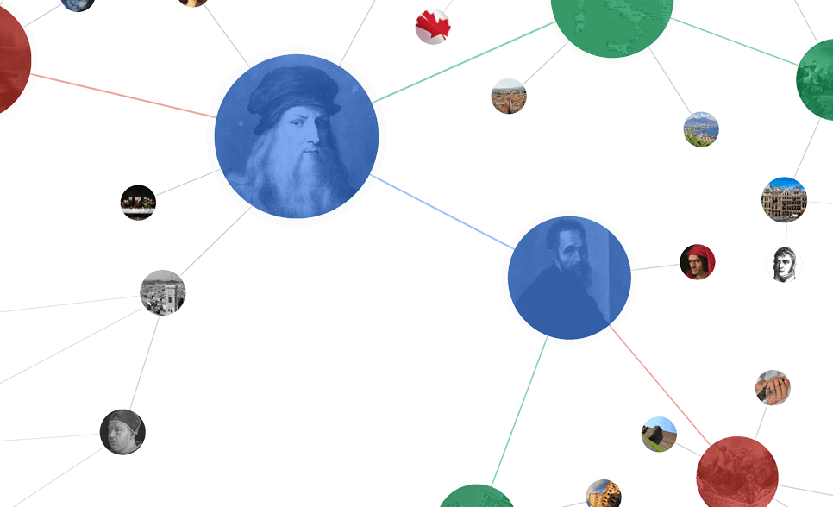

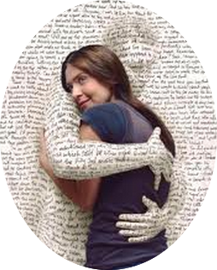



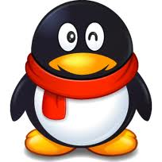
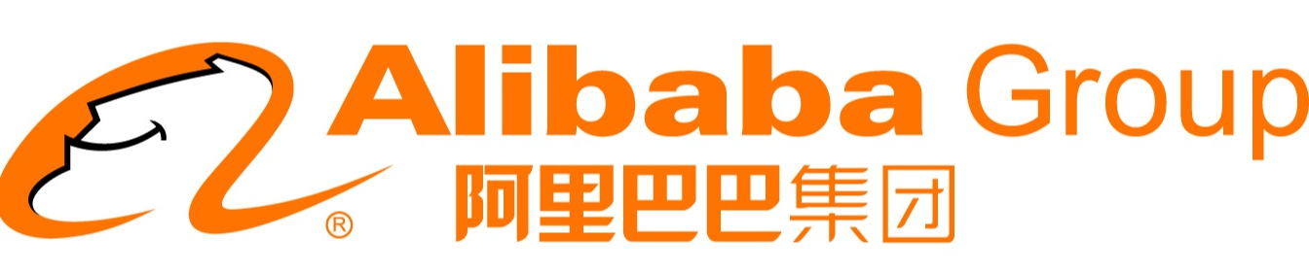
Networked World
1.3 billion users
700 billion minutes/month
280 million users
80% of users are 80-90’s
600 million users
.5 billion tweets/day
560 million users
influencing our daily life
79 million users per month
9.65 billion items/year
800 million users
~50% revenue from network life
500 million users
35 billion on 11/11

Slide 3
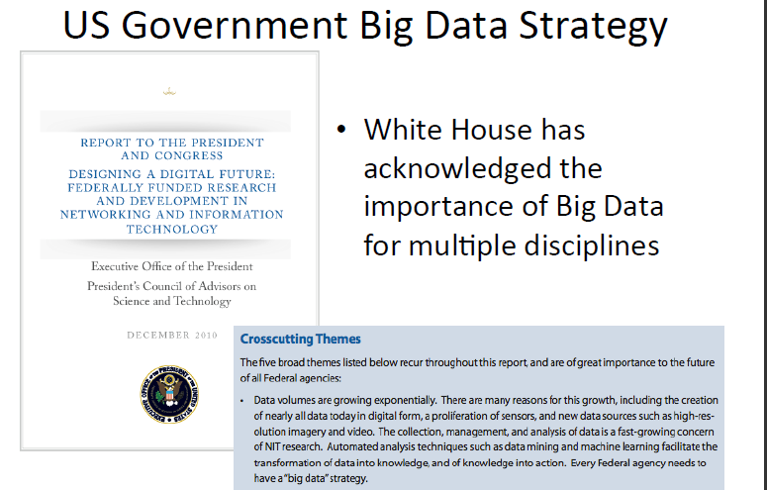
Big Data is the New Oil; Big social data is “Saudi Arabia” in the Oil World
We generate 2.5x10¹⁸ byte big data per day, and 90% of the data was generated in the past 2 yrs
It is becoming the new oil of the 21st century…
In the past year, 1,477 daily briefings provided to US president are based on big data analysis
80% of stock exchanges are based on big data analysis…
Notes:
Big Data is fundamentally changing our world.

Slide 4
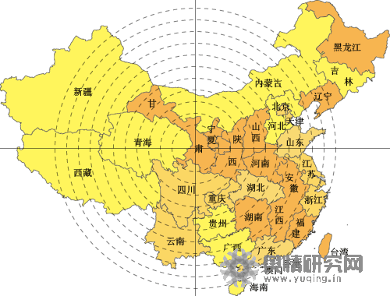
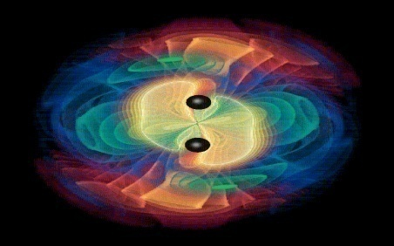

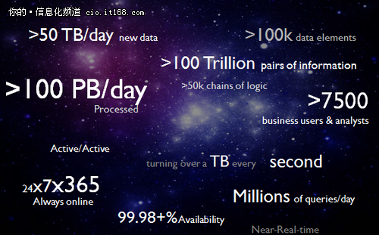
Big Social Analytics
Info. Space vs. Social Space
Opinion Mining
Information
Info. Space
Interaction
Innovation diffusion
Knowledge
Social Space
Intelligence
Business
intelligence

Slide 5
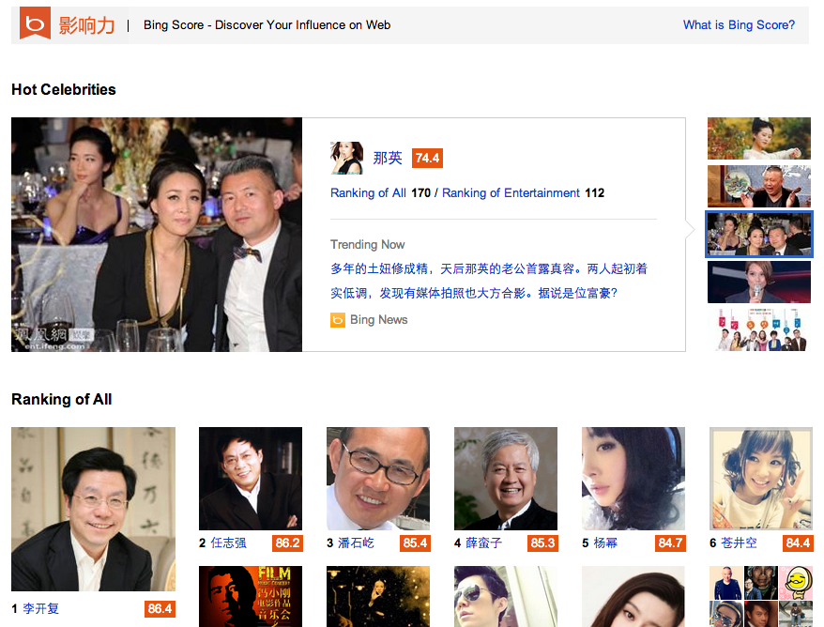
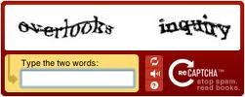


Revolutionary Changes
Social Networks
The Web knows you than yourself:
Contextual computing
Big data marketing
O2O
More …
Human Computation:
CAPTCHA + OCR
MOOC
Duolingo (Machine Translation)
...
Embedding social in search:
Google plus
FB graph search
Bing’s influence
Education
Search

Slide 6
Core Research in Social Network
Application
Prediction
Search
Information Diffusion
Advertise
Macro
Meso
Micro
Social Network Analysis
Group behavior
User modeling
Erdős-Rényi
Structural hole
Triad
Influence
Social tie
Power-law
Action
Small-world
Community
Theory
Social Theories
Algorithmic Foundations
BIG Social Data

Slide 7

Roadmap
User-level
Tie-level
Structure-level
tie
Social role
Influence
- Emotion
- Demographics
- Social Tie
- Social Influence
- Triad Formation
- Kernel Community
- Structural hole
Tencent
MOOC

Slide 8
Let us start with a case study…

Slide 9
“Happy” System (2009)
SMS & Calling
Location
Activities
Emotion?
Can we predict users’ emotion?

Slide 10
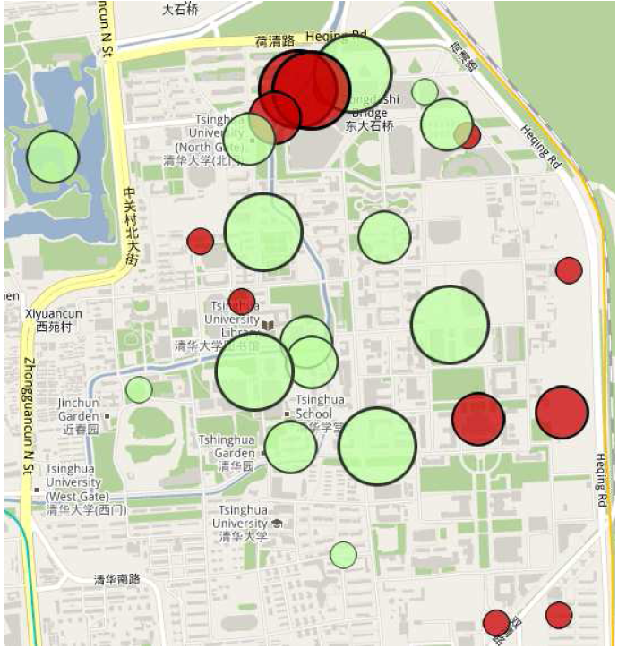
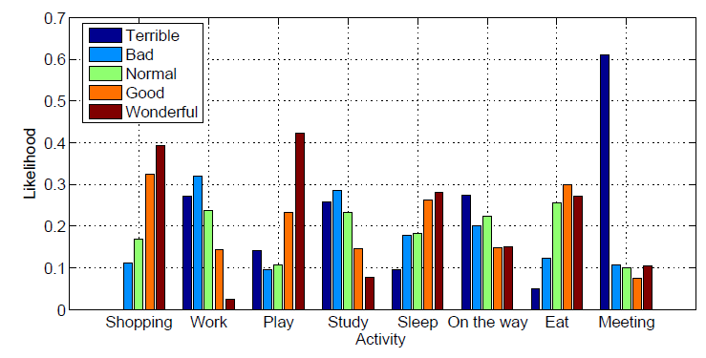
分析结果
圆明园
宿舍
?
?
?
?
?
教室
体育馆
Activity correlation
?
荷塘
Location correlation
(Red-happy)
KO

Slide 11
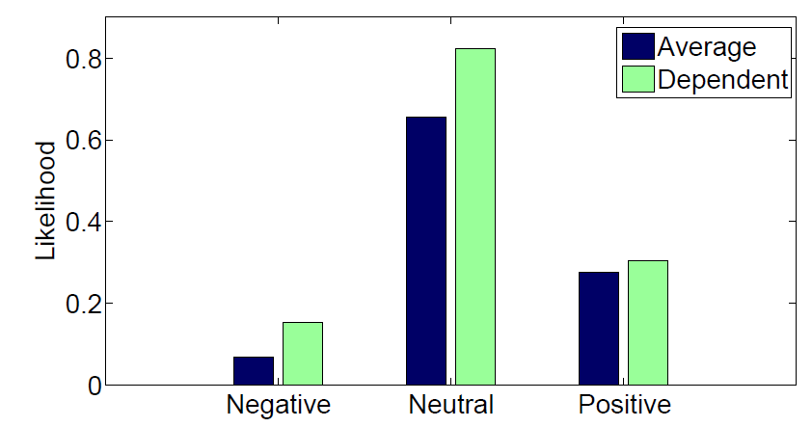
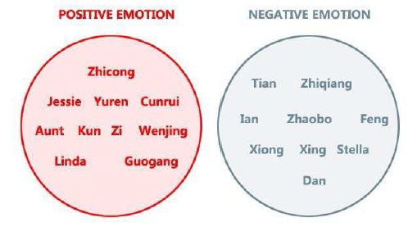
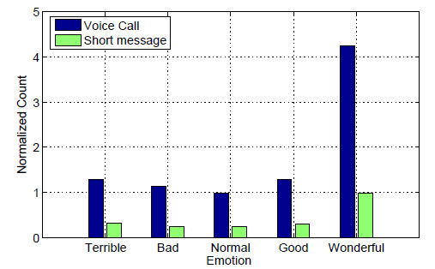
分析结果
(a) Social correlation
(a) Implicit groups by emotions
(c) Calling (SMS) correlation

Slide 12
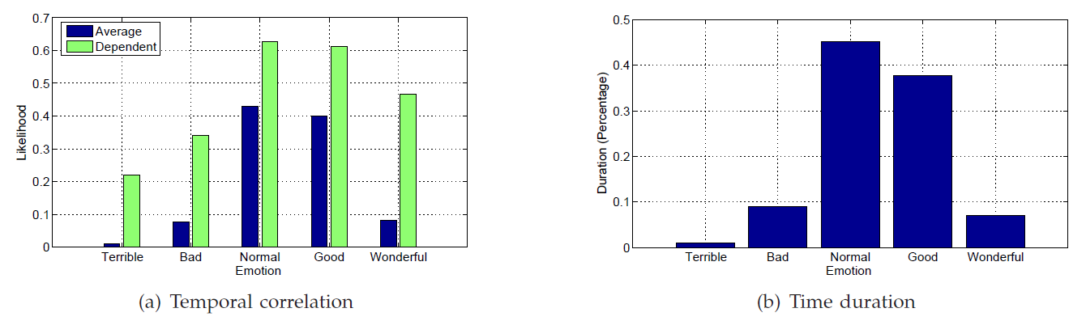
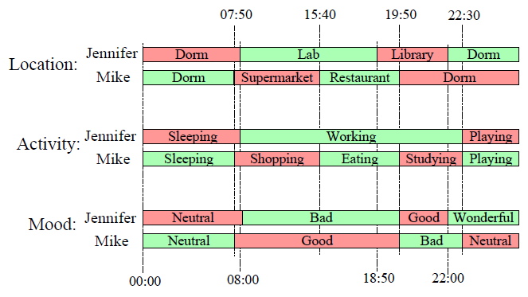
分析结果
Temporal correlation

Slide 13
MoodCast: 动态情感预测模型
Our solution
1. We directly define continuous feature function;
2. Use Metropolis-Hasting algorithm to learn the factor graph model.
[1] Jie Tang, Yuan Zhang, Jimeng Sun, Jinghai Rao, Wenjing Yu, Yiran Chen, and ACM Fong. Quantitative Study of Individual Emotional States in Social Networks. IEEE TAC, 2012, Volume 3, Issue 2, Pages 132-144.

Slide 14





Problem Formulation
Time t
G^{t} =(V, E^{t}, X^{t}, Y^{t})
Emotion: Sad
Time t-1, t-2…
Attributes:
- Location: Lab
- Activity: Working
Learning Task:
Notes:
Next I will introduce our approach. First, we need to give a formal definition of this problem. The input is a set of nodes, edges, attributes and emotions on the time flow. Here V is the set of nodes, or the users, E is the set of edges-the relations between the users, X is the set of attributes and Y is the set of emotions. The task is given the nodes, edges, attributes of the current time and all data of the previous time, predict users emotions

Slide 15




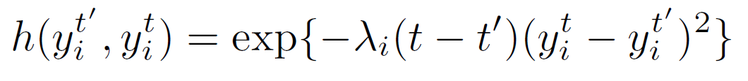
Dynamic Continuous Factor Graph Model
Time t’
Time t
: Binary function
Notes:
We propose a dynamic continuous factor graph model to leverage the three aspects. The first factor function f is attribute factor function. It’s a binary function. If at time t, the attribute is x and the emotion is y, then f(x, y) is 1, otherwise it’s 0.
The second one g is social correlation factor function. To measure the user-independent time-decay factor, we use an exponential function: t minus t’ on e, and the parameter can be absorbed together as beta. The final function is as shown on the slides. Similarly, we have the temporal factor function h. It’s format is like this
One of the challenges of the work is that time is continuous rather discrete time slice

Slide 16
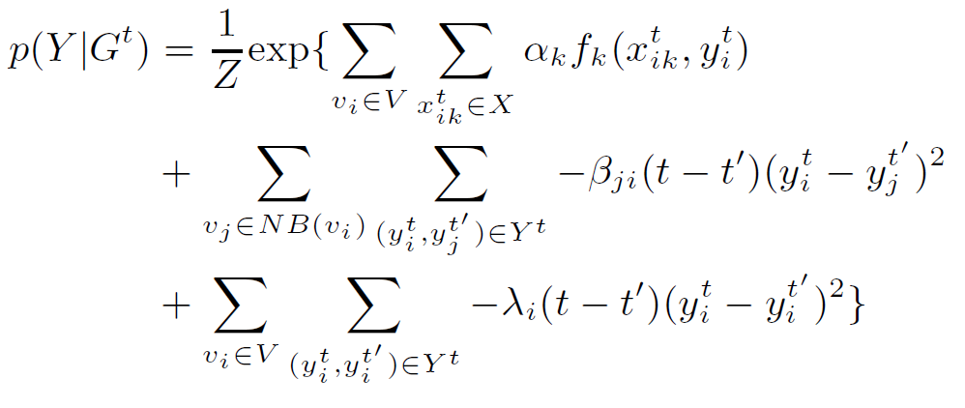

Learning with Factor Graphs
y₅
y₄
y'₃
y₃
y₂
y₁
Attribute
Social
Temporal
Notes:
After we define all the factor functions, we have to learn the parameters. The learning task is to maximize the likelihood which is computed as shown. Z is the normalization and we have to learn parameters alpha, beta and lambda. The goal is to maximize this log-likelihood objective function. The intrinsic difficulty of such learning task is to calculate the normalization factor Z. Some methods are Junction Tree and Belief Propagation.
We use a sampling based Metropolis-Hastings (MH) algorithm which is a kind of Markov-chain Monte Carlo algorithm. The advantage of the MH algorithm is that it can derive a global gradient update for each parameter and it doesn’t need an expensive cost to compute Z

Slide 17
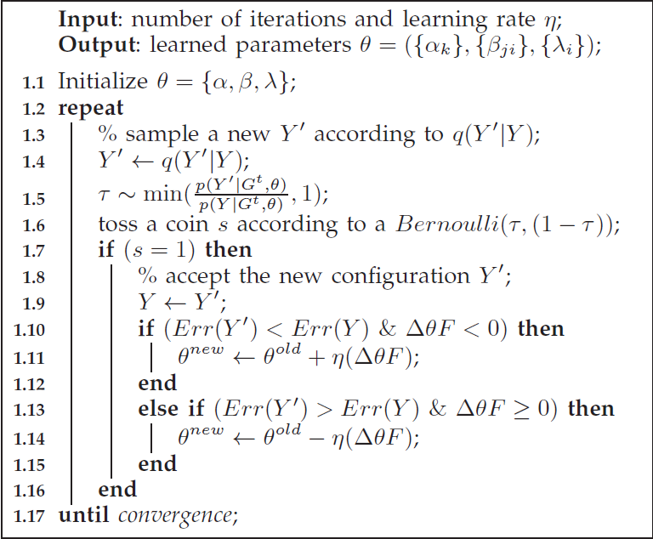
MH-based Learning algorithm
Random Sampling
Update
[1] Yuan Zhang, Jie Tang, Jimeng Sun, Yiran Chen, and Jinghai Rao. MoodCast: Emotion Prediction via Dynamic Continuous Factor Graph Model. In ICDM’10. pp. 1193-1198.

Slide 18
Experiment
Data Set
Baseline
  SVM
  SVM with network features
  Naïve Bayes
  Naïve Bayes with network features
Evaluation Measure:
  Precision, Recall, F1-Measure
 | #Users | Avg. Links | #Labels | Other
MSN | 30 | 3.2 | 9,869 | >36,000hr
LiveJournal | 469,707 | 49.6 | 2,665,166
Notes:
Finally, I will introduce the experiments. This is the data sets we used in the experiment, and the actions is the same as previously introduced. The baseline methods we use includes SVM, which uses the personal features combined with his neighbours, while wvRN is an algorithm proposed in 2003, which makes user of the graph information. The evaluation measure includes precision, recall and F1-measure.

Slide 19
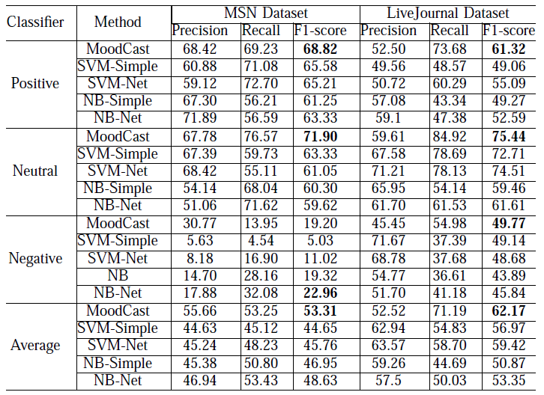
Performance Result
Notes:
This is the performance of different classifiers in different datasets. We classify the emotions into three types: positive, negative and neutral and build classifiers respectively. We can see our algorithm shows better and robust performance.

Slide 20
Roadmap
User-level
Tie-level
Structure-level
tie
Social role
Influence
- Emotion
- Demographics
- Social Tie
- Social Influence
- Triad Formation
- Kernel Community
- Structural hole
Tencent
MOOC

Slide 21



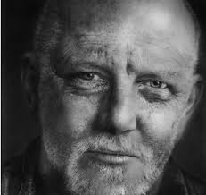
用户模型—预测用户属性及社交策略
Did you know: As of 2014, there are 7.3 billion mobile users.
Users average 22 calls, 23 messages, and 110 status checks per day.
male
Less friends
More stable
female
Young
Senior
have
2x more social connections
4x more opposite-gender circles
than
[1] Yuxiao Dong, Yang Yang, Jie Tang, Yang Yang, Nitesh V. Chawla. Inferring User Demographics and Social Strategies in Mobile Social Networks. KDD’14.

Slide 22
Our Data
Read-world large mobile network data^{[1]}
  An anonymous country
  No communication content.
  Aug. 2008 – Sep. 2008.
  > 7 million mobile users + demographic information.
  > 1 billion communication records (call and message).
Two networks:
Network | #nodes | #edges
CALL | 7,440,123 | 32,445,941
SMS | 4,505,958 | 10,913,601
[1] J.P. Onnela, J. Saramaki, J. Hyvonen, G. Szabo, D. Lazer, K. Kaski, J. Kertesz, A. L. Barabasi. Structure and tie strengths in mobile communication networks. PNAS 2007.

Slide 23
What We Do
How do people communicate / interact with each other with mobile phones?
  Infer human social strategies on demographics.
To what extent can user demographic profiles be inferred from their mobile communication interactions?
  Infer user demographics based on social strategies.
  Applications:
  Viral marketing
  Personalized services
  User modeling
  Customer relationship management
  …

Slide 24
Infer human social strategies on demographics
user demographics + mobile social network
→ social strategies
Notes:
In 1958, Harvard psychologist, Herbert Kelman identified three broad varieties of social influence.[2]

Slide 25
Social Strategy
Human needs are defined according to the existential categories of being, having, doing and interacting^{[1]}.
  Two basic human needs^{[2]}
  To meet new people → Social needs.
  Strengthen existing relationships → Social needs.
Social strategies are used by people to meet social needs.
[1] http://en.wikipedia.org/wiki/Fundamental_human_needs
[2] M.J. Piskorski. Social strategies that work. Harvard Business Review. Nov. 2011.

Slide 26
Social Strategy
However,
  Human needs are constant across historical time periods.
  What changes over time are the strategies by which these needs are satisfied^{[1,2]}.
  Barabasi and Dunbar^{[1]}:
  “Women shift social investment in reproduction and parental care.”
      “Women are more focused on opposite-sex relationships than men during the reproductively active period of their lives.”
      “As women age, their attention ships from their spouse to younger females---their daughters.”
  “Human social strategies have more complex dynamics than previously assumed.”
  What other social strategies?
V. Palchykov, K. Kaski, J. Kertesz, A.-L. Barabasi, R. I. M. Dunbar. Sex differences in intimate relationships. Scientific Reports 2012.
http://en.wikipedia.org/wiki/Fundamental_human_needs

Slide 27
Social Strategy
We study demographic-based social strategy with respect to the micro-level network structures.
  Ego network
  Social tie
  Social triad

Slide 28
Social Strategy: Ego Network
Ego network analysis is becoming an important task in network science^{[1,2,3]}.
  What are the network properties of the central users?
  What are the demographic distributions of the central users’ friends?
S. P. Borgatti, A. Mehra, D. J. Brass, G. Labianca. Network analysis in the social sciences. Science 2009.
J. Ugander, L. Backstrom, C. Marlow, J. Kleinberg. Structural diversity in social contagion. PNAS 2012.
J. Mcauley, J. Leskovec. Discovering social circles in ego networks. ACM TKDD 2014.

Slide 29
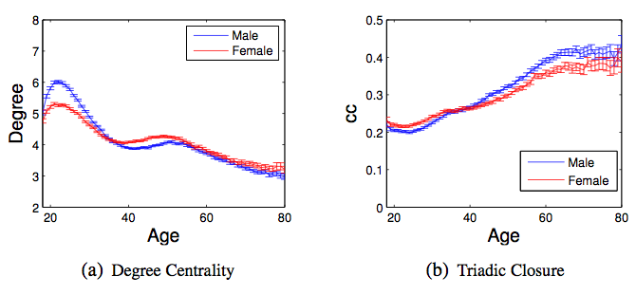
Social Strategy: Ego Network
Peak at 22 years old
Valley and reversion at 38-40 years old
Social Strategies: Young people are very active in broadening their social circles, while seniors have the tendency to maintain small but close connections.
Correlations between user demographics and network properties.

Slide 30
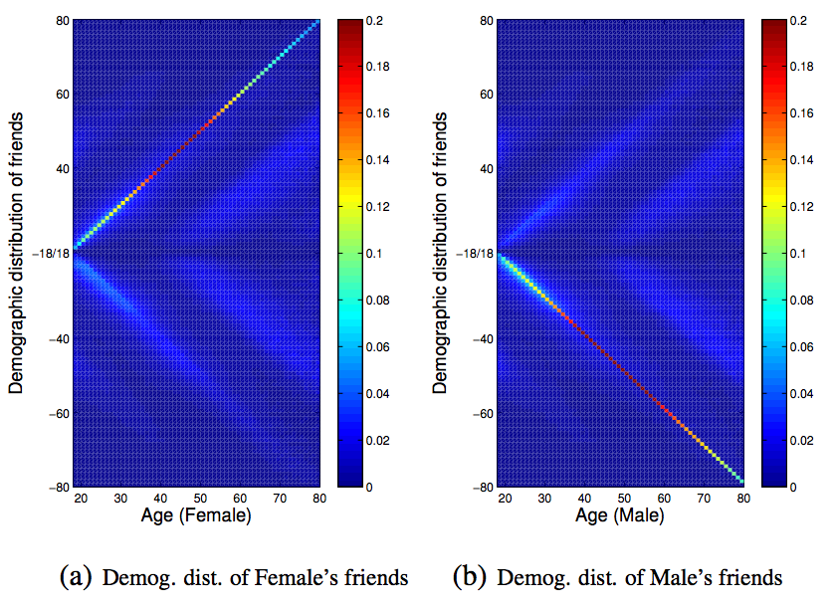
Social Strategy: Ego Network
X: age of central user.
Y: age of friends.
Positive: female friends;
Negative: male friends;
Spectrum: distribution
Social Strategies: People tend to communicate with others of both similar gender and age, i.e., demographic homophily.

Slide 31
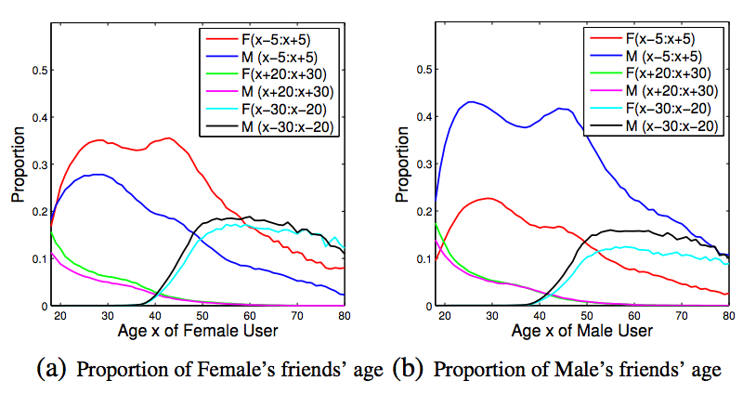
Social Strategy: Ego Network
Same generation
Social Strategies: The young put increasing focus on the same generation, but decrease it after entering middle-age.

Slide 32
Social Strategy: Ego Network
Same generation
older generation
Social Strategies: The young put decreasing focus on the older generation across their lifespans.

Slide 33
Social Strategy: Ego Network
Same generation
older generation
younger generation
Social Strategies: The middle-age people devote more attention on the younger generation even along with the sacrifice of homophily.

Slide 34
Social Strategy: Social Tie
How do two people maintain social tie with respect to their gender and age?
  “Social networks based on dyadic relationships are fundamentally important for understanding of human sociality.”^{[1]}
What are the tie strength distribution between two users with different their gender and age?
  Tie strength is defined by the frequency of communications (calls, smses)^{[2]}.
V. Palchykov, K. Kaski, J. Kertesz, A.-L. Barabasi, R. I. M. Dunbar. Sex differences in intimate relationships. Scientific Reports 2012.
J.P. Onnela, J. Saramaki, J. Hyvonen, G. Szabo, D. Lazer, K. Kaski, J. Kertesz, A. L. Barabasi. Structure and tie strengths in mobile communication networks. PNAS 2007.

Slide 35
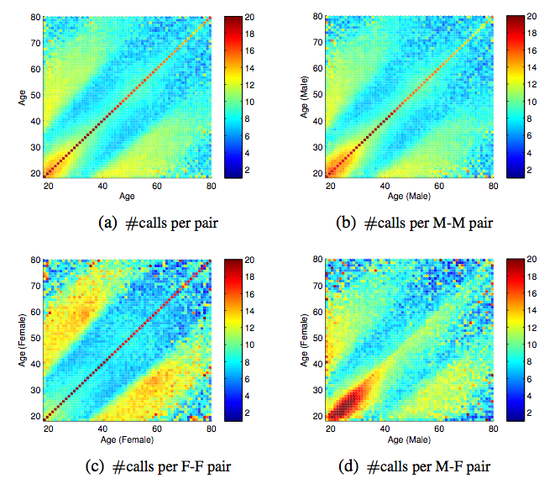
Social Strategy: Social Tie
A
B
X: age of one user.
Y: age of the other user.
Spectrum: #calls per month
(a), (b), (c) are symmetric.
C
D
Social Strategies: Frequent cross-generation interactions are maintained to bridge age gaps.

Slide 36
Social Strategy: Social Tie
B
X: age of one user.
Y: age of the other user.
Spectrum: #calls per month
(a), (b), (c) are symmetric.
C
Social Strategies: Cross-generation interactions between females are more frequent than those between males.

Slide 37
Social Strategy: Social Tie
“Brother” phenomenon
E
X: age of one user.
Y: age of the other user.
Spectrum: #calls per month
(a), (b), (c) are symmetric.
F
Social Strategies: Young male maintain more frequent and broader social connections than young females.

Slide 38
Social Strategy: Social Tie
E
X: age of one user.
Y: age of the other user.
Spectrum: #calls per month
(a), (b), (c) are symmetric.
“Brother” phenomenon
F
G
Social Strategies: Opposite-gender interactions are much more frequent than those between same-gender users.

Slide 39
Social Strategy: Social Triad
How do people create and maintain their close social triad relationships across their lifetime?
  Triad is one of the simplest grouping of individuals that can be studied and is mostly investigated by microsociology^{[1]}.
  Triads are close and balanced relationships.
D. Easley, J. Kleinberg. Networks, Crowds, and Markets: Reasoning About a Highly Connected World. Cambridge U. Press. 2010

Slide 40
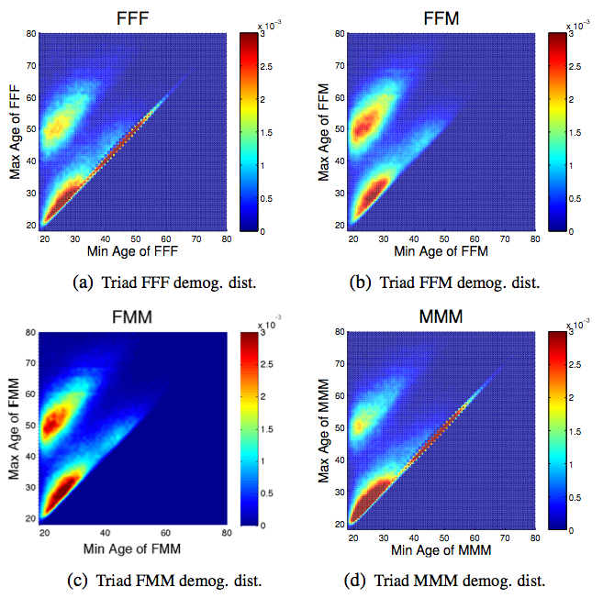
Social Strategy: Social Triad
X: minimum age of 3 users.
Y: maximum age of 3 users.
Spectrum: distribution

Slide 41
Social Strategy: Social Triad
X: minimum age of 3 users.
Y: maximum age of 3 users.
Spectrum: distribution
A
B
C
D
Social Strategies: People expand both same-gender and opposite-gender social groups during the dating and reproductively active period.

Slide 42
Social Strategy: Social Triad
E
F
X: minimum age of 3 users.
Y: maximum age of 3 users.
Spectrum: distribution
G
H
Social Strategies: People’s attention to opposite-gender quickly disappears, and the insistence and social investment on same-gender social groups lasts for a lifetime.
Notes:
More excitingly, when entering middle-age, people only maintain the same-gender triadic relationships, which is revealed by the red diagonal lines in Figure 7(a) and Figure 7(d). However, the opposite-gender triadic relationships vanish when people pass 34 years old in Figure 7(b) and 7(c).

Slide 43
What Else?
Strong interrelations between users’ gender age.
  A 20-year-old female’s behaviors are distinct from not only a 20-year-old male’s, but also from a 50-year-old female’s.

Slide 44
Infer user demographics based on social strategies
social strategies + mobile social network
→ user demographics
Notes:
In 1958, Harvard psychologist, Herbert Kelman identified three broad varieties of social influence.[2]

Slide 45
Problem: Demographic Prediction
Double Dependent-Variable Classification
  Infer users’ gender Y and age Z simultaneously.
  Model correlations between Y and X;
  Model correlations between Z and X;
  Model interrelations between Y and Z;
Gender:
  Male (55%) / Female (45%)
Age:
  Young (18-24) / Young-Adult (25-34) / Middle-Age (35-49) / Senior (>49)
Input:
G = (V^{L}, V^{U}, E, Y^{L}, Z^{L}), X
Output:
f(G, X)→(Y^{U}, Z^{U})

Slide 46
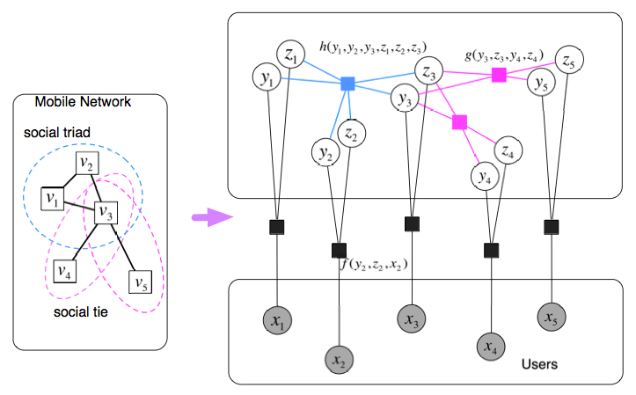

WhoAmI Method
---A double dependent-variable factor graph
Triadic factor h()
Dyadic factor g()
Random variable Z: Age
Random variable Y: Gender
Attribute factor f()
Joint Distribution:
Yuxiao Dong, Yang Yang, Jie Tang, Yang Yang, Nitesh V. Chawla. Inferring User Demographics and Social Strategies in Mobile Social Networks. KDD’14.

Slide 47

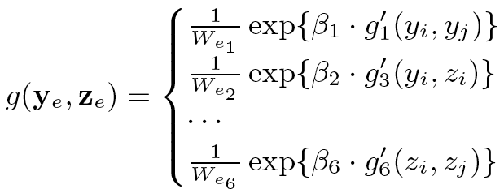
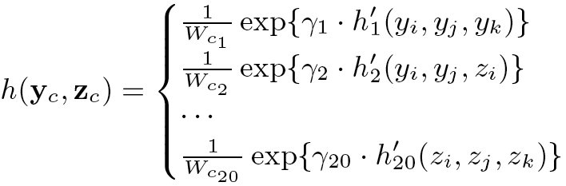
WhoAmI: Model Initialization
Joint Distribution:
Attribute factor:
Dyadic factor:
Interrelations between
gender Y & age Z
Triadic factor:

Slide 48
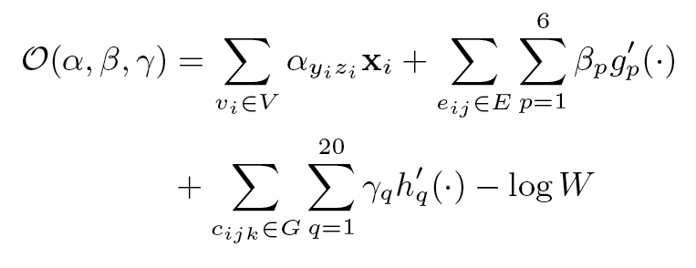
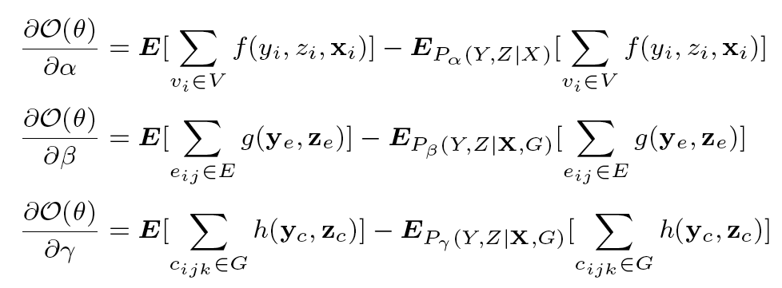
WhoAmI: Objective Function
Object function:
Model learning:
gradient decent
Circles?→LBP

Slide 49
WhoAmI: Distributed Learning
Master
Global update
Slave
Compute local gradient via random sampling
Graph Partition by Locations
Master-Slave Computing
Jie Tang, Sen Wu, Jimeng Sun. Confluence: Conformity influence in large social networks. KDD’13, pages 347-355.

Slide 50
Experiment: Setup
Active users: 1.09 million in CALL, 304,000 in SMS
Baselines:
  Logistic Regression (LRC)^{[1]}
  Support Vector Machine (SVM)^{[2]}
  Naïve Bayes (NB) ^{[1]}
  Random Forest (RF) ^{[1]}
  Bagging (BAG) ^{[1]}
  Gaussian Radial Basis Function Neural Network (RBF) ^{[1]}
  Factor Graph Model (FGM)^{[3]}
  WhoAmI: Double Dependent-Variable Factor Graph (DFG)
  Evaluation Metrics:
  Weighted Prediction/ Weighted Recall / Weighted F1 / Accuracy
WEKA: http://www.cs.waikato.ac.nz/ml/weka/
LibSVM: http://www.csie.ntu.edu.tw/~cjlin/libsvm/
Tiancheng Lou, Jie Tang, John Hopcroft. Learning to predict reciprocity and triadic closure in social networks. ACM TKDD 2013.

Slide 51
Experiment: Features
Given one node v and its ego network:
  Individual feature:
    Individual attribute: degree, neighbor connectivity, clustering coefficient, embeddedness and weighted degree.
  Friend feature:
    Friend attribute: # of connections to female/male, young/young-adult/middle-age/senior friends (from labeled friends).
    Dyadic factor: both labeled and unlabeled friends for social tie structures in v’s ego network.
  Circle feature:
    Circle attribute: # of demographic triads, i.e., v-FF, v-FM, v-MM; v-AA, v-AB, v-AC, v-AD, v-BB, v-BC, v-BD, v-CC, v-CD, v-DD. (A/B/C/C denote the young/young-adult/middle-age/senior)
    Triadic factor: both labeled and unlabeled friends for social triad structures in v’s ego network.
    LCR/SVM/NB/RF/Bag/RBF:
      Individual/Friend/Circle Attributes
    FGM/DFG
      Individual/Friend/Circle Attributes
      Structure feature: Dyadic factors
      Structure feature: Triadic factors
?
?
?
?
V-fm
V-FF

Slide 52
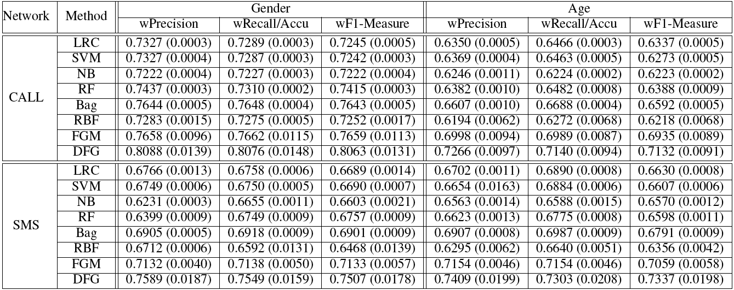
Experiment: Results
We can infer 80% of the users’ GENDER in the CALL network correctly.
We can infer 73% of the users’ AGE in the SMS network correctly.
The CALL connections reveal more users’ GENDER information.
The SMS connections reveal more users’ AGE information.

Slide 53
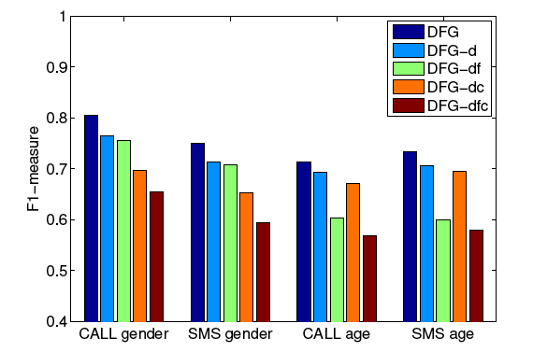
Experiment: Results
DFG-d: stands ignoring the interrelations between gender and age.
DFG-df: stands for further ignoring friend features.
DFG-dc: stands for further ignoring circle features.
DFG-dcf: stands for further ignoring both friend and circle features.
The positive effects of interrelations between gender and age.
Circle features are more powerful for inferring users’ gender.
Friend features are more powerful for inferring users’ age.

Slide 54
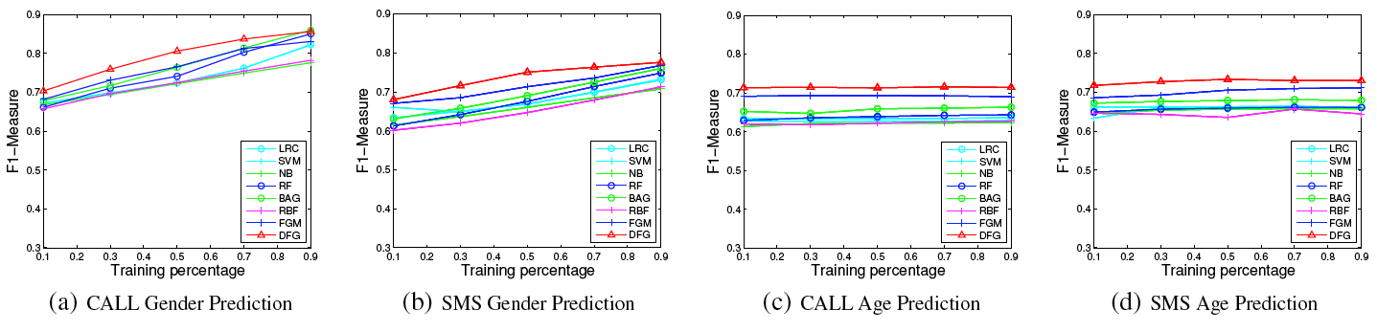
Experiment: Results
Gender
Age
Performance of demographic prediction with different percentage of labeled data

Slide 55
Roadmap
User-level
Tie-level
Structure-level
tie
Social role
Influence
- Emotion
- Demographics
- Social Tie
- Social Influence
- Triad Formation
- Kernel Community
- Structural hole
Tencent
MOOC

Slide 56


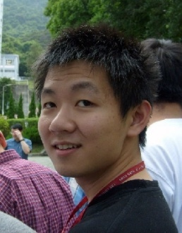
Social Tie Analysis
Family
?
Inferring social ties
Friend
?
Reciprocity
You
Lady Gaga
You
Lady Gaga
Triadic Closure
You
You
?
Lady Gaga
Shiteng
Lady Gaga
Shiteng
KDD 2010, PKDD 2011 (Best Paper Runnerup), WSDM 2012, ACM TKDD

Slide 57
Inferring Social Ties
Family
?
Friend
KDD 2010, PKDD 2011 (Best Paper Runnerup), WSDM 2012, DMKD

Slide 58



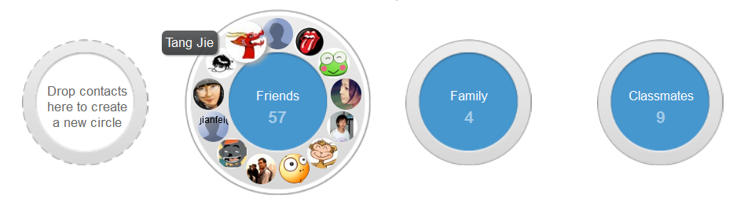
Real social networks are complex...
Nobody exists only in one social network.
  Public network vs. private network
  Business network vs. family network
However, existing networks (e.g., Facebook and Twitter) are trying to lump everyone into one big network
  FB tries to solve this problem via lists/groups
  However…
Google+
which circle? Users do not take time to create it.
Notes:
Nobody exists only in one social network. We have public network and private network; we also have business network and family network. [慢] If you went to a bar last night, I do not think you want to share that information with your family or business networks.
[Click] However, existing online social networks such as Facebook and Twitter are trying to lump everyone into one big social network. For such a problem, Facebook tries to solve it by allowing users to creating friend lists.
[Click] However, the problem is far from solved. Ok, let me ask a question here: how many of you are using the Facebook lists to group all your friends? [手势] Please raise your hand…..
[看一圈] OK, around 10(….) percent, I don’t use either.
Actually, on Facebook, many users are trying to get around of this trouble by creating multiple accounts, which is obviously tedious for most users.
[Click] Recently, Google launched a new project Google+ for supporting “real-life” sharing. One key feature of Google+ is to allow users to build circles of friends. However, no matter how successful Google+ will be, one critical fact that we have to face with is that users do not often take the time to create and maintain their friend list.

Slide 59
Even complex than we imaged!
Only 16% of mobile phone users in Europe have created custom contact groups
  users do not take the time to create it
  users do not know how to circle their friends
The fact is that our social network is black-white…
Notes:
Indeed, one survey of mobile phone users in Europe shows that only 16% of users have created contact groups on their mobile phones. One reason is that users do not take the time to do it; and the other reason is that the users do not know how to circle their friends—in real life, people’s social circles is very dynamic and many circles overlap with each other. [慢] Your enemies of yesterday may become your friends tomorrow.
[Click] So the fact is, our online social network is still black and white.

Slide 60
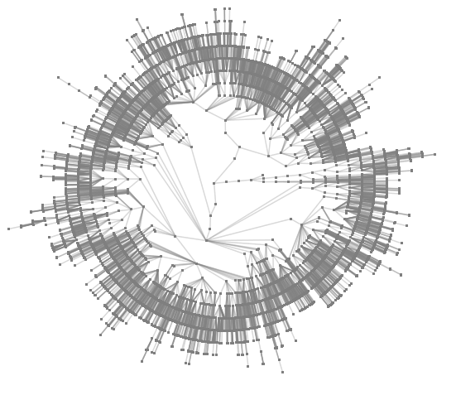
Example 1: finding boss in email networks
(PKDD’11, Best Paper Runnerup)
Enterprise email network
CEO
How to infer
Manager
Employee
User interactions may form implicit groups

Slide 61


Example 2: finding friends in mobile networks
Friends
Other
From Home
08:40
Both in office
08:00 – 18:00
0.89
0.98
From Office
11:35
0.77
From Office
15:20
From Office
17:55
0.63
0.70
From Outside
21:30
0.86
Notes:
Let me give some concrete examples of our problem. The first example is the mobile communication network. Mobile users communicate with each other by making calls and sending text messages. [Click] What we want to do is to infer the friendship in the communication network.

Slide 62
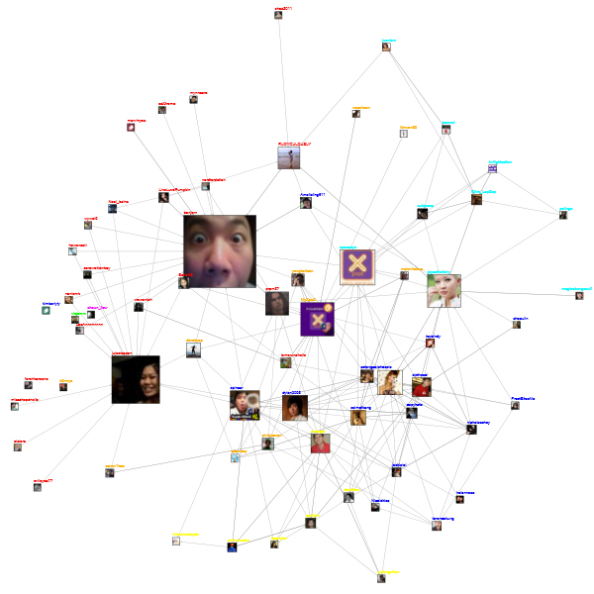
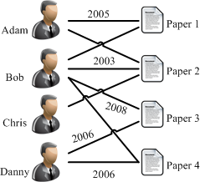
Challenges
What are the fundamental forces behind?
Can we automatically infer the type of social ties?
Publication network
From Home
08:40
Both in office
08:00 – 18:00
Twitter’s following network
From Office
11:35
From Office
15:20
From Office
17:55
From Outside
21:30
Mobile communication network

Slide 63
Networks
Epinions a network of product reviewers: 131,828 nodes (users) and 841,372 edges
  trust relationships between users
Slashdot: 82,144 users and 59,202 edges
  “friend” relationships between users
Mobile: 107 mobile users and 5,436 edges
  to infer friendships between users
Coauthor: 815,946 authors and 2,792,833 coauthor relationships
  to infer advisor-advisee relationships between coauthors
Enron: 151 Enron employees and 3572 edges
  to infer manager-subordinate relationships between users.
Undirected network
Directed network

Slide 64
Problem Formulation
  Input: G=(V,E^{L},E^{U},R^{L},W)
Partially Labeled Network
Other
Friend
V: Set of Users
E^{L},R^{L}: Labeled relationships
?
?
?
E^{U}: Unlabeled relationships
Other
Input:
  G=(V,E^{L},E^{U},R^{L},W)
Output:
f: G→R
Notes:
Now let’s give a formal definition of this problem. Basically, the input is a social network, which contains [Click] a set of users. In the social network, some relationships may be [Click] labeled, [Click] but most are not. Therefore, the input is a [Click] partially label network. [Click] In this problem, the input is a partially labeled network G, the objective is to learn a mapping function f, which can predict the relationship semantics for each relationship in the input social graph. It should be noted that, the partially-labeled property is very important. To learn a high-quality predictive model, we should not only consider the labeled information, but also the unlabeled network structure information.

Slide 65
Basic Idea
V₁
V₃
V₂
?
Friend
?
User→Node
?
?
r₂₄
r₅₆
Other
r₄₅
Relationship→Node
Notes:
Now, let’s discuss about the solutions. In general, there are two ways to model the problem. The first way is to model each user as a node [Click]. And another way is to model each relationship as a node [Click]
The first way is more intuitive, but it’s difficult to model the some correlations between different relationships. We use the second model.

Slide 66
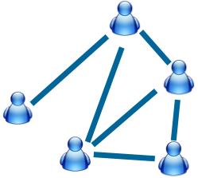
Partially Labeled Pairwise
Factor Graph Model (PLP-FGM)
Constraint factor h
y₂₁=Friend
Partially Labeled
Model
y₁₂=Friend
Latent Variable
y₁₆=Other
Correlation factor g
Problem:
For each relationship, identify which type
has the highest probability?
Attribute factors f
Input
Model
Map relationship to nodes in model
Example:
A makes call to B immediately after the call to C.
Example:
Call frequency between two users?
[1] Wenbin Tang, Honglei Zhuang, and Jie Tang. Learning to Infer Social Ties in Large Networks. In ECML/PKDD'2011. pp. 381-397. (Best Student Paper Runner-up)
Notes:
Now we introduce our partially labeled pairwise factor graph model in detail. Take the mobile network as example. The left side is input mobile social network. [Click] And the right side is the formulized model. [Click] Each relationship in the input network is mapped to a relationship node in the model. [click]
For each relationship node, we have a corresponding latent variable y. [click] The value of latent variable indicates the type of relationship.
In this model, we define three different factors.
The first factor is attribute factor. For each relationship, there may exist some user-specific/link-specific attributes which can reflect the relationship type.
For example:
How frequently two users make call to each other?
These features are added in to the model as "attribute factors.“
The second factor is correlation factor. Different relationships may have some correlations. Let's image such a situation, user Bob makes call to Alice immediately after the call to Carl. Then, the relationship between Bob and Alice, and the relationship between Bob and Carl, are very likely to be the same.
[Click]
The third factor is constraint factor. There also may exist some common knowledge that can help us to infer the relationship types.
[Click]
Finally, this model is a partially labeled model. Some of the nodes are labeled and some are not.
[Click]
Based on this model, The problem is cast as, for each relationship, identify which type has the highest probability.

Slide 67

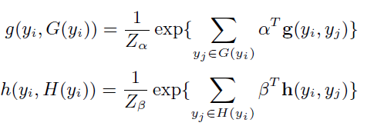

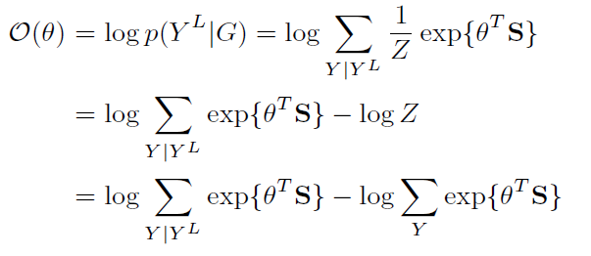
Solutions_{(con’t)}
Different ways to instantiate factors
  We use exponential-linear functions
    Attribute Factor:
    Correlation / Constraint Factor:
  Log-Likelihood of labeled Data:

Slide 68
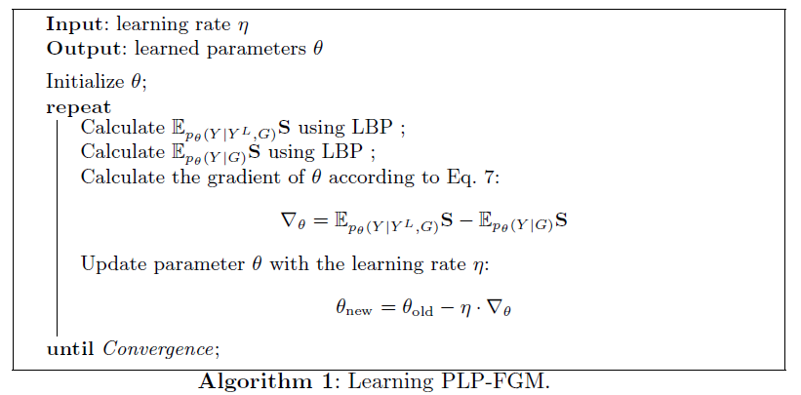
Learning Algorithm
Maximize the log-likelihood of labeled relationships
Expectation Computing
Loopy Belief Propagation
Gradient Ascent Method
Notes:
//算法方块放大
Learning the model, is to estimate a parameter configuration \theta, so that the log-likelihood of observation information are maximized.
[Click]
Therefore, we use gradient decent method to estimate the parameters.
[Click]
And use loopy belief propagation to compute the gradient vector.
核心要说 说清楚 Partially Labeled 的计算方式， Run两次 LBP。

Slide 69
Still Challenges?
Questions:
- How to obtain sufficiently training data?
- Can we leverage knowledge from other network?

Slide 70
Inferring Social Ties Across Networks
Epinions
Mobile
What is the knowledge to transfer?
Jie Tang, Tiancheng Lou, and Jon Kleinberg. Inferring Social Ties across Heterogeneous Networks. In WSDM'2012. pp. 743-752.

Slide 71
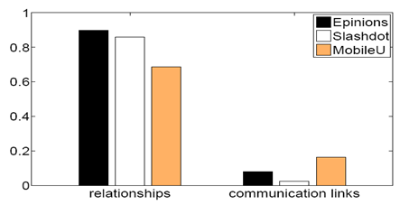
Social Theories
Social balance theory
Structural hole theory
Social status theory
Two-step-flow theory
Observations:
(1) The underlying networks are unbalanced;
(2) While the friendship networks are balanced.
Notes:
social balance theory suggests that people in a social network are incline to form into a balanced
network structure.
The phrase the enemy of my enemy is my friend is a proverb that advances the concept that someone who is the enemy of your enemy is therefore your friend.

Slide 72
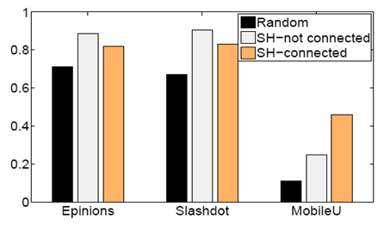
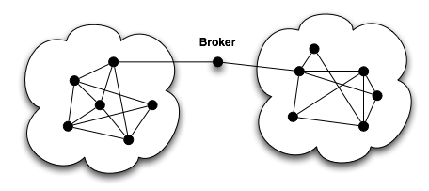
Social Theories—Structural hole
Social balance theory
Structural hole theory
Social status theory
Two-step-flow theory
Observations: Users are more likely (+25-150% higher than change) to have the same type of relationship with C if C spans structural holes
Structural hole
Notes:
The structural hole theory is an important extension of social network theory. Structural holes [1] in a social network indicate those people who can broker connections between otherwise disconnected sub networks.
Users are more likely (+70%) to have the same type of relationship with structural hole nodes.

Slide 73
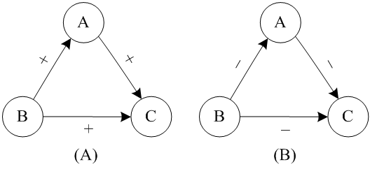
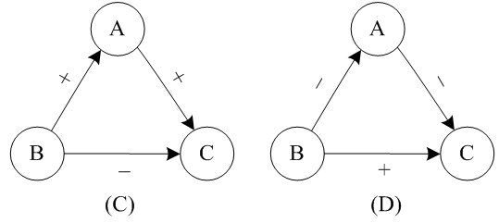
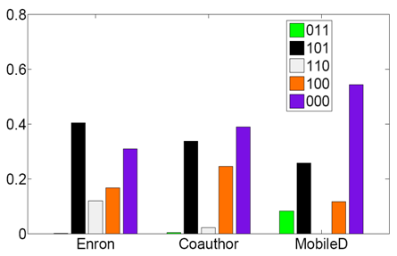
Social Theories—Social status
Social balance theory
Structural hole theory
Social status theory
Two-step-flow theory
Observations: 99% of triads in the networks satisfy the social status theory
Note: Given a triad (A,B,C), let us use 1 to denote the advisor-advisee relationship and 0 colleague relationship. Thus the number 011 to denote A and B are colleagues, B is C’s advisor and A is C’s advisor.
Notes:
early 99% of Triads in The three networks satisfy the social status theory, and they share a similar distribution on the five frequent forms of triads.

Slide 74


Social Theories—Two-step-flow
Social balance theory
Structural hole theory
Social status theory
Two-step-flow theory
OL : Opinion leader;
OU : Ordinary user.
Observations: Opinion leaders are more likely (+71%-84% higher than
chance) to have a higher social-status than ordinary users.
Notes:
Opinion leaders are more likely to have a higher social-status than ordinary users.

Slide 75
Transfer Factor Graph Model
Coauthor network
Bridge via social theories
mobile

Slide 76

Mathematical Formulation
Features defined in source network
Features defined in target network
Triad-based features shared across networks
Jie Tang, Tiancheng Lou, and Jon Kleinberg. Inferring Social Ties across Heterogeneous Networks. In WSDM'2012. pp. 743-752.

Slide 77
Experiments
Data sets
  Epinions: 131,828 nodes (users) and 841,372 edges
  Slashdot: 82,144 users and 59,202 edges
  Mobile: 107 mobile users and 5,436 edges
  Coauthor: 815,946 authors and 2,792,833 coauthor relationships
  Enron: 151 Enron employees and 3572 edges
Comparison methods
  SVM and CRF are two baseline methods
  PFG is the partially-labeled factor graph model
  TranFG is the transfer–based factor graph model

Slide 78

Results – undirected networks
SVM and CRF are two baseline methods
PFG is the proposed partially-labeled factor graph model
TranFG is the proposed transfer–based factor graph model.

Slide 79

Results – directed networks
SVM and CRF are two baseline methods
PFG is the proposed partially-labeled factor graph model
TranFG is the proposed transfer–based factor graph model.

Slide 80
Parasocial vs. Reciprocal
?
You
Lady Gaga
You
Lady Gaga
John E. Hopcroft, Tiancheng Lou, and Jie Tang. Who Will Follow You Back? Reciprocal Relationship Prediction. In CIKM'11. pp. 1137-1146.

Slide 81




Who will follow you back?
On Twitter…
30%
?
100%
?
60%
?
JimmyQiao
1%
Ladygaga
?
Shiteng
Obama
Huwei
Notes:
Here is an example on Twitter, one morning, you add 4 new followers : Ladygaga, Weiyu(Shen), Bangsheng and Liwen.
Do you think they will follow you back? The answer is only No, but also Yes sometimes.
What we did is to try to build a learning framework to compute the probability of follow-backs.
In this example, for Ladygaga, the probability is 1, because she use tools to do follow-back automatically.
And, someone’s follow-back probability is really low, and others’ share different probabilities.

Slide 82




Geographic Distance
Local
vs
Global
John E. Hopcroft, Tiancheng Lou, and Jie Tang. Who Will Follow You Back? Reciprocal Relationship Prediction. In CIKM'2011. pp. 1137-1146.
Notes:
We first describe some high-level investigation of how different factors influence the formation of follow-back relationships, because the motivation of our work is to find the underlying factors and their influence to this task.
We study the following factors.
Geographic distance, do users have a higher probability to follow each other when they are located in the same region?
Firstly, the geographic distance is already not a factor to stop users from developing a reciprocal relationship, because the probabilities of follow-back for different distance are almost the same..But, acorrding to the average number of reciprocal relationships between users from the same time zone is about 50 times higher than others.
Homophily, the principle of homophily suggests that users with similar characteristics tend to associate with each other.
The left figure clearly shows that the probability of two users following back each other when they share commone nieghbors is much higher than usual.
The right figure shows that, elite users have a much stronger tendency to follow each other : more precisely, the follow-back probability between elite users is 8 times higher than ordinary uers. The (alpha, beta) algorithm seems able to better distinguish elite users from ordinary users in our problem setting, because it also considers the community structure among elite users.
On Twitter, besides the explicit network with following links, there are also some implcit network structure that can be induced from the textural information. When users A and B retweet or reply each other’s tweet, the likelihood of their following back each other is 3 times higher than chance. Another intesresting phenomenon is that, compared with replying someone’s tweet, retweeting (forwarding) her tweet seems to be more helpful (15% vs 9%)
Now, we connect our work to a basic social theory, structural balance theory. We examine how the Twitter network satisfy the structural balance property.
The network of two-way relationships on Twitter is balanced (88%), while the network of one-way relationships is not (only 29%).

Slide 83


Homophily
Link homophily: users who share common links will have a tendency to follow each other.
Status homophily: Elite users have a much stronger tendency to follow each other.
Notes:
We first describe some high-level investigation of how different factors influence the formation of follow-back relationships, because the motivation of our work is to find the underlying factors and their influence to this task.
We study the following factors.
Geographic distance, do users have a higher probability to follow each other when they are located in the same region?
Firstly, the geographic distance is already not a factor to stop users from developing a reciprocal relationship, because the probabilities of follow-back for different distance are almost the same..But, acorrding to the average number of reciprocal relationships between users from the same time zone is about 50 times higher than others.
Homophily, the principle of homophily suggests that users with similar characteristics tend to associate with each other.
The left figure clearly shows that the probability of two users following back each other when they share commone nieghbors is much higher than usual.
The right figure shows that, elite users have a much stronger tendency to follow each other : more precisely, the follow-back probability between elite users is 8 times higher than ordinary uers. The (alpha, beta) algorithm seems able to better distinguish elite users from ordinary users in our problem setting, because it also considers the community structure among elite users.
On Twitter, besides the explicit network with following links, there are also some implcit network structure that can be induced from the textural information. When users A and B retweet or reply each other’s tweet, the likelihood of their following back each other is 3 times higher than chance. Another intesresting phenomenon is that, compared with replying someone’s tweet, retweeting (forwarding) her tweet seems to be more helpful (15% vs 9%)
Now, we connect our work to a basic social theory, structural balance theory. We examine how the Twitter network satisfy the structural balance property.
The network of two-way relationships on Twitter is balanced (88%), while the network of one-way relationships is not (only 29%).

Slide 84

Interaction
  Retweet vs. reply
  *Retweeting seems to be more helpful
Notes:
We first describe some high-level investigation of how different factors influence the formation of follow-back relationships, because the motivation of our work is to find the underlying factors and their influence to this task.
We study the following factors.
Geographic distance, do users have a higher probability to follow each other when they are located in the same region?
Firstly, the geographic distance is already not a factor to stop users from developing a reciprocal relationship, because the probabilities of follow-back for different distance are almost the same..But, acorrding to the average number of reciprocal relationships between users from the same time zone is about 50 times higher than others.
Homophily, the principle of homophily suggests that users with similar characteristics tend to associate with each other.
The left figure clearly shows that the probability of two users following back each other when they share commone nieghbors is much higher than usual.
The right figure shows that, elite users have a much stronger tendency to follow each other : more precisely, the follow-back probability between elite users is 8 times higher than ordinary uers. The (alpha, beta) algorithm seems able to better distinguish elite users from ordinary users in our problem setting, because it also considers the community structure among elite users.
On Twitter, besides the explicit network with following links, there are also some implcit network structure that can be induced from the textural information. When users A and B retweet or reply each other’s tweet, the likelihood of their following back each other is 3 times higher than chance. Another intesresting phenomenon is that, compared with replying someone’s tweet, retweeting (forwarding) her tweet seems to be more helpful (15% vs 9%)
Now, we connect our work to a basic social theory, structural balance theory. We examine how the Twitter network satisfy the structural balance property.
The network of two-way relationships on Twitter is balanced (88%), while the network of one-way relationships is not (only 29%).

Slide 85


Structural Balance
(A) and (B) are balanced, but (C) and (D) are not.
Structural balance
  Reciprocal relationships are balanced (88%);
  Parasocial relationships are not (only 29%).
Notes:
We first describe some high-level investigation of how different factors influence the formation of follow-back relationships, because the motivation of our work is to find the underlying factors and their influence to this task.
We study the following factors.
Geographic distance, do users have a higher probability to follow each other when they are located in the same region?
Firstly, the geographic distance is already not a factor to stop users from developing a reciprocal relationship, because the probabilities of follow-back for different distance are almost the same..But, acorrding to the average number of reciprocal relationships between users from the same time zone is about 50 times higher than others.
Homophily, the principle of homophily suggests that users with similar characteristics tend to associate with each other.
The left figure clearly shows that the probability of two users following back each other when they share commone nieghbors is much higher than usual.
The right figure shows that, elite users have a much stronger tendency to follow each other : more precisely, the follow-back probability between elite users is 8 times higher than ordinary uers. The (alpha, beta) algorithm seems able to better distinguish elite users from ordinary users in our problem setting, because it also considers the community structure among elite users.
On Twitter, besides the explicit network with following links, there are also some implcit network structure that can be induced from the textural information. When users A and B retweet or reply each other’s tweet, the likelihood of their following back each other is 3 times higher than chance. Another intesresting phenomenon is that, compared with replying someone’s tweet, retweeting (forwarding) her tweet seems to be more helpful (15% vs 9%)
Now, we connect our work to a basic social theory, structural balance theory. We examine how the Twitter network satisfy the structural balance property.
The network of two-way relationships on Twitter is balanced (88%), while the network of one-way relationships is not (only 29%).

Slide 86
Triad Factor Graph (TriFG)

Slide 87
Experiments
Huge sub-network of twitter
  13,442,659 users and 56,893,234 following links.
  Extracted 35,746,366 tweets.
Dynamic networks
  With an average of 728,509 new links per day.
  Averagely 3,337 new follow-back links per day.
  13 time stamps by viewing every four days as a time stamp
Data | Algotithm | Precision | Recall | F1Measure | Accuracy
Test Case 1 | SVM | 0.6908 | 0.6129 | 0.6495 | 0.9590
 | LRC | 0.6957 | 0.2581 | 0.3765 | 0.9510
 | CRF | 1.0000 | 0.6290 | 0.7723 | 0.9770
 | TriFG | 1.0000 | 0.8548 | 0.9217 | 0.9910
Test Case 2 | SVM | 0.7323 | 0.6212 | 0.6722 | 0.9534
 | LRC | 0.8333 | 0.3030 | 0.4444 | 0.9417
 | CRF | 1.0000 | 0.6333 | 0.7755 | 0.9717
 | TriFG | 1.0000 | 0.8788 | 0.9355 | 0.9907

Slide 88


Effect of Time Span
Distribution of follow back time
  60% for next-time stamp;
  37% for following 3 time stamps.
Different settings of the time span
  Performance drops sharply when two or less;
  Acceptable for three time stamps.
Notes:
The left figure shows the distribution of follow-backs in different time stamps.
60% of follow-backs are performed in the next time stamp,
37% of follow-backs would be still performed in the following 3 time stamps.
The right figure lists the average prediction performance of TriFG in the two test cases with different settings of the time span.
It shows that, when setting the time span as two of less, the prediction performance of TriFG drops sharply.
The performance is acceptable, when setting it as three time stamps.

Slide 89

Case Study

Slide 90
Roadmap
User-level
Tie-level
Structure-level
tie
Social role
Influence
- Emotion
- Demographics
- Social Tie
- Social Influence
- Triad Formation
- Kernel Community
- Structural hole
Tencent
MOOC

Slide 91







“Love Obama”
—social influence in online social networks
I love Obama
I hate Obama, the worst president ever
Obama is fantastic
Obama is great!
No Obama in 2012!
He cannot be the next president!
Positive
Negative
Notes:
Obama has done just that. From social networking to his blog to his Fight the Smears campaign, Obama has made his Web 2.0 presence known. He has over 1.5 million friends on MySpace and Facebook, and he currently has over 28,000,000 followers on Twitter. This personal activity in social networks allows him to quickly get the word out across multiple platforms.

Slide 92
Social Influence
I hate Obama
Positive
Negative
I love Obama
output
0.3
0.7
0.1
0.74
0.2
0.4
0.05
0.5
0.1
[1] Seminar given at the 46th CCF ADL. http://keg.cs.tsinghua.edu.cn/jietang/publications/2013-social-network-models.pdf

Slide 93

Example: Political mobilization
There are two kinds of treatments.
A controlled trial
Social msg group: was shown with msg that indicates one’s friends who have made the votes.
Informational msg group: was shown with msg that indicates how many other.
Control group: did not receive any msg.
Treatment Group 1
Treatment for Group 2
Treatment for Group 1
Treatment for Group 1&2
[1] R. M. Bond, C. J. Fariss, J. J. Jones, A. D. I. Kramer, C. Marlow, J. E. Settle and J. H. Fowler. A 61-million-person experiment in social influence and political mobilization. Nature, 489:295-298, 2012.
Notes:
For case 1, use real randomized experiment:
Users were randomly assigned to a ‘social message’ group, an “informational message” group, or a ‘control group’.
Compare the proportion of users to estimate the causal effect of seeing the faces of voters.

Slide 94

Case 1: Social Influence and Political Mobilization
Social msg group v.s.
Info msg group
Result: The former were 2.08% (t-test, P<0.01) more likely to click on the “I Voted” button
Social msg group v.s.
Control group
Result: The former were 0.39% (t-test, P=0.02) more likely to actually vote (via examination of public voting records)
[1] R. M. Bond, C. J. Fariss, J. J. Jones, A. D. I. Kramer, C. Marlow, J. E. Settle and J. H. Fowler. A 61-million-person experiment in social influence and political mobilization. Nature, 489:295-298, 2012.

Slide 95
Topic-based Social Influence Analysis
Social network -> Topical influence network
[1] J. Tang, J. Sun, C. Wang, and Z. Yang. Social Influence Analysis in Large-scale Networks. In KDD’09, pages 807-816, 2009.

Slide 96
The Solution: Topical Affinity Propagation
Topical Affinity Propagation
  Topical Factor Graph model
  Efficient learning algorithm
  Distributed implementation
[1] Jie Tang, Jimeng Sun, Chi Wang, and Zi Yang. Social Influence Analysis in Large-scale Networks. In KDD, pages 807-816, 2009.

Slide 97

Topical Factor Graph (TFG) Model
Social link
Nodes that have the highest influence on the current node
Node/user
The problem is cast as identifying which node has the highest probability to influence another node on a specific topic along with the edge.

Slide 98

Topical Factor Graph (TFG)
The learning task is to find a configuration for all {y_{i}} to maximize the joint probability.
Objective function:
1. How to define?
2. How to optimize?
Notes:
目标函数P描述了隐变量y_i取任意一组值时的联合概率分布

Slide 99




How to define (topical) feature functions?
similarity
  Node feature function
  Edge feature function
  Global feature function
or simply binary

Slide 100


Model Learning Algorithm
Sum-product:
- Low efficiency!
- Not easy for distributed learning!

Slide 101

New TAP Learning Algorithm
1. Introduce two new variables r and a, to replace the original message m.
2. Design new update rules:
m_{ij}
[1] Jie Tang, Jimeng Sun, Chi Wang, and Zi Yang. Social Influence Analysis in Large-scale Networks. In KDD, pages 807-816, 2009.

Slide 102






The TAP Learning Algorithm

Slide 103

Distributed TAP Learning
Map-Reduce
  Map: (key, value) pairs
    e_{ij} /a_{ij} → e_{i*} /a_{ij}; e_{ij} /b_{ij} → e_{i*} /b_{ij}; e_{ij} /r_{ij} → e_{*j} /r_{ij} .
  Reduce: (key, value) pairs
    e_{ij} / * → new r_{ij}; e_{ij}/* → new a_{ij}
For the global feature function

Slide 104
Experiments
Data set: (http://arnetminer.org/lab-datasets/soinf/)
Evaluation measures
  CPU time
  Case study
  Application
Data set | #Nodes | #Edges
Coauthor | 640,134 | 1,554,643
Citation | 2,329,760 | 12,710,347
Film (Wikipedia) | 18,518 films 7,211 directors 10,128 actors 9,784 writers | 142,426

Slide 105


Social Influence Sub-graph on “Data mining”
On “Data Mining” in 2009

Slide 106

Results on Coauthor and Citation

Slide 107

Scalability Performance

Slide 108
Speedup results
Speedup vs. #Computer nodes
Speedup vs. Dataset size

Slide 109
Still Challenges
How to model dynamic influence?
How to distinguish influence from other social factors?

Slide 110

Dynamic Influence Analysis
G^{t} =(V^{t}, E^{t}, X^{t}, Y^{t})
Actions at time t
Nodes at time t
Edges at time t
Attribute matrix at time t
Input:
G^{t} =(V^{t}, E^{t}, X^{t}, Y^{t})
t = 1,2,…T
Output:
F: f(G^{t}) ->Y^{(t+1)}
Notes:
Influence is usually reflected in changes in social action patterns (user behavior) in the social network. Recent work [31, 68] has studied the problem of learning the influence degree from historical user actions, while some other work [58, 64] investigates how social actions evolve in the context of the network, and how such actions are affected by social influence factors.
Before introducing these methods, we will first define the time-varying attribute augmented networks with user actions:
An action y performed by user vi at time t can be represented as a triple (y, vi, t)

Slide 111


Social Influence & Action Modeling^{[1]}
Action: Who will pay money in the game?
Influence
1
Correlation
Time t+1
3
Time t
John
John
Action bias
4
Personal attributes:
Always watch news
Enjoy sports
….
Dependence
2
[1] C. Tan, J. Tang, J. Sun, Q. Lin, and F. Wang. Social action tracking via noise tolerant time-varying factor graphs. In KDD’10, pages 807–816, 2010.
Notes:
To predict users’ actions, we need to consider complex factors. What information we have, we have a dynamic social network, and also attributes of his own. Intuitively, what factors we need to consider? First, the influence from his friends, second, he will keep the same action or attitude as himself, we call it dependence. Third, correlation between neighbours. Finally, personal interests.

Slide 112


A Discriminative Model: NTT-FGM
Influence
Correlation
Personal attributes
Dependence
Continuous latent action state
Action
Personal attributes
Notes:
The model we propose is as the graph shows. This graph shows a three-stage social network. We first add a continuous latent state for each user’s action state. And the factors are all defined according to the latent state. First we user action bias factor to consider the noise in users’ actions. And the influence factor denotes the influence from the past. Finally correlation factor defines the correlation between users and also personal interests. For the action bias factor, we have two option to choose for binary actions: bernoulli and Gaussian. Gaussian can be extended to continuous actions. So we choose Gaussian in our model for potential extension.

Slide 113



Model Instantiation
How to estimate the parameters?
Notes:
The correlation factor can be naturally modeled in a Markov random field.

Slide 114

Model Learning—Two-step learning
[1] C. Tan, J. Tang, J. Sun, Q. Lin, and F. Wang. Social action tracking via noise tolerant time-varying factor graphs. In KDD’10, pages 807–816, 2010.
Notes:
We employ an EM-style algorithm to train the model. This is the algorithm. Due to the time limit, if you are interested in the algorithm, we can discuss offline.

Slide 115





Learning Algorithm Details
Integration of Z (conditioned on α>0, β>0, λ>0)
Transform Z into a form of multivariate Gaussian dist.
First term is easy, but the others are difficult
b=Xα NT-vector; X is a NT x d matrix by concatenating all time-varying attribute matrices
All coefficients of z
correlation
A is NT x NT matrix
Influence

Slide 116
Experiment
Data Set (http://arnetminer.org/stnt)
Baseline
  SVM
  wvRN (Macskassy, 2003)
Evaluation Measure:
  Precision, Recall, F1-Measure
 | Action | Nodes | #Edges | Action Stats
Twitter | Post tweets on “Haiti Earthquake” | 7,521 | 304,275 | 730,568
Flickr | Add photos into favorite list | 8,721 | 485,253 | 485,253
Arnetminer | Issue publications on KDD | 2,062 | 34,986 | 2,960
Notes:
Finally, I will introduce the experiments. This is the data sets we used in the experiment, and the actions is the same as previously introduced. The baseline methods we use includes SVM, which uses the personal features combined with his neighbours, while wvRN is an algorithm proposed in 2003, which makes user of the graph information. The evaluation measure includes precision, recall and F1-measure.

Slide 117



Results

Slide 118
Roadmap
User-level
Tie-level
Structure-level
tie
Social role
Influence
- Emotion
- Demographics
- Social Tie
- Social Influence
- Triad Formation
- Kernel Community
- Structural hole
Tencent
MOOC

Slide 119
Triadic Closure
You
You
?
Lady Gaga
Shiteng
Lady Gaga
Shiteng
Tiancheng Lou, Jie Tang, John Hopcroft, Zhanpeng Fang, Xiaowen Ding. Learning to Predict Reciprocity and Triadic Closure in Social Networks. ACM TKDD, V(7) 2, July 2013, Article No. 5.

Slide 120
Triadic Closure
90%
0.5%
JimmyQiao
Ladygaga
60%
50%
Shiteng
0.6%
1%
Huwei
Obama

Slide 121

Triads in networks
0 1 2 3 4 5 6 7 8 9 10 11 12
Milo R, Itzkovitz S, Kashtan N, et al.. Superfamilies of evolved and designed networks. Science, 2004
Notes:
Here, we can get 13 different triads, among which 6 has two links and the other 7 have 3 links. In 2004, milo said in his science paper that these 13 different triads in different networks, like in transportation network, biology network, world web wide network, bacteria network, and in different networks, every triads performs distinguished different. Here let’s look deeper in the 13 triads.

Slide 122


Open Triad to Triadic Closure
Hong Huang, Jie Tang, Sen Wu, Lu Liu, and Xiaoming Fu. Mining Triadic Closure Patterns in Social Networks. In WWW'14, pages 499-504.

Slide 123
Weibo Data
Weibo
Time span: Aug 29th, 2012 – Sep 29th, 2012
700 thousand nodes
200 out-degree per user
360 thousand new links
44 thousand newly formed closed triads per day
400 million following links
Notes:
We did our empirical analysis on the weibo data, weibo is chinese twitter. our data is form August 29th to September 29th in 2012, which covers more than 700 thousand users and 400 million following relationships. Average, every user have around 200 degrees, everyday, there are averagely 360 thousand new relationships formed, and about 44 thousand new closed triads formed.

Slide 124

Open Triad to Triadic Closure
Y-axis: probability that each open triad forms triadic closures

Slide 125

Location & Gender
L(A, B) means A and B are from the same city
0—female; 1—male
e.g., 001 means A and B are female while C is male.
Observations: Men are more inclined to form triadic closure.

Slide 126

Social Role
0—ordinary user
1—opinion leader (top 1% PageRank)
e.g., 001 means A and B are ordinary user while C is opinion leader.
Observations: Triads of opinion leaders themselves are more likely to be closed.
Notes:
Then, when we want to consider the social status of users. Here we use PageRank algorithm to rank the top 1 percent of users as opinion leaders. We can see that opinion leader are more likely to form triadic closure than ordinary users. But if the connecting user is opinion leader, it is the worst case to form triadic closure, which corresponds the case that triad no3.

Slide 127
Triad Factor Graph (TriFG)

Slide 128
Triad Closure Prediction Result
Data | Algotithm | Precision | Recall | F1Measure
Test Case 1 | SVM | 0.0870 | 0.1429 | 0.1081
 | LRC | 0.0536 | 0.1404 | 0.0759
 | CRF-balance | 0.0208 | 0.0436 | 0.0282
 | CRF | 0.1111 | 0.0870 | 0.0976
 | wTriFG | 0.3333 | 0.0373 | 0.0671
 | TriFG | 0.4545 | 0.2174 | 0.2941
Test Case 2 | SVM | 0.2000 | 0.2222 | 0.2105
 | LRC | 0.1071 | 0.1667 | 0.1304
 | CRF-balance | 0.0909 | 0.0556 | 0.0690
 | CRF | 0.2222 | 0.2222 | 0.2222
 | wTriFG | 0.5000 | 0.0556 | 0.1000
 | TriFG | 0.8571 | 0.3333 | 0.4800

Slide 129
Follow Influence
You
?
?
Lady Gaga
You
Lady Gaga
Obama
Shiteng

Slide 130

Will the “following” be Influenced?
Large neighbors, but may not be influenced
50%
Few neighbors, but may be significantly influenced
90%
?
0.5%
JimmyQiao
?
30%
Ladygaga
60%
?
Shiteng
40%
1%
?
2%
5%
Huwei
Obama

Slide 131
Influence Test via Triad Formation
Two Categories of Following Influences
A
Whether influence exists?
A
t
t
B
C
B
t’=t+1
C
t’=t+1
Follower diffusion
Followee diffusion
–>: pre-existed relationships
–>: a new relationship added at t
-->: a possible relationship added at t+1

Slide 132
24 Triads in Following Influence
Follower diffusion
Followee diffusion
A
A
A
A
A
A
t
t
t
t
t
t
B
C
B
C
B
C
B
C
B
t'
C
B
t'
C
t'
t'
t'
t'
A
A
A
A
A
A
t
t
t
t
t
t
B
t'
C
B
C
B
t'
C
B
t'
C
B
C
B
t'
C
t'
t'
A
A
A
A
A
A
t
t
t
t
t
t
B
C
B
t'
C
B
t'
C
B
C
B
t'
C
B
t'
C
t'
t'
A
A
A
A
A
A
t
t
t
t
t
t
B
C
B
C
B
C
B
t'
C
B
C
B
t'
C
t'
t'
t'
t'
12 triads
12 triads

Slide 133










Test Result
Two categories of triads have significant influence, compared with two other categories
Attract more followers
Follow More
P1(B->C)=0.5%
P2(B->C)=0.1%
P1(B->C)=14.4%
P2(B->C)=0.1%
…
…
No influence
No influence
P1(B->C)=0.02%
P2(B->C)=0.02%
P1(B->C)=0.02%
P2(B->C)=0.02%

Slide 134


Example: Following Influence Test
Time 1
When you follow a user, will the behavior influences others?
Time 2
Lady Gaga
Lady Gaga
Lei
Sen
Lei
Sen
Peng
Peng
Treatment Group
RCT:
Treatment group: people who followed some other people or who have friends following others at time t;
Controlled group: people who did not follow anyone and do not have any friends following others at time t.
[1] T. Lou, J. Tang, J. Hopcroft, Z. Fang, and X. Ding. Learning to Predict Reciprocity and Triadic Closure in Social Networks. ACM TKDD, (accepted).
Notes:
The challenge is that we cannot do a real randomized treatment trial.

Slide 135
Twitter Data
Twitter data
  “Lady Gaga” -> 10K followers -> millions of followers;
  13,442,659 users and 56,893,234 following links.
  35,746,366 tweets.
A complete dynamic network
  We have all followers and all followees for every user
  112,044 users and 468,238 follows
  From 10/12/2010 to 12/23/2010
  13 timestamps by viewing every 4 days as a timestamp

Slide 136


Test 1: Timing Shuffle Test
Method: Shuffle the timing of all the following relationships.
  Compare the rate under the original and shuffled dataset.
Result
A
Shuffle test
A
t_{AC}
t’_{AC}
B
C
B
C
t_{BC}
t’_{BC}
Original
Shuffle
t-test, P<0.01
Follower diffusion
Followee diffusion
[1] A. Anagnostopoulos, R. Kumar, M. Mahdian. Influence and correlation in social networks. In KDD, pages 7-15, 2008.

Slide 137


Test 2: Influence Decay Test
Method: Remove the time information t of AC
  Compare the probability of B following C under the original and w/o time dataset.
Result
A
A
t
Shuffle test
B
C
B
C
t’
t’
Original
w/o time
t-test, P<0.01
Follower diffusion
Followee diffusion

Slide 138


Test 3: Influence Propagation Test
Method: Remove the relationship between A and B.
  Compare the rate under the original and w/o edge dataset.
Result
A
A
t
t
Reverse test
B
C
B
C
t’
t’
Original
w/o edge
t-test, P<0.01
Follower diffusion
Followee diffusion
Notes:
Following influence propagates through the edge between two nodes.

Slide 139
Follow Influence Model
In-depth observations
Follow influence model

Slide 140
Follower Diffusion: Power of Reciprocity
A
A
A
t
t
<
t
B
C
B
C
B
C
t'
t'
t'
B ->A
A->B
B<->A
Observation: Following influence is more significant when there is a reciprocal relationship between B and A.
Explanation: “intimacy” is one of the three key factors that can increase people’s likelihood to respond to social influence(social impact theory)

Slide 141
Followee Diffusion: One-way Relationship
A
A
A
t
VS
t
>
t
B
C
B
C
B
C
t'
t'
t'
A ->C
A<->C
A<-C
Observation: Following influence is more significant when there is a one-way relationship from A to C.
Explanation: Users usually prefer to check their followee’s followees, from whom they select those they may be interested to follow.

Slide 142
Reversed Relationship
A
A
A
A
t
<
t
t
<
t
B
C
B
C
B
C
B
C
t'
t'
t'
t'
Without C->B
With C ->B
Without C->B
With C ->B
Observation: Following influence is more significant when there is a reversed relationship from C to B.
Explanation: Users are highly encouraged to follow their followers.

Slide 143
Social Theories: Structural Balance^{[1]}
A
A
t
t
B
C
B
C
t'
t'
Follower diffusion
Followee diffusion
Social Balance: my friend’s friend is also my friend
The probabilities of B following C in the two triads are higher than others in their respective categories.
Explanation: Users have tendency to form a balanced triad
Fritz Heider (1958). The Psychology of Interpersonal Relations. John Wiley & Sons.

Slide 144
Social Theories: Social Status
Follower diffusion
Followee diffusion
Followee diffusion:
  P(0XX) > P(1XX).
    Low-status users act as a bridge to connect users so as to form a closure triad. The likelihood of 0XX is 1.4 times of 1XX.
  P(X1X) > P(X0X).
    Elite users play a more important role to form the triadic closure. The likelihood of X1X is almost double the probability of X0X.
  P(XX1) > P(XX0).
    The rich gets richer. The likelihood of XX1 is nearly 2 times higher than that of XX0. This phenomenon validates the mechanism of preferential attachment.
Follower diffusion
  We also found the pattern P(X1X) > P(X0X).

Slide 145

Influence Learning Model
The formation of one following edge at time t’ actually may be influenced by the formation of multiple neighbor edges e_{BA1} , e_{BA2} and e_{AnC} at time t.
We assume the neighbor edges activated at time t independently trigger a new edge.
The generative model FCM (Following cascade model)
The formed edges
The unformed edges
We exact 24*8 features from the neighbor edges of each edge pair (e,e’)
  24 triad structures and 8 triad statuses
We aggregate different pairs with same features together and estimate the probabilities associated to 24*8 triads.

Slide 146


Applications: Influence Maximization
Alice
John
Mary
Find a set S of k initial followers to follow user v such that the number of newly activated users to follow v is maximized.

Slide 147
Applications: Friend Recommendation
Bob
Ada
Mike
Find a set S of k initial followees for user v such that the total number of new followees accepted by v is maximized

Slide 148
Roadmap
User-level
Tie-level
Structure-level
tie
Social role
Influence
- Emotion
- Demographics
- Social Tie
- Social Influence
- Triad Formation
- Kernel Community
- Structural hole
Tencent
MOOC

Slide 149


Community Kernel^{[1]}
Pareto Principle: Less than 1% of the Twitter users (e.g. entertainers, politicians, writers) produce 50% of its content, while the others (e.g. fans, followers, readers) have much less influence and completely different social behavior.
Kernel users and ordinary users exhibit very different behaviors.
[1] L. Wang, T. Lou, J. Tang, and J. Hopcroft. Detecting Community Kernels in Large Social Networks. ICDM’11, pages 784-793, 2011.
Notes:
Indeed, one survey of mobile phone users in Europe shows that only 16% of users have created contact groups on their mobile phones. One reason is that users do not take the time to do it; and the other reason is that the users do not know how to circle their friends—in real life, people’s social circles is very dynamic and many circles overlap with each other. [慢] Your enemies of yesterday may become your friends tomorrow.
[Click] So the fact is, our online social network is still black and white.
149

Slide 150

Approach (Greedy & WeBA)
Challenges
  How to identify kernel members, and
  How to determine the structural of community kernels.
Formalize the problem into an optimization problem.
  Proposed two new algorithms
  Greedy
    Maximum cardinality search(MCS)
    Runs in linear time
  Global Relaxation
    Random walk(Annealing)
    Theoretical error bound
    Almost linear time.
Notes:
Indeed, one survey of mobile phone users in Europe shows that only 16% of users have created contact groups on their mobile phones. One reason is that users do not take the time to do it; and the other reason is that the users do not know how to circle their friends—in real life, people’s social circles is very dynamic and many circles overlap with each other. [慢] Your enemies of yesterday may become your friends tomorrow.
[Click] So the fact is, our online social network is still black and white.
150

Slide 151



Unbalanced Weakly-Bipartite Structure
Network
Coauthor | 14.19 | 5.34 | 4.42 | 0.37
Wikipedia | 1689.31 | 104.22 | 4.69 | 0.60
Twitter | 110.78 | 26.78 | 2.94 | 0.29
Slashdot | 180.90 | 84.56 | 10.75 | 0.64
Citation | 76.69 | 35.81 | 23.80 | 0.26
Notes:
Indeed, one survey of mobile phone users in Europe shows that only 16% of users have created contact groups on their mobile phones. One reason is that users do not take the time to do it; and the other reason is that the users do not know how to circle their friends—in real life, people’s social circles is very dynamic and many circles overlap with each other. [慢] Your enemies of yesterday may become your friends tomorrow.
[Click] So the fact is, our online social network is still black and white.
151

Slide 152


Greedy Algorithm

Slide 153

Greedy Algorithm
Given an graph and a kernel size
  Initialize the set to be a random vertex
  Iteratively add to the vertex with the most connections to
  Always pick the vertex with the highest degree
Running time and space complexity:
No guaranteed error bound
Repeat times to obtain steady state and reduce the effect of random selection of the initial point

Slide 154

Weight-Balanced Algorithm (WeBA)

Slide 155

Weight-Balanced Algorithm (WeBA)
Theorem 1: A global maximum of the objective function corresponds to a community kernel.
Given an graph and a kernel size , maximizing is NP-hard.
  Initialize the set to be a random subset obtained by Greedy
  Assign weight 1 to each vertex in and weight 0 otherwise
  If such that and , where is the neighboring weight of , the weights of and are modified to locally maximize
relaxation conditions

Slide 156

WeBA

Slide 157



An Example
1
1
1

Slide 158

Weight-Balanced Algorithm (WeBA)
Three pairs of vertices satisfy the relaxation conditions with the maximum $δ=1$
1
1
1

Slide 159


Weight-Balanced Algorithm (WeBA)
$w\left(u\right)←w\left(u\right)+δ$ $w\left(u\right)←1$
$w\left(v\right)←w\left(v\right)−δ$ $w\left(v\right)←0$
0
1
1
1

Slide 160

Weight-Balanced Algorithm (WeBA)
Keep balancing weights as described above until no pairs of vertices satisfy the relaxation conditions
0
1
1
Community Kernel
0
1

Slide 161

WeBA

Slide 162

Finding Auxiliary Community

Slide 163




Finding Auxiliary Community

Slide 164
Experimental Results
Data Sets
  Coauthor (822,415 nodes; 2,928,360 edges)
    Benchmark coauthor network (52,146 nodes; 134,539 edges)
  Wikipedia (310,990 nodes; 10,780,996 edges)
    Namespace talk pages (263 nodes; 1,075 edges)
    User personal pages (266 nodes; 33,829 edges)
  Twitter (465,023 nodes; 833,590 edges)
Algorithms
Local Spectral Partitioning (LSP) | Metis+MQI
d-LSP (high-degree) | Newman1 (betweenness)
p-LSP (high-PageRank) | Newman2 (modularity)
α-β | Louvain

Slide 165

Case Study on Twitter

Slide 166
Results on Coauthor & Wikipedia
On average, WeBA improves Precision by 340% (wiki) and 70% (coauthor), and improves Recall by 130% (wiki) and 41% (coauthor).
 | Precision |  |  |  |  |  | Recall
 | wiki |  | coauthor |  |  |  | wiki |  | coauthor
 | ﻿Talk | User | AI | … | NC | Average | Talk | User | AI | … | NC | Average
LSP | 0.061 | 0.085 | 0.502 | … | 0.342 | 0.573 | 0.171 | 0.315 | 0.458 | … | 0.398 | 0.561
d-LSP | 0.051 | 0.091 | 0.528 | … | 0.504 | 0.617 | 0.427 | 0.273 | 0.519 | … | 0.463 | 0.609
p-LSP | 0.046 | 0.082 | 0.678 | … | 0.403 | 0.641 | 0.442 | 0.237 | 0.337 | … | 0.491 | 0.574
Metis+MQI | 0.049 | 0.012 | 0.847 | … | 0.055 | 0.488 | 0.062 | 0.361 | 0.089 | … | 0.077 | 0.379
Louvain | 0.063 | 0.122 | 0.216 | … | 0.272 | 0.437 | 0.388 | 0.348 | 0.184 | … | 0.19 | 0.343
Newman1 | 0.033 | 0.203 | 0.4 | … | 0.259 | 0.431 | 0.009 | 0.077 | 0.306 | … | 0.174 | 0.311
Newman2 | 0.039 | 0.085 | 0.298 | … | 0.613 | 0.463 | 0.029 | 0.075 | 0.364 | … | 0.467 | 0.335
α-β | 0.324 | 0.336 | 0.443 | … | 0.747 | 0.626 | 0.422 | 0.427 | 0.602 | … | 0.568 | 0.654
WeBA | 0.456 | 0.46 | 0.852 | … | 0.837 | 0.911 | 0.589 | 0.57 | 0.577 | … | 0.582 | 0.664
Greedy | 0.334 | 0.403 | 0.83 | … | 0.746 | 0.752 | 0.432 | 0.499 | 0.545 | … | 0.56 | 0.659
87%
Notes:
Indeed, one survey of mobile phone users in Europe shows that only 16% of users have created contact groups on their mobile phones. One reason is that users do not take the time to do it; and the other reason is that the users do not know how to circle their friends—in real life, people’s social circles is very dynamic and many circles overlap with each other. [慢] Your enemies of yesterday may become your friends tomorrow.
[Click] So the fact is, our online social network is still black and white.
166

Slide 167


Efficiency — Twitter & Coauthor
465,023 nodes, 833,590 edges
822,415 nodes, 2,928,360 edges

Slide 168
Roadmap
User-level
Tie-level
Structure-level
tie
Social role
Influence
- Emotion
- Demographics
- Social Tie
- Social Influence
- Triad Formation
- Kernel Community
- Structural hole
Applications
Tencent
MOOC

Slide 169

Social Role:
Opinion leader vs. Structural hole spanner
Community 2
1% twitter users control 25% retweeting behaviors between communities.
Community 1
Challenge 1 : Structural hole spanner vs Opinion leaders
Challenge 2: How to identify structural hole spanners?
Information diffusion across communities
Structural hole spanners
Community 3
Structural hole users control the information flow between different communities (Burt, 92; Podolny, 97; Ahuja, 00; Kleinberg, 08; Lou & Tang, 13)
T. Lou and J. Tang. Mining Structural Hole Spanners Through Information Diffusion in Social Networks. In WWW'13. pp. 837-848.

Slide 170







Structural Hole in Citation Network
Data Mining
Database
  82 overlapped PC and hundreds of overlapped authors between
  DB (SIGMOD/ICDT/VLDB) and
  DM (SIGKDD/ICDM) during 07-09
Who control the citation?
Notes:
Before talking about the challenges of the work, let’s have a concrete example : DBLP.
The picture shows a coauthor network, vertices are experts in DM and DB.
There are super users very activity in both communities. And they’re believed to act as structural hole spanners in the network.
In fact, there are 82 common program committee members of top conference in both DM and DB.
These authors could apply ideas and techniques from one area to the other, and benefit from the position.
There are two challenges of the problem.
The first challenge is the correlation between SHS and OL. (You may wonder why not use betweenness as the measurement for SHS. Betweenness of one node is the number of shortest path it lies on. The reason is that : real social networks are densely connected, the results via betweenness are more likely to be OLs instead of SHS. )
We agree that most SHS are OLs, but what’s the main difference between them?
We believe SHS have a richer information, The second challenge is that, but who control the information diffusion?

Slide 171

Problem Definition
Which node is the best structural hole spanner?
Community 2
Community 1
Well, mining top-k structural hole spanners is more complex…
Notes:
The input of the problem is a social network, a graph G. And associate with communities information.
So the community is the input of the our problem.
What we want to do is to maximize the following function.
Here Q, is the utility function, to measure how a subset of vertices span structural holes.
Q is a General definition, can be instantiate in many ways, like:
Number of path between communities.
Number of edges between key members among communities
And the VSH is exactly the top-k structural hole spanners we want to compete.

Slide 172
Problem definition
INPUT :
  A social network, G = (V, E) and L communities C = (C₁, C₂, …, C_{L})
Identifying top-k structural hole spanners.
max Q(V_{SH}, C), with |V_{SH}| = k
  Utility function Q(V*, C) : measure V*’s degree to span structural holes.
V_{SH} : Top-k structural holes spanners as a subset of k nodes
Notes:
The input of the problem is a social network, a graph G. And associate with communities information.
So the community is the input of the our problem.
What we want to do is to maximize the following function.
Here Q, is the utility function, to measure how a subset of vertices span structural holes.
Q is a General definition, can be instantiate in many ways, like:
Number of path between communities.
Number of edges between key members among communities
And the VSH is exactly the top-k structural hole spanners we want to compete.

Slide 173
Data
 | #User | #Relationship | #Messages
Coauthor | 815,946 | 2,792,833 | 1,572,277 papers
Twitter | 112,044 | 468,238 | 2,409,768 tweets
Inventor | 2,445,351 | 5,841,940 | 3,880,211 patents
In Coauthor, we try to understand how authors bridge different research fields (e.g., DM, DB, DP, NC, GV);
In Twitter, we try to examine how structural hole spanners control the information diffusion process;
In Inventor, we study how technologies spread across different companies via inventors who span structural holes.
Notes:
In our work, we consider three different networks.
Coauthor is a network of authors, people are linked by coauthorships.
On twitter, we used following links among the users.
Inventor is a network of patents, we study the co-inventing relationship.
All these networks consists of millions of nodes and edges.
In addition, we also have papers, tweets and patents information of the networks, and we will use them to track the information diffusion process.

Slide 174
Our first questions
Observable analysis
  How likely would structural hole spanners connect with “opinion leaders” ?
  How likely would structural hole spanners influence the “information diffusion”?
Notes:
The first one is, (difference between )
The second one is, (information spread )

Slide 175
Structural hole spanners vs
Opinion leaders
Structural hole vs.
Opinion leader vs. Random
Result: Structural hole spanners are more likely to connect important nodes
+15% - 50%
The two-step information flow theory^{[1]} suggests structural hole spanners are connected with many “opinion leaders”
[1] E. Katz. The two-step flow of communication: an up-to-date report of an hypothesis. In Enis and Cox(eds.), Marketing Classics, pages 175–193, 1973.
Notes:
(1) Observation (2) case

Slide 176

Structural hole spanners control the information diffusion
Opinion leaders 5 times higher
Structural hole spanners 3 times higher
  Results: Opinion leaders controls information flows within communities, while Structural hole spanners dominate information spread across communities.
Notes:
we perform another analysis of information diffusion in the Twitter and Coauthor networks.
In twitter, we estimate the probability of OL and SHS appearing on a tweet forward path.
The result shows an interesting phenomena, OL dominate in inner domain information spread, which is 5 times higher than SHS, but on the other hand, SHS almost 3 times the cross domain information flows.

Slide 177

Structural hole spanners influence the information diffusion
In the Coauthor network :
  Structural hole spanners almost double opinion leaders on number of cross domain (and outer domain) citations.
Notes:
In coauthor, we consider the citation as a type of information diffusion.
SHS almost double OL the number of cross domain and outer domain citation.
Cross domain citation is only aimed for cites from other computer science areas.
Outer domain citation is only aimed for cites from non-CS areas, other areas like math and biology.

Slide 178
Intuitions
Structural hole spanners are more likely to connect important nodes in different communities.
Structural hole spanners control the information diffusion between communities.
Model 1 : HIS
Model 2 : MaxD
Notes:
To summize the obersavation, we have 2 intuitions,
1) …
2) …
Based on these two intuitions, we design two models.

Slide 179
Mining structural hole spanners
How to design effective models and algorithms for detecting structural hole spanners?

Slide 180
Model One : HIS
Structural hole spanners are more likely to connect important nodes in different communities.
  If a user is connected with many opinion leaders in different communities, more likely to span structural holes.
  If a user is connected with structural hole spanners, more likely to act as an opinion leader.
Notes:
Based on the first intuition.
For example, v3 and v7 are Ols in two communities, so they have more power to spread information than other nodes v5 and v11,
V6 and v12 can be considered as the bridge to connect two communities.
And v6 have a higher advantage than v12, since v6 connects two OL and v12 only connects two ordinary users.
On the other hand, a node is more likely to act as an OL, if it connects with structural hole spanners.
We develop the first model as the following mutual recursion formulas.
I(v, C) is ..
H(v, S) is ..
A and b are ….

Slide 181
Model One : HIS
Structural hole spanners are more likely to connect important nodes in different communities.
  If a user is connected with many opinion leaders in different communities, more likely to span structural holes.
  If a user is connected with structural hole spanners, more likely to act as an opinion leader.
Model
  I(v, C_{i}) = max { I(v, C_{i}), α_{i} I(u, C_{i}) + β_{S} H(u, S) }
  H(v, S) = min { I(v, C_{i}) }
  I(v, C_{i}) : importance of v in community C_{i}.
  H(v, S) : likelihood of v spanning structural holes across S (subset of communities).
α and β are two parameters
Notes:
Essentially, in Eq. 2, the importance score can be explained as the maximal information flow a user can receive from one of her/his friends.
Eq. 3 suggests that a structural hole spanner in S should be active in all the communities in S. The two update rules, Eqs. 2 and 3 are the basic approaches by which structural holes and importance (authority) reinforce each other.

Slide 182


Algorithm for HIS
By PageRank or HITS
Parameter to control the convergence

Slide 183
Theoretical Analysis—Existence
Given α_{i} and β_{S}, solution exists ( I(v, C_{i}), H(v, S) ≤ 1 ) for any graph, if and only if, α_{i} + β_{S} ≤ 1.
  For the only if direction
    Suppose α_{i} + β_{S} > 1, S = {C_{blue}, C_{yellow}}
    r(u) = r(v) = 1;
    I(u,C_{blue}) = I(u,C_{yellow}) = 1;
    H(u,S) = min { I(u, C_{blue}), I(u, C_{yellow})}=1;
    I(v, C_{yellow}) ≥ α_{i} I(u, C_{i}) + β_{S} H(u, S) = α_{i} + β_{S} > 1
u
v
  I(v, C_{i}) = max { I(v, C_{i}), α_{i} I(u, C_{i}) + β_{S} H(u, S) }
  H(v, S) = min { I(v, C_{i}) }
Notes:
We first proof the only if direction. Suppose we have two communities, one is blue, another is yellow. Two vertex U and V are connected with each other. Vertex V belongs to yellow and vertex U belongs to both yellow and blue. And we are looking for the structural hole between blue and yellow.
Suppose alpha + beta > 1, and the initial value of u and v both equals to 1. Thus the importance scores of vertex U in blue and yellow are also one, which is the same with its structural hole score. By the updating equation, we find that I(v, C_yellow) >= alpha + beta > 1, which is impossible.

Slide 184
Theoretical Analysis—Existence
Given α_{i} and β_{S}, solution exists ( I(v, C_{i}), H(v, S) ≤ 1 ) for any graph, if and only if, α_{i} + β_{S} ≤ 1.
  For the if direction
    If α_{i} + β_{S} ≤ 1, we use induction to prove I(v, C_{i}) ≤ 1;
    Obviously I⁽⁰⁾(v, C_{i}) ≤ r(v) ≤ 1;
    Suppose after the k-th iteration, we have I^{(k)}(v, C_{i}) ≤ 1;
    Hence, in the (k + 1)-th iteration, I^{(k+1)}(v, C_{i}) ≤ α_{i}I^{(k)}(u, C_{i}) + β_{S}H^{(k)}(u, S) ≤ (α_{i} + β_{S})I^{(k)}(u, C_{i}) ≤ 1.
  I(v, C_{i}) = max { I(v, C_{i}), α_{i} I(u, C_{i}) + β_{S} H(u, S) }
  H(v, S) = min { I(v, C_{i}) }

Slide 185
Theoretical Analysis—Convergence
Denote γ = α_{i} + β_{S} ≤ 1, we have
|I^{(k+1)}(v, C_{i}) - I^{(k)}(v, C_{i})| ≤ γ^{k}
  When k = 0, we have I⁽¹⁾(v, C_{i}) ≤ 1, thus
  |I⁽¹⁾(v, C_{i})-I⁽⁰⁾(v, C_{i})| ≤ 1
  Assume after k-th iteration, we have
  |I^{(k+1)}(v, C_{i})-I^{(k)}(v, C_{i})| ≤ γ^{k}
  After (k+1)-th iteration, we have
  I^{(k+2)}(v, C_{i}) = α_{i}I^{(k+1)}(u, C_{i}) + β_{S}H^{(k+1)}(u, S)
  ≤ α_{i}[I^{(k)}(u, C_{i})+γ^{k}] + β_{S}[H^{(k+1)}(u, S)+γ^{k}]
  ≤ α_{i}I^{(k)}(u, C_{i}) + β_{S}H^{(k+1)}(u, S) + γ^{k+1}
  ≤ I^{(k+1)}(u, C_{i}) + γ^{k+1}

Slide 186

Convergence Analysis
Parameter analysis.
  The performance is insensitive to the different parameter settings.
Notes:
We proof condition of existance, and e-convergence property.
After designing an iteratie algorithm, we conduct parameter analysis, show that the performance……

Slide 187
Model Two: MaxD
Structural hole spanner detection: finding top-k nodes such that after removing these nodes, the decrease of the minimal cut will be maximized.
Removing V₆ decreases the minimal cut as 2
Minimal cut: the minimal number of edges to separate nodes in different communities.`
Two communities with the minimal cut as 4

Slide 188
Model Two: MaxD
Structural holes spanners play an important role in information diffusion
Q(V_{SH}, C) = MC (G, C) – MC (G \ V_{SH}, C)
MC(G, C) = the minimal cut of communities C in G.
Shapley value is defined to evaluate the contribution of each user in a cooperative game theory
—Lloyd Shapley, 1953
Notes:
The first model basicly consider the correlation between SHS and OL. but not consider information diffusion.
So, In the second model, we explicitly use information flows in the quality function.
Here we define MC() as the minimal cut of communities in the graph.
What we want to do is to find a subset of nodes, such that without them, the connection between communities would be minimized.

Slide 189
Hardness Analysis
Q(V_{SH}, C) = MC (G, C) – MC (G \ V_{SH}, C)
Hardness analysis
  If |V_{SH}|= 2, the problem can be viewed as minimal node-cut problem
  We already have NP-Hardness proof for minimal node-cut problem, but the graph is exponentially weighted.
  Proof NP-Hardness in an un-weighted (polybounded -weighted) graph, by reduction from k-DENSEST-SUBGRAPH problem.
Notes:
The idea of the second model is straightforward, but it’s harder to find an efficient algorithm to optimize it.
Even when there are only 2 communities. The problem can be viewed as ….
………….
………. Which is not practical in real networks.
We rewrite the proof such that, the edges.

Slide 190
Hardness Analysis
Let us reduce the problem to an instance of the k-DENSEST SUBGRAPH problem
Given an instance {G’=<V, E>, k, d} of the k-DENSEST SUBGRAPH problem, n=|V|, m=|E|;
Build a graph G with a source node S and target node T;
Build n nodes connecting with S with capacity n*m;
Build n nodes for each edge in G’, connect each of them to T with capacity 1;
X₁
Y₁
1
1
n*m
1
Y₂
1
T
X₂
S
1
.
.
.
.
.
.
1
1
n*m
X_{n}
Y_{n*m}
Notes:
The idea of the second model is straightforward, but it’s harder to find an efficient algorithm to optimize it.
Even when there are only 2 communities. The problem can be viewed as ….
………….
………. Which is not practical in real networks.
We rewrite the proof such that, the edges.

Slide 191
Hardness Analysis (cont.)
Build a link from x_{i} to y_{j} with capacity 1 if the x_{i} in G’ appears on the j-th edge;
MC(G)=n*m;
The instance is satisfiable, if and only if there exists a subset
|V_{SH}|=k
such that
MC(G\V_{SH}) <= n(m-d)
X₁
Y₁
1
1
n*m
1
Y₂
1
T
X₂
S
1
.
.
.
.
.
.
1
1
n*m
X_{n}
Y_{n*m}

Slide 192
Proof: NP-hardness (cont.)
For the only if direction
  Suppose we have a sub-graph consists of k nodes {x’} and at least d edges;
  We can choose V_{SH}={x};
  For the k-th edge y in G’, if y exists in the sub-graph, two nodes appearing on y are removed in G;
  Thus y cannot be reached and we lost n flows for y;
  Hence, we have MC(G \ V_{SH}) <= n*(m-d).

Slide 193
Proof: NP-hardness (cont.)
For the if direction
  If there exists a k-subset V_{SH} such that MC(G\V_{SH}) <= n*(m-d);
  Denote V_{SH}’=V_{SH}^{x}, the size of V_{SH}’ is at most k, and MC(G\V_{SH}’) <= n*(m-d);
  Let the node set of the sub-graph be V_{SH}’, thus there are at least d edges in that sub-graph.

Slide 194
Approximation Algorithm
Two approximation algorithms:
  Greedy: in each iteration, select a node which will result in a max-decrease of Q(.) when removed it from the network.
  Network-flow: for any possible partitions E_{S} and E_{T}, we call a network-flow algorithm to compute the minimal cut.
Complexity: O(nkT_{l}(n)); T_{l}(n)—the complexity for computing min-cut
Complexity: O(k²T_{l}(n));
Approximation Ratio: O(n^{1/4+ε})
An example: finding top 3 structural holes
Step 1: select V8 and decrease the minimal cut from 7 to 4
Step 2: select V6 and decrease the minimal cut from 4 to 2
Step 3: select V12 and decrease the minimal cut from 2 to 0

Slide 195

Approximation Algorithm
Greedy : In each round, choose the node which results in the max-decrease of Q.
  Step 1: Consider top O(k) nodes with maximal sum of flows through them as candidates.
Step 2: Compute MC(*, *) by
trying all possible partitions.
Complexity: O(2^{2l}T₂(n)); T₂(n)—the complexity for computing min-cut Approximation ratio: O(log l)
Notes:
Since the problem is NP-hard, we design approximation algorithm using greedy strategy.
In each round, we choose one node to maximal decrease of MC.
To scale up the algorithm to large networks, we only consider top O(k) nodes with
Maximal sum of flows though them as candidates.
One more challenge is to estimate MC(), when L > 2, it’s NP-Hard to get the exact number, so we design a O(logL) approximation by trying all possible partitions of communities.

Slide 196
Mining structural hole spanners
Evaluate the performance of the proposed models.

Slide 197
Experiment
 | #User | #Relationship | #Messages
Coauthor | 815,946 | 2,792,833 | 1,572,277 papers
Twitter | 112,044 | 468,238 | 2,409,768 tweets
Inventor | 2,445,351 | 5,841,940 | 3,880,211 patents
Evaluation metrics
  Accuracy (Overlapped PC members in the Coauthor network)
  Information diffusion on Coauthor and Twitter.
Baselines
  Pathcount: #shortest path a node lies on
  2-step connectivity: #pairs of disconnected neighbors
  Pagerank and PageRank+: high PR in more than one communities

Slide 198

Experiments
Accuracy evaluation on Coauthor network
Predict overlapped PC members on the Coauthor network.
  +20 – 40% on precision of AI-DM, DB-DM and DP-NC
What happened to AI-DM?

Slide 199

Maximization of Information Spread
Clear improvement. (2.5 times)
Top 0.2% - 10 %
Top 1% - 25 %
    Improvement is limited, due to top a few authors dominate.
    Improvement is statistically significant (p << 0.01)
Notes:
For the information spread maximization, we employ twitter and coauthor as the basis, we study how the detected SHS control the diffusion of information.
We can see that, on the twitter netowrk. top 0.2%.
On the coauthor network. …………

Slide 200
Case study on the inventor network
Most structural holes have more than one jobs.
Mark * on inventors with highest PageRank scores.
  HIS selects people with highest PageRank scores,
  MaxD tends to select people how have been working on more jobs.
Inventor | HIS | MaxD | Title
E. Boyden |  | √ | Professor (MIT Media Lab)
 |  |  | Associate Professor (MIT McGovern Inst.)
 |  |  | Group Leader (Synthetic Neurobiology)
A. Czarnik |  | √ | Founder and Manager (Protia, LLC)
 |  |  | Visiting Professor (University of Nevada)
 |  |  | Co-Founder (Chief Scientific Officer)
A. Nishio |  | √ | Director of Operations (WBI)
 |  |  | Director of Department Responsible (IDA)
E. Nowak* | √ |  | Senior vice President (Walt Disney)
 |  |  | Secretary of Trustees (The New York Eye)
Rofougaran | √ |  | Consultant (various wireless companies)
 |  |  | Co-founder (Innovent System Corp.)
 |  |  | Leader (RF-CMOS)
S. Yamazaki* | √ |  | President and majority shareholder (SEL)
Notes:
Now, let me present a case study on the Inventor network.
The table lists top-3 SHS detected by two models.
We find that most SHS have been working in more than one job.

Slide 201

Efficiency
Running time of different algorithms in three data sets
Inefficient!!

Slide 202
Roadmap
User-level
Tie-level
Structure-level
tie
Social role
Influence
- Emotion
- Demographics
- Social Tie
- Social Influence
- Triad Formation
- Kernel Community
- Structural hole
Applications
Tencent
MOOC

Slide 203
Big Data Analytics in Game Data
Online gaming is one of the largest industries on the Internet…
Facebook
  250 million users play games monthly
  200 games with more than 1 million active users
  12% of the company’s revenue is from games
Tencent (Market Cap: ~150B $)
  More than 400 million gaming users
  50% of Tencent’s overall revenue is from games
Zhanpeng Fang, Xinyu Zhou, Jie Tang, Wei Shao, A.C.M. Fong, Longjun Sun, Ying Ding, Ling Zhou, and Jarder Luo. Modeling Paying Behavior in Online Social Networks. In CIKM'14.

Slide 204


Two games: DNF
Dungeon & Fighter Online (DNF)
  A game of melee combat between users and large number of underpowered enemies
  400+ million users, the 2nd largest online game in China
  Users in the game can fight against enemies by individuals or by groups

Slide 205


Two games: QQ Speed
QQ Speed
  A racing game that users can partake in competitions to play against other users
  200+ million users
  Users can race against other users by individuals or forma a group to race together
  Some users may pay…

Slide 206
Task
Given behavior log data and paying logs of online game users, predict
Will social influence play an important role in this task?
Free users -> Paying users

Slide 207

The Big social data
Statistics of the datasets

Slide 208

Demographics Analysis

Slide 209
Analysis – Social influence
Social network construction
  Co-playing network
Social relationship
  Social influence
  Strong/Weak tie
  Status
Structural influence

Slide 210

Social Influence

Slide 211

Influence + Tie Strength

Slide 212

Structural Influence
[1] J. Ugandera, L. Backstromb, C. Marlowb, and J. Kleinberg. Structural diversity in social contagion. PNAS, 109 (20):7591-7592, 2012.
Notes:
最后，我们尝试从关系的多样性上进行分析。上图展示了不同的付费邻居的结构对新付费行为的影响。在上图，我们主要考察了有4个付费邻居的情况。X轴表示这4个付费邻居不同的结构情况，y轴表示成为付费用户的概率。可以看到，如果付费邻居之间的关系越稀疏，用户成为新付费用户的概率越大。付费邻居形成的连通块越多，用户成为新付费用户的概率越大。实验结果基本和DNF一致。

Slide 213

Factorization Machines
The prediction of feature vector x_{i}:
and the corresponding objective function:
Zhanpeng Fang, Xinyu Zhou, Jie Tang, Wei Shao, A.C.M. Fong, Longjun Sun, Ying Ding, Ling Zhou, and Jarder Luo. Modeling Paying Behavior in Online Social Networks. In CIKM'14.

Slide 214


Online Test
Test setting
  Two groups: test group and control group
  Send msgs to invite the user to attend a promotion activity.
test group2
control group

Slide 215






Big Data Analytics in MOOC
108 partners
633 courses
7.1 million users
20+ courses
100,000 users
Chinese EDU association
50+ partners
160+ courses
2.1 million users
host >900 courses
millions of users
~10 partners
40+ courses
1.6 million users
……
Notes:
Online courses are not really new, but they have reached an unprecedented scale since late 2011.
Several organizations: Coursera,edX and Udacity have released MOOCs, which have attracted more than 100,000 students per course. And also the number of courses grows up more than 100 courses.

Slide 216


XuetangX.com
  Develop based on OpenEdX
  XuetangX has some new functionalities such as: internationalization, new video player, course search, equation editor, auto grading, etc.

Slide 217
In Service
Support ~20 Tsinghua MOOCs simultaneously with edX
  Principles of Electric Circuits; History of Chinese Architecture; Data Structure; Historical Relic Treasures and Cultural China; Financial Analysis and Decision Making
Partners’ courses
  MIT: Circuits and Electronics
  UC Berkeley: Cloud Computing and Software Engineering
  Peking University: Principles and Practice of Computer Aided Translation
Support 2 Tsinghua SPOCs
  C++ Programming by Prof. ZHENG Li for 93 students
  Cloud Computing and Soft Engineering by Prof. XU Wei for 35 students

Slide 218

User enrolment in the past months

Slide 219
Rich tracking logs of student behaviors
The huge amount of data available in MOOC offers a unique opportunity for understanding student behavior
Such logs include: watch video, homework, forum, etc.
Item | Number
Users | 76,215
Courses | 9
Logs | ~7.5M
Date span | 2013/09/28- 2014/01/15

Slide 220
One particular question
One fact: 76,215 users and only 3%-6% received the certificates
An interesting question is:
  Who finally received the certificates?
  Does social influence have any effects on users’ behaviors?

Slide 221

Age+Education vs. Certificate

Slide 222

Gender+Age vs. Certificate

Slide 223

Gender+Location vs. Certificate

Slide 224

Forum vs. Certificate

Slide 225

#friends vs. Certificate

Slide 226

Influence vs. Certificate

Slide 227
Can we predict who will/could receive the certificate
Given behavior log data by all users in the MOOC system,
Predict whether a user will finally graduate and receive the certificate of a specific course.

Slide 228
Factorization Machines
The prediction of feature vector x_{i}:
and the corresponding objective function:

Slide 229
Preliminary Results
Method | Features | AUC | Precision | Recall | F1
Factorization Machines | Demographics | 90.80 | 5.91 | 45.24 | 9.89
 | + Social Influence | 96.28 | 27.90 | 51.89 | 36.53
SVM | Demographics | 84.36 | 5.54 | 42.31 | 9.81
 | + Social influence | 96.49 | 25.90 | 50.85 | 34.27
* SVM is a state-of-the-art algorithm for classification/prediction. We use it as the baseline method in our experiments.

Slide 230
小结
大数据将为社交网络分析带来无限的可能
社交网络分析
  用户模型
  用户交互（社交关系、影响力）
  群体行为（Triad形成、核心社区、结构洞）
应用
  游戏网络中的大数据分析
  在线学习中的大数据分析

Slide 231
Related Publications
Jie Tang, Jimeng Sun, Chi Wang, and Zi Yang. Social Influence Analysis in Large-scale Networks. In KDD’09, pages 807-816, 2009.
Chenhao Tan, Jie Tang, Jimeng Sun, Quan Lin, and Fengjiao Wang. Social action tracking via noise tolerant time-varying factor graphs. In KDD’10, pages 807–816, 2010.
Chenhao Tan, Lillian Lee, Jie Tang, Long Jiang, Ming Zhou, and Ping Li. User-level sentiment analysis incorporating social networks. In KDD’11, pages 1397–1405, 2011.
Jie Tang, Sen Wu, and Jimeng Sun. Confluence: Conformity Influence in Large Social Networks. In KDD’13, pages 347-355, 2013.
Yuxiao Dong, Yang Yang, Jie Tang, Yang Yang, Nitesh V. Chawla. Inferring User Demographics and Social Strategies in Mobile Social Networks. In KDD’14, 2014.
Jing Zhang, Biao Liu, Jie Tang, Ting Chen, and Juanzi Li. Social Influence Locality for Modeling Retweeting Behaviors. In IJCAI'13, pages 2761-2767, 2013.
Jing Zhang, Jie Tang, Honglei Zhuang, Cane Wing-Ki Leung, and Juanzi Li. Role-aware Conformity Influence Modeling and Analysis in Social Networks. In AAAI'14, 2014.
Jie Tang, Jing Zhang, Limin Yao, Juanzi Li, Li Zhang, and Zhong Su. ArnetMiner: Extraction and Mining of Academic Social Networks. In KDD’08, pages 990-998, 2008.
Tiancheng Lou and Jie Tang. Mining Structural Hole Spanners Through Information Diffusion in Social Networks. In WWW'13, pages 837-848, 2013.
Lu Liu, Jie Tang, Jiawei Han, and Shiqiang Yang. Learning Influence from Heterogeneous Social Networks. In DMKD, 2012, Volume 25, Issue 3, pages 511-544.
Tiancheng Lou, Jie Tang, John Hopcroft, Zhanpeng Fang, Xiaowen Ding. Learning to Predict Reciprocity and Triadic Closure in Social Networks. In TKDD, Vol 7(2), 2013.
Jimeng Sun and Jie Tang. A Survey of Models and Algorithms for Social Influence Analysis. Social Network Data Analytics, Aggarwal, C. C. (Ed.), Kluwer Academic Publishers, pages 177–214, 2011.
Jie Tang and Jimeng Sun. Models and Algorithms for Social Influence Analysis. In WWW’14. (Tutorial)

Slide 232
References
S. Milgram. The Small World Problem. Psychology Today, 1967, Vol. 2, 60–67
J.H. Fowler and N.A. Christakis. The Dynamic Spread of Happiness in a Large Social Network: Longitudinal Analysis Over 20 Years in the Framingham Heart Study. British Medical Journal 2008; 337: a2338
R. Dunbar. Neocortex size as a constraint on group size in primates. Human Evolution, 1992, 20: 469–493.
R. M. Bond, C. J. Fariss, J. J. Jones, A. D. I. Kramer, C. Marlow, J. E. Settle and J. H. Fowler. A 61-million-person experiment in social influence and political mobilization. Nature, 489:295-298, 2012.
http://klout.com
Why I Deleted My Klout Profile, by Pam Moore, at Social Media Today, originally published November 19, 2011; retrieved November 26 2011
S. Aral and D Walker. Identifying Influential and Susceptible Members of Social Networks. Science, 337:337-341, 2012.
J. Ugandera, L. Backstromb, C. Marlowb, and J. Kleinberg. Structural diversity in social contagion. PNAS, 109 (20):7591-7592, 2012.
S. Aral, L. Muchnik, and A. Sundararajan. Distinguishing influence-based contagion from homophily-driven diffusion in dynamic networks. PNAS, 106 (51):21544-21549, 2009.
J. Scripps, P.-N. Tan, and A.-H. Esfahanian. Measuring the effects of preprocessing decisions and network forces in dynamic network analysis. In KDD’09, pages 747–756, 2009.
Rubin, D. B. 1974. Estimating causal effects of treatments in randomized and nonrandomized studies. Journal of Educational Psychology 66, 5, 688–701.
http://en.wikipedia.org/wiki/Randomized_experiment

Slide 233
References(cont.)
A. Anagnostopoulos, R. Kumar, M. Mahdian. Influence and correlation in social networks. In KDD’08, pages 7-15, 2008.
L. Page, S. Brin, R. Motwani, and T. Winograd. The pagerank citation ranking: Bringing order to the web. Technical Report SIDL-WP-1999-0120, Stanford University, 1999.
G. Jeh and J. Widom. Scaling personalized web search. In WWW '03, pages 271-279, 2003.
G. Jeh and J. Widom, SimRank: a measure of structural-context similarity. In KDD’02, pages 538-543, 2002.
A. Goyal, F. Bonchi, and L. V. Lakshmanan. Learning influence probabilities in social networks. In WSDM’10, pages 207–217, 2010.
P. Domingos and M. Richardson. Mining the network value of customers. In KDD’01, pages 57–66, 2001.
D. Kempe, J. Kleinberg, and E. Tardos. Maximizing the spread of influence through a social network. In KDD’03, pages 137–146, 2003.
J. Leskovec, A. Krause, C. Guestrin, C. Faloutsos, J. VanBriesen, and N. Glance. Cost-effective outbreak detection in networks. In KDD’07, pages 420–429, 2007.
W. Chen, Y. Wang, and S. Yang. Efficient influence maximization in social networks. In KDD'09, pages 199-207, 2009.
E. Bakshy, D. Eckles, R. Yan, and I. Rosenn. Social influence in social advertising: evidence from field experiments. In EC'12, pages 146-161, 2012.
A. Goyal, F. Bonchi, and L. V. Lakshmanan. Discovering leaders from community actions. In CIKM’08, pages 499–508, 2008.
N. Agarwal, H. Liu, L. Tang, and P. S. Yu. Identifying the influential bloggers in a community. In WSDM’08, pages 207–217, 2008.

Slide 234
References(cont.)
E. Bakshy, B. Karrer, and L. A. Adamic. Social influence and the diffusion of user-created content. In EC ’09, pages 325–334, New York, NY, USA, 2009. ACM.
P. Bonacich. Power and centrality: a family of measures. American Journal of Sociology, 92:1170–1182, 1987.
R. B. Cialdini and N. J. Goldstein. Social influence: compliance and conformity. Annu Rev Psychol, 55:591–621, 2004.
D. Crandall, D. Cosley, D. Huttenlocher, J. Kleinberg, and S. Suri. Feedback effects between similarity and social influence in online communities. In KDD’08, pages 160–168, 2008.
P. W. Eastwick and W. L. Gardner. Is it a game? evidence for social influence in the virtual world. Social Influence, 4(1):18–32, 2009.
S. M. Elias and A. R. Pratkanis. Teaching social influence: Demonstrations and exercises from the discipline of social psychology. Social Influence, 1(2):147–162, 2006.
T. L. Fond and J. Neville. Randomization tests for distinguishing social influence and homophily effects. In WWW’10, 2010.
M. Gomez-Rodriguez, J. Leskovec, and A. Krause. Inferring Networks of Diffusion and Influence. In KDD’10, pages 1019–1028, 2010.
M. E. J. Newman. A measure of betweenness centrality based on random walks. Social Networks, 2005.
D. J. Watts and S. H. Strogatz. Collective dynamics of ’small-world’ networks. Nature, pages 440–442, Jun 1998.
J. Sun, H. Qu, D. Chakrabarti, and C. Faloutsos. Neighborhood formation and anomaly detection in bipartite graphs. In ICDM’05, pages 418–425, 2005.

Slide 235
Thank you！
Collaborators: John Hopcroft, Jon Kleinberg, Chenhao Tan (Cornell)
Jiawei Han and Chi Wang (UIUC)
Tiancheng Lou (Google) Jimeng Sun (IBM)
Wei Chen, Ming Zhou, Long Jiang (Microsoft)
Jing Zhang, Zhanpeng Fang, Zi Yang, Sen Wu, Jia Jia (THU)
  Jie Tang, KEG, Tsinghua U, http://keg.cs.tsinghua.edu.cn/jietang
  Download all data & Codes, http://arnetminer.org/download

