Slide 1
人工智能与机器学习
Jie Tang
Computer Science
Tsinghua University

Slide 2
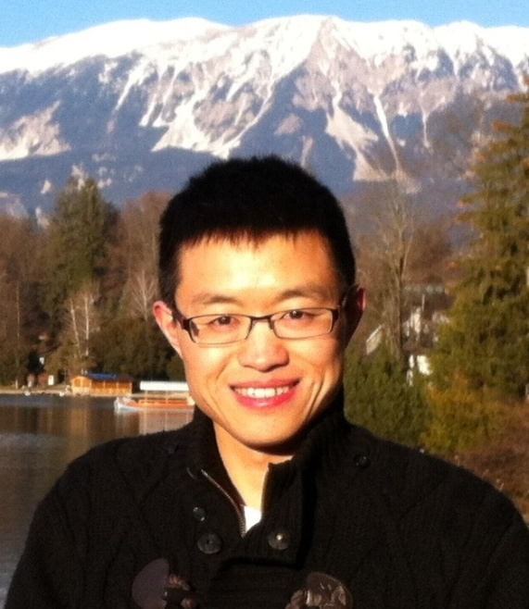
A bit about Myself…
Jie Tang, Full Professor, Vice Chair of Dept. of Computer Science of Tsinghua University. Interests include social network, data mining, machine learning, knowledge graph.
I have been visiting scholar at Cornell U. (working with John Hopcroft, Jon Kleinberg), UIUC (working with Jiawei Han), CUHK (with Jeffrey Yu), and HKUST (with Qiong Luo).
I was awarded with the NSFC for Distinguished Young Scholars, NSFC for Excellent Young Scholars, CCF Young Scientist Award, Newton Advanced Fellowships Award, IBM Innovation Faculty Award, and New Star of Beijing S&T.
Have published more than 300+ paper on international conf/journals, including KDD (20+), IJCAI/AAAI (20+), NIPS/ICML, ACM/IEEE Trans. (27)
#Citation: 13,503 and h-index: 59
Have a notable system, AMiner.org for academic researcher network analysis. The system has attracted 10 million users from 220 countries/regions.
Homepage: http://keg.cs.tsinghua.edu.cn/jietang/

Slide 3

人工智能

Slide 4

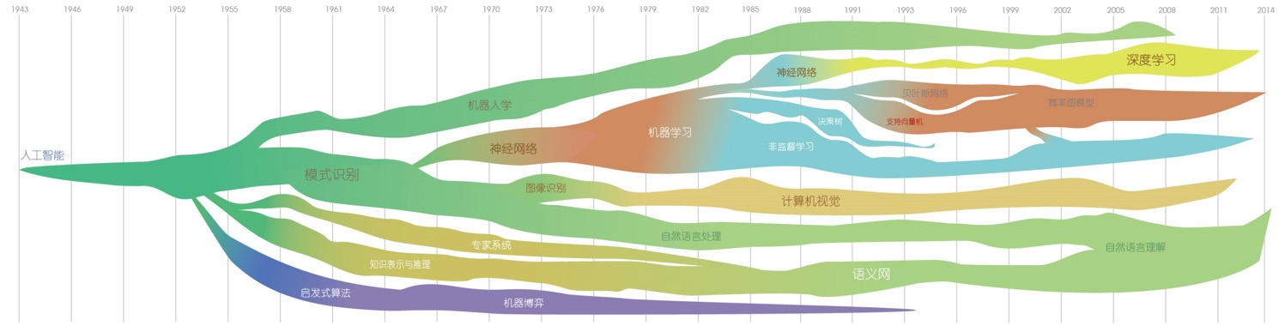
1950计算机象棋博弈
人工智能领域发展趋势 Powered by
Claude Shannon
  Shannon, Claude E. "XXII. Programming a computer for playing chess." Philosophical magazine 41.314 (1950): 256-275.
1954图灵测试
  Alan Turing
  Turing, Alan M. "Solvable and unsolvable problems." Science News-ens. fr 39 (1954).

Slide 5





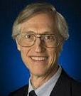
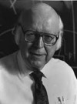
1956达特茅斯会议
人工智能领域发展趋势 Powered by
John
McCarthy
Marvin
Minsky
Nathan
Rochester
Claude
Shannon
    McCarthy, J., et al. "Dartmouth Conference." Dartmouth Summer Research Conference on Artificial Intelligence. 1956
1959一般问题解决器
Herbert
Simon
J.C. Shaw
  Allen Newell
  Newell, A.; Shaw, J.C.; Simon, H.A. (1959). Report on a general problem-solving program. Proceedings of the International Conference on Information Processing. pp. 256–264.

Slide 6
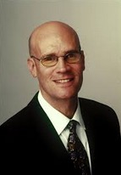
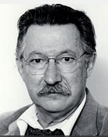
1964 理解自然语言输入
人工智能领域发展趋势 Powered by
  Daniel Bobrow
    Bobrow, Daniel G. "Natural language input for a computer problem solving system." (1964)
1966 ELIZA人机对话
  Joseph
  Weizenbaum
  Weizenbaum, Joseph. "ELIZA—a computer program for the study of natural language communication between man and machine." Communications of the ACM 9.1 (1966): 36-45.

Slide 7
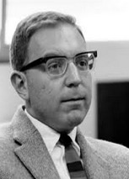
1968 世界首个专家系统DENDRAL
人工智能领域发展趋势 Powered by
  Edward Feigenbaum
  Buchanan, Bruce, Georgia Sutherland, and Edward A. Feigenbaum. Heuristic DENDRAL: a program for generating explanatory hypotheses in organic chemistry. Defense Technical Information Center, 1968.

Slide 8
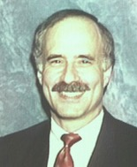
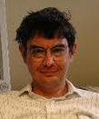
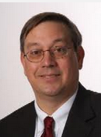
1976 大规模知识库构建与维护
人工智能领域发展趋势 Powered by
  Randall Davis
  Applications of meta level knowledge to the construction, maintenance and use of large knowledge bases[M]. Stanford University, Computer Science Department, AI Laboratory, 1976.
1980 非单调逻辑
  Drew McDermott, Jon Doyle
  McDermott D, Doyle J. Non-monotonic logic I[J]. Artificial intelligence, 1980, 13(1): 41-72.

Slide 9
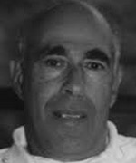
1980 计算机战胜双陆棋世界冠军
人工智能领域发展趋势 Powered by
  Hans Berliner
  Berliner H J. Backgammon computer program beats world champion[J]. Artificial Intelligence, 1980, 14(2): 205-220.

Slide 10
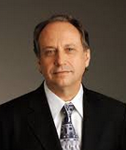
1987 基于行为的机器人学
人工智能领域发展趋势 Powered by
  Rodney Brooks
  Brooks R. A robust layered control system for a mobile robot[J]. Robotics and Automation, IEEE Journal of, 1986, 2(1): 14-23

Slide 11

1987 自我学习双陆棋程序
人工智能领域发展趋势 Powered by
  Gerry Tesauro
  Tesauro G. TD-Gammon, a self-teaching backgammon program, achieves master-level play[J]. Neural computation, 1994, 6(2): 215-219.

Slide 12
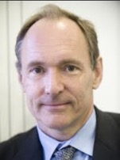
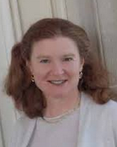
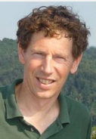
1998 语义互联网路线图
人工智能领域发展趋势 Powered by
  Tim Berners-Lee
  Berners-Lee, Tim. "Semantic web road map." (1998).
2004 OWL语言
  McGuinness, Deborah L., and Frank Van Harmelen. "OWL web ontology language overview." W3C recommendation 10.2004-03 (2004): 10.

Slide 13
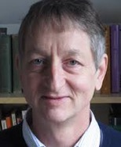
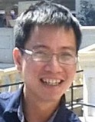
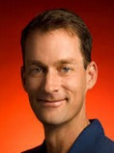
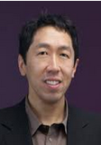
2006 深度学习
人工智能领域发展趋势 Powered by
  Geoffrey Hinton
  Hinton, Geoffrey E., Simon Osindero, and Yee-Whye Teh. "A fast learning algorithm for deep belief nets." Neural computation 18.7 (2006): 1527-1554.
2011 高层抽象特征构建
  Le, Quoc V., et al. "Building high-level features using large scale unsupervised learning." arXiv preprint arXiv:1112.6209 (2011).

Slide 14
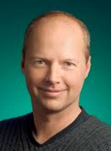
2009 谷歌自动驾驶汽车
人工智能领域发展趋势 Powered by
  Sebastian Thrun
  Markoff, John. "Google cars drive themselves, in traffic." The New York Times 10 (2010): A1.

Slide 15
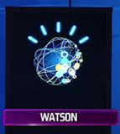
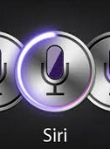
2011 沃森获得Jeopardy冠军
人工智能领域发展趋势 Powered by
  IBM’s Watson
  Markoff, John. "Computer program to take on ‘Jeopardy!’." The New York Times (2009).
2011 自然语言问答
  Apple’s Siri
  Sadun, Erica, and Steve Sande. Talking to Siri: Learning the Language of Apple's Intelligent Assistant. Que Publishing, 2013.

Slide 16
人工智能领域发展趋势 Powered by

Slide 17
人工智能三大流派
符号主义(Symbolicism) 功能主义
  逻辑主义(Logicism)、心理学派(Psychlogism)或计算机主义 (Computerism)
  基本思想:物理符号系统(符号操作系统)假设和有限合理性原理
连接主义(Connectionism)结构主义
  又称仿生学派(Bionicsism)或生理学派(Physiologism)
  基本思想:神经网络及其连接机制和学习算法
行为主义(Actionism)
  又称进化主义(Evolutionism)或控制论学派(Cyberneticsism)
  基本思想:控制论及感知-动作系统

Slide 18
符号主义: 机器定理证明
1954年，⻄蒙、纽厄尔和约翰·肖(John Cliff Shaw)开发了启发式程序“逻辑理论家”LT (Logic Theorist)，证明了数学名著《数学原理》第二章 52个定理中的38个定理，这也是1956年达特茅斯会议上唯一的可运行的人工智能系统(1963年改进后可证明全部52个定理)
1977年，吴文俊创立的吴方法是机器证明的巅峰，其理论根基是希尔伯特定理(多元多项式环中的理想都是有限生成的)，代数范畴内可机器证明的定理都可以用吴方法证明
机器证明的边界:
  吴方法的成功有赖于大多数问题是有结构的，因而可以快速求解，但是更多问题的复杂度是超指数爆炸的，不可计算
  机器证明本质上是“机器定理验证”，机械化方法没有直觉和创造能力

Slide 19
行为主义
行为主义
  又称为进化主义或控制论学派，基于控制论和“动作-感知”型控制系统的人工智能学派
行为基本观点可以概括为:
  知识和形式化表达是人工智能的重要障碍
  智能取决于感知和行动，可利用机器对环境作用后，环境对作用的响应为原型
  智能行为只在现实世界中与环境交互作用而表现出来
  AI可以像人类智能一样逐步进化、分阶段发展和增强

Slide 20
连接主义: 神经网络

Slide 21
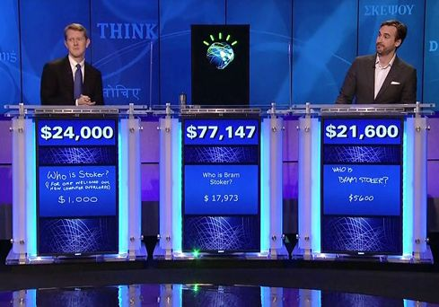
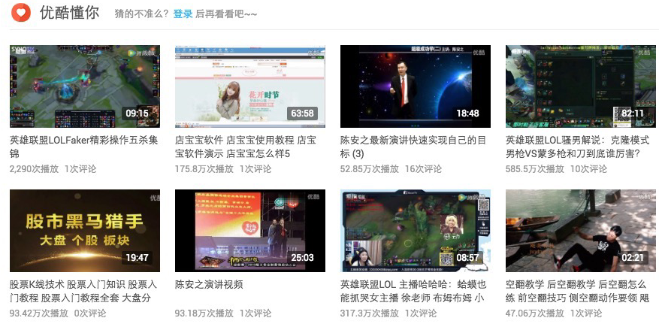
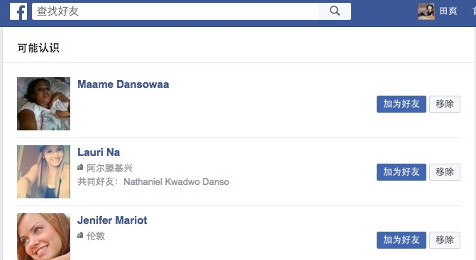

AI应用
QA
Recommendation
Social mining
Search engine
Notes:
Why prior distribution:
To make prediction about new documents

Slide 22
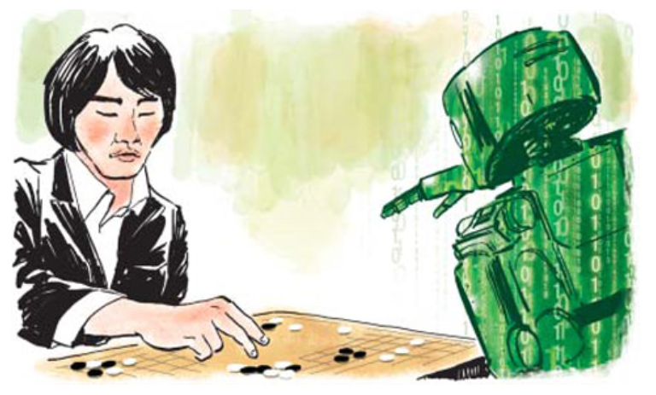
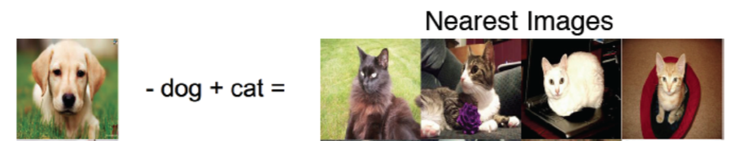
AI应用
AlphaGo
Self-driving
Image recognition
Notes:
Why prior distribution:
To make prediction about new documents

Slide 23
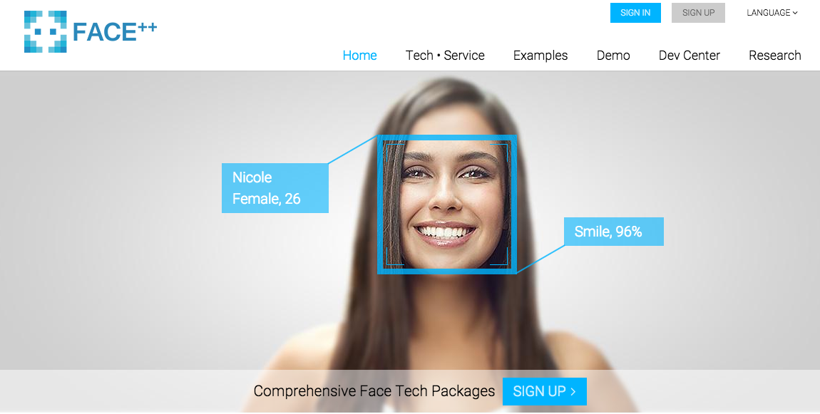
Face Recognition

Slide 24
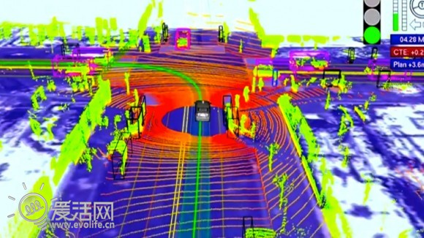
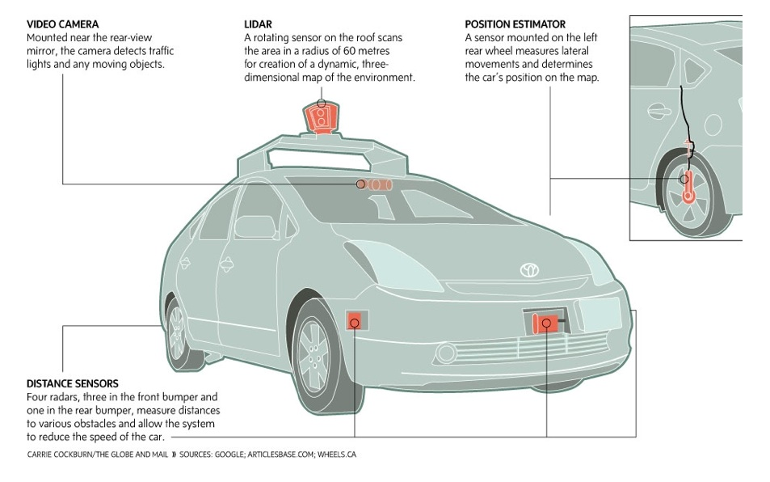
BIG DATA—Google driverless car
Waymo—Head for market
The system combines information gathered from Google Street View with artificial intelligence software that combines input from video cameras inside the car, a LIDAR sensor on top of the vehicle, radar sensors on the front of the vehicle and a position sensor attached to one of the rear wheels that helps locate the car's position on the map
Google's self-driving cars last month hit a 1,725,911-miles-driven milestone.
--2016/06
Self-driving cars to create 1GB of data per second
http://www.fiercebigdata.com/story/self-driving-cars-create-1gb-data-second/2013-07-22
Notes:
which, the company says, haven't resulted in a single accident that wasn't the result of human error.
当时还无人说到deep learning说到collective learning

Slide 25
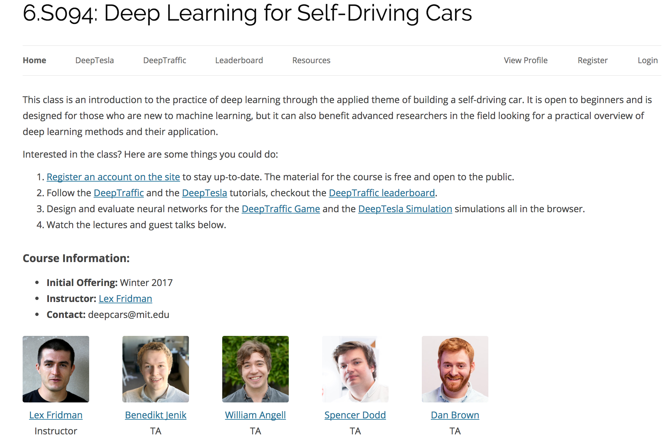
Deep Learning for Self-Driving Cars
http://selfdrivingcars.mit.edu/

Slide 26
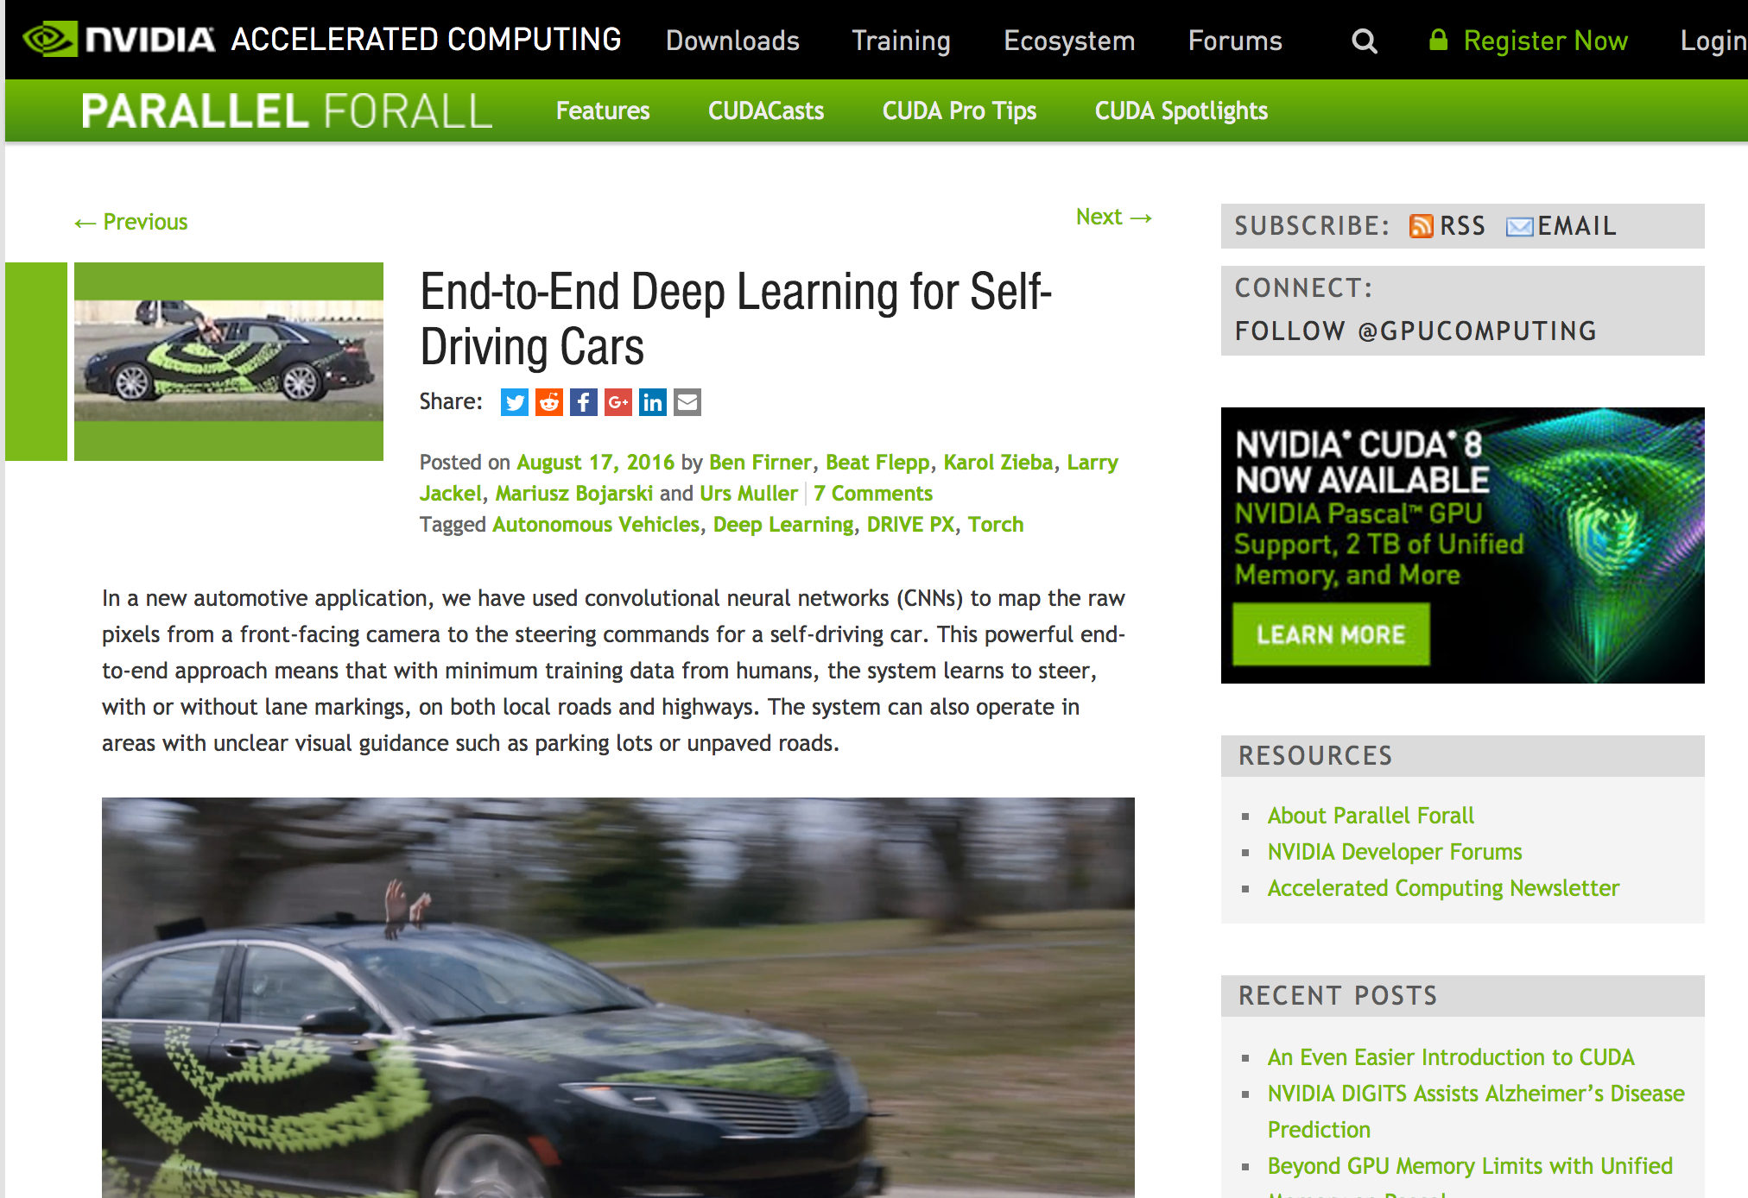
End-to-End Deep Learning for Self-Driving Cars
https://devblogs.nvidia.com/parallelforall/deep-learning-self-driving-cars/

Slide 27
Many companies
Ford just invested $1 billion in self-driving cars
  http://money.cnn.com/2017/02/10/technology/ford-argo-self-driving-cars/
Uber joins race for driverless cars
  Collective learning
Also Tesla, though it is still a bit mysterious technically.

Slide 28
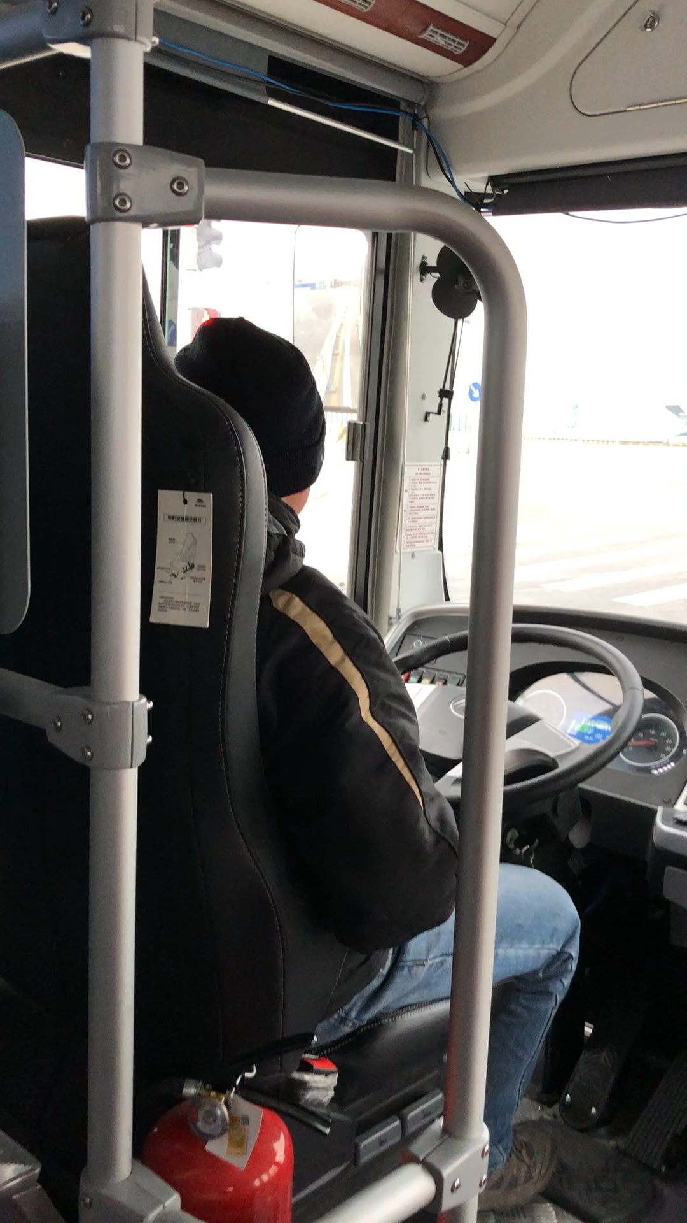
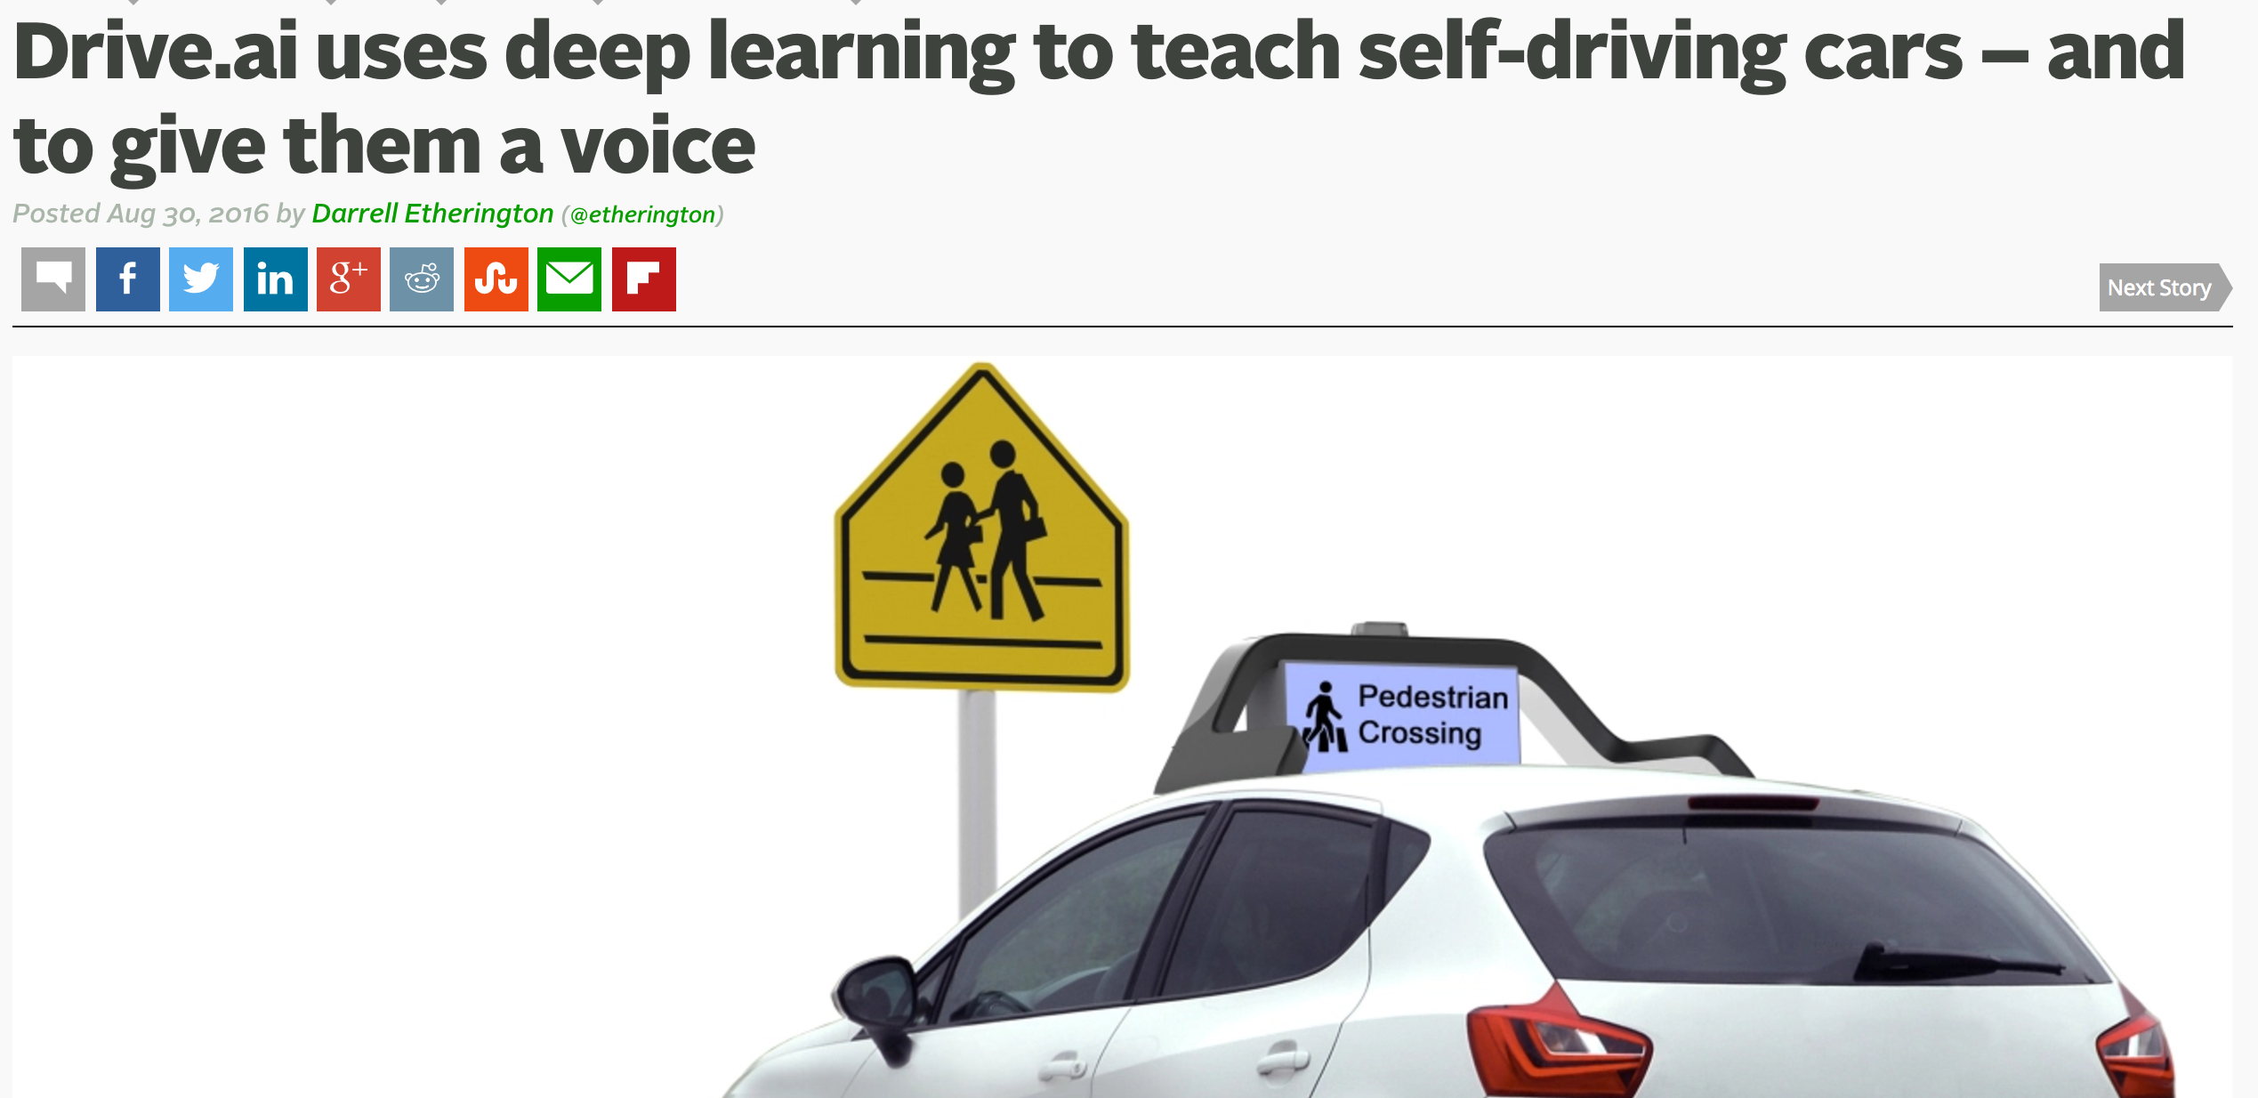
Startup: Drive.ai, 地平线, pony.ai, 驭势科技…

Slide 29
DEEP LEARNING—IBM Watson
Watson is a Question answering (QA) computing system built by IBM. IBM describes it as "an application of advanced Natural Language Processing, Information Retrieval, Knowledge Representation and Reasoning, and Machine Learning technologies to the field of open domain question answering" which is "built on IBM's DeepQA technology for hypothesis generation, massive evidence gathering, analysis, and scoring
In 2011, as a test of its abilities, Watson competed on the quiz show Jeopardy!, in the show's only human-versus-machine match-up to date
Watson had access to 200 million pages of structured and unstructured content consuming four terabytes of disk storage including the full text of Wikipedia, but was not connected to the Internet during the game. For each clue, Watson's three most probable responses were displayed on the television screen. Watson consistently outperformed its human opponents on the game's signaling device.

Slide 30
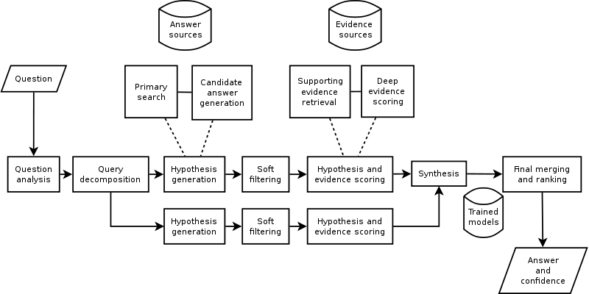
IBM Wastson (cont.)

Slide 31
XiaoIce

Slide 32
几个问题
AI系统的通用特点是什么？
什么是AI系统最核心/难的技术？

Slide 33
机器学习

Slide 34
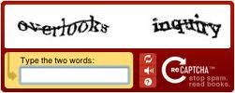
Machine Learning Trend
x_{new}
Training data {(x_{i},y_{i})}
Learning algorithm
f
Predicted y
Big Data
Deep Learning
Collective Learning

Slide 35
Data Structures
An example with p features
x_{i}=[x_{i1}, x_{i2},…, x_{ip}]
Data (set) matrix

Slide 36
Supervised Learning
Training example
Training set

Slide 37
Supervised Learning
Given a training set S={(x₁, y₁),(x₂, y₂),…,(x_{N}, y_{N})}, and x_{i}∈X=R^{m}, i=1,2,…,N
To learn a function f(x), which can best fit the data
x_{new}
Training data {(x_{i},y_{i})}
Learning algorithm
f
Predicted y
  Regression: When y is continuous (i.e., y_{i}∈Y=R), we call the learning problem as regression.
  Classification: When y can take on only a small number of discrete values (e.g., the binary case y_{i}∈Y={1,-1}), we call the learning problem as classification.

Slide 38

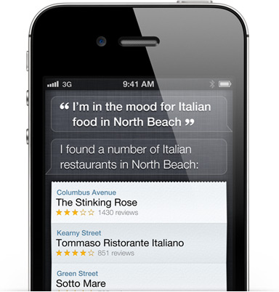
IPhone Siri
Siri understands what you say, knows what you mean, and even talks back.
Siri (pronounced /ˈsɪri/) is an intelligent personal assistant and knowledge navigator which works as an application for Apple's iOS. The application uses a natural language user interface to answer questions, make recommendations, and perform actions by delegating requests to a set of Web services. Apple claims that the software adapts to the user's individual preferences over time and personalizes results, and performing tasks such as finding recommendations for nearby restaurants, or getting directions

Slide 39
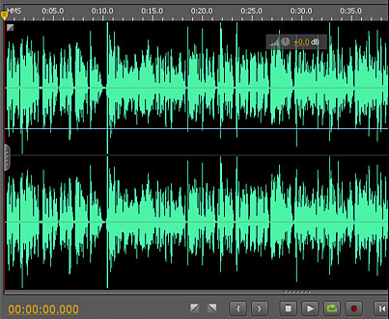
Siri’s first task: Speech-to-Text
Who is the president of US?
x₁={Hz, Position, Volume} y₁ = “Who”

Slide 40

Follow back Prediction
When you follow a friend in Twitter, how likely he will follow back?

Slide 41


Example: Follow-back Prediction
When a follow b, we have a new instance x_{i};
If b immediately follow back a, we say y_{i}=1;
otherwise y_{i}=0;
x_{i}={#fans of a, #fans of b, #common friends between a and b}
?
You
Lady Gaga
If you follow Lady Gaga on Twitter, will she follow back?
Classification

Slide 42
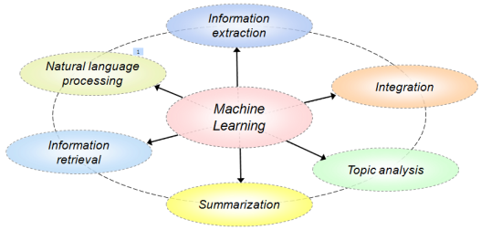
Example: IE using CRF
October 14, 2002, 4:00 a.m. PT
For years, Microsoft Corporation CEO Bill Gates railed against the economic philosophy of open-source software with Orwellian fervor, denouncing its communal licensing as a "cancer" that stifled technological innovation.
Today, Microsoft claims to "love" the open-source concept, by which software code is made public to encourage improvement and development by outside programmers. Gates himself says Microsoft will gladly disclose its crown jewels--the coveted code behind the Windows operating system--to select customers.
"We can be open source. We love the concept of shared source," said Bill Veghte, a Microsoft VP. "That's a super-important shift for us in terms of code access.“
Richard Stallman, founder of the Free Software Foundation, countered saying…
*
Microsoft Corporation
CEO
Bill Gates
Microsoft
Gates
Microsoft
Bill Veghte
Microsoft
VP
Richard Stallman
founder
Free Software Foundation
*
*
NAME
TITLE ORGANIZATION
Bill Gates
CEO
Microsoft
*
Bill
Veghte
VP
Microsoft
Richard
Stallman
founder
Free Soft..

Slide 43
Example: IE using CRF (cont.)
Other
Other
Other
Other
Other
Title
Title
Title
Title
Name
{y}
Name
ORG
Name
Name
ORG
{x}
For years
Microsoft Corporation
CEO
Bill Gates
railed
x₁={For, years, PREP, NOUN} y₁ = Other
Notes:
Microsoft Corporation CEO Bill Gates railed against

Slide 44
Types of Learning Problems
Supervised Learning
  The training data consists of labeled examples.
Unsupervised Learning
  The training data consists of unlabeled examples.
Semi-supervised Learning
  The training data consists of typically a small amount of labeled examples and a large amount of unlabeled examples.
Reinforcement Learning
  Find suitable actions to take in order to maximize a reward.

Slide 45
Types of Learning Problems
Active Learning: Select instances from the underlying data to label, so as to achieve a performance comparable to the supervised learning.
Online Learning: Learn models incrementally from data in a sequential manner.
Transfer Learning: Allow the domains, tasks, and distributions used in training and testing to be different.
Few/One/Zero-Shot Learning: Learn new concepts from just a few/one/zero training example(s).
Automated Machine Learning (AutoML): Automate the process of applying machine learning to real-world problems.
Representation Learning: Learn representation from the data that makes a subsequent learning task easier.
…

Slide 46
https://towardsdatascience.com/machine-learning-types-2-c1291d4f04b1

Slide 47












The State of Machine Learning
Classification Models
Maximal Margin
Reinforcement Learning
Decision tree
Bayesian Classifier
Perceptron
Neural Networks
SVM
(Vapnik)
Q-Learning
Policy Gradient
Actor-Critic
TRPO
Sequential Learning
Deep Learning
Deep RL
HMM, MEMM, CRF,
Voted Perceptron
DNN, CNN, ResNet
DQN, VIN, A3C
Graphical Models
Recurrent Nets
Deep Generative Models
Factor Graph,
Exponential Model,
Topic Model (PLSI, LDA)
RNN, LSTM, GRU
DBN, AutoEncoder,
VAE, GAN, WGAN
For more from http://aminer.org/
Notes:
John Ross Quinlan (Sydney U.->RuleQuest)
Svm: John Shawe-Taylor
Deep learning: Geoffrey Hinton (DNN), Yoshua Bengio (DNN), Andrew Ng, Yann LeCun (CNN)
TM: thomas hofmann, Padhraic Smyth,
HMM: math (Leonard Esau Baum),
GM: Brendan J. Frey, Zoubin Ghahramani (Iran, in Cambridge), daphne koller, Michael Jordan, David Blei
RNN:
LSTM: Jürgen Schmidhuber
GRU: Kyunghyun Cho, AP at NYU, FAIR, postdoc at University of Montreal (Yoshua Bengio)
RL
Policy gradient: Richard S. Sutton, Prof. at University of Alberta, considered one the founding fathers of modern computational reinforcement learning
Trust region policy optimization (TRPO): Pieter Abbeel, Prof. at UCB, OpenAI advisor, advised by Prof. Andrew Ng
DRL
Deep Q-learning Network (DQN): David Silver, Prof. at UCL, DeepMind
Asynchronous Advantage Actor-Critic (A3C) : Volodymyr Mnih, DeepMind, advised by Prof. Geoffrey Hinton
DGM
VAE: Max Welling, Prof. at the University of Amsterdam
GAN: Ian Goodfellow, Google Brain

Slide 49
Machine Learning Algorithms
Basic algorithms
  Supervised learning
    Evaluation
    Perceptron, Bayesian classification, Decision tree, etc.
  Unsupervised learning
    Clustering: K-means, K-medoids, Mixture models
    Dimension Reduction: Principal Component Analysis

Slide 50

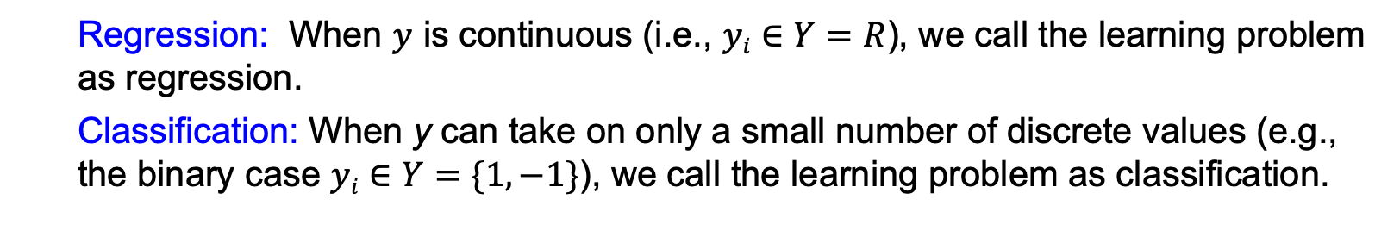
Supervised Learning
Given a training set $S=\{(x1, y1),(x2, y2),…,(xN, yN)\}$, and $xi∈X=Rm$, $i=1,2,…,N$
To learn a function $f(x)$, which can best fit the data
x_{new}
Training data {(x_{i},y_{i})}
Learning algorithm
f
Predicted y
  Regression: When $y$ is continuous (i.e., $yi∈Y=R$), we call the learning problem as regression.
  Classification: When y can take on only a small number of discrete values (e.g., the binary case $yi∈Y=\{1,−1\}$), we call the learning problem as classification.

Slide 51
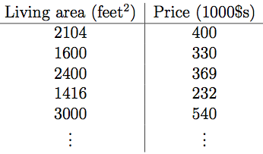

Example
?
VS
You
Lady Gaga
How much will it be, if we want to buy a house with a size of 8000 feet?
If you follow Lady Gaga on Twitter, will she follow back?
Regression
Classification

Slide 52
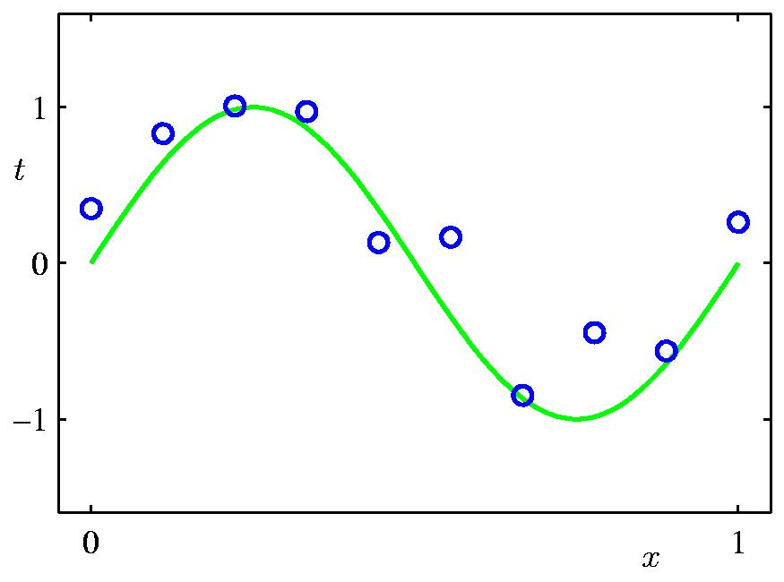
Polynomial Curve Fitting
?
As the first step, we need to decide how we’re going to represent the function $f$.
One example: polynomial curve fitting
Now, given a training set, how do we pick, or learn, the parameters $w$?

Slide 53
Least Squares Loss Function
^{y}_{i}
f(x_{i}, w)

Slide 54
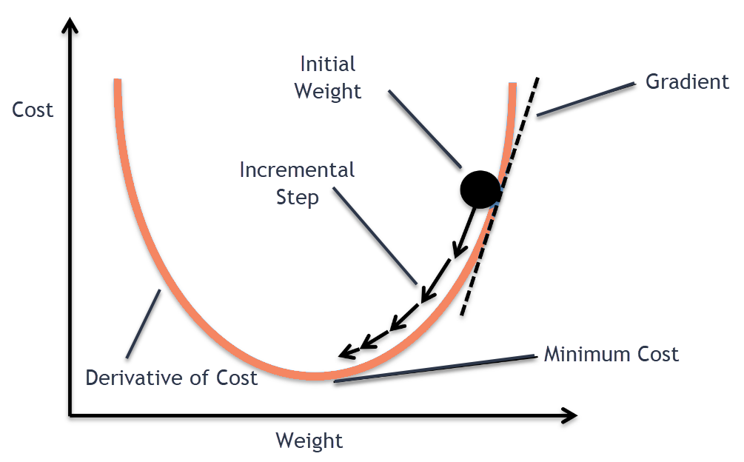
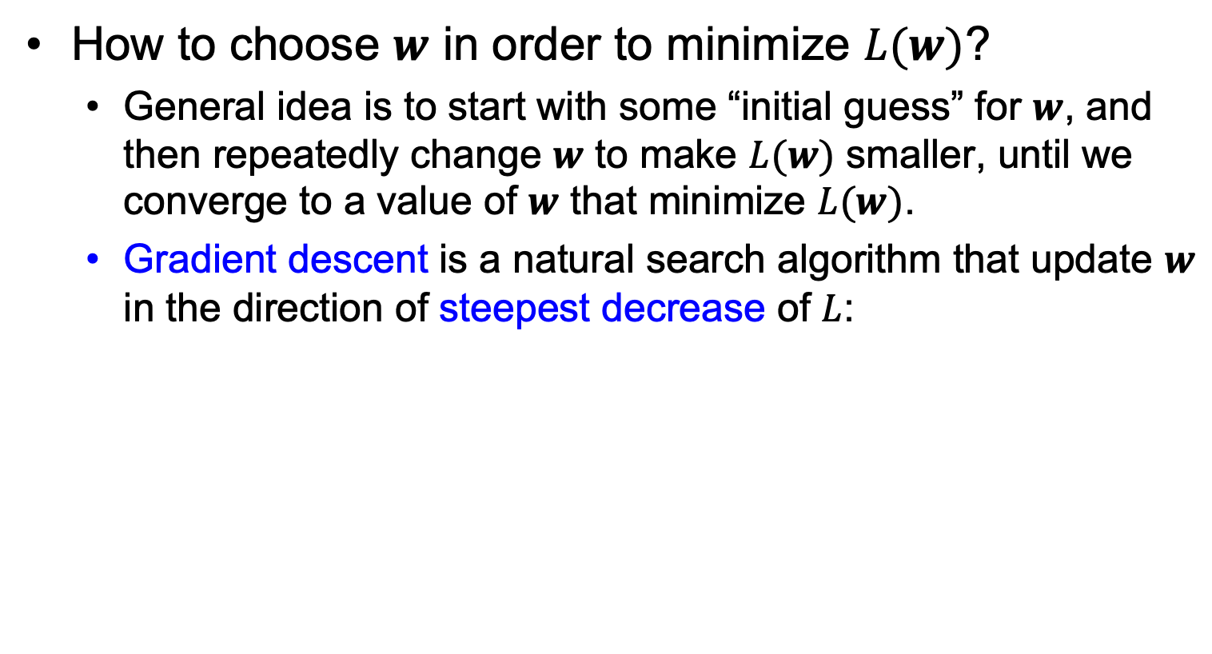
Learning by Gradient Descent
How to choose $w$ in order to minimize $L(w)$?
  General idea is to start with some “initial guess” for $w$, and then repeatedly change $w$ to make $L(w)$ smaller, until we converge to a value of $w$ that minimize $L(w)$.
  Gradient descent is a natural search algorithm that update $w$ in the direction of steepest decrease of $L$:

Slide 55

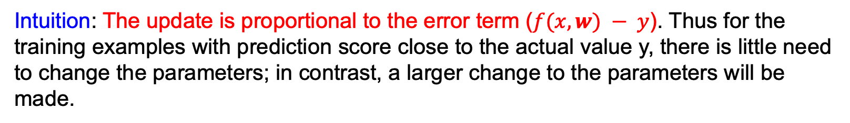
Learning by Gradient Descent (cont.)
Now let us calculate the partial derivative.
First consider one training instance $(x, y)$, so the sum in $L$ can be ignored:
The rule is called LMS (least mean squares) update rule, aka Widrow-Hoff learning rule.
Intuition: The update is proportional to the error term ($f(x, w) − y$). Thus for the training examples with prediction score close to the actual value y, there is little need to change the parameters; in contrast, a larger change to the parameters will be made.

Slide 56
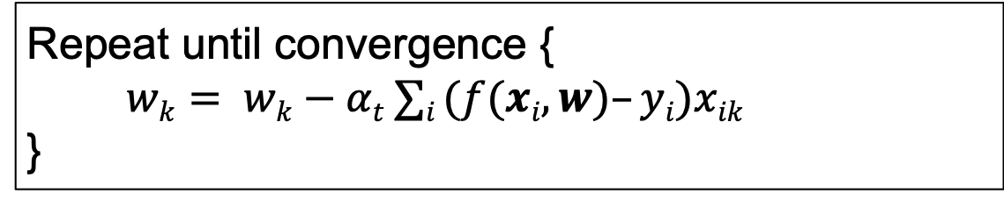
Learning by Gradient Descent (cont.)
Then consider a training data set rather than only one example by two ways:
  Batch gradient descent: Scan through the entire training set before taking a single step of update
Repeat until convergence {
$wk= wk−αt ∑i (f(xi, w)–yi)xik$
}
The learning rate $αt$ decreases with the iteration time $t$.
When the training set is large, batch gradient descent is slow.

Slide 57
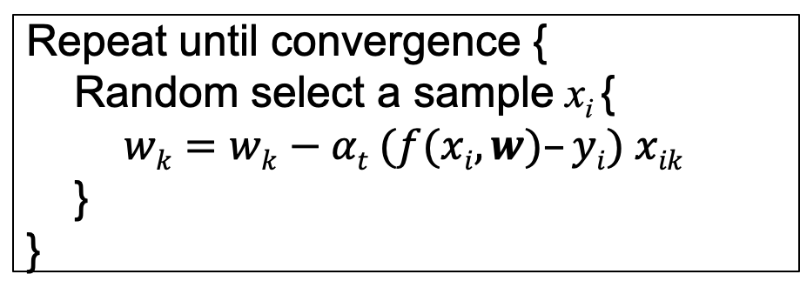
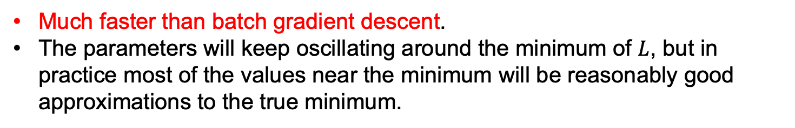
Learning by Gradient Descent (cont.)
Then consider a training data set rather than only one example by two ways:
  Stochastic gradient descent (SGD): Start making progress right away, and continues to make progress with each example it looks at.
Repeat until convergence {
Random select a sample x_{i} {
$wk=wk−αt (f(xi, w)–yi) xik$
}
}
Much faster than batch gradient descent.
The parameters will keep oscillating around the minimum of $L$, but in practice most of the values near the minimum will be reasonably good approximations to the true minimum.

Slide 58

0th Order Polynomial
* A number of the following pages are from Bishop’s slides

Slide 59

1st Order Polynomial

Slide 60

3rd Order Polynomial

Slide 61

9th Order Polynomial

Slide 62

Over-fitting
Root-Mean-Square (RMS) Error:

Slide 63

Polynomial Coefficients

Slide 64


Solution 1: Increasing Data Volume
9th Order Polynomial

Slide 65


Data Set Size
9th Order Polynomial

Slide 66
Solution 2: Regularization
Penalize large coefficient values

Slide 67


Regularization

Slide 68


Regularization

Slide 69



Regularization: vs.

Slide 70

Polynomial Coefficients

Slide 71

Supervised Learning
Given a training set $S=\{(x1, y1),(x2, y2),…,(xN, yN)\}$, and $xi∈X=Rm$, $i=1,2,…,N$
To learn a function $f(x)$, which can best fit the data
x_{new}
Training data {(x_{i},y_{i})}
Learning algorithm
f
Predicted y
  Regression: When $y$ is continuous (i.e., $yi∈Y=R$), we call the learning problem as regression.
  Classification: When y can take on only a small number of discrete values (e.g., the binary case $yi∈Y=\{1,−1\}$), we call the learning problem as classification.

Slide 72
Perceptron—a Linear Model
Consider a two-class, linearly separable classification problem
We are looking for a linear function
i.e.,
Class +1
Class -1

Slide 73
Perceptron: A Neuron
-
b – bias
x₀
w₀
x₁
w₁
∑
f
output y
x_{n}
w_{n}
Non-linear function:
Logistic, sigmoid, ReLU, etc.
Input
vector x
weight
vector w
weighted
sum
Activation
function

Slide 74

Rosenblatt’s Perceptron
The Rosenblatt’s perceptron algorithm considers each training point in turn, adjusting the parameters to correct any mistakes
The algorithm will converge (no mistakes) if the training points are linearly separable through origin; otherwise it won’t converge
Initialize: $w=0$;
Repeat until convergence:
for $i=1,…,m$
if $yi (w·xi) ≤ 0$ then
$w ←w + yi xi$

Slide 75

Perceptron: Property on Update
If we make a mistake on $xi$
After the update, we have
So that increases based on update

Slide 76

Rosenblatt’s Algorithm

Slide 77
Update by Minimizing LMS
Still consider minimizing the least squares loss function
Then we obtain the update rule

Slide 78
Evaluation
Type I error
Accuracy on test set
  The rate of correct classification on the testing set. E.g., if 90 are classified correctly out of the 100 testing cases, accuracy is 90%.
Error Rate on test set
  The percentage of wrong predictions on test set
Confusion Matrix
  For binary class values, “yes” and “no”, a matrix showing true positive, true negative, false positive and false negative rates
 |  | Predicted class
 |  | Yes | No
Actual class | Yes | True positive (TP) | False negative (FN)
 | No | False positive (FP) | True negative (TN)
Type II error
Notes:
分类模型的评估主要通过测试数据集的精度和错误率，精度描述的是分类模型在测试数据集上分类正确的样本的比例；错误率则相反，描述的是分类错误的百分比，具体计算的时候一般通过建立一个混淆矩阵来实现。这里的右边给出了混淆矩阵的建立方法，上面的两列表示模型预测的正样本和副样本，左边描述的是测试集中的正样本和副样本，而矩阵中的四个元素分别表示为TP、FN、FP和TN。TP分别表示在测试集中本身的类标号就是正而分类模型预测的值也是正，FN表示在测试集中是正而模型预测的是副，FP表示在测试集中的类标号是副而模型预测的时候正，TN则表示的是测试集中是副而模型预测的也是副。
最后可以通过以下公式计算精度和错误率。

Slide 79

Evaluation Techniques
Holdout: the training set/testing set.
  Good for a large set of data.
$K$-Fold Cross Validation (交叉验证):
  Divide the data set into k sub-samples.
  In each run, use one distinct sub-sample as testing set and the remaining $k−1$ sub-samples as training set.
  Evaluate the method using the average of the $k$ runs.
  This method reduces the randomness of training set/testing set.
Notes:
在评估的时候，首先要保证测试集和训练集的独立性，其次还要避免测试集和训练集选择的随机性，因此通常采用k-fold交叉验证方法，也翻译成k折交叉验证。该方法是首先将数据集分为k份，然后每次都使用其中的k-1份进行训练，剩下的1份进行测试，依次循环k次，最后用k次的平均值作为最终的评估结果。K-fold交叉验证方法可以有效的降低数据划分的随机性。

Slide 80

Cross Validation
Break up data into groups of the same size
Hold aside one group for testing and use the rest to build model
Repeat
Test
iteration
Large k results in a small bias but large variance
Notes:
这里用一个图例来说明交叉验证方法的过程，这是一个5-折交叉验证方法，首先将数据均分为5份，然后执行5次
第一次的时候取第一份作为测试集，其他四分作为训练集，然后评估训练得到的模型的精度，
第二次则取第二份作为测试集，依次类推。最后5次实验的平均值作为分类模型在该数据集上的精度。

Slide 81
关于Perceptron的疑问
Class +1
Class -1
Perceptron能解决所有分类问题吗？
为什么？

Slide 82
Machine Learning Algorithms
Basic algorithms
  Supervised learning
    Evaluation
    Perceptron, Bayesian classification, Decision tree, etc.
  Unsupervised learning
    Clustering: K-means, K-medoids, Mixture models
    Dimension Reduction: Principal Component Analysis

Slide 83


Clustering
Cluster analysis or clustering is the task of assigning a set of objects into groups (called clusters) so that the objects in the same cluster are more similar (in some sense or another) to each other than to those in other clusters.
1. Social network analysis
In the study of social networks, clustering may be used to recognize communities within large groups of people.
2. News Services like Google News(below figure)
a
Similar news are grouped together.

Slide 84
Partitioning Algorithms: Basic Concept
Partitioning method: Construct a partition of a database D of N objects into a set of k clusters
Given a k, find a partition of k clusters that optimizes the chosen partitioning criterion
  Global optimal: exhaustively enumerate all partitions
  Heuristic methods: k-means and k-medoids algorithms
  k-means (MacQueen’67): Each cluster is represented by the center of the cluster
  k-medoids or PAM (Partition around medoids) (Kaufman & Rousseeuw’87): Each cluster is represented by one of the objects in the cluster

Slide 85

The K-Means Clustering Method
The k-means algorithm is implemented in four steps:
  Compute seed $k$
  Partition objects points as the centroids of the clusters of the current partition (the centroid is the center, i.e., mean point, of the cluster)
  Assign each object to the cluster with the nearest seed point
  Go back to Step 2, stop when no more new assignment

Slide 86
The K-Means Clustering Method
Example
10
10
9
9
8
8
7
7
6
6
5
5
4
Assign each objects to most similar center
Update the cluster means
4
3
3
2
2
1
1
0
0
0
1
2
3
4
5
6
7
8
9
10
0
1
2
3
4
5
6
7
8
9
10
reassign
reassign
K=2
Arbitrarily choose K object as initial cluster center
Update the cluster means

Slide 87
Comments on the K-Means Method
Strength: Relatively efficient: O(tkn), where n is # objects, k is # clusters, and t is # iterations. Normally, k, t << n.
    Comparing: PAM: O(k(n-k)² ), CLARA: O(ks² + k(n-k))
Comment: Often terminates at a local optimum. The global optimum may be found using techniques such as: deterministic annealing and genetic algorithms
Weakness
  Applicable only when mean is defined, then what about categorical data?
  Need to specify k, the number of clusters, in advance
  Unable to handle noisy data and outliers
  Not suitable to discover clusters with non-convex shapes

Slide 88
The K-Medoids Clustering Method
The k-means algorithm is sensitive to outliers !
  Since an object with an extremely large value may substantially distort the distribution of the data.
K-Medoids: Instead of taking the mean value of the object in a cluster as a reference point, medoids can be used, which is the most centrally located object in a cluster.
10
10
9
9
8
8
7
7
6
6
5
5
4
4
3
3
2
2
1
1
0
0
1
2
3
4
5
6
7
8
9
10
0
0
1
2
3
4
5
6
7
8
9
10

Slide 89
The K-Medoids Clustering Method
Find representative objects, called medoids, in clusters
PAM (Partitioning Around Medoids, 1987)
  starts from an initial set of medoids and iteratively replaces one of the medoids by one of the non-medoids if it improves the total distance of the resulting clustering
  PAM works effectively for small data sets, but does not scale well for large data sets
CLARA (Kaufmann & Rousseeuw, 1990)
CLARANS (Ng & Han, 1994): Randomized sampling
Focusing + spatial data structure (Ester et al., 1995)

Slide 90
Typical k-medoids algorithm
Total Cost = 20
10
9
8
Arbitrary choose k object as initial medoids
Assign each remaining object to nearest medoids
7
6
5
4
3
2
1
0
0
1
2
3
4
5
6
7
8
9
10
K=2
Randomly select a nonmedoid object,O_{ramdom}
Total Cost = 26
Do loop
Until no change
10
10
9
Compute total cost of swapping
9
Swapping O and O_{ramdom}
If quality is improved.
8
8
7
7
6
6
5
5
4
4
3
3
2
2
1
1
0
0
1
2
3
4
5
6
7
8
9
10
0
0
1
2
3
4
5
6
7
8
9
10

Slide 91
关于AI的思考

Slide 92


Slide 93
来自《Her》的启发
从技术的角度看，未来我们真的能做到像影片中女主角那样的智能吗？
在未来10年内，最可能实现的AI场景
  自动驾驶、个人助理、情感伴侣、AI医生、AI军事、AI阅读与写作……

Slide 94



AI隐私
VS
加州通过网络隐私保护法，包括人脸识别禁令，警察用来抓罪犯也不行！

Slide 95


Slide 96

AI武器假如分级应从哪些维度考虑？
  杀伤力、自主性

Slide 97
Real AI
However, real AI is still far away…
AI系统
语义鸿沟
知识图谱
人类认知

Slide 98

AI Trend
From perception to cognition
存储与计算
感知
文本、语音
图像、视频
认知
知识推理
机器自主
计算
感知
认知

Slide 99
Related Publications
Ming Ding, Chang Zhou, Qibin Chen, Hongxia Yang, and Jie Tang. Cognitive Graph for Multi-Hop Reading Comprehension at Scale. ACL’19.
Jifan Yu, Chenyu Wang, Gan Luo, Lei Hou, Juanzi Li, Jie Tang, and Zhiyuan Liu. Course Concept Expansion in MOOCs with External Knowledge and Interactive Game. ACL'19.
Jie Zhang, Yuxiao Dong, Yan Wang, Jie Tang, and Ming Ding. ProNE: Fast and Scalable Network Representation Learning. IJCAI’19.
Yukuo Cen, Xu Zou, Jianwei Zhang, Hongxia Yang, Jingren Zhou and Jie Tang. Representation Learning for Attributed Multiplex Heterogeneous Network. KDD’19.
Fanjin Zhang, Xiao Liu, Jie Tang, Yuxiao Dong, Peiran Yao, Jie Zhang, Xiaotao Gu, Yan Wang, Bin Shao, Rui Li, and Kuansan Wang. OAG: Toward Linking Large-scale Heterogeneous Entity Graphs. KDD’19.
Yifeng Zhao, Xiangwei Wang, Hongxia Yang, Le Song, and Jie Tang. Large Scale Evolving Graphs with Burst Detection. IJCAI’19.
Yu Han, Jie Tang, and Qian Chen. Network Embedding under Partial Monitoring for Evolving Networks. IJCAI’19.
Jiezhong Qiu, Yuxiao Dong, Hao Ma, Jian Li, Chi Wang, Kuansan Wang, and Jie Tang. NetSMF: Large-Scale Network Embedding as Sparse Matrix Factorization. WWW'19.
Jiezhong Qiu, Jian Tang, Hao Ma, Yuxiao Dong, Kuansan Wang, and Jie Tang. DeepInf: Modeling Influence Locality in Large Social Networks. KDD’18.
Jiezhong Qiu, Yuxiao Dong, Hao Ma, Jian Li, Kuansan Wang, and Jie Tang. Network Embedding as Matrix Factorization: Unifying DeepWalk, LINE, PTE, and node2vec. WSDM’18.
Jie Tang, Jing Zhang, Limin Yao, Juanzi Li, Li Zhang, and Zhong Su. ArnetMiner: Extraction and Mining of Academic Social Networks. KDD’08.
  For more, please check here http://keg.cs.tsinghua.edu.cn/jietang

Slide 100
Thank you！
Collaborators:
Jie Zhang, Jiezhong Qiu, Ming Ding, Qibin Chen, Yifeng Zhao, Yukuo Cen, Yu Han, Fanjin Zhang, Xu Zou, Yan Wang, et al. (THU)
Yuxiao Dong, Chi Wang, Hao Ma, Kuansan Wang (Microsoft)
Hongxiao Yang, Chang Zhou, Le Song, Jingren Zhou, et al. (Alibaba)
  Jie Tang, KEG, Tsinghua U http://keg.cs.tsinghua.edu.cn/jietang
  Download all data & Codes https://keg.cs.tsinghua.edu.cn/cogdl/

