Slide 1
Graph Neural Networks and Applications
—A Review
Jie Tang
Computer Science
Tsinghua University
  The slides can be downloaded at http://keg.cs.tsinghua.edu.cn/jietang

Slide 2


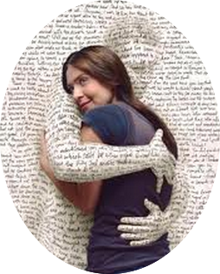







Networked World
2 billion MAU
26.4 billion minutes/day
>777 million trans. (alipay)
200 billion on 11/11
320 million MAU
Peak: 143K tweets/s
462 million users
influencing our daily life
700 million MAU
95 million pics/day
~1.5 billion MAU
70 minutes/user/day
300 million MAU
30 minutes/user/day
QQ: 860 million MAU
WeChat: 1.1 billion MAU
Notes:
http://www.digitaltrends.com/social-media/facebook-users-50-minutes/#:Tt28J4FGJlT5fA

Slide 3
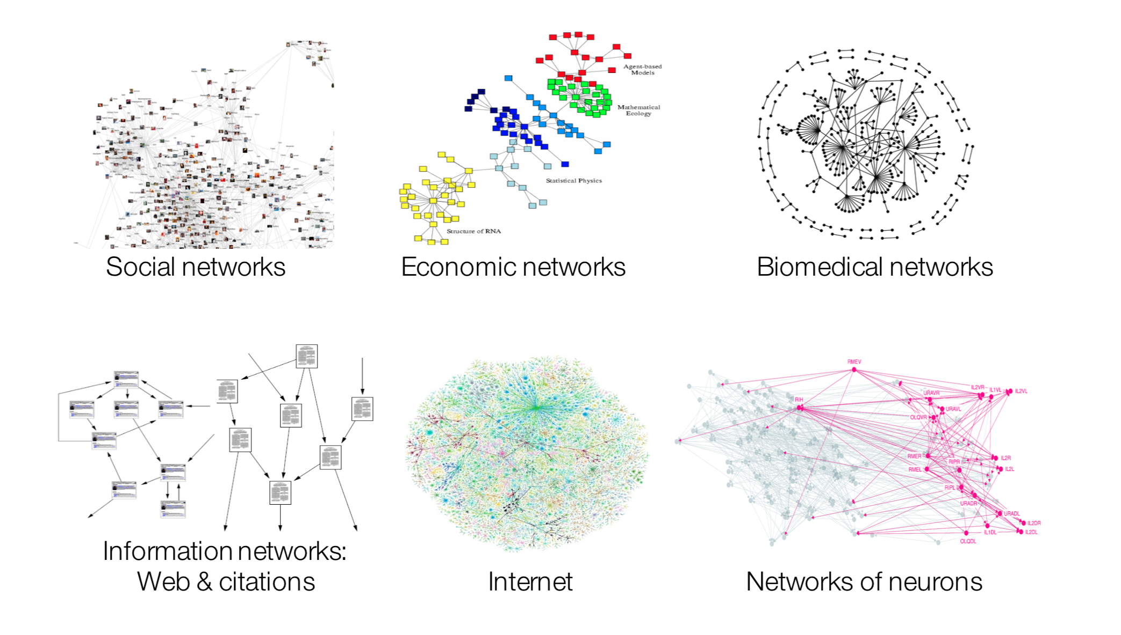
Many Data are Networks¹
Example from Jure’s slides

Slide 4
Machine Learning with Networks
ML tasks in networks:
  Node classification
    Predict a type of a given node
  Link prediction
    Predict whether two nodes are linked
  Community detection
    Identify densely linked clusters of nodes
  Network similarity
    How similar are two (sub)networks?

Slide 5
Data Mining over Networks
DM tasks in networks:
  Modeling individual behavior
  Modeling group behavioral patterns
  Reveal anomaly patterns
  Deal with big scale
David Lazer, Alex Pentland, Lada Adamic, Sinan Aral, Alber-Laszlo Barabasi, et al. Computational Social Science. Science 2009.

Slide 6
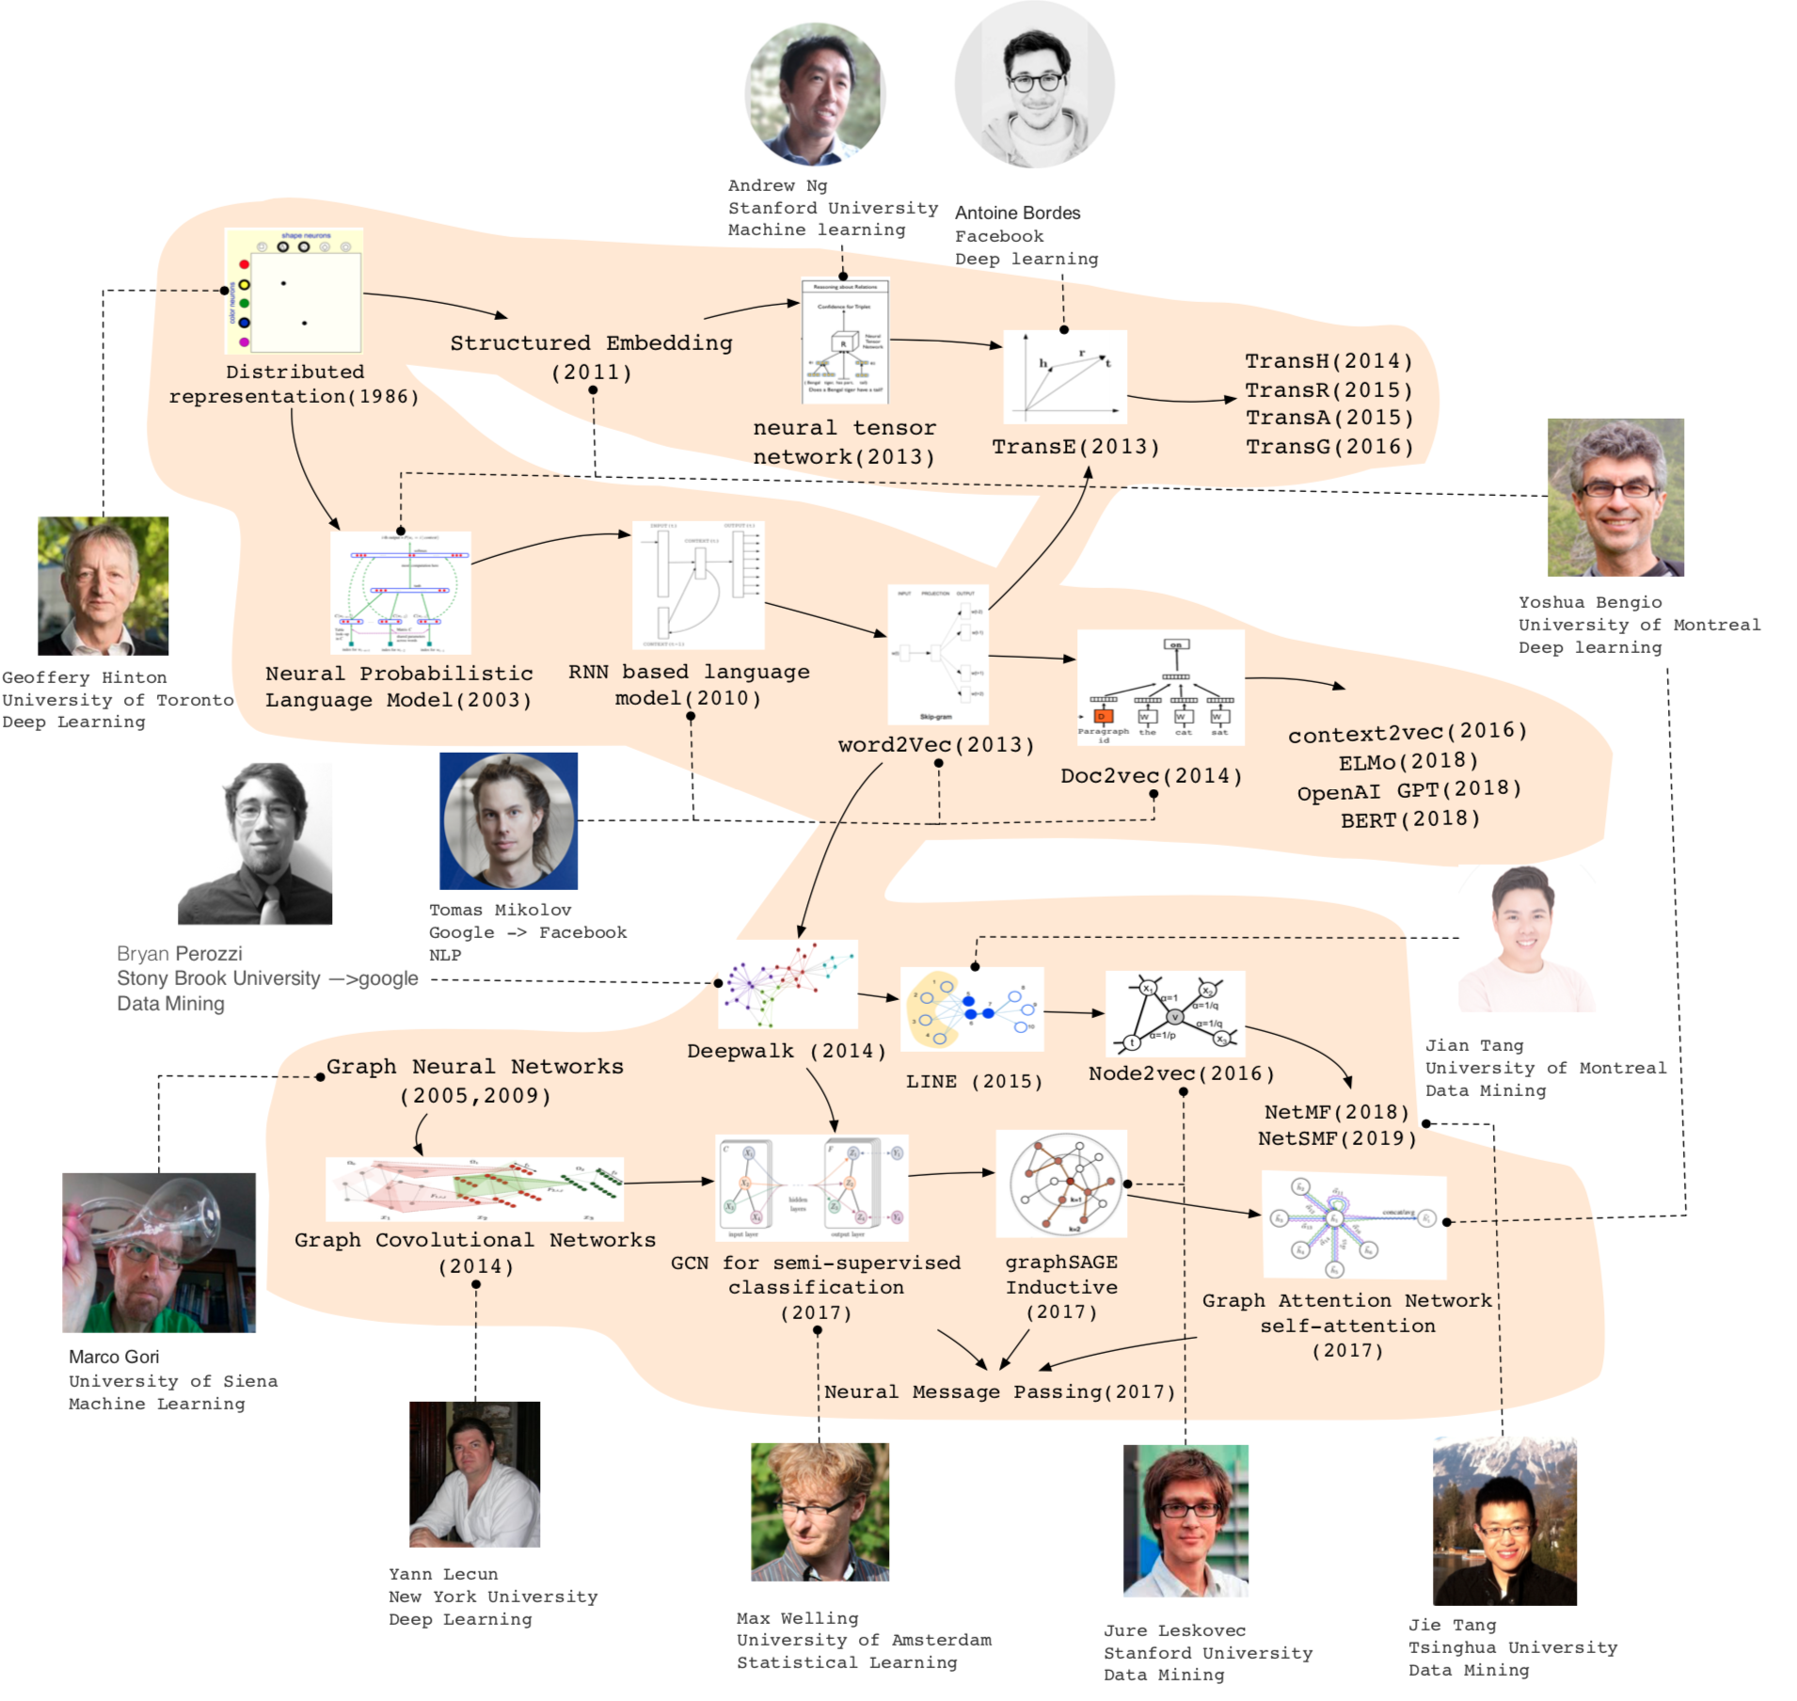

Slide 7
Let us start with an example
—Social influence and prediction

Slide 8
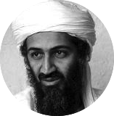






Social Influence: “Love Trump”
Trump makes USA great again
I hate Trump, the worst president ever
Trump is fantastic
Trump is great!
No Trump in 2020!
He cannot be the next president!
Positive
Negative
Notes:
Obama has done just that. From social networking to his blog to his Fight the Smears campaign, Obama has made his Web 2.0 presence known. He has over 1.5 million friends on MySpace and Facebook, and he currently has over 28,000,000 followers on Twitter. This personal activity in social networks allows him to quickly get the word out across multiple platforms.

Slide 9
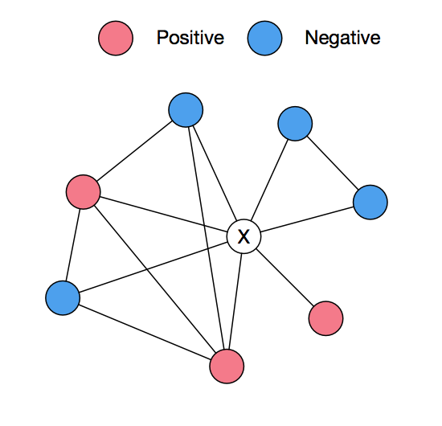
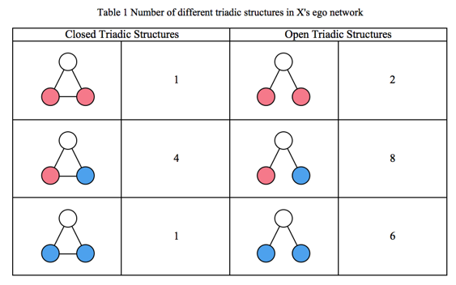
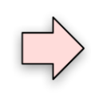
Beyond Peer Influence
Influence is a very complicated mechanism
  Peer influence
  Conformity influence
  Structural influence
or
?
Positive or negative?

Slide 10
Social prediction in Tencent networks
  Example: King of Glory (王者荣耀)
v₁
v₂
Who are more likely to be “active”, v₁ or v₂?
e.g., active = “call-back King of Glory”
Inactive neighbor
Active neighbor
v
User to be influenced
J. Qiu, J. Tang, H. Ma, Y. Dong, K. Wang, and J. Tang. DeepInf: Social Influence Prediction with Deep Learning. KDD'18.

Slide 11
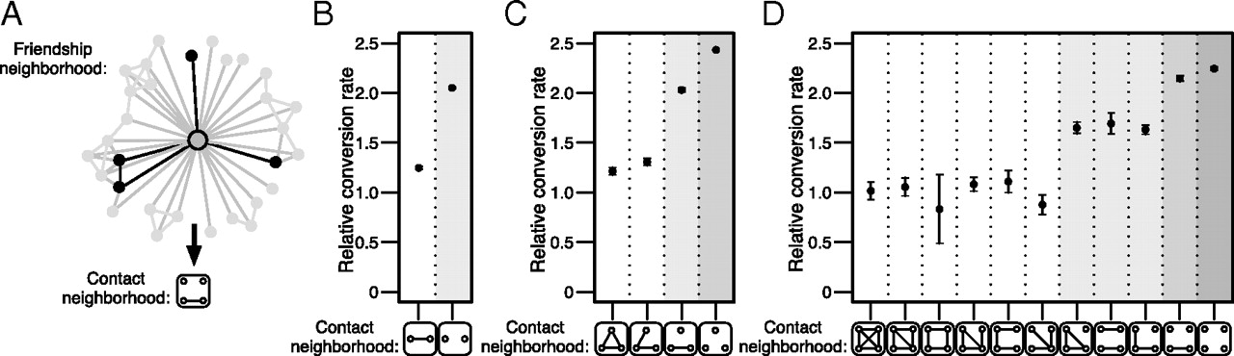
Structural Influence
J. Ugander, L. Backstrom, C. Marlow, J. Kleinberg. Structural diversity in social contagion. PNAS, 2012, 109 (16) 5962-5966.

Slide 12
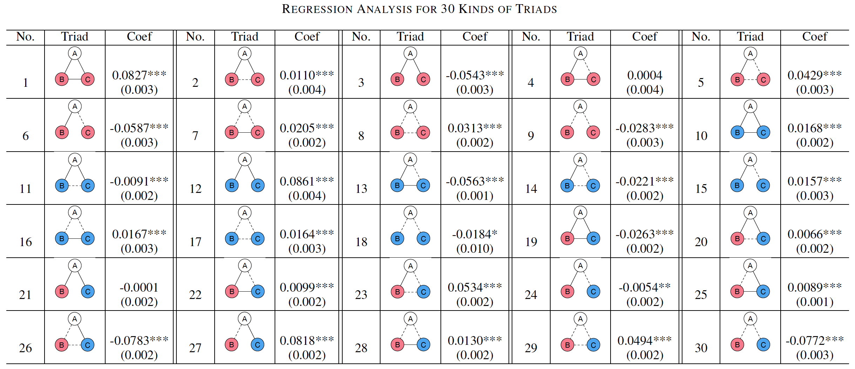
Influence Learning
Learning influence in signed triads
And apply the triadic influence for prediction

Slide 13
Possible Solution
Influence features + Hand craft features
predictive model
Class +1
+
Class -1
predictive model
But defining features is tedious and inefficient…

Slide 14

Representation Learning on Networks
?
Class +1
0.8
0.2
0.3
…
0.0
0.0
Class -1
How to automate the representation of each user?

Slide 15
Outline
Representation Learning on Networks
Revisiting Graph Neural Networks
Applications
Conclusion and Q&A

Slide 16




Review Representation Learning for Networks
d-dimensional vector, d<<|V|
Representation Learning/
Graph Embedding
0.8
0.2
0.3
…
0.0
0.0
Users with the same label are located in the d-dimensional space closer than those with different labels
e.g., node classification
label2
label1

Slide 17
Why is it hard?
Modern deep learning toolbox is designed for simple sequences or grids.
  CNNs for fixed-size images/grids...
  RNNs or word2vec for text/sequences...
But networks are far more complex!
  Complex topographical structure (i.e., no spatial locality like grids)
  No fixed node ordering or reference point (i.e., the isomorphism problem)
  Often dynamic and have multimodal features.

Slide 18
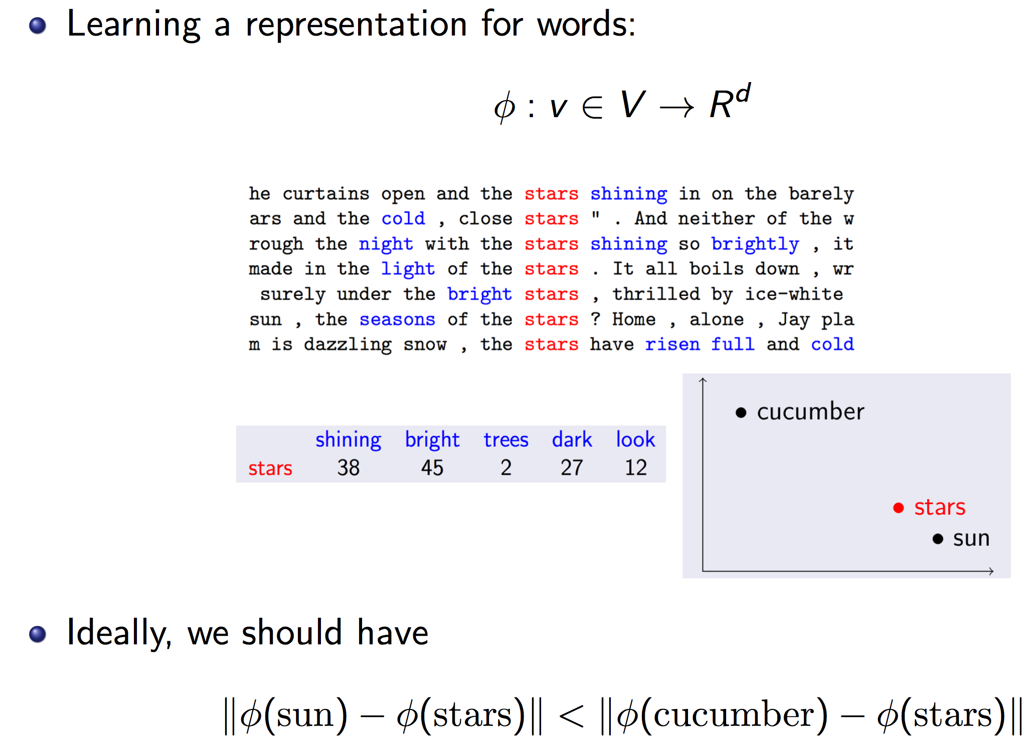
Recall word2vec for NLP

Slide 19
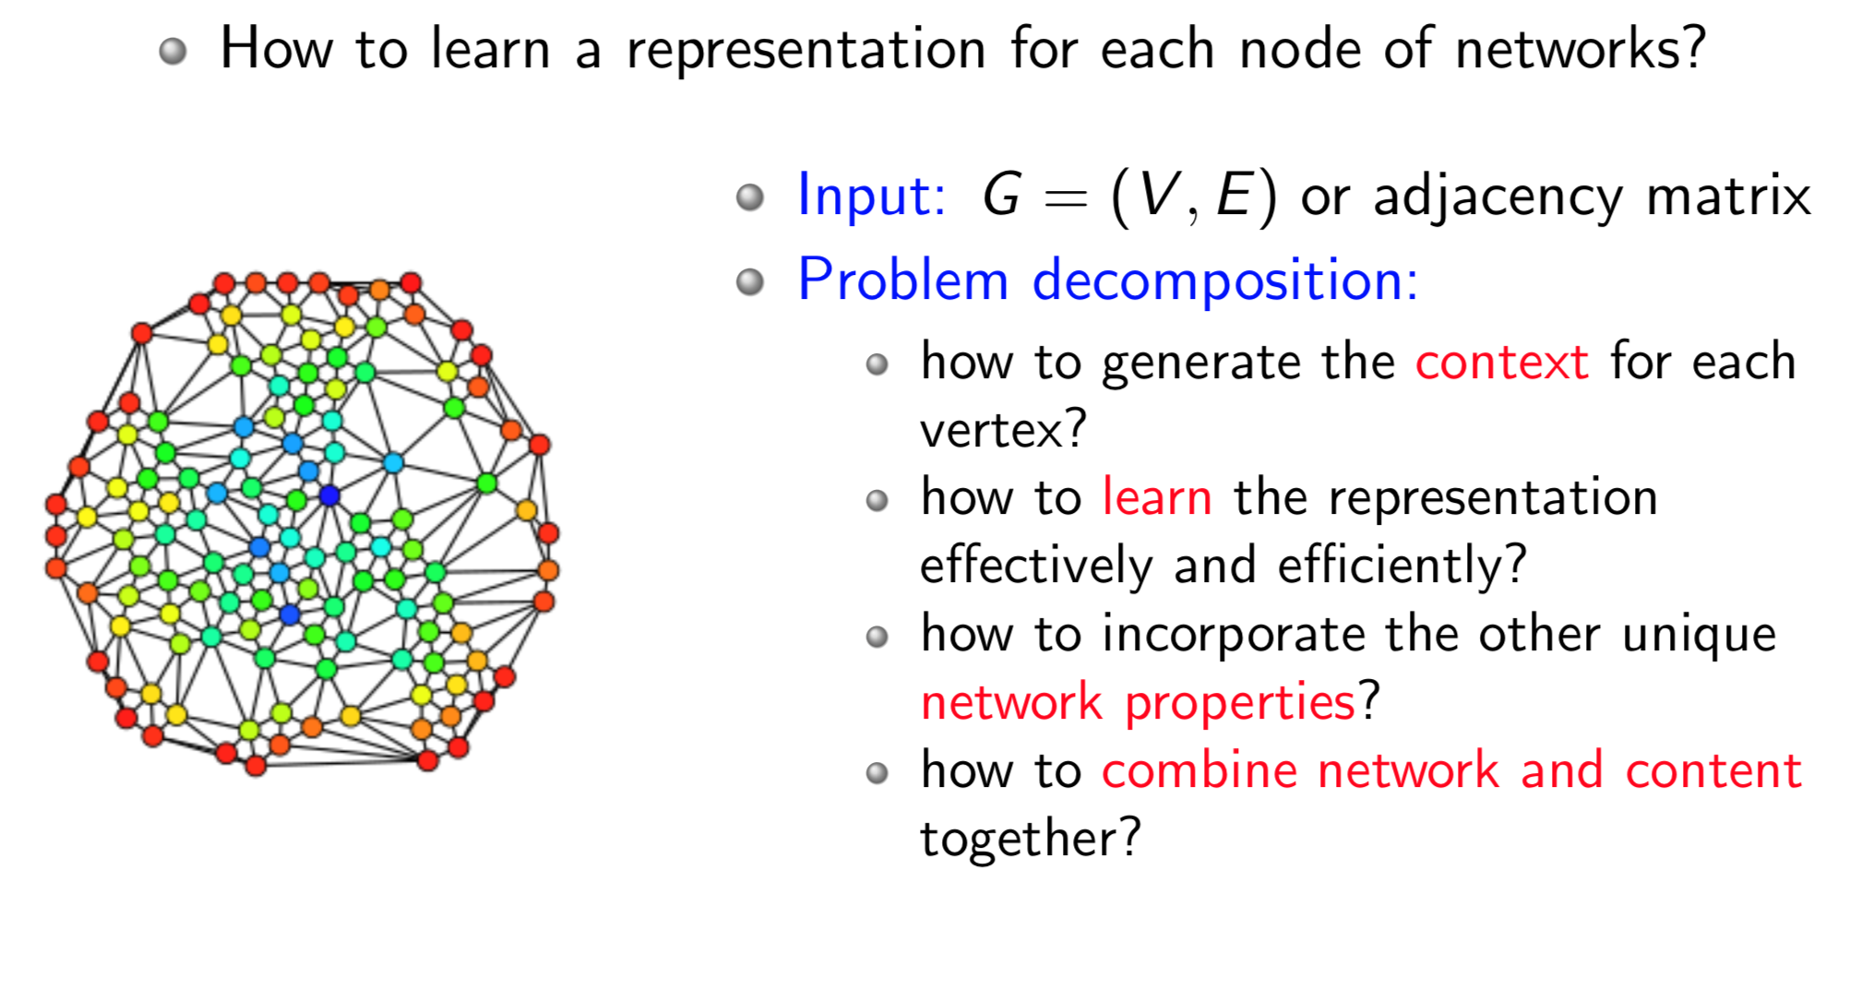
Node Embeddings

Slide 20
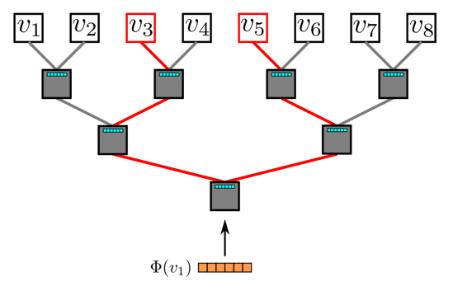
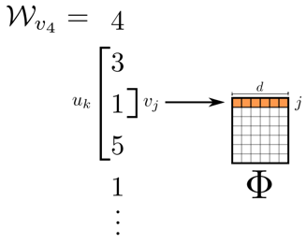
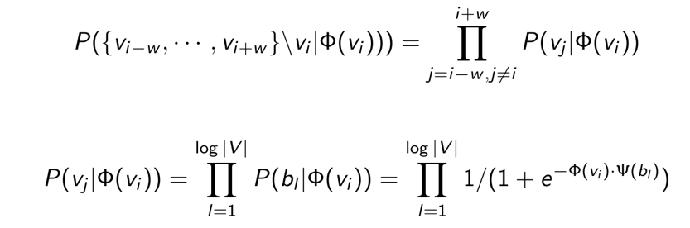
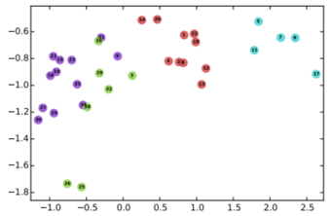
DeepWalk
Random walk
One example RW path
SkipGram with Hierarchical softmax
v₃
v₄
v₄
v₃
v₁
v₅
v₆
v₁
v₅
v₂
v₆
Hierarchical softmax
B. Perozzi, R. Al-Rfou, and S. Skiena. 2014. Deepwalk: Online learning of social representations. KDD, 701–710.

Slide 21
DeepWalk
Random walk
One example RW path
SkipGram with Hierarchical softmax
v₃
v₄
v₄
v₃
v₁
v₅
v₆
v₁
v₅
v₂
v₆
Hierarchical softmax
B. Perozzi, R. Al-Rfou, and S. Skiena. 2014. Deepwalk: Online learning of social representations. KDD, 701–710.

Slide 22
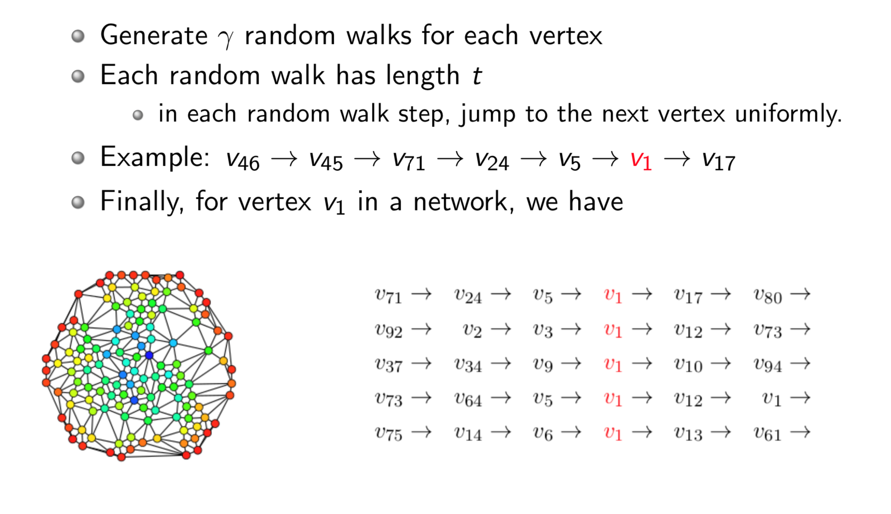
Random Walk

Slide 23
DeepWalk
Random walk
One example RW path
SkipGram with Hierarchical softmax
v₃
v₄
v₄
v₃
v₁
v₅
v₆
v₁
v₅
v₂
v₆
Hierarchical softmax
B. Perozzi, R. Al-Rfou, and S. Skiena. 2014. Deepwalk: Online learning of social representations. KDD, 701–710.

Slide 24
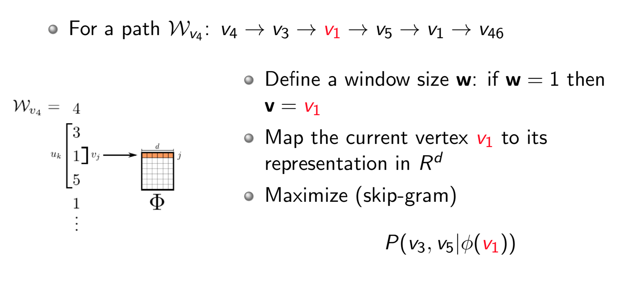
Representation Mapping

Slide 25
DeepWalk
Random walk
One example RW path
SkipGram with Hierarchical softmax
v₃
v₄
v₄
v₃
v₁
v₅
v₆
v₁
v₅
v₂
v₆
Hierarchical softmax
B. Perozzi, R. Al-Rfou, and S. Skiena. 2014. Deepwalk: Online learning of social representations. KDD, 701–710.

Slide 26
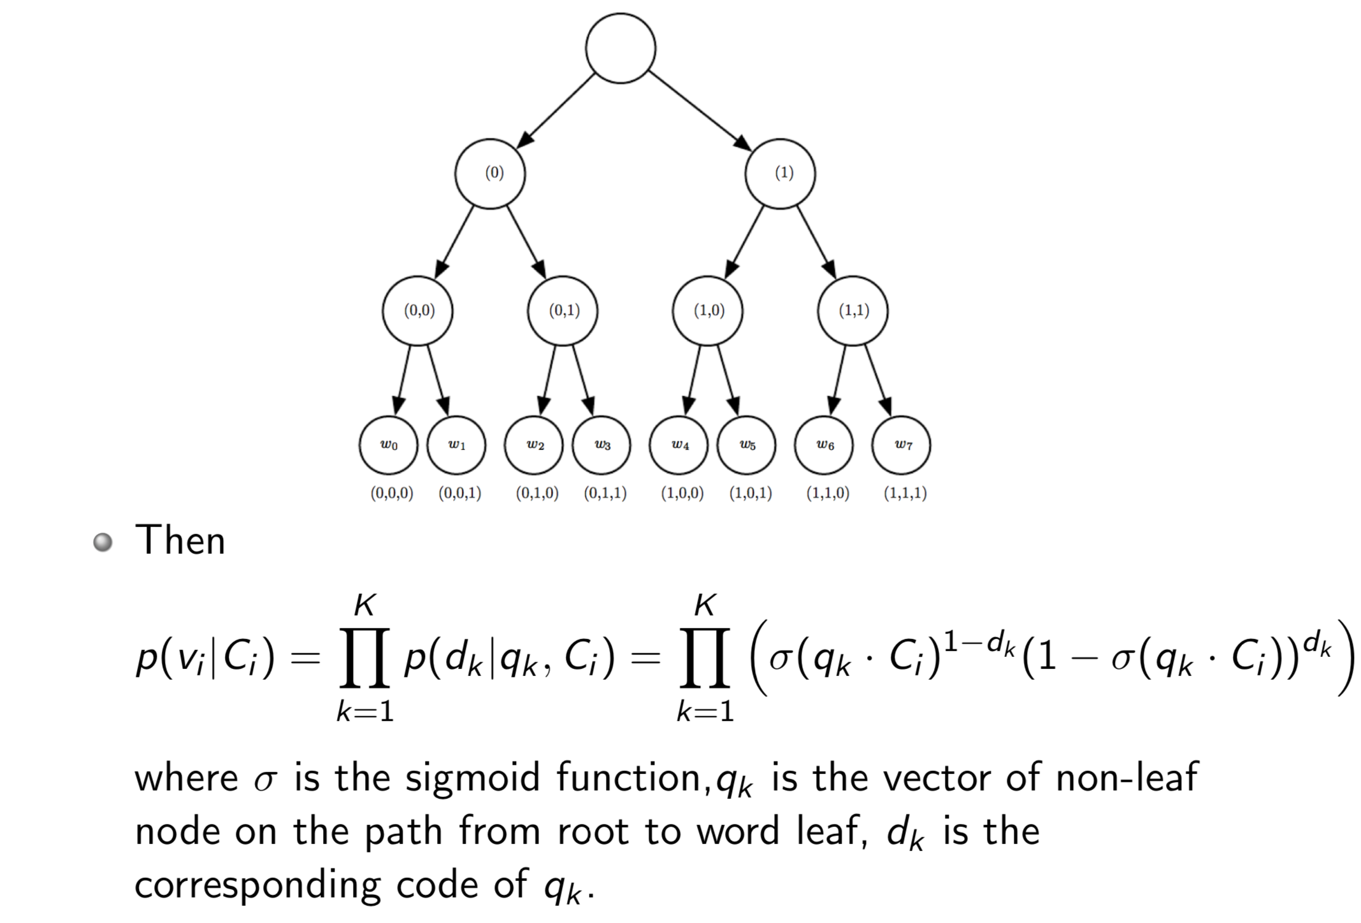
Hierarchical Softmax

Slide 27
Parameter Learning
Randomly initialize the representations
Each classifier in the hierarchy has a set of weights
Use SGD (stochastic gradient descent) to update both classifier weights and vertex representations simultaneously

Slide 28
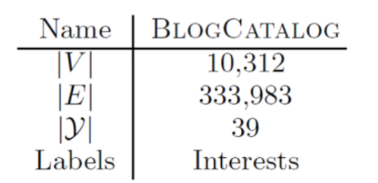
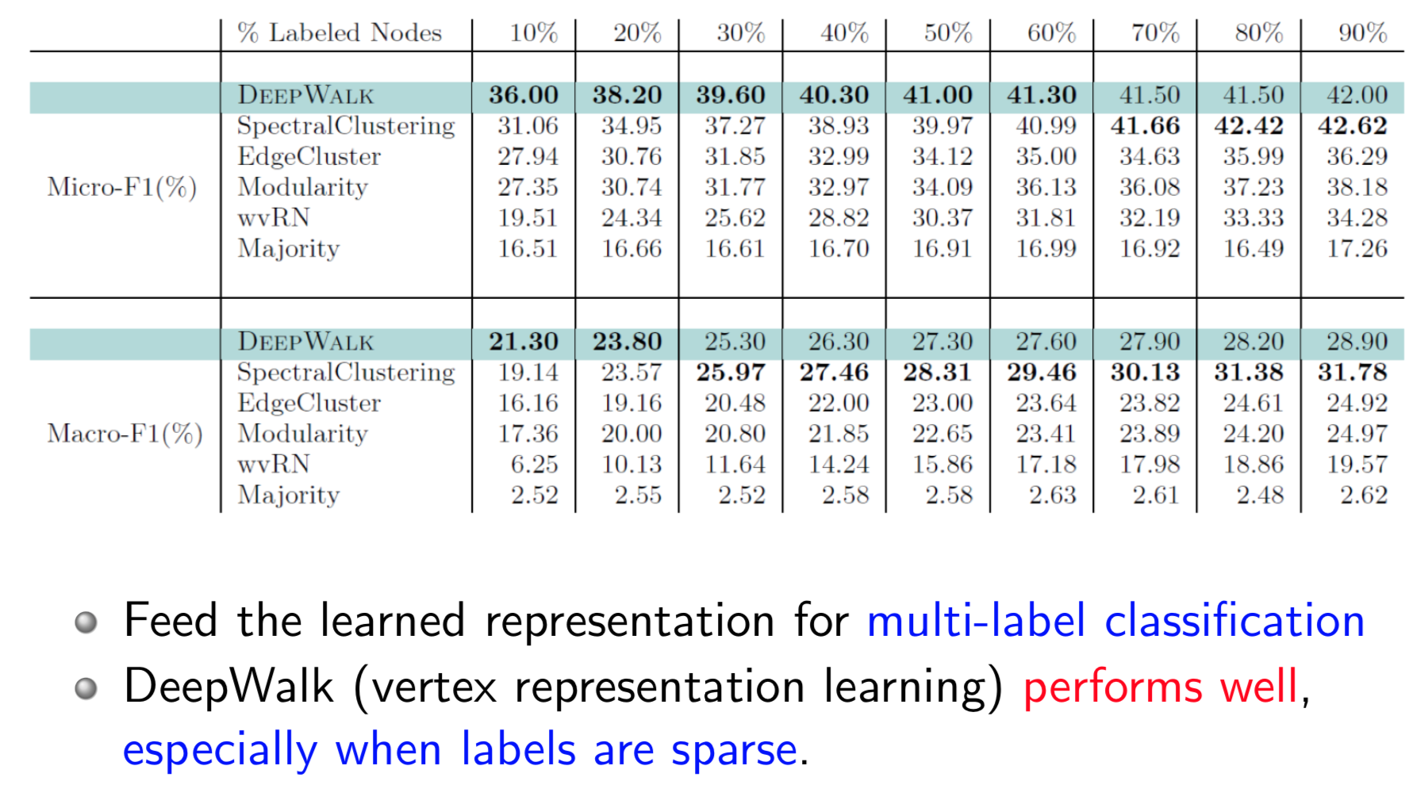
Results: BlogCatalog

Slide 29
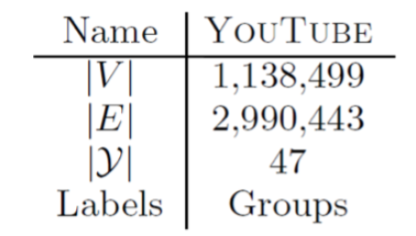
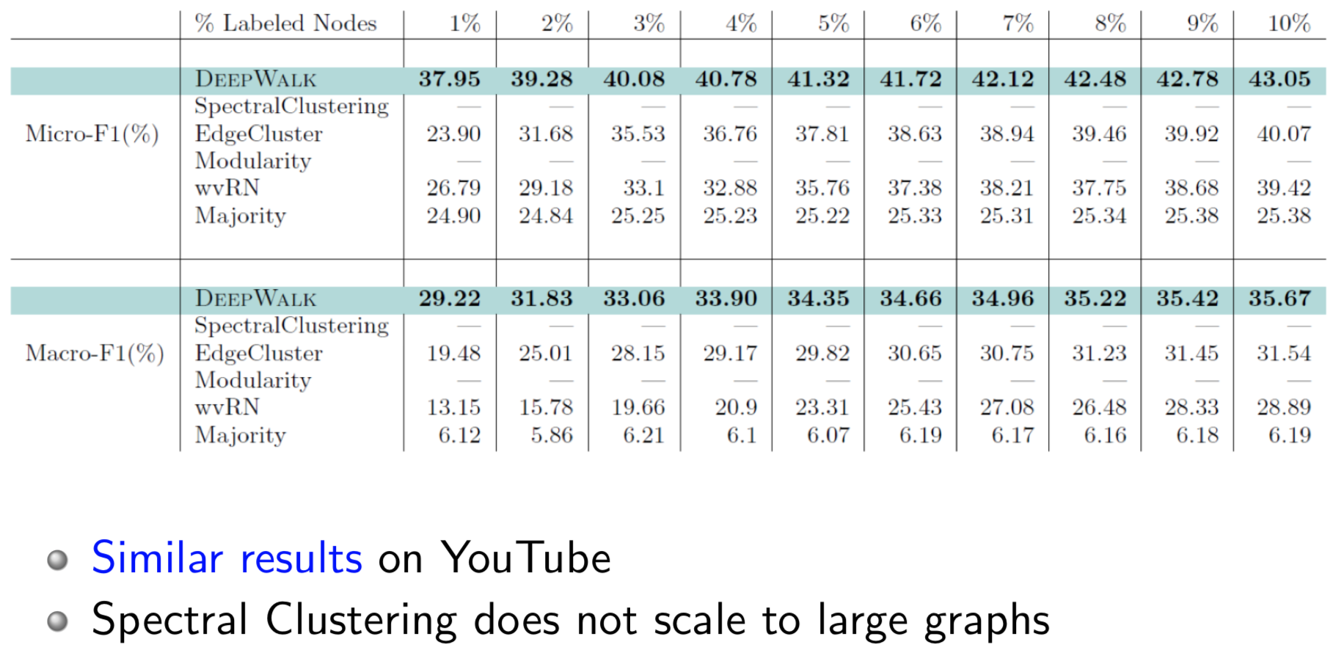
Results: YouTube

Slide 30
DeepWalk utilizes fixed-length, unbiased random walks to generate context for each node, can we do better?

Slide 31
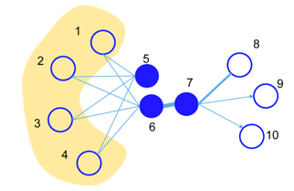
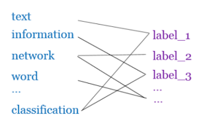
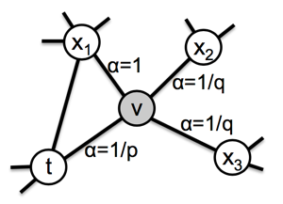
Later…
LINE^{[1]}: explicitly preserves both first-order and second-order proximities.
PTE^{[2]}: learn heterogeneous text network embedding via a semi-supervised manner.
Node2vec^{[3]}: use a biased random walk to better explore node’s neighborhood.
J. Tang, M. Qu, M. Wang, M. Zhang, J. Yan, and Q. Mei. 2015. Line: Large-scale information network embedding. WWW, 1067–1077.
J. Tang, M. Qu, and Q. Mei. 2015. Pte: Predictive text embedding through large-scale heterogeneous text networks. KDD, 1165–1174.
A. Grover and J. Leskovec. 2016. node2vec: Scalable feature learning for networks. KDD, 855–864.

Slide 32
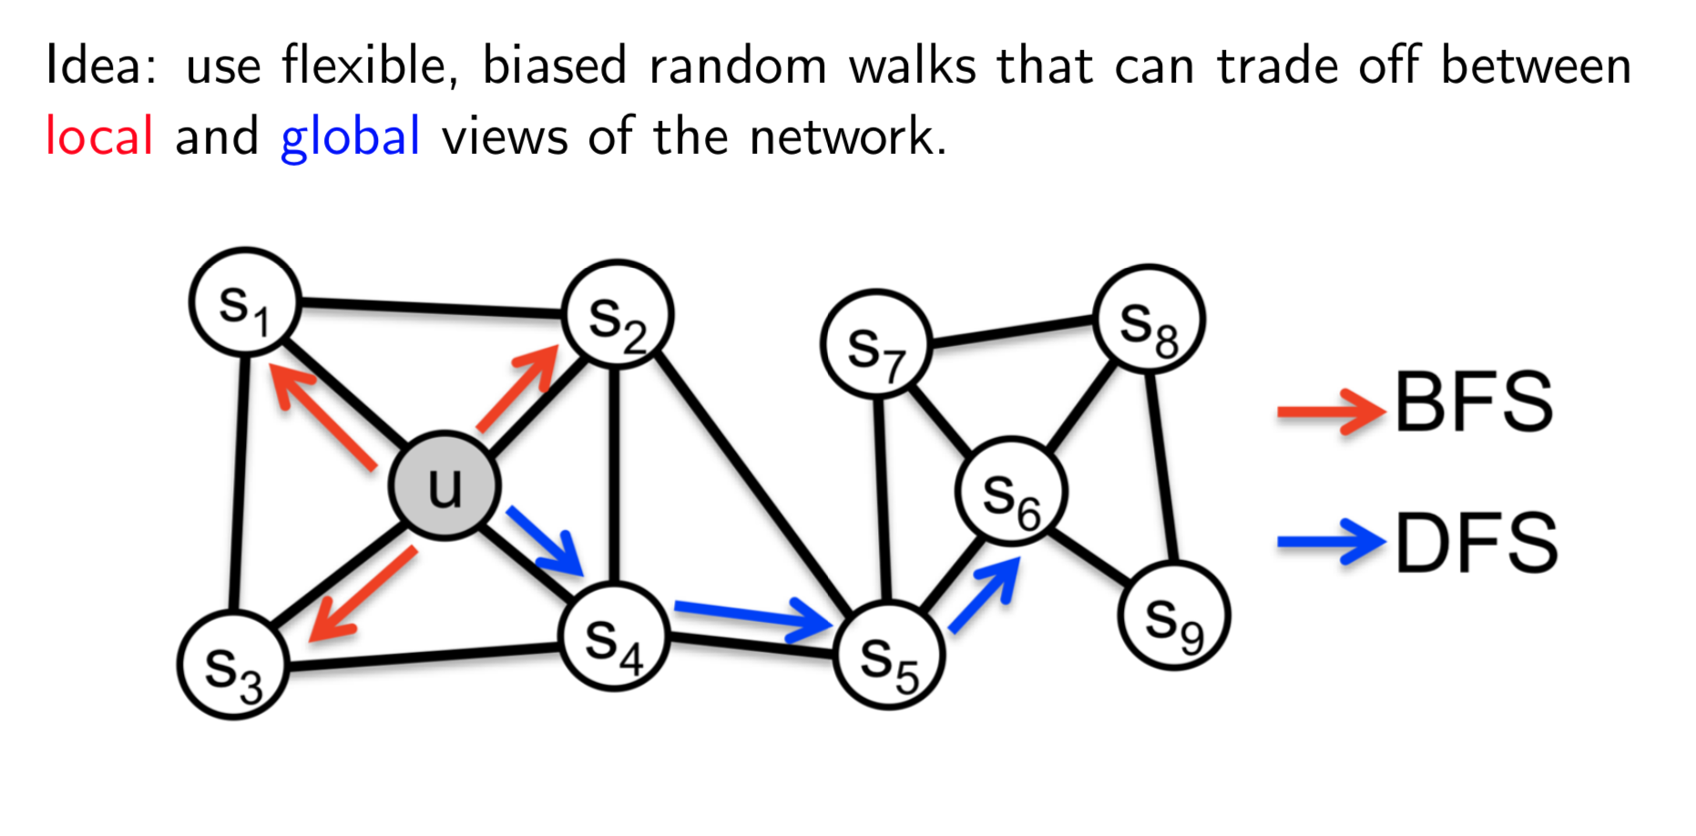
node2vec: Biased Walks
A. Grover and J. Leskovec. 2016. node2vec: Scalable feature learning for networks. KDD, 855–864.

Slide 33
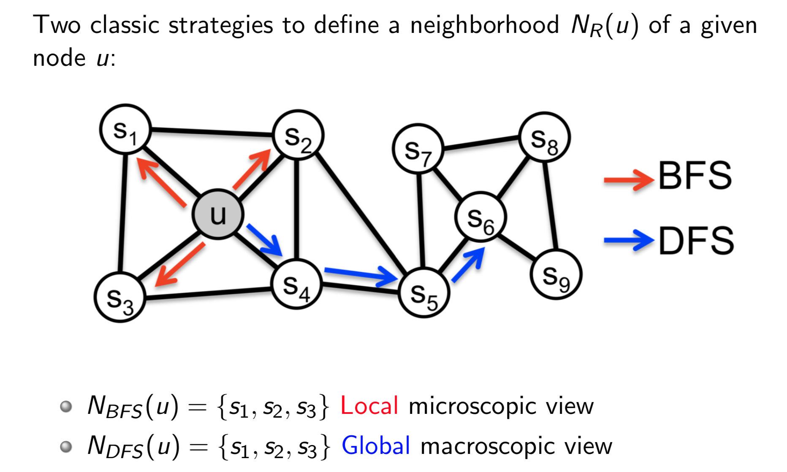
node2vec:Biased Walks

Slide 34
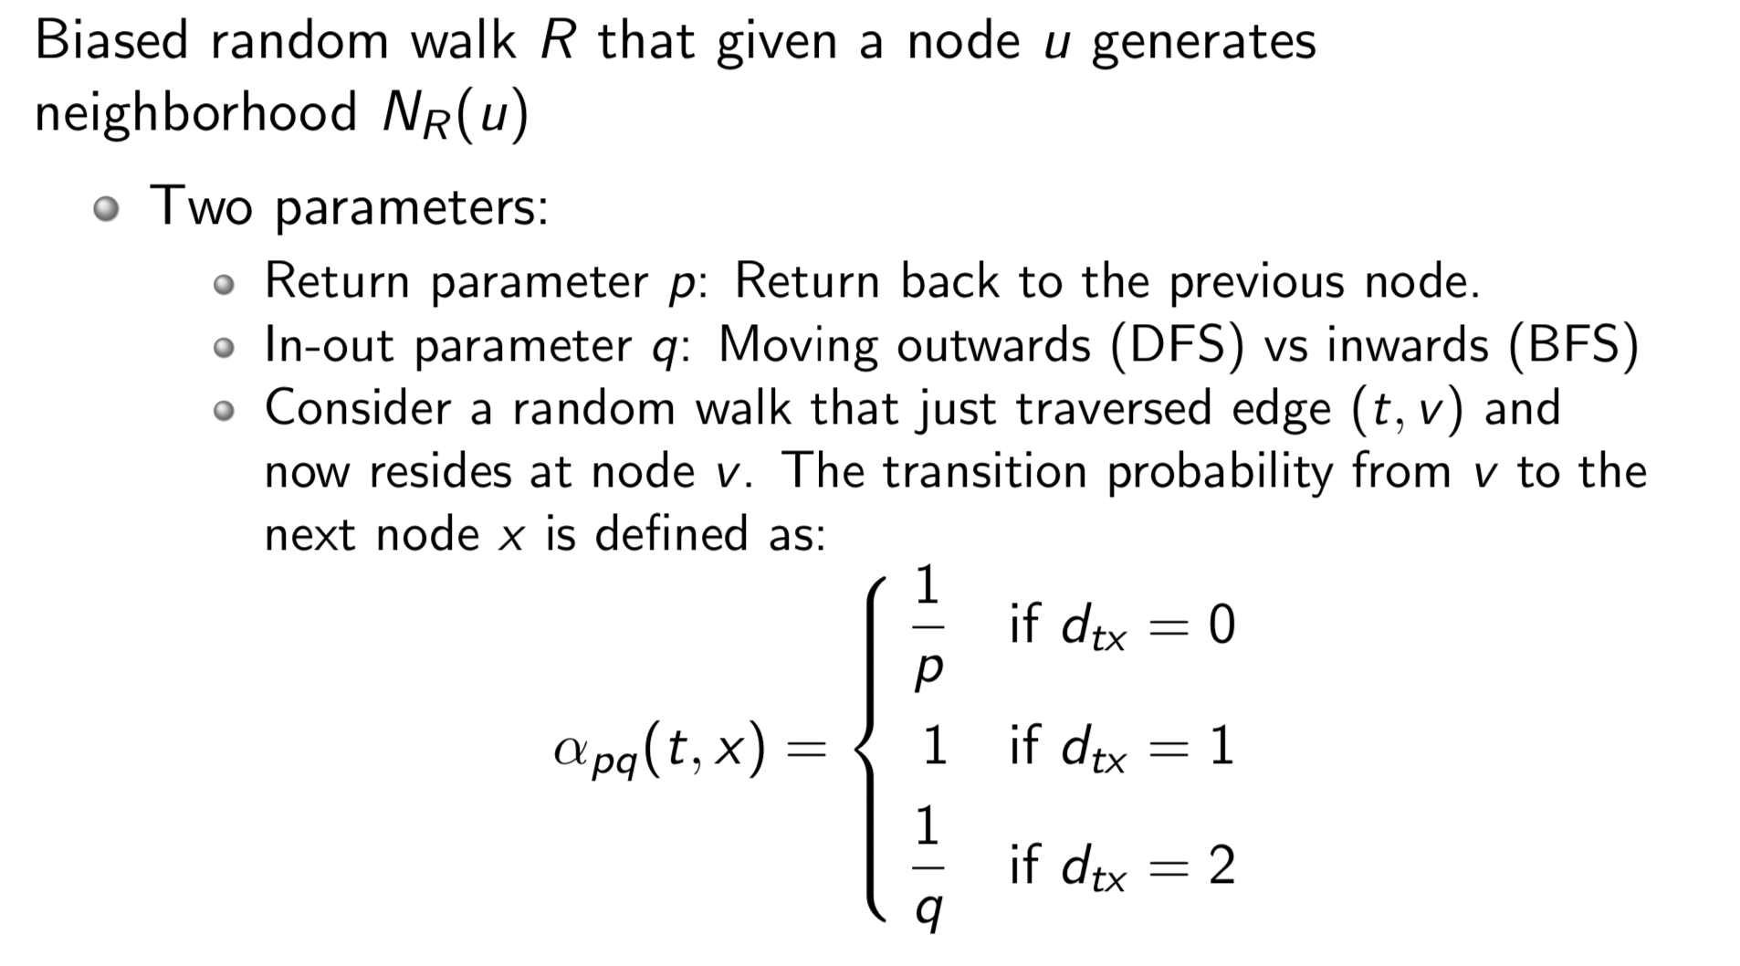
Biased Random Walks

Slide 35
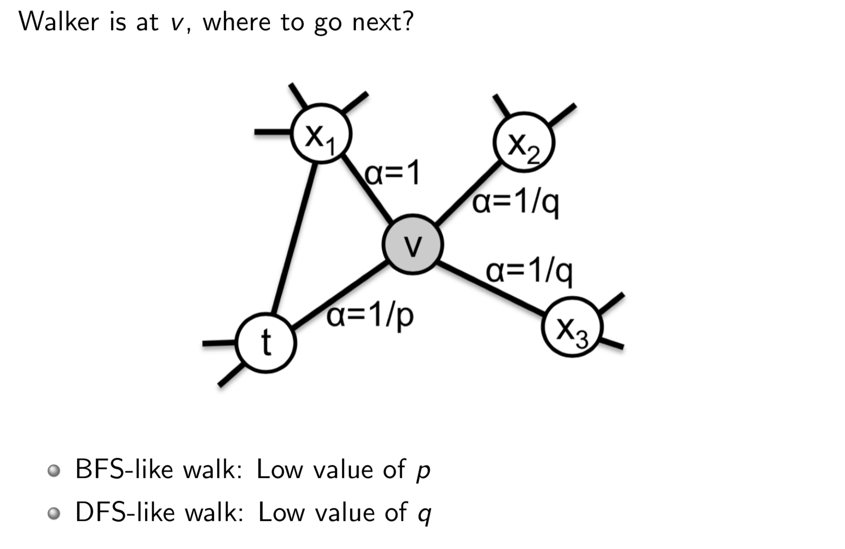
Biased Random Walks

Slide 36
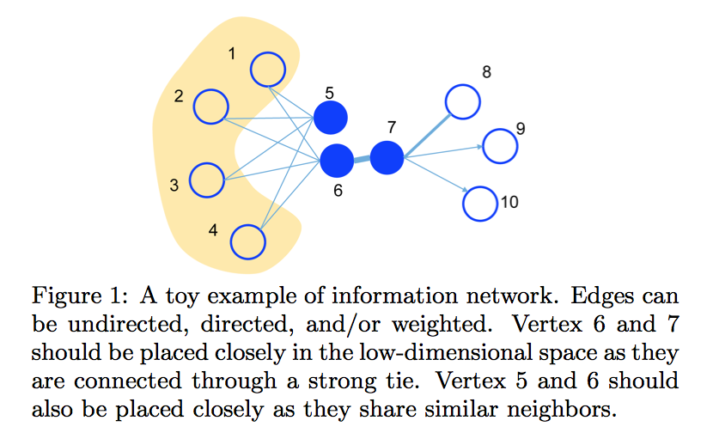
LINE: Information Network Embedding
J. Tang, M. Qu, M. Wang, M. Zhang, J. Yan, and Q. Mei. 2015. Line: Large-scale information network embedding. WWW, 1067–1077.

Slide 37
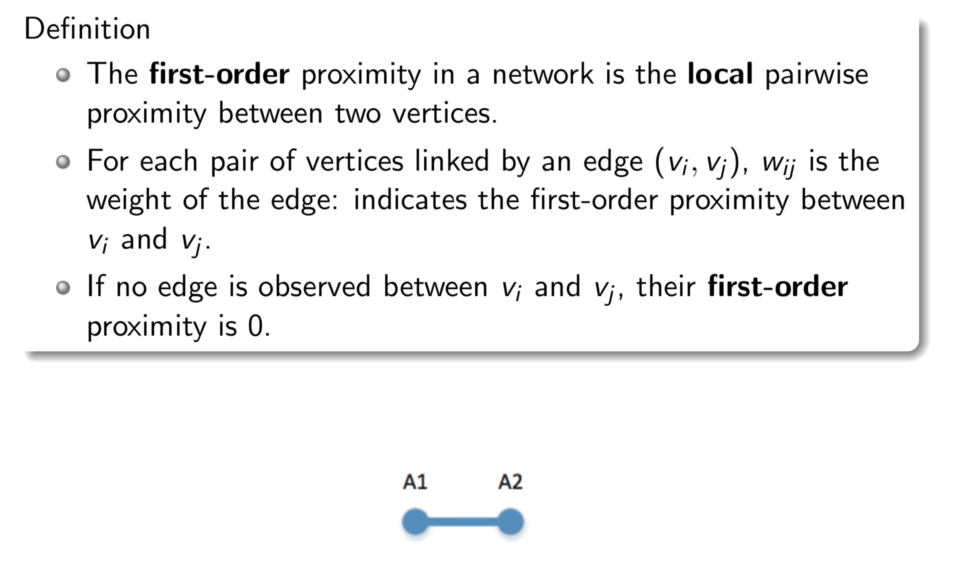
Line: First-order Proximity

Slide 38
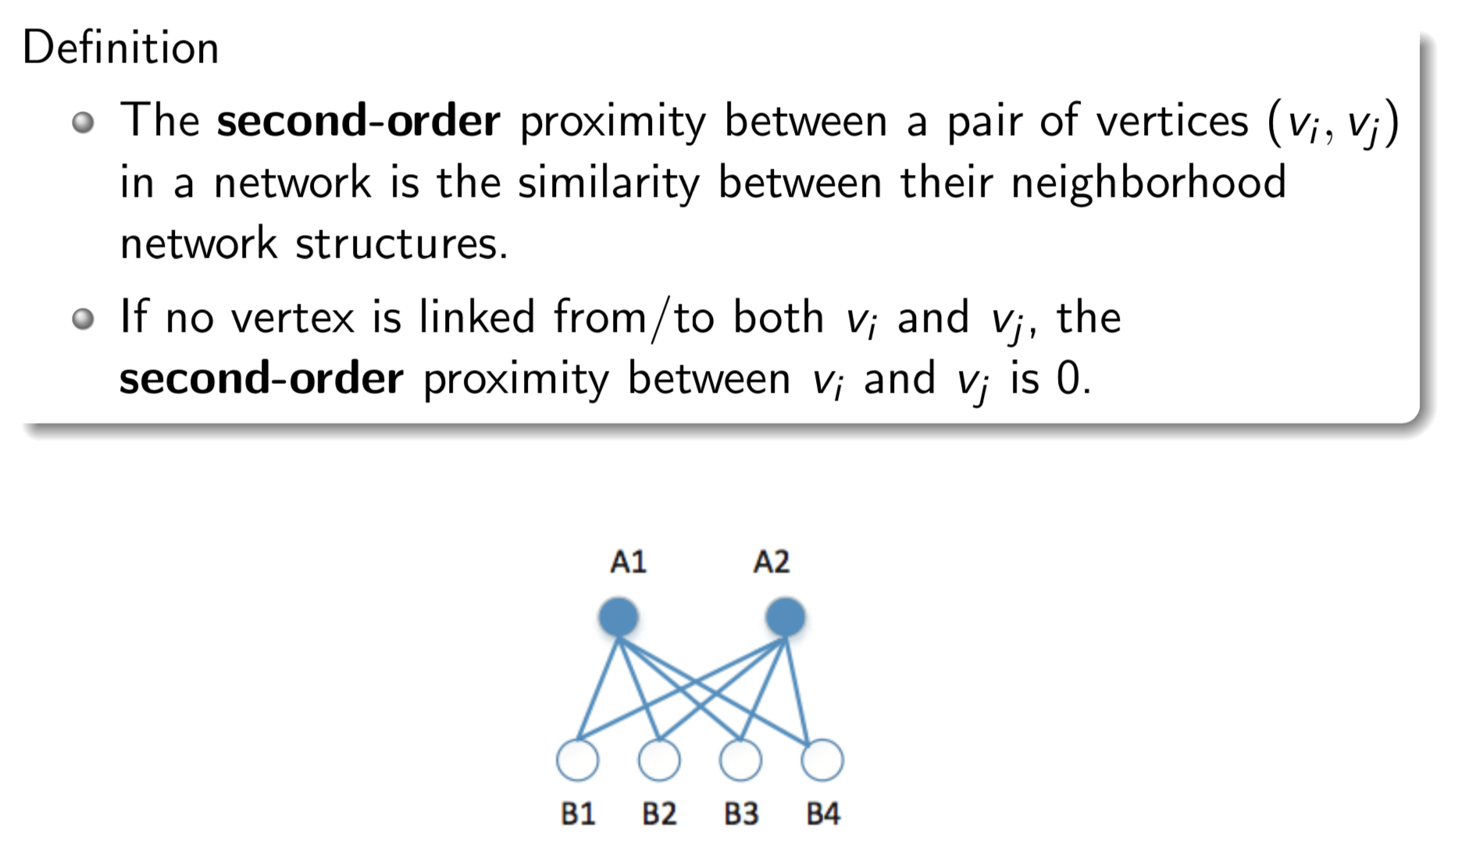
LINE: Second-order Proximity

Slide 39
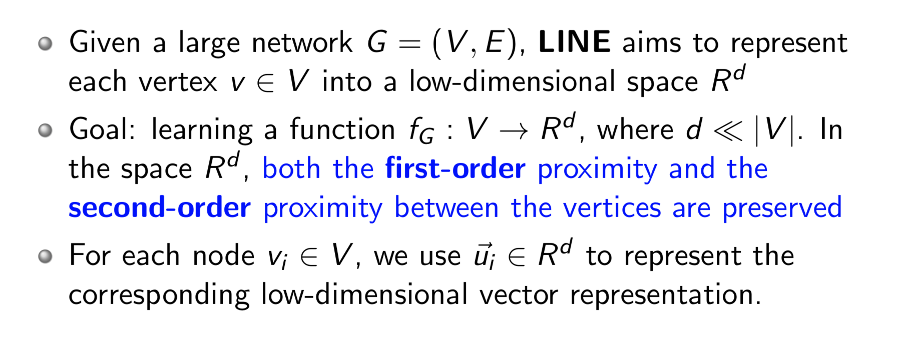
LINE: Large-scale Information Network Embedding

Slide 40
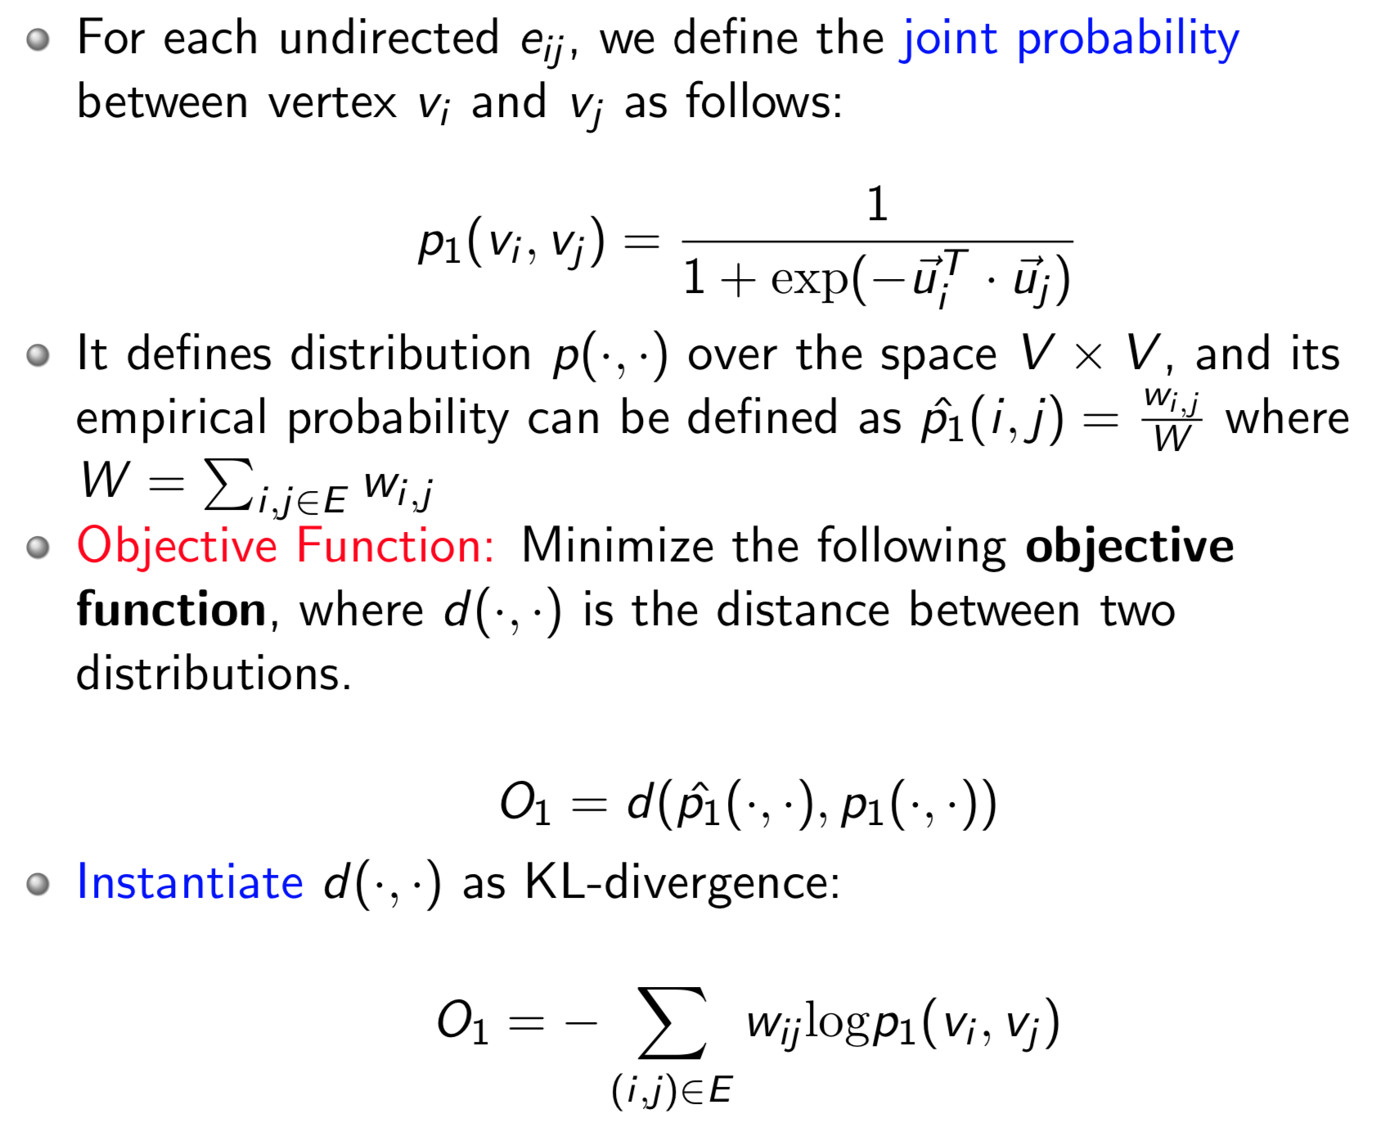
LINE with First-order Proximity

Slide 41
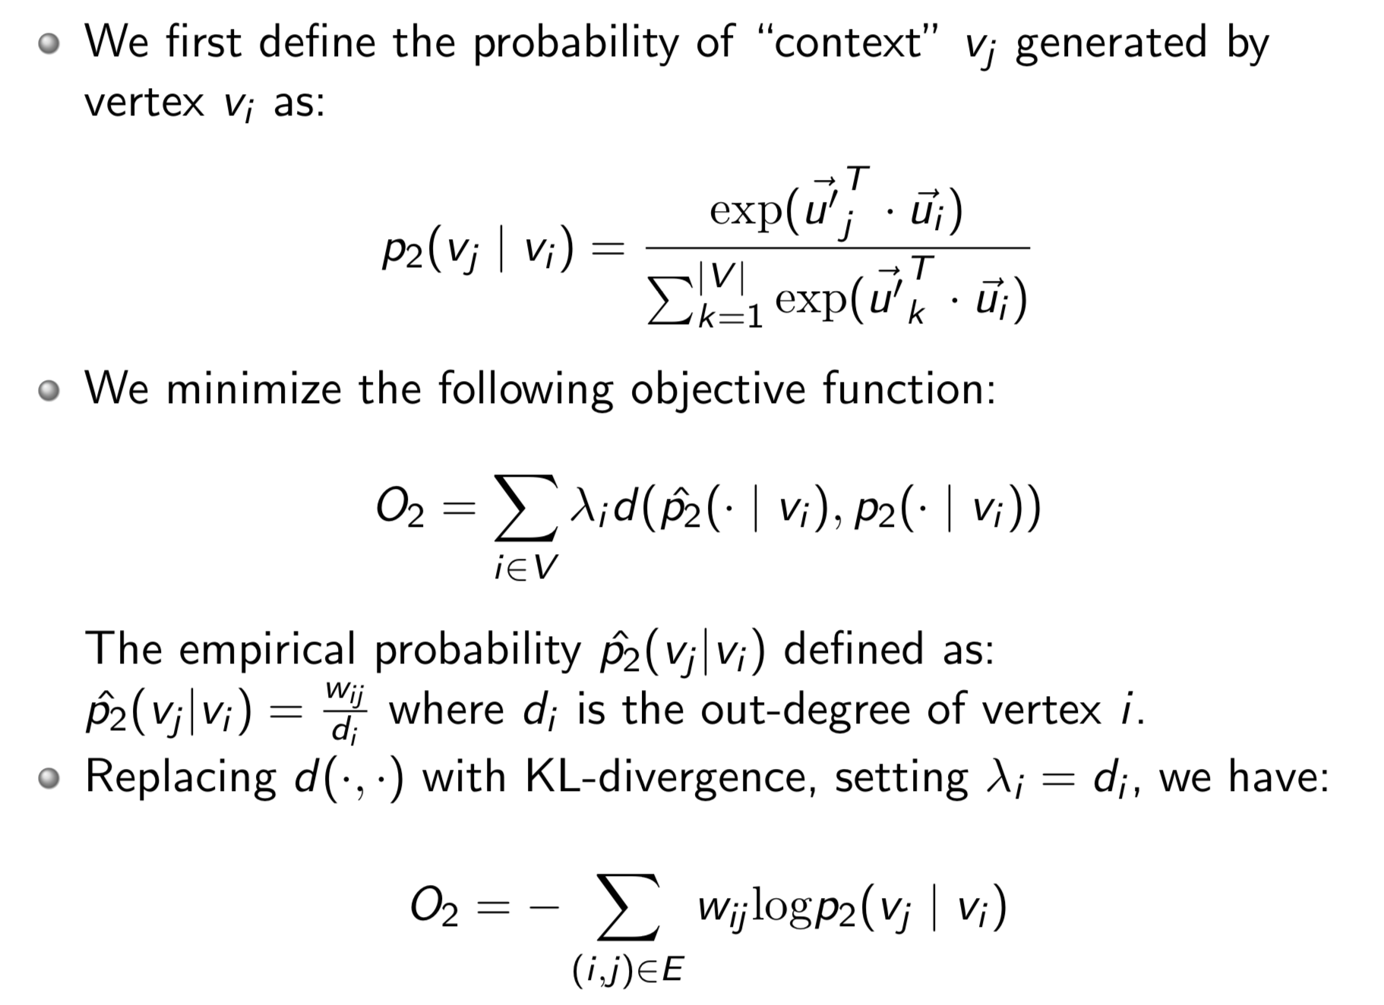
LINE with Second-order Proximity

Slide 42
Combining first-order and second-order proximities
A simple and effective way: train the LINE model which preserves the first-order proximity and second-order proximity separately and then concatenate the embeddings trained by the two methods together for each vertex.
A more principled way to combine the two proximity is to jointly train the two objective function, a future work?

Slide 43
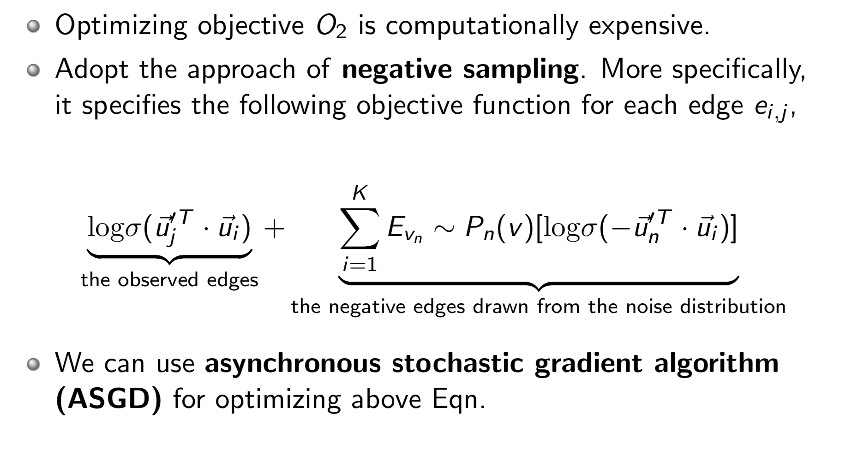
Model Optimization

Slide 44
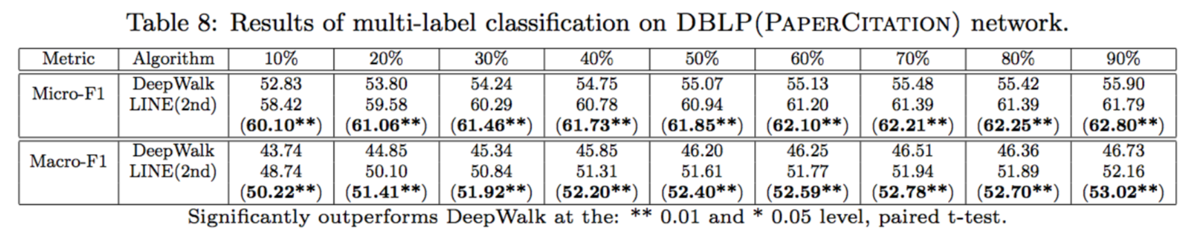
Performance
Task: Predict which paper is published at the different conferences: AAAI, CIKM, ICML, KDD, NIPS, SIGIR, and WWW
Result: The LINE(2nd) performs quite well and generates meaningful layout of the network (nodes with same colors are distributed closer).

Slide 45
Questions
What are the fundamentals underlying the different models?
or
Can we unify the different network embedding approaches?

Slide 46
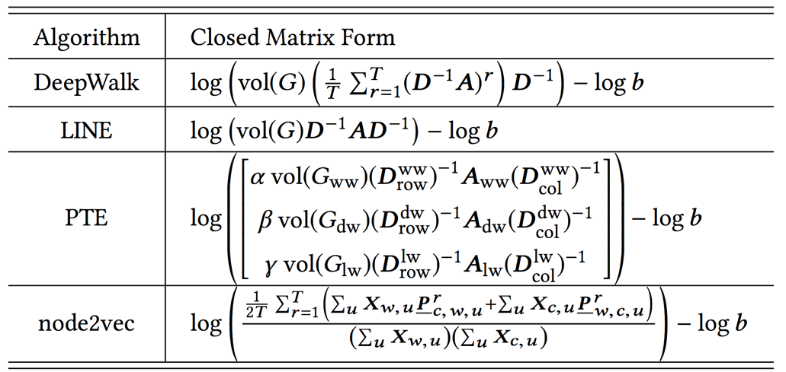
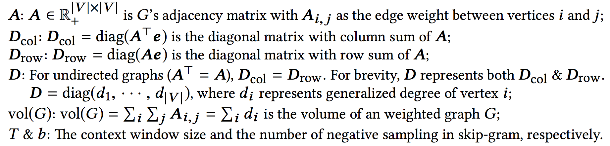
Unifying DeepWalk, LINE, PTE, and node2vec into Matrix Forms
Qiu et al. Network embedding as matrix factorization: unifying deepwalk, line, pte, and node2vec. WSDM’18. The most cited paper in WSDM’18 as of May 2019

Slide 47
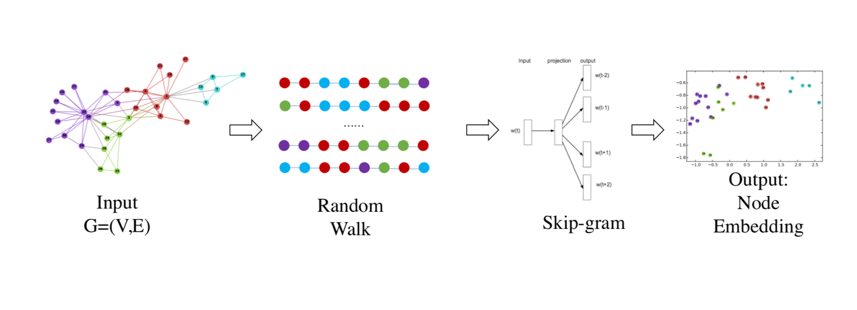
Starting with DeepWalk

Slide 48
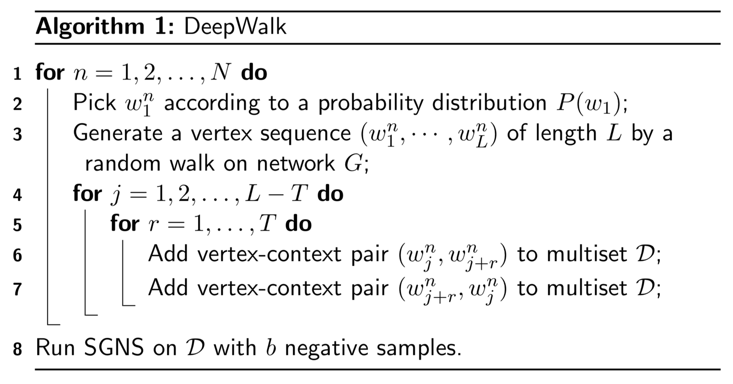
DeepWalk Algorithm

Slide 49
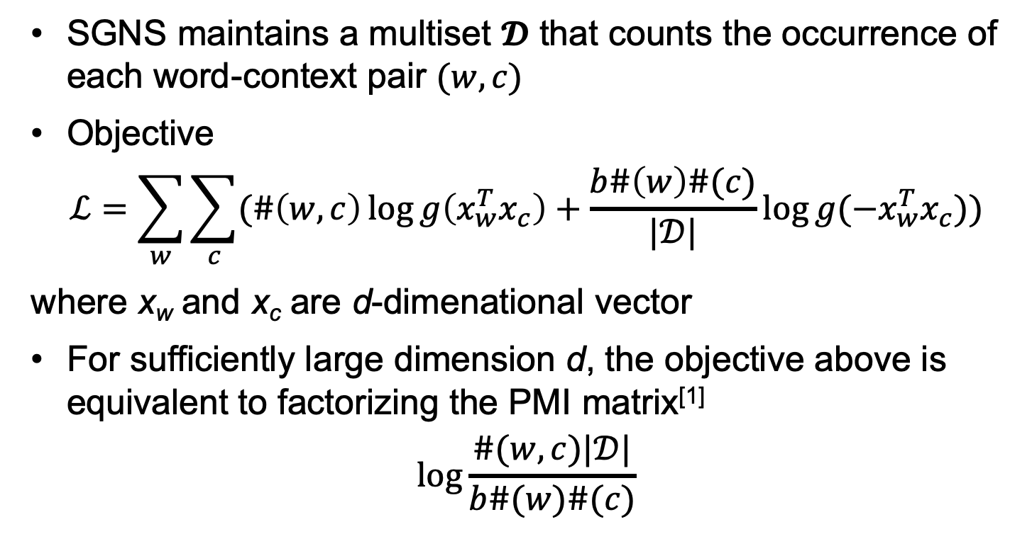
Skip-gram with Negative Sampling
SGNS maintains a multiset $𝓓$ that counts the occurrence of each word-context pair $(w, c)$
Objective
$$ℒ=\sum_{w}{\sum_{c}{(\#\left(w,c\right)\log{g\left(x_{w}^{T}x_{c}\right)+\frac{b\#\left(w\right)\#(c)}{|𝒟|}\log{g(−x_{w}^{T}x_{c})}})}}$$
where x_{w} and x_{c} are d-dimenational vector
For sufficiently large dimension d, the objective above is equivalent to factorizing the PMI matrix^{[1]}
$$\log{\frac{\#(w,c)|𝒟|}{b\#(w)\#(c)}}$$
Levy and Goldberg. Neural word embeddings as implicit matrix factorization. In NIPS 2014

Slide 50
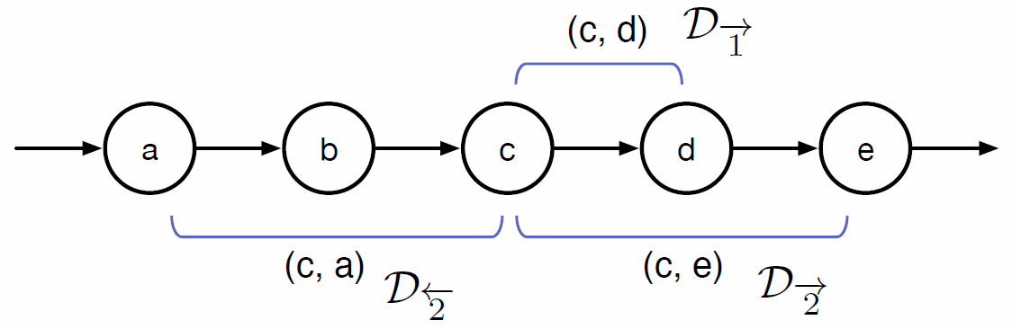
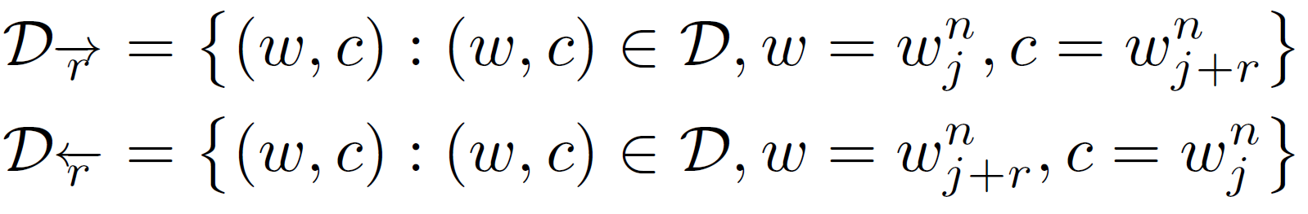
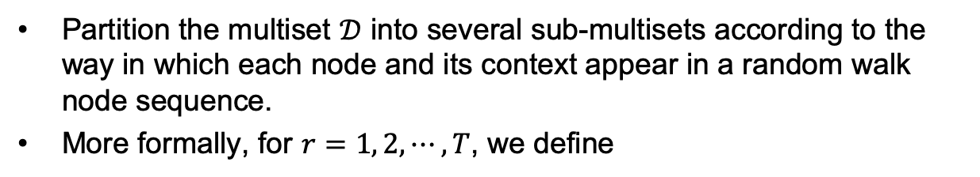
Understanding random walk + skip gram
Partition the multiset $𝒟$ into several sub-multisets according to the way in which each node and its context appear in a random walk node sequence.
More formally, for $r=1, 2,⋯, T$, we define
Divide-and-Conquer

Slide 51
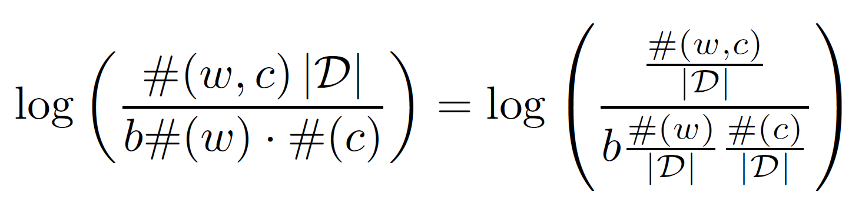
Understanding random walk + skip gram

Slide 52
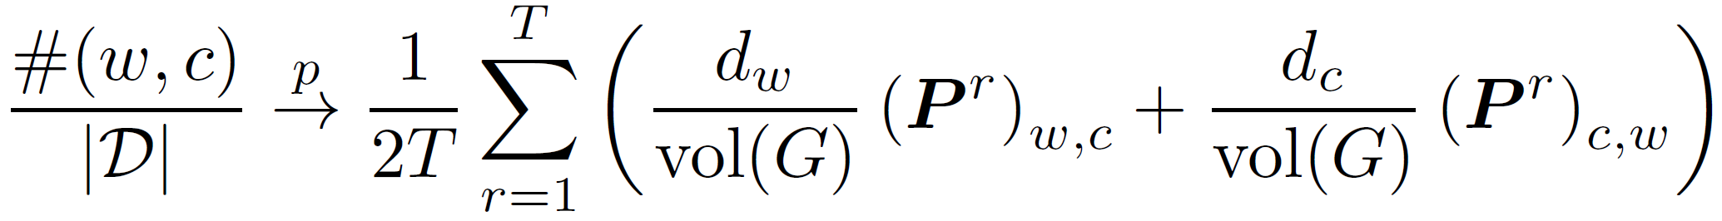
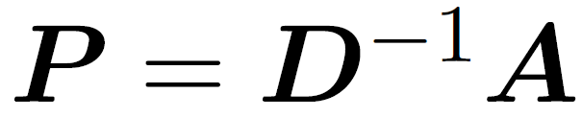
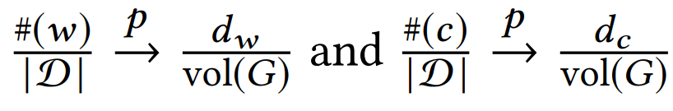
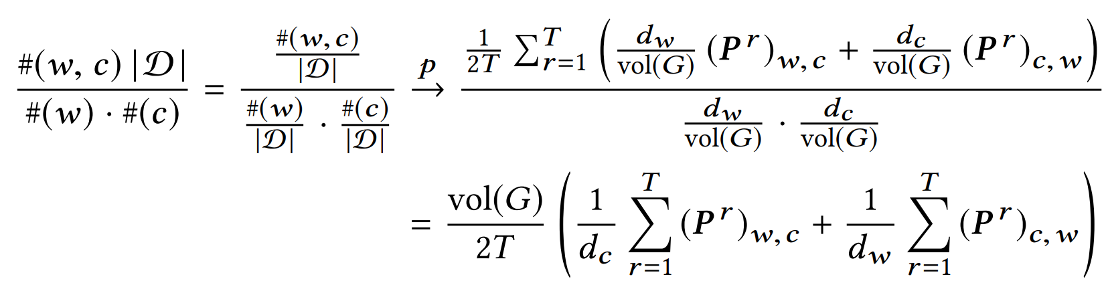

Understanding random walk + skip gram
the length of random walk $L→∞$
Qiu et al. Network embedding as matrix factorization: unifying deepwalk, line, pte, and node2vec. WSDM’18. The most cited paper in WSDM’18 as of May 2019

Slide 53



Slide 54












DeepWalk is factorizing a matrix
$$w_{i−2 }$$
$$w_{i−1 }$$
$$w_{i}$$
$$w_{i+1 }$$
$$w_{i+2 }$$
DeepWalk is asymptotically and implicitly factorizing
$$vol\left(G\right)=\sum_{i}{\sum_{j}{A_{ij}}}$$
$$A$$
Adjacency matrix
b: #negative samples
T: context window size
$$D$$
Degree matrix

Slide 55

LINE

Slide 56


PTE

Slide 57

node2vec — 2nd Order Random Walk

Slide 58
Unifying DeepWalk, LINE, PTE, and node2vec into Matrix Forms
Qiu et al. Network embedding as matrix factorization: unifying deepwalk, line, pte, and node2vec. WSDM’18. The most cited paper in WSDM’18 as of May 2019

Slide 59
NetMF: explicitly factorizing the DW matrix
Matrix Factorization
$$w_{i−2 }$$
$$w_{i−1 }$$
$$w_{i}$$
$$w_{i+1 }$$
$$w_{i+2 }$$
A unified algorithm NetMF to explicitly factorizes the derived matrix
Qiu et al. Network embedding as matrix factorization: unifying deepwalk, line, pte, and node2vec. WSDM’18. The most cited paper in WSDM’18 as of May 2019

Slide 60

Explicitly factorize the matrix
  * approximate D^{-1/2}AD^{-1/2} with its top-h eigenpairs U_{h}𝝠_{h}U_{h}^{T}
  * decompose using Arnoldi algorithm^{[1]}
  * decompose using Arnoldi algorithm^{[1]}
R. Lehoucq, D. Sorensen, and C.Yang. 1998. ARPACK users’ guide: solution of large-scale eigenvalue problems with implicitly restarted Arnoldi methods. SIAM.

Slide 61

Experimental Setup
** Code available at https://github.com/xptree/NetMF

Slide 62

Results

Slide 63


Challenge in NetMF
Small world
Academic graph

Slide 64






Sparsify $S$
For random-walk matrix polynomial
where and non-negative
One can construct a $\left(1+ε\right)$-spectral sparsifier $\tilde{L}$ with non-zeros
in time
for undirected graphs
D. Cheng, Y. Cheng, Y. Liu, R. Peng, and S.H. Teng, Efficient Sampling for Gaussian Graphical Models via Spectral Sparsification, COLT 2015.
D. Cheng, Y. Cheng, Y. Liu, R. Peng, and S.H. Teng. Spectral sparsification of random-walk matrix polynomials. arXiv:1502.03496.

Slide 65

Sparsify $S$
For random-walk matrix polynomial
where and non-negative
One can construct a $\left(1+ε\right)$-spectral sparsifier $\tilde{L}$ with non-zeros
in time

Slide 66

NetSMF --- Sparse
Factorize the constructed matrix
J. Qiu, Y. Dong, H. Ma, J. Li, C. Wang, K. Wang, and J. Tang. NetSMF: Large-Scale Network Embedding as Sparse Matrix Factorization. WWW’19.

Slide 67

NetSMF — Approximation Error

Slide 68

Datasets
** Code available at https://github.com/xptree/NetSMF

Slide 69

Results
** Code available at https://github.com/xptree/NetSMF

Slide 70

ProNE: Fast and Scalable Network Embedding
J. Zhang, Y. Dong, Y. Wang, J. Tang, and M. Ding. ProNE: Fast and Scalable Network Representation Learning. IJCAI’19.

Slide 71




NE as Sparse Matrix Factorization
node-context set (sparsity)
To avoid the trivial solution
Local negative samples drawn from
Modify the loss (sum over the edge-->sparse)
Notes:
We further use local negative samples to avoid trivial solutions.
Actually, the appearance of a context v_j is accompanied by negative samples P_D,j, which is proportional to the summation of p_ij over all nodes connected to node j.
So we obtain the modified loss function, which is still the summation of log loss on all edges and sparsity is guaranteed.

Slide 72


NE as Sparse Matrix Factorization
Let the partial derivative w.r.t. be zero
Matrix to be factorized (sparse)
Notes:
let its partial derivative with respect to r_i^T c_j be zero, we can obtain the value of r_i^T c_j .
Via Defining matrix M_ij to be the r_i^T c_j, we transforms the graph representation learning into decomposition of a sparse matrix M.

Slide 73

NE as Sparse Matrix Factorization
Compared with matrix factorization method (e.g., NetMF)
Sparsity (local structure and local negative samples)→
much faster and scalable (e.g., randomized tSVD, O(|E|))
The optimization (single thread) is much faster than SGD used in DeepWalk, LINE, etc. and is still scalable!!!
Challenge: may lose high order information!
Improvement via spectral propagation
V.S.
Notes:
Compared with the matrix decomposition version of DeepWalk, NetMF, sparseness of decomposition matrix brings faster speed and better scalability.
But it may lose high-order information. For this reason, we enhance it through the spectral propagation of ProNE.

Slide 74



Higher-order Cheeger’s inequality
Bridge graph spectrum and graph partitioning
k-way Cheeger constant : reflects the effect of the graph partitioned into k parts. A smaller value of means a better partitioning effect.
J. R. Lee, S. O. Gharan, L. Trevisan. Multiway spectral partitioning and higher-order cheeger inequalities. Journal of the ACM (JACM), 2014, 61(6): 37.
Notes:
In graph spectral theory, the normalized graph Laplacian L = I – D^-1 A can be decomposed as U Λ U^T , where Λ is a diagnol matrix of n eigenvalues.
We introduce the high-order Cheeger inequality, which reveals the relationship between the spectrum of the graph and the graph partitioning.
Specifically, The effect of the graph partitioned into k parts is reflected by p_G(k), which is just controlled by the corresponding eigenvalue.
A smaller value of p_G(k) means a better partitioning effect.

Slide 75
Complexity of ProNE
Spectral propagation only involves sparse matrix multiplication! The complexity is linear!
sparse matrix factorization + spectral propagation
= O(|V|d² + k|E|)
Notes:
In conclusion, both spectral propagation and sparse matrix decomposition are linear with the network size (#edges and #nodes * dimension)
Therefore the final complexity is linear.

Slide 76


Results
* ProNE (1 thread) v.s.
Others (20 threads)
* 10 minutes on Youtube (~1M nodes)
** Code available at https://github.com/THUDM/ProNE

Slide 77


Effectiveness experiments
* ProNE (SMF) = ProNE w/ only sparse matrix factorization
Embed 100,000,000 nodes by one thread:
29 hours with performance superiority
** Code available at https://github.com/THUDM/ProNE
Notes:
We conduct multi-label classification experiments and use the Micro-f1 score in logistic regression to evaluate the performance of proposed method.
We named the interim embedding results generated by the sparse matrix factorization step in ProNE as ProNE(SMF).
Interestingly, ProNE is comparable to or sometimes even better than existing popular network embedding benchmarks.
With the spectral propagation technique further incorporated, ProNE generates the best performance among all baselines.
To sum up, our algorithm does not lose accuracy at high speeds and performs best on almost all datasets.

Slide 78



Spectral Propagation: k-way Cheeger

Slide 79
NetMF vs. ProNE
V.S.
NetMF is slow depending on the density of the matrix
ProNE=sparse MF + spectral propagation is much faster
Is that possible? NetMF + Pro=ProNetMF?

Slide 80





Representation Learning on Networks
NetMF
$$S=f(A)$$
RLN by Matrix
Input:
Adjacency Matrix
$$A$$
Output:
Vector
$$Z$$
achieve better accuracy
NetSMF
$$\text{Sparsify} S$$
Scalable RLN
handle 100M graph
ProNE
Fast RLN
$$Z=f(Z′)$$
offer 10-400X speedups
Qiu et al. Network embedding as matrix factorization: unifying deepwalk, line, pte, and node2vec. WSDM’18. The most cited paper in WSDM’18 as of May 2019
J. Qiu, Y. Dong, H. Ma, J. Li, C. Wang, K. Wang, and J. Tang. NetSMF: Large-Scale Network Embedding as Sparse Matrix Factorization. WWW’19.
J. Zhang, Y. Dong, Y. Wang, J. Tang, and M. Ding. ProNE: Fast and Scalable Network Representation Learning. IJCAI’19.

Slide 81
Outline
Representation Learning on Networks
Revisiting Graph Neural Networks
Applications
Conclusion and Q&A

Slide 82

From Shallow to Deep
So far we have focused on shallow encoders, i.e. embedding lookups:

Slide 83

From Shallow to Deep

Slide 84

A Naive Approach With Deep Neural Network

Slide 85
GCN
GCNs can be considered as a simplification of the traditional graph spectral methods
The common strategy is to model a node’s neighborhood as the receptive field and then apply the graph convolution operation

Slide 86







Recent GCN Research
2018
GraphSGAN
FastGCN
2018
2018
GAT
GraphSAGE
2017
2017
GCN

Slide 87

GCN Model Architecture

Slide 88

The Core of Graph Neural Networks
a
b
$$h_{v}=f(h_{a}, h_{b}, h_{c}, h_{d}, h_{e})$$
v
c
e
d
Neighborhood Aggregation:
  Aggregate neighbor information and pass into a neural network

Slide 89

Convolutional neural network
$$∑WX$$

Slide 90
Convolutional neural network
$$∑WX$$

Slide 91
Convolutional neural network
$$∑WX$$

Slide 92
Convolutional neural network
$$∑WX$$

Slide 93
Convolutional neural network
$$∑WX$$

Slide 94
Graph Neural Networks
a
b
$$h_{v}=f(h_{a}, h_{b}, h_{c}, h_{d}, h_{e})$$
v
c
e
d
Neighborhood Aggregation:
  Aggregate neighbor information and pass into a neural network
  It can be viewed as a center-surround filter in CNN---graph convolutions!

Slide 95

GNN: Graph Convolutional Networks
a
b
$$h_{v}^{k}=σ(W_{k}\sum_{u∈N\left(v\right)∪v}{\frac{h_{u}^{k−1}}{\sqrt{|N(u)||N(v)|}}})$$
v
c
e
d
Kipf et al. Semi-supervised Classification with Graph Convolutional Networks. ICLR 2017

Slide 96



GNN: Graph Convolutional Networks
parameters in layer $k$
a
b
Non-linear activation function (e.g., ReLU)
$$h_{v}^{k}=σ(W_{k}\sum_{u∈N\left(v\right)∪v}{\frac{h_{u}^{k−1}}{\sqrt{|N(u)||N(v)|}}})$$
v
c
e
d
node $v$’s embedding at layer $k$
the neighbors of node $v$

Slide 97
GNN: Graph Convolutional Networks
a
b
$$h_{v}^{k}=σ(W_{k}\sum_{u∈N\left(v\right)∪v}{\frac{h_{u}^{k−1}}{\sqrt{|N(u)||N(v)|}}})$$
v
c
e
d
Kipf et al. Semi-supervised Classification with Graph Convolutional Networks. ICLR 2017

Slide 98


GNN: Graph Convolutional Networks
b
Aggregate from $v$’s neighbors
a
$$h_{v}^{k}=σ(W_{k}\sum_{u∈N\left(v\right)}{\frac{h_{u}^{k−1}}{\sqrt{\left|N\left(u\right)\right|\left|N\left(v\right)\right|}}}+$$
$${ W}_{k} \sum_{v}{ \frac{h_{v}^{k−1}}{\sqrt{|N(v)||N(v)|}}})$$
v
c
e
d
Aggregate from itself
Kipf et al. Semi-supervised Classification with Graph Convolutional Networks. ICLR 2017

Slide 99
GNN: Graph Convolutional Networks
The same parameters for both its neighbors & itself
a
b
$$h_{v}^{k}=σ(W_{k}\sum_{u∈N\left(v\right)}{\frac{h_{u}^{k−1}}{\sqrt{\left|N\left(u\right)\right|\left|N\left(v\right)\right|}}}+$$
$${ W}_{k} \sum_{v}{ \frac{h_{v}^{k−1}}{\sqrt{|N(v)||N(v)|}}})$$
v
c
e
d
Kipf et al. Semi-supervised Classification with Graph Convolutional Networks. ICLR 2017

Slide 100


GNN: Graph Convolutional Networks
$$D^{−\frac{1}{2}}AD^{−\frac{1}{2}}H^{\left(k\right)}W^{\left(k\right)}$$
a
b
$$h_{v}^{k}=σ(W_{k}\sum_{u∈N\left(v\right)}{\frac{h_{u}^{k−1}}{\sqrt{\left|N\left(u\right)\right|\left|N\left(v\right)\right|}}}+$$
$${ W}_{k} \sum_{v}{ \frac{h_{v}^{k−1}}{\sqrt{|N(v)||N(v)|}}})$$
v
c
e
d
$$D^{−\frac{1}{2}}ID^{−\frac{1}{2}}H^{\left(k\right)}W^{\left(k\right)}$$
Kipf et al. Semi-supervised Classification with Graph Convolutional Networks. ICLR 2017

Slide 101





GNN: Graph Convolutional Networks
$$H^{k}=σ\left(D^{−\frac{1}{2}}\left(A+I\right)D^{−\frac{1}{2}}H^{\left(k\right)}W^{\left(k\right)}\right)$$
$Z$ =$H^{K}$
$$G=(V, E, A)$$
$$H^{0}= X$$
Input
Output

Slide 102

GCN Model Architecture
Kipf et al. Semi-supervised Classification with Graph Convolutional Networks. ICLR 2017

Slide 103

Performance

Slide 104

GNN: Graph Convolutional Networks
$$H^{k}=σ\left(D^{−\frac{1}{2}}\left(A+I\right)D^{−\frac{1}{2}}H^{\left(k\right)}W^{\left(k\right)}\right)$$
GCN is one way of neighbor aggregations
  GraphSage
  Graph Attention
  … …

Slide 105

GraphSAGE Model Arthitecture
Hamilton et al. Inductive Representation Learning on Large Graphs. NIPS 2017

Slide 106

GraphSage
GCN
$$h_{v}^{k}=σ(W_{k}\sum_{u∈N\left(v\right)∪v}{\frac{h_{u}^{k−1}}{\sqrt{|N(u)||N(v)|}}})$$
a
b
v
c
e
GraphSage
d
$$h_{v}^{k}=σ({[A}_{k}⋅AGG\left(\left\{h_{u}^{k−1}, ∀u∈N\left(v\right)\right\}\right), B_{k}h_{v}^{k−1}])$$
Generalized aggregation: any differentiable function that maps set of vectors to a single vector
Hamilton et al. Inductive Representation Learning on Large Graphs. NIPS 2017
Slide snipping from “Hamiltion & Tang, AAAI 2019 Tutorial on Graph Representation Learning”

Slide 107
GraphSage
GCN
$$h_{v}^{k}=σ(W_{k}\sum_{u∈N\left(v\right)∪v}{\frac{h_{u}^{k−1}}{\sqrt{|N(u)||N(v)|}}})$$
a
b
v
c
e
GraphSage
Instead of summation, it concatenate neighbor & self embeddings
d
$$h_{v}^{k}=σ({[A}_{k}⋅AGG\left(\left\{h_{u}^{k−1}, ∀u∈N\left(v\right)\right\}\right), B_{k}h_{v}^{k−1}])$$
Generalized aggregation: any differentiable function that maps set of vectors to a single vector
Hamilton et al. Inductive Representation Learning on Large Graphs. NIPS 2017
Slide snipping from “Hamiltion & Tang, AAAI 2019 Tutorial on Graph Representation Learning”

Slide 108

Performance

Slide 109
Graph Attention Networks
a
b
v
Realistically, neighbors play different influences
c
e
d
Velickovic et al. Graph Attention Networks. ICLR 2018

Slide 110

Graph Attention Networks
GCN
$$h_{v}^{k}=σ(W_{k}\sum_{u∈N\left(v\right)∪v}{\frac{h_{u}^{k−1}}{\sqrt{|N(u)||N(v)|}}})$$
a
b
v
c
e
Graph Attention
d
$$h_{v}^{k}=σ(\sum_{u∈N\left(v\right)∪v}{α_{v,u}W^{k}h_{u}^{k−1}})$$
Learned attention weights
Velickovic et al. Graph Attention Networks. ICLR 2018

Slide 111

GAT Results

Slide 112
Again, what are the fundamentals underlying the different models?

Slide 113


GCN can be viewed as multi-layer graph convolution network
with the following propagation rule
where is the normalized adjacency matrix, H^{(l)} is the D^{(l)}-dimensional hidden representation in the l layer.

Slide 114




NRGCN: Node Ranking-aware GCN
Neighborhood aggregation in GCN:
Neighborhood aggregation in NRGCN (for node i):
  P and Q: diagonal matrix, node ranking-aware rescaling
  D : node ranking-aware encoder
  and are adaptively adjusted according to the network ranking of node i
Node status
influence
Network dynamics are driven by nodes’ status and influence

Slide 115



NRGCN: Model Enhancements
NRGCN layer:
Multi-head Propagation mechanism:
Multi-hop variants:

Slide 116




Generalization to Graph Attention
When P normalizes signals in different range, the model can function as node, edge, and path attention mechanisms
(Node attention) (Edge attention)
(K-hop edge attention) (Path attention)
GAT can be considered as a special case of NRGCN

Slide 117
NSGCN: Network Sampling GCN
Observation: structural dependency and information redundancy in graph-structured data.
Sampling can help to explore the network information!!!

Slide 118


NSGCNhalf: a test model
Sample half of the nodes as set C
Recover the feature matrix by propagation
NSGCNhalf (GCN model with partial nodes’ features) can generate very close performance to the ordinary GCN.

Slide 119


NSGCNdp: Exponential ensemble
Different sampled subnetworks may provide different views of the original network.
Dropout-like ensemble model NSGCNdp:
  Exponential ensemble of NSGCNhalf
  Sample half of the nodes and do the NSGCNhalf training process at each training epoch
  Inference with the entire feature matrix and a discount factor 0.5
Training Loss
Inference

Slide 120



NSGCNdm: Disagreement Minimization
Minimize the disagreement of two complementary NSGCNdps (on C and V-C at each training epoch)
The objective to minimize the disagreement at a certain epoch can be obtained by Jensen-Shannon-divergence:
Training Loss
Inference

Slide 121

NSGCN: Network Sampling GCN

Slide 122

Experiments (transductive)

Slide 123

Experiments (transductive)

Slide 124

Experiments (inductive)

Slide 125
Outline
Representation Learning on Networks
Revisiting Graph Neural Networks
Applications
Conclusion and Q&A

Slide 126
App1: Social Prediction
  Example: King of Glory
v₁
v₂
Who are more likely to be “active”, v₁ or v₂?
e.g., active = “call-back King of Glory”
Inactive neighbor
Active neighbor
v
User to be influenced
J. Qiu, J. Tang, H. Ma, Y. Dong, K. Wang, and J. Tang. DeepInf: Social Influence Prediction with Deep Learning. KDD'18.

Slide 127
End-2-End Behavior Prediction Framework
An end-to-end influence-based behavior prediction framework
J. Qiu, J. Tang, H. Ma, Y. Dong, K. Wang, and J. Tang. DeepInf: Social Influence Prediction with Deep Learning. KDD'18.

Slide 128

Results
LR/SVM: Logistic regression/Support vector machine
PSCN: SOTA deep graph kernel model (ICML’16)
DeepInf-GAT: Our solution with GAT as building blocks

Slide 129

App2: Recommendation in E-commerce
Recommend items to users by considering Attributed Multiplex Heterogeneous Networks (AMHEN)
Notes:
Given the attributed multiplex network, how do we predict whether a user will click or buy an item? We formalize this problem as a multiplex link prediction problem. How do we solve this problem? Representation learning is a appropriate method to solve this problem.

Slide 130

Six Different Network Types
Notes:
There have been tremendous attempts in the literature to investigate embedding learning for complex networks. Depending on the network topology and attributed property, we categorize six different types of networks：HON, AHON, HEN, AHEN, MHEN, AMHEN. As we can seen, among them the AMHEN has been least studied.

Slide 131
Multiplex Heterogeneous Graph Embedding
Y. Cen, X. Zou, J. Zhang, H. Yang, J. Zhou and J. Tang. Representation Learning for Attributed Multiplex Heterogeneous Network. KDD’19.
Notes:
This is the overview of our models. The left part of the figure is to generate overall node embeddings. The base embedding is the common part of the node embeddings for different views. The edge embedding, or view-specific embedding of each node for each view is aggregated from neighbors and other views. The right part of the figure is heterogeneous skip-gram.

Slide 132

Dataset Statistics
The experiments of first four sampled datasets are conducted on a single Linux server.
The experiment on Alibaba dataset is conducted on Alibaba’s distributed cloud platform.
** Code available at https://github.com/THUDM/GATNE
Notes:
Our experiments include two parts. One is conducted on a single Linux server and the other is on Alibaba’s distributed cloud platform. In the first part of the experiments, we use four sampled datasets, including Amazon, YouTube, Twitter, and Alibaba-S. The statistics of the datasets are listed in the table.

Slide 133

Recommendation Results
Data
  Small: Amazon, YouTube, Twitter w/ 10K nodes
  Large: Alibaba w/ 40M nodes and 0.5B edges
GATNE outperforms all sorts of baselines in the various datasets.
** Code available at https://github.com/THUDM/GATNE

Slide 134

Results on Alibaba Dataset
41,991,048 nodes and 571,892,183 edges
Node types: user, item
Edge types (Views): click, add-to-preference, add-to-cart, and conversion
Notes:
The Alibaba dataset contains 41 million nodes and a half billion edges. We implement DeepWalk, MVE, and MNE in Alibaba Distributed Cloud Platform. As we can see, GATNE-I significantly outperforms GATNE-T and other baselines.

Slide 135
Alibaba Offline A/B Tests
GATNE-I is deployed on Alibaba’s distributed cloud platform for its recommendation system. The training dataset has about 100 million users and 10 million items with 10 billion interactions between them.
Under the framework of A/B tests, an offline test is conducted on GATNE-I, MNE and DeepWalk. The experimental goal is to maximize Hit-Rate. The results demonstrate that GATNE-I improves Hit-Rate by 3.26% and 24.26% compared to MNE and DeepWalk respectively.
Notes:
GATNE-I is deployed on Alibaba’s distributed cloud platform for its recommendation system. The training dataset has about 100 million users and 10 million items with 10 billion interactions between them. Under the framework of A/B tests, an offline test is conducted on GATNE-I, MNE and DeepWalk. The experimental goal is to maximize Hit-Rate. The results demonstrate that GATNE-I improves Hit-Rate by 3.26% and 24.26% compared to MNE and DeepWalk respectively.

Slide 136


Graph Embedding: A Quick Summary
Cognitive Graph
2019: Ding et al., ACL’19
ProNE, GATNE, BurstGraph
2019: Zhang et al., IJCAI’19; Cen et al., KDD’19; Zhao et al., IJCAI’19
FastGCNs, Graph attention
2018: Velickovic et al., ICLR’18, Chen et al., ICLR 2018
NetMF & NetSMF
2018: Qiu et al., WSDM’18 & WWW’19
Neural message passing, GraphSage
2017: Gilmer et al., ICML’17; Hamilton et al., NIPS’17
Gated graph neural network
2016: Li et al., ICLR’16
structure2vec
2016: Dai et al., ICML’16
Graph convolutional network
2015: Duvenaud et al., NIPS’15; Kipf & Welling ICLR’17
PTE, metapath2vec
2015: Tang et al., KDD’15; Dong et al., KDD’17
LINE, node2vec
2015: Tang et al., WWW’15; Grover & Leskovec, KDD’16
DeepWalk
2014: Perozzi et al., KDD’14
Spectral graph convolution
2014: Bruna et al., ICLR’14
word2vec (skip-gram)
2013: Mikolov et al., ICLR’13
Graph neural network
2005: Gori et al., IJCNN’05
Spectral clustering
2000: Ng et al. & Shi, Malik
Spectral partitioning
1973: Donath & Hoffman

Slide 137
Related Publications
Jie Zhang, Yuxiao Dong, Yan Wang, Jie Tang, and Ming Ding. ProNE: Fast and Scalable Network Representation Learning. IJCAI’19.
Yukuo Cen, Xu Zou, Jianwei Zhang, Hongxia Yang, Jingren Zhou and Jie Tang. Representation Learning for Attributed Multiplex Heterogeneous Network. KDD’19.
Fanjin Zhang, Xiao Liu, Jie Tang, Yuxiao Dong, Peiran Yao, Jie Zhang, Xiaotao Gu, Yan Wang, Bin Shao, Rui Li, and Kuansan Wang. OAG: Toward Linking Large-scale Heterogeneous Entity Graphs. KDD’19.
Yifeng Zhao, Xiangwei Wang, Hongxia Yang, Le Song, and Jie Tang. Large Scale Evolving Graphs with Burst Detection. IJCAI’19.
Yu Han, Jie Tang, and Qian Chen. Network Embedding under Partial Monitoring for Evolving Networks. IJCAI’19.
Ming Ding, Chang Zhou, Qibin Chen, Hongxia Yang, and Jie Tang. Cognitive Graph for Multi-Hop Reading Comprehension at Scale. ACL’19.
Jiezhong Qiu, Yuxiao Dong, Hao Ma, Jian Li, Chi Wang, Kuansan Wang, and Jie Tang. NetSMF: Large-Scale Network Embedding as Sparse Matrix Factorization. WWW'19.
Jiezhong Qiu, Jian Tang, Hao Ma, Yuxiao Dong, Kuansan Wang, and Jie Tang. DeepInf: Modeling Influence Locality in Large Social Networks. KDD’18.
Jiezhong Qiu, Yuxiao Dong, Hao Ma, Jian Li, Kuansan Wang, and Jie Tang. Network Embedding as Matrix Factorization: Unifying DeepWalk, LINE, PTE, and node2vec. WSDM’18.
Jie Tang, Jing Zhang, Limin Yao, Juanzi Li, Li Zhang, and Zhong Su. ArnetMiner: Extraction and Mining of Academic Social Networks. KDD’08.
  For more, please check here http://keg.cs.tsinghua.edu.cn/jietang

Slide 138
Thank you！
Collaborators:
Jie Zhang, Jiezhong Qiu, Ming Ding, Qibin Chen, Yifeng Zhao, Yukuo Cen, Yu Han, Fanjin Zhang, Xu Zou, Yan Wang, et al. (THU)
Yuxiao Dong, Chi Wang, Hao Ma, Kuansan Wang (Microsoft)
Hongxiao Yang, Chang Zhou, Le Song, Jingren Zhou, et al. (Alibaba)
  Jie Tang, KEG, Tsinghua U http://keg.cs.tsinghua.edu.cn/jietang
  Download all data & Codes https://keg.cs.tsinghua.edu.cn/cogdl/

