Slide 1
Intelligent Feed Recommendation
Jie Tang
Department of Computer Science and Technology
Tsinghua University
  The slides can be downloaded at http://keg.cs.tsinghua.edu.cn/jietang

Slide 2


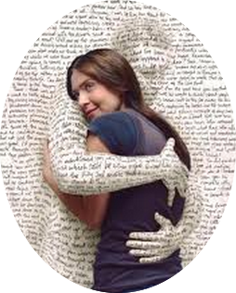







Networked World
2 billion MAU
26.4 billion minutes/day
>777 million trans. (alipay)
200 billion on 11/11
320 million MAU
Peak: 143K tweets/s
350 million users
influencing our daily life
700 million MAU
95 million pics/day
~200 million MAU
70 minutes/user/day
300 million MAU
30 minutes/user/day
QQ: 860 million MAU
WeChat: 1 billion MAU
Notes:
http://www.digitaltrends.com/social-media/facebook-users-50-minutes/#:Tt28J4FGJlT5fA

Slide 3

30 years before…
Web 1.0 = Information Space
  Google’s PageRank
  Kleinberg’s HITS
-
?
+
0.99
?
+
0.99
?
0.80
-
-
+
… …
0.01
L. Page, S. Brin, R. Motwani, & T. Winograd. (1999). The pagerank citation ranking: bringing order to the web. Stanford University.
J. M. Kleinberg. Authoritative sources in a hyperlinked environment. Journal of the ACM (JACM) 46.5 (1999): 604-632.

Slide 4

20 years before…
Web 2.0 = Info Space + Users
Personalized recommendation
Collaborative Filtering
Interaction
P. Resnick, N. Iacovou, M. Suchak, P. Bergstrom, & J. Riedl. (1994). GroupLens: an open architecture for collaborative filtering of netnews. ACM CSCW 1994.

Slide 5


10 years before…
Info. Space + Social Space
Info. Space
Interaction
Social Space
Interaction
J. Scott. (1991, 2000, 2012). Social network analysis: A handbook.
D. Easley and J. Kleinberg. Networks, crowds, and markets: Reasoning about a highly connected world. Cambridge University Press, 2010.

Slide 6
Recently…
Online data are becoming more and more complicated
  Homogeneous->heterogeneous->multiplex heterogeneous
Challenges
Representation
Adaptive
Recommendation
eXplainable Recommendation
Y. Cen, X. Zou, J. Zhang, H. Yang, J. Zhou and J. Tang. Representation Learning for Attributed Multiplex Heterogeneous Network. KDD’19.
Notes:
Meng Qu, Jian Tang, Jingbo Shang, Xiang Ren, Ming Zhang, and Jiawei Han. 2017. An Attention-based Collaboration Framework for Multi-View Network Representation Learning. In CIKM’17. ACM, 1767–1776.

Slide 7
Outline
Representation Learning for Complex Networks
One-shot Online Recommendation
Recommendation with Personalized Description
Conclusion and Q&A

Slide 8
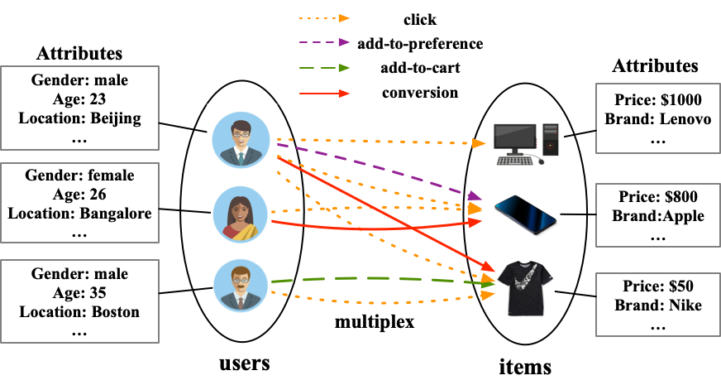
Representation Learning for Multiplex Networks
Multiplex networks comprise not only multi-typed nodes and/or edges but also a rich set of attributes.
How do we deal with the multiplex edges?
Notes:
Given the attributed multiplex network, how do we predict whether a user will click or buy an item? We formalize this problem as a multiplex link prediction problem. How do we solve this problem? Representation learning is a appropriate method to solve this problem.

Slide 9



Review Representation Learning for Networks
d-dimensional vector, d<<|V|
Representation Learning/
Graph Embedding
0.8
0.2
0.3
…
0.0
0.0
Users with the same label are located in the d-dimensional space closer than those with different labels
e.g., node classification
label2
label1

Slide 10
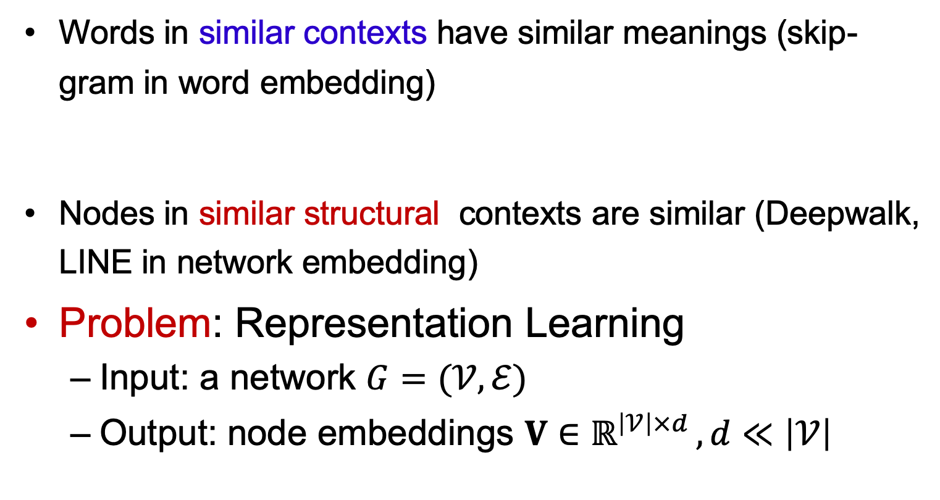
Distributional Hypothesis of Harris
Words in similar contexts have similar meanings (skip-gram in word embedding)
Nodes in similar structural contexts are similar (Deepwalk, LINE in network embedding)
Problem: Representation Learning
  Input: a network $G=(𝒱,ℰ)$
  Output: node embeddings $V∈ℝ^{\left|𝒱\right|×d }, d≪\left|𝒱\right|$
Notes:
As we all know, in skip-gram model, words in similar contexts have similar meanings.
Therefore, migrating the distribution hypothesis in NLP, we have that nodes with similar structural contexts are similar in graphs, and their embedding should be closer.

Slide 11
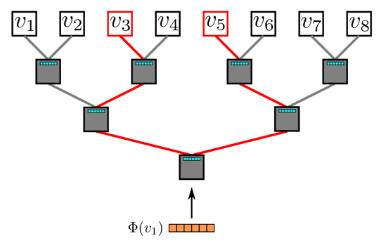
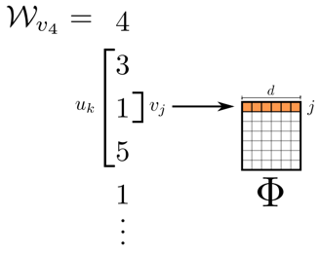
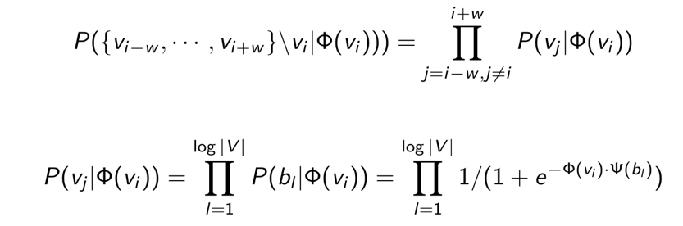
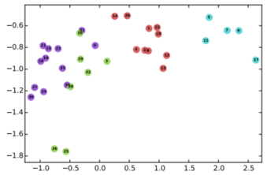
DeepWalk
Random walk
One example RW path
SkipGram with Hierarchical softmax
v₃
v₄
v₄
v₃
v₁
v₅
v₆
v₁
v₅
v₂
v₆
Hierarchical softmax
B. Perozzi, R. Al-Rfou, and S. Skiena. 2014. Deepwalk: Online learning of social representations. KDD, 701–710.

Slide 12
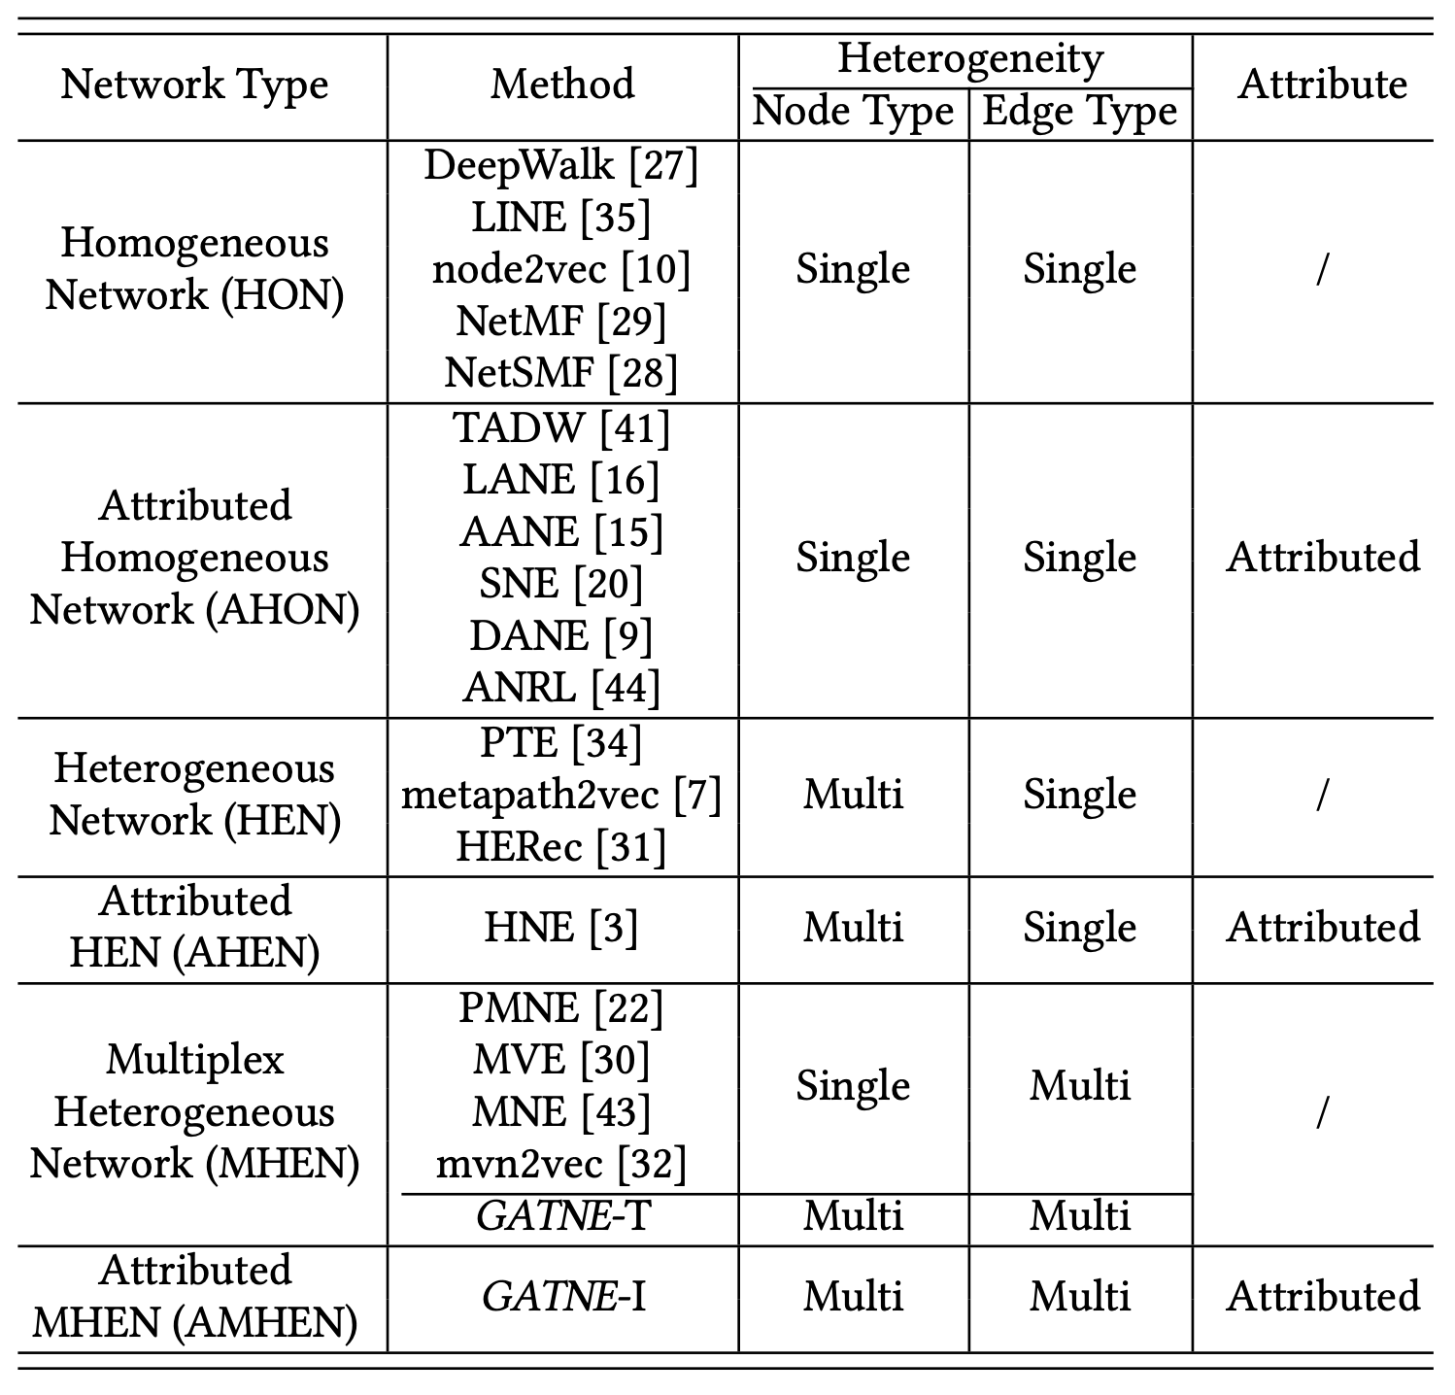
Six Different Network Types
Notes:
There have been tremendous attempts in the literature to investigate embedding learning for complex networks. Depending on the network topology and attributed property, we categorize six different types of networks：HON, AHON, HEN, AHEN, MHEN, AMHEN. As we can seen, among them the AMHEN has been least studied.

Slide 13

Problem: AMHEN Embedding
Input: an attributed multiplex heterogeneous network $G=\left(𝒱,ℰ,𝒜\right), ℰ=∪_{r∈ℛ}ℰ_{r}$ where $ℛ$ indicates the set of different views
Output: vertex embeddings $V^{(1)},…,V^{\left(\left|ℛ\right|\right)}$ for each view
$ℛ$={click, add-to-preference, add-to-cart, conversion}
Notes:
Now, we formalize our problem. Given an attributed multiplex heterogeneous network, the problem is to learn node embeddings for each view. For example, in this e-commerce situation, we need to learn four different embeddings for each node. Node embeddings of click view can do the click prediction.

Slide 14
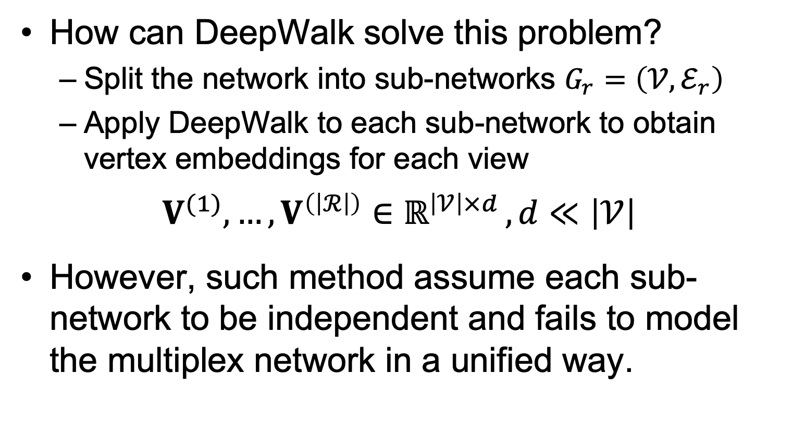
Apply DeepWalk to Multiplex Networks
How can DeepWalk solve this problem?
  Split the network into sub-networks $G_{r}=\left(𝒱,ℰ_{r}\right)$
  Apply DeepWalk to each sub-network to obtain vertex embeddings for each view
$$V^{(1)},…,V^{\left(\left|ℛ\right|\right)}∈ℝ^{\left|𝒱\right|×d }, d≪\left|𝒱\right|$$
However, such method assume each sub-network to be independent and fails to model the multiplex network in a unified way.
Notes:
How does DeepWalk solve this problem? First, we can split the network into sub-networks. Each sub-network contains the edges with the same edge type. For each sub-network, we can apply DeepWalk to obtain node embeddings. However, such method assume each sub-network to be independent and fails to model the multiplex network in a unified way.

Slide 15
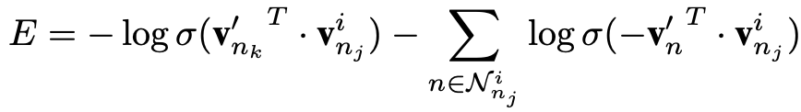
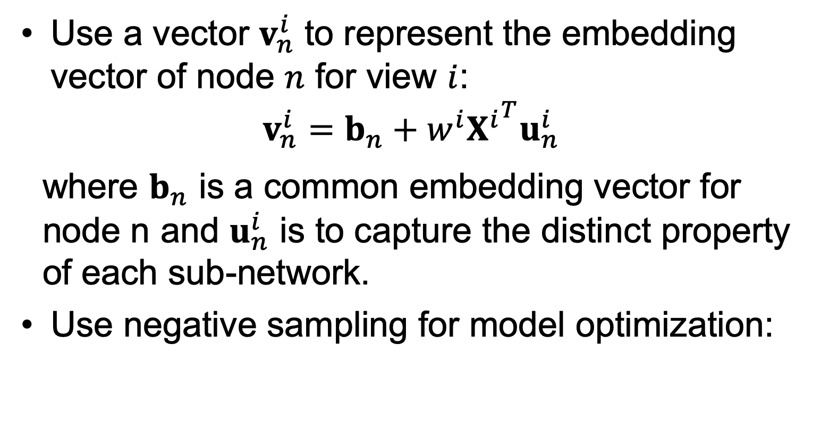
Multiplex Network Embedding^{[1]}
Use a vector $v_{n}^{i}$ to represent the embedding vector of node $n$ for view $i$:
$$v_{n}^{i}=b_{n}+w^{i}{X^{i}}^{T}u_{n}^{i}$$
where $b_{n}$ is a common embedding vector for node n and $u_{n}^{i}$ is to capture the distinct property of each sub-network.
Use negative sampling for model optimization:
Hongming Zhang, Liwei Qiu, Lingling Yi, and Yangqiu Song. Scalable Multiplex Network Embedding. IJCAI’18.
Notes:
One related work is an IJCAI-18 paper aiming for multiplex network embedding. The embedding for each view is calculated from a common embedding and an view-specific embedding for each node. The model optimization uses negative sampling.

Slide 16
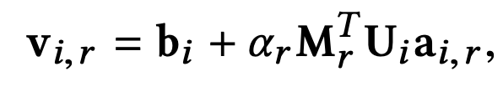
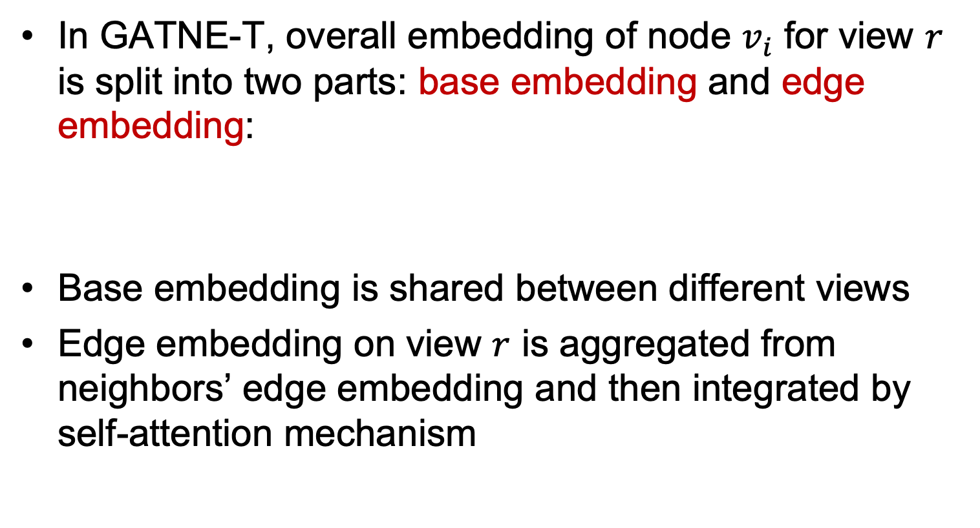
Our Transductive Model: GATNE-T
In GATNE-T, overall embedding of node $v_{i}$ for view $r$ is split into two parts: base embedding and edge embedding:
Base embedding is shared between different views
Edge embedding on view $r$ is aggregated from neighbors’ edge embedding and then integrated by self-attention mechanism
Y. Cen, X. Zou, J. Zhang, H. Yang, J. Zhou and J. Tang. Representation Learning for Attributed Multiplex Heterogeneous Network. KDD’19.
Notes:
In GATNE-T, overall embedding of node $v_{i}$ for view $r$ is split into two parts: base embedding and edge embedding. Base embedding is shared between different views. Edge embedding on view $r$ is aggregated from neighbors’ edge embedding and then integrated by self-attention mechanism.

Slide 17

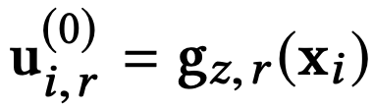

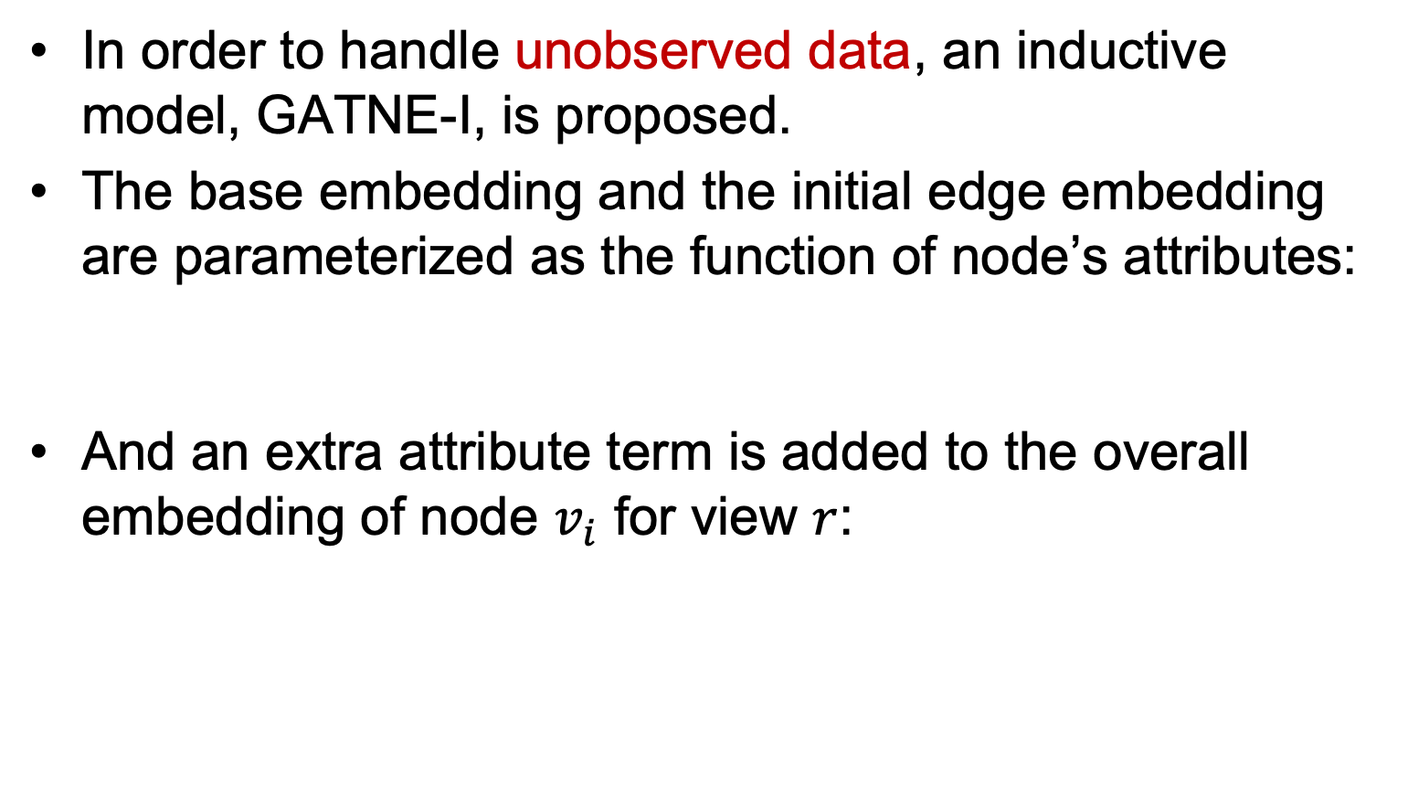
Inductive Model: GATNE-I
In order to handle unobserved data, an inductive model, GATNE-I, is proposed.
The base embedding and the initial edge embedding are parameterized as the function of node’s attributes:
And an extra attribute term is added to the overall embedding of node $v_{i}$ for view $r$:
transformation function from attributes to base embeddings
transformation function from attributes to edge embeddings
Notes:
In order to handle unobserved data, an inductive model, GATNE-I, is proposed. The base embedding and the initial edge embedding are parameterized as the function of node’s attributes. And an extra attribute term is added to the overall embedding of node $v_{i}$ for view $r$, where z represents the node type.

Slide 18
GATNE: Multiplex Heterogeneous Graph Embedding
Y. Cen, X. Zou, J. Zhang, H. Yang, J. Zhou and J. Tang. Representation Learning for Attributed Multiplex Heterogeneous Network. KDD’19.
Notes:
This is the overview of our models. The left part of the figure is to generate overall node embeddings. The base embedding is the common part of the node embeddings for different views. The edge embedding, or view-specific embedding of each node for each view is aggregated from neighbors and other views. The right part of the figure is heterogeneous skip-gram.

Slide 19
Experimental Setting
Task: Link prediction
A validation/test set that contains 5%/10% randomly selected edges respectively and equal number of randomly selected non-edges.
We use the validation set for early stopping and the test set only to report the performance.
Some commonly used evaluation criteria, i.e., ROC-AUC, PR-AUC, and F1 score, are reported in our experiment.
Notes:
Let me clarify our setting of link prediction task. We use a validation/test set that contains 5%/10% randomly selected edges respectively and equal number of randomly selected non-edges. We use the validation set for early stopping and the test set only to report the performance. Some commonly used evaluation criteria, i.e., ROC-AUC, PR-AUC, and F1 score, are reported in our experiment.

Slide 20
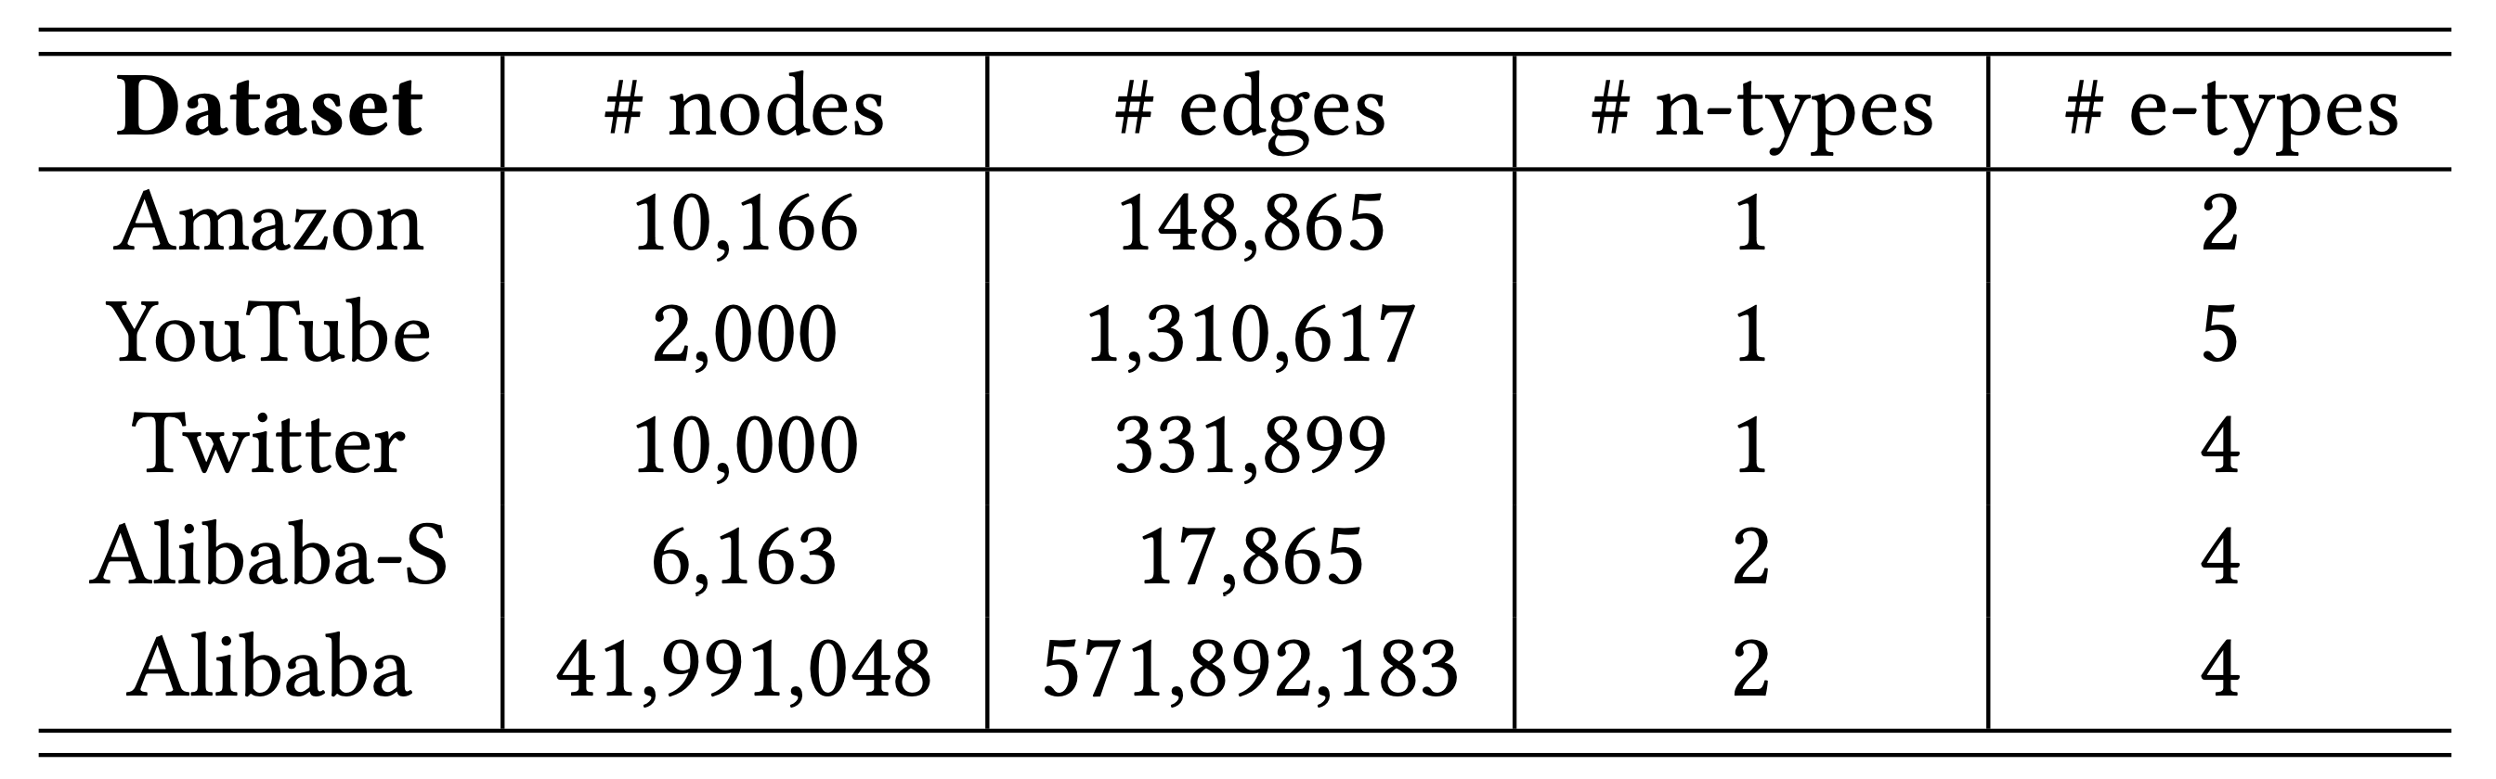
Dataset Statistics
The experiments of first four sampled datasets are conducted on a single Linux server.
The experiment on Alibaba dataset is conducted on Alibaba’s distributed cloud platform.
** Code available at https://github.com/THUDM/GATNE
Notes:
Our experiments include two parts. One is conducted on a single Linux server and the other is on Alibaba’s distributed cloud platform. In the first part of the experiments, we use four sampled datasets, including Amazon, YouTube, Twitter, and Alibaba-S. The statistics of the datasets are listed in the table.

Slide 21
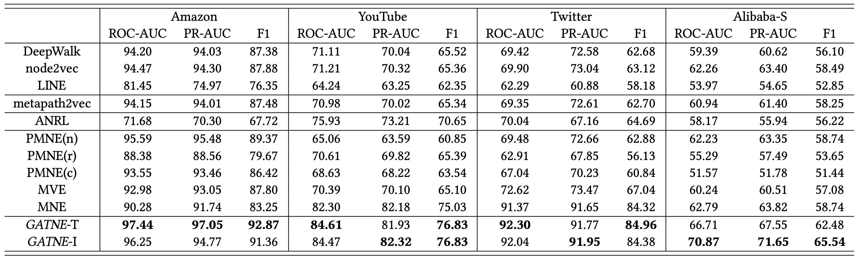
Link Prediction Results
Data
  Small: Amazon, YouTube, Twitter w/ 10K nodes
  Large: Alibaba w/ 40M nodes and 0.5B edges
GATNE outperforms all sorts of baselines in the various datasets.
** Code available at https://github.com/THUDM/GATNE

Slide 22
Experimental Analysis
Notes:
The top left figure is the convergence curve for GATNE models on Alibaba dataset. The inductive model converges faster and achieves better performance than the transductive model. In the top right figure, the training time on Alibaba dataset decreases as the number of workers increases. GATNE-I takes less training time to converge compared with GATNE-T. The figure shows that GATNE is quite scalable on the distributed platform, as the training time decreases significantly when we add up the number of workers. The bottom two figures show the performance of GATNE-T and GATNE-I on Alibaba-S when changing base/edge embedding dimensions exponentially. Overall trend is from underfit to fit and from fit to Overfit with the increase of base/edge embedding dimension.

Slide 23
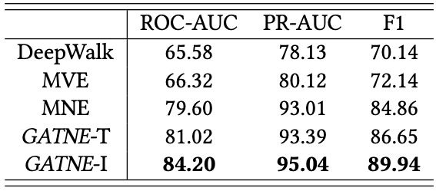
Results on Alibaba Dataset
41,991,048 nodes and 571,892,183 edges
Node types: user, item
Edge types (Views): click, add-to-preference, add-to-cart, and conversion
Notes:
The Alibaba dataset contains 41 million nodes and a half billion edges. We implement DeepWalk, MVE, and MNE in Alibaba Distributed Cloud Platform. As we can see, GATNE-I significantly outperforms GATNE-T and other baselines.

Slide 24
Alibaba Offline A/B Tests
GATNE-I is deployed on Alibaba’s distributed cloud platform for its recommendation system. The training dataset has about 100 million users and 10 million items with 10 billion interactions between them.
Under the framework of A/B tests, an offline test is conducted on GATNE-I, MNE and DeepWalk. The experimental goal is to maximize Hit-Rate. The results demonstrate that GATNE-I improves Hit-Rate by 3.26% and 24.26% compared to MNE and DeepWalk respectively.
Notes:
GATNE-I is deployed on Alibaba’s distributed cloud platform for its recommendation system. The training dataset has about 100 million users and 10 million items with 10 billion interactions between them. Under the framework of A/B tests, an offline test is conducted on GATNE-I, MNE and DeepWalk. The experimental goal is to maximize Hit-Rate. The results demonstrate that GATNE-I improves Hit-Rate by 3.26% and 24.26% compared to MNE and DeepWalk respectively.

Slide 25
Outline
Representation Learning for Complex Networks
One-shot Online Recommendation
Recommendation with Personalized Description
Conclusion and Q&A

Slide 26
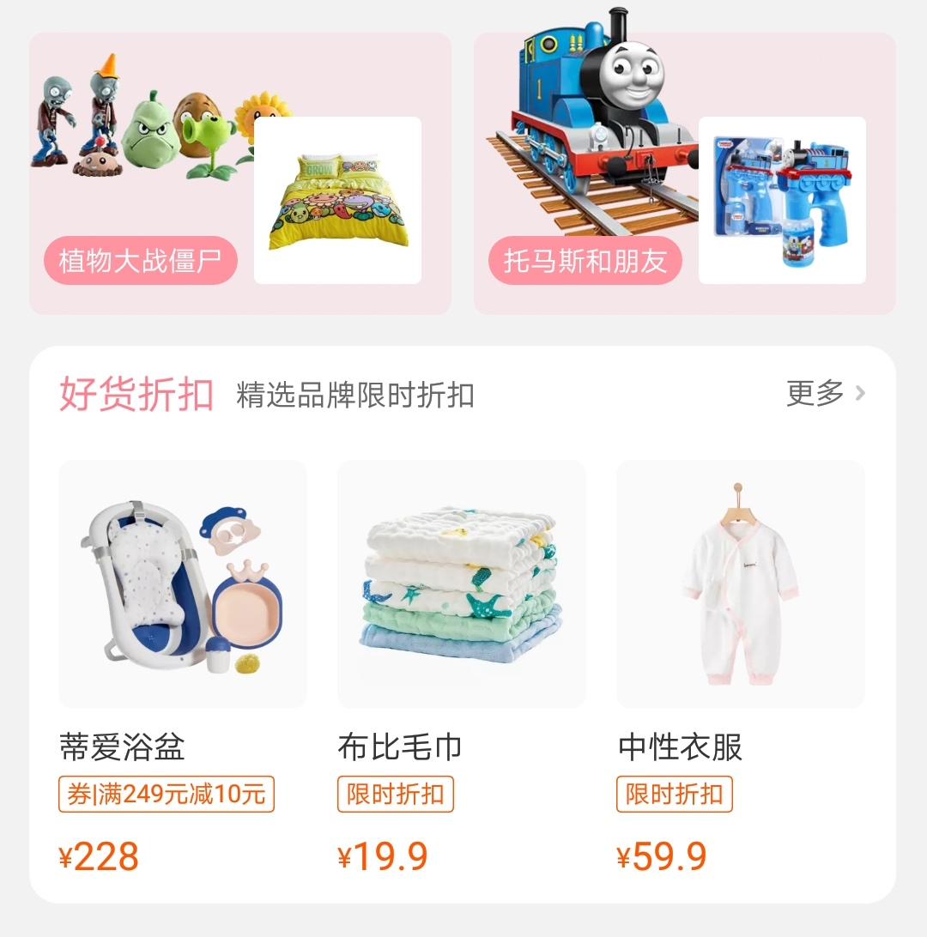

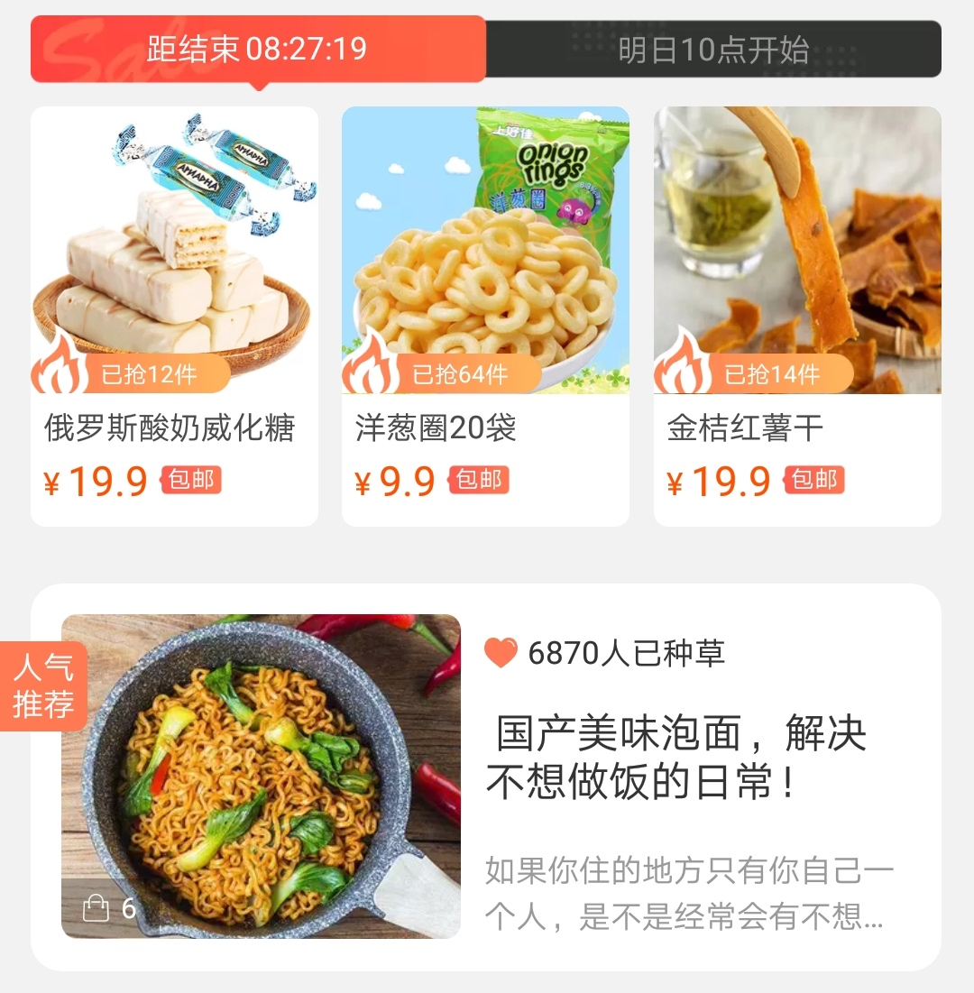

Different Scenarios
Baby
Travel
Food
Notes:
Traditional recommendation algorithms, such as collaborative filtering and content-based recommendation, mainly focus on recommendation on a single context. Nowadays, online recommender systems typically contain many scenarios that recommendations can take place. For example, in the Taobao app, there are various subpages showing item recommendation for different purposes or different promotions, such as the items for new born babies, the destinations for travelling and the take-up foods for lunch. The behavior pattern of the same user might differ significantly in different scenario contexts. For example, during Double 11 promotion, the largest online shopping festival in China, consumers sometimes shop impulsively allured by the low discounts, so they bug many items that they won’t purchase in everyday life. In such scenarios, the contextual information of Double 11 is quite critical.

Slide 27
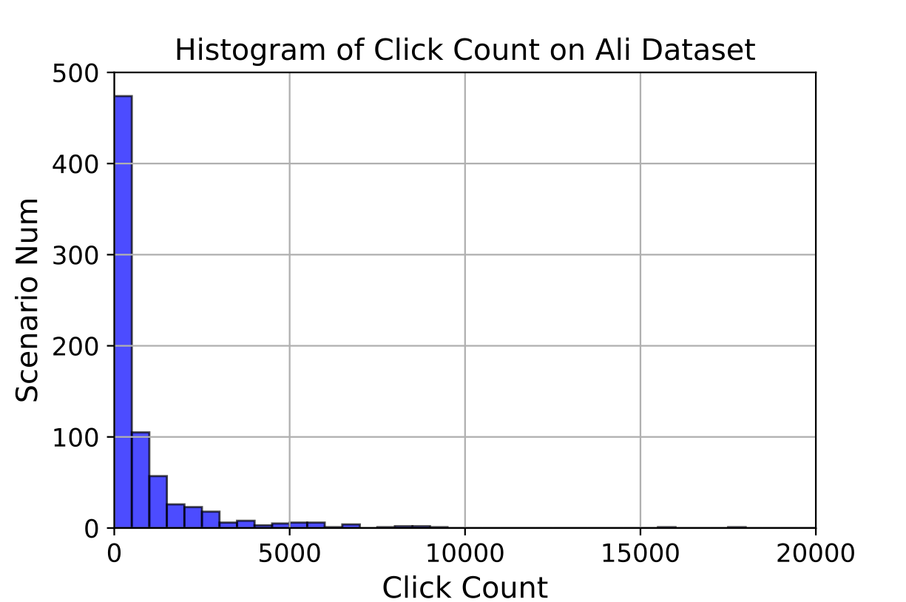
Challenges
Long-tailed scenarios are common in recommender systems
Training recommenders on new scenarios requires great human efforts
Notes:
However, the scenario-aware recommendation problem is not trivial. Firstly, a large portion of scenarios in a system is actually long-tailed, without enough user feedback. Moreover, the life cycle of a scenario can be quite short. In Taobao, most promotions end within a few days or even a few hours after being launched, without enough time to collect sufficient user feedback for training. Most existing recommendation algorithms rely on extensive observed data and are brittle to new scenarios. Secondly, when training a predictive model on a new scenario, the hyperparameters often have a great influence on the performance and optimal hyperparameters in different scenarios may differ significantly. Finding a right combination of hyperparameters usually requires great human efforts along with sufficient computation resources.

Slide 28
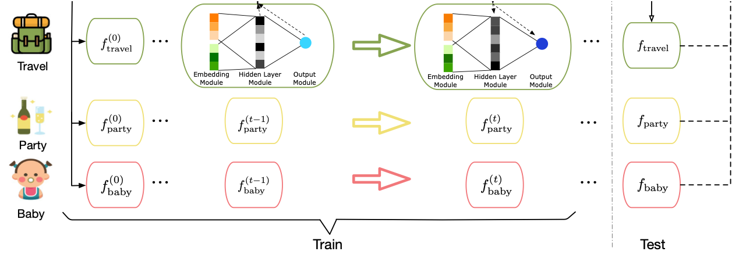
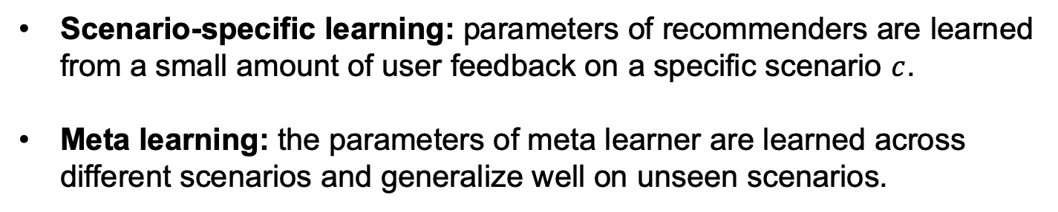
s²Meta: Sequential Sce-Spec Meta Learner
Scenario-specific learning: parameters of recommenders are learned from a small amount of user feedback on a specific scenario $c$.
Meta learning: the parameters of meta learner are learned across different scenarios and generalize well on unseen scenarios.
Z. Du, X. Wang, H. Yang, J. Zhou and J. Tang. Sequential Scenario-Specific Meta Learner for Online Recommendation. KDD’19.
Notes:
To tackle these challenges, we propose a framework that consists of two learning levels. The first level is the scenario-specific learning. On a specific scenario, parameters of recommenders are learned from a small amount of user feedback according to the policy of meta learner. The meta learner is based on neural networks and its policy is dependent on its parameters The second level is the meta learning. The parameters of the meta learner are learned across different scenarios to get generalization capacity on unseen scenarios.

Slide 29
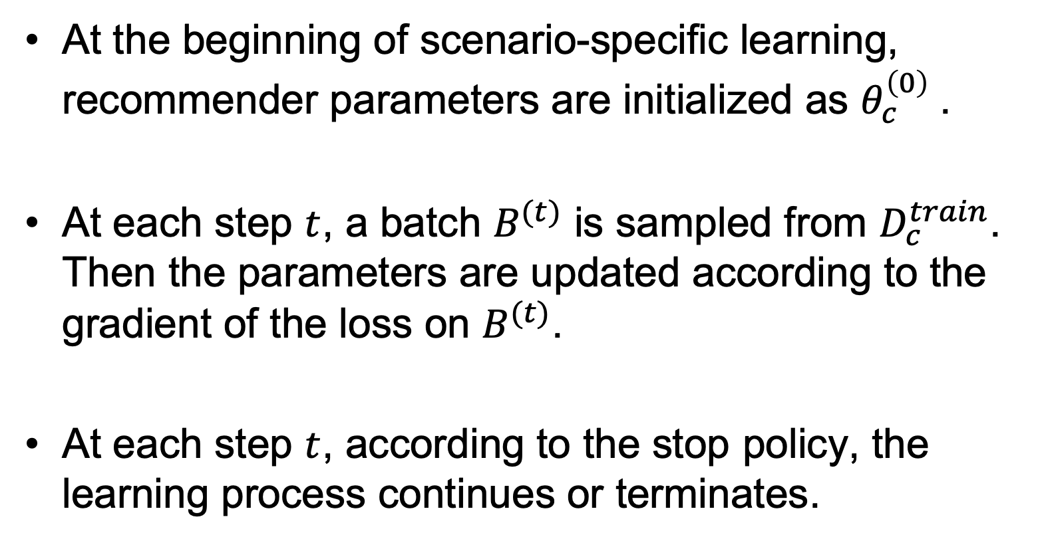
Learning as a Sequential Process
At the beginning of scenario-specific learning, recommender parameters are initialized as $θ_{c}^{\left(0\right)}$.
At each step $t$, a batch $B^{(t)}$ is sampled from $D_{c}^{train}$. Then the parameters are updated according to the gradient of the loss on $B^{(t)}$.
At each step $t$, according to the stop policy, the learning process continues or terminates.
Notes:
We analyze the traditional machine learning process controlled by human experts and model the scenario-specific learning as a sequential process. At the beginning the parameters of recommender are initialized.Then at each step, a batch is sampled from the training set and the loss on the batch is computed. The parameters of the model is updated according to the gradient of the loss. At each step, the learning process either continues or terminates according to some stop policy, e.x. early stopping.

Slide 30
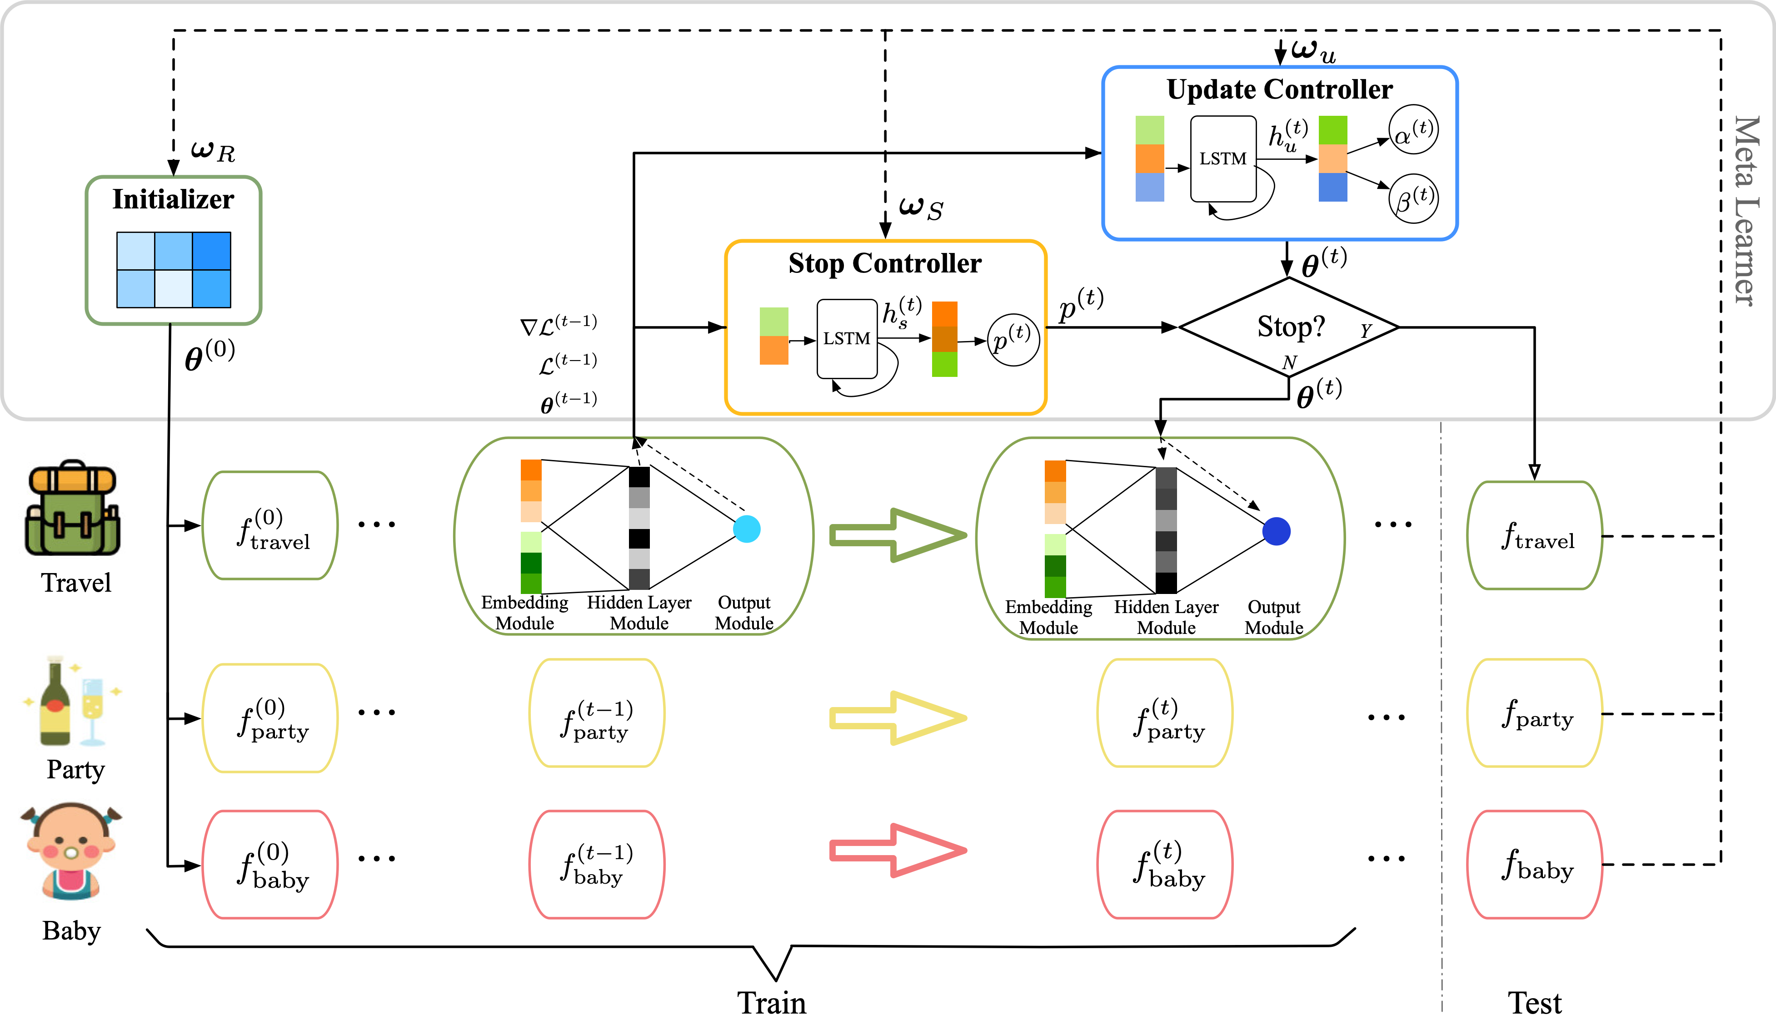
s²Meta: Sequential Sce-Spec Meta Learner
Meta learning
Sce-spec learning
Z. Du, X. Wang, H. Yang, J. Zhou and J. Tang. Sequential Scenario-Specific Meta Learner for Online Recommendation. KDD’19.
Notes:
The meta learner plays a key role in our framework.Corresonding to the sequential scenario-specific learning process, the meta learner consists of three parts. The initializer automatically initializes the recommender to be broadly suitable to many scenarios. The update controller finetunes its parameters with flexible updating strategy.And the stop controller stops learning timely to avoid overfitting.

Slide 31
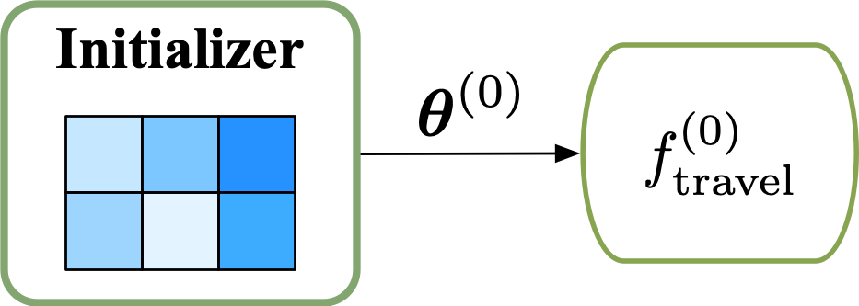
Global Parameter Initialization
Following MAML¹, we initialize the recommender parameters from a global initial values shared across different scenarios.
Notes:
The first part is the parameter initialization.
Traditionally, the parameters of a neural network are initialized by randomly sampling from a normal distribution or uniform distribution.
However, updating the parameters from a random state requires many iterations and large amounts of training instances. This can also lead to overfitting.
Instead, we initialize the parameters from a global initial value. The global value is optimized across many ifferent scenarios. It might not perform well on a specific scenarios, but can be quickly adapted to a new scenario with a few steps of update on a small dataset.

Slide 32
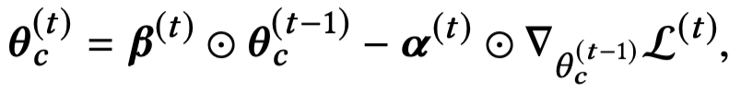
Few-shot based Update Strategy
We implement a more flexible update strategy than hand-crafted optimizers:
Notes:
Traditionally, parameters of neural networks are updated with SGD and its variations.
Handcrafted update algorithms do not apply to all the scenarios
hyperparameters matter with limited update steps

Slide 33
Stop Policy
The early-stop strategy is not proper for small datasets.
A stochastic policy is learned to decide whether to stop based on previous loss and gradient scales.
Notes:
Traditionally, the learning process is controlled by the early-stopping. So we divide a validation set from the training set. When the performance on the validation set begins to drop, the learning process is stopped. However, this is not practical since we are working with small training sets.
Another method is to only train for a fixed number of steps. We could tune the step number as a hyperparameter with a meta-validation set. However,the complexity of learning on different scenarios might be different and a fixed step number is not optimal for all the scenarios.
Instead, we use a stochastic, dynamic policy to decide the number of training steps. At each step, the stop controller predicts the stop probability p_t and randomly choose to stop or not according to the probability.The stop controller is an LSTM whose input is the current loss and the norm of current gradient. p_t is predicted according to the current hidden state of LSTM.

Slide 34
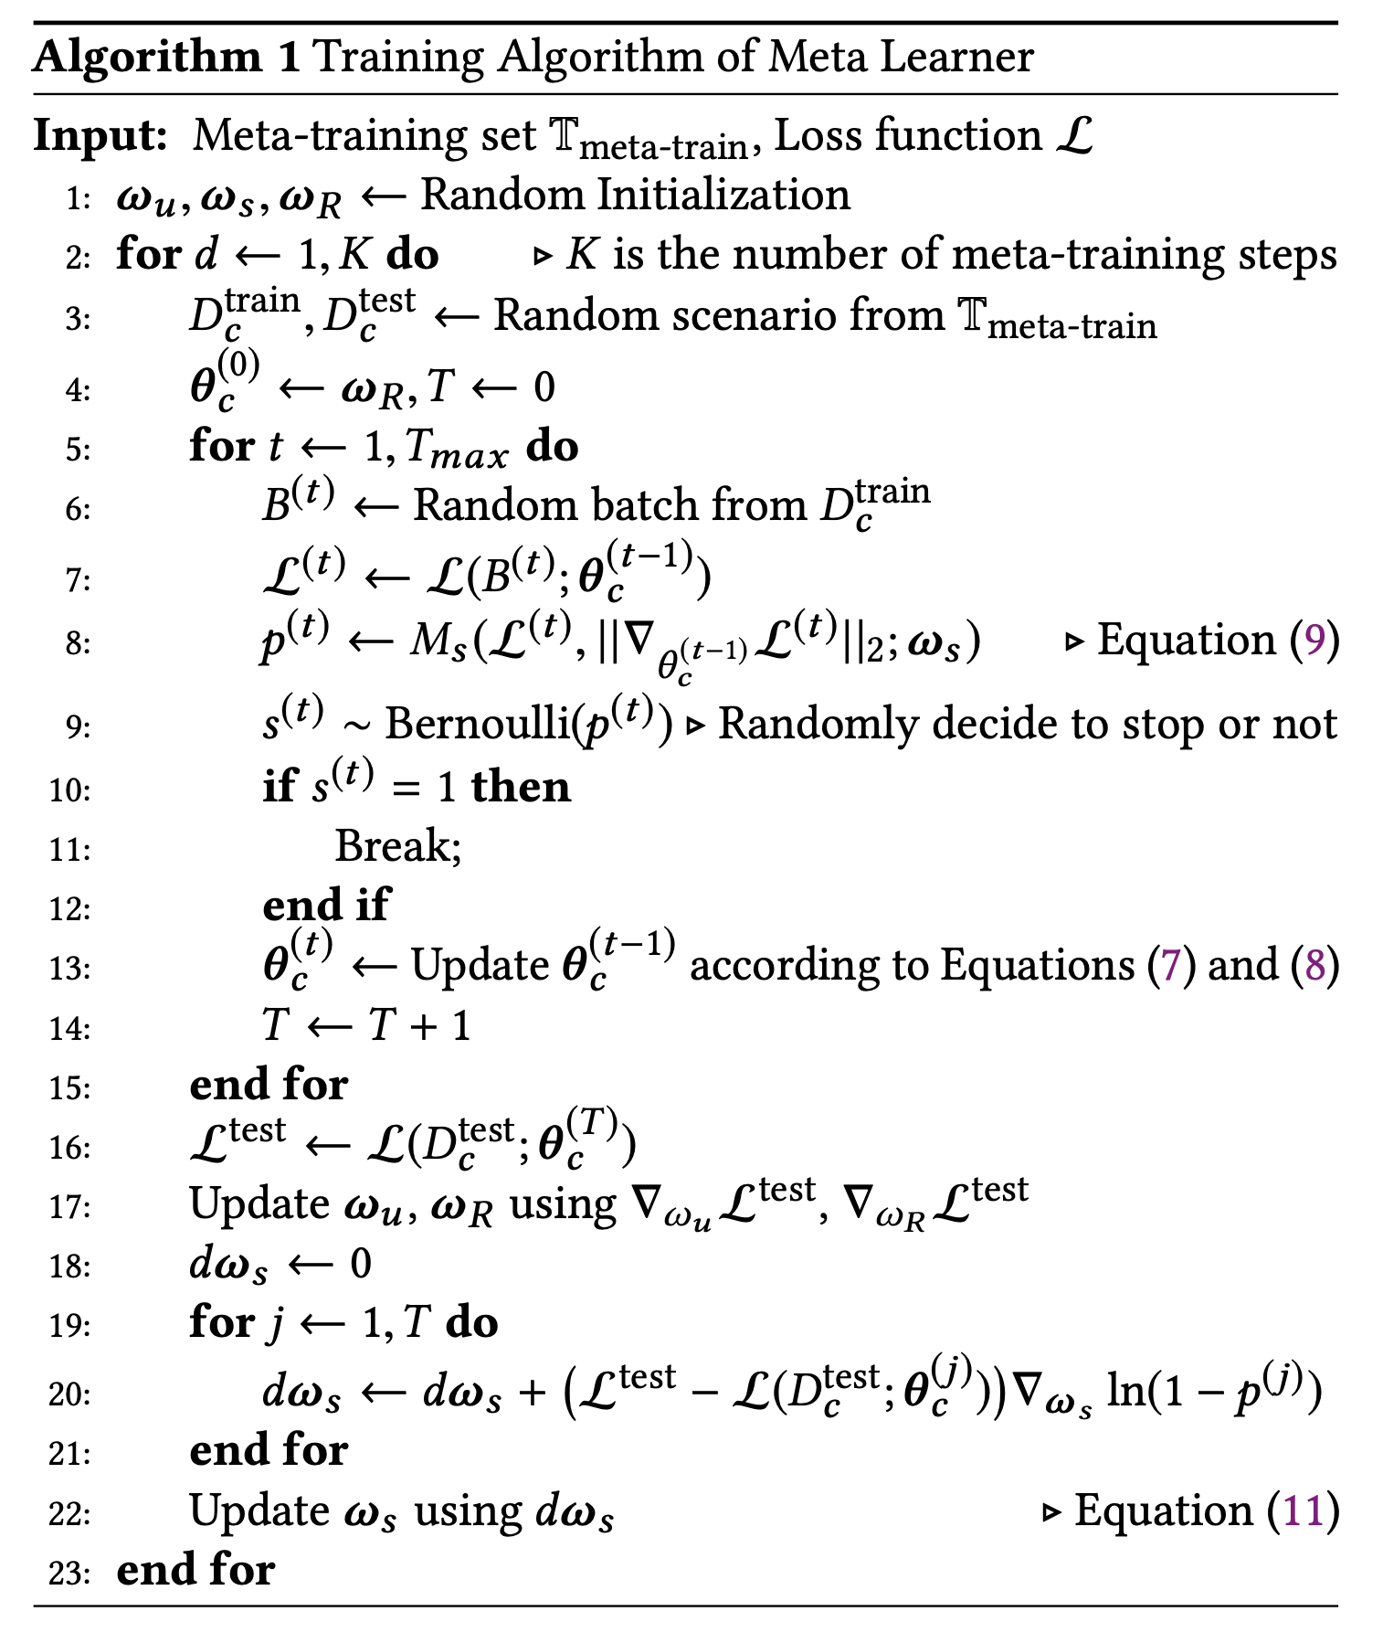
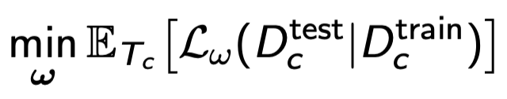
Learning Algorithm
a set of training tasks (scenarios)
Optimize w by
stop controller are updated with policy gradient

Slide 35
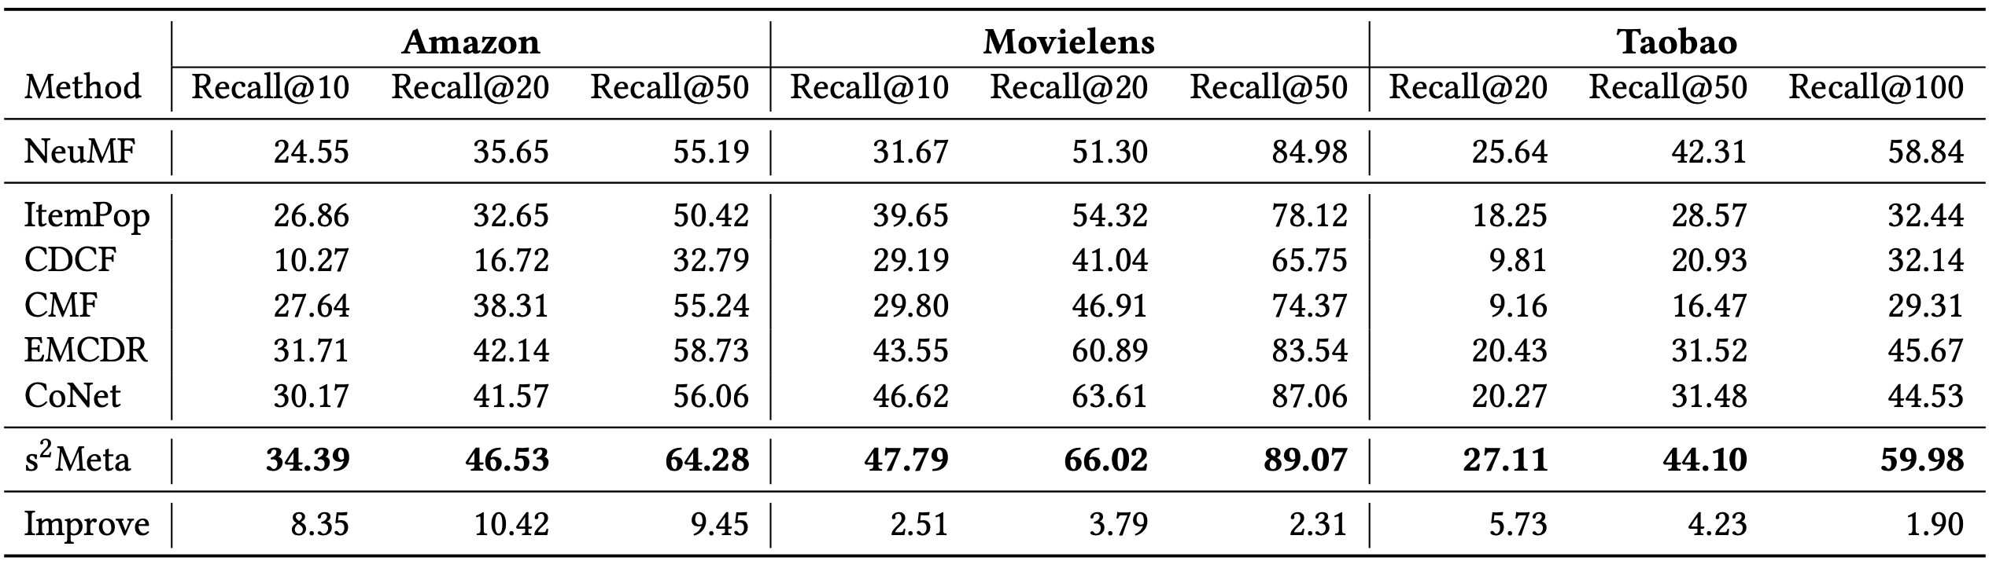
Evaluation
Data
  two public datasets
  one large-scale scenario-based dataset, https://tianchi.aliyun.com/dataset/dataDetail?dataId=9716
Comparison methods: state-of-the-art item recommendation methods for both general setting and cross-domain setting.
** Code available at https://github.com/THUDM/ScenarioMeta
Notes:
We conduct extensive experiments on several datasets. We use two public datasets well-known for item recommendation, the Amazon Review dataset and Movielens dataset. We also use a large-sacle scenario-based dataset built from the Taobao App. This dataset is also made public available. For baselines, we select the state-of-the-art baseline in general item recommendation. We also compare our method with various cross-domain recommendation methods, to evaluate the ablity to transfer knowledge across different scenarios.

Slide 36
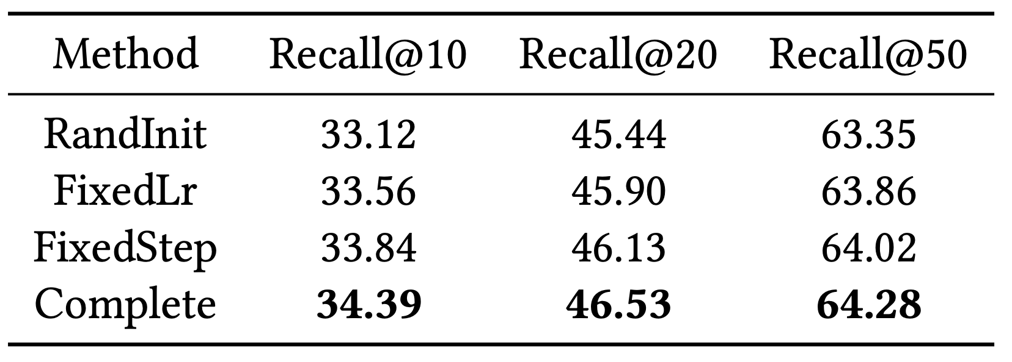
Ablation Study
We remove the initializer, update controller and stop controller respectively.
Random initialization hurts the performance most. The effect of removing stop controller is relatively small.
** Code available at https://github.com/THUDM/ScenarioMeta
Notes:
We also conduct ablation study on the Amazon dataset, to evaluate the contribution of different parts. Here we remove the three parts of ml …., and evaluate the variations’ performance. From the resutls, we can see that, replacing the ini … most. With limited traininig data, the random initili -> overfitting. The influcence of removing stop controller is least. as its function can be partly replaced by the update controller.

Slide 37
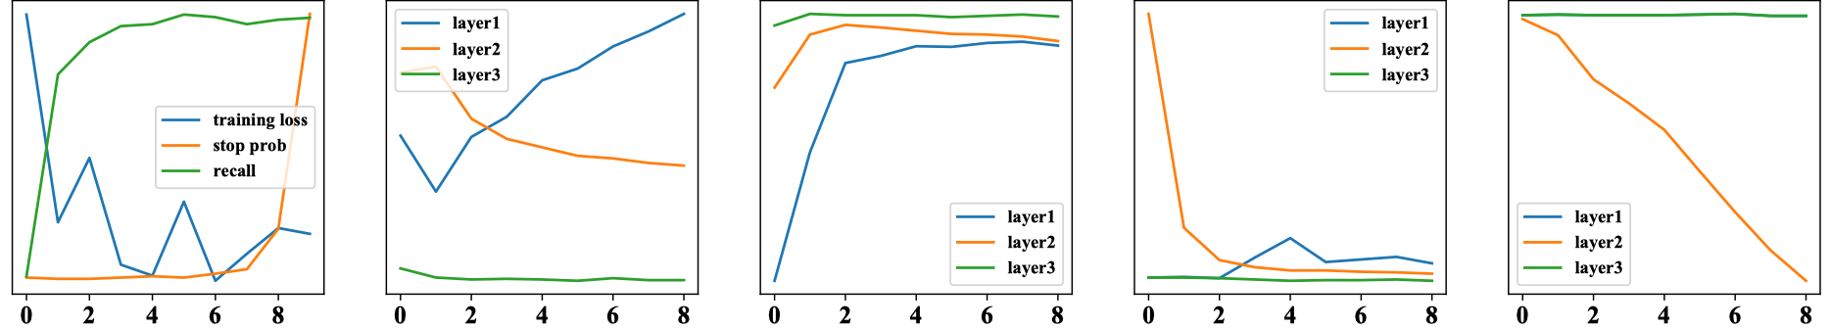
Case Study
performance
input gates(w)
forget gates(w)
input gates(b)
forget gates(b)
As the training loss ceases to drop, the stop probability rises dramatically, leading to termination of the learning process.
The strategy might help to quickly adjust the parameters by updating a part of the parameters at a time.
Notes:
We also conduct a case study to analyze the learning process the meta learner learned automatically. We select a normal scenario on Amazon and visualize its learning process. The leftmost figure is the training loss, stop probability and Recall@10 on test set at every training step. We can see that as the … This shows that the policy learned by stop controller can stops the learning when the training loss is stable. The other four figures show the input gates and forget gates of weight matrices and bias vectors in different layers. We can see that for the last hidden layer, its parameters remain stable. The parameters of the first two layers are updated in different stages. In the first half of the training process, the input gate of the second layer is high, representing that the parameters are quickly updated.

Slide 38
Outline
Representation Learning for Complex Networks
One-shot Online Recommendation
Recommendation with Personalized Description
Conclusion and Q&A

Slide 39




Recommendation Scenario
User
Product
Product Description
Notes:
In online stores, how do people do this? Typically, people will communicate less often.
They read textual descriptions by themselves, and maybe also have a look at the images.
And online salesmen mainly provide assistance, instead of introducing product information and promoting sales.
不同的在线上购物中，用户对某个商品的了解是通过点击商品之后，阅读商品的描述文本以及看商品图实现的。这些商品描述主要是卖家预先写好的，相比线下的销售员，有很大的局限

Slide 40

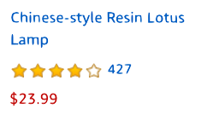
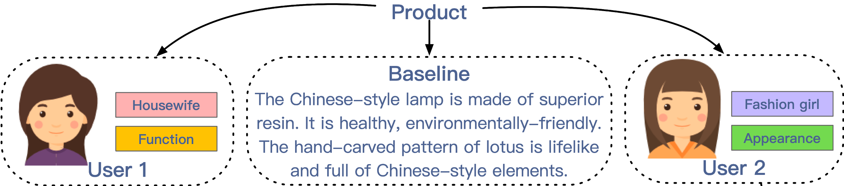
Recommendation– Different Users
Notes:
Suppose we have two users
举个例子，假设我们有两个不同的用户点击了同一个商品。
第一位用户是个家庭主妇，且更注重实用性；第二位用户更加年轻，并且更加注重外观。
我们发现不同的人对这些特点有不同的偏好，但我们总是对用户呈现固定的描述。

Slide 41
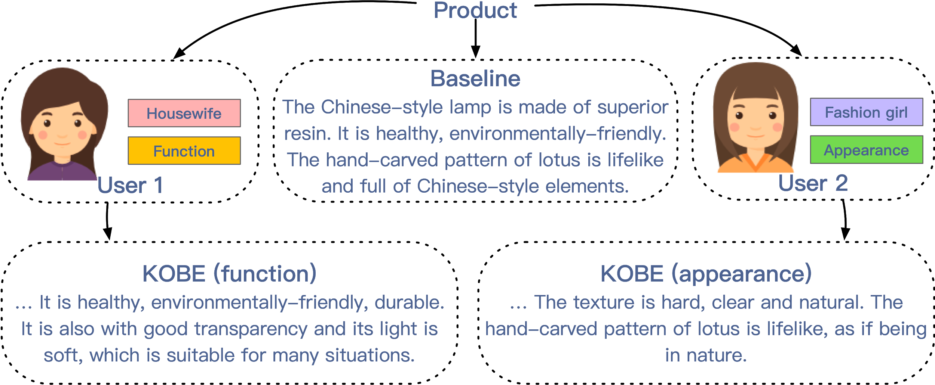
Recommendation– Different Users
Personalized Product Descriptions!
Notes:
于是我们认为应该给用户提供个性化的商品描述。

Slide 42
Recommendation– Different Users
Can we automatically generating product descriptions with personalized, diverse, and informative content?
Personalized Product Descriptions!
Notes:
于是我们认为应该给用户提供个性化的商品描述。

Slide 43
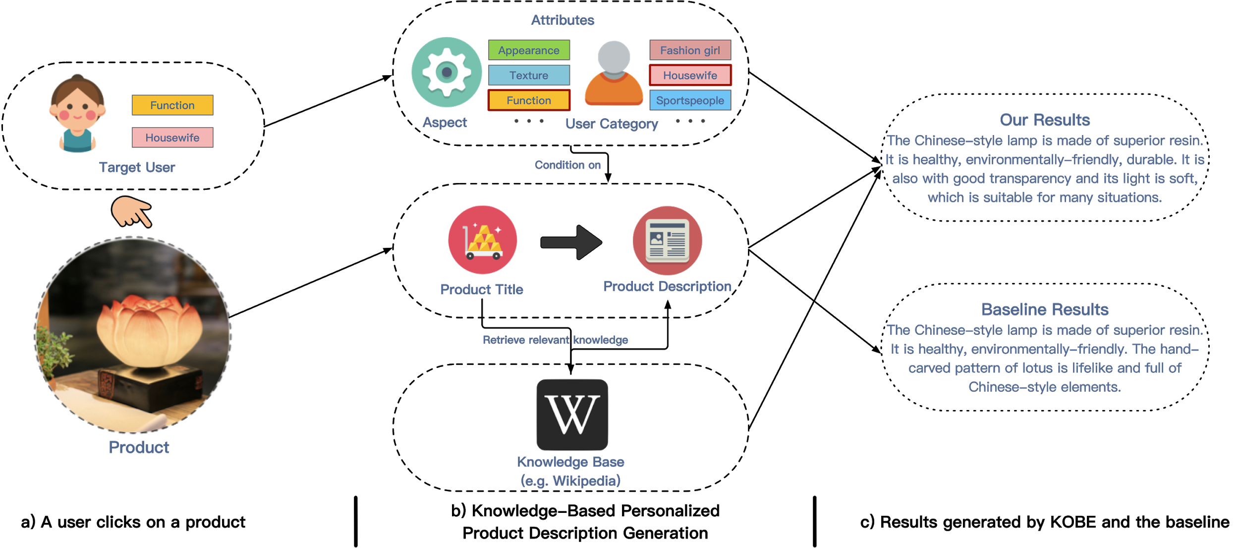
KOBE: KnOwledge Based pErsonalized product description generation model
Q. Chen, J. Lin, Y. Zhang, H. Yang, J. Zhou and J. Tang. Towards Knowledge-Based Personalized Product Description Generation in E-commerce. KDD’19.
Notes:
Overall, our model is based on a seq2seq framework. It auto-regressively predicts the next token, based on these inputs.
To achieve personalization, we take the desired control information as input and build a conditional seq2seq framework.
To make the descriptions informative and diverse, we incorporate knowledge from external knowledge bases.
KOBE generate a product description, given 1) the product title, 2) the desired product aspect and user category and 3) the relevant knowledge retrieved from an existing knowledge base.

Slide 44
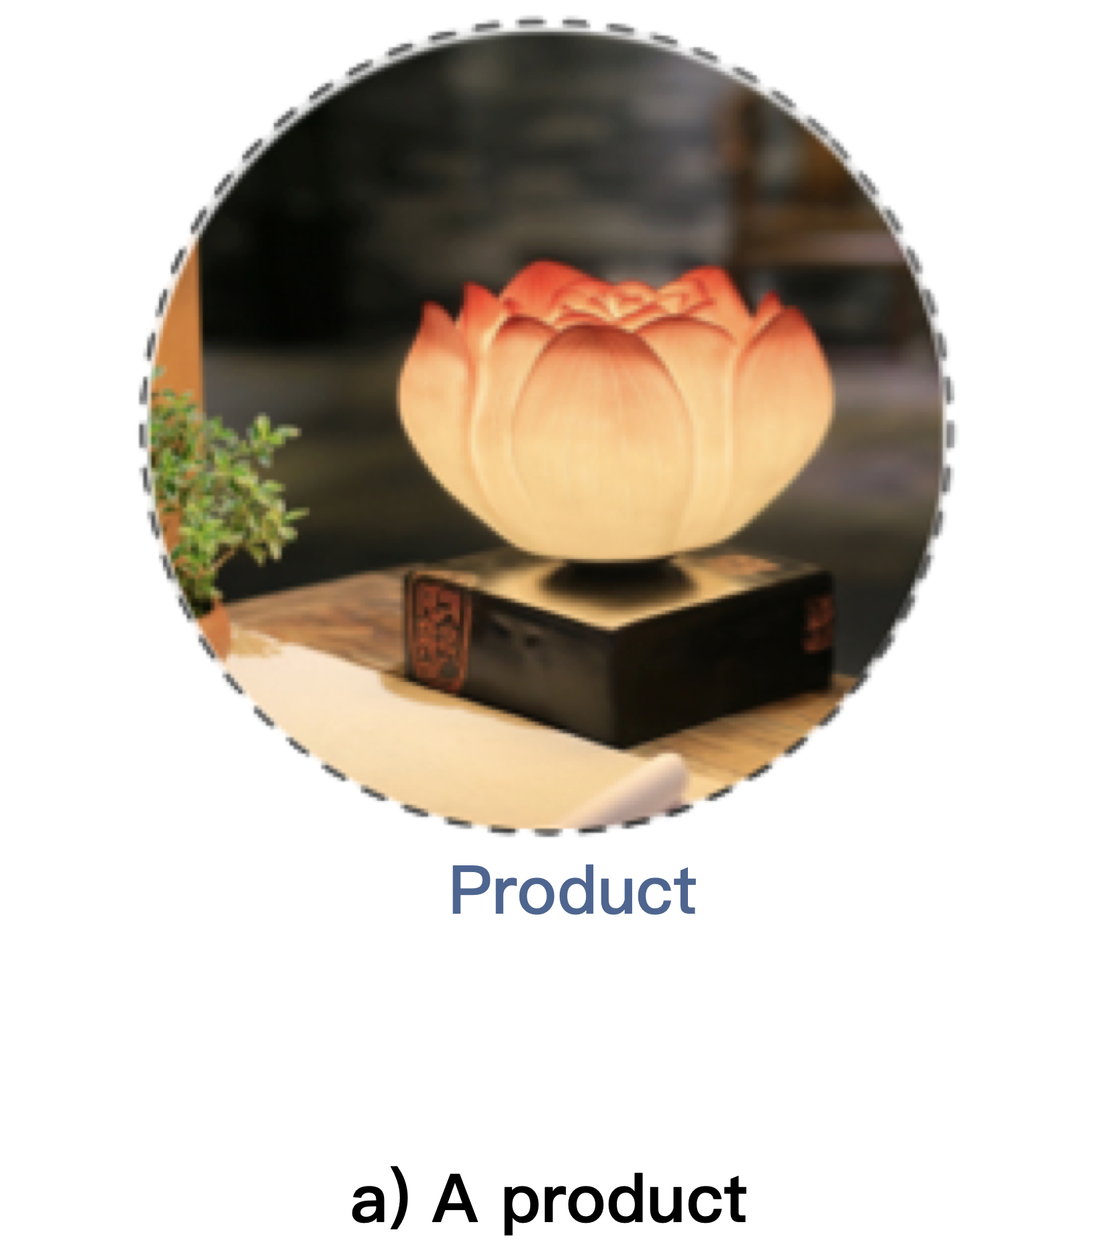
Given a product…
Notes:
Now we build our model KOBE step by step.
Let’s start with a product. Given a product, How to automatically generate its descriptions?

Slide 45
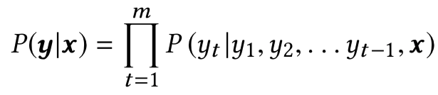
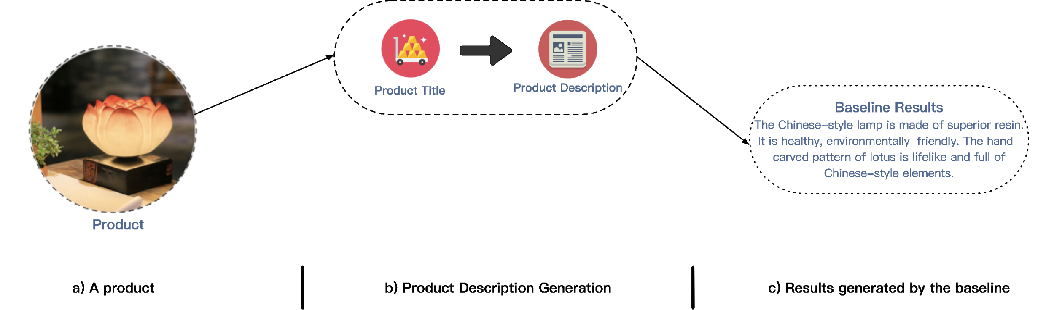
KOBE – Seq2seq Baseline
Notes:
First, given this product, we learn how to generate the description for it.
You may have seen this equation, the sequence to sequence framework. We build our model on this framework to generate description from product title.

Slide 46
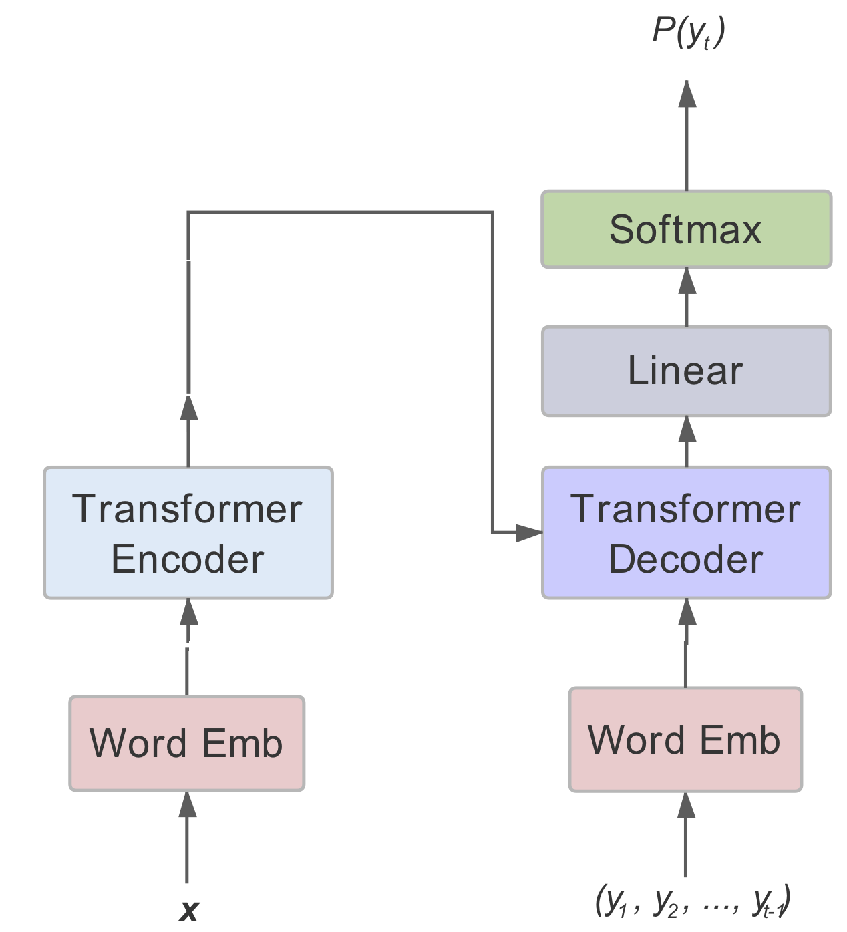
KOBE – Seq2seq Baseline
Notes:
First, given this product, we learn how to generate the description for it.
You may have seen this equation, the sequence to sequence framework. We build our model on this framework to generate description from product title.

Slide 47
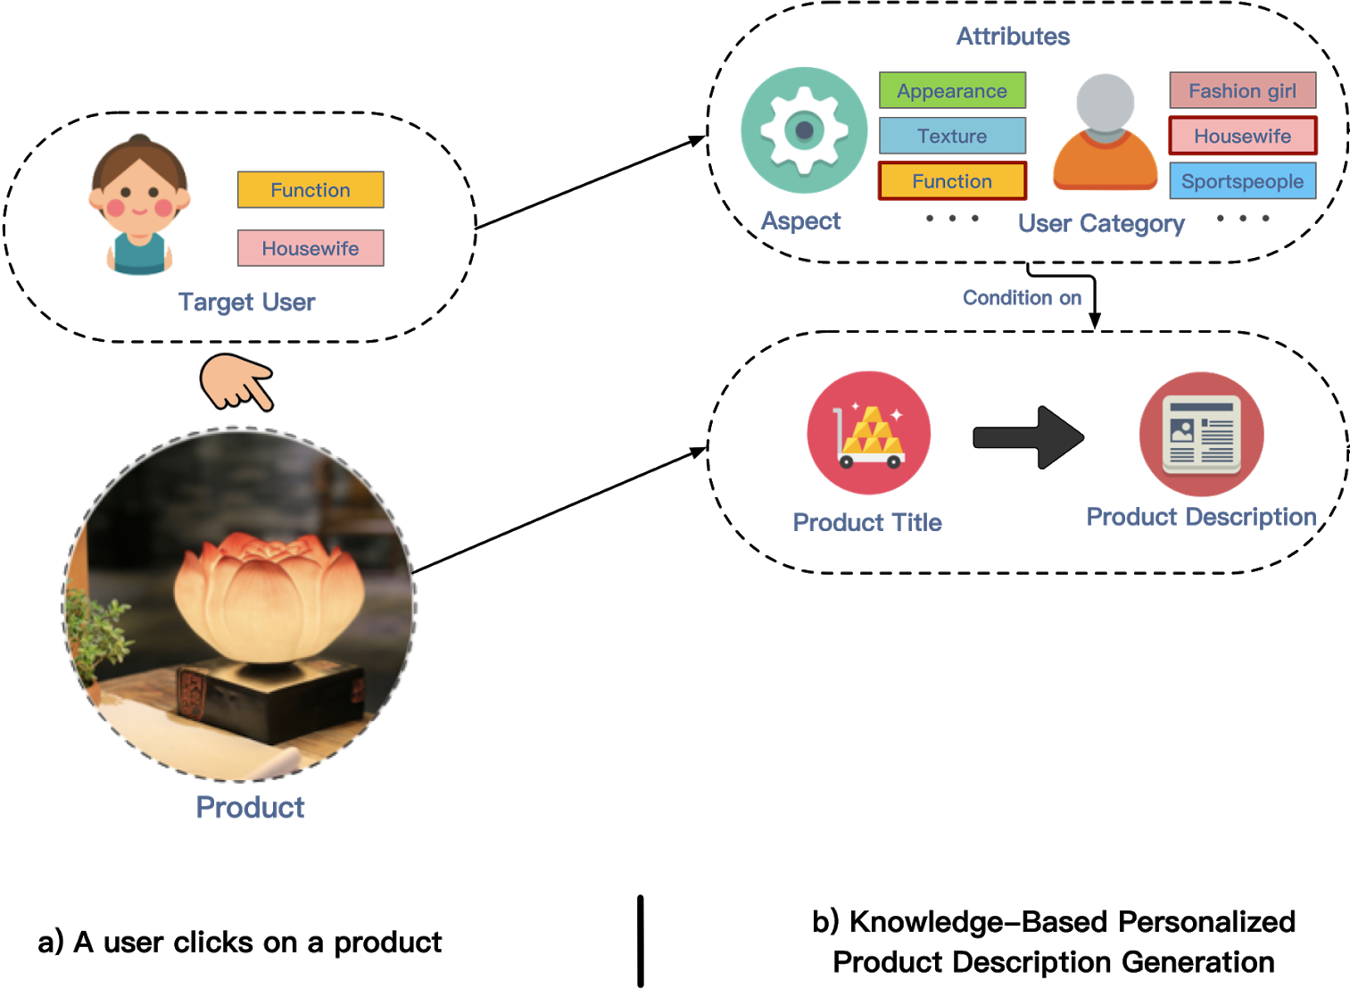
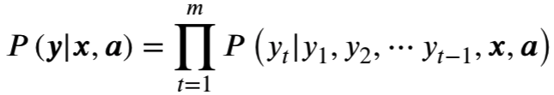
KOBE – Attribute Fusion
Notes:
Secondly, we take the user into consideration.
Given the user preferences, like `geek` or `artist`, we called them attributes. We condition our model on these attributes

Slide 48
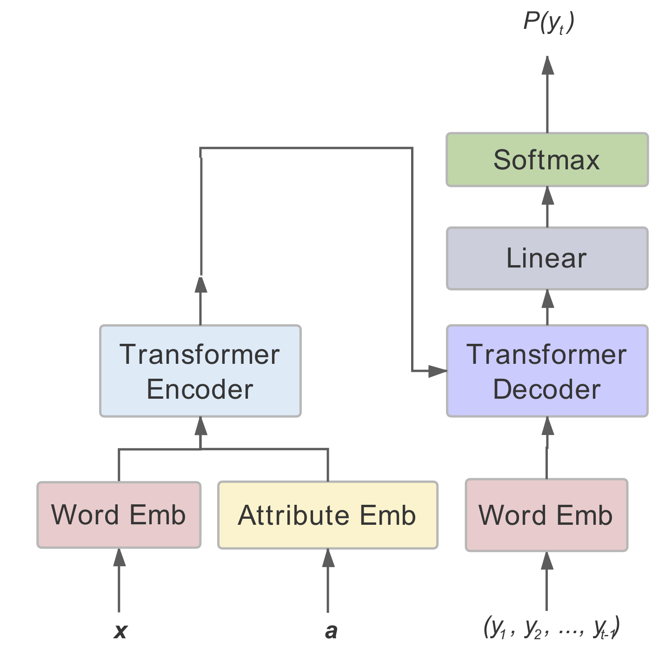
KOBE – Attribute Fusion
Notes:
Here we show how to add attributes as control information. We tried representing the attributes as tokens and concatenate them to the input sequence. We also tried to use different <start of sequence> symbols for different attributes. But we found out adding the embeddings to the token embeddings performs best.

Slide 49
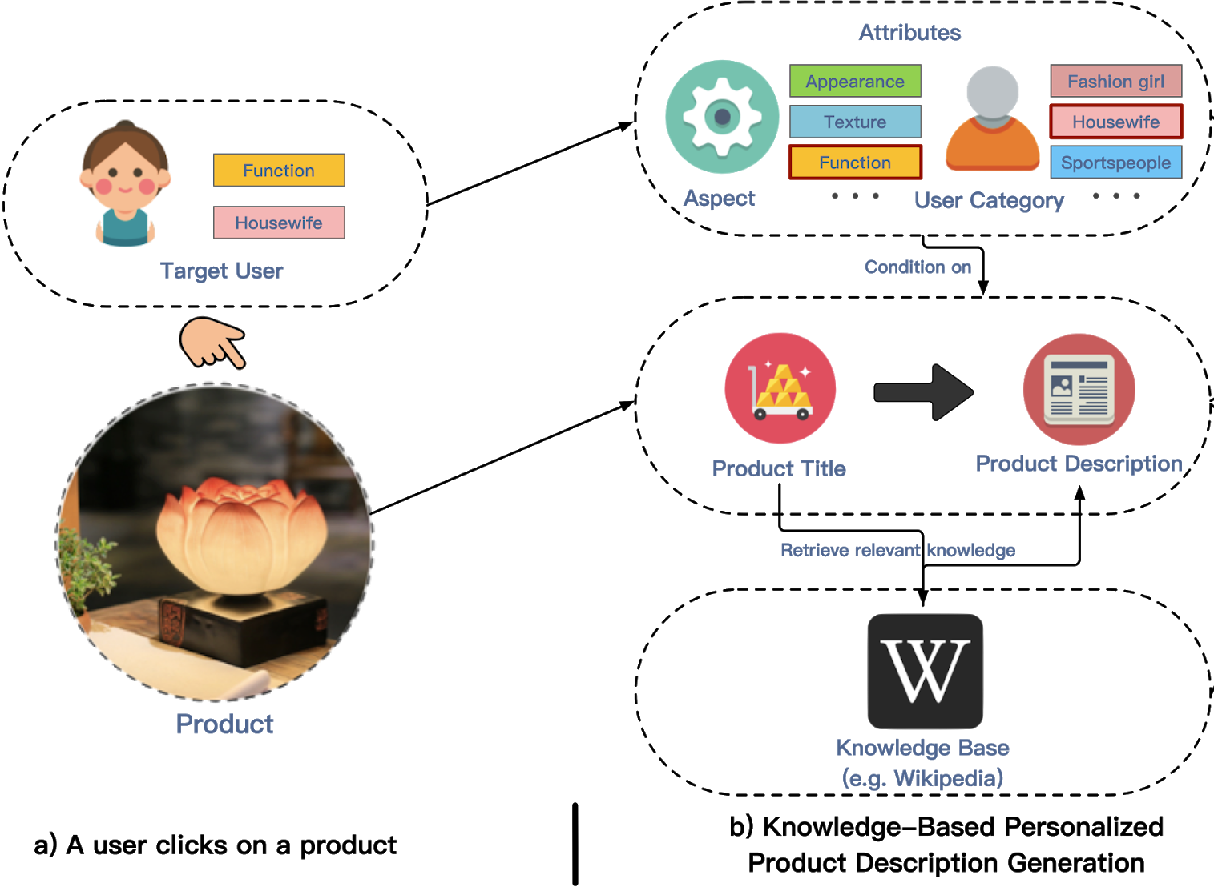
KOBE – Knowledge Incorporation
BiDAF (Bidirectional Attention Flow)
Notes:
Thirdly, to generate product descriptions, we need actual knowledge about the products.
The model will need to memorize all the facts about products, how things work, to generate a description.
To reduce this burden for the model, we retrieve knowledge of the product from a knowledge base and provide them as additional input to the model.
% To give an insight on why this happens, compare this to machine translation.
In translation, there is a limited connection between the two languages. The vocabulary is fixed. The grammar is easy to learn. And we can guess the meaning of an unseen sentence in English pretty well.

Slide 50
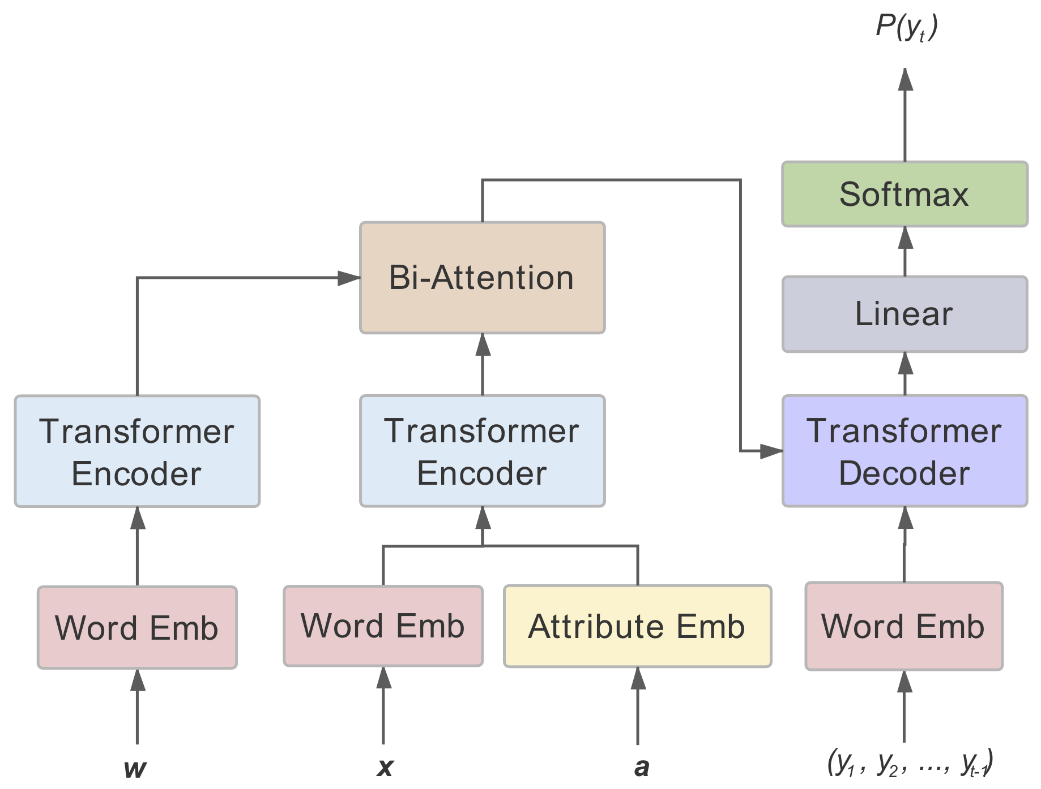
KOBE – Knowledge Incorporation
Notes:
To incorporate knowledge into our model, we first retrieve relevant knowledge from a knowledge base called CN-dbpedia by matching the product title and get $w$. But, different types of knowledge should be considered to have different importance and so does the product title. So we adopt a bi-directional attention mechanism and combine the knowledge in this way.

Slide 51
KOBE: KnOwledge Based pErsonalized product description generation model
Q. Chen, J. Lin, Y. Zhang, H. Yang, J. Zhou and J. Tang. Towards Knowledge-Based Personalized Product Description Generation in E-commerce. KDD’19.
Notes:
Overall, our model is based on a seq2seq framework. It auto-regressively predicts the next token, based on these inputs.
To achieve personalization, we take the desired control information as input and build a conditional seq2seq framework.
To make the descriptions informative and diverse, we incorporate knowledge from external knowledge bases.
KOBE generate a product description, given 1) the product title, 2) the desired product aspect and user category and 3) the relevant knowledge retrieved from an existing knowledge base.

Slide 52
Evaluation
Evaluation is also challenging…
  No ground-truth
TaoDescribe
  We have created a new benchmark!
  over 2,000,000 products and their descriptions
  composed by the sellers and content producers on TaoBao from 11/2013 to 12/2018
  Data format (product title, product description, attributes, knowledge)
** All Data and Code available at https://github.com/THUDM/KOBE/
Notes:
Now the experiments part.
We created and open-sourced a dataset called TaoDescribe, containing over 2 million products and their descriptions written by humans.

Slide 53
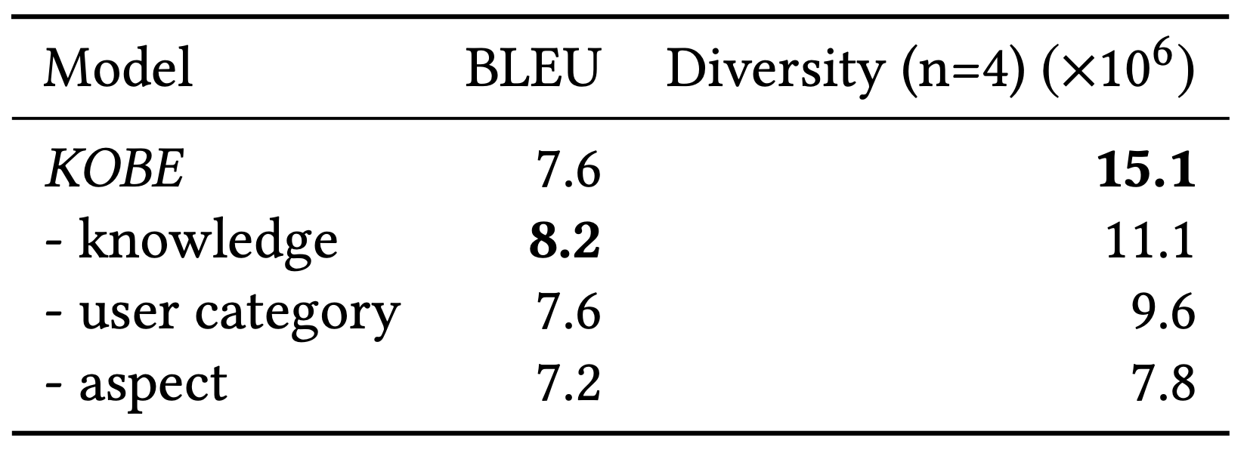
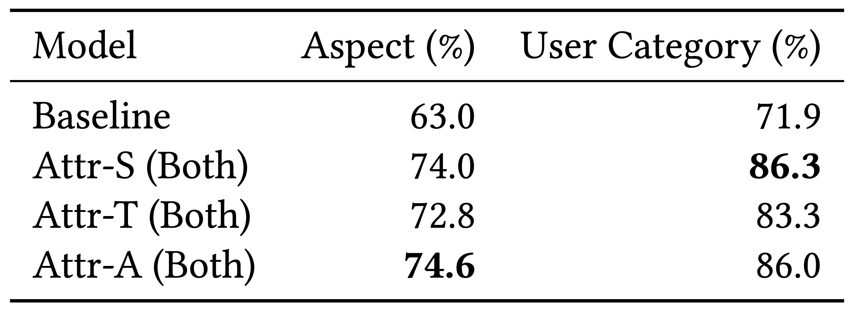
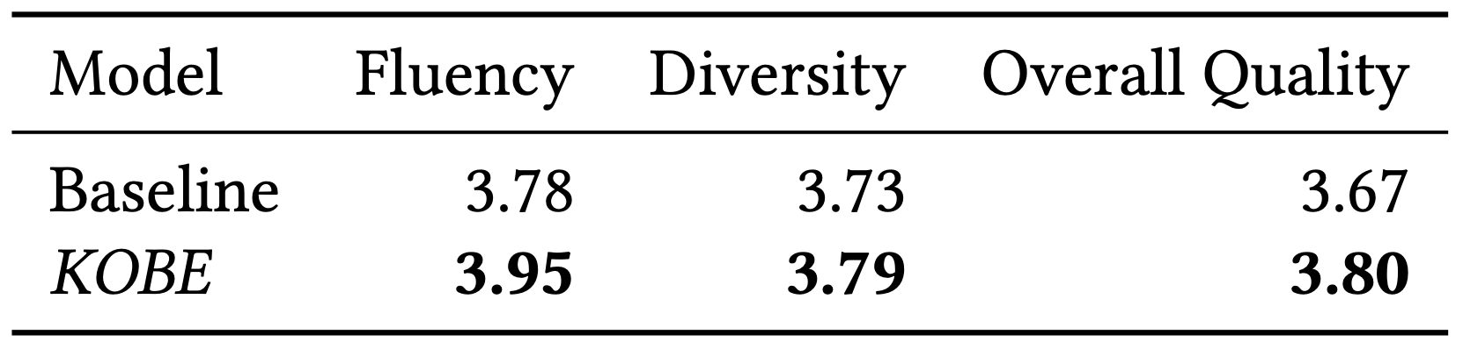
Experimental Results
Generation quality
  BLEU
Generation diversity
  Lexical diversity
Personalization
  Attribute capturing
Human evaluation
** All Data and Code available at https://github.com/THUDM/KOBE/
Notes:
First, does KOBE improve generation quality?
BLEU measures the overlap between the generated and the ground truth and is widely adopted for Seq2seq tasks such as machine translation.
We can see kobe improves the generation quality.
Second, does KOBE improve generation diversity?
The diversity score computed as the number of distinct ngrams generated on the test set.
The results show that both personalization and knowledge improve the diversity, which means more contents are generated.
Third, does KOBE achieve better personalization?
In other words, how well do we control the style of the product descriptions?
If the style information can be recovered from the generated text, we consider it successful.
So we train a classifier to predict attributes from ground truth descriptions and use it to predict the attributes of generated descriptions. If the more predictions match the input attributes, the score is higher.
The human evaluation also shows KOBE is better than the baseline.

Slide 54
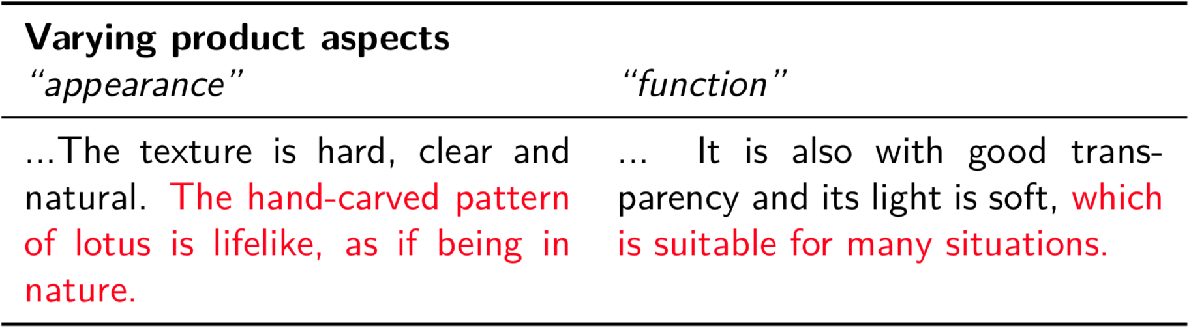

Case Study
Notes:
Now let’s have a look at some generated results.
This product is a Chinese-style lamp. For this product, we vary the control information.
On the left, we let the model to focus on the appearance of the product.
On the right, the function.
This is another example. It’s similar to the previous one but now we vary the user category attribute. This product is a Euro-style wooden desk.
On the left, we presume the user to be a housewife, while on the right, a geek.

Slide 55

CogDL
—A Toolkit for ​Deep Learning on Graphs
** Code available at https://keg.cs.tsinghua.edu.cn/cogdl/

Slide 56

CogDL
—A Toolkit for ​Deep Learning on Graphs
Notes:
CogDL is a graph representation learning toolkit that allows researchers and developers to train baseline or custom models for node classification, link prediction and other tasks on graphs. It provides implementations of several models, including: non-GNN Baselines like Deepwalk, LINE, NetMF, GNN Baselines like GCN, GAT, Graphsage.

Slide 57

Feed Recommendation
Challenges
Representation
Adaptive
Recommendation
eXplainable Recommendation

Slide 58
Intelligent Feed Recommendation
CogDL: A Toolkit for ​Deep Learning on Graphs
GATNE
Representation Learning
Input:
User-item multiplex networks
Output:
Recommended items
achieve better accuracy
s²Meta
One-shot Recommendation
Scenario adaptation
KOBE
Description Generation
Personalized description
Open Data:
TaoDescribe, etc.
Open Code:
https://github.com/THUDM

Slide 59
Related Publications
Yukuo Cen, Xu Zou, Jianwei Zhang, Hongxia Yang, Jingren Zhou and Jie Tang. Representation Learning for Attributed Multiplex Heterogeneous Network. KDD’19.
Zhengxiao Du, Xiaowei Wang, Hongxia Yang, Jingren Zhou and Jie Tang. Sequential Scenario-Specific Meta Learner for Online Recommendation. KDD’19.
Qibin Chen, Junyang Lin, Yichang Zhang, Hongxia Yang, Jingren Zhou and Jie Tang. Towards Knowledge-Based Personalized Product Description Generation in E-commerce. KDD’19.
Jie Zhang, Yuxiao Dong, Yan Wang, Jie Tang, and Ming Ding. ProNE: Fast and Scalable Network Representation Learning. IJCAI’19.
Yifeng Zhao, Xiangwei Wang, Hongxia Yang, Le Song, and Jie Tang. Large Scale Evolving Graphs with Burst Detection. IJCAI’19.
Yu Han, Jie Tang, and Qian Chen. Network Embedding under Partial Monitoring for Evolving Networks. IJCAI’19.
Jiezhong Qiu, Yuxiao Dong, Hao Ma, Jian Li, Chi Wang, Kuansan Wang, and Jie Tang. NetSMF: Large-Scale Network Embedding as Sparse Matrix Factorization. WWW'19.
Jiezhong Qiu, Yuxiao Dong, Hao Ma, Jian Li, Kuansan Wang, and Jie Tang. Network Embedding as Matrix Factorization: Unifying DeepWalk, LINE, PTE, and node2vec. WSDM’18.
Jie Tang, Jing Zhang, Limin Yao, Juanzi Li, Li Zhang, and Zhong Su. ArnetMiner: Extraction and Mining of Academic Social Networks. KDD’08.
  For more, please check here http://keg.cs.tsinghua.edu.cn/jietang

Slide 60
Thank you！
Collaborators:
Yukuo Cen, Zhengxiao Du, Qibin Chen, Xu Zou, Yan Wang, et al. (THU)
Hongxiao Yang, Chang Zhou, Le Song, Jingren Zhou, et al. (Alibaba)
  Jie Tang, KEG, Tsinghua U http://keg.cs.tsinghua.edu.cn/jietang
  Download all data & Codes https://github.com/THUDM

Slide 61
Next Steps
Interact with users
  Maintain a meaningful dialog with the user while constantly making new recommendations
Generate efficient questions instead of descriptions
  A user reads a description and judges it’s good for him/her or not
  Why not ask for preferences and recommend items satisfying the condition?

Slide 62
Next Steps
Adversarial
  Can a user’s buying decision be reversed by changing only a few words?
  Can we change the product title so that the generated description is about another irrelevant product?
Make use of user feedbacks on descriptions
  Which part of a description attracts users the most?
  Can we plan the description in advance, sorting sentences according to their importance to the user?

Slide 63

Next Steps - Recommender Dialog System

Slide 64
Recommender Dialog System – Basic Idea
Interact with users
  In KOBE, we generate textual descriptions after recommendation and we don’t get any user feedbacks like “I don’t like this genre.” on the displayed descriptions, which may be suboptimal.
  We try to maintain a meaningful multi-turn dialog with the user while constantly making new recommendations.
  The dialog system and the recommender can improve each other via external knowledge.

Slide 65


Basic Framework

Slide 66


Ours – Incorporating Dialog Content

Slide 67

Ours – Knowledge Graph Propagation

Slide 68


Ours – Entity Attention

Slide 69

Ours Vocabulary Bias

Slide 70


Experimental Results
Does dialog improve recommendation?
Does recommendation improve dialog?

Slide 71

Analysis
How does dialog improve recommendation?

Slide 72

Analysis
How does recommendation improve dialog?
Table: Vocabulary bias when a movie is mentioned.

