Slide 1

Models and Algorithms for
Social Influence Analysis
Jie Tang and Jimeng Sun
Tsinghua University, China
IBM TJ Watson, USA

Slide 2
Agenda
Social Influence
Test
Measure
Models
  Randomization test
  Shuffle test
  Reverse test
1
2
  Reachability-based methods
  Structure Similarity
  Structure + Content Similarity
  Action-based methods
3
  Linear Threshold Model
  Cascade Model
  Algorithms
  Jie Tang, KEG, Tsinghua U Download all data from AMiner.org

Slide 3

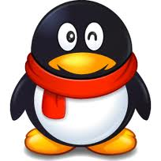
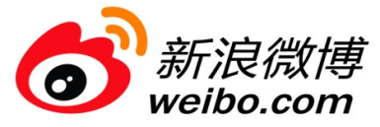



Social Networks
>1000 million users
The 3rd largest “Country” in the world
More visitors than Google
>780 million users
2013, users, 40% yearly increase
400 million
2009, 2 billion tweets per quarter
2010, 4 billion tweets per quarter
2011, tweets per quarter
25 billion
More than 6 billion images
Pinterest, with a traffic higher than Twitter and Google

Slide 4
A Trillion Dollar Opportunity
Social networks already become a bridge to connect our daily physical life and the virtual web space
On2Off ^{[1]}
[1] Online to Offline is trillion dollar business
http://techcrunch.com/2010/08/07/why-online2offline-commerce-is-a-trillion-dollar-opportunity/
Notes:
With the growth of local commerce on the Web, the links between online and physical commerce are becoming stronger.
The key to O2O is that it finds consumers online and brings them into real-world stores. . It is a combination of payment model and foot traffic generator for merchants (as well as a “discovery” mechanism for consumers) that creates offline purchases. It is inherently measurable, since every transaction (or reservation, for things like OpenTable) happens online. This is distinctively different from the directory model (think: Yelp, CitySearch, etc) in that the addition of payment helps quantify performance and close the loop—more on that later.
What do Groupon, OpenTable,Restaurant.com, and SpaFinder all have in common? They grease the wheels of online-to-offline commerce.

Slide 5
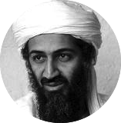





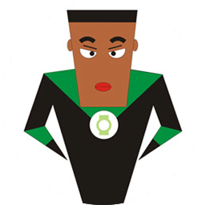
“Love Obama”
I love Obama
I hate Obama, the worst president ever
Obama is fantastic
Obama is great!
No Obama in 2012!
He cannot be the next president!
Positive
Negative
Notes:
Obama has done just that. From social networking to his blog to his Fight the Smears campaign, Obama has made his Web 2.0 presence known. He has over 1.5 million friends on MySpace and Facebook, and he currently has over 45,000 followers on Twitter. This personal activity in social networks allows him to quickly get the word out across multiple platforms.

Slide 6
What is Social Influence?
Social influence occurs when one's opinions, emotions, or behaviors are affected by others, intentionally or unintentionally.^{[1]}
  Informational social influence: to accept information from another;
  Normative social influence: to conform to the positive expectations of others.
[1] http://en.wikipedia.org/wiki/Social_influence

Slide 7
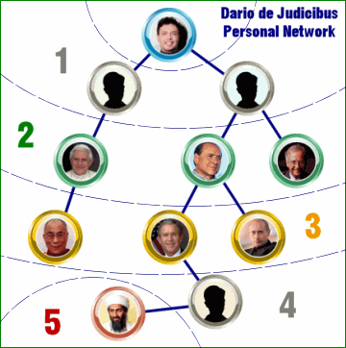
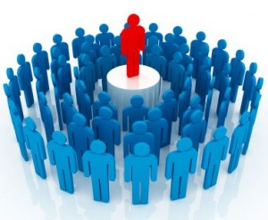
Three Degree of Influence
Six degree of separation^{[1]}
Three degree of Influence^{[2]}
You are able to influence up to >1,000,000 persons in the world, according to the Dunbar’s number^{[3]}.
[1] S. Milgram. The Small World Problem. Psychology Today, 1967, Vol. 2, 60–67
[2] J.H. Fowler and N.A. Christakis. The Dynamic Spread of Happiness in a Large Social Network: Longitudinal Analysis Over 20 Years in the Framingham Heart Study. British Medical Journal 2008; 337: a2338
[3] R. Dunbar. Neocortex size as a constraint on group size in primates. Human Evolution, 1992, 20: 469–493.

Slide 8
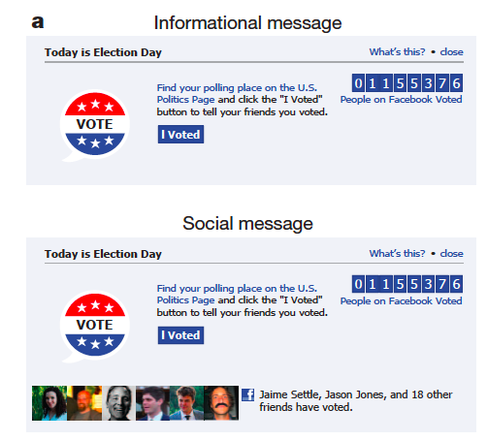
Does Social Influence really matter?
Case 1: Social influence and political mobilization^{[1]}
  Will online political mobilization really work?
A controlled trial (with 61M users on FB)
Social msg group: was shown with msg that indicates one’s friends who have made the votes.
Informational msg group: was shown with msg that indicates how many other.
Control group: did not receive any msg.
[1] R. M. Bond, C. J. Fariss, J. J. Jones, A. D. I. Kramer, C. Marlow, J. E. Settle and J. H. Fowler. A 61-million-person experiment in social influence and political mobilization. Nature, 489:295-298, 2012.

Slide 9
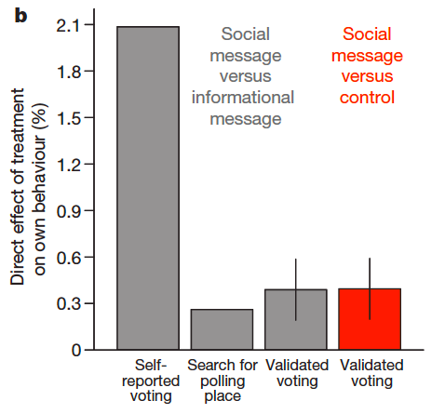
Case 1: Social Influence and Political Mobilization
Social msg group v.s.
Info msg group
Result: The former were 2.08% (t-test, P<0.01) more likely to click on the “I Voted” button
Social msg group v.s.
Control group
Result: The former were 0.39% (t-test, P=0.02) more likely to actually vote (via examination of public voting records)
[1] R. M. Bond, C. J. Fariss, J. J. Jones, A. D. I. Kramer, C. Marlow, J. E. Settle and J. H. Fowler. A 61-million-person experiment in social influence and political mobilization. Nature, 489:295-298, 2012.

Slide 10
Case 2: Klout^{[1]}—Social Media Marketing
Toward measuring real-world influence
  Twitter, Facebook, G+, LinkedIn, etc.
  Klout generates a score on a scale of 1-100 for a social user to represent her/his ability to engage other people and inspire social actions.
  Has built 100 million profiles.
Though controversial^{[2]}, in May 2012, Cathay Pacific opens SFO lounge to Klout users
  A high Klout score gets you into Cathay Pacific’s SFO lounge
[1] http://klout.com
[2] Why I Deleted My Klout Profile, by Pam Moore, at Social Media Today, originally published November 19, 2011; retrieved November 26 2011
Notes:
Launched in 2009

Slide 11
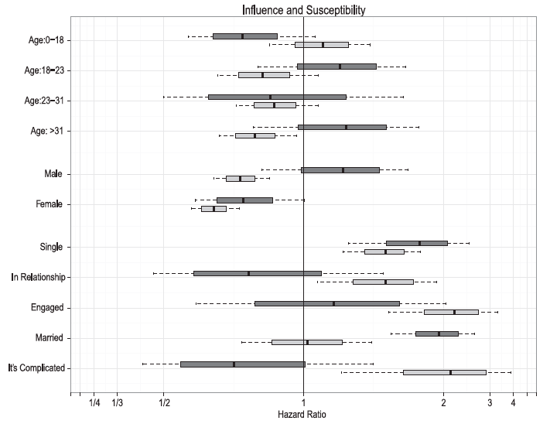
Case 3: Influential verse Susceptible^{[1]}
Study of product adoption for 1.3M FB users
Results:
Younger users are more (18%, P<0.05) susceptible to influence than older users
Men are more (49%, P<0.05) influential than women
Single and Married individuals are significantly more (>100%, P<0.05) influential than those who are in a relationship
Married individuals are the least susceptible to influence
[1] S. Aral and D Walker. Identifying Influential and Susceptible Members of Social Networks. Science, 337:337-341, 2012.

Slide 12
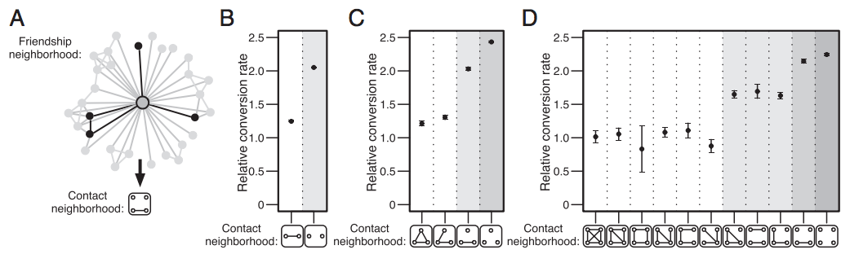
Case 4: Who influenced you and How?
Magic: the structural diversity of the ego network^{[1]}
Results: Your behavior is influenced by the “structural diversity” (the number of connected components in your ego network) instead of the number of your friends.
[1] J. Ugandera, L. Backstromb, C. Marlowb, and J. Kleinberg. Structural diversity in social contagion. PNAS, 109 (20):7591-7592, 2012.
Notes:
Can also consider moving this page to measure part

Slide 13
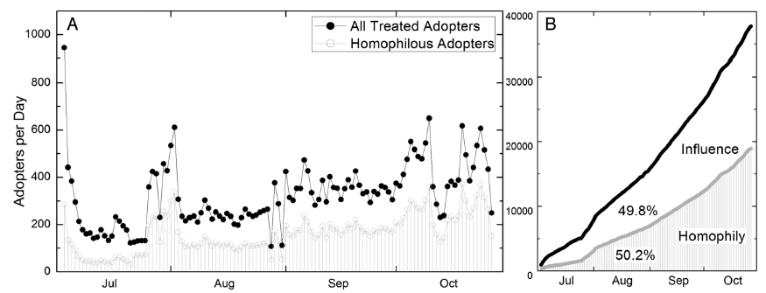
Case 5: Influence and Correlation
“Break” the myth of social influence
Results:
Homophily explains >50% of the perceived behavioral contagion
Previous methods overestimate peer influence by 300-700%
[1] S. Aral, L. Muchnik, and A. Sundararajan. Distinguishing influence-based contagion from homophily-driven diffusion in dynamic networks. PNAS, 106 (51):21544-21549, 2009.

Slide 14
Challenges: WH³
Whether social influence exist?
How to measure influence?
How to model influence?
How influence can help real applications?

Slide 15
Preliminaries

Slide 16





Notations
Time t
Node/user: v_{i}
Time t-1, t-2…
Attributes: x_{i}
- location, gender, age, etc.
Action/Status: y_{i}
- e.g., “Love Obama”
G =(V, E, X, Y)
G^{t} — the superscript t represents the time stamp
— represents a link/relationship from v_{i} to v_{j} at time t

Slide 17
Homophily
Homophily
  A user in the social network tends to be similar to their connected neighbors.
Originated from different mechanisms
  Social influence
    Indicates people tend to follow the behaviors of their friends
  Selection
    Indicates people tend to create relationships with other people who are already similar to them
  Confounding variables
    Other unknown variables exist, which may cause friends to behave similarly with one another.

Slide 18
Influence and Selection^{[1]}
Similarity between user i and j at time t-1 is larger than a threshold
Denominator: the conditional probability that an unlinked pair will become linked
Numerator: the same probability for unlinked pairs whose similarity exceeds the threshold
Denominator: the probability that the similarity increase from time t-1 to time t between two nodes that were not linked at time t-1
Numerator: the same probability that became linked at time t
A Model is learned through matrix factorization/factor graph
There is a link between user i and j at time t
[1] J. Scripps, P.-N. Tan, and A.-H. Esfahanian. Measuring the effects of preprocessing decisions and network forces in dynamic network analysis. In KDD’09, pages 747–756, 2009.
Notes:
Matrix alignment framework
Learn the weight of different attributes for establishing relationships between users
The diagonal elements of W correspond to the vector of weights of attributes

Slide 19
Other Related Concepts
Cosine similarity
Correlation factors
Hazard ratio
t-test

Slide 20
Cosine Similarity
A measure of similarity
Use a vector to represent a sample (e.g., user)
To measure the similarity of two vectors x and y, employ cosine similarity:

Slide 21
Correlation Factors
Several correlation coefficients could be used to measure correlation between two random variables x and y.
Pearsons’ correlation
It could be estimated by
Note that correlation does NOT imply causation
mean
Standard deviation
Notes:
Correlation between variables is a measure of how well the variables are related. The most common measure of correlation in statistics is the Pearson Correlation

Slide 22
Hazard Ratio
Hazard Ratio
  Chance of an event occurring in the treatment group divided by its chance in the control group
  Example:
  Chance of users to buy iPhone with >=1 iPhone user friend(s)
  Chance of users to buy iPhone without any iPhone user friend
  Measuring instantaneous chance by hazard rate h(t)
  The hazard ratio is the relationship between the instantaneous hazards in two groups
  Proportional hazards models (e.g. Cox-model) could be used to report hazard ratio.
Notes:
Survival analysis is a branch of statistics which deals with death in biological organisms and failure in mechanical systems.
hazard ratio can reflect the influence from a user’s friend on the purchase of iPhone.

Slide 23
t-test
A t-test usually used when the test statistic follows a Student’s t distribution if the null hypothesis is supported.
To test if the difference between two variables are significant
Welch’s t-test
  Calculate t-value
  Find the p-value using a table of values from Student’s t-distribution
  If the p-value is below chosen threshold (e.g. 0.01) then the two variables are viewed as significant different.
Unbiased estimator of sample variance
sample mean
#participants in the control group
#participants in the treatment group
Notes:
One-sample t-test
Null hypothesis = the population mean is equal to mu0
Welch’s t-test (equal or unequal mean, unequal variance)

Slide 24
Data Sets

Slide 25
Ten Cases
Network | #Nodes | #Edges | Behavior
Twitter-net | 111,000 | 450,000 | Follow
Weibo-Retweet | 1,700,000 | 400,000,000 | Retweet
Slashdot | 93,133 | 964,562 | Friend/Foe
Mobile (THU) | 229 | 29,136 | Happy/Unhappy
Gowalla | 196,591 | 950,327 | Check-in
ArnetMiner | 1,300,000 | 23,003,231 | Publish on a topic
Flickr | 1,991,509 | 208,118,719 | Join a group
PatentMiner | 4,000,000 | 32,000,000 | Patent on a topic
Citation | 1,572,277 | 2,084,019 | Cite a paper
Twitter-content | 7,521 | 304,275 | Tweet “Haiti Earthquake”
Most of the data sets will be publicly available for research.

Slide 26

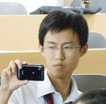

Case 1: Following Influence on Twitter
Time 1
Time 2
Lady Gaga
Lady Gaga
Lei
Sen
Lei
Sen
Peng
Peng
When you follow a user in a social network, will the be-
havior influences your friends to also follow her?

Slide 27

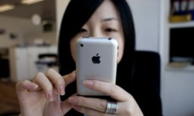
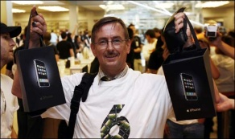
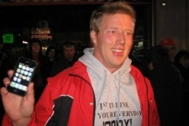

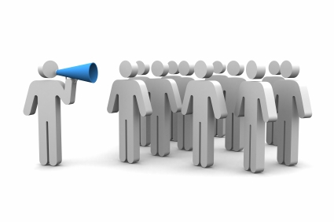
Case 2: Retweeting Influence
Bob
Who will follow to retweet it?
Andy
Dan
Jon
When you (re)tweet something

Slide 28


Case 3: Commenting Influence
News:
Alan Cox Exists Intel.
Governments Want Private Data
Re:…
+ Friend
- Foe
-
-
Re:…
Re:…
Re:…
+
-
+
+
Re:…
-
Did not comment
Re:…
Re:…
negative influence from foes
positive influence from friends

Slide 29
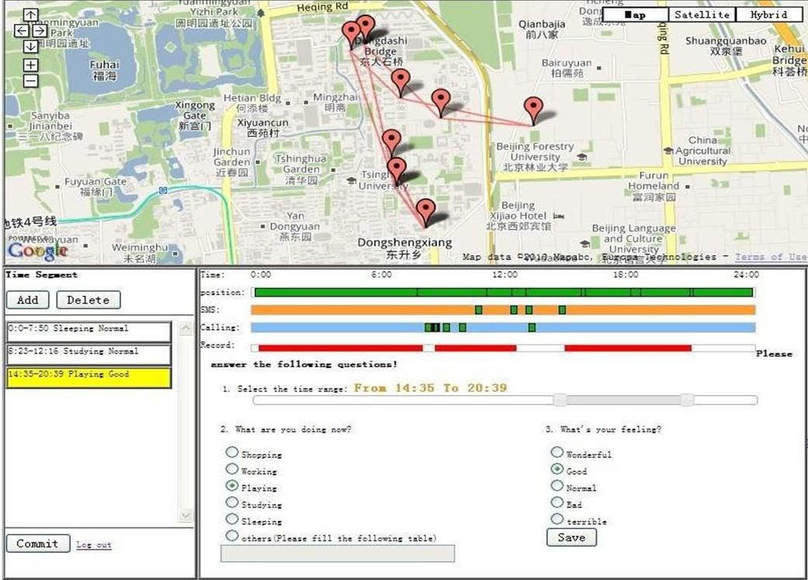
Case 4: Emotion Influence
SMS & Calling
Location
Activities
Emotion?

Slide 30
Case 4: Emotion Influence (cont.)
Can we predict users’ emotion?

Slide 31
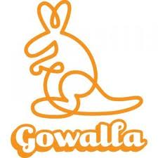
Case 5: Check-in Influence in Gowalla
Legend
Alice
Alice’s friend
Other users
1’
1’
1’
1’
If Alice’s friends check in this location at time t
Will Alice also check in nearby?

Slide 32

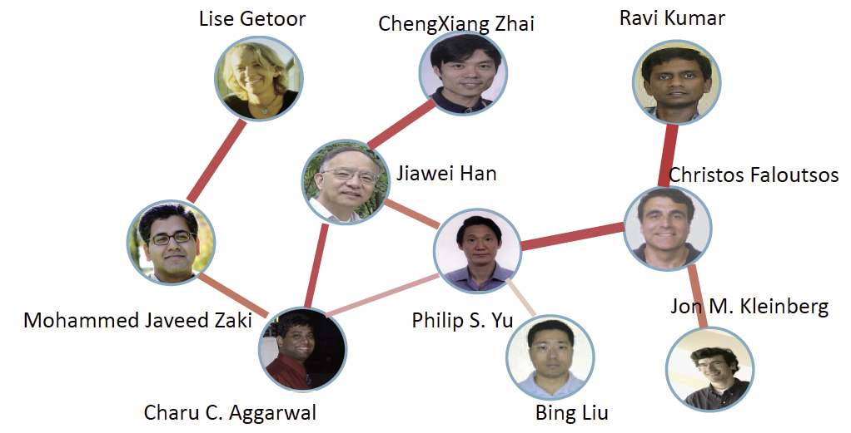
Case 6: Correlation & Influence in Academia
Text mining
DM
Graph mining
DM
Sentiment analysis
SN

Slide 33
Case 7: Patenting Influence
How competitors’ patenting behaviors influence each other

Slide 34
Social Influence
Social Influence
Test
Measure
Models
1
2
3

Slide 35
Social Influence
Social Influence
Test
Measure
Models
1
2
3

Slide 36
Randomization
Theoretical fundamentals^{[1, 2]}
  In science, randomized experiments are the experiments that allow the greatest reliability and validity of statistical estimates of treatment effects.
Randomized Control Trials (RCT)
  People are randomly assigned to a “treatment” group or a “controlled” group;
  People in the treatment group receive some kind of “treatment”, while people in the controlled group do not receive the treatment;
  Compare the result of the two groups, e.g., survival rate with a disease.
[1] Rubin, D. B. 1974. Estimating causal effects of treatments in randomized and nonrandomized studies.
Journal of Educational Psychology 66, 5, 688–701.
[2] http://en.wikipedia.org/wiki/Randomized_experiment
Notes:
Randomized experiments first appeared in psychology, where they were introduced by Charles Sanders Peirce,[8] and in education.[9][10][11] Later, randomized experiments appeared in agriculture, due to Jerzy Neyman[12] and Ronald A. Fisher.
By the late 20th century, RCTs were recognized as the standard method for "rational therapeutics" in medicine.

Slide 37
RCT in Social Network
We use RCT to test the influence and its significance in SN.
Two challenges:
  How to define the treatment group and the controlled group?
  How to find a real random assignment?

Slide 38
Example: Political mobilization
There are two kinds of treatments.
A controlled trial
Social msg group: was shown with msg that indicates one’s friends who have made the votes.
Informational msg group: was shown with msg that indicates how many other.
Control group: did not receive any msg.
Treatment Group 1
Treatment for Group 2
Treatment for Group 1
Treatment for Group 1&2
[1] R. M. Bond, C. J. Fariss, J. J. Jones, A. D. I. Kramer, C. Marlow, J. E. Settle and J. H. Fowler. A 61-million-person experiment in social influence and political mobilization. Nature, 489:295-298, 2012.
Notes:
For case 1, use real randomized experiment:
Users were randomly assigned to a ‘social message’ group, an “informational message” group, or a ‘control group’.
Compare the proportion of users to estimate the causal effect of seeing the faces of voters.

Slide 39
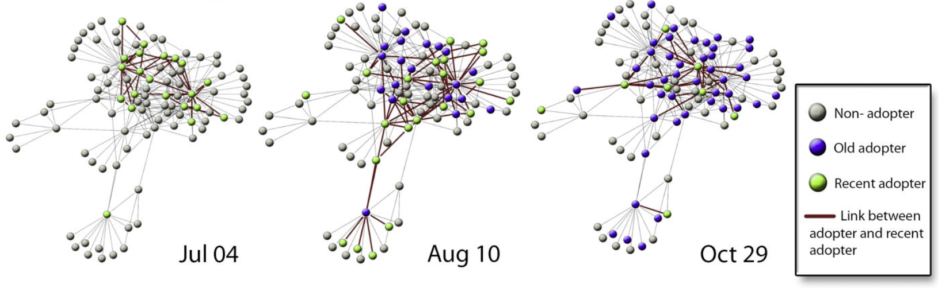
Adoption Diffusion of Y! Go
Yahoo! Go is a product of Yahoo to access its services of search, mailing, photo sharing, etc.
RCT:
Treatment group: people who did not adopt Y! Go but have friend(s) adopted Y! Go at time t;
Controlled group: people who did not adopt Y! Go and also have no friends adopted Y! Go at time t.
[1] S. Aral, L. Muchnik, and A. Sundararajan. Distinguishing influence-based contagion from homophily-driven diffusion in dynamic networks. PNAS, 106 (51):21544-21549, 2009.
Notes:
Yahoo go started from 2007 and was closed in Jan. 2010

Slide 40
For an example
Yahoo! Go
  27.4 M users, 14 B page views, 3.9 B messages
The RCT
  Control seeds: random sample of 2% of the entire network (3.2M nodes)
  Experimental seeds: all adopters of Yahoo! Go from 6/1/2007 to 10/31/2007 (0.5M nodes)
[1] S. Aral, L. Muchnik, and A. Sundararajan. Distinguishing influence-based contagion from homophily-driven diffusion in dynamic networks. PNAS, 106 (51):21544-21549, 2009.

Slide 41
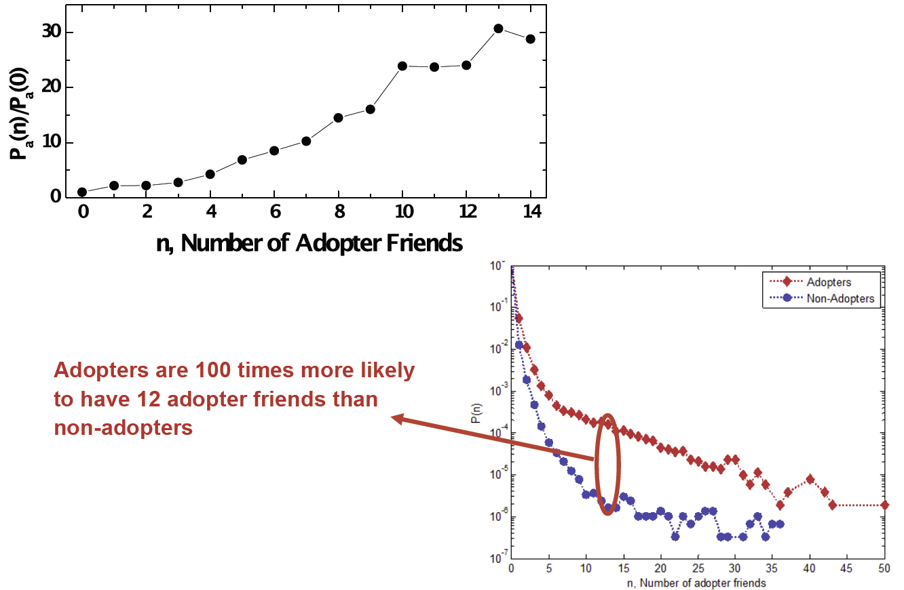
Evidence of Influence?
Is the setting fair?

Slide 42
Matched Sampling Estimation
Bias of existing randomized methods
  Adopters are more likely to have adopter friends than non-adopters
Matched sampling estimation
  Match the treated observations with untreated who are as likely to have been treated, conditional on a vector of observable characteristics, but who were not treated
All attributes associated with user i at time t
A binary variable indicating whether user i will be treated at time t
The new RCT:
Treatment group: a user i who have k friends have adopted the Y! Go at time t;
Controlled group: a matched user j who do not have k friends adopt Y! Go at time t, but is very likely to have k friends to adopt Y!Go at time t, i.e., |p_{it} - p_{jt}|<σ

Slide 43
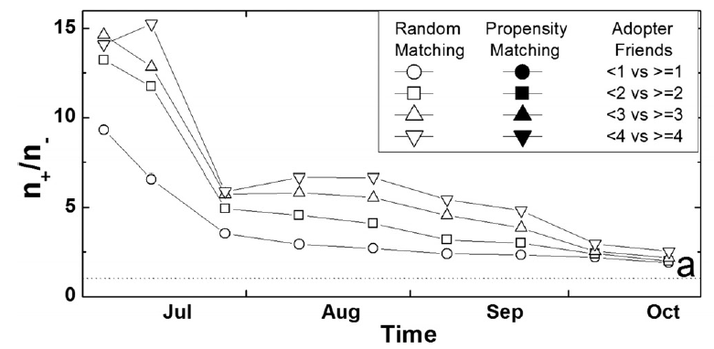
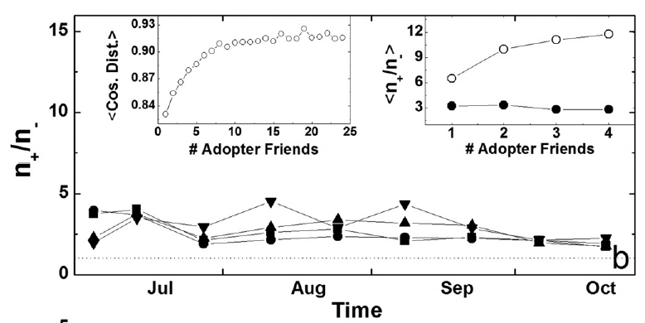
Results—Random sampling and Matched sampling
The fraction of observed treated to untreated adopters (n₊/n₋) under:
(a) Random sampling;
(b) Matched sampling.

Slide 44
Two More Methods
Shuffle test: shuffle the activation time of users.
  If social influence does not play a role, then the timing of activation should be independent of the timing of activation of others.
Reverse test: reserve the direction of all edges.
  Social influence spreads in the direction specified by the edges of the graph, and hence reversing the edges should intuitively change the estimate of the correlation.

Slide 45
Example: Following Influence Test
Time 1
When you follow a user, will the behavior influences others?
Time 2
Lady Gaga
Lady Gaga
Lei
Sen
Lei
Sen
Peng
Peng
Treatment Group
RCT:
Treatment group: people who followed some other people or who have friends following others at time t;
Controlled group: people who did not follow anyone and do not have any friends following others at time t.
[1] T. Lou, J. Tang, J. Hopcroft, Z. Fang, and X. Ding. Learning to Predict Reciprocity and Triadic Closure in Social Networks. ACM TKDD, (accepted).
Notes:
The challenge is that we cannot do a real randomized treatment trial.

Slide 46
Influence Test via Triad Formation
Two Categories of Following Influences
A
Whether influence exists?
A
t
t
B
C
B
t’=t+1
C
t’=t+1
Follower diffusion
Followee diffusion
–>: pre-existed relationships
–>: a new relationship added at t
-->: a possible relationship added at t+1

Slide 47
24 Triads in Following Influence
Follower diffusion
Followee diffusion
A
A
A
A
A
A
t
t
t
t
t
t
B
C
B
C
B
C
B
C
B
t'
C
B
t'
C
t'
t'
t'
t'
A
A
A
A
A
A
t
t
t
t
t
t
B
t'
C
B
C
B
t'
C
B
t'
C
B
C
B
t'
C
t'
t'
A
A
A
A
A
A
t
t
t
t
t
t
B
C
B
t'
C
B
t'
C
B
C
B
t'
C
B
t'
C
t'
t'
A
A
A
A
A
A
t
t
t
t
t
t
B
C
B
C
B
C
B
t'
C
B
C
B
t'
C
t'
t'
t'
t'
12 triads
12 triads

Slide 48
Twitter Data
Twitter data
  “Lady Gaga” -> 10K followers -> millions of followers;
  13,442,659 users and 56,893,234 following links.
  35,746,366 tweets.
A complete dynamic network
  We have all followers and all followees for every user
  112,044 users and 468,238 follows
  From 10/12/2010 to 12/23/2010
  13 timestamps by viewing every 4 days as a timestamp

Slide 49
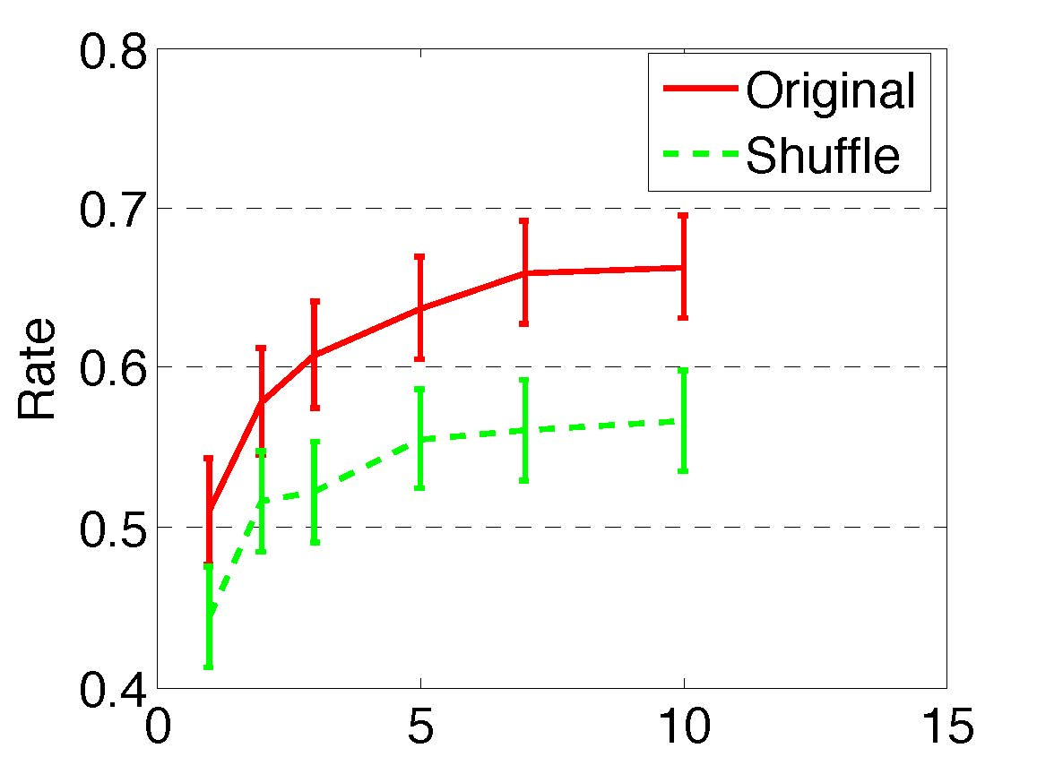
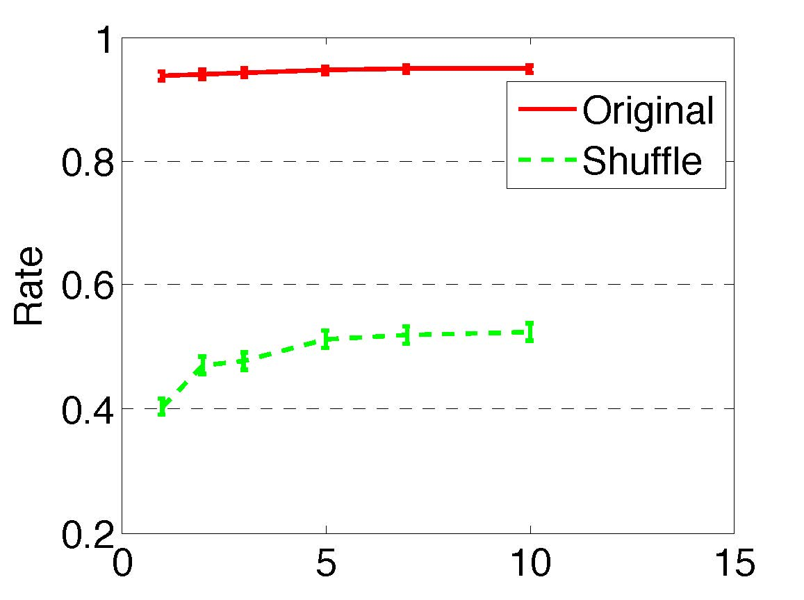
Test 1: Timing Shuffle Test
Method: Shuffle the timing of all the following relationships.
  Compare the rate under the original and shuffled dataset.
Result
A
Shuffle test
A
t_{AC}
t’_{AC}
B
C
B
C
t_{BC}
t’_{BC}
Original
Shuffle
t-test, P<0.01
Follower diffusion
Followee diffusion
[1] A. Anagnostopoulos, R. Kumar, M. Mahdian. Influence and correlation in social networks. In KDD, pages 7-15, 2008.

Slide 50
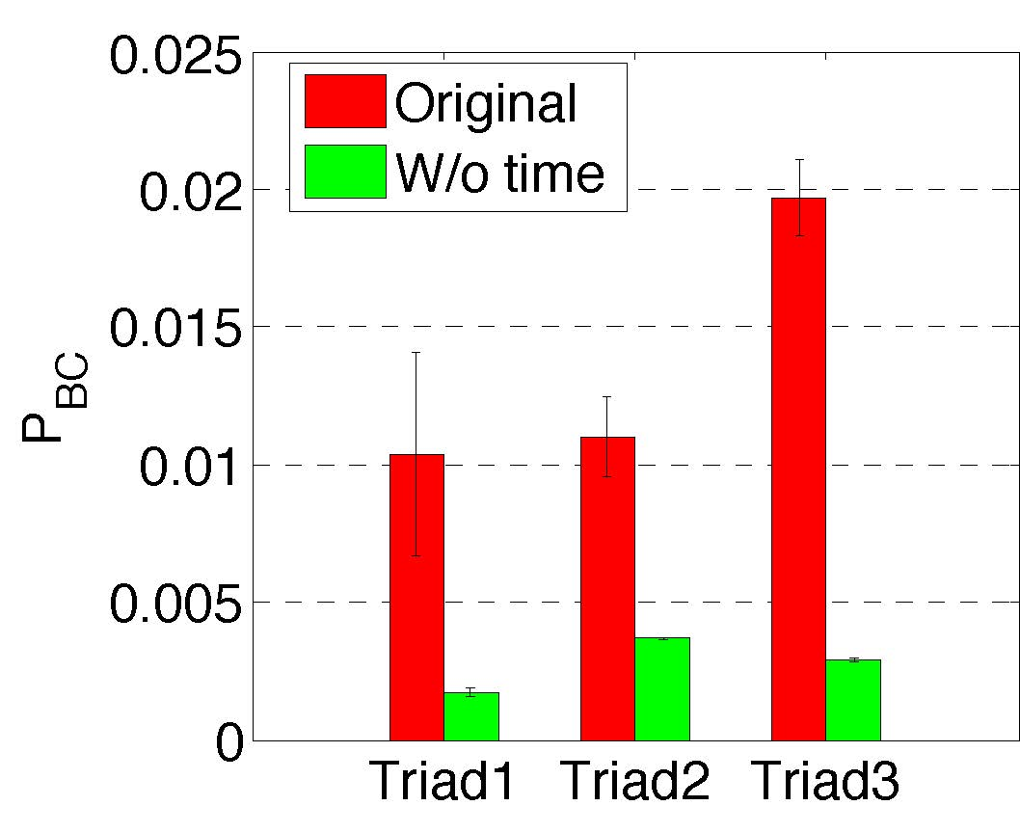
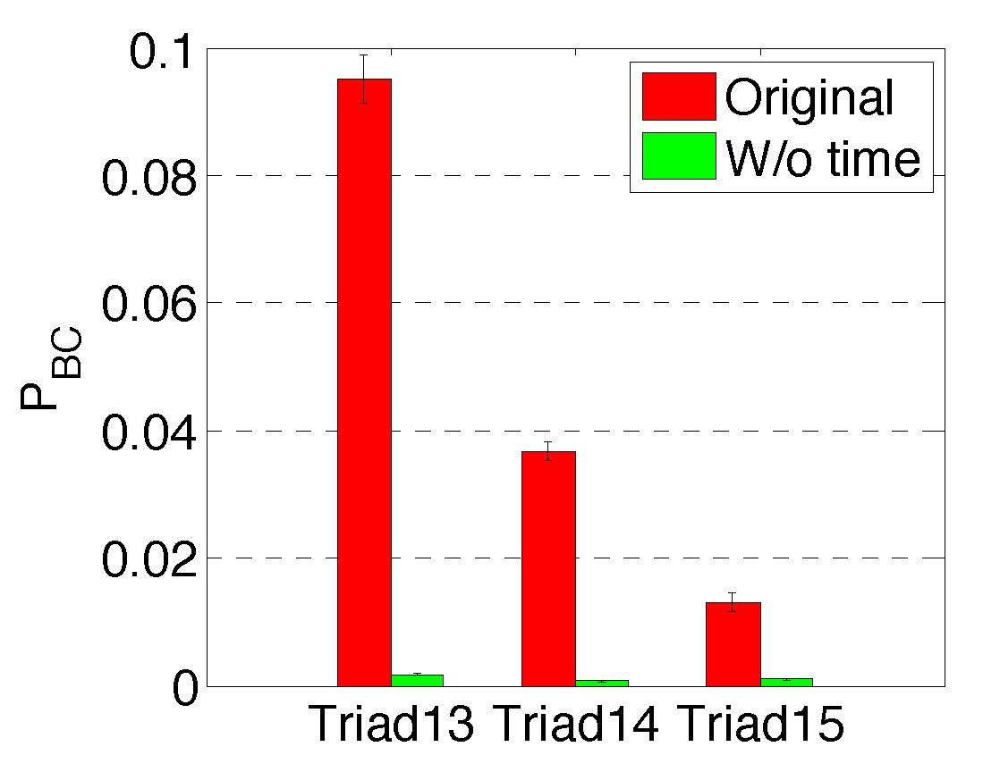
Test 2: Influence Decay Test
Method: Remove the time information t of AC
  Compare the probability of B following C under the original and w/o time dataset.
Result
A
A
t
Shuffle test
B
C
B
C
t’
t’
Original
w/o time
t-test, P<0.01
Follower diffusion
Followee diffusion

Slide 51
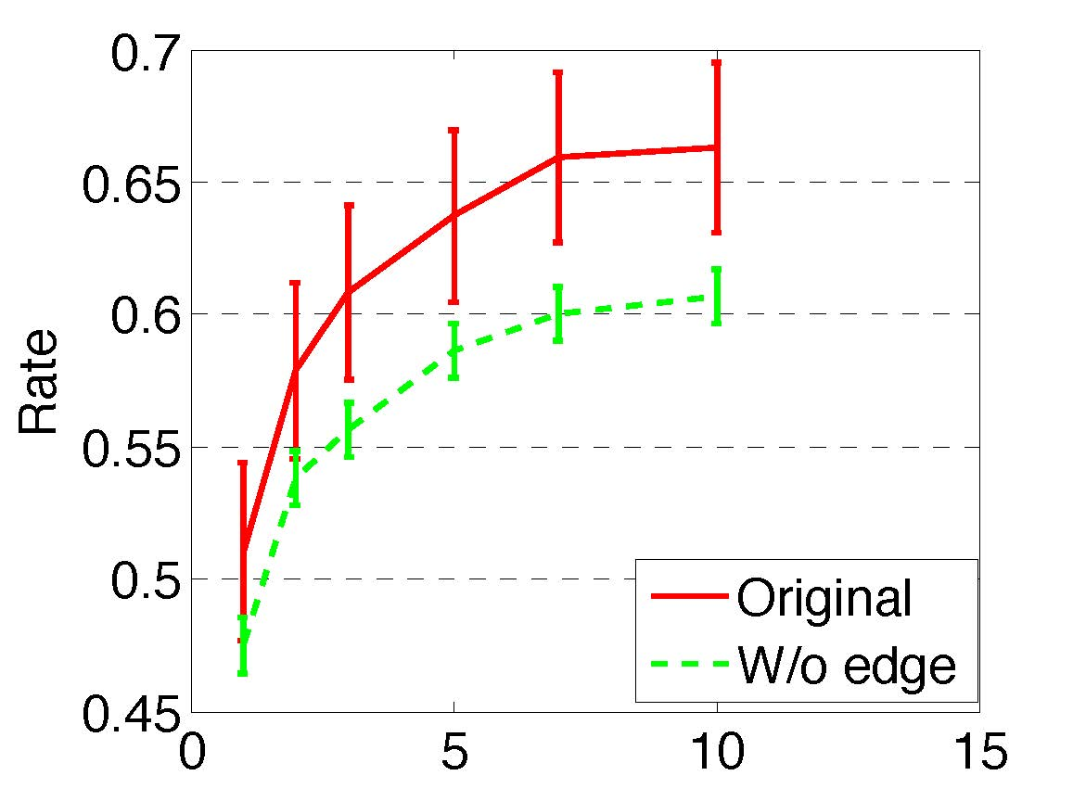
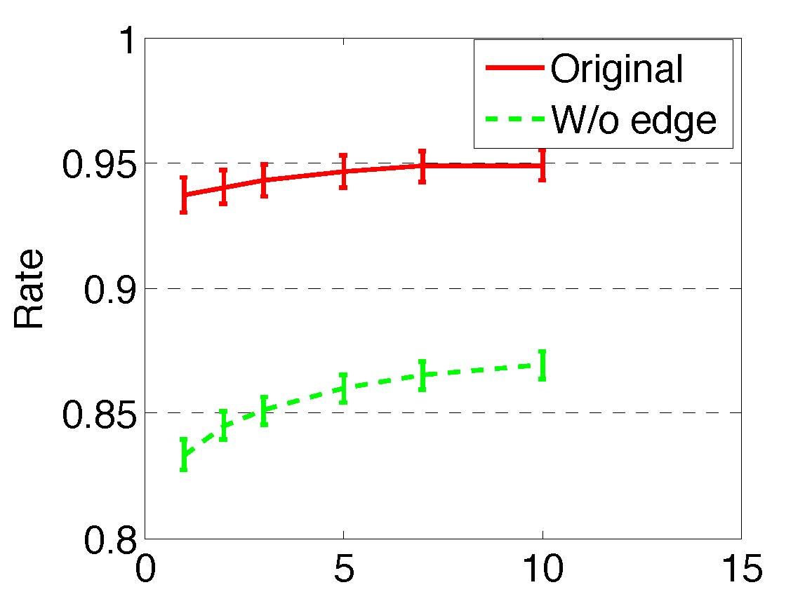
Test 3: Influence Propagation Test
Method: Remove the relationship between A and B.
  Compare the rate under the original and w/o edge dataset.
Result
A
A
t
t
Reverse test
B
C
B
C
t’
t’
Original
w/o edge
t-test, P<0.01
Follower diffusion
Followee diffusion
Notes:
Following influence propagates through the edge between two nodes.

Slide 52
Summary
Randomization test
  Define “treatment” group
  Define “controlled” group
  Random assignment
Shuffle test
Reverse test

Slide 53
Output of Influence Test
Positive
Negative
output
There indeed exists influence!

Slide 54
Social Influence
Social Influence
Test
Measure
Models
1
2
3
“The idea of measuring influence is kind of crazy. Influence has always been something that we each see through our own lens.”
—by CEO and co-founder of Klout, Joe Fernandez

Slide 55
Methodologies
Reachability-based methods
Structure Similarity
Structure + Content Similarity
Action-based methods

Slide 56
Reachability-based Method
Let us begin with PageRank^{[1]}
0.2
0.2
3
4
2
0.2
0.2
5
1
0.2
?
?
3
4
2
?
?
5
1
(0.2+0.2*0.5+0.2*1/3+0.2)0.85+0.15*0.2
[1] L. Page, S. Brin, R. Motwani, and T. Winograd. The pagerank citation ranking: Bringing order to the web. Technical Report SIDL-WP-1999-0120, Stanford University, 1999.

Slide 57
Random Walk Interpretation
0.1
0.1
1/3
3
Probability distribution
P(t) = r
Stationary distribution
P(t+1) = M P(t)
4
1/3
1/3
2
0.15
0.25
5
1
0.4

Slide 58
Random Walk with Restart^{[1]}
0.1
0.1
1/3
3
4
1/3
1/3
2
0.15
0.25
q
U_{q}=1
1
1
0.4
[1] J. Sun, H. Qu, D. Chakrabarti, and C. Faloutsos. Neighborhood formation and anomaly detection in bipartite graphs. In ICDM’05, pages 418–425, 2005.

Slide 59

Measure Influence via Reachability^{[1]}
Influence of a path
Influence of user u on v
0.5
0.5
u
v
0.5
0.5
Influence(u, v)
=0.5*0.5+0.5*0.5
Note: The method only considers the network information and does not consider the content information
All paths from u to v within path length t
[1] G. Jeh and J. Widom. Scaling personalized web search. In WWW '03, pages 271-279, 2003.

Slide 60
Methodologies
Reachability-based methods
Structure Similarity
Structure + Content Similarity
Action-based methods

Slide 61
SimRank
SimRank is a general similarity measure, based on a simple and intuitive graph-theoretic model (Jeh and Widom, KDD’02).
C is a constant between 0 and 1, e.g., C=0.8
The set of pages which have inks pointing to u
[1] G. Jeh and J. Widom, SimRank: a measure of structural-context similarity. In KDD, pages 538-543, 2002.

Slide 62
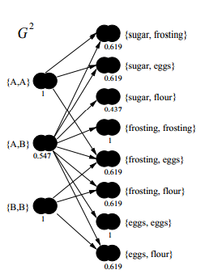
Bipartite SimRank
Extend the basic SimRank equation to bipartite domains consisting of two types of objects
{A, B} and {a, b}.
E.g.,
People A and B are similar if they purchase similar items.
Items a and b are similar if they are purchased by similar people.

Slide 63
MiniMax Variation
In some cases, e.g., course similarity, we are more care about the maximal similarity of two neighbors.
Note: Again, the method only considers the network information.

Slide 64
Methodologies
Reachability-based methods
Structure Similarity
Structure + Content Similarity
Action-based methods

Slide 65
Topic-based Social Influence Analysis
Social network -> Topical influence network
[1] J. Tang, J. Sun, C. Wang, and Z. Yang. Social Influence Analysis in Large-scale Networks. In KDD’09, pages 807-816, 2009.

Slide 66
The Solution: Topical Affinity Propagation
Topical Affinity Propagation
  Topical Factor Graph model
  Efficient learning algorithm
  Distributed implementation
[1] Jie Tang, Jimeng Sun, Chi Wang, and Zi Yang. Social Influence Analysis in Large-scale Networks. In KDD, pages 807-816, 2009.

Slide 67
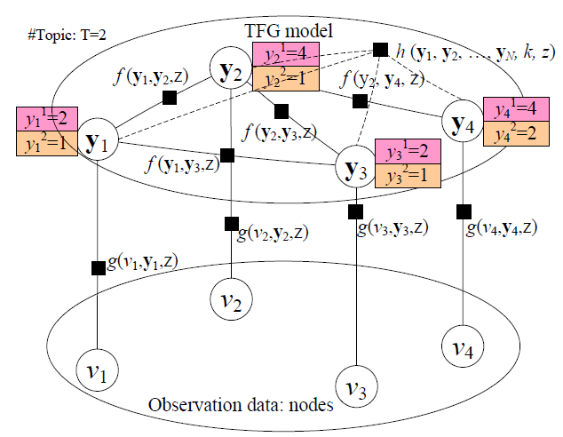
Topical Factor Graph (TFG) Model
Social link
Nodes that have the highest influence on the current node
Node/user
The problem is cast as identifying which node has the highest probability to influence another node on a specific topic along with the edge.

Slide 68
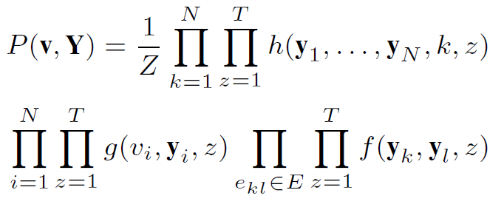
Topical Factor Graph (TFG)
The learning task is to find a configuration for all {y_{i}} to maximize the joint probability.
Objective function:
1. How to define?
2. How to optimize?
Notes:
目标函数P描述了隐变量y_i取任意一组值时的联合概率分布

Slide 69
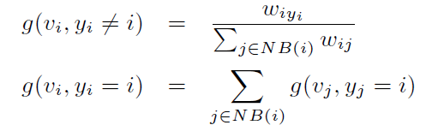
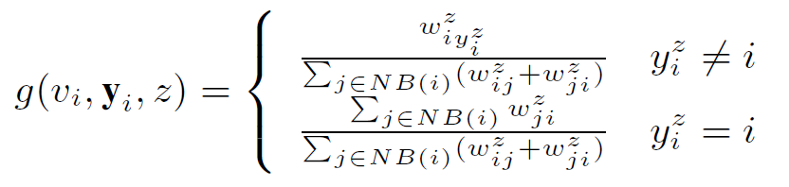

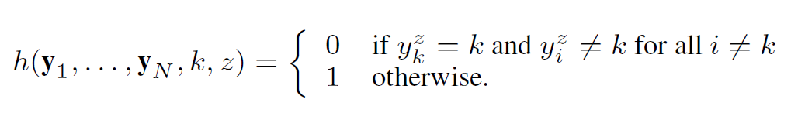
How to define (topical) feature functions?
similarity
  Node feature function
  Edge feature function
  Global feature function
or simply binary

Slide 70
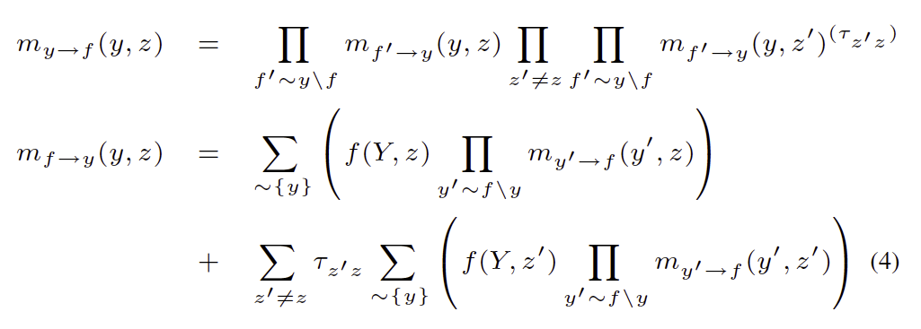
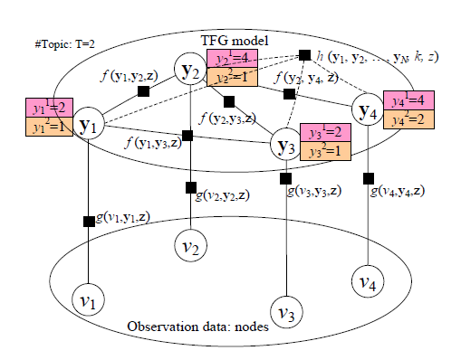
Model Learning Algorithm
Sum-product:
- Low efficiency!
- Not easy for distributed learning!

Slide 71
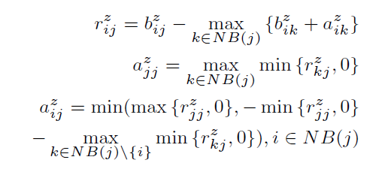
New TAP Learning Algorithm
1. Introduce two new variables r and a, to replace the original message m.
2. Design new update rules:
m_{ij}
[1] Jie Tang, Jimeng Sun, Chi Wang, and Zi Yang. Social Influence Analysis in Large-scale Networks. In KDD, pages 807-816, 2009.

Slide 72
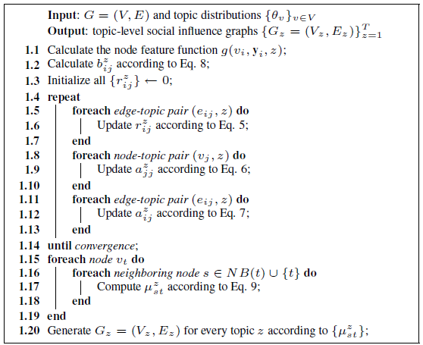





The TAP Learning Algorithm

Slide 73
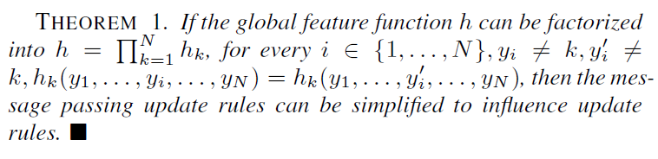
Distributed TAP Learning
Map-Reduce
  Map: (key, value) pairs
    e_{ij} /a_{ij} → e_{i*} /a_{ij}; e_{ij} /b_{ij} → e_{i*} /b_{ij}; e_{ij} /r_{ij} → e_{*j} /r_{ij} .
  Reduce: (key, value) pairs
    e_{ij} / * → new r_{ij}; e_{ij}/* → new a_{ij}
For the global feature function

Slide 74
Experiments
Data set: (http://arnetminer.org/lab-datasets/soinf/)
Evaluation measures
  CPU time
  Case study
  Application
Data set | #Nodes | #Edges
Coauthor | 640,134 | 1,554,643
Citation | 2,329,760 | 12,710,347
Film (Wikipedia) | 18,518 films 7,211 directors 10,128 actors 9,784 writers | 142,426

Slide 75
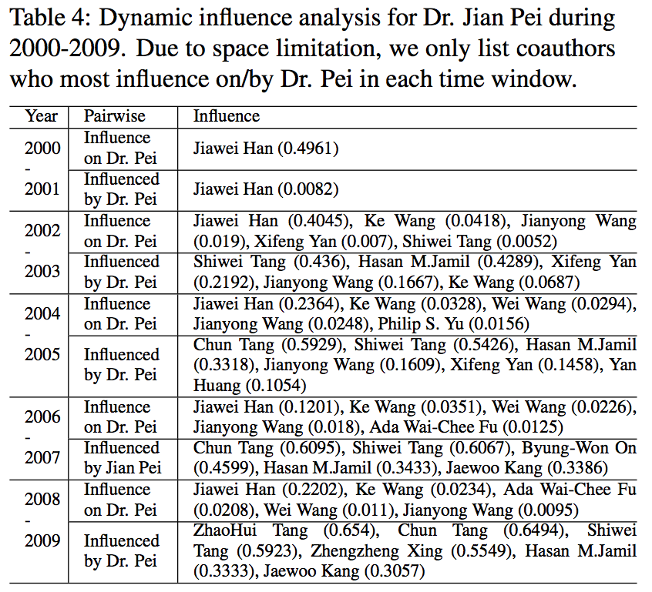
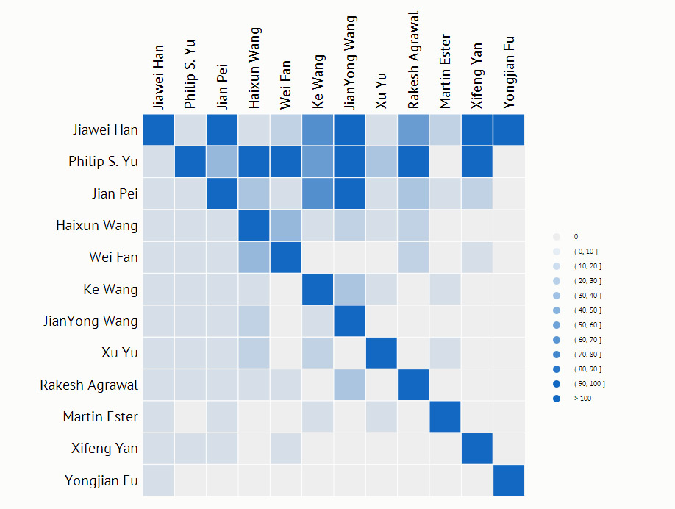
Social Influence Sub-graph on “Data mining”
On “Data Mining” in 2009

Slide 76
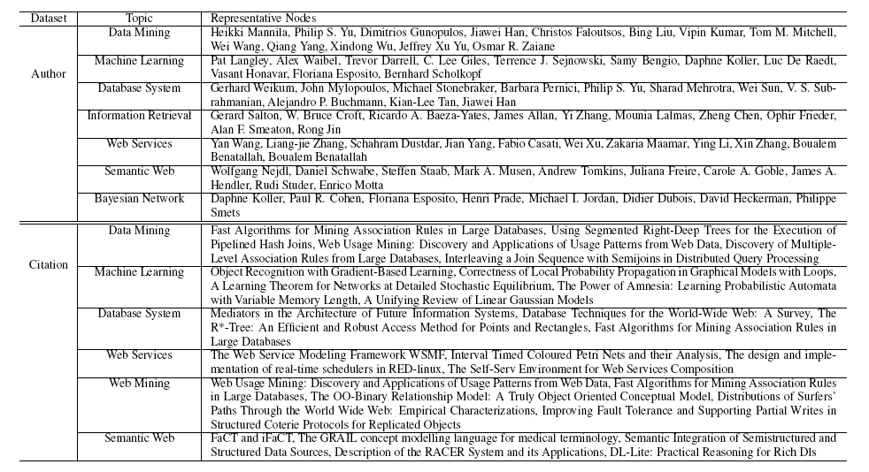
Results on Coauthor and Citation

Slide 77
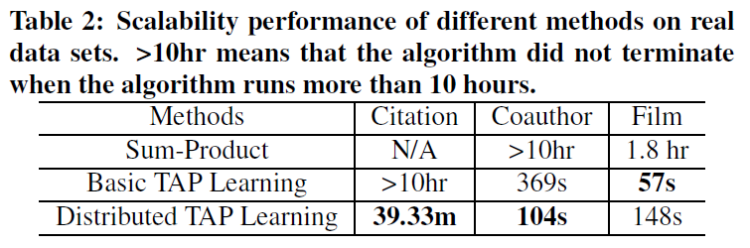
Scalability Performance

Slide 78
Speedup results
Speedup vs. #Computer nodes
Speedup vs. Dataset size

Slide 79
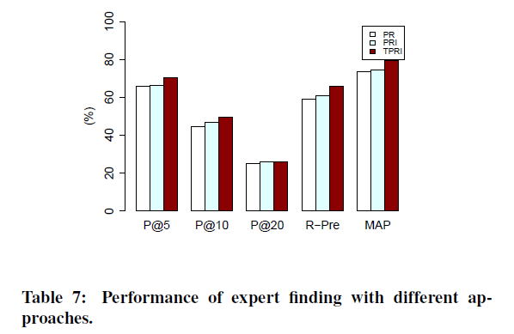
Application—Expert Finding^{[1]}
Note: Well though this method can combine network and content information, it does not consider users’ action.
Expert finding data from http://arnetminer.org/lab-datasets/expertfinding/
[1] J. Tang, J. Zhang, L. Yao, J. Li, L. Zhang, and Z. Su. ArnetMiner: Extraction and Mining of Academic Social Networks. In KDD’08, pages 990-998, 2008.

Slide 80
Methodologies
Reachability-based methods
Structure Similarity
Structure + Content Similarity
Action-based methods

Slide 81
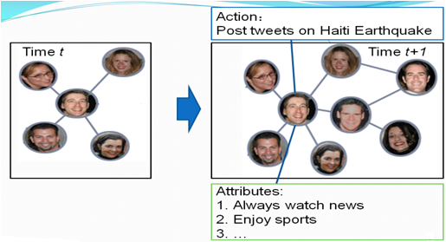
Influence and Action
G^{t} =(V^{t}, E^{t}, X^{t}, Y^{t})
Actions at time t
Nodes at time t
Edges at time t
Attribute matrix at time t
Input:
G^{t} =(V^{t}, E^{t}, X^{t}, Y^{t})
t = 1,2,…T
Output:
F: f(G^{t}) ->Y^{(t+1)}
Notes:
Influence is usually reflected in changes in social action patterns (user behavior) in the social network. Recent work [31, 68] has studied the problem of learning the influence degree from historical user actions, while some other work [58, 64] investigates how social actions evolve in the context of the network, and how such actions are affected by social influence factors.
Before introducing these methods, we will first define the time-varying attribute augmented networks with user actions:
An action y performed by user vi at time t can be represented as a triple (y, vi, t)

Slide 82
(a) Learning Influence Probabilities ^{[1]}
Goal: Learn user influence and action influence from historical actions
Assumption
  If user v_{i} performs an action y at time t and later his friend v_{j} also perform the action, then there is an influence from v_{i} to v_{j}
User Influenceability: quantifies how influenceable a user is.
where is the difference between the time when v_{j} performing the action and the time when user v_{i} performing the action, given e_{ij}=1.
Action propagation from v_{i} to v_{j} within Δt
threshold
[1] A. Goyal, F. Bonchi, and L. V. Lakshmanan. Learning influence probabilities in social networks. In WSDM’10, pages 207–217, 2010.
Notes:
Goyal et al. [31] study the problem of learning the influence degrees (called probabilities) from a historic log of user actions.
The goal of this work is find a (static of dynamic) model to best capture the user influence and action influence informati
They give the concept of user influential probability and action influential probability.on in the network.
So, we define an influenceability score
representing how influenceable a user is, as the ratio between
the number of actions for which we have evidence that the
user was influenced, over the total number of actions performed

Slide 83
(a) Learning Influence Probabilities ^{[1]}
Action Influenceability: quantify how influenceable an action is.
where is the difference between the time when v_{j} performing the action and the time when user v_{i} performing the action, given e_{ij}=1; represents the action propagation score
[1] A. Goyal, F. Bonchi, and L. V. Lakshmanan. Learning influence probabilities in social networks. In WSDM’10, pages 207–217, 2010.
Notes:
Goyal et al. [31] study the problem of learning the influence degrees (called probabilities) from a historic log of user actions. They present the concept of user influential probability and action influential probability.
The goal of learning influence probabilities [31] is find a (static of dynamic) model to best capture the user influence and action influence information in the network.
We expect that for actions with high infl(a), predictions
(based on influence models) of user performing those actions
will yield a relatively higher precision and recall values
compared to other actions. We will revisit this in the experimental
section.

Slide 84
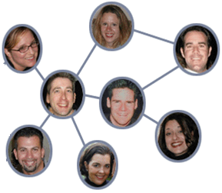
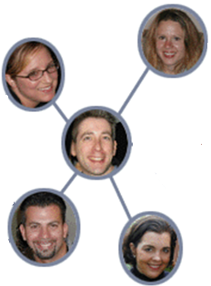
(b) Social Influence & Action Modeling^{[1]}
Action Prediction：
Will John post a tweet on “Haiti Earthquake”?
Influence
1
Correlation
Time t+1
3
Time t
John
John
Action bias
4
Personal attributes:
Always watch news
Enjoy sports
….
Dependence
2
[1] C. Tan, J. Tang, J. Sun, Q. Lin, and F. Wang. Social action tracking via noise tolerant time-varying factor graphs. In KDD’10, pages 807–816, 2010.
Notes:
To predict users’ actions, we need to consider complex factors. What information we have, we have a dynamic social network, and also attributes of his own. Intuitively, what factors we need to consider? First, the influence from his friends, second, he will keep the same action or attitude as himself, we call it dependence. Third, correlation between neighbours. Finally, personal interests.

Slide 85
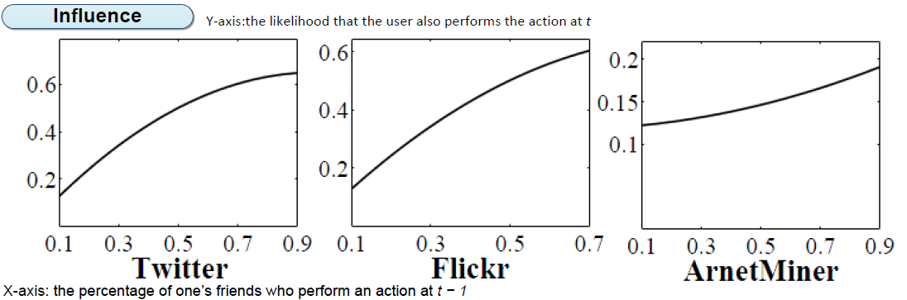
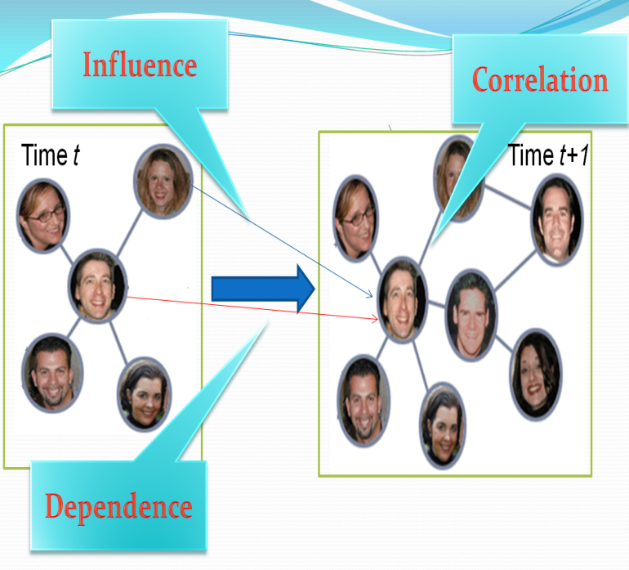
Statistical Study: Influence
Y-axis: the likelihood that the user also performs the action at time t
X-axis: the percentage of one’s friends who perform an action at time (t − 1)
Twitter Action: Tweet on “Haiti Earthquake”
Flickr Action: Add a picture into favorite list
ArnetMiner Action: Publish on a conference
Notes:
We made statistical study to validate these factors. This is the validation of influence. X-axis stands for the percentage of one’s friends who perform an action at t-1, and the y-axis represents the likelihood that the user also performs the action at t. We can see, as more friends perform the action, a user also tends to perform the action.

Slide 86

Statistical Study: Dependence
Y-axis: the likelihood that a user performs an action
X-axis: different time windows (1-7)
Notes:
Next it is the dependence. The x-axis stands for different time windows. And the black one is the likelihood that a user perform an actions at t if he performed it at t-1, while the light one is the average likelihood that a user perform the action. We can see that the black one is always larger than the light one.

Slide 87

Statistical Study: Correlation
Y-axis: the likelihood that two friends(random) perform an action together
X-axis: different time windows (1-7)
Notes:
Finally we study the correlation. The x-axis represents different time windows, too. And the black one denotes the likelihood that two friends perform the actions at the same time. The light one is the likelihood that randomly two users perform the same action at the same time. We also see that the black one is larger.

Slide 88


A Discriminative Model: NTT-FGM
Influence
Correlation
Personal attributes
Dependence
Continuous latent action state
Action
Personal attributes
Notes:
The model we propose is as the graph shows. This graph shows a three-stage social network. We first add a continuous latent state for each user’s action state. And the factors are all defined according to the latent state. First we user action bias factor to consider the noise in users’ actions. And the influence factor denotes the influence from the past. Finally correlation factor defines the correlation between users and also personal interests. For the action bias factor, we have two option to choose for binary actions: bernoulli and Gaussian. Gaussian can be extended to continuous actions. So we choose Gaussian in our model for potential extension.

Slide 89



Model Instantiation
How to estimate the parameters?
Notes:
The correlation factor can be naturally modeled in a Markov random field.

Slide 90

Model Learning—Two-step learning
[1] C. Tan, J. Tang, J. Sun, Q. Lin, and F. Wang. Social action tracking via noise tolerant time-varying factor graphs. In KDD’10, pages 807–816, 2010.
Notes:
We employ an EM-style algorithm to train the model. This is the algorithm. Due to the time limit, if you are interested in the algorithm, we can discuss offline.

Slide 91
Experiment
Data Set (http://arnetminer.org/stnt)
Baseline
  SVM
  wvRN (Macskassy, 2003)
Evaluation Measure:
  Precision, Recall, F1-Measure
 | Action | Nodes | #Edges | Action Stats
Twitter | Post tweets on “Haiti Earthquake” | 7,521 | 304,275 | 730,568
Flickr | Add photos into favorite list | 8,721 | 485,253 | 485,253
Arnetminer | Issue publications on KDD | 2,062 | 34,986 | 2,960
Notes:
Finally, I will introduce the experiments. This is the data sets we used in the experiment, and the actions is the same as previously introduced. The baseline methods we use includes SVM, which uses the personal features combined with his neighbours, while wvRN is an algorithm proposed in 2003, which makes user of the graph information. The evaluation measure includes precision, recall and F1-measure.

Slide 92



Results

Slide 93
Measuring Following Influence
-A Generative Model

Slide 94
Measuring Following Influence
Time 1
Time 2
Lady Gaga
Lady Gaga
Lei
Sen
Lei
Sen
Peng
Peng
When you follow a user in a social network, will the be-
havior influences your friends to also follow her?

Slide 95
Recall we defined two kinds of influence..
Two Categories of Following Influences
A
A
t
t
B
C
B
t’=t+1
C
t’=t+1
Follower diffusion
Followee diffusion
–>: pre-existed relationships
–>: a new relationship added at t
-->: a possible relationship added at t+1

Slide 96



A Generative Model: FCM
The formation of one following edge at time t’ actually may be influenced by the formation of multiple neighbor edges e_{BA1} , e_{BA2} and e_{AnC} at time t.
We assume the neighbor edges activated at time t independently trigger a new edge.
The generative model FCM (Following cascaded model)
The formed edges
The unformed edges

Slide 97




Parameter Estimation
We exact 24*8 features from the neighbor edges of each edge pair (e,e’)
  24 triad structures and 8 triad statuses
We aggregate different pairs with same features together and estimate the probabilities associated to 24*8 triads.

Slide 98
Experiments
Improving link prediction
  Link formation is used to verify the the influence probabilities learned by FCM.
  A model has a good performance If it can best recover the process of link formation over time.
  Link formation is modeled as both classification and ranking problem.
Comparison methods
  FCM (our approach)
  CF
  Katz
  SimRank

Slide 99


Link Prediction Performance
SVN, LRC, and FCM all use the same features except that FCM considers the diffusion process of following influence.
Link predction as classification
CF, SimRank and Katz ignore the dynamic evolution of the network structure (e.g., an edge newly formed at t may trigger the neighbor edges at t’).
Link formation as ranking

Slide 100

Follower Diffusion: Power of Reciprocity
A
A
A
t
t
<
t
B
C
B
C
B
C
t'
t'
t'
B ->A
A->B
B<->A
Observation: Following influence is more significant when there is a reciprocal relationship between B and A.
Explanation: “intimacy” is one of the three key factors that can increase people’s likelihood to respond to social influence(social impact theory)

Slide 101

Followee Diffusion: One-way Relationship
A
A
A
t
VS
t
>
t
B
C
B
C
B
C
t'
t'
t'
A ->C
A<->C
A<-C
Observation: Following influence is more significant when there is a one-way relationship from A to C.
Explanation: Users usually prefer to check their followee’s followees, from whom they select those they may be interested to follow.

Slide 102


Reversed Relationship
A
A
A
A
t
<
t
t
<
t
B
C
B
C
B
C
B
C
t'
t'
t'
t'
Without C->B
With C ->B
Without C->B
With C ->B
Observation: Following influence is more significant when there is a reversed relationship from C to B.
Explanation: Users are highly encouraged to follow their followers.

Slide 103
Social Theories: Structural Balance^{[1]}
A
A
t
t
B
C
B
C
t'
t'
Follower diffusion
Followee diffusion
Social Balance: my friend’s friend is also my friend
The probabilities of B following C in the two triads are higher than others in their respective categories.
Explanation: Users have tendency to form a balanced triad
Fritz Heider (1958). The Psychology of Interpersonal Relations. John Wiley & Sons.

Slide 104

Social Theories: Social Status
Followee diffusion:
P(0XX) > P(1XX)
1: Elite user
0: Low-status user
A
0
A
1
t
>
t
B
C
B
C
t'
t'
Low-status users act as a bridge to connect users so as to form a closure triad.
The likelihood of 0XX is 1.4 times of 1XX.

Slide 105
Social Theories: Social Status
Followee diffusion:
P(X1X) > P(X0X)
1: Elite user
0: Low-status user
A
A
t
>
t
1
B
C
0
B
C
t'
t'
Elite users play a more important role to form the triadic closure.
The likelihood of X1X is almost double the probability of X0X.

Slide 106
Social Theories: Social Status
Followee diffusion:
P(XX1) > P(XX0)
1: Elite user
0: Low-status user
A
A
t
>
t
B
C
1
B
C
0
t'
t'
The rich gets richer.
The likelihood of XX1 is nearly 2 times higher than that of XX0.
This phenomenon validates the mechanism of preferential attachment.

Slide 107

Social Theories: Social Status
Follower diffusion:
P(X1X) > P(X0X)
1: Elite user
0: Low-status user
A
A
t
>
t
1
B
C
0
B
C
t'
t'
Elite users play a more important role to form the triadic closure.
The likelihood of X1X is almost double the probability of X0X.

Slide 108
Summaries
Reachability-based methods
Structure Similarity
Structure + Content Similarity
  Topical Affinity Propagation (TAP)
Action-based methods
  A discriminative model: NTT-FGM
  A generative model: FCM

Slide 109
Output of Measuring Influence
Positive
Negative
output
0.3
0.7
0.1
0.74
0.2
0.4
0.05
0.5
0.1

Slide 110
Understanding the Emotional Impact in Social Networks
[1] J. Jia, S. Wu, X. Wang, P. Hu, L. Cai, and J. Tang. Can We Understand van Gogh’s Mood? Learning to Infer Affects from Images in Social Networks. In ACM Multimedia, pages 857-860, 2012.

Slide 111
Social Influence
Social Influence
Test
Measure
Models
1
2
3

Slide 112

Influence Maximization
Influence maximization
  Minimize marketing cost and more generally to maximize profit.
  E.g., to get a small number of influential users to adopt a new product, and subsequently trigger a large cascade of further adoptions.
Probability of influence
B
A
0.8
C
0.5
0.1
0.4
0.6
0.1
0.6
D
E
F
0.1
[1] P. Domingos and M. Richardson. Mining the network value of customers. In Proceedings of the seventh ACM SIGKDD international conference on Knowledge discovery and data mining (KDD’01), pages 57–66, 2001.
Notes:
The problem of influence maximization can be traced back to the research on “word-of-mouth” and “viral marketing

Slide 113
Problem Abstraction
We associate each user with a status:
  Active or Inactive
  The status of the chosen set of users (seed nodes) to market is viewed as active
  Other users are viewed as inactive
Influence maximization
  Initially all users are considered inactive
  Then the chosen users are activated, who may further influence their friends to be active as well

Slide 114
Diffusion Influence Model
Linear Threshold Model
Cascade Model

Slide 115

Linear Threshold Model
General idea
  Whether a given node will be active can be based on an arbitrary monotone function of its neighbors that are already active.
Formalization
  f_{v} : map subsets of v’s neighbors’ influence to real numbers in [0,1]
  θ_{v} : a threshold for each node
  S: the set of neighbors of v that are active in step t-1
  Node v will turn active in step t if f_{v}(S) >θ_{v}
Specifically, in [Kempe, 2003], f_{v} is defined as , where b_{v,u} can be seen as a fixed weight, satisfying
[1] D. Kempe, J. Kleinberg, and E. Tardos. Maximizing the spread of influence through a social network. In Proceedings of the ninth ACM SIGKDD international conference on Knowledge discovery and data mining (KDD’03), pages 137–146, 2003.

Slide 116

Linear Threshold Model: An example
A
1st try, 0.7>0.5
B
0.3
0.7
0.74
0.2
1st try
0.74<0.8
0.4
0.1
0.05
0.5
2nd try, 0.74+0.1>0.8
0.1
C

Slide 117
Cascade Model
Cascade model
  p_{v}(u,S) : the success probability of user u activating user v
  User u tries to activate v and finally succeeds, where S is the set of v’s neighbors that have already attempted but failed to make v active
Independent cascade model
  p_{v}(u,S) is a constant, meaning that whether v is to be active does not depend on the order v’s neighbors try to activate it.
  Key idea: Flip coins c in advance -> live edges
  F_{c}(A): People influenced under outcome c (set cover)
  F(A) = Sum _{c}P(c) F_{c}(A) is submodular as well
[1] D. Kempe, J. Kleinberg, and E. Tardos. Maximizing the spread of influence through a social network. In Proceedings of the ninth ACM SIGKDD international conference on Knowledge discovery and data mining (KDD’03), pages 137–146, 2003.

Slide 118
Theoretical Analysis
NP-hard [1]
  Linear threshold model
  General cascade model
Kempe Prove that approximation algorithms can guarantee that the influence spread is within(1-1/e) of the optimal influence spread.
  Verify that the two models can outperform the traditional heuristics
Recent research focuses on the efficiency improvement
  [2] accelerate the influence procedure by up to 700 times
It is still challenging to extend these methods to large data sets
[1] D. Kempe, J. Kleinberg, and E. Tardos. Maximizing the spread of influence through a social network. In Proceedings of the ninth ACM SIGKDD international conference on Knowledge discovery and data mining(KDD’03), pages 137–146, 2003.
[2] J. Leskovec, A. Krause, C. Guestrin, C. Faloutsos, J. VanBriesen, and N. Glance. Cost-effective outbreak detection in networks. In Proceedings of the 13th ACM SIGKDD international conference on Knowledge discovery and data mining (KDD’07), pages 420–429, 2007.

Slide 119


Objective Function
Objective function:
- f (S) = Expected #people influenced when targeting a set of users S
Define f (S) as a monotonic submodular function
where
[1] P. Domingos and M. Richardson. Mining the network value of customers. In Proceedings of the seventh ACM SIGKDD international conference on Knowledge discovery and data mining (KDD’01), pages 57–66, 2001.
[2] D. Kempe, J. Kleinberg, and E. Tardos. Maximizing the spread of influence through a social network. In Proceedings of the ninth ACM SIGKDD international conference on Knowledge discovery and data mining(KDD’03), pages 137–146, 2003.

Slide 120

Maximizing the Spread of Influence
Solution
  Use a submodular function to approximate the influence function
  Then the problem can be transformed into finding a k-element set S for which f (S) is maximized.
approximation ratio
[1] D. Kempe, J. Kleinberg, and E. Tardos. Maximizing the spread of influence through a social network. In Proceedings of the ninth ACM SIGKDD international conference on Knowledge discovery and data mining (KDD’03), pages 137–146, 2003.
Notes:
Thus, the problem can be transformed into finding a k-element set S for which f(S) is maximized. The problem, can be solved using a greedy hill-climbing algorithm which approximates the optimal solution within a factor of (1 − 1/e). The following theorem formally defines the problem
The model can be further extended to assume that each node v has an associated non-negative weight wv, which can be used to capture the human prior knowledge to the task at hand, e.g., how important it is that v be activated in the final outcome.

Slide 121
Algorithms
General Greedy
Low-distance Heuristic
High-degree heuristic
Degree Discount Heuristic

Slide 122

General Greedy
General idea: In each round, the algorithm adds one vertex into the selected set S such that this vertex together with current set S maximizes the inﬂuence spread.
Any random diffusion process

Slide 123
Low-distance Heuristic
Consider the nodes with the shortest paths to other nodes as seed nodes
Intuition
  Individuals are more likely to be influenced by those who are closely related to them.
Notes:
Another commonly used influence measure in sociology is distance centrality, which considers the nodes with the shortest paths
to other nodes as be seed nodes. This strategy is based on the intuition that individuals are more likely to be influenced by those who are closely related to them

Slide 124
High-degree heuristic
Choose the seed nodes according to their degree.
Intuition
  The nodes with more neighbors would arguably tend to impose more influence upon its direct neighbors.
  Know as “degree centrality”
Notes:
It chooses the seed nodes according to their degree dv. The strategy is very simple but also natural because the nodes with more
neighbors would arguably tend to impose more influence upon its direct neighbors. This consideration of high-degree nodes is also known in the sociology literature as “degree centrality”

Slide 125

Degree Discount Heuristic^{[1]}
General idea: If u has been selected as a seed, then when considering selecting v as a new seed based on its degree, we should not count the edge v->u
Specifically, for a node v with d_{v} neighbors of which t_{v} are selected as seeds, we should discount v’s degree by
2t_{v} +(d_{v}-t_{v}) t_{v} p
where p=0.1.
[1] W. Chen, Y. Wang, and S. Yang. Efficient influence maximization in social networks. In KDD'09, pages 199-207, 2009.
Notes:
The general idea of this approach is that if u has been selected as a seed, then when considering selecting v as a new seed based
on its degree, we should not count the edge vu towards its degree. This is referred to as SingleDiscount. More specifically, for a node v with dv neighbors of which tv are selected as seeds already, we should discount v’s degree by

Slide 126
Summaries
Influence Maximization Models
  Linear Threshold Model
  Cascade Model
Algorithms
  General Greedy
  Low-distance Heuristic
  High-degree heuristic
  Degree Discount Heuristic

Slide 127


Social Influence
Applications
Social Influence
Test
Measure
Models
1
2
3

Slide 128
Application: Social Advertising^{[1]}
Conducted two very large field experiments that identify the effect of social cues on consumer responses to ads on Facebook
Exp. 1: measure how responses increase as a function of the number of cues.
Exp. 2: examines the effect of augmenting traditional ad units with a minimal social cue
Result: Social influence causes significant increases in ad performance
[1] E. Bakshy, D. Eckles, R. Yan, and I. Rosenn. Social influence in social advertising: evidence from field experiments. In EC'12, pages 146-161, 2012.

Slide 129
Application: Opinion Leader^{[1]}
Propose viral marketing through frequent pattern mining.
Assumption
  Users can see their friends actions.
Basic formation of the problem
  Actions take place in different time steps, and the actions which come up later could be influenced by the earlier taken actions.
Approach
  Define leaders as people who can influence a sufficient number of people in the network with their actions for a long enough period of time.
  Finding leaders in a social network makes use of action logs.
[1] A. Goyal, F. Bonchi, and L. V. Lakshmanan. Discovering leaders from community actions. In CIKM’08, pages 499–508, 2008.
Notes:
Social influence analysis techniques can also be leveraged for online advertising

Slide 130
Application: Influential Blog Discovery^{[1]}
Influential Blog Discovery
  In the web 2.0 era, people spend a significant amount of time on user-generated content web sites, like blog sites.
  Opinion leaders bring in new information, ideas, and opinions, and disseminate them down to the masses.
Four properties for each bloggers
  Recognition: A lot of inlinks to the article.
  Activity generation: A large number of comments indicates that the blog is influential.
  Novelty: with less outgoing links.
  Eloquence: Longer articles tend to be more eloquent, and can thus be more influential.
[1] N. Agarwal, H. Liu, L. Tang, and P. S. Yu. Identifying the influential bloggers in a community. In WSDM’08, pages 207–217, 2008.
Notes:
In the web 2.0 era, people spend a significant amount of time on user-generated content web sites, a classic example of which are blog sites. People form an online social network by visiting other users’ blog posts. Some of the blog users bring in new information, ideas, and opinions, and disseminate them down to the masses.
The work presents a model which takes advantages of the above four properties to describe the influence flow in the influence-graph consisting of all the blogger pages. Basically, the influence flow probability is defined as follows

Slide 131
Example 1: Influence maximization with the learned influence probabilities

Slide 132

Maximizing Influence Spread
Goal
  Verify whether the learned influence probability can help maximize influence spread.
Data sets
  Citation and Coauthor are from Arnetminer.org;
  Film is from Wikipedia, consisting of relationships between directors, actors, and movies.

Slide 133






Influence Maximization
(a) With uniform influence
(b) With the learned influence
The influence probability from to is simply defined as as , where
is the in-degree of .
Influence probability learned from the model we introduced before.
[1] C. Wang, J. Tang, J. Sun, and J. Han. Dynamic Social Influence Analysis through Time-dependent Factor Graphs. In ASONAM’11, pages 239-246, 2011.

Slide 134
Example 2: Following Influence Applications

Slide 135
Following Influence Applications
Time 1
Time 2
Lady Gaga
Lady Gaga
Lei
Sen
Lei
Sen
Peng
Peng
When you follow a user in a social network, will the be-
havior influences your friends to also follow her?

Slide 136



Applications: Influence Maximization
Alice
John
Mary
Find a set S of k initial followers to follow user v such that the number of newly activated users to follow v is maximized.

Slide 137
Applications: Friend Recommendation
Bob
Ada
Mike
Find a set S of k initial followees for user v such that the total number of new followees accepted by v is maximized

Slide 138


Application Performance
Influence Maximization
Recommendation
High degree
  May select the users that do not have large influence on following behaviors.
Uniform configured influence
  Can not accurately reflect the correlations between following behaviors.
Greedy algorithm based on the influence probabilities learned by FCM
  Captures the entire features of three users in a triad (i.e., triad structures and triad statuses)

Slide 139
Example 3: Emotion Influence
[1] J. Tang, Y. Zhang, J. Sun, J. Rao, W. Yu, Y. Chen, and ACM Fong. Quantitative Study of Individual Emotional States in Social Networks. IEEE TAC, 2012, Volume 3, Issue 2, Pages 132-144.

Slide 140
Happy System
SMS & Calling
Location
Activities
Emotion
Can we predict users’ emotion?

Slide 141


Observations (cont.)
The Old Summer Palace
Dorm
?
?
?
?
Classroom
GYM
Activity correlation
?
Location correlation
(Red-happy)
Karaoke

Slide 142



Observations
(a) Social correlation
(a) Implicit groups by emotions
(c) Calling (SMS) correlation

Slide 143


Observations (cont.)
Temporal correlation

Slide 144
MoodCast: Dynamic Continuous Factor Graph Model
Our solution
1. We directly define continuous feature function;
2. Use Metropolis-Hasting algorithm to learn the factor graph model.

Slide 145
Problem Formulation
Time t
G^{t} =(V, E^{t}, X^{t}, Y^{t})
Emotion: Sad
Time t-1, t-2…
Attributes:
- Location: Lab
- Activity: Working
Learning Task:
Notes:
Next I will introduce our approach. First, we need to give a formal definition of this problem. The input is a set of nodes, edges, attributes and emotions on the time flow. Here V is the set of nodes, or the users, E is the set of edges-the relations between the users, X is the set of attributes and Y is the set of emotions. The task is given the nodes, edges, attributes of the current time and all data of the previous time, predict users emotions

Slide 146





Dynamic Continuous Factor Graph Model
Time t’
Time t
: Binary function
Notes:
We propose a dynamic continuous factor graph model to leverage the three aspects. The first factor function f is attribute factor function. It’s a binary function. If at time t, the attribute is x and the emotion is y, then f(x, y) is 1, otherwise it’s 0.
The second one g is social correlation factor function. To measure the user-independent time-decay factor, we use an exponential function: t minus t’ on e, and the parameter can be absorbed together as beta. The final function is as shown on the slides. Similarly, we have the temporal factor function h. It’s format is like this
One of the challenges of the work is that time is continuous rather discrete time slice

Slide 147


Learning with Factor Graphs
y₅
y₄
y'₃
y₃
y₂
y₁
Attribute
Social
Temporal
Notes:
After we define all the factor functions, we have to learn the parameters. The learning task is to maximize the likelihood which is computed as shown. Z is the normalization and we have to learn parameters alpha, beta and lambda. The goal is to maximize this log-likelihood objective function. The intrinsic difficulty of such learning task is to calculate the normalization factor Z. Some methods are Junction Tree and Belief Propagation.
We use a sampling based Metropolis-Hastings (MH) algorithm which is a kind of Markov-chain Monte Carlo algorithm. The advantage of the MH algorithm is that it can derive a global gradient update for each parameter and it doesn’t need an expensive cost to compute Z

Slide 148

MH-based Learning algorithm
Random Sampling
Update
[1] J. Tang, Y. Zhang, J. Sun, J. Rao, W. Yu, Y. Chen, and ACM Fong. Quantitative Study of Individual Emotional States in Social Networks. IEEE TAC, 2012, Volume 3, Issue 2, Pages 132-144.

Slide 149
Experiment
Data Set
Baseline
  SVM
  SVM with network features
  Naïve Bayes
  Naïve Bayes with network features
Evaluation Measure:
  Precision, Recall, F1-Measure
 | #Users | Avg. Links | #Labels | Other
MSN | 30 | 3.2 | 9,869 | >36,000hr
LiveJournal | 469,707 | 49.6 | 2,665,166
Notes:
Finally, I will introduce the experiments. This is the data sets we used in the experiment, and the actions is the same as previously introduced. The baseline methods we use includes SVM, which uses the personal features combined with his neighbours, while wvRN is an algorithm proposed in 2003, which makes user of the graph information. The evaluation measure includes precision, recall and F1-measure.

Slide 150

Performance Result
Notes:
This is the performance of different classifiers in different datasets. We classify the emotions into three types: positive, negative and neutral and build classifiers respectively. We can see our algorithm shows better and robust performance.

Slide 151

Factor Contributions
Mobile
All factors are important for predicting user emotions
Notes:
We also analyze the contributions of each factors. Minus S means we ignore the social factors. Minus ST means we ignore both social and temporal factors. Similarly, A means the activity attribute and l means the location attribute. We can see the factors considered can all help the prediction of users’ actions. The only exception is that when ignoring the social correlation factor function on the MSN data set, there is little effect on the prediction performance. By carefully investigating the data set, we found that in our MSN data set, the friendship network is sparse and the mobile users seldom contact with each other through mobiles. This may be the reason

Slide 152
Summaries
Applications
  Social advertising
  Opinion leader finding
  Social recommendation
  Emotion analysis
  etc.

Slide 153
Social Influence Summaries
Social Influence
Test
Measure
Models
  Randomization test
  Shuffle test
  Reverse test
1
2
  Reachability-based methods
  Structure Similarity
  Structure + Content Similarity
  Action-based methods
3
  Linear Threshold Model
  Cascade Model
  Algorithms

Slide 154
Related Publications
Jie Tang, Jimeng Sun, Chi Wang, and Zi Yang. Social Influence Analysis in Large-scale Networks. In KDD’09, pages 807-816, 2009.
Jie Tang, Jing Zhang, Limin Yao, Juanzi Li, Li Zhang, and Zhong Su. ArnetMiner: Extraction and Mining of Academic Social Networks. In KDD’08, pages 990-998, 2008.
Chenhao Tan, Jie Tang, Jimeng Sun, Quan Lin, and Fengjiao Wang. Social action tracking via noise tolerant time-varying factor graphs. In KDD’10, pages 807–816, 2010.
Chenhao Tan, Lillian Lee, Jie Tang, Long Jiang, Ming Zhou, and Ping Li. User-level sentiment analysis incorporating social networks. In KDD’11, pages 1397–1405, 2011.
Jia Jia, Sen Wu, Xiaohui Wang, Peiyun Hu, Lianhong Cai, and Jie Tang. Can We Understand van Gogh’s Mood? Learning to Infer Affects from Images in Social Networks. In ACM MM, pages 857-860, 2012.
Lu Liu, Jie Tang, Jiawei Han, Meng Jiang, and Shiqiang Yang. Mining Topic-Level Influence in Heterogeneous Networks. In CIKM’10, pages 199-208, 2010.
Tiancheng Lou, Jie Tang, John Hopcroft, Zhanpeng Fang, Xiaowen Ding. Learning to Predict Reciprocity and Triadic Closure in Social Networks. In TKDD.
Jimeng Sun and Jie Tang. Models and Algorithms for Social Influence Analysis. In WSDM’13. (Tutorial)
Lu Liu, Jie Tang, Jiawei Han, and Shiqiang Yang. Learning Influence from Heterogeneous Social Networks. In DMKD, 2012, Volume 25, Issue 3, pages 511-544.
Jimeng Sun and Jie Tang. A Survey of Models and Algorithms for Social Influence Analysis. Social Network Data Analytics, Aggarwal, C. C. (Ed.), Kluwer Academic Publishers, pages 177–214, 2011.
Chi Wang, Jie Tang, Jimeng Sun, and Jiawei Han. Dynamic Social Influence Analysis through Time-dependent Factor Graphs. In ASONAM’11, pages 239-246, 2011.
Jing Zhang, Zhanpeng Fang, Wei Chen, and Jie Tang. Social Influence on User Following Behaviors in Social Networks. (submitted)

Slide 155
References
S. Milgram. The Small World Problem. Psychology Today, 1967, Vol. 2, 60–67
J.H. Fowler and N.A. Christakis. The Dynamic Spread of Happiness in a Large Social Network: Longitudinal Analysis Over 20 Years in the Framingham Heart Study. British Medical Journal 2008; 337: a2338
R. Dunbar. Neocortex size as a constraint on group size in primates. Human Evolution, 1992, 20: 469–493.
R. M. Bond, C. J. Fariss, J. J. Jones, A. D. I. Kramer, C. Marlow, J. E. Settle and J. H. Fowler. A 61-million-person experiment in social influence and political mobilization. Nature, 489:295-298, 2012.
http://klout.com
Why I Deleted My Klout Profile, by Pam Moore, at Social Media Today, originally published November 19, 2011; retrieved November 26 2011
S. Aral and D Walker. Identifying Influential and Susceptible Members of Social Networks. Science, 337:337-341, 2012.
J. Ugandera, L. Backstromb, C. Marlowb, and J. Kleinberg. Structural diversity in social contagion. PNAS, 109 (20):7591-7592, 2012.
S. Aral, L. Muchnik, and A. Sundararajan. Distinguishing influence-based contagion from homophily-driven diffusion in dynamic networks. PNAS, 106 (51):21544-21549, 2009.
J. Scripps, P.-N. Tan, and A.-H. Esfahanian. Measuring the effects of preprocessing decisions and network forces in dynamic network analysis. In KDD’09, pages 747–756, 2009.
Rubin, D. B. 1974. Estimating causal effects of treatments in randomized and nonrandomized studies. Journal of Educational Psychology 66, 5, 688–701.
http://en.wikipedia.org/wiki/Randomized_experiment

Slide 156
References(cont.)
A. Anagnostopoulos, R. Kumar, M. Mahdian. Influence and correlation in social networks. In KDD’08, pages 7-15, 2008.
L. Page, S. Brin, R. Motwani, and T. Winograd. The pagerank citation ranking: Bringing order to the web. Technical Report SIDL-WP-1999-0120, Stanford University, 1999.
G. Jeh and J. Widom. Scaling personalized web search. In WWW '03, pages 271-279, 2003.
G. Jeh and J. Widom, SimRank: a measure of structural-context similarity. In KDD’02, pages 538-543, 2002.
A. Goyal, F. Bonchi, and L. V. Lakshmanan. Learning influence probabilities in social networks. In WSDM’10, pages 207–217, 2010.
P. Domingos and M. Richardson. Mining the network value of customers. In KDD’01, pages 57–66, 2001.
D. Kempe, J. Kleinberg, and E. Tardos. Maximizing the spread of influence through a social network. In KDD’03, pages 137–146, 2003.
J. Leskovec, A. Krause, C. Guestrin, C. Faloutsos, J. VanBriesen, and N. Glance. Cost-effective outbreak detection in networks. In KDD’07, pages 420–429, 2007.
W. Chen, Y. Wang, and S. Yang. Efficient influence maximization in social networks. In KDD'09, pages 199-207, 2009.
E. Bakshy, D. Eckles, R. Yan, and I. Rosenn. Social influence in social advertising: evidence from field experiments. In EC'12, pages 146-161, 2012.
A. Goyal, F. Bonchi, and L. V. Lakshmanan. Discovering leaders from community actions. In CIKM’08, pages 499–508, 2008.
N. Agarwal, H. Liu, L. Tang, and P. S. Yu. Identifying the influential bloggers in a community. In WSDM’08, pages 207–217, 2008.

Slide 157
References(cont.)
E. Bakshy, B. Karrer, and L. A. Adamic. Social influence and the diffusion of user-created content. In EC ’09, pages 325–334, New York, NY, USA, 2009. ACM.
P. Bonacich. Power and centrality: a family of measures. American Journal of Sociology, 92:1170–1182, 1987.
R. B. Cialdini and N. J. Goldstein. Social influence: compliance and conformity. Annu Rev Psychol, 55:591–621, 2004.
D. Crandall, D. Cosley, D. Huttenlocher, J. Kleinberg, and S. Suri. Feedback effects between similarity and social influence in online communities. In KDD’08, pages 160–168, 2008.
P. W. Eastwick and W. L. Gardner. Is it a game? evidence for social influence in the virtual world. Social Influence, 4(1):18–32, 2009.
S. M. Elias and A. R. Pratkanis. Teaching social influence: Demonstrations and exercises from the discipline of social psychology. Social Influence, 1(2):147–162, 2006.
T. L. Fond and J. Neville. Randomization tests for distinguishing social influence and homophily effects. In WWW’10, 2010.
M. Gomez-Rodriguez, J. Leskovec, and A. Krause. Inferring Networks of Diffusion and Influence. In KDD’10, pages 1019–1028, 2010.
M. E. J. Newman. A measure of betweenness centrality based on random walks. Social Networks, 2005.
D. J. Watts and S. H. Strogatz. Collective dynamics of ’small-world’ networks. Nature, pages 440–442, Jun 1998.
J. Sun, H. Qu, D. Chakrabarti, and C. Faloutsos. Neighborhood formation and anomaly detection in bipartite graphs. In ICDM’05, pages 418–425, 2005.

Slide 158
Thank you！
Collaborators: John Hopcroft, Lillian Lee, Chenhao Tan (Cornell)
Jiawei Han and Chi Wang (UIUC)
Tiancheng Lou (Google)
Wei Chen, Ming Zhou, Long Jiang (Microsoft)
Jing Zhang, Zhanpeng Fang, Zi Yang, Sen Wu, Jia Jia (THU)
  Jie Tang, KEG, Tsinghua U, http://keg.cs.tsinghua.edu.cn/jietang
  Jimeng Sun, IBM TJ Watson, http://www.dasfa.net/jimeng
  Download all data & Codes, http://arnetminer.org/download

