Slide 1
Data2Knowledge: Mining Data Semantics
—Principles and Case Studies
Jie Tang
Knowledge Engineering Group, Department of Computer Science
Tsinghua University
Ying Ding
School of Library and Information Science
Indiana University
Notes:
1

Slide 2

Mining Knowledge from Big Data
Knowledge
Drown or Survive?
Notes:
We are facing with a big data era. Many people are talking about big data. However, Big data itself is not valuable. Only if we mine knowledge from the data, we can actually benefit from it. On the other hand, mining the big data also needs the help of knowledge.
发现和充分利用大数据的价值需要新型数据挖掘与分析方法，能够从非结构化数据的庞大宝藏中获得知识和洞察力
组织互联网知识
Google, Bing, Sogou…
大数据 + 知识

Slide 3
Convert Web Data into Web Semantics
Well, this is not a new concept…
Notes:
So, the major topic we want to discuss here is how to convert the web data into web semantics. Well, this is not a totally new concept.

Slide 4
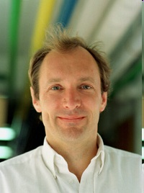
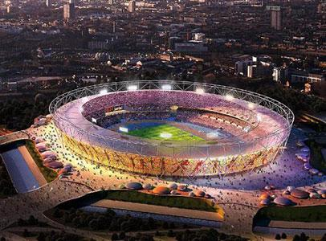
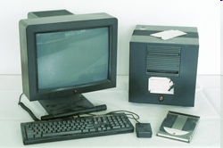
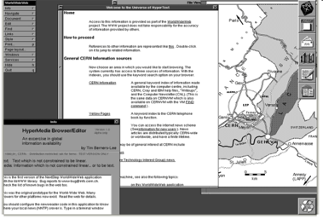
The world's first web server
Tim Berners-Lee (1989)
http://info.cern.ch
“This is for every one”
Architecture
  Internet
  hypertext (HTML)
  Web Browser
  HTTP
Engineer changed the World
Notes:
About http://info.cern.ch
CERN, the European Organization for Nuclear Research, is where it all began in March 1989. A physicist, Tim Berners-Lee, wrote a proposal for information management showing how information could be transferred easily over the Internet by using hypertext, the now familiar point-and-click system of navigating through information. The following year, Robert Cailliau, a systems engineer, joined in and soon became its number one advocate.
The idea was to connect hypertext with the Internet and personal computers, thereby having a single information network to help CERN physicists share all the computer-stored information at the laboratory. Hypertext would enable users to browse easily between texts on web pages using links.
Resources:
[1] http://info.cern.ch/default.html

Slide 5
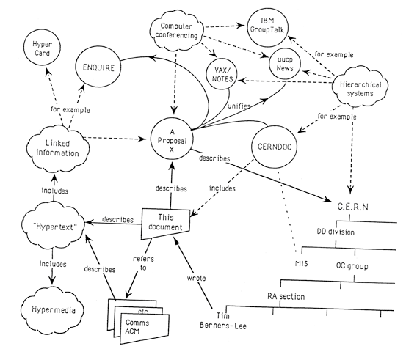
Tim Berners-Lee’s Proposal in 1989
Linked information system
Linked Data was there
Notes:
Where is this module used?
Who wrote this code? Where does he works?
What documents exist about the concept?
Which laboratories are included in that project?
Which systems depend on this device?
What documents refer to this one?

Slide 6
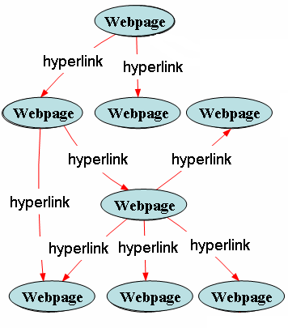
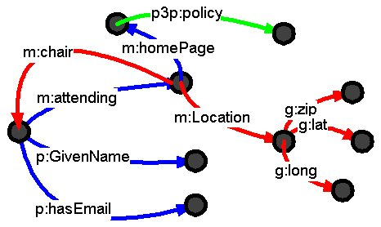
Semantic Web Motivations
In 1999, Tim further proposed “Semantic Web”…
Current Web
Semantic Web
event
person
User Centric &
Computer Understanding
Notes:
Before that, I will first give brief description about the motivation of semantic web.
Currently, there are numerous information on the Web. These information are distributed on the web and are connected with hyperlinks. But these web pages are designed for human and need human to understand content of Webpages and relations between Webpages. The web is user centric and human understanding.
Because the ability of human consuming and processing the information is limited, it affects the fully use of numerous information seriously. therefore, it hinders the web application in the areas of e-government, e-commerce.
So, the inventor of WWW, tim berners Lee put forward the vision of semantic web. He said that the semantic web is not new web, it is the extension of web. In semantic web, the semantic of information is well-defined, and enable computers and people to work in co-operation.”.
In semantic web, we call it user centric and computer understanding.
This is one paradigm of semantic web compared with current web. The webpages and hypelinks are all described as resources and have their uris. Also, they have semantic descriptions. For example, webpages can have metadata definition and the links between webpages have their explicitly defined relationships. For example, linked of data.

Slide 7
Data Web V.S. Semantic Web
hyperlink
person
Webpage
attend
Metadata
Level
location
event
city
Instance Level
Yahoo page1
Tim
Yahoo page1
attend
WWW’13
Twitter page1
location
Rio
Data Web
Semantic Web
Notes:
To make it more clear.

Slide 8
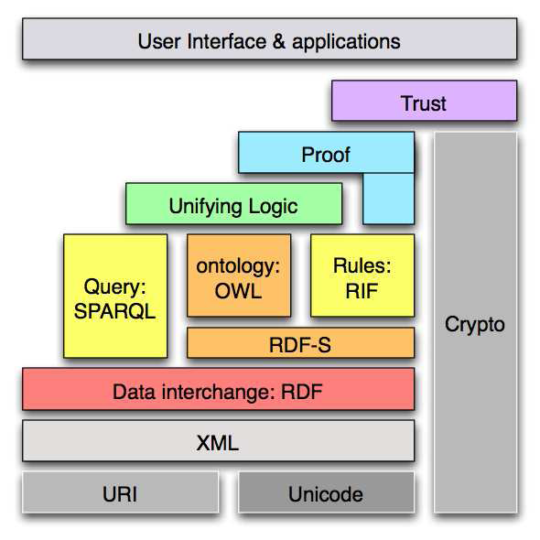
Semantic Web Layercake

Slide 9
In the past ten years…
Ontology engineering
  Creating ontologies
  Mapping ontologies
  Versioning ontologies
  Reasoning ontologies
Triple Store
  SPARQL
  Small-size triple stores
Summary:
  Creating building blocks for SW: languages, ontologies, reasoners, storage/query
  Very AI and Logic driven
  No-domain focus
(subject, predicate, object)
e.g., Bob is 35
Bob knows Fred
Notes:
In the past ten years, people have been working on ontology engineering, like create ontologies, mapping ontologies, versioning ontologies and reasoning ontologies, and also working on ontology storage. These works have created building blocks for semantic web and the goal is to totally change the Web into web semantics.

Slide 10
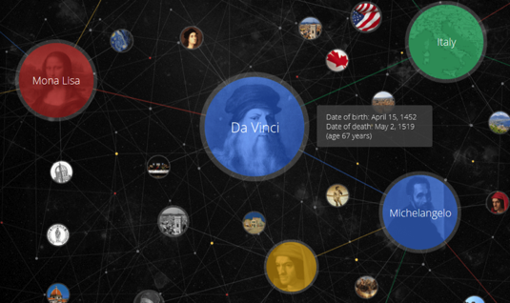
A “mistake”…
“Bible”: RDF, DAML+OIL, OWL
Notes:
So, the idea is to use the new language to replace or to combine with the traditional http protocol. It requires all information providers to add some semantics based on the different languages RDF, DAML, OWL into the traditional web pages.

Slide 11
However,
Unfortunately, no information publisher was really motivated to create the ontology-based knowledge…
Notes:
Unfortunately, no one wants to do that, simply coz information publisher cannot clearly find benefit (“money”) from the ontology-based knowledge engineering work…

Slide 12






Fortunately, social network is coming…
>1000 million users
The 3rd largest “Country” in the world
More visitors than Google
>780 million users
2013, users, 40% yearly increase
400 million
2009, 2 billion tweets per quarter
2010, 4 billion tweets per quarter
2011, tweets per quarter
25 billion
More than 6 billion images
Pinterest, with a traffic higher than Twitter and Google
Notes:
People are happy to contribute different types of knowledge for free.

Slide 13
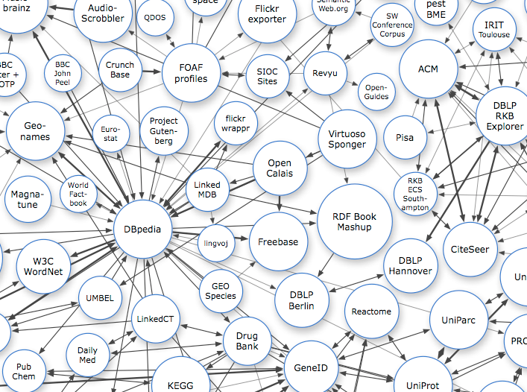

Knowledge Base
Wikipedia->DBpedia
  The central position of multi-lingual DBpedia
  DBpedia contains about 3.64 million entities: 416K persons, 520K places, etc.
Notes:
How many contributors on wikipedia?

Slide 14
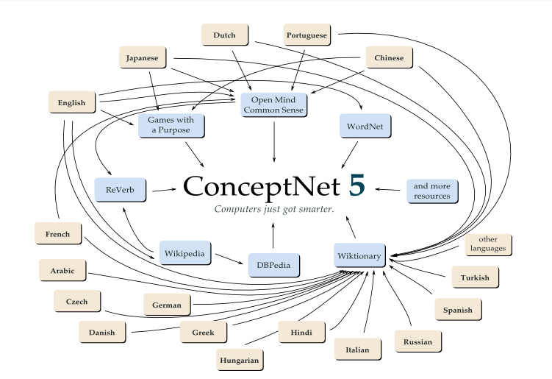
ConceptNet
ConceptNet
  A project initiated by MIT;
  A semantic network containing common sense knowledge computers should know about the world
  Data comes from:
    Open Mind Common Sense project
    DBPedia
    ReVerb
    WordNet
    “game with a purpose”

Slide 15
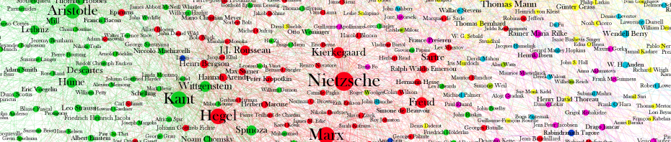
Freebase
Freebase
  A product of Metaweb that was acquired by Google in 2010;
  A collaborative knowledge base containing >23M entities.
  Composed collaboratively by its community members

Slide 16
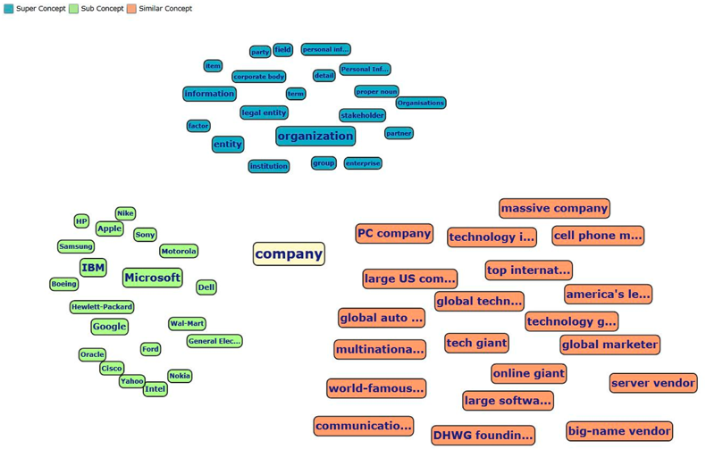
Probase
Text->Knowledge
  A product of Microsoft;
  Concepts are automatically acquired from unstructured web pages;
  Knowledge is represented with uncerntainty.
Probase has a large
concept space
(>2.7M categories).

Slide 17
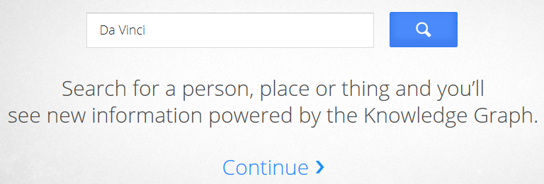
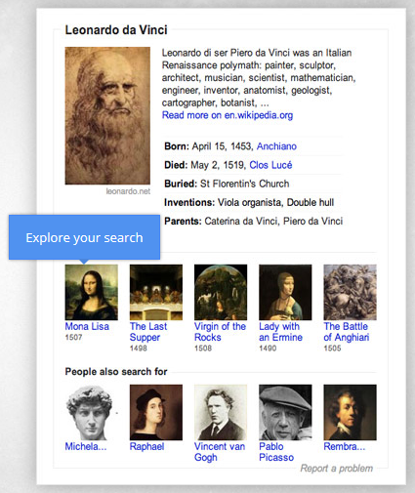
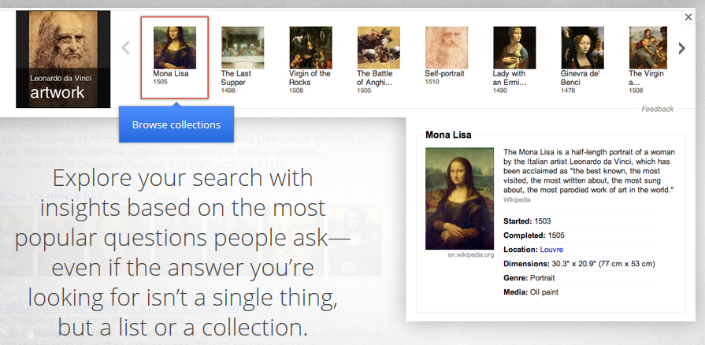
Google Knowledge Graph
Google Knowledge Graph
  Make search “more human”.
  Derived from CIA World Factbook, Freebase and Wikipedia.
  500 million objects, 3.5 billion facts and relationships
  Added to Google search engine on May 16, 2012 in US.
  Also help improve question answering, etc.

Slide 18
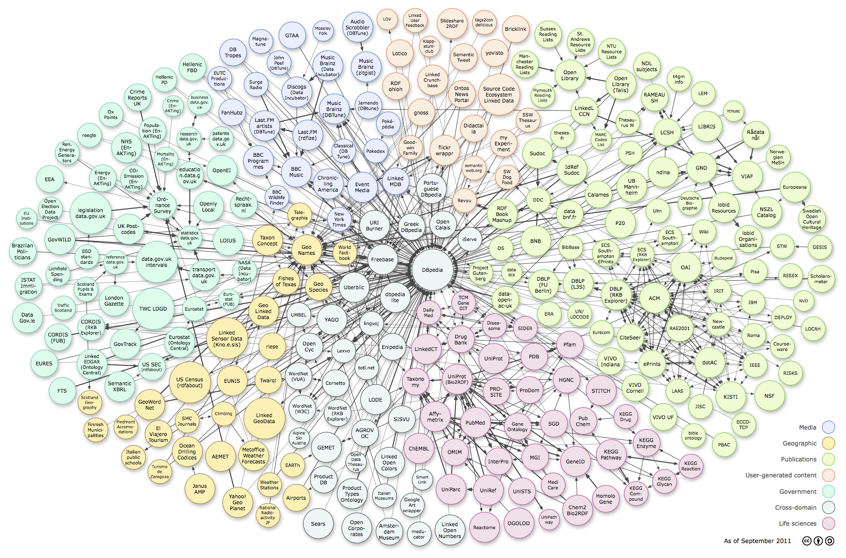
链接数据-万维网上的数据库

Slide 19
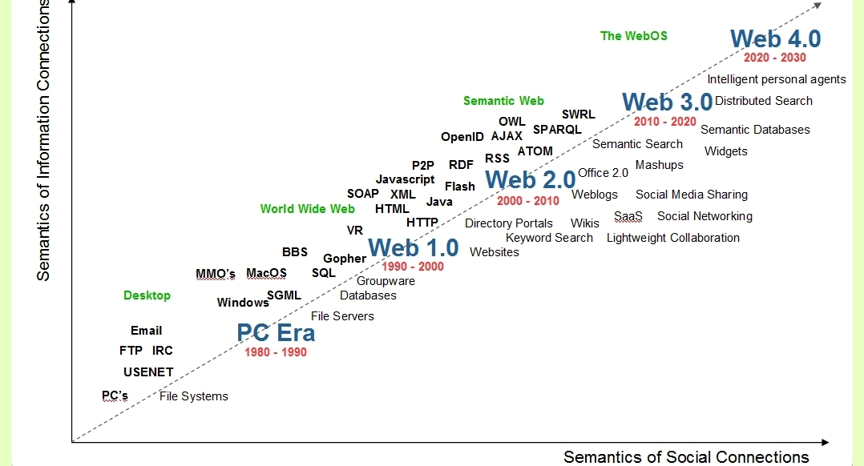
Timeline

Slide 20
Semantic Web Now
Domain-focused
  Medical domain
  Geospatial domain
  Finance domain
Light weight ontologies
  Lifting up existing thesaurus: SKOS
  Manually created high quality ontologies
Entity search/class search/knowledge graph
  More than SPARQL
  Less reasoning
More applied
  Smooth data integration problem
  Enterprise data management systems

Slide 21
The era of big and complex data…
Web trend
  Data centric → User centric
  Offline sparse social → Online dense social
  Large-scale data mining → Big data deep analystic
Tech trend
  Formal text → Informal text
  User modeling → Collective intelligence
  Keyword-based modeling → Semantic-based modeling
  Macro-level analysis → Micro-level analysis
  …

Slide 22
It is the time for Social+Tech to change the world…
Social
+
Tech.
=
Web Semantics

Slide 23
Data2Knowledge platform…
Data2Knowledge
Mining drug discovery data
Predicting targets
Repurposing drugs
Heterogeneous graph search
SLAP
Mining more data…
Mining knowledge from patents:
Competitor analysis
Company search
Patent summarization
...
Mining knowledge from articles:
Researcher profiling
Expert search
Topic analysis
Reviewer suggestion
PatentMiner
ArnetMiner

Slide 24
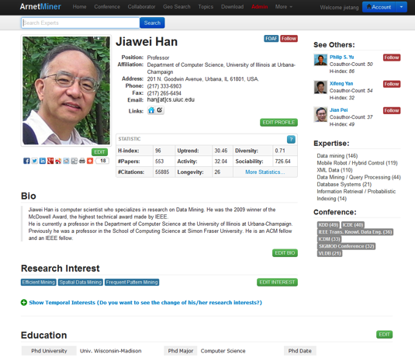
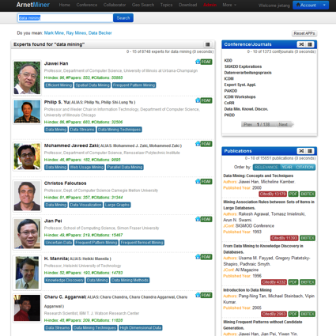
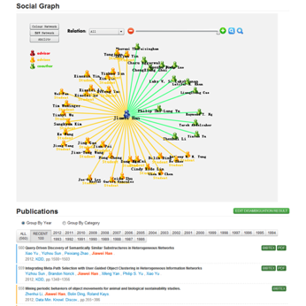
AMiner (ArnetMiner)^{[1]}
Academic Social Network Analysis and Mining system—Aminer (http://aminer.org)
  Online since 2006
  >1 million researcher profiles
  >131 million requests
  >2.35 Terabyte data
  100K IP access from 170 countries / month
  10% increase of visits per month
Key Features
  Mining semantics from academic data
  Deep social network analysis
  Knowledge based search
[1] J. Tang, J. Zhang, L. Yao, J. Li, L. Zhang, and Z. Su. ArnetMiner: Extraction and Mining of Academic Social Networks. In SIGKDD’08. pp.990-998.

Slide 25
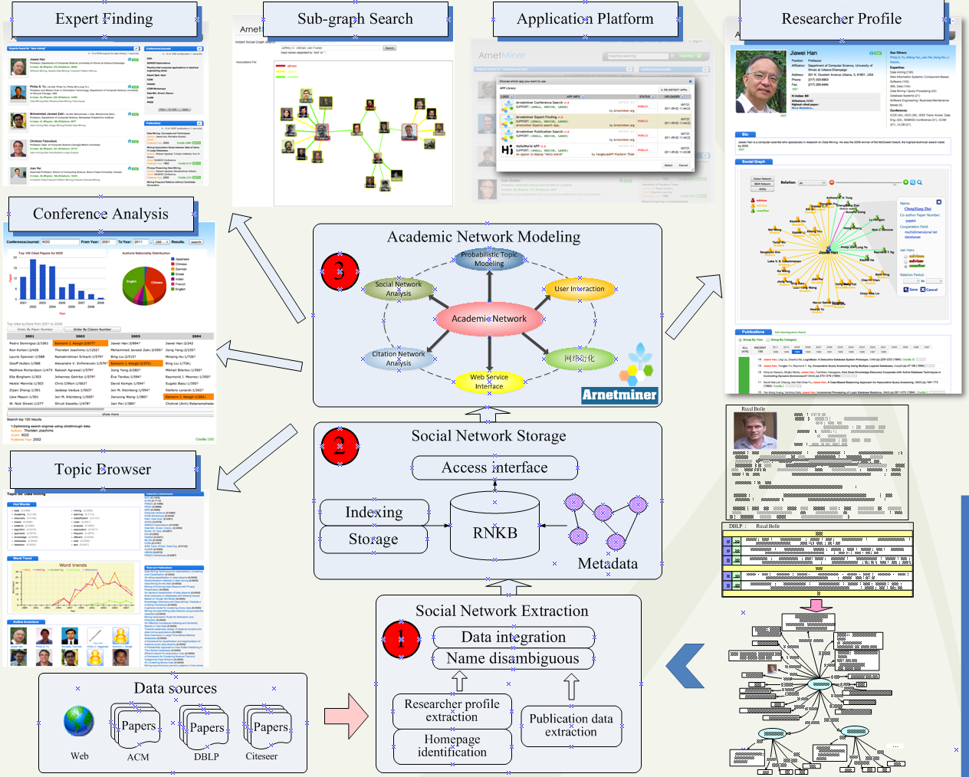
4
- Researcher profile extraction
- Expert finding
- Social network search
- Topic browser
- Conference analysis
- ArnetApp platform
Notes:
AMiner provides comprehensive search and mining services for academic community：
* Researcher Profile Extraction：Automatically create profile for each researcher, including basic information, research interest, social circles, and publication records.
* Expert finding：Find experts, authoritative journals and conferences and influential papers in a specific field.
* Social network search：Find social network sub-graph between researchers.
* Topic browser：Automatically find hot-topics and the evolution trend of the topic.
* Conference Analysis：Analyze authors nationality distribution, top cited papers and authors and find the most successful year.
* ArnetApp platform：Use RESTFul API to invoke searching and data services of Aminer; deploy your applications on Aminer and share them with researchers all around the world.

Slide 26
Mining Data Semantics
  Knowledge extraction
  Name disambiguation
Knowledge Base
Knowledge Acquisition
Knowledge Linking
Knowledge Search
Social Analysis
1
  Ontology matching
  Knowledge linking
2
  Topic modeling
  Expertise search
  Cross domain search
  Topic trend analysis
3
  Social tie analysis
  Kernel community
  Collaborative reading
4

Slide 27
Mining Data Semantics
  Knowledge extraction
  Name disambiguation
Knowledge Base
Knowledge Acquisition
Knowledge Linking
Knowledge Search
Social Analysis
1
  Ontology matching
  Knowledge linking
2
  Topic modeling
  Expertise search
  Cross domain search
  Topic trend analysis
3
  Social tie analysis
  Kernel community
  Collaborative reading
4

Slide 28
Motivating Example
2
Contact Information
1
Educational history
1
Academic services
Publications
1
2
1
coauthor
Ruud Bolle
affiliation
UIUC
Publication #3
2
2
position
Professor
Publication #5
coauthor

Slide 29
Motivating Example
2
Contact Information
1
Two key issues:
  How to accurately extract the researcher profile information from the Web?
  How to integrate the information from different sources?
Educational history
1
Academic services
Publications
1
2
1
coauthor
Ruud Bolle
affiliation
UIUC
Publication #3
2
2
position
Professor
Publication #5
coauthor

Slide 30
Researcher Network Extraction^{[1,2]}
70.60% of the researchers have at least one homepage or an introducing page
85.6% from universities
14.4% from companies
71.9% are homepages
28.1% are introducing pages
40% are in lists and tables
60% are natural language text
There are a large number of person names having the ambiguity problem
Even 3 “Yi Li” graduated the author’s lab
70% moved at least one time
[1] J. Tang, L. Yao, D. Zhang, and J. Zhang. A Combination Approach to Web User Profiling. ACM Transactions on Knowledge Discovery from Data (TKDD), (vol. 5 no. 1), Article 2 (December 2010), 44 pages.
[2] J. Tang, D. Zhang, and L. Yao. Social Network Extraction of Academic Researchers. In ICDM’07. pp. 292-301.

Slide 31
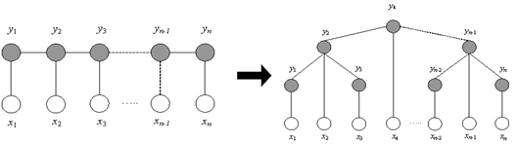

Our Approach Picture
– based on Markov Random Field
Markov Property:
Special Cases:
- Conditional Random Fields
- Hidden Markov Random Fields
Researcher Profiling
Name Disambiguation
Notes:
Markov Random Field (MRF) is a probability distribution of labels (hidden variables) that obeys the Markov property.

Slide 32
Processing Flow^{[1]}
Preprocessing
1
Tagging
Train
Standard word
Determine Tokens
Special word
Assigning tags
Image Token
Inputted docs
Term
Document
Punc. mark
Test
Labeling data
Model Learning
2
Feature
definitions
Learning a CRF model
A unified tagging model
Labeled data
Tagging results
[1] J. Tang, M. Hong, J. Li, and B. Liang. Tree-Structured Conditional Random Fields for Semantic Annotation. In ISWC’06. pp. 640-653.
Notes:
Our approach consists of two stages: training and test.
In training, given the training texts, we first preprocess the text.
In the preprocessing, we separate the text into paragraphs by taking two or more consecutive line breaks as the endings of paragraphs. And then we identify tokens in the paragraphs. We define five types of tokens: ‘standard word’, ‘non-standard word’, punctuation mark, space, and line break.
Then with the labeled data, we define features and learn a unified tagging model.
In test, the informal text is preprocessed in the same way as that in the training, first paragraph segmentation and then token identification.
Next, we assign possible tags to each token based on the type of the token. Finally, we determine the most likely corresponding sequence of tags by using the trained tagging model. In this paper, as the tagging model, we make use of CRF.
Now, three key points are token definition, possible tags assignment, and feature definitions.

Slide 33
Linear CRFs
- Green nodes are hidden vars, - Purple nodes are observations
…
…
…
ADR
…
ADR
AFF
AFF
AFF
AFF
AFF
AFF
POS
POS
POS
POS
POS
POS
OTH
OTH
OTH
OTH
OTH
OTH
He
is
a
Professor
at
UIUC
Notes:
In tagging, we employ Conditional Random Fields (CRF) as the tagging model. The CRF model is used to find the sequence of tags having the highest likelihood.
The tagging can be performed with an efficient algorithm (the Viterbi algorithm).

Slide 34
Modeling with TCRFs
A
D
R
O
Z1
O
E1
…
O
Z2
O
E2
Zipcode:
200030
Email:
ajcoob@...
…
Zipcode:
200030
Email:
ajcorp@...
3. Company Directorate Info
4. Company Registration Info
Notes:
We still use the example in our explanation.
using the TCRF model, we can model the hierarchical dependencies, for example between the text and the sub-section title .
We see the two zipcodes and the two emails respectively have dependencies with the sub-section title “company directorate info” and the sub-section title “company registration info”. We can then use the dependencies to distinguish the two zipcodes and the two emails.

Slide 35
TCRF Model^{[1]}
Model:
Extraction:
How to estimate the parameters?
[1] J. Tang, M. Hong, J. Li, and B. Liang. Tree-Structured Conditional Random Fields for Semantic Annotation. In ISWC’06. pp. 640-653.
Notes:
Now, I would like to explain the TCRF model.
First for a linear-chain model, according to its definition, it can be written as
The first equation is the conditional distribution of the label sequence y given observation sequence x.
Z is a normalization factor. F denotes all features in the sequence. Where t represents edge feature and s represents vertex feature. The edge feature is the feature transited from the previous state and current state. Lambda and mu are feature weights.
In annotation, the task is to find the label sequence that has the largest probability.
In TCRF model, the major difference is the feature computation. Here the edge features include parent-child edge feature, sibling edge feature, child-parent edge feature. And the state feature is the same as that in linear-conditional random fields.
Then, our question is how to estimate the parameters.

Slide 36
Parameter Estimation
(1) With training data D={(x^{(i)}, y^{(i)})}, the log-likelihood objective function:
p(y|x)
p(y^{p}, y^{c}|x)
p(y^{c}, y^{p}|x)
p(y^{s}, y^{s}|x)
where Θ={λ₁, λ₂,…; μ_{k}, μ_{k+1},…}
(2) Derivative of the objective function with respect to a λj
here:
- f denotes both the edge feature t and the vertex feature s;
- c (clique) denotes both edge e and vertex v;
-λ denotes the two kinds of parameters λ and μ.
(3) With the objective function and the derivative function, we can use any gradient-based methods (e.g. L-BFGS) to solve the optimization problem so as to do the parameter estimation
Notes:
Parameter estimation is to determine the parameters Θ={λ1, λ2,…; μk, μk+1,…} from training data D={(x(i), y(i))} with empirical distribution p(x, y).
More specifically, we optimize the log-likelihood objective function with respect to a conditional model p(y|x, Θ):
to facilitate the description, we use f to denote both the edge feature function t and the vertex feature function s; use c to denote both edge e and vertex v; and use λ to denote the two kinds of parameters λ and μ.
Thus, the derivative of the object function with respect to a parameter λj associated with clique index c is:
With the objective function and the derivative functions, we can use any gradient-based methods (for example L-BFGS, Voted Perceptron) to solve the optimization problems so as to do the parameter estimation,
Now we see in the derivative function that the feature functions themselves are easy to be calculated. Then let us see the the conditional probability P(yc|x). It again can be decomposed into four types of probabilities: P(y|x), p(yP, yc|x), p(yc, yp|x), and p(ys, ys|x).
The marginal probabilities can be done using many inference algorithms for undirected model (for example, Belief Propagation [25]). However, as the graphical structure in TCRFs can be a tree with cycles, exact inference can be expensive in TCRFs. We propose utilizing the Tree-based Reparameterization (TRP) algorithm [24] to compute the approximate probabilities of the factors.

Slide 37
Calculating the Marginal Probabilities
Tree-based Reparametrization (TRP)
  TRP is based on the fact that any exact algorithm for optimal inference on trees actually computes marginal distributions for pairs of neighboring nodes.
TRP Algorithm
  Step 1: Initialization
  Step 2: Updates
    Generating a spanning tree
    Propagation on the spanning tree
    Stop if terminations are met
Notes:
TRP is based on the fact that any exact algorithm for optimal inference on trees actually computes marginal distributions for pairs of neighboring vertices .
TRP consists of two main steps: Initialization and Updates.
In each iteration of the Updates, we first select a spanning tree from the undirected graph of the TCRF, then we conduct propagation on the spanning tree.
The updates stop if termination conditions are met.

Slide 38
TRP—Step 1: Initialization
X1
X2
X3
T⁰₁=k·exp(s(x1, y1))
T⁰₂=k·exp(s(x2, y2))
T⁰₃=k·exp(s(x3, y3))
y1
y2
y3
T⁰₁₂=k·exp(t(x, y1, y2))
T⁰₂₃=k·exp(t(x, y2, y3))
T⁰₁₄=k·exp(t(x, y1, y4))
T⁰₂₅=k·exp(t(x, y2, y5))
T⁰₃₆=k·exp(t(x, y3, y6))
T⁰₄₅=k·exp(t(x, y4, y5))
T⁰₅₆=k·exp(t(x, y5, y6))
y4
y5
y6
T⁰₄=k·exp(s(x4, y4))
T⁰₅=k·exp(s(x5, y5))
T⁰₆=k·exp(s(x6, y6))
X4
X5
X6
Notes:
We here give an example of running the TRP. The purple oval denotes the observation text and the green circles denote the annotation labels.
The first step in TRP is initialization. Initialization can be done in many different ways. Here we use Ti to denote the marginal probabilities of each vertex and use Tij to denote the marginal probabilities of each edge in the graph.
Here we use vertex features and edge features to respectively initialize the marginal probabilities.

Slide 39
TRP—Step2: a) Generating spanning tree
Methods: Edge cutting and edge adding
X1
X2
X3
y1
y2
y3
y4
y5
y6
X4
X5
X6
Notes:
Then the second step in TRP is Updates. Before conducting propagation in the updates, we need to find a spanning tree to avoid the expensive computational cost.
Usually, there are two methods for generating the spanning tree: edge cutting and edge adding.
In edge cutting, we try to cut off edges in the graph one by one until a spanning tree is generated. The cutting can be random.
In edge adding, we first remove all the edges and then add the edge one by one until a spanning tree is generated. The adding can also be random.
In our approach, we employ the edge adding method. The processing can be like this… after adding each edge, we check if the generated graph is a spanning tree. If not we continue the adding and if so we stop. We also check to avoid a cycle on the tree.
When selecting spanning trees R={Γi}, the only constraint is that the trees in R cover the edge set of the original undirected graph U. In practice, we select trees randomly, but we select first edges that have never been used in any previous iteration.

Slide 40
TRP—Step2: b) Propagation
X1
X2
X3
y1
y2
y3
y4
y5
y6
X4
X5
X6
Notes:
The second sub-step in the Updates step is propagation.
We use the belief propagation method to compute the marginals on the generated spanning tree.
The updates continue until some termination conditions are satisfied.
So far, the termination conditions are defined as: if the maximal change of the marginals is below a predefined threshold or the update times exceed a predefined number (defined as 1000 in our experiments), then stop the updates.

Slide 41
After The First Iteration
X1
X2
X3
T¹₁
T¹₂
T¹₃
y1
y2
y3
T⁰₁₄
T⁰₃₆
y4
y5
y6
T¹₄
T¹₅
T¹₆
X4
X5
X6
Notes:
This the result after the first update. We see that the two edges y1y4 and y3y6 are not updated as they are not included in the spanning tree.

Slide 42
TRP—Step2
Repeat a) and b) until convergence…

Slide 43
Token Definitions
Standard word
Standard word | Words in natural language
Special word | Including several general ‘special words’ e.g. email address, IP address, URL, date, number, money, percentage, unnecessary tokens (e.g. ‘===’ and ‘###’), etc.
Image token | <IMAGE src="defaul3.jpg" alt=""/>
Term | base NP, like “Computer Science”
Punctuation marks | Including period, question mark, and exclamation mark
Words in natural language
Special word
Including several general ‘special words’
e.g. email address, IP address, URL, date, number, money, percentage, unnecessary tokens (e.g. ‘===’ and ‘###’), etc.
Image token
<IMAGE src="defaul3.jpg" alt=""/>
Term
base NP, like “Computer Science”
Punctuation marks
Including period, question mark, and exclamation mark
Notes:
We identify tokens by using heuristics. There are five types of tokens: ‘standard word’, ‘non-standard word’, punctuation mark, space, and line break. Standard words are words in natural language. Non-standard words include several general ‘special words’, for example, email address, IP address, URL, date, number, and so on. We identify non-standard words by using regular expressions. Punctuation marks include period, question mark, and exclamation mark. Words and punctuation marks are separated into different tokens if they are joined together. Natural spaces and line breaks are also regarded as tokens respectively.

Slide 44
Possible Tag Assignment
Token type | Possible tags
Standard word | All possible tags
Special word | Position, Affiliation, Address, Email, Phone, Fax, Phd/Ms/Bs-date
Image token | Photo, Email
Term token | Position, Affiliation, Address, Phd/Ms/Bs-univ, Phd/Ms/Bs-major
Punctuation marks | Position, Affiliation, Address, Email, Phone, Fax, Phd/Ms/Bs-date

Slide 45
Feature Definition
Content features
Standard Word
Word features
Whether the current token is a word
Morphological features
Whether the word is capitalized
Image Token
Image size
The size of the image
Image height/width ratio
The value of height/width. The value of a person photo is often larger than 1
Image format
JPG or BMP
Image color
The number of the “unique color” used in the image and the number of bits used for per pixel, i.e. 32,24,16,8,1
Face recognition
Whether the current image contains a person face
Image filename
Whether the filename contains (partially) the researcher name
Image “ALT”
Whether the “alt” of the image contains (partially) the researcher name
Image positive keywords
“myself”, “biology”
Image negative keywords
“ads”, “banner”, “logo”

Slide 46
Feature Definition
Pattern features
Term features
Positive words | “Fax:” for Fax, “director” for Position
Special tokens | Whether the current token is a special word
Term | Whether the current token is a term
Dictionary | Whether the current token is included in a dictionary

Slide 47
Profiling Experiments
Dataset (http://arnetminer.org/lab-datasets/profiling/)
  1,000 researchers from ArnetMiner.org
Baseline
  Amilcare
  Support Vector Machines
  Unified_NT (CRFs without transition features)
Evaluation measures
  Precision, Recall, F1

Slide 48
Profiling Results—5-fold cross validation
Profiling Task | TCRF | Unified_NT | SVM | Amilcare
Photo | 89.11 | 88.64 | 88.86 | 31.62
Position | 69.44 | 64.70 | 64.68 | 56.48
Affiliation | 83.52 | 72.16 | 73.86 | 46.65
Phone | 91.10 | 78.72 | 79.71 | 83.33
Fax | 90.83 | 64.28 | 64.17 | 86.88
Email | 80.35 | 75.47 | 79.37 | 78.70
Address | 86.34 | 75.15 | 77.04 | 66.24
Bsuniv | 67.38 | 57.56 | 59.54 | 47.17
Bsmajor | 64.20 | 59.18 | 60.75 | 58.67
Bsdate | 53.49 | 40.59 | 28.49 | 52.34
Msuniv | 57.55 | 47.49 | 49.78 | 45.00
Msmajor | 63.35 | 61.92 | 62.10 | 57.14
Msdate | 48.96 | 41.27 | 30.07 | 56.00
Phduniv | 63.73 | 53.11 | 57.01 | 59.42
Phdmajor | 67.92 | 59.30 | 59.67 | 57.93
Phddate | 57.75 | 42.49 | 41.44 | 61.19
Overall | 83.37 | 72.09 | 73.57 | 62.30
83.37
Notes:
Address and affiliation always contain many tokens, the dependencies between the tokens can help improve the accuracy, other approaches can not utilize the dependencies

Slide 49
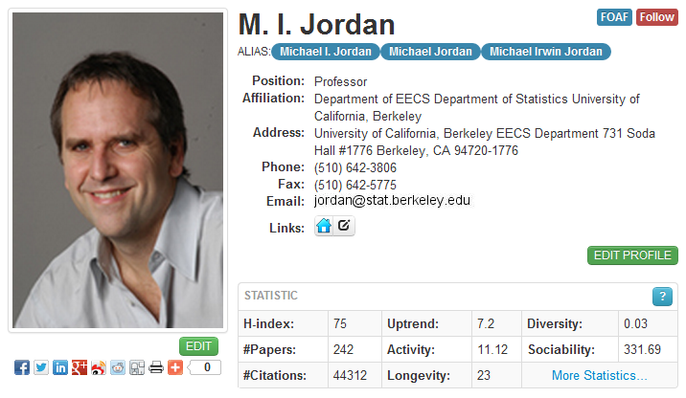
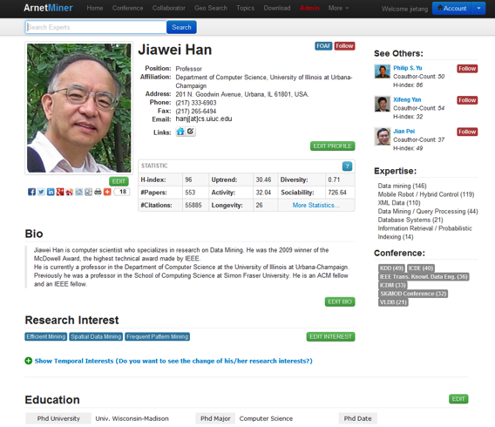
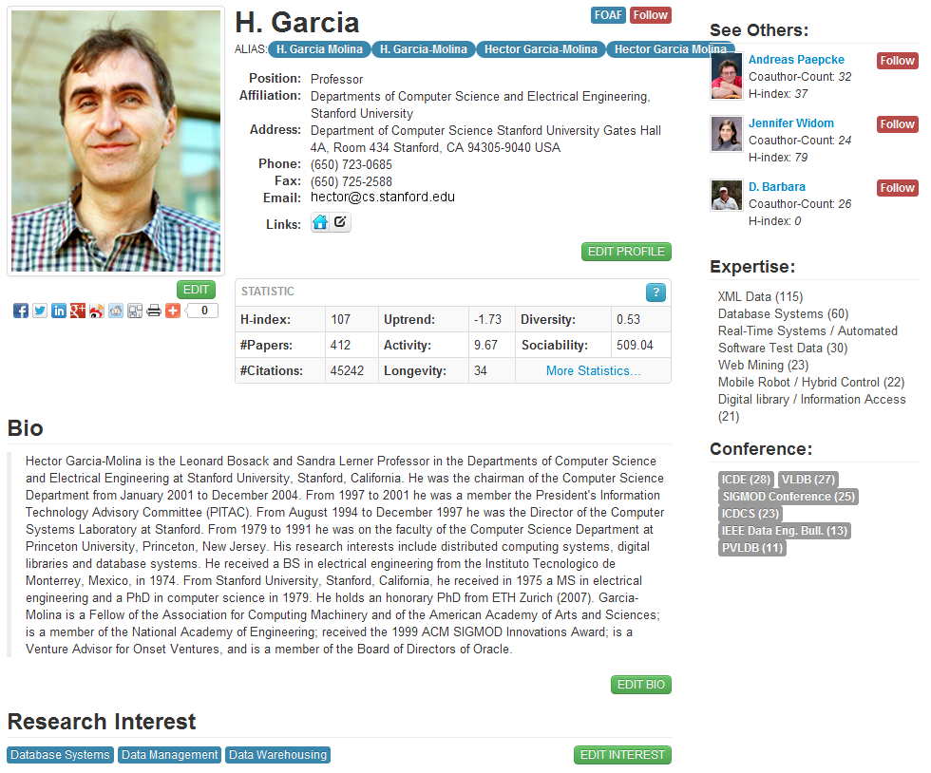
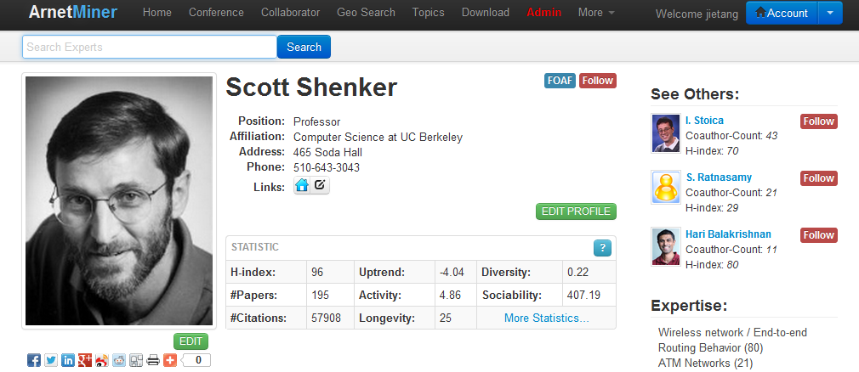
Researcher Profile Database^{[1]}
Extracted more than 1,000,000 researcher profiles from the Web
[1] J. Tang, L. Yao, D. Zhang, and J. Zhang. A Combination Approach to Web User Profiling. ACM Transactions on Knowledge Discovery from Data (TKDD), (vol. 5 no. 1), Article 2 (December 2010), 44 pages.

Slide 50
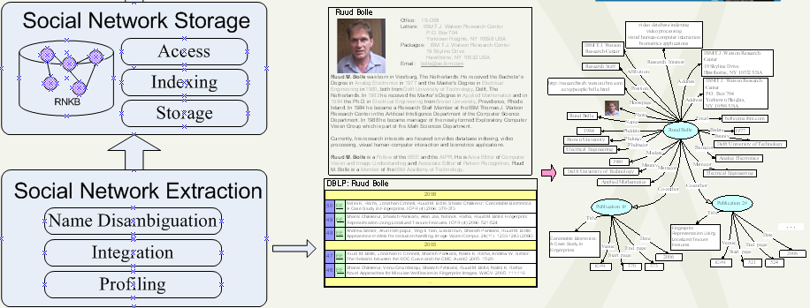

Slide 51
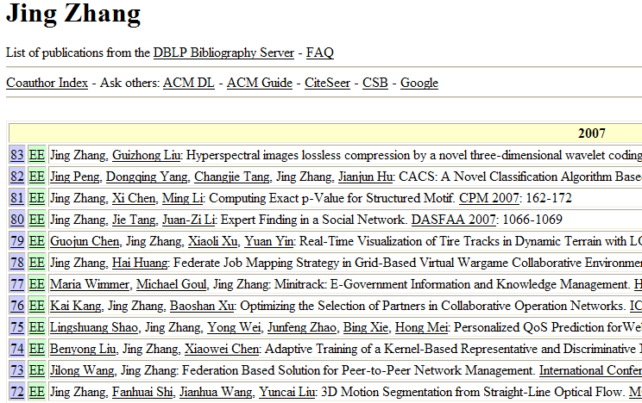
Name Disambiguation^{[1,2]}
Name | Affiliation
Jing Zhang (26) | Shanghai Jiao Tong Univ.
 | Yunnan Univ.
 | Tsinghua Univ.
 | Alabama Univ.
 | Univ. of California, Davis
 | Carnegie Mellon University
 | Henan Institute of Education
- How to perform the assignment automatically?
- How to estimate the person number?
[1] J. Tang, A.C.M. Fong, B. Wang, and J. Zhang. A Unified Probabilistic Framework for Name Disambiguation in Digital Library. IEEE Transaction on Knowledge and Data Engineering (TKDE) , Volume 24, Issue 6, 2012, Pages 975-987.
[2] X. Wang, J. Tang, H. Cheng, and P. S. Yu. ADANA: Active Name Disambiguation. ICDM’11, pages 794-803, 2011.

Slide 52
Our Method to Name Disambiguation
A hidden Markov Random Field model
Observable Variables X represent publications
Hidden Variables Y represent the labels of publications
Paper relationships define the dependencies over hidden variables
[1] D. Zhang, J. Tang, J. Li, and K. Wang. A Constraint-Based Probabilistic Framework for Name Disambiguation. CIKM’07. pp. 1019-1022.

Slide 53
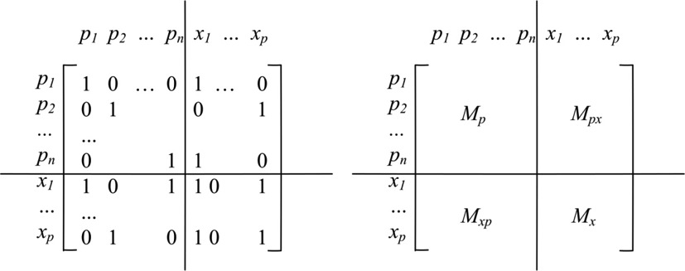
Relationship Definition
C | W | Constraint Name | Description
c₁ | w₁ | Co-Conference | p_{i}.pubvenue = p_{j}.pubvenue
c₂ | w₂ | CoAuthor | r, s>0, a_{i}^{(r)}=a_{j}^{(s)}
c₃ | w₃ | Citation | p_{i} cites p_{j} or p_{j} cites p_{i}
c₄ | w₄ | Constraints | Feedbacks supplied by users
c₅ | w₅ | τ-CoAuthor | one common author in τ extension

Slide 54
Parameterized Distance Function
We define the distance function as follows (Basu, 04):
where
We can see that actually maps each vector x_{i} into another new space, i.e. A^{1/2}x_{i}
To simplify our question, we define A as a diagonal matrix

Slide 55
Objective Function
maximize
2
1
2
minimize

Slide 56
EM Framework
Initialization
  use constraints to generate initial k clusters
E-Step
M-Step
  Update cluster centroid
  Update parameter matrix A

Slide 57
Estimation of Person Number K
We use Bayesian Information Criterion (BIC) as the metric to estimate the person number K
Process:
  Start from K=1;
  Split the cluster if BIC(M_{k+1})>BIC(M_{k});
  Repeat until no split.

Slide 58
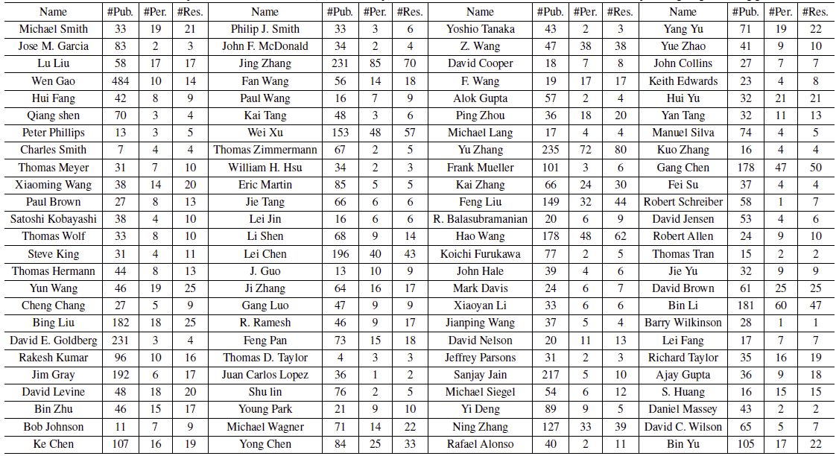
Disambiguation Experiments
Data Sets:
Notes:
The simplifying form is popular in bibliographic records.

Slide 59
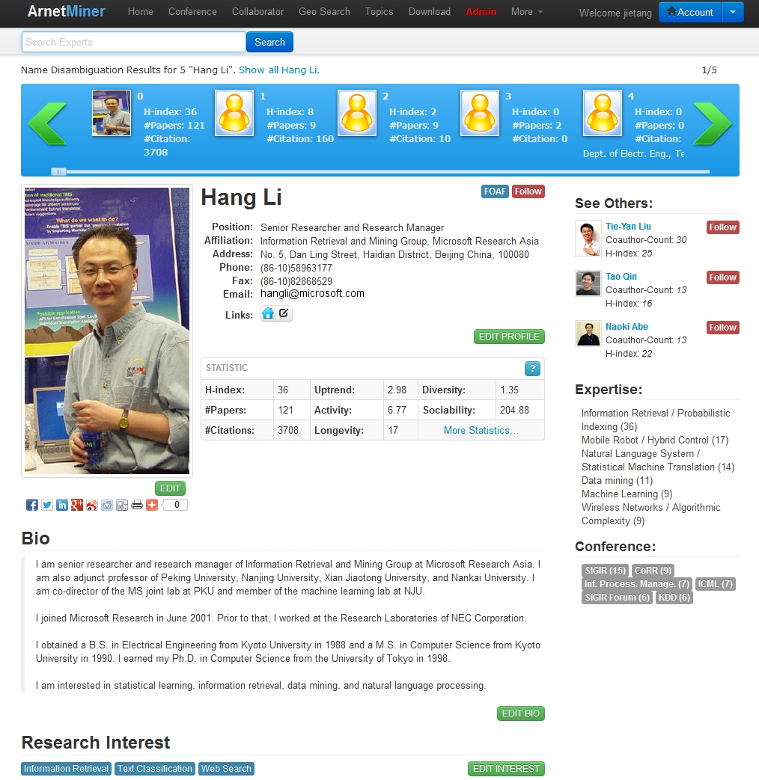
Disambiguation Performance
Our Approach

Slide 60
Contribution of Relationships

Slide 61
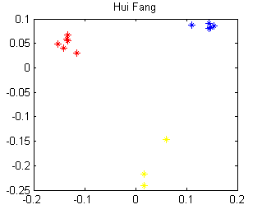
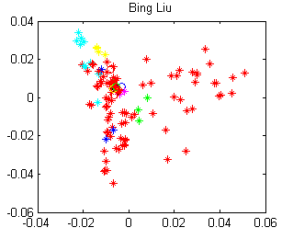
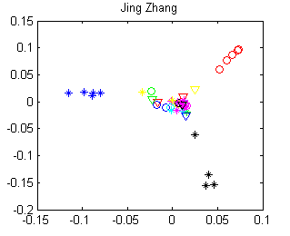
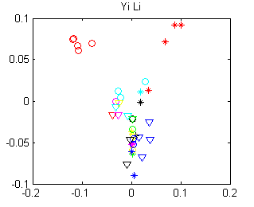
Distribution Analysis
All methods can achieve good performance
Our method can achieve good performance and also find the person number correctly
Our method can obtain not bad results, but cannot accurately find the person number

Slide 62
Mining Data Semantics
  Knowledge extraction
  Name disambiguation
Knowledge Base
Knowledge Acquisition
Knowledge Linking
Knowledge Search
Social Analysis
1
  Ontology matching
  Knowledge linking
2
  Topic modeling
  Expertise search
  Cross domain search
  Topic trend analysis
3
  Social tie analysis
  Kernel community
  Collaborative reading
4

Slide 63
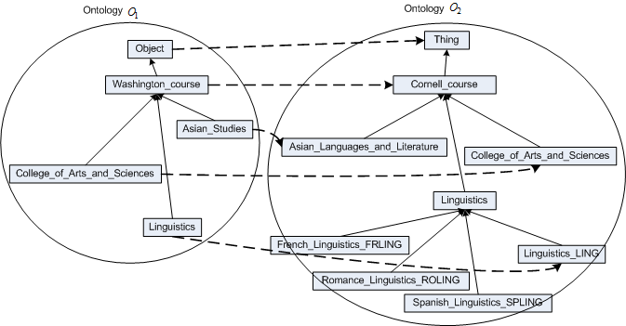
What is?
Notes:
Here, we use an example to explain what is schema matching.
The two schemas are defined respectively for courses of Washington university and Cornell university. The definition is organized into a hierarchy. The rectangle represents concept and the directed edge represents relation.
The task of ontology mapping is to find the corresponding relationships between the concepts of the two ontologies.
The red directed line represents the mapping from schema o1 to schema o2.

Slide 64
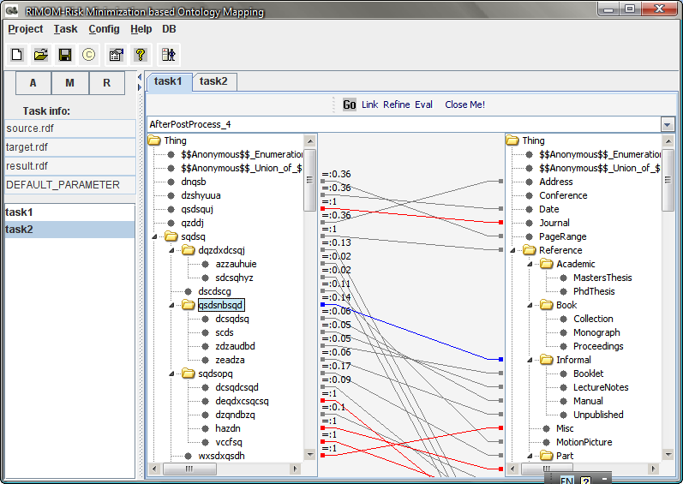
RiMOM^{[1-3]}-A Tool for Ontology Matching
http://keg.cs.tsinghua.edu.cn/project/RiMOM/
[1] J. Tang, J. Li, B. Liang, X. Huang, Y. Li, and K. Wang. Using Bayesian Decision for Ontology Mapping. Journal of Web Semantics, Vol(4) 4:243-262, December 2006.
[2] J. Li, J. Tang, Y. Li, and Q. Luo. RiMOM: A Dynamic Multi-Strategy Ontology Alignment Framework. IEEE TKDE, Vol(21) 8:1218-1232, 2009.
[3] Q. Zhong, H. Li, J. Li, G. Xie, J. Tang, and L. Zhou. A Gauss Function based Approach for Unbalanced Ontology Matching. SIGMOD’09, pages 669-680, 2009.
Notes:
64

Slide 65
Knowledge Linking Outline
Dynamic Multi-strategy Ontology Matching
Unbalanced Ontology Matching
Cross-source Knowledge Linking

Slide 66
RiMOM: A Dynamic Multi-strategy Ontology Alignment Framework^{[1]}
Matching = Multi-strategies + Strategy selection
- Linguistic similarity factor
- Structural similarity factor
Concept/Attribute name
Concept/Attribute path
Concept/Attribute’s description
Instance
Structure
Associate a loss for each candidate matching
Strategy selection: determine if we should use the strategies
[1] J. Li, J. Tang, Y. Li, and Q. Luo. RiMOM: A Dynamic Multi-Strategy Ontology Alignment Framework. IEEE TKDE, Vol(21) 8:1218-1232, 2009.
Notes:
Our method the combination of multiple strategies and global optimization.
In mapping discovery, different information can be exploited, e.g. element name, element path, element description, instance, and taxonomy structure. We designed a method for each of the available clues.
Our method is a global optimization. Each candidate mapping is associated with a loss.
By local optimization, it is aimed at finding best mapping for each source element.
By global optimization, it is aimed at finding best mapping for the two schemas.

Slide 67
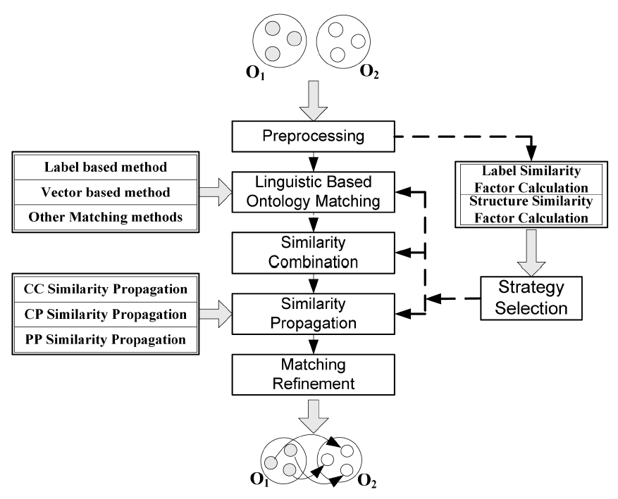
A General Processing Flow
Strategy pool
Similarity factor

Slide 68
Multiple Strategies
Concept name: similarity(washington_course, cornell_course)
Concept path: similarity(/object/washington_course, /thing/cornell_course)
Concept description: classifier = train(O₂) and classify (O₁, classifier)
Instance: classifier = train(O₂) and classify (O₁, classifier)
Structure: taxonomy information. E.g. Hypernyms and Hyponyms
Notes:
We use an example to explain the multiple strategies in our approach.
In this example, the element washington_course in the source schema to cornell_course in the target schema is assigned as a candidate mapping.
First we use the element names to calculate their similarity. We first conduct word tokenization for the element names. Then for each pair of words, we employ a dictionary wordnet to compute their semantic similarity. And we also utilize a statistical method to compute their statistical similarity.
Then for each element, we can obtain its path from the root node of the schema. We then make use of the similar method to calculate the similarity of the two element paths.
In schema, element usually has description and description is often expressed by natural language and is also one kind of valuable information for ontology mapping. Typically, it reflects more meaning of the element than element name itself. This is an example of the two element descriptions.
We use text classification method to find mapping by using the element description. Specifically, we use word frequencies in element descriptions of the target ontology to construct a classifier. Then we exploit words in element descriptions of the source schema for prediction.
An instance typically has a name and a set of properties together with their values. We treat all of them as the textual content of the instance. We also take the documents that related to the instance as a kind of source to its textual content. For example, this is a related document to the washington_course’s instance. We also make use of the word frequencies in the textual content of the instance to discover mappings. the principle is similar to that in method of element description.
Finally, we also employ the structural information. The structure information include taxonomy information. E.g. Hypernyms and Hyponyms. This is an example of using structure information. In the example, we have already know two mappings through the other strategies, then we can infer that the other two elements might also have a mapping.

Slide 69



Multiple Linguistic Strategies
Edit distance on entity’s label
WordNet:
Vector-based similarity

Slide 70
Similarity Propagation
Ontology 1 Ontology 2
The construction of an intermediate graph from original ontologies
Notes:
Now RiMOM will use similarity propagation upon the combined result, based on the structural information in ontologies. The assumption behind this method is, if two entities have a high similarity, then maybe their siblings or parents or properties could also be of high similar. So a high similarity will give other entity pairs which have relations with these corresponding entities a positive impact. And vice versa. Thus we could propagate the similarity across the entity pairs, improving the results. For the propagation, first we should construct an intermediate graph based on the original ontologies. The nodes in the intermediate graph are entity pairs, and each node is associated a value indicating the similarity between the entities. For two nodes in the intermediate graph, if the entities are connected by the same type of relation in their corresponding ontologies, the these two nodes are connected by this type of relation. Here’s an example. In Ontology 1, Reference is connected to Thing through subClassOf relationship, and in Ontology 2, Entry is connected to Object through the same subClassOf relationship, then in the intermediate graph, the node (Reference, Entry) is connected to (Thing, Object) through subClassOf. And it’s same for the hasProperty relation. For each edge in the intermediate graph, we will assign a weight to it, this value indicates how strong the similarity will pass through the corresponding edge. We will demonstrate the propagation in the next page.

Slide 71
Similarity Propagation (cont.)
0.7
Propagate similarities along edges
Three types of edges:
  Class to Class (CCP)
  Class to Property (CPP)
  Property to Property (PPP)
weight=0.5
0.3
0.6
0.5
0.2
0.6+0.7*0.25+0.9*0.5=1.225
0.9
Notes:
The Propagation is a process of iteration. In each iteration, one node’s similarity is updated by the similarities of it’s adjacent nodes, and the weights of edges are taken into account. Let’s look at this intermediate graph. Suppose we’ve got the similarity for these nodes. And suppose all the weights of edges equal to 0.5. Then in next iteration, node (Reference, Entry) will get similarity from (Thing, Object) and (location, place). Thus it’s value will become 0.6+0.7*0.5+0.9*0.5=1.4. The similarities of other nodes will change also. Then we’ll do a normalization, scaling each one to the range of 0 and 1. When between two adjacent iteration the average similarity change for each node is small enough, we stop the iteration and output the result to next step. In experiments we’ve found that propagating through all types of edges is not appropriate for some mapping tasks. Thus we classify the edges into 3 categories. The first one contains the edges connecting classes, like the subClassOf relation. The second one contains the edges connecting classes and properties, like the hasProperty and range relations. The third one contains the edges connecting properties, for example the subPropertyOf relation. We use strategy selection to determine which of the three categories of edges will take effect when we do propagation.

Slide 72
Strategy Pool
Strategy pool
Vector-similarity
Edit-distance
weighted vector generation
  content feature
  structure feature
cosine similarity
Sim = 1-ED(label₁, label₂)
Background-knowledge
Similarity-combination
external knowledge
similarity definition
Path-similarity
Similarity-propagation
entity path
path similarity definition
three propagation strategies
CCP, PPP, CPP

Slide 73
Strategy Selection—Similarity factor
Ontology 1 Ontology 2
Label similarity factor
Structure similarity factor
F_LS = 6/10
F_SS = 1/2
max(#c₁, #c₂) = 10
max(#nonleaf_c₁, #nonleaf_c₂) = 2
Notes:
Next I’ll describe how we get these factors. The Label Similarity Factor is computed by counting the number of entity pairs in which two entities have the same label and then dividing the maximum number of entities in both ontologies. Here is an example. Suppose we have two ontologies: ontology 1 and ontology 2. The eclipses represent the entities. Then there are 6 entity pairs of entities with same label, as connected by the red lines. And the maximum number of entities is 10, so the Label Similarity Factor of these two ontologies equals 0.6. By counting the number of “common” entity pairs between these two ontologies and then dividing the maximum number of non-leaf entities, we will get the Structure Similarity Factor. For “common” entity pairs we mean the entity pairs in which the two entites have the same number of sub-entities. So in this example, Ontology 1 and Ontology 2 only have one pair of “common” entity as indicated by the red line. Ontology 1 has 2 non-leaf entities, while Ontology 2 has only 1. Therefore the Structure Similarity Factor is 0.5. These two factors will be used as the basis of strategy selection.

Slide 74
Strategy Selection
Strategy Selection
  Selection with the two similarity factors
  Determining whether a strategy is to be used in the alignment process
  E.g. if F_SS>0.25, we use CCP, CPP, and PPP for propagation. …
Linguistic Strategy
  Adding structural features in vector-based similarity

Slide 75
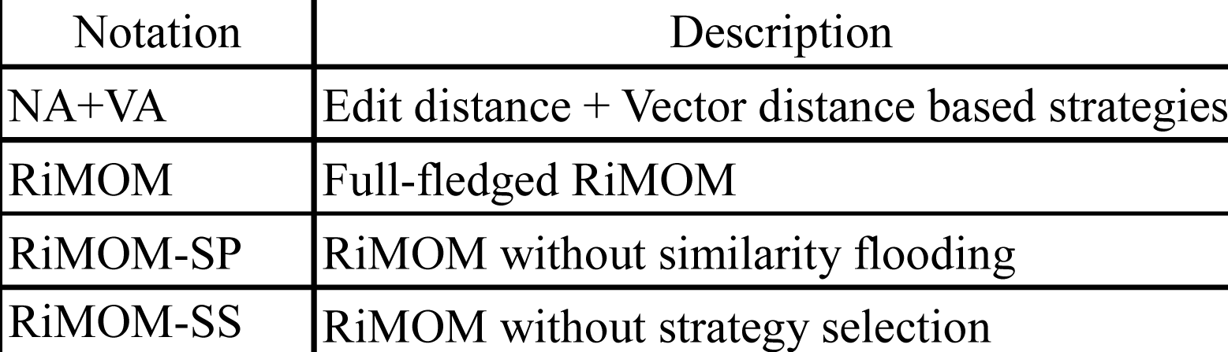
Data Sets
OAEI 2006
  Benchmark (15-69), 53 alignment tasks
  Directory: (4,500), Yahoo and ODP
  Food: (16,000 vs. 41,000), two SKOS thesaurus
OAEI 2007
Comparison methods

Slide 76
Statistics on the Data Set
Data set | Ontology | #concept | #attribute | #alignment （ground truth） | #instance
Benchmark | Reference Ontology | 33 | 59 | -- | 76
 | 101 | 33 | 61 | 91 | 111
 | 103 | 33 | 61 | 91 | 111
 | 104 | 33 | 61 | 91 | 111
 | 201 | 34 | 62 | 91 | 111
 | 202 | 34 | 62 | 91 | 111
 | 204 | 33 | 61 | 91 | 111
 | 205 | 34 | 61 | 91 | 111
 | 221 | 34 | 61 | 91 | 111
 | 222 | 29 | 61 | 91 | 111
 | 223 | 68 | 61 | 91 | 111
 | 224 | 33 | 59 | 91 | 0
 | 225 | 33 | 61 | 91 | 111
 | 228 | 33 | 0 | 33 | 55
 | 230 | 25 | 54 | 75 | 83
 | 301 | 15 | 40 | 61 | 0
 | 302 | 15 | 31 | 48 | 0
 | 303 | 54 | 72 | 49 | 0
 | 304 | 39 | 49 | 76 | 0

Slide 77
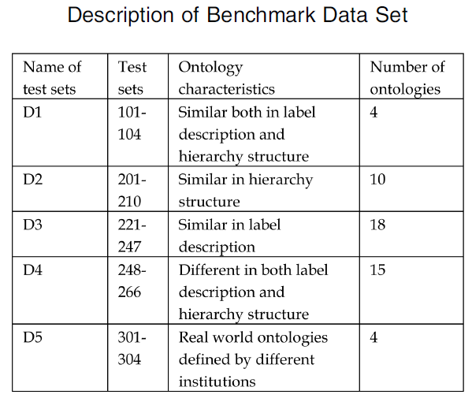
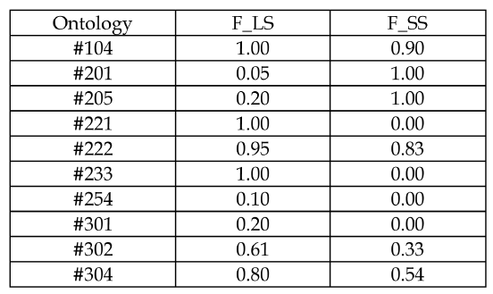
Similarity between Ontologies

Slide 78
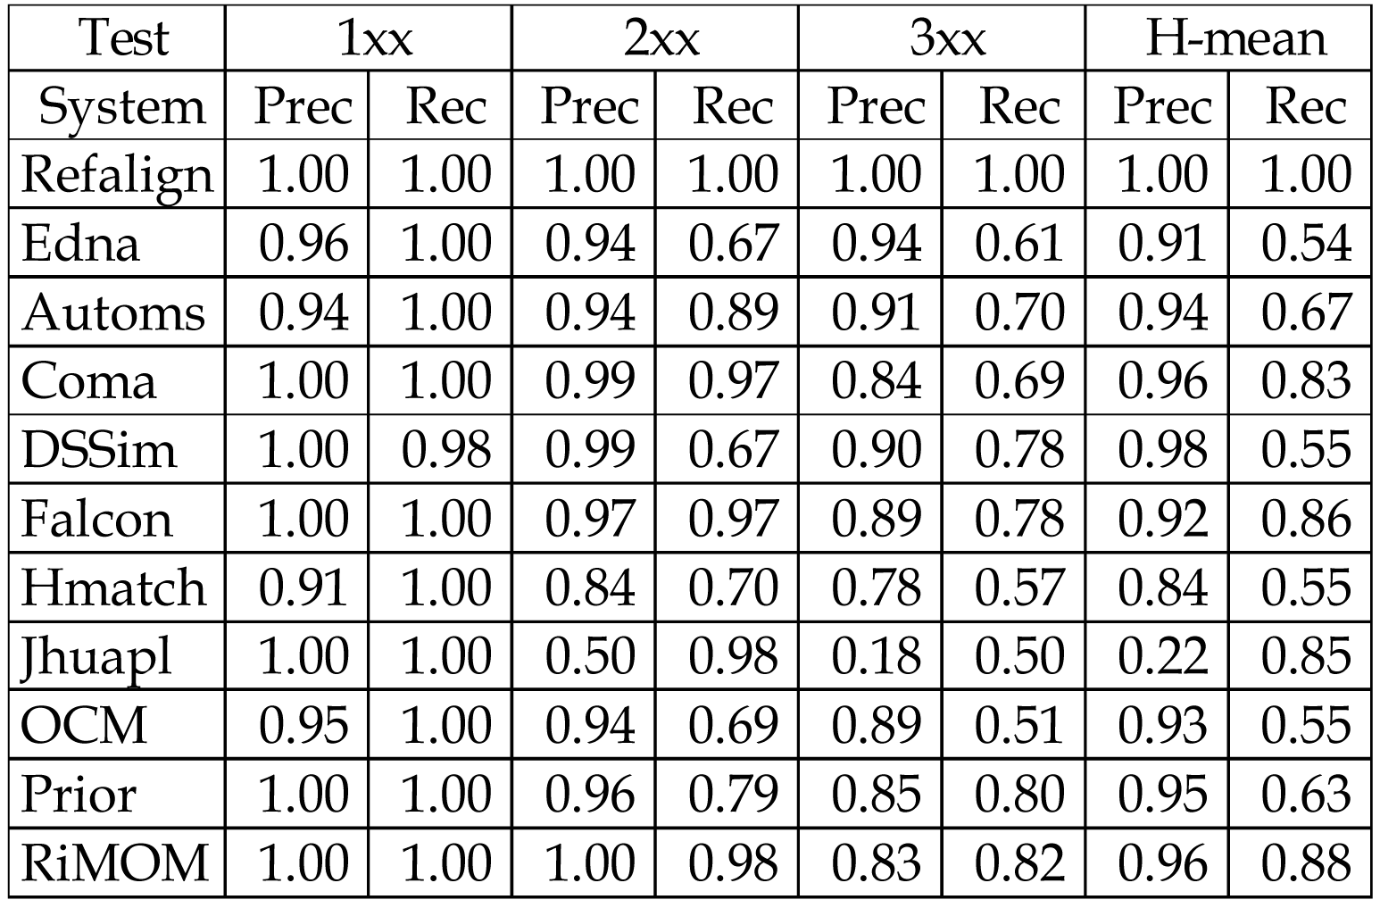
Results on OAEI2006

Slide 79
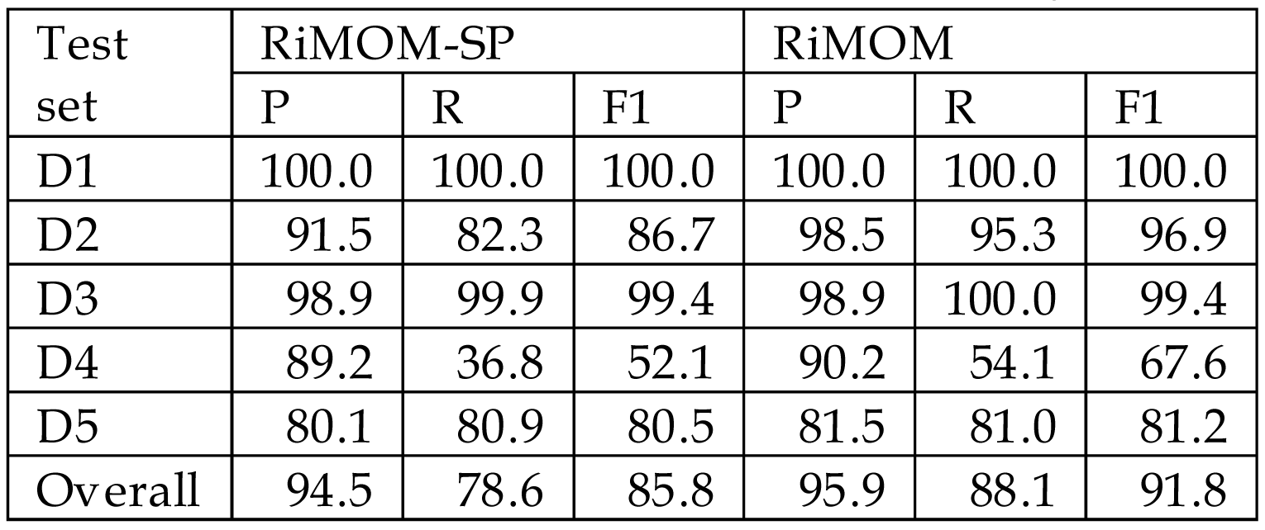
RiMOM vs. RiMOM-SP

Slide 80
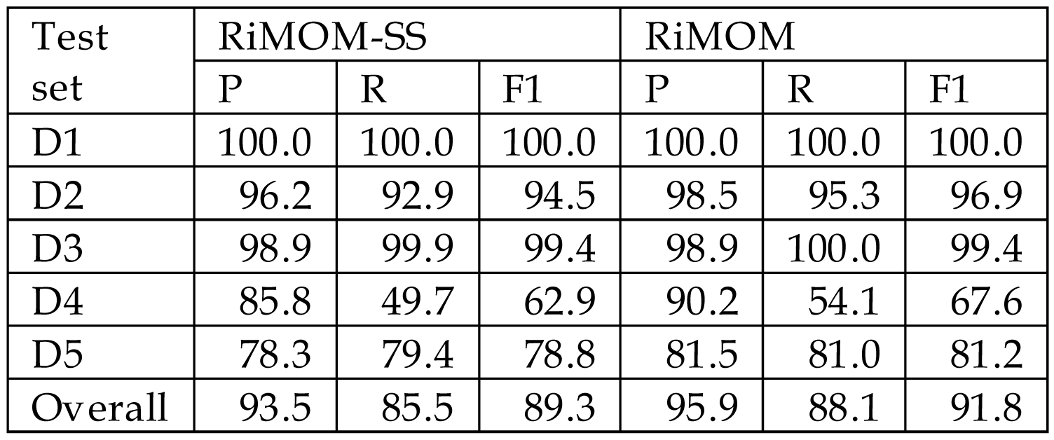
RiMOM vs. RiMOM-SS

Slide 81
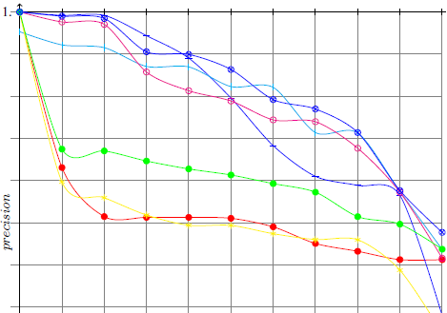

Results on OAEI 2006

Slide 82
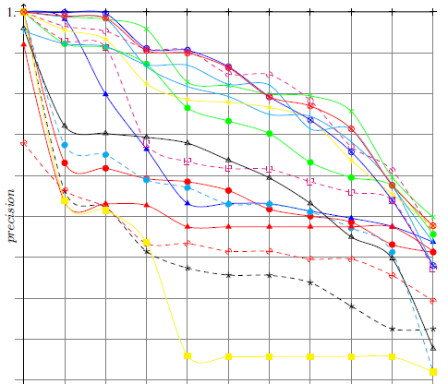
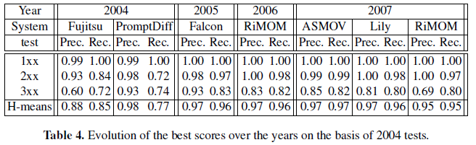
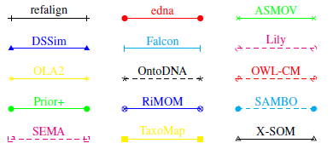
Results on OAEI 2007

Slide 83
Result on OAEI 2008

Slide 84
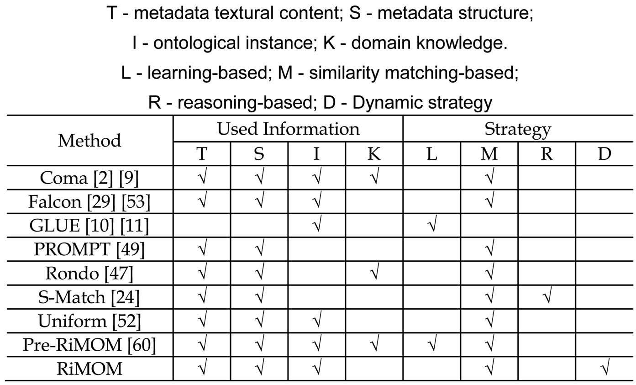
Relationship with Several Classical Methods

Slide 85
Experiences
Structure information is very important in many alignment tasks for achieving high performance
An effective method for combining the multiple strategies can enhance alignment performance
  Investigate more factors to describe the characteristics of the ontologies
  Exploit new strategies for ontology alignment
Notes:
Experiences in exploiting several new strategies for ontology alignment
Further improve precisions without decreasing the recall
Benchmark: 96%
Food task: 40%
Directory: 71%

Slide 86
Knowledge Linking Outline
Dynamic Multi-strategy Ontology Matching
Unbalanced Ontology Matching
Cross-source Knowledge Linking

Slide 87

Unbalanced Ontology
Several challenges:
  Single domain vs. multiple domains
  Small size vs. large-size ontology

Slide 88
Key Problems
Linguistic-based strategy
  |O₁| x |O₂|
Structure-based strategy
  In memory graphs
  Iterative propagation
Onto1 Onto2

Slide 89
Our Approach^{[1]}
1.Select candidates
3. matching
2. construct
Sub-ontology
Lightweight ontology
Heavyweight ontology
[1] Q. Zhong, H. Li, J. Li, G. Xie, J. Tang, and L. Zhou. A Gauss Function based Approach for Unbalanced Ontology Matching. SIGMOD’09, pages 669-680, 2009.

Slide 90

Step 1: Select Candidates
  Complexity:
  |O₁| x |O₂|
Edit-distance
e.g. site vs. cite
WordNet
Similarity between c_{i} and O_{l}

Slide 91





Step 2: Construct Sub-ontology
similarity
influence

Slide 92

Step 3: Finding Matching Results
Onto1 Onto2

Slide 93
Data Set
OAEI 2007
  GEMET: (5,280) The European Environment Agency GEMET ontology.
  AGROVOC: (28,439) AGROVOC thesaurus provided by Food and Agriculture Organization of the United Nations.
  NAL: (42,326) The Agricultural thesaurus released by the National Agricultural Library.
Evaluation Measures
  Precision
  Recall
  F1-Measure
  CPU Time

Slide 94




Data Statistics

Slide 95



Precision

Slide 96



Recall

Slide 97

F1-Measure

Slide 98
Knowledge Linking Outline
Dynamic Multi-strategy Ontology Matching
Unbalanced Ontology Matching
Cross-source Knowledge Linking

Slide 99


Motivation
Wikipedia Base
  4,096,240 English articles
  602,972 Chinese articles
  218,000 Cross lingual links (October 2011) between Ch-En
  Baidu Baike, 5.5 million Chinese articles
  Hudong, 6.8 million Chinese articles
  Find missing crosslingual links
  [Sorg 2008] German-English
  [Oh 2008] Japanese-English
Notes:
However, there is one problem with Wikipedia. Articles in different languages are highly unbalanced in Wikipedia. Here is a figure that shows the top 12 language editions of Wikipeida, English Wikipedia has the largest number articles, and then German and French Wikipedias. We find that there are big differences among the top three editions, not to mention taking other editions into account. For example, there are only 382 thousand Chinese articles in Wikipedia, about only 10% of English articles. Because large number of English articles do not have corresponding Chinese articles, there are only 218 thousand crosslingual links between English and Chinese articles in Wikipedia. The unbalance problem makes it difficult to extract crosslingual links with sufficient coverage from Wikipedia.
But on the other hand, there several other large scale wiki knowledge bases besides Wikipedia. For example Baidu Baike and Hudong, two large scale Chiense wiki knowledge bases, contain 3.9 million and 5.1 million Chinese articles respectively. If we can build crosslingual links between Baidu/Hudong and Wikipedia, the scale of Chinese-English crosslingual resource would be greatly enriched.

Slide 100
Knowledge Linking^{[1]}
The problem of knowledge linking
  Given K₁ and K₂
  For each a_{i} ∈ K₁ ，find a_{j} ∈ K₂ that
  a_{i}⇔a_{j}
  Crosslingual knowledge linking
    K₁ and K₂ are in different languages
Can we find cross lingual links across heterogeneous wiki knowledge bases?
[1] Z. Wang, J. Li, Z. Wang, and J. Tang. Cross-lingual Knowledge Linking Across Wiki Knowledge Bases. WWW’12, pages 459-468, 2012.

Slide 101


Knowledge Linking
Titles
Links
Categories
Cross lingual links
Authors
Notes:
Here is an example for a possible crosslingual link between Wikipedia and Baidu Baike. The left side is an English article “Anaerobic exercise” in Wikipedia, which describes a intense exercise used by athletes in non-endurance sports to promote strength, speed and power and by body builders to build muscle mass. In the left side bars, there are several crosslingual links link to German, Japanese equivalent articles, but without links to Chinese article. However, we can find the Chinese article “无氧运动” in Baidu. This is an example of manually finding equivalent articles between Wikipedia and Baidu, when we build an approach to automatically find these links, there will be several challenges.
anaerobic [,ænεə'rəubik]

Slide 102
Several key challenges
Linguistics
  Translation based methods highly depend on the specific translation tools. Can we find cross lingual links without translation?
Model
  Different kinds of information that could be used in knowledge linking. How to define a model to incorporate both the local features of articles and relations of cross-lingual links together?
Efficiency
  Wiki knowledge bases contain thousands and millions of articles. How to develop an effective and efficient algorithm that can deal with both complex and large data sets?
Notes:
Linguistic: traditional crosslingual approaches usually use translation tools to bridge the gap between different languages, so they highly depend on the specific translation tools. There are rich information in Wikipedia, both lexical and structural, can we construct language independent features for knowledge linking so that we do not need any translation tools?
Model: What kind of model can we use to take correlations of crosslingual links and constraints into account?
Efficiency: Wiki knowledge bases contain thousands and millions of articles. How to develop an effective and efficient algorithm that can deal with both complex and large data sets?

Slide 103

Our Solution
Linkage Factor Graph Model
Pairwise connectivity graph

Slide 104
Linkage Factor Graph Model
Constraint factor
Linking cardinalities constraint
Variable y: label of article pair
(Equivalent or Inequivalent)
Correlation factor
relation between y
Attribute factor
posterior probability of y given x
Variable x: attribute vector of concept (article) pair
Notes:
Next, I will introduce our approach.
We propose a linkage factor graph to model different factors in knowledge linking problem.
The input of this model is the PCG of two wiki knowledge bases

Slide 105


Some observations
Link homophily: do articles linking to or linked by equivalent articles tend to be equivalent?
Category homophily: do articles have equivalent category tags tend to be equivalent?
Author interest: are authors’ interests useful in finding crosslingual links?
a, b
a
b
f(y_{ab}, y_{cd})
equal to
c
d
c, d
Notes:
In order to solve the above challenges, we first get some observations from the Wikipedia data.
We randomly selected ten thousand English-Chinese article pairs connected by cross-lingual links from Wikipedia. And make some analysis on these article pairs.
We want to find out whether articles linking to or linked by equivalent articles tend to be equivalent? Whether articles have equivalent category tags tend to be equivalent? And are author’s information useful in knowledge linking?
In order to answer these three questions, We first calculate the probabilities of being equivalent conditioned on the number of common outlinks, inlinks, categories in the data set. In UP-LEFT figure, red line shows the probabilities conditioned on the number of inlinks, blue line shows the probabilities conditioned on the number of outlinks.
Homophily (i.e., "love of the same") is the tendency of individuals to associate and bond with similar others.

Slide 106
Experiments
Dataset
  randomly select 2,000 English articles with cross-lingual links to Chinese articles from Wikipedia
  2000×2000 article pairs are generated from the selected Chinese and English articles.
  2000 positive examples and others are negative examples
Comparison methods
  Title Matching (TM): match titles after translation
  Similarity Aggregation (SA): combine several similarities by computing their average value
  SVM: train classification model based on four similarities to predict new links
  SVM-SC: train SVM with features defined by [Sorg 2008]

Slide 107


Results
Results
（3-fold cross validation）
TM gets high precision but low recall；
SVM gets better precision while SVM-SC gets better recall, SVM-SC outperforms SVM by 0.8% in terms of F1-score.
LFG achieves the best recall and F1-score among all these methods.
Top-k Precision

Slide 108
Results
Discover crosslingual links between Wikipedia and Baidu
 | Articles | Categories | Authors
Wikipedia | 3,786,000 | 531,771 | 3,592,495
Baidu | 3,941,659 | 599,463 | 1,454,204
217,689
96,970
202,141

Slide 109
Generalization
Generalization to multiple online networks…

Slide 110
Discover Cross Network Links
Different online social networks have overlaps
    “91% of Twitter users also have Facebook account”
How information diffuse across different social networks?
How to jointly model the user behavior in multiple social networks?
First, we need to discover the links across different social network of users

Slide 111

A More Concrete Example

Slide 112


Data Sets
Person profile data extracted from 4 networks
  ArnetMiner: an academic collaboration network
  Linkedin: a professional social network
  Videolecture: a network contain co-author relationships on presentations
  GoogleScholar: an academic collaboration network
Statistics on the Data Set
denotes the number of overlapping users between the two given networks
GoogleScholar | 10459 534271 9670 6505 462

Slide 113

Challenges
Heterogeneous profile structure on different social networks
Profile structure of Arnetminer and Linkedin

Slide 114

Challenges
Features are sparse due to missing data
Features and their percentage of availability in different social networks

Slide 115



Our Approach: Color Model
Step 1: Integrating multiple social networks
  Assign a distinct color for every node in the same network.
  Generate candidate pairs using edit distance between names.
  Construct cross network link between each candidate pairs.
  Calculate similarity score between each candidate pairs as the weight of the cross network link.
    where are word vectors for feature of

Slide 116


Our Approach: Color Model
Step 2: Merge & Cut.
After merge (u, v) into a new node z, edges link to v from nodes with Color(u) and edges link to u from nodes with Color(v) will be cut.
If we want to cut edge (u, v), at least 2 other edges (x, v) and (x, u) needs to be cut as well.

Slide 117






Our Approach: Color Model
The Objective Function
  After u and v merged into x, (x, v) and (z, x) will be merged into (x, z) with weight
  The cost of cutting edge in this merging process:
  Minimize the merge cost:
NP-hard even with 3 colors!
Solve with a greedy algorithm.

Slide 118

Our Approach vs. Baseline

Slide 119
Mining Data Semantics
  Knowledge extraction
  Name disambiguation
Knowledge Base
Knowledge Acquisition
Knowledge Linking
Knowledge Search
Social Analysis
1
  Ontology matching
  Knowledge linking
2
  Topic modeling
  Expertise search
  Cross domain search
  Topic trend analysis
3
  Social tie analysis
  Kernel community
  Collaborative reading
4

Slide 120
Knowledge Search Outline
Topic Modeling
Expertise Search
Cross-domain Search
Topic Trend Analysis

Slide 121
The Academic Network
In Academic Research Network
Heterogeneous objects:
Paper, Person, Conf./Journal
Relationships:
Conf./Journal publish paper
Paper cite paper
Person write paper
Person is PC member of Conf./Journal
Person is coauthor of person
- How to design a unified model to model relationships between the heterogeneous data?
- How to accurately search expertise person/paper/conference?

Slide 122

Language Model for Expertise Search
Notes:
We use expert search as example

Slide 123

pLSA Model for Expertise Search^{[1]}
[1] J. Zhang, J. Tang, and J. Li. Expert Finding in a Social Network. DASFAA’07. pp. 1066-1069.

Slide 124

Topic-based Heterogeneous Ranking
Data mining
Modeling using VSM
Principles of Data Mining.
DJ Hand - Drug Safety, 2007 - drugsafety.adisonline.com
Search with keyword
Return
Advances in Knowledge Discovery and Data Mining
UM Fayyad, G Piatetsky-Shapiro, P Smyth, R…
Data Mining: Concepts and Techniques
J Han, M Kamber - 2001…
Search with semantic modeling
Modeling using semantic topics
Experts
Expertise conferences
Topics
Data mining
0.4
Association Rules
Return
Data mining
0.2
Database systems
0.15
0.1
Data management
0.05
0.02
Web databases
Information systems
Expertise papers

Slide 125
Challenges
How to model the heterogeneous academic network?
How to capture the link information for ranking objects in the academic network?
Topic
Notes:
125
本文的主要工作，就是研究如何为学术社会网络统一建模，不但模型化各种异构数据的特点，还模型化他们之间的关系。我们采用话题模型的方法来实现。具体来说，本文的主要工作是：

Slide 126
(1) Modeling the Academic Network^{[1]}
authors
words
Topic
ACT1
conference
ACT2
ACT3
Author-Conference-Topic Model
[1] J. Tang, J. Zhang, L. Yao, J. Li, L. Zhang, and Z. Su. ArnetMiner: Extraction and Mining of Academic Social Networks. SIGKDD’08. pages 990-998, 2008.

Slide 127
Generative Story of ACT1 Model
Paper
Latent Dirichlet Co-clustering
Shafiei and Milios
We present a generative model for clustering documents and terms. Our model is a four hierarchical bayesian model. We present efficient inference techniques based on Markow Chain Monte Carlo. We report results in document modeling, document and terms clustering …
NLP
P(c|z)
ICDM 0.23
KDD 0.19
….
IR
ICDM
NIPS
mining 0.23
clustering 0.19
classification 0.17
….
ML
P(w|z)
DM
clustering
Shafiei
NLP
inference
IR
P(c|z)
ICML 0.23
NIPS 0.19
….
DM
ML
model 0.23
learning 0.19
boost 0.17
….
P(w|z)
Milios
Generative process
Notes:
127

Slide 128


ACT Model 1
Generative process:
ACT1

Slide 129

Topic Modeling Results

Slide 130

(2) Integrating with Random Walk^{[1]}
Modeling academic network with topics
Random walk over the academic network
+
Author-Conference-Topic Model [Tang et al., 08]
[1] J. Tang, J. Zhang, R. Jin, Z. Yang, K. Cai, L. Zhang, and Z. Su. Topic Level Expertise Search over Heterogeneous Networks. Machine Learning Journal, Volume 82, Issue 2 (2011), Pages 211-237.

Slide 131



Combination Method 1
Stage 1:
Random walk
Ranking score
Combination by multiplication
Topic layer
Topic-based relevance score
Stage 2.
Topic-based relevance

Slide 132


Combination Method 2
Ranking score
Transition probability

Slide 133




Potential Applications
Expertise search
Citation Tracing
LDA
PLSA
HITS
AT
PHITS
ACT
Citation
Influence
ACCT
Topic trend analysis
Hot topic on a conference
Researcher interests
Association search

Slide 134

Academic Search Results
Arnetminer data:
14,134 researchers
10,716 papers
1,434 conferences
Evaluation measures:
pooled relevance
+ human judgement
Baselines:
- BM25
- LM
- PLSI
- LDA
- AT

Slide 135

Academic Search Results (cont.)
Arnetminer data:
448,365 researchers
981,599 papers
4,435 conferences
Evaluation measures:
pooled relevance
Baselines:
- BM25
- Libra
- Rexa

Slide 136
Knowledge Search Outline
Topic Modeling
Expertise Search
Cross-domain Search
Topic Trend Analysis

Slide 137
Cross-domain Collaboration^{[1]}
Interdisciplinary collaborations have generated huge impact, for example,
  51 (>1/3) of the KDD 2012 papers are result of cross-domain collaborations between graph theory, visualization, economics, medical inf., DB, NLP, IR
  Research field evolution
Biology
bioinformatics
Computer
Science
[1] J. Tang, S. Wu, J. Sun, and H. Su. Cross-domain Collaboration Recommendation. SIGKDD’12. pp. 1285-1293.
Notes:
collaborations between biology and computer science revolutionized the field of bioinformatics.
Because of the cross-domain collaborations, originally extremely expensive tasks such DNA sequence analysis have become scalable and affordable to a much broader population.

Slide 138

Cross-domain Collaboration (cont.)
Increasing trend of cross-domain collaborations
Data Mining(DM), Medical Informatics(MI), Theory(TH), Visualization(VIS)
Notes:
increasing trend of cross-domain collaborations over the past fifteen years across different domains in a
publication database (Cf. § 4 for details). In most of the cases, there exists a clear increasing trend of the cross-domain collaborations.

Slide 139










Challenges
Sparse Connection: <1%
Data Mining
1
Theory
Large graph
?
?
Automata theory
heterogeneous network
Complementary expertise
Graph theory
2
Sociall network
Complexity theory
Topic skewness: 9%
3
Notes:
Describe the problem
First, sparse connection, compared to traditional collaborations within a domain, cross-domain collaborations are very rare. partly because it is difficult for an outsider to find the right collaborator in the field that one does not know. This also makes it challenging to directly use a supervised learning approach due to the lack of training samples.
Second, complementary expertise, cross-domain collaborators often have different expertise and interest; For example, data mining researchers can easily identify who they want to work with in the data mining field, because they are familiar with the sub topics. However, for a cardiologist who wants to apply data mining techniques to predict heart failures, it will be difficult for her to find the right collaborators in data mining. Because these two fields (cardiology and data mining) are totally different with different terminology and problems. It is very difficult for one from cardiology to identify the right topics in data mining to look for collaborators.
Third, topic skewness, not all topics are relevant for crossdomain collaborations. In fact, in our study, only less than one-tenth of all possible topics pairs across domains have collaborations. Therefore, for the task of cross-domain collaboration recommendation, we should focus on better modeling those topics with high probability of having cross-domain collaborations

Slide 140

Approach 1: Author Matching
Data Mining
Medical Informatics
G^{S}
G^{T}
Cross-domain coauthorships
Author
Sparse connection!
v₁
v'₁
1
v₂
v'₂
…
…
Coauthorships
v_{N}
v' _{N'}
v_{q}
Query user
Notes:
Based on the historic cross-domain collaborations, we create a collaboration graph, as shown in Figure 2(a).
The problem is to rank relevant nodes in the target domain GT for a given query node vq in the source domain GS. Measuring the relatedness of two nodes in the graph can be achieved using the Random Walks with Restarts (RWR) theory [22, 28]. Starting from node vq, a RWR is performed by following a link to another node according to the weight of the link at each step.1 Also, in every step, there is a probability to return the node vq. The relatedness score of node
vi wrt node vq is defined as the stationary probability ri that the random walk will finally arrive node vi,
The problem of the author matching method is that the connections across the two domains are rare. This makes it difficulty for ….
Another problem for the The author matching method is that it only considers the network structure information, but ignores the content (topic) information.

Slide 141
Approach 2: Topic Matching
Topics Extraction
Data Mining
Medical Informatics
Topics
Topics
Complementary Expertise!
Topic skewness!
G^{S}
G^{T}
z₁
2
z'₁
v₁
3
v'₁
z₂
z'₂
v₂
v'₂
…
z₃
z'₃
…
…
…
v_{N}
z_{T}
z'_{T}
v' _{N'}
v_{q}
Topics correlations
Notes:
First, we apply the topic model such as LDA or ACT model to the source and the target domains respectively and obtain two sets of topic distributions. Then we estimate the alignment between topics of these two domains. We calculate the alignment according to the historic cross-domain collaborations.

Slide 142
Approach 3: Cross-domain Topic Learning
Identify “cross-domain” Topics
Data Mining
Medical Informatics
Topics
G^{S}
G^{T}
z₁
v₁
v'₁
z₂
v₂
v'₂
…
z₃
…
v_{N}
…
v' _{N'}
z_{K}
v_{q}
Notes:
The topic matching method does not discriminate the “collaboration” topics from those topics existing in only one domain. As a result, the “irrelevant” topics (irrelevant to collaboration) may hurt the collaboration recommendation performance. We develop a new topic modeling approach called Cross-domain Topic Learning (CTL) to model topics of the source domain and the target domain simultaneously.

Slide 143

Collaboration Topics Extraction^{[1]}
Step 1:
Step 2:
[1] J. Tang, S. Wu, J. Sun, and H. Su. Cross-domain Collaboration Recommendation. SIGKDD’12. pp. 1285-1293.
Notes:
The basic idea here is to use two correlated generative processes to model the source and the target domains together. The first process is tomodel documents written by authors from single domain (either source or target). The second process is to model collaborated documents. For each word in a collaborated document, we use a Bernoulli distribution to determine whether it is generated from a “collaboration” topic or a topic-specific to one domain only.

Slide 144

Intuitive explanation of Step 2 in CTL
Collaboration topics
Notes:
Figure 4 illustrates an example of CTL learning. Before CTL learning, each author only has topic distribution in either source or target domain (zero probability on topics from the other domain).
Then, CTL smoothes topics distributions across the two domains. Users from the source domain will also have a probability over topics extracted from the target domain, and vice versa. After training the CTL model, we also obtain a set of “collaboration topics” between the two domains, i.e., topics with the highest posterior probabilities
P(z|s = 0, ·) (or P(z|s = 0, ·) > ) in the collaborated documents. (Here, · indicates all the other parameters we should consider when calculating the probability.) For example in right hand side of Figure 4, the box indicates those collaboration topics.

Slide 145
Data Set and Baselines
Arnetminer (available at http://arnetminer.org/collaboration)
Baselines
  Content Similarity(Content)
  Collaborative Filtering(CF)
  Hybrid
  Katz
  Author Matching(Author), Topic Matching(Topic)
Domain | Authors | Relationships | Source
Data Mining | 6,282 | 22,862 | KDD, SDM, ICDM, WSDM, PKDD
Medical Informatics | 9,150 | 31,851 | JAMIA, JBI, AIM, TMI, TITB
Theory | 5,449 | 27,712 | STOC, FOCS, SODA
Visualization | 5,268 | 19,261 | CVPR, ICCV, VAST, TVCG, IV
Database | 7,590 | 37,592 | SIGMOD, VLDB, ICDE
Notes:
We consider the following five sub-domains: • Data Mining: We use papers of the following data mining
conferences: KDD, SDM, ICDM, WSDM and PKDD, which result in a network with 6,282 authors
and 22,862 co-author relationships.
Content Similarity(Content)
Based on similarity between authors’ publications
Collaborative Filtering(CF)
Leverage the existing collaborations to make the recommendation.
Hybrid
Linear combination of the scores obtained by the Content and the CF methods.
Katz
Best link predictor in link-prediction problem for social networks
Author Matching(Author)
Based on the random walk with restart on the collaboration graph
Topic Matching(Topic)
Combining the extracted topics into the random walking algorithm

Slide 146
Performance Analysis
Training: collaboration before 2001 Validation: 2001-2005
Cross Domain | ALG | P@10 | P@20 | MAP | R@100 | ARHR -10 | ARHR -20
Data Mining(S) to Theory(T) | Content | 10.3 | 10.2 | 10.9 | 31.4 | 4.9 | 2.1
 | CF | 15.6 | 13.3 | 23.1 | 26.2 | 4.9 | 2.8
 | Hybrid | 17.4 | 19.1 | 20.0 | 29.5 | 5.0 | 2.4
 | Author | 27.2 | 22.3 | 25.7 | 32.4 | 10.1 | 6.4
 | Topic | 28.0 | 26.0 | 32.4 | 33.5 | 13.4 | 7.1
 | Katz | 30.4 | 29.8 | 21.6 | 27.4 | 11.2 | 5.9
 | CTL | 37.7 | 36.4 | 40.6 | 35.6 | 14.3 | 7.5
Content Similarity(Content): based on similarity between authors’ publications
Collaborative Filtering(CF): based on existing collaborations
Hybrid: a linear combination of the scores obtained by the Content and the CF methods.
Katz: the best link predictor in link-prediction problem for social networks
Author Matching(Author): based on the random walk with restart on the collaboration graph
Topic Matching(Topic): combining the extracted topics into the random walking algorithm

Slide 147

Performance on New Collaboration Prediction
CTL can still maintain about 0.3 in terms of MAP which is significantly higher than baselines.

Slide 148




Parameter Analysis
(a) varying the number of topics T (b) varying α parameter
(c) varying the restart parameter τ in the random walk (d) Convergence analysis

Slide 149



Prototype System http://arnetminer.org/collaborator
Treemap: representing subtopic
in the target domain
Recommend Collaborators &
Their relevant publications

Slide 150
Knowledge Search Outline
Topic Modeling
Expertise Search
Cross-domain Search
Topic Trend Analysis

Slide 151
Modeling the Academic Network^{[1]}
words
authors
Coauthors decide topics, then each topic generates words and decides a publication venue
Topic
conference
Author-Conference-Topic Model (ACT Model)
[1] J. Tang, J. Zhang, L. Yao, J. Li, L. Zhang, and Z. Su. ArnetMiner: Extraction and Mining of Academic Social Networks. SIGKDD’08. pages 990-998, 2008.

Slide 152
Topic Modeling Results

Slide 153


Topic Trend Analysis
Timeline for “deep learning”

Slide 154


Topic Trend Analysis
Trend analysis of “deep learning”
Communities of the “deep learning”

Slide 155
Mining Data Semantics
  Knowledge extraction
  Name disambiguation
Knowledge Base
Knowledge Acquisition
Knowledge Linking
Knowledge Search
Social Analysis
1
  Ontology matching
  Knowledge linking
2
  Topic modeling
  Expertise search
  Cross domain search
  Topic trend analysis
3
  Social tie analysis
  Kernel community
  Collaborative reading
4

Slide 156

Mining semantics of relationships
Nobody exists merely in one social network.
  Public network vs. private network
  Business network vs. family network
However, existing networks (e.g., Facebook and Twitter) are trying to lump everyone into one big network
  FB/QQ tries to solve this problem via lists/groups
  however…
Google circles
Notes:
I do not think you want to talk about that you went to a bar in last weekend with your family network or your business network.

Slide 157
Mining semantics of relationships
Only 16% of mobile phone users in Europe have created custom contact groups
  users do not take the time to create it
  users do not know how to circle their friends
The Problem is that online social network are
black white…

Slide 158


Mining Advisor-advisor relationships^{[1]}
[1] C. Wang, J. Han, Y. Jia, J. Tang, D. Zhang, Y. Yu, and J. Guo. Mining Advisor-Advisee Relationships from Research Publication Networks. SIGKDD'10. pp. 203-212.

Slide 159

General Approach to Identify Social Ties^{[1]}
Enterprise email network
CEO
How to infer
Manager
Employee
User interactions may form implicit groups
[1] W. Tang, H. Zhuang, and J. Tang. Learning to Infer Social Ties in Large Networks. ECML/PKDD'11. pp.381-397. (Best Student Paper Runner-up)

Slide 160


Community Kernel^{[1]}
Pareto Principle: Less than 1% of the Twitter users (e.g. entertainers, politicians, writers) produce 50% of its content, while the others (e.g. fans, followers, readers) have much less influence and completely different social behavior.
Kernel users and ordinary users exhibit very different behaviors.
[1] L. Wang, T. Lou, J. Tang, and J. Hopcroft. Detecting Community Kernels in Large Social Networks. ICDM’11, pages 784-793, 2011.
Notes:
Indeed, one survey of mobile phone users in Europe shows that only 16% of users have created contact groups on their mobile phones. One reason is that users do not take the time to do it; and the other reason is that the users do not know how to circle their friends—in real life, people’s social circles is very dynamic and many circles overlap with each other. [慢] Your enemies of yesterday may become your friends tomorrow.
[Click] So the fact is, our online social network is still black and white.
160

Slide 161

Approach (Greedy & WeBA)
Challenges
  How to identify kernel members, and
  How to determine the structural of community kernels.
Formalize the problem into an optimization problem.
  Proposed two new algorithms
  Greedy
    Maximum cardinality search(MCS)
    Runs in linear time
  Global Relaxation
    Random walk(Annealing)
    Theoretical error bound
    Almost linear time.
Notes:
Indeed, one survey of mobile phone users in Europe shows that only 16% of users have created contact groups on their mobile phones. One reason is that users do not take the time to do it; and the other reason is that the users do not know how to circle their friends—in real life, people’s social circles is very dynamic and many circles overlap with each other. [慢] Your enemies of yesterday may become your friends tomorrow.
[Click] So the fact is, our online social network is still black and white.
161

Slide 162
Experimental Results
Data Sets
  Coauthor (822,415 nodes; 2,928,360 edges)
    Benchmark coauthor network (52,146 nodes; 134,539 edges)
  Wikipedia (310,990 nodes; 10,780,996 edges)
    Namespace talk pages (263 nodes; 1,075 edges)
    User personal pages (266 nodes; 33,829 edges)
  Twitter (465,023 nodes; 833,590 edges)
Algorithms
Local Spectral Partitioning (LSP) | Metis+MQI
d-LSP (high-degree) | Newman1 (betweenness)
p-LSP (high-PageRank) | Newman2 (modularity)
α-β | Louvain

Slide 163

Case Study on Twitter

Slide 164
Results on Coauthor & Wikipedia
On average, WeBA improves Precision by 340% (wiki) and 70% (coauthor), and improves Recall by 130% (wiki) and 41% (coauthor).
 | Precision |  |  |  |  |  | Recall
 | wiki |  | coauthor |  |  |  | wiki |  | coauthor
 | ﻿Talk | User | AI | … | NC | Average | Talk | User | AI | … | NC | Average
LSP | 0.061 | 0.085 | 0.502 | … | 0.342 | 0.573 | 0.171 | 0.315 | 0.458 | … | 0.398 | 0.561
d-LSP | 0.051 | 0.091 | 0.528 | … | 0.504 | 0.617 | 0.427 | 0.273 | 0.519 | … | 0.463 | 0.609
p-LSP | 0.046 | 0.082 | 0.678 | … | 0.403 | 0.641 | 0.442 | 0.237 | 0.337 | … | 0.491 | 0.574
Metis+MQI | 0.049 | 0.012 | 0.847 | … | 0.055 | 0.488 | 0.062 | 0.361 | 0.089 | … | 0.077 | 0.379
Louvain | 0.063 | 0.122 | 0.216 | … | 0.272 | 0.437 | 0.388 | 0.348 | 0.184 | … | 0.19 | 0.343
Newman1 | 0.033 | 0.203 | 0.4 | … | 0.259 | 0.431 | 0.009 | 0.077 | 0.306 | … | 0.174 | 0.311
Newman2 | 0.039 | 0.085 | 0.298 | … | 0.613 | 0.463 | 0.029 | 0.075 | 0.364 | … | 0.467 | 0.335
α-β | 0.324 | 0.336 | 0.443 | … | 0.747 | 0.626 | 0.422 | 0.427 | 0.602 | … | 0.568 | 0.654
WeBA | 0.456 | 0.46 | 0.852 | … | 0.837 | 0.911 | 0.589 | 0.57 | 0.577 | … | 0.582 | 0.664
Greedy | 0.334 | 0.403 | 0.83 | … | 0.746 | 0.752 | 0.432 | 0.499 | 0.545 | … | 0.56 | 0.659
87%
Notes:
Indeed, one survey of mobile phone users in Europe shows that only 16% of users have created contact groups on their mobile phones. One reason is that users do not take the time to do it; and the other reason is that the users do not know how to circle their friends—in real life, people’s social circles is very dynamic and many circles overlap with each other. [慢] Your enemies of yesterday may become your friends tomorrow.
[Click] So the fact is, our online social network is still black and white.
164

Slide 165


Efficiency — Twitter & Coauthor
465,023 nodes, 833,590 edges
822,415 nodes, 2,928,360 edges

Slide 166
If you are interested in…
Social Tie Analysis--Computational Aspects
  http://keg.cs.tsinghua.edu.cn/jietang/publications/2012-Jie-Tang-Social-tie-analysis.pdf
Kernel Community, Structural Hole
  http://keg.cs.tsinghua.edu.cn/jietang/publications/2012-Jie-Tang-Influence-kernel-structural-hole.pdf
Social Influence
  http://keg.cs.tsinghua.edu.cn/jietang/publications/WSDM13-tutorial-social-influence-analysis.pdf

Slide 167
AMiner.org
- Knowledge-based academic social network analysis and mining
Papers published: ACM TKDD, IEEE TKDE, J. Informetrics,
KDD’08-12, WWW’12, SIGMOD’09, IJCAI’09
http://aminer.org/
Notes:
开发了研究者社会网络分析与挖掘系统Arnetminer

Slide 168
ArnetMiner’s History
Date | Version | New Features
2006/5 | V0.1 | Profile extraction, person/paper/conf. search
2006/8 | V1.0 | Rewritten all codes in Java.
2007/7 | V2.0 | Survey search, research interest, association search
2008/4 | V3.0 | Query understanding, New search GUI, log analysis
2008/11 | V4.0 | Graph search, topic mining, NSFC/NSF
2009/4 | V5.0 | Bole/course search, profile editing, open resources, #citation
2009/12 | V6.0 | Academic statistics, user feedbacks, refined ranking
2010/5 | V7.0 | Name disambiguation, reviewer assignment, supervisor suggestion, open API
2010/7 | V8.0 | ArnetApp Platform
2011/7 | V II | AMiner, location search, conference analysis
2012 | V 1.0 | New UI, cross-domain collaboration

Slide 169




AMiner History
2006
2009
2010
2012
  Research profiling
  Integration
  Interest analysis
  Topic analysis
  Course search
  Expert search
  520K users from 187 countries
  Association
  Disambiguation
  Suggestion
  1.02M users from 202 countries
  Geo search
  Collaboration recommendation
  432M users from 220 countries

Slide 170


Person Search
Basic Info.
Citation statistics
Social Network
Research Interests
Publications

Slide 171

Expertise
Search
Finding experts,
expertise conferences,
and expertise papers
for “data mining”

Slide 172

Geographic search
Finding the most hot regions on
“data mining”

Slide 173


Conference Analysis
Which year is the most successful in the KDD’s history?
Who are the most cited authors?
What is author distribution for the highly cited KDD papers in the past years?

Slide 174

Reviewer
Suggestion
Inerest matching
COI avoiding
Load balancing
Forcast review quality

Slide 175

Cross-domain
Collaboratinon
Recommendation
What kinds of topics should you collaborate with the target domain?
Who are the best collaborators on each topic?

Slide 176



Topic Browser
200 topics have been discovered automatically from the academic network

Slide 177


Academic Performance Measure
Academic Statistics
New Stars

Slide 178

User Distribution
  4.04 million IP from 220 countries/regions
Notes:
截止目前，Arnetminer系统已有来自200个国家和地区277万独立IP的访问，这里列出了访问量前10的国家。

Slide 179
User Distribution
  4.32 million IP from 220 countries/regions
Top 10 countries
1. USA 6. Canada
2. China 7. Japan
3. Germany 8. Spain
4. India 9. France
5. UK 10. Italy
Notes:
截止目前，Arnetminer系统已有来自200个国家和地区277万独立IP的访问，这里列出了访问量前10的国家。

Slide 180





Widely used..
The largest publisher:
Elsevier
Conferences
KDD 2010
KDD 2011
KDD 2012
WSDM 2011
ICDM 2011
ICDM 2012
SocInfo 2011
ICMLA 2011
WAIM 2011
etc.
……

Slide 181
Case 2: PatentMiner

Slide 182
What is PMiner?^{[1]}
Current patent analysis systems focus on search
  Google Patent, WikiPatent, FreePatentsOnline
PMiner is designed for an in-depth analysis of patent activity at the topic-level
  Topic-driven modeling of patents
  Heterogeneous network co-ranking
  Intelligent competitive analysis
  Patent summarization
* Patent data:
> 3.8M patents
> 2.4M inventors
> 400K companies
> 10M citation relationships
* Journal data:
> 2k journal papers
> 3.7k authors
The crawled data is increasing to >300 Gigabytes.
[1] J. Tang, B. Wang, Y. Yang, P. Hu, Y. Zhao, X. Yan, B. Gao, M. Huang, P. Xu, W. Li, and A. K. Usadi. PatentMiner: Topic-driven Patent Analysis and Mining. KDD'12. pp. 1366-1374.

Slide 183



Knowledge and Network Integration
A Uniform Patent Search and Analytic System
Hidden Topics
Patents
Competitive Network

Slide 184
Patent Search
Topics of search results
Top Patents
Top Inventors
Top Companies

Slide 185



Topic-based Analysis for “Microsoft”
Notes:
Also, for a specific company, the system analyzes its patent trend, that is, in a year like 2010, how many patents the company issued. Analysis results of hot terms trends, and top inventors trends also shows here [click]. Additionally, we mine the competitive relationships between companies in this work. For example, here is a list of Microsoft’s competitors generated by the system. We see that IBM and Apple are on the list. We also give a comparison between competitors. [40]

Slide 186



A court decision in 08/2012: Samsung’s Galaxy smart phone infringed upon a series of patents of Apple’s iphone, besides 4 appearance design patents, 3 software patents so-called 381, 915, and 163 are included, respectively cover "bounce back" , “pinch-to-zoom”, and “tap-to-zoom”.
The above 3 software patents all belong to the following three patent categories: active solid-state devices (touch screen), computer graphics processing (graph scaling), and selective visual display systems (tap to select).

Slide 187


Demo^{[1]}
[1] Y. Yang, J. Tang, J. Keomany, Y. Zhao, Y. Ding, J. Li, and L. Wang. Mining Competitive Relationships by Learning across Heterogeneous Networks. CIKM’12. pp. 1432-1441.

Slide 188
Case 3: SLAP
—Link Prediction for Drug Discovery

Slide 189



















SLAP: Link Prediction for Drug Discovery^{[1]}
Text
CSV
Table
HTML
XML
Patient
Disease
Tissue
Cell
Pathway
DNA
RNA
Protein
Drug
[1] D. J. Wild, Y. Ding, A. Sheth, L. Harland, E. M. Gifford, and M.S. Lajiness System chemical biology and the Semantic Web: What they mean for the future of drug discovery research. Drug Discovery Today, 2012, 17(9-10), 469-474.

Slide 190


Chem2Bio2RDF^{[1]}
NCI Human Tumor Cell Lines Data
PubChem Compound Database
PubChem Bioassay Database
PubChem Descriptions of all PubChem bioassays
Pub3D: A similarity-searchable database of minimized 3D structures for PubChem compounds
Drugbank
MRTD: An implementation of the Maximum Recommended Therapeutic Dose set
Medline: IDs of papers indexed in Medline, with SMILES of chemical structures
ChEMBL chemogenomics database
KEGG Ligand pathway database
Chem2Bio2RDF
Comparative Toxicogenomics Database
PhenoPred Data
HuGEpedia: an encyclopedia of human genetic variation in health and disease.
31m chemical structures
59m bioactivity data points
19m publications
~5,000 drugs
[1] B. He, J. Tang, Y. Ding, H. Wang, Y. Sun, J. H. Shin, B. Chen, G. Moorthy, J. Qiu, P. Desai, D. J. Wild. Mining relational paths in integrated biomedical data. PLOS ONE, 2011, 6(12), pages e27506.

Slide 191











Dereferenable URI
PlotViz: Visualization
Bio2RDF
Browsing
RDF
Triple store
Cytoscape Plugin
Chem2Bio2RDF
Linked Path Generation
LODD
uniprot
Others
SPARQL ENDPOINTS
Third party tools

Slide 192
Troglitazone
Chemical ontology
bind
bind
ACSL4
hypoglycemic drug
pathway
PPARA
bind
PPAR signaling pathway
GO
Chemical ontology
bind
Eicosapentaenoic Acid
Chemical ontology
Rosiglitazone
Response to nutrient
Pioglitazone
bind
GO
pathway
bind
bind
PPARG

Slide 193
Semantic is important for association
Cmpd
1
Protein
2
Cmpd 2
Protein
1
bind
bind
bind
Cmpd1
Protein
2
GO:00001
Protein
1
bind
hasGO
hasGO
Cmpd1
Protein
2
Protein
1
bind
PPI
Cmpd1
hypertension
Cmpd 2
Protein
1
hasSideeffect
hasSide ffect
bind
Cmpd1
substructure1
Cmpd 2
Protein
1
hasSubstructure
hasSubstructure
bind

Slide 194

Example: Troglitazone and PPARG
Association score: 2385.9
Association significance: 9.06 x 10⁻⁶ => missing link predicted

Slide 195

Substructure
Chemical ontology
Compound
Protein
Disease
Side effect
Alendronate (CID:2088) & FDPS
SLAP: p value: 0.004

Slide 196

SLAP web service ^{[1]} http://chem2bio2rdf.org/slap
[1] H. Wang, Y. Ding, J. Tang, X. Dong, B. He, J. Qiu, and D. J. Wild. Finding complex biological relationships in recent PubMed articles using Bio-LDA. PLOS ONE, 2011, 6(3), pages e17243.

Slide 197
Comparison with Connectivity Map
Connectivity Map (CMap) manually maps experimental drug-gene-disease links
Both predictive SLAP and experimental CMAP profiles were used to calculate the most similar drugs for 8 drugs (similarity > 0.75)
Of 21 drug-target pairs identified by SLAP, 19 were verified by Cmap.

Slide 198




Opportunity: exploiting social network and semantic web in the real-world
Web, relational data, ontological data, social data
Data2Knowledge: Data Mining and Social Network techniques
Scientific
Literature
Users cover >180
countries
>600K researcher
>3M papers
Arnetminer.org
(NSFC, 863)
Social search
& mining
Social extraction
Social mining
IBM US, Tencent
IBM CRL
Advertisement
Advertisement
Recommendation
Sohu
Mobile Context
Mobile search
& recommendation
Nokia
Energy trend
analysis
Energy product
Evolution
Techniques
Trend
Oil Company
Large-scale
Mining
Scalable algorithms
for message tagging
and community
Discovery
Google
Search, browsing, complex query, integration, collaboration, trustable analysis, decision support, intelligent services,

Slide 199
Related Publications
Jie Tang, Jing Zhang, Ruoming Jin, Zi Yang, Keke Cai, Li Zhang, and Zhong Su. Topic Level Expertise Search over Heterogeneous Networks. Machine Learning Journal, 2011.
Jie Tang, Limin Yao, Duo Zhang, and Jing Zhang. A Combination Approach to Web User Profiling. ACM TKDD, 2010.
Jie Tang, A.C.M. Fong, Bo Wang, and Jing Zhang. A Unified Probabilistic Framework for Name Disambiguation in Digital Library. IEEE TKDE, 2012.
Juanzi Li, Jie Tang, Yi Li, Qiong Luo. RiMOM: A Dynamic Multi-Strategy Ontology Alignment Framework. IEEE TKDE, 2009. (Top 6 cited papers among TKDE 2009's papers)
Jie Tang, Juanzi Li, Bangyong Liang, Xiaotong Huang, Yi Li, and Kehong Wang. Using Bayesian Decision for Ontology Mapping. JWS, 2006. (if =3.41) (Top 10 cited papers in JWS's history)
Jie Tang, Sen Wu, Jimeng Sun, and Hang Su. Cross-domain Collaboration Recommendation. KDD'12. pp. 1285-1293. (Full Presentation & Best Poster Award)
Jie Tang, Bo Wang, Yang Yang, Po Hu, Yanting Zhao, Xinyu Yan, Bo Gao, Minlie Huang, Peng Xu, Weichang Li, and Adam K. Usadi. PatentMiner: Topic-driven Patent Analysis and Mining. KDD'12. pp. 1366-1374.
Qian Zhong, Hanyu Li, Juanzi Li, Guotong Xie, Jie Tang, and Lizhu Zhou. A Gauss Function based Approach for Unbalanced Ontology Matching. SIGMOD'09. pp.669-680.
Zhichun Wang, Juanzi Li, Zhigang Wang, and Jie Tang. Cross-lingual Knowledge Linking Across Wiki Knowledge Bases. WWW'12. pp. 459-468.
Zhichun Wang, Juanzi Li, and Jie Tang. Boosting Cross-lingual Knowledge Linking via Concept Annotation. IJCAI'13.

Slide 200
Related Publications
Chi Wang, Jiawei Han, Yuntao Jia, Jie Tang, Duo Zhang, Yintao Yu, Jingyi Guo. Mining Advisor-Advisee Relationships from Research Publication Networks. KDD’10.
Jie Tang, Jing Zhang, Limin Yao, Juanzi Li, Li Zhang, and Zhong Su. ArnetMiner: Extraction and Mining of Academic Social Networks. KDD’08. (Top 6 cited papers among KDD 2008's papers)
Bing He, Jie Tang, Ying Ding, Huijun Wang, Yuyin Sun, Jae Hong Shin, Bin Chen, Ganesh Moorthy, Judy Qiu, Pankaj Desai, David J. Wild. Mining relational paths in integrated biomedical data. PLOS ONE, 2011, 6(12), pages e27506.
Huijun Wang, Ying Ding, Jie Tang, Xiao Dong, Bing He, Judy Qiu, and David J. Wild. Finding complex biological relationships in recent PubMed articles using Bio-LDA. PLOS ONE, 2011, 6(3), pages e17243.
Liaoruo Wang, Tiancheng Lou, Jie Tang, and John E. Hopcroft. Detecting Community Kernels in Large Social Networks. ICDM’11. pp. 784-793.
Wenbin Tang, Honglei Zhuang, and Jie Tang. Learning to Infer Social Ties in Large Networks. ECML/PKDD'11. pp.381-397. (Best Student Paper Runner-up)
Jie Tang, Mingcai Hong, Juanzi Li, and Bangyong Liang. Tree-Structured Conditional Random Fields for Semantic Annotation. ISWC'06. pp. 640-653
David J. Wild, Ying Ding, Amith Sheth, L. Harland, E. M. Gifford, and M.S. Lajiness System chemical biology and the Semantic Web: What they mean for the future of drug discovery research. Drug Discovery Today, 2012, 17(9-10), 469-474.

Slide 201
Acknowledgements
Thanks to all the collaborators:
John Hopcroft, Liaoruo Wang (Cornell)
Jiawei Han, Chi Wang, Duo Zhang (UIUC)
Limin Yao (UMASS)
Tiancheng Lou (Google)
Keke Cai, Zhong Su, Li Zhang (IBM)
Bing He, Judy Qiu, Yuyin Sun, Huijun Wang, David Wild (Indiana)
Mingcai Hong, Juanzi Li, Wenbin Tang, Zhichun Wang, Zhigang Wang, Sen Wu, Zi Yang, Jing Zhang, Honglei Zhuang (THU)

Slide 202

Q&A
Knowledge is power!
Demo: http://aminer.org http://pminer.org HP: http://keg.cs.tsinghua.edu.cn/jietang/

