Slide 1
Web-based Social Network Mining
—Theory, Methodologies, and Applications
Jie Tang
Knowledge Engineering Group
Department of Computer Science and Technology
Tsinghua University
Email: jietang@tsinghua.edu.cn
Notes:
1

Slide 2
Web-based Social Network Mining
—Theory, Methodologies, and Applications
Social data integration
2
Search/query
over networks
3
Trust and privacy
7
Social knowledge acquisition
1
Attribute/link prediction
4
Social dynamics
6
Social influence analysis
5
Theoretical layer
Collective learning
Learning from users
Social theory
Graphical models
Web 2.0: Web of People->Web 3.0: Web of Semantics

Slide 3
Outline
ArnetMiner: Academic Social Network
Core Techniques
  Knowledge Acquisition
  Semantic Integration
  Heterogeneous Ranking
  Social Influence Analysis
Demo
Notes:
This is the outline of my presentation.
At first, I will give a brief introduction about our group
Next, I will introduce our research work related to semantic web
Then, is their applications in some domains.
At last, I will give a brief introduction about our future research focus.

Slide 4
ArnetMiner.org
- Academic research social network analysis and mining system
提供全面的研究者网络分析与挖掘功能
Papers published: ACM TKDD, KDD’08-10, SDM’09,
ICDM’07-09, CIKM’07-09, DKE, JIS
http://arnetminer.org/
Notes:
开发了研究者社会网络分析与挖掘系统Arnetminer

Slide 5
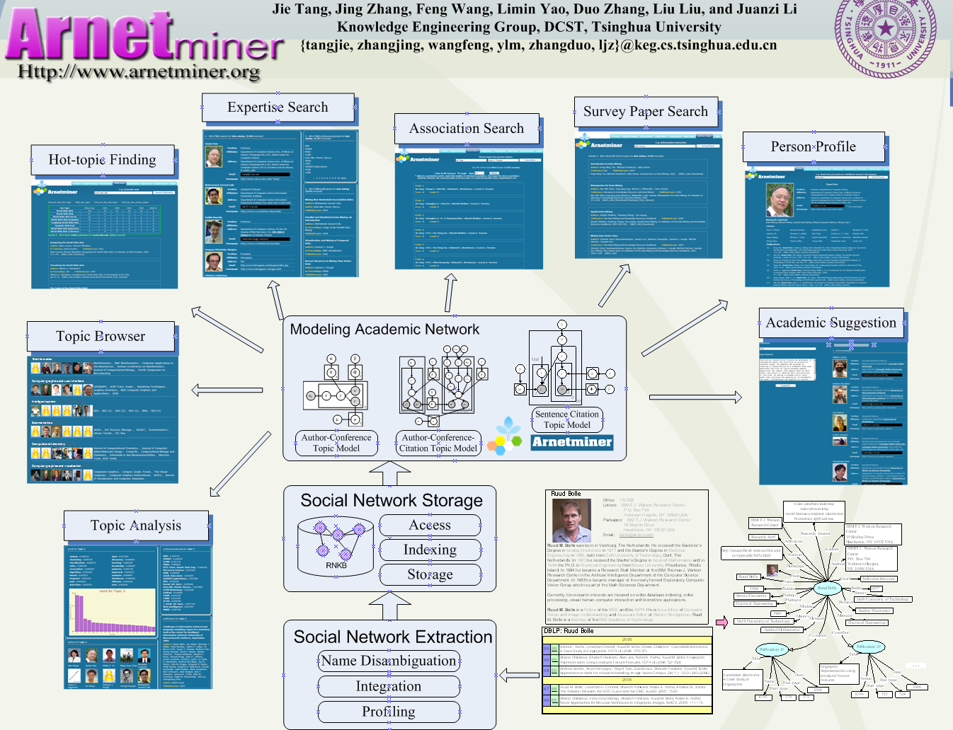
3
2
1

Slide 6
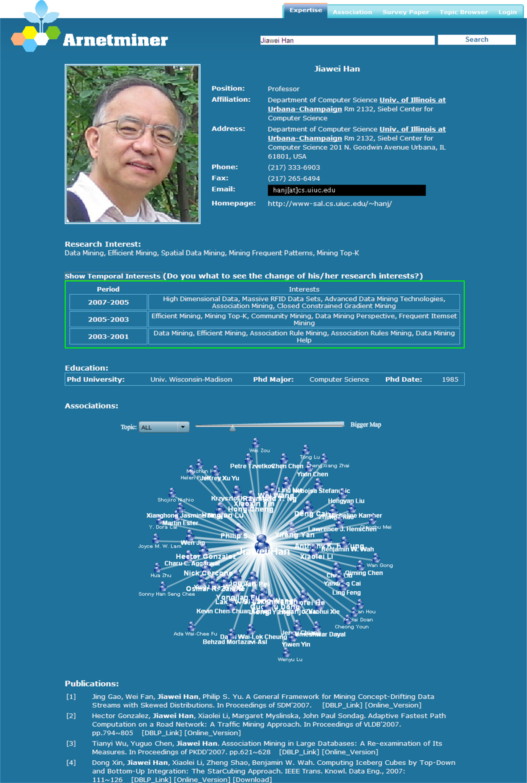
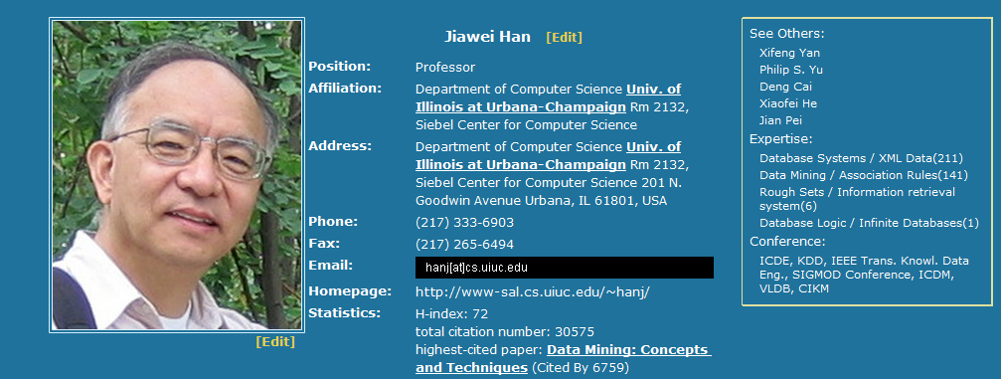
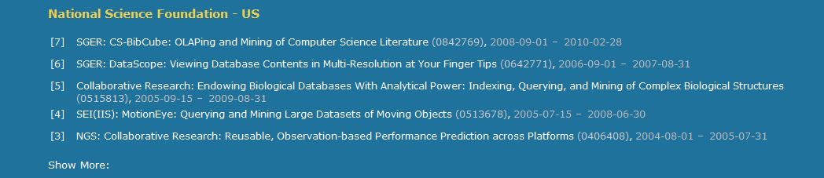
Person Search
Basic Info.
Citation statistics
Research Interests
Social Network
Fundings
Publications

Slide 7
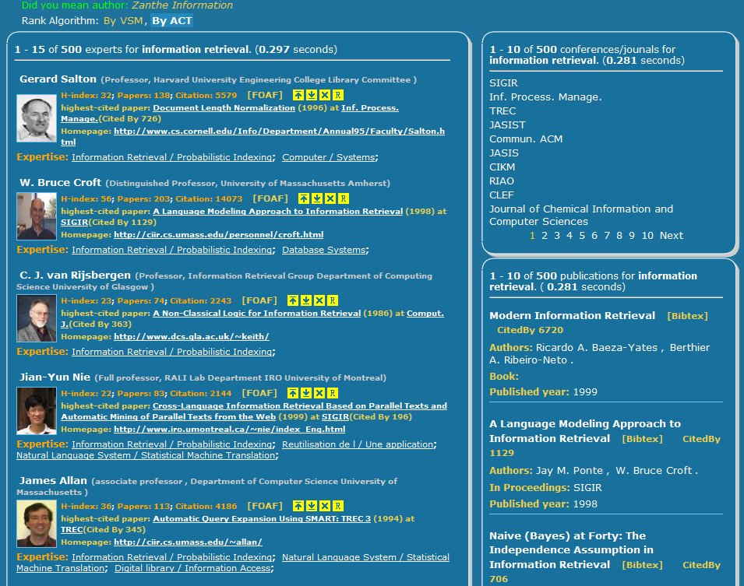
Expertise
Search
Finding experts,
expertise conferences,
and expertise papers
for “information retrieval”

Slide 8
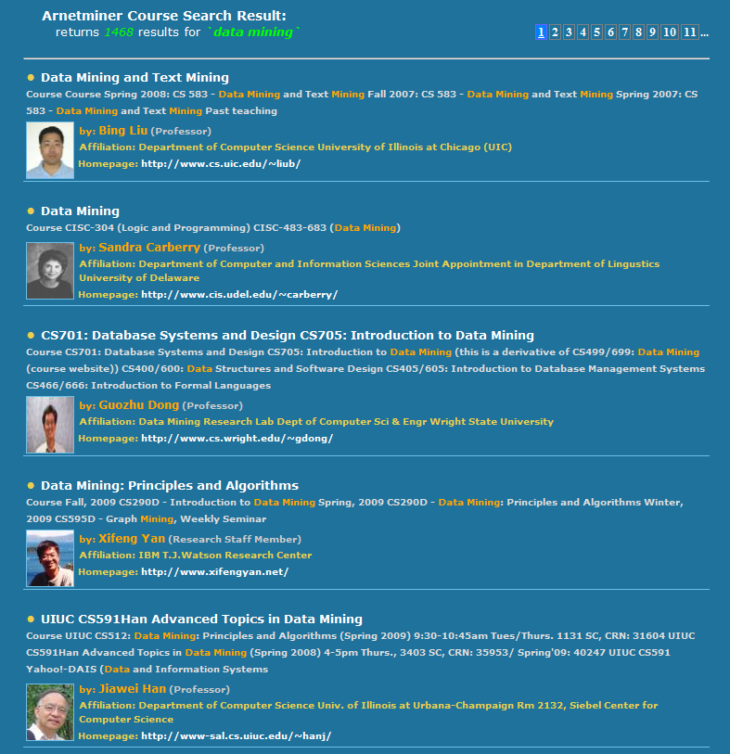
Course Search
Finding courses for “data mining”

Slide 9
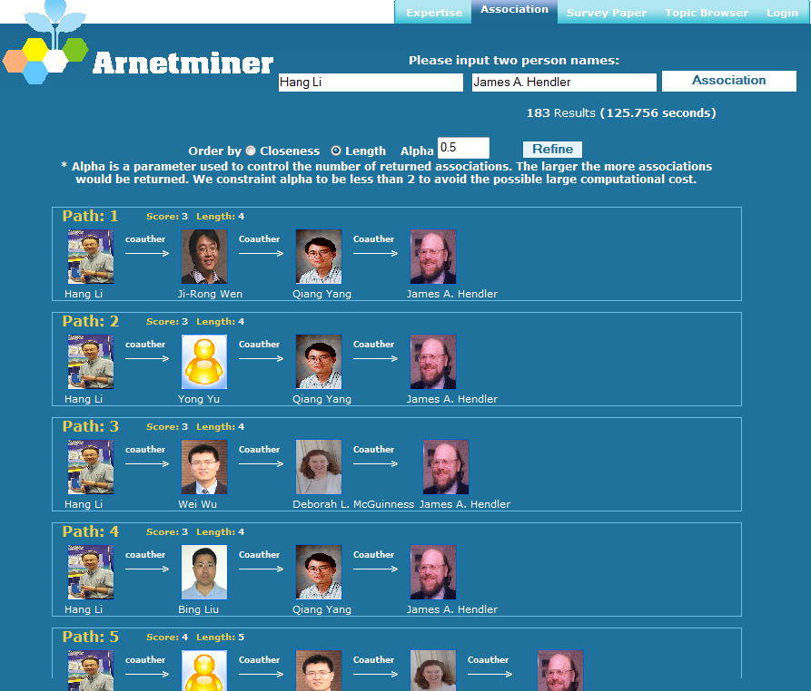
Association Search
Finding associations between persons
- high efficiency
- Top-K associations
Usage:
- to find a partner
- to find a person with same interests

Slide 10
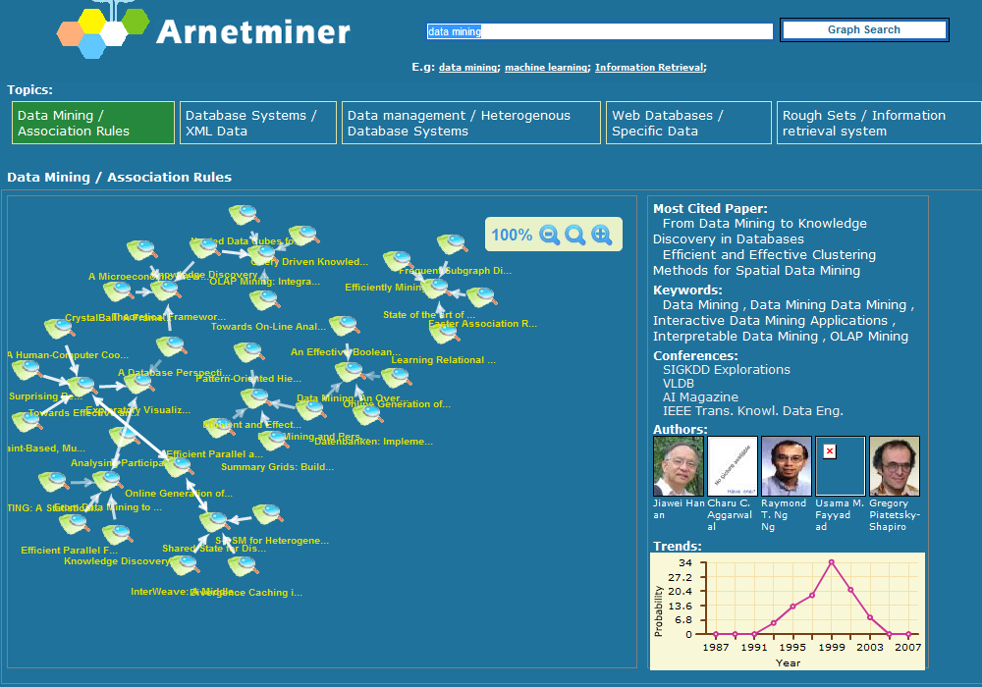
Sub-Graph Search
Sub graphs

Slide 11
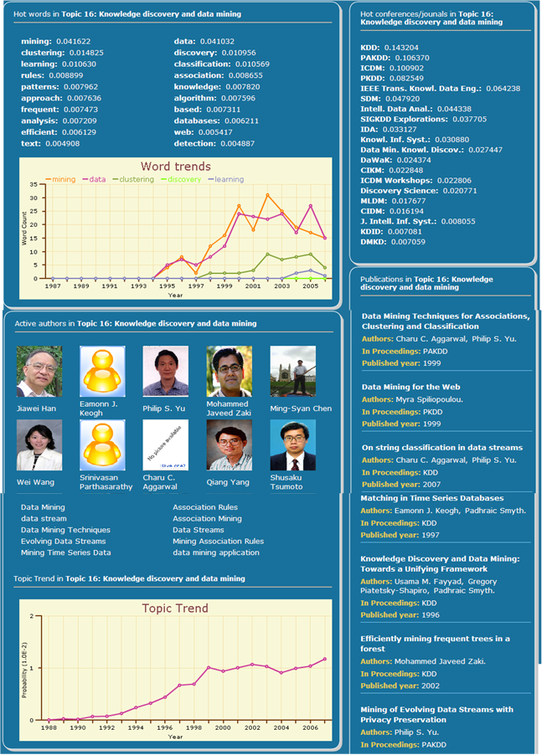
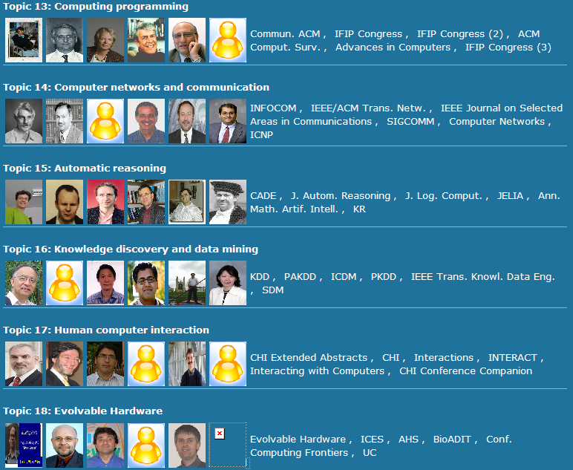
Topic Browser
200 topics have been discovered automatically from the academic network

Slide 12
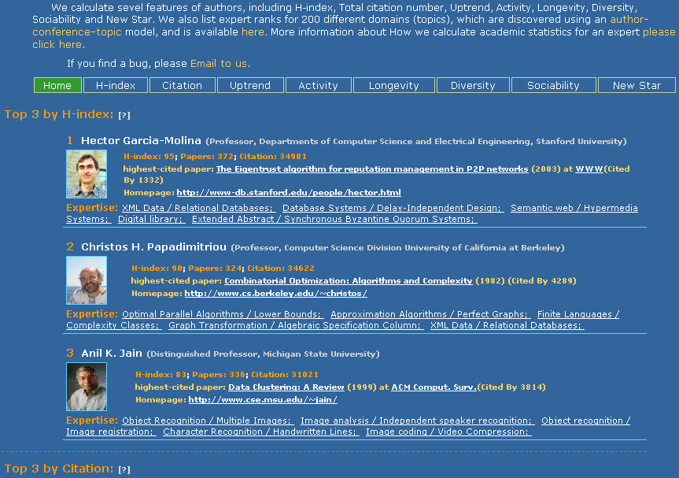
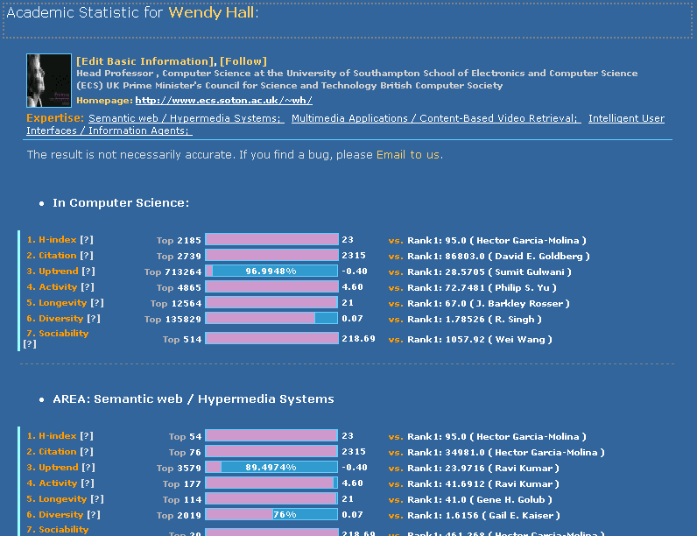
Academic Statistics
Academic Statistics
Personal Statistics

Slide 13
Coming Soon

Slide 14
Outline
ArnetMiner: Academic Social Network
Core Techniques
  Knowledge Acquisition
  Semantic Integration
  Heterogeneous Ranking
  Social Influence Analysis
Demo
Notes:
This is the outline of my presentation.
At first, I will give a brief introduction about our group
Next, I will introduce our research work related to semantic web
Then, is their applications in some domains.
At last, I will give a brief introduction about our future research focus.

Slide 15
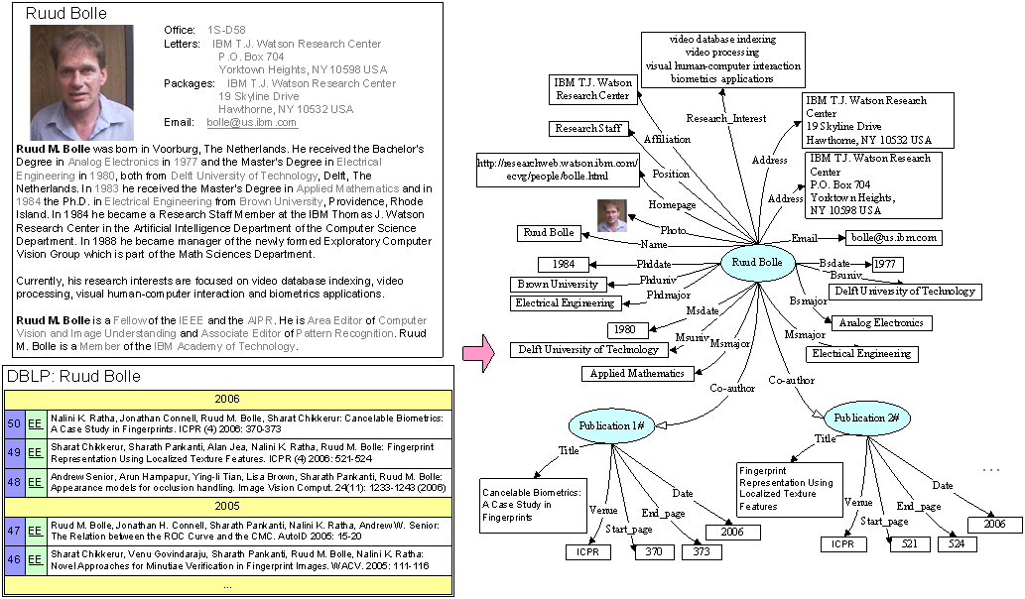
ArnetMiner: Overview
2
3
1

Slide 16
CT1: Knowledge Acquisition from Social Web
(ACM TKDD, ISWC’06, ICDM’07, ACL’07, CIKM’07-08)
2
Contact Information
1
Two questions:
  How to accurately extract the researcher profile information from the Web?
  How to integrate the information from different sources?
Educational history
1
Academic services
Publications
1
2
1
coauthor
Ruud Bolle
affiliation
UIUC
Publication #3
2
2
position
Professor
Publication #5
coauthor

Slide 17
Researcher Network Extraction
70.60% of the researchers have at least one homepage or an introducing page
85.6% from universities
14.4% from companies
71.9% are homepages
28.1% are introducing pages
40% are in lists and tables
60% are natural language text
There are a large number of person names having the ambiguity problem
Even 3 “Yi Li” graduated from the author’s lab
70% moved at least one time

Slide 18
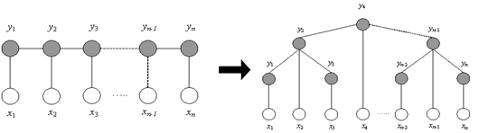

Our Approach Picture
– based on Markov Random Field
Markov Property:
Special cases:
- Conditional Random Fields
- Hidden Markov Random Fields
Researcher Profiling
Name Disambiguation
Notes:
Markov Random Field (MRF) is a probability distribution of labels (hidden variables) that obeys the Markov property.

Slide 19
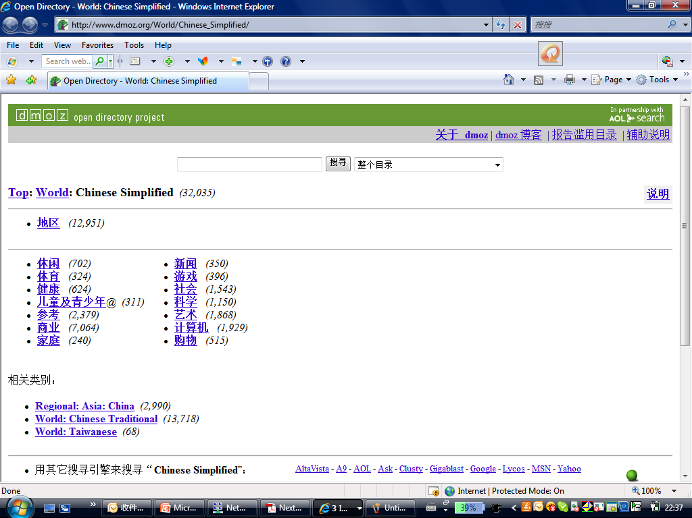
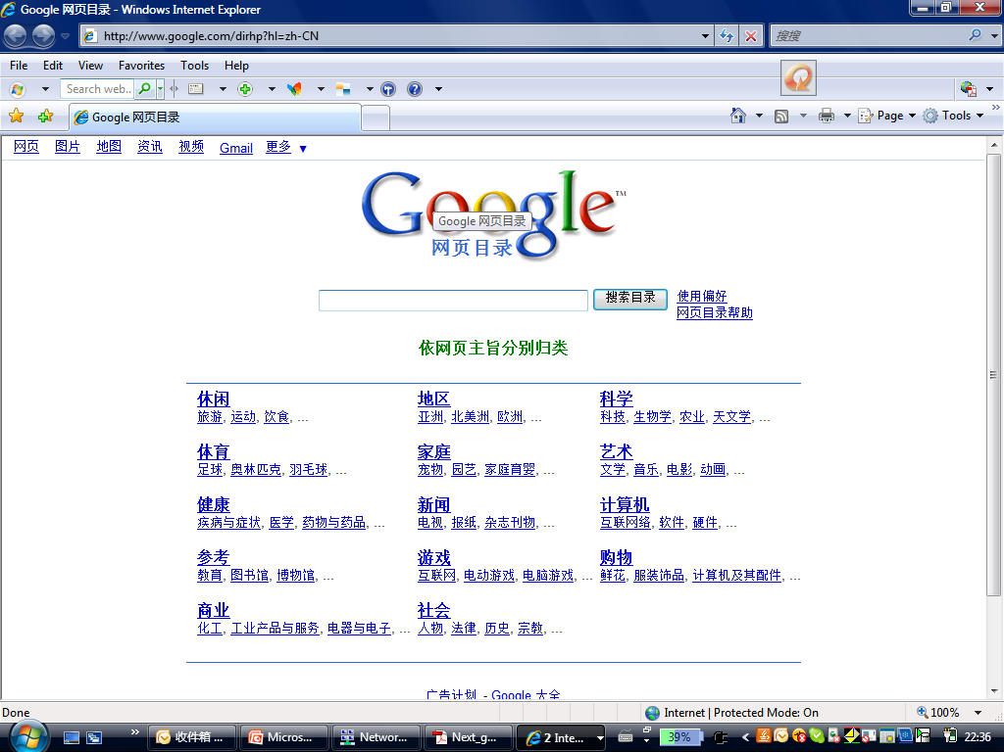
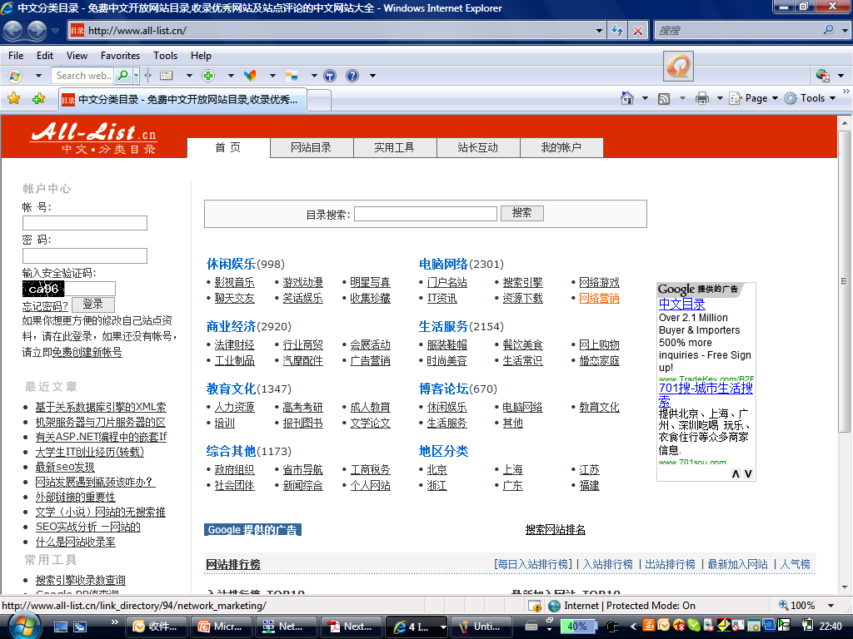
CT2: Semantic Integration
(IEEE TKDE, SIGMOD’09, IJCAI’09, ISWC’09)

Slide 20
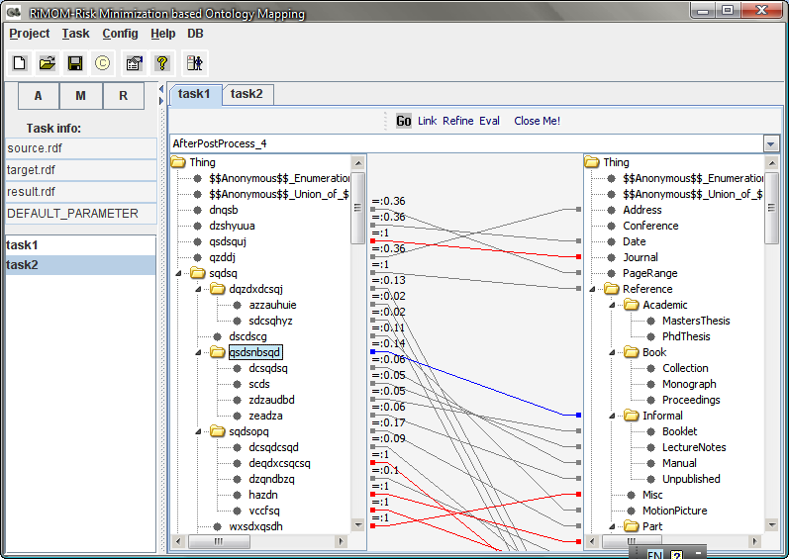
RiMOM-A Tool for Semantic Integration
(OAEI’06-09)
“I’m really surprised by the good results of these years RiMOM, you can compete with the top systems that make use of such background knowledge.”
http://keg.cs.tsinghua.edu.cn/project/RiMOM/
Notes:
我们提出的方法参加了2008年OAEI 国际本体映射比赛，在参赛的5个任务中，有四项都取得取得了前三名的好成绩。这是其中三项的比赛结果。OAEI比赛的负责人在邮件中写道，对我们今年在OAEI中的取得的好成绩感到惊讶。
此外，我们撰写的本体映射的论文被目前在IEEE transaction的computer socity 中影响因子排名第三的学术期刊TKDE录用。我们录用的特点不是发明一种新的映射方法，而是为给定的本体映射任务找到适合的映射方法，从而提高映射的精度。
20

Slide 21
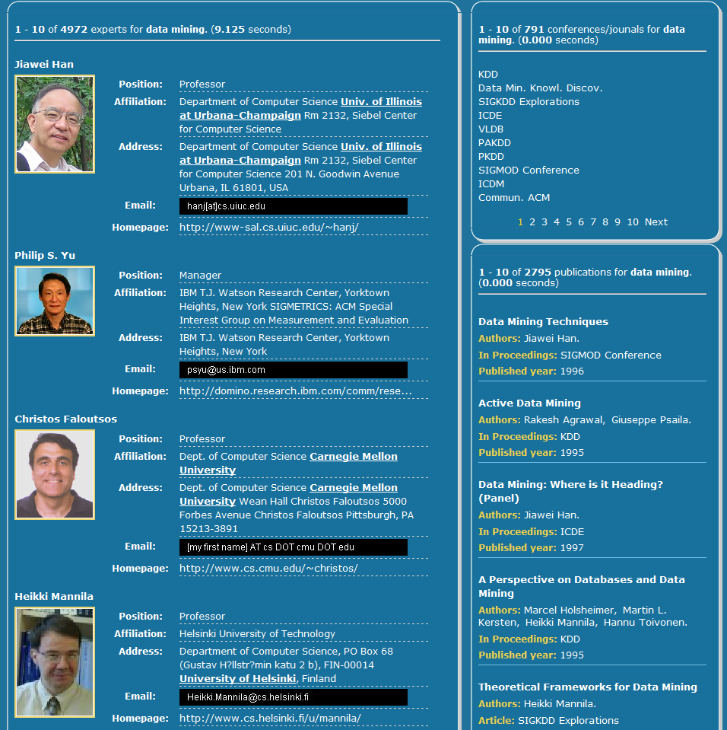
CT3: Topic-based Heterogeneous Ranking
(KDD’08, ICDM’08, CIKM’09, DKE)
Data mining
Modeling using VSM
Principles of Data Mining.
DJ Hand - Drug Safety, 2007 - drugsafety.adisonline.com
Search with keyword
Return
Advances in Knowledge Discovery and Data Mining
UM Fayyad, G Piatetsky-Shapiro, P Smyth, R…
Data Mining: Concepts and Techniques
J Han, M Kamber - 2001…
Search with semantic modeling
Experts
Expertise conferences
Modeling using semantic topics
Topics
Data mining
0.4
Association Rules
Return
Expertise papers
Data mining
0.2
Database systems
0.15
0.1
Data management
0.05
0.02
Web databases
Information systems

Slide 22
Challenges
How to model the heterogeneous academic network?
How to capture the link information for ranking objects in the academic network?
Topic
Notes:
22
本文的主要工作，就是研究如何为学术社会网络统一建模，不但模型化各种异构数据的特点，还模型化他们之间的关系。我们采用话题模型的方法来实现。具体来说，本文的主要工作是：

Slide 23
Modeling the Academic Network
authors
words
Topic
ACT1
conference
ACT2
ACT3
Author-Conference-Topic Model [Tang et al., 08]

Slide 24
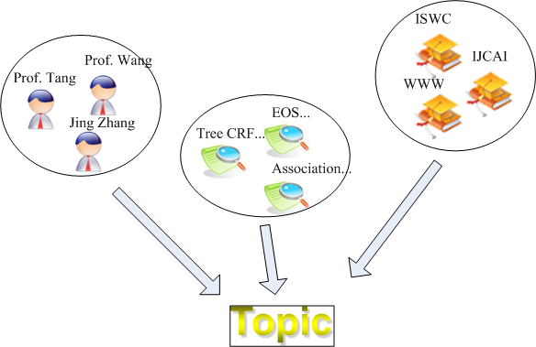
Integrating Topic Model into Random Walk
Modeling academic network with topics
Random walk over the academic network
+
Author-Conference-Topic Model [Tang et al., 08]

Slide 25


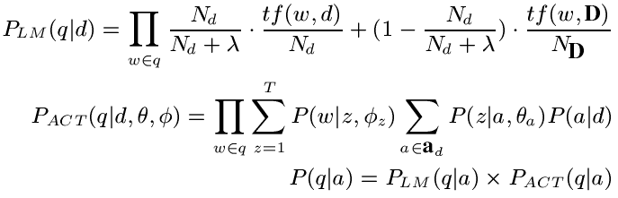
Combination Method 1
Stage 1:
Random walk
Ranking score
Combination by multiplication
Topic layer
Topic-based relevance score
Stage 2.
Topic-based relevance

Slide 26
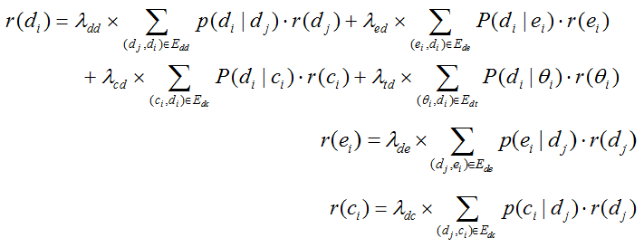
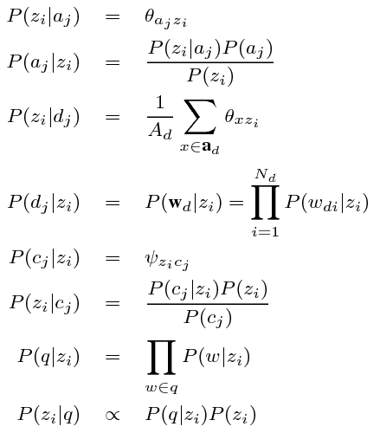
Combination Method 2
Ranking score
Transition probability

Slide 27
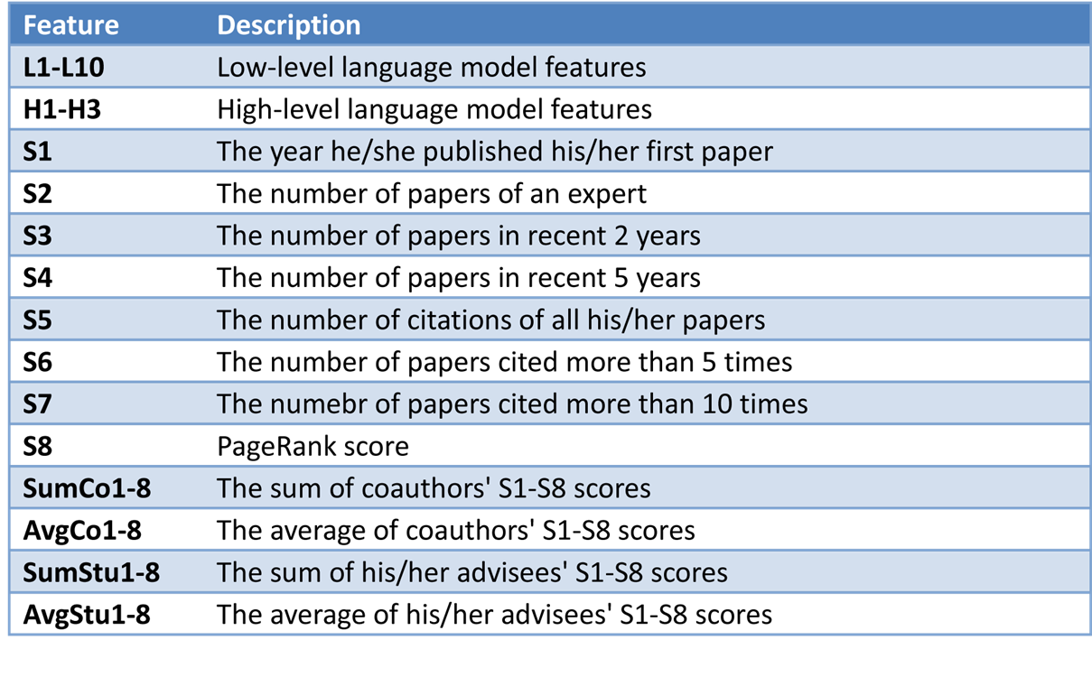
Learning to Rank Experts
Combining more information
Empirical loss
weight
feature
Model penalty
Language model, BM25, tf*idf

Slide 28
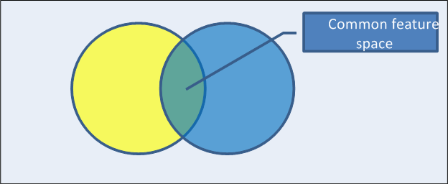
Heterogeneous Cross-domain Ranking
conf
author/paper
Loss in one domain
Loss in another domain
Common feature space

Slide 29
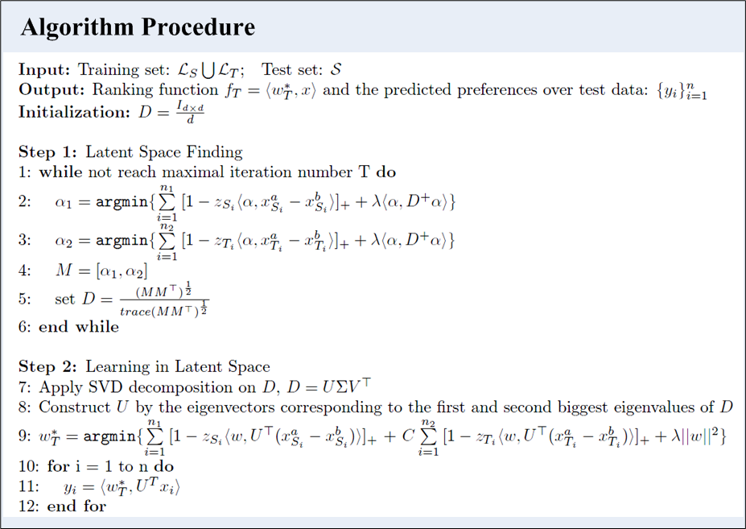
Learning Algorithm
Equivalent objective function:
Optimize the loss function for each domain
Common space discovery
Optimize the weight via the common space

Slide 30
Experimental Results
Data sets
  Homogeneous Data
    LETOR 2.0: TREC2003, TREC2004, and OHSUMED
  Heterogeneous Data
    Academic network consisting of 14,134 authors, 10,716 papers, and 1,434 conferences.
  Heterogeneous Tasks
    Expert finding vs. Bole search
Baselines
  RSVM
  Language model

Slide 31
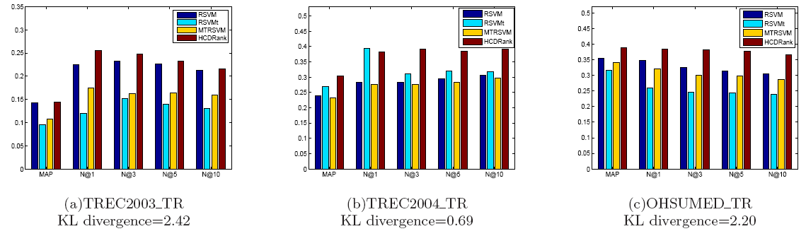
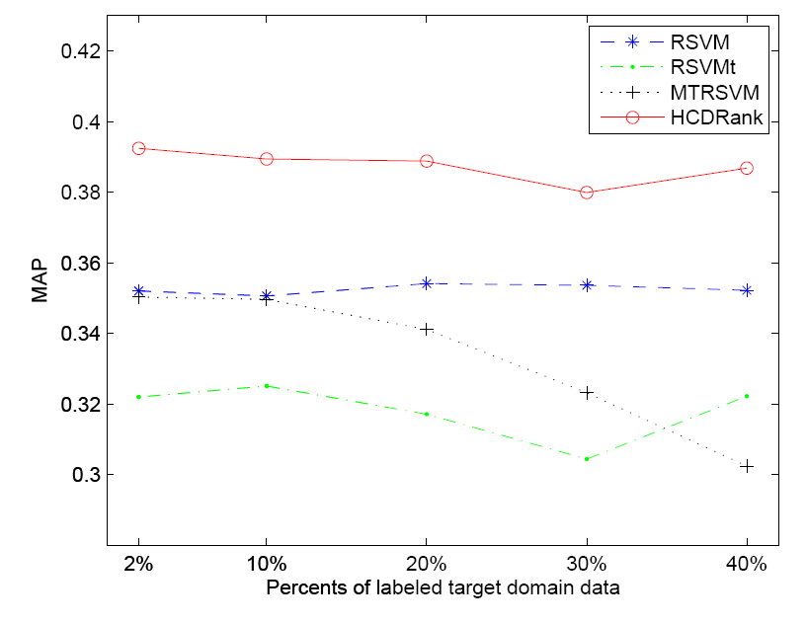
Results on Homogeneous Data

Slide 32
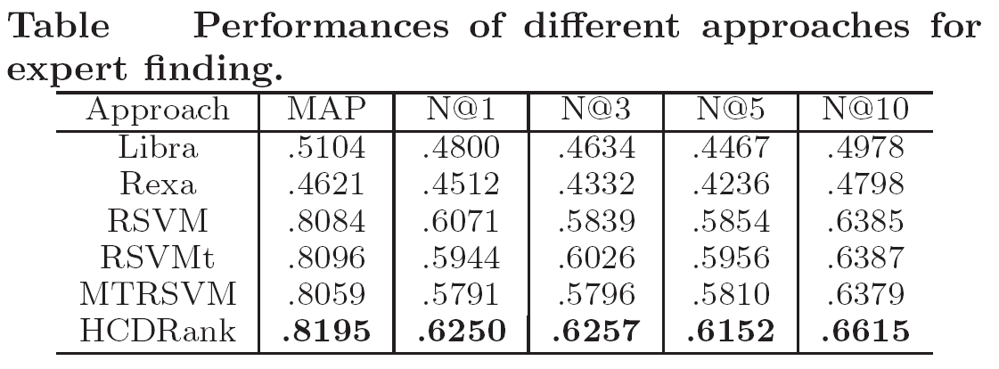
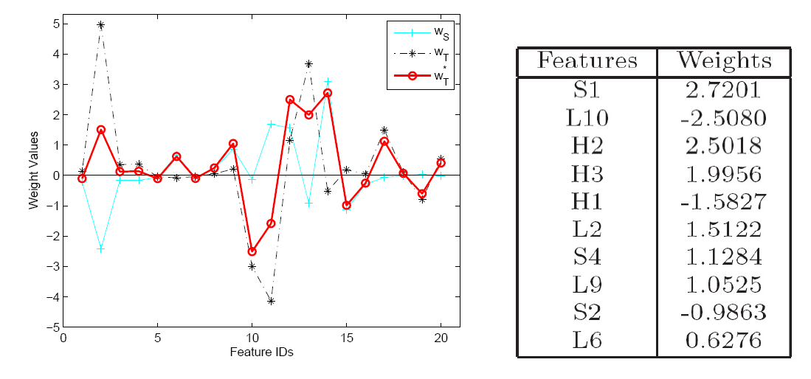
Results on Heterogeneous Data

Slide 33
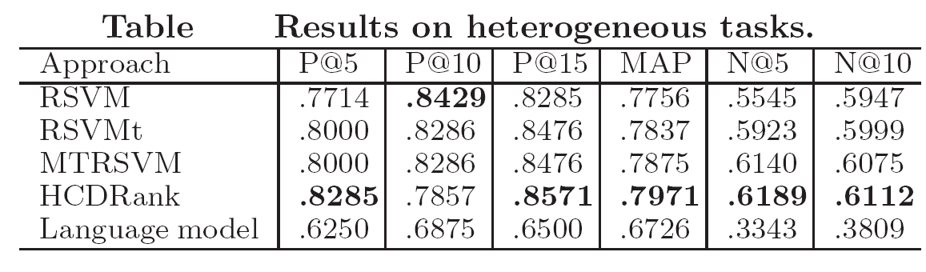
Results on Heterogeneous Tasks
Expert finding verse Bole search (finding best supervisor)
To obtain ground truth of bole for each query
  We sent emails to 50 senior researchers and 50 junior researchers (91.6% are post doc or graduates)
  Average their feedbacks

Slide 34
CT4: Social Influence Analysis
(KDD’10, KDD’10, KDD’09, ICDM’09, JIS)
How to quantify the influence between users?
What is the relationship between users?
Can we predict the user’s actions?

Slide 35
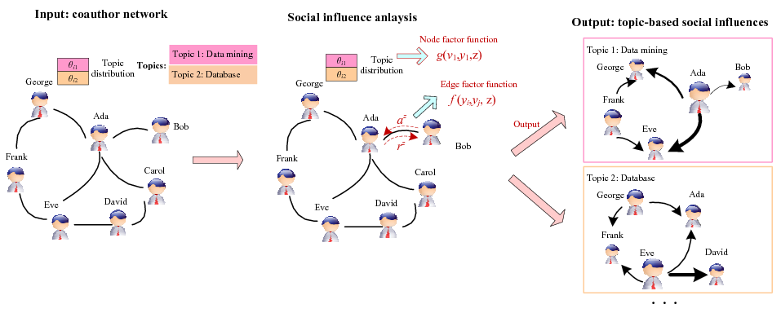
Topic-based Social Influence Analysis
Social network -> Topical influence network

Slide 36
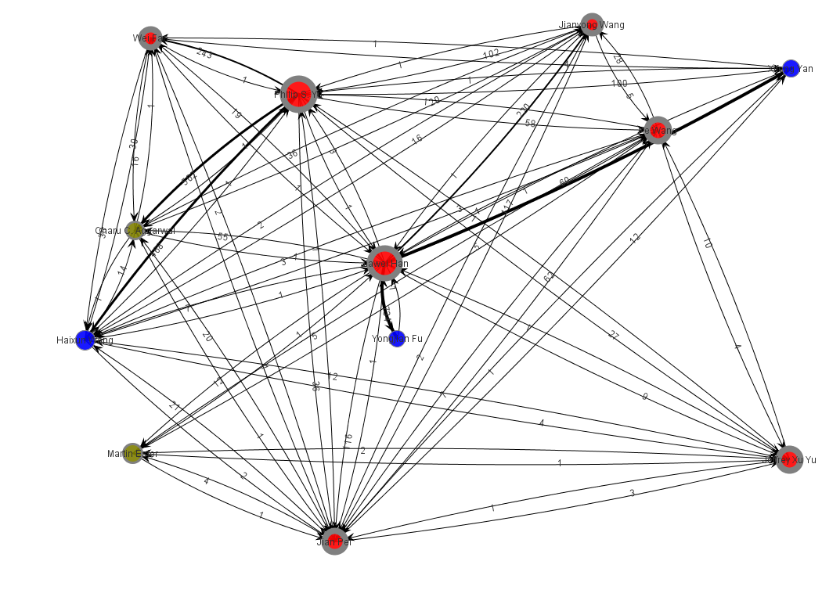
Social Influence Sub-graph on “Data mining”

Slide 37
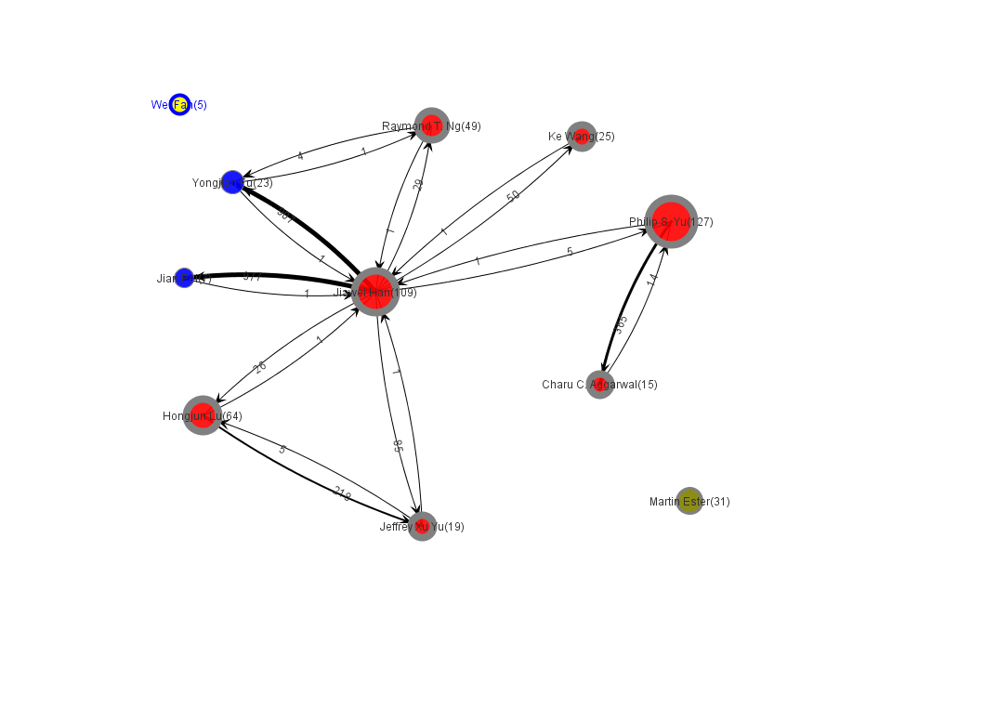
Dynamic Influence Analysis (2000)

Slide 38
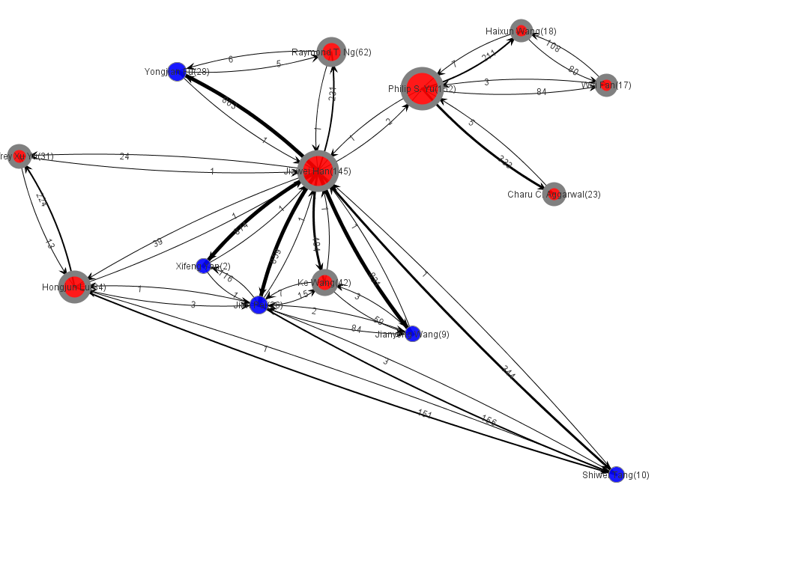
Dynamic Influence Analysis (2002)

Slide 39
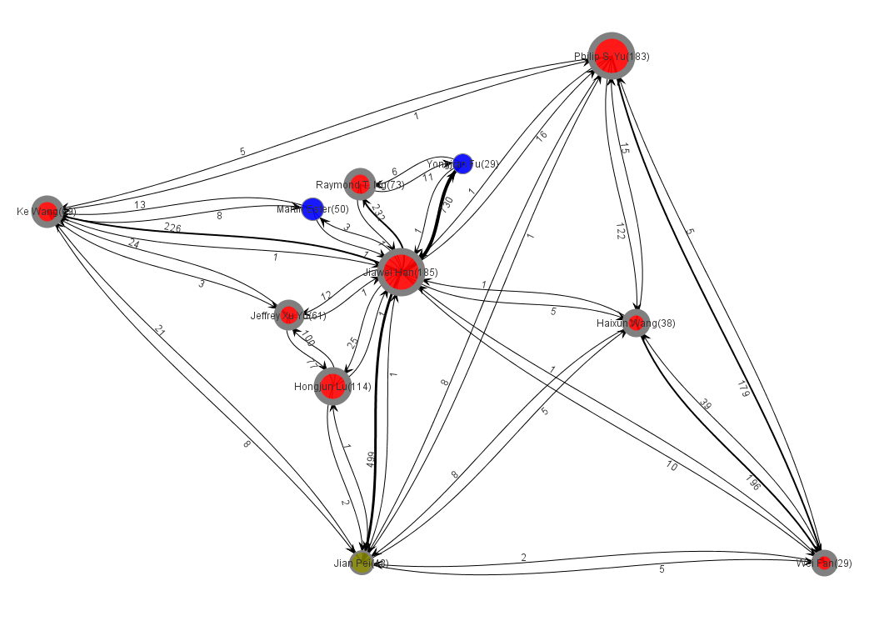
Dynamic Influence Analysis (2004)

Slide 40
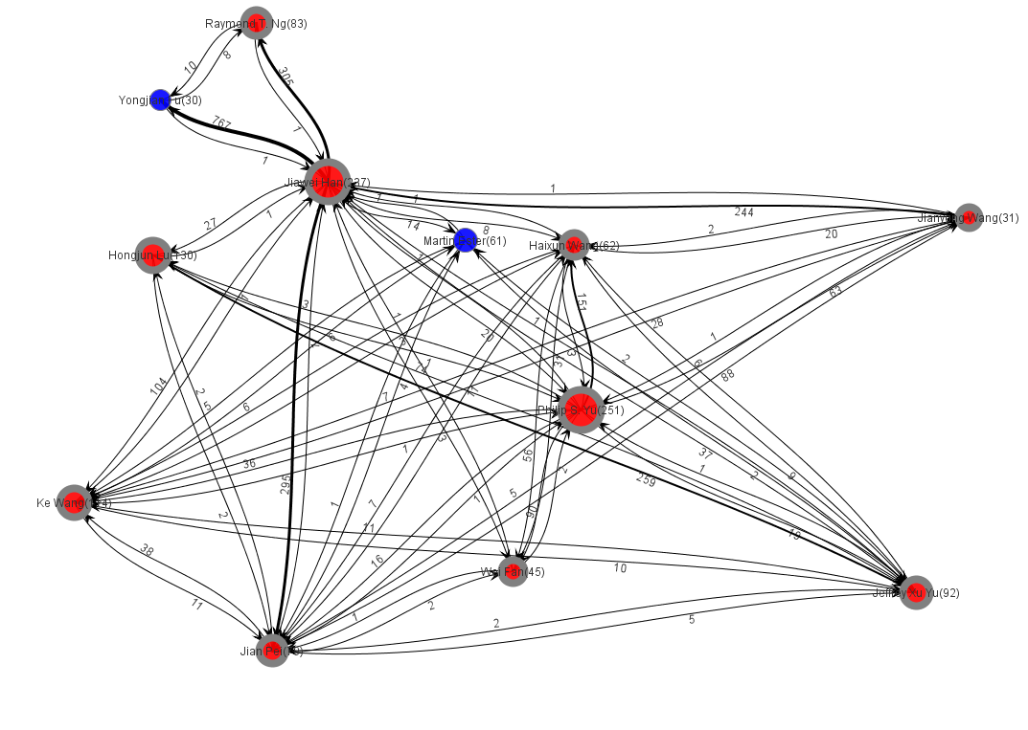
Dynamic Influence Analysis (2006)

Slide 41
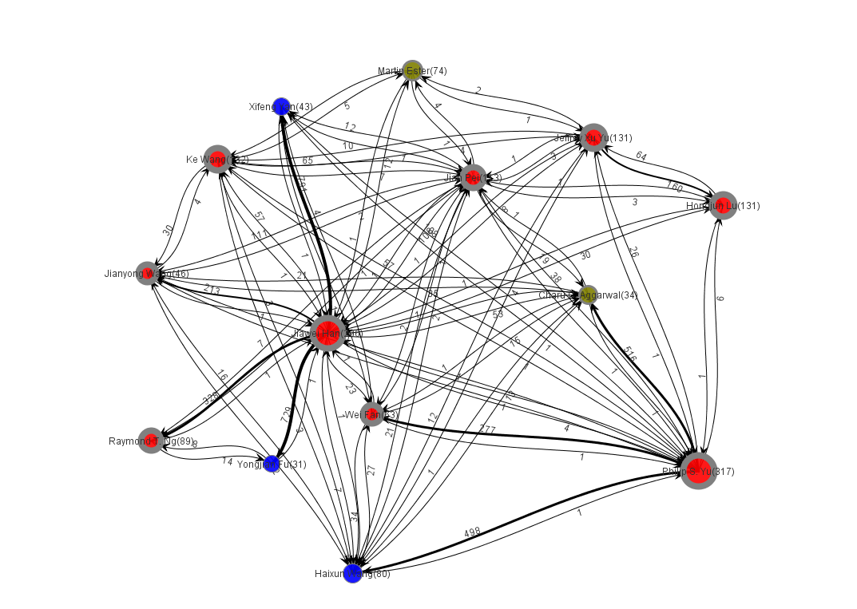
Dynamic Influence Analysis (2008)

Slide 42
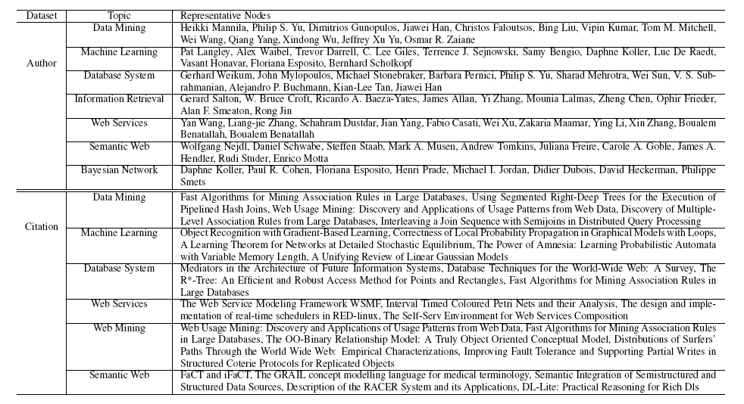
Influential nodes on different topics

Slide 43
CT4: Social Influence Analysis
(KDD’10, KDD’10, KDD’09, ICDM’09, JIS)
How to quantify the influence between users?
What is the relationship between users?
Can we predict the user’s actions?

Slide 44
Mining Advisor-Advisee Relationship from Research Publication Networks

Slide 45
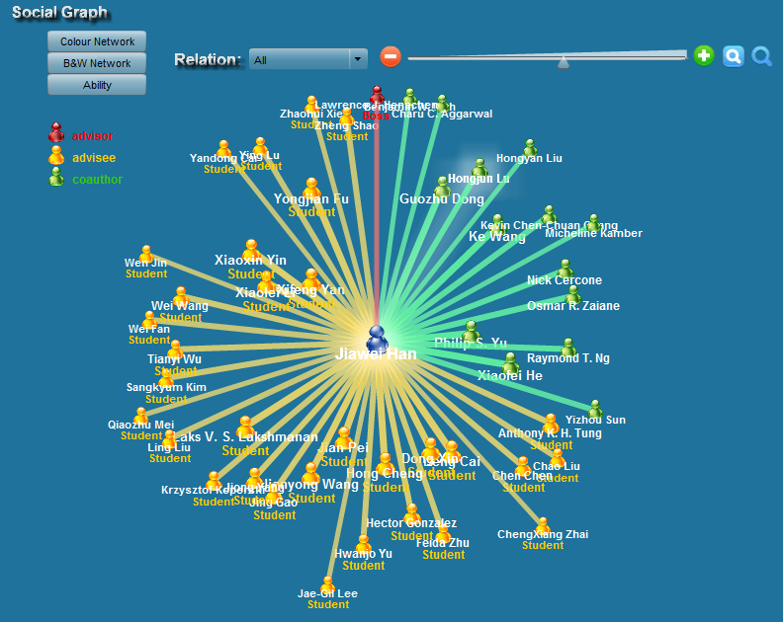
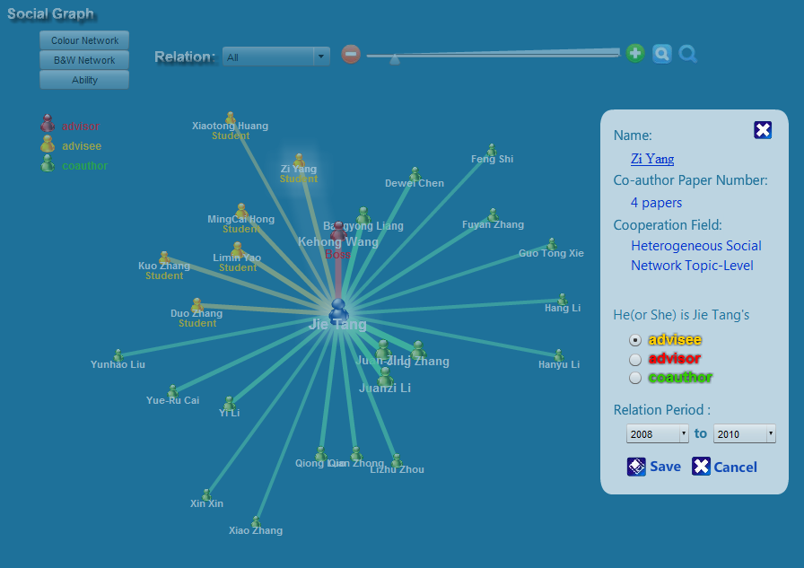
Results

Slide 46
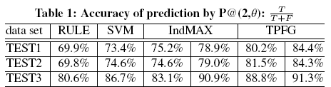
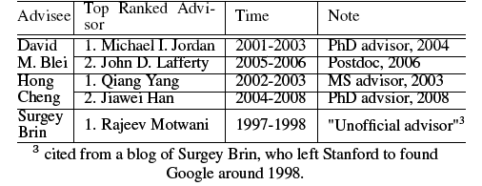
Results (cont.)

Slide 47
CT4: Social Influence Analysis
(KDD’10, KDD’10, KDD’09, ICDM’09, JIS)
How to quantify the influence between users?
What is the relationship between users?
Can we predict the user’s actions?

Slide 48
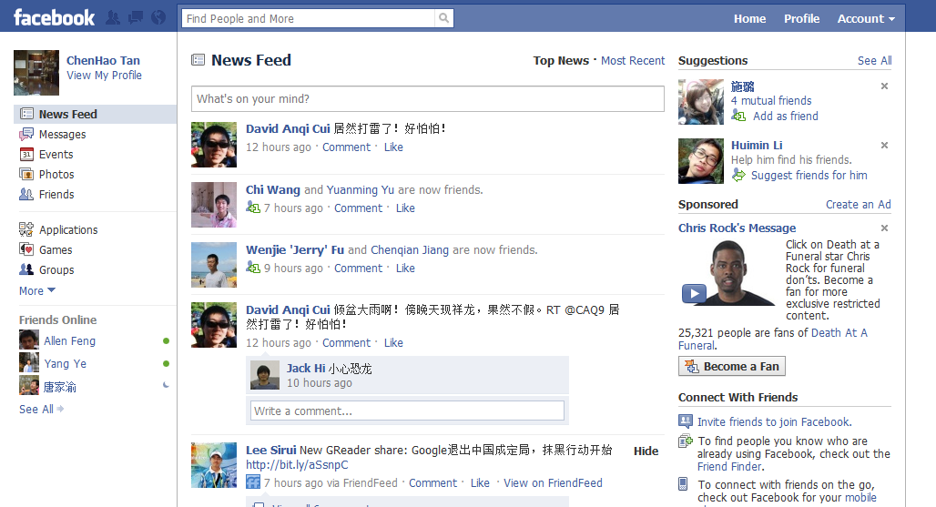
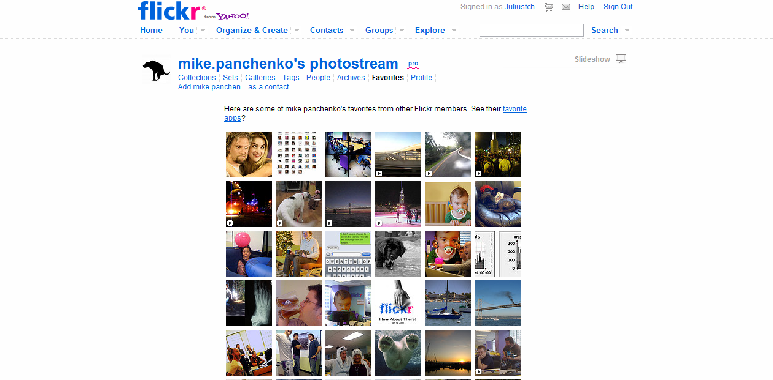
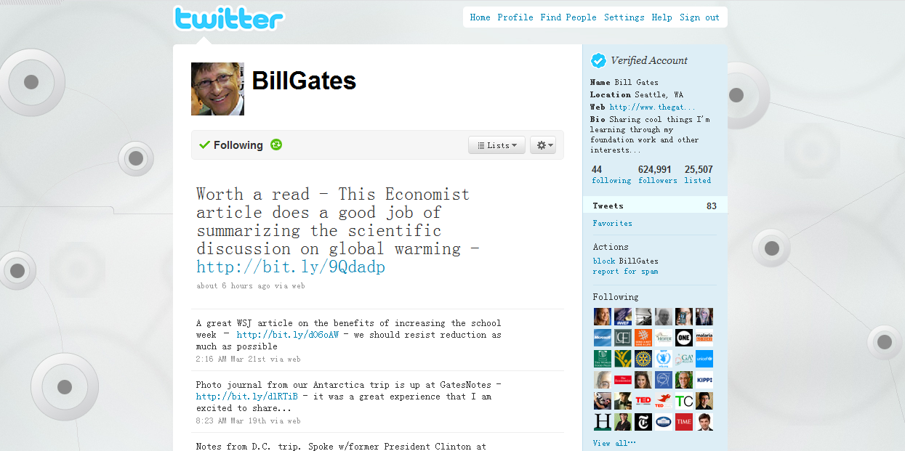

What can we do in SNS?
Notes:
Diameter, community, etc.

Slide 49


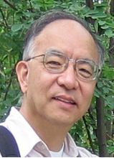
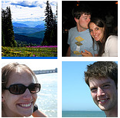
Social Action
Twitter
Flickr
KDD
Add favorites
Comment on Haiti Earthquake
Publish in KDD Conference

Slide 50
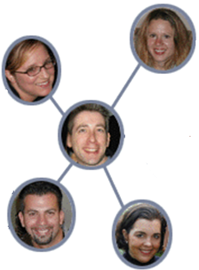
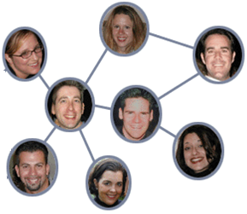
Action
Influence
Action Bias
Correlation
Comment on Haiti Earthquake
Time t
Time t+1
Dependence
Always watch news
Enjoy sports
…
Attribute

Slide 51


Results

Slide 52
Arnetminer Today
— A brief summary

Slide 53
ArnetMiner’s History
2006/5, V0.1 Perl-based CGI version
  Profile extraction, person/paper/conf. search
2006/8, V1.0 Java (Demo @ ASWC)
  Rewrite the above functions
2007/7, V2.0 (Demo @ KDD, ISWC)
  New: survey search, research interest, association search
2008/4, V3.0 (Demo @ WWW)
  Query understanding, New search GUI, log analysis
2008/11, V4.0 (Demo @ KDD, ICDM)
  Graph search, topic mining, NSFC/NSF
2009/4, V5.0 (Demo @ KDD)
  Bole/course search, profile editing, open resources, #citation
2009/12, V6.0
  Academic statistics, user feedbacks, refined ranking
V7.0, coming soon
  Name disambiguation, reviewer assignment, supervisor suggestion, open API

Slide 54



ArnetMiner Today
Messages from Users
* Arnetminer data:
> 0.6 M researcher profiles
> 3M papers
> 17M citation relationships
> 5K conferences
> 50M logs
* Visits come from more than 190 countries
* Continuously +20% increase of visits per month
* More than 2,000 unique IP visits per day.
… I’ve happened to visit your Arnetminer, and shocked. It was really impressive, its usefulness and your works!!! … [from …@selab.snu.ac.kr]
…I would first of all congratulate you on the excellent work you have done in Arnetminer and I am much inspired… [from …@nu.edu.pk]
a survey by UK Southampton
Title: Semantic Technologies for Learning and Teaching in Web 2.0.
— Thanassis Tiropanis, Hugh Davis, Dave Millard, Mark Weal
…Exposing the expertise of the institution to the outside world in order to attract funding and students. ArnetMiner is the most representative example of such tools at the moment…
Contextualised queries and searches, searches across repositories potentially in different departments or institutions, and matching of people for collaborative activities. Best example of the surveyed technologies to this end is ArnetMiner.
… Arnetminer is one of my favorite tools to find folk and academic relatives… [from …@qlink.com]
Top 10 countries
1. USA 6. Canada
2. China 7. Japan
3. Germany 8. Taiwan
4. India 9. France
5. UK 10. Italy
Dear Dr. Jie Tang,
Can you include our papers (http://www.waset.org) in your Arnetminer?... [from …@waset.org]
.. top top! I am very interested in your ArnetMiner. Is that possible give me a bit of your social network data… [from …@cse.ust.hk]

Slide 55




Opportunity: exploiting semantic web and social network in the real-world
Web, relational data, ontological data, social data
Data Mining and Social Network techniques
Scientific
Literature
Users cover >180
countries
>600K researcher
>3M papers
Arnetminer.org
Social search
& mining
Social network
Extraction
Social network
Mining
IBM
Advertisement
Advertisement
Recommendation
Sohu
Mobile Context
Mobile search
& recommendation
Nokia
Energy trend
analysis
Energy product
Evolution
Techniques
Trend
Oil Company
Large-scale
Mining
Scalable algorithms
for message tagging
and community
Discovery
Google
科技信息资源内容监测与分析服务平台 (中国科技部信息情报研究所)
Search, browsing, complex query, integration, collaboration, trustable analysis, decision support, intelligent services,

Slide 56
Representative Publications
Jie Tang, Limin Yao, Duo Zhang, and Jing Zhang. A Combination Approach to Web User Profiling. ACM TKDD, 2010.
Juanzi Li, Jie Tang, Yi Li, Qiong Luo. RiMOM: A Dynamic Multi-Strategy Ontology Alignment Framework. IEEE TKDE, 2009.
Chenhao Tan, Jie Tang, Jimeng Sun, Quan Lin, and Fengjiao Wang. Social Action Tracking via Noise Tolerant Time-varying Factor Graphs. KDD’10.
Chi Wang, Jiawei Han, Yuntao Jia, Duo Zhang, Yintao Yu, Jie Tang, Jingyi Guo. Mining Advisor-Advisee Relationships from Research Publication Networks. KDD’10.
Jie Tang, Jimeng Sun, Chi Wang, and Zi Yang. Social Influence Analysis in Large-scale Networks. KDD'09.
Jie Tang, Jing Zhang, Limin Yao, Juanzi Li, Li Zhang, and Zhong Su. ArnetMiner: Extraction and Mining of Academic Social Networks. KDD’08.
Jie Tang, Hang Li, Yunbo Cao, and Zhaohui Tang. Email Data Cleaning. KDD’05.
Jie Tang, Ho-fung Leung, Qiong Luo, Dewei Chen, and Jibin Gong. Towards Ontology Learning from Folksonomies. IJCAI’09.
Qian Zhong, Hanyu Li, Juanzi Li, Guotong Xie, Jie Tang, Lizhu Zhou. A Gauss Function based Approach for Unbalanced Ontology Matching. SIGMOD’09.
Feng Shi, Juanzi Li, Jie Tang. Actively Learning Ontology Matching via User Interaction. ISWC’09.
Chonghui Zhu, Jie Tang, Hang Li, Hwee Tou Ng, and Tiejun Zhao. A Unified Tagging Approach to Text Normalization. ACL’07.
Others: ICDM’07-09, CIKM’07-09, SDM’09, ISWC’06, DKE, JIS, etc.

Slide 57
Thanks!
Demo: http://arnetminer.org
HP: http://keg.cs.tsinghua.edu.cn/persons/tj/

