Slide 1

Computational Models for Social Network Analysis
—mining big social networks (Part III: Group and Structure)
Jie Tang
Computer Science, Tsinghua University
@WWW’2017

Slide 2

Roadmap
data
User
Tie
Structure
Heterogeneous
Micro
Macro
tie
Dynamic
Influence
- User Modeling
- Demographics
- Social Role
- Social Tie/Link
- Homophily
- Social Influence
- Triad Formation
- Community
- Group Behavior
Big&Big
social
Social Theories
Graph Theories
BIG Networks

Slide 3
Roadmap
data
User
Tie
Structure
Heterogeneous
Micro
Macro
tie
Dynamic
Influence
- User Modeling
- Demographics
- Social Role
- Social Tie/Link
- Homophily
- Social Influence
- Triad Formation
- Community
- Group Behavior
Big&Big
social
Social Theories
Graph Theories
BIG Networks

Slide 4
Two Questions
How groups are formed in the social networks and what is the lifecycle of the different groups?
How different people influence the information diffusion in the network—structural hole.

Slide 5
Group Chat in WeChat
Invite
Invite
~2.3 million groups generated everyday
>25% messages are generated in group chats
Notes:
In this work, we study group chat.
The left figure is a screenshot of wechat app on mobile phone.
The scenario is steve want to invite two friends,<click> Luke and Mohammed to a group chat.
I have to say group chats are really important in WeChat, there are about 2.3 million groups generated everyday. One quarter of messages are generated in groups chats.

Slide 6
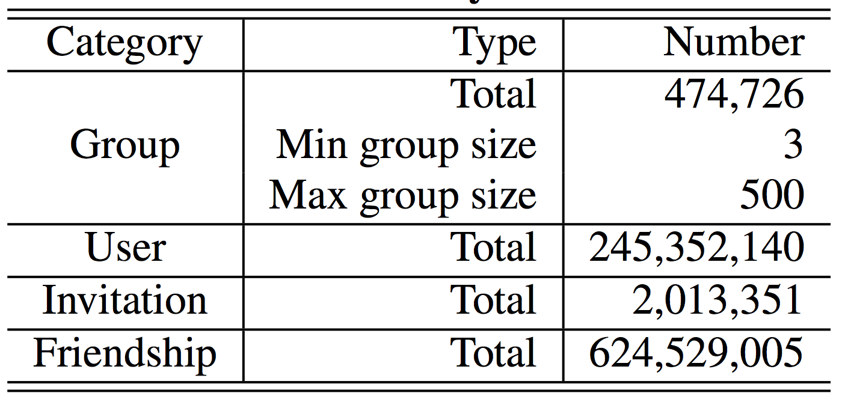
WeChat Data
Group: groups generated on July 26th, 2015
User: group members + users in fringe
Invitation: (u, v, C, T)
Friendship: (u, v, T)
Group Member
Fringe
Invite
friend
Notes:
We got a sample of 4.7 hundred thousand group chats generated on July 26th last year. For each group, we consider the corresponding users to be its group members as well as all the users in the fringe of the group.
<click>
Here the fringe is defined as group memnbers’ one-hop friends.
We also have invitation data which is showed by the blue arrow line <click> and denoted by 4-tuple (u, v, C, T), indicating user u invited user v to group C at time T.
Moreover, we have the friendship relationship data which is showed by the dotted line <click> and denoted by 3-tuple, indicating user u and user v become friends at time T.

Slide 7
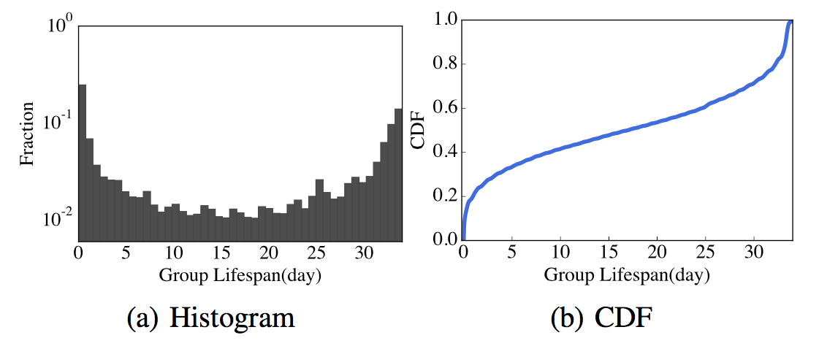
Group Lifecycle Dichotomy
How long would a group chat survive?
Definition: Group Lifespan. Duration from the timestamp at which a group is initialized, to the timestamp at which no group members sends chat messages anymore.
Short-term group v.s Long-term group
Notes:
We first want to study the lifecycle of groups. We want to answer how long would a group chat survive.
<click>
We did some preliminary analysis for all the groups in our data set.
Interestingly, we found that:
Firstly, almost 40% of groups stop interaction within only a week <click>
Secondly, About 30% of groups sustain longer than one month <click>
Based on the observations, we categorize groups into short-term groups and long-term groups according to their lifespan.
<click>

Slide 8
Group Lifecycle Dichotomy – Case Study
Short-term group v.s Long-term group
Event-driven v.s. Relationship-driven
Notes:
Intuitively, the lifespan of a group chat is correlated with its social functions. We manually examined 100 randomly selected groups, 60 of them are long-term groups, and the other 40 are short-term groups.
It seems that in travelling and meeting <click>, people tend to create short-term groups.
And family members and friends would create long-term groups. <click>
In general, <click> event-driven groups usually have a short lifespan, while relationship-driven groups have long lifespan.

Slide 9
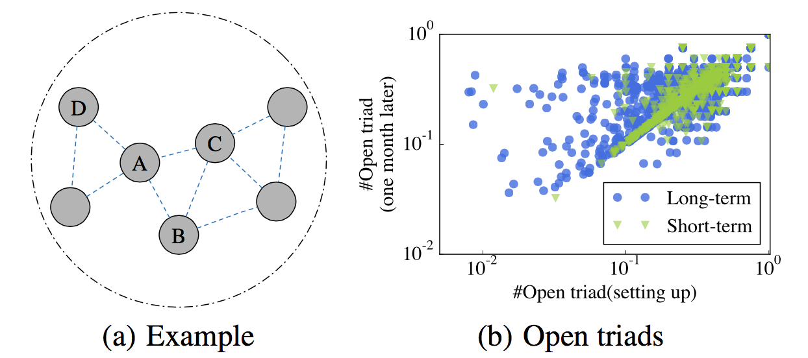
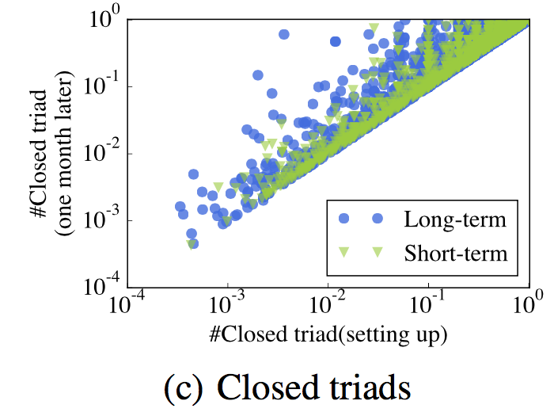
Group Lifecycle Dichotomy – Structure Dynamics
Open Triad
Closed
Triad
Long-term Group: Strong dynamics in terms of underlying friendship structure.
Short-term Group: Less likely to develop friendship over time.
Notes:
We further answer the question what are the fundamental factors that determine groups’lifespan.
We first study how the change of open triad and closed triad influence the lifespan of groups.
Figure a shows a snapshot of a group, the vertices A, B, and C form a closed triad while A, C, and D form a open triad.
We first consider open triad. <click> In figure b, x-axis is the normalized number of open triads at the very beginning of a group, and the y-axis is the normalized number of closed triads on month later. If the structure are not changing at all, we expect to see data points centering around the diagonal line. However, it seems that long-term groups show strong dynamics.
<click>
The result is similar for closed triad.
Over all, the long-term ones show stronger dynamics while most short-term groups are less likely to develop friendship over time.

Slide 10
Group Lifecycle Dichotomy – Group Cascade Tree
Definition: Group Cascade Tree. A directed graph where each group member is a node, and a directed edge from u to v is constructed if u (inviter) successfully invites v (invitee) to the group.
Example of long-term groups
WeChat Group
Group Cascade Tree
Invite
Invite
Example of short-term groups
Notes:
we also study the group formation processes.
The invitations in a group chats actually form a group cascade tree.
<click>
In general, most of long-term groups tend to have a complicated tree structure;
<click>
whereas many short-term group cascade trees display an approximate star graph structure.
Here are two examples of them.

Slide 11
Group Lifecycle Dichotomy – Cascade Tree Pattern
Depth=1
Depth=2
Subtree size: The size of sub-cascade
Depth: The depth of invitation
Wiener Index: Average distance between two nodes
Notes:
To quantify such difference, we introduce the following metrics that capture the structure of cascade tree, that is subtree size, depth and wiener index.
Subtree size is the size of sub-cascade. In this example, the size of the red subtree is 3.
Depth is the depth of invitation. In this example, the depth of node c is 2.
Wiener index is defined to be the average distance between two nodes in the cascade tree.
In this example, the wiener index of this cascade tree is 2.

Slide 12
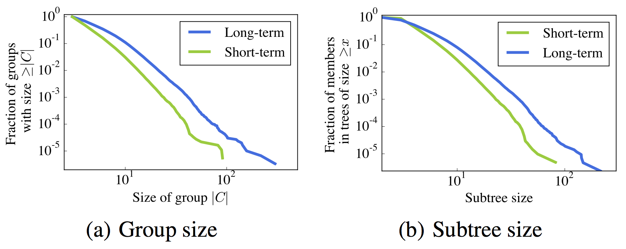
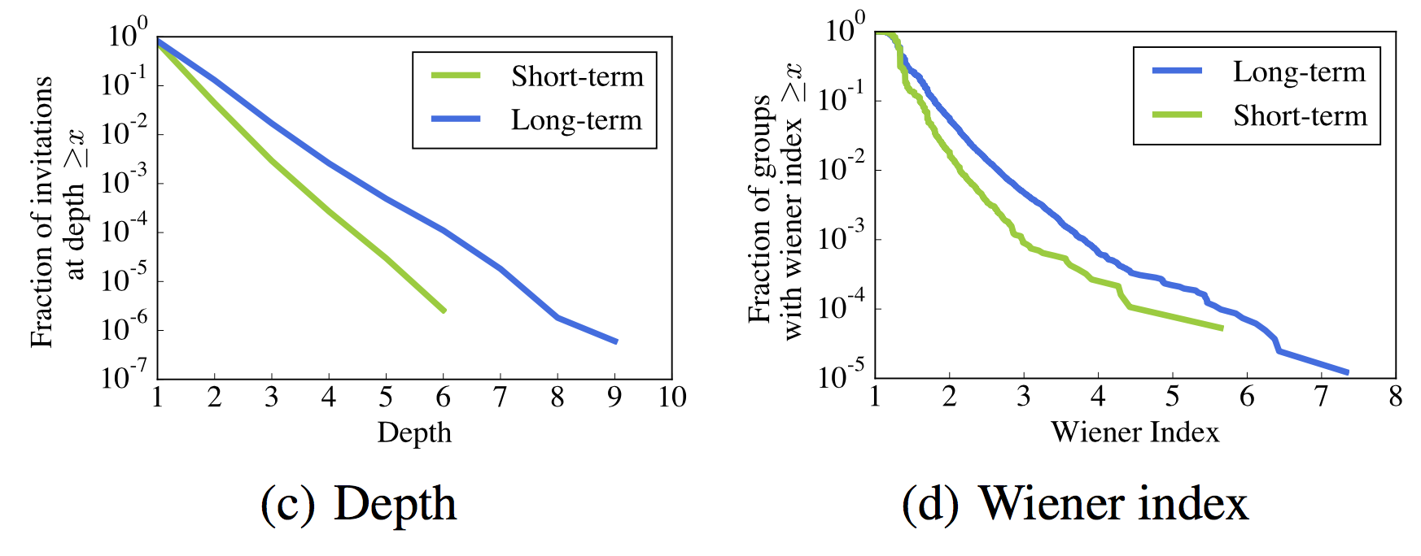
Group Lifecycle Dichotomy—Cascade Tree Pattern
>10% of users have subtree size >= 10
10% of invitations occur at >=3
10% with W-index >= 2
Only ~2% have substree size >= 10
Only 1% occur at >= 3
99% with W-index < 2
For node C
  Subtree size: 3
  Depth: 2
For the left example:
  Wiener index: 2
Notes:
We plot the power-law-like distributions of the three metrics for groups with different lifespan.
There are significant differences between long-term and short-term groups according to the three metrics.
For example, <click> 10% of invitations in long-term groups occur at depth 3 or greater; whereas for short-term groups, the number is less than 1%.

Slide 13
Group Lifecycle Dichotomy — Features
Group Level:
For group C at time T
Group Structure | The number of open triads at T and at the setting up of group.
 | The number of closed triads at T and at the setting up of group.
Cascade Tree | Wiener index.
 | Number of members whose depth equal to k, k = 1,2,...,9.
Demographics | Number of members who stated their gender to be X.
 | Entropy of member’s gender
Notes:
Based on above analysis, we define three categories of features to capture the characteristics of group C at time T.
That is group structure feature, cascade tree feature, and demographics feature.
For group structure feature, for example, we have the number of open triads at T and the setting up of this group.
For cascade tree feature, for example, we have the wiener index.
For demographics, for example, we have the number of members who stated their gender to male or female.

Slide 14
Group Lifecycle Dichotomy—Prediction
SVM 10-fold Cross Validation
Features | AUC | Precision | Recall | F1
All Features | 66.62 | 63.23 | 57.66 | 60.32
-Structure | 64.75 | 59.36 | 62.83 | 61.04
-Cascade | 65.36 | 64.49 | 47.67 | 54.82
-Demographics | 65.24 | 57.35 | 65.71 | 61.25
+Structure | 64.21 | 61.98 | 42.51 | 50.43
+Cascade | 61.23 | 57.35 | 65.71 | 61.25
+Demographics | 62.77 | 63.18 | 41.41 | 50.03
All Features | 66.62 | 63.23 | 57.66 | 60.32
+Cascade | 61.23 | 57.35 | 65.71 | 61.25
Task 1: Group Separability: Predict groups’ lifespan.
Task 2: Early Prediction: Can we predict the group lifecycle in early stage.
Notes:
Based on the above features, we have two prediction tasks here.
The first one is the group separability, to predict whether one group is long-term or short-term.
We find best classification performance (66.62% AUC) can be obtained with full set of features. <click>
and the set ofcascade features by itself can yield good performance. <click>

Slide 15
Group Lifecycle Dichotomy—Prediction
SVM 10-fold Cross Validation
Features | AUC | Precision | Recall | F1
1 hour | 57.95 | 54.16 | 56.80 | 55.45
1 day | 65.08 | 61.92 | 53.38 | 57.34
5 days | 65.46 | 62.52 | 54.11 | 58.01
10 days | 65.57 | 62.48 | 56.81 | 59.51
20 days | 65.76 | 62.78 | 56.56 | 59.51
1 month | 66.62 | 63.23 | 57.66 | 60.32
1 day | 65.08 | 61.92 | 53.38 | 57.34
1 month | 66.62 | 63.23 | 57.66 | 60.32
Task 1: Group Separability: Predict groups’ lifespan.
Task 2: Early Prediction: Can we predict the group lifespan in early stage.
Notes:
The second task is the early prediction task.
we find that features extracted one day after the groups being set up can yield AUC accuracy as high as 65.08%, <click>
which is almost as good as 66.62% when we extract features one month after the groups being set up. <clcik>

Slide 16
Membership Cascade
invitee
invitee
inviter
inviter
invitee
Q1: Who are inviters?
Q2: Who are invitees?
Notes:
So far, we have studied the lifecycle of groups where long-term show complicated cascade tree pattern, while the short-term groups have approximate star graph structure.
Since the group gain new members by invitations, that means the group formation process could be formulated as a membership cascade process.
At some timestamp T, some of group members become inviters <click> which is denoted by blue here
and then they choose some of her friends to be invitees <click> which is denoted by red here.
So here we have two questions: who are inviters and who are invitees?

Slide 17
Membership Cascade—Inviter
  ~80% of the first invitations happen within 5 days after the inviter joining the group
  >80% of consecutive invitations by the same inviter happen within 2 days of interval
Notes:
For Q1, We study the time-dependence pattern of invitation from the perspective of inviters.
Overall, the invitations are really time-sensitive.
For example: <click> ~80% of the first invitations happen within 5 days after the inviter joining the group and
<click> >80% of consecutive invitations happen within 2 days.
[delete]Definition: Invitation Interval is defined as the time interval between any two consecutive invitations. First Invitation Latency is defined as the interval between the timestamp at which a user joins a group and the timestamp when he/she invites another friend to the same group for the first time.

Slide 18
Membership Cascade—Invitees’ Local Structure
Slight decrease
V has 4 friends already in the group
k=4
Notes:
For Q2, we study how membership cascade process is influenced by invitees’local structure, that is invitees’ ego network.
In the left example, user v has 4 friends who have already joined the group, that is user A, B, C, and D.
And we want to know how the number of in-group friends k determine the probability of joining a group.
Intuitively, the more friends you have in the group, the more likely you will get invited.
Is it true or not.?
<click>
The results for WeChat are very interesting.
When k is smaller then 20, there is an increase of probability with respect to k. <click>
there is a slight decrease when k is larger than 20 <click>
We infer that it is caused by the mechanism of WeChat, that when a group has more than 40 users, inviting friends to join the group requires invitees’ confirmation.

Slide 19
Membership Cascade—Invitees’ Local Structure
V has 4 friends already in the group
They form 3 connected components
Zhang, Liu, Tang et al, IJCAI’2013
[1] Jing Zhang, Biao Liu, Jie Tang, Ting Chen, and Juanzi Li. Social Influence Locality for Modeling Retweeting Behaviors. In Proceedings of the 23rd International Joint Conference on Artificial Intelligence (IJCAI'13)
Notes:
In the same example, we also note V’s 4 in-group friends form 3 connected components.
And we want to answer the question how the structural diversity (here measured by the number of cc) influence the probability of joining a group.
<click>
We choose the k to be 2,3,4,5, 6-10, and larger than 10.
We show that the probability of joining a group is positively correlated with the number of friends already in the group, but negatively correlated with the number of connected components her in-group friends form.
This result is consistent with previous observation in retweeting behaviors.

Slide 20
Membership Cascade—Features
Inviter Level (for member u in group C at time T )
History Behavior | How long has it been since u invited others to C.
Local Structure | The number and fraction of u’s friends in the group
Invitee Level (for user u in the fringe of group C at time T )
Demographics | User u’s stated gender.
Local Structure | Number of friends already in the group.
Notes:
Basd on above analysis, we define the features to capture the characteristics of membership cascade.
For inviters, the features are defined for member u in group C at time T.
we define the history behavior features, for example, how long has it been since u invited others to C.
We also define local structure features, for example, the number of u’s friends in the group.
For invitees, the features are defined for for user u in the fringe of group C at time T we define the demographics features, e.g, user u’s stated gender.
We also define the local structure features, e.g. the number of friends already in the group.

Slide 21
Membership Cascade—Prediction
SVM 10-fold Cross Validation
Task | Feature Used | AUC | Precision | Recall | F1
Inviter | All | 95.31 | 85.95 | 88.39 | 87.15
 | -History Behavior | 91.52 | 82.07 | 84.31 | 83.17
 | -Local Structure | 93.22 | 84.50 | 87.04 | 85.75
Invitee | All | 98.66 | 54.55 | 93.47 | 68.69
 | -Demographics | 98.05 | 45.76 | 94.68 | 61.70
 | -Local Structure | 89.29 | 11.85 | 76.53 | 20.52
All | 95.31 | 85.95 | 88.39 | 87.15
-History Behavior | 91.52 | 82.07 | 84.31 | 83.17
All | 98.66 | 54.55 | 93.47 | 68.69
-Local Structure | 89.29 | 11.85 | 76.53 | 20.52
Notes:
We see that our model is quite effective, with AUC of 95% and F1 of 87% in predicting inviter <click>
and with AUC of 98% and F1 of 69% in predicting invitee <click>
we also find that historical behavioral features can be important factors in the task of predicting inviter; <click>
while local structural features are the dominant ones in predicting invitee. <click>

Slide 22
Two Questions
How groups are formed in the social networks and what is the lifecycle of the different groups?
How different people influence the information diffusion in the network—structural hole.

Slide 23

Information Diffusion:
Opinion leader vs. Structural hole spanner
Community 2
Opinion leader
Community 1
1% twitter users generated 50% original tweets.
Structural hole spanners
1% twitter users control 25% retweeting behaviors between communities.
Information diffusion across communities
Community 3
[1] S. Wu, J. M. Hofman, W. A. Mason, and D. J. Watts. Who says what to whom on twitter. In WWW’11, pages 705–714, 2011.
[2] T. Lou and J. Tang. Mining Structural Hole Spanners Through Information Diffusion in Social Networks. In WWW'13. pp. 837-848.

Slide 24
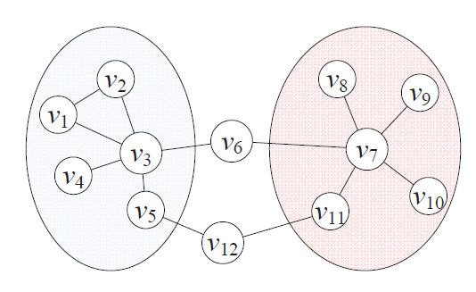
Problem Definition
Which node is the best structural hole spanner?
Community 2
Community 1
Well, mining top-k structural hole spanners is more complex…
Notes:
The input of the problem is a social network, a graph G. And associate with communities information.
So the community is the input of the our problem.
What we want to do is to maximize the following function.
Here Q, is the utility function, to measure how a subset of vertices span structural holes.
Q is a General definition, can be instantiate in many ways, like:
Number of path between communities.
Number of edges between key members among communities
And the VSH is exactly the top-k structural hole spanners we want to compete.

Slide 25
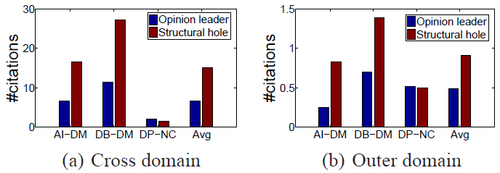
Structural hole spanners control information diffusion?
In the Coauthor network :
  Structural hole spanners almost double opinion leaders on number of cross domain (and outer domain) citations.
Notes:
In coauthor, we consider the citation as a type of information diffusion.
SHS almost double OL the number of cross domain and outer domain citation.
Cross domain citation is only aimed for cites from other computer science areas.
Outer domain citation is only aimed for cites from non-CS areas, other areas like math and biology.

Slide 26

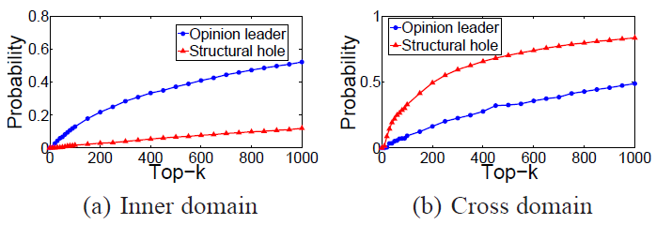
Structural hole spanners control the information diffusion
Opinion leaders 5 times higher
Structural hole spanners 3 times higher
  Results: Opinion leaders controls information flows within communities, while Structural hole spanners dominate information spread across communities.
Notes:
we perform another analysis of information diffusion in the Twitter and Coauthor networks.
In twitter, we estimate the probability of OL and SHS appearing on a tweet forward path.
The result shows an interesting phenomena, OL dominate in inner domain information spread, which is 5 times higher than SHS, but on the other hand, SHS almost 3 times the cross domain information flows.

Slide 27
Problem definition
INPUT :
  A social network, G = (V, E) and L communities C = (C₁, C₂, …, C_{L})
Identifying top-k structural hole spanners.
max Q(V_{SH}, C), with |V_{SH}| = k
  Utility function Q(V*, C) : measure V*’s degree to span structural holes.
V_{SH} : Top-k structural holes spanners as a subset of k nodes
Notes:
The input of the problem is a social network, a graph G. And associate with communities information.
So the community is the input of the our problem.
What we want to do is to maximize the following function.
Here Q, is the utility function, to measure how a subset of vertices span structural holes.
Q is a General definition, can be instantiate in many ways, like:
Number of path between communities.
Number of edges between key members among communities
And the VSH is exactly the top-k structural hole spanners we want to compete.

Slide 28
Structural hole spanners vs. Opinion leaders
Structural hole vs.
Opinion leader vs. Random
Result: Structural hole spanners are more likely to connect important nodes
+15% - 50%
The two-step information flow theory^{[1]} suggests structural hole spanners are connected with many “opinion leaders”
[1] E. Katz. The two-step flow of communication: an up-to-date report of an hypothesis. In Enis and Cox(eds.), Marketing Classics, pages 175–193, 1973.
Notes:
(1) Observation (2) case

Slide 29
Model One : HIS
Structural hole spanners are more likely to connect important nodes in different communities.
  If a user is connected with many opinion leaders in different communities, more likely to span structural holes.
  If a user is connected with structural hole spanners, more likely to act as an opinion leader.
Notes:
Based on the first intuition.
For example, v3 and v7 are Ols in two communities, so they have more power to spread information than other nodes v5 and v11,
V6 and v12 can be considered as the bridge to connect two communities.
And v6 have a higher advantage than v12, since v6 connects two OL and v12 only connects two ordinary users.
On the other hand, a node is more likely to act as an OL, if it connects with structural hole spanners.
We develop the first model as the following mutual recursion formulas.
I(v, C) is ..
H(v, S) is ..
A and b are ….

Slide 30
Model One : HIS
Structural hole spanners are more likely to connect important nodes in different communities.
  If a user is connected with many opinion leaders in different communities, more likely to span structural holes.
  If a user is connected with structural hole spanners, more likely to act as an opinion leader.
Model
  I(v, C_{i}) = max { I(v, C_{i}), α_{i} I(u, C_{i}) + β_{S} H(u, S) }
  H(v, S) = min { I(v, C_{i}) }
  I(v, C_{i}) : importance of v in community C_{i}.
  H(v, S) : likelihood of v spanning structural holes across S (subset of communities).
α and β are two parameters
Notes:
Essentially, in Eq. 2, the importance score can be explained as the maximal information flow a user can receive from one of her/his friends.
Eq. 3 suggests that a structural hole spanner in S should be active in all the communities in S. The two update rules, Eqs. 2 and 3 are the basic approaches by which structural holes and importance (authority) reinforce each other.

Slide 31
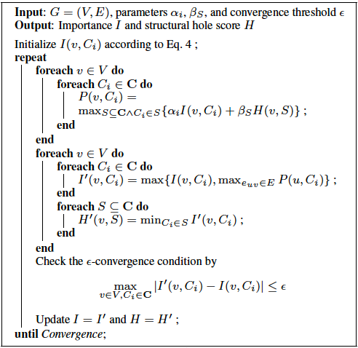

Algorithm for HIS
By PageRank or HITS
Parameter to control the convergence

Slide 32
Theoretical Analysis — Existence
Given α_{i} and β_{S}, solution exists ( I(v, C_{i}), H(v, S) ≤ 1) for any graph, if and only if, α_{i} + β_{S} ≤ 1.
  For the only if direction
    Suppose α_{i} + β_{S} > 1, S = {C_{blue}, C_{yellow}}
    r(u) = r(v) = 1;
    I(u,C_{blue}) = I(u,C_{yellow}) = 1;
    H(u,S) = min { I(u, C_{blue}), I(u, C_{yellow})}=1;
    I(v, C_{yellow}) ≥ α_{i} I(u, C_{i}) + β_{S} H(u, S) = α_{i} + β_{S} > 1
u
v
  I(v, C_{i}) = max { I(v, C_{i}), α_{i} I(u, C_{i}) + β_{S} H(u, S) }
  H(v, S) = min { I(v, C_{i}) }
Notes:
We first proof the only if direction. Suppose we have two communities, one is blue, another is yellow. Two vertex U and V are connected with each other. Vertex V belongs to yellow and vertex U belongs to both yellow and blue. And we are looking for the structural hole between blue and yellow.
Suppose alpha + beta > 1, and the initial value of u and v both equals to 1. Thus the importance scores of vertex U in blue and yellow are also one, which is the same with its structural hole score. By the updating equation, we find that I(v, C_yellow) >= alpha + beta > 1, which is impossible.

Slide 33
Theoretical Analysis — Existence
Given α_{i} and β_{S}, solution exists ( I(v, C_{i}), H(v, S) ≤ 1) for any graph, if and only if, α_{i} + β_{S} ≤ 1.
  For the if direction
    If α_{i} + β_{S} ≤ 1, we use induction to prove I(v, C_{i}) ≤ 1;
    Obviously I⁽⁰⁾(v, C_{i}) ≤ r(v) ≤ 1;
    Suppose after the k-th iteration, we have I^{(k)}(v, C_{i}) ≤ 1;
    Hence, in the (k + 1)-th iteration, I^{(k+1)}(v, C_{i}) ≤ α_{i}I^{(k)}(u, C_{i}) + β_{S}H^{(k)}(u, S) ≤ (α_{i} + β_{S})I^{(k)}(u, C_{i}) ≤ 1.
  I(v, C_{i}) = max { I(v, C_{i}), α_{i} I(u, C_{i}) + β_{S} H(u, S) }
  H(v, S) = min { I(v, C_{i}) }

Slide 34
Theoretical Analysis — Convergence
Denote γ = α_{i} + β_{S} ≤ 1, we have
|I^{(k+1)}(v, C_{i}) - I^{(k)}(v, C_{i})| ≤ γ^{k}
  When k = 0, we have I⁽¹⁾(v, C_{i}) ≤ 1, thus
  |I⁽¹⁾(v, C_{i})-I⁽⁰⁾(v, C_{i})| ≤ 1
  Assume after k-th iteration, we have
  |I^{(k+1)}(v, C_{i})-I^{(k)}(v, C_{i})| ≤ γ^{k}
  After (k+1)-th iteration, we have
  I^{(k+2)}(v, C_{i}) = α_{i}I^{(k+1)}(u, C_{i}) + β_{S}H^{(k+1)}(u, S)
  ≤ α_{i}[I^{(k)}(u, C_{i})+γ^{k}] + β_{S}[H^{(k+1)}(u, S)+γ^{k}]
  ≤ α_{i}I^{(k)}(u, C_{i}) + β_{S}H^{(k+1)}(u, S) + γ^{k+1}
  ≤ I^{(k+1)}(u, C_{i}) + γ^{k+1}

Slide 35
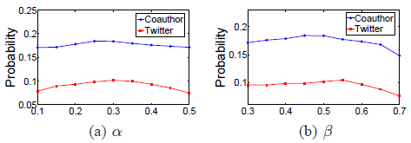
Convergence Analysis
Parameter analysis.
  The performance is insensitive to the different parameter settings.
Notes:
We proof condition of existance, and e-convergence property.
After designing an iteratie algorithm, we conduct parameter analysis, show that the performance……

Slide 36
Model Two: MaxD
Structural hole spanner detection: finding top-k nodes such that after removing these nodes, the decrease of the minimal cut will be maximized.
Removing V₆ decreases the minimal cut as 2
Minimal cut: the minimal number of edges to separate nodes in different communities.`
Two communities with the minimal cut as 4

Slide 37
Model Two: MaxD
Structural holes spanners play an important role in information diffusion
Q(V_{SH}, C) = MC (G, C) – MC (G \ V_{SH}, C)
MC(G, C) = the minimal cut of communities C in G.
Shapley value is defined to evaluate the contribution of each user in a cooperative game theory
—Lloyd Shapley, 1953
Notes:
The first model basicly consider the correlation between SHS and OL. but not consider information diffusion.
So, In the second model, we explicitly use information flows in the quality function.
Here we define MC() as the minimal cut of communities in the graph.
What we want to do is to find a subset of nodes, such that without them, the connection between communities would be minimized.

Slide 38
Hardness Analysis
Q(V_{SH}, C) = MC (G, C) – MC (G \ V_{SH}, C)
Hardness analysis
  If |V_{SH}|= 2, the problem can be viewed as minimal node-cut problem
  We already have NP-Hardness proof for minimal node-cut problem, but the graph is exponentially weighted.
  Proof NP-Hardness in an un-weighted (polybounded -weighted) graph, by reduction from k-DENSEST-SUBGRAPH problem.
Notes:
The idea of the second model is straightforward, but it’s harder to find an efficient algorithm to optimize it.
Even when there are only 2 communities. The problem can be viewed as ….
………….
………. Which is not practical in real networks.
We rewrite the proof such that, the edges.

Slide 39
Hardness Analysis
Let us reduce the problem to an instance of the k-DENSEST SUBGRAPH problem
Given an instance {G’=<V, E>, k, d} of the k-DENSEST SUBGRAPH problem, n=|V|, m=|E|;
Build a graph G with a source node S and target node T;
Build n nodes connecting with S with capacity n*m;
Build n nodes for each edge in G’, connect each of them to T with capacity 1;
X₁
Y₁
1
1
n*m
1
Y₂
1
T
X₂
S
1
.
.
.
.
.
.
1
1
n*m
X_{n}
Y_{n*m}
Notes:
The idea of the second model is straightforward, but it’s harder to find an efficient algorithm to optimize it.
Even when there are only 2 communities. The problem can be viewed as ….
………….
………. Which is not practical in real networks.
We rewrite the proof such that, the edges.

Slide 40
Hardness Analysis (cont.)
Build a link from x_{i} to y_{j} with capacity 1 if the x_{i} in G’ appears on the j-th edge;
MC(G)=n*m;
The instance is satisfiable, if and only if there exists a subset
|V_{SH}|=k
such that
MC(G\V_{SH}) <= n(m-d)
X₁
Y₁
1
1
n*m
1
Y₂
1
T
X₂
S
1
.
.
.
.
.
.
1
1
n*m
X_{n}
Y_{n*m}

Slide 41
Proof: NP-hardness (cont.)
For the only if direction
  Suppose we have a sub-graph consists of k nodes {x’} and at least d edges;
  We can choose V_{SH}={x};
  For the k-th edge y in G’, if y exists in the sub-graph, two nodes appearing on y are removed in G;
  Thus y cannot be reached and we lost n flows for y;
  Hence, we have MC(G \ V_{SH}) <= n*(m-d).

Slide 42
Proof: NP-hardness (cont.)
For the if direction
  If there exists a k-subset V_{SH} such that MC(G\V_{SH}) <= n*(m-d);
  Denote V_{SH}’=V_{SH}^{x}, the size of V_{SH}’ is at most k, and MC(G\V_{SH}’) <= n*(m-d);
  Let the node set of the sub-graph be V_{SH}’, thus there are at least d edges in that sub-graph.

Slide 43
Approximation Algorithm
Two approximation algorithms:
  Greedy: in each iteration, select a node which will result in a max-decrease of Q(.) when removed it from the network.
  Network-flow: for any possible partitions E_{S} and E_{T}, we call a network-flow algorithm to compute the minimal cut.
Complexity: O(nkT_{l}(n)); T_{l}(n)—the complexity for computing min-cut
Complexity: O(k²T_{l}(n));
Approximation Ratio: O(n^{1/4+ε})
An example: finding top 3 structural holes
Step 1: select V8 and decrease the minimal cut from 7 to 4
Step 2: select V6 and decrease the minimal cut from 4 to 2
Step 3: select V12 and decrease the minimal cut from 2 to 0

Slide 44
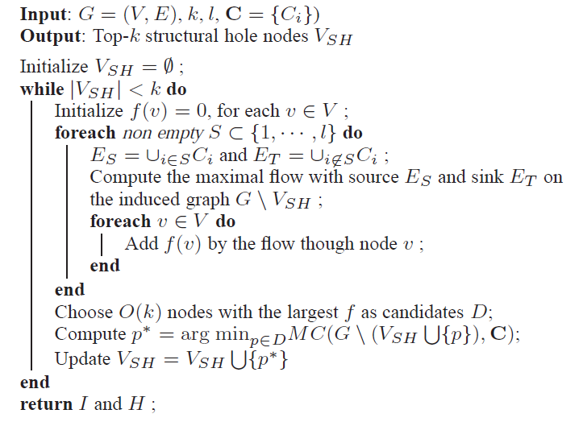
Approximation Algorithm
Greedy : In each round, choose the node which results in the max-decrease of Q.
  Step 1: Consider top O(k) nodes with maximal sum of flows through them as candidates.
Step 2: Compute MC(*, *) by
trying all possible partitions.
Complexity: O(2^{2l}T₂(n)); T₂(n)—the complexity for computing min-cut Approximation ratio: O(log l)
Notes:
Since the problem is NP-hard, we design approximation algorithm using greedy strategy.
In each round, we choose one node to maximal decrease of MC.
To scale up the algorithm to large networks, we only consider top O(k) nodes with
Maximal sum of flows though them as candidates.
One more challenge is to estimate MC(), when L > 2, it’s NP-Hard to get the exact number, so we design a O(logL) approximation by trying all possible partitions of communities.

Slide 45
Mining structural hole spanners
Evaluate the performance of the proposed models.

Slide 46
Experiment
 | #User | #Relationship | #Messages
Coauthor | 815,946 | 2,792,833 | 1,572,277 papers
Twitter | 112,044 | 468,238 | 2,409,768 tweets
Inventor | 2,445,351 | 5,841,940 | 3,880,211 patents
Evaluation metrics
  Accuracy (Overlapped PC members in the Coauthor network)
  Information diffusion on Coauthor and Twitter.
Baselines
  Pathcount: #shortest path a node lies on
  2-step connectivity: #pairs of disconnected neighbors
  Pagerank and PageRank+: high PR in more than one communities

Slide 47
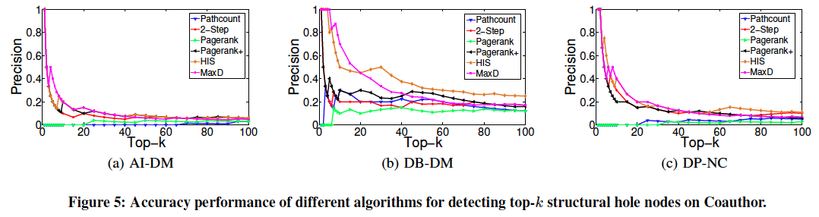
Experiments
Accuracy evaluation on Coauthor network
Predict overlapped PC members on the Coauthor network.
  +20 – 40% on precision of AI-DM, DB-DM and DP-NC
What happened to AI-DM?

Slide 48
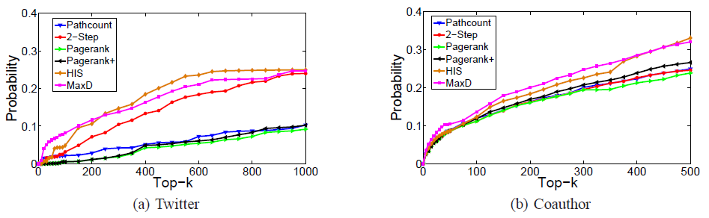
Maximization of Information Spread
Clear improvement. (2.5 times)
Top 0.2% - 10 %
Top 1% - 25 %
    Improvement is limited, due to top a few authors dominate.
    Improvement is statistically significant (p << 0.01)
Notes:
For the information spread maximization, we employ twitter and coauthor as the basis, we study how the detected SHS control the diffusion of information.
We can see that, on the twitter netowrk. top 0.2%.
On the coauthor network. …………

Slide 49
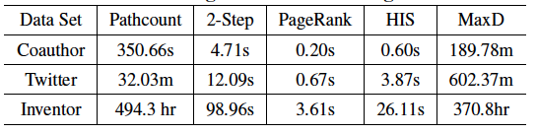
Efficiency
Running time of different algorithms in three data sets
HIS is very fast, but MaxD is not very efficient.

Slide 50
Big Network Analysis
data
User
Tie
Topology
Heterogeneous
Micro
Macro
tie
Dynamic
Influence
- User Modeling
- Demographics
- Social Role
- Social Tie/Link
- Homophily
- Social Influence
- Triad Formation
- Community
- Group Behavior
Big&Big
social
Social Theories
Graph Theories
BIG Networks

Slide 51
Thank you！
Collaborators: John Hopcroft, Jon Kleinberg, Chenhao Tan (Cornell)
Jiawei Han (UIUC), Philip Yu (UIC)
Jian Pei (SFU), Hanghang Tong (ASU)
Tiancheng Lou (Google&Baidu), Jimeng Sun (GIT)
Wei Chen, Ming Zhou, Long Jiang, Chi Wang, Yuxiao Dong (Microsoft)
Yutao Zhang, Jing Zhang, Zhanpeng Fang, Zi Yang, Sen Wu, etc. (THU)
  Jie Tang, KEG, Tsinghua U, http://keg.cs.tsinghua.edu.cn/jietang
  Download all data & Codes, http://arnetminer.org/data
  http://arnetminer.org/data-sna

