Slide 1

The Lifecycle and Cascade of WeChat
Social Messaging Groups
Jiezhong Qiu† , Yixuan Li#, Jie Tang† , Zheng Lu‡ , Hao Ye‡ , Bo Chen‡,
Qiang Yang* and John E. Hopcroft#
† Tsinghua University
# Cornell University
‡ Tencent Corporation, Beijing, China
* Hong Kong University of Science and Technology
Notes:
Thanks for chair for the introduction.
This is …
I am going to talk about The Lifecycle and Cascade of WeChat Social Messaging Groups.
This is a joint work with collaborator from Tsingua, Cornell, HKUST, and the Tencent Corporation.

Slide 2
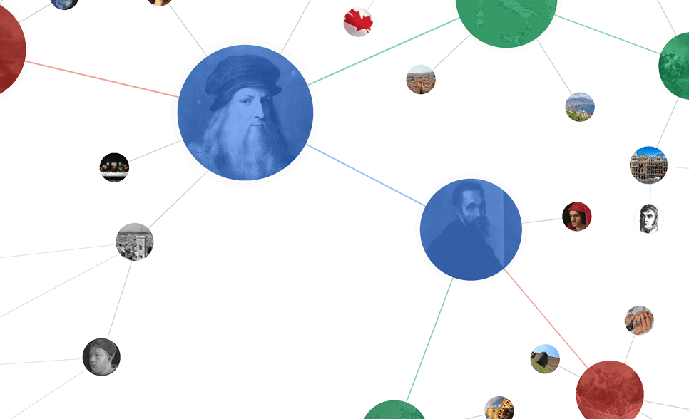

Social Media
Open, Fast, Visible
Private, Relationship-focused
>1 billion created accounts
~697 million MAUs
>70 million MAUs outside of China
http://tencent.com/en-us/ir/news/2016.shtml
Notes:
Sociel media are really popular in our daily life.
Generally, there are two types of social media. The first one is open, fast and visible. For example, facebook, twitter, and weibo.
The second one is much more private and relationship-focused, e.g. WhatsApp, LINE, and WeChat.
In this work, we mainly study the second one <click>
in particular, we study wechat <click>
WeChat is a social messaging service like whatsapp and line.
<click>
As of December 2015, WeChat has over one billion users, 697 million monthly active users with 70 million outside of China.

Slide 3
Group Chat in WeChat
Invite
Invite
~2.3 million groups generated everyday
>25% messages are generated in group chats
Notes:
In this work, we study group chat.
The left figure is a screenshot of wechat app on mobile phone.
The scenario is steve want to invite two friends,<click> Luke and Mohammed to a group chat.
I have to say group chats are really important in WeChat, there are about 2.3 million groups generated everyday. One quarter of messages are generated in groups chats.

Slide 4
Data Set
Group: groups generated on July 26th, 2015
User: group members + users in fringe
Invitation: (u, v, C, T)
Friendship: (u, v, T)
Group Member
Fringe
Invite
friend
Notes:
We got a sample of 4.7 hundred thousand group chats generated on July 26th last year. For each group, we consider the corresponding users to be its group members as well as all the users in the fringe of the group.
<click>
Here the fringe is defined as group memnbers’ one-hop friends.
We also have invitation data which is showed by the blue arrow line <click> and denoted by 4-tuple (u, v, C, T), indicating user u invited user v to group C at time T.
Moreover, we have the friendship relationship data which is showed by the dotted line <click> and denoted by 3-tuple, indicating user u and user v become friends at time T.

Slide 5
Group Lifecycle Dichotomy
Definition: Group Lifespan. Duration from the timestamp at which a group is initialized, to the timestamp at which no group members sends chat messages anymore.
How long would a group chat survive?
Short-term group v.s Long-term group
Notes:
We first want to study the lifecycle of groups. We want to answer how long would a group chat survive.
<click>
We did some preliminary analysis for all the groups in our data set.
Interestingly, we found that:
Firstly, almost 40% of groups stop interaction within only a week <click>
Secondly, About 30% of groups sustain longer than one month <click>
Based on the observations, we categorize groups into short-term groups and long-term groups according to their lifespan.
<click>

Slide 6
Group Lifecycle Dichotomy – Case Study
Short-term group v.s Long-term group
Event-driven v.s. Relationship-driven
Notes:
Intuitively, the lifespan of a group chat is correlated with its social functions. We manually examined 100 randomly selected groups, 60 of them are long-term groups, and the other 40 are short-term groups.
It seems that in travelling and meeting <click>, people tend to create short-term groups.
And family members and friends would create long-term groups. <click>
In general, <click> event-driven groups usually have a short lifespan, while relationship-driven groups have long lifespan.

Slide 7
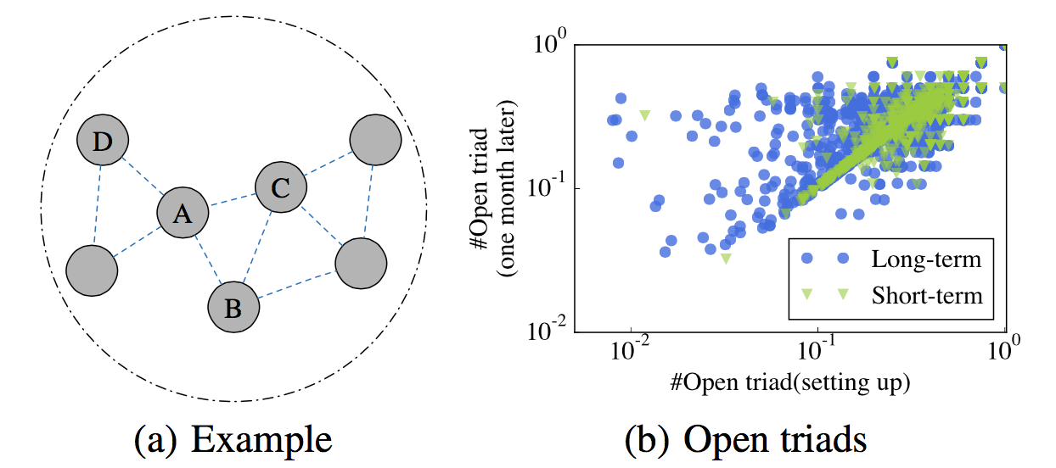
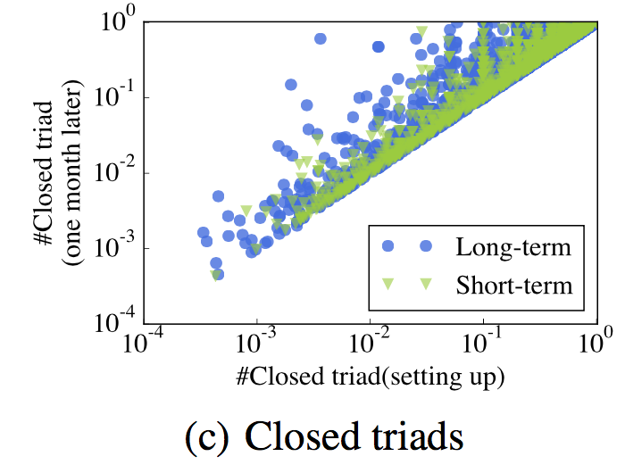
Group Lifecycle Dichotomy – Structure Dynamics
Open Triad
Closed
Triad
Long-term Group: Strong dynamics in terms of underlying friendship structure.
Short-term Group: Less likely to develop friendship over time.
Notes:
We further answer the question what are the fundamental factors that determine groups’lifespan.
We first study how the change of open triad and closed triad influence the lifespan of groups.
Figure a shows a snapshot of a group, the vertices A, B, and C form a closed triad while A, C, and D form a open triad.
We first consider open triad. <click> In figure b, x-axis is the normalized number of open triads at the very beginning of a group, and the y-axis is the normalized number of closed triads on month later. If the structure are not changing at all, we expect to see data points centering around the diagonal line. However, it seems that long-term groups show strong dynamics.
<click>
The result is similar for closed triad.
Over all, the long-term ones show stronger dynamics while most short-term groups are less likely to develop friendship over time.

Slide 8
Group Lifecycle Dichotomy – Group Cascade Tree
Definition: Group Cascade Tree. A directed graph where each group member is a node, and a directed edge from u to v is constructed if u (inviter) successfully invites v (invitee) to the group.
Example of long-term groups
WeChat Group
Group Cascade Tree
Invite
Invite
Example of short-term groups
Notes:
we also study the group formation processes.
The invitations in a group chats actually form a group cascade tree.
<click>
In general, most of long-term groups tend to have a complicated tree structure;
<click>
whereas many short-term group cascade trees display an approximate star graph structure.
Here are two examples of them.

Slide 9
Group Lifecycle Dichotomy – Cascade Tree Pattern
Depth=1
Depth=2
Subtree size: The size of sub-cascade
Depth: The depth of invitation
Wiener Index: Average distance between two nodes
Notes:
To quantify such difference, we introduce the following metrics that capture the structure of cascade tree, that is subtree size, depth and wiener index.
Subtree size is the size of sub-cascade. In this example, the size of the red subtree is 3.
Depth is the depth of invitation. In this example, the depth of node c is 2.
Wiener index is defined to be the average distance between two nodes in the cascade tree.
In this example, the wiener index of this cascade tree is 2.

Slide 10
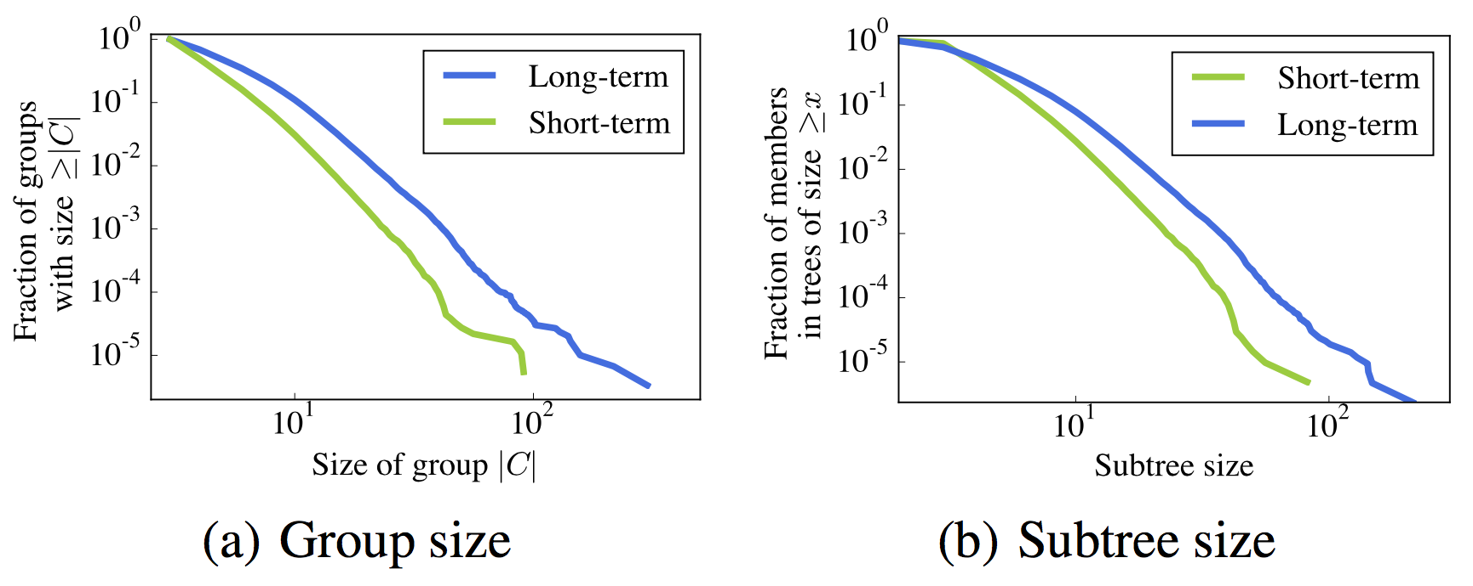
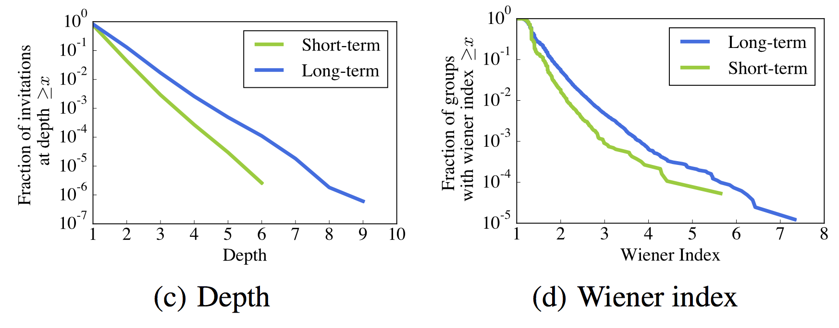
Group Lifecycle Dichotomy—Cascade Tree Pattern
>10% of users have subtree size >= 10
10% of invitations occur at >=3
10% with W-index >= 2
Only ~2% have substree size >= 10
Only 1% occur at >= 3
99% with W-index < 2
For node C
  Subtree size: 3
  Depth: 2
For the left example:
  Wiener index: 2
Notes:
We plot the power-law-like distributions of the three metrics for groups with different lifespan.
There are significant differences between long-term and short-term groups according to the three metrics.
For example, <click> 10% of invitations in long-term groups occur at depth 3 or greater; whereas for short-term groups, the number is less than 1%.

Slide 11
Group Lifecycle Dichotomy — Features
Group Level:
For group C at time T
Group Structure | The number of open triads at T and at the setting up of group.
 | The number of closed triads at T and at the setting up of group.
Cascade Tree | Wiener index.
 | Number of members whose depth equal to k, k = 1,2,...,9.
Demographics | Number of members who stated their gender to be X.
 | Entropy of member’s gender
Notes:
Based on above analysis, we define three categories of features to capture the characteristics of group C at time T.
That is group structure feature, cascade tree feature, and demographics feature.
For group structure feature, for example, we have the number of open triads at T and the setting up of this group.
For cascade tree feature, for example, we have the wiener index.
For demographics, for example, we have the number of members who stated their gender to male or female.

Slide 12
Group Lifecycle Dichotomy—Prediction
SVM 10-fold Cross Validation
Features | AUC | Precision | Recall | F1
All Features | 66.62 | 63.23 | 57.66 | 60.32
-Structure | 64.75 | 59.36 | 62.83 | 61.04
-Cascade | 65.36 | 64.49 | 47.67 | 54.82
-Demographics | 65.24 | 57.35 | 65.71 | 61.25
+Structure | 64.21 | 61.98 | 42.51 | 50.43
+Cascade | 61.23 | 57.35 | 65.71 | 61.25
+Demographics | 62.77 | 63.18 | 41.41 | 50.03
All Features | 66.62 | 63.23 | 57.66 | 60.32
+Cascade | 61.23 | 57.35 | 65.71 | 61.25
Task 1: Group Separability: Predict groups’ lifespan.
Task 2: Early Prediction: Can we predict the group lifecycle in early stage.
Notes:
Based on the above features, we have two prediction tasks here.
The first one is the group separability, to predict whether one group is long-term or short-term.
We find best classification performance (66.62% AUC) can be obtained with full set of features. <click>
and the set ofcascade features by itself can yield good performance. <click>

Slide 13
Group Lifecycle Dichotomy—Prediction
SVM 10-fold Cross Validation
Features | AUC | Precision | Recall | F1
1 hour | 57.95 | 54.16 | 56.80 | 55.45
1 day | 65.08 | 61.92 | 53.38 | 57.34
5 days | 65.46 | 62.52 | 54.11 | 58.01
10 days | 65.57 | 62.48 | 56.81 | 59.51
20 days | 65.76 | 62.78 | 56.56 | 59.51
1 month | 66.62 | 63.23 | 57.66 | 60.32
1 day | 65.08 | 61.92 | 53.38 | 57.34
1 month | 66.62 | 63.23 | 57.66 | 60.32
Task 1: Group Separability: Predict groups’ lifespan.
Task 2: Early Prediction: Can we predict the group lifespan in early stage.
Notes:
The second task is the early prediction task.
we find that features extracted one day after the groups being set up can yield AUC accuracy as high as 65.08%, <click>
which is almost as good as 66.62% when we extract features one month after the groups being set up. <clcik>

Slide 14
Membership Cascade
invitee
invitee
inviter
inviter
invitee
Q1: Who are inviters?
Q2: Who are invitees?
Notes:
So far, we have studied the lifecycle of groups where long-term show complicated cascade tree pattern, while the short-term groups have approximate star graph structure.
Since the group gain new members by invitations, that means the group formation process could be formulated as a membership cascade process.
At some timestamp T, some of group members become inviters <click> which is denoted by blue here
and then they choose some of her friends to be invitees <click> which is denoted by red here.
So here we have two questions: who are inviters and who are invitees?

Slide 15
Membership Cascade—Inviter
  ~80% of the first invitations happen within 5 days after the inviter joining the group
  >80% of consecutive invitations by the same inviter happen within 2 days of interval
Notes:
For Q1, We study the time-dependence pattern of invitation from the perspective of inviters.
Overall, the invitations are really time-sensitive.
For example: <click> ~80% of the first invitations happen within 5 days after the inviter joining the group and
<click> >80% of consecutive invitations happen within 2 days.
[delete]Definition: Invitation Interval is defined as the time interval between any two consecutive invitations. First Invitation Latency is defined as the interval between the timestamp at which a user joins a group and the timestamp when he/she invites another friend to the same group for the first time.

Slide 16
Membership Cascade—Invitees’ Local Structure
Slight decrease
V has 4 friends already in the group
k=4
Notes:
For Q2, we study how membership cascade process is influenced by invitees’local structure, that is invitees’ ego network.
In the left example, user v has 4 friends who have already joined the group, that is user A, B, C, and D.
And we want to know how the number of in-group friends k determine the probability of joining a group.
Intuitively, the more friends you have in the group, the more likely you will get invited.
Is it true or not.?
<click>
The results for WeChat are very interesting.
When k is smaller then 20, there is an increase of probability with respect to k. <click>
there is a slight decrease when k is larger than 20 <click>
We infer that it is caused by the mechanism of WeChat, that when a group has more than 40 users, inviting friends to join the group requires invitees’ confirmation.

Slide 17
Membership Cascade—Invitees’ Local Structure
V has 4 friends already in the group
They form 3 connected components
Zhang, Liu, Tang et al, IJCAI’2013
[1] Jing Zhang, Biao Liu, Jie Tang, Ting Chen, and Juanzi Li. Social Influence Locality for Modeling Retweeting Behaviors. In Proceedings of the 23rd International Joint Conference on Artificial Intelligence (IJCAI'13)
Notes:
In the same example, we also note V’s 4 in-group friends form 3 connected components.
And we want to answer the question how the structural diversity (here measured by the number of cc) influence the probability of joining a group.
<click>
We choose the k to be 2,3,4,5, 6-10, and larger than 10.
We show that the probability of joining a group is positively correlated with the number of friends already in the group, but negatively correlated with the number of connected components her in-group friends form.
This result is consistent with previous observation in retweeting behaviors.

Slide 18
Membership Cascade—Features
Inviter Level (for member u in group C at time T )
History Behavior | How long has it been since u invited others to C.
Local Structure | The number and fraction of u’s friends in the group
Invitee Level (for user u in the fringe of group C at time T )
Demographics | User u’s stated gender.
Local Structure | Number of friends already in the group.
Notes:
Basd on above analysis, we define the features to capture the characteristics of membership cascade.
For inviters, the features are defined for member u in group C at time T.
we define the history behavior features, for example, how long has it been since u invited others to C.
We also define local structure features, for example, the number of u’s friends in the group.
For invitees, the features are defined for for user u in the fringe of group C at time T we define the demographics features, e.g, user u’s stated gender.
We also define the local structure features, e.g. the number of friends already in the group.

Slide 19
Membership Cascade—Prediction
SVM 10-fold Cross Validation
Task | Feature Used | AUC | Precision | Recall | F1
Inviter | All | 95.31 | 85.95 | 88.39 | 87.15
 | -History Behavior | 91.52 | 82.07 | 84.31 | 83.17
 | -Local Structure | 93.22 | 84.50 | 87.04 | 85.75
Invitee | All | 98.66 | 54.55 | 93.47 | 68.69
 | -Demographics | 98.05 | 45.76 | 94.68 | 61.70
 | -Local Structure | 89.29 | 11.85 | 76.53 | 20.52
All | 95.31 | 85.95 | 88.39 | 87.15
-History Behavior | 91.52 | 82.07 | 84.31 | 83.17
All | 98.66 | 54.55 | 93.47 | 68.69
-Local Structure | 89.29 | 11.85 | 76.53 | 20.52
Notes:
We see that our model is quite effective, with AUC of 95% and F1 of 87% in predicting inviter <click>
and with AUC of 98% and F1 of 69% in predicting invitee <click>
we also find that historical behavioral features can be important factors in the task of predicting inviter; <click>
while local structural features are the dominant ones in predicting invitee. <click>

Slide 20
Summary
We take the first step to study social messaging groups.
We discover a strong dichotomy of groups in terms of their lifecycle.
We define the membership cascade process and develop a model to predict the dynamics of the process.

Slide 21
Furture Research
Coevolution of chat groups
Comparison between information diffusion and membership cascade process.
Role of chat group in the whole WeChat ecosystem

Slide 22
Thank you！
Collaborators:
Yixuan Li, John E. Hopcroft (Cornell)
Jie Tang (THU)
Qiang Yang (HKUST)
Zheng Lu, Hao Ye, Bo Chen (Tencent)

