Slide 1
Sampling Representative Users from Large Social Networks
Jie Tang, Chenhui Zhang
Tsinghua University
Keke Cai, Li Zhang, Zhong Su
IBM, China Research Lab
Download Code&Data here: http://aminer.org/repuser

Slide 2
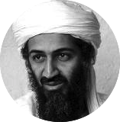






Sampling Representative Users
Goal: Finding k users who can best represent the other users.
C
A
0.7
0.3
supercompting
0.7
data mining
0.6
0.74
big data
0.3
HCI
0.3
0.2
B
0.1
visualization
0.1
0.05
0.5
0.4
0.1
data mining
0.8
social network
0.5
HCI
0.2
data mining
0.3
HPC
0.2
http://aminer.org/repuser
Notes:
Let us first give an example to demonstrate the motivation of this work.
The input is a network with weighted edges where the value of each edge indicates the representative degree between users.
The table of each node lists the attribute value of the user, i.e., Green Lantern has a higher interest degree (0.8) on topic “data mining” than the degree (0.2) on “HCI”.
Our goal is to find k users who can best represent the other users in the network in terms of all attributes.

Slide 3
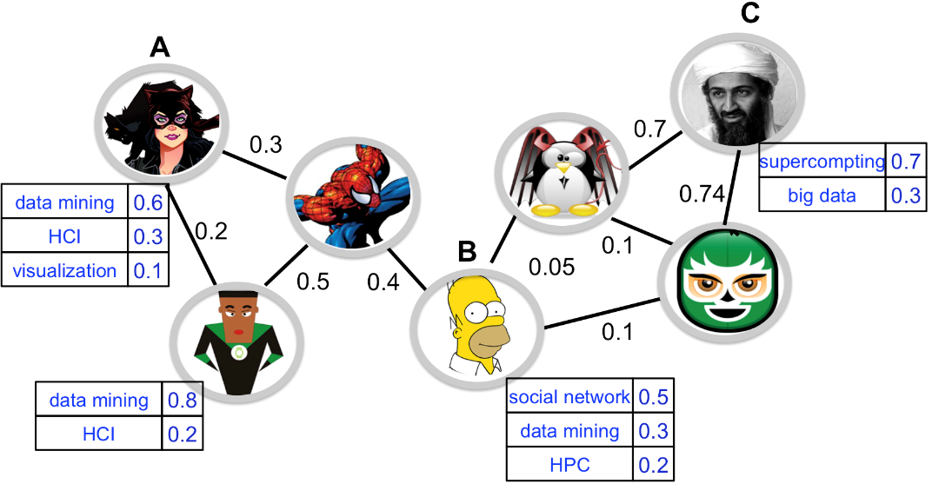
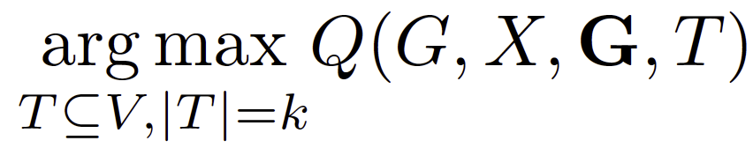
Sampling Representative Users
Problem Formulation
G=(V, E): the input social network
T (|T|=k): Selected subset of representative users
X=[x_{ik}]_{nxm}: attribute matrix
G={(V₁, a_{j1}), …, (V_{t}, a_{jt})}_{jt}
(V₁, a_{j1}): a subset of users V1 with the attribute value a_{j1}
Goal: how to find the subset T (|T|=k) in order to maximize the utility function Q?
Notes:
Formally we can have the following problem definition: Given (1) a social network G = (V, E), where V is the set of users and E is the set of directed edges, (2) d attributes associated with each user, a desirable number k of users to be selected, (3) t attribute groups to be represented, (4) a quality function Q, how to find the set T of k representative users with maximal quality?

Slide 4
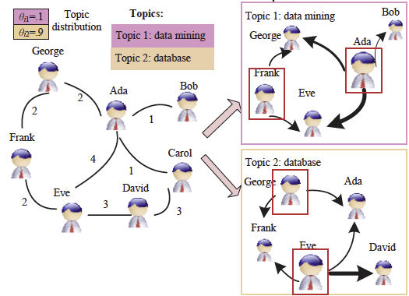
Related Work
Graph sampling
  Sampling from large graphs
  [Leskovec-Faloutsos 2006]
  Graph cluster randomization
  [Ugander-Karrer-Backstrom-Kleinberg 2013]
  Sampling community structure
  [Maiya-Berger 2010]
  Network sampling with bias
  [Maiya-Berger 2011]
Social influence test, quantification, and diffusion
  Influence and correlation [Anagnostopoulos-et-al 2008]
  istinguish influence and homophily [Aral-et-al 2009, La Fond-Nevill 2010]
  Topic-based influence measure [Tang-Sun-Wang-Yang 2009, Liu-et-al 2012]
  Learning influence probability [Goyal-Bonchi-Lakshmanan 2010]
  Linear threshold and cascaded model [Kempe-Kleinberg-Tardos 2003]
  Efficient algorithm [Chen-Wang-Yang 2009]
Notes:
Graph sampling is one of the most relevant research to our work. However, most existing works focus on studying the network
topology and ignore the topic information.
Social influence analysis is also relevant to our work. For example influence maximization tries to find a set of nodes (users) in a social network who can maximize the spread of influence. However, the objective of sampling representative users is to identify a few “average” users who can statistically represent the characteristics of all users. Thus, the two problems naturally are very different.

Slide 5
The Proposed Models:
S3 and SSD

Slide 6
Proposed Models
Theorem 1. For any fixed Q, the Q-evaluated Representative Users Sampling problem is NP-hard, even there is only one attribute
Two instantiation models
  Basic principles: synecdoche and metonymy
  Statistical Stratified Sampling (S3): Treat one user as being a synecdochic representative of all users
  Strategic Sampling for Diversity (SSD): Treat one measurement on that user as being a metonymic indicator of all of the relevant attributes of that user and all users
Prove by connecting to the Dominating Set Problem
Notes:
We first perform a theoretical investigation of the problem. We link this problem to the Dominating Set Problem and prove its NP-hardness.
If there is only one attribute (i.e., a1) and only one attribute group (V, a1), we can see that for a given subset of V, a person is perfectly represented if and only if the corresponding vertex is dominated. Therefore the Dominating Set Problem is equivalent to the problem of evaluating whether there exists a k-element representative set to represent all users perfectly.
Synecdoche: in which a specific instance stands for the general case
Metonymy: in which a specific concept stands for another related or broader concept

Slide 7

Statistical Stratified Sampling (S3)
Maximize the representative degree of all attribute groups
  Trade-offs: choose some less representative users on some attributes in order to increase the global representative
Quality Function
G={(V₁, a_{j1}), …, (V_{t}, a_{jt})}_{jt}
(V₁, a_{j1}): a subset of users V₁ with the attribute value a_{j1}
The degree that T represent the l^{-th} attribute group G_{l}
Avoid bias from large groups
Importance of the attribute group
Notes:
We give the quality function of S3 model.
We assign a score $m_{l}>0$ to indicate the “importance” of this group. Usually we can choose $m_{l}$ to be related with the size of $V_{l}$. The groups with a higher $m_{l}$ value should be better represented. It is preferable to have some “bias” to select user who can represent large attribute groups. We use a value $β∈(0, 1]$ to denote this bias. $P(T, l)$ is the representative degree of $T$ for attribute group $(V_{l}, a_{j_{l}})$.

Slide 8
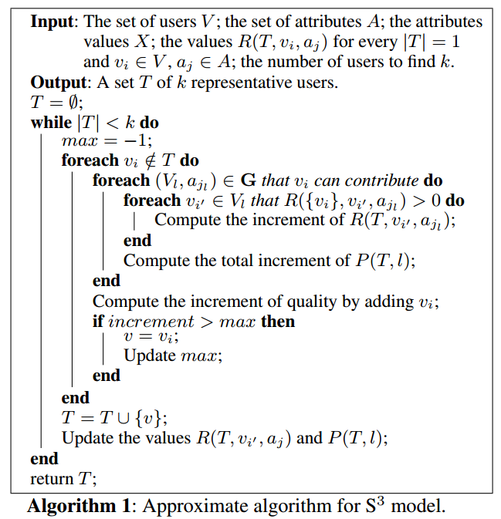
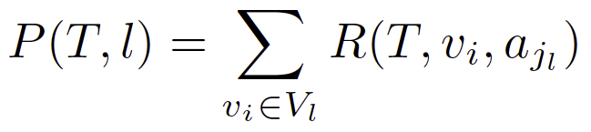
Approximate Algorithm
R(T, v_{i} , a_{jl}): representative degree of T for v_{i} on attribute a_{j}
R(T, v, a) can be simply defined as if some user from T has the same value of attribute a as v, then R(T, v, a) =1; otherwise R(T, v, a) =0.
Notes:
We propose a greedy heuristic algorithm. Each time we traverse all users and find the one that mostly increases the quality function Q. The complexity of the algorithm is $O(t × k × |E|)$.

Slide 9

Theoretical Analysis
The greedy algorithm for the S3 model can guarantee a (1-1/e) approximation
Submodular property
Let
where T* is the optimal solution;
T^{k} is the solution obtained in the k-th iteration.
Thus
Recall
Finally
Notes:
The quality function of S3 is both monotonically increasing and submodular. For every monotonically increasing, submodular, non-negative function f on V, the set generated by the greedy heuristic is at least (1 − 1/e) of the optimal solution

Slide 10

Strategic Sampling for Diversity (SSD)
Maximize the diversification of the selected representative users
Approximation Algorithm
  each time we choose the poorest group (with the smallest λ_{l}•P(T, l)),
  and then select the user who maximally increases the representative degree of this group
Diversity parameter
We set it as λ_{l}=1/|V_{l}|
Notes:
In this model our goal is the diversification of delegates. “Diversity” here means that we want to sample users such that we have a balanced $P(T, l)$ for all attributes (by avoiding extremely large or small $P(T, l)$).
In the quality function of SSD, $λ_{l}$ is a positive constant associated with the attribute group $(V_{l}, a_{j_{l}})$. We call the attribute group with smallest $λ_{l} · P(T, l)$ the poorest group. The quality function depends on the performance of $T$ for the poorest group.

Slide 11
Theoretical Analysis
Theorem 2. Suppose the representative set generated by S3 is T, the optimal set is T*. Then the greedy algorithm for SSD can guarantee an approximation ratio of C/d•Q*, where d is the number of attributes, C is a constant, and Q* is the optimal solution.
Proof. The proof is based on the proof for S3.

Slide 12
Experiments

Slide 13
Datasets
Co-author network: ArnetMiner (http://aminer.org)
  Network: Authors and coauthor relationships from major conferences
  Attributes: Keywords from the papers in each dataset as attributes
  Ground truth: Take program committee (PC) members of the conferences during 2007-2009 as representative users
Microblog network: Sina Weibo (http://weibo.com)
  Network: users and following relationships
  Attributes: location, gender, registration date, verified type, status, description and the number of friends or followers
  No ground truth
Notes:
We perform experiments on two different genres of datasets. The first type is author datasets: Database and Data mining.
For the Database domain, we extract authors from papers published on three major conferences (SIGMOD, VLDB, ICDE) during 2007-2009.
For the Data Mining domain, we extract authors from papers published on three major conferences (SIGKDD, ICDM, CIKM) during 2007-2009.
As for the attributes of authors, we extract keywords from the papers in each dataset. For each author, we then define
the value of an attribute as the number of times she/he uses the corresponding keyword in the authored papers.
The second type of data is a mibroblog network. We crawled the messages from Weibo

Slide 14
Datasets: Co-author and Weibo
Coauthor
Dataset | Conf. | #nodes | #edges | #PC
Database | SIGMOD | 3,447 | 9,507 | 256
 | VLDB | 3,606 | 8,943 | 251
 | ICE | 4,150 | 9,120 | 244
SUM | ALL | 8,027 | 23,770 | 291
Data Mining | SIGKDD | 2,494 | 4,898 | 243
 | ICDM | 2,121 | 3,452 | 211
 | CIKM | 2,942 | 4,921 | 205
SUM | ALL | 6,394 | 12,454 | 373
Weibo
Dataset | #nodes | #edges
Program | 19,152 | 19,225
Food | 189,176 | 204,863
Student | 79,052 | 76,559
Public welfare | 324,594 | 383,702
Notes:
This is the statistic of the two networks.

Slide 15
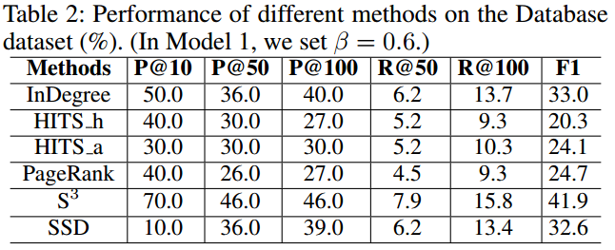
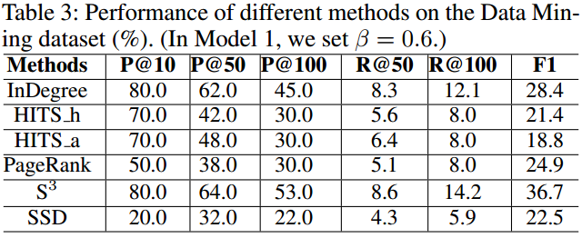
Accuracy Performance
Results: S3 outperforms all the other methods In terms of P@10, P@50 and achieves the best F1 score
Comparison methods:
InDegree: select representative users by the number of indegree
HITS_h and HITS_a: first apply HITS algorithm to obtain authority and hub scores of each node. Then the two methods respectively select representative users according to the two scores
PageRank: select representative users according to the pagerank score
Notes:
We evaluate the performance of the proposed models for sampling representative users on the two datasets.
We compare with several methods: InDegree: select representative users by the number of indegree
HITS_h and HITS_a: first apply HITS algorithm to obtain authority and hub scores of each node. Then the two methods respectively select representative users according to the two scores
PageRank: select representative users according to the pagerank score
High precision of the proposed models.
In terms of P@10, P@50, and P@100, the S3 model significantly outperforms the other methods on the Database, and performs best as well on Data Mining in terms of P@10, P@50.
On the Database the SSD model finally achieves the best accuracy by Precision, Recall, and F1-measure, while on Data Mining S3 model achieves the best accuracy.

Slide 16
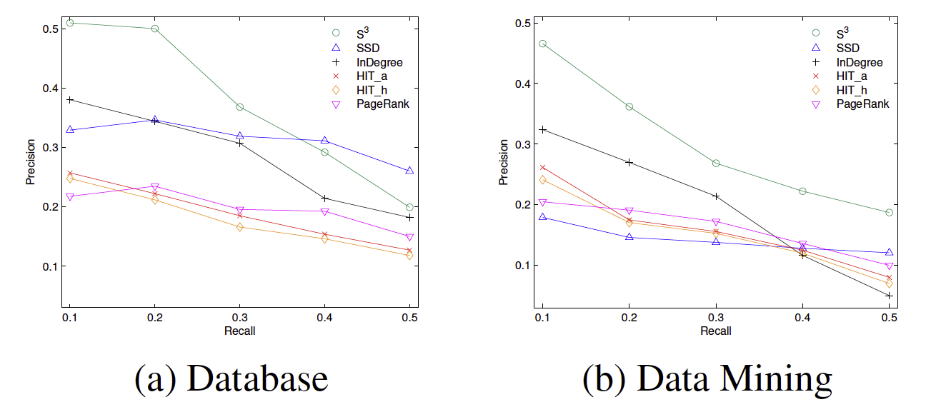
Accuracy Performance
The precision-recall curve of the different methods
Notes:
This figure shows the precision-recall curve of the different methods.
It can be seen that on the Database dataset, our S3 model clearly outperforms the baseline methods. The SSD underperforms the InDegree algorithm when the recall is small, but when increasing the recall, for example up to 40%, the SSD model performs the best, even better than the S3 model. On the Data Mining dataset, the S 3 also model clearly performs best. The SSD model starts to perform better when increasing recall.

Slide 17
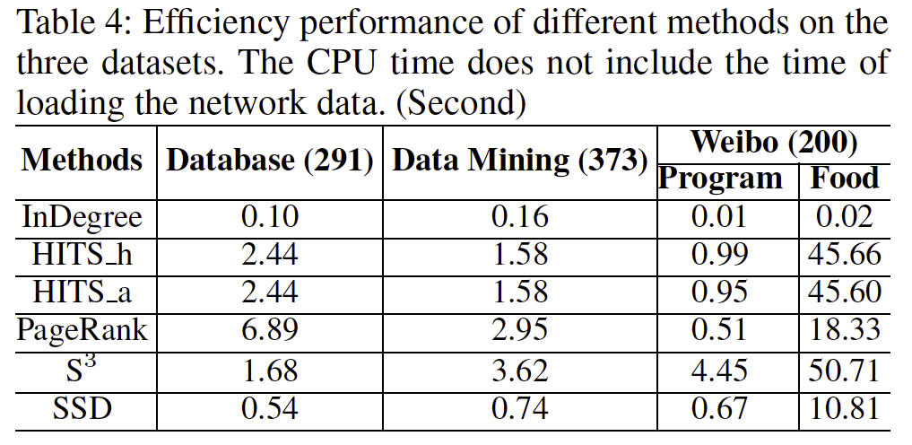
Efficiency Performance
S3 and SSD respectively only need 50 and 10 seconds to perform the sampling over a network of ~200,000 nodes
Notes:
We further compare the efficiency of the proposed methods with the baseline methods. Table 4 lists the CPU time required by the different methods to find representative users respectively from the coauthor datasets and the Weibo dataset. Our methods are very efficient.
S3 and SSD respectively only need 50 and 10 seconds to perform the sampling over a network of ~200,000 nodes

Slide 18
Case Study
Database |  | Data Mining
S3 | PageRank | S3 | PageRank
Jiawei Han Jeffrey F. Naughton Beng Chin Ooi Samuel Madden Johannes Gehrke Kian-Lee Tan Surajit Chaudhuri Elke A. Rundensteiner Divyakant Agrawal Wei Wang | Serge Abiteboul Rakesh Agrawal Michael J. Carey Jiawei Han Michael Stonebraker Manish Bhide Ajay Gupta H. V. Jagadish Surajit Chaudhuri Warren Shen | Philip S. Yu Jiawei Han Christos Faloutsos ChengXiang Zhai Bing Liu Vipin Kumar Jieping Ye Ming-Syan Chen Padhraic Smyth C. Lee Giles | Philip S. Yu Jiawei Han Jian Pei Christos Faloutsos Ke Wang Wei-Ying Ma Jianyong Wang Jeffrey Xu Yu Haixun Wang Hongjun Lu
Advantages of S3:
S3 tends to select users with more diverse attributes;
S3 can tell on which attribute the selected users can represent.
Notes:
Compared with the authority-based baseline method (PageRank), our method has several distinct advantages:
The baseline method can only measure the similarity between nodes, but does not consider the diversity of attributes, which is necessary for the statistical representation.
The baseline method cannot tell which users can be represented by a selected representative user on a specific attribute, while our methods have the capacity to do so.

Slide 19
Conclusions
Formulate a novel problem of $Q$-evaluated Sampling Representative Users (Q-SRU)
Theoretically prove the NP-Hardness of the Q-SRU problem
Propose two instantiation sampling models
Present efficient algorithms with provable approximation guarantees

Slide 20
Sampling Representative Users from Large Social Networks
Jie Tang, Chenhui Zhang
Tsinghua University
Keke Cai, Li Zhang, Zhong Su
IBM, China Research Lab
Download Code&Data here: http://aminer.org/repuser

Slide 21


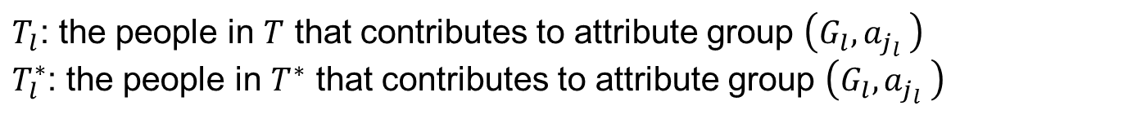
Theoretical Analysis
$T_{l}$: the people in $T$ that contributes to attribute group $\left(G_{l},a_{j_{l}} \right)$
$T_{l}^{∗}$: the people in $T^{∗}$ that contributes to attribute group $\left(G_{l},a_{j_{l}} \right)$
For a fixed attribute group $\left(G_{l},a_{j_{l}} \right)∈ G$, the function $P(T,l)$ is submodular
Let $wl$ be maximal number such that the first $wl$ elements selected by greedy are all contained in $T$
(1)
If
there must be
If
we can continue selecting people for $(G_{l}, a_{j_{l}})$until $|T_{l}^{∗}|$ people are selected. And the set becomes $T′$

Slide 22




Theoretical Analysis
(2)
Therefore by inequality (2)
(3)
We argue that for any $l≠l_{0}$, there must be
(4)
By inequalities (3) and (4), the summation
As we get a contradiction with inequality (1), this theorem is thus proved.

