Slide 1
Weakly Learning to Match Experts in Online Community
Yujie Qian†‡ Jie Tang† Kan Wu†
† Tsinghua University
‡ Massachusetts Institute of Technology
Notes:
Hi, I am Yujie Qian. Today I am presenting “Weakly Learning to Match Experts in Online Community”. It is a joint work with Jie Tang and Kan Wu. This work was done while I was studying at Tsinghua University.

Slide 2

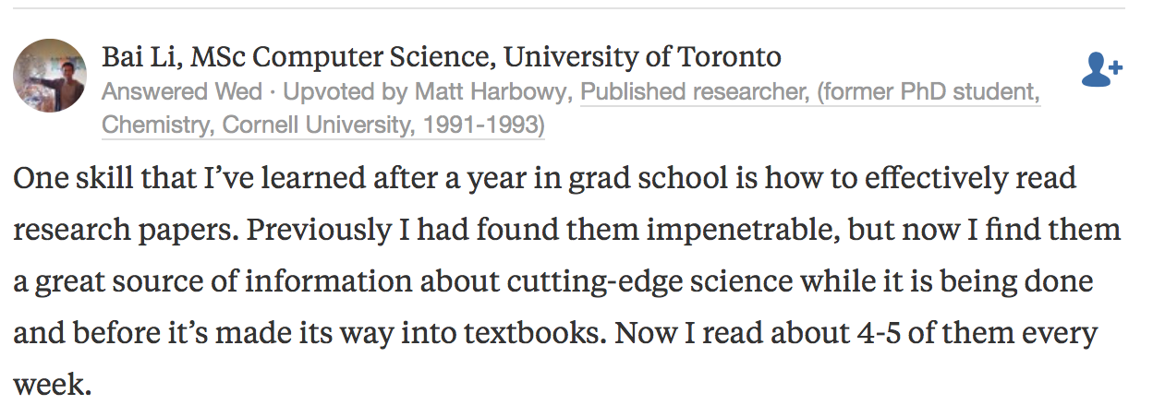
Question-and-Answer
Question
Answers by other users
Notes:
In this paper, we study the problem of matching experts in online community. Let’s first start with an example. In question-and-answer website such as Quora, user can post their questions online, and then other users who are familiar with this topic might provide their answers.

Slide 3

Question-and-Answer
Invite users to answer unsolved questions
User response:
agree to answer
decline to answer
Notes:
In order to keep these QA websites to be helpful and efficient, we would like to see the questions on the website can receive qualified answers within reasonable time. A central task for these website is to find appropriate users for each given question. Most of the QA websites are now actively inviting users to answer the questions. Here shows three questions recommended to me on Quora, and I can choose to either agree or decline to answer. The task of matching experts in this example is to find users who will be able to and will agree to answer a given question.

Slide 4
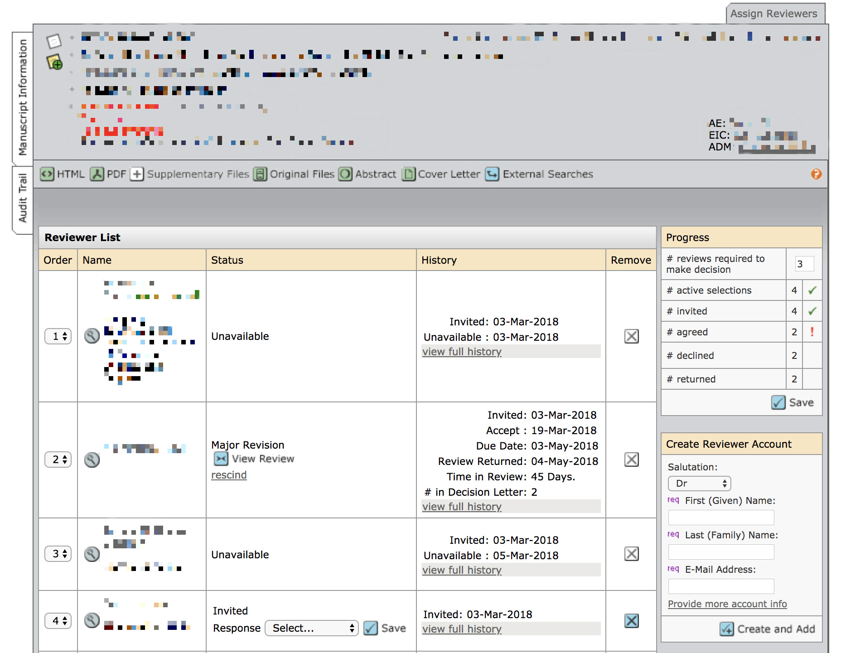
Peer Review
Invite experts to review journal/conference submission
Paper Information
(title, abstract, authors, …)
Reviewer 1
decline to review
Reviewer 2
agree to review
Reviewer 3
decline to review
Reviewer 4
no response
Notes:
Another example is academic peer review. In academic conferences or journals, the organizers need to invite experts to review the submissions. This figure shows a journal managing website. The journal editor can see the submission’s information, including the title, auhtors, abstract, and main content, and then invite several reviewers to review this paper. However, a serious problem is that the acceptance rate of the review invitation is usually quite low. We can see for this paper in the figure, only one of the invited reviewers agreed to review, while the other three declined or didn't respond. So the editor has to invite some other reviewers.

Slide 5
How to match the question/paper with the best experts?
The best experts should
  have sufficient knowledge on the topic;
  be willing to answer/review.
Notes:
The problem we are studying in this work is, how to match the question or paper with the best experts?
There are two things need to be considered. The first is that the experts should have sufficient knowledge on the specific topic. It is the focus of most previous research. The second is that the experts should be willing to answer the question or review the paper. We want to emphasize that the latter is the actual goal of our expert matching problem, but is usually neglected in previous work.

Slide 6
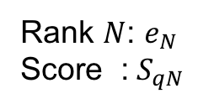
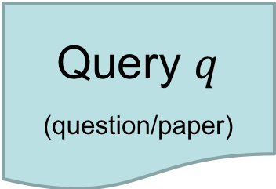
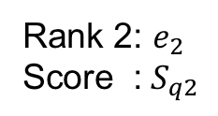
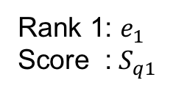

Problem: Match Questions to Experts
Input:
Candidate Experts
$$E=\{e_{1},…,e_{N}\}$$
Query $q$
(question/paper)
…
Output:
……
Ranked expert list
Rank 1: $e_{1}$
Score :$S_{q1}$
Rank 2: $e_{2}$
Score :$S_{q2}$
Rank $N$: $e_{N}$
Score :$S_{qN}$
Notes:
Formally, the input of the expert matching problem has two parts, a query q which can be either a question or a paper, and then a set of candidate experts. The output is a ranked expert list where each expert is associated with a ranking score.

Slide 7
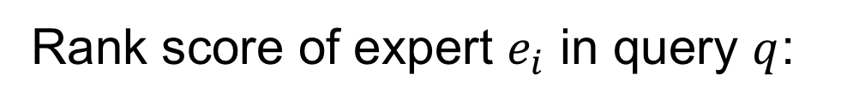
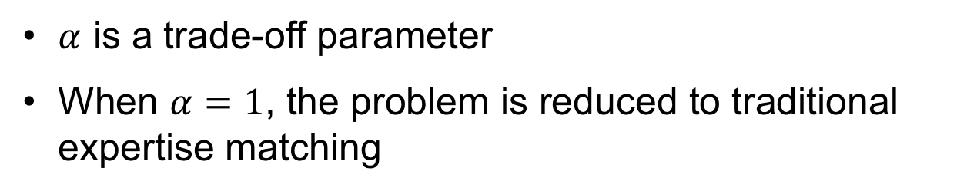
Formulation
Rank score of expert $e_{i}$ in query $q$:
expertise matching
willingness to answer
$α$ is a trade-off parameter
When $α=1$, the problem is reduced to traditional expertise matching
Notes:
We define the ranking score to be a trade-off between the expertise matching degree and the willingness to answer, with a controllable parameter alpha. Note that when we set alpha=1, the problem is reduced to traditional expertise matching problem.

Slide 8
Challenges
Difficult to predict the expert response.
Difficult to collect labeled data.
Difficult to evaluate the performance of a potential solution.
Notes:
The challenges of this problem include the following: it is very difficult to predict the expert responses, since there are a lot of factors which might affect the expert to agree or not. And it is usually difficult to collect sufficient labeled data. Moreover, it is also not easy to evaluate the performance of a potential solution, especially in an online fashion.

Slide 9
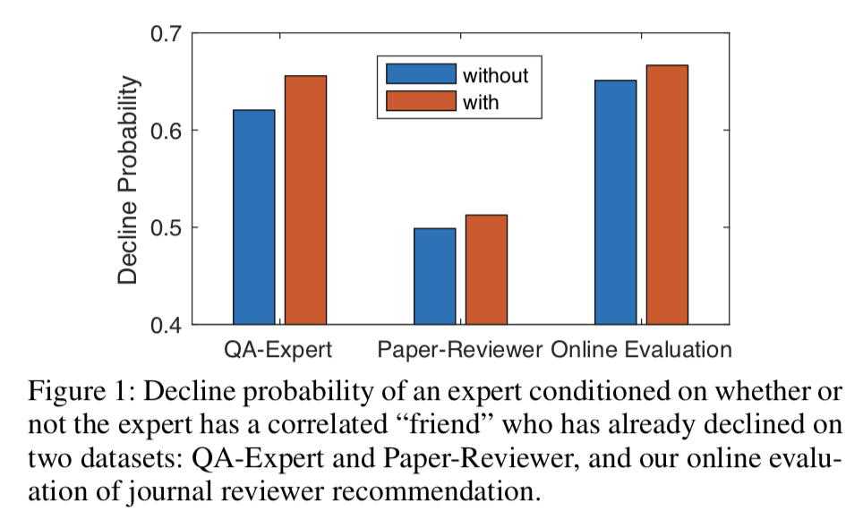
Motivation
Incorporate the correlations between experts
Observation: the expert who has a “friend” already declined is more likely to decline as well.
Notes:
In this work, our main idea is to incorporate the correlations between experts in order to better predict the expert response. It is motivated by an observation that the expert who has a “friend” already declined the invitation is more likely to decline as well. The correlations are defined differently in each data, for example we use the coauthorship in finding paper reviewers.

Slide 10
Weakly Supervised Factor Graph (WeakFG)
Our Solution:
Notes:
We propose a weakly supervised factor graph to deal with the challenges discussed before. We call it WeakFG for short.

Slide 11
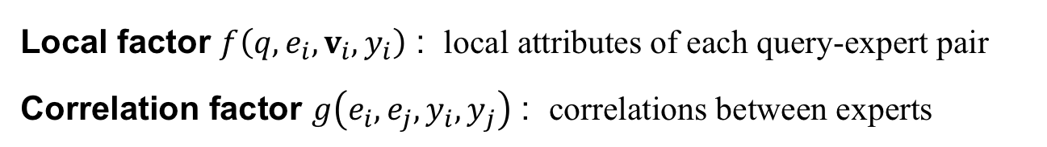
WeakFG
Output:
Whether each expert will accept / decline
Edges:
correlations
Embeddings
Nodes:
query-expert pairs
Local factor $f\left(q,e_{i},v_{i},y_{i}\right)$ : local attributes of each query-expert pair
Correlation factor $g\left(e_{i},e_{j},y_{i},y_{j}\right)$ : correlations between experts
Notes:
In WeakFG, we define a graph, where the nodes are the query-expert pairs, and the edges represent the correlations between experts. Two kinds of factors are defined, where local factor f captures the local attributes of each query-expert pair, and the correlation factor captures the correlation between experts.

Slide 12
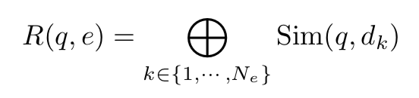
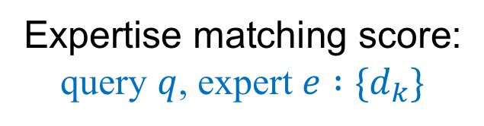
Expertise Matching
Expertise matching score:
query $q$, expert $e :\{d_{k}\}$
aggregation
max / average
document similarity
$Sim(q,d_{k})$ can be implemented in different ways:
Language models
Topic models
Embedding Methods
  Word Mover’s Distance (WMD) ^{[1]}
  Document to Vector (D2V) ^{[2]}
[1] Kusner, Matt, et al. "From word embeddings to document distances." International Conference on Machine Learning. 2015.
[2] Le, Quoc, and Tomas Mikolov. "Distributed representations of sentences and documents." International Conference on Machine Learning. 2014.
Notes:
We first explain how we calculate the expertise matching score in our work. Each expert can be considered as a set of documents, such as the questions they have answered, or the papers they have published. Then we define the expertise matching score to be the aggregation of the similarities between the query and each document in the expert’s set, using max or average aggregation.
The document similarity can be implemented in different ways such as language models and topic models. We also adopt some recent embedding-based methods, such as the word mover’s distance and document to vector, to improve expertise matching performance.

Slide 13
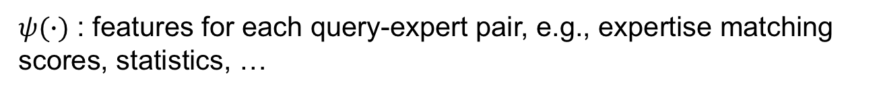
WeakFG
Local factor function:
Correlation factor function:
$ψ(∙)$ : features for each query-expert pair, e.g., expertise matching scores, statistics, …
$φ(∙)$ : indicator for specific correlation between experts
Notes:
We have defined two classes of factor functions in WeakFG. The first one is local factor function. Expertise matching scores, as well as other statistical features associated with each query-expert pair, are captured by the local factor function. The correlation factor function is defined between the output variables of related experts, to encode their correlation. Here alpha and beta are the model parameters to be learned.

Slide 14
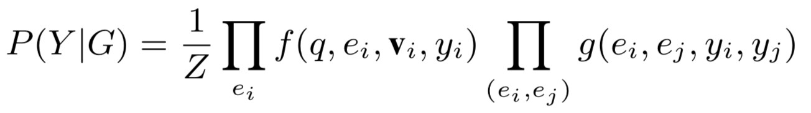
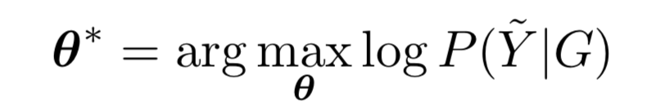
Model Learning
Objective function:
Optimization: gradient ascent algorithm
Estimate the gradient with Loopy Belief Propagation (LBP)
Notes:
Then we define the maximum likelihood objective by combining the two kinds of factor functions, and optimize it with the gradient ascent algorithm. The gradient estimation is non-trivial in factor graphs. In this work, we choose the Loopy Belief Propagation algorithm to estimate the gradients for each update.

Slide 15
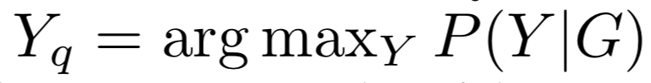
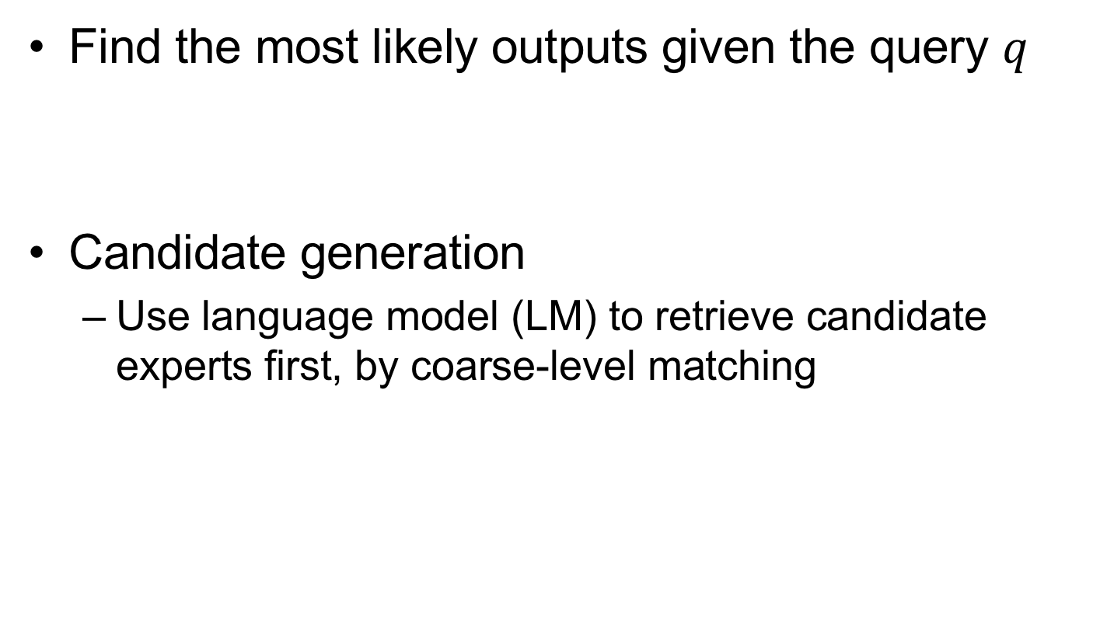
Prediction
Find the most likely outputs given the query $q$
Candidate generation
  Use language model (LM) to retrieve candidate experts first, by coarse-level matching
Notes:
In the prediction phase, the goal is to find the most likely outputs given the query. Note that we first use a language model to do a coarse level matching to generate the candidates, and then use the WeakFG to generate the ranking. For more details about training and prediction, please check our paper.

Slide 16
Experiments
Datasets
  QA-Expert *
    Match questions to users in a QA website
    182 questions, 599 users
  Paper-Reviewer
    Match conference submissions to PCs
    935 submissions, 440 PCs
* https://biendata.com/competition/bytecup2016/
Notes:
To evaluate our method, we performed both off-line and online evaluation. As for offline evaluation, we conduct experiments on two different datasets. QA-Expert is a dataset from an international data challenge. The task in this dataset is to match questions to users of a QA website. Paper-Reviewer is a dataset constructed from the reviewing data of a conference, and the task is to match submissions to the program committee members. We consider the program committee members’ biddings as the positive responses.

Slide 17
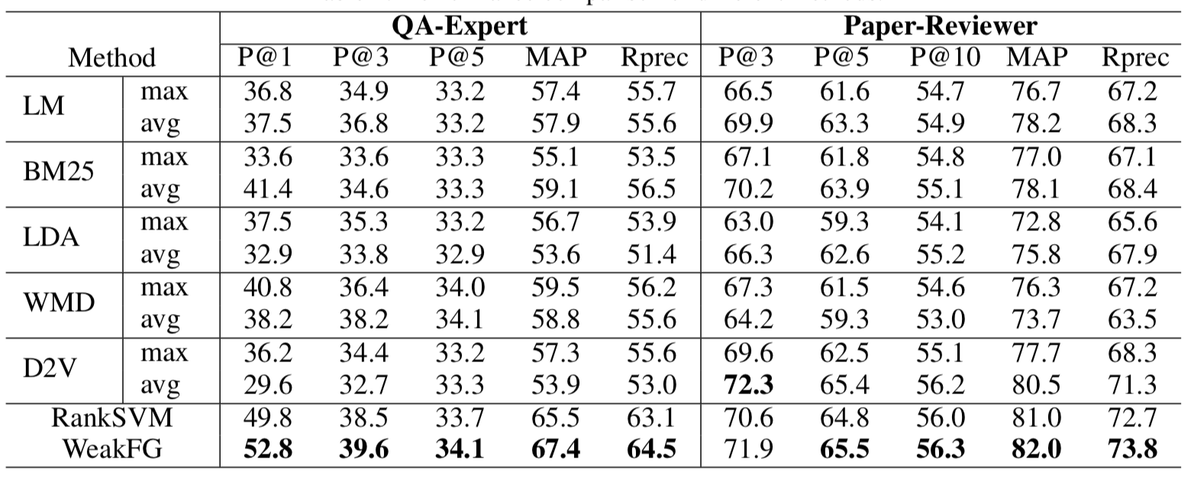
Results
WeakFG outperforms traditional expertise matching and baseline ranking algorithm.
Notes:
From the results, we can clearly see that WeakFG outperforms traditional expertise matching methods and the baseline RankSVM algorithm. It confirms the necessity of considering the expert’s willingness to answer or review in expert matching. We also validate that it is beneficial to incorporate correlations between experts, so that we we can better utilize the labeled data and thus improve the predictions.

Slide 18
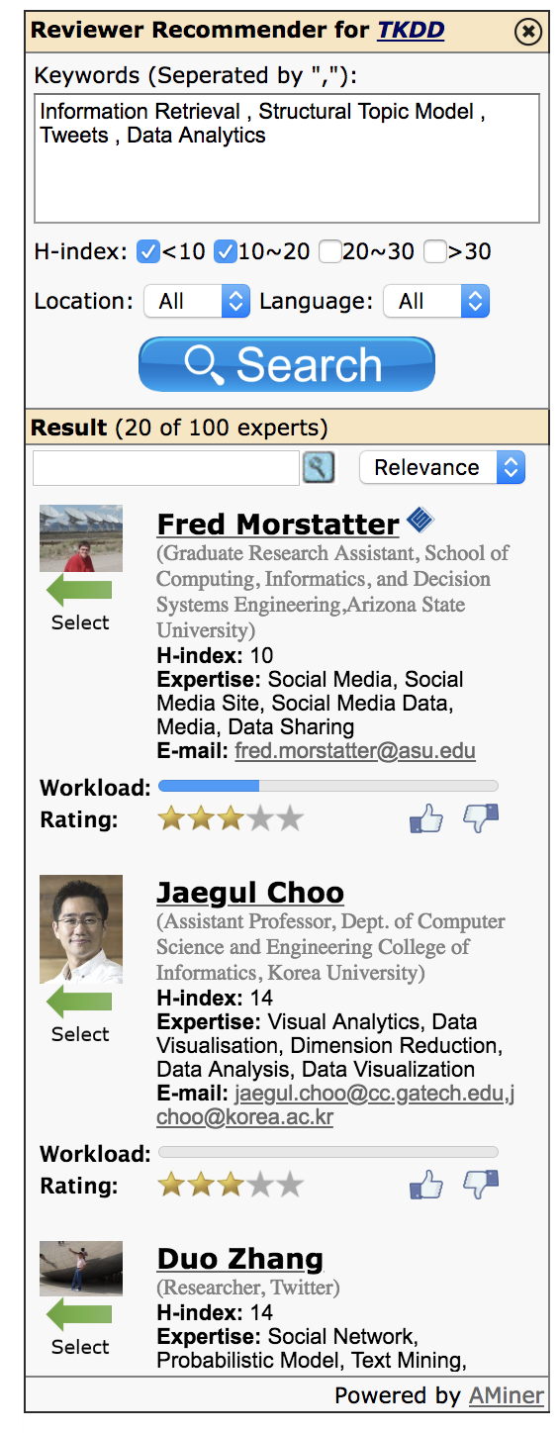
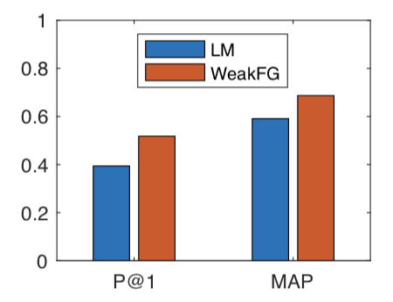
Online Evaluation
Reviewer Recommender*
Supported by AMiner (aminer.cn)
Help journal editors to find qualified reviewers
Deployed on Chrome Web Store
Used by journals such as ACM TKDD, Science China, etc.
WeakFG improves recommendation quality!
* https://chrome.google.com/webstore/detail/reviewer-recommender/holgegjhfkdkpclackligifbkphemhmg
Notes:
In order to perform online evaluation, we developed an online reviewer recommendation tool based on the AMiner academic data mining system, and deployed it on the Chrome Web Store. It helps journal editors to find qualified reviewers for a given submission. This tool has already been used by several journals such as ACM Transactions on Knowledge Discovery from Data, and Science China. Our online evaluation results also show that WeakFG improves recommendation quality significantly compared with traditional methods.

Slide 19
Thank you!
Yujie Qian
yujieq@mit.edu
Notes:
This is the end of my presentation. Thanks for your listening!

