Slide 1


Network Embedding under Partial Monitoring for Evolving Networks
Yu Han¹, Jie Tang¹ and Qian Chen²
¹Department of Computer Science and Technology
Tsinghua University
²Tencent Corporation
  The slides can be downloaded at http://keg.cs.tsinghua.edu.cn/jietang

Slide 2





Motivation
d-dimensional vector, d<<|V|
Network/Graph Embedding
Representation Learning
0.8
0.2
0.3
…
0.0
0.0
Users with the same label are located in the d-dimensional space closer than those with different labels
e.g., node classification
label2
label1
Notes:
Network embedding is not strange to most of you. Network embedding can be regarded as a kind of representation learning specific to networks. The target of network embedding is to learn the real-valued low-dimensional vector representations for the nodes based on the structure of the networks, which is beneficial to downstream application tasks, such as link prediction.

Slide 3

Challenges
Info. Space + Social Space
Challenges
big
Info. Space
Interaction
dynamic
hetero
geneous
Social Space
Interaction
J. Scott. (1991, 2000, 2012). Social network analysis: A handbook.
D. Easley and J. Kleinberg. Networks, crowds, and markets: Reasoning about a highly connected world. Cambridge University Press, 2010.
Notes:
In practice, there are two challenges for network embedding on real world networks. First, networks are usually dynamic and evolve all the time. More importantly, sometimes we have to query the nodes to learn about the changes of the networks. For example, in a web network, we have to crawl the web pages to discover their outgoing links and their changes. In addition, many large network platforms adopt log systems to record the behavior of the nodes. If we want to know whether two nodes established a relationship, we have to check the behavior logs of these two nodes. Unfortunately, due to the great cost of the query, it is often impractical to query all the nodes at every moment. In other words, we can only probe part of the nodes to update the image of the network structure.

Slide 4
Problem: partial monitoring
What is network embedding under partial monitoring?
We can only probe part of the nodes to perceive the change of the network!
Notes:
So what is network embedding under partial monitoring? Let’s take a look at this figure. This is a toy case about partial monitoring. The network at t0 is the original network. Then it evolves. When the time reaches t1, this edge disappears, while this edge appears. However, if we can only probe node v, we only know the appearance of this edge and cannot know the disappearance of this edge. So the image of the network structure under partial monitoring is not certain to be the same with the true network.

Slide 5
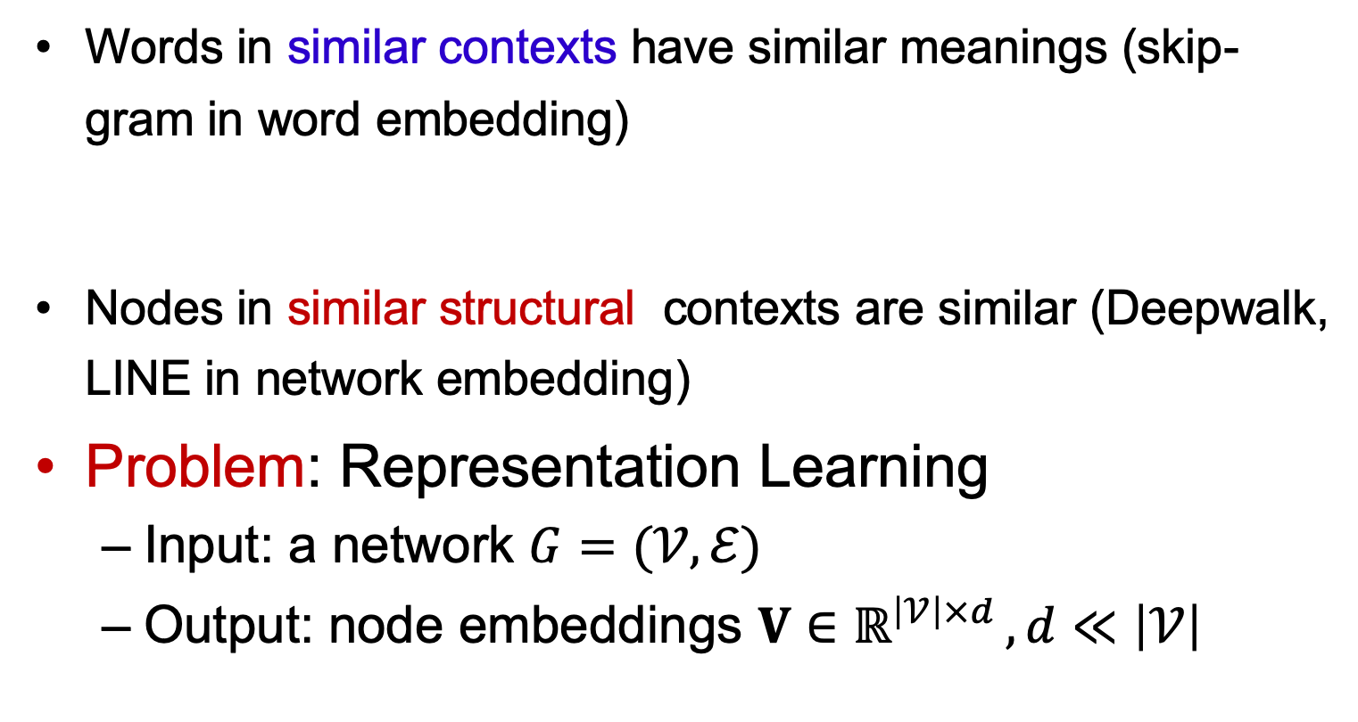
Revisit NE: distributional hypothesis of harris
Words in similar contexts have similar meanings (skip-gram in word embedding)
Nodes in similar structural contexts are similar (Deepwalk, LINE in network embedding)
Problem: Representation Learning
  Input: a network $G=(𝒱,ℰ)$
  Output: node embeddings $V∈ℝ^{\left|𝒱\right|×d }, d≪\left|𝒱\right|$
Notes:
Let’s first revisit existing network embedding models. In fact, the key idea of network embedding models is extracting the proximities among the nodes so that the embedding values can preserve and reflect the extracted proximities. So to some extent, one proximity results in one network embedding algorithm.

Slide 6

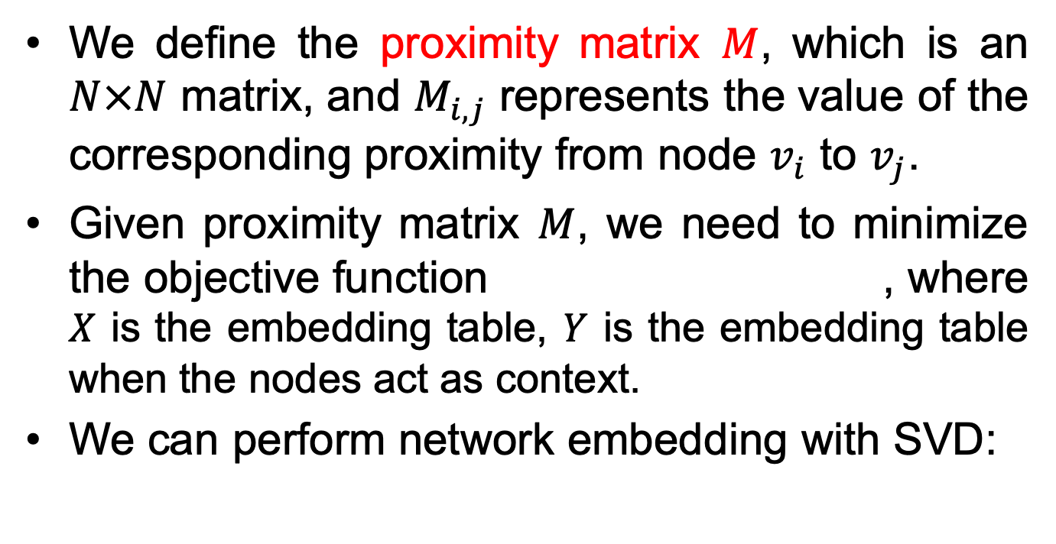
Network Embedding
We define the proximity matrix $M$, which is an $N×N$ matrix, and $M_{i,j}$ represents the value of the corresponding proximity from node $v_{i}$ to $v_{j}$.
Given proximity matrix $M$, we need to minimize the objective function , where $X$ is the embedding table, $Y$ is the embedding table when the nodes act as context.
We can perform network embedding with SVD:
Qiu et al. Network embedding as matrix factorization: unifying deepwalk, line, pte, and node2vec. WSDM’18. The most cited paper in WSDM’18 as of May 2019
Notes:
First we define the proximity matrix M, which is a N by N matrix, where M(i,j) represents the value of the corresponding proximity from node vi to node vj. Given proximity matrix M, the learned distributed representation of the nodes should reflect the proximities adopted, that is to minimize this objective function. We can perform network embedding with matrix factorization. X is the embedding table, Y is the embedding table when the nodes act as context.

Slide 7


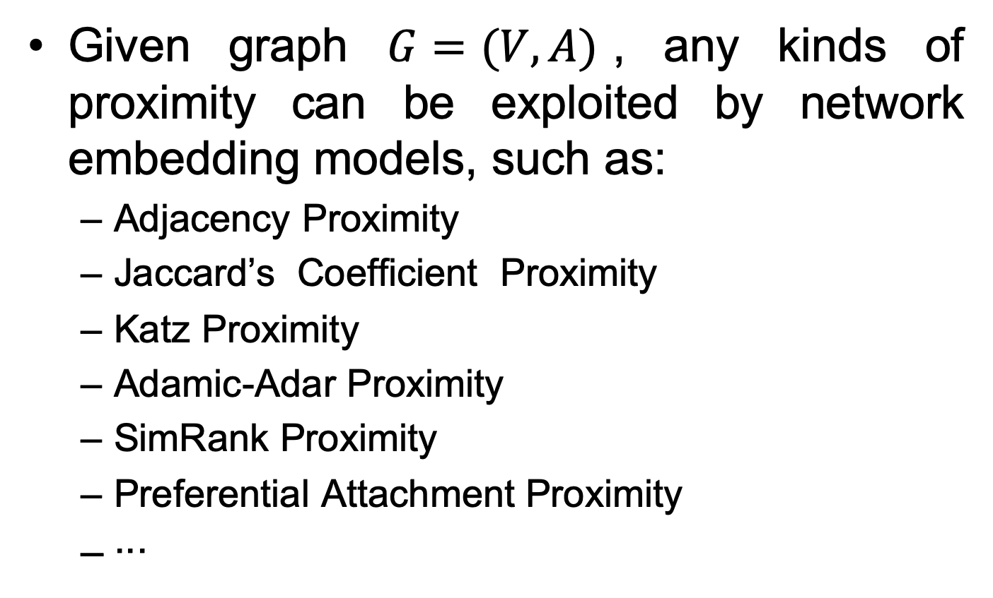
Proximity Matrix
Given graph $G=(V, A)$, any kinds of proximity can be exploited by network embedding models, such as:
  Adjacency Proximity
  Jaccard’s Coefﬁcient Proximity
  Katz Proximity
  Adamic-Adar Proximity
  SimRank Proximity
  Preferential Attachment Proximity
  ∙∙∙
Notes:
Given a graph, any kinds of proximity can be exploited by network embedding models, such as Adjacency proximity, Adamic-Adar proximity, Katz proximity, Jaccard’s coefficient proximity, SimRank proximity, etc..

Slide 8
Problem
If we can only probe part of the nodes to perceive the change of the network, how to select the nodes to make the embeddings as accurate as possible?
Notes:
Let’s get back to our problem. At first , we can get the true proximity matrix M0 and relatively accurate embeddings with the true network structure. However, we can only probe part of the nodes to perceive the change of the network at the following time stamps, so how to select the appropriate nodes to make the embeddings as accurate as possible?

Slide 9

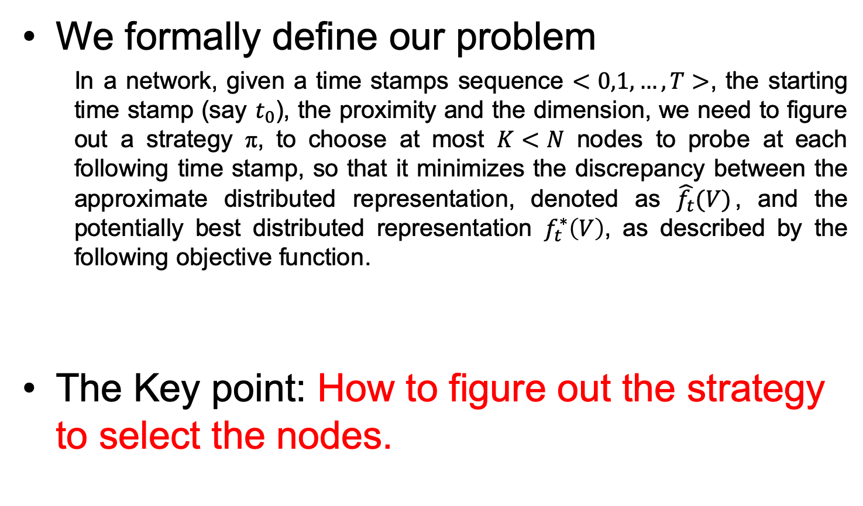
Problem
We formally define our problem
In a network, given a time stamps sequence $<0,1,…,T>$, the starting time stamp (say $t_{0}$), the proximity and the dimension, we need to figure out a strategy π, to choose at most $K<N$ nodes to probe at each following time stamp, so that it minimizes the discrepancy between the approximate distributed representation, denoted as $\hat{f_{t}}(V)$, and the potentially best distributed representation $f_{t}^{∗}\left(V\right)$, as described by the following objective function.
The Key point: How to figure out the strategy to select the nodes.
Notes:
Then we formulate the problem of network embedding under partial monitoring, that is given time stamps, the proximity matrix at the first stamp, we need to figure out a strategy to choose at most K nodes to probe at each following time stamp so that it minimizes the discrepancy between the approximate node embedding and the potentially best node embedding. So the key point is how to figure out the strategy to select the nodes.

Slide 10
Problem
It is a sequential decision problem
Obviously, the best strategy is to capture as much “change” as possible with limited “probing budget”.
Notes:
So it is a sequential decision problem and the best strategy is to capture as much “change” as possible with limited probing budget.

Slide 11
Credit Probing Network Embedding
Based on a kind of reinforcement learning problem, namely Multi-armed Bandit (MAB)
Choose the “productive” nodes according to their historical “rewards”.
At each time stamp t_{j} , we maintain a “credit” for each node v_{i}, which is the consideration for selecting the nodes.
The “credit” should make a trade-off between exploitation and exploration.
Notes:
In this work, we propose credit probing network embedding based on Multi-armed Bandit. We choose the “productive” nodes according to their historical “rewards”, which is the change of the proximity matrix. At each time stamp, we maintain a “credit” for each node, which is the standard for selecting the nodes. The credit should make a trade off between exploitation and exploration.

Slide 12

Credit Probing Network Embedding
The “credit” for each node v_{i} at time stamp t_{j} can be defined as:
Exploration
Exploitation
Current time stamp
Empirical mean of v_{i}’s historical rewards ||M||_{F,} which refer to the the change it bring to the proximity matrix M from the last time stamp.
Hyperparameter to make a trade off between exploration and exploitation
Times that v_{i} has been probed
Notes:
The credit for each node vi at time stamp tj can be defined as this. The first item is the empirical mean of vi’s historical rewards, which is the change it bring to the proximity matrix M. It stands for the exploitation. The second item stands for the exploration. tj is the current time stamp, while Tvi is the times that vi has been probed. \lambda is a hyperparameter to make a trade off between exploration and exploitation. We can see that a higher historical reward and a smaller number of probe times can lead to a higher credit, which is in line with our purpose of balancing exploitation and exploration.

Slide 13
Credit Probing Network Embedding
How to evaluate the difference between two embeddings X and X*?
Obviously, it makes no sense to measure their concrete values with ||X-X*||_{F}.
So we define two metrics: Magnitude Gap and Angle Gap from their geometric meanings.
Notes:
Then there is a problem which is how to evaluate the difference between two embedding tables, such as X and X*. This is not trivial. Obviously, it makes no sense to measure the difference between their concrete values with a F norm. So we define two metrics, namely Magnitude Gap and Angle Gap, from their geometric meanings.

Slide 14

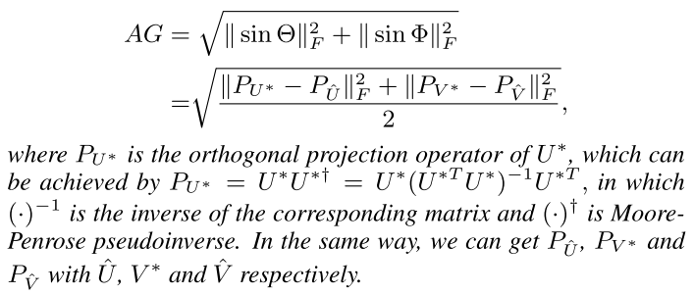
Credit Probing Network Embedding
Magnitude Gap
Angle Gap
Notes:
These are the definitions of magnitude gap and angle gap. S is the vector of singular values. \Theta is the diagonal matrix of canonical angles of the two matrices of left singular vectors, while \Phi is that of right singular vectors.

Slide 15


Credit Probing Network Embedding
We prove the error bound for loss of magnitude gap and angle gap with matrix perturbation theory and combinatorial multi-armed bandit theory:
Notes:
We prove the error bound for loss of magnitude gap and angle gap with matrix perturbation theory and combinatorial multi-armed bandit theory. One can refer to the paper for the detailed proof.

Slide 16
Experimental Setting
Approaching the Potential Optimal Values
  Datasets: AS
  Baselines: Random, Round Robin, Degree Centrality, Closeness Centrality
  Metrics: Magnitude Gap, Angle Gap
  Link Prediction
  Datasets: WeChat
  Baselines: BCGD¹ with the four settings
  Metrics: AUC
Zhu et al. Scalable temporal latent space inference for link prediction in dynamic social networks. TKDE, 28(10):2765–2777, 2016
Notes:
We evaluate the performance of CPNE from two aspects. First, we evaluate CPNE’s ability to approach the potential optimal values, which is to minimize the magnitude gap and the angle gap. Second, we evaluate CPNE’s performance for an important application problem, link prediction. We use two data sets to conduct the experiments.

Slide 17
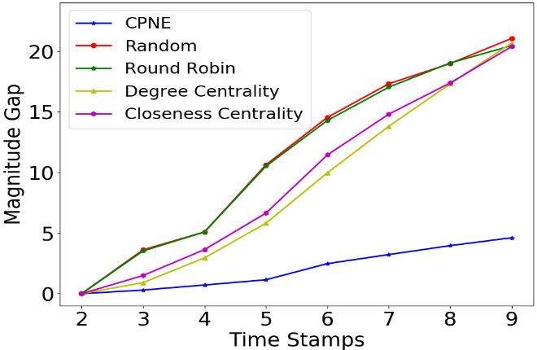
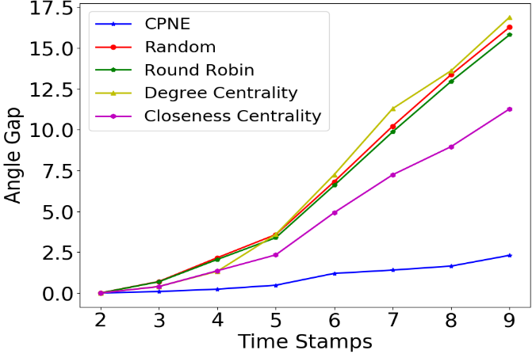
Experimental Results
Approaching the Potential Optimal Values
Notes:
The upper two figures are the results of the first experiment when K = 128, while the lower two figures are the results of the test for the sensitivity of hyperparameter K. We can see CPNE outperforms the baseline models significantly. We can also find that for the four baseline models, the performances of Closeness Centrality is somehow slightly better than the other three baseline models. This may be because that the nodes with higher closeness centrality usually change more than other nodes in this network, and deserve more attention when the network evolves.

Slide 18
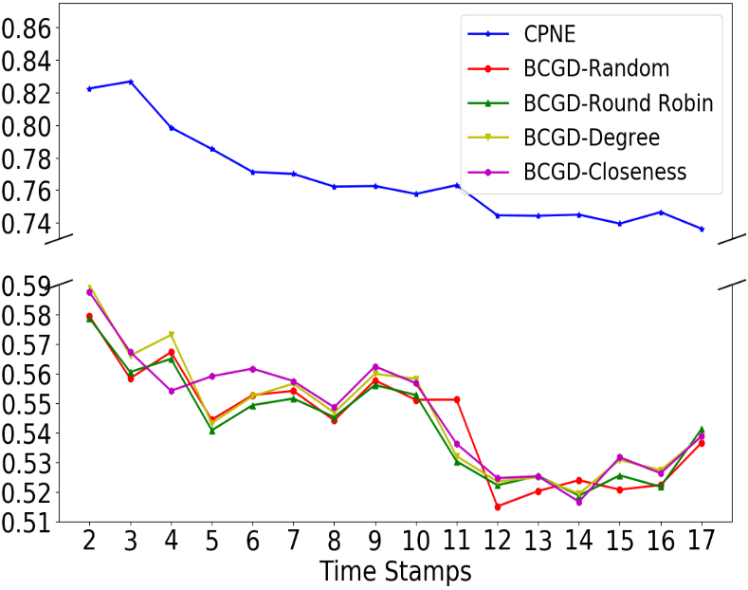
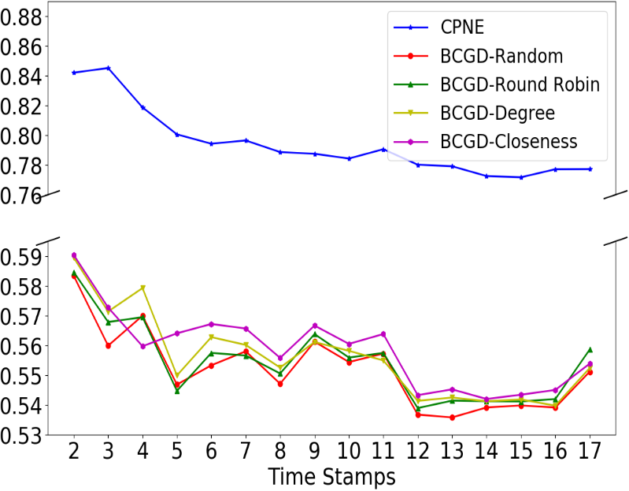
Experimental Results
  Link Prediction
K = 500
K = 1000
Notes:
These two figures are the results of link prediction on Wechat when K = 500 and 1000. CPNE still achieves a significant improvement in terms of AUC over baselines.

Slide 19
Further Consideration
Trying other reinforcement learning algorithms to solve such problems.
Trying deep models to learning embedding values in such a setting.
Notes:
As for the future work, we will try other reinforcement learning algorithms to solve such problems. In addition, how to employ deep learning models to learning embedding values in such a setting is also interesting and meaningful.

Slide 20
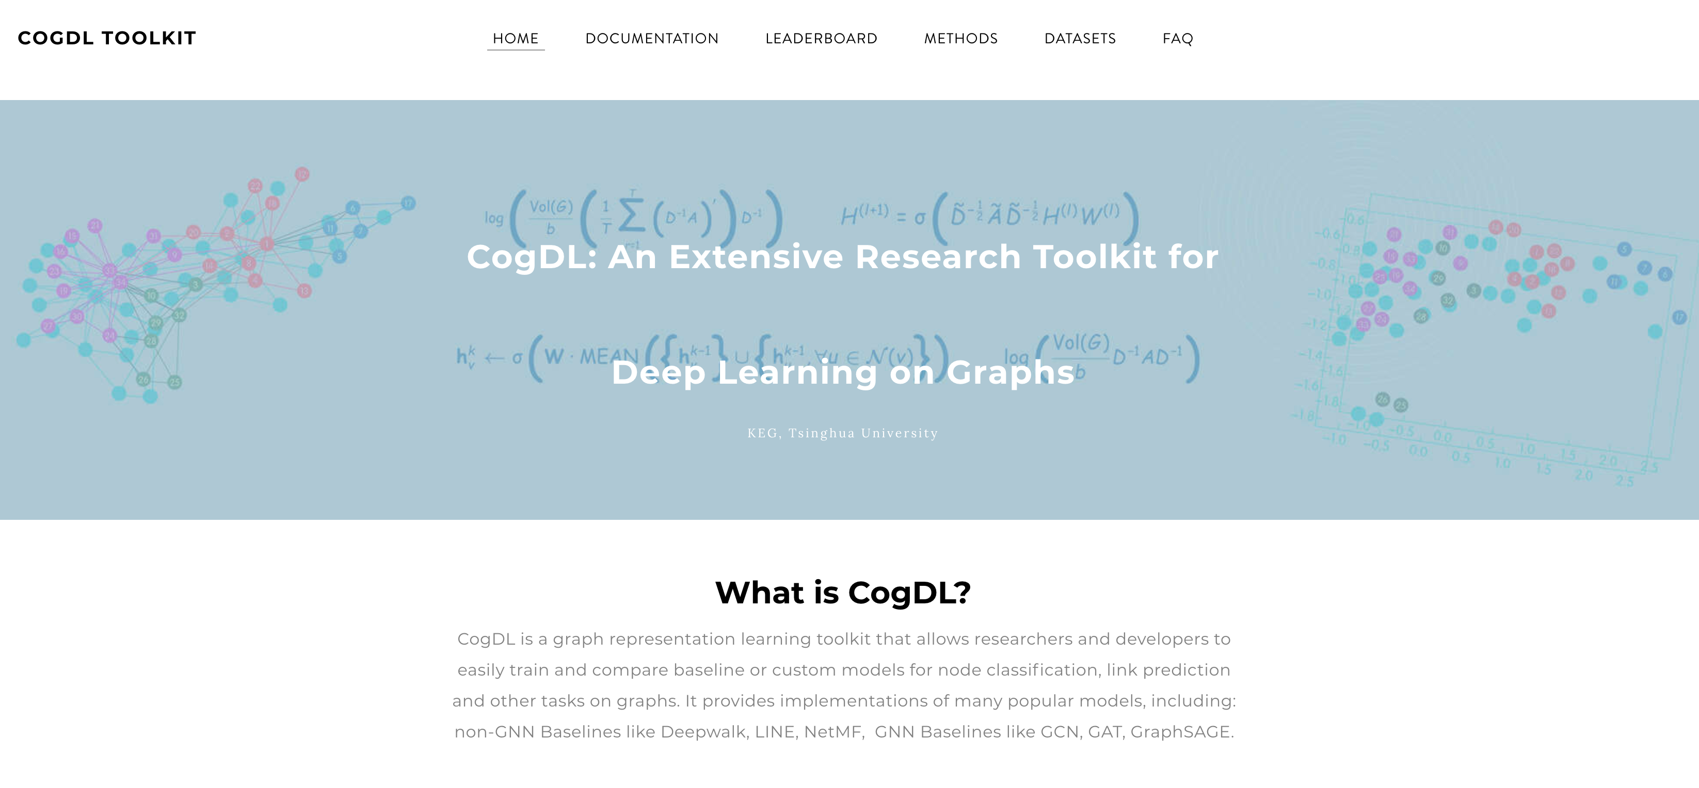
CogDL
—A Toolkit for ​Deep Learning on Graphs
** Code available at https://keg.cs.tsinghua.edu.cn/cogdl/

Slide 21
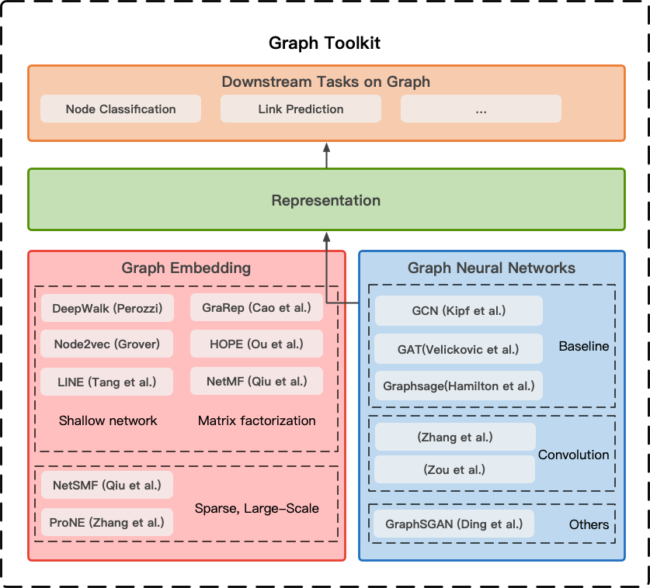
CogDL
—A Toolkit for ​Deep Learning on Graphs
Notes:
CogDL is a graph representation learning toolkit that allows researchers and developers to train baseline or custom models for node classification, link prediction and other tasks on graphs. It provides implementations of several models, including: non-GNN Baselines like Deepwalk, LINE, NetMF, GNN Baselines like GCN, GAT, Graphsage.

Slide 22
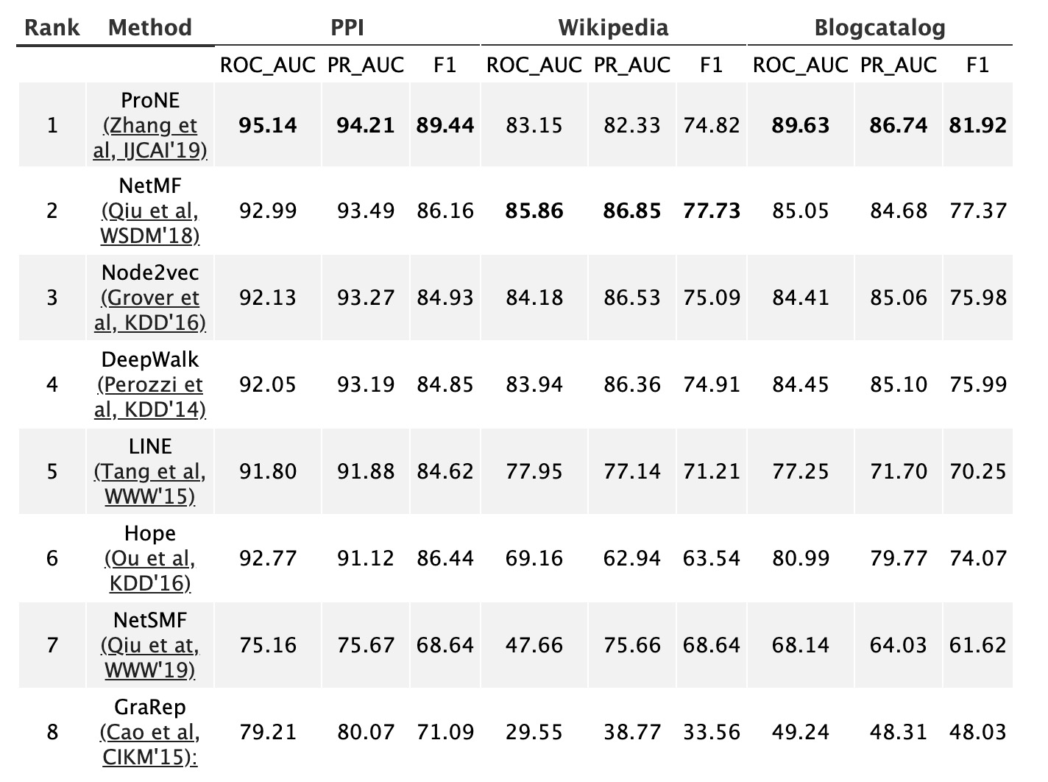
Leaderboards: Link Prediction
http://keg.cs.tsinghua.edu.cn/cogdl/link-prediction.html
Notes:
For link prediction, we adopt Area Under the Receiver Operating Characteristic Curve (ROC AUC), standard evaluation metric AUC and F1- score, which represents the probability that vertices in a random unobserved link are more similar than those in a random nonexistent link. We evaluate these measures while removing 15 percents of edges on these dataset. We repeat our experiments for 10 times and report the three matrices in order.

Slide 23
Join us
Feel free to join us with the three following ways:
  add your data into the leaderboard
  add your result into the leaderboard
  add your algorithm into the toolkit
Notes:
You are welcome to join us.

Slide 24
Related Publications
Yu Han, Jie Tang, and Qian Chen. Network Embedding under Partial Monitoring for Evolving Networks. IJCAI’19.
Jie Zhang, Yuxiao Dong, Yan Wang, Jie Tang, and Ming Ding. ProNE: Fast and Scalable Network Representation Learning. IJCAI’19.
Yukuo Cen, Xu Zou, Jianwei Zhang, Hongxia Yang, Jingren Zhou and Jie Tang. Representation Learning for Attributed Multiplex Heterogeneous Network. KDD’19.
Fanjin Zhang, Xiao Liu, Jie Tang, Yuxiao Dong, Peiran Yao, Jie Zhang, Xiaotao Gu, Yan Wang, Bin Shao, Rui Li, and Kuansan Wang. OAG: Toward Linking Large-scale Heterogeneous Entity Graphs. KDD’19.
Yifeng Zhao, Xiangwei Wang, Hongxia Yang, Le Song, and Jie Tang. Large Scale Evolving Graphs with Burst Detection. IJCAI’19.
Ming Ding, Chang Zhou, Qibin Chen, Hongxia Yang, and Jie Tang. Cognitive Graph for Multi-Hop Reading Comprehension at Scale. ACL’19.
Jiezhong Qiu, Yuxiao Dong, Hao Ma, Jian Li, Chi Wang, Kuansan Wang, and Jie Tang. NetSMF: Large-Scale Network Embedding as Sparse Matrix Factorization. WWW'19.
Jiezhong Qiu, Jian Tang, Hao Ma, Yuxiao Dong, Kuansan Wang, and Jie Tang. DeepInf: Modeling Influence Locality in Large Social Networks. KDD’18.
Jiezhong Qiu, Yuxiao Dong, Hao Ma, Jian Li, Kuansan Wang, and Jie Tang. Network Embedding as Matrix Factorization: Unifying DeepWalk, LINE, PTE, and node2vec. WSDM’18.
Jie Tang, Jing Zhang, Limin Yao, Juanzi Li, Li Zhang, and Zhong Su. ArnetMiner: Extraction and Mining of Academic Social Networks. KDD’08.
  For more, please check here http://keg.cs.tsinghua.edu.cn/jietang

Slide 25
Thank you！
  Jie Tang, KEG, Tsinghua U http://keg.cs.tsinghua.edu.cn/jietang
  Download all data & Codes https://keg.cs.tsinghua.edu.cn/cogdl/

