Slide 1
Social Influence Analysis in Large-scale Networks
Jie Tang¹, Jimeng Sun², Chi Wang¹, and Zi Yang¹
¹Dept. of Computer Science and Technology
Tsinghua University
²IBM TJ Watson Research Center, USA
June 30th 2009

Slide 2
Motivation
Social influence plays a key role in many (online) social networks, e.g., MSN, Flickr, DBLP
Quantitative measure of the strength of social influence can benefit many real applications
Expert finding
Social recommendation
Influence maximization
…
Notes:
degree distribution, diameter, community, etc.

Slide 3
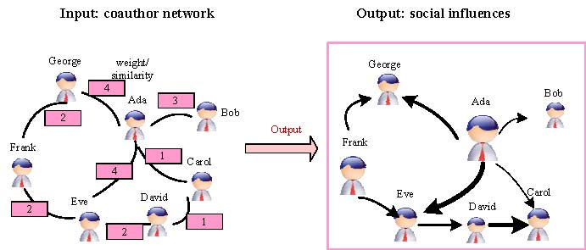
Example—Influence Maximization
Social influence
?
Marketer Alice
Find a small subset of nodes (users) in a social network that could maximize the spread of influence (Domingos, 01; Richardson, 02; Kempe, 03)

Slide 4
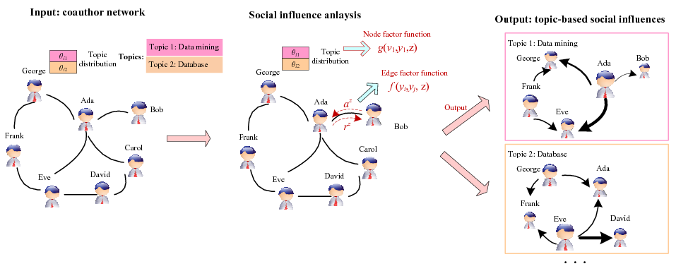
Topic-based Social Influence Analysis
Social network -> Topical influence network

Slide 5

How a person influence a social community?
How two persons
Influence each other?
?
?
Several key challenges:
How to differentiate the social influences from different angles (topics)?
How to incorporate different information (e.g., topic distribution and network structure) into a unified model？
How to estimate the model on real-large networks?

Slide 6
Outline
Related Work
Topical Affinity Propagation
Topical Factor Graph Model
Basic TAP Learning
Distributed TAP Learning
Experiments
Conclusion & Future Work

Slide 7
Related Work—Social networks and influences
Social network
Metrics to characterize a social network
Web community discovery [Flake,2000]
Influence in social network
The existence of influence. [Singla, 2008] [Anagnostopoulos, 2008]
The correlation between social similarity and interactions [Crandall, 2008]
Notes:
where cohesive subgraphs are defined as “subsets of actors among whom there are relatively strong, direct, intense, frequent, or positive ties

Slide 8
Related Work—large-scale mining
Factor graph models
A graph model [Kschischang, 2001]
Computing marginal function [Frey, 2006]
Message passing/affinity propagation [Frey, 2007]
Distributed programming model
Map-reduce [J. Dean, 2004]
Notes:
。

Slide 9
Outline
Related Work
Topical Affinity Propagation
Topical Factor Graph Model
Basic TAP Learning
Distributed TAP Learning
Experiments
Conclusion & Future Work

Slide 10
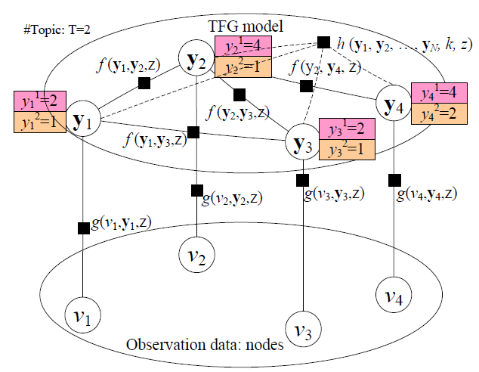
Topical Factor Graph (TFG) Model
Social link
Nodes that have the highest influence on the current node
Node/user
The problem is cast as identifying which node has the highest probability to influence another node on a specific topic along with the edge.

Slide 11
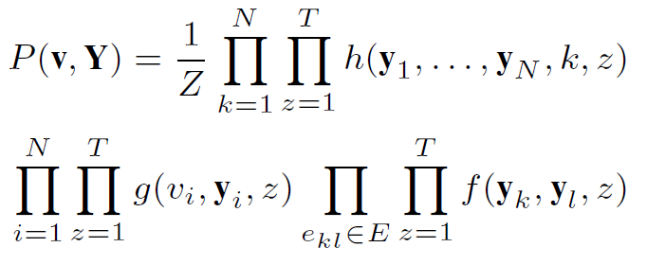
Topical Factor Graph (TFG)
The learning task is to find a configuration for all {y_{i}} to maximize the joint probability.
Objective function:
1. How to define?
2. How to optimize?
Notes:
目标函数P描述了隐变量y_i取任意一组值时的联合概率分布

Slide 12
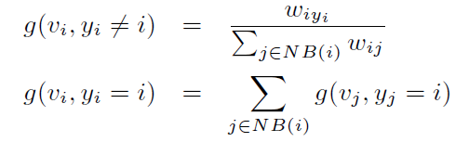
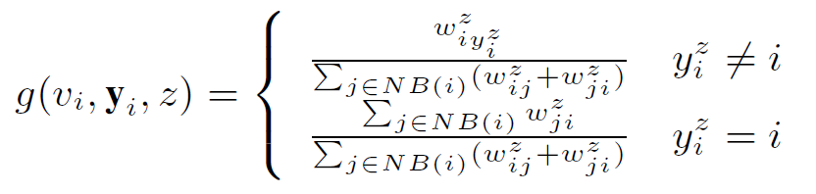

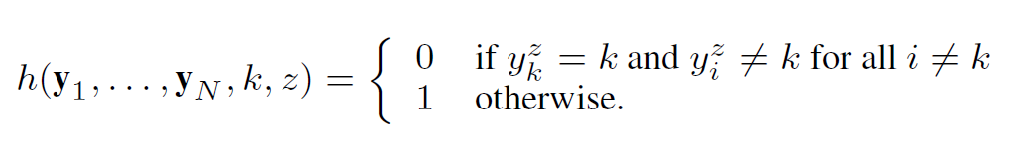
How to define (topical) feature functions?
similarity
Node feature function
Edge feature function
Global feature function
or simply binary

Slide 13
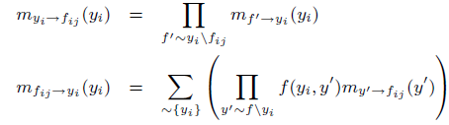
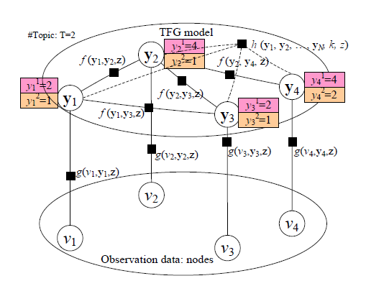
Model Learning Algorithm
Sum-product:
- Low efficiency!
- Not easy for distributed learning!

Slide 14
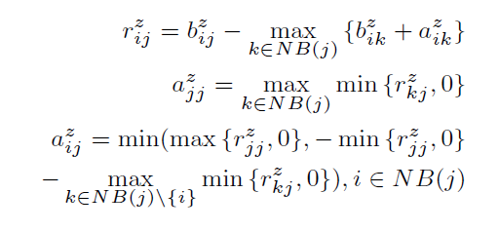
New TAP Learning Algorithm
1. Introduce two new variables r and a, to replace the original message m.
2. Design new update rules:

Slide 15
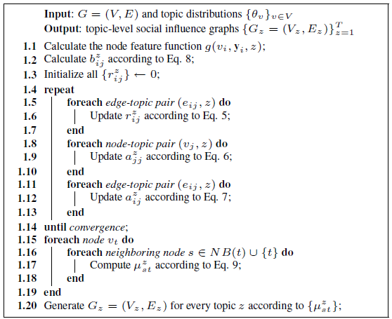





The TAP Learning Algorithm

Slide 16
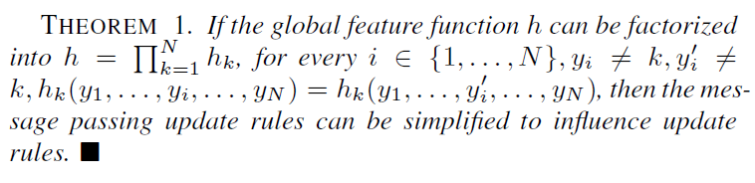
Distributed TAP Learning
Map-Reduce
Map: (key, value) pairs
e_{ij} /a_{ij} → e_{i*} /a_{ij}; e_{ij} /b_{ij} → e_{i*} /b_{ij}; e_{ij} /r_{ij} → e_{*j} /r_{ij} .
Reduce: (key, value) pairs
e_{ij} / * → new r_{ij}; e_{ij}/* → new a_{ij}
For the global feature function

Slide 17
Outline
Related Work
Topical Affinity Propagation
Topical Factor Graph Model
Basic TAP Learning
Distributed TAP Learning
Experiments
Conclusion & Future Work

Slide 18
Experiment
Data set: (ArnetMiner.org and Wikipedia)
Coauthor dataset：640,134 authors and 1,554,643 coauthor relations
Citation dataset: 2,329,760 papers and 12,710,347 citations between these papers
Film dataset: 18,518 films, 7,211 directors, 10,128 actors, and 9,784 writers
Evaluation measures
CPU time
Case study
Application

Slide 19
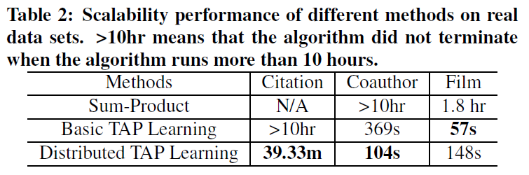
Scalability Performance

Slide 20
Speedup results
Speedup vs. #Computer nodes
Speedup vs. Dataset size

Slide 21
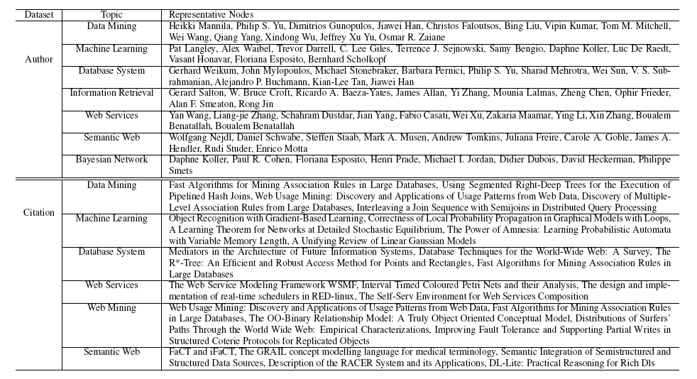
Influential nodes on different topics

Slide 22
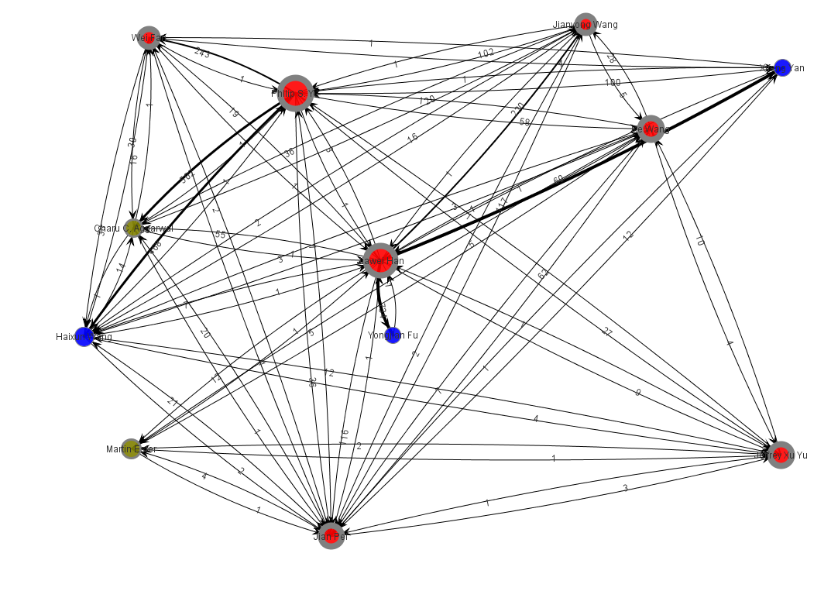
Social Influence Sub-graph on “Data mining”

Slide 23
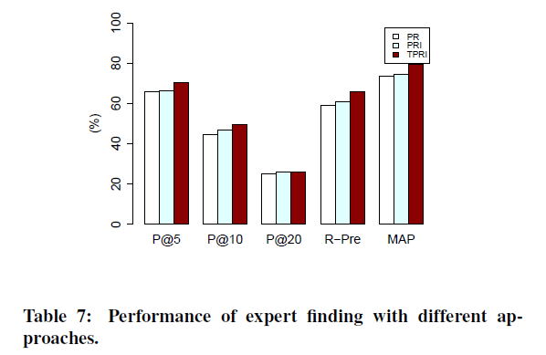
Application—Expert Finding
Expert finding data from (Tang, KDD08; ICDM08)
http://arnetminer.org/lab-datasets/expertfinding/

Slide 24
Application—Influence Maximization
Who is the opinion leader in a community
Community
?
Marketer Alice
[Domingos, 01; Richardson, 02; Kempe, 03]

Slide 25
Outline
Related Work
Topical Affinity Propagation
Topical Factor Graph Model
Basic TAP Learning
Distributed TAP Learning
Experiments
Conclusion & Future Work

Slide 26
Conclusion
Formalize a novel problem of topic-based social influence analysis.
Propose a Topical Factor Graph model to describe the problem using a graphical probabilistic model.
Present an algorithm and its distributed version to efficiently train the TFG model.
Experimental results on three different types of data sets demonstrate the effectiveness and efficiency of the proposed approach.

Slide 27
Future Work
Model:
Jointly learn topic distribution and social influence
Semi-supervised learning
Many other social analysis tasks:
Influence maximization
Community influence
Personality
…

Slide 28
Thanks!
Q&A
Online resource: (data, codes, tools)
http://arnetminer.org/lab-datasets/soinf/
HP: http://keg.cs.tsinghua.edu.cn/persons/tj/
For more information,
please come to our poster tonight!

Slide 29
Background
Social influence plays a key role in many (online) social networks:
Instant messaging: MSN, Jaber, Skype
Sharing site: Flickr, Picasa, Youtube
Wikis, blogs, microblogs
Collaboration network: DBLP
Social network analysis has mainly focused on macro-level models
E.g., degree distribution, community, diameter, etc.
Social influence analysis
Qualitatively measure the existence of social influence
No quantitative measure of the strength of social influence
Notes:
degree distribution, diameter, community, etc.

Slide 30
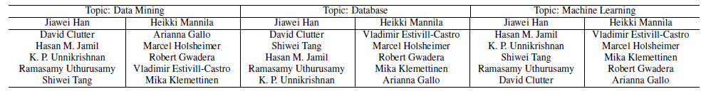
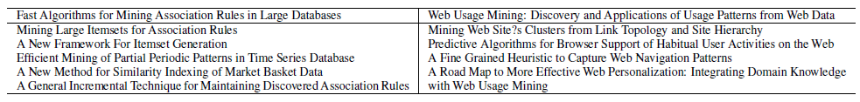
Influence between individuals
Coauthor data
On Citation data

