Slide 1

Social Action Tracking via Noise Tolerant Time-varying Factor Graphs
¹Chenhao Tan, ¹Jie Tang, ²Jimeng Sun, ³Quan Lin, ⁴Fengjiao Wang
¹Department of Computer Science and Technology, Tsinghua University, China
²IBM TJ Watson Research Center, USA
³Huazhong University of Science and Technology, China
⁴Beijing University of Aeronautics and Astronautics, China
Notes:
Good afternoon. I am Chenhao Tan, from Tsinghua University. And the title of my talk is social action tracking via noise tolerant time-varying factor graphs. This is a joint work with Jie Tang, Jimeng Sun, Quan Lin and Fengjiao Wang.

Slide 2
Outline
Motivation
Approach
Experiment
Conclusion & Future Work
Notes:
This is the outline of this talk. First of all, I will introduce the motivation of this work.

Slide 3



Motivation
500 million users
the 3rd largest “Country” in the world
More visitors than Google
Action: Update statues, create event
More than 4 billion images
Action: Add tags, Add favorites
2009, 2 billion tweets per quarter
2010, 4 billion tweets per quarter
Action: Post tweets, Retweet
Notes:
Online Social network has become quite important in people’s daily life. For example, there are more than 400 million users, which can be viewed as the third largest country in the world. And even more visitors than Google. While flickr, as a photo-sharing site ,there are more than 4 billion images. And Twitter has 4 billion tweets per quarter this year. And users can have various actions in online social network. For example, users in facebook can update statuses, create events and so on.

Slide 4

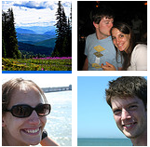
User Action in Social Networks
Twitter
Flickr
Arnetminer
Post tweets on “Haiti Earthquake”
Publish in KDD Conference
Add photo to her favorites
Notes:
We take three concrete example actions which we analyzed in the paper as example for users’ actions in social networks. First, users in Twitter can post tweets on Haiti earthquake. Second, users in Flickr can add photos as favorites. Third, researchers can publish in KDD conference.
So an interesting problem is how to predict users’actions, for example whether a user will post tweeets on Haiti Earthquake. If you post tweets on Haiti Earthquake, whether your friends will also do it? How your decision will be influenced by your friends and your own personal interest?
And to solve this problem, there are two immediate challenges. First, how to model dynamic social actions simultaneously condering multiple factors? second, how to employ the model to predict actions.

Slide 5
User Action in Social Networks
Questions:
What factors influence you to add a photo into your favorite list?
- If you post a tweet on “Haiti Earthquake”, will your friends retweet it or reply?
Challenge:
- How to track and model users’ actions?
- How to predict users’ actions over time?
Notes:
We take three concrete example actions which we analyzed in the paper as example for users’ actions in social networks. First, users in Twitter can post tweets on Haiti earthquake. Second, users in Flickr can add photos as favorites. Third, researchers can publish in KDD conference.
So an interesting problem is how to predict users’actions, for example whether a user will post tweeets on Haiti Earthquake. If you post tweets on Haiti Earthquake, whether your friends will also do it? How your decision will be influenced by your friends and your own personal interest?
And to solve this problem, there are two immediate challenges. First, how to model dynamic social actions simultaneously condering multiple factors? second, how to employ the model to predict actions.

Slide 6
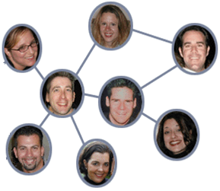
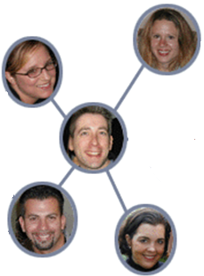
Complex Factors
Action Prediction：
Will John post a tweet on “Haiti Earthquake”?
Influence
Correlation
1
3
Time t+1
Time t
John
John
Attributes:
Always watch news
Enjoy sports
….
Personal attributes
Dependence
4
2
Notes:
To predict users’ actions, we need to consider complex factors. What information we have, we have a dynamic social network, and also attributes of his own. Intuitively, what factors we need to consider? First, the influence from his friends, second, he will keep the same action or attitude as himself, we call it dependence. Third, correlation between neighbours. Finally, personal interests.

Slide 7
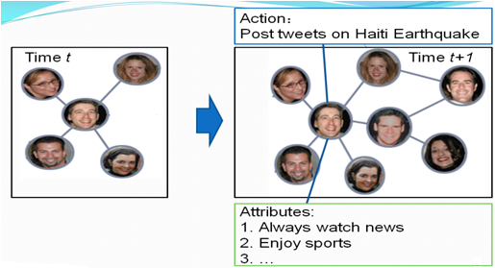
Problem formulation
G^{t} =(V^{t}, E^{t}, X^{t}, Y^{t})
Actions at time t
Nodes at time t
Edges at time t
Attribute matrix at time t
Input:
G^{t} =(V^{t}, E^{t}, X^{t}, Y^{t})
t = 1,2,…T
Output:
F: f(G^{t}) ->Y^{t}
Notes:
Next I will introduce our approach. First, we need to give a formal definition of this problem. The input includes a series of attribute augmented networks, Gt. And Gt contains blabla…We need to learn a mapping function to map G_t to y_t

Slide 8
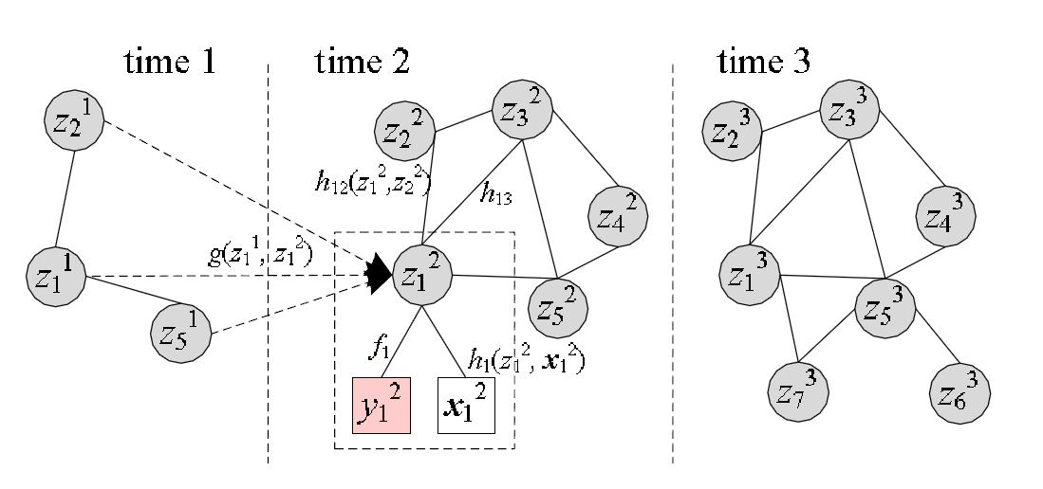

NTT-FGM Model
Influence
Correlation
Continuous latent action state
Personal attributes
Dependence
Action
Personal attributes
Notes:
The model we propose is as the graph shows. This graph shows a three-stage social network. We first add a continuous latent state for each user’s action state. And the factors are all defined according to the latent state. First we user action bias factor to consider the noise in users’ actions. And the influence factor denotes the influence from the past. Finally correlation factor defines the correlation between users and also personal interests. For the action bias factor, we have two option to choose for binary actions: bernoulli and Gaussian. Gaussian can be extended to continuous actions. So we choose Gaussian in our model for potential extension.

Slide 9
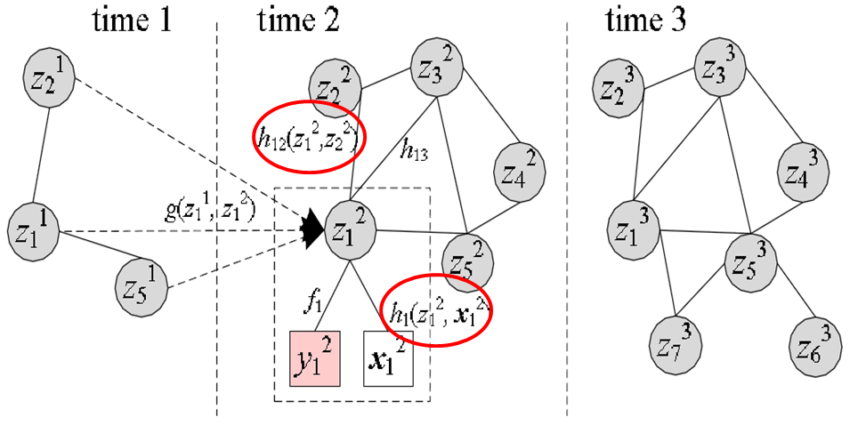
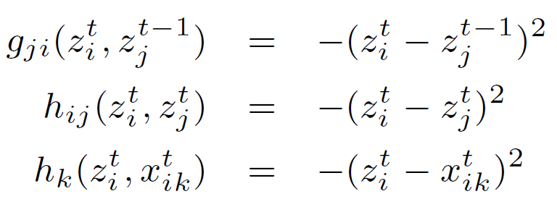
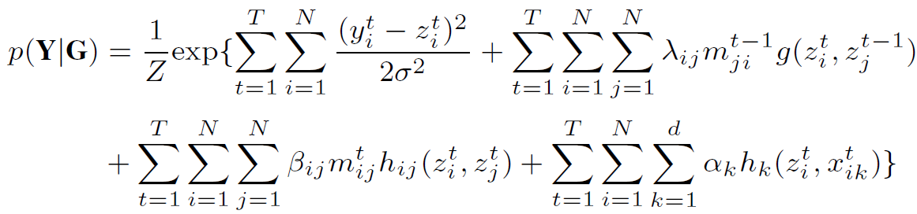
Model Instantiation
How to estimate the parameters?
Notes:
This is the probability function of the factor graph. We need to confirm that the exponential function is integrable for model learning. So we define g, h function as quadratic to make use of the multinominal Gaussian distribution. Then our task is to estimate the parameters.

Slide 10
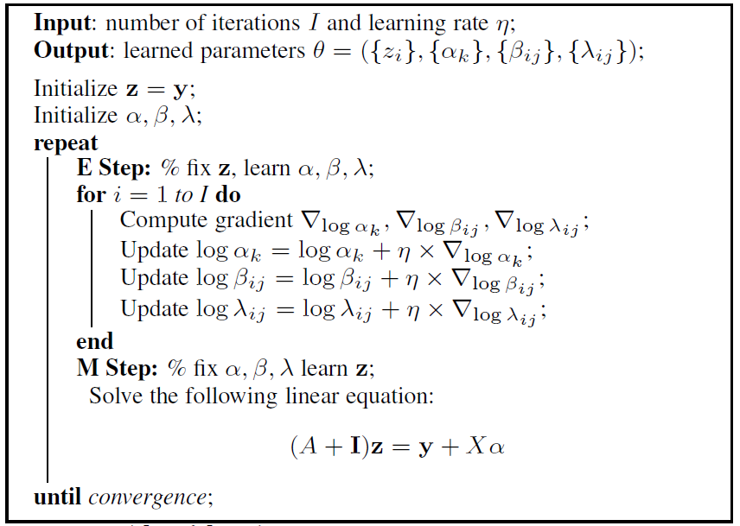
Model Learning
Extremely time costing!!
Our solution: distributed learning (MPI)
Notes:
We employ an EM-style algorithm to train the model. This is the algorithm. Due to the time limit, if you are interested in the algorithm, we can discuss offline.

Slide 11

Distributed Learning
Most Time-costing
  Compute the gradients
Notes:
In the experiments, we found the most time-costing part is to compute the gradienst. And we use MPI to develop a parallel version based on master-slave model.

Slide 12
Experiment
Data Set
Baseline
  SVM
  wvRN (Macskassy, 2003)
Evaluation Measure:
  Precision, Recall, F1-Measure
 | Action | Nodes | #Edges | Action Stats
Twitter | Post tweets on “Haiti Earthquake” | 7,521 | 304,275 | 730,568
Flickr | Add photos into favorite list | 8,721 | 485,253 | 485,253
Arnetminer | Issue publications on KDD | 2,062 | 34,986 | 2,960
Notes:
Finally, I will introduce the experiments. This is the data sets we used in the experiment, and the actions is the same as previously introduced. The baseline methods we use includes SVM, which uses the personal features combined with his neighbours, while wvRN is an algorithm proposed in 2003, which makes user of the graph information. The evaluation measure includes precision, recall and F1-measure.

Slide 13
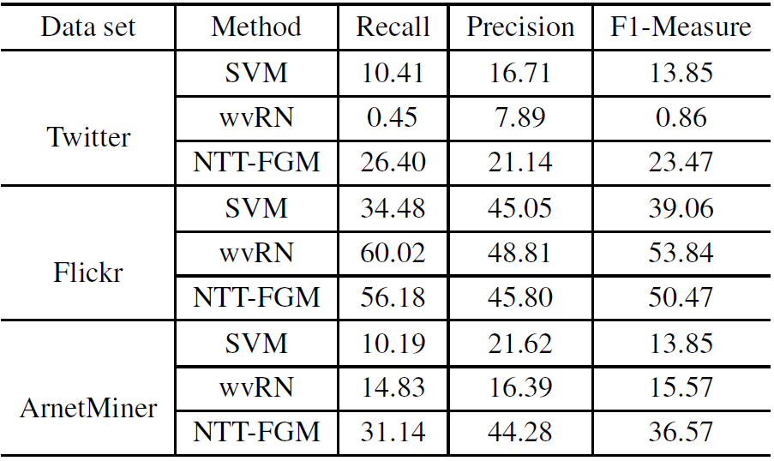
Performance Analysis
Notes:
This is the performance in different datasets. We can see our algorithm shows better and robust performance. And the wvRN is sensitive to the data set, though it is a little large in F1 measure in the filckr data set.

Slide 14
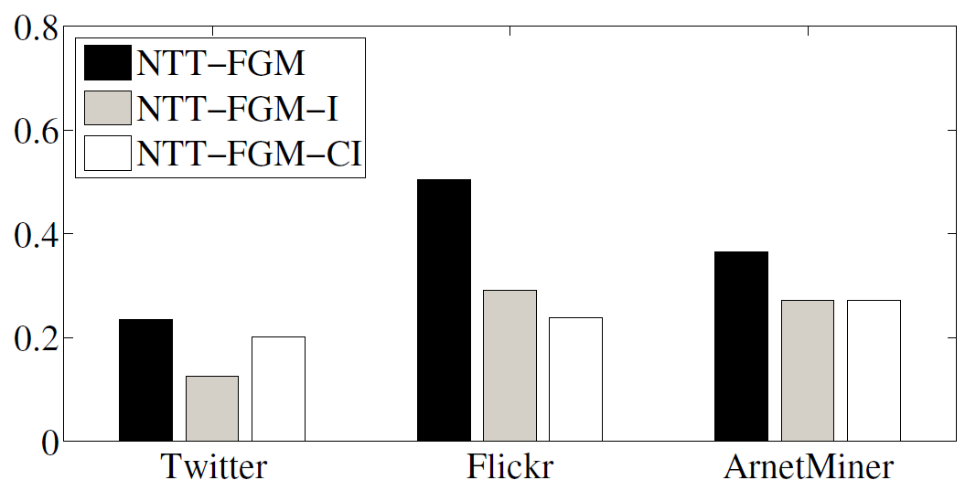
Factor Contribution Analysis
NTT-FGM: Our model
NTT-FGM-I: Our model ignoring influence
NTT-FGM-CI: Our model ignoring influence and correlation
Notes:
We also analyze the performance after ignoring different factors. We can see the factors considered can all help the prediction of users’ actions.

Slide 15
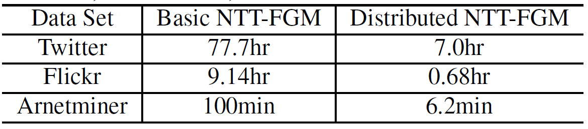
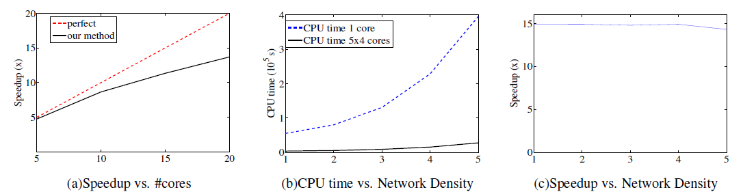
Efficiency Performance
Notes:
For scalability analysis, we can see that our distributing algorithm performs much better than basic methods. And we also compare the speedup with different cores. We also synthesized graph with different network density. We can see our speedup shows consistently good performance.

Slide 16
Conclusion
Formally formulate the problem of social action tracking
Propose a unified model: NTT-FGM to simultaneously model various factors
Present an efficient learning algorithm and develop a distributed implementation
Validate the proposed approach on three different data sets, and our model achieves a better performance

Slide 17
Thank you！
QA?
Data & Code: http://arnetminer.org/stnt
Welcome to our poster!
Notes:
Thank you. More resources can be found in this site. Do you have any questions?

Slide 18
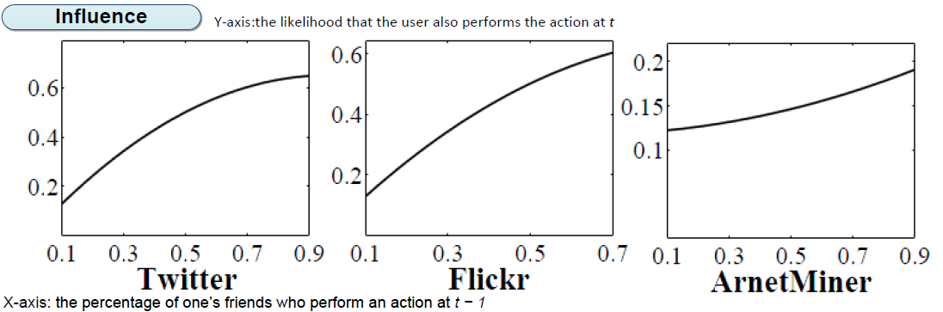
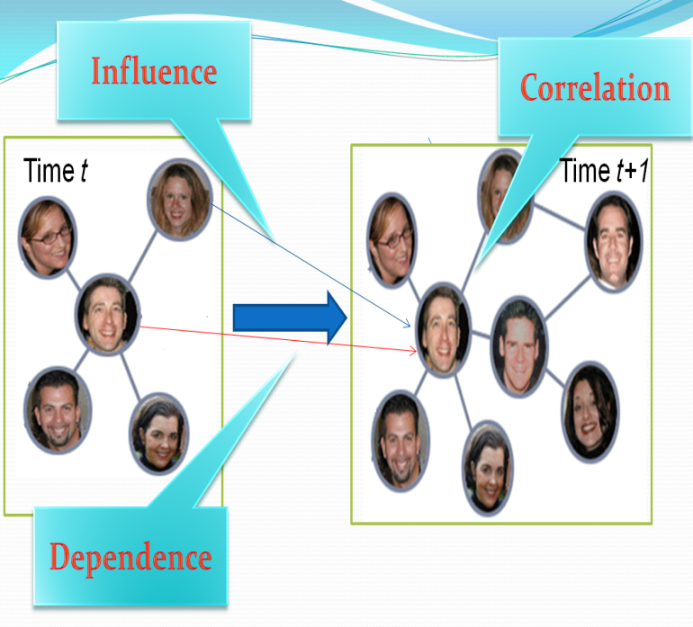
Statistical Study: Influence
Y-axis: the likelihood that the user also performs the action at t
X-axis: the percentage of one’s friends who perform an action at t − 1
Notes:
We made statistical study to validate these factors. This is the validation of influence. X-axis stands for the percentage of one’s friends who perform an action at t-1, and the y-axis represents the likelihood that the user also performs the action at t. We can see, as more friends perform the action, a user also tends to perform the action.

Slide 19
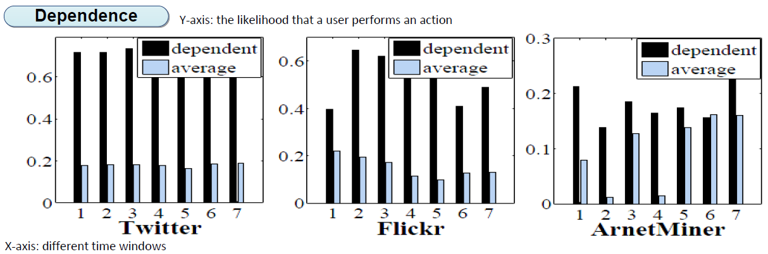
Statistical Study: Dependence
Y-axis: the likelihood that a user performs an action
X-axis: different time windows
Notes:
Next it is the dependence. The x-axis stands for different time windows. And the black one is the likelihood that a user perform an actions at t if he performed it at t-1, while the light one is the average likelihood that a user perform the action. We can see that the black one is always larger than the light one.

Slide 20
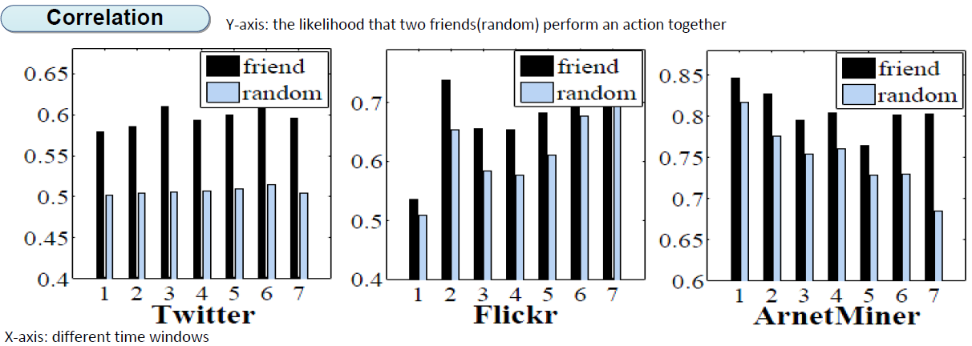
Statistical Study: Correlation
Y-axis: the likelihood that two friends(random) perform an action together
X-axis: different time windows
Notes:
Finally we study the correlation. The x-axis represents different time windows, too. And the black one denotes the likelihood that two friends perform the actions at the same time. The light one is the likelihood that randomly two users perform the same action at the same time. We also see that the black one is larger.

Slide 21
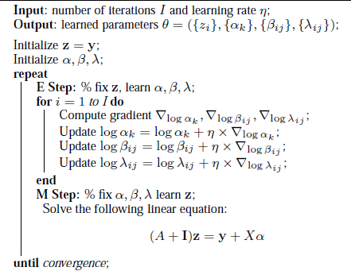
Appendix

Slide 22

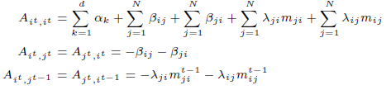
Appendix

Slide 23
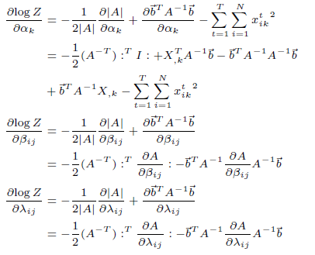
Appendix

Slide 24
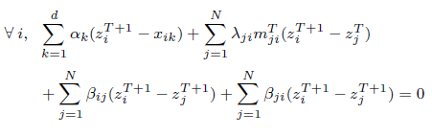
Prediction
Based on the learning parameters we just need to solve the following equations:

Slide 25
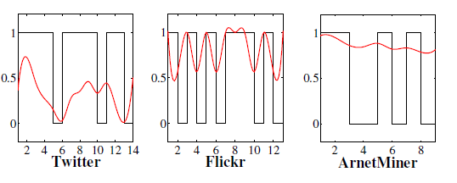
Latent State Analysis
Action Bias Factor: f(y₁²|z₁²)
Influence Factor: g(z₁¹,z₁²)
Correlation Factor: h(z₁²,z₂²), h(z₁²,x₁²)

