Slide 1



Inferring User Demographics and Social Strategies in Mobile Social Networks
Yuxiao Dong#, Yang Yang⁺, Jie Tang⁺, Yang Yang#, Nitesh V. Chawla#
#University of Notre Dame
⁺Tsinghua University

Slide 2




Yuxiao Dong, Yang Yang, Jie Tang, Yang Yang, Nitesh V. Chawla. Inferring User Demographics and Social Strategies in Mobile Social Networks. KDD 2014.
Did you know:
As of 2014, there are 7.3 billion mobile phones, larger than the global population.
Users average 22 calls, 23 messages, and 110 status checks per day.
male
Fewer friends
More stable
female
Younger
Older
have
2x more social friends
4x more opposite-gender circles
than
Notes:
Today, there are more than 7 billion mobile users. On average, users make 22 calls, send 23 messages, and check mobiles for 100 times per day.
We found different people use different strategies to communicate with each other, for example, young users have 2 times more friends than older users, and young male users have 4 times more female friends than older users.
based on the communication patterns, We propose a model WhoAmI to infer users’ demographics.

Slide 3
Big Mobile Data
Real-world large-scale mobile data
  An anonymous country.
  No communication content.
  Aug. 2008 – Sep. 2008.
  > 7 million mobile users + demographic information.
    Gender: Male (55%) / Female (45%)
    Age: Young (18-24) / Young-Adult (25-34) / Middle-Age (35-49) / Senior (>49)
  > 1 billion communication records (call and message).
Two networks:
Network | #nodes | #edges
CALL | 7,440,123 | 32,445,941
SMS | 4,505,958 | 10,913,601

Slide 4
What We Do
How do people communicate / interact with each other with mobile phones?
  Infer human social strategies on demographics.
To what extent can user demographic profiles be inferred from their mobile communication interactions?
  Infer user demographics based on social strategies.
  Applications:
  Viral marketing
  Personalized services
  User modeling
  Customer churn warning
  …

Slide 5
Infer human social strategies on demographics
user demographics + mobile social network
→ social strategies
Notes:
In 1958, Harvard psychologist, Herbert Kelman identified three broad varieties of social influence.[2]

Slide 6
Social Strategy
Human needs are defined according to the existential categories of being, having, doing, and interacting^{[1]}. Two basic human needs^{[2]} are to
  Meet new people → Social needs.
  Strengthen existing relationships → Social needs.
Social strategies are used by people to meet social needs.
  Human needs are constant across historical time periods.
  However, the strategies by which these needs are satisfied change over time^{[1,3]} .
  Barabasi and Dunbar^{[3]}:
  “Women are more focused on opposite-sex relationships than men during the reproductively active period of their lives.” … “As women age, their attention ships from their spouse to younger females---their daughters.”
  “Human social strategies have more complex dynamics than previously assumed.”
http://en.wikipedia.org/wiki/Fundamental_human_needs
M.J. Piskorski. Social strategies that work. Harvard Business Review. Nov. 2011.
V. Palchykov, K. Kaski, J. Kertesz, A.-L. Barabasi, R. I. M. Dunbar. Sex differences in intimate relationships. Scientific Reports 2012.

Slide 7
Social Strategy
We study demographic-based social strategy with respect to the micro-level network structures.
  Ego network
  Social tie
  Social triad
Female
Male

Slide 8
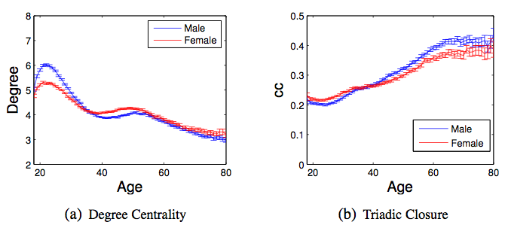
Social Strategy: Ego Network
Correlations between user demographics and network properties.

Slide 9
Social Strategy: Ego Network
2 times
2 times
Correlations between user demographics and network properties.
Social Strategies: Young people are active in broadening their social circles, while seniors have the tendency to maintain small but close connections.

Slide 10
Social Strategy: Ego Network
In your mobile phone contact list,
do you have more female or male friends?

Slide 11
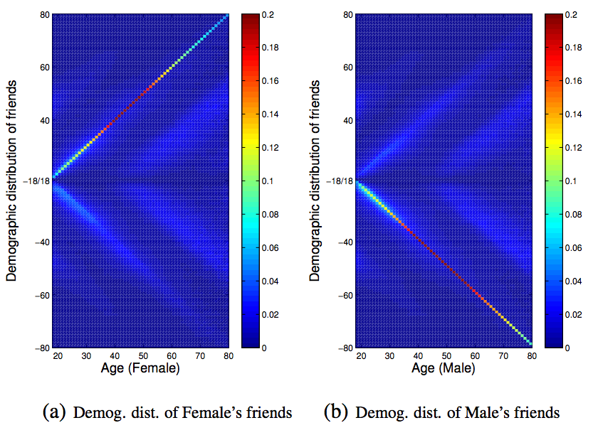
Social Strategy: Ego Network
Female friends’ age
X: age of central user.
Y: age of friends.
Positive Y: female friends;
Negative Y: male friends;
Spectrum: distribution
Male friends’ age
Social Strategies: People tend to communicate with others of both similar gender and age, i.e., demographic homophily.

Slide 12
Social Strategy: Social Tie
How frequently do you call your mother
vs. your significant other?
“Social networks based on dyadic relationships are fundamentally important for understanding of human sociality.”^{[1]}
Social tie strength is defined by the frequency of communications (calls, messages)^{[2]}.

Slide 13
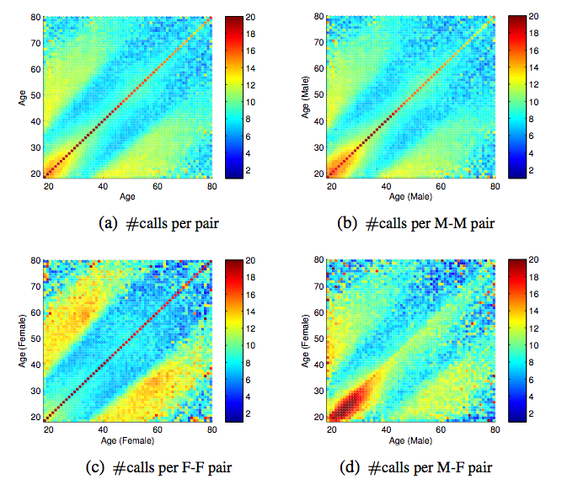
Social Strategy: Social Tie
X: age of one user.
Y: age of the other user.
Spectrum: #calls per month
(a), (b), (c) are symmetric.
Notes:
Large margin between figures

Slide 14
Social Strategy: Social Tie
M
N
X: age of one user.
Y: age of the other user.
Spectrum: #calls per month
(a), (b), (c) are symmetric.
P
Q
M,N,P,Q:
10~15 calls per month are made between parents and children.
Social Strategies: Frequent cross-generation interactions are maintained to bridge age gaps.
Notes:
ABCD other zimus

Slide 15
Social Strategy: Social Tie
X: age of one user.
Y: age of the other user.
Spectrum: #calls per month
(a), (b), (c) are symmetric.
E
“Brother” phenomenon
E vs. F:
E: Male: ±5 years old interactions
F: Female: only same-age interactions.
F
Social Strategies: Young male maintain more frequent and broader social connections than young females.

Slide 16
Social Strategy: Social Tie
X: age of one user.
Y: age of the other user.
Spectrum: #calls per month
(a), (b), (c) are symmetric.
E
E,F vs. G:
G: f-m: >30 calls per months
E/F: m-m or f-f: 10~15 calls
F
G
Social Strategies: Opposite-gender interactions are much more frequent than those between young same-gender users.
Notes:
Regions not areas
Young to be defined

Slide 17
Social Strategy: Social Tie
X: age of one user.
Y: age of the other user.
Spectrum: #calls per month
(a), (b), (c) are symmetric.
H
I
H,I vs. J:
J
Social Strategies: When people become mature, reversely, same-gender interactions are more frequent than those between opposite-gender users.

Slide 18
Social Strategy: Social Triad
  Social triad is one of the simplest grouping of individuals that can be studied and is mostly investigated by microsociology^{[1]}.
How do people maintain their social triadic relationships across their lifetime?
D. Easley, J. Kleinberg. Networks, Crowds, and Markets: Reasoning About a Highly Connected World. Cambridge U. Press. 2010

Slide 19
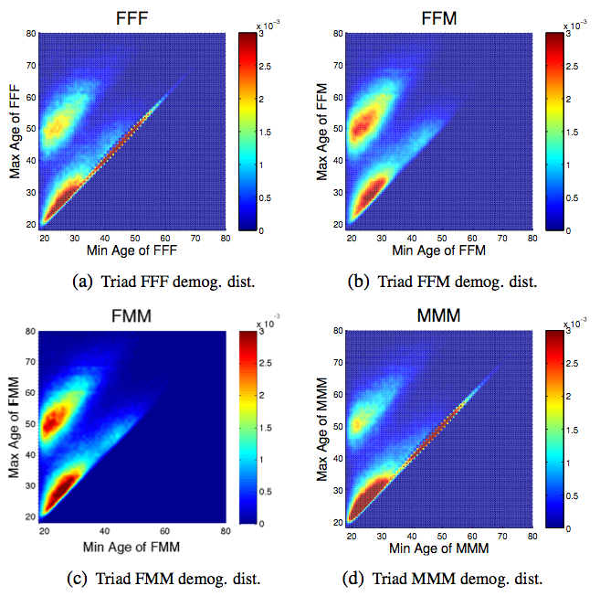
Social Strategy: Social Triad
X: minimum age of 3 users.
Y: maximum age of 3 users.
Spectrum: distribution

Slide 20
Social Strategy: Social Triad
X: minimum age of 3 users.
Y: maximum age of 3 users.
Spectrum: distribution
M
N
M,N,P,Q:
Intense red areas
P
Q
Social Strategies: People expand both same-gender and opposite-gender social groups during the dating and reproductively active period.

Slide 21
Social Strategy: Social Triad
X: minimum age of 3 users.
Y: maximum age of 3 users.
Spectrum: distribution
E
F
E,H vs. F,G:
#same-gender triads are ~6 times more than #opposite-gender triads.
G
H
Social Strategies: People’s attention to opposite-gender groups quickly disappears, and the insistence and social investment on same-gender social groups lasts for a lifetime.

Slide 22
Infer user demographics based on social strategies
social strategies + mobile social network
→ user demographics
Notes:
In 1958, Harvard psychologist, Herbert Kelman identified three broad varieties of social influence.[2]

Slide 23
Problem: Demographic Prediction
Gender or Age Classification
  Infer users’ gender Y and age Z separately.
  Model correlations between gender Y and attributes X;
  Model correlations between age Z and attributes X;
Input:
G = (V^{L}, V^{U}, E, Y^{L}), X
Output:
f(G, X)→(Y^{U})
Miss the interrelation between Y and Z !
Input:
G = (V^{L}, V^{U}, E, Z^{L}), X
Output:
f(G, X)→( Z^{U})

Slide 24
Problem: Demographic Prediction
Double Dependent-Variable Classification
  Infer users’ gender Y and age Z simultaneously.
  Model correlations between gender Y and attributes X;
  Model correlations between age Z and attributes X;
  Model interrelations between Y and Z;
Gender:
  Male (55%) / Female (45%)
Age:
  Young (18-24) / Young-Adult (25-34) / Middle-Age (35-49) / Senior (>49)
Input:
G = (V^{L}, V^{U}, E, Y^{L}, Z^{L}), X
Output:
f(G, X)→(Y^{U}, Z^{U})

Slide 25
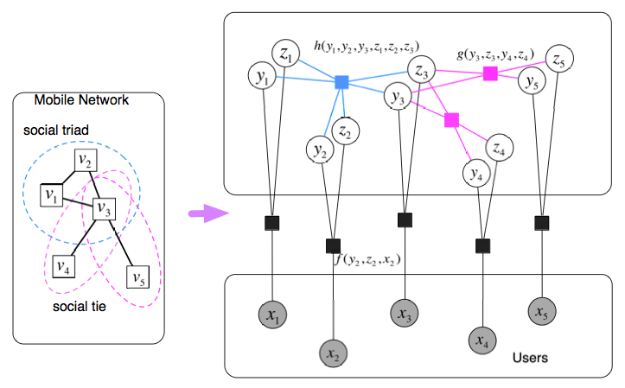

WhoAmI Method
---A double dependent-variable factor graph
Modeling social strategies on social triad
Modeling social strategies on social tie
Triadic factor h()
Dyadic factor g()
Modeling interrelations
between gender and age
Random variable Z: Age
Random variable Y: Gender
Attribute factor f()
Modeling social strategies
on social ego
Joint Distribution:
Code is available at: http://arnetminer.org/demographic
Notes:
Green text
Show one by one factor

Slide 26

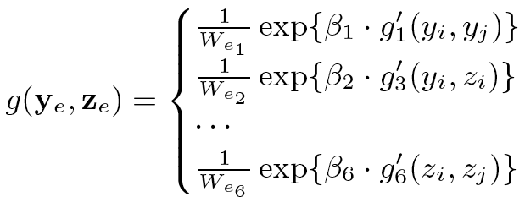
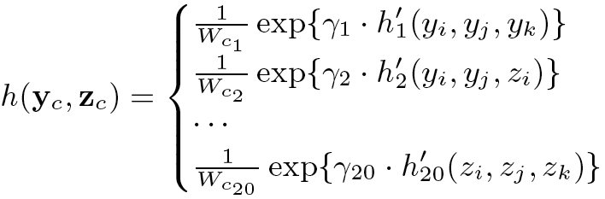
WhoAmI: Model Initialization
Joint Distribution:
Attribute factor:
Interrelations between
gender Y & age Z
Dyadic factor:
Triadic factor:
Code is available at: http://arnetminer.org/demographic
Notes:
Green

Slide 27
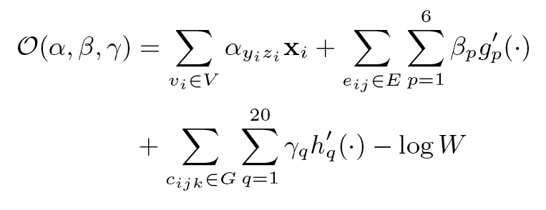
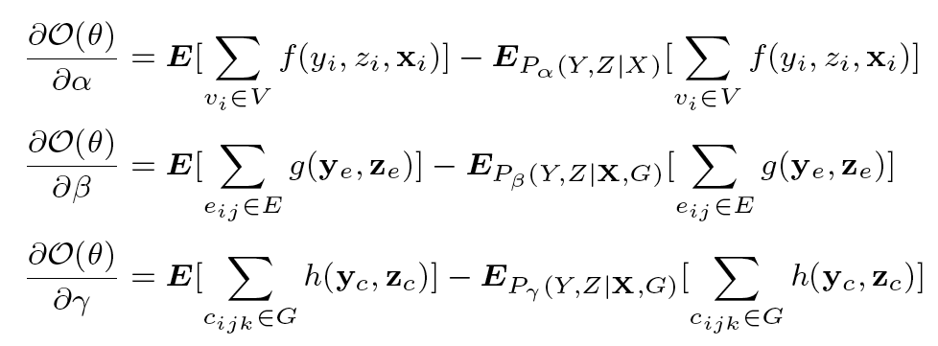
WhoAmI: Objective Function
Objective function:
Model learning:
gradient descent
Circles?→LBP^{[1]}
K. P. Murphy, Y. Weiss, M. I. Jordan. Loopy Belief Propagation for Approximate Inference: An Empirical Study. UAI’99.
Code is available at: http://arnetminer.org/demographic
Notes:
green

Slide 28
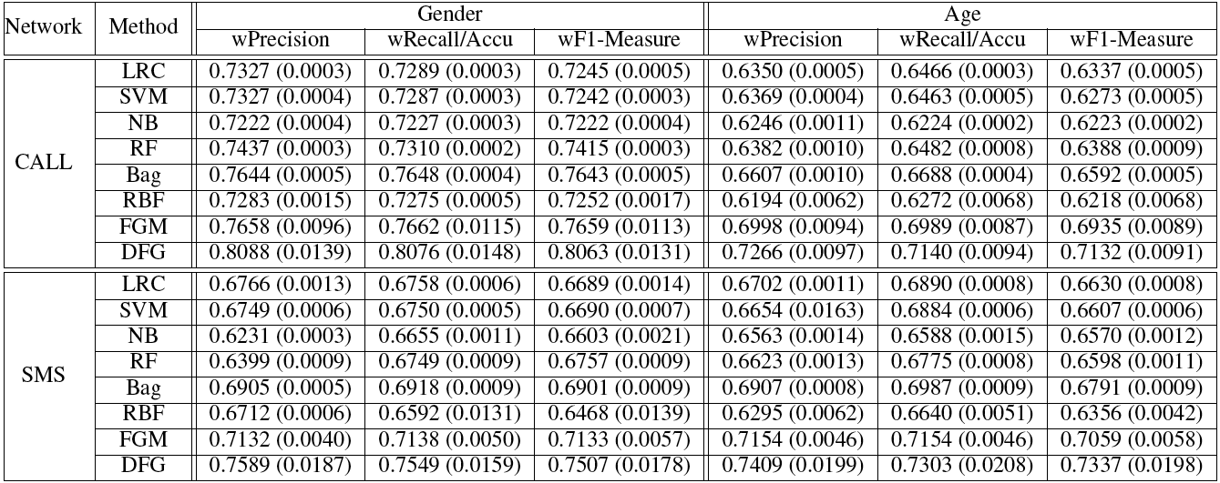
Experiment
Data: active users (#contacts >=5 in two months)
  >1.09 million users in CALL
  >304 thousand users in SMS
  50% as training data
  50% as test data

Slide 29
Experiment
Baselines:
    LRC: Logistic Regression
    SVM: Support Vector Machine
    NB: Naïve Bayes
    RF: Random Forest
    BAG: Bagged Decision Tree
    RBF: Gaussian Radial Basis Function Neural Network
    FGM: Factor Graph Model
    DFG: WhoAmI: Double Dependent-Variable Factor Graph

Slide 30
Experiment
Evaluation Metrics:
    Weighted Precision
    Weighted Recall
    Weighted F1 Measure
    Accuracy

Slide 31
Experiment
The proposed WhoAmI (DFG) outperforms baselines by up to 10% in terms of F1.
We can infer 80% of the users’ GENDER in the CALL network correctly.
The CALL behaviors reveal more users’ GENDER information than SMS.
We can infer 73% of the users’ AGE in the SMS network correctly.
The SMS behaviors reveal more users’ AGE information than CALL.

Slide 32
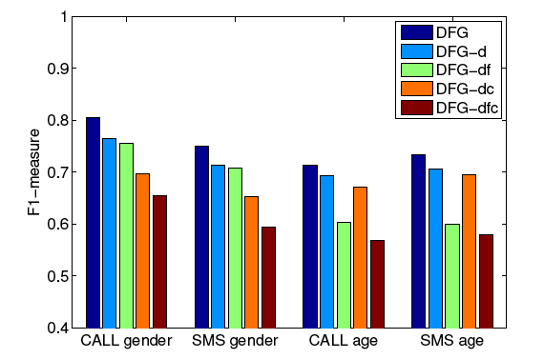
Experiment: Results
DFG-d: stands for ignoring the interrelations between gender and age.
DFG-df: stands for further ignoring tie features.
DFG-dc: stands for further ignoring triad features.
DFG-dcf: stands for further ignoring tie and triad features.
The positive effects of interrelations between gender and age.
Social Triad features are more powerful for inferring users’ gender.
Social Tie features are more powerful for inferring users’ age.

Slide 33
Conclusion
Unveil the demographic-based social strategies used by people to meet their social needs:
Propose WhoAmI, a Double Dependent-Variable Factor Graph, for inferring users’ genders and ages simultaneously.
Demonstrate the proposed WhoAmI method in a large-scale mobile social network.
male
Fewer friends
More stable
female
Younger
Older

Slide 34
Acknowledgements
Army Research Laboratory
U.S. Air Force Office of Scientific Research (AFOSR) and the Defense Advanced Research Projects Agency (DARPA)
National High-Tech R&D Program
Natural Science Foundation of China
National Basic Research Program of China

Slide 35
Inferring User Demographics and Social Strategies in Mobile Social Networks
Thank You!
Yuxiao Dong#, Yang Yang⁺, Jie Tang⁺, Yang Yang#, Nitesh V. Chawla#
#University of Notre Dame
⁺Tsinghua University
Code is available at: http://arnetminer.org/demographic

Slide 36

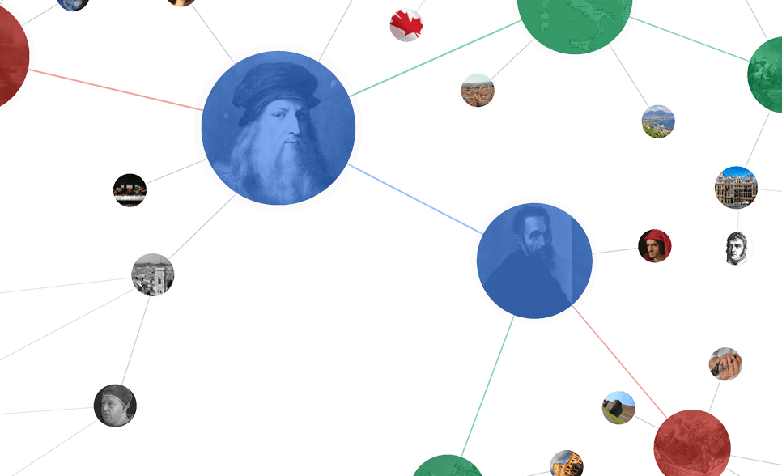







Big Network Data
1.26 billion users
700 billion minutes/month
280 million users
80% of users are 80-90’s
555 million users
.5 billion tweets/day
560 million users
influencing our daily life
79 million users per month
9.65 billion items/year
800 million users
~50% revenue from network life
500 million users
35 billion on 11/11

Slide 37

Big Network Data
1.26 billion users
700 billion minutes/month
280 million users
80% of users are 80-90’s
$19 billion acquisition
Feb. 2014
555 million users
.5 billion tweets/day
560 million users
influencing our daily life
79 million users per month
9.65 billion items/year
800 million users
~50% revenue from network life
500 million users
35 billion on 11/11

Slide 38
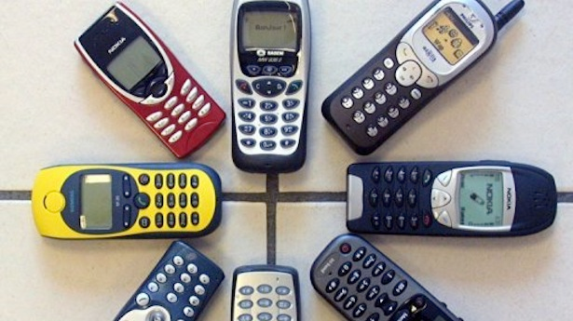
Big Mobile Network Data
1.26 billion users
700 billion minutes/month
280 million users
80% of users are 80-90’s
555 million users
.5 billion tweets/day
560 million users
influencing our daily life
7.3 billion mobile devices in 2014^{[1]}
>100% of global population
79 million users per month
9.65 billion items/year
800 million users
~50% revenue from network life
500 million users
35 billion on 11/11
1. http://www.itu.int/ International Telecommunications Union (ITU) at 2013 Mobile World Congress.

Slide 39
Big Mobile Network Data
In 2013, 97% of adults have a mobile phone in the US^{[1]}
  made 3 billion phone calls per day
  sent 6 billion text messages per day
  This talk (15 mins):
  21 million calls & 42 million messages
On average, in one day each mobile user in the US^{[2]}
  makes, receives or avoids 22 phone calls
  sends or receives text messages 23 times
  checks her/his phone 110 times.
http://www.accuconference.com/blog/Cell-Phone-Statistics.aspx
http://www.dailymail.co.uk/news/article-2276752/Mobile-users-leave-phone-minutes-check-150-times-day.html

Slide 40
Related work
Previous work on mobile social networks mainly focuses on macro-level models^{[1,2]}.
  No Demographics.
Reality Mining^{[3]}
  The friendship network of 100 specific users (student of faculty in MIT).
  Demographics + Human interactions.
The 2012 Nokia Mobile Data Challenge^{[4]}
  Infer user demographics by using communication records of 200 users.
J.P. Onnela, J. Saramaki, J. Hyvonen, G. Szabo, D. Lazer, K. Kaski, J. Kertesz, A.-L. Barabasi. Structure and tie strengths in mobile communication networks. PNAS 2007.
M. Seshadri, S. Machiraju, A. Sridharan, J. Bolot, C. Faloutsos, J. Leskovec. Mobile call graphs: Beyond power-law and lognormal distributions. KDD’08.
http://realitycommons.media.mit.edu/
https://research.nokia.com/page/12000

Slide 41
WhoAmI: Distributed Learning
Master
Global update
Slave
Compute local gradient via random sampling
Graph Partition by Locations
Master-Slave Computing
Inevitable loss of correlation factors!
Jie Tang, Sen Wu, Jimeng Sun. Confluence: Conformity influence in large social networks. KDD’13.

Slide 42
Experiment: Features
Given one node v and its ego network:
  Individual feature:
    Individual attribute: degree, neighbor connectivity, clustering coefficient, embeddedness and weighted degree.
  Friend feature:
    Friend attribute: # of connections to female/male, young/young-adult/middle-age/senior friends (from labeled friends).
    Dyadic factor: both labeled and unlabeled friends for social tie structures in v’s ego network.
  Circle feature:
    Circle attribute: # of demographic triads, i.e., v-FF, v-FM, v-MM; v-AA, v-AB, v-AC, v-AD, v-BB, v-BC, v-BD, v-CC, v-CD, v-DD. (A/B/C/C denote the young/young-adult/middle-age/senior)
    Triadic factor: both labeled and unlabeled friends for social triad structures in v’s ego network.
    LCR/SVM/NB/RF/Bag/RBF:
      Individual/Friend/Circle Attributes
    FGM/DFG
      Individual/Friend/Circle Attributes
      Structure feature: Dyadic factors
      Structure feature: Triadic factors
?
?
?
?
V-fm
V-FF

Slide 43
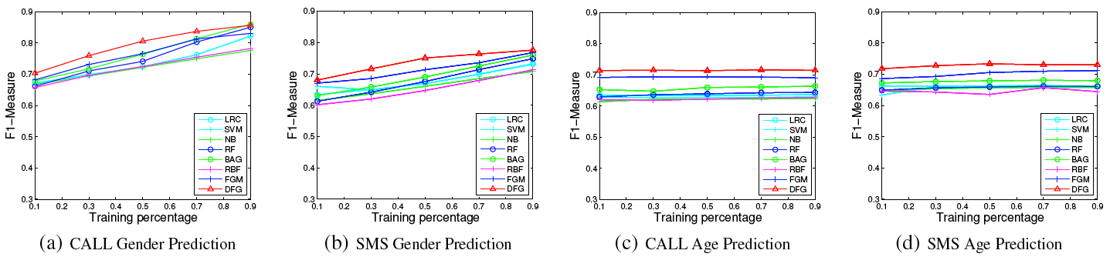
Experiment: Results
Gender
Age
Performance of demographic prediction with different percentage of labeled data

Slide 44
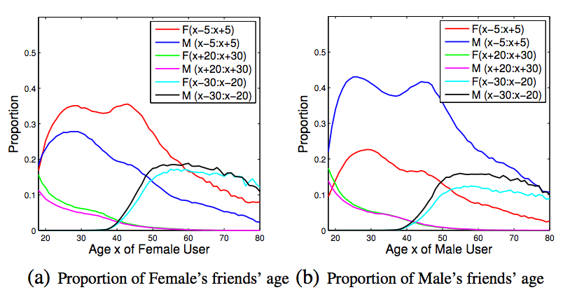
Social Strategy: Ego Network
same-generation
friends
Social Strategies: The young put increasing focus on the same generation, but decrease it after entering middle-age.

Slide 45
Social Strategy: Ego Network
same-generation
friends
older-generation
friends
Social Strategies: The young put decreasing focus on the older generation across their lifespans.

Slide 46
Social Strategy: Ego Network
same-generation
friends
older-generation
friends
younger-generation
friends
Social Strategies: The middle-age people devote more attention on the younger generation even along with the sacrifice of homophily.

