Slide 1
Probabilistic Community and Role Model for Social Networks
Yu Han¹ and Jie Tang^{1,2,3}
¹Department of Computer Science and Technology, Tsinghua University
²Tsinghua National Laboratory for Information Science and Technology (TNList)
³Jiangsu Collaborative Innovation Center for Language Ability, Jiangsu Normal University, China
yuhanthu@126.com, jietang@tsinghua.edu.cn
Notes:
1

Slide 2







Social Networks
There are visible and invisible elements in social networks
visible elements: users, links, actions
invisible elements: communities, roles
Visible and invisible elements interact and affect each other
users may have closer relationships within a community than across communities
users’ actions depend both on the attributes of themselves and on the influence of their communities
…
Notes:
Social network is not strange to us. There are visible and invisible elements in a social network. Invisible elements include users, links and actions, while invisible elements include communities and roles. Visible and invisible elements interact and affect each other in many ways, together constituting a complex system. For example, users may have closer relationships within a community than across communities. Users usually take a few kinds of actions in a social network, and whether a user take a specific action depends both on the attributions of itself and on the influence of their communities.

Slide 3









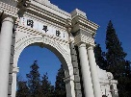



Social Networks
This paper is good.
Reweet 2nd
Tweet
Reweet 3rd
Reweet 1st
Bob
Ellen
John
Jessica
Opinion Leader
Upload
Comment
Structural Hole Spanner
Alan
I like this photo.
Joy
Notes:
This is an example of social networks. In this network, there are three communities. Links are usually dense within a community and sparse across communities. Users have different attributes, and accordingly play different roles. For example, Jessica plays the role of structural hole spanner, while John plays the role of opinion leader. Users may take actions, such as uploading a picture, giving comment to a picture, posting a message, or reposting a message, etc. Whether a user take an action depends its role and communities. For example, structural hole spanners tend to transfer messages across communities. Most users like to comment on the pictures uploaded by their friends.

Slide 4
Problems:
How should we model a complex social network so that the model can capture the intrinsic relations between all these elements, such as conformity inﬂuence, individual attributes, and actions?
How do we use a social network model to handle issues such as community detection and behavior prediction without changing model itself?
Limitations of existing work:
Utilizing only portions of the available social network information.
Focusing only on a few aspects of social networks, missing the global view.
Basing on discriminative methods, ignoring the nature of social networks.
Using deterministic method. Can not handle uncertain cases.
Notes:
Face to such a complex social network, there are two problems. First, how should we model a complex social network so that the model can capture the intrinsic relations between all these elements? Second, how do we use a social network model to handle issues such as community detection and behavior prediction without changing model itself?
There are many existing works on it. However, the result is not satisfactory due to the following limitations. First, some works utilize only portions of the available social network information. For example, some works only use the static structure of a social network, ignoring the dynamic actions of users. Second, some works focus only on a few aspects of social network, missing the global view. Third, some works base on discriminative methods, ignoring the nature of social networks. For example, some works only focus on deal with a specific issue such as community detection or information diffusion, with a discriminative model. These kind of model seems reasonable in some cases, but may be not in others. The last, some works use deterministic method and can not handle uncertain cases.

Slide 5
Our goal:
To propose a uniﬁed probabilistic framework to model a social network, which can exactly reflect the intrinsic relationships between all visible and invisible elements of a social network, and can be used to handle practical issues in a social network.
Notes:
So our goal is to propose a uniﬁed probabilistic framework to model a social network, which can exactly reflect the intrinsic relationships between all visible and invisible elements of a social network, and can be used to handle practical issues in a social network.

Slide 6
Intuitions and Assumptions
Intuitions
Assumptions
Links.
Locally inhomogeneous.
Each node may belong to several communities.
Assumption 1: Each node has a distribution over the communities.
Assumption 2: Each community has a distribution over the links.
Attributions.
Each node has many attributes, such as in-degree, out-degree, etc.
Based on these attributes, we can classify the nodes into clusters.
Each cluster can be regarded as a role that nodes play.
Assumption 3: The attributes of each role satisfy a speciﬁc distribution—such as a Gaussian distribution.
Assumption 4: Each node has a distribution over roles according to its attributes.
Actions.
Whether a node takes a speciﬁc action partly depends on the community it belongs to.
Whether a node takes an action may also depend on the role it plays.
Assumption 5: Community and role have a distribution over actions.
Notes:
The intuition behind our model is three-fold, corresponding to the three visible elements respectively.
First let’s begin with links/edges. According to former studies, the distribution of edges is usually locally inhomogeneous, and highly concentrated within special groups of nodes, but sparse between these groups. Besides, each node may belong to several communities, and whether it has a link to other nodes might depend on the communities to which it belongs. Based on these intuitions, we can get two assumptions. Each node has a distribution over the communities, and each community has a distribution over the links.
Then we come to the attributions. In a social network, each node has many attributions, such as degrees, etc. Based on these attributions, we can classify the nodes into clusters. Each cluster can be regarded as a role that nodes play. The nodes which play the same role may have similar attributions. For example, opinion leaders all have high degrees. Base on these intuitions, we can get two assumptions that the attributes of each role satisfy a specific distribution, such as a Gaussian distribution, and that each node has a distribution over roles according to its attributions.
The last, actions. Whether a node takes a specific action partly depends on the community it belongs to. Whether a node takes an action may also depend on the role it plays. Based on these intuitions, we can get an assumption that the community that the nodes belong to and the role that the nodes play have a distribution over actions.

Slide 7



CRM
Distribution of communities and roles over edges
For each node v in the graph:
1. Draw ζ from Dirichlet(λ);
Distribution of nodes over communities
2. Draw a φ_{v} from Dirichlet(β) prior;
Distribution of nodes over communities
3. For each edge e_{v,i} :
Draw a community z_{v,i} = c from multinomial distribution φ_{v} ;
Community
Draw an edge e_{v,i} from a multinomial distribution ζ^{(c)} speciﬁc to community c.
Role
For each node v in the graph:
1. Draw a θ_{v} from Dirichlet(α) prior;
2. Draw a role d_{v} = r from multinomial distribution θ_{v} ;
y
3. For each attribute of v, draw a value x_{h} ^{(r)} ∼ N(µ_{r,h} , σ_{r,h}² ).
e
x
For each action y_{m} :
1. Draw ρ from Dirichlet(γ) prior;
2. Draw a community c_{v} for v from φ_{v} ;
3. Draw a community c_{u} for u, which is the target of the action, from φ_{u} ;
Actions
4. Draw a role r from θ_{v} ;
5. Draw y_{m} ∼ Multinomial(ρ^{τ,r}).
Distribution of communities over edges
Attributions
Edges/Links
Notes:
Based on the above assumptions, we propose a probabilistic generative model called Community Role Model(CRM) to represent a social network. The whole model can be divided into three processes, each generating a kind of visible element respectively.
The first process is to generate links/edges. For each node v in the graph, first draw ζ from Dirichlet(λ), second draw a φ_{v} from Dirichlet(β) prior. For each edge e_{v,i}, first draw a community z_{v,i} = c from multinomial distribution φ_{v}, then draw an edge e_{v,i} from a multinomial distribution ζ^{(c)} speciﬁc to community c.
Next we generate attributions. For each node v in the graph, first draw a θ_{v} from Dirichlet(α) prior, second draw a role d_{v} = r from multinomial distribution θ_{v,} then for each attribute of v, draw a value x_{h} ^{(r)} ∼ N(µ_{r,h} , σ_{r,h}² ).
Last, we generate actions. For each action y_{m ,} first draw ρ from Dirichlet(γ) prior, second draw a community c_{v} for v from φ_{v} , third draw a community c_{u} for u, which is the target of the action, from φ_{u},, fourth draw a role r from θ_{v}, last draw y_{m} ∼ Multinomial(ρ^{τ,r}).
The shaded nodes e, x, y denote three visible elements respectively. Two latent variable z and d denote two invisible elements respectively. ζ , φ, ρ, θ are parameters for the four multinomial distribution respectively, which are the distribution of communities over links, the distribution of nodes over communities, the distribution of community and role over actions, and the distribution of nodes over roles. µ and σ are the parameters of attributions’ distribution.

Slide 8
Experiments
We ﬁrst use a real dataset to learn the parameters of CRM. Then we use the parameters to generate a synthetic social network. Then we evaluate CRM by the following three tasks:
Structure recovery.
We compare the diﬀerence of structures between the generated synthetic network and the real network by means of six metrics: degree distribution, cluster coeﬃcient, etc.
Behavior prediction.
CRM can predict users’ actions by parameter ρ.
Community detection.
CRM can mine communities by parameter ζ.
Notes:
We evaluate the eﬀectiveness of the proposed CRM model on real-world datasets. We ﬁrst use a real dataset to learn the parameters of CRM. Then we use the parameters to generate a synthetic social network that, ideally, should recover the original appearance. After that, we evaluate CRM by the following three tasks:
The first task is structure recovery. For this task, we compare the diﬀerence of structures between the generated synthetic network and the real network by means of six metrics which can reflect the structure of a network from different angles. Obviously, the more similar the features of the synthetic network and real network, the better the model.
The second task is behavior prediction. Parameter ρ can represent the probability for a node to take a specific action, so we can use it to predict users’ behaviors.
The last task is community detection. We can use parameter ζ to mine communities.

Slide 9
Datasets
Coauthor
1,765 nodes, 13,415 links.
Facebook
4,039 nodes, 88,234 links.
Weibo
1,776,950 nodes, 308,489,739 links.
Notes:
To evaluate CRM, we use three datasets.
The Coauthor dataset contains 1765 computer authors, 13,415 corresponding collaboration relationships, and 7,233 papers published at 28 computer science conferences.
The Facebook dataset is downloaded from a web site, which can be found in the references part of the paper. It contains information from 4,039 Facebook users and 88,234 links.
Weibo is a microblogging service in China, which reports having more than 5 hundred million registered users. We use a sub-network with 1,776,950 users, 308,489,739 following relationships, 300,000 original messages and 23,755,810 repost actions.

Slide 10
Structural Recovery
Baseline: MAG (UAI’11)
Datasets:
Coauthor
Facebook
Metrics
Degree is the degree of nodes versus the number of corresponding nodes.
Pairs of Nodes is the cumulative number of pairs of nodes that can be reached in ≤ h hops.
Eigenvalues are eigenvalues of the adjacency matrix representing the given network versus their rank.
Eigenvector is the components of the leading eigenvector versus the rank.
Clustering Coeﬃcient is the average local clustering coeﬃcient of nodes versus their degree.
Triangle Participation Ratio is the number of triangles that a node is adjacent to versus the number of nodes.
Notes:
For structural recovery, we use MAG proposed by a paper in UAI’11 as the baseline method. We use Coauthor and Facebook as the datasets. Then we use Degree, Pairs of Nodes, Eigenvalues, Eigenvector, Clustering Coefficient, and Triangle Participation Ratio as the metrics.

Slide 11
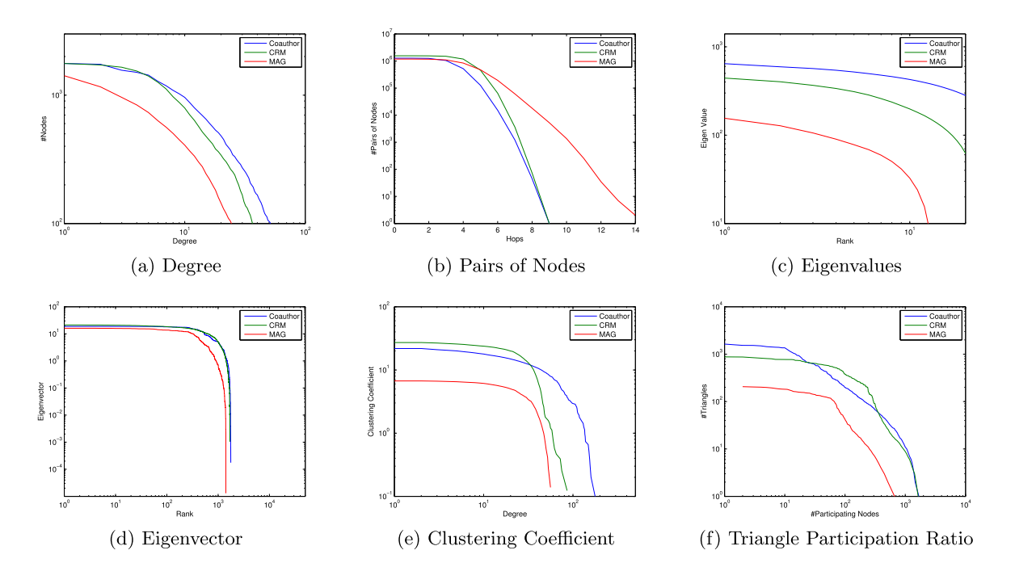
Structural Recovery
Metric values of the Coauthor network and the two networks generated by CRM and MAG. CRM outperforms MAG for every metric.
Notes:
This is the result on the Coauthor network. Each subfigure is a metric value. The blue line is the original network, i.e. the ground truth. The green one is the result of CRM, while the blue one is the result of baseline. Due to the heavy-tailed phenomenon of the metrics, we plot them in terms of cumulative distribution functions. Obviously, the more closer the lines of the synthetic network and the real network, the better the model.

Slide 12
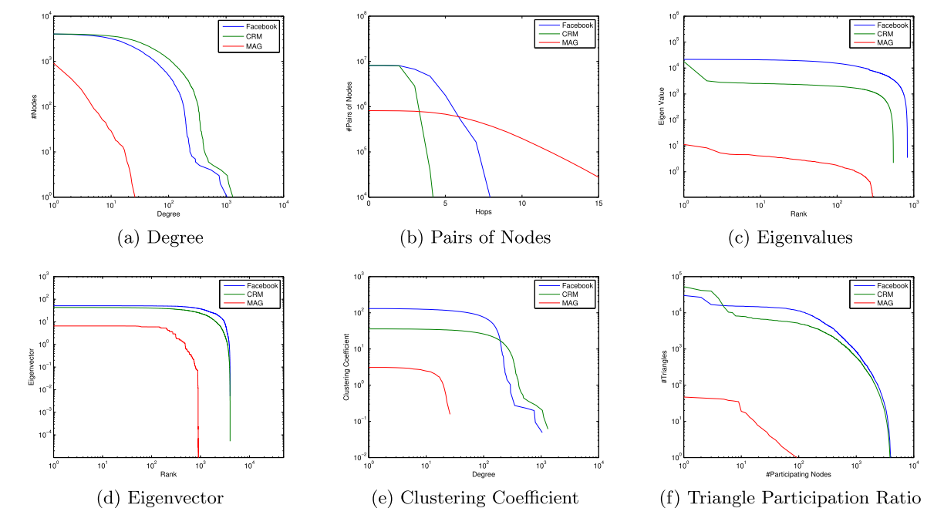
Structural Recovery
Metric values of the Facebook network and the two networks generated by CRM and MAG. CRM outperforms MAG for every metric.
Notes:
This is the result on the Facebook network. Both of the two sets of results show that our model outperforms baseline for every metric.

Slide 13
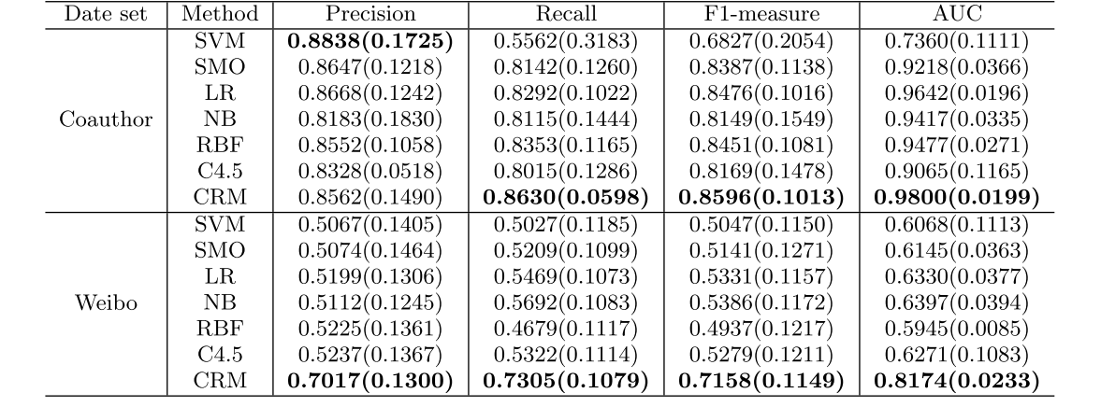
Behavior Prediction
Baseline: SVM, SMO, LR, NB, RBF, C4.5
Datasets:
Coauthor
Weibo
Metrics: Precision, Recall, F1, AUC
Notes:
Let’s take a look at the result of behavior prediction. Because we treat this problem as a classify problem, we can use traditional classify algorithms as our baseline. For this task, we use Coauthor and Weibo as our datasets. We use Precision, Recall, F1 and AUC as the metrics. From the result we can see that except for the precision on Coauthor dataset, our model outperforms other baselines in all other cases.

Slide 14
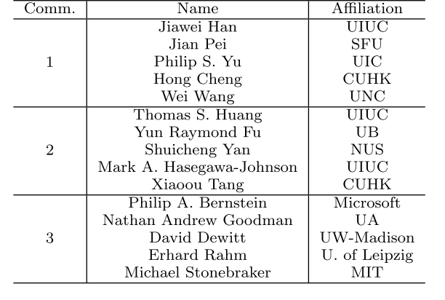
Community Detection
Datasets:
Coauthor
Result:
Notes:
We use a case study to demonstrate its eﬀectiveness in detecting communities qualitatively. We try several settings for number of communities on Coauthor dataset, and fix C = 150 at last. According to ζ after training, we can obtain the representative researchers with the highest probabilities in each community. This table shows the highest top 5 authors in three communitis.

Slide 15
Future Work
Mining more factors
Integrating nonparametric methords
Notes:
As for future work, it would be intriguing to mine more factors that aﬀect network structure and user behaviors so as to simulate a dynamic social network. It is also interesting to integrate nonparametric methods into our model to base parameter value choices on the data itself.

Slide 16
Thank you!
Q&A

