Slide 1



COSNET: Connecting Heterogeneous Social Networks with Local and Global Consistency
Yutao Zhang⁺, Jie Tang⁺, Zhilin Yang⁺, Jian Pei#, and Philip S. Yu*
⁺Tsinghua University
#Simon Fraser University
*University of Illinois at Chicago
Notes:
1

Slide 2
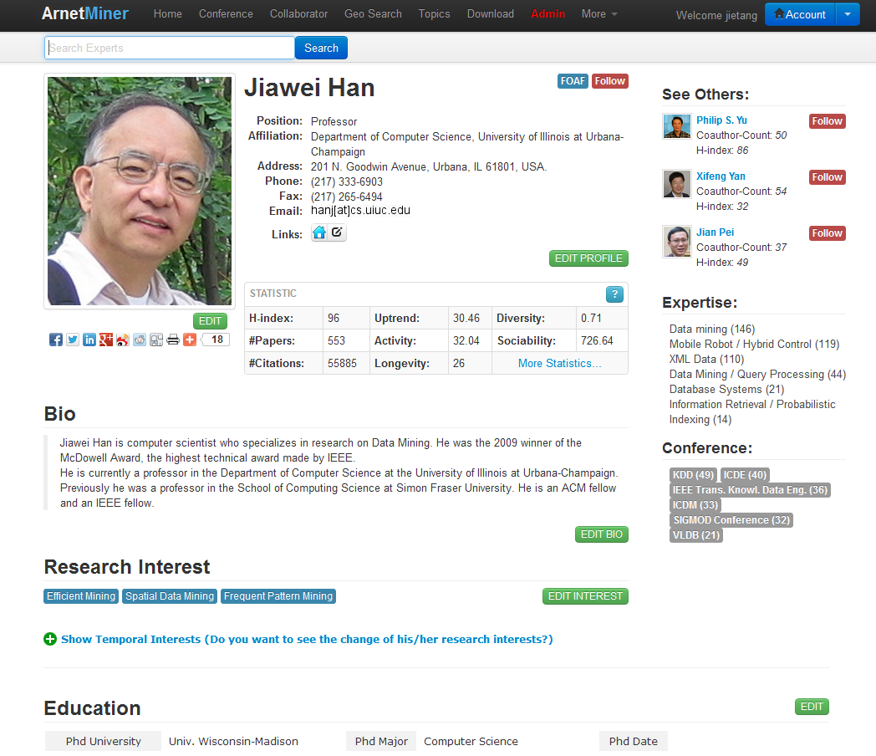
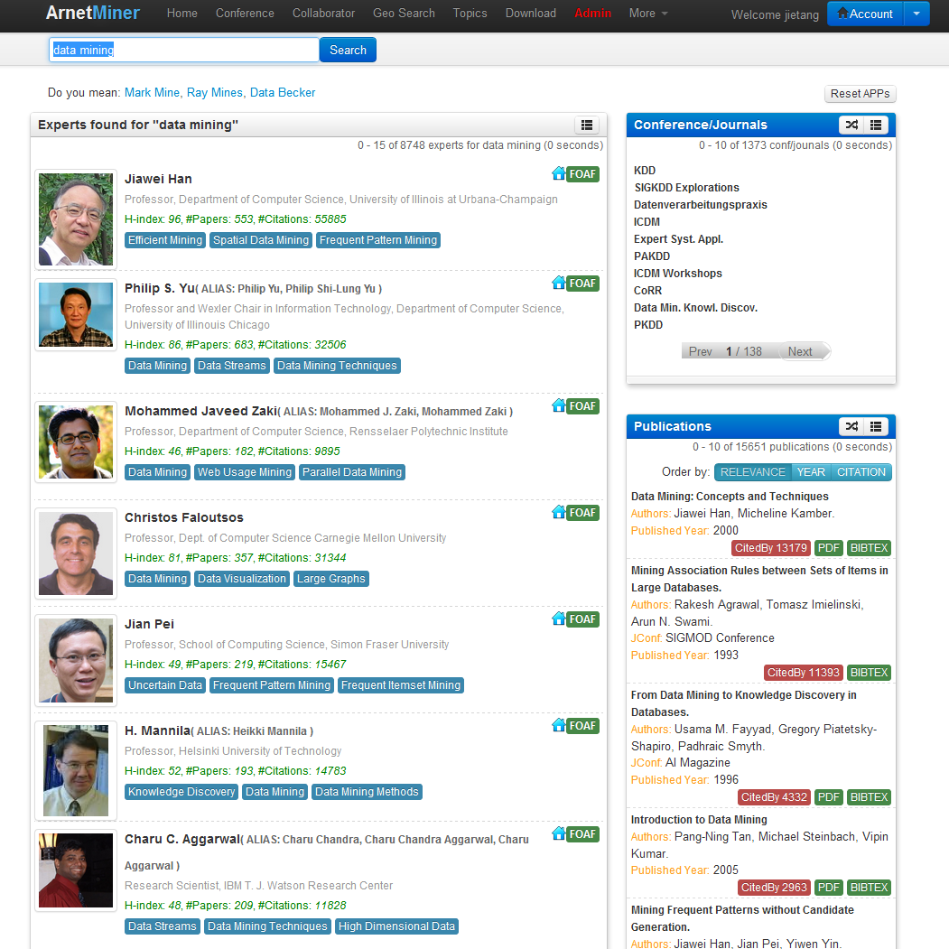
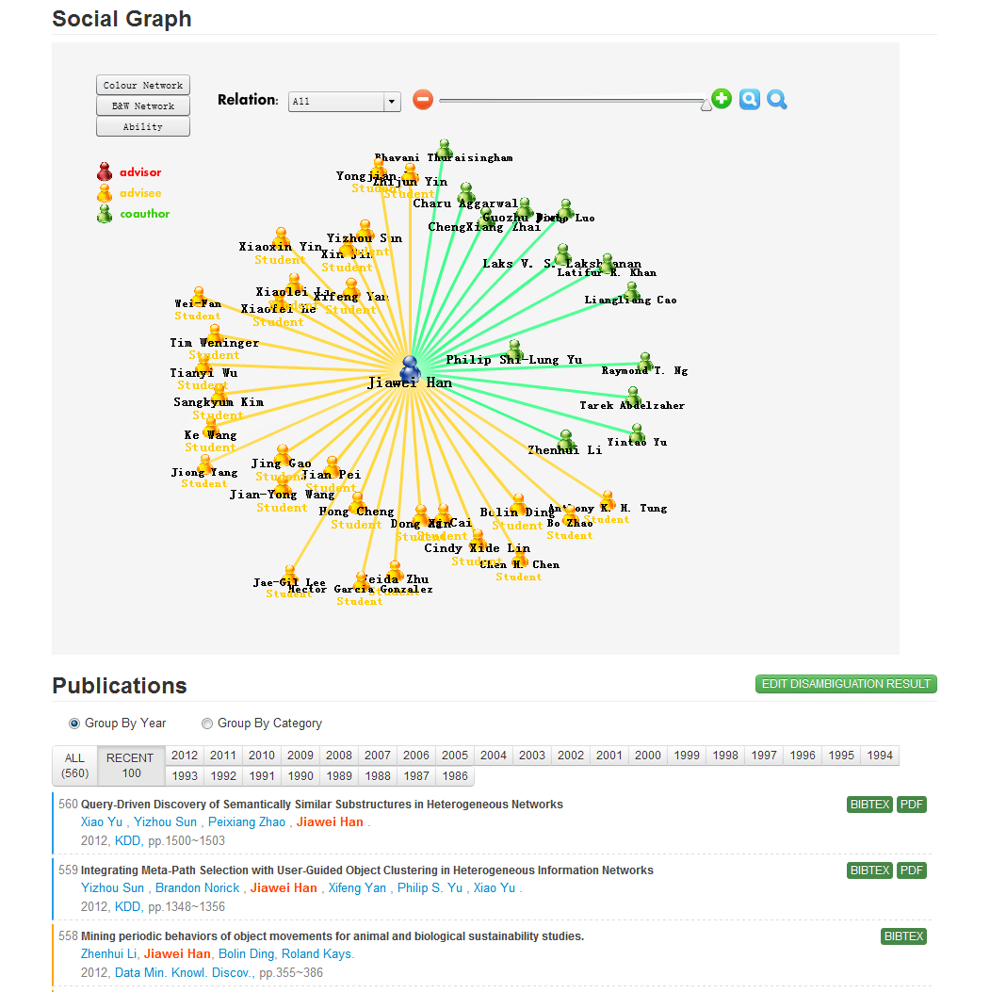
AMiner II (ArnetMiner)
Academic Social Network Analysis and Mining system—AMiner (http://aminer.org)
  Online since 2006
  >38 million researcher profiles
  >100 million publications
  >241 million requests
  >12.35 Terabyte data
  100K IP access from 170 countries per month
  10% increase of visits per month
Deep analysis, mining, and search
Notes:
。

Slide 3
Knowledge Acquisition from the Web
(ACM TKDD, WWW’12, ISWC’06, ICDM’07, ACL’07)
2
Contact Information
1
Educational history
1
Academic services
Publications
1
2
1
coauthor
Ruud Bolle
affiliation
UIUC
Publication #3
2
2
position
Professor
Publication #5
coauthor

Slide 4
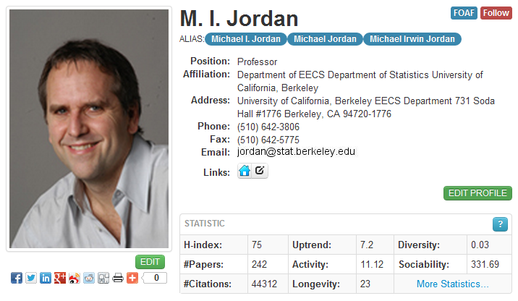
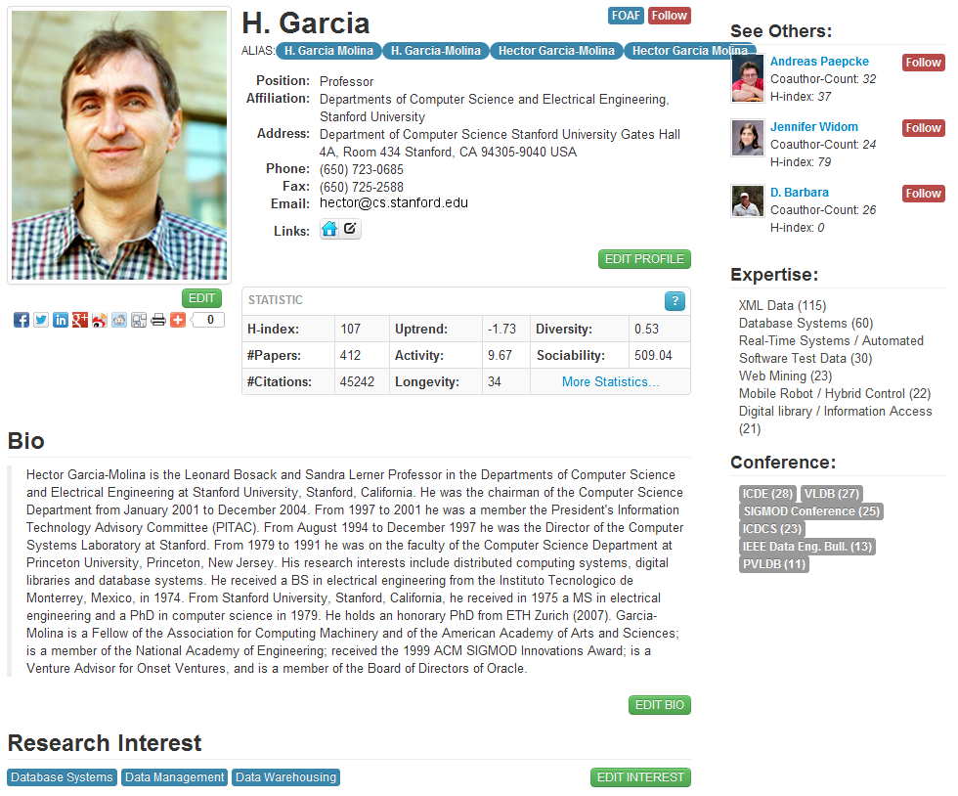
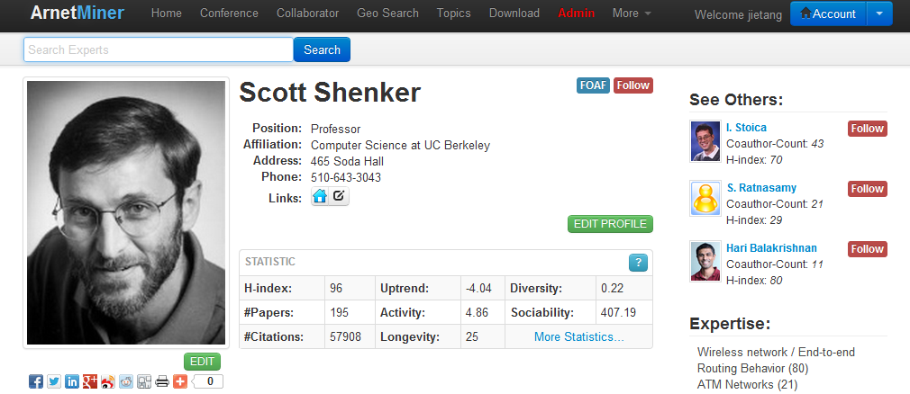
Researcher Profile Database^{[1]}
Extracted more than 1,000,000 researcher profiles from the Web
[1] J. Tang, L. Yao, D. Zhang, and J. Zhang. A Combination Approach to Web User Profiling. ACM Transactions on Knowledge Discovery from Data (TKDD), (vol. 5 no. 1), Article 2 (December 2010), 44 pages.

Slide 5
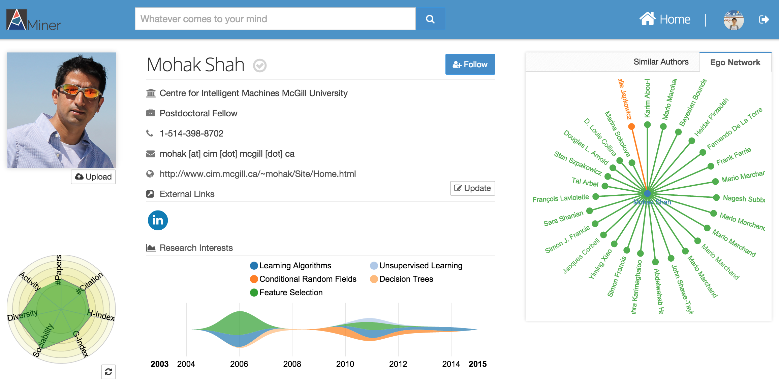
Is this Enough?

Slide 6
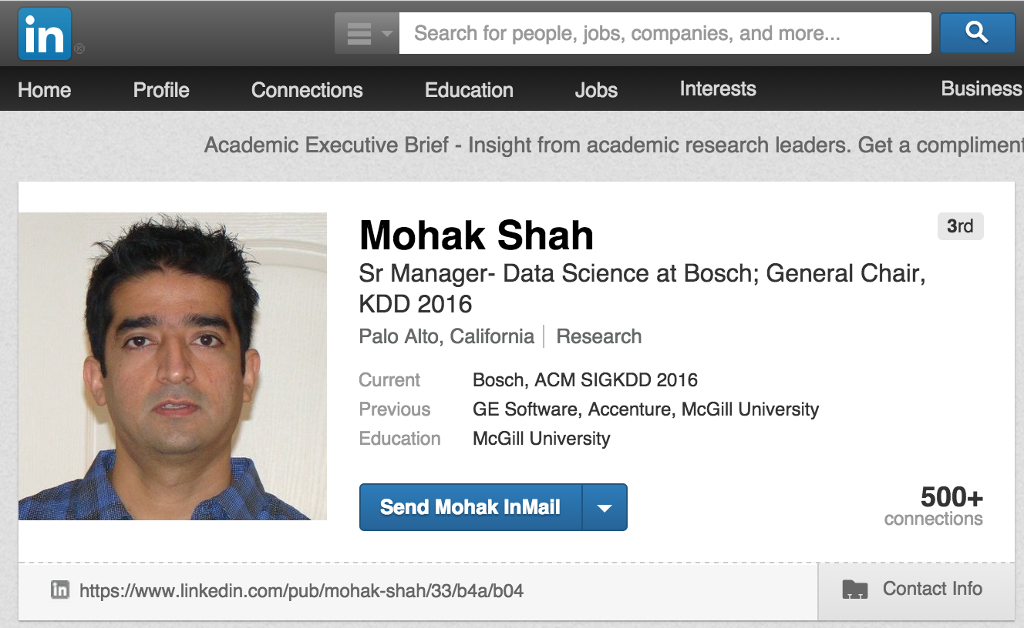
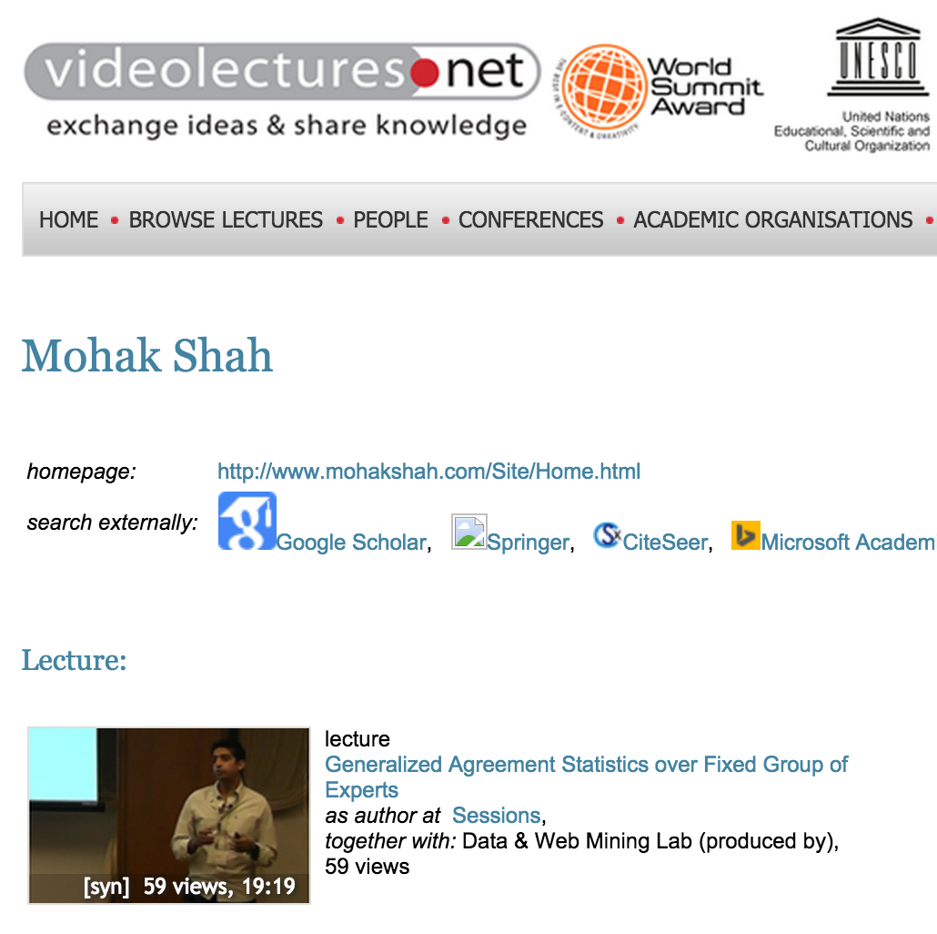

Required semantics are distributed in multiple sources
LinkedIn
Videolectures

Slide 7
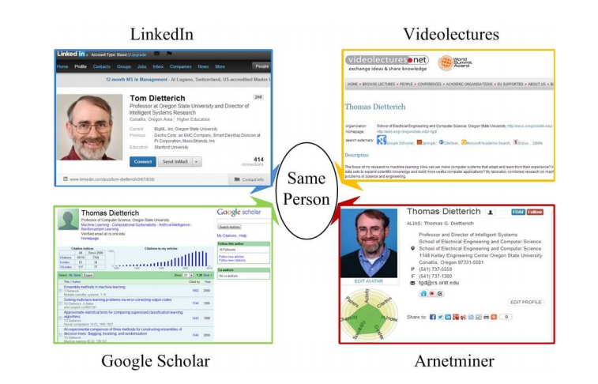
Identity Linking
Identifying users from multiple heterogeneous networks and integrating semantics from the different networks together.

Slide 8
COSNET: Connecting Social Networks with Local and Global Consistency
Input: G={G¹, G², …, G^{m}}, with G^{k}=(V^{k}, E^{k}, R^{k})
Formalization: X={x_{i}}, all possible pairwise matchings and each corresponds to
COSNET: an energy-based model
[1] Yutao Zhang, Jie Tang, Zhilin Yang, Jian Pei, and Philip Yu. COSNET: Connecting Heterogeneous Social Networks with Local and Global Consistency. KDD’15.

Slide 9
Local vs. Global consistency
Given three networks,

Slide 10
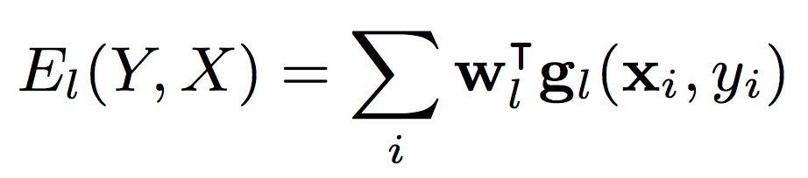
Local vs. Global consistency
Local matching: matching users by profiles
Pairwise similarity features
  Username similarity and uniqueness
  Profile content similarity
  Ego network similarity
  Social status
Local consistency
Energy function

Slide 11
Local vs. Global consistency
Network matching: matching users’ ego networks
Network matching
Local consistency
Encourage “neighborhood-preserving matching”

Slide 12
Local vs. Global consistency
Network matching: matching users’ ego networks
True
True
Network matching
Local consistency

Slide 13
Local vs. Global consistency
Network matching: matching users’ ego networks
True
True
Network matching
Local consistency
True
x
False

Slide 14
Local vs. Global consistency
Network matching: matching users’ ego networks
True
True
Network matching
Local consistency
True
x
False
False
x
x
False

Slide 15

Local vs. Global consistency
Network matching: matching users’ ego networks
True
True
Network matching
Local consistency
True
x
False
False
x
x
False

Slide 16
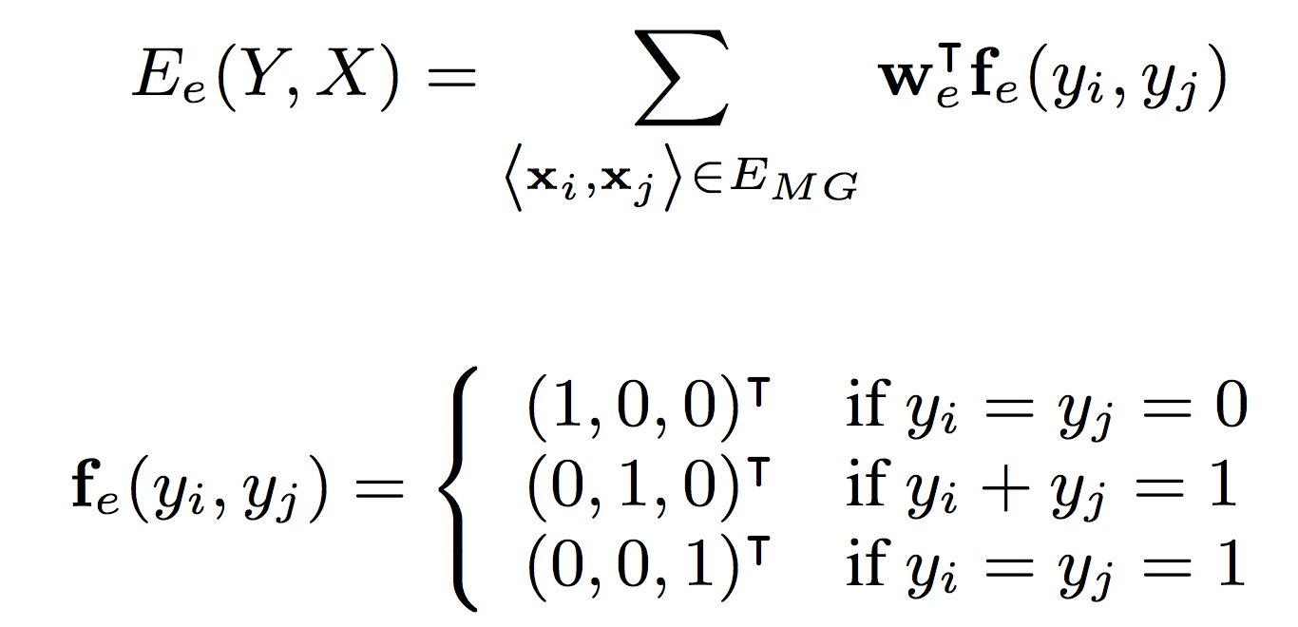
Network Matching
Network matching: matching users’ ego networks
Input networks
Matching graph
Energy function

Slide 17
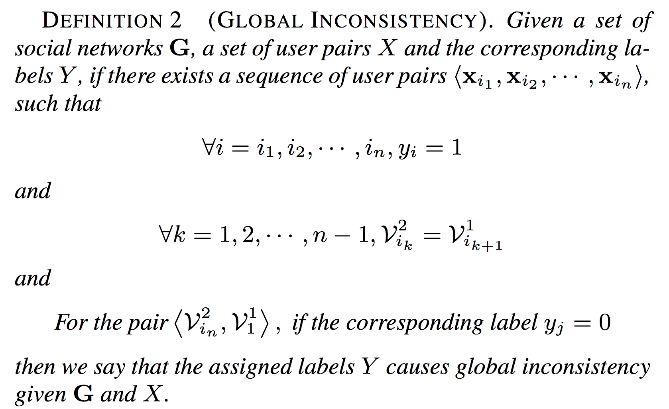
Local vs. Global consistency
Global consistency: matching users by avoiding global inconsistency
Network matching
Local consistency
Global inconsistency
Avoid “global inconsistency”

Slide 18
Local vs. Global consistency
Global consistency: matching users by avoiding global inconsistency
Network matching
Local consistency
x
Global inconsistency
x
x
x
x
x

Slide 19


Local vs. Global consistency
Global consistency: matching users by avoiding global inconsistency
Network matching
Local consistency
x
Inconsistent!
Global inconsistency
x
x
x
x
x

Slide 20
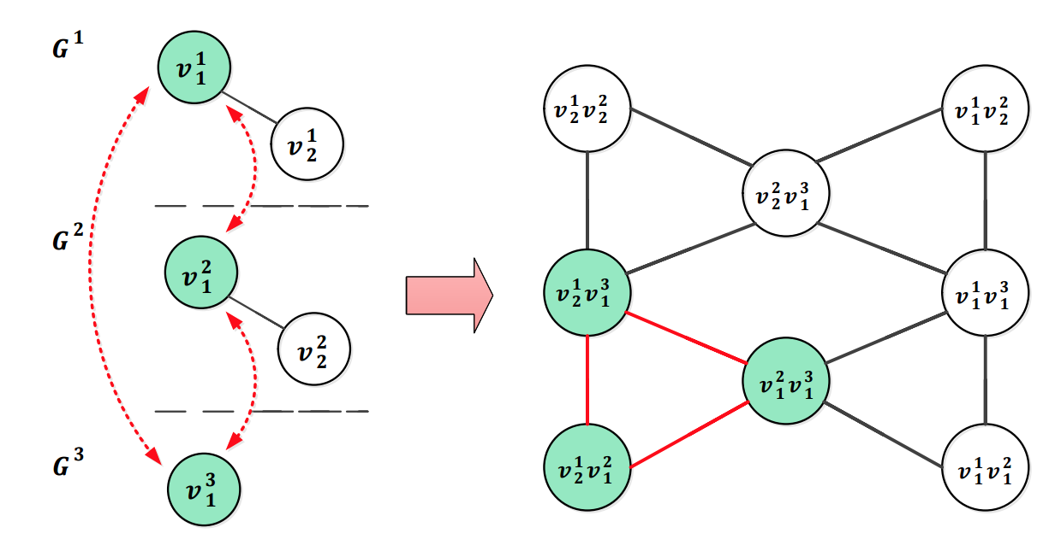
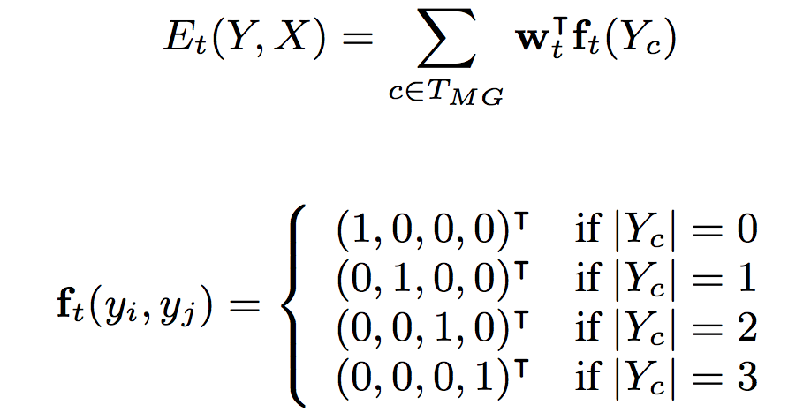
Avoid Global Inconsistency
Input networks
Matching graph
Energy function

Slide 21
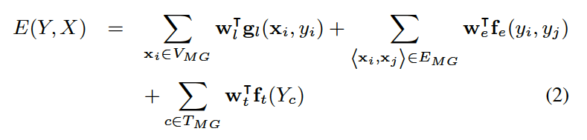
Model Construction
Objective function by combining all the energy functions

Slide 22
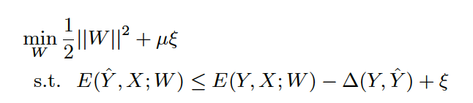
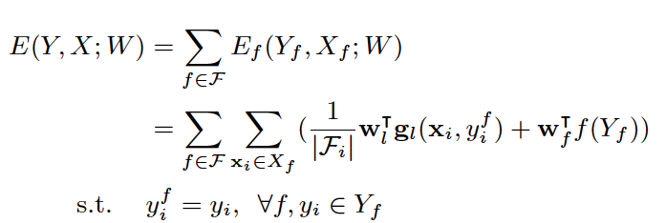
Model Learning
Max-margin learning
As the original problem is intractable, we use Lagrangian relaxation to decompose the original objective function into a set of easy-to-solve sub-problems

Slide 23
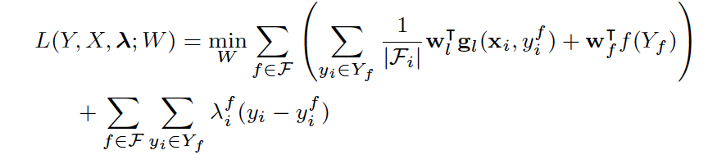
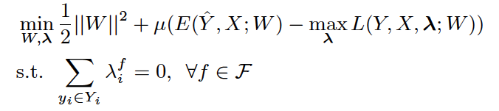
Model Learning (cont.)
Dual decomposition
This provides a lower bound to the original function
The resulting objective function is convex and non-differentiable, and can be solved by projected sub-gradient method

Slide 24
Results

Slide 25
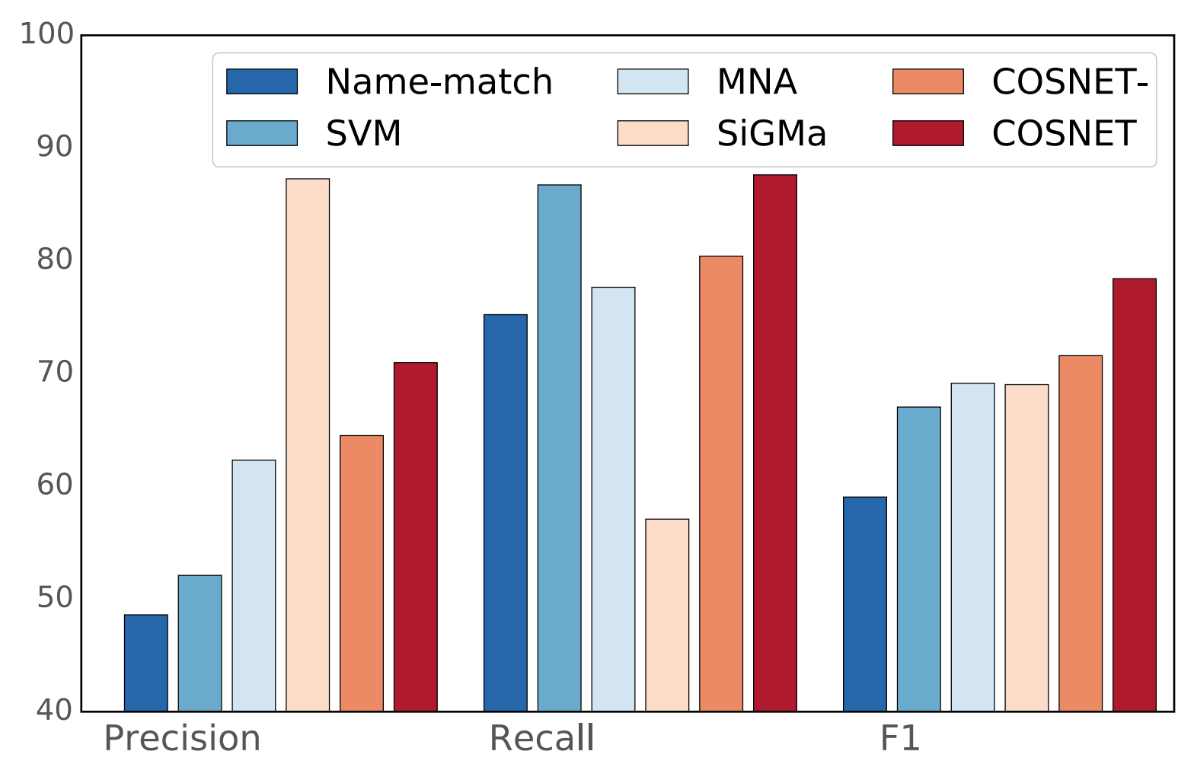
Connecting AMiner with …
LinkedIn and VideoLectures
Name-match: match name only;
SVM: use classifier to identify the same user;
MNA: an optimization method;
SiGMa: local propagation;
COSNET: our method;
COSNET-: w/o global consistency.

Slide 26
Connecting Social Media Sites
Twitter, LiveJournal, Last.fm, Flickr, MySpace
Name-match: match name only;
SVM: use classifier to identify the same user;
MNA: an optimization method;
SiGMa: local propagation;
COSNET: our method;
COSNET-: w/o global consistency.

Slide 27
Effects of Global Consistency
COSNET-: w/o global consistency.
Academia Collection
SNS Collection

Slide 28
Application in AMiner

Slide 29

Thanks!
  http://aminer.org
  Data & source code http://aminer.org/cosnet

