Slide 1




CoupledLP: Link Prediction in Coupled Networks
Yuxiao Dong#, Jing Zhang⁺, Jie Tang⁺, Nitesh V. Chawla#, Bai Wang*
#University of Notre Dame
⁺Tsinghua University
*Beijing University of Posts and Telecommunications

Slide 2





Mobile Networks
2015.08.08 10:30
2015.08.08 10:48
2015.08.08 11:01
2015.08.08 11:29
……
2016.01.01 00:00
……

Slide 3

Mobile Networks
2015.08.08 10:30
2015.08.08 10:48
2015.08.08 11:01
2015.08.08 11:29
……
2016.01.01 00:00
……

Slide 4
Disease-Gene Networks
Disease network
Cross network
Gene network
K.I. Goh, M. E. Cusick, D. Valle, B. Childs, M. Vidal, and A.-L. Barabási. The human disease network. PNAS 2007.
D. Davis, N. V. Chawla. Exploring and Exploiting Disease Interactions from Multi-Relational Gene and Phenotype Networks. PLoS One 2011.
J. Menche, A. Sharma, M. Kitsak, S. D. Ghiassian, M. Vidal, J. Loscalzo, A.-L. Barabási. Uncovering disease-disease relationships through the incomplete interactome. Science 2015.

Slide 5
Coupled Networks
Given a source network G^{S} = (V^{S}, E^{S}) and a target network G^{T} = (V^{T}, E^{T}), they compose coupled networks if there exists a cross link e_{ij} with one node v_{i} ∈ V^{S} and the other node v_{j} ∈ V^{T}. The cross network G^{C} = (V^{C}, E^{C}) is a bipartite network containing all the cross links in the coupled networks.
Source network
Cross network
Target network
Coupled networks

Slide 6
Coupled Link Prediction
Given the source network G^{S} and the cross network G^{C} in coupled networks G = (G^{S}, G^{T}, G^{C}), the task is to find a predictive function:
f : (G^{S}, G^{C}) → Y^{T}
where Y^{T} is the set of labels for the potential links in the target network G^{T}.
Source network
Cross network
Target network
Input
Output

Slide 7
Challenges
Source network
Cross network
Target network
Heterogeneity
Incompleteness
Asymmetry
Input
Output

Slide 8
Related Work: Traditional Link Prediction
t₁
t₂
A
B
A
B
C
D
C
D
E
E
F
F
G
G
Input
Output
1. D. Liben-Nowell and J. Kleinberg. The link prediction problem for social networks. CIKM’03.

Slide 9
Related Work: Heterogeneous Link Prediction
Input
Output
1. Y. Sun, J. Han, C. C. Aggarwal, N. V. Chawla. Will Will This Happen? Relationship Prediction in Heterogeneous Information Networks. WSDM’12.

Slide 10
Related Work: Transfer Link Prediction
Source network
Target network
Input
Output
Y. Dong, J. Tang, S. Wu, J. Tian, N. V. Chawla. J. Rao, H. Cao. Link Prediction and Recommendation across Heterogeneous Networks. ICDM’12
J. Tang, T. Lou, J. Kleinberg, S. Wu. Transfer Link Prediction across Heterogeneous Networks. TOIS 2015.

Slide 11
Related Work: Cross-Domain Link Prediction
Source network
Target network
Cross network
Input
Output
1. J. Tang, S. Wu, J. Sun, H. Su. Cross-Domain Collaboration Recommendation. KDD’12.

Slide 12
Related Work: Anchor Link Prediction
A network
B network
Self-linkage network
Input
Output
X. Kong, J. Zhang, P. S. Yu. Inferring anchor links across multiple heterogeneous social networks. CIKM’13.
Y. Zhang, J. Tang, Z. Yang, J. Pei, and P. S. Yu. COSNET: Connecting Heterogeneous Social Networks with Local and Global Consistency. KDD’15.

Slide 13
Challenges
Source network
Cross network
Target network
Heterogeneity
Incompleteness
Asymmetry
Input
Output

Slide 14
CoupledLP Framework
1. Implicit Target Network Construction
    Solve Incompleteness
2. Coupled Factor Graph Model
    Solve Asymmetry
    Solve Heterogeneity

Slide 15
CoupledLP Framework
Incompleteness
Source network
Cross network
Target network
87%
99%
80%
75%
Input
Output
Implicit Target Network Construction
1. V. Leroy, B. B. Cambazoglu, and F. Bonchi. Cold start link prediction. In KDD ’10.

Slide 16
CoupledLP: Implicit Target Network
Atomic Propagations for constructing an implicit target network
Direct
Coupling
Co-citation
MM
+
MM^{T}
+
M^{T}M
top z%
1. R. Guha, R. Kumar, P. Raghavan, and A. Tomkins. Propagation of trust and distrust. In WWW ’04

Slide 17
CoupledLP Framework
Asymmetry
Heterogeneity
Source network
Cross network
Target network
87%
99%
80%
75%
Input
Output
Coupled Factor Graph

Slide 18
Basic Idea
Input Network
Factor Graph
v₆
y₁₂
v₅
v₁
v₂
v₃
y₂₃
y₃₄
v₄
F. R. Kschischang, B. J. Frey, and H. andrea Loeliger. Factor graphs and the sum-product algorithm. In IEEE TOIT 2001.
Jie Tang, Tiancheng Lou, and Jon Kleinberg. Inferring social ties across heterogeneous networks. In WSDM '12

Slide 19
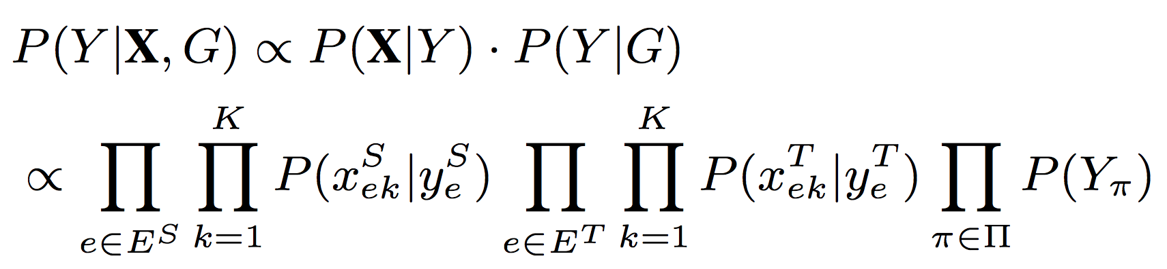
CoupledLP: Coupled Factor Graph

Slide 20
CoupledLP: Coupled Factor Graph
Attribute Factor
Asymmetry
model source and target network separately
meta-path
1. Jie Tang, Tiancheng Lou, and Jon Kleinberg. Inferring social ties across heterogeneous networks. In WSDM '12.

Slide 21
CoupledLP: Coupled Factor Graph
Meta-path Factor
Asymmetry
Heterogeneity
model source and target network separately
meta-path
1. Jie Tang, Tiancheng Lou, and Jon Kleinberg. Inferring social ties across heterogeneous networks. In WSDM '12.

Slide 22

CoupledLP: Coupled Factor Graph
?
disease
……
express
express⁻¹
gene
gene
associate
express
disease
disease
express⁻¹
gene
gene
?
meta-path
Y. Sun, J. Han, C. C. Aggarwal, N. V. Chawla. Will Will This Happen? Relationship Prediction in Heterogeneous Information Networks. In WSDM’12.

Slide 23
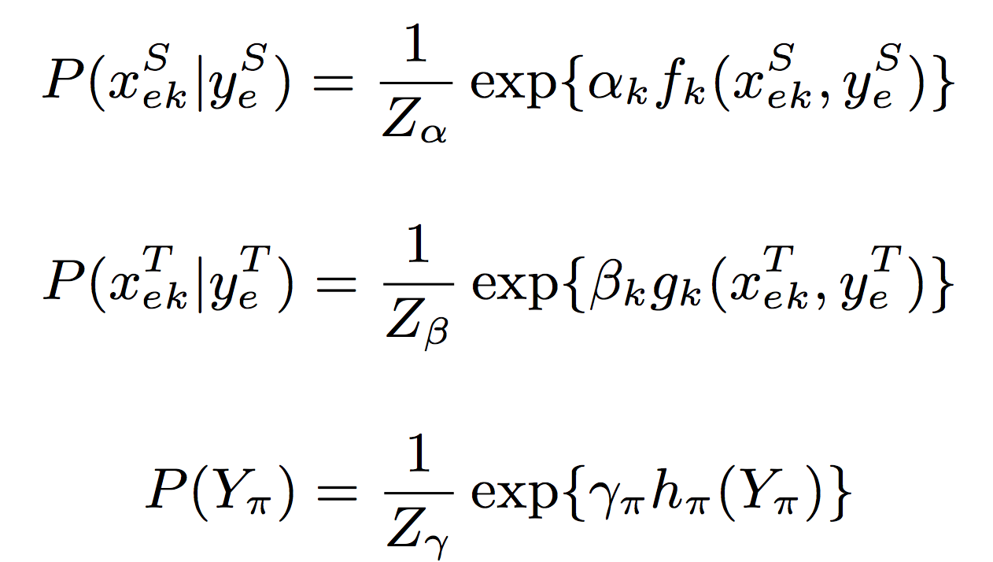
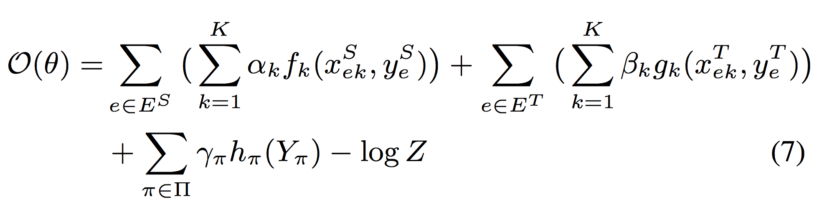
CoupledLP: Coupled Factor Graph
Factor Initialization: exponential-linear
Objective Function:
model source & target network separately
meta-path
bridge source & target networks

Slide 24
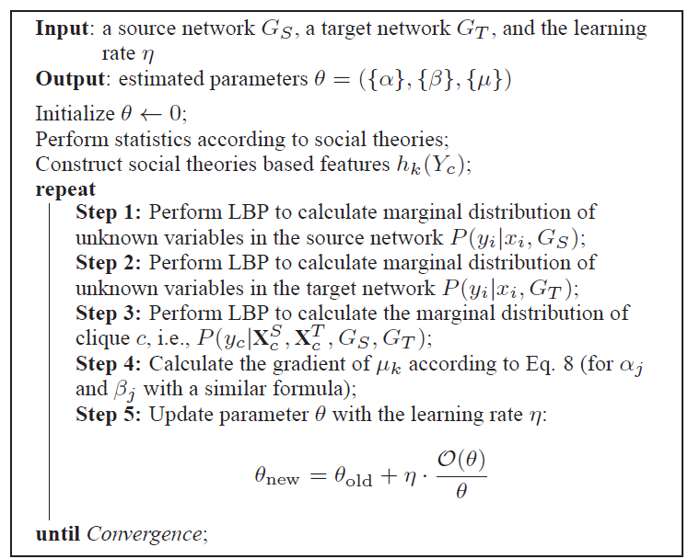
CoupledLP: Coupled Factor Graph
Learning: Gradient Decent method
1. Jie Tang, Tiancheng Lou, and Jon Kleinberg. Inferring social ties across heterogeneous networks. In WSDM '12.

Slide 25
CoupledLP Framework
1. Implicit Target Network Construction
    Solve Incompleteness
2. Coupled Factor Graph Model
    Solve Asymmetry
    Solve Heterogeneity

Slide 26
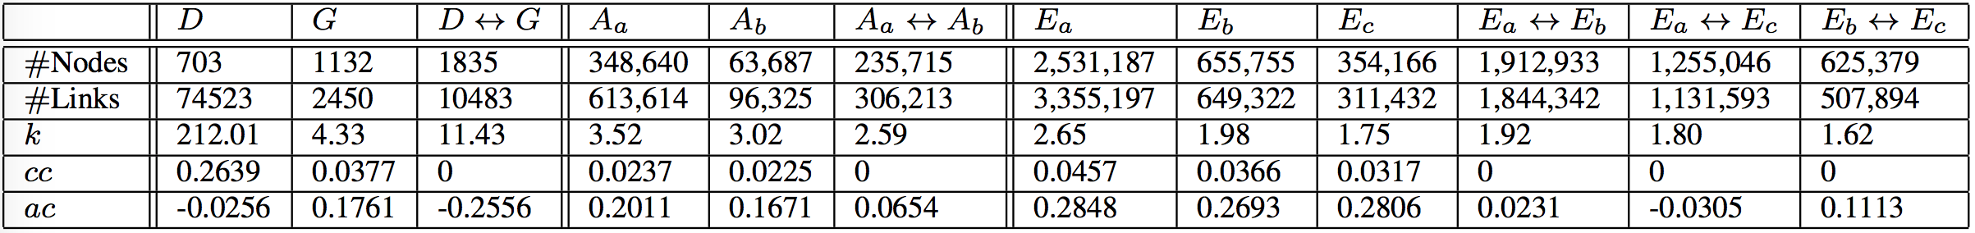
Experiments: Data
k: average degree; cc: clustering coefficient; ac: associative coefficient
Healthcare Networks
Disease (D)---Gene (G)
D. Davis, N. V. Chawla. Exploring and Exploiting Disease Interactions from Multi-Relational Gene and Phenotype Networks. PLoS One 2011.
N. Du, C. Faloutsos, B. Wang, and L. Akoglu. Large human communication networks: patterns and a utility-driven generator. In KDD ’09.
Y. Dong, Y. Yang, J. Tang, Y. Yang, and N. V. Chawla. Inferring user demographics and social strategies in mobile social networks. In KDD’14.

Slide 27
Experiments: Data
k: average degree; cc: clustering coefficient; ac: associative coefficient
Healthcare Networks
Disease (D)---Gene (G)
Mobile Phone Call Networks
Two Operators: Aa---Ab
D. Davis, N. V. Chawla. Exploring and Exploiting Disease Interactions from Multi-Relational Gene and Phenotype Networks. PLoS One 2011.
N. Du, C. Faloutsos, B. Wang, and L. Akoglu. Large human communication networks: patterns and a utility-driven generator. In KDD ’09.
Y. Dong, Y. Yang, J. Tang, Y. Yang, and N. V. Chawla. Inferring user demographics and social strategies in mobile social networks. In KDD’14.

Slide 28

Experiments: Data
k: average degree; cc: clustering coefficient; ac: associative coefficient
Healthcare Networks
Disease (D)---Gene (G)
Mobile Phone Call Networks
Two Operators: Aa---Ab
Mobile Phone Call Networks
Three Operators: Ea---Eb---Ec
D. Davis, N. V. Chawla. Exploring and Exploiting Disease Interactions from Multi-Relational Gene and Phenotype Networks. PLoS One 2011.
N. Du, C. Faloutsos, B. Wang, and L. Akoglu. Large human communication networks: patterns and a utility-driven generator. In KDD ’09.
Y. Dong, Y. Yang, J. Tang, Y. Yang, and N. V. Chawla. Inferring user demographics and social strategies in mobile social networks. In KDD’14.

Slide 29
Experiments: Data
k: average degree; cc: clustering coefficient; ac: associative coefficient
Asymmetry
Heterogeneity

Slide 30
Experiments: Coupled Networks
1
2
3
4
5
6
7
8
9
10
10 Coupled Prediction Cases

Slide 31
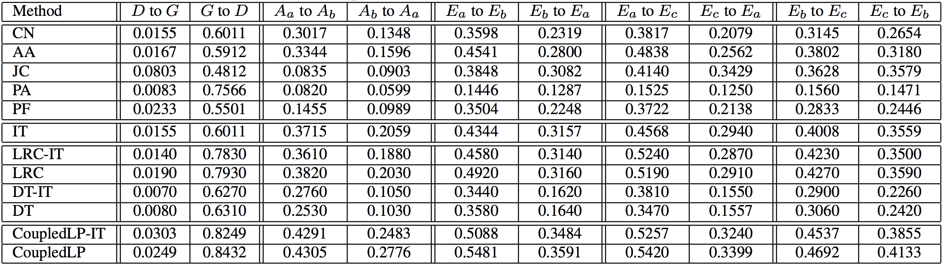
Experiments
AUPR or AUROC or Precision @ k
10 Coupled Prediction Cases

Slide 32
Baselines
AUPR or AUROC or Precision @ k
    Unsupervised Methods:
        Common Neighbors (CN)
        Adamic Adar (AA)
        Jaccard Coefficient (JC)
        Preferential Attachment (PA)
        PropFlow (PF)
        Implicit Target Network (IT)
    Supervised Methods:
        Logistic Regression (LRC)
          LRC-IT
        Decision Tree (DT)
          DT-IT
        CoupledLP
          CoupledLP-IT
features
LRC-IT, DT-IT, CoupledLP-IT: NO Implicit Target network construction
R. N. Lichtenwalter, J. T. Lussier, and N. V. Chawla. New perspectives and methods in link prediction. In KDD ’10.
L. Backstrom and J. Leskovec. Supervised random walks: predicting and recommending links in social networks. In WSDM’11.

Slide 33
Experiments
AUPR or AUROC or Precision @ k
    Training Links:
        source links between nodes with cross links
        1% target links
    Test Links:
        99% target links

Slide 34
Evaluation Metrics
AUPR or AUROC or Precision @ k
    Area Under Precision Recall Curve (AUPR)
    Area Under Receiver Operating Characteristic Curve (AUROC)
    Precision at Top k
R. N. Lichtenwalter, J. T. Lussier, and N. V. Chawla. New perspectives and methods in link prediction. In KDD ’10.
L. Backstrom and J. Leskovec. Supervised random walks: predicting and recommending links in social networks. In WSDM’11.

Slide 35
AUPR Results
AUPR

Slide 36
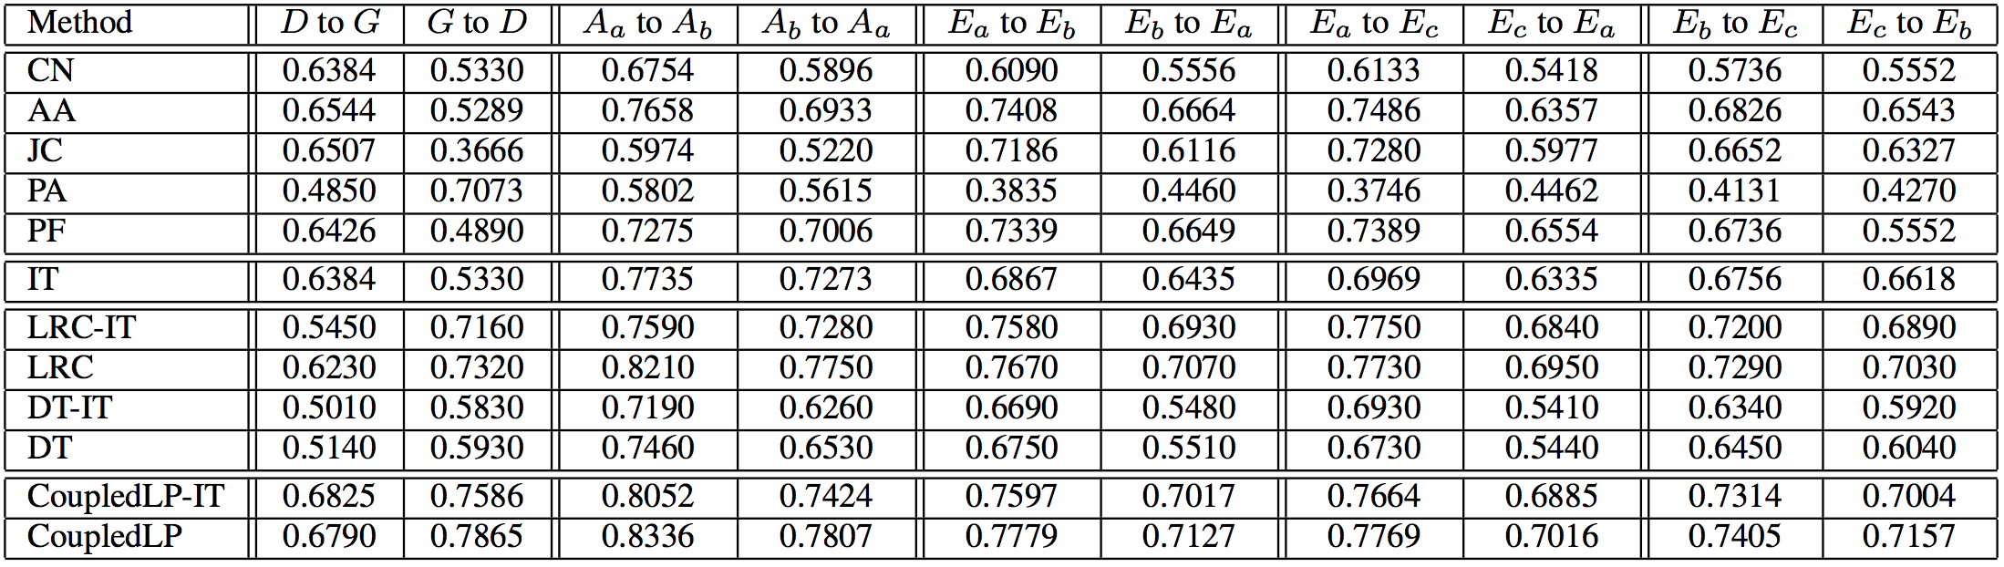
AUROC Results
AUROC

Slide 37
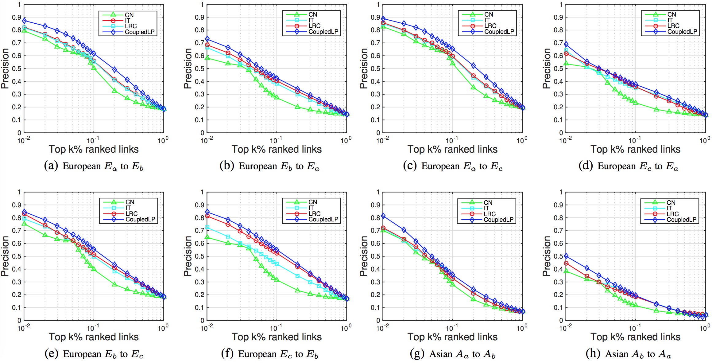
Precision@k Results
Precision @ k

Slide 38
Effects of Implicit Target Network
AUPR

Slide 39
Effects of Implicit Target Network
AUPR

Slide 40
Future Work
1. Efficiency of CoupledLP
2. One-step prediction framework
3. User behavior in coupled networks
… …

Slide 41
Conclusion
Coupled Link Prediction Problem
Source network
Cross network
Target network
Input
Output
CoupledLP Framework
Implicit Target Network Construction
    Solve Incompleteness
Coupled Factor Graph Model
    Solve Asymmetry
    Solve Heterogeneity

Slide 42
Questions
Thank You!
Data & Code:
https://aminer.org/coupledlp

Slide 43
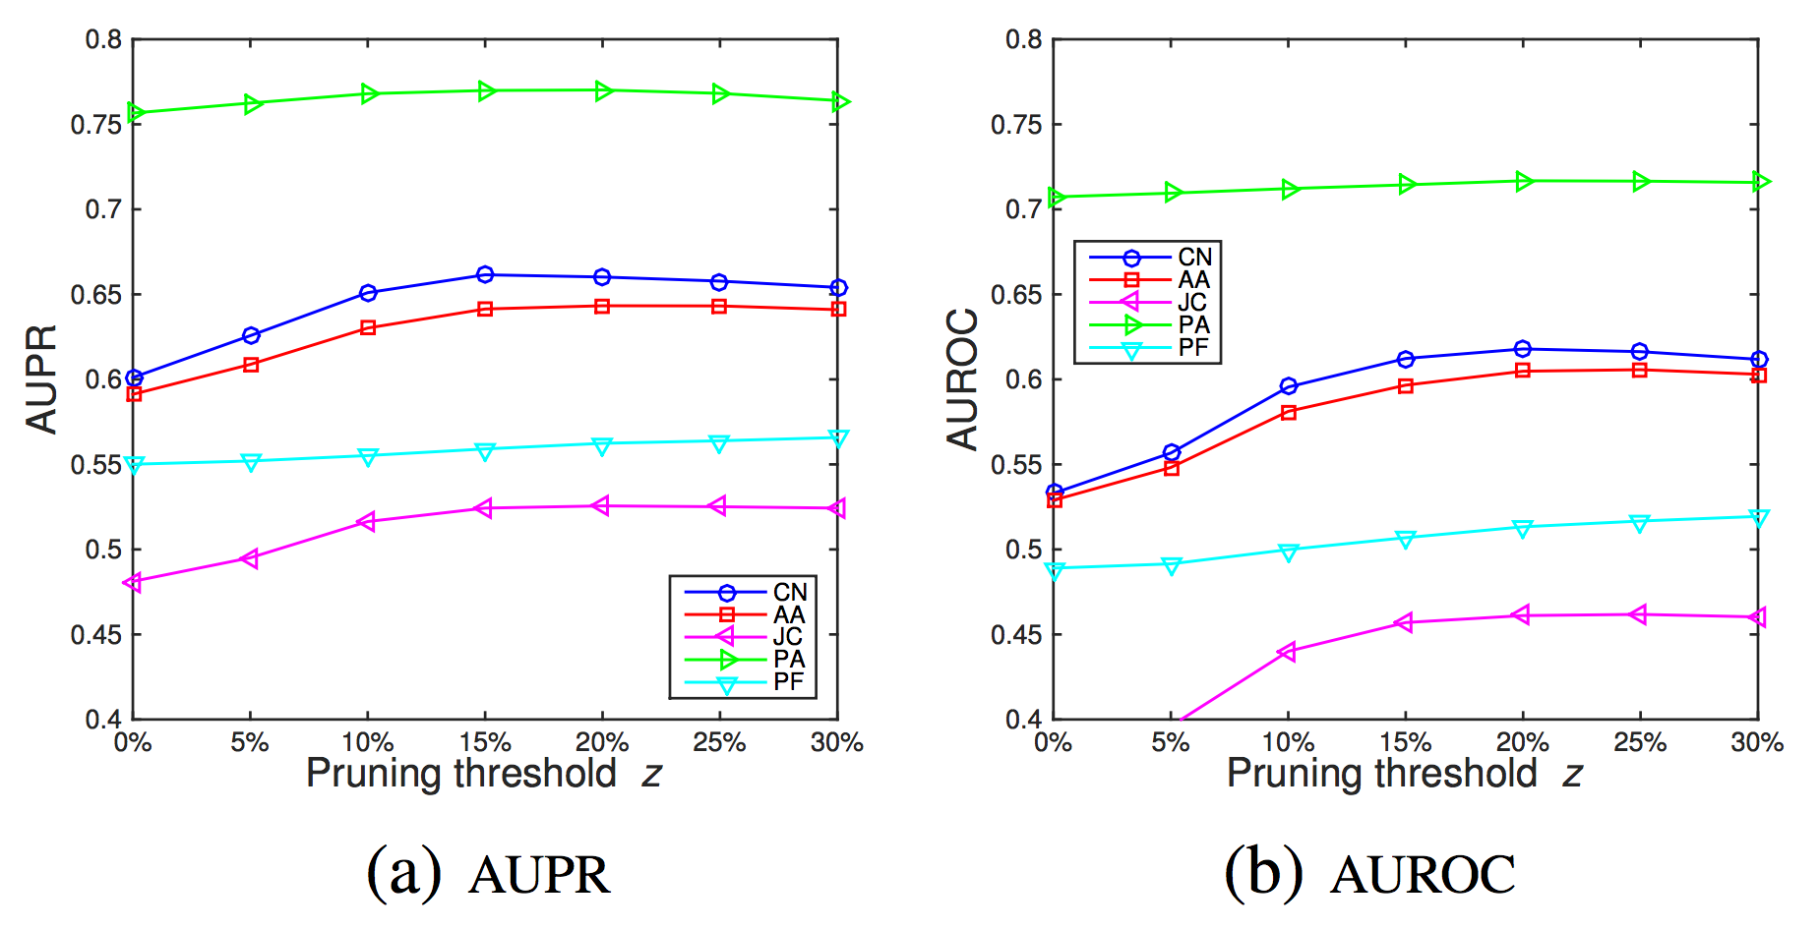
Effects of Implicit Target Network
+5% AUPR
+8% AUROC
x-axis: pruning threshold z
y-axis: AUPR / AUROC
Unsupervised methods on implicit target network

