Slide 1



Entity Matching across Heterogeneous Sources
Yang Yang*, Yizhou Sun⁺, Jie Tang*, Bo Ma#, and Juanzi Li*
*Tsinghua University
⁺Northeastern University
#Carnegie Mellon University
Data&Code available at: http://arnetminer.org/document-match/
Notes:
The title of this talk is
20s

Slide 2
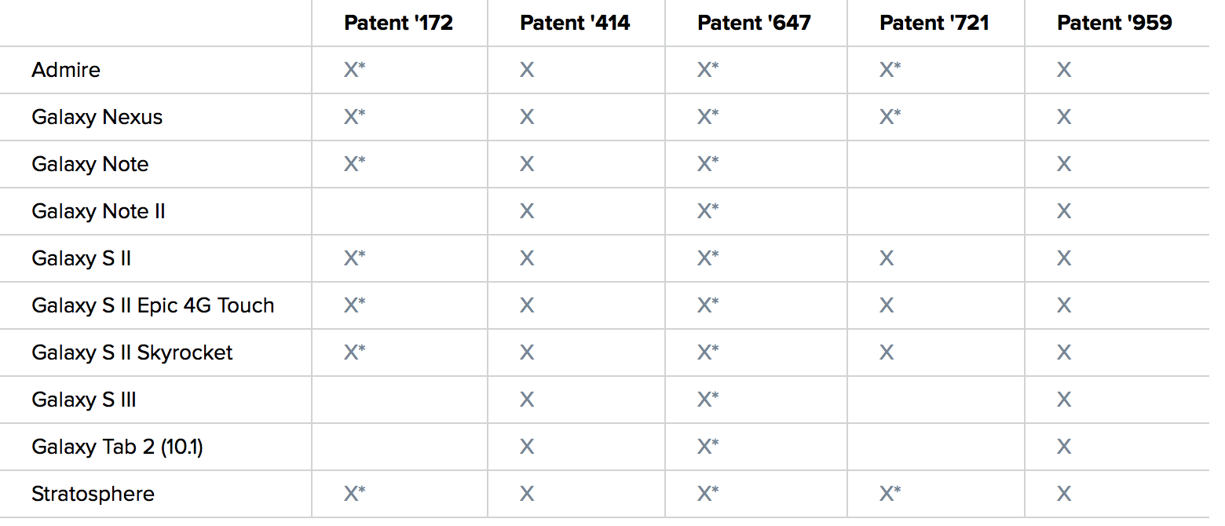
Apple Inc. VS Samsung Co.
A patent infringement suit starts from 2012.
  Lasts 2 years, involves $158+ million and 10 countries.
  7 / 35546 patents are involved.
Apple’s patent
How to find patents relevant
to a specific product?
SAMSUNG devices accused by APPLE.
Notes:
Three years ago, there was a patent infringement lawsuit between Apple and Samsung.
Both companies claims their patents were infringed by the other’s products.
The lawsuit lasted over 2 years, involved over 158 million us dollars and 10 countries.
At that time, there were over 35 thousand of patents held by the two companies in total. Among which 7 patents were involved in the lawsuit.
This famous lawsuit suggests an important problem: how to find patents relevant to a specific product? Among the 35 thousand of patents, which ones are relevant to iphone or samsung galaxy?
60s
Both companies claimed their own patents were infringed by some of the other’s products.

Slide 3
Cross-Source Entity Matching
Given an entity in a source domain, we aim to find its matched entities from target domain.
  Product-patent matching;
  Cross-lingual matching;
  Drug-disease matching.
Product-Patent matching
Notes:
The problem can be generalized as a cross-source entity matching problem.
Given an entity in a source domain, finding its matched entities from another (target) domain.
It is an important task in many applications.
For example, a patent expert may be interested in finding related patents in a patent database for a product;
Given an English Wiki page, a user may be interested in finding related Chinese Wiki pages;
and a doctor may be interested in finding all related drugs for a specific disease.

Slide 4
Problem
C₁
C₂
Input 1: Dual source corpus
{C₁, C₂}, where C_{t}={d₁, d₂, …, d_{n}} is a collection of entities
Input 2: Matching relation matrix
L_{ij}=
1, d_{i} and d_{j} are matched
0, not matched
?, unknown
Notes:
There are two parts of the input data.
The first part is a dual source corpus, which consists of entities from each source. For instance, in product-patent matching, one source would be Wikipedia, which provide the descriptions of products, and another source is a patent database. Each entity is represented by a bag of words.
The second part of the input data is a matching relation matrix, which represents the matching status between entities in the dual source corpus.
If di and dj are matched, lij = 1, otherwise it=-1. and there are also some missing links we need to infer.
So given a dual source corpus and a matching relation matrix with missing values, our goal is to infer the missing values in the matrix.

Slide 5
Challenges
1
Two domains have less or no overlapping in content
Daily expression
vs
Professional expression
Notes:
Different from traditional entity matching tasks, one key challenge of such problem is that the documents from different sources may have less or event no overlapping in content. They may use rather different terminologies when describing the same topic. For example, the terms used to describe Siri, are quite different in Wikipedia and patents.
As the figure shows, the Siri Wiki article uses more daily expressions to describe Siri (e.g., “voice control,” “personal assistant,” “iPhone,” etc.) , in order to make it easier to understand by everyone.
However, more professional and technical terms are used in patents (e.g., “information retrieval,” “heuristic modules,” “computer-readable medium,” etc.).
The descriptions of two related entities from different sources can be very dissimilar in terms of their text similarity, thus the traditional text-based search can no longer solve the problem.

Slide 6
Challenges
1
Two domains have less or no overlapping in content
???
2
How to model the topic-level relevance probability
Notes:
In addition, it would be interesting to know on which topic the target entity is relevant to the source entity.
For example, the patent “Method for improving voice recognition” is talking about “voice control” and its relevance probability to the source Wiki article on this topic is 0.83.
The relevance probability of the second patent is 0.54 but on topic “ranking”.
The second challenge is how to model the topic-level relevance probability.
4’25

Slide 7
Our Approach
Cross-Source Topic Model
Notes:
To address these two challenges, we propose the cross-source topic model.

Slide 8

Baseline
Topic extraction
query
Little-overlapping content
-> disjoint topic space
Rank
Ranking candidates by topic similarity
Notes:
Intuitively, two entities are matched with each other if they refer to the same topic.
%So topic extraction will help us infer the connection between entities.
A straight forward method here is first extract latent topics by traditional topic models like lda.
We then calculates the similarity between a wiki article and a patent based on their topics distribution.
We can use cosine similarity or a random walk with restart framework for measuring the similarity.
However, as we mentioned before, the terminologies used in different sources are quite different.
In this situation, traditional topic models would fail to identify the same topic frame two sources but separate the topic into two or more.
On the other words, the topic space of different sources will be disjoint.

Slide 9
Cross-Sampling
Bridge topic space by leveraging known matching relations.
d_{n} is matched with d’_{m}
How latent topics influence matching relations?
If C=1, sample topics according to d_{n}’s topic distribution
If C=0, sample topics according to the topic distribution of d’_{m}
Toss a coin C
Notes:
To address the issue, we propose the cross-sampling process, which is an important concept in our approach.
Generally, cross sampling aims to leverage known matching relations between entities to bridge the topics from different sources. %and model the cross-source topics.
Specifically, suppose we have already know that dn from source 1 is matched with dm from source 2.
And we are generating topics for a word w of dn.
Traditional topic models will sample topics according to dn's topic distribution, while in cross-sampling, we first toss a coin according to a binomial distribution. If the coin heads up, we sample the topics according to dn's topic distribution, just like traditional ways. Otherwise, we sample w's topics according to the topic distribution of dn's matching entity, which is dm.
By cross sampling, w's topic distribution depends on both dn and dm.
And it bridges the topics in source 2 to the entity in source 1.
%In cross sampling, we consider how the known matching relations influence the latent topics.
How can we leverage the extracted topics to match entities between different entities?
However, the topic extraction and entity matching are separated.
How can we put theses two component into a uniform framework and let them influence each other?

Slide 10
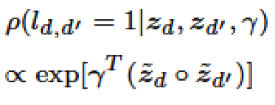
Inferring Matching Relation
Infer matching relations by leveraging extracted topics.
Notes:
We model the matching relations as a binary variable and assume that entities with similar topic distributions tend to be matched with a higher probability.
Specifically, for two entities, we define their matching probability to be proportional to the Hadamard product of the two entities' topic appearance.
In this definition, when two entities' topics are close, their matching probability increases exponentially.

Slide 11
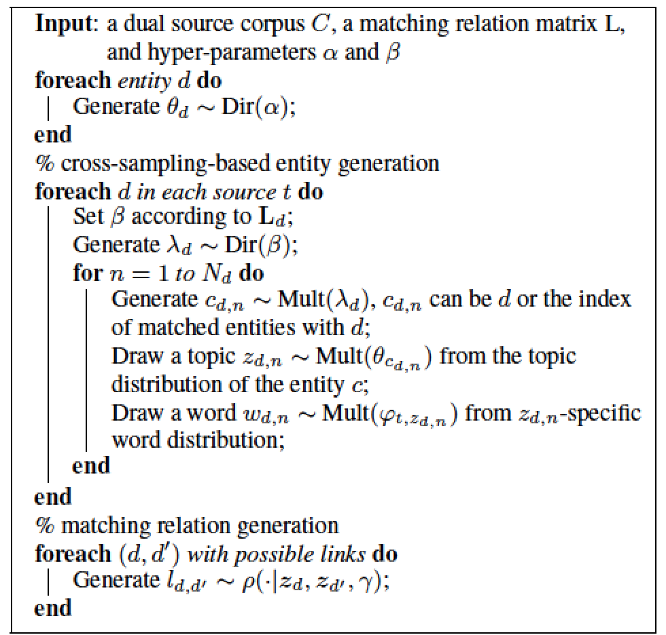
Cross-Source Topic Model
Step 1:
Step 2:
Latent topics
Matching relations
Notes:
This is the whole picture of the proposed model.
As we introduced previously, it contains two parts, the cross-sampling based entity generation, which leverages known relations to extract cross-source topics, and another part is matching relation generation, which utilizes the topics to infer unknown matching relations.
Overall, our model considers how the matching relations and latent topics influence each other.
%For easy to understand, this part can be regarded as a logistic regression, which uses Hadamard production of the appearance of each topic in two documents as input.

Slide 12
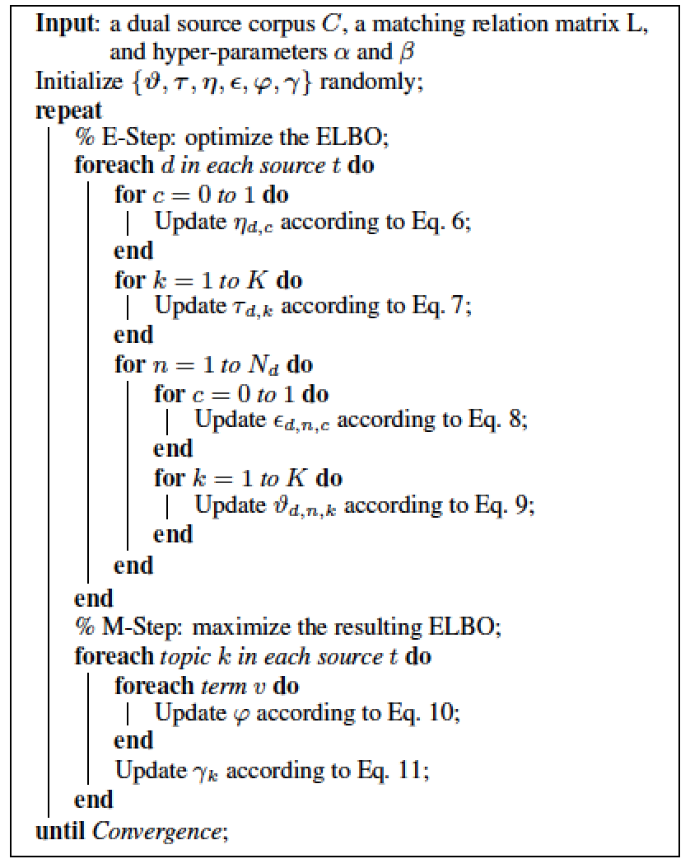


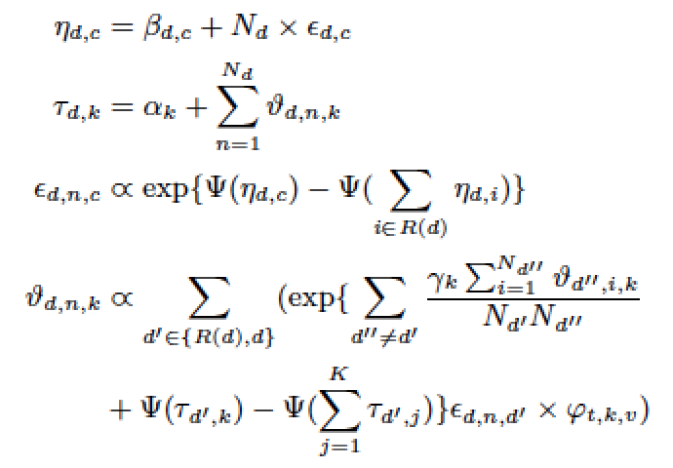
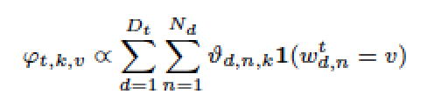
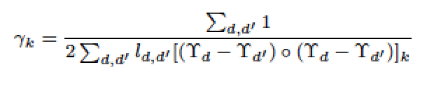
Model Learning
Variational EM
  Model parameters:
  Variational parameters:
  E-step:
  M-step:
Notes:
We employ variational EM for model learning.
At E-step we optimize the evidence lower bound by fixing model parameters and update variational parameters.
At M-step we update model parameters.
5’30

Slide 13
Experiments
Task I: Product-patent matching
Task II: Cross-lingual matching

Slide 14
Task I: Product-Patent Matching
Given a Wiki article describing a product, finding all patents relevant to the product.
Data set:
  13,085 Wiki articles;
  15,000 patents from USPTO;
  1,060 matching relations in total.
Notes:
233 queries and find 1,060 matching relations in total.

Slide 15
Experimental Results
Training: 30% of the matching relations randomly chosen.
Method | P@3 | P@20 | MAP | R@3 | R#20 | MRR
CS+LDA | 0.111 | 0.083 | 0.109 | 0.011 | 0.046 | 0.053
RW+LDA | 0.111 | 0.117 | 0.123 | 0.033 | 0.233 | 0.429
RTM | 0.501 | 0.233 | 0.416 | 0.057 | 0.141 | 0.171
RW+CST | 0.667 | 0.167 | 0.341 | 0.200 | 0.333 | 0.668
CST | 0.667 | 0.250 | 0.445 | 0.171 | 0.457 | 0.683
  Content Similarity based on LDA (CS+LDA): cosine similarity between two entities’ topic distribution extracted by LDA.
  Random Walk based on LDA (RW+LDA): random walk on a graph where edges indicate the hyperlinks between Wiki articles and citations between patents.
  Relational Topic Model (RTM): used to model links between documents.
  Random Walk based on CST (RW+CST): uses CST instead of LDA comparing with RW+LDA.
Notes:
We compare our method with four baselines. The first method calculates the similarity between a Wiki article and a patent based on their topic distribution calculated by LDA. Given a query, which is an entity from source domain, it ranks entities from target domain according to the their similarities to the query.
The second method ranks candidates by combing the topics into a random walk with restart algorithm.
The first two methods are unsupervised. We can see that with the help of known relations as guidance, our method, CST, outperforms unsupervised methods.
The third method is a topic model generally used to model the links between documents. The difference between RTM and CST is our method has cross-sampling process to better extract cross-source topics and better detect the matching relations.
The last baseline combines CST and random walk framework to consider both content information and structural information. To our surprise, further considering structural information hurts the performance. For instance, it drops around 23% in terms of MAP.
By a careful investigation, we find that a Wiki article normally has lots of hyperlinks to other articles. In average, each article has 56.4 outlinks. Mush noise is contained in these links and thus hurts the performance. However, the structural information does help for top results. For instance P@3 and R@3.

Slide 16
Task II: Cross-lingual Matching
Given an English Wiki article,we aim to find a Chinese article reporting the same content.
Data set:
  2,000 English articles from Wikipedia;
  2,000 Chinese articles from Baidu Baike;
  Each English article corresponds to one Chinese article.
Notes:
The second task is cross-lingual matching.

Slide 17
Experimental Results
Training: 3-fold cross validation
Method | Precision | Recall | F1-Measure | F2-Measure
Title Only | 1.000 | 0.410 | 0.581 | 0.465
SVM-S | 0.957 | 0.563 | 0.709 | 0.613
LFG | 0.661 | 0.820 | 0.732 | 0.782
LFG+LDA | 0.652 | 0.805 | 0.721 | 0.769
LFG+CST | 0.682 | 0.849 | 0.757 | 0.809
  Title Only: only considers the (translated) title of articles.
  SVM-S: famous cross-lingual Wikipedia matching toolkit.
  LFG^{[1]}: mainly considers the structural information of Wiki articles.
  LFG+LDA: adds content feature (topic distributions) to LFG by employing LDA.
  LFG+CST: adds content feature to LFG by employing CST.
[1] Zhichun Wang, Juanzi Li, Zhigang Wang, and Jie Tang. Cross-lingual Knowledge Linking Across Wiki Knowledge Bases. WWW'12. pp. 459-468.
Notes:
We compare five baseline methods. The first one only considers the title of two articles. It first translate the title of a Chinese Wiki page into an English one, and says two documents are matched if they have the same title.
We see this method performs extremely well in terms of precision.
The second method is a famous cross-lingual Wiki matching toolkit. Both the first and second methods are based on translated terminologies and perform well in terms of precision. However, they did note capture the hidden topics of entities, and miss a number of matching relations, which hurts the Recall.
The third method focuses on structural information. We enhance this method by further considering content information by utilizing LDA and CST respectively. From the table, we see that LFG+CST outperforms the others.

Slide 18
Topics Relevant to Apple and Samsung
(Topic titles are hand-labeled)
Title | Top Patent Terms | Top Wiki Terms
Gravity Sensing | Rotational, gravity, interface, sharing, frame, layer | Gravity, iPhone, layer, video, version, menu
Touchscreen | Recognition, point, digital, touch, sensitivity, image | Screen, touch, iPad, os, unlock, press
Application Icons | Interface, range, drives, icon, industrial, pixel | Icon, player, software, touch, screen, application
Notes:
At last, let us take look at the topics extracted by our model. Here we list the top three topics relevant to Apple and Samsung. One of the topics is “Application Icons”. Actually, one of the Apple patents been infringed by Samsung, is the design patent about square icons on interface, which is related to this topic.

Slide 19
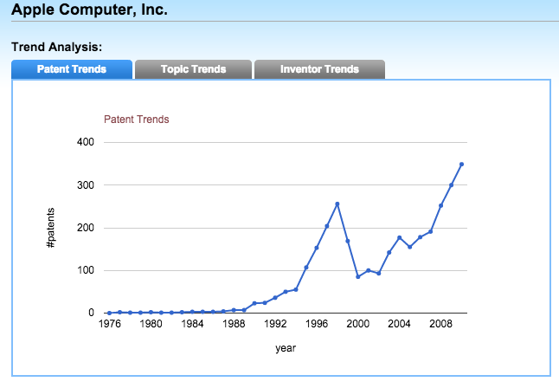
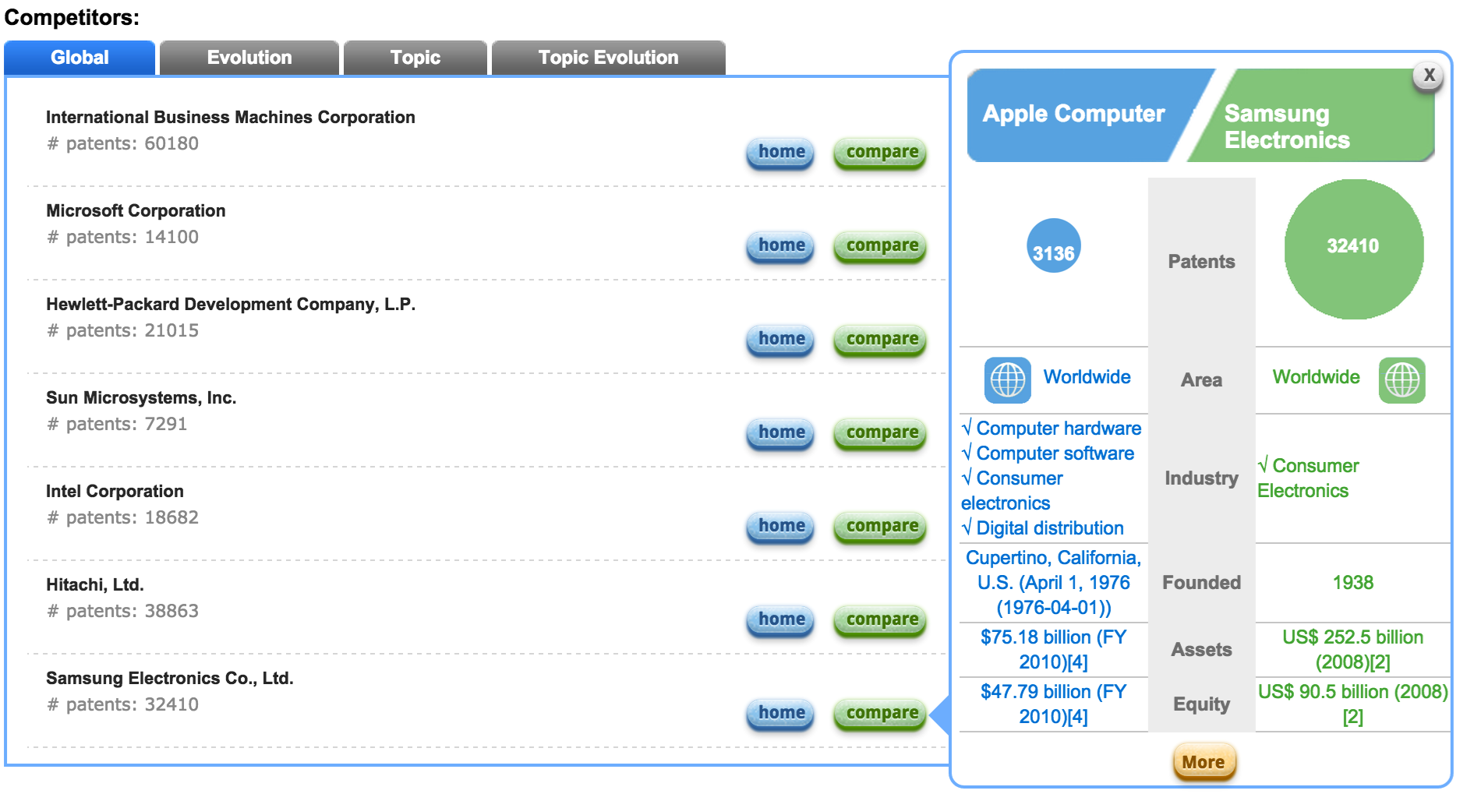
Prototype System competitor analysis @ http://pminer.org
Radar Chart: topic comparison
Basic information comparison: #patents, business area, industry, founded year, etc.
Notes:
Based on our work, we develop a prototype system online, which provides the competitive relationship analysis between companies.
For example, it demonstrate one which topics two companies are competing on.

Slide 20
Conclusion
Study the problem of entity matching across heterogeneous sources.
Propose the cross-source topic model, which integrates the topic extraction and entity matching into a unified framework.
Conduct two experimental tasks to demonstrate the effectiveness of CST.

Slide 21
Entity Matching across Heterogeneous Sources
Thank You!
Yang Yang*, Yizhou Sun⁺, Jie Tang*, Bo Ma#, and Juanzi Li*
*Tsinghua University
⁺Northeastern University
#Carnegie Mellon University
Data&Code available at: http://arnetminer.org/document-match/

Slide 22

Apple Inc. VS Samsung Co.
A patent infringement lawsuit starts from 2012.
  Nexus S, Epic 4G, Galaxy S 4G, and the Samsung Galaxy Tab, infringed on Apple’s intellectual property: its patents, trademarks, user interface and style.
  Lasts over 2 years, involves $158+ million.
How to find patents relevant to a specific product?

Slide 23
Problem
Given an entity in a source domain, we aim to find its matched entities from target domain.
  Given a textural description of a product, finding related patents in a patent database.
  Given an English Wiki page, finding related Chinese Wiki pages.
  Given a specific disease, finding all related drugs.
Notes:
The problem we study in this work is, given an entity in a source domain, finding its matched entities from another (target) domain.
It is an important task in many applications.
For example, a patent expert may be interested in finding related patents in a patent database for a product; a user may be interested in finding all the related Chinese Wiki pages for a particular English Wiki page; and a doctor may be interested in finding all related drugs for a specific disease.
Similar search problems can be found in many other applications.

Slide 24
Basic Assumption
For entities from different sources, their matching relations and hidden topics are influenced by each other.
How to leverage the known matching relations to help link hidden topic spaces of two sources?
Notes:
For entities from different sources, their matching relations and hidden topics are influenced by each other.
Leverage the known matching relations to help the extraction of hidden topics, and use the extracted topics to infer the unknown relations.

Slide 25
Cross-Sampling
1
d₁ and d₂ are matched …
Notes:
We propose a cross-sampling method to link the same topics with different representations, which are the word distributions.
The basic idea of cross-sampling is that when generating topics for an entity d, the sampling process is not only based on the topic distribution of d, but also the topic distributions of all the matching entities of d.
Let’s say we have two sources, in which document d_1 from source 1 is matched with document d_2 from source 2.
At first, documents from different sources have disjoint topic space as they have no overlap in the content.
For example, a user would like to edit a Chinese Wikipedia article about “Barack Obama.” Before he starts, he may take a look at what topics the corresponding English Wikipedia article
contains, and finds out that the article contains Obama’s early career as a Chicago community organizer. Thus he will edit the Chinese Wikipedia article to present Obama’s experience as a community organizer but in different words.

Slide 26
Cross-Sampling
2
Sample a new term w₁ for d₁
Toss a coin c, if c=0, sample w₁’s topic according to d₁
Notes:
We then generate a word w for d_1. For traditional topic models, we will first generate a latent topic for w, according the topic distribution of d_1, then sample w according to a multinomial distribution associated with the sampled topic over all words. However, in cross-sampling, we first toss a binary coin c, if c equals to zero, we sample w’s corresponding topic according to d_1’s topic distribution just like traditional topic models.

Slide 27
Cross-Sampling
3
Sample a new term w₁ for d₁
Otherwise sample w₁’s topic according to d₂
Notes:
If c equals to one, we sample w’s topic according to d_2’s topic distribution.
After this iteration, the disjoint topics will have overlap by leveraging known matching relations.

Slide 28
Parameter Analysis
(a) Number of topics K
(b) Ratio
(c) Precision
(d) Convergence analysis
Notes:
We then see how parameters of the proposed model influence the performance.
Lets focus on the second figure, which demonstrate how the prior of cross-sampling influence the performance.
Here, higher ratio indicates larger probability to sample a topic for a word from matching document instead of its own document.
In the product-patent matching problem, the value of MAP reaches largest when the ratio is 4.
In the crosslingual problem, F1 reaches the maximum value when the ratio is 2.
Compared with cross-lingual matched articles, patents and Wiki articles with matching relations are more dissimilar in topics: patents focus on specific technologies,
while Wiki articles describe general functions of products.
Cross-lingual matched articles report the same objects but in different languages.
Thus the prior of cross-sampling in cross lingual matching problem should be larger.
It indicates that the hyper-parameters of CST can be determined intuitively: if the matching entities in a specific problem assumed to be more similar in topics, we can give a larger value to the prior.

Slide 29
Experimental Results
Training: 30% of the matching relations randomly chosen.
Method | P@3 | P@20 | MAP | R@3 | R#20 | MRR
CS+LDA | 0.111 | 0.083 | 0.109 | 0.011 | 0.046 | 0.053
RW+LDA | 0.111 | 0.117 | 0.123 | 0.033 | 0.233 | 0.429
RTM | 0.501 | 0.233 | 0.416 | 0.057 | 0.141 | 0.171
RW+CST | 0.667 | 0.167 | 0.341 | 0.200 | 0.333 | 0.668
CST | 0.667 | 0.250 | 0.445 | 0.171 | 0.457 | 0.683
  Content Similarity based on LDA (CS+LDA): cosine similarity between two articles’ topic distribution extracted by LDA.
  Random Walk based on LDA (RW+LDA): random walk on a graph where edges indicate the hyperlinks between Wiki articles and citations between patents.
  Relational Topic Model (RTM): used to model links between documents.
  Random Walk based on CST (RW+CST): uses CST instead of LDA comparing with RW+LDA.
Notes:
We compare our method with four baselines. The first method calculates the similarity between a Wiki article and a patent based on their topic distribution calculated by LDA. Given a query, which is an entity from source domain, it ranks entities from target domain according to the their similarities to the query.
The second method ranks candidates by combing the topics into a random walk with restart algorithm.
The first two methods are unsupervised. We can see that with the help of known relations as guidance, our method, CST, outperforms unsupervised methods.
The third method is a topic model generally used to model the links between documents. The difference between RTM and CST is our method has cross-sampling process to better extract cross-source topics and better detect the matching relations.
The last baseline combines CST and random walk framework to consider both content information and structural information. To our surprise, further considering structural information hurts the performance. For instance, it drops around 23% in terms of MAP.
By a careful investigation, we find that a Wiki article normally has lots of hyperlinks to other articles. In average, each article has 56.4 outlinks. Mush noise is contained in these links and thus hurts the performance. However, the structural information does help for top results. For instance P@3 and R@3.

Slide 30
Experimental Results
Training: 30% of the matching relations randomly chosen.
Method | P@3 | P@20 | MAP | R@3 | R#20 | MRR
CS+LDA | 0.111 | 0.083 | 0.109 | 0.011 | 0.046 | 0.053
RW+LDA | 0.111 | 0.117 | 0.123 | 0.033 | 0.233 | 0.429
RTM | 0.501 | 0.233 | 0.416 | 0.057 | 0.141 | 0.171
RW+CST | 0.667 | 0.167 | 0.341 | 0.200 | 0.333 | 0.668
CST | 0.667 | 0.250 | 0.445 | 0.171 | 0.457 | 0.683
  Content Similarity based on LDA (CS+LDA): cosine similarity between two articles’ topic distribution extracted by LDA.
  Random Walk based on LDA (RW+LDA): random walk on a graph where edges indicate the hyperlinks between Wiki articles and citations between patents.
  Relational Topic Model (RTM): used to model links between documents.
  Random Walk based on CST (RW+CST): uses CST instead of LDA comparing with RW+LDA.
Notes:
We compare our method with four baselines. The first method calculates the similarity between a Wiki article and a patent based on their topic distribution calculated by LDA. Given a query, which is an entity from source domain, it ranks entities from target domain according to the their similarities to the query.
The second method ranks candidates by combing the topics into a random walk with restart algorithm.
The first two methods are unsupervised. We can see that with the help of known relations as guidance, our method, CST, outperforms unsupervised methods.
The third method is a topic model generally used to model the links between documents. The difference between RTM and CST is our method has cross-sampling process to better extract cross-source topics and better detect the matching relations.
The last baseline combines CST and random walk framework to consider both content information and structural information. To our surprise, further considering structural information hurts the performance. For instance, it drops around 23% in terms of MAP.
By a careful investigation, we find that a Wiki article normally has lots of hyperlinks to other articles. In average, each article has 56.4 outlinks. Mush noise is contained in these links and thus hurts the performance. However, the structural information does help for top results. For instance P@3 and R@3.

