Slide 1




GCC: Graph Contrastive Coding for Graph Neural Network Pre-Training
Jiezhong Qiu, Qibin Chen, Yuxiao Dong, Jing Zhang,
Hongxia Yang, Ming Ding, Kuansan Wang, Jie Tang
Notes:
Hi, this is our work GCC: Graph Contrastive Coding for Graph Neural Network Pre-Training in KDD 2020.
I am Jiezhong qiu from Tsinghua University,
This is a joint work with Qibin Chen, Ming Ding and Jie Tang from Tsinghua University, Yuxiao Dong and Kuansan Wang from MSR,
Jing Zhang from Renmin University of China, and Hong Yang from Alibaba DAMA Academy.

Slide 2
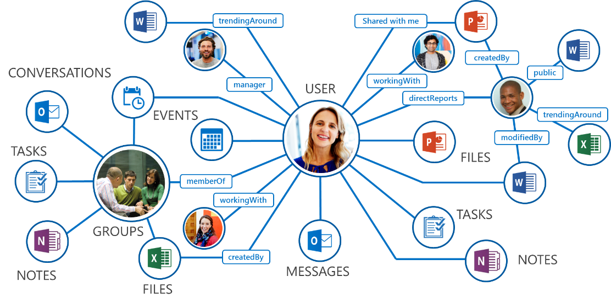

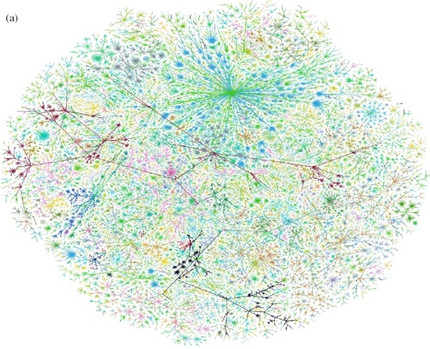
Real-world Graphs
Biological Graph
Question:
How to design machine learning models to learn the universal structural patterns across networks?
Social/Business Graph
Knowledge Graph
Internet Graph
Transportation Graph
figure credit: Web
Notes:
Graphs are everywhere around us, including the social/business graphs, biological graphs, knowledge graphs, internet graphs, and transportation graphs.
Over the past two decades, the main focus of network science research has been on discovering and abstracting the universal structural properties underlying different real-world graphs.s
For example, power law degree distribution, small world, motif distribution, community organization, and core-periphery structure.
Pause
Our research question is that How to design machine learning models to learn the universal structural patterns across graphs.

Slide 3
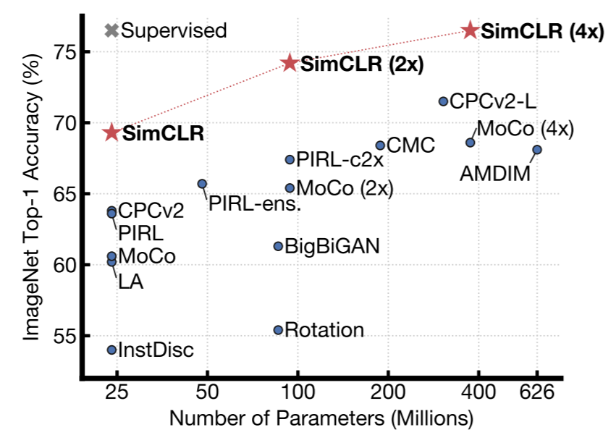
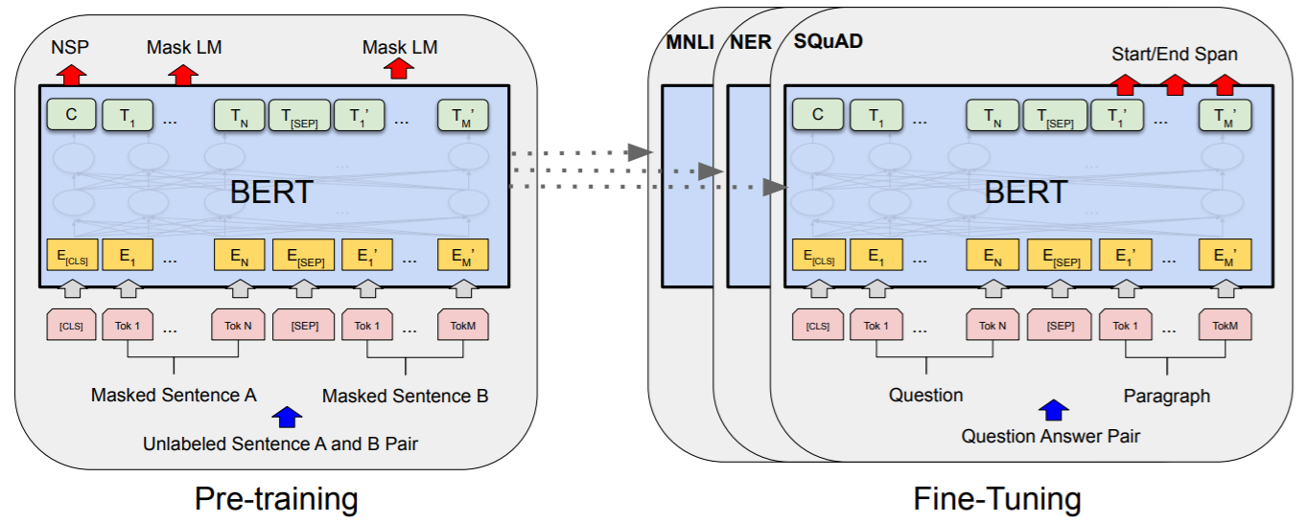
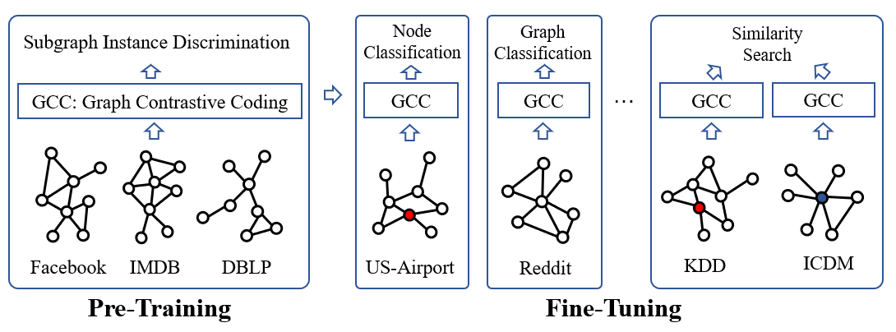
Pre-training and Fine-tuning
Computer Vision
ResNet
ImageNet
NLP
BERT
Wikipedia + Book corpus
Graph Learning
GCC
Notes:
Such idea of combining machine learning models (especially deep learning models) and large-scale datasets is also known as pre-training.
Recent years have witnessed the great success of the pre-training and fine-tuning framework, especially in computer vision and natural language processing.
Where the pre-trained resnet models and the pre-trained transformer models have become standard backbone in various down-stream tasks.
However, it remains unknown that whether such Pre-training and Fine-tuning idea works in graph learning.
Our works introduces the GCC framework, that is, graph contrastive coding, for graph neural network pre-training.

Slide 4
Problem
GNN pre-training problem.
Notes:
In this talk, we first formalize the graph neural network pre-training problem, and then propose our GCC framework.

Slide 5
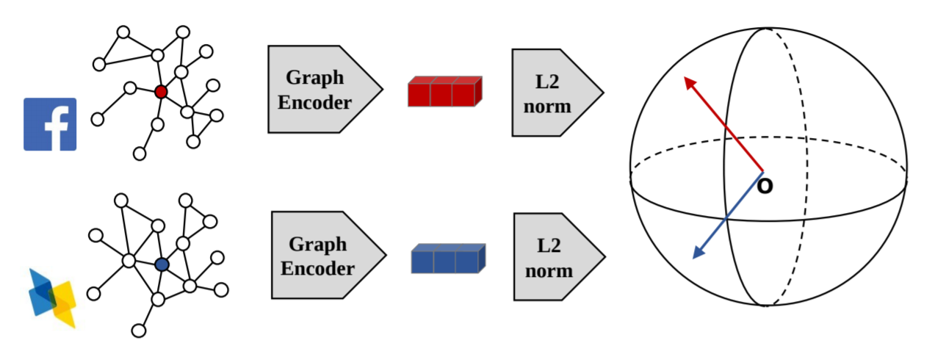
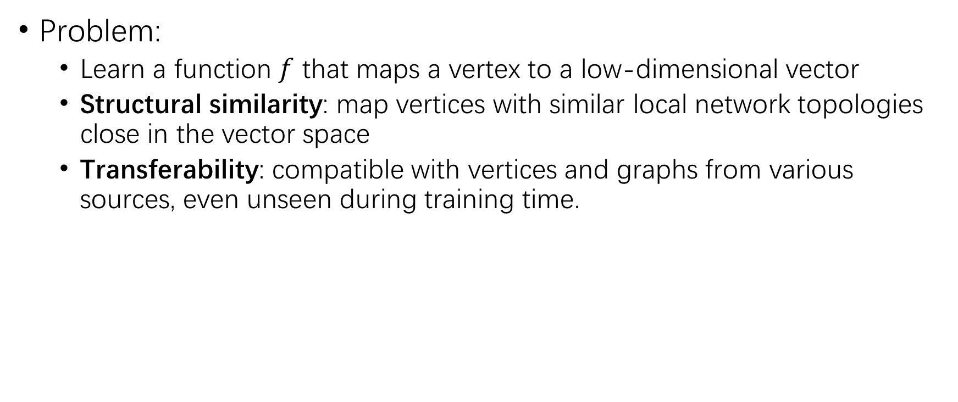
The GNN Pre-Training Problem
Problem:
  Learn a function $f$ that maps a vertex to a low-dimensional vector
  Structural similarity: map vertices with similar local network topologies close in the vector space
  Transferability: compatible with vertices and graphs from various sources, even unseen during training time.
Notes:
The GNN-pretraining problem is to learn a function $f$ that maps a vertex to a low-dimensional vector
The function f should satisfies structural similarity and transferability.
Strutural similarity means that f should map vertices with similar local network topologies close in the vector space
Transferability means that f should be compatible with vertices and graphs from various sources, even unseen during training time.
Here is a illustrative example, we aim to measure the structural similarity between a user from the Facebook social graph and a scholar from the DBLP co-authorship network.

Slide 6
GCC Framework
Graph Contrastive Coding
Notes:
Now we propose our graph contrastive coding framework, that is GCC framework.

Slide 7
Graph Contrastive Coding (GCC)
Node
Classification
Graph
Classification
s
s
Subgraph Instance Discrimination
Similarity
Search
GCC: Graph Contrastive Coding
GCC
GCC
…
GCC
GCC
Facebook
IMDB
DBLP
US-Airport
Reddit
KDD
ICDM
Pre-Training
Fine-Tuning
Hypothesis:
Graph structural patterns are universal and transferable across networks.
Notes:
Our design is to pre-train GNN models on representative social and information networks, such as Facebook, IMDB and DBLP.
Then the pre-trained model can be fine-tuned on various graph learning datasets and graph learning tasks, which are unseen during pre-training.
such as node classification on US-airport dataset and graph classification on Reddit dataset.
Our goal and philosophy is to learn universal and transferable graph structural patterns across networks.

Slide 8
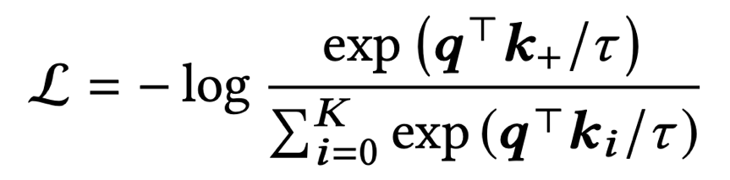
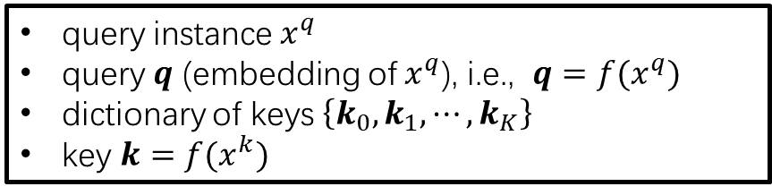
GCC Pre-training
Pre-training Task: Instance Discrimination
InfoNCE Loss: output instance representations that are capable of capturing the similarities between instances
Contrastive learning for graphs?
  Q1: How to define instances in graphs?
  Q2: How to define (dis) similar instance pairs?
  Q3: What are the proper encoders?
query instance $x^{q}$
query $q$ (embedding of${ x}^{q}$), i.e., $q=f(x^{q})$
dictionary of keys $\left\{k_{0},k_{1}, ⋯, k_{K}\right\}$
key $k=f(x^{k})$
Notes:
The design of the pre-training task is the most important part of GCC. We propose to use the subgraph instance discrimination as the pre-training task.
We adopt instance discrimination as the pre-training task and the infoNCE loss and the learning objective.
From a dictionary look-up perspective, given an encoded query q and a dictionary of K +1 encoded keys {k0, · · · ,kK },
We want to looks up a single key (denoted by k+) that q matches in the dictionary.
To apply such framework on graphs, we need to answer three questions.
What are the instances, that is what are q and ks.
How to define (dis) similar instance pairs in and across graphs? That is which k is the key that q matches?
What are the the proper encoders to achieve q and ks.

Slide 9
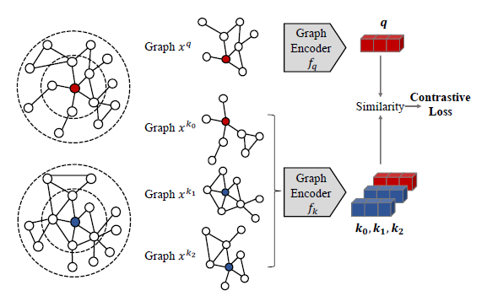
GCC Pre-training
Q1: How to define instances in graphs?
Q2: How to define (dis) similar instance?
Q3: What are the proper encoders?
Notes:
We answer the three question with a running example.
The running example consists of three steps:
The first step of is to sample seed vertices from training graphs. In this example, the red and blue vertices and sampled to be seeds.
The second step is to sample subgraphs by random walk staring from these seeds.
In this example, we sample two subgraphs from the red seeds and two subgraphs from the blue seeds.
We define instances as these subgraphs, and our pre-training task is to distinguish subgraphs from the same seeds against subgraphs from different seeds.
The final step is to encode subgraphs with graph neural networks, we would expect that, after encoding by GNNs, red vectors are closed to each other, while red and blue vectors are far away from each other.

Slide 10
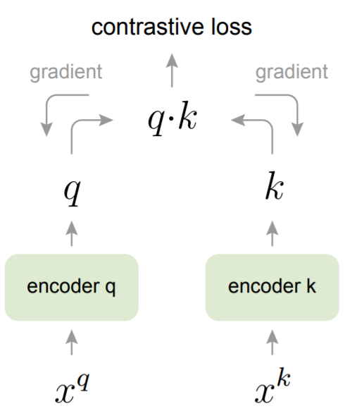
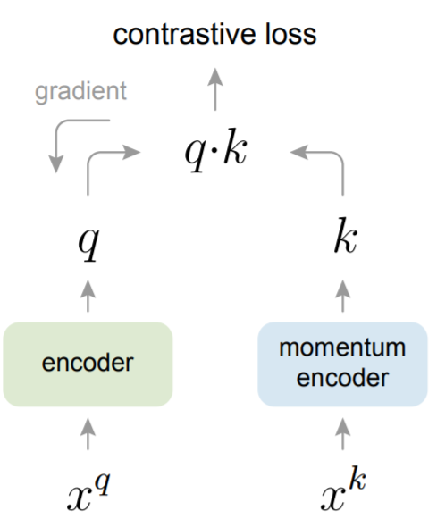
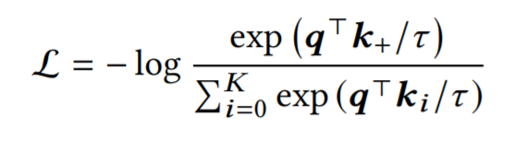

GCC Pre-training: Learning Algorithms
Optimizing Contrastive Loss
  Encoded query $q$
  $K+1$ encoded keys $\left\{k_{0},⋯,k_{K}\right\}$
End-to-end
(E2E)
Momentum Contrast
(MoCo)
figure credit:
Momentum Contrast for Unsupervised Visual Representation Learning
arxiv.org/abs/1911.05722
Notes:
The are several learning algorithms to optimize the contrastive loss.
The most straightforward one is end-to-end learning, which considers samples in a mini-batch as the dictionary.
The objective in then optimized with respect to parameters of query encoder and key encoder together,
both accept gradient updates by backpropagation consistently. The main drawback of E2E is that the dictionary size is constrained by the batch size.
That is you can not have large batch training if you do not have enough resource.
MoCo is a new solution designed to increase the dictionary size without additional backpropagation costs. It maintains a queue of samples from preceding mini-batches. During optimization, it only updates the parameters of query encoder by backpropagation, and the key encoder is updated by a momentum-based update rule.

Slide 11
GCC Fine-tuning
Node
Classification
Graph
Classification
Fine-tuning
s
s
Similarity
Search
GCC
GCC
…
GCC
GCC
Graph Encoder
Classifier
Label y
US-Airport
Reddit
KDD
ICDM
Fine-Tuning
Notes:
Now we move to the fine-tuning stage of GCC.
After pre-training, the graph neural network can be easily reused in down-streaming tasks by fine-tuning, such as node classification, graph classification and similarity search.
Take graph classification for example, suppose you have a graph and you want to predict its label y.
You can simply stack a classification layer after the pre-trained gnn encoder for prediction.
Both the parameters of gnn and the classification layer can be tuned in down-stream tasks with task-specific supervision.

Slide 12
GCC Fine-tuning: Full v.s. Freezing
Full fine-tuning
Freezing fine-tuning
Full Fine-tuning
Freezing Fine-tuning
Graph Encoder
Classifier
Graph Encoder
Classifier
Label
Label
Feature Extractor
Notes:
There are two fine-tuning settings for GCC, that is, full fine-tuning and freezing fine-tuning.
Just as their names imply, full fine-tuning means both the pre-trained gnn and the classifier are tuned in down-stream tasks;
And freezing fine-tuning means the pre-trained gnn are frozen as a feature extractor, and the classifier is tuned.

Slide 13
Experiments
Notes:
We have introduce both the pre-training and the fine-tuning of GCC, then we move the experiments.

Slide 14
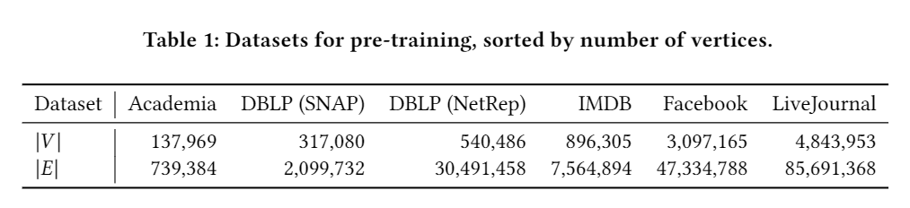
GCC Pre-Training / Fine-tuning
Subgraph Instance Discrimination
GCC: Graph Contrastive Coding
Six real-world information networks for pre-training.
Fine-tuning Tasks:
  Node classification
  Graph classification
  Top-k Similarity search
Facebook
IMDB
DBLP
Pre-Training
Node
Classification
Graph
Classification
s
s
Similarity
Search
GCC
GCC
…
GCC
GCC
US-Airport
Reddit
KDD
ICDM
Fine-Tuning
Notes:
We conduct GCC pre-training on six popular, real world graphs, such as Facebook, IMDB and Facebook, and fine-tune GCC on three
Graph learning tasks, node classification, graph classification and similarity search.

Slide 15
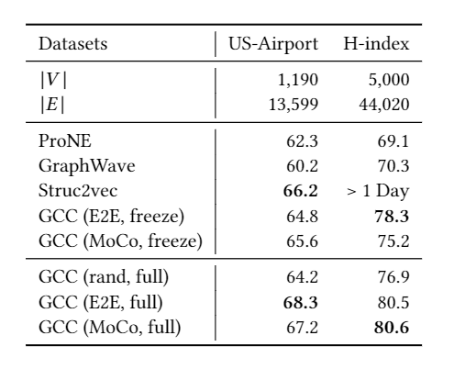
Task 1: Node Classification
Setup
  US-Airport
  AMiner academic graph
Node
Classification
GCC
US-Airport
Notes:
The first task is node classification.
In node classification task, we sample subgraphs around each node as the input of pre-trained gnn encoder, and use the encoded representation to predict node labels.
We conduct experiments on us-airport dataset and a academic graph datasets, achieve state of the art results comparing to baselines.

Slide 16
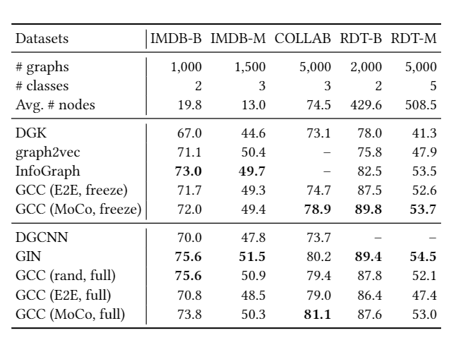
Task 2: Graph Classification
Setup
  COLLAB, RDT-B, RDT-M, & IMDB-B, IMDB-M
Graph
Classification
s
GCC
Reddit
Notes:
The second task is graph classification.
In graph classification task, we encode each graphs with our pre-trained gnn encoder, and use the encoded representation to predict graph labels.
We conduct experiments on five popular graph classification datasets, achieve comparable and sometimes better results, comparing to the state of the art model GIN.

Slide 17
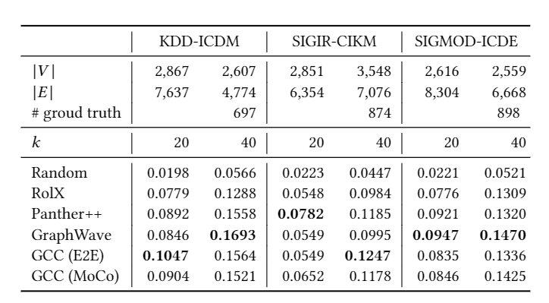
Task 3: Top-k Similarity Search
Setup
  AMiner academic graph
s
Similarity
Search
GCC
GCC
KDD
ICDM
Notes:
The third task is similarity search.
The problem of top-k similarity search is defined as follows. Given two graphs, for example KDD and ICDM co-author graphs, we want to find the most similar vertex from
KDD co-author graph for each vertex in the ICDM co-author graph. In this dataset, the ground truth is defined to be authors publish in both conferences.
GCC also achieves comparable, sometimes better results comparing the baselines such as Graphwave.

Slide 18
Conclusion
Node
Classification
Graph
Classification
s
s
Subgraph Instance Discrimination
Similarity
Search
GCC: Graph Contrastive Coding
GCC
GCC
…
GCC
GCC
Facebook
IMDB
DBLP
US-Airport
Reddit
KDD
ICDM
Pre-Training
Fine-Tuning
We study the pre-training of GNN with the goal of characterizing and transferring structural representations in social and information networks.
We present Graph Contrastive Coding, which is a graph-based contrastive learning framework to pre-train GNN.
The pre-trained GNN achieves competitive performance to its supervised trained-from-scratch counterparts in 3 graph learning tasks on 10 graph datasets.
Notes:
To conclude this work,
We study the pre-training of graph neural networks with the goal of characterizing and transferring structural representations in social and information networks. We present Graph Contrastive Coding (GCC), which is a graph-based contrastive learning framework to pre-train graph neural networks from multiple graph datasets. The pre-trained graph neural network achieves competitive performance to its supervised trained-from-scratch counterparts in three graph learning tasks on ten graph datasets.

Slide 19
Thanks.
Q&A
https://github.com/THUDM/GCC
Notes:
Thanks for your listening.
We release our code at github, and welcome any questions.

Slide 20
Find us at KDD 2020
https://github.com/THUDM/GCC
Notes:
In summary, GCC is a contrastive learning framework that achieves state-of-the-art results on 10 datasets on 3 graph learning tasks.
If you are interested in, find us at KDD2020.

