Slide 1
Understanding Negative Sampling in Graph Representation Learning
Zhen Yang*†, Ming Ding*†, Chang Zhou‡, Hongxia Yang‡, Jingren Zhou‡, Jie Tang†
†Department of Computer Science and Technology, Tsinghua University
‡DAMO Academy, Alibaba Group
*These authors contributed equally to this work.

Slide 2
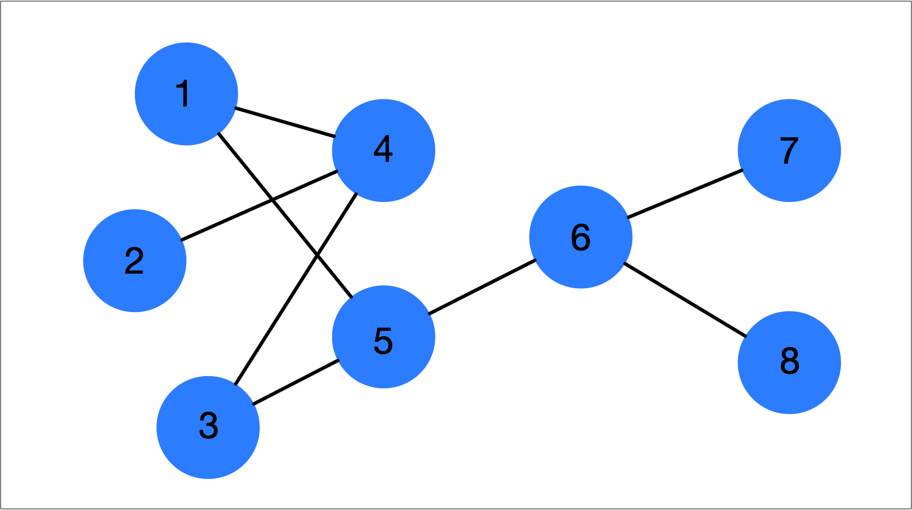
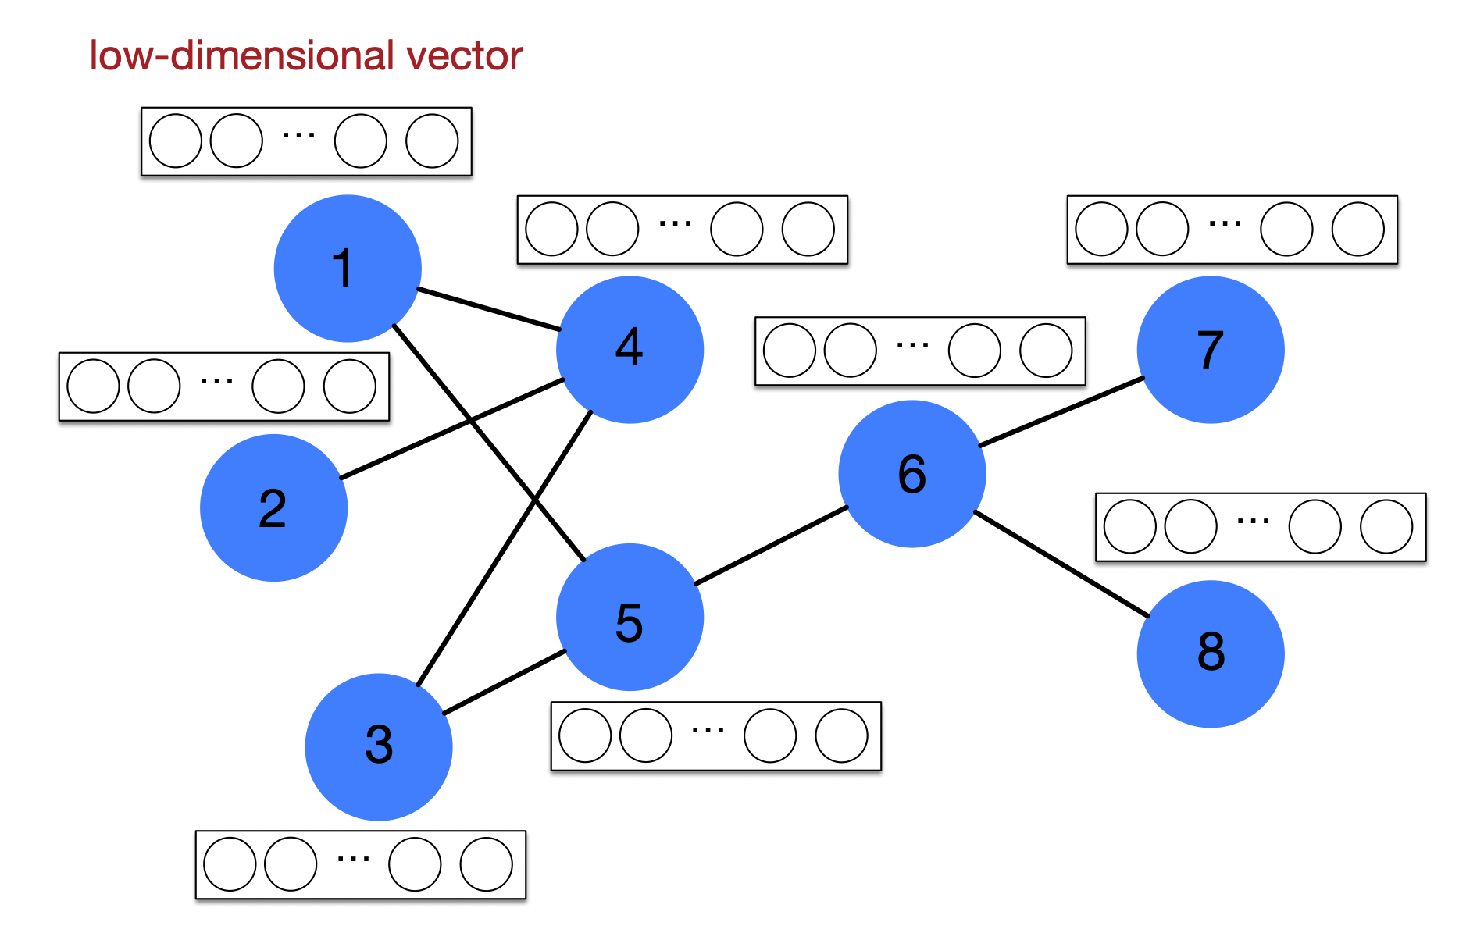
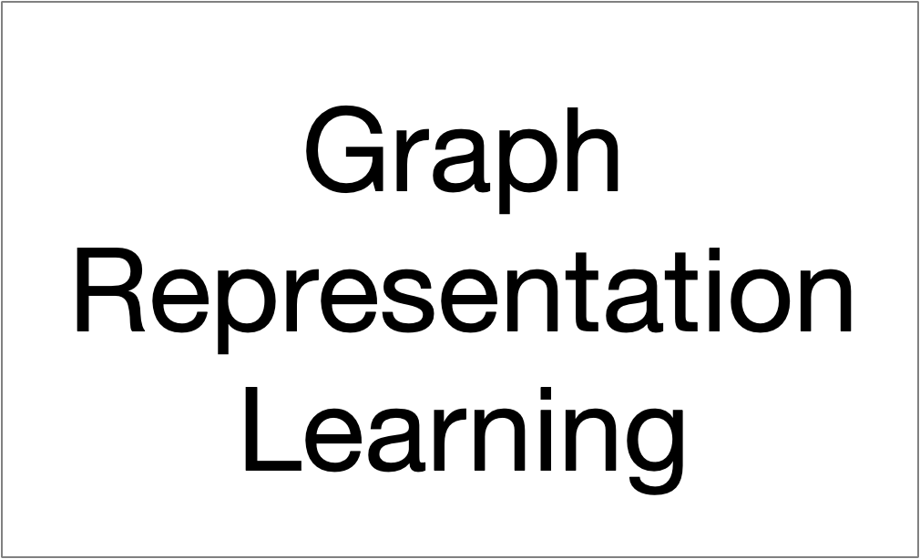
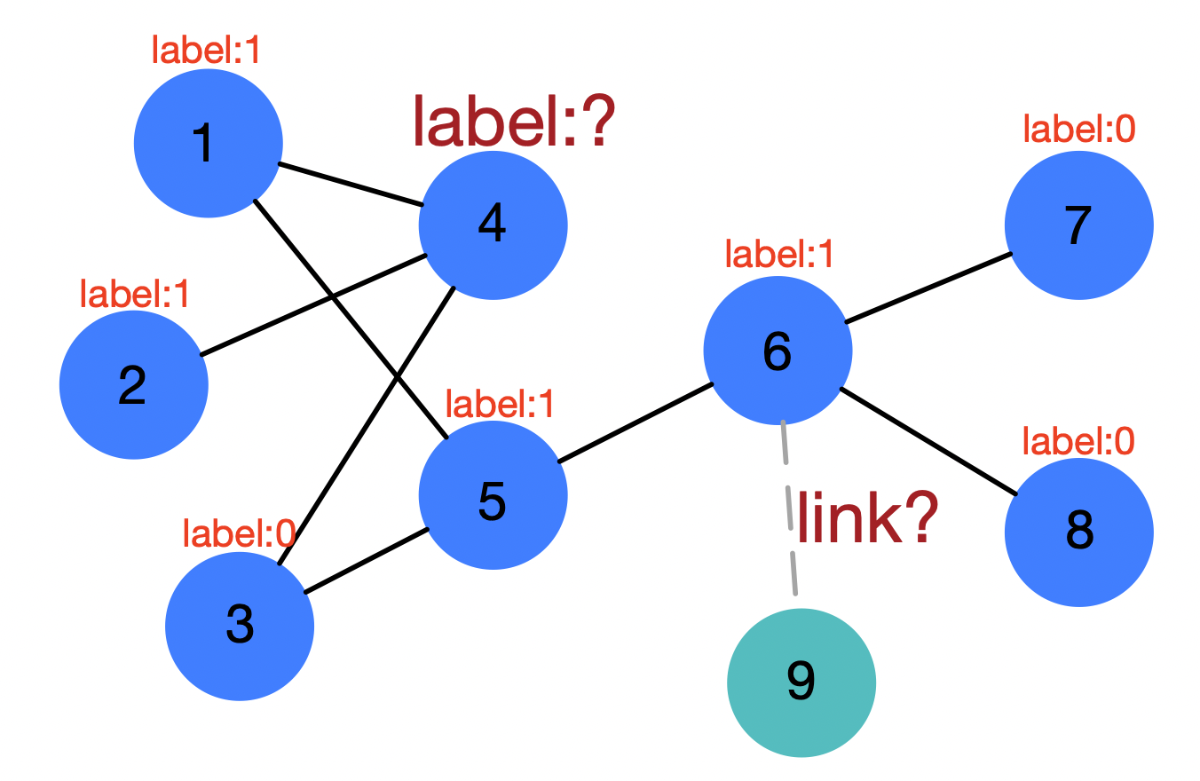
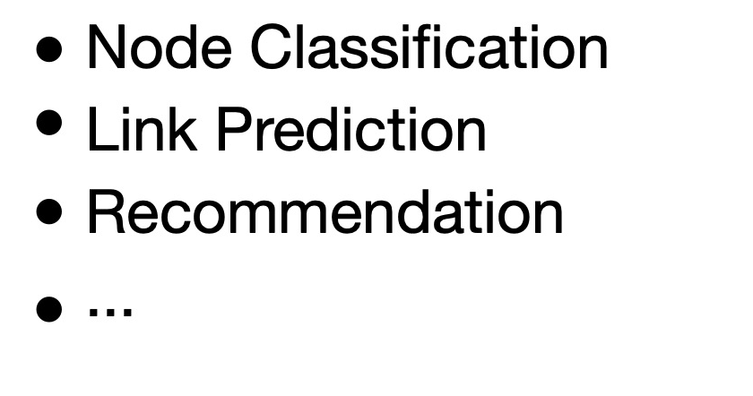
Graph Representation Learning
Graph
Embeddings
Downstream Tasks
Tasks

Slide 3
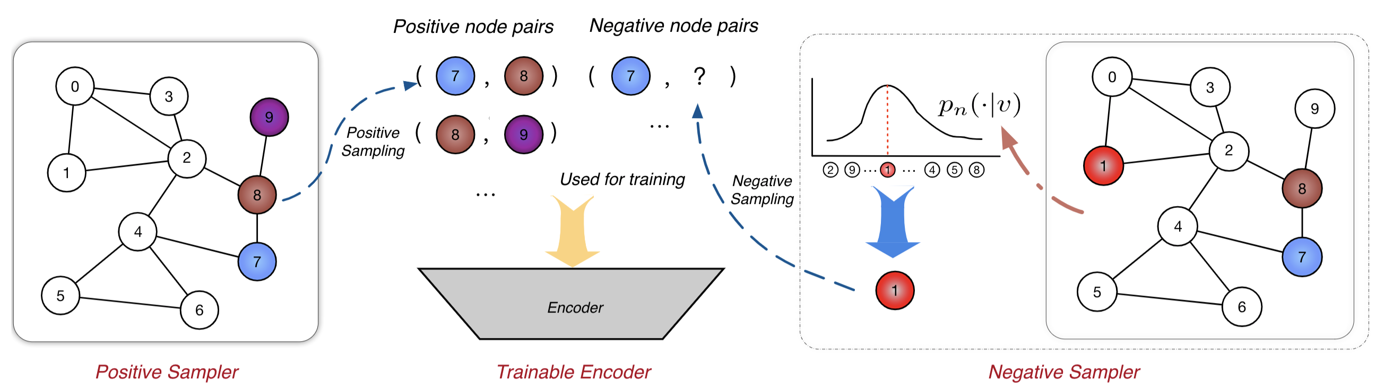
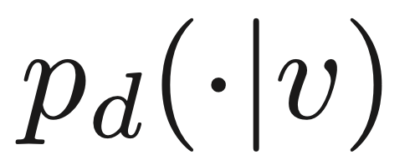
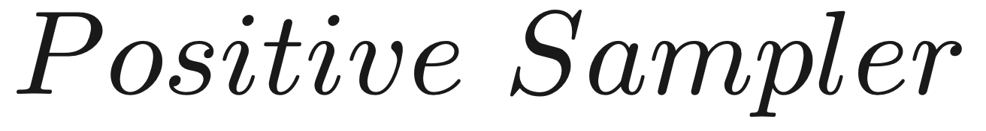
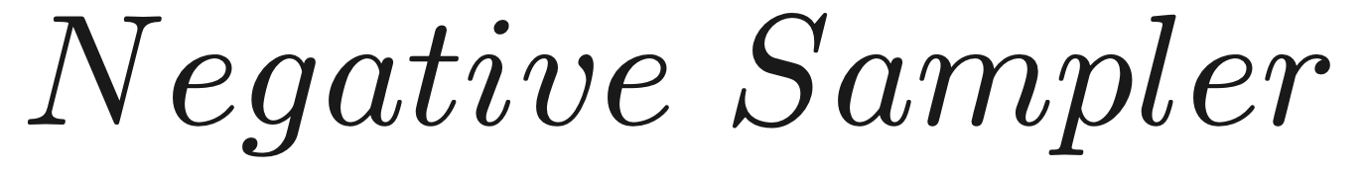
Sampled Noise Contrastive Estimation Framework
SampledNCE Framework
Cross-entropy loss
Sample positive nodes
Generate node embeddings
Sample negative nodes

Slide 4

Problems & Challenges
Related Work:
Degree-based Negative Sampling
01
Advantage: simple and fast
Disadvantage: static, inconsiderate to the personalization of nodes.
02
Hard-samples Negative Sampling
Advantage: mine hard negative samples
Disadvantage: sampling with rejection may cost so many time to try.
03
GAN-based Negative Sampling
Unexplored
Lacking systematically analyzed
Advantage: adversially generate “difficult” samples
Disadvantage: Training difficulties; Long training time

Slide 5
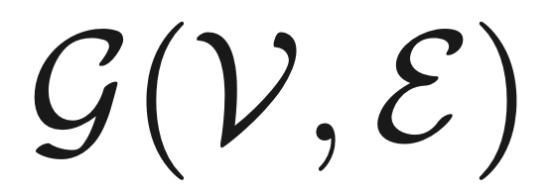
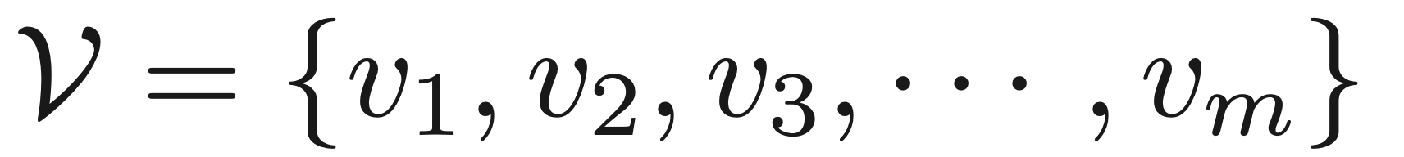
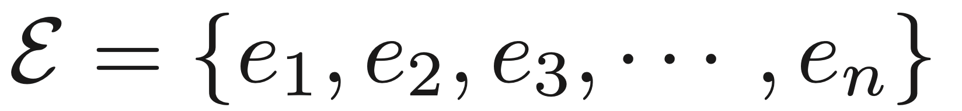
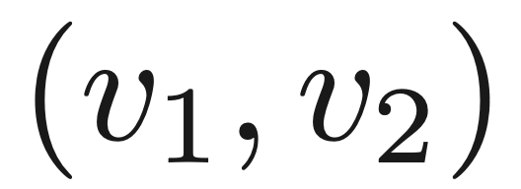
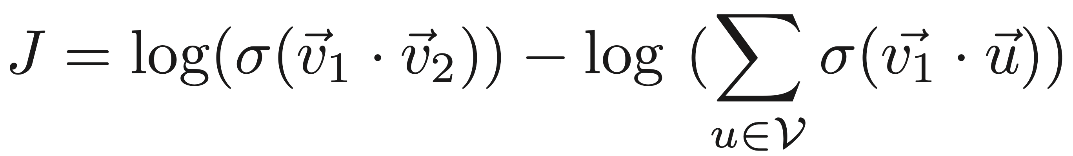
Negative Sampling
Definition:
Given a graph , where is the node set,
is the edge set.
For a node pair , maximize the log-likelihhod of this pair and minimize the log-likelihood of all unconnected node pairs:
calculate all nodes
Negative Sampling: sample k negative nodes to replace all nodes.
only calculate k nodes
1) Accelerate the training process. 2) Reduce computational complexity
Purpose:

Slide 6
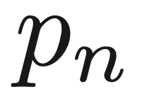
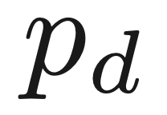
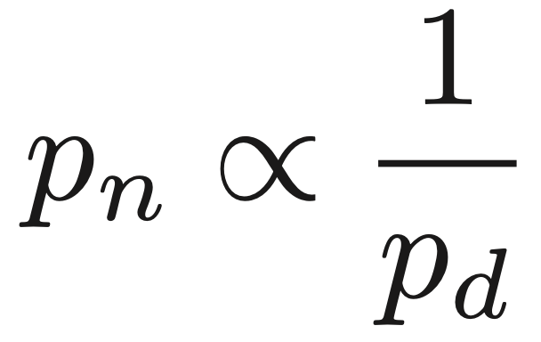
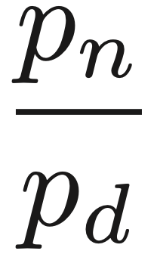
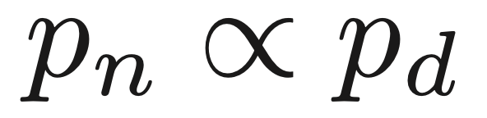
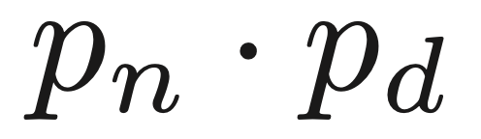
How does negative sampling influence the learning?
Q1: Does affect the embedding learning?
◎ Yes
◎ No
Q2: What is the relationship between and ?
◎
◎
◎
◎
Notations:
Positive Sampling Distribution
Negative Sampling Distribution

Slide 7
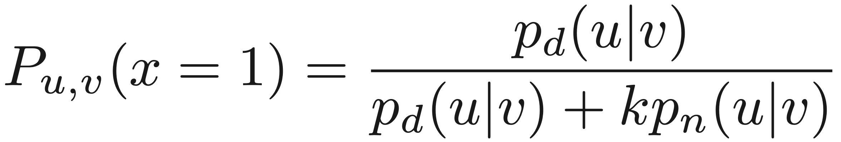
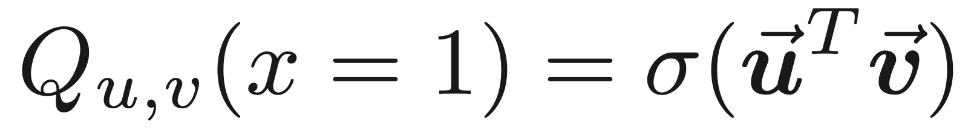

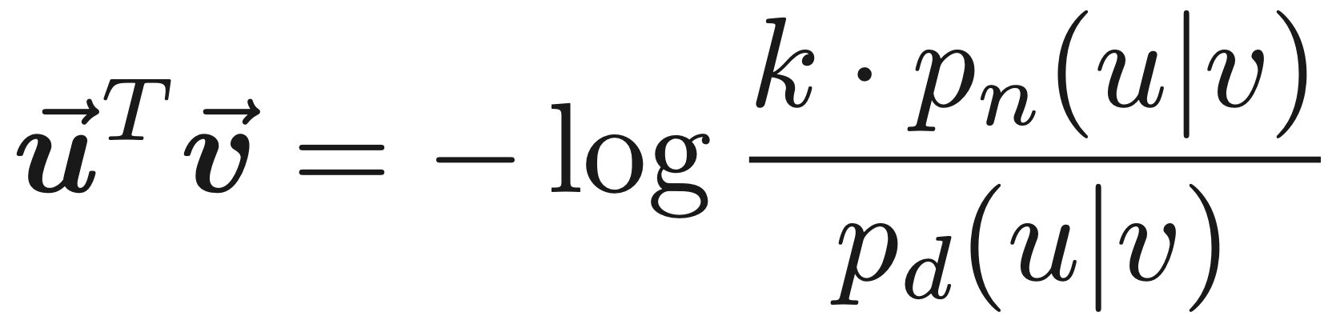
How does negative sampling influence the learning?
Objective Function:
Bernoulli distributions:
Simplify As:
Gibbs Inequality:
Optimal Embedding:

Slide 8
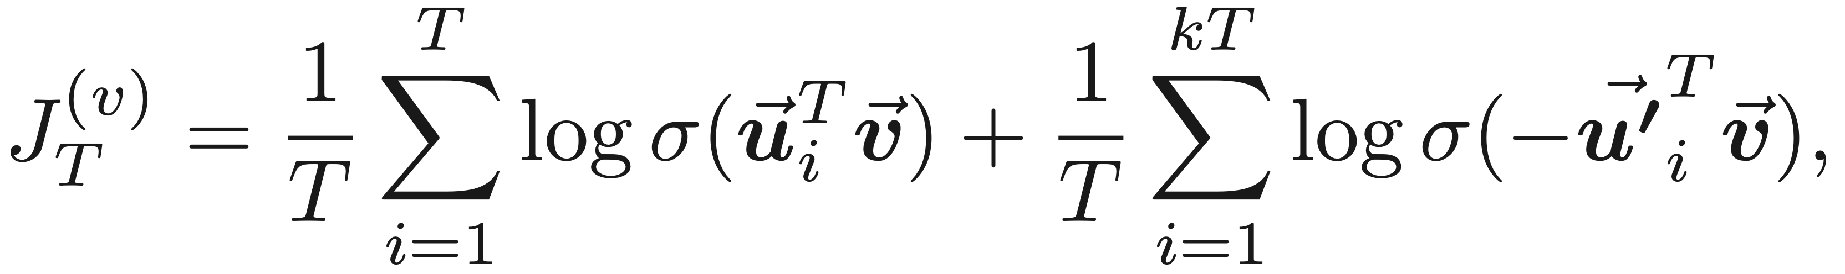
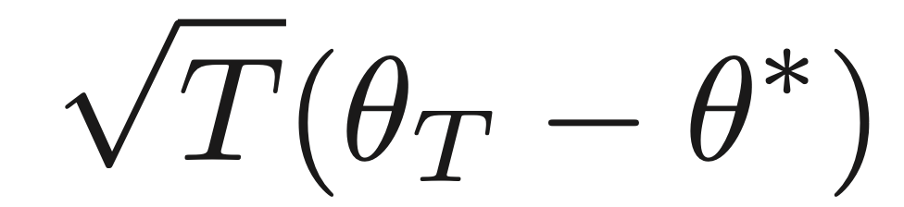
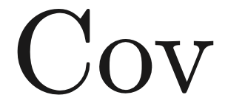
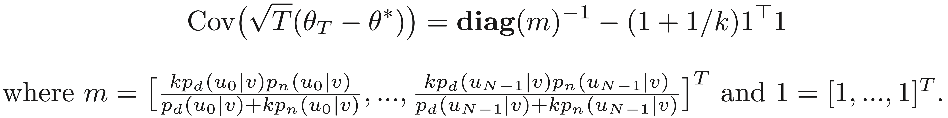
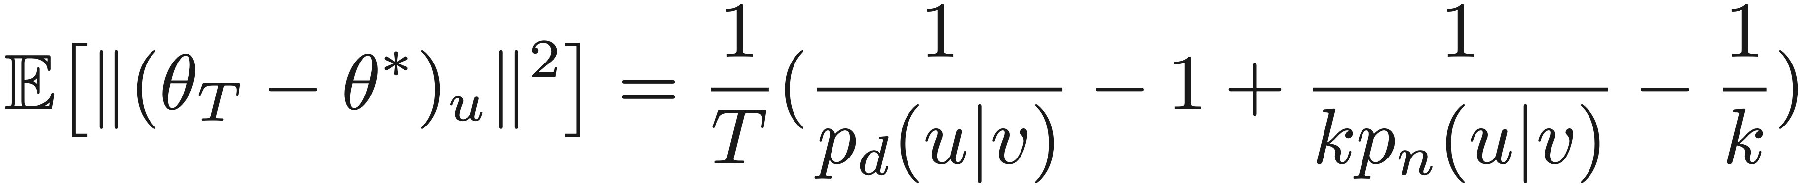
What extent does negative sampling influence the learning?
Empirical Risk：
Theorem
Theorem: the random variable asymptotically converges to a distribution with zero mean vector and covariance matrix .
Proof by
Taylor Expansion
Mean Squared Error:

Slide 9
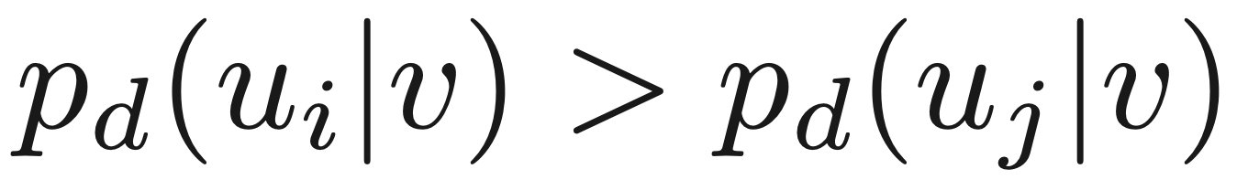
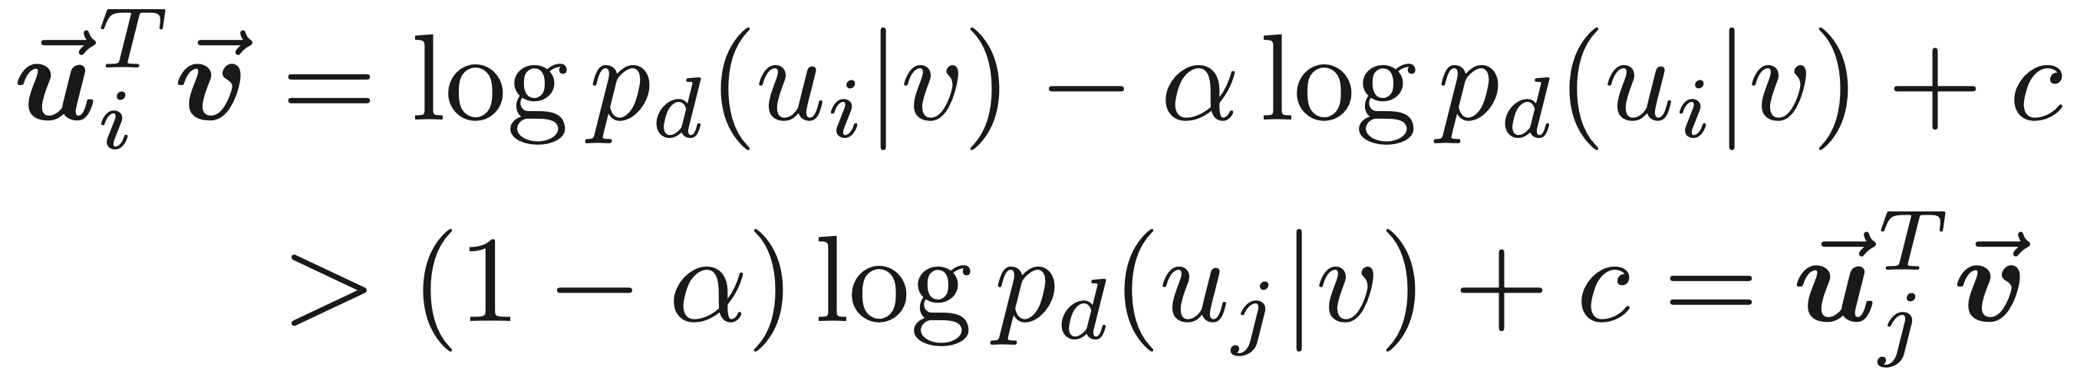
The Principle of Negative Sampling
A simple solution is to sample negative nodes positively but sub-linearly correlated to their positive sampling distribution.
Monotonicity:
Optimal Embedding

Slide 10
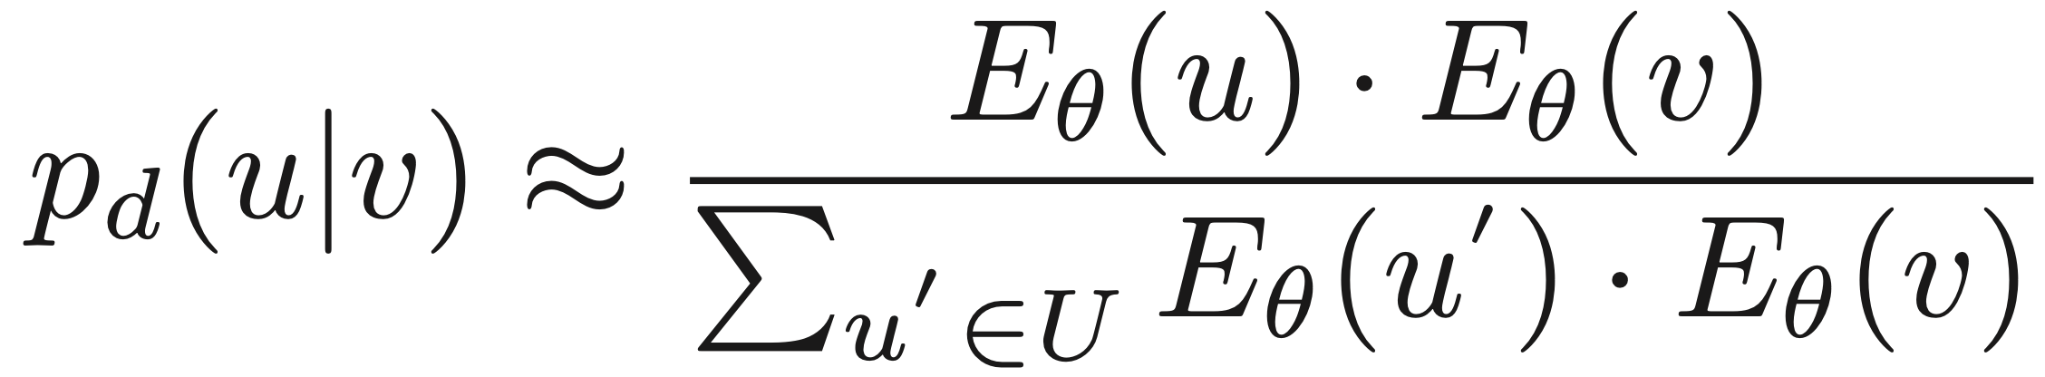
Our Solution: MCNS Model
Markov chain Monte Carlo Negative Sampling (MCNS)：
an effective and scalable negative sampling strategy.
applies our theory with an approximated positive distribution based on current embeddings.
leverages a special Metropolis-Hastings algorithm for sampling.
An Approximated Positive Distribution:
Self-contrast approximation:
- replacing by inner products based on the current encoder

Slide 11
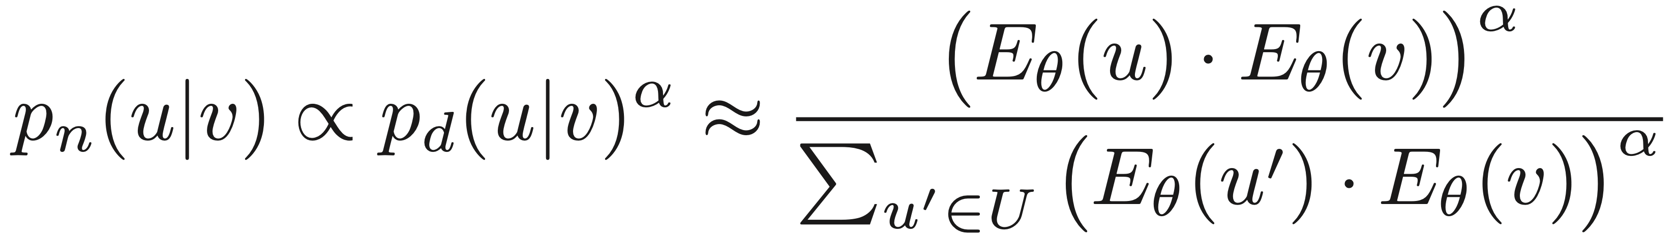
Our Solution: MCNS Model
Negative Distribution:
Very time-consuming
Each sampling requires 𝑂 (𝑛) time, making it impossible for middle- or large-scale graphs.
Accelerating by Metropolis-Hastings algorithm.

Slide 12
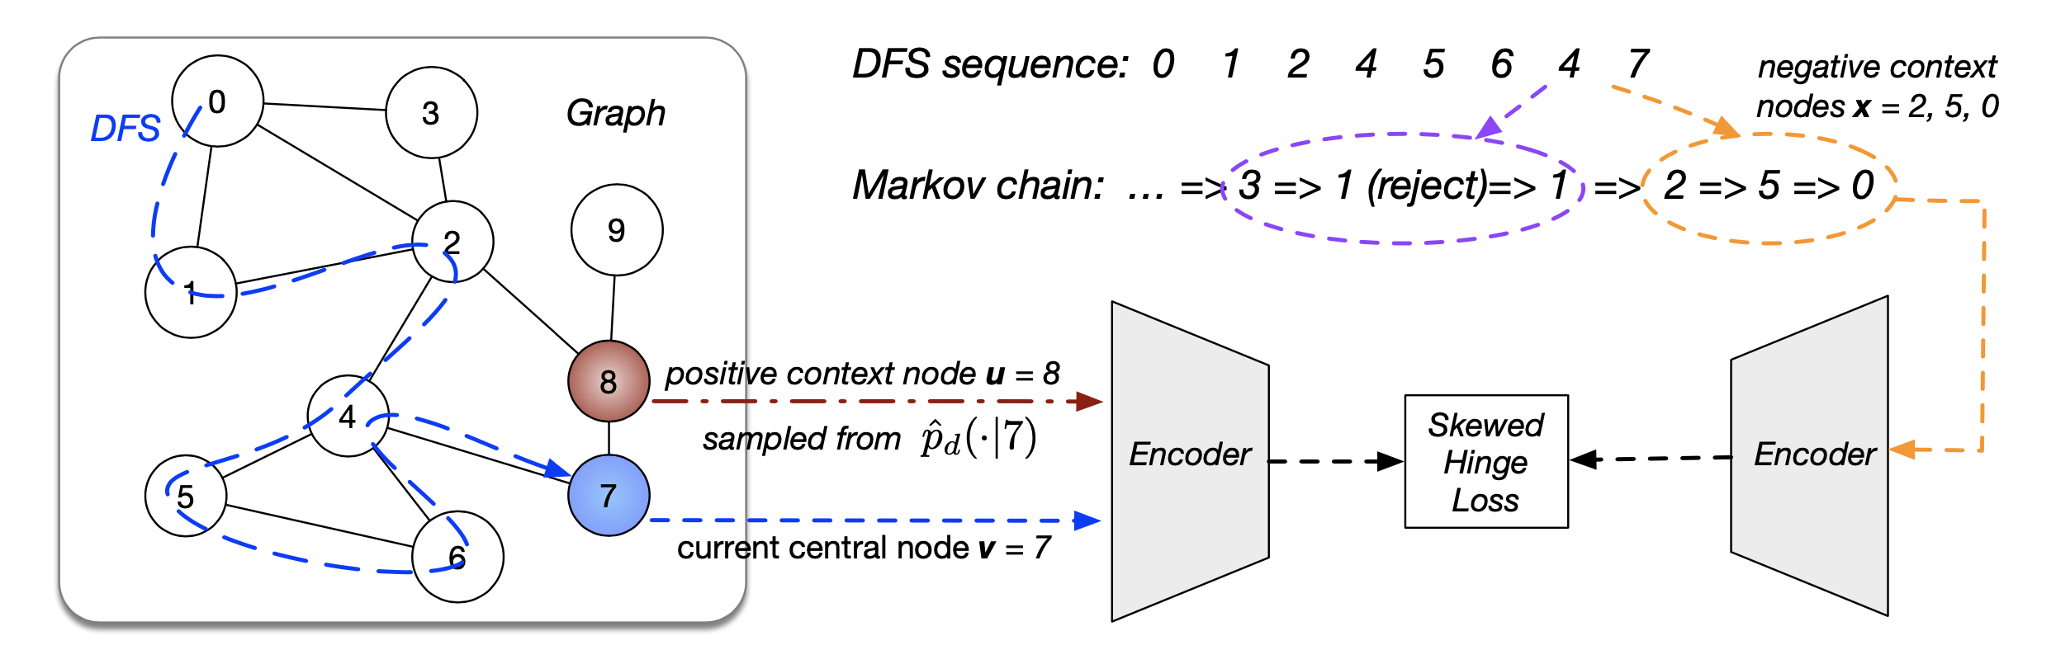
Our Solution: MCNS Model

Slide 13
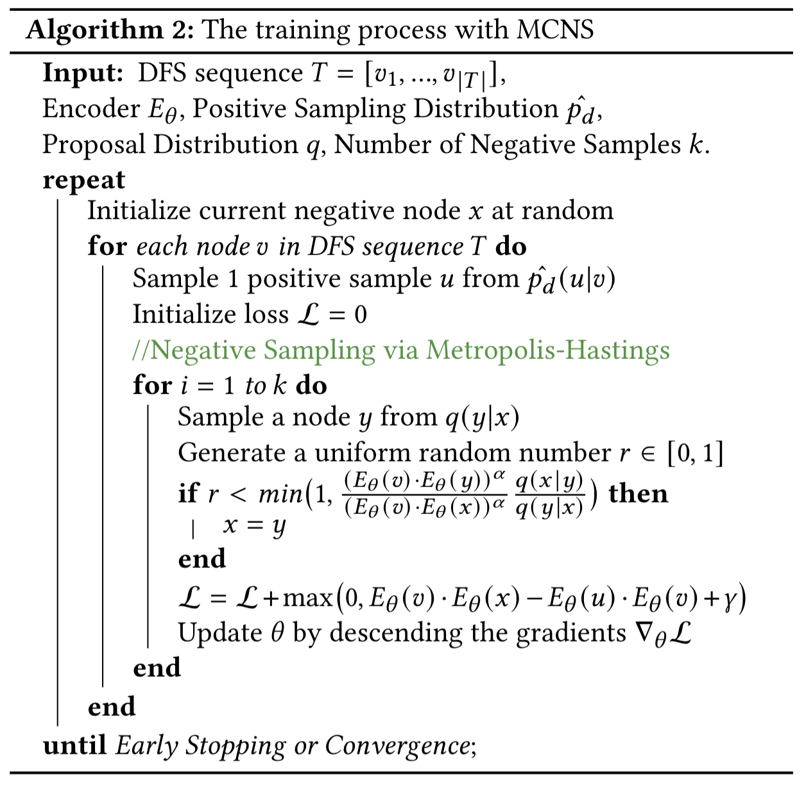
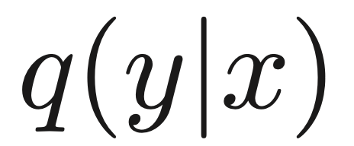

Our Solution: MCNS Model
Step-1
Proposal Distribution :
mixing uniform sampling and sampling from the nearest k nodes with probability each.
Step-2
Step-3
Step-4
Step-5

Slide 14
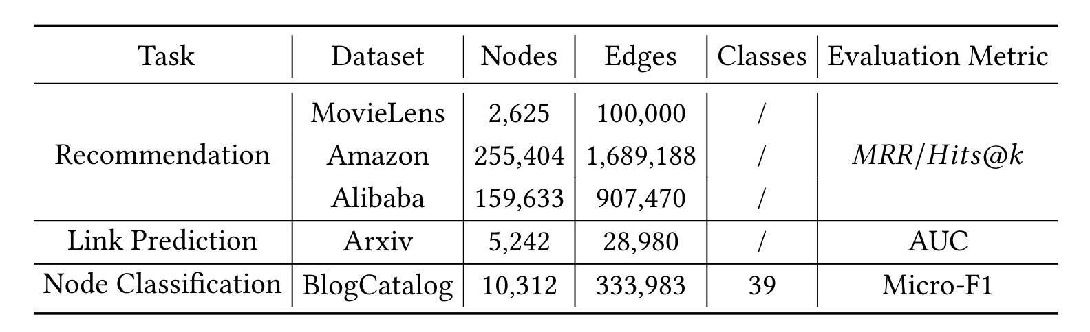
Experimental Settings
3 representative tasks. 3 graph representation learning algorithms.
5 datasets. 19 experimental settings.

Slide 15
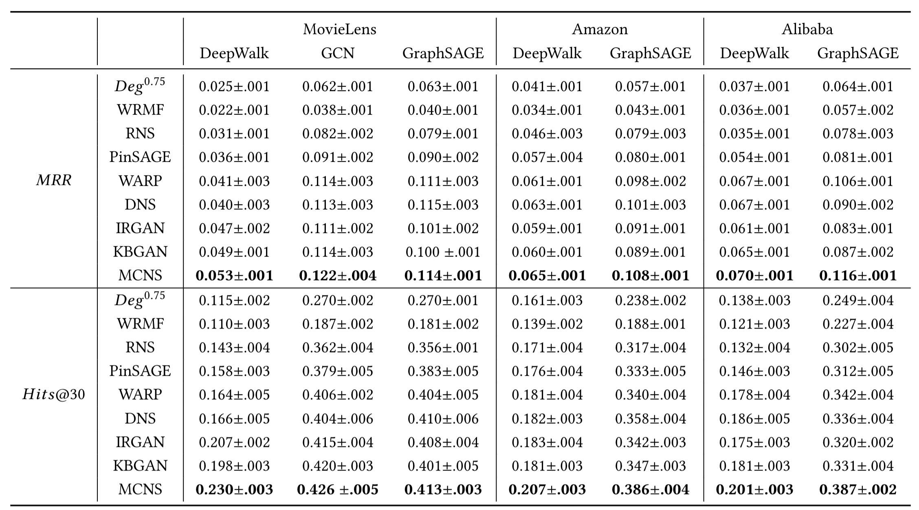
Recommendation Results
MCNS achieves significant gains of 2%∼ 13% over the best baselines.

Slide 16
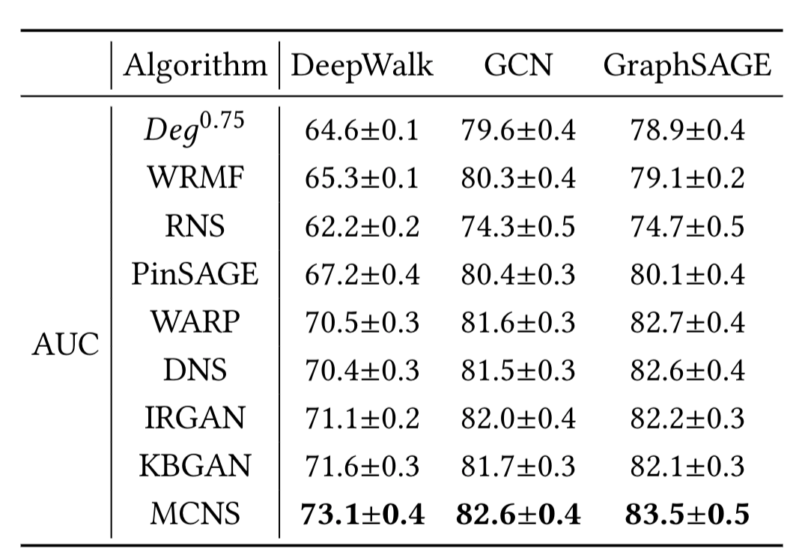
Link Prediction Results
MCNS outperforms all baselines with various graph representation learning methods

Slide 17
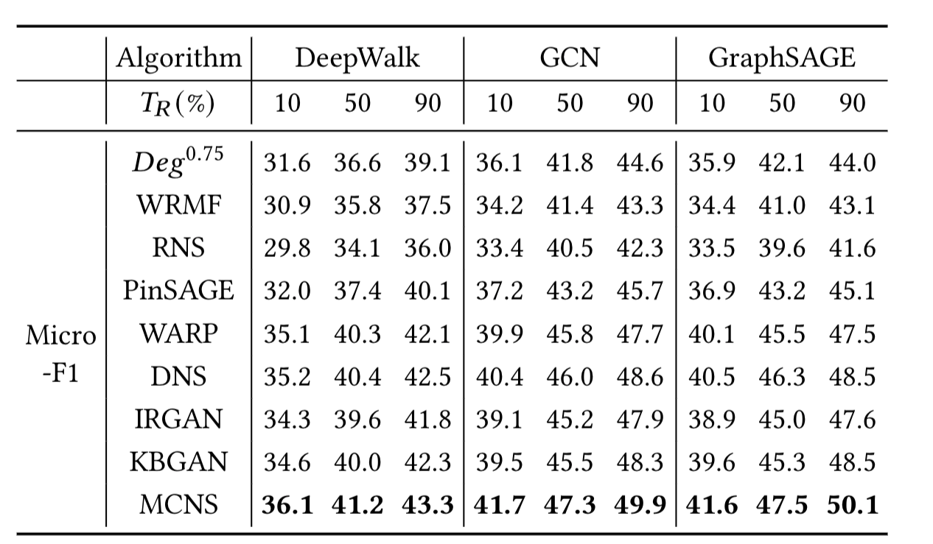
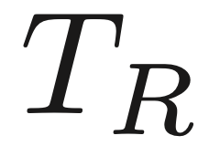
Node Classification Results
MCNS stably outperforms all baselines regardless of the training set ratio .

Slide 18
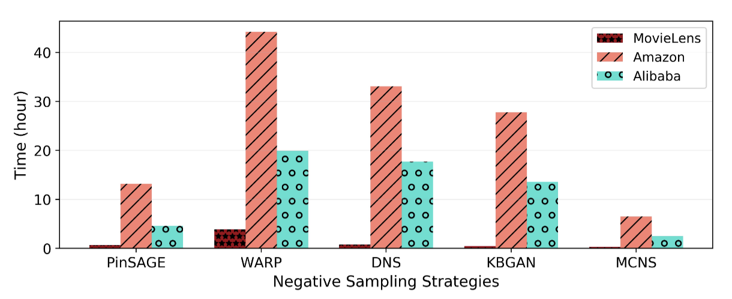
Efficiency Comparison
Runtime Comparisons:
The runtime of MCNS and hard-samples or GAN-based strategies with GraphSAGE encoder in recommendation task.

Slide 19
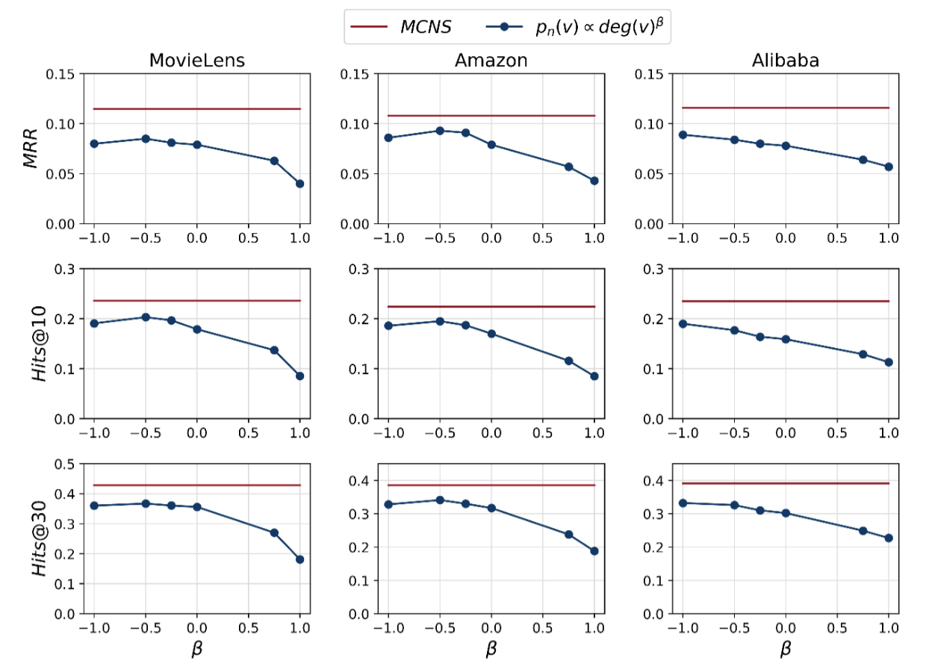
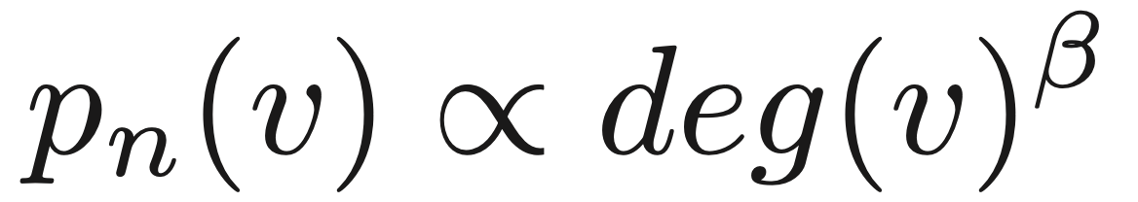
Futher Analysis: Comparison with Power of Degree
Degree-based NS:
Abscissa: 𝛽 varies from -1 to 1.
Results:
1) Best 𝛽 varies on datasets.
2) MCNS naturally adapts to different datasets.

Slide 20
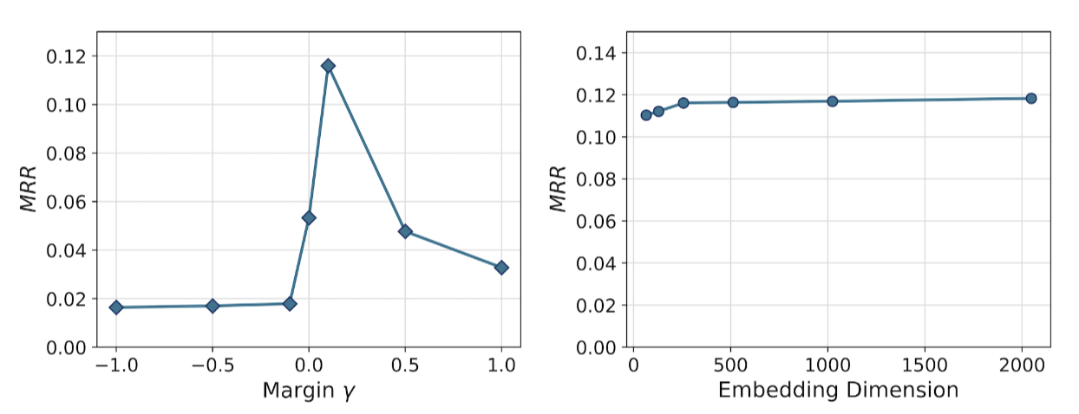
Futher Analysis: Parameter Analysis
Embedding Dimension:
- set as 512
- achieve the trade-off between perfortmance and time consumption.
Margin 𝛾:
- the hinge loss begins to take effect when 𝛾 ≥ 0
- reaches its optimum at 𝛾 ≈ 0.1
0.1

Slide 21
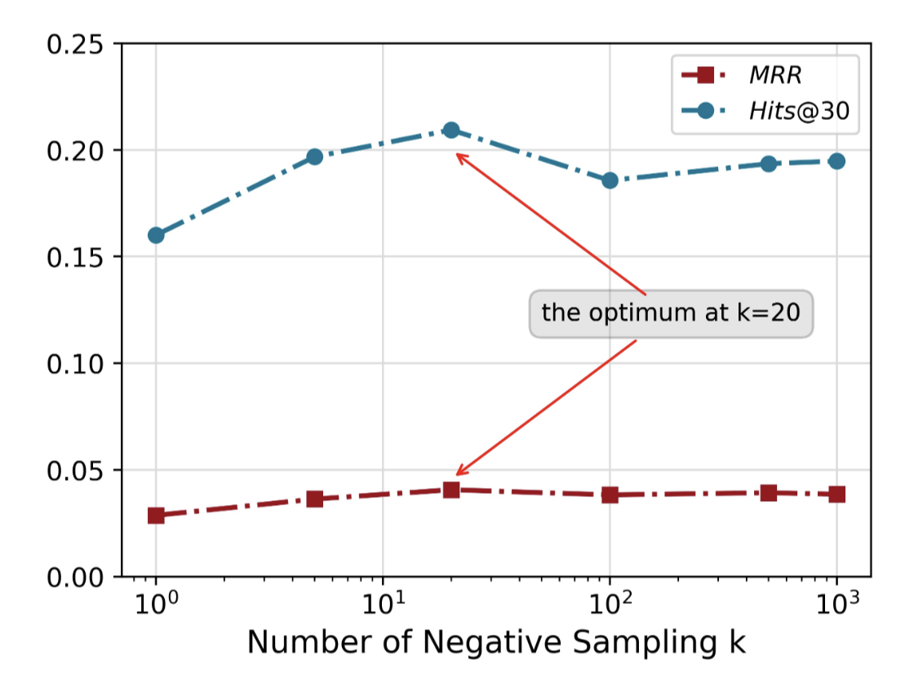
Further Understanding
Whether sampling more negative samples is always helpful ?
Improve at first: decrease the risk
Decrease after the optimum: extra bias is added

Slide 22
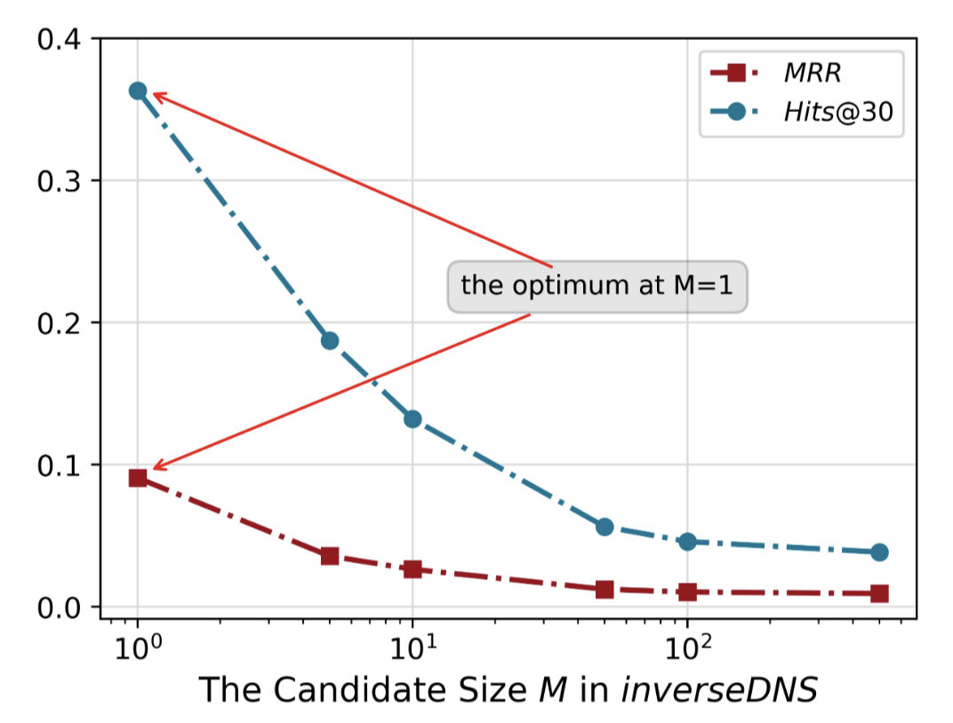
Further Understanding
Why our conclusion contradicts with the intuition “positively sampling nearby nodes and negatively sampling far away nodes” ?
InverseDNS: selecting the one scored lowest in the candidate items.
Performance go down as 𝑀 increases.

Slide 23
Summary
We systematically analyze the role of negative sampling from the perspectives of both objective and risk; and quantify that the negative sampling distribution should be positively but sub-linearly correlated to their positive sampling distribution.
We propose MCNS, approximating the positive distribution with self-contrast approximation and accelerating negative sampling by Metropolis-Hastings.
We achieve state-of-the-art performance in recommendation, link prediction and node classification, on a total of 19 experimental settings.

Slide 24
Thank you~
Code & Data: https://github.com/THUDM/MCNS

