Slide 1
Multi-topic based Query-oriented Summarization
Jie Tang*, Limin Yao#, and Dewei Chen*
*Dept. of Computer Science and Technology
Tsinghua University
#Dept. of Computer Science, University of Massachusetts Amherst
April, 2009
Notes:
Good morning everyone, my name is Jie Tang and I am from Tsinghua University.
In this presentation, I am going to talk about “A Discriminative Approach to Topic-Based Citation Recommendation”. This is a joint work with Jing Zhang.

Slide 2

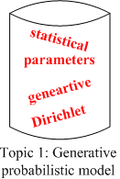
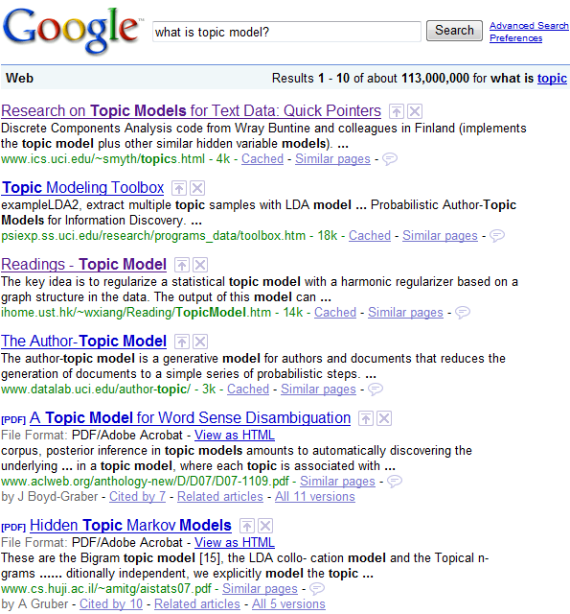
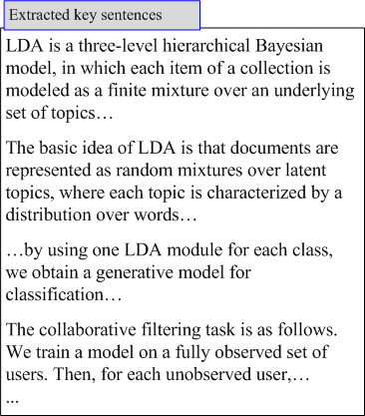
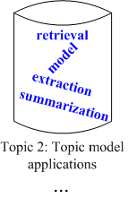
Query-oriented Summarization
What are the major topics in the returned docs?
However…
?

Slide 3
Query-oriented Summarization
What are the major topics in the returned docs?
However…
?
Statistics show:
44.62% of the news articles are about multi-topics.
36.85% of the DUC data clusters are about multi-topics.

Slide 4
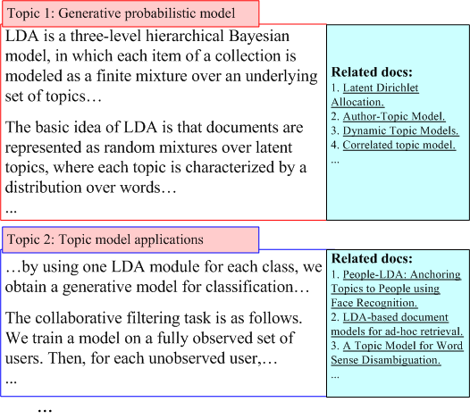
Multi-topic based Query-oriented Summarization
?
Topic-based summarization

Slide 5
Multi-topic based Query-oriented Summarization
?
Challenging questions:
How to identify the topics?
How to extract the summary for each topic?
Topic-based summarization

Slide 6




Our Solution
Summary generation
Topic smoothing
Topic modeling
Generate the summary based on the discovered topic models
Employ a regularization framework to smooth the topic distribution
Proposal of a query LDA (qLDA) model to model queries and documents together
Toward Multi-topic based query-oriented summarization

Slide 7
Outline
Related Work
Modeling of Query-oriented Topics
Latent Dirichlet Allocation
Query Latent Dirichlet Allocation
Topic Modeling with Regularization
Generating Summary
Sentence Scoring
Redundancy Reduction
Experiments
Conclusions

Slide 8
Related Work
Document summarization
Term frequency (Nenkova, et al. 06; Yih, et al. 07)
Topic signature (Lin and Hovy, 00)
Topic theme (Harabagiu and Lacatusu, 05)
Oracle score (Conroy, et al. 06)
Topic-based summarization
V-topic: using HMM for summarization (Barzilay and Lee, 02)
Opinion summarization (Gruhl, et al. 05; Liu et al. 05)
Bayesian query-focused summarization (Daume, et al. 06)
Topic modeling and regularization
pLSI (Hofmann, 99), LDA (Blei, et al. 2003)
TMN (Mei, et al. 08), etc.
Notes:
Measures for scoring sentences

Slide 9
Outline
Related Work
Modeling of Query-oriented Topics
Latent Dirichlet Allocation
Query Latent Dirichlet Allocation
Topic Modeling with Regularization
Generating Summary
Sentence Scoring
Redundancy Reduction
Experiments
Conclusions

Slide 10
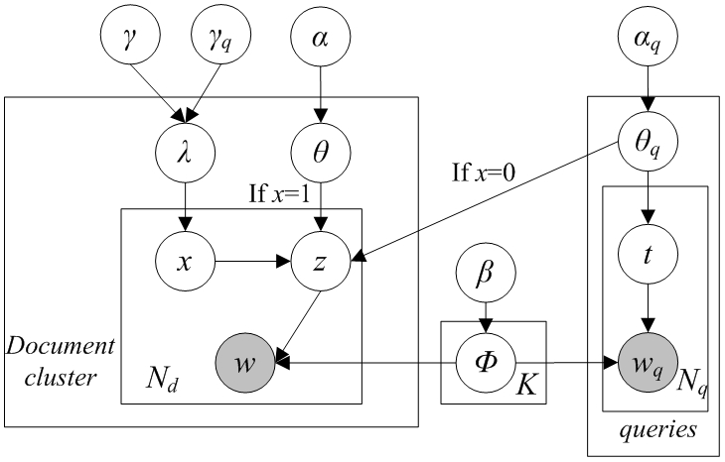
qLDA – Query Latent Dirichlet Allocation
Doc-specific topic dist.
Query-specific topic dist.
topic
coin
topic

Slide 11
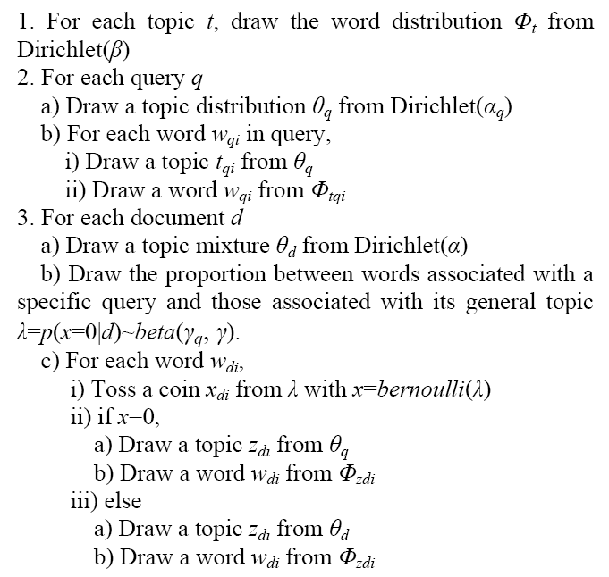
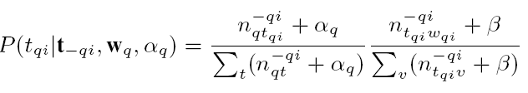
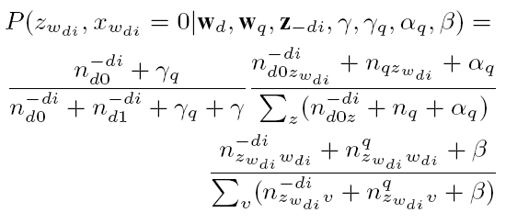
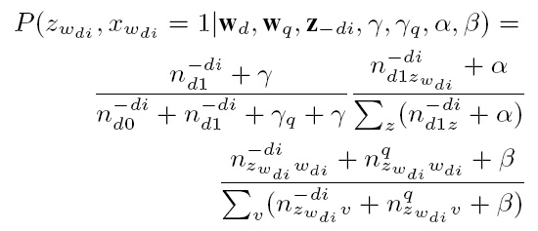
qLDA

Slide 12
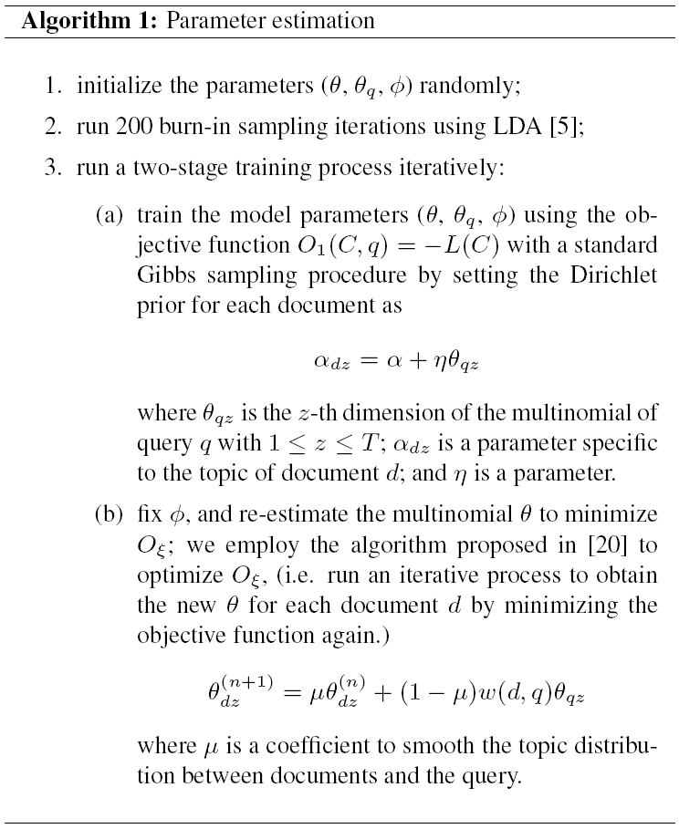

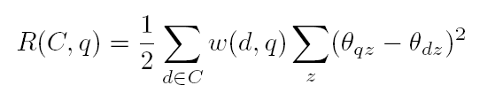
Topic Modeling with Regularization
The new objective function:
with

Slide 13
Outline
Related Work
Modeling of Query-oriented Topics
Latent Dirichlet Allocation
Query Latent Dirichlet Allocation
Topic Modeling with Regularization
Generating Summary
Sentence Scoring
Redundancy Reduction
Experiments
Conclusions

Slide 14

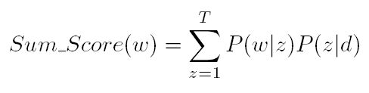


Measures for Scoring Sentences
Four measures: Max_score, Sum_score, Max_TF_score, and Sum_TF_score.
Max_score
Sum_score
Max_TF_score
Sum_TF_score
#sampled topic z in cluster c
#word w in cluster c
# all word tokens in cluster c

Slide 15
Redundancy Reduction
A five-step approach
Step 1: Ranking all
Step 2: Candidate selection (top 150)
Step 3: Feature extraction (TF*IDF)
Step 4: Clustering (CLUTO)
Step 5: Re-rank

Slide 16
Outline
Related Work
Modeling of Query-oriented Topics
Latent Dirichlet Allocation
Query Latent Dirichlet Allocation
Topic Modeling with Regularization
Generating Summary
Sentence Scoring
Redundancy Reduction
Experiments
Conclusions

Slide 17
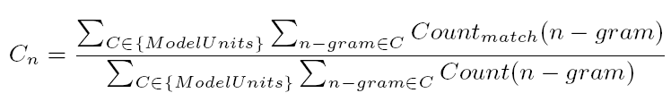
Experimental Setting
Data Sets
DUC2005/06: 50 tasks and each task consists of one query and 20-50 documents
Epinions (epinions.com): in total 1,277 reviews for 44 different “iPod” products
Evaluation Measures
ROUGE
Parameter Setting
T=60 for DUC and T=30 for Epinions
2000 sampling iterations

Slide 18
Comparison Methods
TF: term frequency
pLSI: topic model learned by pLSI
pLSI+TF: combination of TF and pLSI
LDA: topic model learned by LDA
LDA+TF: combination of TF and LDA
qLDA: topic model learned by the proposed qLDA
qLDA+TF: combination of TF and qLDA
TMR: topic model learned by the proposed TMR
TMR+TF: combination of TF and TMR

Slide 19
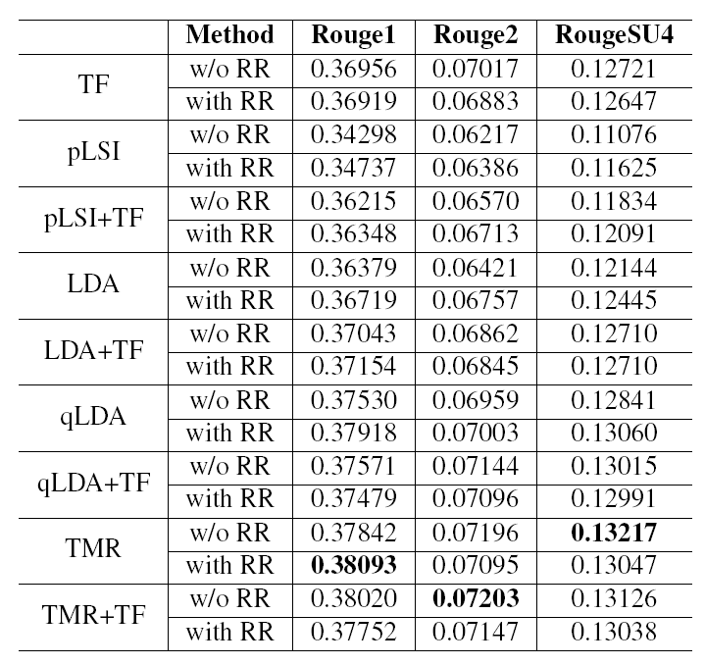
Results on DUC05

Slide 20
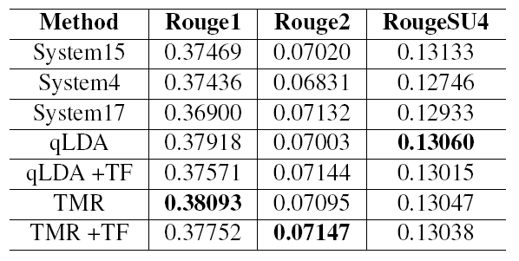
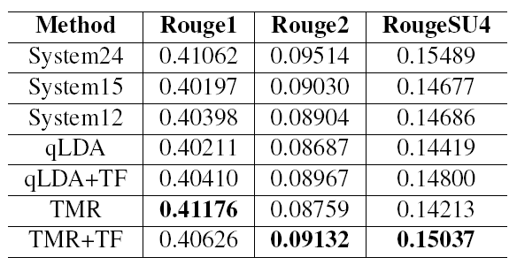
Comparison with the Best
Comparison with the best system on DUC05
Comparison with the best system on DUC06

Slide 21
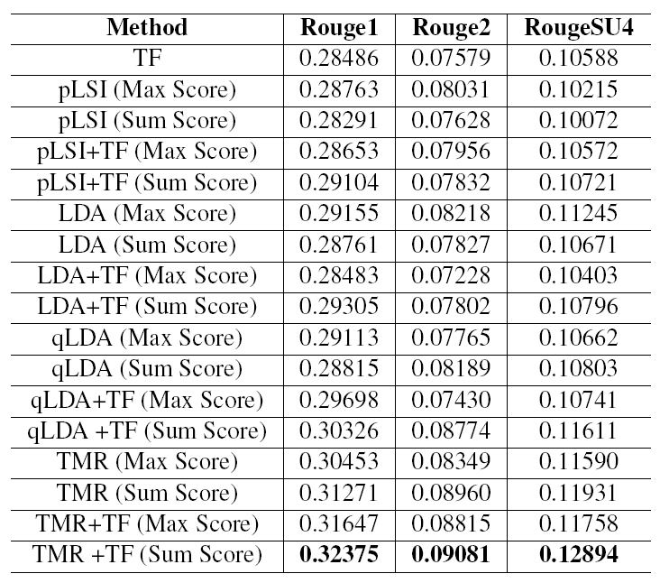
Results on Epinions

Slide 22
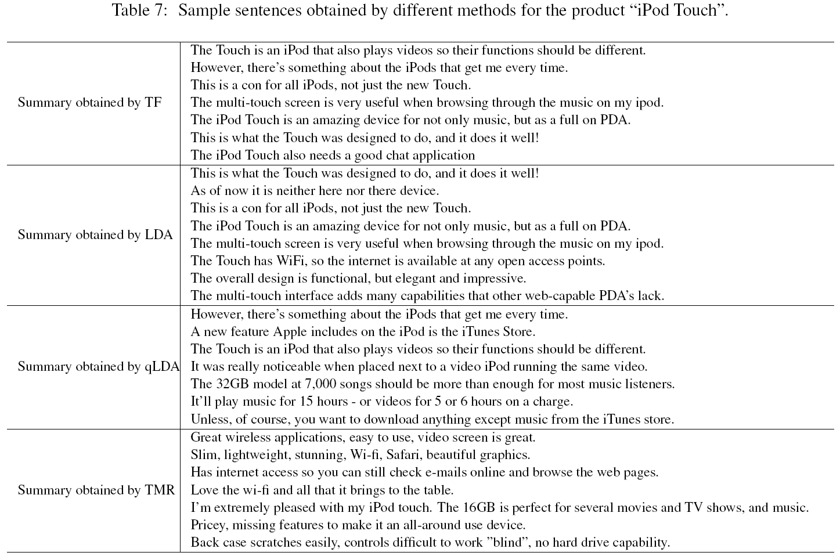
Case Study

Slide 23
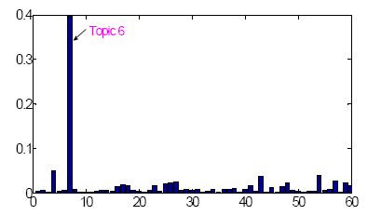
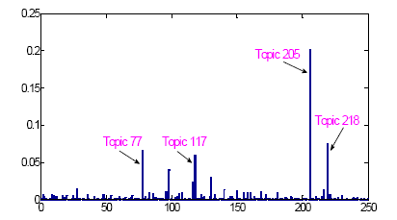
Distribution Analysis
T=60
T=250
Topic distribution for in D357 (T=60 and T=250). The x axis denotes topics and the y axis denotes the occurrence probability of each topic in D357.

Slide 24
Outline
Related Work
Modeling of Query-oriented Topics
Latent Dirichlet Allocation
Query Latent Dirichlet Allocation
Topic Modeling with Regularization
Generating Summary
Sentence Scoring
Redundancy Reduction
Experiments
Conclusions

Slide 25
Conclusion
Formalize the problems of multi-topic based query-oriented summarization
Propose a query Latent Dirichlet Allocation for modeling queries and documents
Propose using regularization to smooth the topic distribution
Propose four measures for scoring sentences based on the obtained topic models
Experimental results show that the proposed approach for query-oriented summarization perform better than the baselines.

Slide 26
Thanks!
Q&A

