Slide 1
Self-supervised Learning
Generative or Contrastive
（Outline)
Xiao Liu, Fanjin Zhang, Zhenyu Hou, Zhaoyu Wang, Li Mian, Jing Zhang, Jie Tang*
Slide Maintain: Xiao Liu, Haoyun Hong
Knowledge Engineering Group, Tsinghua University
arXiv: https://arxiv.org/abs/2006.08218
AMiner: https://www.aminer.cn/pub/5ee8986f91e011e66831c59b/

Slide 2
Index
Introduction
Generative self-supervised learning
Contrastive self-supervised learning
Generative-contrastive self-supervised learning
Theory behind self-supervised learning
Discussion
Reference
(in the rest of slides, we use ``SSL’’ for ``self-supervised learning’’)

Slide 3
1. Introduction

Slide 4
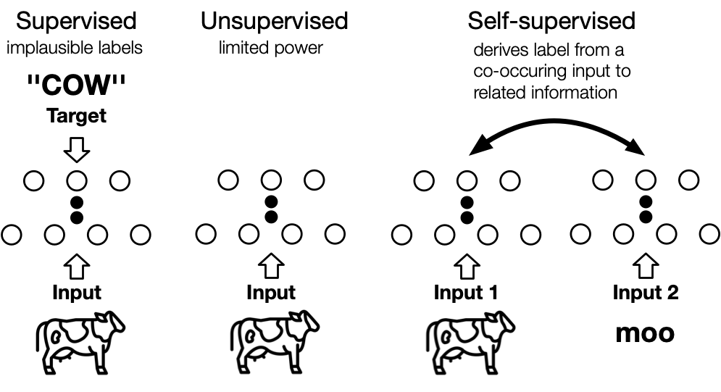
What is self-supervised learning
An illustration to distinguish the supervised, unsupervised and self-supervised learning framework. In self-supervised learning, the ``related information'' could be another modality, parts of inputs, or another form of the inputs.

Slide 5
What is self-supervised learning
Jitendra Malik: "Supervision is the opium of the AI researcher"
Alyosha Efros: "The AI revolution will not be supervised"
Yann LeCun: "self-supervised learning is the cake, supervised learning is the icing on the cake, reinforcement learning is the cherry on the cake"

Slide 6
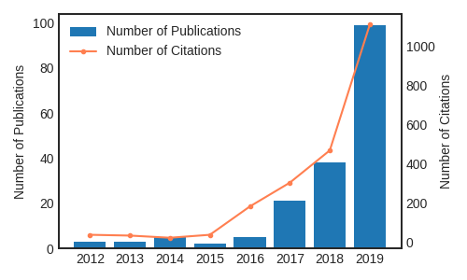
Soar in the SSL
Number of publications and citations on self-supervised learning from 2012-2019. Self-supervised learning is gaining huge attention in recent years. Data from Microsoft Academic Graph. This only includes paper containing the complete keyword ``self-supervised learning'', so the real number should be even larger.

Slide 7
2. Generative SSL

Slide 8
Generative SSL category
Auto-regressive (AR) model
Flow-based model
Auto-encoding (AE) model
Hybrid Generative models

Slide 9
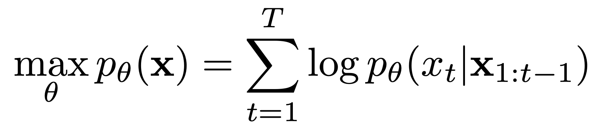
Auto-regressive (AR) model
Auto-regressive (AR) models can be viewed as “Bayes net structure” (directed graph model). The joint distribution can be factorized as a product of conditionals where the probability of each variable is dependent on the previous variables.
  GPT / GPT-2
  PixelCNN / PixelRNN
  GraphRNN / MRNN / GCPN

Slide 10
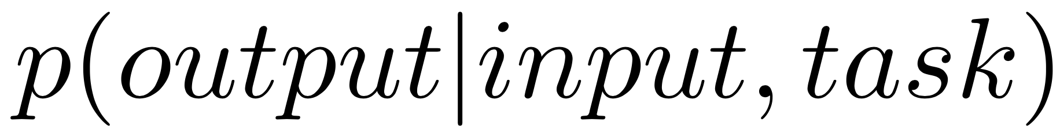
GPT/GPT-2 (NLP)
Improving language understanding by generative pre-training. (2018, Radford et al.)
  Maximizing the likelihood under the forward autoregressive factorization
  Use Transformer decoder architecture for language modeling
  Very good at text generation because it is a single-direction model

Slide 11
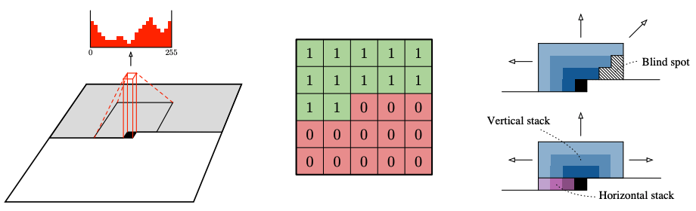
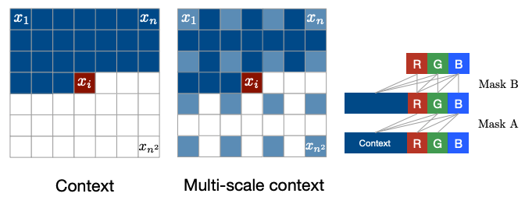
PixelCNN / PixelRNN (CV)
Pixel recurrent neural networks. (ICML 2016, Oord et al.)
Conditional image generation with pixelcnn decoders. (NIPS 2016, Oord et al.)
  use auto-regressive methods to model images pixel by pixel
PixelCNN
PixelRNN

Slide 12
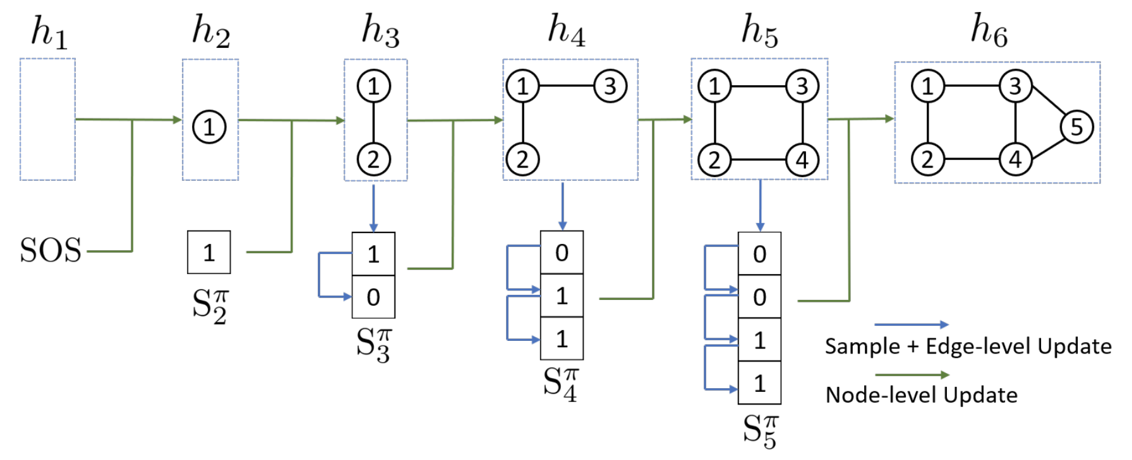
GraphRNN (Graph)
Graphrnn: Generating realistic graphs with deep auto-regressive models. (ICML 2018, You et al.)
  decompose the graph generation process into a sequence generation of nodes and edges conditioned on the graph generated so far.

Slide 13
MRNN / GCPN (Graph)
Molecularrnn: Generating realistic molecular graphs with optimized properties. (2019, Popova et al.)
Graph convolutional policy network for goal-directed molecular graph generation. (NIPS 2018, You et al.)
  use a reinforcement learning framework to generate molecule graphs through optimizing domain-specific rewards.
  MRNN mainly uses RNN-based networks
  GCPN employs GCN-based encoder networks

Slide 14
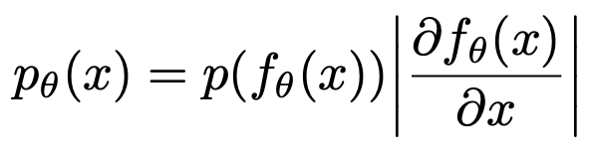
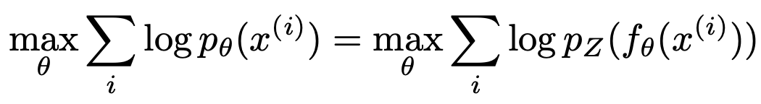
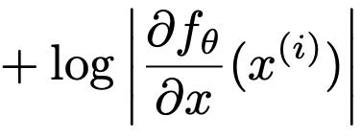
Flow-based Model
directly formalizing high dimensional densities p(x) is difficult.
we hope to generate it “step by step” by stacking a series of invertible transforming functions that describing different data characteristics respectively.
Advantage: mapping between x and z is invertible
  NICE / RealNVP / Glow

Slide 15
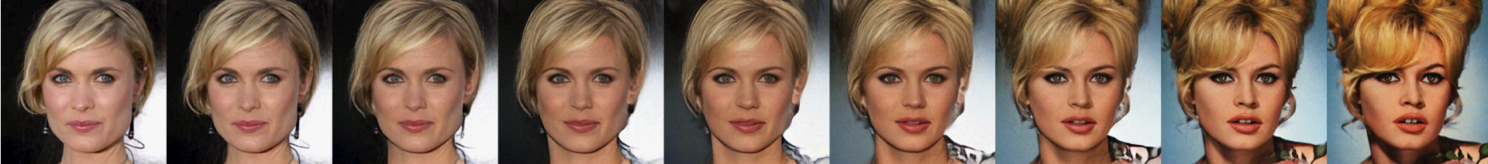
NICE / RealNVP / Glow (CV)
Nice: Non-linear independent components estimation. (2014, Dinh et al.)
Density estimation using real nvp (2016, Dinh et al.)
Glow: Generative flow with invertible 1x1 convolutions. (NIPS 2018, Kingma et al.)
  model learns disentangled transformation functions

Slide 16
Auto-encoding (AE) Model
reconstruct (part of) inputs from (corrupted) inputs
probably the most popular generative model due to its flexibility
  Basic AE Model
  Context Prediction Model (CPM)
  Denoising AE Model (DAE)
  Variational AE Model (VAE)

Slide 17
Basic AE Model
first introduced for pre-training artificial neural networks
Restricted Boltzmann Machine: a special AE
  Undirected graphical model
  Two layers: visible layer and hidden layer
  minimize the difference between the marginal distribution of models and data distributions
Basic AE
  Could be view as ``directed graphical model’’
  Encoder and Decoder
  linear autoencoder corresponds to the PCA method

Slide 18
Context Prediction Model (CPM)
predict contextual information based on inputs
  Word2Vec (CBOW or SkipGram)
  DeepWalk-based graph representation

Slide 19
Word2vec: CBOW / SkipGram (NLP)
Distributed representations of words and phrases and their compositionality (NIPS 2013, Mikolov et al.)
CBOW
  predict the input tokens based on context tokens
SkipGram
  predict context tokens based on input tokens
w(t)
w(t-2)
w(t-1)
w(t+1)
w(t+2)
sum
w(t-2)
w(t-1)
w(t+1)
w(t+2)
w(t)
CBOW
SkipGram

Slide 20
Deepwalk / LINE (Graph)
Deepwalk: Online learning of social representations. (KDD 2014, Perozzi et al.)
  samples truncated random walks to learn latent node embedding based on the Skip-Gram
  treats random walks as the equivalent of sentences
Line: Large-scale information network embedding (WWW 2015, Tang et al.)
  generate neighbors based on current nodes

Slide 21
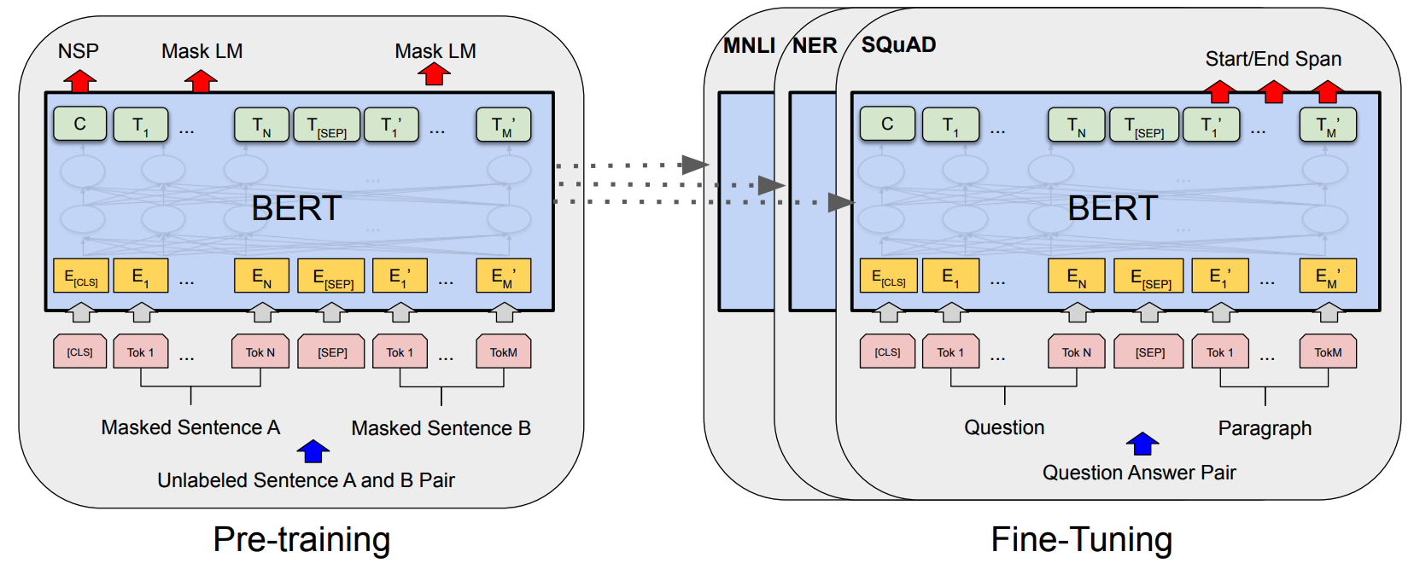
Denoising AE: BERT (NLP)
Intuition: representation should be robust to the introduction of noise
  Masked Language Model (MLM)
BERT: Pre-training of Deep Bidirectional Transformers for Language Understanding (NAACL 2019, Devlin et al.)
  [MASK]: a unique token introduced in the training process to mask some tokens
  Predict masked tokens based on their context information,
  Pre-train and fine-tune

Slide 22
SpanBERT / ERNIE (NLP)
Spanbert: Improving pre-training by representing and predicting spans. (TACL 2020, Joshi et al.)
  mask continuous random spans rather than random tokens
  trains the span boundary representations to predict the masked spans
Ernie: Enhanced representation through knowledge integration (2019, Sun et al.)
  masks entities or phrases to learn entity-level and phrase-level knowledge
Ernie: Enhanced language representation with informative entities. (2019, Zhang et al.)
  integrates knowledge (entities and relations) in knowledge graphs into language models

Slide 23
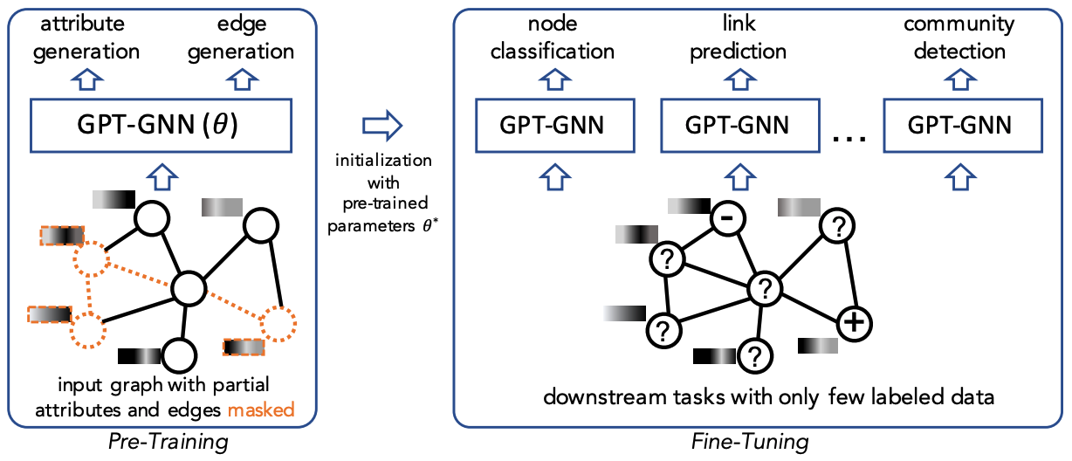
GPT-GNN (Graph)
GPT-GNN: Generative Pre-Training of Graph Neural Networks (KDD 2020, Hu et al.)

Slide 24



Variational AE
Assumes that data are generated from underlying latent (unobserved) representation
Posterior distribution
  Unobserved variables
  Estimation:
Evidence Lower Bound (ELBO)
  VAE
  VQ-VAE / VQ-VAE 2
  VGAE / DVNE / vGraph

Slide 25
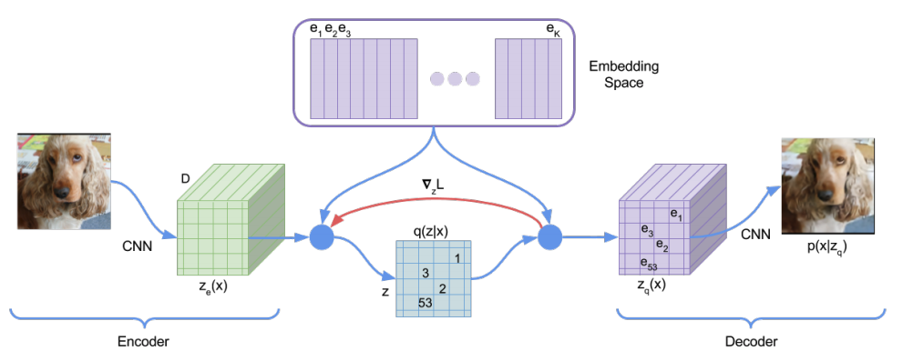
VAE / VQ-VAE (CV)
Auto-encoding variational bayes. (2013, Kingma et al.)
  Assume continuous latent variables
  Assume latent distribution conforms to normal distribution
Neural discrete representation learning (NIPS 2017, Oord et al.)
  Learn discrete latent variables: many modalities are inherently discrete
  Vector Quantization (VQ): the discrete latent variables are calculated by the nearest neighbor lookup using a shared, learnable embedding table

Slide 26
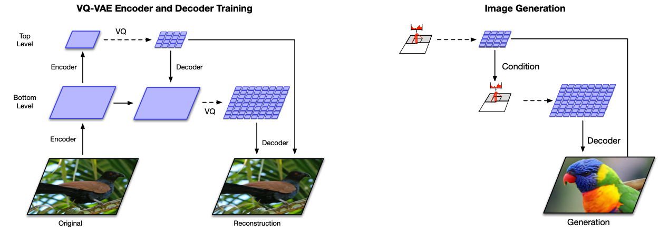
VQ-VAE 2 (CV)
Generating diverse high-fidelity images with vq-vae-2 (NIPS 2019, Razavi et al.)
  Using a powerful PixelCNN prior (rather than normal distribution)
  multi-scale hierarchical organization for local and global information

Slide 27
VGAE / DVNE / vGraph (Graph)
VGAE: Variational graph auto-encoders (2016, Kipf et al.)
  Using the same variational inference technique as VAE with graph
  convolutional networks (GCN) as the encoder
  The objective is to reconstruct the adjacency matrix of the graph by measuring node proximity
DVNE: Deep variational networkembedding in wasserstein space. (SIGKDD,2016, Kipf et al.)
  Learning Gaussian node embedding to model the uncertainty of nodes
  Using 2-Wasserstein distance to measure the similarity between the distributions for its effectiveness in preserving network transitivity
vGraph: Deep variational networkembedding in wasserstein space. (SIGKDD,2016, Kipf et al.)
  Performing node representation learning and community detection collaboratively through a generative variational inference framework

Slide 28
Hybrid Generative Models
Combine the advantages of different models
  Combining AR and AE Model
  Combining AE and Flow-based Models

Slide 29
  Combining AR and AE Model
Intuition: combine the advantages of both AR and AE
  MADE
  XLNet

Slide 30
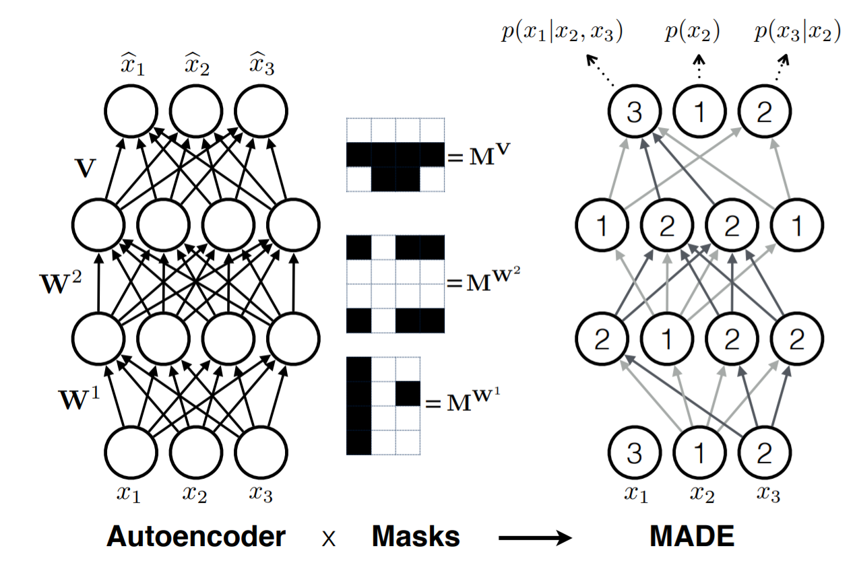
MADE (CV)
MADE: Masked autoencoder for distribution estimation (2015, Mathieu et al.)
  Masking the autoencoder’s parameters to respect auto-regressive constraints
  Can be easily parallelized on conditional computations, and can get direct and cheap estimates of high-dimensional joint probabilities

Slide 31
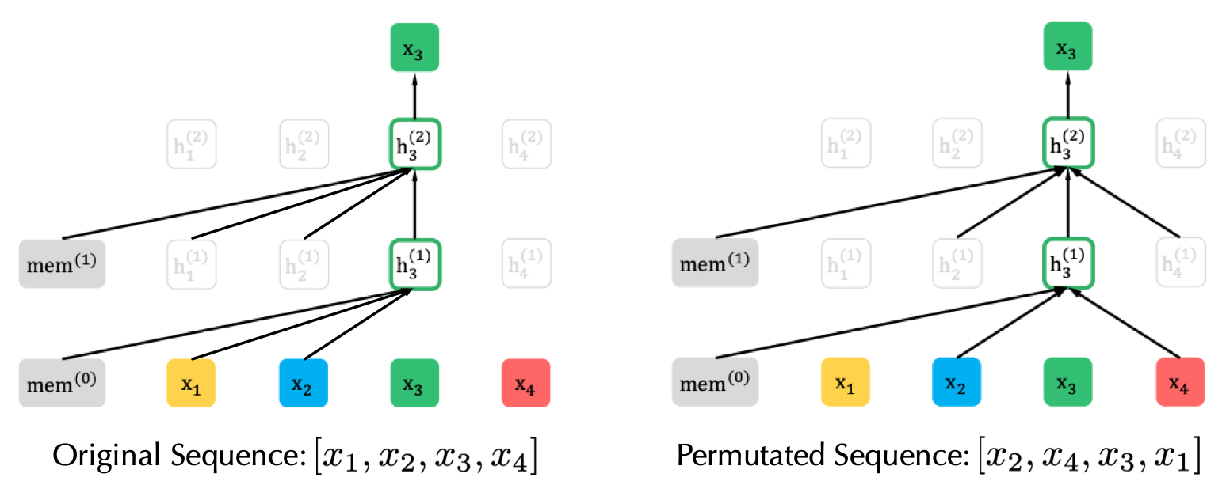
XLNet (NLP)
XLNet: Generalized autoregressive pretraining for language understanding (NIPS 2019, Yang et al.)
  PLM: Permutation Language Model
    Based-on AR model
    learning bidirectional contexts by permutation
    reparameterization and a special two-stream self-attention for target-aware prediction
  Transformer-XL: Extra Long Transformer
    segment recurrence mechanism + relative encoding scheme

Slide 32
  Combining AE and Flow-based Models
Intuition: combine the advantages of both AE and Flow-based models
  GraphAF

Slide 33
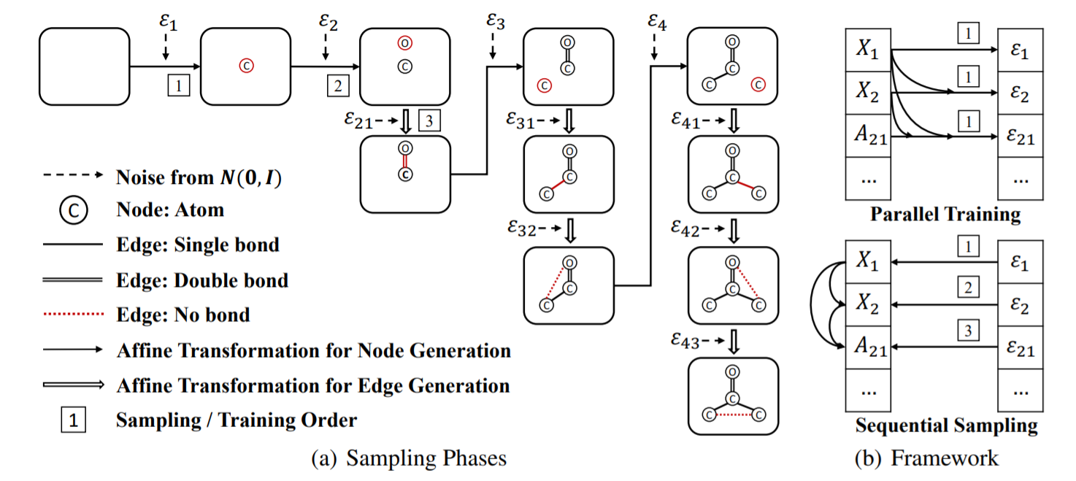
GraphAF (Graph)
GraphAF: a flow-based autoregressive model for molecular graph generation (2020, Shi et al.)
  a flow-based autoregressive model for the molecule graph generation
  incorporates detailed domain knowledge into the reward design
  defines an invertible transformation from a base distribution (e.g., multivariate Gaussian) to a molecular graph structure

Slide 34
3. Contrastive Self-supervised Learning

Slide 35
Contrastive Self-supervised Learning
Context-Instance Contrast
Context-Context Contrast
Self-supervised Contrastive Pre-training for Semi-supervised Self-training

Slide 36
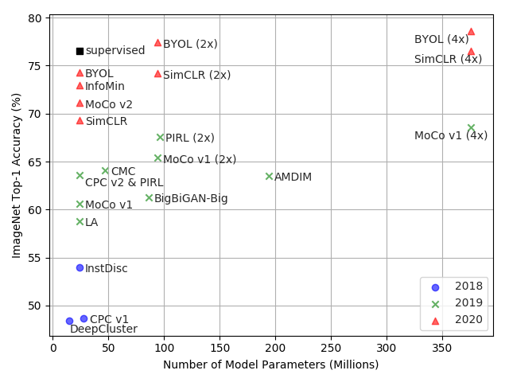
Boost in contrastive pre-training

Slide 37
Context-Instance Contrast
The context-instance contrast, or so-called global-local contrast, focuses on modeling the belonging relationship between the local feature of a sample and its global context representation.
  Predict Relative Position (PRP)
  Maximize Mutual Information (MI)

Slide 38
Predict Relative Position
Focuses on learning relative positions between local components.
The global context serves as an implicit requirement for predicting these relations
  RotNet / Jigsaw / PIRL
  ALBERT

Slide 39
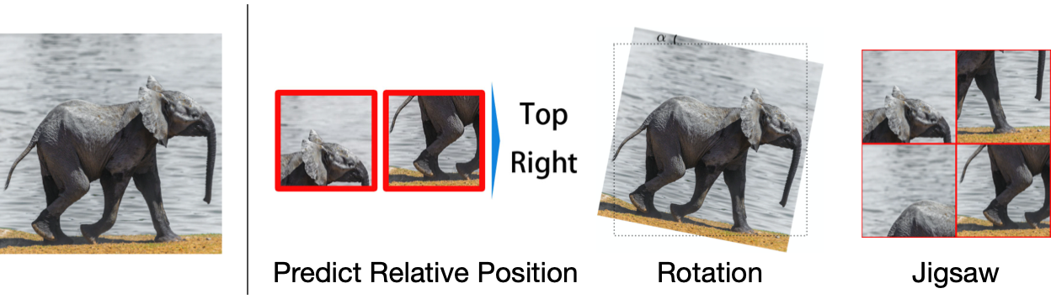
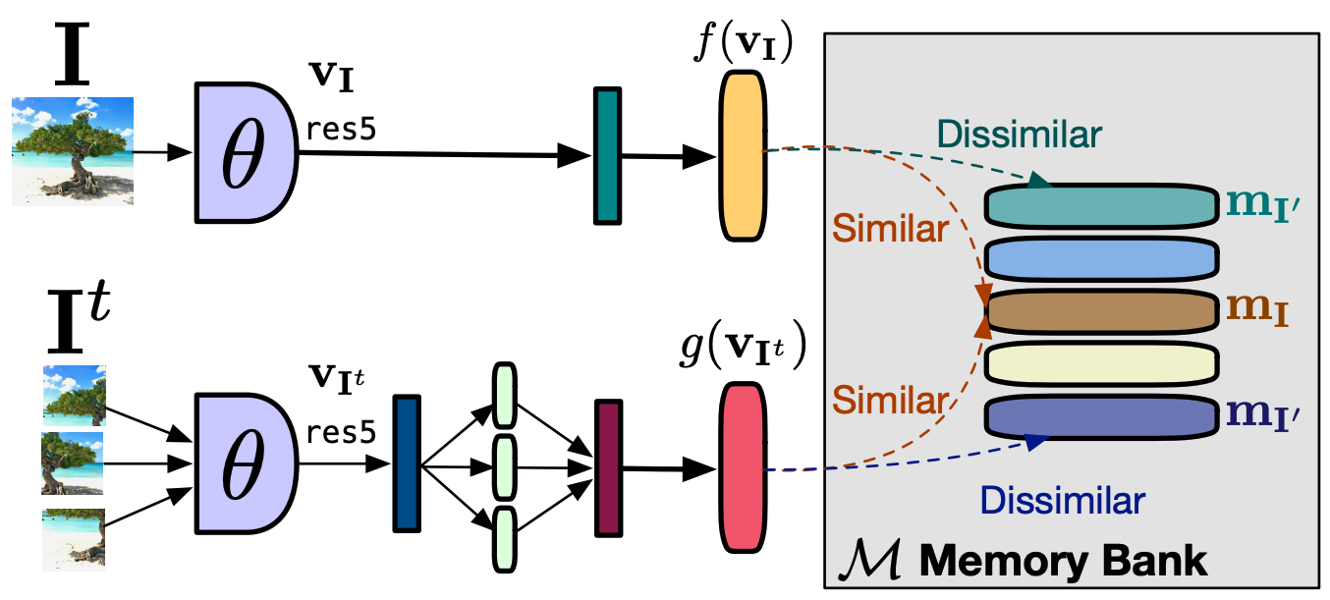
RotNET / Jigsaw / PIRL (CV)
Self-Supervised Learning of Pretext-Invariant Representations (CVPR 2019, Misra et al.)
  PIRL for short
  Use jigsaw pretext task

Slide 40
ALBERT (NLP)
ALBERT: A lite bert for self-supervised learning of language representations (2019, Lan et al.)
  proposes Sentence Order Prediction (SOP) task to replace Next Sentence Prediction (NSP)
  in NSP, the negative next sentence is sampled from other passages that may have different topics with the current one, turning the NSP into a far easier topic model problem.
  in SOP, two sentences that exchange their position are regarded as a negative sample, making the model concentrate on the coherence of the semantic meaning.

Slide 41
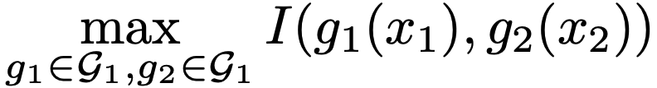
Maximize Mutual Information (MI)
focuses on learning the explicit belonging relationships between local parts and global context. The relative positions between local parts are ignored.
Generally, this kind of models optimize
  Deep InfoMax / CPC
  AMDIM / CMC
  InfoWord
  Deep Graph InfoMax (DGI) / InfoGraph
  S²GRL

Slide 42
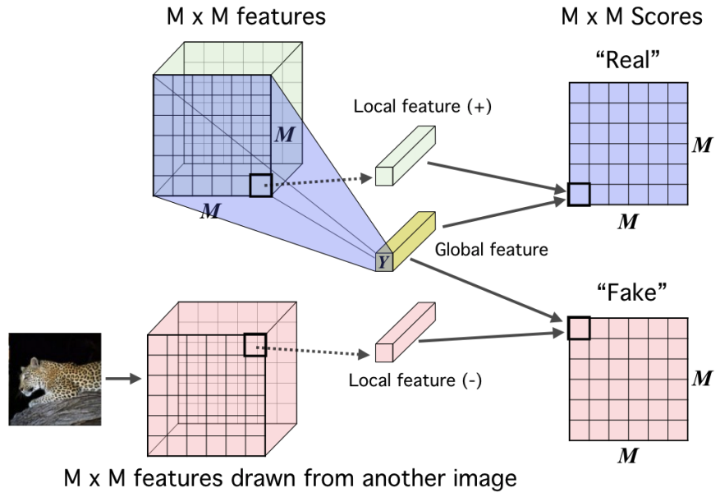
  Deep InfoMax (CV)
Deep InfoMax: Learning deep representations by mutual information estimation and maximization (2018, Hjelm et al.)
  the first one to explicitly model mutual information through a contrastive learning task, which maximize the MI between a local patch and its global context.
  provides us with a new paradigm and boosts the development of self-supervised learning.

Slide 43
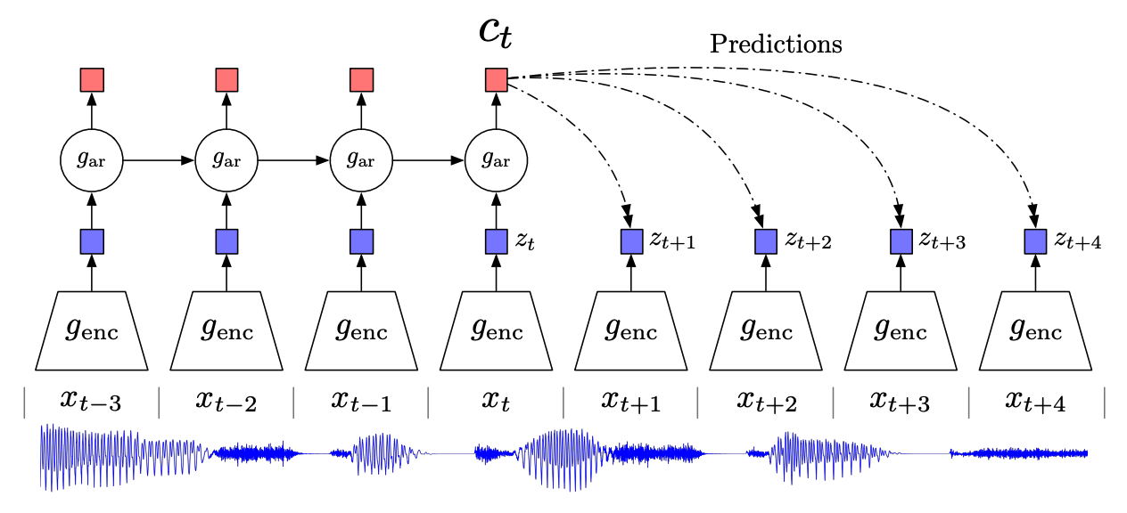
CPC (Audio / CV)
CPC: Representation learning with contrastive predictive coding. (2018, Oord et al.)
  a follower of Deep InfoMax for speech recognition
  maximize the association between a segment of audio and its context audio and its context audio
  also being applied to CV

Slide 44
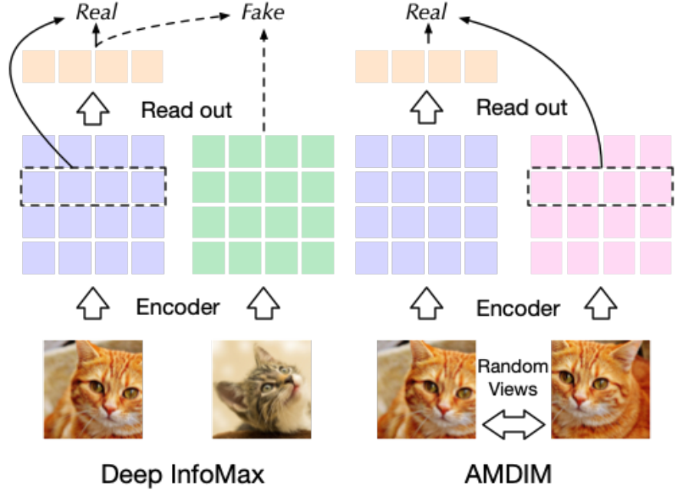
  AMDIM (CV)
AMDIM: Learning representations by maximizing mutual information across views (NIPS 2019, Bachman et al.)
  enhances the positive association between a local feature and its context
CMC: Contrastive multi-view coding (2019, Tian et al.)
  extends single enhanced positive view to multi-view

Slide 45
  InfoWord
A mutual information maximization perspective of language representation learning (2019, Kong et al.)
  proposes to maximize the mutual information between a global representation of a sentence and n-grams in it
  The context is induced from the sentence with selected n-grams being masked, and the negative contexts are randomly picked out from the corpus

Slide 46
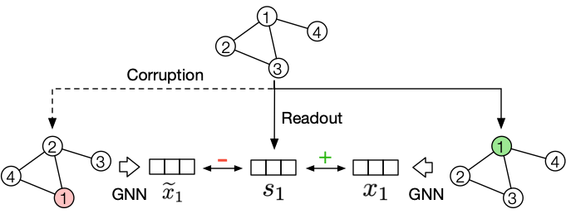
  Deep Graph InfoMax (Graph)
Deep graph infomax (2018, Velickovic et al.)
  considers a node’s representation as the local feature and the average of randomly samples 2-hop neighbors as the context
  To generate negative contexts, DGI proposes to corrupt the original context by keeping the sub-graph structure and permuting the node features

Slide 47
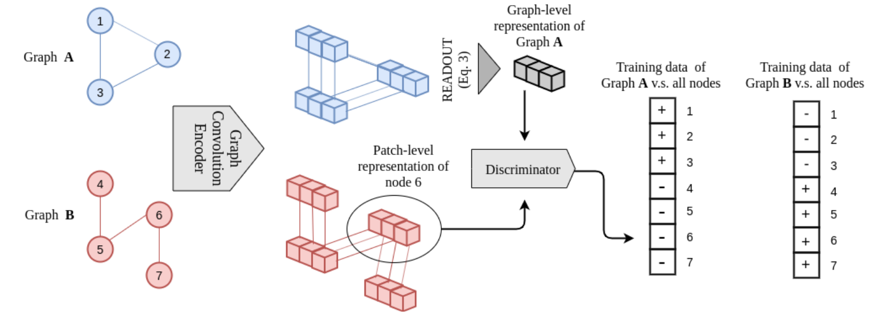
InfoGraph (Graph)
Infograph: Unsupervised and semi-supervised graph-level representation learning via mutual information maximization
(2019, Sun et al.)
  targets at learning graph-level representation rather than node level, maximizing the mutual information between graph-level representation and substructures at different levels

Slide 48
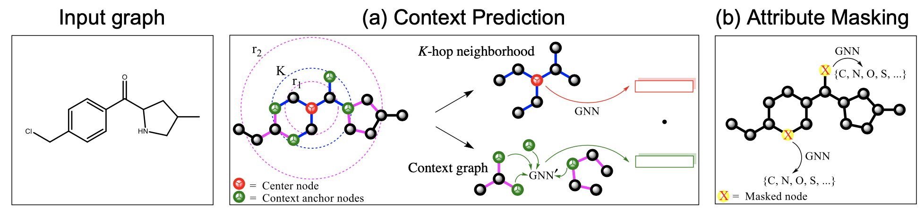
  Strategies Pre-train GNN / S²GRL (Graph)
Strategies for Pre-graining Graph Neural Networks (ICLR 2020, Hu et al.)
  Context prediction: MI-based contrastive objective
  Attribute masking: DAE-based generative objective
Self-Supervised Graph Representation Learning via Global Context Prediction (2020, Peng et al.)
  K-hop context prediction

Slide 49
Context-Context Contrast
Recently, MoCo and SimCLR outperform the context-instance-based methods and achieve a competitive result to supervised methods under the linear classification protocol, through a context-to-context level direct comparison.
  Cluster-based Discrimination
  Instance Discrimination

Slide 50
Cluster-based Discrimination
Context-context contrast is first studied in clustering-based methods
  Deep Cluster
  Local Aggregation
  ClusterFit

Slide 51
  Deep Cluster
Deep clustering for unsupervised learning of visual features (ECCV 2018, Caron et al.)
  Image classification asks the model to categorize images correctly, and the representation of images in the same category should be similar. Therefore, the motivation is to draw similar images near in the embedding space
  In self-supervised learning, to solve the label problem, the model proposes to leverage clustering to yield pseudo labels and asks a discriminator to predict on images’ label

Slide 52
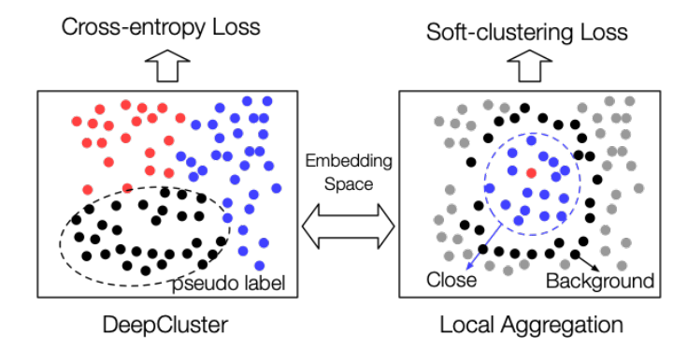
  Local Aggregation
Local aggregation for unsupervised learning of visual embeddings (IEEE ICCV 2019, Zhuang et al.)
  Identifies neighbors separately for each example
  employs an objective function that directly optimizes a local soft-clustering metric

Slide 53
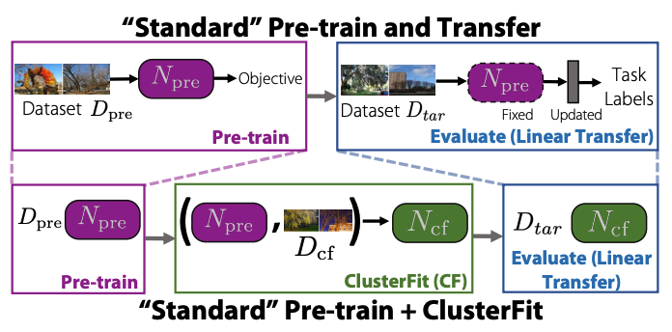
  ClusterFit
Clusterfit: Improving generalization of visual representations (2019, Yan et al.)
  introduces a cluster prediction fine-tuning stage similar to DeepCluster between the above two stages, which improves the representation’s performance on downstream classification evaluation

Slide 54
Instance Discrimination
The prototype of leveraging instance discrimination as a pretext task is InstDisc.
  Moco
  SimCLR
  InfoMin
  BYOL
  GCC

Slide 55
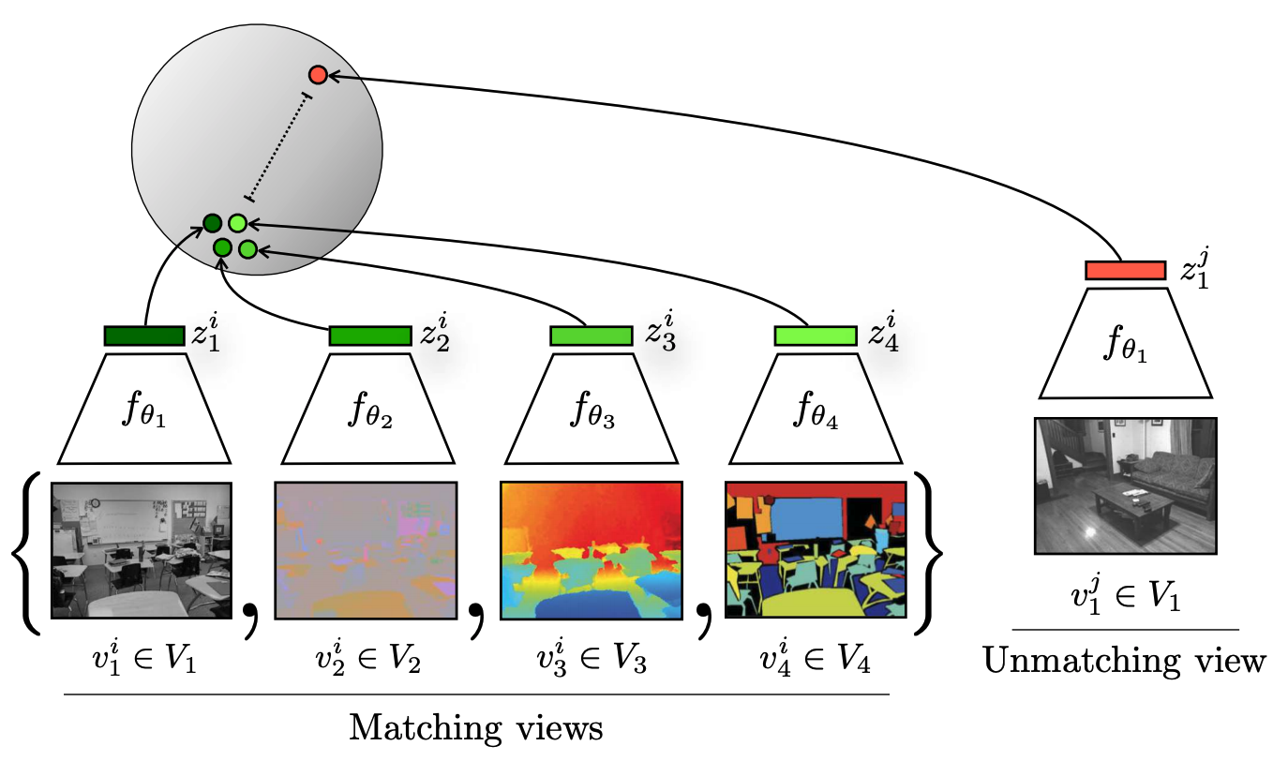
CMC (CV)
CMC: Contrastive multi-view coding (2019, Tian et al.)
  proposes to measure the context-context similarity rather than context-instance similarity

Slide 56
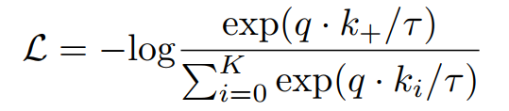
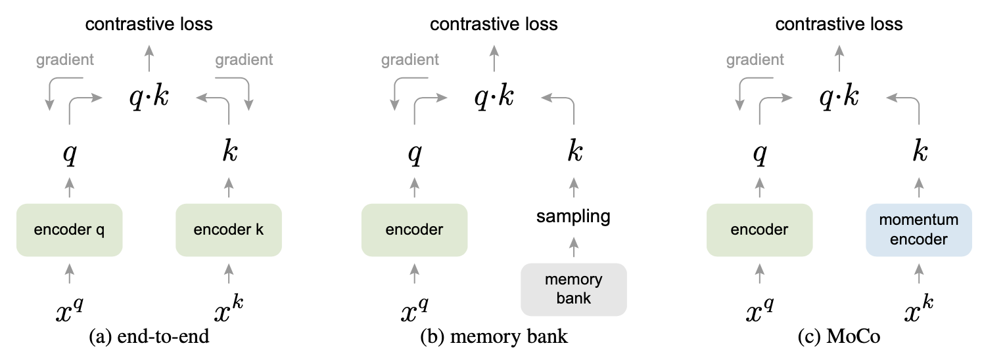
  MoCo / MoCo v2 (CV)
Momentum contrast for unsupervised visual representation learning (2019, He et al.)
  leveraging instance discrimination via momentum contrast
  optimize the following objective
  designs the momentum contrast learning with two encoders
  employs a queue to save the recently encoded batches as negative samples

Slide 57
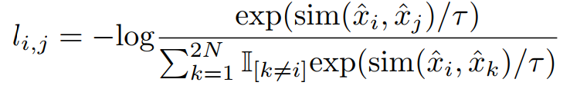
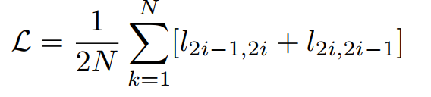
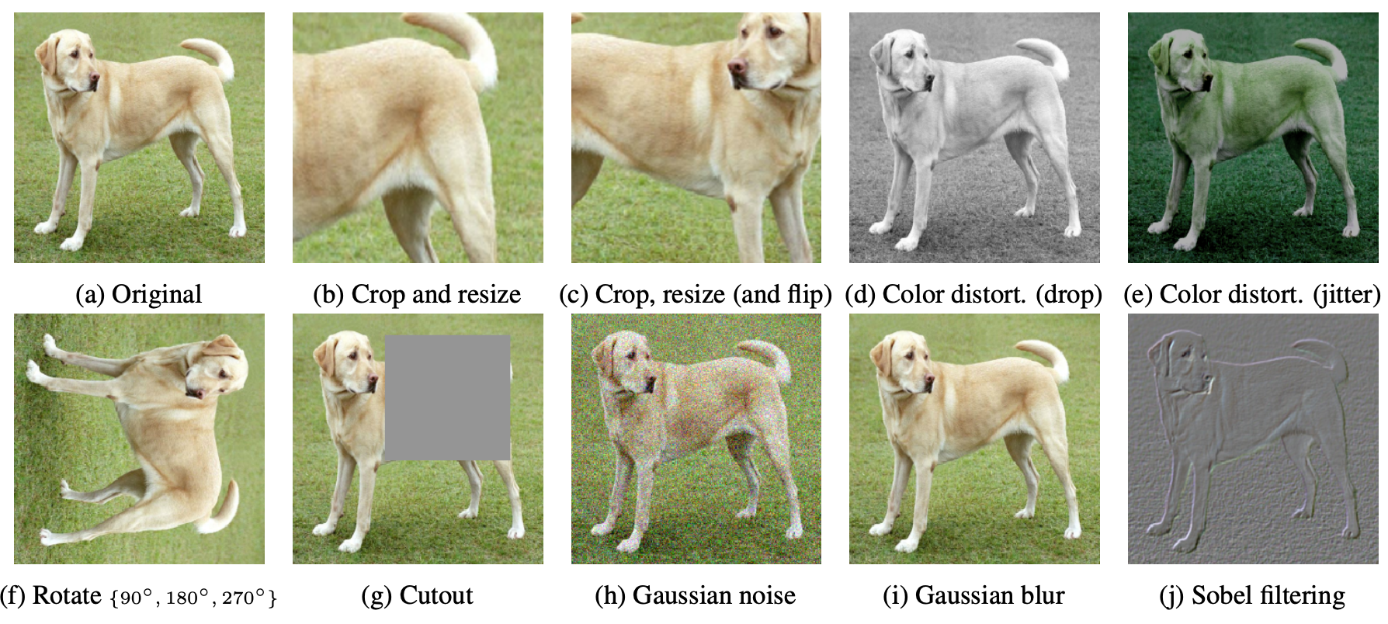
  SimCLR
A simple framework for contrastive learning of visual representations (2020, Chen et al.)
  further illustrate the importance of a hard positive sample strategy by introducing data augmentation in 10 forms
  use the pairwise contrastive loss NT-Xent loss

Slide 58
  InfoMin (CV)
What makes for good views for contrastive learning (2020, Tian et al.)
  claim that for better augmented views in contrastive learning, we should select those views with less mutual information
    Unsupervised method: reduce MI between views
    Semi-supervised method: reduce MI while preserving label-related information

Slide 59
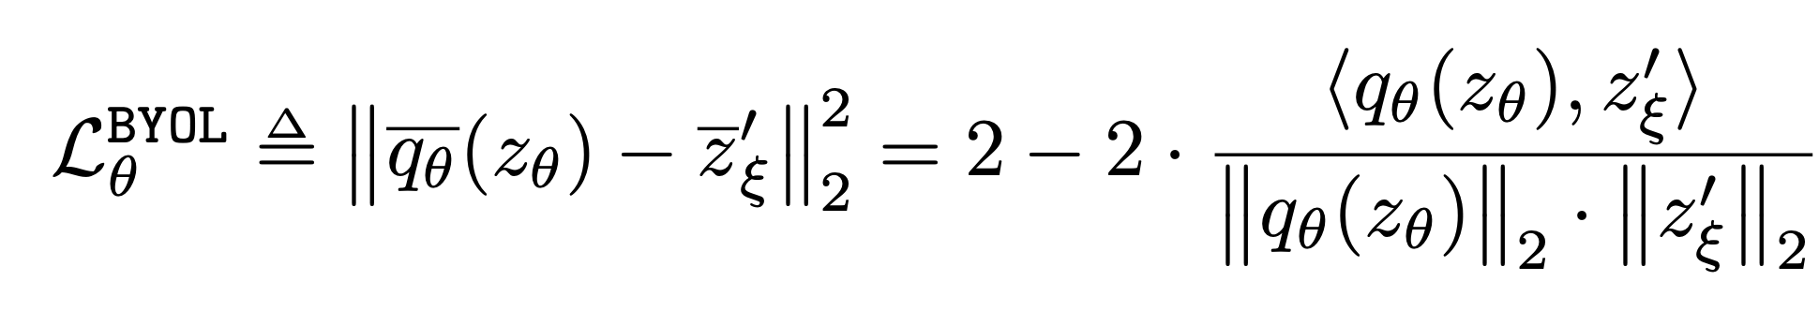
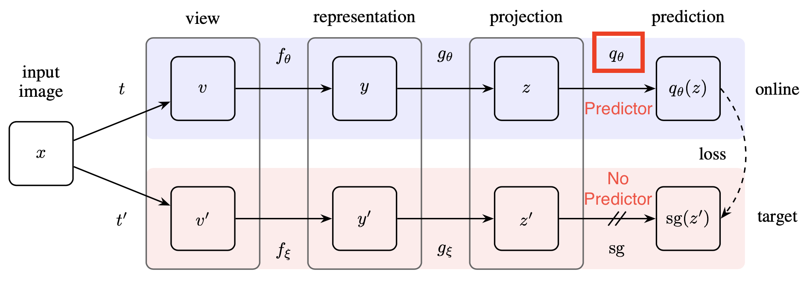
  BYOL
Bootstrap your own latent: A new approach to self-supervised
learning (2020, Grill et al.)
  discards negative sampling in self-supervised learning but achieve an even better result over InfoMin
  regression loss rather than cross-entropy loss

Slide 60
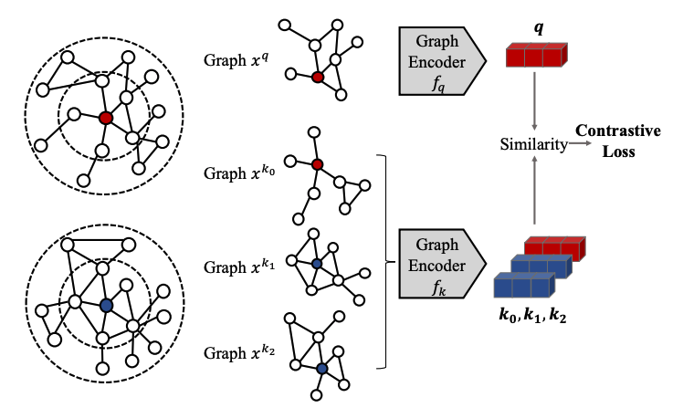
  Graph Contrastive Coding (GCC)
Gcc: Graph contrastive coding for graph neural network pre-training(2020,Qiu et al.)
  a pioneer to leverage instance discrimination as the pretext task for structural information pre-training

Slide 61
Self-supervised Contrastive Pre-training for Semi-supervised Self-training
No matter how self-supervised learning models improve, they are still only powerful feature extractor, and to transfer to downstream task we still need abundant labels. And to bridge the gap between self pretraining and downstream task, semi-supervised learning is exactly what we are looking for.
The success in combining self-supervised contrastive pretraining and semi-supervised self-training open up our eyes
for a future data efficient deep learning paradigm. More
work is expected for investigating their latent mechanisms.

Slide 62
SimCLR v2 (CV)
Big Self-Supervised Models are Strong Semi-Supervised Learners (2020, Ting et al)
  Three-step framework to combine contrastive SSL and self-training semi-supervised learning
    Self-supervised pre-training: the same as SimCLR.
    Fine-tuning with 1% or 10% of ImageNet labels.
    Self-training: used fine-tuned model as teacher network to yield labels on unlabeled data to train a smaller student network
  Other architecture modifications
  Outperform supervised learning with only 10% of original labels

Slide 63
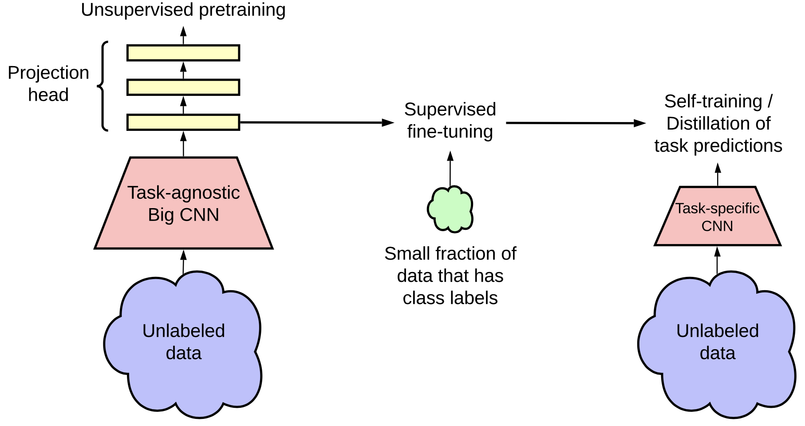
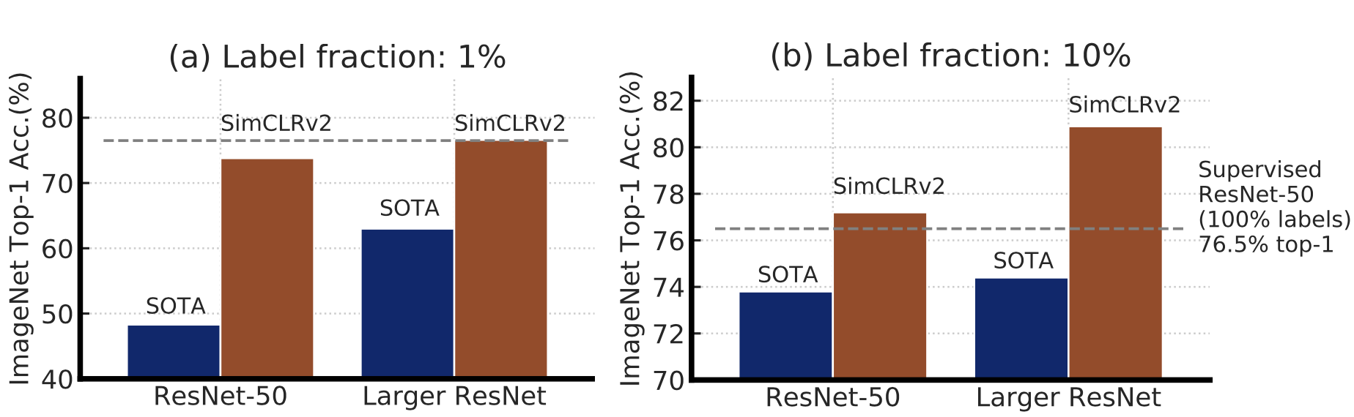
SimCLR v2 (CV)

Slide 64
4. Generative-Contrastive (Adversarial) Self-supervised Learning

Slide 65
Generative-Contrastive (Adversarial) Self-supervised Learning
Why Generative-Contrastive (Adversarial)?
Generate with Complete Input
Recover with Partial Input
Pre-trained Language Model
Graph Learning
Domain Adaptation and Multi-modality Representation

Slide 66
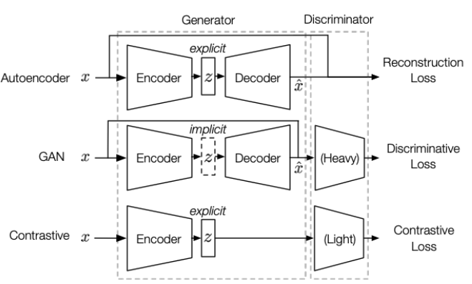
Why Generative-Contrastive (Adversarial)?
Generative SSL: maximum likelihood estimation (MLE)
  Two fatal problems
    sensitive and conservative distribution
    low-level abstraction
Discriminative and contrastive objectives can solve
  adversarial methods absorb merits from both generative and contrastive methods together with some drawbacks.

Slide 67
Generate with Complete Input
The inception of adversarial representation learning should be attributed to Generative Adversarial Networks (GAN), which proposes the adversarial training framework.
Follow GAN, many variants emerge and reshape people’s understanding of deep learning’s potential.
  GAN
  AAE
  BiGAN / ALI

Slide 68
  GAN
Unsupervised representation learning with deep convolutional generative adversarial networks (2015, Radford et al.)
  optimize this min-max game
  However, there is a gap between generation and representation. Compared to autoencoder’s explicit latent sample distribution p_{z}(z), GAN’s latent distribution p_{z}(z) is implicitly modeled. We need to extract this implicit distribution out.

Slide 69
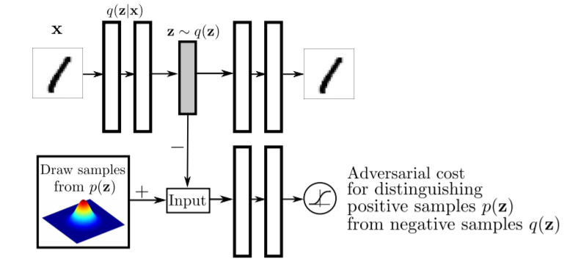
  AAE
Adversarial autoencoders. (2015, Makhzani et al.)
  To bridge the gap of the GAN, AAE first proposes a solution to
  follow the natural idea of the autoencoder.
  replace the generator with an explicit variational autoencoder (VAE).
  substitutes the KL divergence function to a discriminative loss
  However, AAE still preserves the reconstruction error, which contradicts with GAN’s core idea.

Slide 70
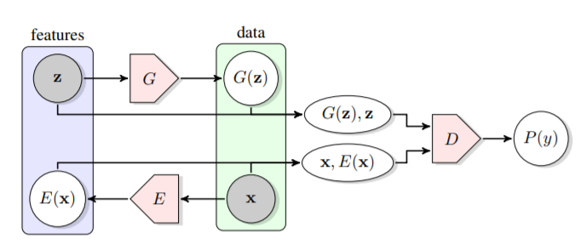
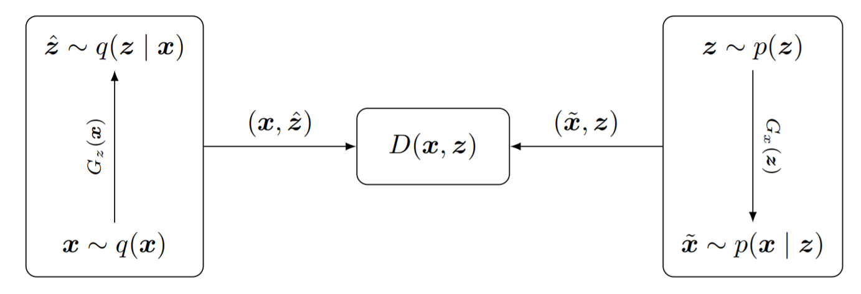
  BiGAN / ALI
BiGAN: Adversarial feature learning (2016, Donahue et al.)
ALI: Adversarially learned inference (2016, Dumoulin et al.)
  embrace adversarial learning without reservation and put forward a new framework.
  The training goal is that encoder should learn to “convert” generator. The distribution does not make any assumption about the data itself. The distribution is shaped by the discriminator, which captures the semantic-level difference
  v

Slide 71
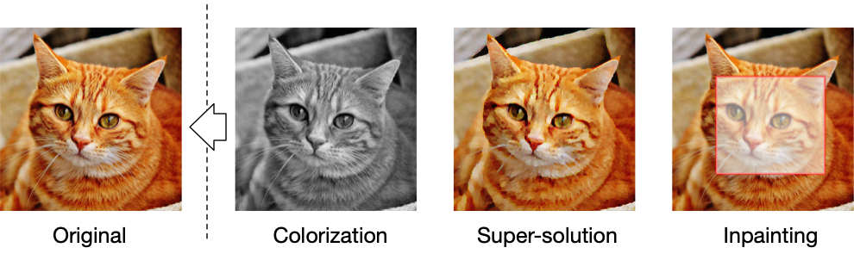
Recover with Partial Input
GAN’s architecture is not born for representation learning, and modification is needed to apply its framework.
  colorization
  inpainting
  super-resolution

Slide 72
  Colorization (CV)
Colorful image colorization (ECCV 2016, Zhang et al.)
  the problem can be described as given one color channel in an image
  and to predict the value of two other channels
  the encoder and decoder networks can be set to any form of convolutional neural networks
  transforms the generation task into a classification one

Slide 73
  Inpainting (CV)
Globally and locally consistent image completion (ACM ToG 2017, Iizuka et al.)
Context encoders: Feature learning by inpainting (CVPR 2016, Pathak et al.)
  ask the model to predict an arbitrary part of an image given the rest of it
  a discriminator is employed to distinguish the inpainted image with the original one

Slide 74
  Super-resolution (CV)
Photo-realistic single image super-resolution using a generative adversarial network (CVPR 2017, Ledig et al.)
  recover high-resolution images from blurred low-resolution ones in the adversarial setting

Slide 75
Pre-trained Language Model
For a long time, the pre-trained language model (PTM) focuses on maximum likelihood estimation based pretext task, because discriminative objectives are thought to be helpless due to languages’ vibrant patterns. However, recently some work shows excellent performance and sheds light on contrastive objectives’ potential in PTM.
  ELECTRA
  WKLM / REALM

Slide 76
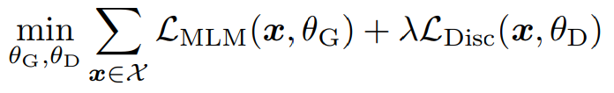
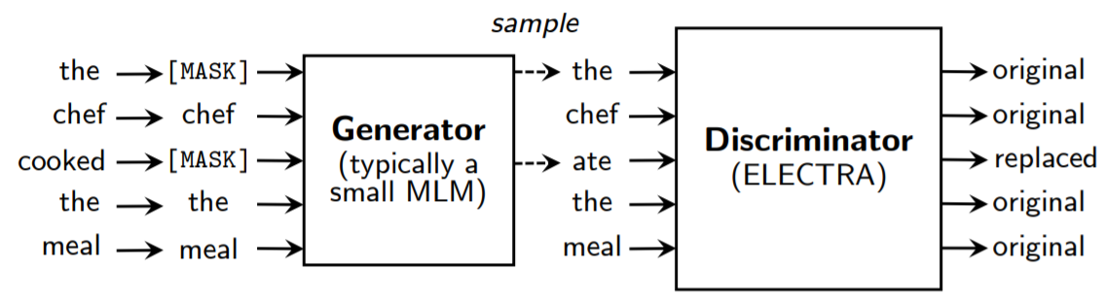
  ELECTRA
ELECTRA: Pretraining text encoders as discriminators rather than generators (2020, Clark et al.)
  ELECTRA proposes Replaced Token Detection (RTD) and leverages GAN’s structure to pre-train a language model
  The final objective could be written as

Slide 77
  WKLM / REALM
WKLM: Pretrained encyclopedia: Weakly supervised knowledge-pretrained language model (2019, Xiong et al.)
  For entities in Wikipedia paragraphs, WKLM replaced them with similar entities and trained the language model to distinguish them in a similar discriminative objective as ELECTRA, performing quite well in downstream tasks like question answering
Realm: Retrieval-augmented language model pre-training (2020, Guu et al.)
  conducts higher article-level retrieval augmentation to the language model.
  not using the discriminative objective.

Slide 78
Graph Learning
In graph learning, there are also attempts to utilize adversarial learning. Interestingly, their ideas are quite different from each other.
  Adversarial Network Embedding (ANE)
  GraphGAN
  GraphSGAN

Slide 79
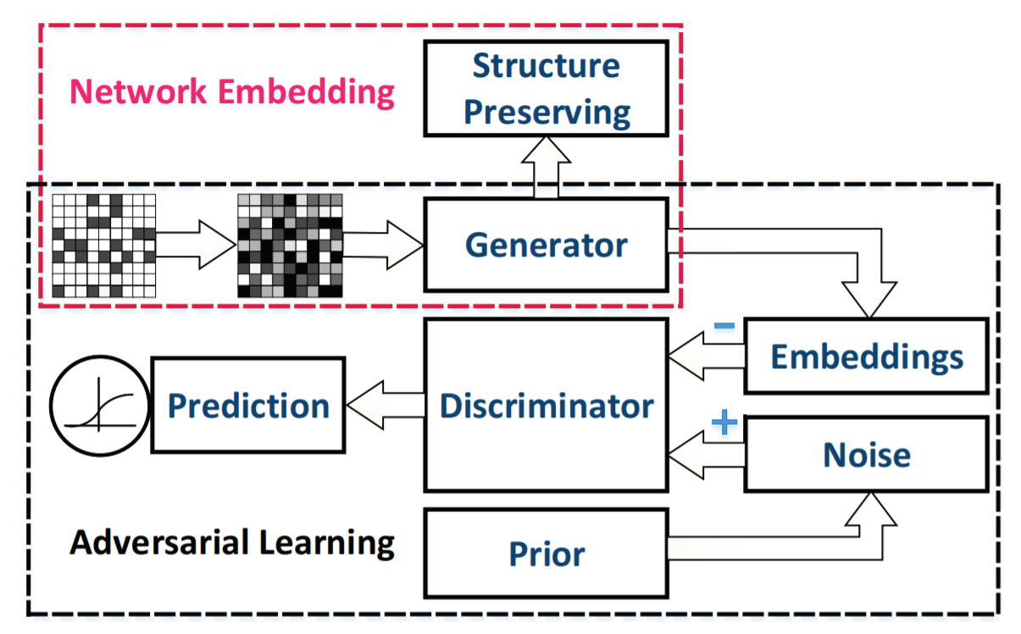
  Adversarial Network Embedding (ANE)
Adversarial network embedding (AAAI 2018, Dai et al.)
  designs a generator G that is updated in two stages: 1) G encodes sampled graph into target embedding and computes traditional NCE with
  a context encoder F like Skip-gram, 2) discriminator D is asked to distinguish embedding from G and a sampled one from a prior distribution.
  The optimized objective is a sum of the above two objectives, and the generator G could yield better node representation for the classification task.

Slide 80
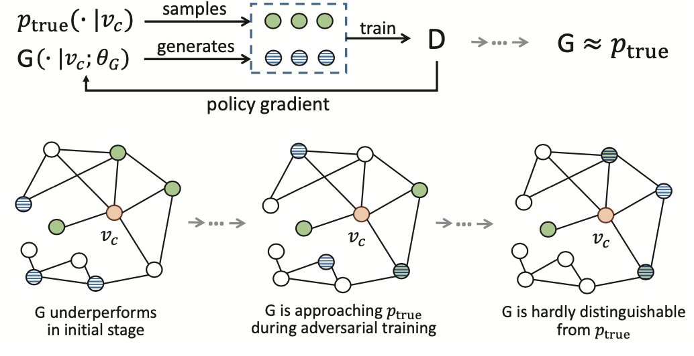
  GraphGAN
Graphgan: Graph representation learning with generative adversarial nets (AAAI 2018, Wang et al.)
  considers to model the link prediction task and follow the original GAN style discriminative objective to distinguish directly at node-level rather than representation-level.

Slide 81

  GraphSGAN
Semi-supervised learning on graphs with generative adversarial nets (ACM CIKM 2018, Ding et al.)
  applies the adversarial method in semisupervised graph learning with the motivation that most classification errors in the graph are caused by marginal nodes

Slide 82
Domain Adaptation and Multi-modality Representation
Essentially, the discriminator in adversarial learning serves to match the discrepancy between latent representation distribution and data distribution.
This function naturally relates to domain adaptation and multi-modality representation problems, which aim at aligning different representation distribution.

Slide 83
5. Theory behind Self-supervised Learning

Slide 84
Theory behind Self-supervised Learning
GAN
Maximizing Lower Bound
Contrastive Self-supervised Representation Learning

Slide 85
GAN
As generative models, GANs pays attention to the difference between real data distribution and generated data distribution.
An important drawback of supervised learning is that it easily get trapped into spurious information. As an alternative, GAN show its superior potential in learning disentangled features empirically and theoretically.
  Divergence Matching
  Disentangled Representation

Slide 86
  Divergence Matching
Different divergence functions leads to different GAN variants.
  f-GAN

Slide 87
  f-GAN
f-gan: Training generative neural samplers using variational divergence minimization (NIPS 2016, Nowozin et al)
  shows that the generative-adversarial approach is a special case of an exsiting more general variational divergence estimation problem and uses f-divergence to train the generative models
  the optimization target of the minmax GAN is

Slide 88

  Divergence Matching
GAN show its superior potential in learning disentangled features empirically and theoretically.
  InfoGAN

Slide 89

  InfoGAN
Infogan: Interpretable representation learning by information maximizing generative adversarial nets (NIPS 2016, Chen et al)
  first proposes to learn disentangled representation with DCGAN
  Since mutual information is notoriously hard to compute, the authors leverage the variational inference approcach to estimates its lower bound, and the final objective for InfoGAN is modified as:
  Experiments show that InfoGAN surely learns a good disentangled representation on MNIST

Slide 90
Maximizing Lower Bound
Maximizing Lower Bound
  Evidence Lower Bound
  Mutual Information

Slide 91

  Evidence Lower Bound
VAE learns the representation through learning a distribution qφ(z|x) to approximate the posteriori distribution pθ(z|x):
VAE maximizes the ELBO to minimize the difference between qφ(z|x) and pθ(z|x)

Slide 92

  Mutual Information
Most of current contrastive learning methods aim to maximize the MI of the input and its representation with joint density p(x| y) and marginal densities p(x) and p(y):
  Deep Infomax
  InfoNCE

Slide 93
  Deep Infomax
Learning deep representations by mutual information estimation and maximization (2018, Hjelm et al)
  maximizes the MI of local and global features and replaces KL-divergence with JS-divergence
  the optimization target is
  From a probability point of view, GAN and Deep InfoMax are derived from the same process but for a different learning target

Slide 94

  InfoNCE
Representation learning with contrastive predictive coding (2018, Oord et al)
  Instance Discrimination directly optimizes the proportion of gap of positive pairs and negative pairs. One of the commonly used estimators is InfoNCE:
  Therefore the MI I(x| y) ≥ log(N) - L. The approximation becomes increasingly accurate, and I(x| y) also increases as N grows.

Slide 95

  InfoNCE
Representation learning with contrastive predictive coding (2018, Oord et al)
  MI maximization can also be analyzed from the metric learning view. By connecting InfoNCE to the triplet (k-plet) loss in deep learning community. The InfoNCE can be rewriten as follows:
  In particular f is contrained to the form f(x; y) =φ(x)^{T} φ(y) for a certain function φ. Then the InfoNCE is corresponding to the expectation of the multi-class k-pair loss:

Slide 96
Contrastive Self-supervised Representation Learning
  Relationship with Supervised Learning
  Understand Contrastive Loss
  Generalization

Slide 97

  Relationship with Supervised Learning
reaches higher accuracy with fewer labels but plateaus to the same accuracy as baseline, and converges to baseline performance before accuracy plateaus
cannot help on improving accuracy
self-supervised trained neural networks are more robust and stable
Outperform supervised distribution in out-of-distribution detection on difficult, near-distribution outliers

Slide 98


  Understand Contrastive Loss
theoretical analysis on functions of contrastive loss, and split it into two terms:
directly optimize alignment and uniformity loss as:
The success of BYOL raises doubt that whether alignment and
uniformity are necessarily in the form of upper two losses. This illustrates us that we may still achieve uniformity via other techniques

Slide 99

  Generalization
Contrastive learning assumes that similar data pair (x, x+) comes from a distribution D_{sim} and negative sample (x₁⁻,…, x_{k}⁻) from a dstribution D_{neg} that is presumably unrelated to x. Under the hypothesis that semantically similar points are sampled from the same latent class, the unsupervised loss can be expressed as:
to find a funtion that minimizes the empirical unsupervised loss within the capacity of the used encoder
not always pick the best supervised representation function
is theoretically proved to benefit the downstream classification tasks

Slide 100
6.Discussions and Future Directions

Slide 101
Discussions and Future Directions
Theoretical Foundation
Transferring to downstream tasks
Transferring across datasets
Exploring potential of sampling strategies
Early Degeneration for Contrastive Learning

Slide 102
Theoretical Foundation
Though self-supervised learning has achieved great success, few works investigate the mechanisms behind it. In Part 5, we list several recent works on this topic and show that theoretical analysis is significant to avoid misleading empirical conclusions.

Slide 103
Transferring to downstream tasks
There is an essential gap between pre-training and downstream tasks. Researchers design elaborate pretext tasks to help models learn some critical features of the dataset that can transfer to other jobs, but sometimes this may fail to realize.
Besides, the process of selecting pretext tasks seems to be too heuristic and tricky without patterns to follow.

Slide 104
Transferring across datasets
This problem is also known as how to learn inductive biases or inductive learning. Traditionally, we split a dataset into the training used for learning the model parameters and the testing part for evaluation.
An essential prerequisite for this learning paradigm is that
data in the real world conforms to the distribution in our
dataset. Nevertheless, this assumption frequently fails in
experiments.
Self-supervised representation learning solves part of this problem, especially in the field of natural language processing.

Slide 105
Exploring potential of sampling strategies
Scientists attribute one of the reasons for the success of mutual
information-based methods to better sampling strategies. A series of other contrastive methods may also support this conclusion.
They propose to leverage super large amounts of negative samples and augmented positive samples, whose effects are studied in deep metric learning.

Slide 106
Early Degeneration for Contrastive Learning
Contrastive learning methods such as MoCo and SimCLR are
rapidly approaching the performance of supervised learning for computer vision. However, their incredible performances are generally limited to the classification problem.
Problems above are probably because the contrastive objectives often get trapped into embedding spaces’ early degeneration problem.
We expect that there would be techniques or new paradigms to solve the early degeneration problem while preserving contrastive learning’s advantages.

Slide 107
7. Reference

Slide 108
[1] H. Ajakan, P. Germain, H. Larochelle, F. Laviolette, and M. Marchand. Domain-adversarial neural networks. arXiv preprint arXiv:1412.4446, 2014.
[2] F. Alam, S. Joty, and M. Imran. Domain adaptation with adversarial training and graph embeddings. arXiv preprint arXiv:1805.05151, 2018.
[3] A. A. Alemi, B. Poole, I. Fischer, J. V. Dillon, R. A. Saurous, and
K. Murphy. Fixing a broken elbo. arXiv preprint arXiv:1711.00464, 2017.
[4] S. Arora, H. Khandeparkar, M. Khodak, O. Plevrakis, and
N. Saunshi. A theoretical analysis of contrastive unsupervised
representation learning. arXiv preprint arXiv:1902.09229, 2019.
[5] A. Asai, K. Hashimoto, H. Hajishirzi, R. Socher, and C. Xiong.
Learning to retrieve reasoning paths over wikipedia graph for
question answering. arXiv preprint arXiv:1911.10470, 2019.

Slide 109
[6] P. Bachman, R. D. Hjelm, and W. Buchwalter. Learning representations by maximizing mutual information across views. In NIPS, pages 15509–15519, 2019.
[7] Y. Bai, H. Ding, S. Bian, T. Chen, Y. Sun, and W. Wang. Simgnn: A neural network approach to fast graph similarity computation. In WSDM, pages 384–392, 2019.
[8] D. H. Ballard. Modular learning in neural networks. In AAAI, pages 279–284, 1987.
[9] D. Bau, J.-Y. Zhu, H. Strobelt, B. Zhou, J. B. Tenenbaum, W. T. Freeman, and A. Torralba. Gan dissection: Visualizing and understanding generative adversarial networks. arXiv preprint arXiv:1811.10597, 2018.
[10] Y. Bengio, R. Ducharme, P. Vincent, and C. Jauvin. A neural probabilistic language model. Journal of machine learning research, 3(Feb):1137–1155, 2003.

Slide 110
[11] Y. Bengio, N. Leonard, and A. Courville. Estimating or propagating gradients through stochastic neurons for conditional computation. arXiv preprint arXiv:1308.3432, 2013.
[12] Y. Bengio, P. Y. Simard, and P. Frasconi. Learning long-term dependencies with gradient descent is difficult. IEEE transactions on neural networks, 5 2:157–66, 1994.
[13] M. Besserve, R. Sun, and B. Scholkopf. Counterfactuals uncover the modular structure of deep generative models. arXiv preprint arXiv:1812.03253, 2018.
[14] Y. Blau and T. Michaeli. Rethinking lossy compression: The ratedistortion-perception tradeoff. arXiv preprint arXiv:1901.07821, 2019.
[15] P. Bojanowski, E. Grave, A. Joulin, and T. Mikolov. Enriching word vectors with subword information. Transactions of the Association for Computational Linguistics, 5:135–146, 2017.

Slide 111
[16] A. Brock, J. Donahue, and K. Simonyan. Large scale gan training for high fidelity natural image synthesis. arXiv preprint arXiv:1809.11096, 2018.
[17] L. Cai and W. Y. Wang. Kbgan: Adversarial learning for knowledge graph embeddings. arXiv preprint arXiv:1711.04071, 2017.
[18] S. Cao, W. Lu, and Q. Xu. Grarep: Learning graph representations with global structural information. In CIKM ’15, 2015.
[19] S. Cao, W. Lu, and Q. Xu. Deep neural networks for learning graph representations. In AAAI, 2016.
[20] M. Caron, P. Bojanowski, A. Joulin, and M. Douze. Deep clustering for unsupervised learning of visual features. In Proceedings of the ECCV (ECCV), pages 132–149, 2018.

Slide 112
[21] H. Chen, B. Perozzi, Y. Hu, and S. Skiena. Harp: Hierarchical representation learning for networks. In AAAI, 2018.
[22] T. Chen, S. Kornblith, M. Norouzi, and G. Hinton. A simple framework for contrastive learning of visual representations. arXiv preprint arXiv:2002.05709, 2020.
[23] T. Chen, S. Kornblith, K. Swersky, M. Norouzi, and G. Hinton. Big self-supervised models are strong semi-supervised learners. arXiv preprint arXiv:2006.10029, 2020.
[24] T. Chen, Y. Sun, Y. Shi, and L. Hong. On sampling strategies for neural network-based collaborative filtering. In SIGKDD, pages 767–776, 2017.
[25] X. Chen, Y. Duan, R. Houthooft, J. Schulman, I. Sutskever, and P. Abbeel. Infogan: Interpretable representation learning by information maximizing generative adversarial nets. In NIPS, pages 2172–2180, 2016.

Slide 113
[26] X. Chen, H. Fan, R. Girshick, and K. He. Improved baselines with momentum contrastive learning. arXiv preprint arXiv:2003.04297, 2020.
[27] L. Chongxuan, T. Xu, J. Zhu, and B. Zhang. Triple generative adversarial nets. In NIPS, pages 4088–4098, 2017.
[28] K. Clark, M.-T. Luong, Q. V. Le, and C. D. Manning. Electra: Pretraining text encoders as discriminators rather than generators. arXiv preprint arXiv:2003.10555, 2020.
[29] A. Conneau, G. Lample, M. Ranzato, L. Denoyer, and H. Jegou. Word translation without parallel data. arXiv preprint arXiv:1710.04087, 2017.
[30] Q. Dai, Q. Li, J. Tang, and D. Wang. Adversarial network embedding. In AAAI, 2018.

Slide 114
[31] Z. Dai, Z. Yang, Y. Yang, J. G. Carbonell, Q. Le, and R. Salakhutdinov. Transformer-xl: Attentive language models beyond a fixedlength context. In Proceedings of the 57th Annual Meeting of the Association for Computational Linguistics, pages 2978–2988, 2019.
[32] V. R. de Sa. Learning classification with unlabeled data. In NIPS, pages 112–119, 1994.
[33] J. Deng, W. Dong, R. Socher, L.-J. Li, K. Li, and L. Fei-Fei. Imagenet: A large-scale hierarchical image database. In CVPR, pages 248–255. Ieee, 2009.
[34] J. Devlin, M.-W. Chang, K. Lee, and K. Toutanova. Bert: Pretraining of deep bidirectional transformers for language understanding. In Proceedings of the 2019 Conference of the North American Chapter of the Association for Computational Linguistics: Human Language Technologies, Volume 1 (Long and Short Papers), pages 4171–4186, 2019.
[35] M. Ding, J. Tang, and J. Zhang. Semi-supervised learning on graphs with generative adversarial nets. In Proceedings of the 27th ACM CIKM, pages 913–922, 2018.

Slide 115
[36] M. Ding, C. Zhou, Q. Chen, H. Yang, and J. Tang. Cognitive graph for multi-hop reading comprehension at scale. arXiv preprint arXiv:1905.05460, 2019.
[37] L. Dinh, D. Krueger, and Y. Bengio. Nice: Non-linear independent components estimation. arXiv preprint arXiv:1410.8516, 2014.
[38] L. Dinh, J. Sohl-Dickstein, and S. Bengio. Density estimation using real nvp. arXiv preprint arXiv:1605.08803, 2016.
[39] C. Doersch, A. Gupta, and A. A. Efros. Unsupervised visual representation learning by context prediction. In Proceedings of the IEEE ICCV, pages 1422–1430, 2015.
[40] J. Donahue, P. Krahenb ¨ uhl, and T. Darrell. Adversarial feature learning. arXiv preprint arXiv:1605.09782, 2016.20

Slide 116
[41] J. Donahue and K. Simonyan. Large scale adversarial representation learning. In NIPS, pages 10541–10551, 2019.
[42] C. Donnat, M. Zitnik, D. Hallac, and J. Leskovec. Learning structural node embeddings via diffusion wavelets. In SIGKDD, pages 1320–1329, 2018.
[43] V. Dumoulin, I. Belghazi, B. Poole, O. Mastropietro, A. Lamb, M. Arjovsky, and A. Courville. Adversarially learned inference. arXiv preprint arXiv:1606.00704, 2016.
[44] Y. Ganin, E. Ustinova, H. Ajakan, P. Germain, H. Larochelle, F. Laviolette, M. Marchand, and V. Lempitsky. Domain-adversarial training of neural networks. The Journal of Machine Learning Research, 17(1):2096–2030, 2016.
[45] S. Gidaris, P. Singh, and N. Komodakis. Unsupervised representation learning by predicting image rotations. arXiv preprint arXiv:1803.07728, 2018.

Slide 117
[46] R. Girshick, J. Donahue, T. Darrell, and J. Malik. Rich feature hierarchies for accurate object detection and semantic segmentation. In CVPR, pages 580–587, 2014.
[47] I. Goodfellow, J. Pouget-Abadie, M. Mirza, B. Xu, D. Warde-Farley, S. Ozair, A. Courville, and Y. Bengio. Generative adversarial nets. In NIPS, pages 2672–2680, 2014.
[48] J.-B. Grill, F. Strub, F. Altche, C. Tallec, P. H. Richemond, E. Buchatskaya, C. Doersch, B. A. Pires, Z. D. Guo, M. G. Azar, et al. Bootstrap your own latent: A new approach to self-supervised learning. arXiv preprint arXiv:2006.07733, 2020.
[49] A. Grover and J. Leskovec. node2vec: Scalable feature learning for networks. In SIGKDD, pages 855–864, 2016.
[50] A. Grover, A. Zweig, and S. Ermon. Graphite: Iterative generative modeling of graphs. In ICML, 2018.

Slide 118
[51] M. Gutmann and A. Hyvarinen. Noise-contrastive estimation: A new estimation principle for unnormalized statistical models. In Proceedings of the Thirteenth International Conference on Artificial Intelligence and Statistics, pages 297–304, 2010.
[52] K. Guu, K. Lee, Z. Tung, P. Pasupat, and M.-W. Chang. Realm: Retrieval-augmented language model pre-training. arXiv preprint arXiv:2002.08909, 2020.
[53] W. L. Hamilton, R. Ying, and J. Leskovec. Representation learning on graphs: Methods and applications. IEEE Data Eng. Bull., 40:52–74, 2017.
[54] W. L. Hamilton, Z. Ying, and J. Leskovec. Inductive representation learning on large graphs. In NIPS, 2017.
[55] K. He, H. Fan, Y. Wu, S. Xie, and R. Girshick. Momentum contrast for unsupervised visual representation learning. arXiv preprint arXiv:1911.05722, 2019.

Slide 119
[56] K. He, X. Zhang, S. Ren, and J. Sun. Deep residual learning for image recognition. In CVPR, pages 770–778, 2016.
[57] D. Hendrycks, M. Mazeika, S. Kadavath, and D. Song. Using self-supervised learning can improve model robustness and uncertainty. In NeurIPS, pages 15663–15674, 2019.
[58] R. D. Hjelm, A. Fedorov, S. Lavoie-Marchildon, K. Grewal, P. Bachman, A. Trischler, and Y. Bengio. Learning deep representations by mutual information estimation and maximization. arXiv preprint arXiv:1808.06670, 2018.
[59] J. Ho, X. Chen, A. Srinivas, Y. Duan, and P. Abbeel. Flow++: Improving flow-based generative models with variational dequantization and architecture design. In ICML, pages 2722–2730, 2019.
[60] W. Hu, B. Liu, J. Gomes, M. Zitnik, P. Liang, V. Pande, and J. Leskovec. Strategies for pre-training graph neural networks. In ICLR, 2019.

Slide 120
[61] Z. Hu, Y. Dong, K. Wang, and Y. Sun. Heterogeneous graph transformer. arXiv preprint arXiv:2003.01332, 2020.
[62] G. Huang, Z. Liu, and K. Q. Weinberger. Densely connected convolutional networks. 2017 IEEE CVPR, pages 2261–2269, 2017.
[63] S. Iizuka, E. Simo-Serra, and H. Ishikawa. Globally and locally consistent image completion. ACM Transactions on Graphics (ToG), 36(4):1–14, 2017.
[64] S. Ioffe and C. Szegedy. Batch normalization: Accelerating deep network training by reducing internal covariate shift. ArXiv, abs/1502.03167, 2015.
[65] P. Isola, J.-Y. Zhu, T. Zhou, and A. A. Efros. Image-to-image translation with conditional adversarial networks. In CVPR, pages 1125–1134, 2017.

Slide 121
[66] L. Jing and Y. Tian. Self-supervised visual feature learning with deep neural networks: A survey. arXiv preprint arXiv:1902.06162, 2019.
[67] M. Joshi, D. Chen, Y. Liu, D. S. Weld, L. Zettlemoyer, and O. Levy. Spanbert: Improving pre-training by representing and predicting spans. Transactions of the Association for Computational Linguistics, 8:64–77, 2020.
[68] T. Karras, S. Laine, and T. Aila. A style-based generator architecture for generative adversarial networks. In CVPR, pages 4401–4410, 2019.
[69] D. Kim, D. Cho, D. Yoo, and I. S. Kweon. Learning image representations by completing damaged jigsaw puzzles. In 2018 IEEE Winter Conference on Applications of Computer Vision (WACV), pages 793–802. IEEE, 2018.
[70] D. P. Kingma and P. Dhariwal. Glow: Generative flow with invertible 1x1 convolutions. In NIPS, pages 10215–10224, 2018.

Slide 122
[71] D. P. Kingma and M. Welling. Auto-encoding variational bayes. arXiv preprint arXiv:1312.6114, 2013.
[72] T. N. Kipf and M. Welling. Semi-supervised classification with graph convolutional networks. arXiv preprint arXiv:1609.02907, 2016.
[73] T. N. Kipf and M. Welling. Variational graph auto-encoders. arXiv preprint arXiv:1611.07308, 2016.
[74] L. Kong, C. d. M. d’Autume, W. Ling, L. Yu, Z. Dai, and D. Yogatama. A mutual information maximization perspective of language representation learning. arXiv preprint arXiv:1910.08350, 2019.
[75] A. Krizhevsky, I. Sutskever, and G. E. Hinton. Imagenet classification with deep convolutional neural networks. In NIPS, pages 1097–1105, 2012.

Slide 123
[76] Z. Lan, M. Chen, S. Goodman, K. Gimpel, P. Sharma, and R. Soricut. Albert: A lite bert for self-supervised learning of language representations. arXiv preprint arXiv:1909.11942, 2019.
[77] G. Larsson, M. Maire, and G. Shakhnarovich. Learning representations for automatic colorization. In ECCV, pages 577–593. Springer, 2016.
[78] G. Larsson, M. Maire, and G. Shakhnarovich. Colorization as a proxy task for visual understanding. In CVPR, pages 6874–6883, 2017.
[79] Y. LeCun, Y. Bengio, and G. Hinton. Deep learning. nature, 521(7553):436–444, 2015.
[80] Y. LeCun, B. Boser, J. S. Denker, D. Henderson, R. E. Howard, W. Hubbard, and L. D. Jackel. Backpropagation applied to handwritten zip code recognition. Neural Comput., 1(4):541–551, Dec. 1989.

Slide 124
[81] Y. LeCun, L. Bottou, G. B. Orr, and K.-R. Muller. Efficient backprop. In Neural Networks: Tricks of the Trade, This Book is an Outgrowth of a 1996 NIPS Workshop, page 9–50, Berlin, Heidelberg, 1998. Springer-Verlag.
[82] C. Ledig, L. Theis, F. Huszar, J. Caballero, A. Cunningham, A. Acosta, A. Aitken, A. Tejani, J. Totz, Z. Wang, et al. Photorealistic single image super resolution using a generative adversarial network. In CVPR, pages 4681–4690, 2017.
[83] D. Li, W.-C. Hung, J.-B. Huang, S. Wang, N. Ahuja, and M.-H. Yang. Unsupervised visual representation learning by graphbased consistent constraints. In ECCV, pages 678–694. Springer, 2016.
[84] R. Li, S. Wang, F. Zhu, and J. Huang. Adaptive graph convolutional neural networks. ArXiv, abs/1801.03226, 2018.
[85] B. Liu. Sentiment analysis and opinion mining. Synthesis lectures on human language technologies, 5(1):1–167, 2012.

Slide 125
[86] Y. Liu, M. Ott, N. Goyal, J. Du, M. Joshi, D. Chen, O. Levy, M. Lewis, L. Zettlemoyer, and V. Stoyanov. Roberta: A robustly optimized bert pretraining approach. arXiv preprint arXiv:1907.11692, 2019.
[87] J. Long, E. Shelhamer, and T. Darrell. Fully convolutional networks for semantic segmentation. In CVPR, pages 3431–3440, 2015.
[88] A. Makhzani, J. Shlens, N. Jaitly, I. Goodfellow, and B. Frey. Adversarial autoencoders. arXiv preprint arXiv:1511.05644, 2015.
[89] M. Mathieu. Masked autoencoder for distribution estimation. 2015.
[90] T. Mikolov, K. Chen, G. S. Corrado, and J. Dean. Efficient estimation of word representations in vector space. CoRR, abs/1301.3781, 2013.

Slide 126
[91] T. Mikolov, I. Sutskever, K. Chen, G. S. Corrado, and J. Dean. Distributed representations of words and phrases and their compositionality. In NIPS’13, pages 3111–3119, 2013.
[92] I. Misra and L. van der Maaten. Self-supervised learning of pretext-invariant representations. arXiv preprint arXiv:1912.01991, 2019.21
[93] V. Nair and G. E. Hinton. Rectified linear units improve restricted boltzmann machines. In ICML, 2010.
[94] A. Newell and J. Deng. How useful is self-supervised pretraining for visual tasks? In CVPR, pages 7345–7354, 2020.
[95] A. Ng et al. Sparse autoencoder. CS294A Lecture notes, 72(2011):1–19, 2011.

Slide 127
[96] M. Noroozi and P. Favaro. Unsupervised learning of visual representations by solving jigsaw puzzles. In ECCV, pages 69–84. Springer, 2016.
[97] M. Noroozi, A. Vinjimoor, P. Favaro, and H. Pirsiavash. Boosting self-supervised learning via knowledge transfer. In CVPR, pages 9359–9367, 2018.
[98] S. Nowozin, B. Cseke, and R. Tomioka. f-gan: Training generative neural samplers using variational divergence minimization. In NIPS, pages 271–279, 2016.
[99] A. v. d. Oord, Y. Li, and O. Vinyals. Representation learning with contrastive predictive coding. arXiv preprint arXiv:1807.03748, 2018.
[100] M. Ou, P. Cui, J. Pei, Z. Zhang, and W. Zhu. Asymmetric transitivity preserving graph embedding. In KDD ’16, 2016.

Slide 128
[101] D. Pathak, P. Krahenbuhl, J. Donahue, T. Darrell, and A. A. Efros. Context encoders: Feature learning by inpainting. In CVPR, pages 2536–2544, 2016.
[102] Z. Peng, Y. Dong, M. Luo, X. ming Wu, and Q. Zheng. Selfsupervised graph representation learning via global context prediction. ArXiv, abs/2003.01604, 2020.
[103] Z. Peng, Y. Dong, M. Luo, X.-M. Wu, and Q. Zheng. Selfsupervised graph representation learning via global context prediction. arXiv preprint arXiv:2003.01604, 2020.
[104] B. Perozzi, R. Al-Rfou, and S. Skiena. Deepwalk: Online learning of social representations. In SIGKDD, pages 701–710, 2014.
[105] M. E. Peters, M. Neumann, M. Iyyer, M. Gardner, C. Clark, K. Lee, and L. Zettlemoyer. Deep contextualized word representations. arXiv preprint arXiv:1802.05365, 2018.

Slide 129
[106] M. Popova, M. Shvets, J. Oliva, and O. Isayev. Molecularrnn: Generating realistic molecular graphs with optimized properties. arXiv preprint arXiv:1905.13372, 2019.
[107] J. Qiu, Q. Chen, Y. Dong, J. Zhang, H. Yang, M. Ding, K. Wang, and J. Tang. Gcc: Graph contrastive coding for graph neural network pre-training. arXiv preprint arXiv:2006.09963, 2020.
[108] J. Qiu, Y. Dong, H. Ma, J. Li, K. Wang, and J. Tang. Network embedding as matrix factorization: Unifying deepwalk, line, pte, and node2vec. In WSDM ’18, 2018.
[109] J. Qiu, Y. Dong, H. Ma, J. Li, K. Wang, and J. Tang. Network embedding as matrix factorization: Unifying deepwalk, line, pte, and node2vec. In WSDM, pages 459–467, 2018.
[110] J. Qiu, J. Tang, H. Ma, Y. Dong, K. Wang, and J. Tang. Deepinf: Social influence prediction with deep learning. In KDD’18, pages 2110–2119. ACM, 2018.

Slide 130
[111] X. Qiu, T. Sun, Y. Xu, Y. Shao, N. Dai, and X. Huang. Pre-trained models for natural language processing: A survey. arXiv preprint arXiv:2003.08271, 2020.
[112] A. Radford, L. Metz, and S. Chintala. Unsupervised representation learning with deep convolutional generative adversarial networks. arXiv preprint arXiv:1511.06434, 2015.
[113] A. Radford, K. Narasimhan, T. Salimans, and I. Sutskever. Improving language understanding by generative pre-training.
[114] A. Radford, J. Wu, R. Child, D. Luan, D. Amodei, and I. Sutskever. Language models are unsupervised multitask learners. OpenAI Blog, 1(8):9, 2019.
[115] P. Rajpurkar, J. Zhang, K. Lopyrev, and P. Liang. Squad: 100,000+ questions for machine comprehension of text. arXiv preprint arXiv:1606.05250, 2016.

Slide 131
[116] A. Razavi, A. van den Oord, and O. Vinyals. Generating diverse high-fidelity images with vq-vae-2. In NIPS, pages 14837–14847, 2019.
[117] L. F. Ribeiro, P. H. Saverese, and D. R. Figueiredo. struc2vec: Learning node representations from structural identity. In SIGKDD, pages 385–394, 2017.
[118] M. T. Ribeiro, S. Singh, and C. Guestrin. ” why should i trust you?” explaining the predictions of any classifier. In SIGKDD, pages 1135–1144, 2016.
[119] N. Sarafianos, X. Xu, and I. A. Kakadiaris. Adversarial representation learning for text-to-image matching. In Proceedings of the IEEE ICCV, pages 5814–5824, 2019.
[120] A. M. Saxe, J. L. McClelland, and S. Ganguli. Exact solutions to the nonlinear dynamics of learning in deep linear neural networks. CoRR, abs/1312.6120, 2013.

Slide 132
[121] J. Shen, Y. Qu, W. Zhang, and Y. Yu. Adversarial representation learning for domain adaptation. stat, 1050:5, 2017.
[122] T. Shen, T. Lei, R. Barzilay, and T. Jaakkola. Style transfer from non-parallel text by cross-alignment. In NIPS, pages 6830–6841, 2017.
[123] C. Shi, M. Xu, Z. Zhu, W. Zhang, M. Zhang, and J. Tang. Graphaf: a flow-based autoregressive model for molecular graph generation. arXiv preprint arXiv:2001.09382, 2020.
[124] K. Simonyan and A. Zisserman. Very deep convolutional networks for large-scale image recognition. arXiv preprint arXiv:1409.1556, 2014.
[125] A. Sinha, Z. Shen, Y. Song, H. Ma, D. Eide, B.-j. P. Hsu, and K. Wang. An overview of microsoft academic service (mas) and applications. In WWW’15, pages 243–246, 2015.

Slide 133
[126] P. Smolensky. Information processing in dynamical systems: Foundations of harmony theory. Technical report, Colorado Univ at Boulder Dept of Computer Science, 1986.
[127] F.-Y. Sun, J. Hoffmann, and J. Tang. Infograph: Unsupervised and semi-supervised graph-level representation learning via mutual information maximization. arXiv preprint arXiv:1908.01000, 2019.
[128] F.-Y. Sun, M. Qu, J. Hoffmann, C.-W. Huang, and J. Tang. vgraph: A generative model for joint community detection and node representation learning. In NIPS, pages 512–522, 2019.
[129] K. Sun, Z. Zhu, and Z. Lin. Multi-stage self-supervised learning for graph convolutional networks. ArXiv, abs/1902.11038, 2020.
[130] Y. Sun, S. Wang, Y. Li, S. Feng, X. Chen, H. Zhang, X. Tian, D. Zhu, H. Tian, and H. Wu. Ernie: Enhanced representation through knowledge integration. arXiv preprint arXiv:1904.09223, 2019.

Slide 134
[131] C. Szegedy, W. Liu, Y. Jia, P. Sermanet, S. Reed, D. Anguelov, D. Erhan, V. Vanhoucke, and A. Rabinovich. Going deeper with convolutions. 2015 IEEE CVPR, pages 1–9, 2015.
[132] J. Tang, M. Qu, M. Wang, M. Zhang, J. Yan, and Q. Mei. Line: Large-scale information network embedding. In WWW’15, pages 1067–1077, 2015.
[133] W. L. Taylor. “cloze procedure”: A new tool for measuring readability. Journalism quarterly, 30(4):415–433, 1953.
[134] Y. Tian, D. Krishnan, and P. Isola. Contrastive multiview coding. arXiv preprint arXiv:1906.05849, 2019.
[135] Y. Tian, C. Sun, B. Poole, D. Krishnan, C. Schmid, and P. Isola. What makes for good views for contrastive learning. arXiv preprint arXiv:2005.10243, 2020.

Slide 135
[136] M. Tschannen, O. Bachem, and M. Lucic. Recent advances in autoencoder-based representation learning. arXiv preprint arXiv:1812.05069, 2018.
[137] M. Tschannen, J. Djolonga, P. K. Rubenstein, S. Gelly, and M. Lucic. On mutual information maximization for representation learning. arXiv preprint arXiv:1907.13625, 2019.
[138] A. van den Oord, S. Dieleman, H. Zen, K. Simonyan, O. Vinyals, A. Graves, N. Kalchbrenner, A. Senior, and K. Kavukcuoglu. Wavenet: A generative model for raw audio. In 9th ISCA Speech Synthesis Workshop, pages 125–125.
[139] A. Van den Oord, N. Kalchbrenner, L. Espeholt, O. Vinyals, A. Graves, et al. Conditional image generation with pixelcnn decoders. In NIPS, pages 4790–4798, 2016.
[140] A. van den Oord, O. Vinyals, et al. Neural discrete representation learning. In NIPS, pages 6306–6315, 2017.

Slide 136
[141] A. Van Oord, N. Kalchbrenner, and K. Kavukcuoglu. Pixel recurrent neural networks. In ICML, pages 1747–1756, 2016.
[142] A. Vaswani, N. Shazeer, N. Parmar, J. Uszkoreit, L. Jones, A. N. Gomez, Ł. Kaiser, and I. Polosukhin. Attention is all you need. In NIPS, pages 5998–6008, 2017.
[143] P. Velickovi ˇ c, G. Cucurull, A. Casanova, A. Romero, P. Lio, and Y. Bengio. Graph attention networks. arXiv preprint arXiv:1710.10903, 2017.
[144] P. Velickovi ˇ c, W. Fedus, W. L. Hamilton, P. Li ´ o, Y. Bengio, and R. D. Hjelm. Deep graph infomax. arXiv preprint arXiv:1809.10341, 2018.
[145] H. Wang, J. Wang, J. Wang, M. Zhao, W. Zhang, F. Zhang, X. Xie, and M. Guo. Graphgan: Graph representation learning with generative adversarial nets. In AAAI, 2018.

Slide 137
[146] P. Wang, S. Li, and R. Pan. Incorporating gan for negative sampling in knowledge representation learning. In AAAI, 2018.22
[147] T. Wang and P. Isola. Understanding contrastive representation learning through alignment and uniformity on the hypersphere. arXiv preprint arXiv:2005.10242, 2020.
[148] Z. Wang, Q. She, and T. E. Ward. Generative adversarial networks: A survey and taxonomy. arXiv preprint arXiv:1906.01529, 2019.
[149] C. Wei, L. Xie, X. Ren, Y. Xia, C. Su, J. Liu, Q. Tian, and A. L. Yuille. Iterative reorganization with weak spatial constraints: Solving arbitrary jigsaw puzzles for unsupervised representation learning. In CVPR, pages 1910–1919, 2019.
[150] Z. Wu, Y. Xiong, S. X. Yu, and D. Lin. Unsupervised feature learning via non-parametric instance discrimination. In CVPR, pages 3733–3742, 2018.

Slide 138
[151] Q. Xie, M.-T. Luong, E. Hovy, and Q. V. Le. Self-training with noisy student improves imagenet classification. In CVPR, pages 10687–10698, 2020.
[152] S. Xie, R. B. Girshick, P. Dollar, Z. Tu, and K. He. Aggregated residual transformations for deep neural networks. 2017 IEEE CVPR, pages 5987–5995, 2017.
[153] W. Xiong, J. Du, W. Y. Wang, and V. Stoyanov. Pretrained encyclopedia: Weakly supervised knowledge-pretrained language model. arXiv preprint arXiv:1912.09637, 2019.
[154] X. Yan, I. Misra, A. Gupta, D. Ghadiyaram, and D. Mahajan. Clusterfit: Improving generalization of visual representations. arXiv preprint arXiv:1912.03330, 2019.
[155] J. Yang, D. Parikh, and D. Batra. Joint unsupervised learning of deep representations and image clusters. In CVPR, pages 5147–5156, 2016.

Slide 139
[156] Z. Yang, Z. Dai, Y. Yang, J. Carbonell, R. R. Salakhutdinov, and Q. V. Le. Xlnet: Generalized autoregressive pretraining for language understanding. In NIPS, pages 5754–5764, 2019.
[157] Z. Yang, P. Qi, S. Zhang, Y. Bengio, W. W. Cohen, R. Salakhutdinov, and C. D. Manning. Hotpotqa: A dataset for diverse, explainable multi-hop question answering. arXiv preprint arXiv:1809.09600, 2018.
[158] J. You, B. Liu, Z. Ying, V. Pande, and J. Leskovec. Graph convolutional policy network for goal-directed molecular graph generation. In NIPS, pages 6410–6421, 2018.
[159] J. You, R. Ying, X. Ren, W. Hamilton, and J. Leskovec. Graphrnn: Generating realistic graphs with deep auto-regressive models. In ICML, pages 5708–5717, 2018.
[160] S. Zagoruyko and N. Komodakis. Wide residual networks. ArXiv, abs/1605.07146, 2016.

Slide 140
[161] J. Zhang, Y. Dong, Y. Wang, J. Tang, and M. Ding. Prone: fast and scalable network representation learning. In IJCAI, pages 4278–4284, 2019.
[162] M. Zhang, Z. Cui, M. Neumann, and Y. Chen. An end-to-end deep learning architecture for graph classification. In AAAI, 2018.
[163] R. Zhang, P. Isola, and A. A. Efros. Colorful image colorization. In ECCV, pages 649–666. Springer, 2016.
[164] R. Zhang, P. Isola, and A. A. Efros. Split-brain autoencoders: Unsupervised learning by cross-channel prediction. In CVPR, pages 1058–1067, 2017.
[165] Z. Zhang, X. Han, Z. Liu, X. Jiang, M. Sun, and Q. Liu. Ernie: Enhanced language representation with informative entities. arXiv preprint arXiv:1905.07129, 2019.

Slide 141
[166] D. Zhu, P. Cui, D. Wang, and W. Zhu. Deep variational network embedding in wasserstein space. In SIGKDD, pages 2827–2836, 2018.
[167] J.-Y. Zhu, R. Zhang, D. Pathak, T. Darrell, A. A. Efros, O. Wang, and E. Shechtman. Toward multimodal image-to-image translation. In NIPS, pages 465–476, 2017.
[168] C. Zhuang, A. L. Zhai, and D. Yamins. Local aggregation for unsupervised learning of visual embeddings. In Proceedings of the IEEE ICCV, pages 6002–6012, 2019.
[169] B. Zoph, G. Ghiasi, T.-Y. Lin, Y. Cui, H. Liu, E. D. Cubuk, and Q. V. Le. Rethinking pre-training and self-training. arXiv preprint arXiv:2006.06882, 2020.
[170] B. Zoph and Q. V. Le. Neural architecture search with reinforcement learning. arXiv preprint arXiv:1611.01578, 2016.

Slide 142
Thank you！
  Jie Tang, KEG, Tsinghua U http://keg.cs.tsinghua.edu.cn/jietang
  Download all data & Codes https://keg.cs.tsinghua.edu.cn/cogdl/

