Slide 1
MRT: Tracing the Evolution of
Scientific Publications
Da Yin, Weng Lam Tam, Ming Ding, and Jie Tang

Slide 2
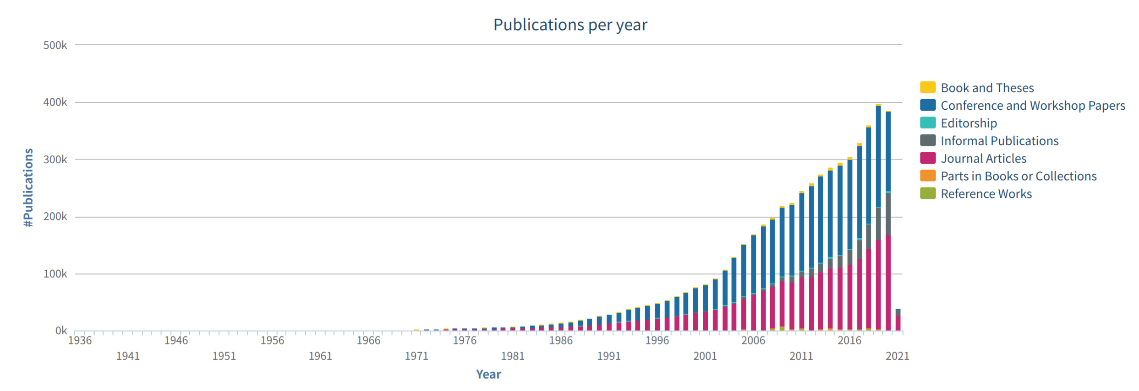
Backgrounds
Science evolution is becoming more and more fast
  Computer Science: Number of publications in DBLP has grown a lot
    2000 (77k) -> 2020 (408k) +430%
  For example, top AI conferences accept over 1,000 papers every year
    2020: CVPR (1,467), AAAI (1,591)
Number of publications in DBLP

Slide 3
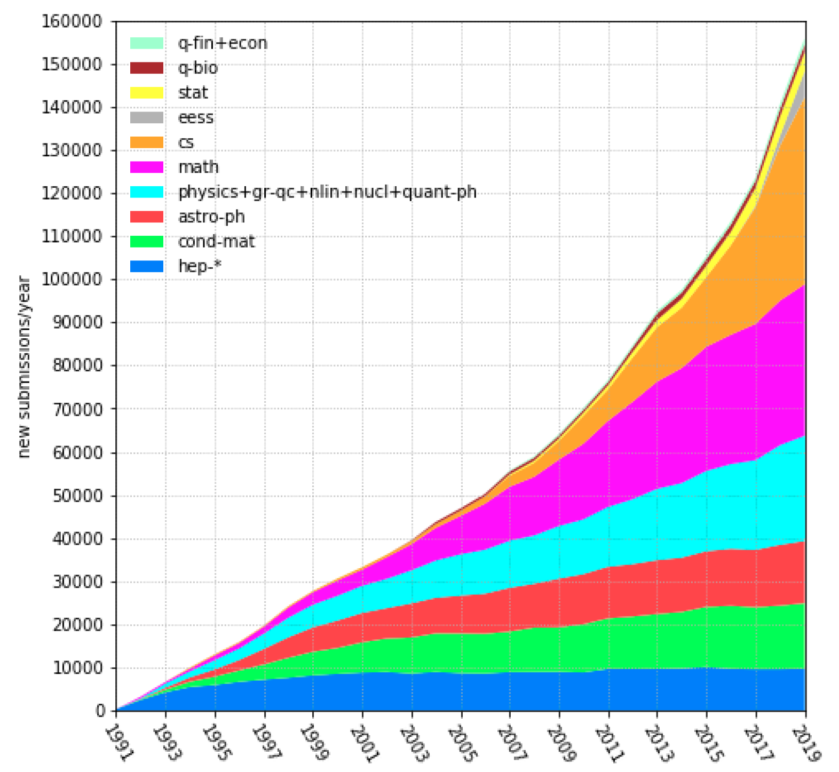
Background
Other research fields
    Biology, Math, Physics, etc. : the number of arXiv publications also increases a lot at various speed.
    STM report: The number of all kinds of publications in 2018 reaches over 3 million and continuously goes up with a rate of 6% each year.
  Researchers need to digest lots of latest papers!
  Data mining techniques can be used to help scholars find useful information
Number of publications in arXiv
Johnson R, Watkinson A, Mabe M. The stm report[J]. An overview of scientific and scholarly publishing. 5th edition October, 2018

Slide 4
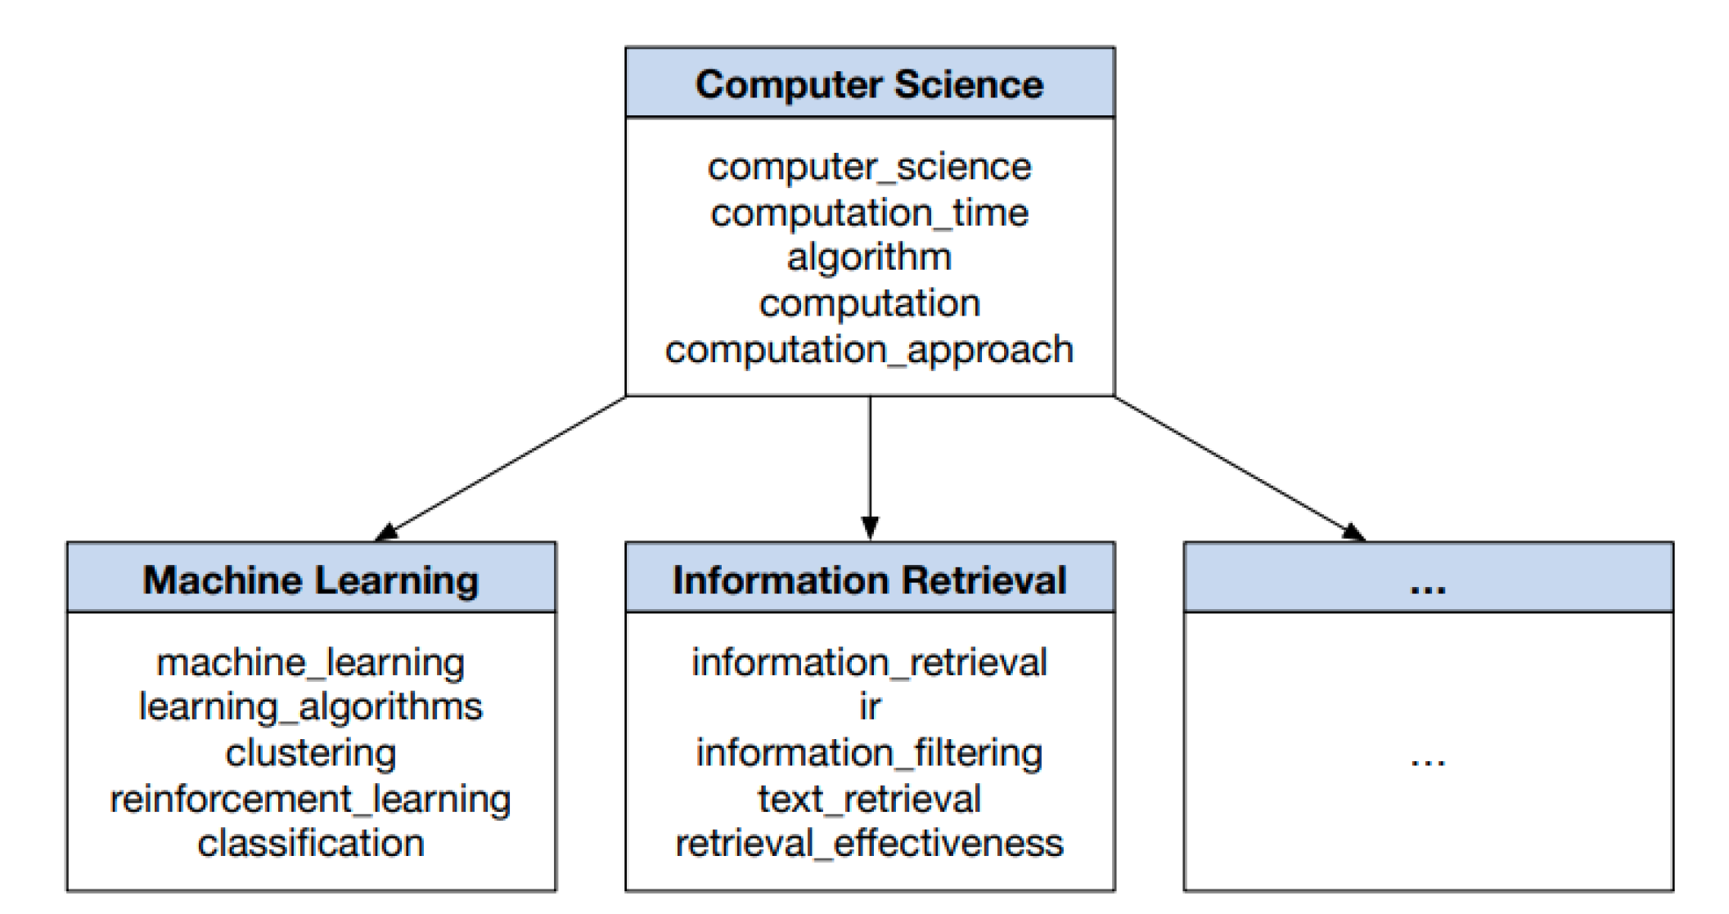
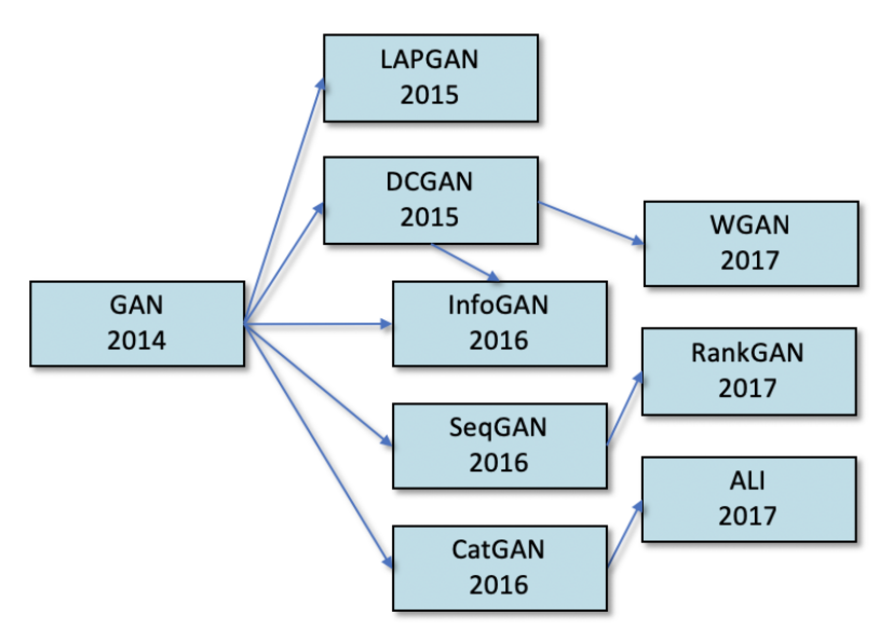
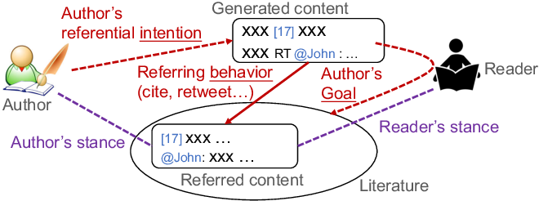
Background
Previous research on academic data mining
  Concept extraction: Extract concepts from papers and construct taxonomy
  Citation analysis: Analyse the roles of citations
  Algorithm roadmap: Sketch algorithm evolution graph from papers
Problem: Mainly focus on the over generalized information and lose lots of paper details
Concept extraction
Citation analysis
Algorithm roadmap
Zhang C, Tao F, Chen X, et al. Taxogen: Constructing topical concept taxonomy by adaptive term embedding and clustering[C]. KDD. 2018
Yu, W., Yu, M., Zhao, T., & Jiang, M. Identifying Referential Intention with Heterogeneous Contexts[C]. WWW. 2020
Zha H, Chen W, Li K, et al. Mining algorithm roadmap in scientific publications[C]. KDD. 2019

Slide 5
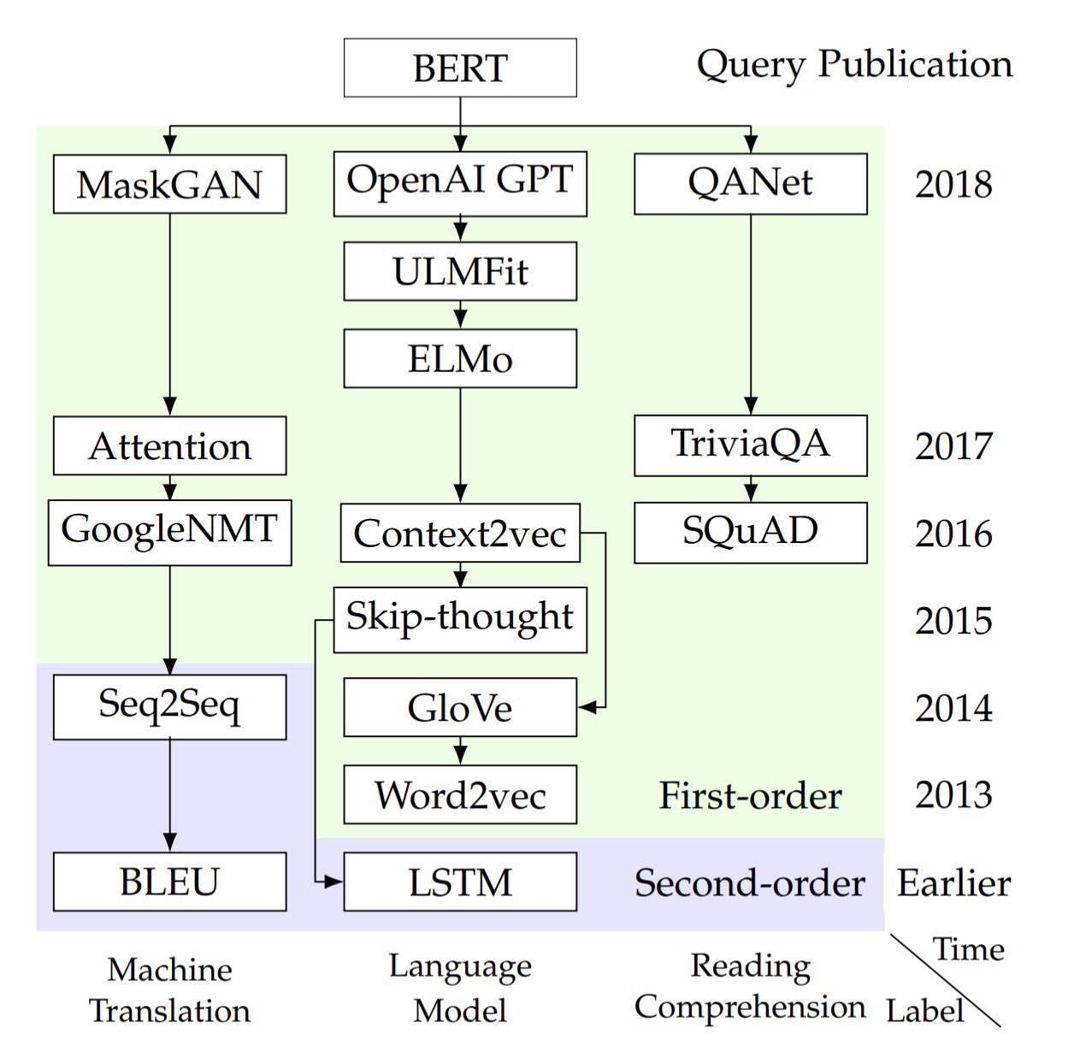
Background
What researchers need?
For example, where does BERT’s ideas come from?
  Some ideas come from Language Model
    Pre-training: GPT / ULMFit / ELMo
    Word Embedding: GloVe, Word2vec
    Sequence Encoding: LSTM
  Some ideas come from Machine Translation
    Transformer: Attention
    MLM: MaskGAN
  Some come from Reading Comprehension …
Devlin J, Chang M W, Lee K, et al. Bert: Pre-training of deep bidirectional transformers for language understanding[C]. NAACL-HLT. 2019

Slide 6
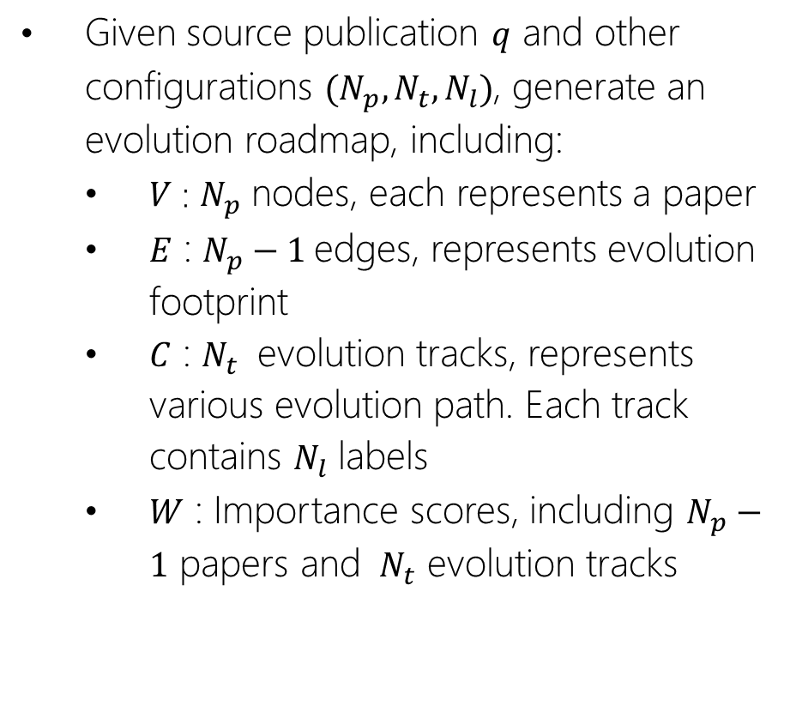
Problem Definition
Given source publication $q$ and other configurations $(N_{p},N_{t},N_{l})$, generate an evolution roadmap, including:
  $V$ : $N_{p}$ nodes, each represents a paper
  $E$ : $N_{p}−1$edges, represents evolution footprint
  $C$ : $N_{t}$ evolution tracks, represents various evolution path. Each track contains $N_{l}$ labels
  $W$ : Importance scores, including $N_{p}−1$ papers and ${ N}_{t}$ evolution tracks

Slide 7
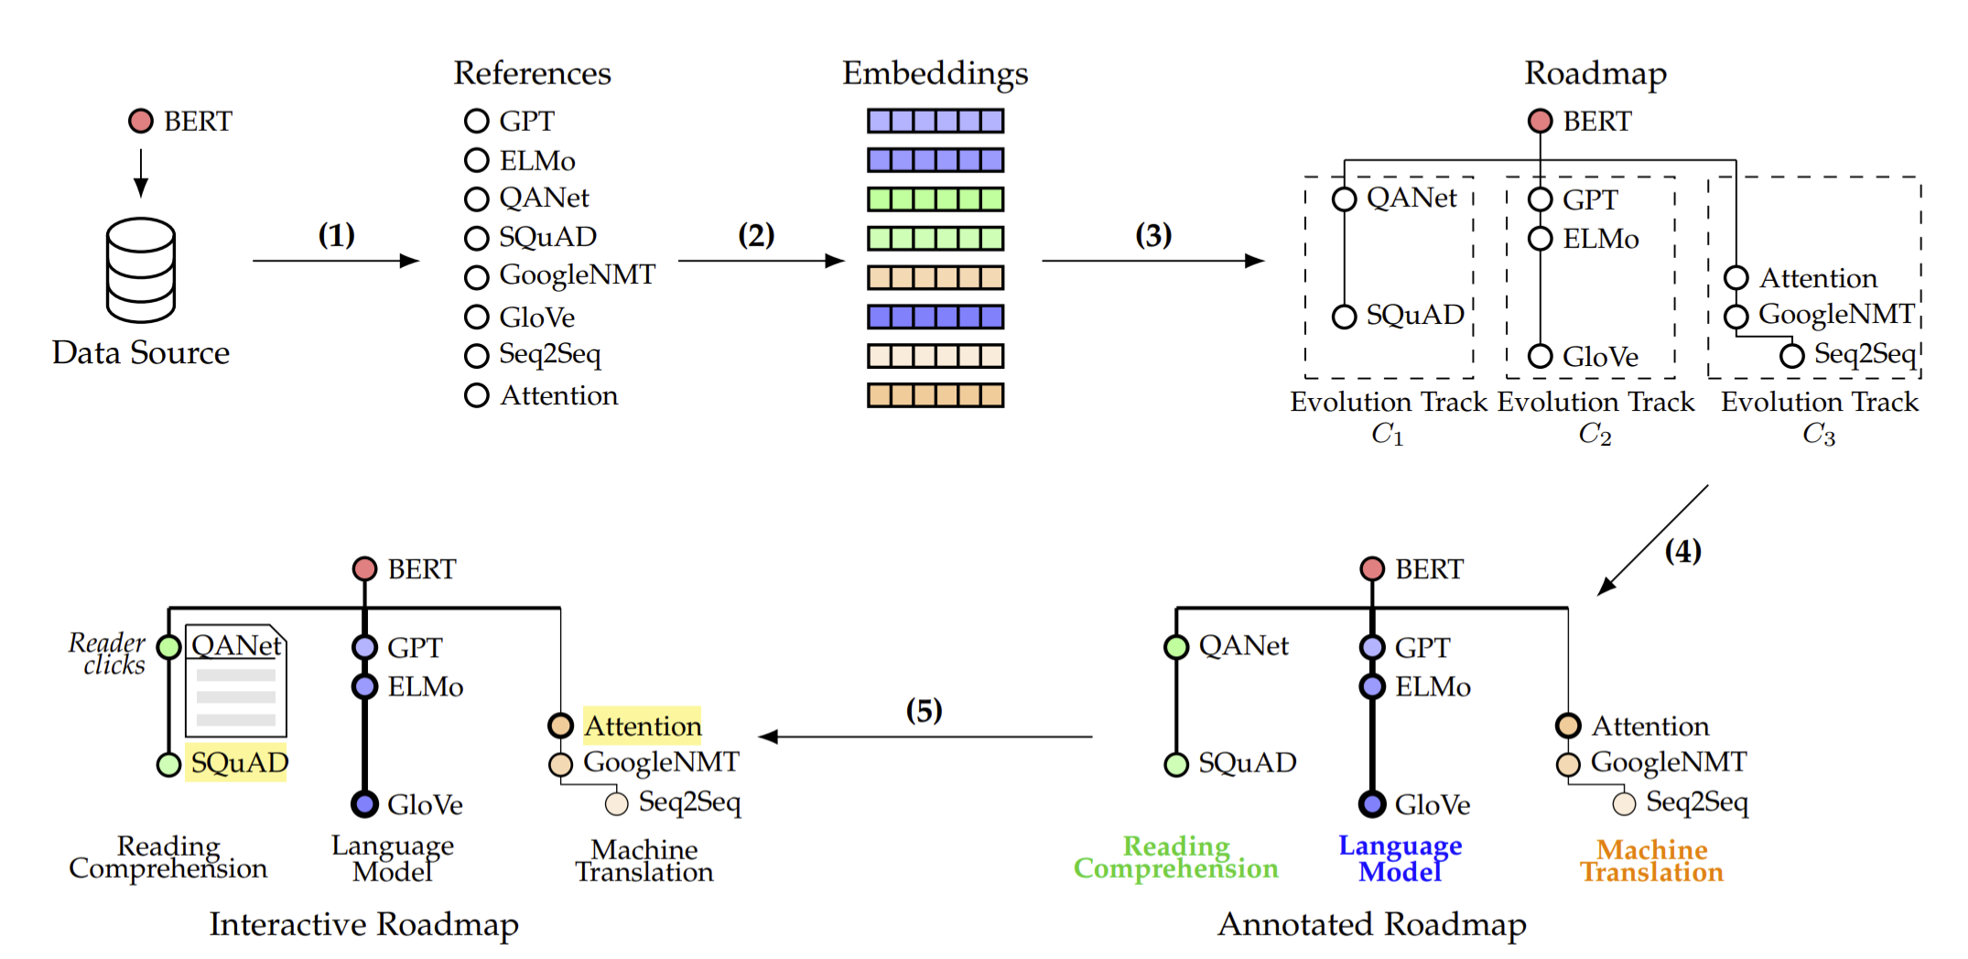
Method
1. Fetch reference papers
2. Generate paper embeddings
3. Generate evolution tracks
4. Generate labels and importance scores
5. Interact with users

Slide 8
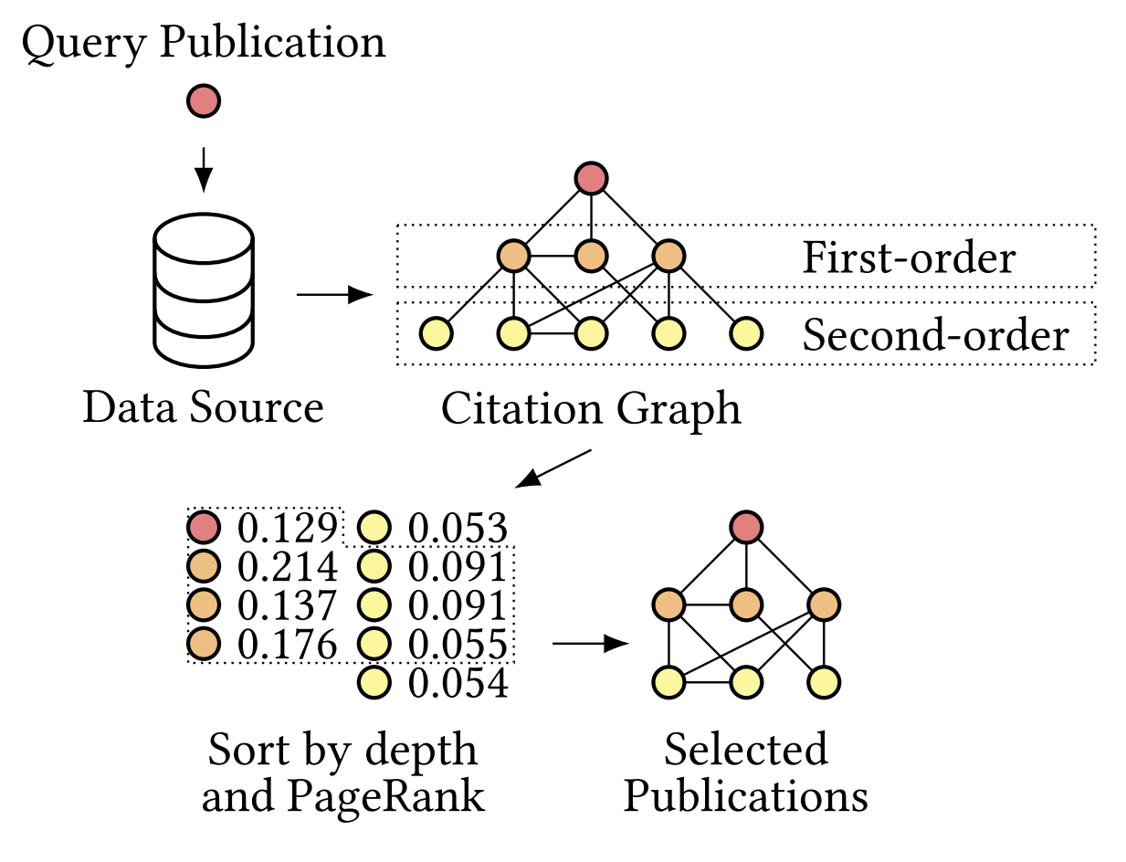
Method
1. Fetch reference papers
  Data source
    SemanticScholar & AMiner
    Web API
    Only metadata (title + abstract)
  Extend higher order reference papers
  Build citation graph
  Use PageRank (or other algorithm) to select papers
Page L, Brin S, Motwani R, et al. The pagerank citation ranking: Bringing order to the web. [R]. Stanford InfoLab, 1999.

Slide 9
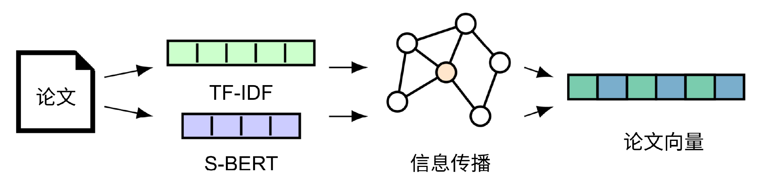
Method
2. Generate paper embeddings
  Use TF-IDF / S-BERT to encode paper semantic information ( title + abstract )
    TF-IDF focuses on literal information and is good at identifying keywords
    Sentence-BERT focuses on latent semantic information
  Use spectral propagation in ProNE to incorporate structural information
    ProNE propagates information to neighbourhoods
Paper
TF-IDF
Paper Embedding
S-BERT
Spectral
Propagation

Slide 10
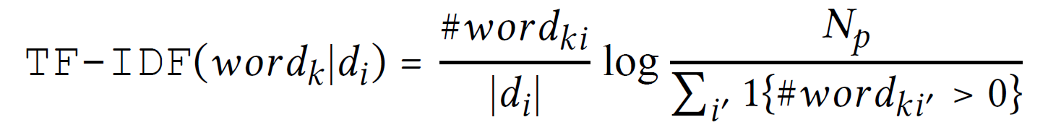

Method
2. Generate paper embeddings
  TF-IDF: Term Frequency – Inverse Document Frequency
    Lemmatization & N-gram
    Take ${ n}_{w}$ most frequent words in subgraph to build TF-IDF document vector

Slide 11
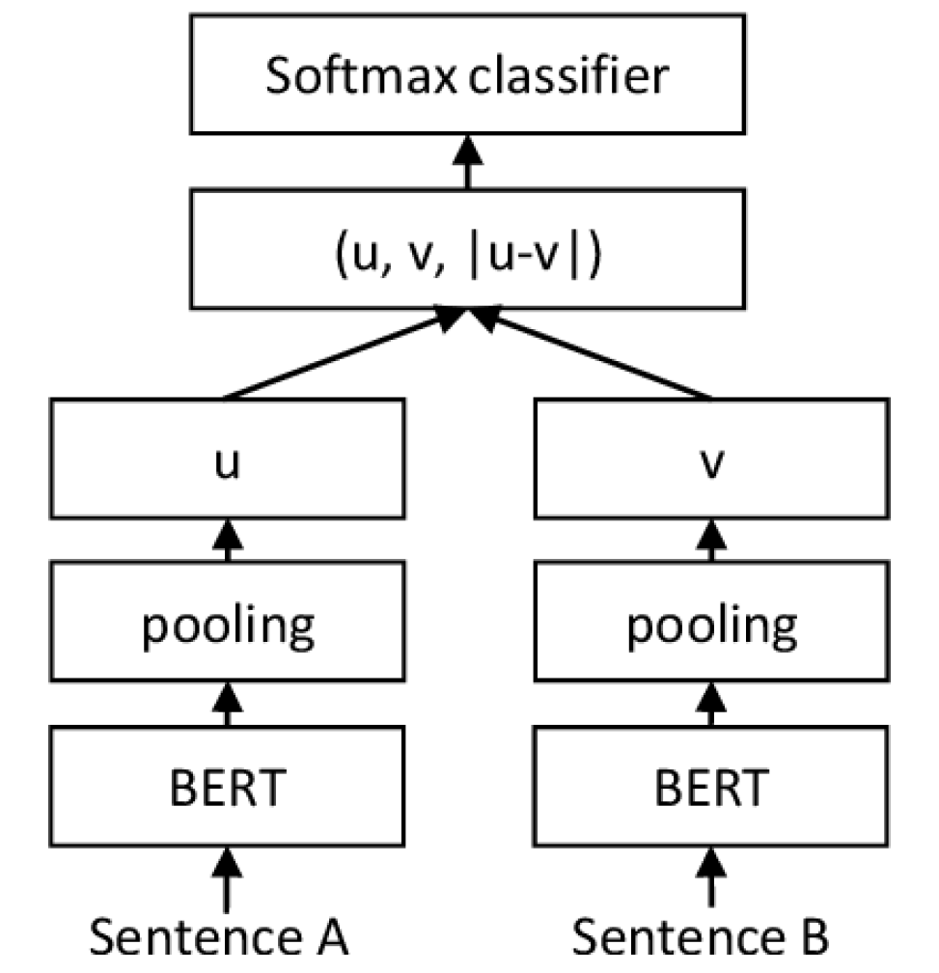
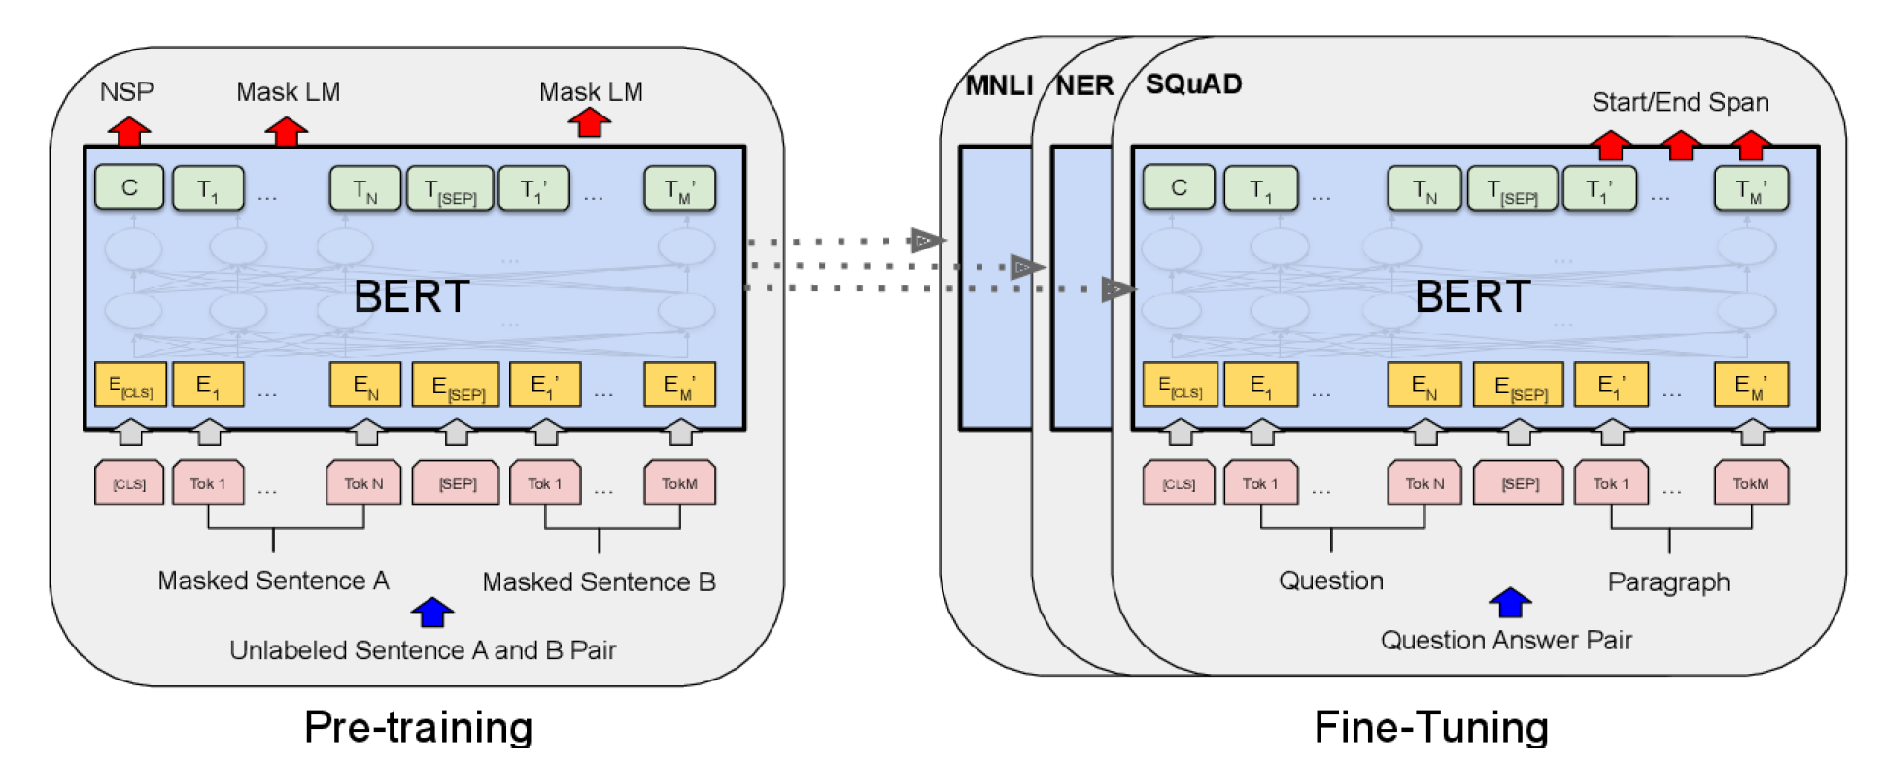
Method
2. Generate paper embeddings
  S-BERT: SentenceBERT
    Fine-tune sentences on top of pre-trained BERT model
    Encode latent semantic information
BERT pre-training model
SentenceBERT fine-tuning structure
Reimers N, Gurevych I. Sentence-bert: Sentence embeddings using siamese bert-networks[J]. arXiv preprint arXiv:1908.10084, 2019

Slide 12
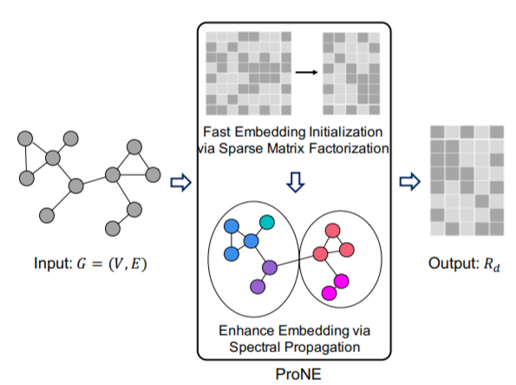

Method
2. Generate paper embeddings
  ProNE
    Fast matrix factorization to initialize node embeddings
    Spectral propagation to enhance representation capability on local and global signals
      Propagation process
$$x ← D^{−1}A\left(I_{N}−\tilde{L}\right)x$$
Zhang J, Dong Y, Wang Y, et al. Prone: fast and scalable network representation learning[C]. IJCAI. 2019: 4278-4284

Slide 13
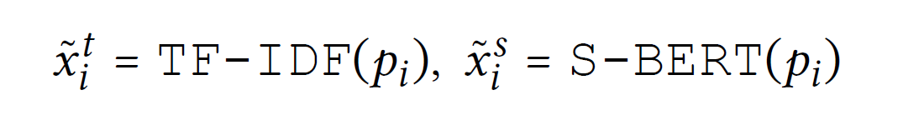
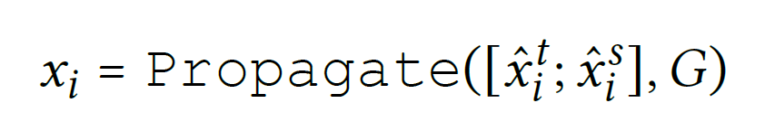
Method
2. Generate paper embeddings
  Propagation
Paper
TF-IDF
Paper Embedding
S-BERT
Spectral
Propagation

Slide 14
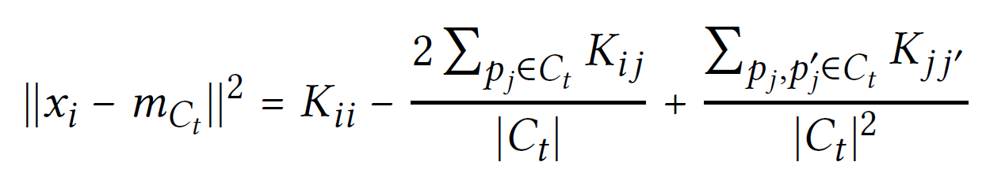
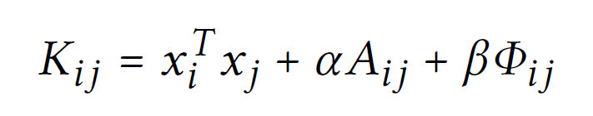
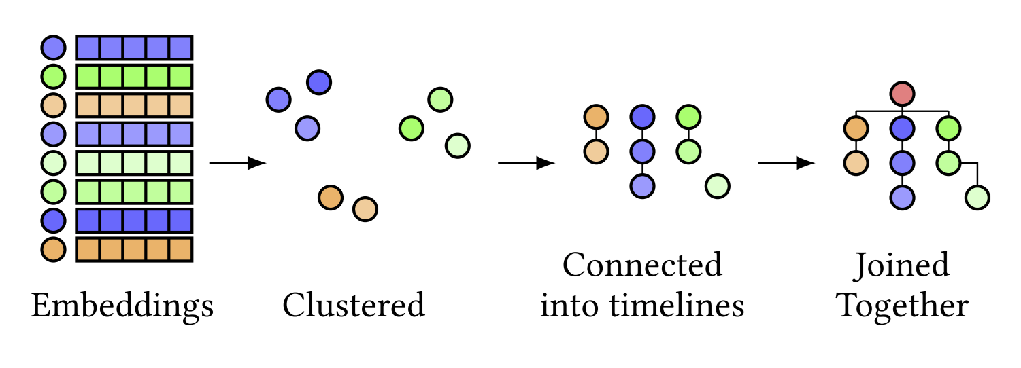

Method
3. Generate evolution tracks
  Use kernel k-means to cluster $N_{p}−1$reference papers into $N_{t}$topics
  Connect papers according to their publication date or citation order
Kipf T N, Welling M. Semi-supervised classification with graph convolutional networks[J]. arXiv preprint arXiv:1609.02907, 2016.

Slide 15
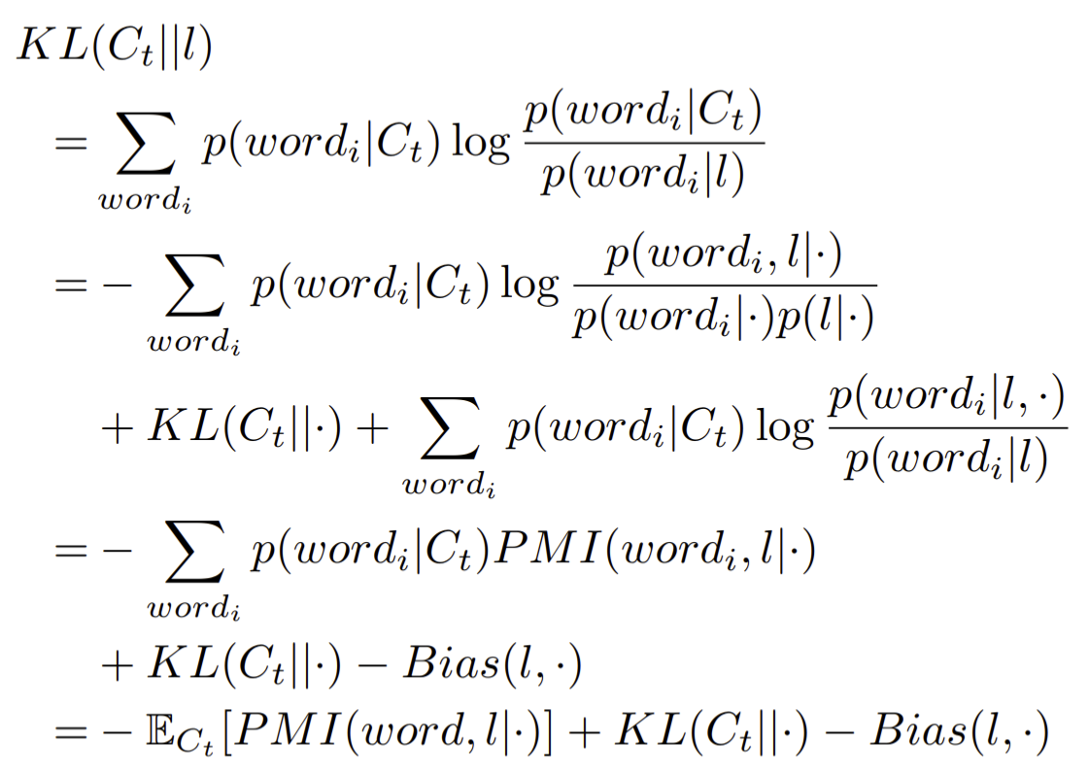
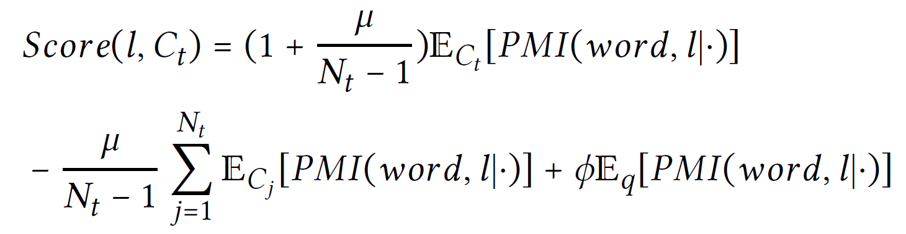
Method
4. Generate labels and importance scores
  Label generation
    First extract label candidates
      N-gram + Frequency threshold
    Then sort candidates according to three criteria
      Label should cover the paper content in current evolution tracks
      Label should be different from other evolution tracks
      Label should be related to the source paper
Mei Q, Shen X, Zhai C. Automatic labeling of multinomial topic models[C]. KDD. 2007.

Slide 16
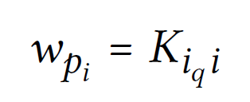
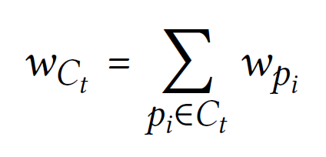
Method
4. Generate labels and importance scores
  Importance scores generation
    Directly use the kernel weight in clustering
    Evolution track importance is the sum of all paper importance scores inside

Slide 17
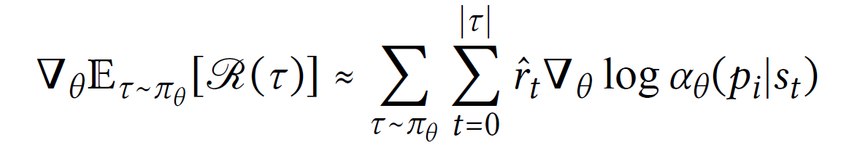
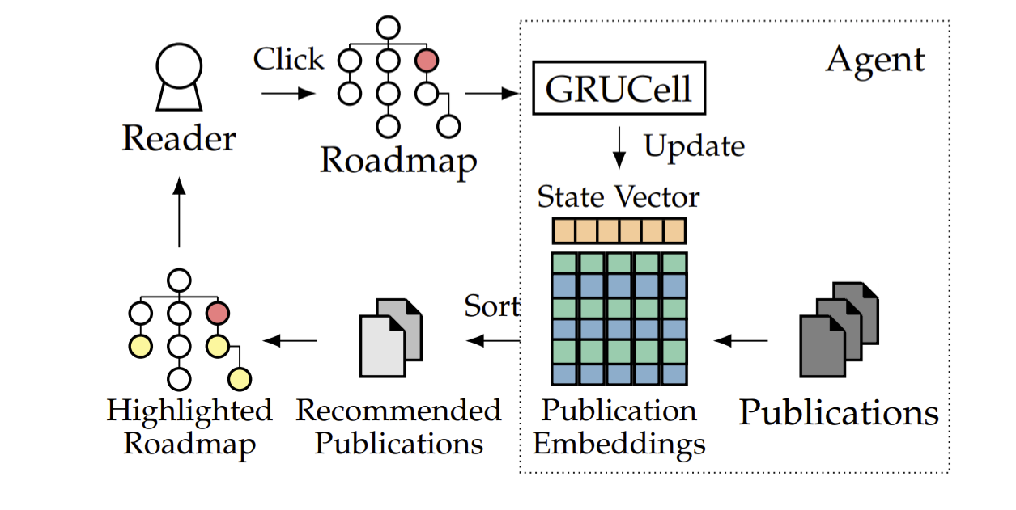
Method
5. Interact with users
  Design a recommendation module to highlight most related papers
  Two strategies
    When no user data available, recommend paper by selecting papers with the closest embeddings
    When user data available, train a reinforcement learning model to make dynamic recommendation to maximize the expected clicks.
Chen M, Beutel A, Covington P, et al. Top-k off-policy correction for a reinforce recommender system[C]. WSDM ’19. 2018.

Slide 18
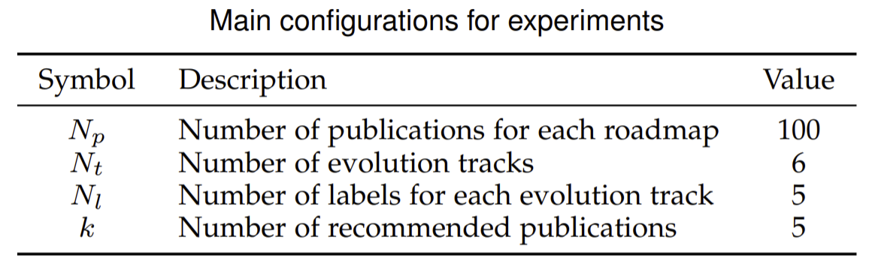
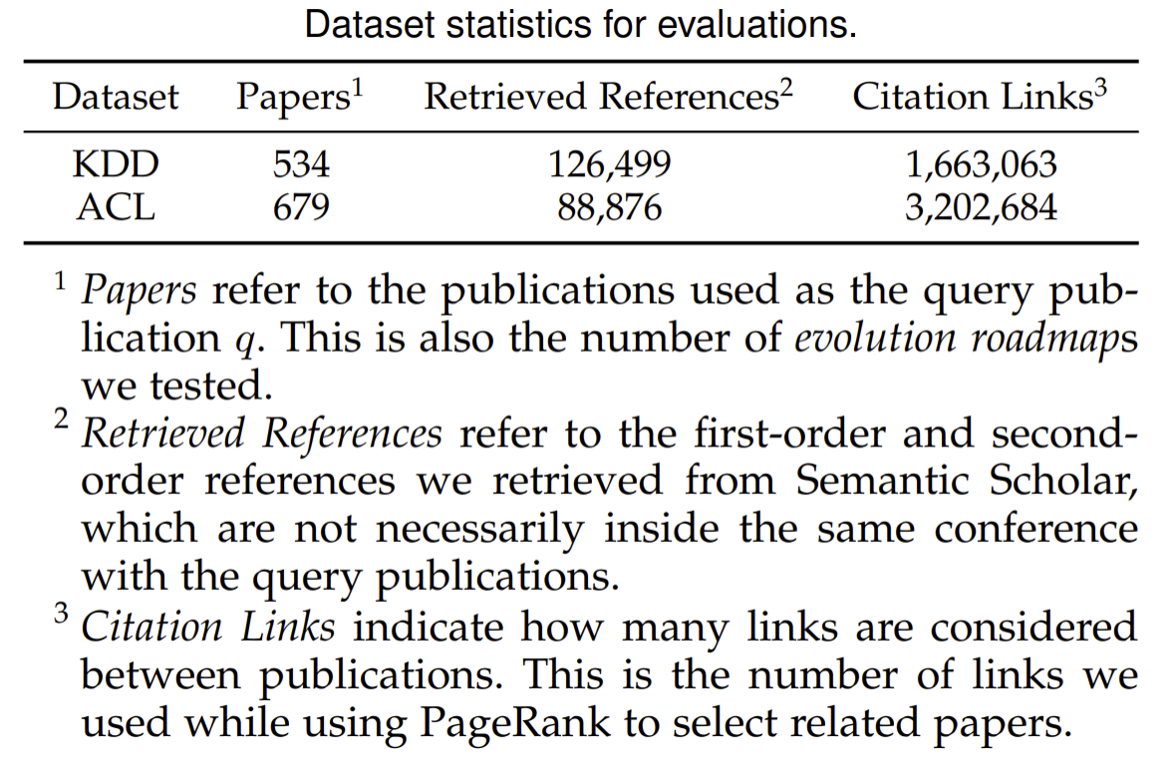
Evaluations
Dataset
  KDD & ACL 2019~2020 conference papers as source paper
  Use SemanticScholar data source to generate papers

Slide 19
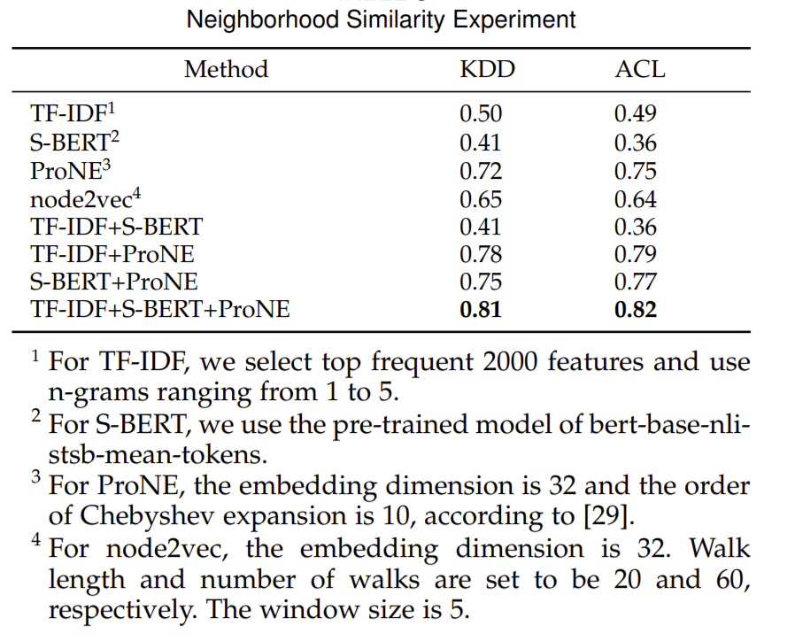
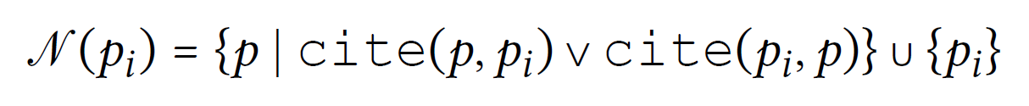
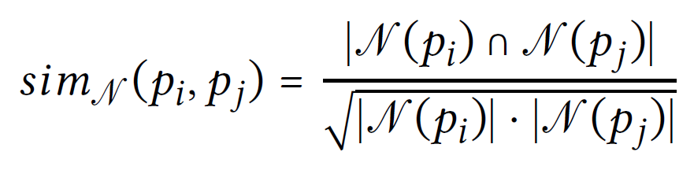
Evaluations
Neighborhood Similarity
  Evaluate the quality of paper embeddings
  Use neighborhood similarity as ground truth
    If two papers share similar neighborhoods (have lots of reference or cited papers in common), they should have close paper embeddings
  Use Spearman correlation coefficient to measure

Slide 20
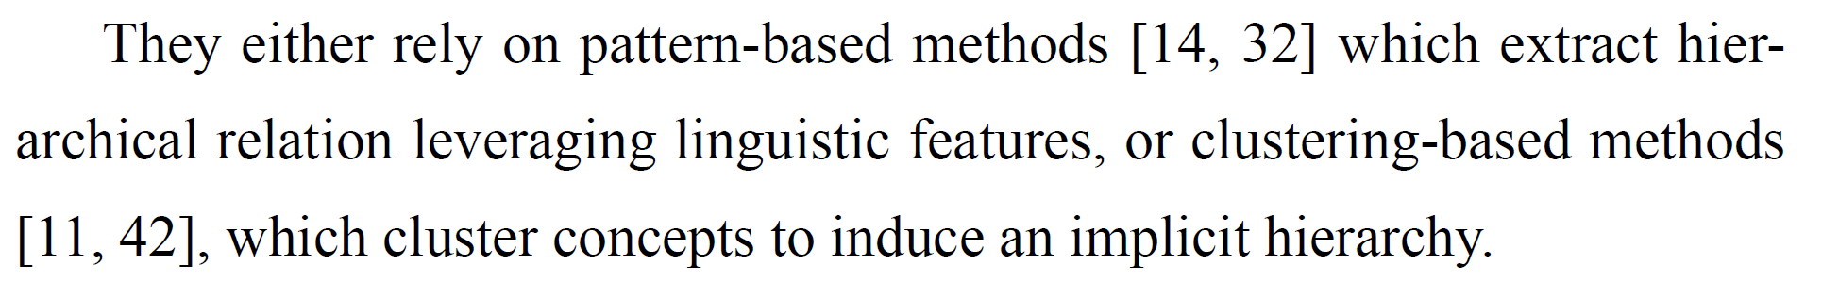
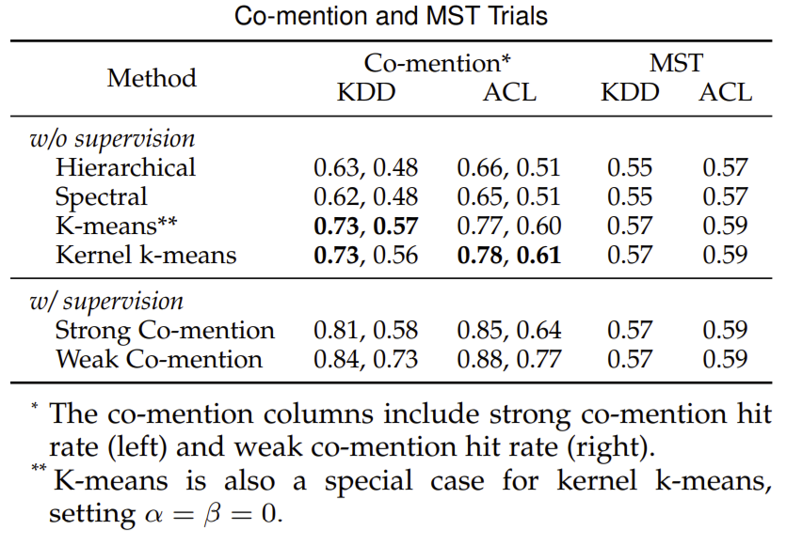
Evaluation
Co-mention and MST Trials
  Evaluate the quality of roadmap structure
  Co-mention: reference papers mentioned together in the source paper should be clustered together
  MST: Connecting papers into timelines should not break too much close relationships between papers
Example: [14] and [32] is strongly related, and weakly related to [11]

Slide 21
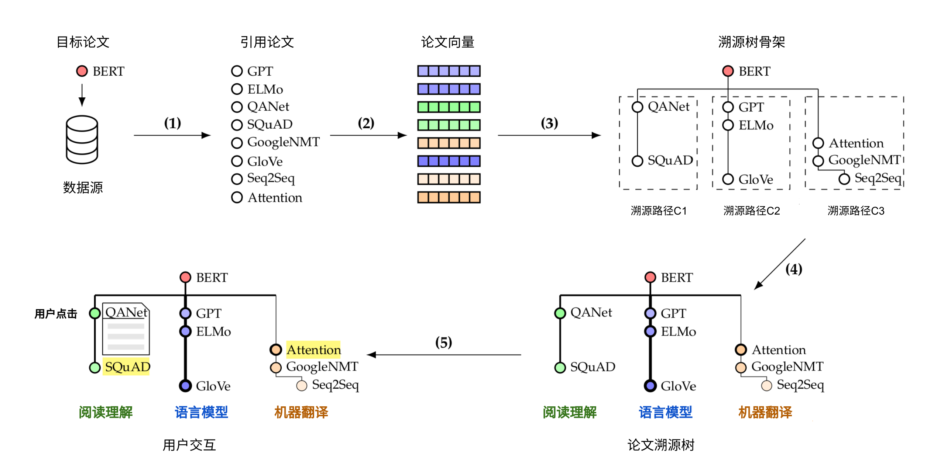
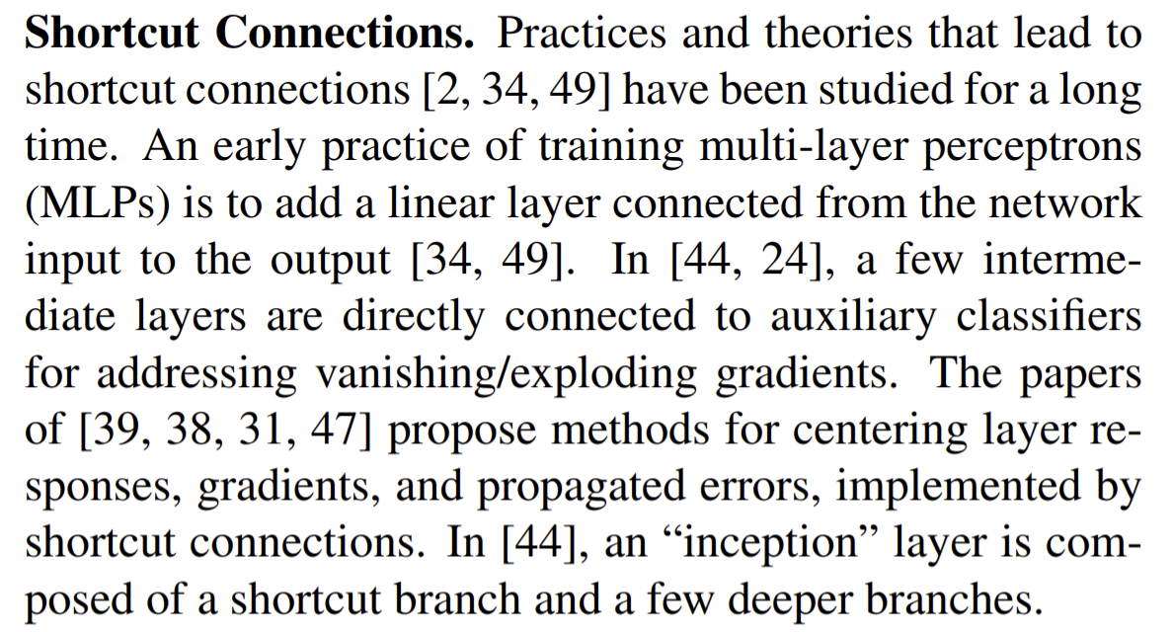
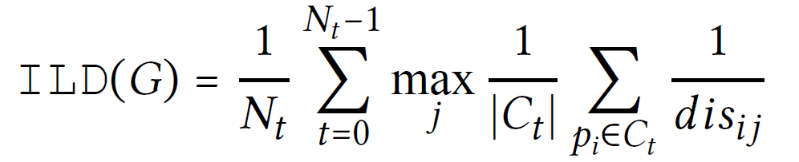
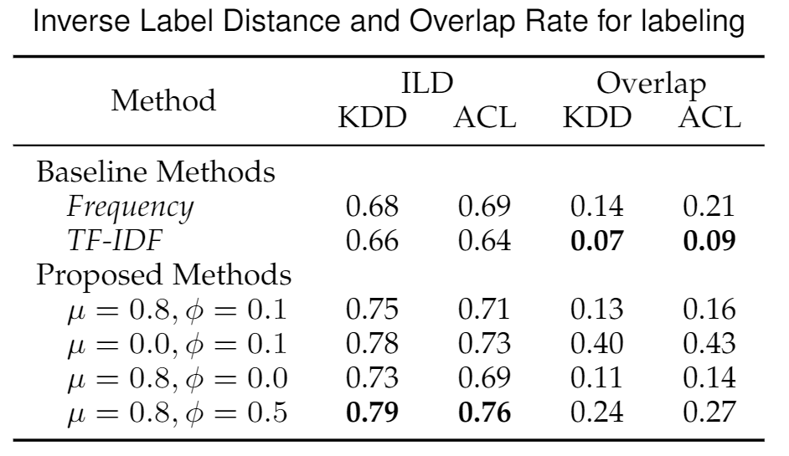
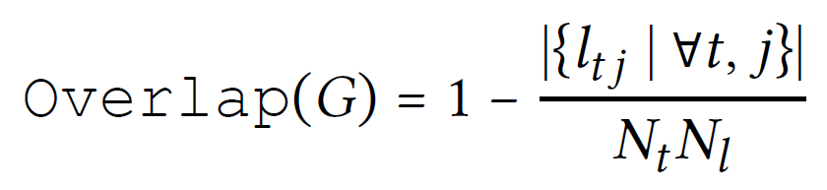
Evaluation
Inverse Label Distance and Overlap Rate
  Evaluate the quality of generated labels
  ILD: For each evolution track, reference papers inside should be mentioned at a close position to the label
  Overlap: Different evolution tracks, should have different labels
Example: [2, 34, 49] is closely related to Shortcut Connections.

Slide 22
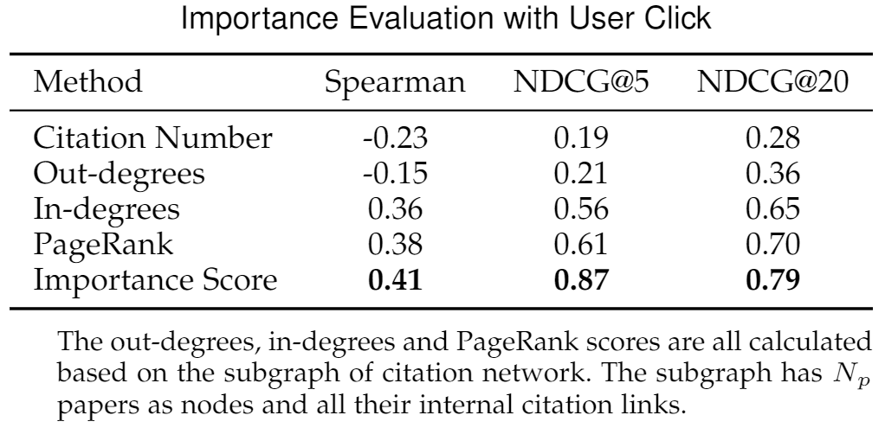
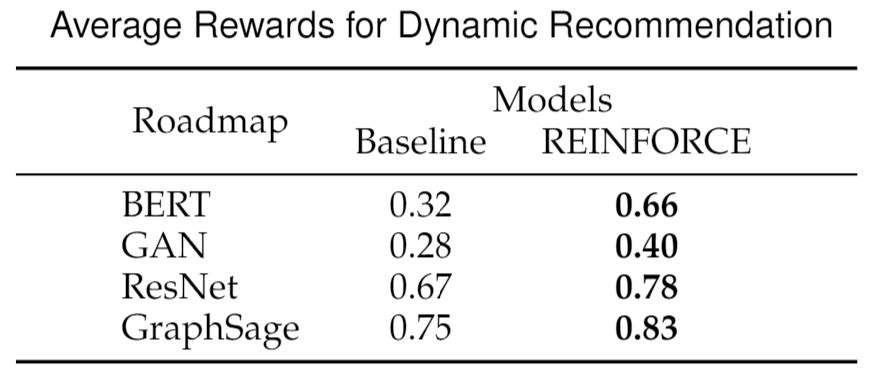
Evaluation
User Feedback
  Importance Evaluation
    Papers with more clicks should receive higher important scores
  Recommendation Evaluation
    The CTR for the recommended papers
  Human Evaluation
    3.68/5 (Baseline) vs. 3.82/5 (Proposed)

Slide 23
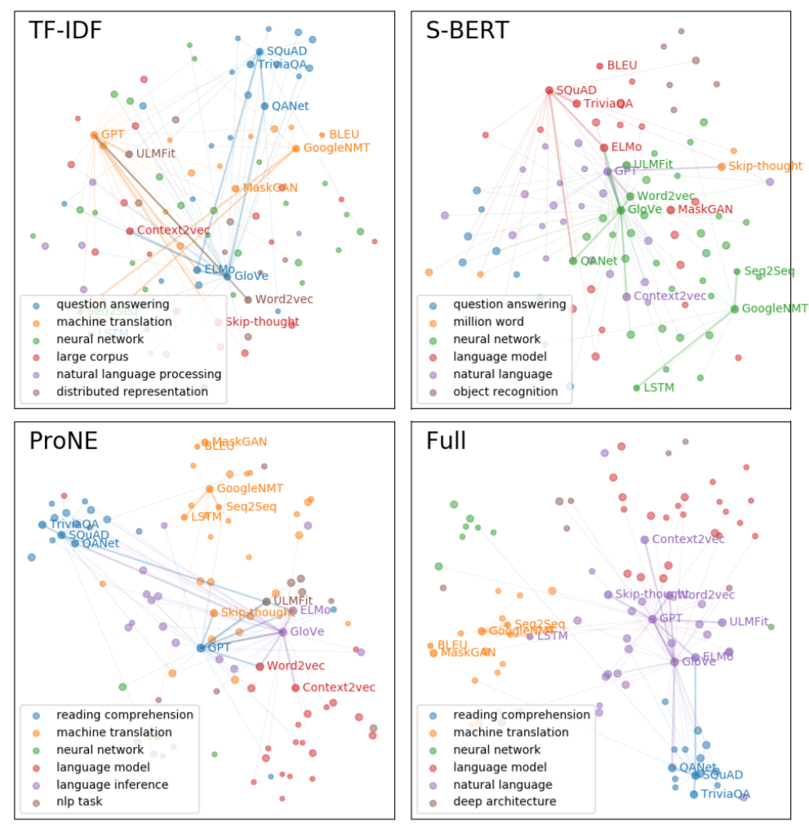
Case Study
Paper Embeddings
  TF-IDF embedding cannot align NLP with “natural language processing” and therefore cannot categorize ULMFit properly.
  S-BERT cluster QANet into “machine learning” due to its use of lots of machine translation ideas such as backtranslation
  ProNE is hard to deal papers with high citations such as GPT or GloVe

Slide 24
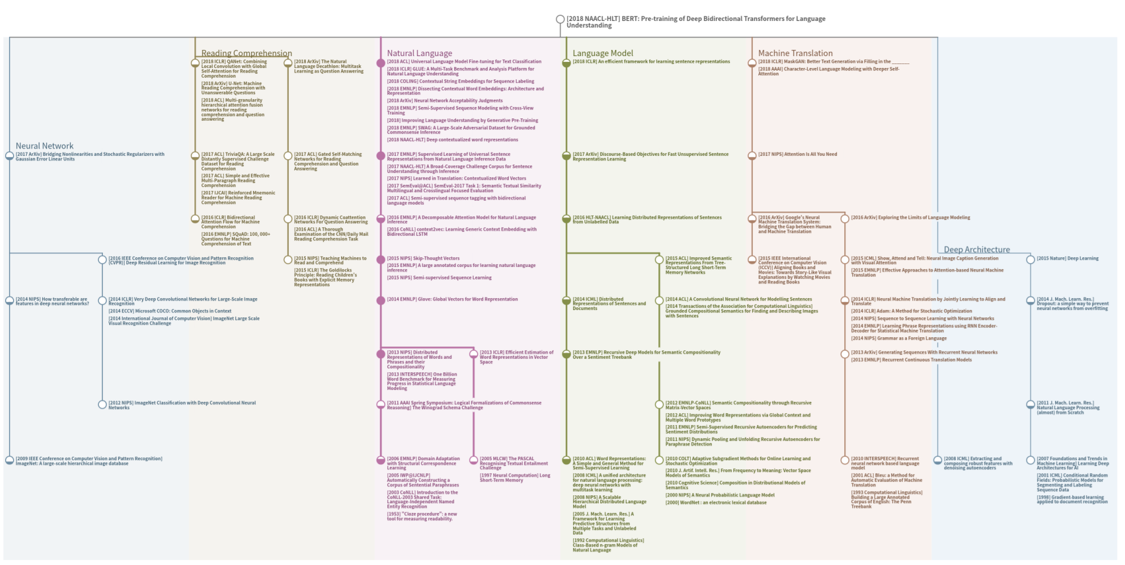

Slide 25
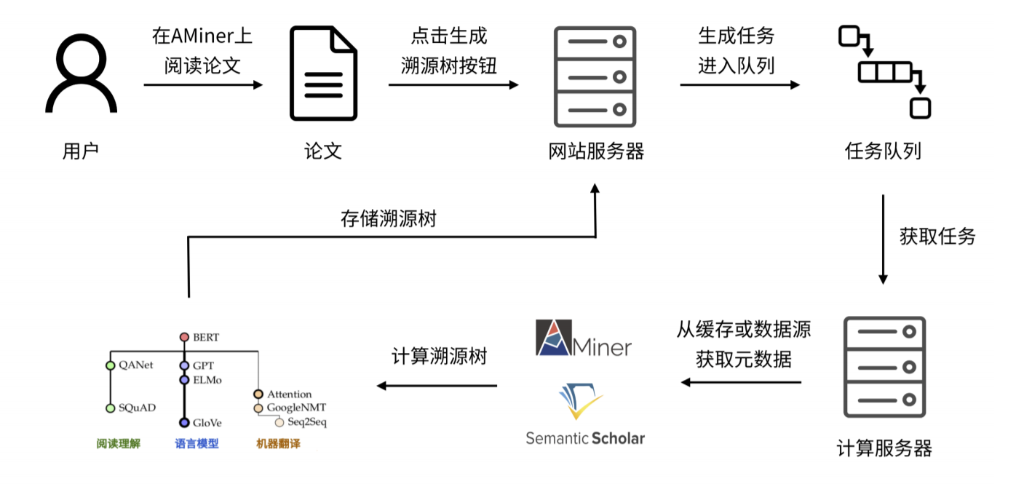
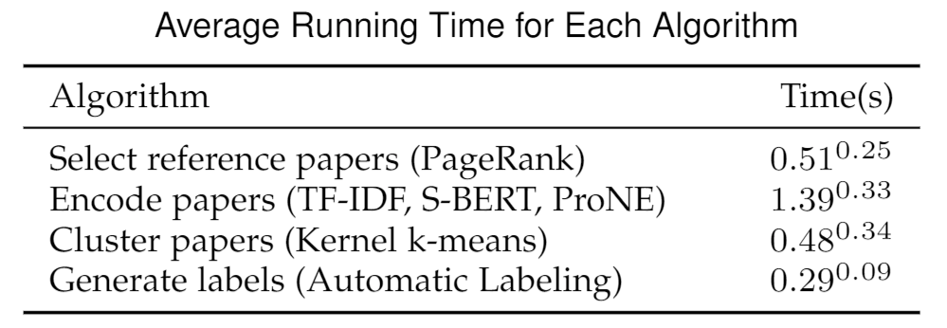
System Deploy
Read Paper
on AMiner
Click MRT Button
New Task created
Deployed to AMiner
  Over 7,000 users
  About 20,000 access (Mar. 2021)
Async online service
  Single MRT generation requires tens of seconds
  Mostly spends on accessing Web API to retrieve paper data
  When cache is available, MRT can be calculated in 2~3 seconds with the help of GPU
  If S-BERT is disabled, the MRT can be generated more fast even without GPU
User
Paper
Web Server
Task Queue
Store MRT
Fetch Task
Calculate
MRT
Fetch metadata
Calculation Server
https://mrt.aminer.cn

