Slide 1

Understanding WeChat User Preferences and "Wow" Diffusion
Fanjin Zhang, Jie Tang, Xueyi Liu, Zhenyu Hou, Yuxiao Dong,
Jing Zhang, Xiao Liu, Ruobing Xie, Kai Zhuang, Xu Zhang,
Leyu Lin and Philip S. Yu

Slide 2
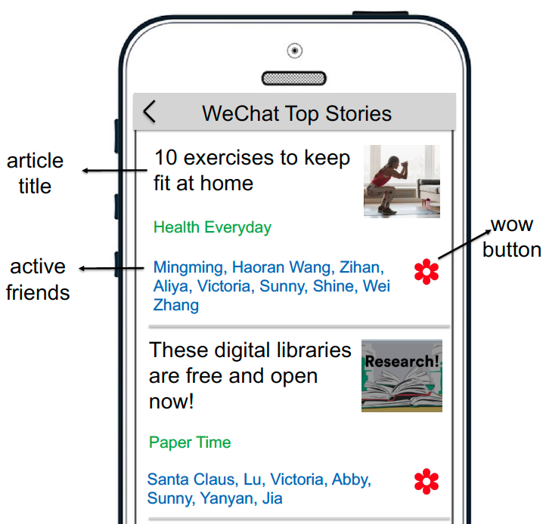
WeChat Top Stories
Top stories suggests contents based on users’ personal preferences and their friends’ sharing (referred to as “Wow”).
The user can choose to “Click” (view) the recommended article or follow to “Wow” the article.
The “Wow” feature acts as a diffusion process.

Slide 3
Motivation
How can user attributes, the correlations between users, and the local network structure influence user behavior?
What are the differences between various kinds of user feedback (such as “click”, “like”, and “share”) w.r.t. the above factors?
To what extent users’ behavior can be predicted from their social connections and attributes.

Slide 4
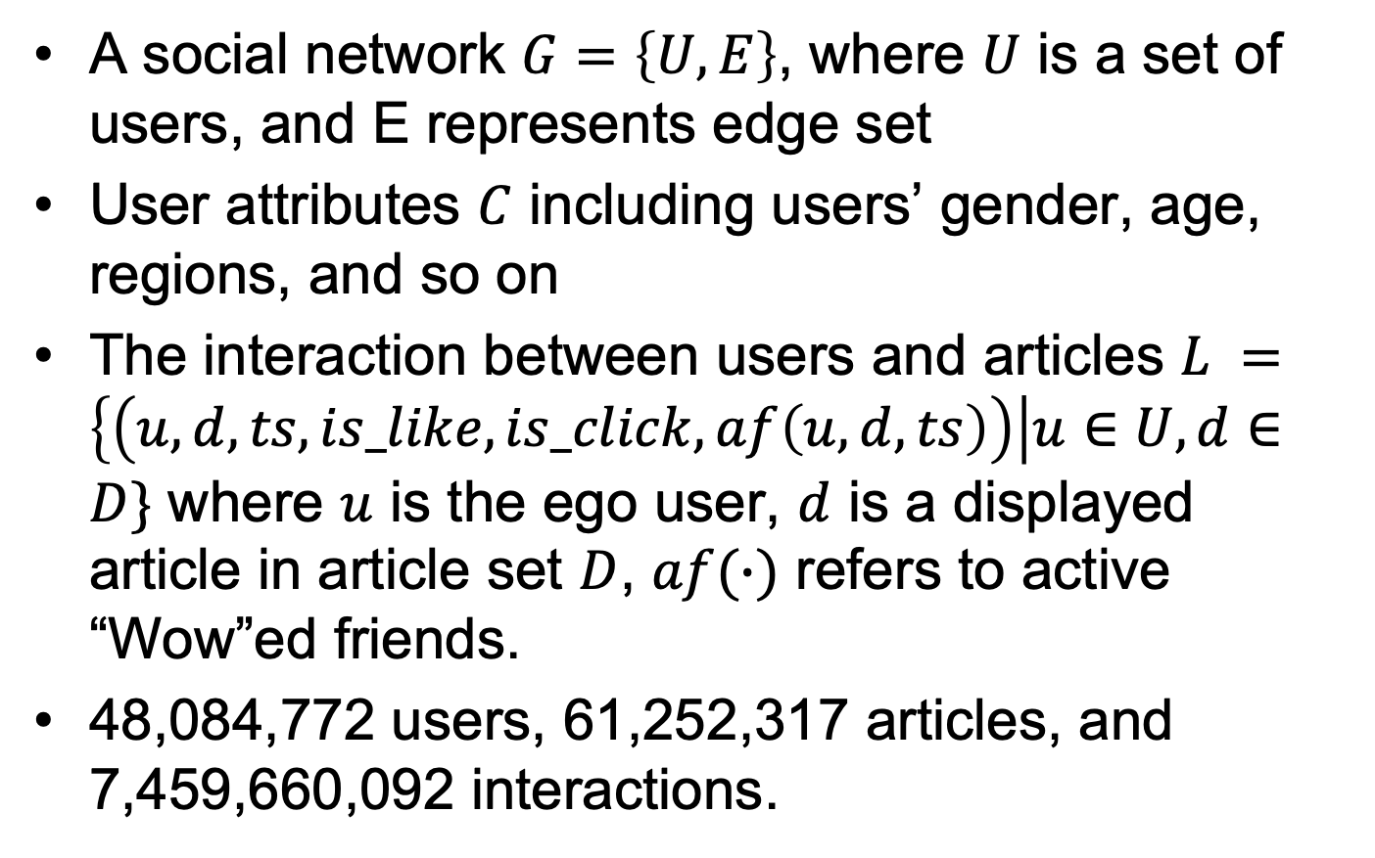
Top Stories Dataset
A social network $G=\left\{U, E\right\}$, where $U$ is a set of users, and E represents edge set
User attributes $C$ including users’ gender, age, regions, and so on
The interaction between users and articles $L =\left\{\left(u, d, ts, is_like, is_click, af\left(u, d, ts\right)\right)\right|u∈U, d∈D\}$ where $u$ is the ego user, $d$ is a displayed article in article set $D$, $af(∙)$ refers to active “Wow”ed friends.
48,084,772 users, 61,252,317 articles, and 7,459,660,092 interactions.

Slide 5
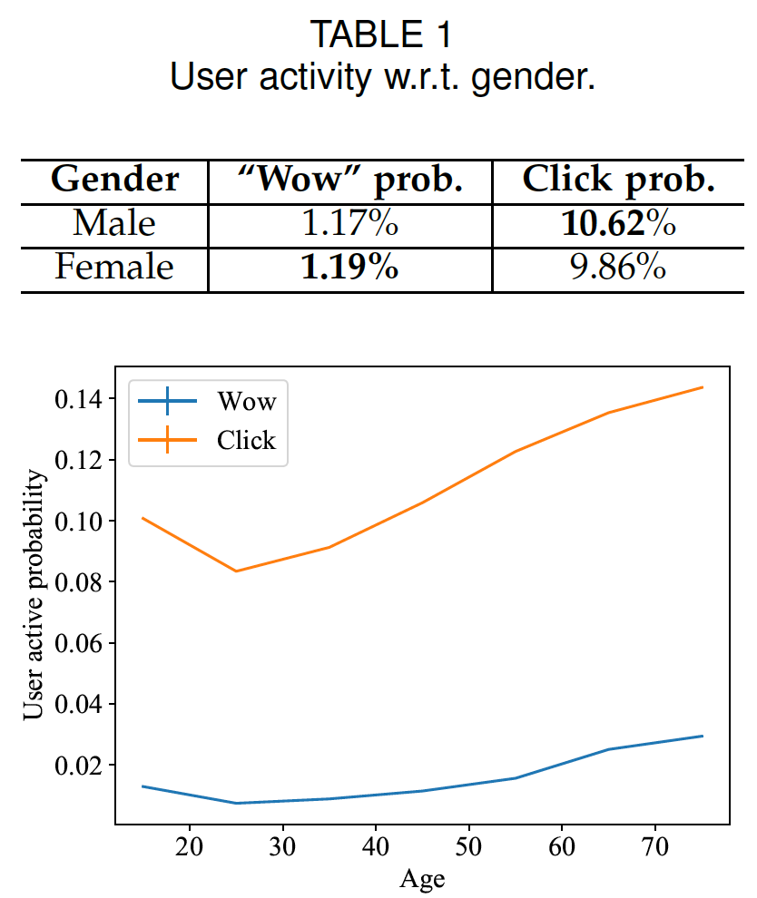
Analysis: User Demographics
Males tend to consume content.
Females are more active in social circles.
The “wow” and click probability of the 20s is the lowest among all ages.

Slide 6
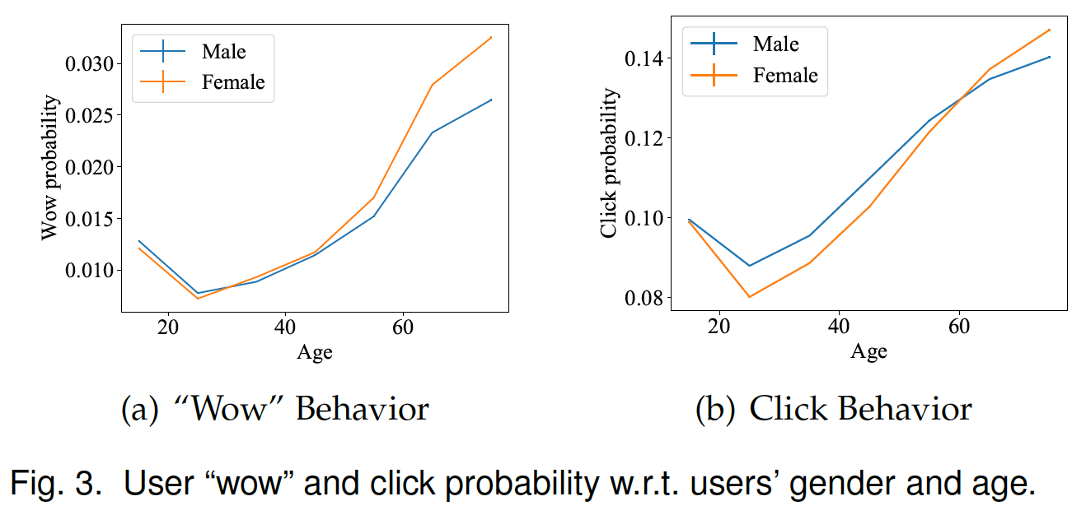
Analysis: User Demographics
The cross-attribute factor is more complicated.

Slide 7
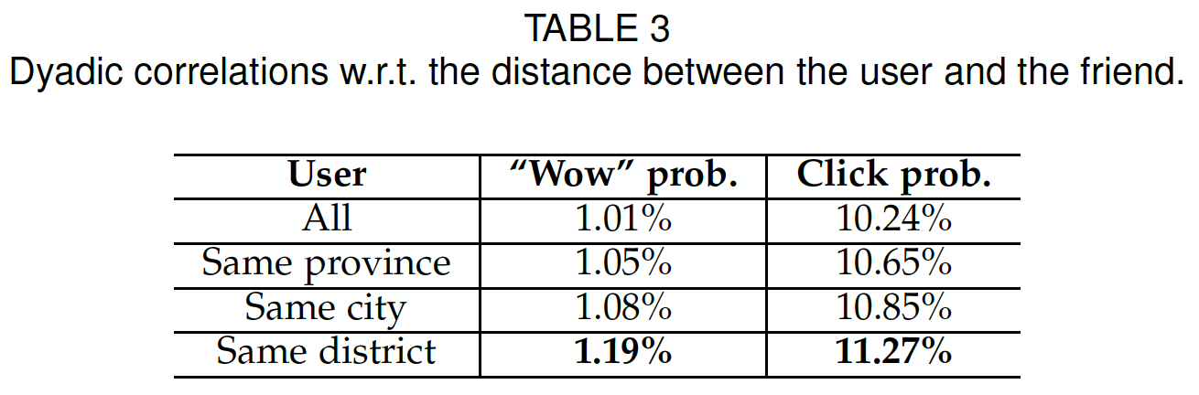
Analysis: Dyadic and Triadic Correlations
When the geographic distance between the ego user and the friend is closer, the “wow” probability and click probability of the ego user is higher.
Interest homophily exists w.r.t. user region.

Slide 8
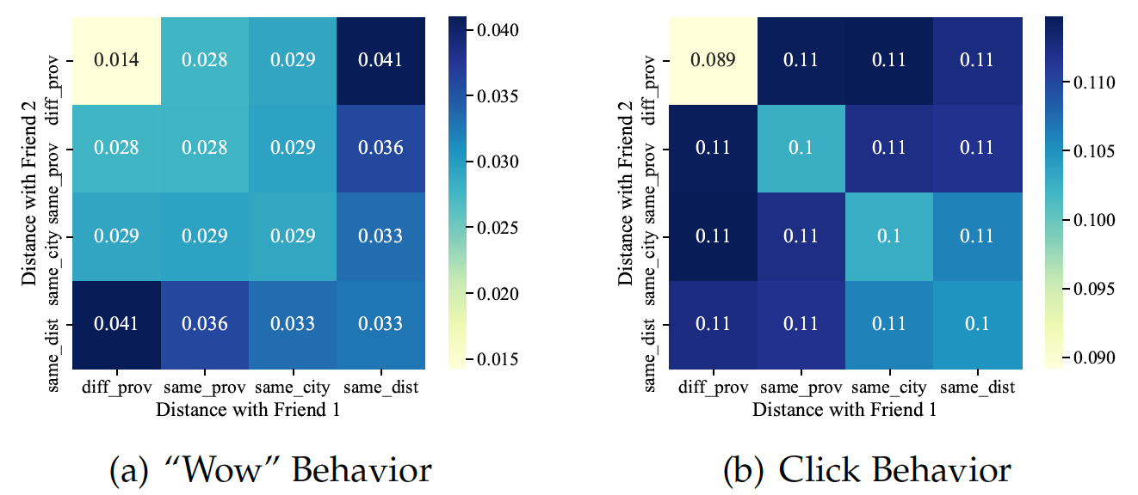
Analysis: Dyadic and Triadic Correlations
“Attribute diversity” may provide evidence that the “wow”ed articles are acknowledged by various users.

Slide 9
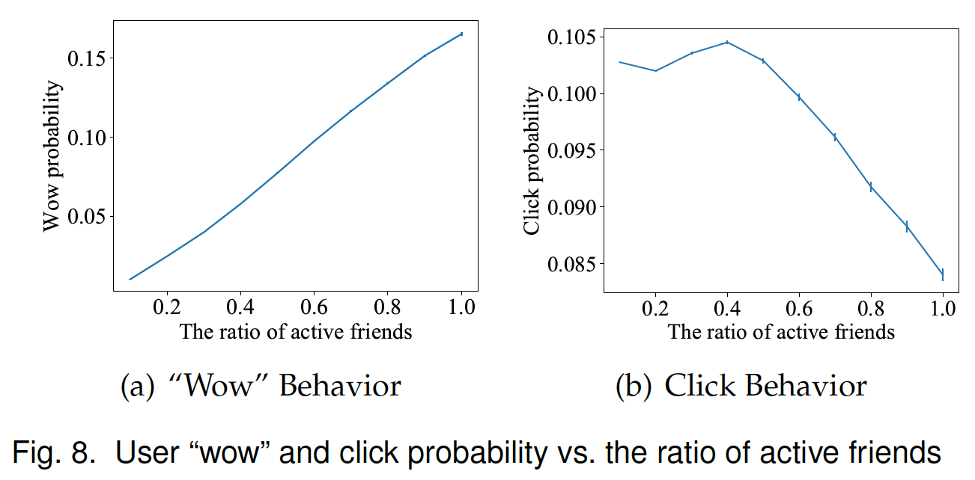
Analysis: Ego Network Properties
Very different patterns
“Wow”: conformity; Click: information overload

Slide 10
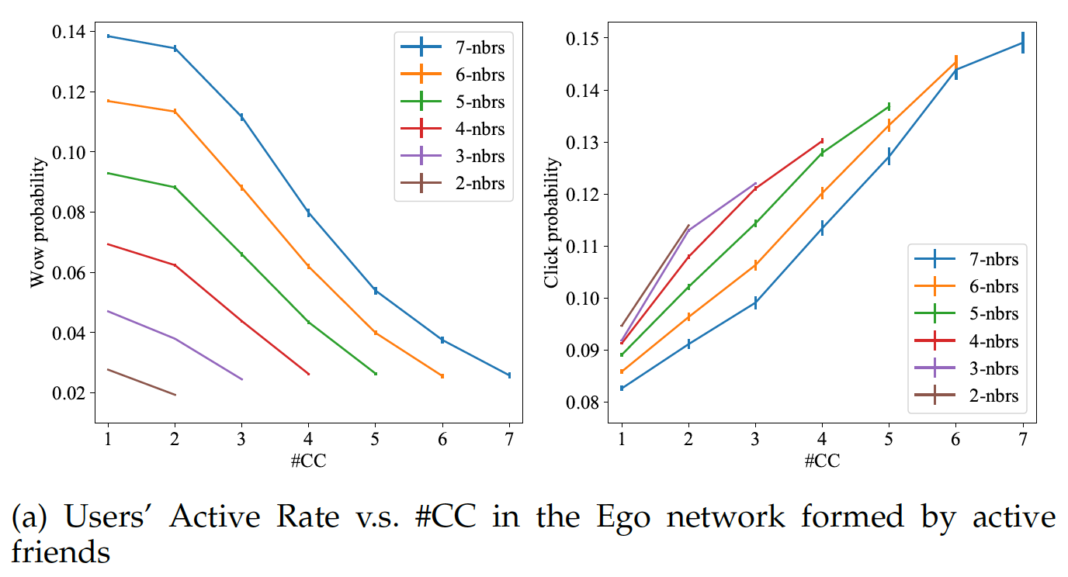
Analysis: Ego Network Properties
The number of connected components (#CC) — structural diversity

Slide 11
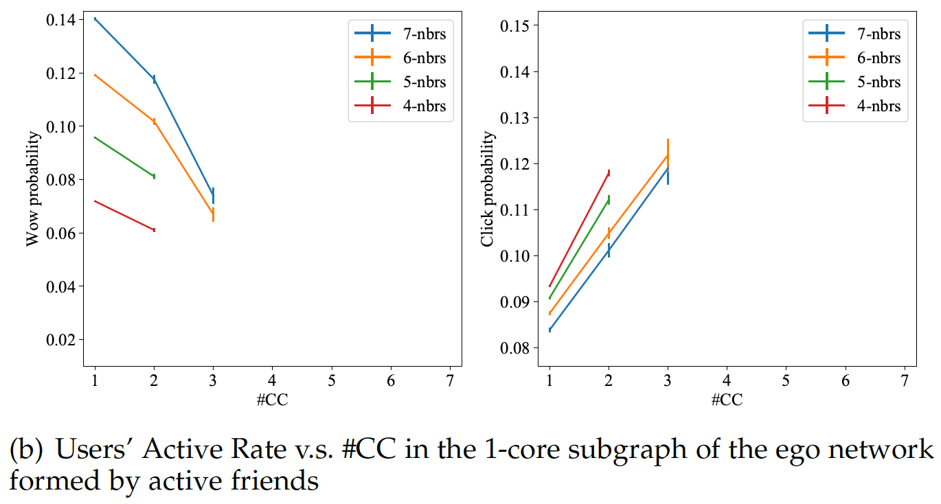
Analysis: Ego Network Properties
The structural topology of cleaned ego networks probably gives a better discriminative ability to predict ego users’ activity.

Slide 12
Analysis Summary
Males are more likely to click but less likely to “wow” articles than females. Counterintuitively, the young generations (people in their 20s and 30s) have the lowest active rate in Top Stories.
For dyadic or triadic correlations,
  there exists interest homophily between users and friends (such as about gender and region),
  but attribute diversity (such as region) also positively correlates with users’ activity when there is more than one active friend.

Slide 13
Analysis Summary
According to ego network topology, the patterns of “wow” and click behavior are very different.
  For instance, when fixing the number of active friends, users’ “wow” probability is negatively correlated to #CC formed by active friends, but for click behavior, it is the opposite.
  The patterns can be more significant when the ego network is cleaned.

Slide 14
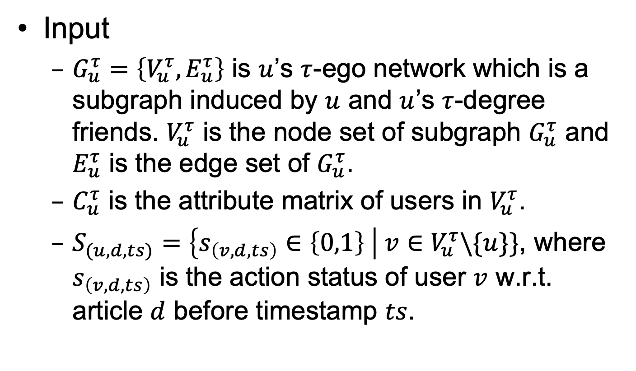
User Behavior Prediction
Input
  $G_{u}^{τ}=\left\{V_{u}^{τ},E_{u}^{τ}\right\}$ is $u$’s $τ$-ego network which is a subgraph induced by $u$ and $u$’s $τ$-degree friends. $V_{u}^{τ}$ is the node set of subgraph $G_{u}^{τ}$ and $E_{u}^{τ}$ is the edge set of $G_{u}^{τ}$.
  $C_{u}^{τ}$ is the attribute matrix of users in $V_{u}^{τ}$.
  $S_{(u,d,ts)}=\left\{s_{\left(v,d,ts\right)}∈\left\{0,1\right\} \right| v∈V_{u}^{τ}\backslash \{u\}\}$, where $s_{\left(v,d,ts\right)}$ is the action status of user $v$ w.r.t. article $d$ before timestamp $ts$.

Slide 15

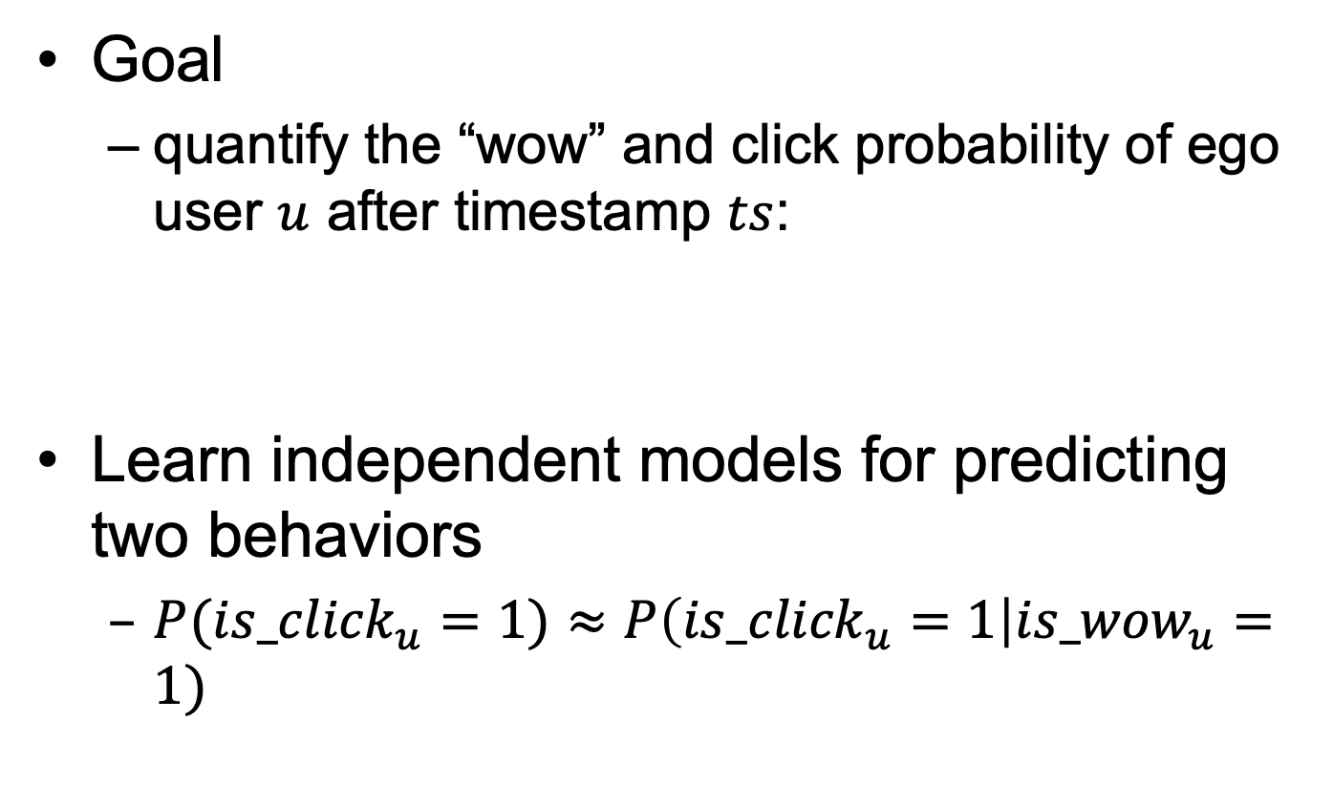
User Behavior Prediction
Goal
  quantify the “wow” and click probability of ego user $u$ after timestamp $ts$:
Learn independent models for predicting two behaviors
  $P({is_click}_{u}=1)≈P\left({is_click}_{u}=1\right|{is_wow}_{u}=1)$

Slide 16
Ideas from Analysis
To model cross-attribute factors for users’ different attributes, we adopt the factorization machine technique to generate second-order features to model feature interactions for each individual.
To remove noise in the ego networks, our model propagates initial user features in the modulated spectral domain, to generate user embeddings based on cleaned ego networks.

Slide 17
Ideas from Analysis
To model dyadic correlations, we adopt a new graph attention mechanism to model feature interactions between neighbors.
To model the connected components — the hierarchical structure of the ego networks, we generate hierarchical representations of ego networks by clustering nodes together and learning on the coarsened graphs iteratively.

Slide 18
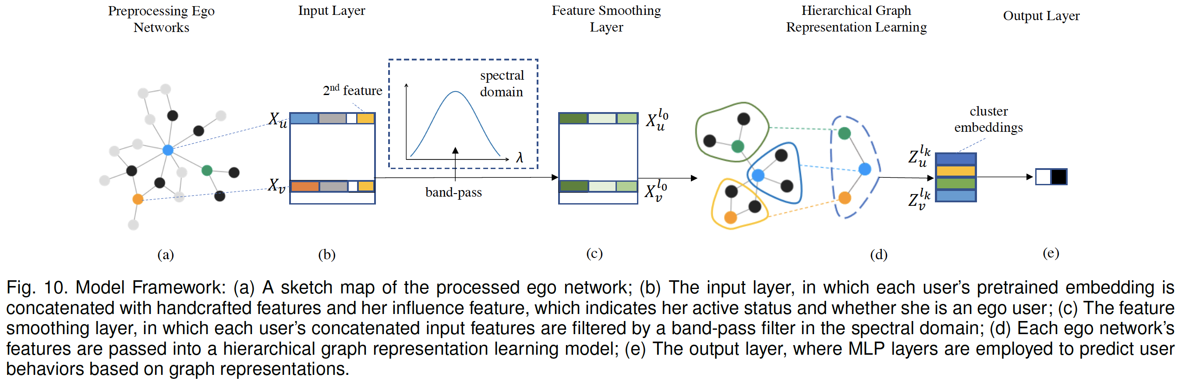
Model Framework — DiffuseGNN

Slide 19
(a) Preprocessing Ego Networks
Sampling a subset of users from one’s ego-network
  Breadth-First Search (BFS)

Slide 20
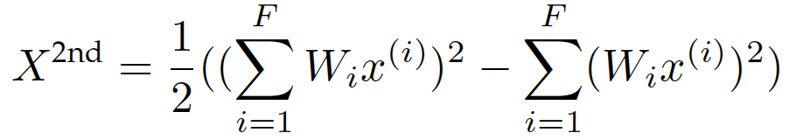
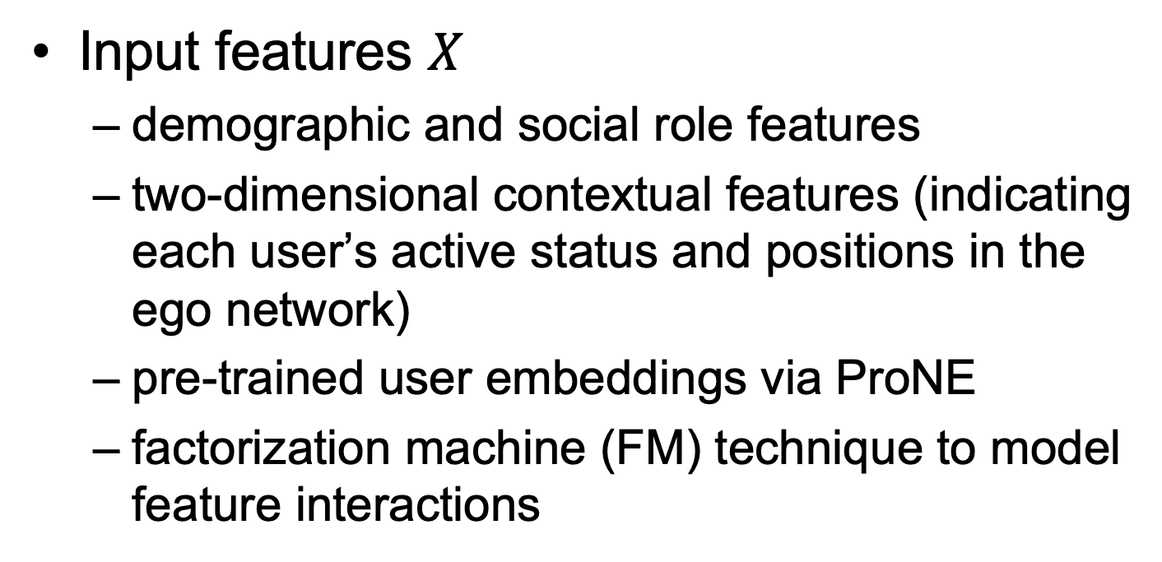
(b) Input Layer
Input features $X$
  demographic and social role features
  two-dimensional contextual features (indicating each user’s active status and positions in the ego network)
  pre-trained user embeddings via ProNE
  factorization machine (FM) technique to model feature interactions

Slide 21
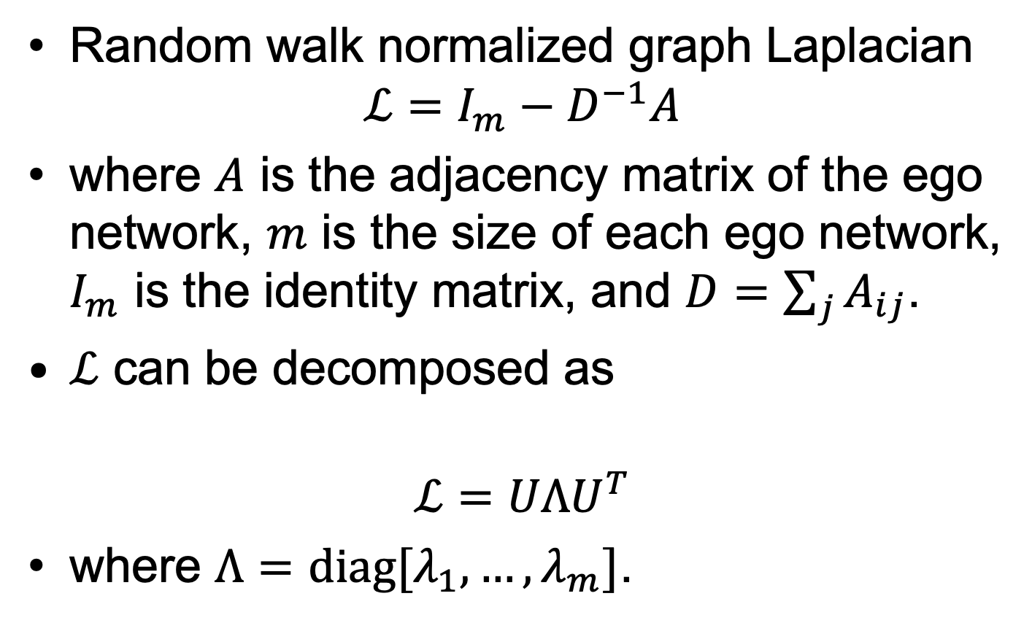
(c) Feature Smoothing Layer
Random walk normalized graph Laplacian
$$ℒ=I_{m}−D^{−1}A$$
where $A$ is the adjacency matrix of the ego network, $m$ is the size of each ego network, $I_{m}$ is the identity matrix, and $D=\sum_{j}{A_{ij}}$.
$ℒ$ can be decomposed as
$$ℒ=UΛU^{T}$$
where $Λ=diag[λ_{1},…,λ_{m}]$.

Slide 22


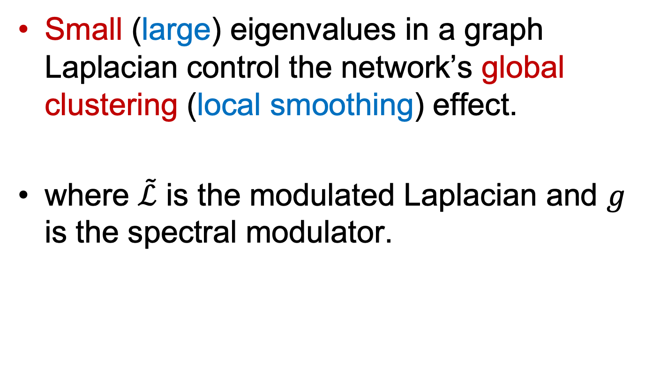
(c) Feature Smoothing Layer
Small (large) eigenvalues in a graph Laplacian control the network’s global clustering (local smoothing) effect.
where $\tilde{ℒ}$ is the modulated Laplacian and $g$ is the spectral modulator.

Slide 23
(d) Hierarchical Graph Representation Learning
Idea:
  design a hierarchical representation learning method to encode the substructures of ego networks
  cluster similar nodes iteratively to encode these substructures
  employ graph neural networks as basic modules

Slide 24


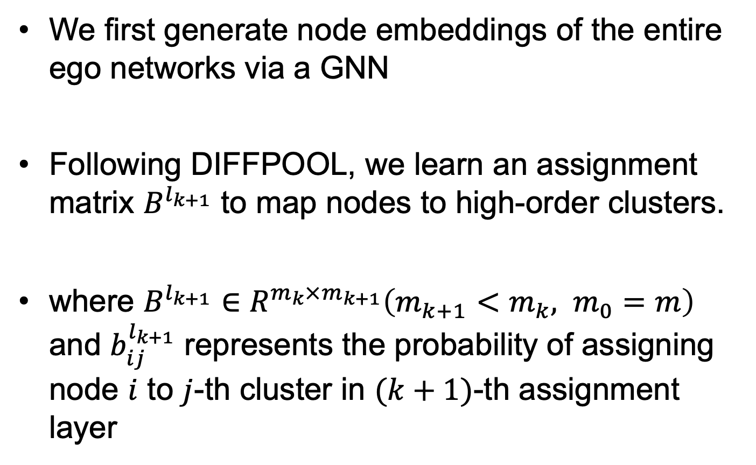
(d) Hierarchical Graph Representation Learning
We first generate node embeddings of the entire ego networks via a GNN
Following DIFFPOOL, we learn an assignment matrix $B^{l_{k+1}}$ to map nodes to high-order clusters.
where $B^{l_{k+1}}∈R^{m_{k}×m_{k+1}}\left(m_{k+1}<m_{k}, m_{0}=m\right)$ and $b_{ij}^{l_{k+1}}$ represents the probability of assigning node $i$ to $j$-th cluster in $(k+1)$-th assignment layer

Slide 25
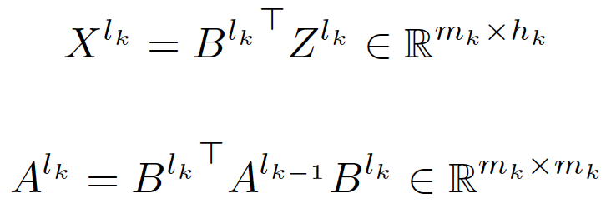

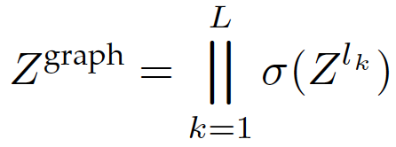
(d) Hierarchical Graph Representation Learning
An ego network can be transformed into a smaller graph iteratively
Based on the coarsened graph, the coarse-level node embeddings can be generated by

Slide 26
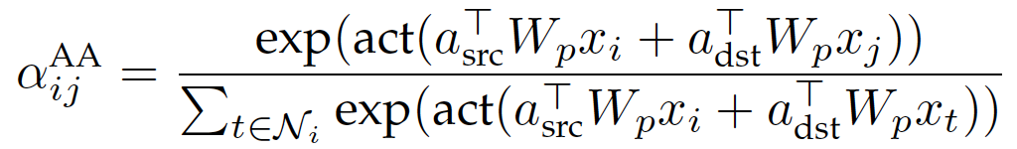
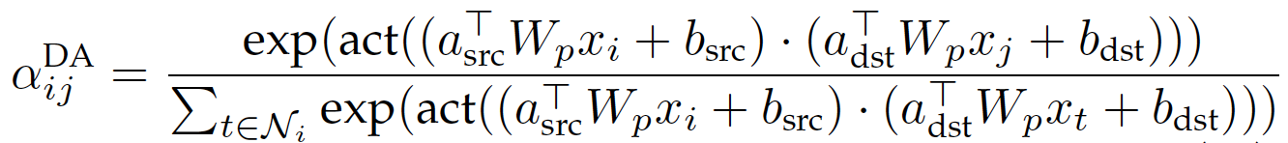
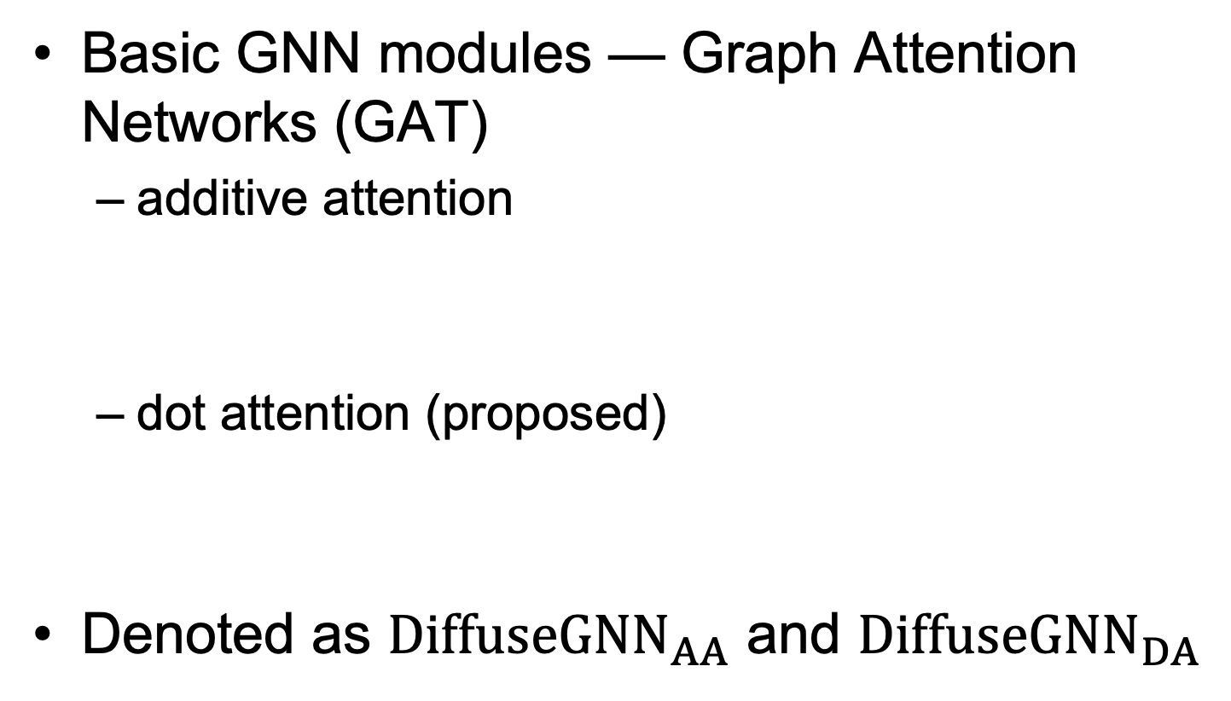
(d) Hierarchical Graph Representation Learning
Basic GNN modules — Graph Attention Networks (GAT)
  additive attention
  dot attention (proposed)
Denoted as ${DiffuseGNN}_{AA}$ and ${DiffuseGNN}_{DA}$

Slide 27

(e) Output Layer
Pass $Z^{graph}$ into fully connected layers to generate prediction scores
Use cross-entropy loss function

Slide 28
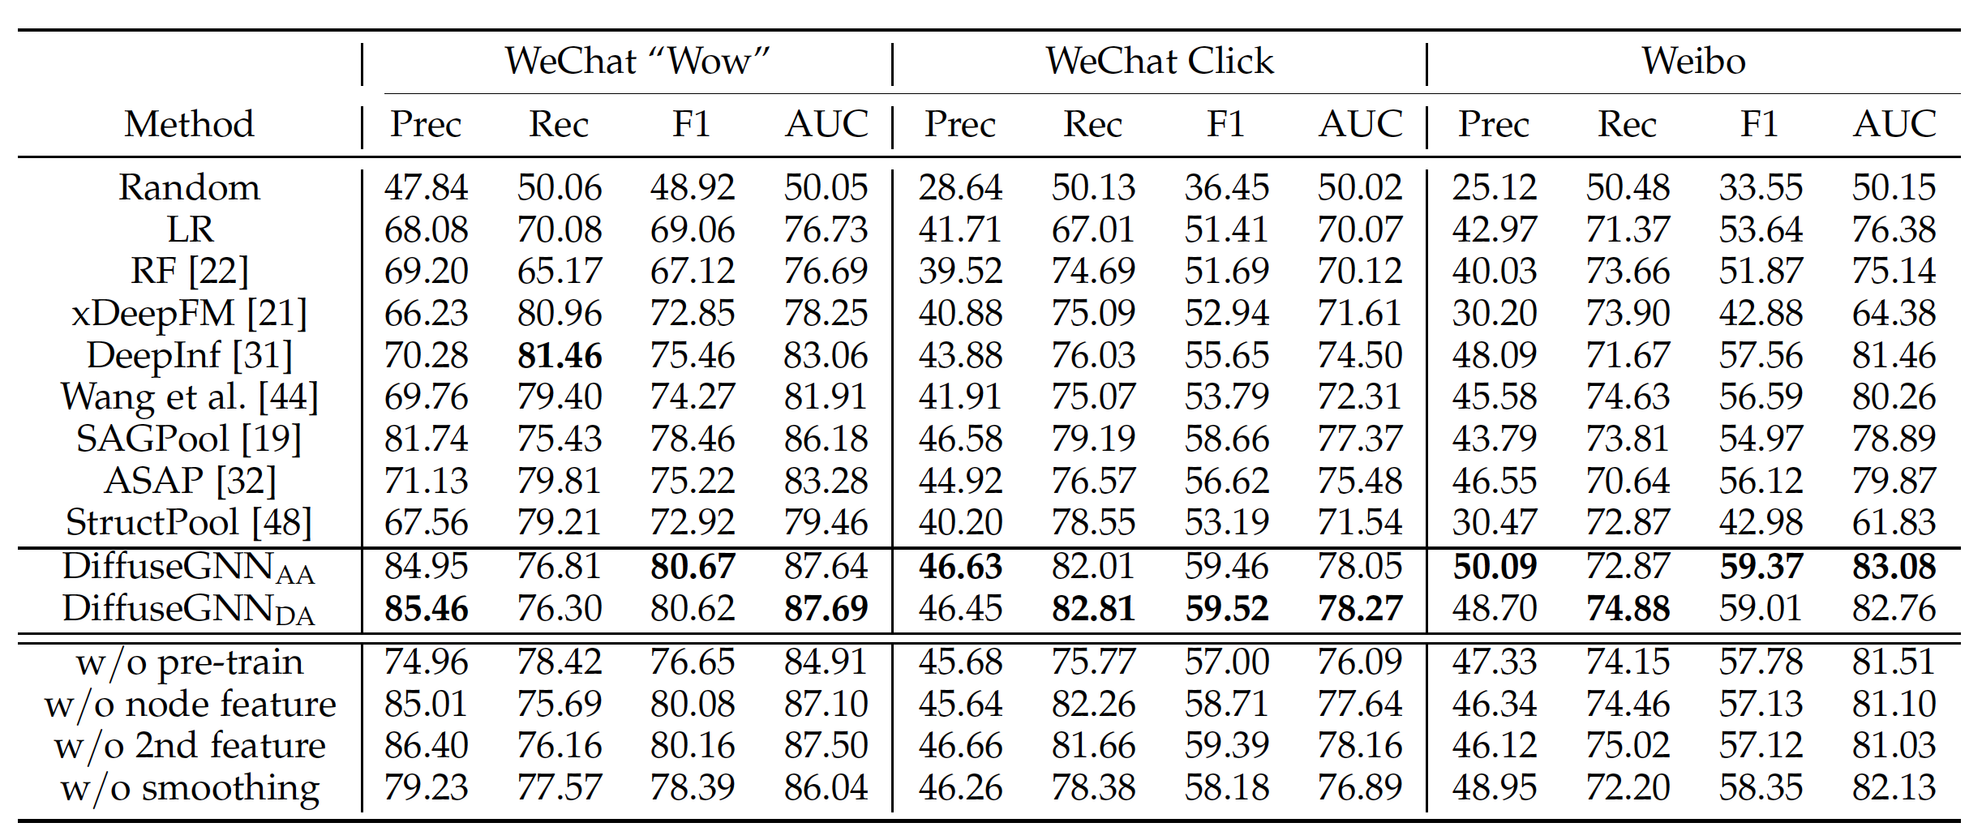
Prediction Results
DiffuseGNN outperforms traditional classifiers, SOTA social influence prediction models and hierarchical graph representation learning methods.

Slide 29
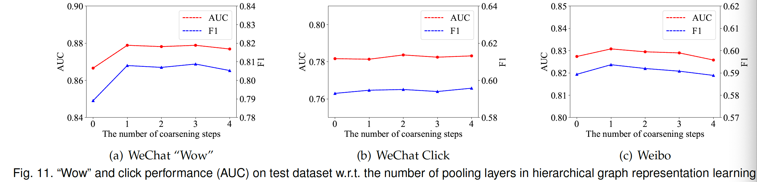
Parameter Analysis
Hierarchical graph representation is clearly better than “flat” representation.
1 coarsening step is best for WeChat “Wow” and Weibo, while 2 coarsening step is best for WeChat Click.

Slide 30
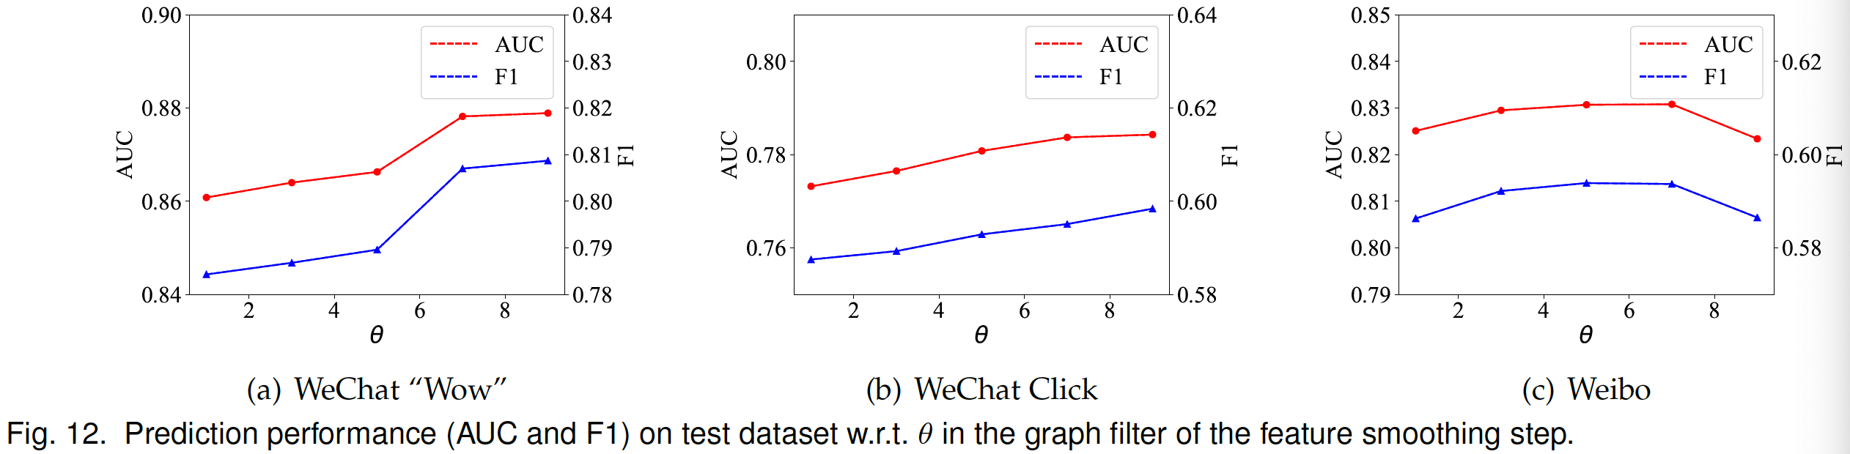
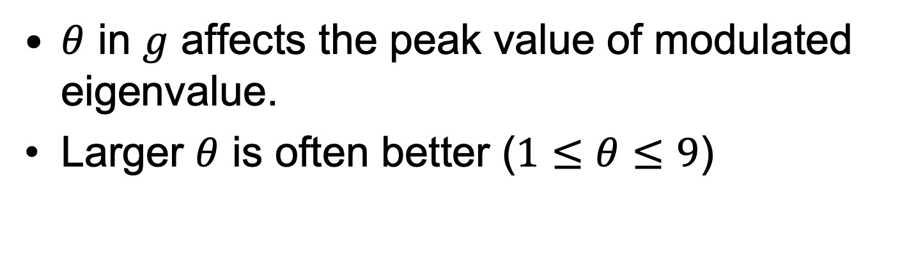
Parameter Analysis
$θ$ in $g$ affects the peak value of modulated eigenvalue.
Larger $θ$ is often better ($1≤θ≤9$)

Slide 31
Conclusion
Our study reveals several interesting patterns about the correlations between users’ “Wow” and click behavior and factors of different granularities.
Based on our discoveries, we propose a new model framework DiffuseGNN to predict user behaviors.
Experiments show that DiffuseGNN consistently outperforms state-of-the-art baseline methods on WeChat and Weibo dataset.

Slide 32
Thank You
ArXiv: https://arxiv.org/abs/2103.02930
Code: https://github.com/zfjsail/wechat-wow-analysis

