Slide 1

Mining Triadic Closure Patterns in Social Networks
Hong Huang, University of Goettingen
Jie Tang, Tsinghua University
Sen Wu, Stanford University
Lu Liu, Northwestern University
Xiaoming Fu, University of Goettingen

Slide 2
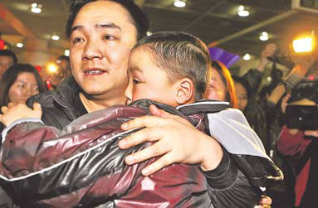

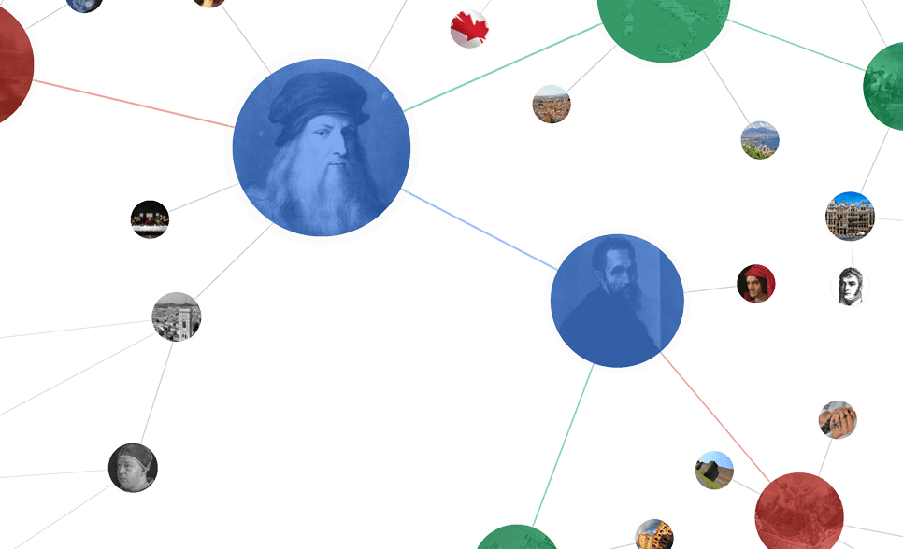

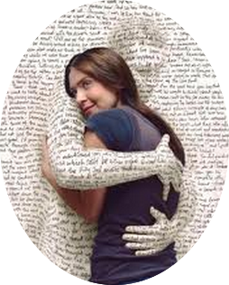






Networked World
1.26 billion users
700 billion minutes/month
280 million users
80% of users are 80-90’s
555 million users
.5 billion tweets/day
560 million users
influencing our daily life
79 million users per month
9.65 billion items/year
800 million users
~50% revenue from network life
500 million users
35 billion on 11/11
Notes:
We are now in a networked world, like Facebook, twitter, amazon, everyday, Even in WWW2014, we have whova to help you, do you check in our session?
how much time do you spent on these social network every day? In some extent, it has shaped our life, isn’t it? Take Weibo for example, weibo is a microblogging service in china, which is Chinese Twitter, until 2012, it has 560 million users. It influence most of Chinese’s daily life. For example, there one is a activity called take a photo, save a kipped napped child to ask users to take a picture and post it on Weibo when they met some lost child. 8 months later, 6 lost children found their parents.

Slide 3
A Trillion Dollar Opportunity
Social networks already become a bridge to connect our daily physical life and the virtual web space
On2Off ^{[1]}
[1] Online to Offline is trillion dollar business
http://techcrunch.com/2010/08/07/why-online2offline-commerce-is-a-trillion-dollar-opportunity/
Notes:
So we can see that social networks has already become a bridge to connect our daily physical life and the virtual web space. So now we want to look deeper to see the structure of this social networks.

Slide 4
“Triangle Laws”
Real social networks have a lot of triangles
  Friends of friends are friends
Any patterns?
  2X the friends, 2X the triangles?
B
A
C
How many different structured triads can we have?
Christos Faloutsos’s keynote speech on Apr.9
Notes:
In the social networks, as talked by Christos in his keynote speech on Apr.9th, real social networks have a lot of triangles, we are more concerned that whether friends of friends are still friends? And we are also want to dig out the patterns among these networks. If we use triads to represents the triangles that with three users. Here comes one questions: how many different structured triads can we have, if we consider there are at least two links in the triad. In the undirected network, it is very easy, just two possibilities, two links and three links. But in the directed networks, the case is much more complicated.

Slide 5
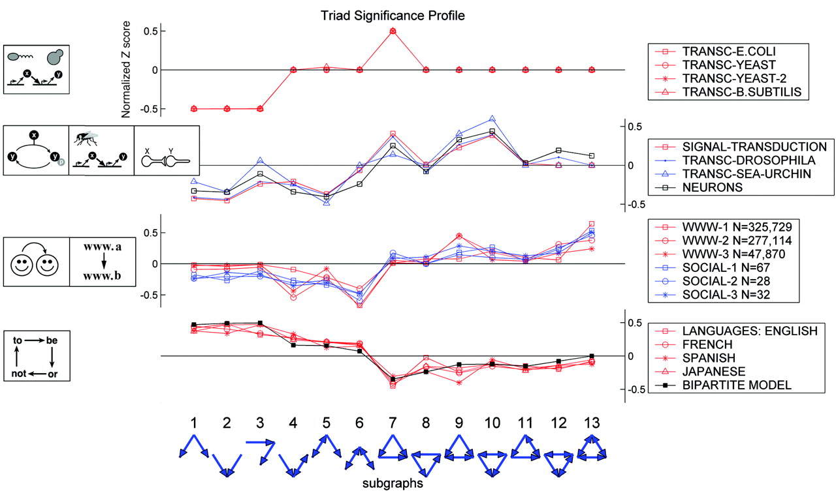
Triads in networks
0 1 2 3 4 5 6 7 8 9 10 11 12
Milo R, Itzkovitz S, Kashtan N, et al.. Superfamilies of evolved and designed networks. Science, 2004
Notes:
Here, we can get 13 different triads, among which 6 has two links and the other 7 have 3 links. In 2004, milo said in his science paper that these 13 different triads in different networks, like in transportation network, biology network, world web wide network, bacteria network, and in different networks, every triads performs distinguished different. Here let’s look deeper in the 13 triads.

Slide 6



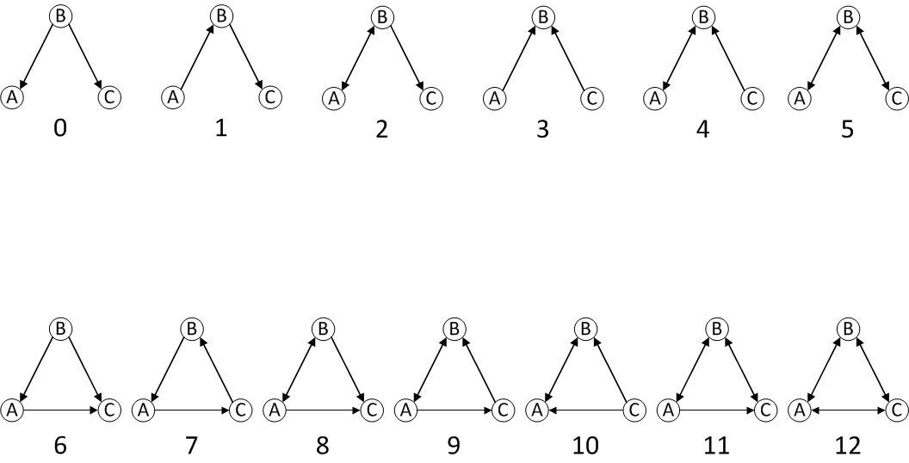
Open Triad to Triadic Closure
Open Triad
However, the formation mechanism is not clear…
Closed Triad
Notes:
Here, we call the above 6 triads as open triads, and the below 7 triads as closed triads, and also triadic closure. If at time t, A follows C, and we can see that triads …becomes triads…, and if C follows A, then triads … becomes …, when A follows C and C follows A back, so on and so forth. We can get how different open triads becomes closed triads, however, the formation mechanism is not clear yet.

Slide 7
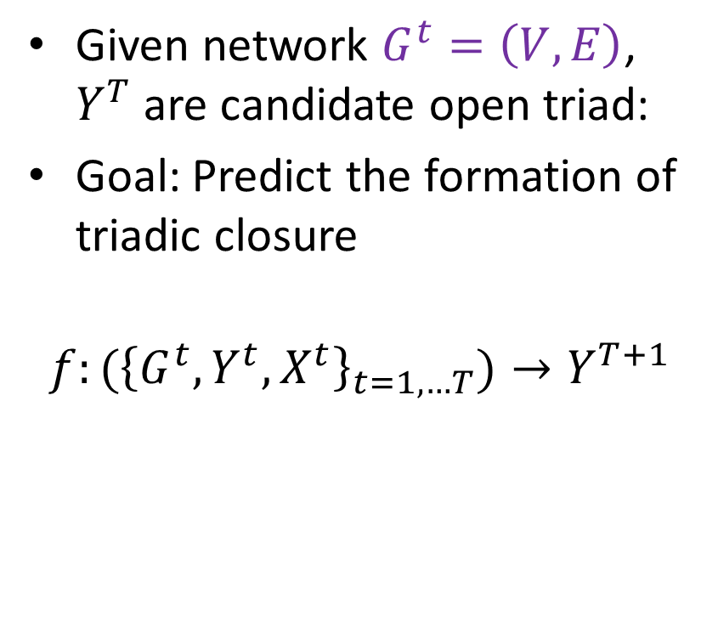




Problem Formalization
Given network $G^{t}=\left(V, E\right)$, $Y^{T}$ are candidate open triad:
Goal: Predict the formation of triadic closure
$$f:({\left\{G^{t},Y^{t},X^{t}\right\}}_{t=1,…T})→Y^{T+1}$$
B
$$t_{1}$$
$$t_{2}$$
A
?
C
$$t_{3}$$
$t_{3}>t_{2}>$ $t_{1}$
Notes:
Then in this paper, we have our problem formalization as follows. Given a network …, Yt are candidate open triad, our goal is to predict the formation of triadic closure, namely if at time t1, some relationship establishes, then at time t2, B and C connects, our goal is to predict whether A and C will connect at time t3.

Slide 8
Dataset
Weibo
Time span: Aug 29th, 2012 – Sep 29th, 2012
700 thousand nodes
200 out-degree per user
360 thousand new links
44 thousand newly formed closed triads per day
400 million following links
Notes:
We did our empirical analysis on the weibo data, weibo is chinese twitter. our data is form August 29th to September 29th in 2012, which covers more than 700 thousand users and 400 million following relationships. Average, every user have around 200 degrees, everyday, there are averagely 360 thousand new relationships formed, and about 44 thousand new closed triads formed.

Slide 9
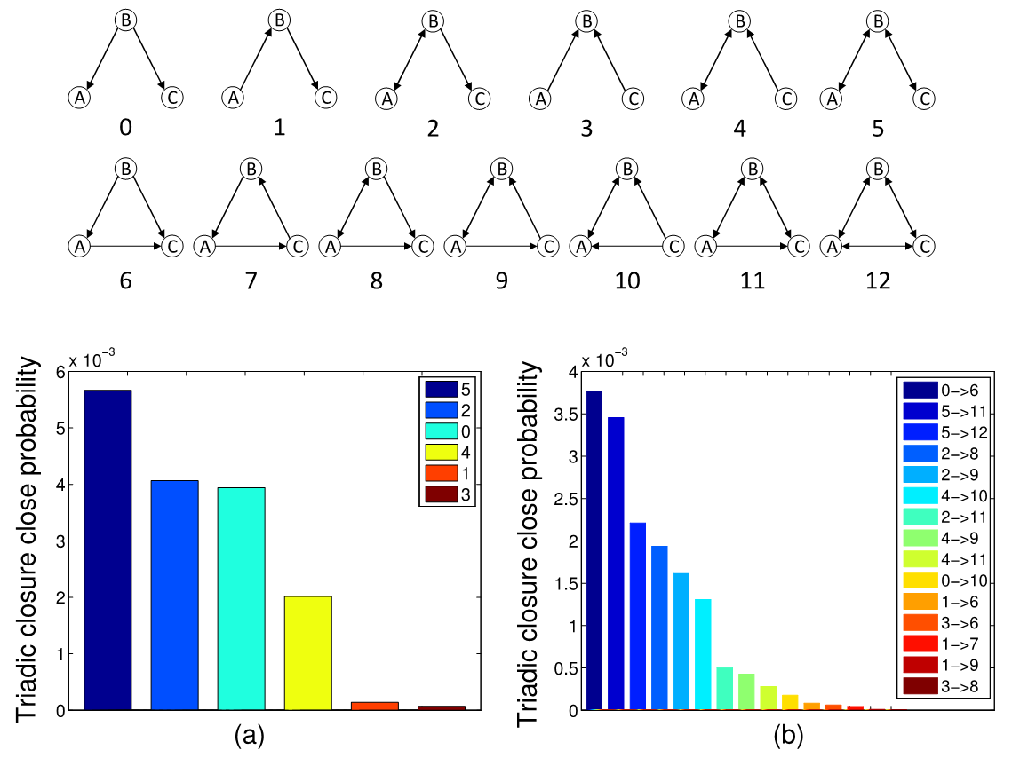
Observation - Network Topology
Y-axis: probability that each open triad forms triadic closures
Notes:
Let’s first look at the network topology. The left below figure shows the probability that each open triads forms triadic closure. We can see that triad no5 have the highest probability to form triadic closure. If two way-relationships means friend, so friend's friends are more likely to be connected. Make sense, en!!!
Then it is very clear that which one is worst? Yes, triad no 3, a person who has a lot of fans, like lady-gaga, it is very hard for her followers to build some relationships.
So we can see more details in below right figure.

Slide 10
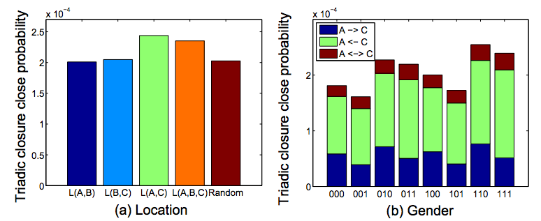
Observation - Demography
L(A, B) means A and B are from the same city
0—female; 1—male
e.g., 001 means A and B are female while C is male.
Notes:
Then let’s move to demography observation. In the left figure, we consider the location. L(A,B) means A and B are from the same city. We can see that if there are some users from the same city, the open triads is more likely to be closed. Before we talk about the gender correlation, I would like to ask you a question, in a small group of three users, if three users are all female or male, which one is more likely to be closed? And boyfriend of girl’s girl friend versus girlfriend of boy’s boyfriend which one is more likely to be closed? Guess…
Yes, girls are more likely to connect with her boyfriend’s boyfriend. And male group are more likely to be closed. Are you one of them?

Slide 11
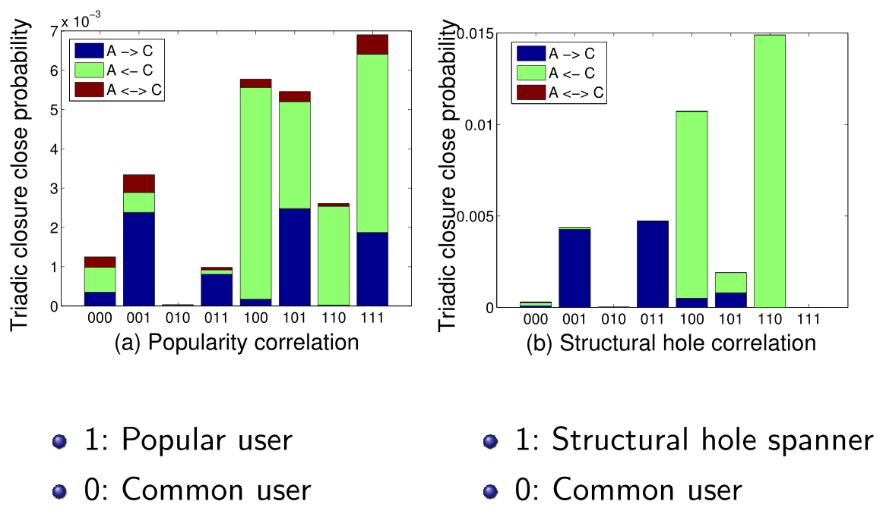
Observation - Social Role
0—ordinary user
1—opinion leader (top 1% PageRank)
e.g., 001 means A and B are ordinary user while C is opinion leader.
Notes:
Then, when we want to consider the social status of users. Here we use PageRank algorithm to rank the top 1 percent of users as opinion leaders. We can see that opinion leader are more likely to form triadic closure than ordinary users. But if the connecting user is opinion leader, it is the worst case to form triadic closure, which corresponds the case that triad no3.

Slide 12
Summary
Intuitions:
  Men are more inclined to form triadic closure
  Triads of opinion leaders themselves are more likely to be closed.
  …
Correlation
Notes:
From our pervious observations, we have several intuitions, like men are more inclined to form triadic closure. And opinion leaders are more likely to be closed.
Besides these intuitions, we also have some correlations, as show in the right figure, when the blue triad become closed, then the blue triad have higher probability to become closed.
Since tradition methods cannot deal with these correlation information, so in this paper, we proposed a triad factor graph method to do the prediction.

Slide 13
The proposed model and results
Considered the intuitions and correlations…
Notes:
And let’s move in the model part.

Slide 14
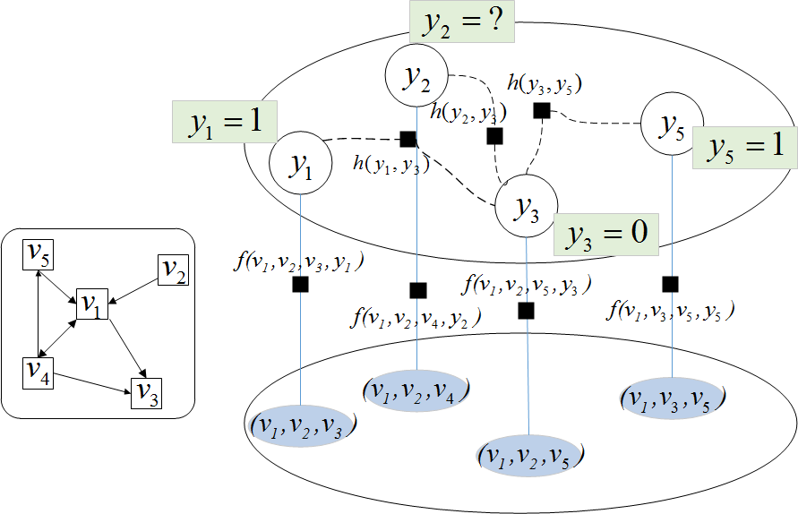
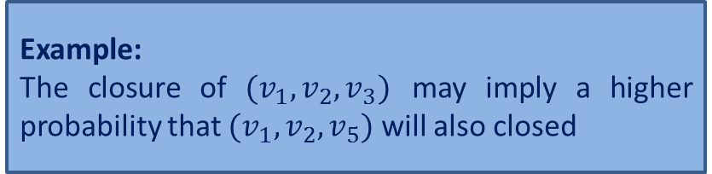
Triad Factor Graph (TriadFG) Model
Correlation
Factor h
Latent Variable
Attribute factor f
Input network
Example:
The closure of $(v_{1},v_{2},v_{3})$ may imply a higher probability that $(v_{1},v_{2},v_{5})$ will also closed
Example:
Whether three users come from the same place?
Map candidate open triads to nodes in model
Model
Notes:
As shown in the model, the left side is input network. And the right side is the formulized model. Each open triad in the input network is mapped to a triad candidate node in the model.
For each triad candidate node, we have a corresponding latent variable y. The value of latent variable indicates the status of the open triad.
In this model, we define two different factors.
The first factor is attribute factor. For each open triad, there may exist some information inferred from our observation.
For example:
whether two users come from the same city?
These features are added in to the model as "attribute factors.“
The second factor is correlation factor. Different open triads may have some correlations. Just like what we said before, the closure of (v1,v2,v3) may imply a higher probability that v1,v2,v5 will also be closed
Finally, this model is a partially labeled model. Some of the nodes are labeled and some are not.
Based on this model, The problem is, for each open triad, identify which one has the highest probability.

Slide 15
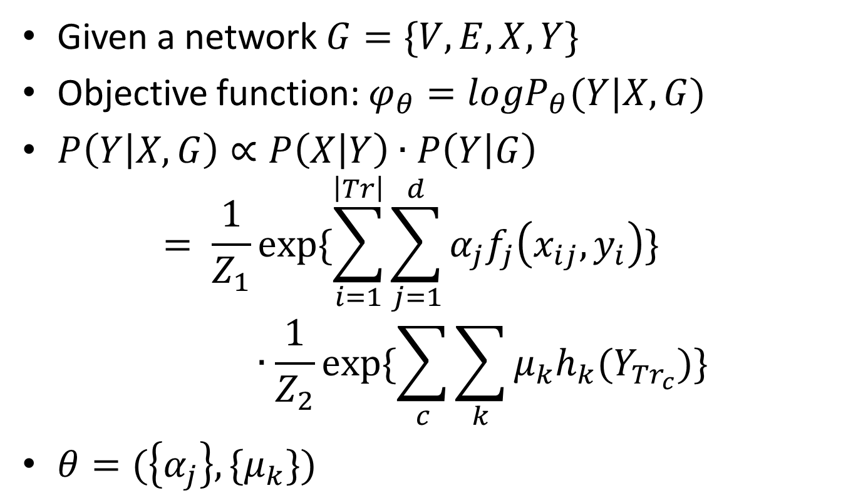
Solution
Given a network $G=\{V,E,X,Y\}$
Objective function: $φ_{θ}=logP_{θ}(Y|X,G)$
$P\left(Y | X,G\right)∝P\left(X | Y\right)∙P\left(Y | G\right)$
$$= \frac{1}{Z_{1}}exp⁡\{\sum_{i=1}^{\left|Tr\right|}{\sum_{j=1}^{d}{α_{j}f_{j}\left(x_{ij},y_{i}\right)}}\}∙\frac{1}{Z_{2}}exp⁡\{\sum_{c}{\sum_{k}{μ_{k}h_{k}(Y_{{Tr}_{c}})}}\}$$
$θ=(\left\{α_{j}\right\},\{μ_{k}\})$
attribute factor f
Correlation factor h
Notes:
Our objective is to maximize log-likelihood of observation function. We can instantiate our observation function within attribute factor and correlation factor. And then learning the model.

Slide 16
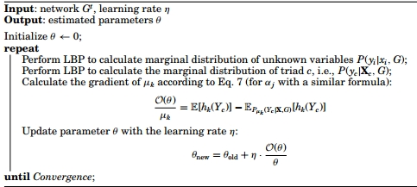
Learning Algorithm
Lou T, Tang J, Hopcroft J, et al. Learning to predict reciprocity and triadic closure in social networks[J]. ACM Transactions on Knowledge Discovery from Data (TKDD), 2013, 7(2): 5.
Notes:
Learning the model, is to estimate a parameter configuration \theta, so that the log-likelihood of observation information are maximized.
Here we use gradient decent method to estimate the parameters.
And use loopy belief propagation to compute the gradient
If you want more details, please go to our paper.

Slide 17
Results on the Weibo data
Baselines: SVM, Logistic
Algorithm | Precision | Recall | F1 | Accuracy
SVM | 0.890 | 0.844 | 0.866 | 0.882
Logistic | 0.882 | 0.913 | 0.897 | 0.885
TriadFG | 0.901 | 0.953 | 0.926 | 0.931
Notes:
We did our experiments on weibo data. We compare our methods with baselines SVM and Logistic. We use same features in the three methods, so we can see our methods are better than the baseline methods.

Slide 18
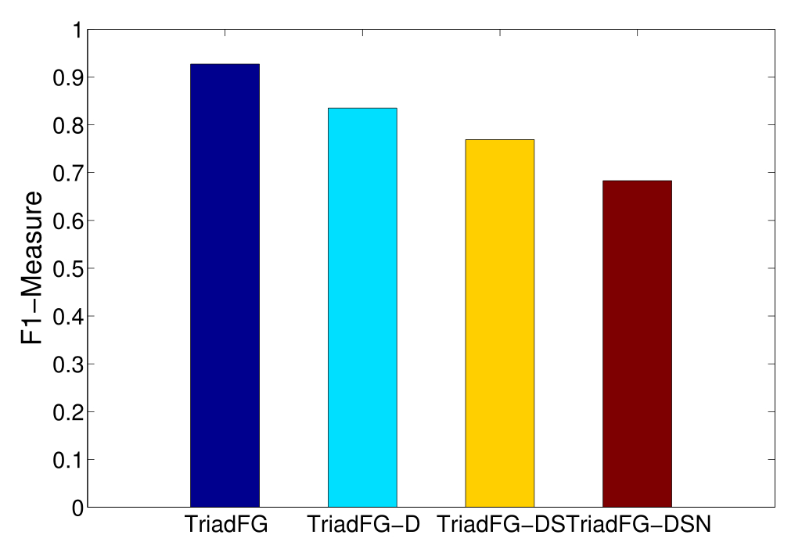
Factor Contribution Analysis
Demography(D)
Popularity(S)
Network Topology(N)
Structural hole (H)
Notes:
Then let’s look at the contributions of different factors. We consider the four different factors, demography, popularity, network topology and structural hole. We can see that social role factor is much more important than demography factor.

Slide 19
Conclusion
Problem: Triadic closure formation prediction
Observations
  Network Topology
  Demography
  Social Role
Solution: TriadFG model
Future work
B
A
?
C
Notes:
In the end, let’s have a quick conclusion.
In this paper, we consider a triadic closure formation prediction problem, based on our empirical analysis on network topology, demography and social role, we have some intuitions like men are more inclined to form triadic closure. And opinion leaders are more likely to be closed. Then we proposed a triad factor graph model to do our prediction.

Slide 20
Thanks
Jing Zhang in Tsinghua Uni.
for sharing her Weibo data!

Slide 21
Thank you!

Slide 22
Attribute factor Definition
 | Feature | Function
Network topology | Is open triad 5/2/0/4/1/3 | 1/1/1/1/0/0
Demography | A,B,C from the same place | 1
 | A,C from the same place | 1
 | C is female | 1
 | B is female | 1
Social role | A/B/C is popular user | 1/0/1
 | A,B,C are all popular user | 1
 | Two users are popular | 1
 | One user is popular | 1
 | A/B/C is structural hole spanner | 1/0/1
 | Two users are structural hole spanner | 1
 | One user is structural hole spanner | 1

Slide 23
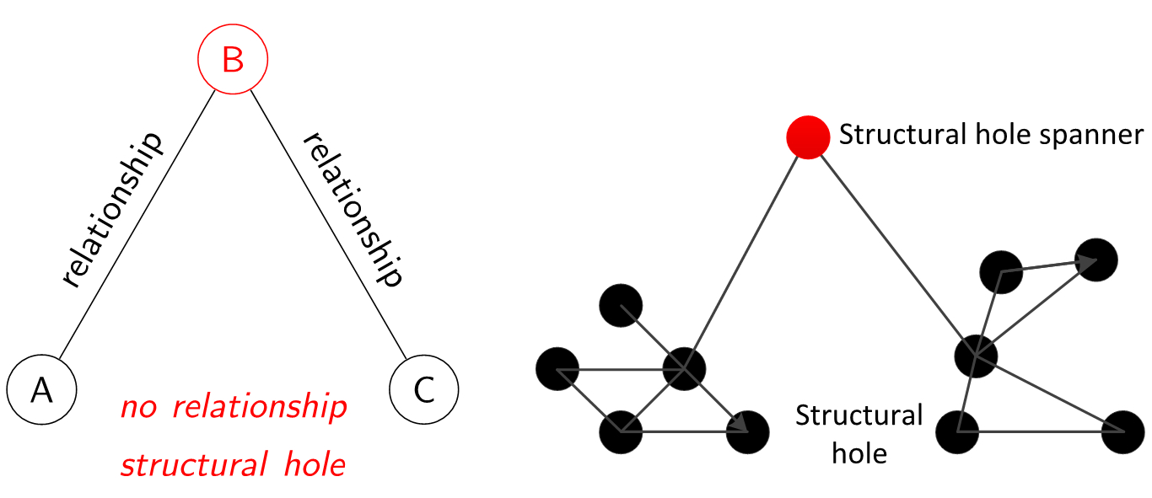
Structural hole
When two separate clusters possess non-redundant information, there is said to be a structural hole between them

Slide 24
Observation - Social Role
0—ordinary user; 1—opinion leader
e.g., 001 means A and B are ordinary user while C is opinion leader.
0—ordinary user; 1—structural hole spanner
e.g., 001 means A and B are ordinary user while C is structural hole spanner .
Lou T, Tang J. Mining structural hole spanners through information diffusion in social networks, www2013

Slide 25
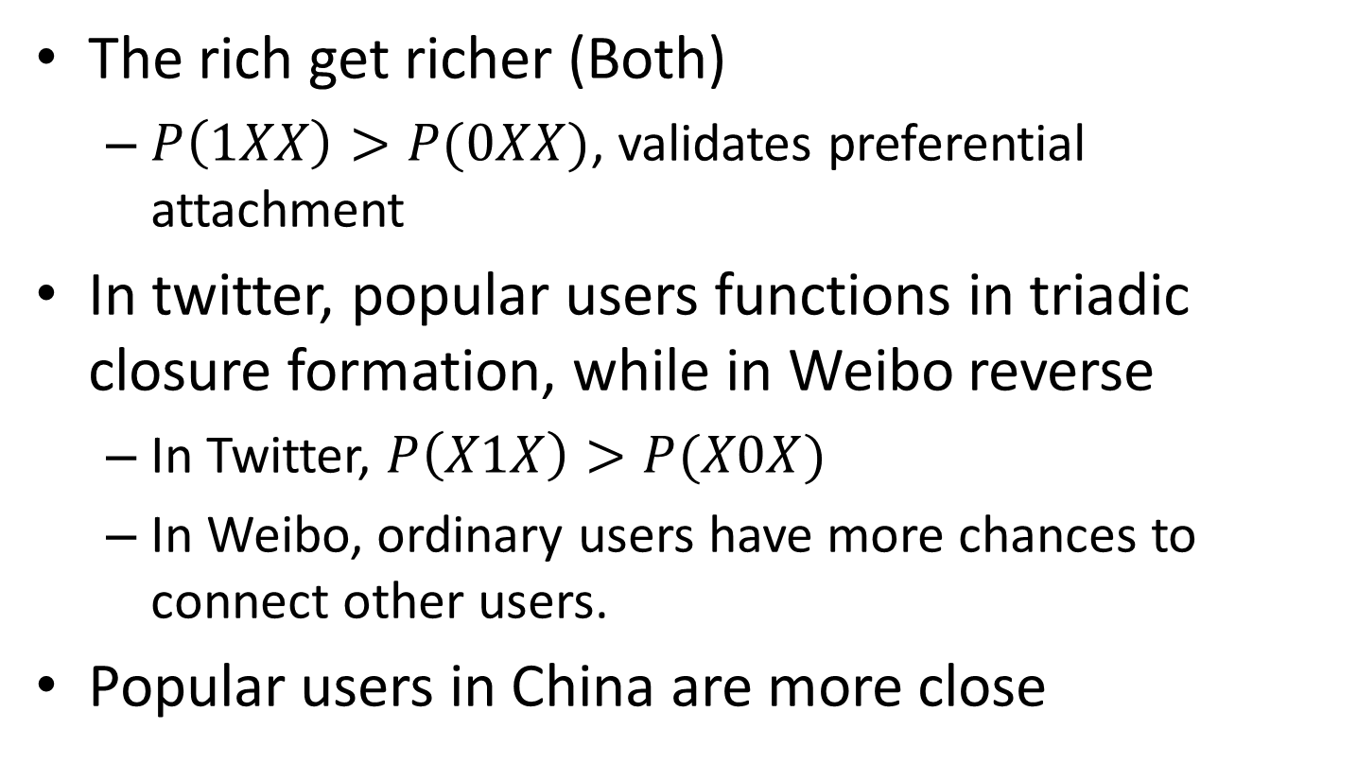
Popular users in Weibo vs. Twitter
The rich get richer (Both)
  $P\left(1XX\right)>P(0XX)$, validates preferential attachment
In twitter, popular users functions in triadic closure formation, while in Weibo reverse
  In Twitter, $P\left(X1X\right)>P(X0X)$
  In Weibo, ordinary users have more chances to connect other users.
Popular users in China are more close

Slide 26
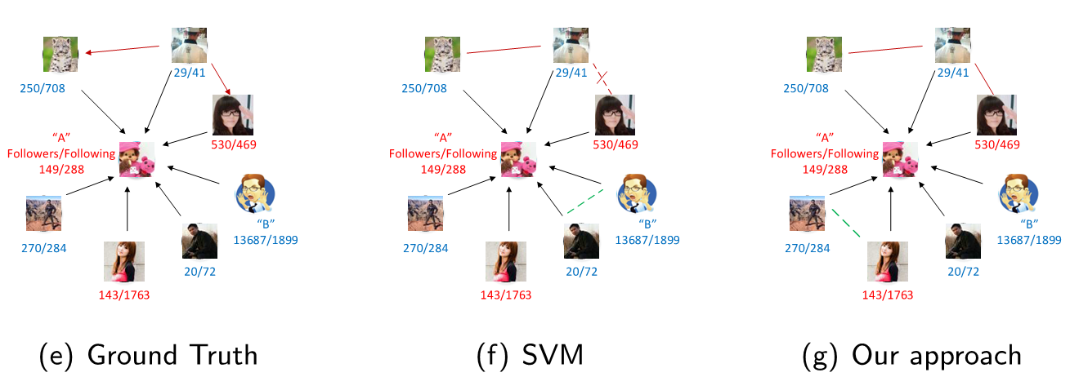
Qualitative Case Study

