Slide 1
Incorporating Social Context and Domain Knowledge for Entity Recognition
Jie Tang, Zhanpeng Fang
Department of Computer Science, Tsinghua University
Jimeng Sun
College of Computing, Georgia Institute of Technology
Notes:
1

Slide 2
Entity Recognition in Social Media
People use blogs, forums, and review sites to share opinions on politicians or products.
One fundamental analytic issue is to recognize entity instances from the UGC short documents. However, the problem is very challenging
  “S4” vs. “Samsung Galaxy S4”
  “Fruit company” vs. “Apple Inc.”
  “Peace West King” vs. “Xilai Bo” (a sensitive Chinese politician)
  …
Notes:
The rapid development of online social networks has significantly enriched our daily communications. As a result, large volumes of unstructured short-text documents are created.
In some cases, people may deliberately use some new words to name an event or a product, just for fun or for other purposes

Slide 3
A Concrete Example
Challenges: short text + social networks + domain knowledge = ?
Notes:
First, as each message is very short, traditional methods for entity recognition that deal with messages independently would lead to unsatisfactory results. Second, the social network provides rich structure information, which should be leveraged. Third, the knowledge base also encodes useful domain knowledge (e.g., hypernyms and hyponyms), which should be utilized in the instance recognition process.

Slide 4
Related Work
Entity recognition
  Modeling as a ranking problem based on boosting and voted perceptron (Collins [9])
  Incorporating long-distance dependency (Finkel et al. [13])
  Use Labeled LDA [26] to exploit Freebase to help extraction (Ritter et al. [27])
  Entity morph (Huang et al. [17])
Entity resolution
  A collective method for entity resolution in relational data (Bhattacharya and Getoor [4])
  A hierarchical topic model for resolving name ambiguity (Kataria et al. [18])
  Name disambiguation in digital libraries (Tang et al. [32])

Slide 5
Approach Framework
—SOCINST

Slide 6
Preliminary: Sequential Labeling
OTH
OTH
OTH
OTH
OTH
LOC
LOC
LOC
LOC
LOC
The label results y
POL
POL
POL
POL
POL
The input text x
Peace-West
King
from
Chongqing
fell
where f represents features and Θ are model parameters.

Slide 7
Sequential Labeling with CRFs
POL
POL
OTH
LOC
OTH
y
x
Peace-West
King
from
Chongqing
fell
μ and λ are parameters to be learned from the training data.
f_{k} denotes the k-th feature defined for token x_{i}
f_{j} denotes the j-th feature defined for two consecutive tokens x_{i}; and x_{j};

Slide 8
Sequential Labeling with CRFs
POL
POL
OTH
LOC
OTH
y
x
Peace-West
King
from
Chongqing
fell
Performance of the model will be bad when dealing with short-text due to sparsity
μ and λ are parameters to be learned from the training data.
f_{k} denotes the k-th feature defined for token x_{i}
f_{j} denotes the j-th feature defined for two consecutive tokens x_{i}; and x_{j};

Slide 9
Sequential Labeling Incorporating Topics
POL
POL
OTH
LOC
OTH
y
P(z|y)
θ
z₁
z₂
z₃
…
z_{T}
P(x|z)
x
Peace-West
King
from
Chongqing
fell

Slide 10
Latent Dirichlet Allocation
β
ϕ_{k}
Distribution of topic over words
Distribution of document over topics
k∈[1,K]
α
θ_{m}
z_{m,n}
x_{m,n}
Word
n∈[1,N_{m}]
m∈[1,M]
α, β: Prior distributions
(Dirichlet distribution)
Document
Topic
[5] D. Blei, A. Y. Ng, and M. I. Jordan. Latent dirichlet allocation. JMLR, 3:993–1022, 2003.
Notes:
Alpha, beta: for words that don’t appear, we don’t want to give them 0 prob == smoothing

Slide 11
Extend to Model Authorship and Categories
Article
Liberia Declared Free of Ebola
Shafiei and Milios
After the West African nation goes more than a month with no new reported cases of viral infection, the World Health Organization says the country is Ebola-free.
…
P(c|z)
disease 0.23
sympton 0.19
….
Disease
Treatment
disease1 0.23
sympton1 0.19
health 0.17
….
DS
P(w|z)
TM
Shafiei
World Health Organization
…
Ebola
P(c|z)
treatment 0.23
operation 0.19
….
DS
TM
treatment1 0.23
operation 0.19
disease1 0.17
….
P(w|z)
Milios
[35] J. Tang, J. Zhang, L. Yao, J. Li, L. Zhang, and Z. Su. Arnetminer: Extraction and mining of academic social networks. In KDD’08, pages 990–998, 2008
Generative process
Notes:
11
两个研究者要写一篇论文。论文中每个单词的生成都符合这个过程，首先选择一个作者负责这个单词的生成，这个作者又按照一定的概率分布生成了一个话题，这个话题按照一定的概率分布生成了这个单词和会议。依次类推，我们就生成了整片论文。但是论文的内容不都是原创的，有一部分是参考文献中的方法，为了建立起参考文献和论文内容的关系，我们在生成参考文献的时候，为每个参考文献选一个话题，然后按照一定的概率分布生成当前的参考文献。

Slide 12
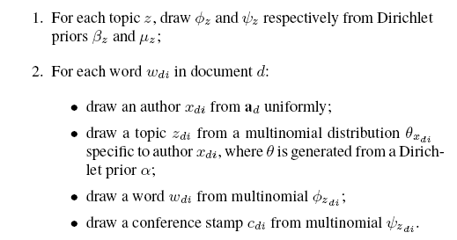
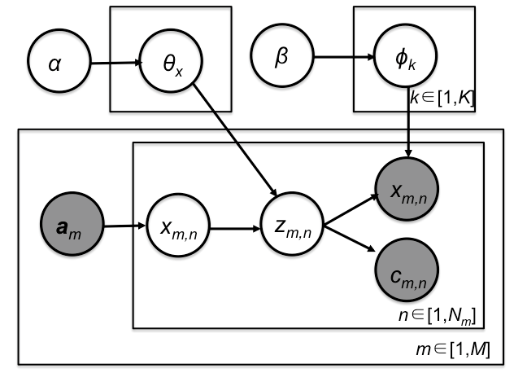
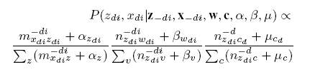
ACT Model
Generative process:
words
authors
category tag
ACT
Topic
category
[35] J. Tang, J. Zhang, L. Yao, J. Li, L. Zhang, and Z. Su. Arnetminer: Extraction and mining of academic social networks. In KDD’08, pages 990–998, 2008

Slide 13
Still challenges
However, we still cannot model domain knowledge and social context!
SOCINST: Modeling Domain Knowledge and Social Context Simultaneously

Slide 14
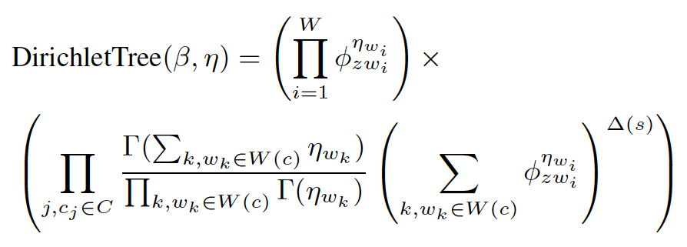
Modeling Domain Knowledge
[1] D. Andrzejewski, X. Zhu, and M. Craven. Incorporating domain knowledge into topic modeling via dirichlet forest priors. In ICML’09, pages 25–32, 2009.
Notes:
If a document d does not have any links to other documents or the author does not have any relationships with others, then for each word wdi, we draw a topic zdi from a topic distribution v specific to author v and then use the topic to sample the word. In particular, for sampling word wdi,we check if the word is an instance of some concept c 2 KB in the training dataset. The generative process is described in Algorithm 2. If it is not, then we use a topic-specific multinomial distribution zdi to generate the word. But if it is an instance of concept c, then we first sample the concept c from the multinomial zdi and then sample the word from the concept-specific multinomial c. Intuitively, we replace the sampling of a word with a two-level generative process.
At the first level, we select the corresponding concept according to a concept path distribution multi(); and at the second level, sample the word. Figure 4 shows an example of the sampling process. Theoretically, this process can be explained by the Dirichlet tree distribution [11, 31], a generalization of the Dirichlet distribution. In a Dirichlet distribution, all words in a document are treated independently; thus it is difficult to model dependencies between words. The Dirichlet tree distribution can be considered as a tree where words are leaf nodes, concepts are internal nodes, and the root node is the super concept of all nodes. Each tree edge encodes weight from the parent node to the child node. Let S(c) be the immediate child of concept node c, W(c) be the leaf nodes (words) in the subtree under concept c, W be all leaves

Slide 15
Modeling Social Context
θ_{A}
User A’s Social context is defined as a mixture of topic distributions of neighbors, i.e.
θ_{B}
θ_{C}
Notes:
We mainly consider two types of social relationships: collaboration relationships and reference relationships. A collaboration relationship indicates that two users vi and vj collaborate with each other; for example collaboration on a scientific paper. A reference relationship indicates that vi has a document that refers to one of vj ’s documents. For example, in Twitter, if user vi adds a post as a reply on vj ’s microblog, then we create a reference relationship. The relationship can be either directed or
undirected. For simplicity, here we consider only undirected relationships. For each relationship, (v; v0), and a new multinomial
distribution #vv0 is constructed by combining the two multinomial v and v0 specific to the two users v and v0. The new distribution
#vv0 is then defined as (v +v0 ), a simple mixture of the two expanded multinomials of v and v0 [7], where is a normalization
factor to guarantee that the sum of the distribution is 1. Finally, the word wdi is sampled from a topic zdi according to the new distribution #vv0 .

Slide 16
Theoretical Basis
Aggregation property of Dirichlet distribution
If
then
Inverse of the aggregation property
If
then

Slide 17
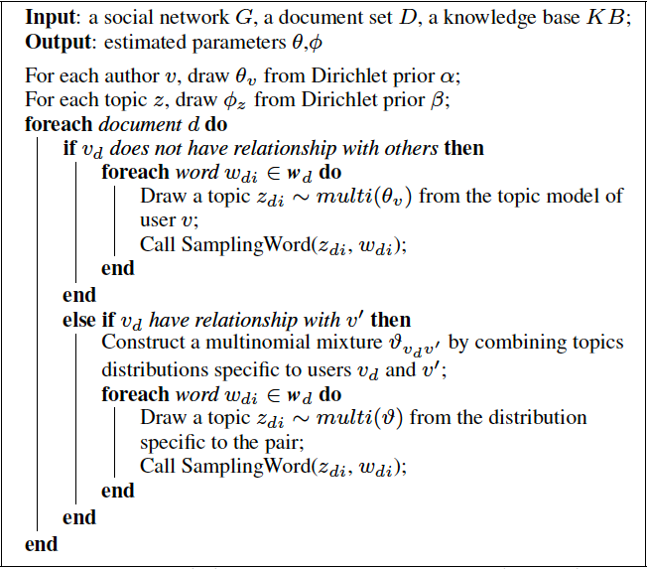
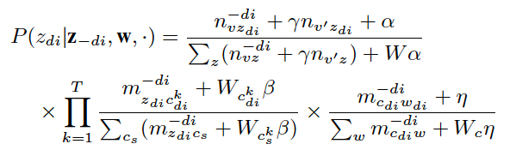
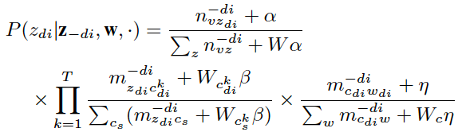
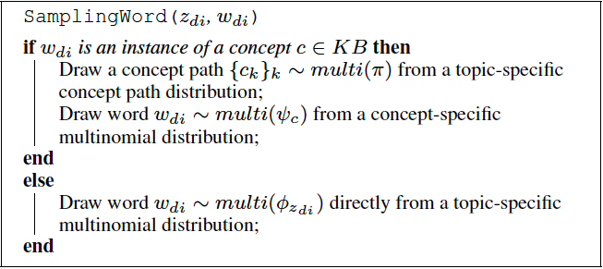

Model Learning

Slide 18
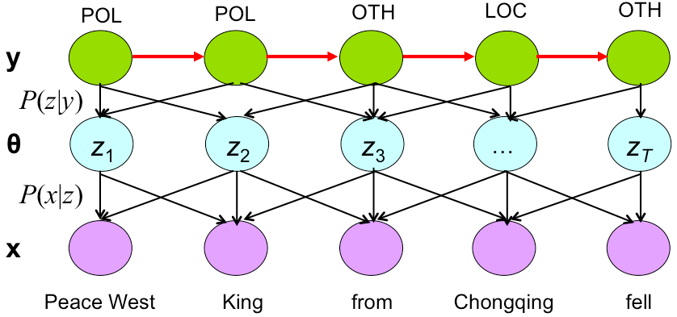
Sequential Labeling Incorporating Topics
Notes:
We now discuss how to combine the learned topic information into sequential labeling model for instance recognition. First, we
apply the proposed SOCINST model to the document set to learn the topic distributions. Then we define feature functions in the sequential labeling method based on the topic distributions for instance recognition. Specifically, we define K topic-specific feature functions in the CRF model for each token, where K is the number of topics learned by the topic model. We use a threshold
to determine whether a topic is relevant to an instance or not. If P(zjv) > , then the value of the corresponding unit is 1, otherwise 0. Figure 3(b) shows the graphical representation of the sequential labeling process with SOCINST.

Slide 19
Experiments

Slide 20
Data Sets
All codes and datasets can be downloaded here
http://aminer.org/socinst/
Dataset
Goal:
  Weibo: Our goal is to extract real morph instances in the dataset.
  I2B2: Our goal here is to extract private health information instances in the dataset.
  ICDM’12 Contest: Our goal is to recognize product mentions in the dataset.
Domain | #documents | #instances | #relationships
Weibo | 1,800 | 545 | 10,763
I2B2 | 899 | 2,400 | 27,175
ICDM’12 Contest | 2,110 | 565 | NA
Notes:
Weibo. Weibo is the most popular microblogging service in
China. The dataset is from [17]. The dataset includes 1,553,347
tweets crawled from Weibo from May 1st, 2013 to June 30th,
2013. Human annotations have been made on the dataset to label
morph entities (e.g., “Fruit company”) and their corresponding targets
(“Apple Inc.”). In total, there are 107 different morph entities.
We view each distinct morph entity as a concept in the knowledge
base. We randomly sampled 1,800 tweets that contain the morph
entities. We use the following relationship to construct the relationship
between users. Finally, we extracted 10,763 relationships.
Our goal is to extract real morph instances in the dataset.
I2B2. This is a health care dataset from [37]. It was used in
the 2006 Deidentification Challenge on automatically identifying
private health information from medical discharge records.4 The
dataset comprises 899 medical records, with a total of 2,400 private
health information instances in the records. We view each patient
as a user and create a relationship between patients if they go to the
same hospital. In total, we have 27,175 relationships. The knowledge
base consists of eight concepts, such as Doctor, Location, and
Hospital. Our goal here is to extract private health information instances
in the dataset.
ICDM’12 Contest. This is a product forum dataset used in the
ICDM’12 Contest5. The task is to automatically recognize product
mentions in forum textual content and to also disambiguate which
product(s) in product catalogs are being referenced. The dataset
comprises 2,110 documents and a total of 565 labeled product mentions
in these documents. We view each product catalog as a concept
in the knowledge base and finally construct a large knowledge
base of 15,367,328 concepts. The dataset does not provide the user
information; thus, we mainly focus on evaluating the effect of incorporating
domain knowledge for instance recognition. Our goal
is to recognize product mentions in the dataset.

Slide 21
I2B2
HISTORY OF PRESENT ILLNESS :
Mr. Blind is a 79-year-old white male with a history of diabetes mellitus , inferior myocardial infarction , who underwent open repair of his increased diverticulum November 13th at Sephsandpot Center. The patient developed hematemesis November 15th and was intubated for respiratory distress.
He was transferred to the Valtawnprinceel Community Memorial Hospital for endoscopy and esophagoscopy on the 16th of November which showed a 2 cm linear tear of the esophagus at 30 to 32 cm .
Patient
Doctor
Date
Location
Hospital

Slide 22
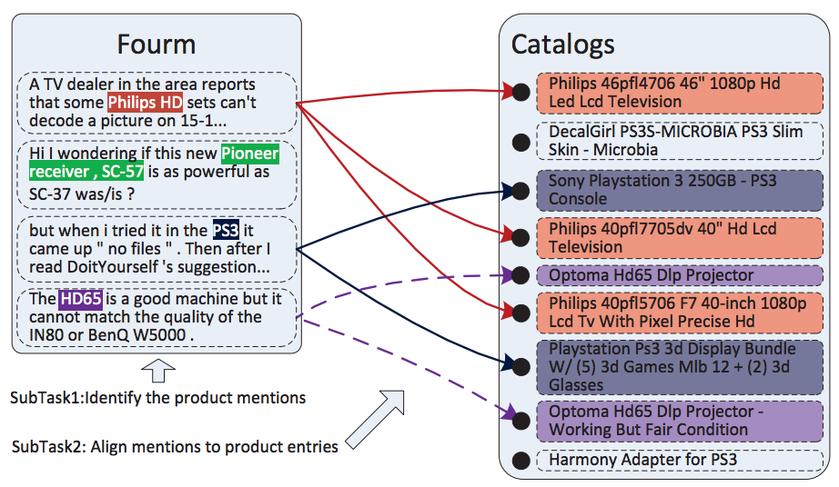
ICDM’12 Contest

Slide 23
Results
SM: Simply extracts all the terms/symbols that are annotated
RT: Recognizes target instances from the test data by a set of rule templates
CRF: Trains a CRF model using features associated with each token
CRF+AT: Uses Author-Topic (AT) [30] to train a model and then it use the learned topics as features for CRF for instance recognition
SOCINST: Our proposed model

Slide 24
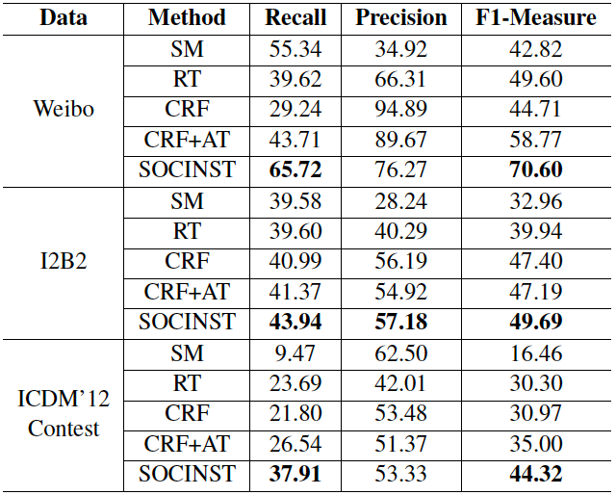
Results
SM: Simply extracts all the terms/symbols that are annotated
RT: Recognizes target instances from the test data by a set of rule templates.
CRF: Trains a CRF model using features associated with each token
CRF+AT: Uses Author-Topic (AT) [30] to train a model and then it use the learned topics as features for CRF for instance recognition
SOCINST: Our proposed model

Slide 25
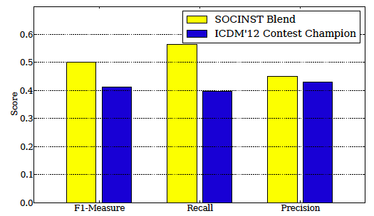
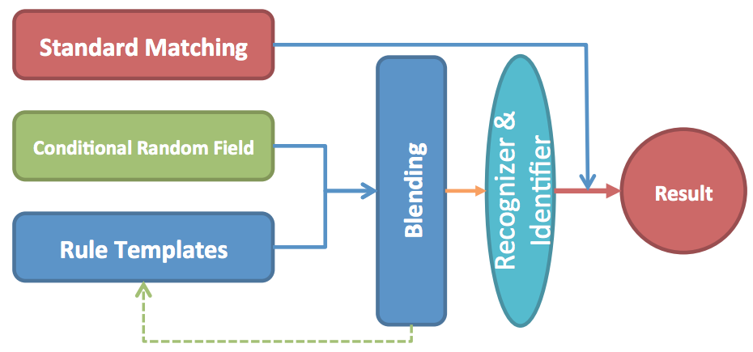
More Results—ICDM’12 Contest
Performance comparison of SOCINST and the first place [38] in ICDM’12 Contest.
By incorporating the modeling results into the CRF model
[38] S. Wu, Z. Fang, and J. Tang. Accurate product name recognition from user generated content. In ICDM’12 Contest.

Slide 26
Effects of Social Context and Domain Knowledge
SOCINST_{base}— we removed both social context and domain knowledge from our method;
SOCINST-SC— we removed social context from our method;
SOCINST-DK— we removed domain knowledge from our method;

Slide 27
Parameter Analysis

Slide 28
Parameter Analysis (cont.)
* All the other hyperparameters fixed
The number of topics is set to K = 15

Slide 29
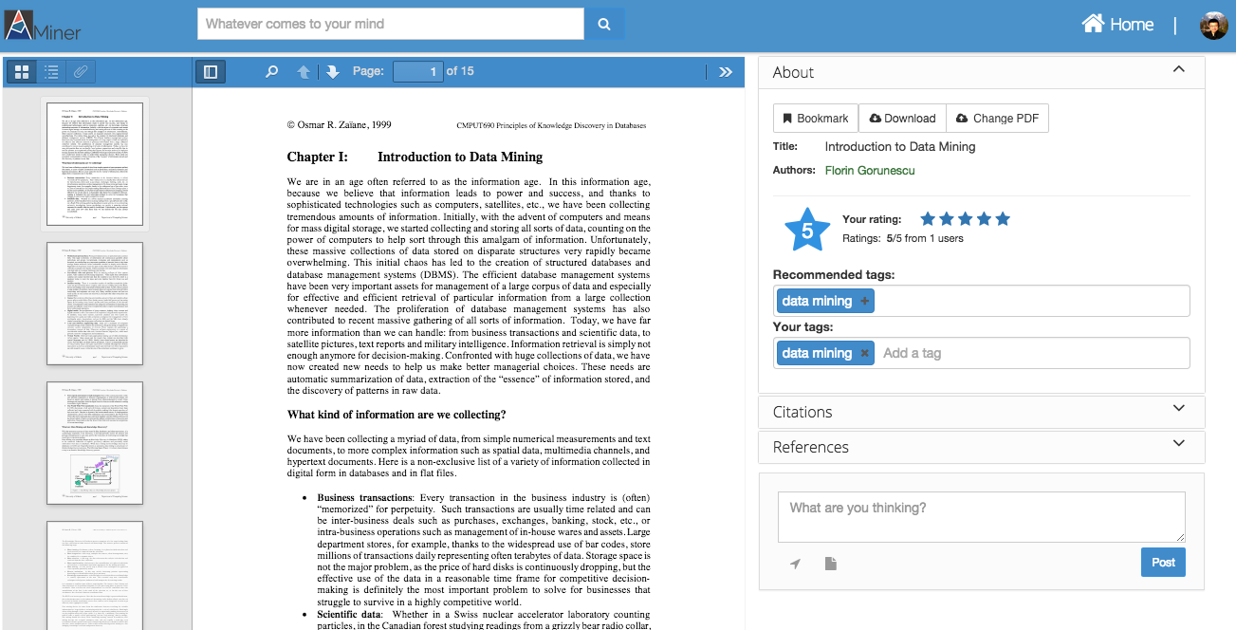
AMiner
(http://aminer.org)

Slide 30
Conclusion
Study the problem of instance recognition by incorporating social context and domain knowledge
Propose a topic modeling approach to learn topics by considering social relationships between users and context information from a domain knowledge base
Experimental results on three different datasets validate the effectiveness and the efficiency of the proposed method.

Slide 31
Future work
The general idea of incorporating social context and domain knowledge for entity recognition represents a new research direction
Combining the sequential labeling model and the proposed SOCINST into a unified model should be beneficial
Further incorporating other social interactions, such as social influence, to help instance recognition is an intriguing direction

Slide 32
Thank you！
Collaborators:
Jimeng Sun (Georgia Tech)
Zhanpeng Fang (THU)
  Jie Tang, KEG, Tsinghua U, http://keg.cs.tsinghua.edu.cn/jietang
  Download all data & Codes, http://aminer.org/socinst

Slide 33
Modeling Short Text with Topics
Document d
warning 0.3 system 0.2..
Topic
“Generating” word x
in doc d in the collection
Topic
Aid 0.1
donation 0.05
support 0.02 ..
1 -
x
…
statistics 0.2
loss 0.1
dead 0.05 ..
Topic
B
Is 0.05
the 0.04
a 0.03 ..
Background B
Parameters:
= noise-level (manually set)
are estimated with Maximum Likelihood

Slide 34
α
θ_{x}
β
ϕ_{k}
k∈[1,K]
x_{m,n}
a_{m}
x_{m,n}
z_{m,n}
c_{m,n}
n∈[1,N_{m}]
m∈[1,M]
Notes:
Alpha, beta: for words that don’t appear, we don’t want to give them 0 prob == smoothing

