Slide 1



Smart Jump: Automated Navigation Suggestion for Videos in MOOCs
Han Zhang†, Maosong Sun†, Xiaochen Wang†, Zhengyang Song†, Jie Tang†, Jimeng Sun‡
†Tsinghua University
‡Georgia Institute of Technology
Notes:
Thanks for chair for the introduction.
This is Han Zhang from Tsinghua University.
I am going to talk about Smart Jump: Automated Navigation Suggestion for Videos in MOOCs.
This is a joint work with collaborators from Tsinghua, Xuetangx.com Corporation, and Georgia Tec.

Slide 2







MOOCs
808 courses
5,900,000 users
Notes:
There are many MOOC platforms all over the world. For example, <click> the famous three: coursera, edx and udacity.
There are also some MOOC platforms in China, like <click> Xuetangx.com, Chinese University MOOC and imooc.com
<click>The dataset in our paper comes from xuetangx.com. XuetangX.com has more than 800 courses and 5 million users.
The study of the data is very important because we can learn users and help them improve learning efficiency.

Slide 3

Jump Back: How much time, do you know?
t
t+8
$$5S$$
According to what we have discussed we find that the fifth activity belongs to cash outflow of a business activity.
$$5S×5000000=6944hours$$
(Users)
Notes:
The problem we study in our paper is about jump back actions in MOOC videos.
First of All, let me show you two common sce’narios that bother users when they jump back in MOOC videos.
Next is the first scenario,
<click>
this is a video timeline. <click> And the teacher says a sentence from tth second to t+8th second.
When jump back, users usually jump to the middle of the sentence like this. <click>then she has to wait to begin her reviewing until the sentence ends. <click> As a result, she wasted five seconds from this position to the end of the sentence.
<click>
Now we have 5 million users, it means that nearly 7 thousand hours have been wasted.

Slide 4
Multiple Jumping
1
3
2
4
5
2.6 clicks on average for a complete jumping back
Notes:
The second scenario is multiple jumping.
<click>
For example, a user here jumped for five times like this to seek the accurate position that she wants to review from.
<click>
The dataset reports that a user has 2.6 clicks on average for a complete jumping back.

Slide 5

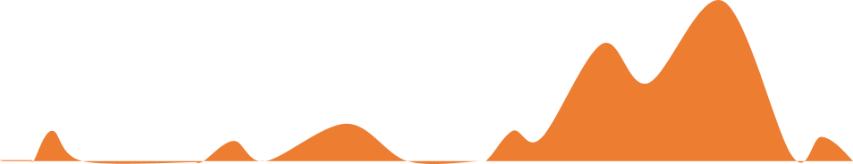

Problem: Smart Jump
Challenge 1: What are the underlying factors behind the jump?
Jump-back
Navigation
Distribution
Challenge 2: How to incorporate individual information for an accurate recommendation?
0.07
0.35
0.11
0.26
Personalized Suggestion
Let’s begin with …
First, we introduce …
The example is that …
Next … capital assets … investment property …
Automated suggestion for video navigation
Notes:
To improve learning efficiency, can we predict the end position for users automatically when they intent to jump back?
<click>
In this paper, we research on the problem that realize automated suggestion for this kind of video navigation, and we call it smart jump.
To illustrate the problem we are going to deal with, we give an example scenario here:
<click>
This is a lecture from a course. A user wants to jump back from this start position.
The gray curve shows the jump-back navigation distribution of this lecture according to the his’torical data.
These orange circles are our suggestions for possible end positions. Different size represents different probabilities that the user will jump back to.
For example, the place with the highest probability (0.35) is to describe an example in the lecture, and the second position is the concept of “capital assets”
It is not the same with navigation distribution because it is personalized.
In dealing with the problem, we have two main challenges:
<click>
The first one, What are the underlying factors behind the jump?
<click> and second, How to incorporate individual information for an accurate recommendation?

Slide 6
Complete-jump
Complete-jump construction base on DFA
Two basic complete-jump patterns
Notes:
We have mentioned that users may click several times in a jump-back action, so we have to construct these clicks recorded in logs into a complete-jump first.
<click>
The construction are based on a Determi’nistic finite au’tomaton.
<click>
Then We find two basic complete-jump patterns. In the first pattern (the top one), the user jumps back, watches the video for some time, then jumps back again, and in the second one (the bottom one), the user jumps back, watches the video and jumps forward. Other complete-jumps are the combinations of the two basic patterns.

Slide 7
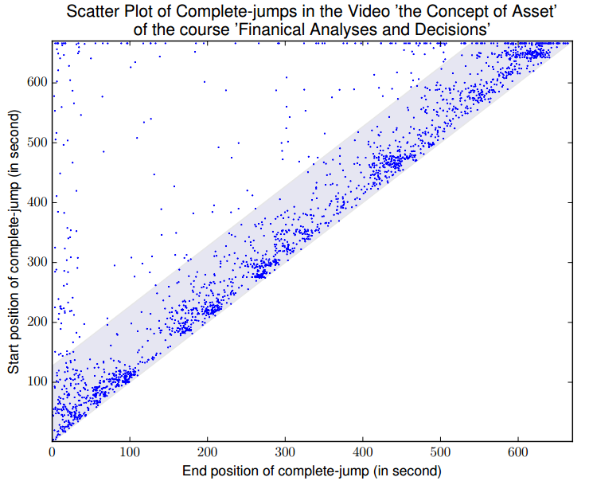
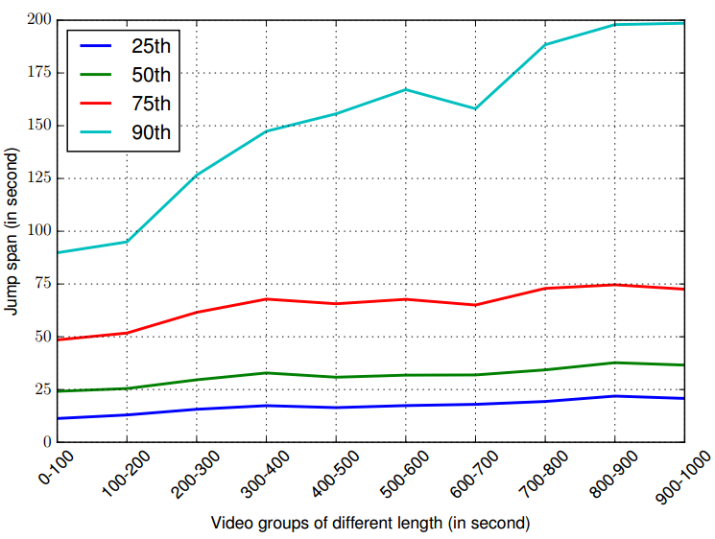
Observations – Video Related
Most jumps are close to the diagonal
(~90% locate in the light blue area)
Jump span is positively correlated with the length of videos.
Complete-jumps with longer jump span are more easily to be affected by video length
Notes:
We conduct investigations on the dataset from different perspectives. Here are the observations related to videos.
<click>
This figure is a scatter plot of all jump-backs in a video from a science course. A dot in the plot represents a jump-back in the video. Y axis represents the start position of a jump-back, and x axis represents the end position. <click> clearly we can see that most jumps are close to the diagonal. Almost 90% percent of back-jumps locate in the light blue area. It means that the span of most jump-backs are not too long.
<click>
And then we did analysis on the relationship between video length and jump span.
The length of videos vary in1000 seconds, we group the videos every 100 seconds and draw the jump-span distribution of four percentiles: 25, 50, 75and 90 percent.
<click>
From this figure, we draw the conclusion that jump span is positively correlated with the length of videos.
Particularly, longer jump span are more easily to be affected by video length.

Slide 8
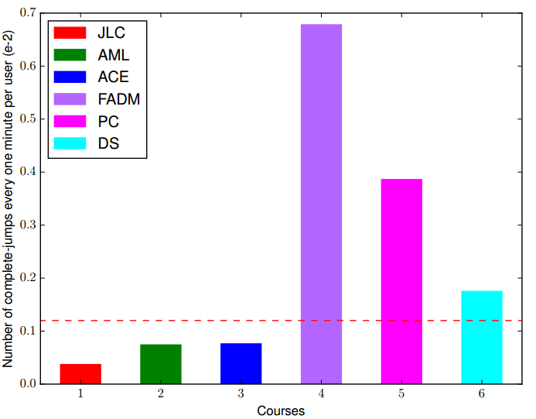
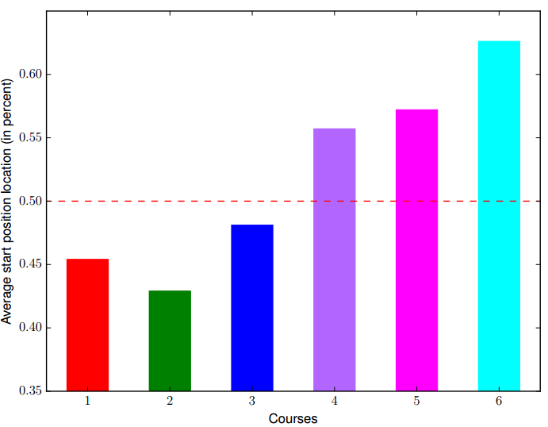
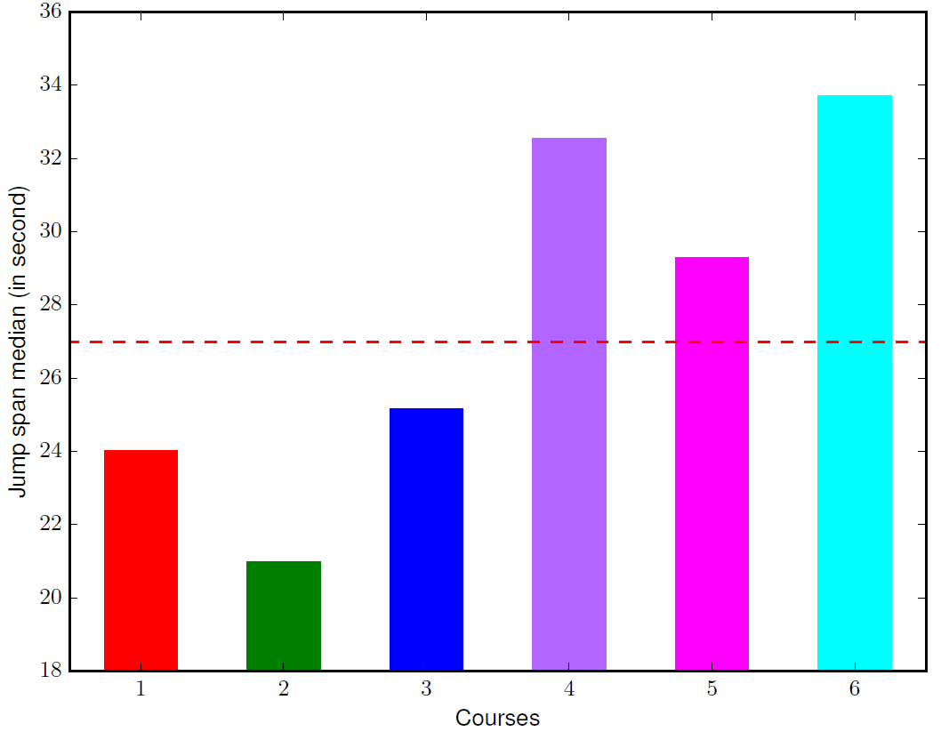
Observations – Course Related
Science courses contain much more frequent jump-backs than non-science courses.
Users in non-science courses jump back earlier than users in science courses.
Users in science courses are likely to rewind farther than users in non-science courses.
Notes:
Next is the observations related to courses.
<click>
First of all, we count jump-back frequency of each course, which are illustrated in the histogram figure.
The first three bars represent three non-science courses, and the last three bars represent three science courses.
It shows that jump-back actions in science courses are much more frequent than non-science courses. This may because, in general, science courses are difficult than non-science courses, Users need to study some videos multiple times in order to understand the content.
<click>
Then we investigate on the start position of jump-backs, we can see that users in non-science courses jump back earlier than users in non-science courses.
<click>
The third figure illustrates jump span median of each courses. It indicates that users of science courses are likely to rewind farther than those of non-science courses.

Slide 9
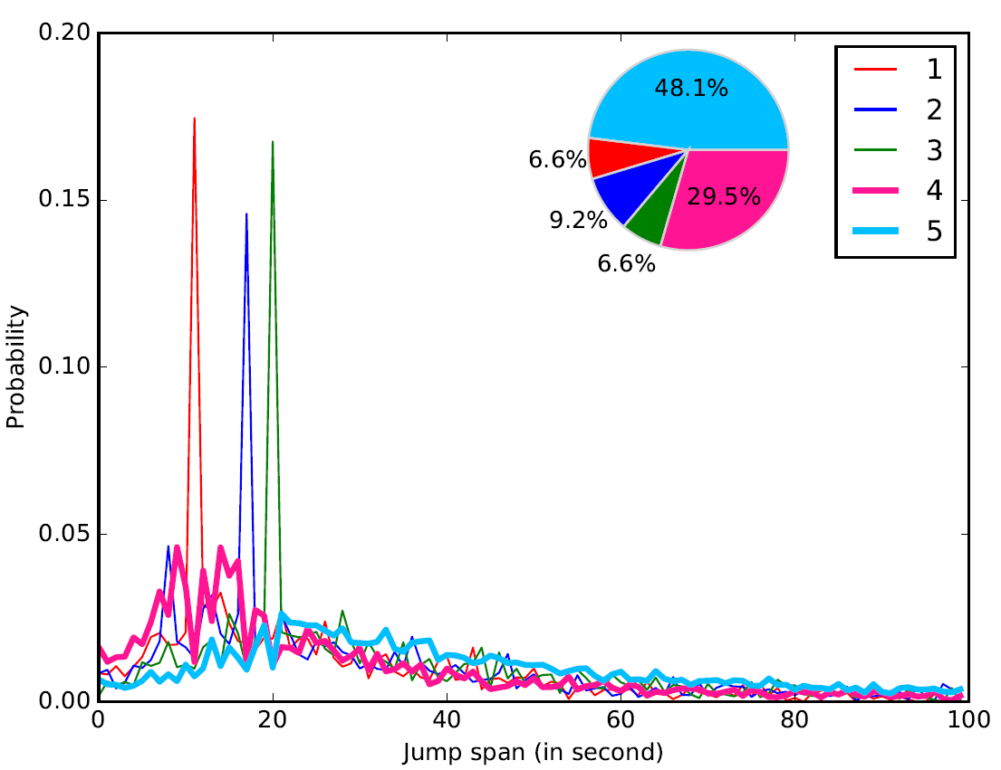
Observations – User Related
6.6% users prefer 10 seconds
9.2% users prefer 17 seconds
6.6% users prefer 20 seconds
Notes:
Different individual users would have different jump-back patterns. To catch the differences, we categorize users into different types based on their jump span records by k-means clustering.
The results show that 6.6% users prefer to jump back near 10 seconds, 9.2% near 17 seconds and 6.6% near 20 seconds

Slide 10
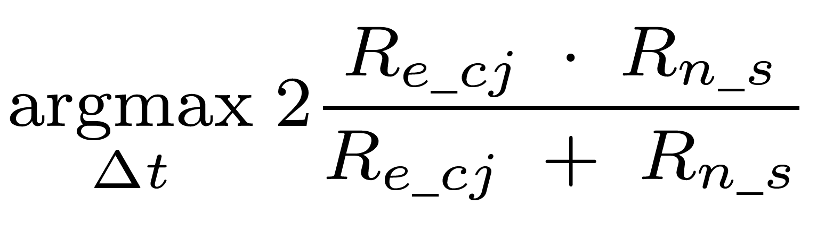
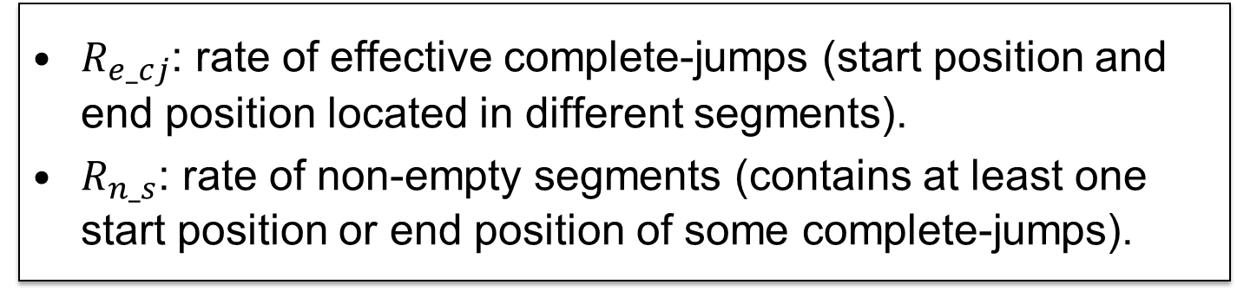
Video Segmentation
0 s
In the next ninth economic activity
The enterprise has paid 4,000,000 yuan
What is the money used for
Of which 2,500,000 yuan is paid for the expenditure of sales department
1,500,000 for the expenditure of administrative department
30 s
……
$R_{e_cj}$: rate of effective complete-jumps (start position and end position located in different segments).
$R_{n_s}$: rate of non-empty segments (contains at least one start position or end position of some complete-jumps).
Notes:
Before making suggestion, we first segment each video into snippets using the transcript of each video. This is the transcript distribution in the video timeline. What we need to do is to find appropriate breakpoints to segment the video according to the duration time between every two sentences.
<click>
The threshold of duration time are selected according to this objective function, <click>Recj is the rate of effective complete-jumps. An effective complete-jumps means that the start position and end position located in different segments. <click>Rns the rate of non-empty segments. A segment is called non-empty when it contains at least one start position or end position of some complete-jumps. Our principle are to result in more effective complete-jumps and non-empty segments.
<click>
Then we can know where to set breakpoints to segment videos like this.

Slide 11
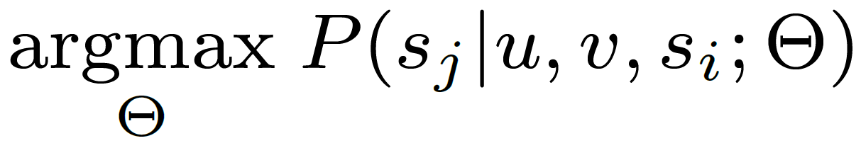




Problem Formulation
……
S
$$S_{j−1}$$
$$S_{j}$$
……
$$S_{i−1}$$
$$S_{i}$$
Notes:
After segmentation, a video is partitioned into a sequence of segments like this. Now our problem is to rank this segments and make suggestions.
Formally, given a video v, a user u, the start position in segment si, the objective is to train a model to maximize the probability that user u would jump back to segment sj of video v

Slide 12
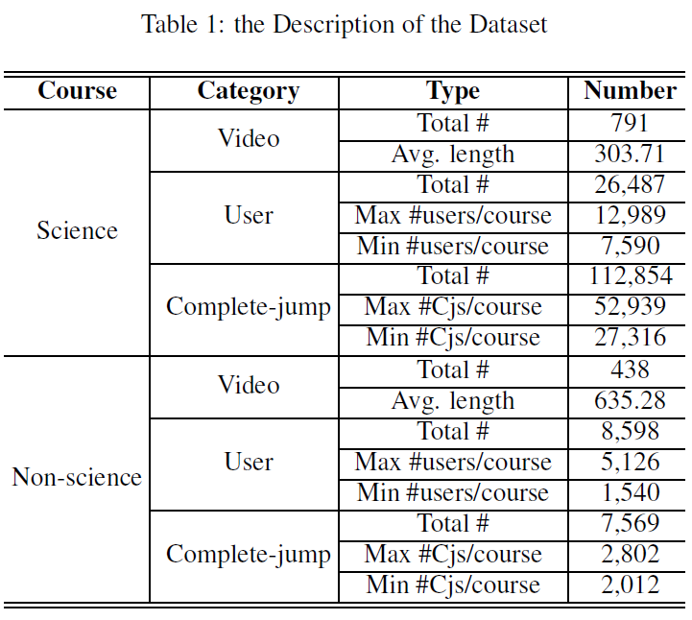
Data Set
Science: Financial Analysis and Decision Making,
Data Structure
Principle of Circuits.
Non-science: Japanese Language and Culture
the Aesthetics of Modern Life,
Chinese Ancient Civilization Etiquette
Notes:
We study the problem based on the data from Xuetangx.com, which is one of the largest MOOC platform in China.
<click>
The data set consist of six courses, three of which are the most popular science courses, the other three are most popular non-science courses.
<click>
This table describes the details of the data set. In total, there are around one thousand and two hundred videos, and 35 thousand users.

Slide 13
Features
Basic features | One-hot representation of user id
 | Start and end position of complete-jump
Video | Length of video in second
 | Kth percentile of jump span in the video, K = 25, 50, 75, 90
Start position | Number of complete-jumps start from the position
 | Entropy of jump span
User | Number of complete-jumps of the user
 | User category generated by k-means clustering
Notes:
Based on abservations, we define four categories of features to predict the end positions.
That is basic feature, video feature, start position feature and user feature.
For basic feature, for example, we have One-hot representation of user id and Start and end position of complete-jump.
For video feature, for example, we have the video length.
For start position feature, for example, we have the number of complete-jumps start from the position.
For user feature, we have user category.

Slide 14





Experimental set – Negative Sample Construction
……
S
S
……
$$S_{j−2}$$
$$S_{j−1}$$
$$S_{j}$$
$$S_{i−1}$$
$$S_{i}$$
We randomly select m (tunable parameter) end positions as negative samples
Notes:
In our experiment, a positive sample corresponds to a complete-jump that truly occurs.
<click>
For each positive sample, we generate several negative samples by choosing different end positions.
<click>
Here we randomly select m end positions as negative samples.

Slide 15
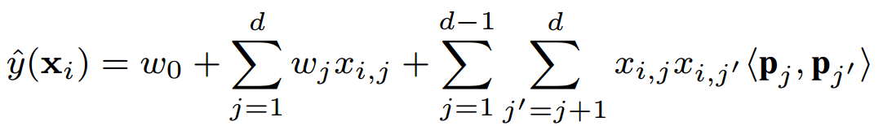
End Position Prediction
Course | Model | AUC | Recall | Precision | F1-score
Science | LRC | 72.46 | 64.28 | 25.95 | 37.37
 | SVM | 71.92 | 64.06 | 25.45 | 36.42
 | FM | 74.02 | 68.36 | 27.61 | 39.28
Non-science | LRC | 72.59 | 72.96 | 69.23 | 70.69
 | SVM | 73.52 | 79.03 | 68.39 | 73.28
 | FM | 73.57 | 79.82 | 67.56 | 72.88
Model | AUC | Recall | Precision | F1-score
LRC | 72.46 | 64.28 | 25.95 | 37.37
SVM | 71.92 | 64.06 | 25.45 | 36.42
FM | 74.02 | 68.36 | 27.61 | 39.28
LRC | 72.59 | 72.96 | 69.23 | 70.69
SVM | 73.52 | 79.03 | 68.39 | 73.28
FM | 73.57 | 79.82 | 67.56 | 72.88
Notes:
We tried different classification models and <click>found that FM achieved the best performance in both Science and Non-science courses.
This may be because that there exists correlations among features from videos, start positions and users.
<click>
And FM can model the interaction between features though feature combination.

Slide 16
End Position Ranking
Method | n = 1 | n = 2 | n = 3 | n = 5
Baseline | 33.21 | 53.21 | 66.15 | 81.99
FM | 37.05 | 60.40 | 76.04 | 89.59
Baseline | 39.26 | 62.61 | 76.64 | 91.30
FM | 42.25 | 72.42 | 88.43 | 96.05
Course | Method | n = 1 | n = 2 | n = 3 | n = 5
Science | Baseline | 33.21 | 53.21 | 66.15 | 81.99
 | FM | 37.05 | 60.40 | 76.04 | 89.59
Non-science | Baseline | 39.26 | 62.61 | 76.64 | 91.30
 | FM | 42.25 | 72.42 | 88.43 | 96.05
Hits@n to evaluate the ranking performance
Baseline method is based on navigation distribution of all users
Our method based on FM outperforms baseline over ~10%
Notes:
Then we use the classification result of probability to rank the end positions and <click>use hits@n to evaluate the ranking performance.
<click>
Baseline method is based on navigation distribution. The more people jump back to, the larger the probability is.
<click>
It shows that our method using FM outperforms baseline over nearly 10 percent.

Slide 17
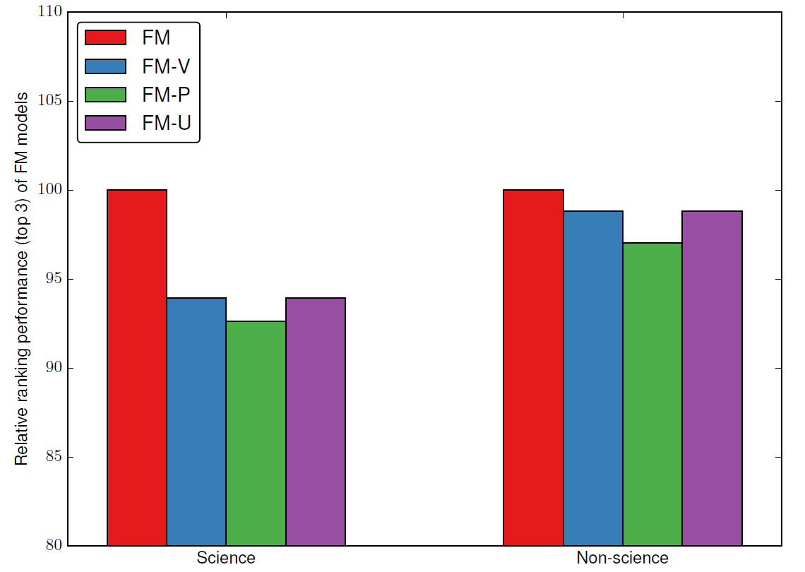
Feature Contribution Ignoring each category of features
Each category of features contributes improvement in the performance
Our method works well by combining different features
Notes:
We conduct feature contribution by ignoring each category of features.
<click>
Here is the result.
Left group is the result of science courses and right is non-science courses
The first bar contains all features. The second one ignores video related features. The third one ignores start position related features and the fourth one ignores user related features.
<click>
We find that each category of features contributes improvement in the performance and our method works well by combining different features.

Slide 18
Summary
We formally define an interesting problem of automated navigation suggestion in MOOCs, and systematically study the problem on a real large MOOC dataset.
We reveal several interesting phenomena about jump-back behaviors.
We propose a method to predict users’ jump-back behaviors.
Notes:
In summary,
<click>
We formally define an interesting problem of automated navigation suggestion in MOOCs, and systematically study the problem on a real large MOOC dataset.
<click>
We reveal several interesting phenomena about jump-back behaviors.
<click>
We propose a predictive method to predict users’ jump-back behaviors.

Slide 19
Future Research
Explore more factors that have influence on video navigation, like user location, visual information, etc.
Take account of dynamic information, like the behaviors just before a jump-back.
Design a better predictive model with higher accuracy
Notes:
In the future work,
<click>
We want to Explore more factors that have influence on video navigation, like user location, visual information, etc.
<click>
And Take account of dynamic information, like the behaviors just before a jump-back.
<click>
And Design a better predictive model with higher accuracy

Slide 20
Thank you！
Collaborators:
Jie Tang, Maosong Sun, Xiaochen Wang, Zhengyang Song (THU)
Jimeng Sun (Gatech)
Notes:
Thank you very much for your careful listening and thanks my collaborators from Tsinghua university and Georgia Institute of technology.

