Slide 1
Forecasting Potential Diabetes Complications
Yang Yang, Jie Tang, Juanzi Li
Tsinghua University
Walter Luyten, Marie-Francine Moens
Katholieke Universiteit Leuven
Lu Liu
Northwestern University
Notes:
I am Yang Yang from Tsinghua University. In this talk, I am going to talk about forecasting potential diabetes complications. This is a joint work with Jie and Juanzi from Tsinghua University, and Walter and Sien from KU Leuven, and also Lu from Northerwestern University.
pharmacology

Slide 2
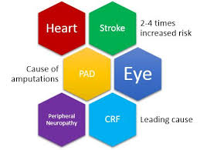
Diabetes Complications
Life-Threatening
Over 4.8 million people died in 2012 due to diabetes^{[1]}.
Over 68% of diabetes-related mortality is caused by diabetes complications^{[2]}.
471 billion USD, while 185 million patients remain undiagnosed^{[1]}.
Need to be diagnosed in time
coronary heart disease
diabetic retinopathy
[1] http://www.diabetes.org/
[2] http://www.idf.org/diabetesatlas/
Notes:
Diabetes is a very common chronic disease. It damages human tissues over time and leads to life-threatening complications, e.g., coronary heart disease, diabetic retinopathy, and so on. Studies show that over 4.8 million people died in 2012 due to diabetes. 68% of diabetes-related mortality is caused by complications. Also, although 471 billion US dollars were spent on healthcare for diabetes patients worldwide in 2012, still half of the people with diabetes remain undiagnosed.
As the data shows, diabetes complications need to be diagnosed in time. (1min)

Slide 3

Forecasting Diabetes Complication
Output: diabetes complications
Input: a patient’s lab test results
Bilirubin example
Routine urine analysis
coronary heart disease
diabetic retinopathy
Notes:
In this work, we study the problem of automatically forecasting diabetes complications from a patient’s clinical records. More specifically, what we would like to do is as follows: given a potential diabetes patient’s clinical record, which consists of a series of lab test results, we’d like to find particular complications that patient may have. %This is a brief description of the addressed problem. We will formulate it into a machine learning problem few pages latter.

Slide 4
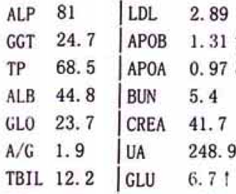
Data Set
A collection of real clinical records from a hospital in Beijing, China over one year.
Item | Statistics
Clinical records | 181,933
Patient | 35,525
Lab tests | 1,945
Clinical record
Challenge: feature sparseness
Each clinical record only contains 24.43 different lab tests
65.5% of lab tests exist in < 10 clinical records (0.00054%).
Notes:
The data set we used in this work is a collection of real clinical records from a hospital in Beijing over one year. The data set consists of 181,933 clinical records and 35,525 patients. Each clinical record contains the lab test results of a particular patient. The key challenge in this work is feature sparseness: first, we have around 2k lab tests in total, however, each clinical record only contains around 24 lab test. Secondly, 65% of lab tests are recorded in less than 10 clinical records.

Slide 5
Our Approach
Notes:
Next I will introduce our approach.

Slide 6
Baseline Model I
Learning task:
Limitations:
Cannot model correlations between y
Cannot handle sparse features
Notes:
We begin with a straight forward method to demonstrate how we formulate the addressed problem into a machine learning problem. We let x to represent each clinical record, it is represented as a feature vector, with each dimension denoting a lab test. Our task is to learn a function to map the observed x to y. Here y is a state variable which denotes a set of complications the patient may have. Traditional methods like svm and lr can be utilized here.
However, this method suffers from the limitations that it can not model the correlations between y, and it can not handle the sparse features.

Slide 7
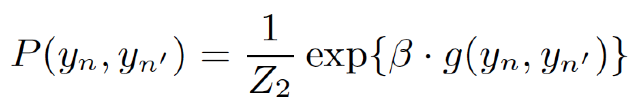
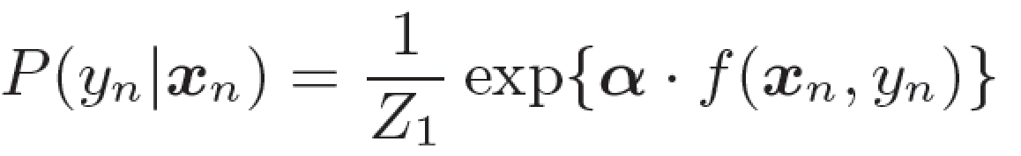
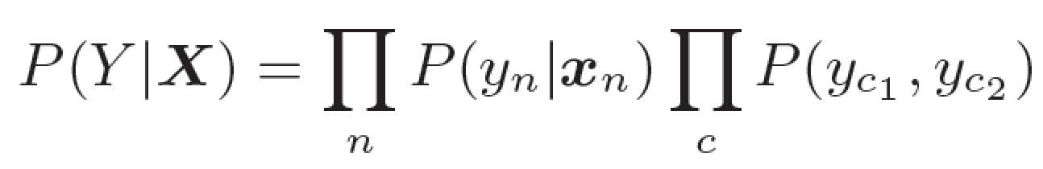
Baseline Model II
Still cannot handle sparse features!
Objective function:
Notes:
We propose the second model to consider the correlations between two clinical records one patient has at adjacent time stamps. The intuition behind this is that the patient’s health condition will not vary much at adjacent time stamps. In this work, we use factor graph to implement model II. Specifically, we define two factors to represent the correlation between the observed variables and the state variable, and the correlations between two state variables, and define the objective function as the joint distribution of state variables conditioned on observed variables. However, this method still suffers from the feature sparseness problem.

Slide 8
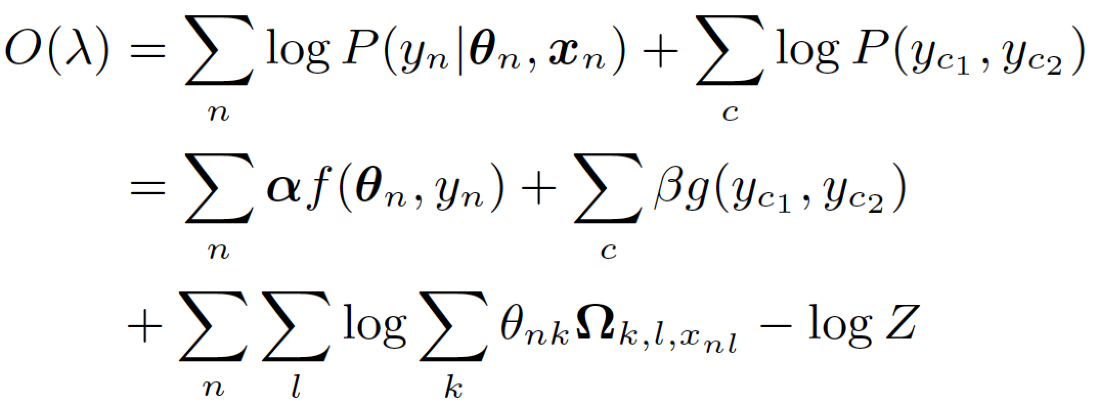
Proposed Model
classification
dimensional reduction
Objective function:
Notes:
Based on model II, we bring in a latent space layer by projecting the original sparse features into a lower-dimensional latent space using a mixture of Gaussian. Then we do the classification based on the projected results. The two steps are interactive. The dimensional reduction helps to improve the classification results by handling the feature sparseness problem, and the classification results guides the dimensional reduction process.

Slide 9
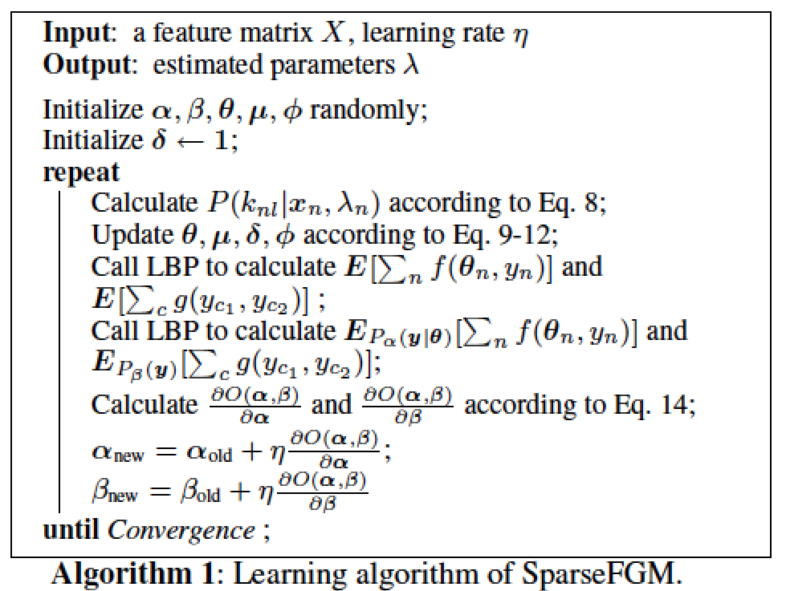
Learning Algorithm
1
2
Notes:
We use an approximate learning algorithm to estimate the model parameters. For each iteration, we first fix all the parameters used for classification and update the parameters used for dimensional reduction, then we fix the dimensional reduction parameters and update the classification parameters.

Slide 10
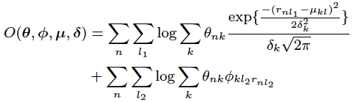
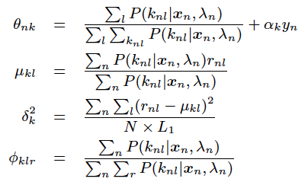
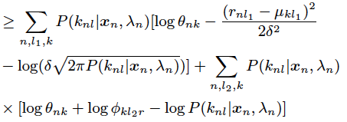
Learning Algorithm (cont.)
Update the dimensional reduction parameters
The remaining part of SparseFGM could be regarded as a mixture generative model, with the log-likelihood
Jensen’s inequality tells us that
Derivate with respect to each parameters, set them to zero, and get the update equations.
1
1
Notes:
For more details, we use an EM algorithm to update the feature reduction parameters.

Slide 11
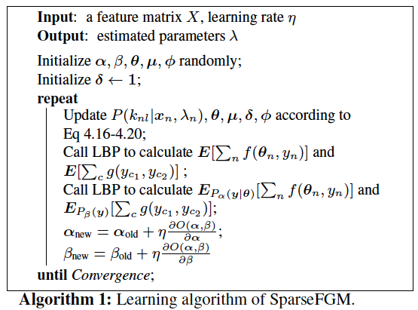

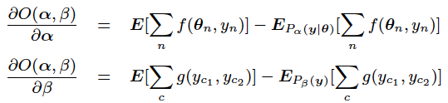
Learning Algorithm (cont.)
Update the classification parameters
New log-likelihood
Adopt a gradient descent method to optimize the new log-likelihood
Notes:
We use a gradient descent algorithm to update classification parameters.

Slide 12


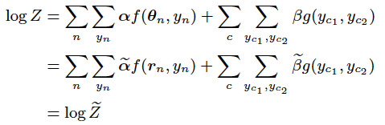

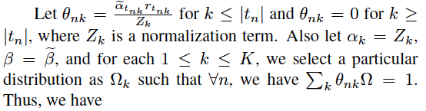
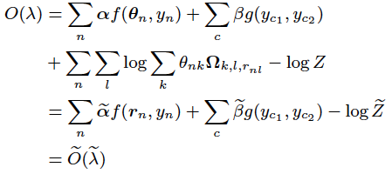
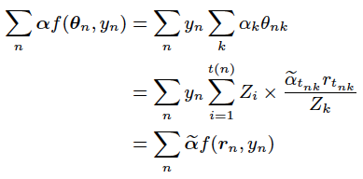
Theoretical Analysis
2
3
1
1
、
2
、
3
indicate
Notes:
We also proof that when the size of latent space is no less than the number valued features each instance contains, the maximal log-likelihood of the proposed model will be no less than traditional factor graph models.

Slide 13
Experiments
Notes:
Let’s go to the experiment part.

Slide 14
Setting
Experiments
Is our model effective?
How do different diabetes complications associate with each lab test?
Can we forecast all diabetes complications well?
Comparison Methods
SVM (model I)
FGM (model II)
FGM+PCA (an alternative method to handle feature sparseness)
SparseFGM (our approach)
Notes:
We have introduced the data set before, which is a set of real clinical records from a hospital in Beijing. We compare our model with three baselines. SVM can be regarded as an example of model I, which just consider the correlations between observed lab test results and labels. Factor graph model is an example of model II, which further consider the correlations between labels. The last baseline is an alternative method to handle feature sparseness problem. It first use PCA to convert the features into a set of principal components, which is then used as the input of factor graph model. SparseFGM is our proposed model.

Slide 15
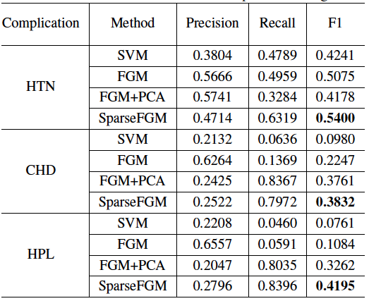
Experimental Results
HTN: hypertension, CHD: coronary heart disease, HPL: hyperlipidemia
SVM and FGM suffer from feature sparseness. -59.9% in recall.
FGM vs. FGM + PCA
(increase +40.3% in recall)
PGM+PCA vs. SparseFGM
(increase +13.5% in F1)
Notes:
Here we demonstrate the classification performance of three kinds of complications: hypertensions, coronary heart disease, and hyperlipidemia. As the experimental results show, model I and II suffer from feature sparseness especially in terms of recall. PCA improve the performance by dimensional reduction. Our method outperforms others by integrating the dimensional reduction and classification into a uniform framework to better estimate the parameters.

Slide 16
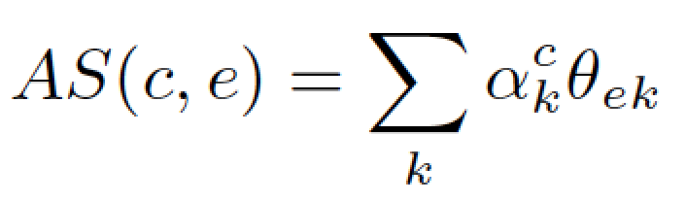
Association Pattern Illustration
insomnia
WBC in the urine
causes frequent voiding -> no good sleep at night
Association score:
c: complication, e: lab test
Notes:
We then study how different complications associate with different lab tests. For example, we see that white blood cell is strongly associated with insomnia. This association has an interesting explanation: WBC in the urine are typically found in urinary tract infections which cause frequent voiding, so people who have to go to the toilet frequently can hardly get a good sleep at night.
CVD 脑血管疾病
Bro 支气管炎
OP 骨质疏松
DR 糖尿病视网膜病变
FL 脂肪肝
Blood glucose 血糖
WBC 白血细胞
Protein 蛋白质

Slide 17
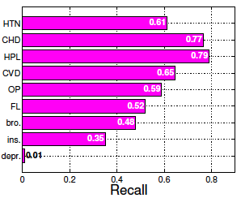
Can We Forecast All Diabetes Complications?
HPL can be forecasted precisely based on lab test results.
Notes:
Can we forecast all kinds diabetes complications? Unfortunately we can not. This figure represents the term of recall when forecasting different types of diabetes complications. We see that hyperlipidemia can be forecasted precisely based on lab test results, while depression is usually recognized from psychological investigation instead of physiological lab tests.

Slide 18
Conclusion
We study the problem of forecasting diabetes complications.
We propose a graphical model which integrates dimensional reduction and classification into a uniform framework.
We further study the underlying associations between different diabetes complications and lab test types.

Slide 19
Thanks!
Q&A?
@ Yang Yang
http://yangy.org/

