Slide 1
How Do Your Friends on Social Media Disclose Your Emotions?
Yang Yang, Jia Jia, Shumei Zhang, Boya Wu,
Qicong Chen, Juanzi Li, Chunxiao Xing, and Jie Tang
Tsinghua University

Slide 2
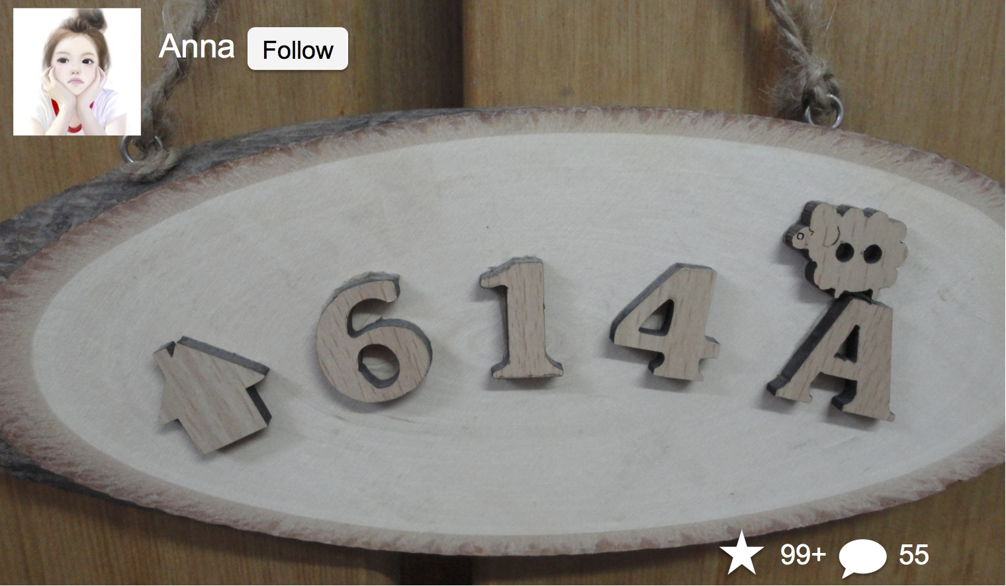
Was Anna Happy When She Published
This Photo On Flickr?

Slide 3
Was Anna Happy When She Published
This Photo On Flickr?
A lovely doorplate
Anna: a girl who just graduated

Slide 4
Was Anna Happy When She Published
This Photo On Flickr?

Slide 5
Emotion Learning Method

Slide 6
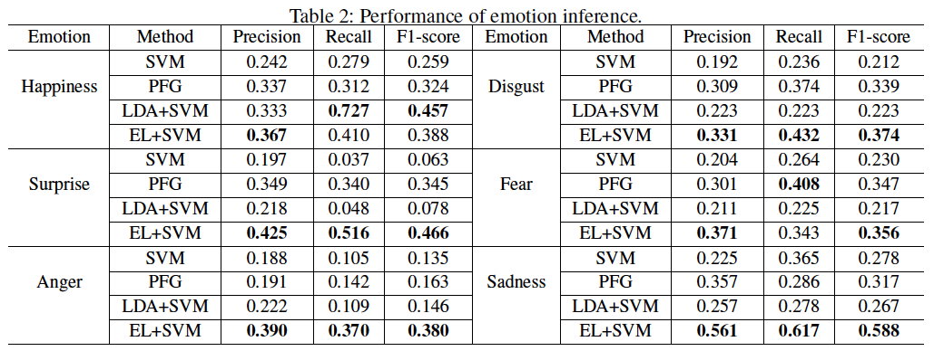
Emotion Inference
Averagely +37.4% in terms of F1
SVM: regards the visual features of images as inputs and uses a SVM as a classifier.
PFG: considers both color features and social correlations among images.
LDA+SVM: first uses LDA to extract latent topics from comments, then uses visual features, topic distributions, and social ties as features to train a SVM.

Slide 7
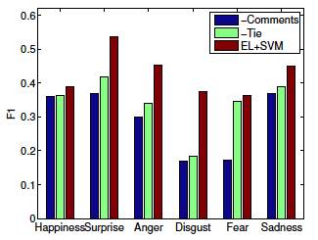
To What Extend Your Friends Can Disclose Your Emotions?
-Comments stands for the proposed method ignoring comment information
-Tie ignores social tie information
Fear images have similar visual features with Sadness and Anger.
Homophily suggests that friends with similar interests tend to have similar understanding of disgust

Slide 8
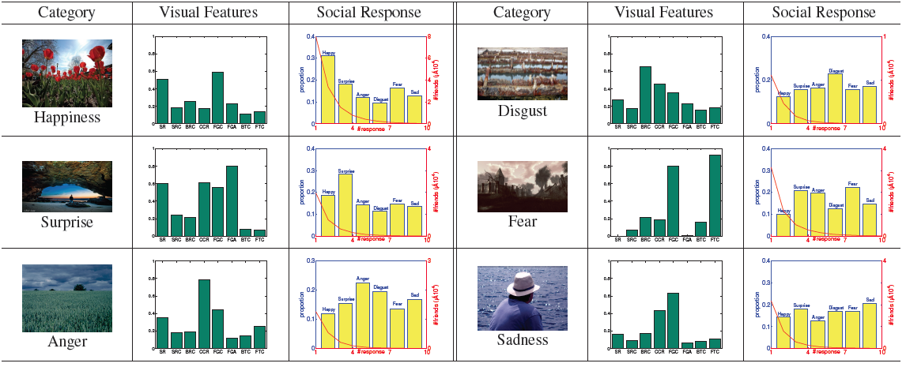
Image Interpretations
Our model demonstrates how visual features distribute over different emotions. (e.g., images representing Happiness have high saturation)
Positive emotions attract more response (+4.4 times) and more easily to influence others compared with negative emotions.

Slide 9
Thanks!
Code & Data:
  http://aminer.org/emotion

