Slide 1
CIKM Competition 2014 Second Place Solution
Team: FAndy
Zhanpeng Fang, Jie Tang
Department of Computer Science
Tsinghua University

Slide 2
Task
Given a sequence of query sessions
  Example
  Class1 Query1 –
  Class1 Query1 Title1
  Class2 Query2 –
  Class2 Query2 Title2
  Class2 Query2 Title3
Classify the class label of test queries

Slide 3
Challenges
Encoding character
  Only little prior knowledge can be used
Heterogeneous data
  Query, title, session information
User search behavior
  How to incorporate user search behavior to help the classification task?
Unlabeled data
  How to utilize the large scale unlabeled data?

Slide 4
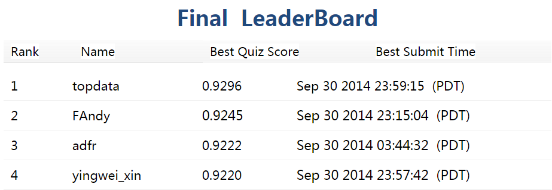
Result
0.9245(public score)/0.9245(private score)
2nd place winner
Achieve in 4 days, from Sep. 27th to Sep. 30th EST
2014/10/26

Slide 5
Our Approach
Feature extraction
  Bag of words
  User search behavior
Learning models
  Logistic regression
  Gradient boosted decision trees
  Factorization machines
Ensemble

Slide 6
Feature Extraction – Bag of Words
Given a query Q
One gram, two grams, last gram of Q
  0 -> 0.8452

Slide 7
Feature Extraction – Bag of Words
Given a query Q
One gram, two grams, last gram of Q
  0 -> 0.8452
One gram, two grams of the clicked titles
  0.8452 -> 0.9091, top 12 in the leaderboard!

Slide 8
Feature Extraction – Bag of Words
Given a query Q
One gram, two grams, last gram of Q
  0 -> 0.8452
One gram, two grams of the clicked titles
  0.8452 -> 0.9091, top 12 in the leaderboard!
More bag of words features?
  Queries in the same session of Q?
  Titles in the same session of Q?

Slide 9
Feature Extraction – Bag of Words
Given a query Q
One gram, two grams, last gram of Q
  0 -> 0.8452
One gram, two grams of the clicked titles
  0.8452 -> 0.9091, top 12 in the leaderboard!
More bag of words features?
  Queries in the same session of Q?
  Titles in the same session of Q?
  Performance decreases, 0.9091 -> 0.89x
  How to use the session information?

Slide 10
Feature Extraction – Search Behavior
Given a query Q
Macro features
  #total search, average length of clicked titles, length of the query
  0.9091 -> 0.9105

Slide 11
Feature Extraction – Search Behavior
Given a query Q
Macro features
  #total search, average length of clicked titles, length of the query
  0.9091 -> 0.9105
Session class features
  For each potential class C, calculate:
    #class C queries in the same session
    #class C queries in the next/previous query
  0.9105 -> 0.9145

Slide 12
Feature Extraction – Search Behavior
Same session’s queries can help but might contain noises

Slide 13
Feature Extraction – Search Behavior
Same session’s queries can help but might contain noises
Only use similar queries!
Same session’s queries feature
  Bag of words feature for same session’s queries that are similar to the query Q
  Use Jaccard to measure similarity between queries
  0.9145 -> 0.9182, utilizing the large scale unlabeled data!

Slide 14
Feature Extraction – Search Behavior
Further add clicked titles of same session’s similar queries
  Performance decrease, 0.9182 -> 0.9176

Slide 15
Learning Models
Logistic regression
  Use the implementation of Liblinear
Factorization machine
  Use the implementation of LibFM
Gradient boosted decision trees
  Use the implementation of XGBoost
Method | Implementation | Score on leaderboard
Logistic Regression | Liblinear | 0.9182
Factorization Machine | LibFM | 0.9151
GBDT | XGBoost | 0.9225

Slide 16
Ensemble
Ensemble prediction results from different models by logistic regression
Ensemble can significantly improves the performance
Method | Implementation | Score on Validation
Logistic Regression | Liblinear | 0.9182
Factorization Machine | LibFM | 0.9151
GBDT | XGBoost | 0.9225
Ensemble | Liblinear | 0.9245

Slide 17
Summary
“Tricks” on how to win 2nd place
  Use unlabeled data
  Train multiple models
  Ensemble different results

Slide 18
Thank you!
Questions？

