Slide 1
AMiner (ArnetMiner)
—Toward understanding big scholar data http://aminer.org
Jie Tang
Tsinghua University
[1] J. Tang, J. Zhang, L. Yao, J. Li, L. Zhang, and Z. Su. ArnetMiner: Extraction and Mining of Academic Social Networks. KDD’08. pp.990-998.
Notes:
1

Slide 2
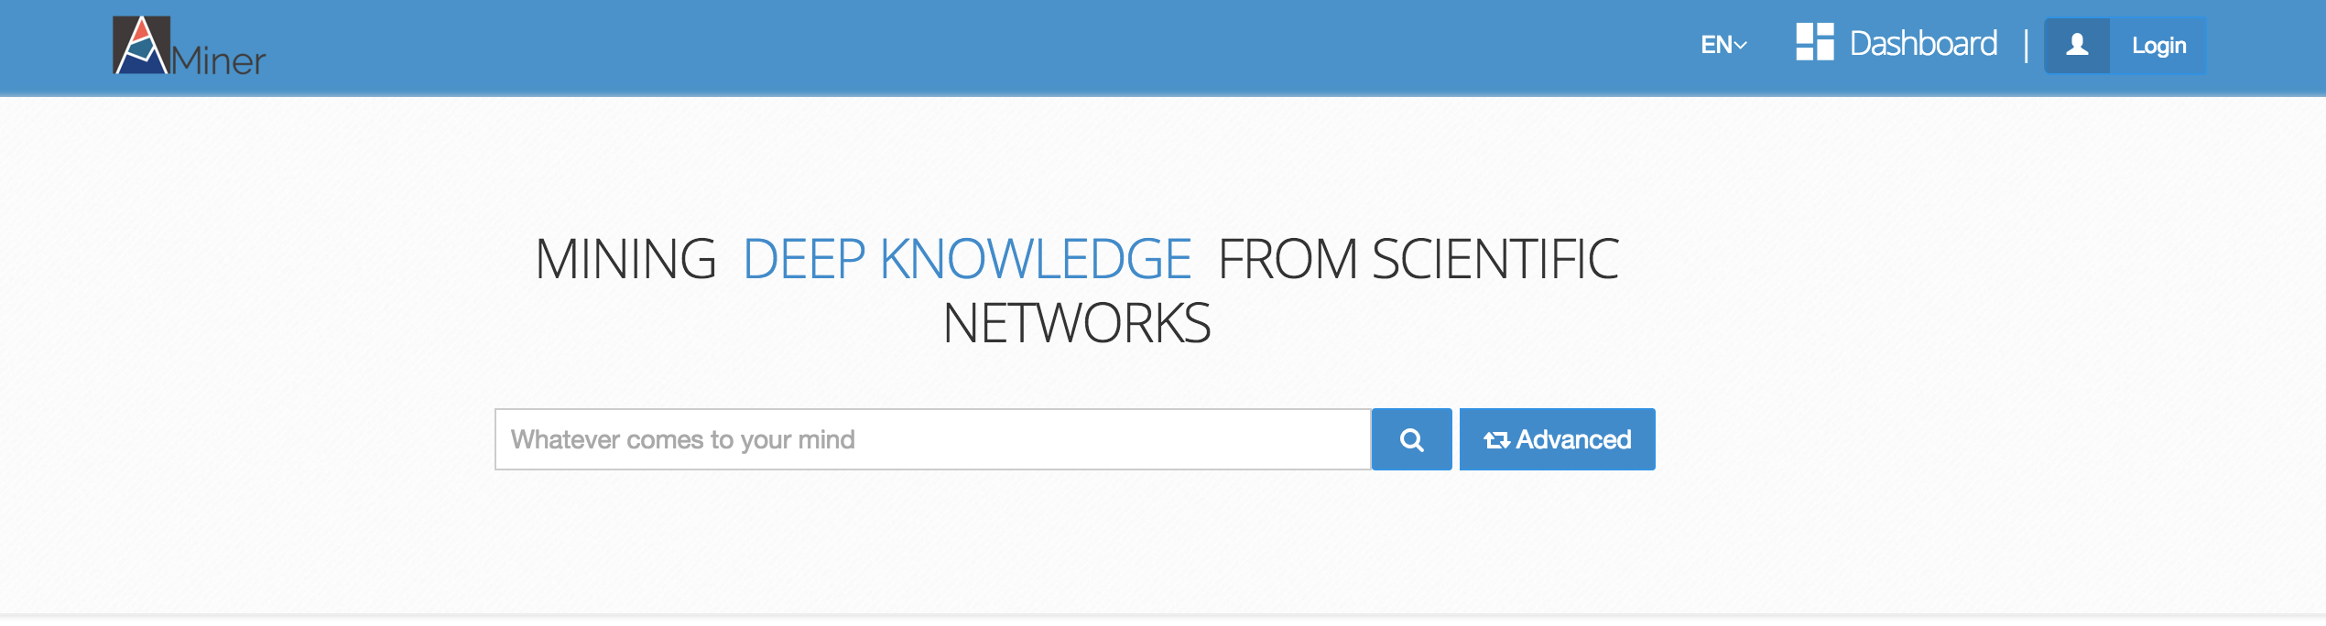
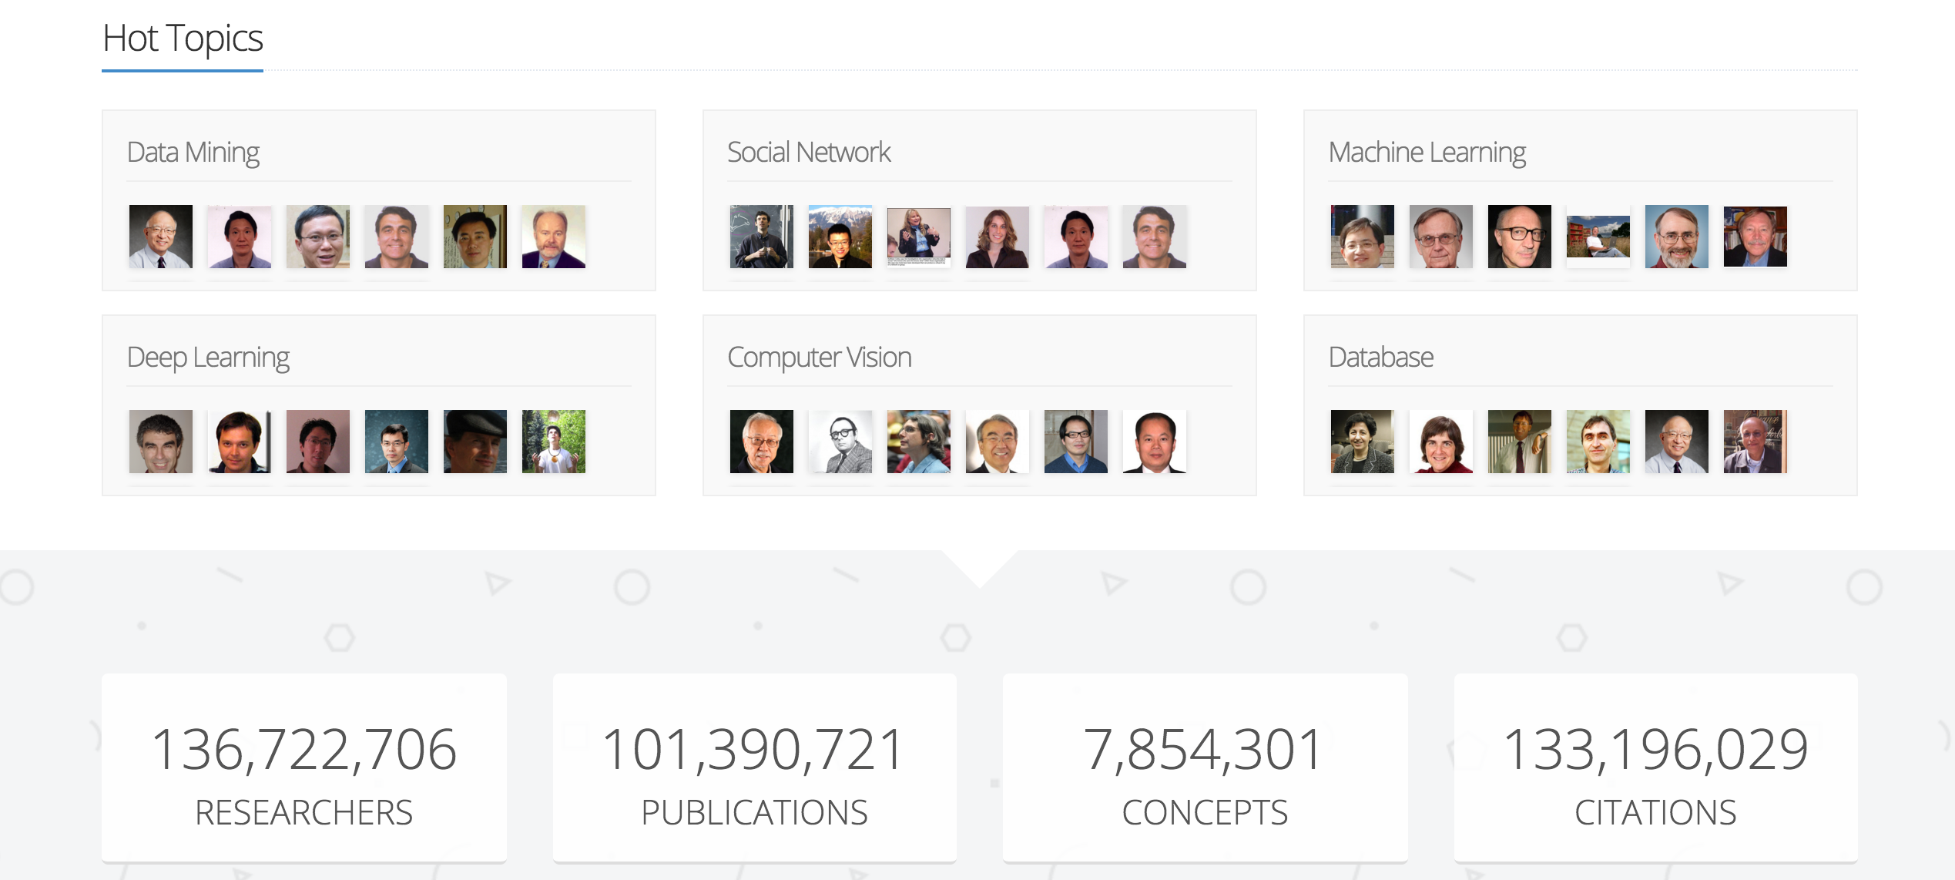
An author-centric academic search and mining system…

Slide 3
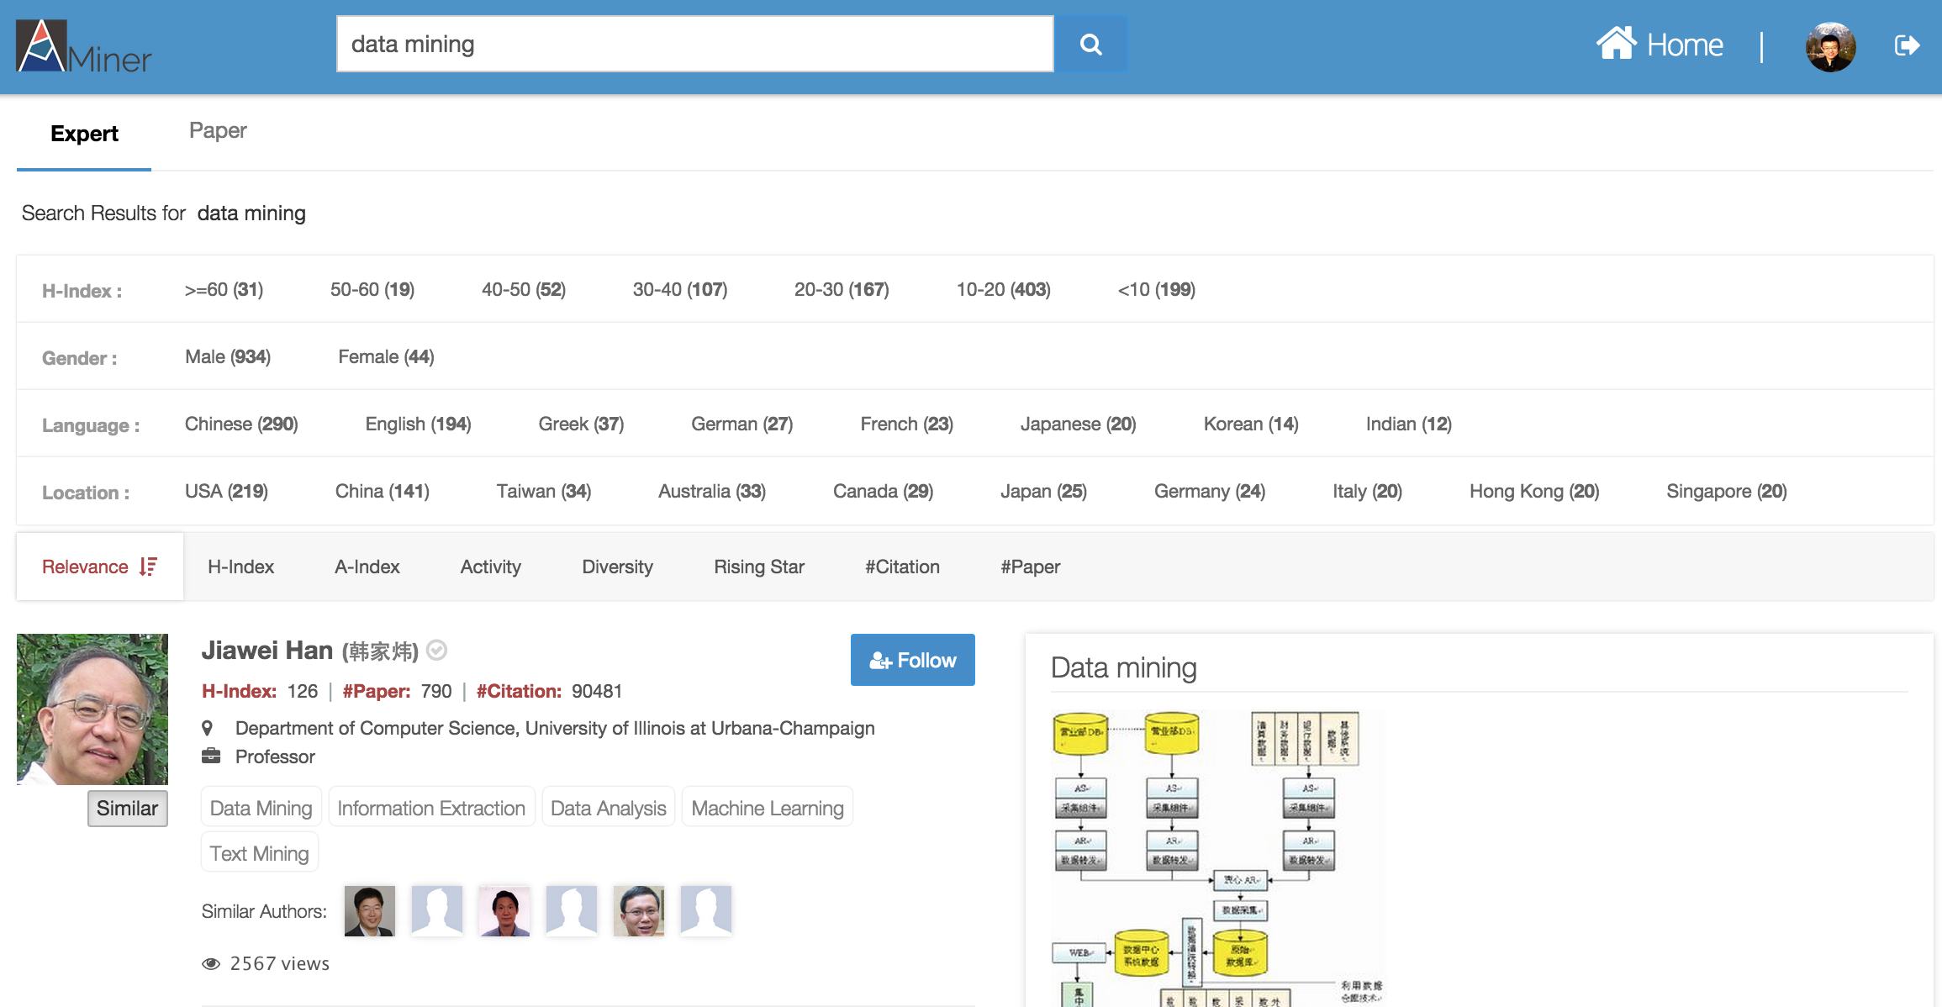
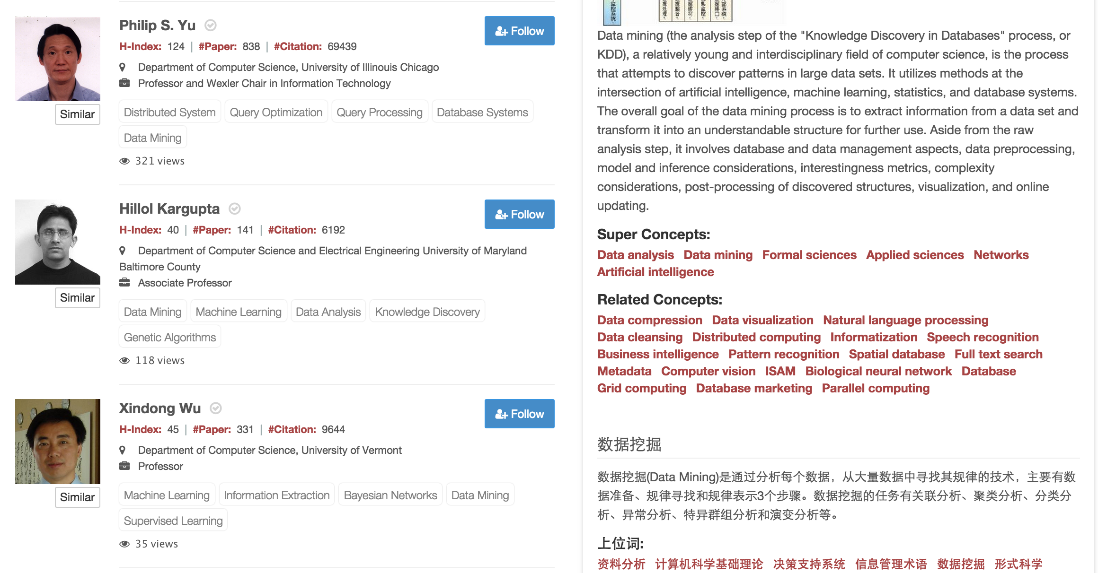
Expert
Search
Demographics: gender, language, location, etc.
Finding experts,
for “data mining”
Knowledge about
“data mining”
Similar Authors

Slide 4
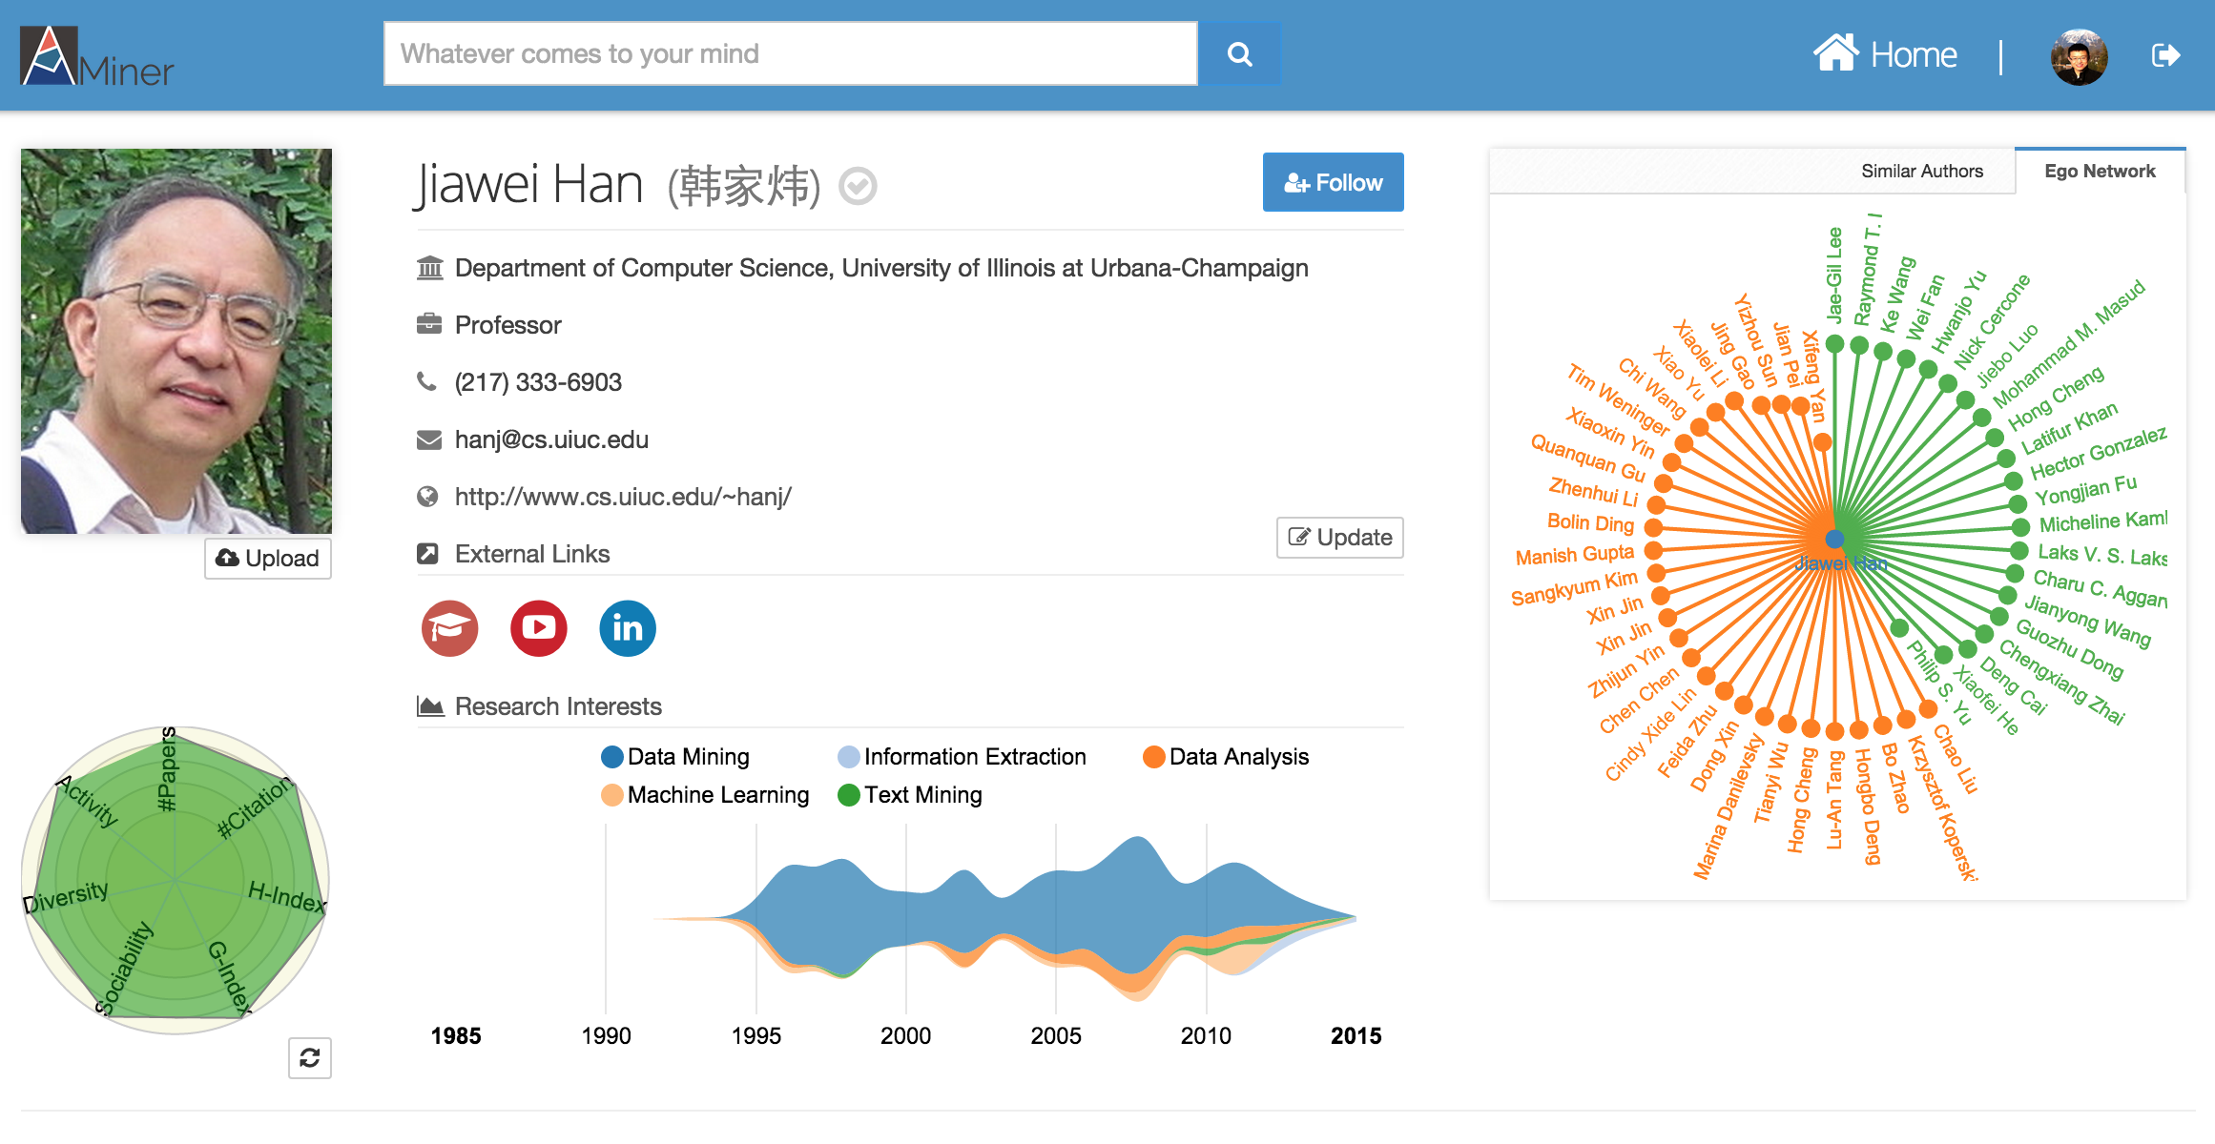

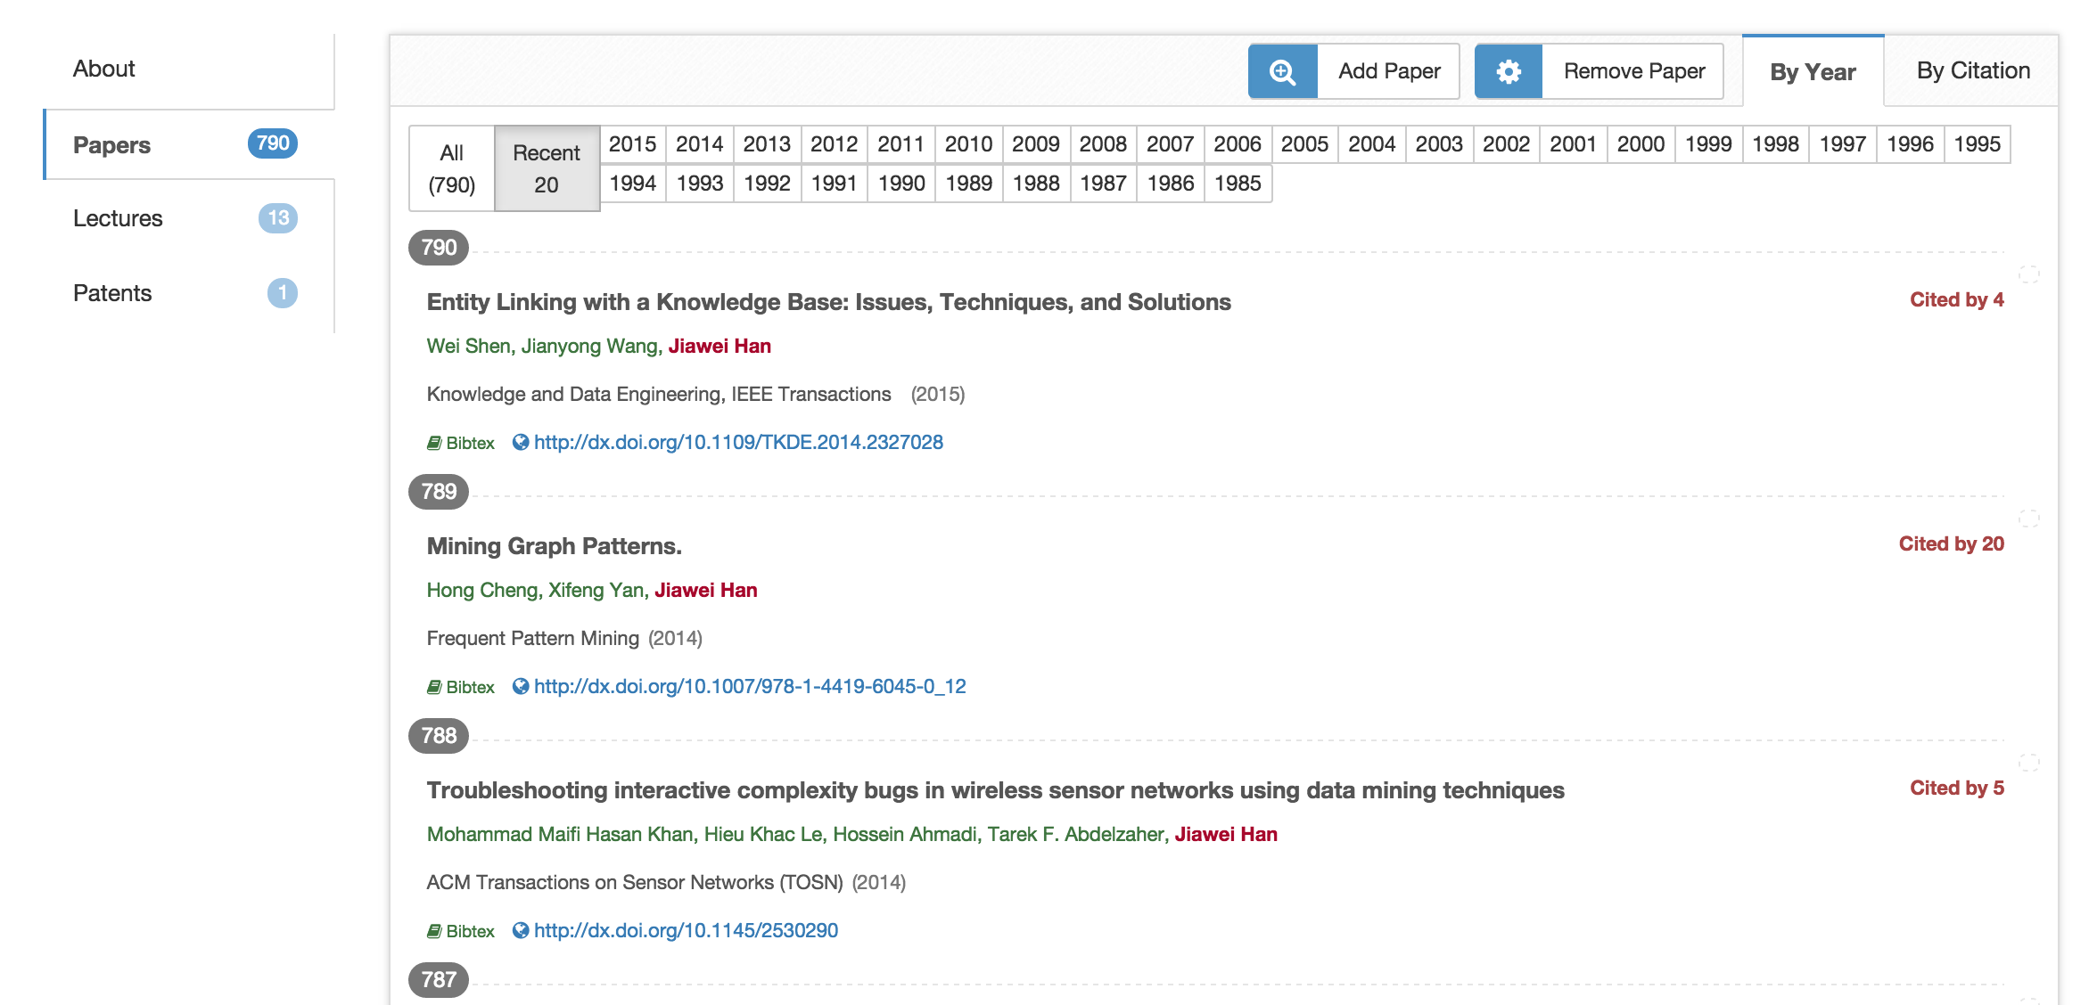
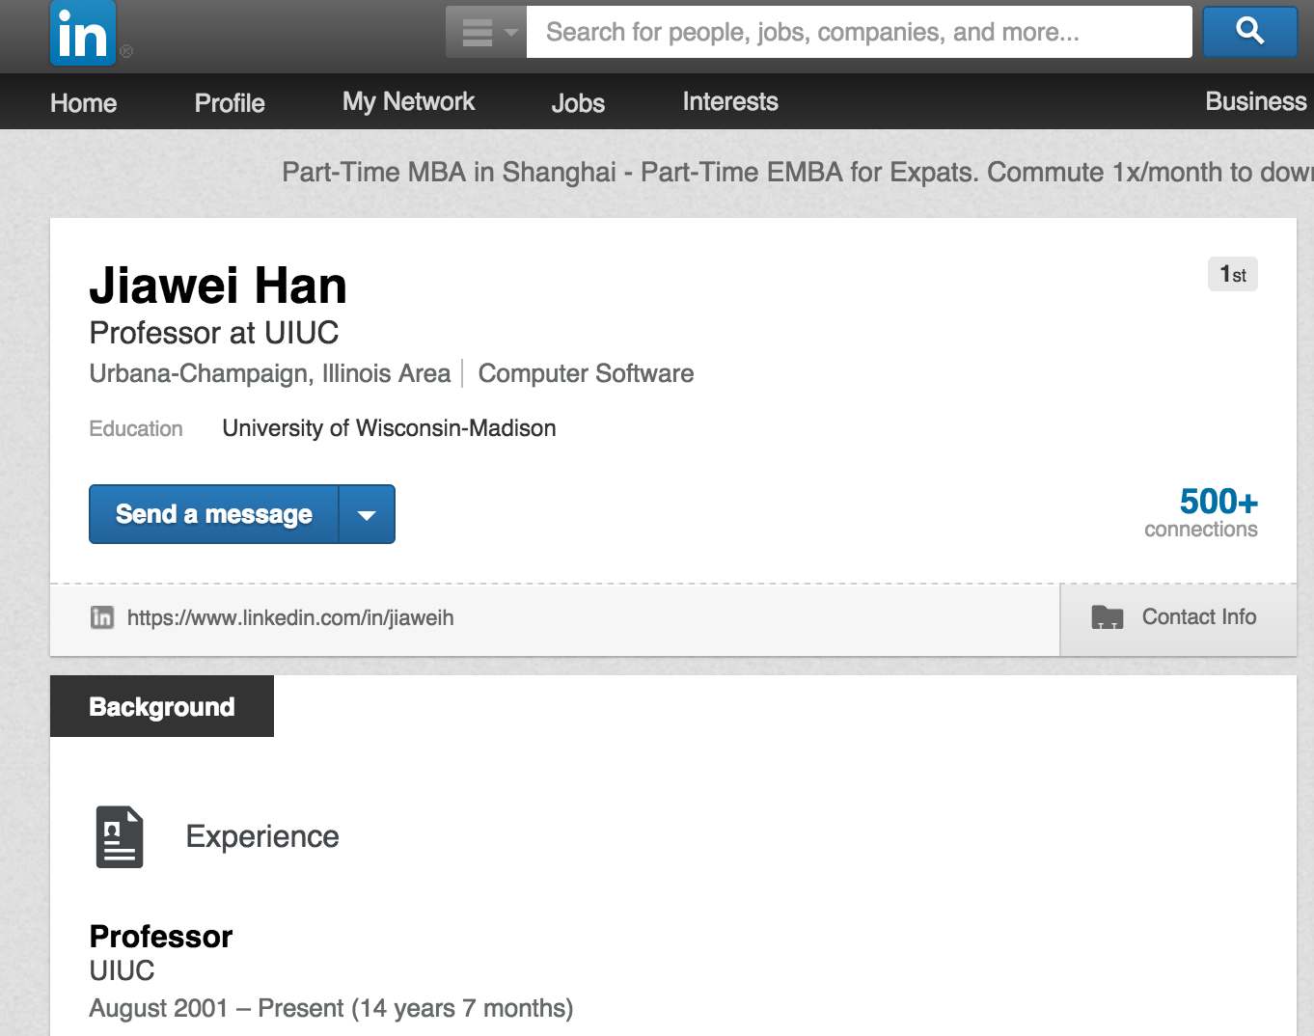
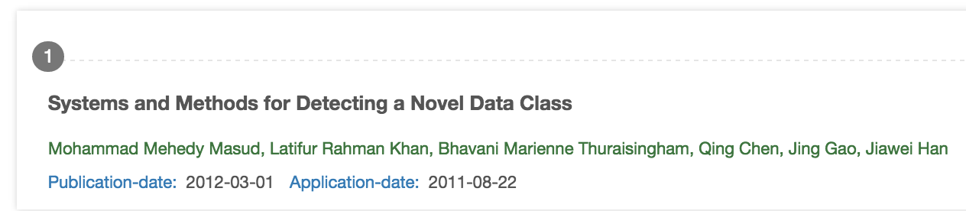
Researcher
Profile
Basic Info.
Research Interests
Citation Statistics
Ego Network

Slide 5
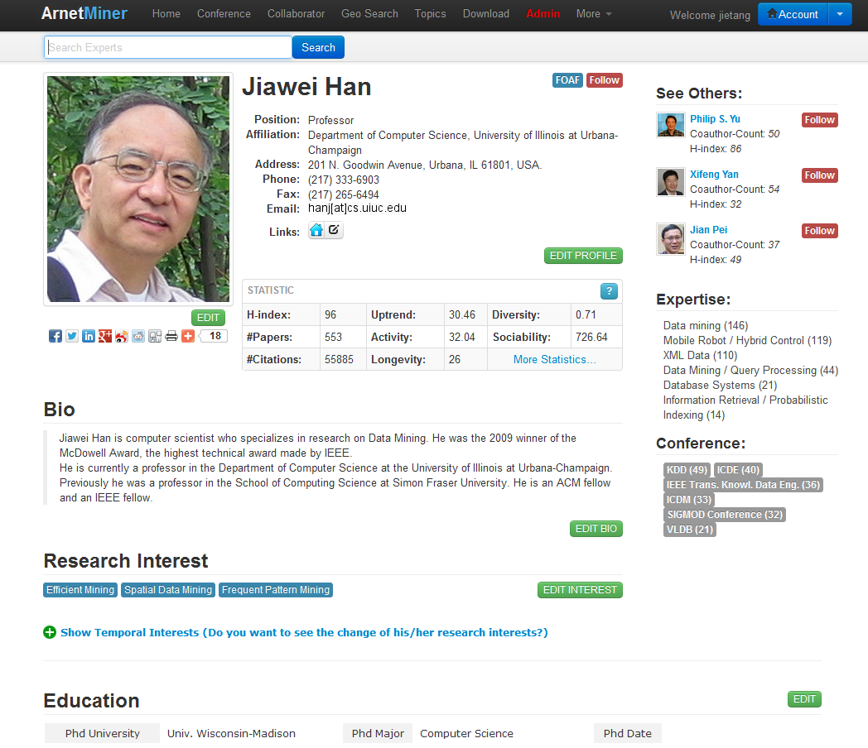
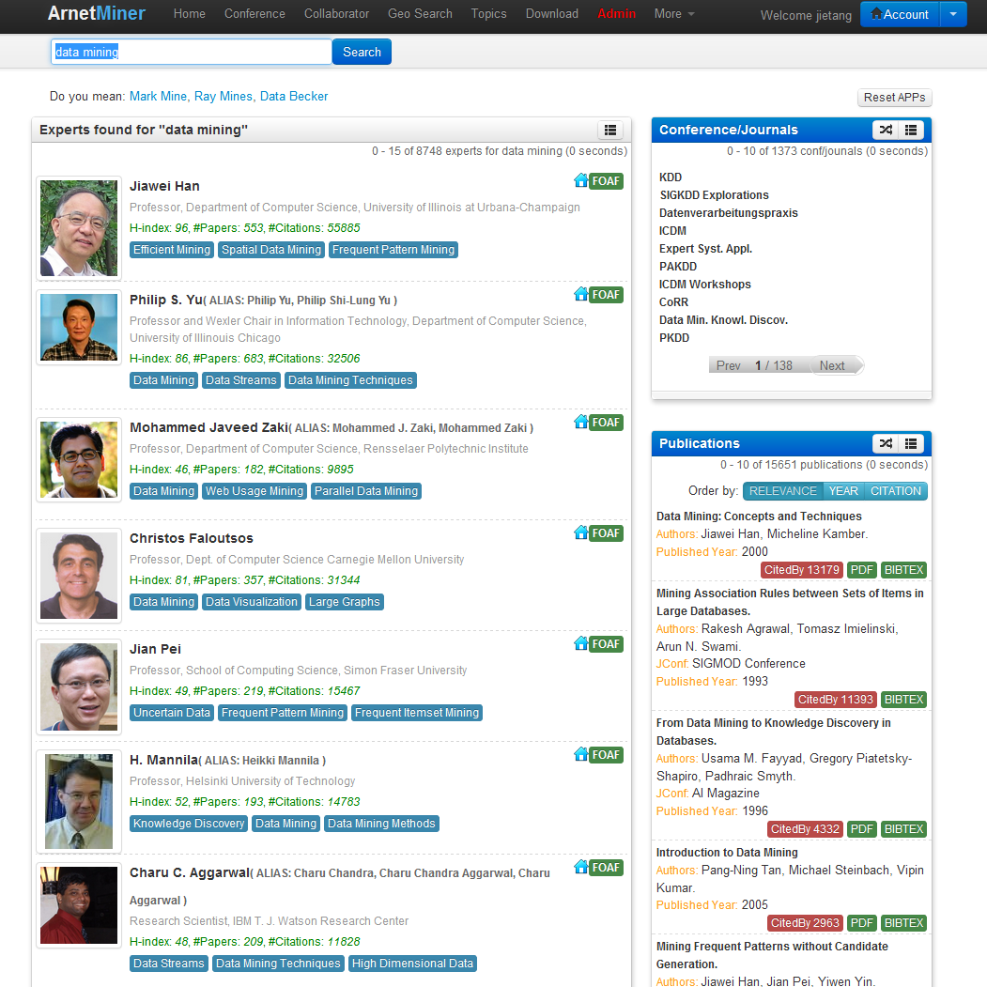
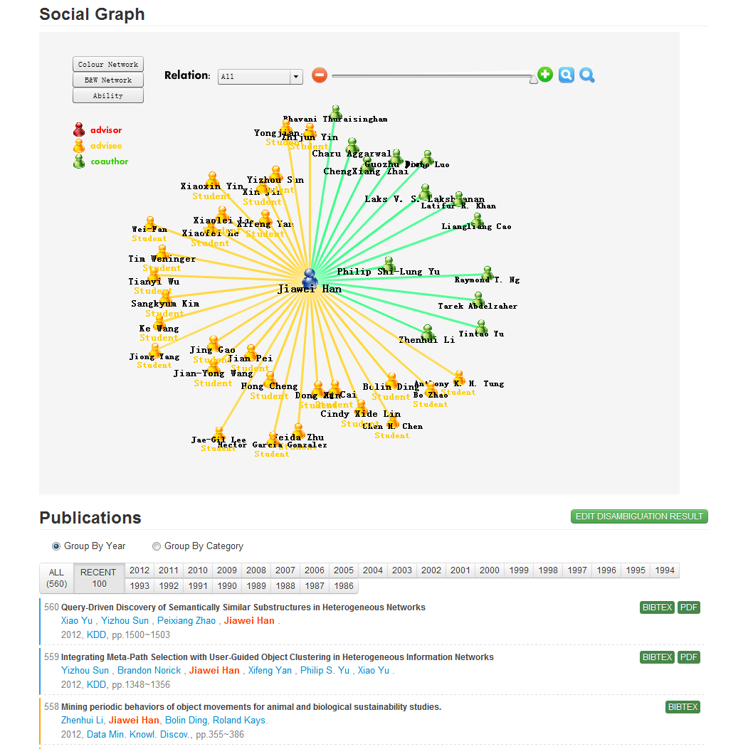
AMiner
Academic search and mining system—http://aminer.org
  Online since 2006
  >136 million researcher profiles
  >101 million publication papers
  >341 million requests
  100K IP access from 170 countries per month
Deep analysis, mining, and search
Notes:
基于前面的理论研究成果，我们自主研发了研究者社会网络挖掘与搜索系统Arnetminer，系统从2006年开始在线运行，收集了大量的学术数据，到目前为止，系统累积2.35TB数据，有超过1.3亿次用户访问，每月就用来自170个国家的10万用户访问。

Slide 6
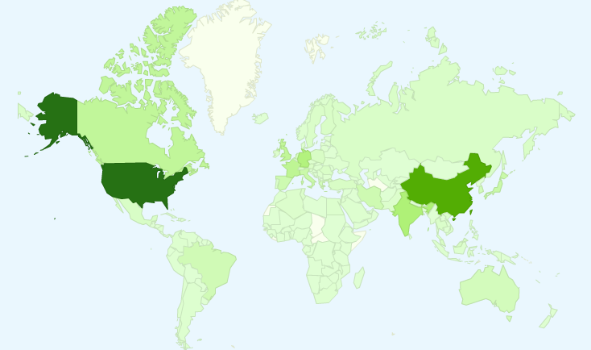
User Distribution
  8.32 million IP from 220 countries/regions
Notes:
截止目前，Arnetminer系统已有来自200个国家和地区277万独立IP的访问，这里列出了访问量前10的国家。

Slide 7
User Distribution
  8.32 million IP from 220 countries/regions
Top 10 countries
1. USA 6. Canada
2. China 7. Japan
3. Germany 8. Spain
4. India 9. France
5. UK 10. Italy
Notes:
截止目前，Arnetminer系统已有来自200个国家和地区277万独立IP的访问，这里列出了访问量前10的国家。

Slide 8
Technologies
—How to populate a semantic-based profile database for researchers?
Extraction
Integration
Mining

Slide 9
Extracting Semantics from the Web
(ACM TKDD, WWW’12, ISWC’06, ICDM’07, ACL’07)
2
Contact Information
1
Two questions:
  How to accurately extract the semantic-based profile information from the Web?
  How to deal with the name ambiguity problem?
Educational History
1
Academic Services
Publications
1
2
1
coauthor
Ruud Bolle
affiliation
UIUC
Publication #3
2
2
position
Professor
Publication #5
coauthor

Slide 10
Researcher Network Extraction^{[1,2]}
70.60% of the researchers have at least one homepage or an introducing page
85.6% from universities
14.4% from companies
71.9% are homepages
28.1% are introducing pages
40% are in lists and tables
60% are natural language text
There are a large number of person names having the ambiguity problem
Even 3 “Yi Li” graduated the author’s lab
70% moved at least one time
[1] J. Tang, L. Yao, D. Zhang, and J. Zhang. A Combination Approach to Web User Profiling. ACM Transactions on Knowledge Discovery from Data (TKDD), (vol. 5 no. 1), Article 2 (December 2010), 44 pages.
[2] J. Tang, D. Zhang, and L. Yao. Social Network Extraction of Academic Researchers. ICDM’07. pp. 292-301.

Slide 11
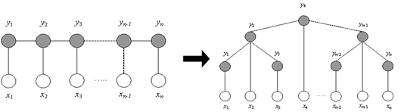

Our Approach Picture
– based on Markov Random Field
Markov Property:
Special Cases:
- Conditional Random Fields
- Hidden Markov Random Fields
Researcher Profiling
Name Disambiguation
Notes:
Markov Random Field (MRF) is a probability distribution of labels (hidden variables) that obeys the Markov property.

Slide 12
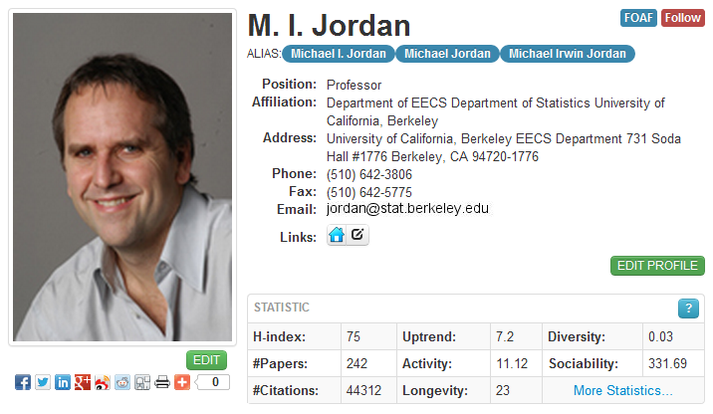
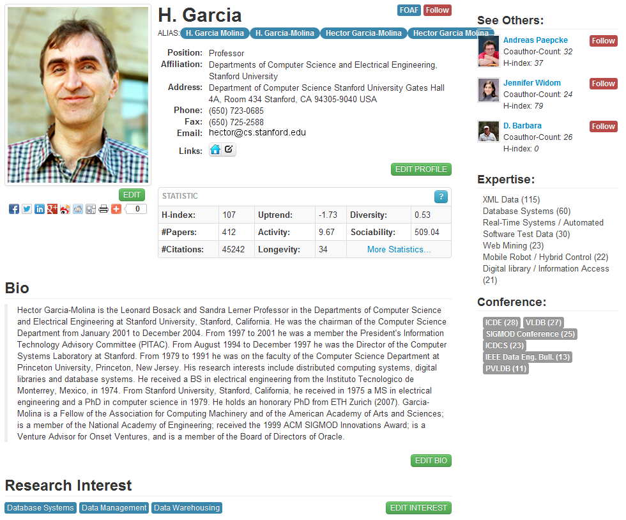
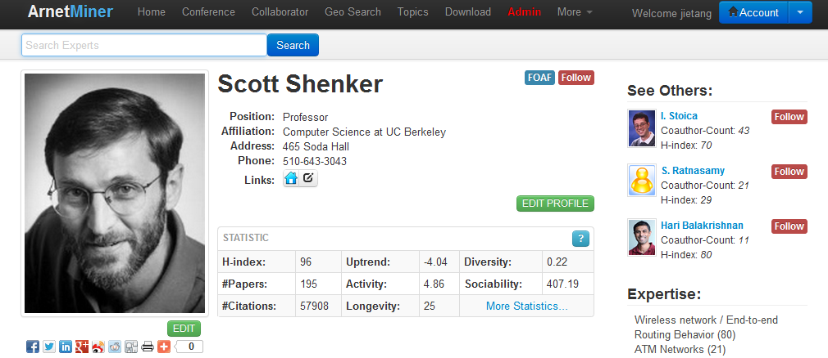
Researcher Profile Database
Extracted more than 1,000,000 researcher profiles from the Web
J. Tang, L. Yao, D. Zhang, and J. Zhang. A Combination Approach to Web User Profiling. ACM Transactions on Knowledge Discovery from Data (TKDD), (vol. 5 no. 1), Article 2 (December 2010), 44 pages.

Slide 13
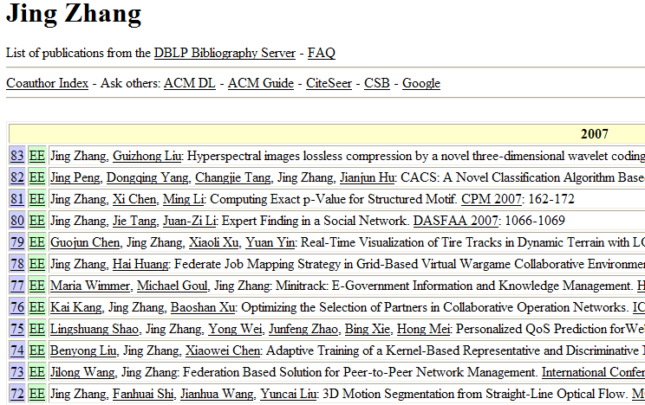
Name Disambiguation
Name | Affiliation
Jing Zhang (26) | Shanghai Jiao Tong Univ.
 | Yunnan Univ.
 | Tsinghua Univ.
 | Alabama Univ.
 | Univ. of California, Davis
 | Carnegie Mellon University
 | Henan Institute of Education
- How to perform the assignment automatically?
- How to estimate the person number?
[1] J. Tang, A.C.M. Fong, B. Wang, and J. Zhang. A Unified Probabilistic Framework for Name Disambiguation in Digital Library. IEEE Transaction on Knowledge and Data Engineering (TKDE) , Volume 24, Issue 6, 2012, Pages 975-987.
[2] X. Wang, J. Tang, H. Cheng, and P. S. Yu. ADANA: Active Name Disambiguation. ICDM’11, pages 794-803, 2011.

Slide 14
Our Method to Name Disambiguation
A hidden Markov Random Field model
Observable Variables X represent publications
Hidden Variables Y represent the labels of publications
Paper relationships define the dependencies over hidden variables
J. Tang, A.C.M. Fong, B. Wang, and J. Zhang. A Unified Probabilistic Framework for Name Disambiguation in Digital Library. IEEE Transaction on Knowledge and Data Engineering (TKDE) , Volume 24, Issue 6, 2012, Pages 975-987.

Slide 15
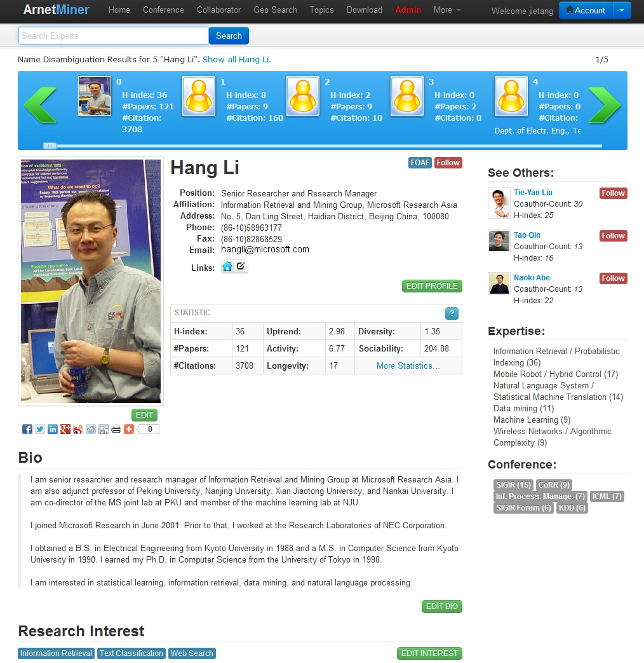
Disambiguation Performance

Slide 16
Still problems?
P1: error propagation in the profile extraction
  Homepage finding
  Profile extraction from the identified pages
P2: the “accurately” extracted semantics are
not really “accurate”?

Slide 17
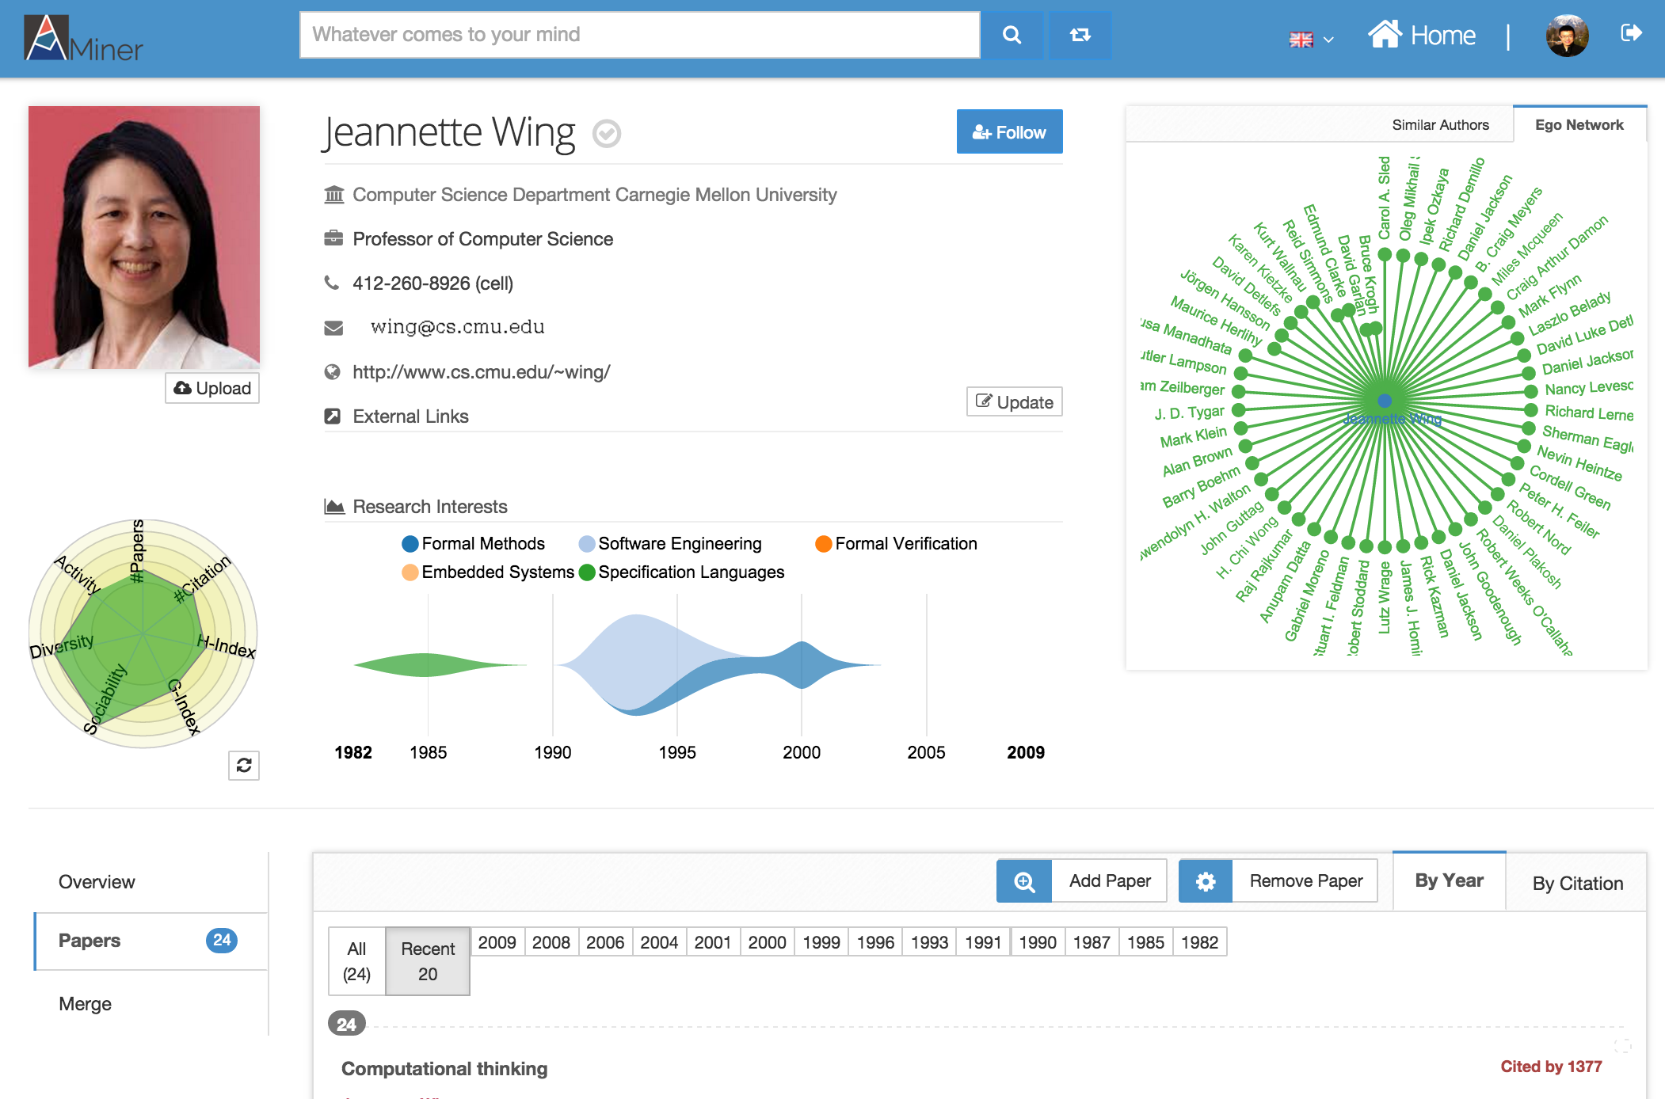
Is this Enough?
Notes:
Out of date

Slide 18
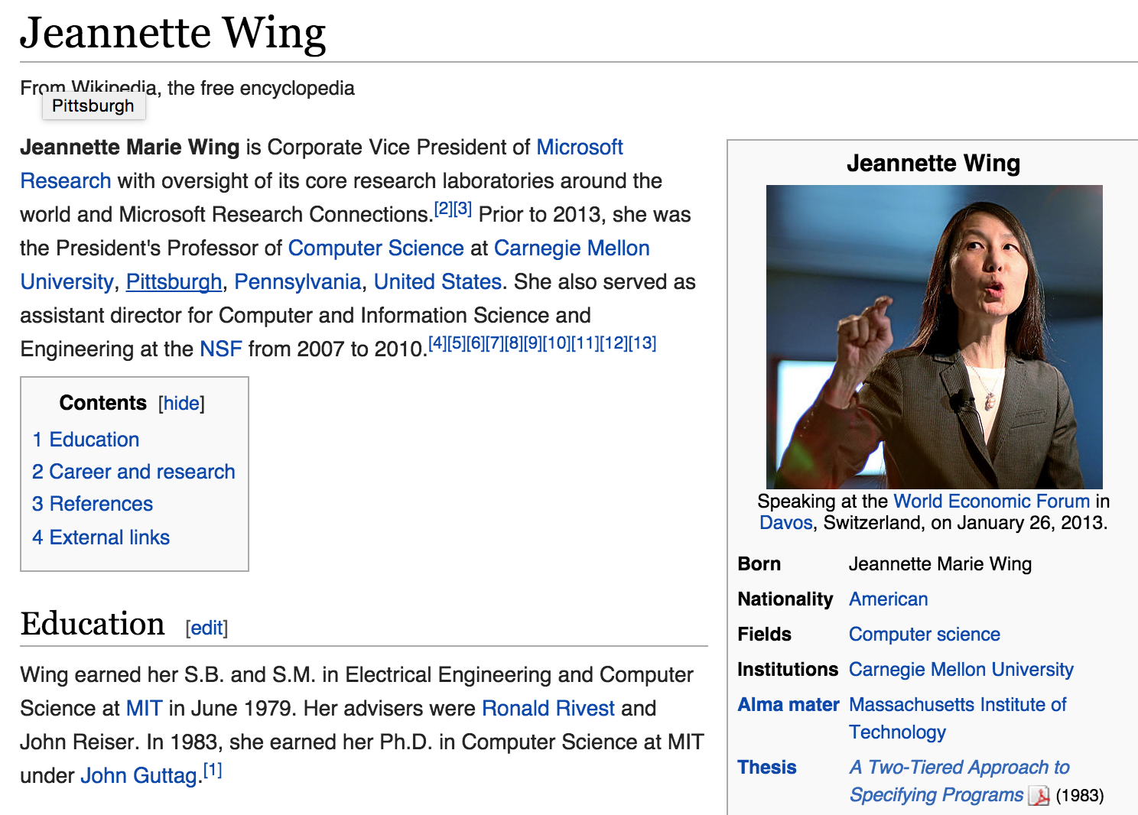
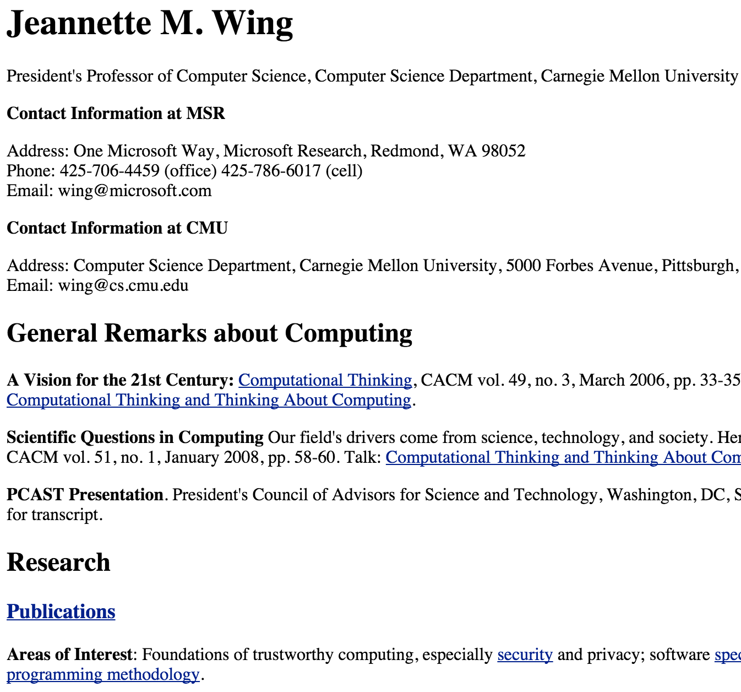
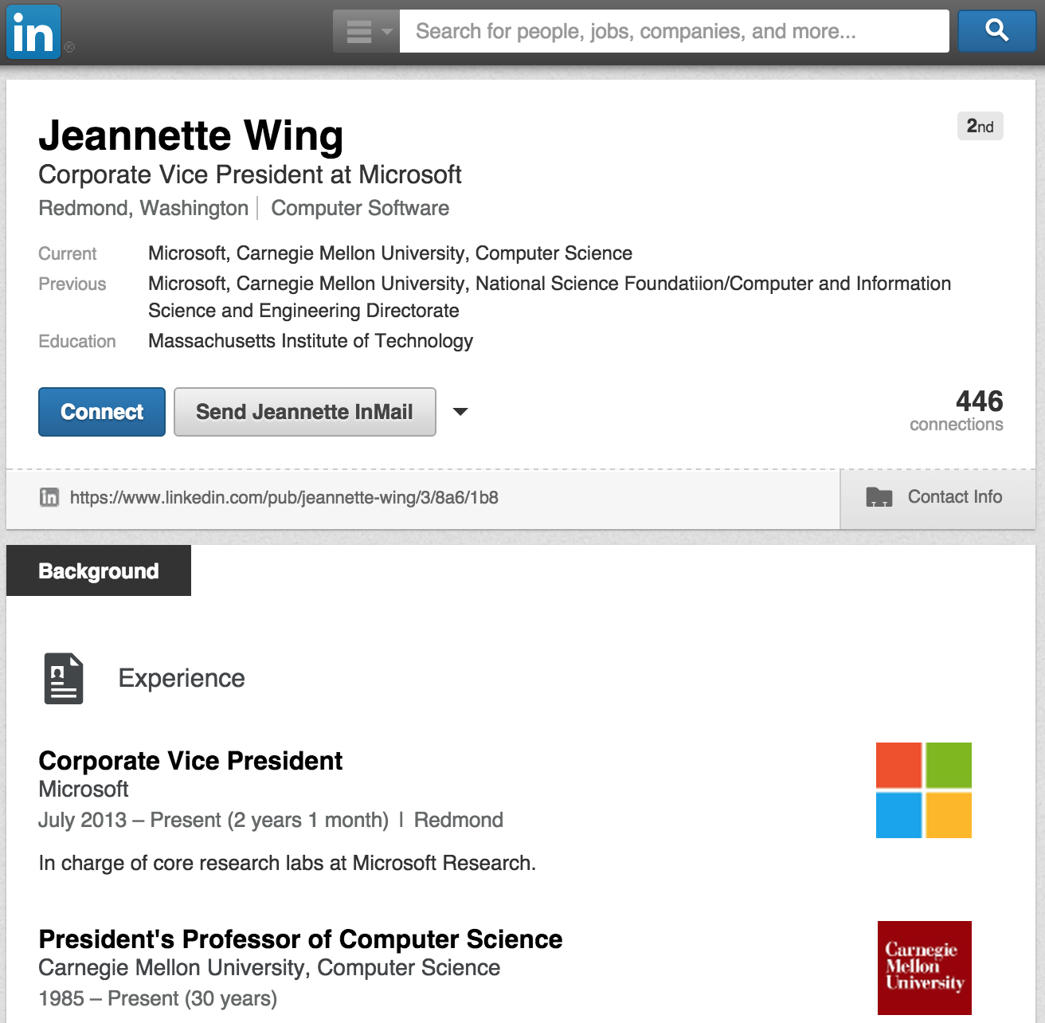
Semantics are distributed…
Wikipedia
Homepage
LinkedIn
AMiner

Slide 19
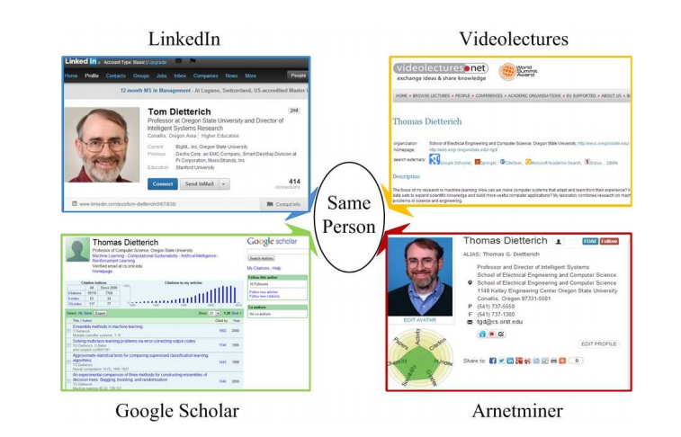
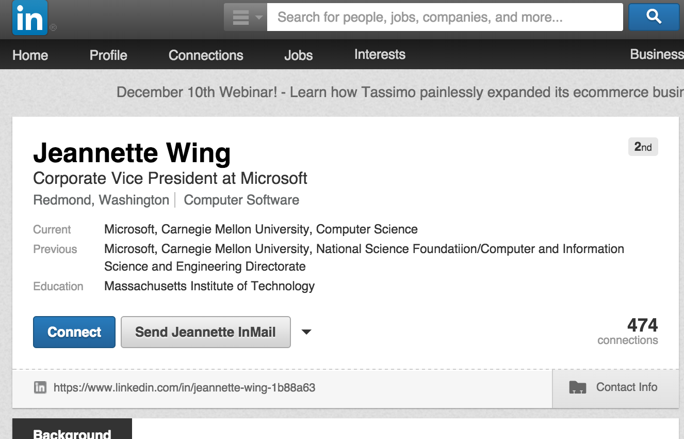
Integrating Semantics across Networks
Identifying users from multiple heterogeneous networks and integrating semantics from the different networks together.
LinkedIn
WikiPedia
Jeannette Wing
Jeannette Wing
Google Scholar
AMiner
Notes:
is a fundamental issue in many applications

Slide 20




Local + Global consistency
AMiner
Network matching
Local consistency
x
Inconsistent!
Global inconsistency
x
x
x
x
x

Slide 21
COSNET: Connecting Social Networks with Local and Global Consistency
Yutao Zhang, Jie Tang, Zhilin Yang, Jian Pei, and Philip Yu. COSNET: Connecting Heterogeneous Social Networks with Local and Global Consistency. KDD’15, page 1485-1494.

Slide 22
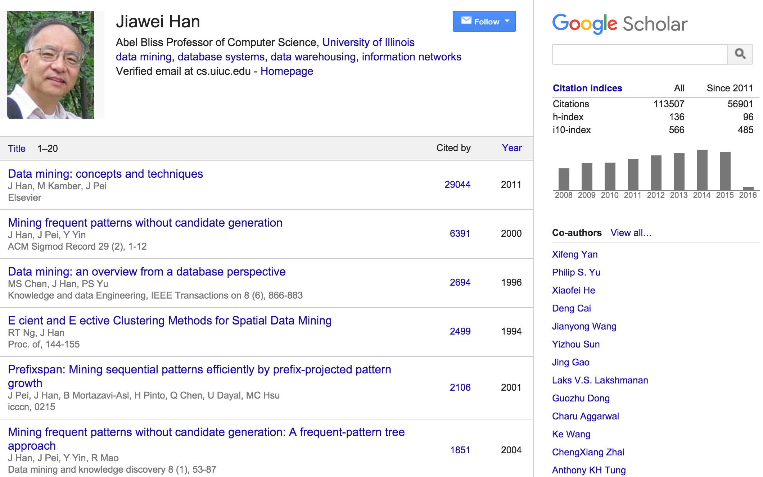
AMiner

Slide 23
AMiner
Ego Network

Slide 24
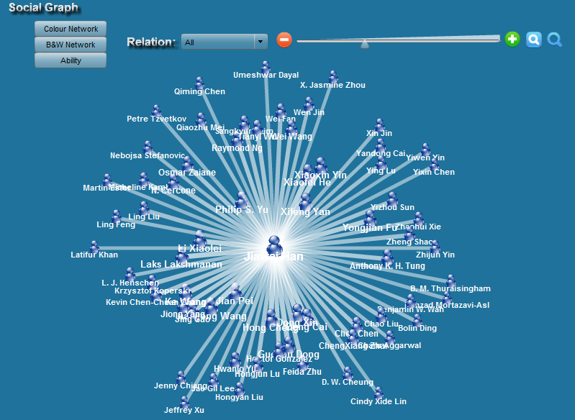
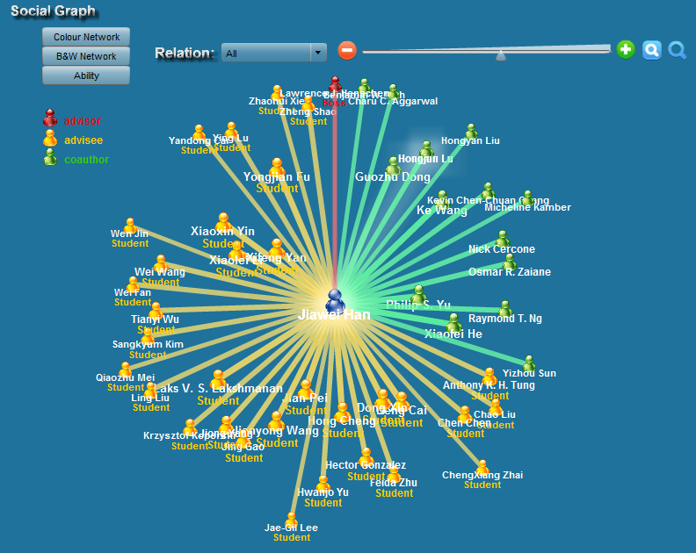
Network Semantics
How to mine semantics within networks?
  Who are Jiawei Han’s students and advisor?

Slide 25
Mining Network Semantics
Semantic network
C. Wang, J. Han, Y. Jia, J. Tang, D. Zhang, Y. Yu, and J. Guo. Mining Advisor-Advisee Relationships from Research Publication Networks. KDD'10, pages 203-212.

Slide 26
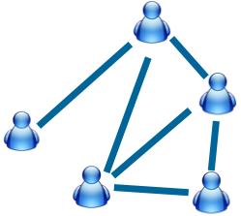
Partially Labeled Pairwise
Factor Graph Model (PLP-FGM)
Constraint factor h
y₂₁=Friend
y₁₂=Friend
Latent Variable
y₁₆=Other
Correlation factor g
Attribute factors f
Input
Model
Map relationship to nodes in model
Example:
Author A has a longer publication history than both B and C.
Example:
#Coauthored papers by two authors?
Wenbin Tang, Honglei Zhuang, and Jie Tang. Learning to Infer Social Ties in Large Networks. In ECML/PKDD'2011. pp. 381-397. (Best Student Paper Runner-up)
Notes:
Now we introduce our partially labeled pairwise factor graph model in detail. Take the mobile network as example. The left side is input mobile social network. [Click] And the right side is the formulized model. [Click] Each relationship in the input network is mapped to a relationship node in the model. [click]
For each relationship node, we have a corresponding latent variable y. [click] The value of latent variable indicates the type of relationship.
In this model, we define three different factors.
The first factor is attribute factor. For each relationship, there may exist some user-specific/link-specific attributes which can reflect the relationship type.
For example:
How frequently two users make call to each other?
These features are added in to the model as "attribute factors.“
The second factor is correlation factor. Different relationships may have some correlations. Let's image such a situation, user Bob makes call to Alice immediately after the call to Carl. Then, the relationship between Bob and Alice, and the relationship between Bob and Carl, are very likely to be the same.
[Click]
The third factor is constraint factor. There also may exist some common knowledge that can help us to infer the relationship types.
[Click]
Finally, this model is a partially labeled model. Some of the nodes are labeled and some are not.
[Click]
Based on this model, The problem is cast as, for each relationship, identify which type has the highest probability.

Slide 27
AMiner
Ego Network

Slide 28
Why you will love AMiner?
—finding collaborations, applying PhD, reviewing, recruiting…
Related publications: ACM TKDD (2), IEEE TKDE (3), KDD’08-15, WWW’12-15,J. Informetrics, SIGMOD’09, IJCAI’09-15, ICML’14

Slide 29

Examples – Expert search
When starting a
Work on a new research topic;
Or brainstorming for novel ideas.
Researcher
Who are experts in this field?
What are the top conferences in the field?
What are the best papers?
What are the top research labs?
?

Slide 30
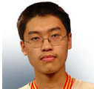
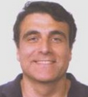
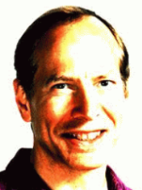
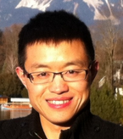
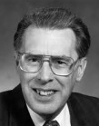
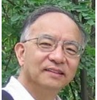
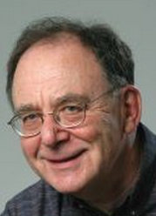

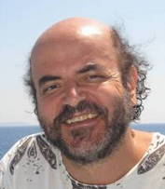
Examples – Collaboration Recommendation
Data Mining
Theory
Large Graph
?
Heterogeneous Network
Automata theory
Graph
Theory
Social
Network
Complexity Theory
Notes:
Interdisciplinary collaborations have generated huge impact, for example,
51 (>1/3) of the KDD 2012 papers are result of cross-domain collaborations between graph theory, visualization, economics, medical inf., DB, NLP, IR
Research field evolution
Describe the problem
First, sparse connection, compared to traditional collaborations within a domain, cross-domain collaborations are very rare. partly because it is difficult for an outsider to find the right collaborator in the field that one does not know. This also makes it challenging to directly use a supervised learning approach due to the lack of training samples.
Second, complementary expertise, cross-domain collaborators often have different expertise and interest; For example, data mining researchers can easily identify who they want to work with in the data mining field, because they are familiar with the sub topics. However, for a cardiologist who wants to apply data mining techniques to predict heart failures, it will be difficult for her to find the right collaborators in data mining. Because these two fields (cardiology and data mining) are totally different with different terminology and problems. It is very difficult for one from cardiology to identify the right topics in data mining to look for collaborators.
Third, topic skewness, not all topics are relevant for crossdomain collaborations. In fact, in our study, only less than one-tenth of all possible topics pairs across domains have collaborations. Therefore, for the task of cross-domain collaboration recommendation, we should focus on better modeling those topics with high probability of having cross-domain collaborations

Slide 31
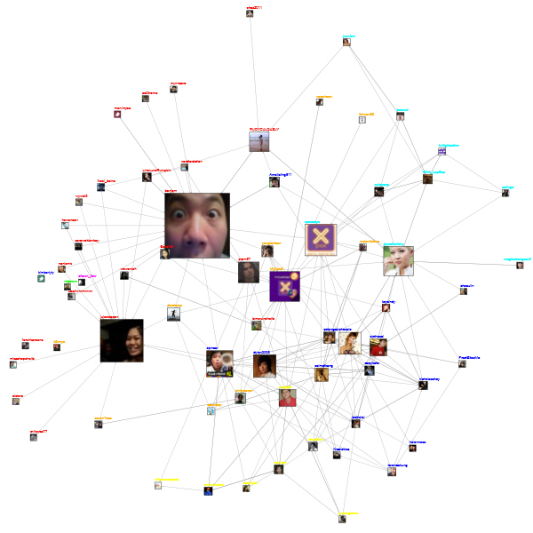
Examples – More Challenging Questions…
Looking for researchers from the U.S. who can speak Chinese…
Organization
or Agency
?
Want to recruit female researchers working on WSDM

Slide 32




Examples – Reviewer Suggestion
Who are best matching reviewers for each paper?
Who will accept the invitation to review the paper
Conf. Committee
Journal Editors
?
Paper content
Notes:
criticize

Slide 33
Applications

Slide 34
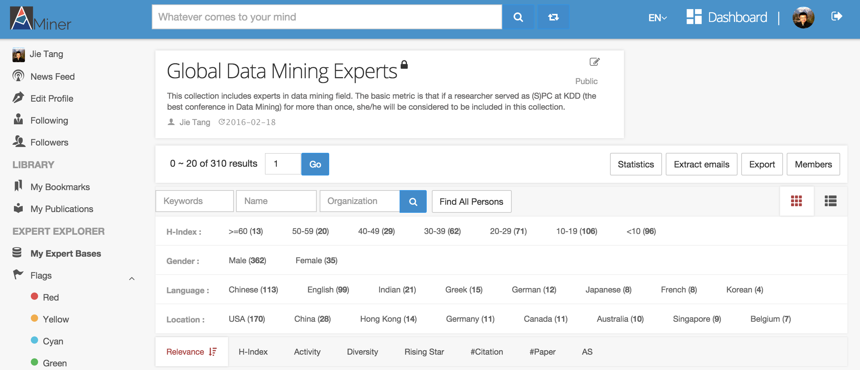
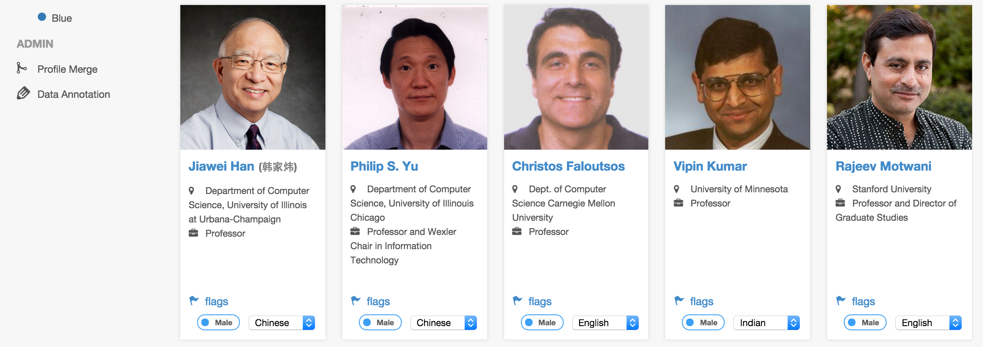
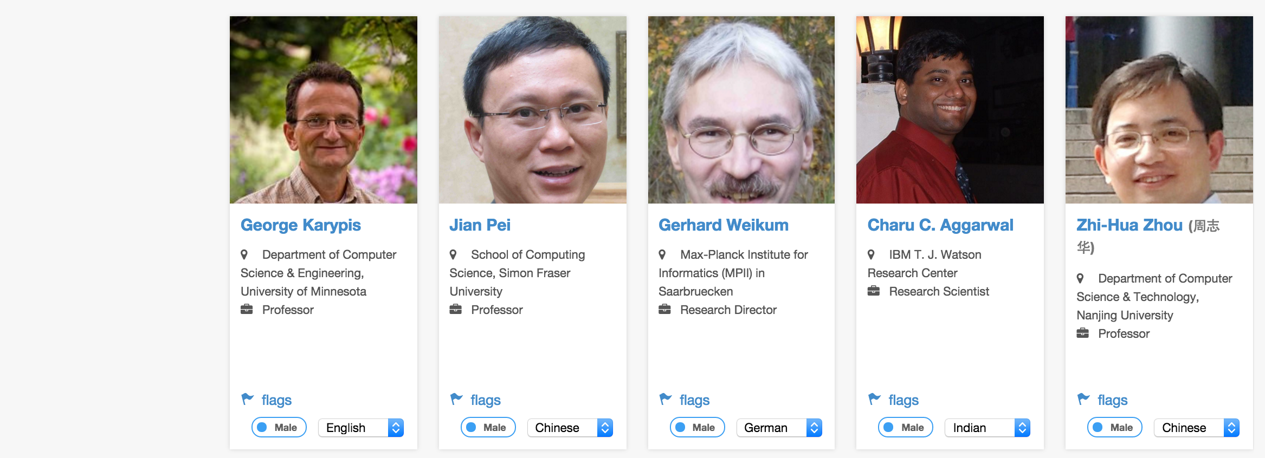
Data Mining
Experts
https://aminer.org/datamining-experts/

Slide 35
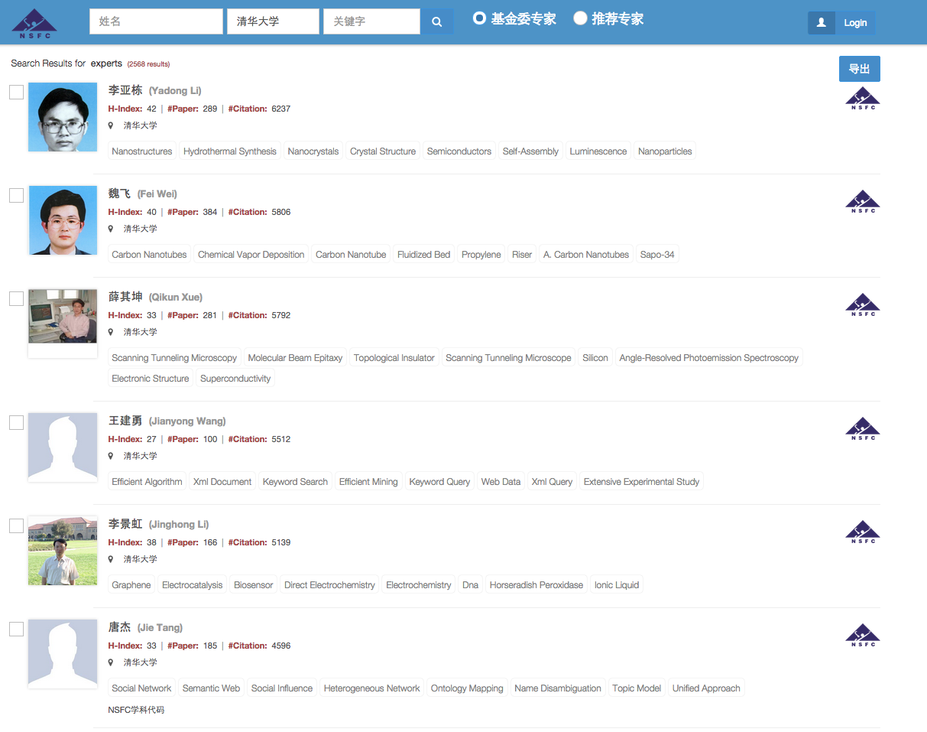
NSFC (NSF of China)
—proposal reviewer recommendation

Slide 36
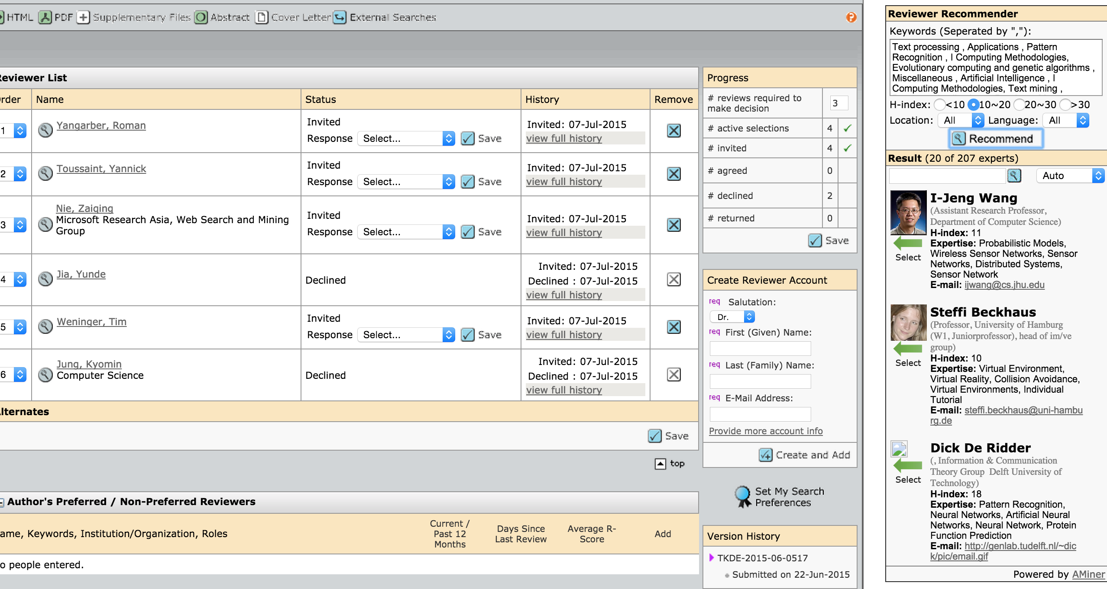
Integration with ScholarOne
Find the extension—reviewer recommender—from Chrome Web Store
ScholarOne is a submission management system used by many journals such as
IEEE Transactions and ACM Transactions.

Slide 37
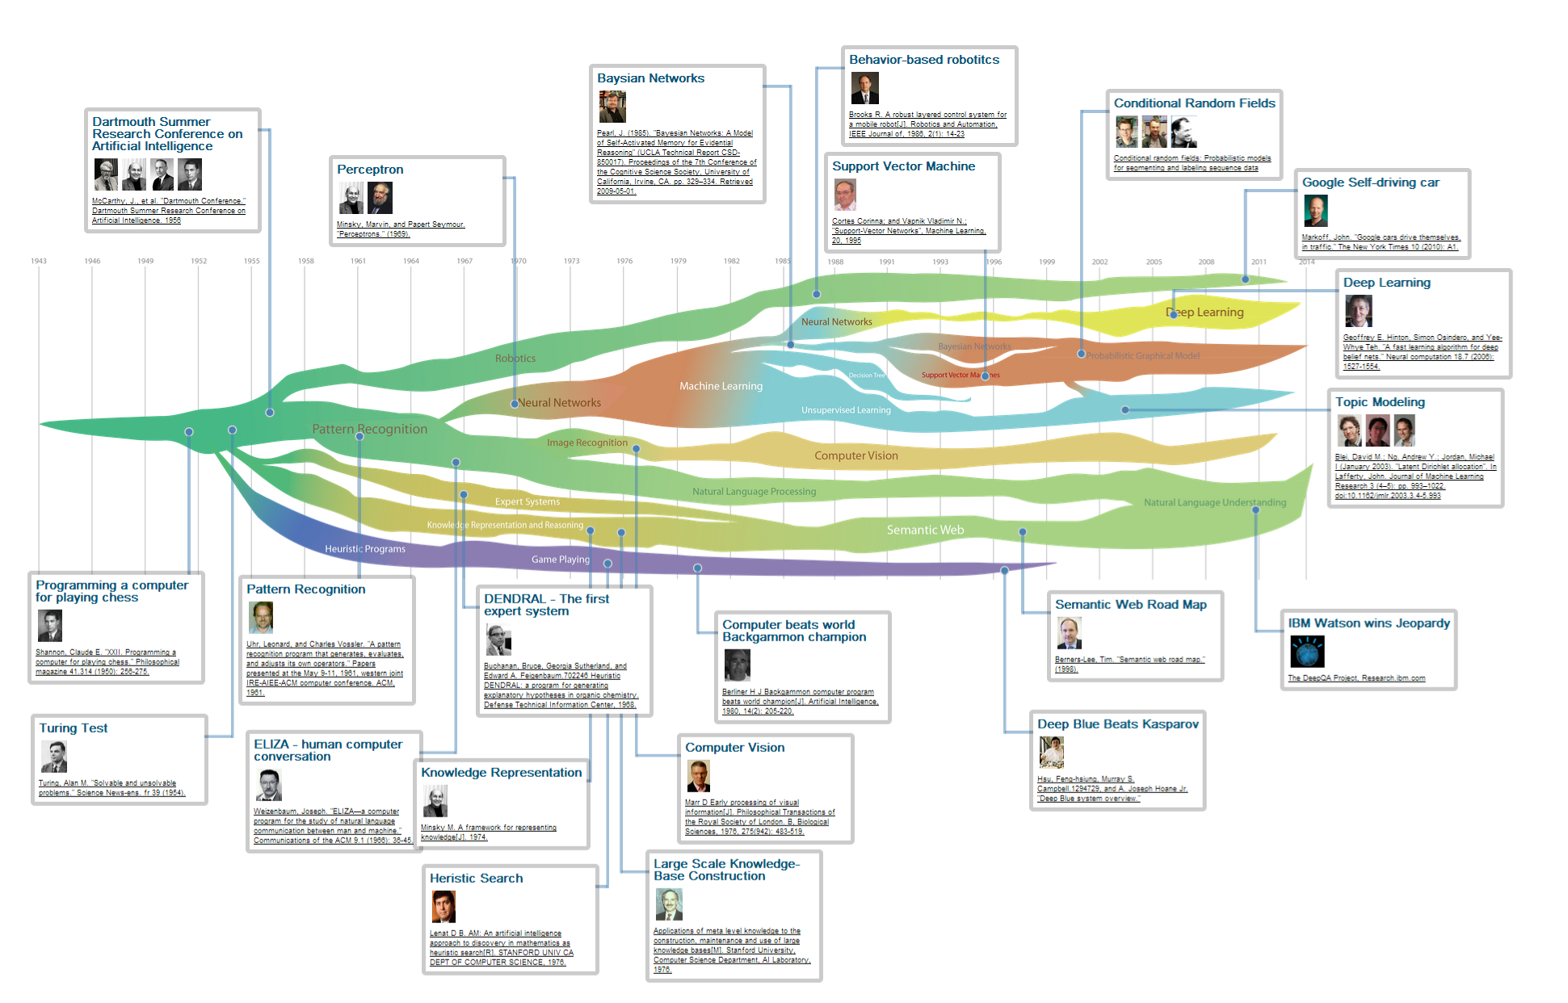
Knowledge Trend for “AI”

Slide 38
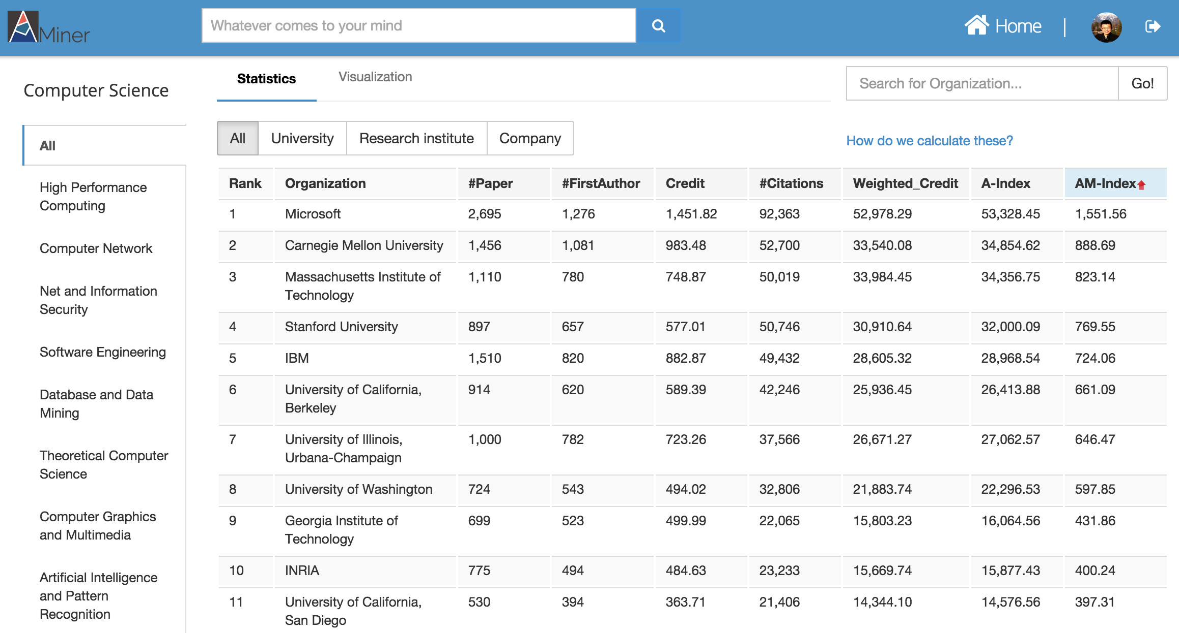
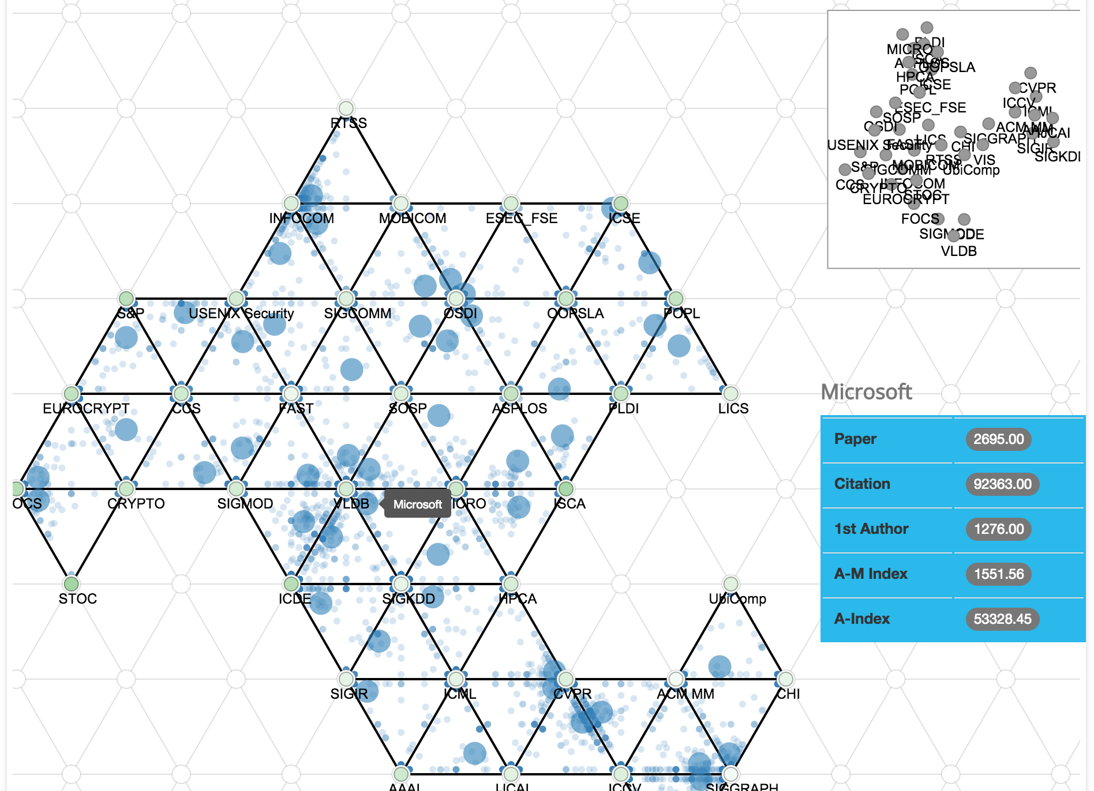
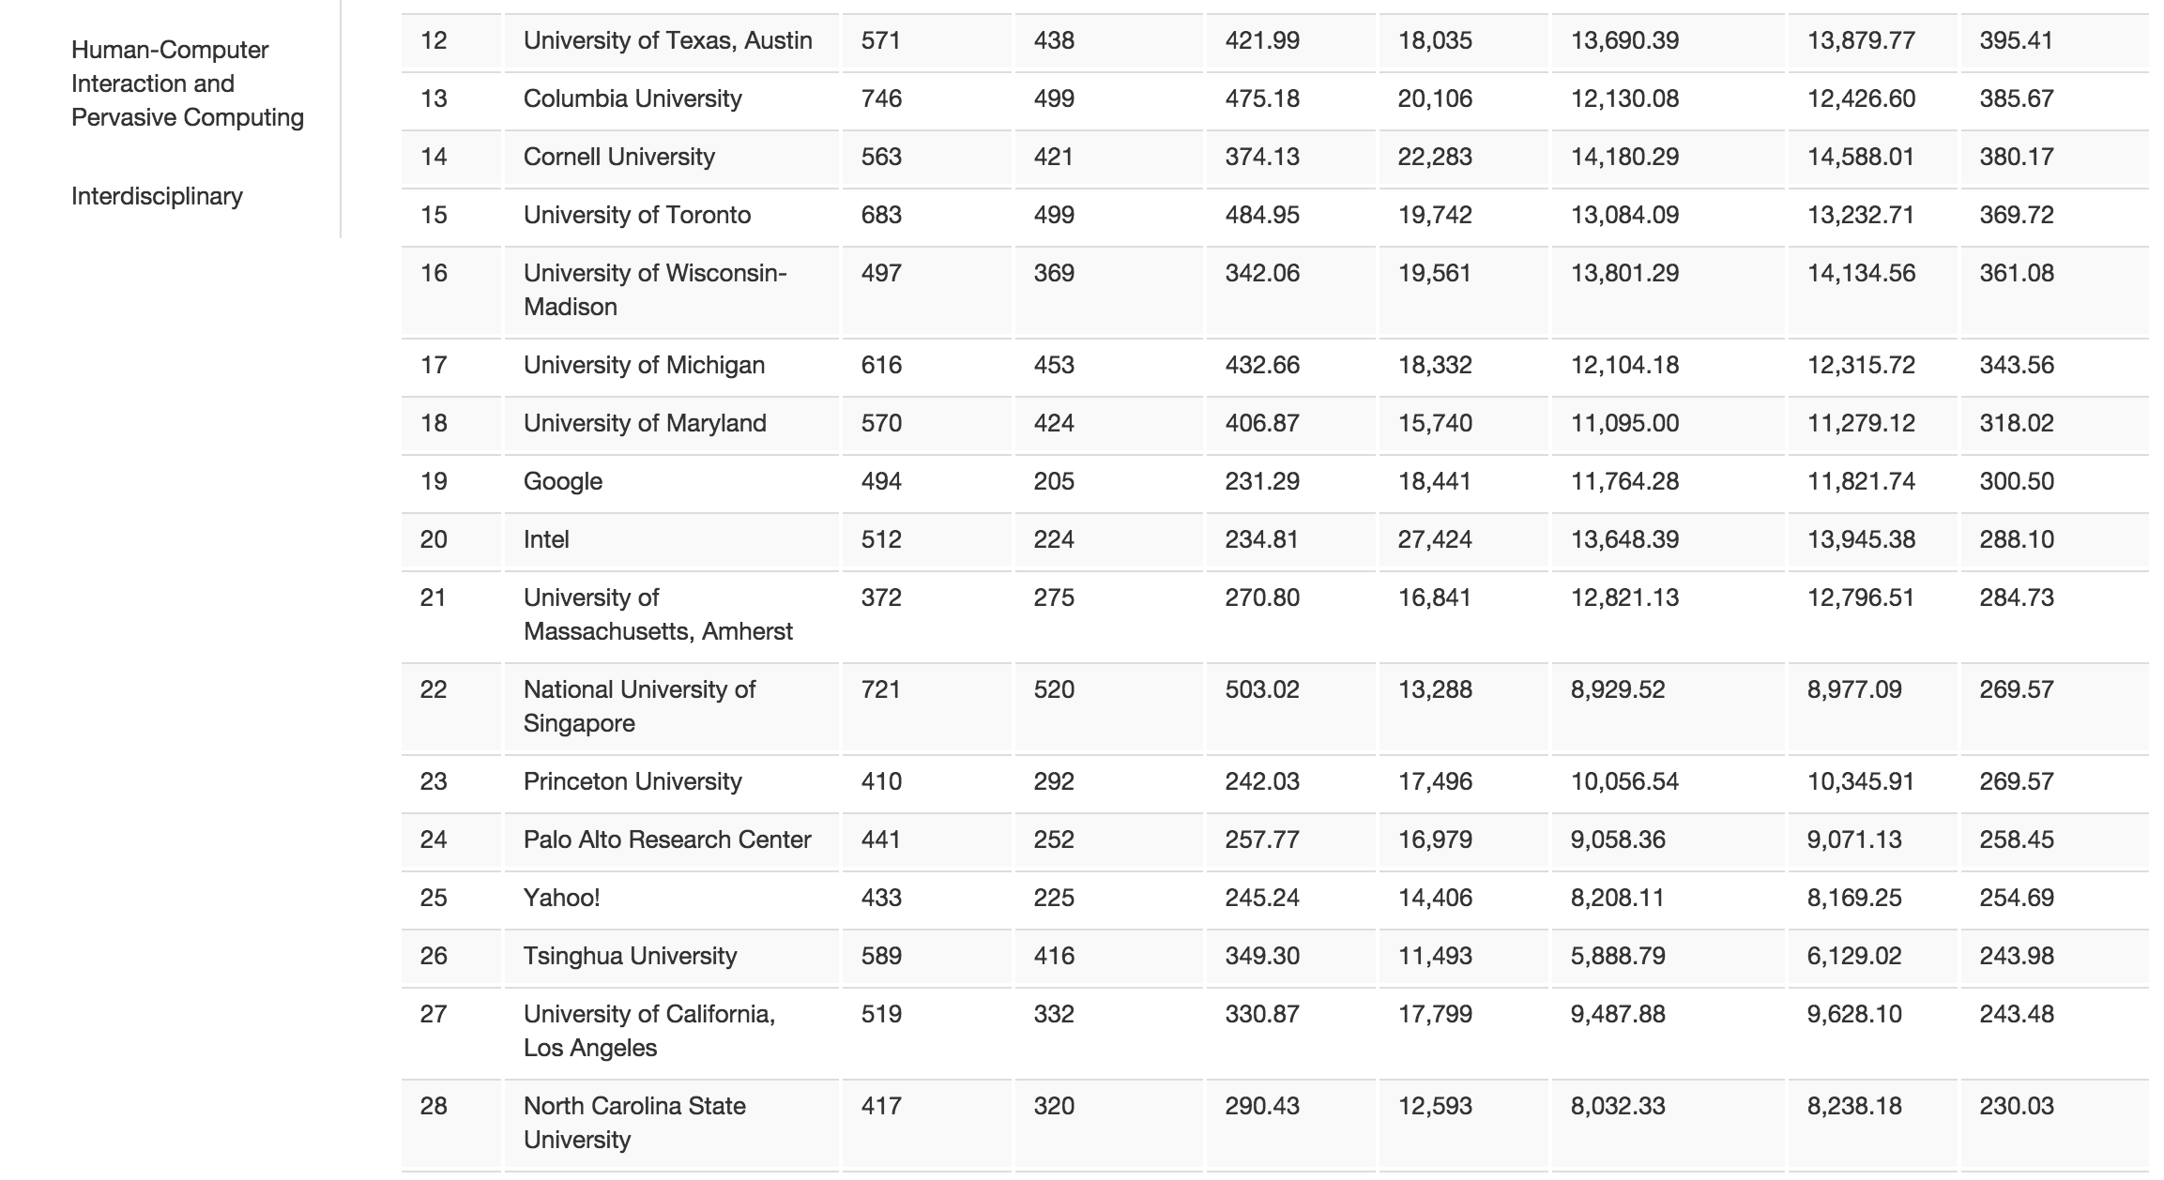
Organization
Ranking
By different metrics

Slide 39
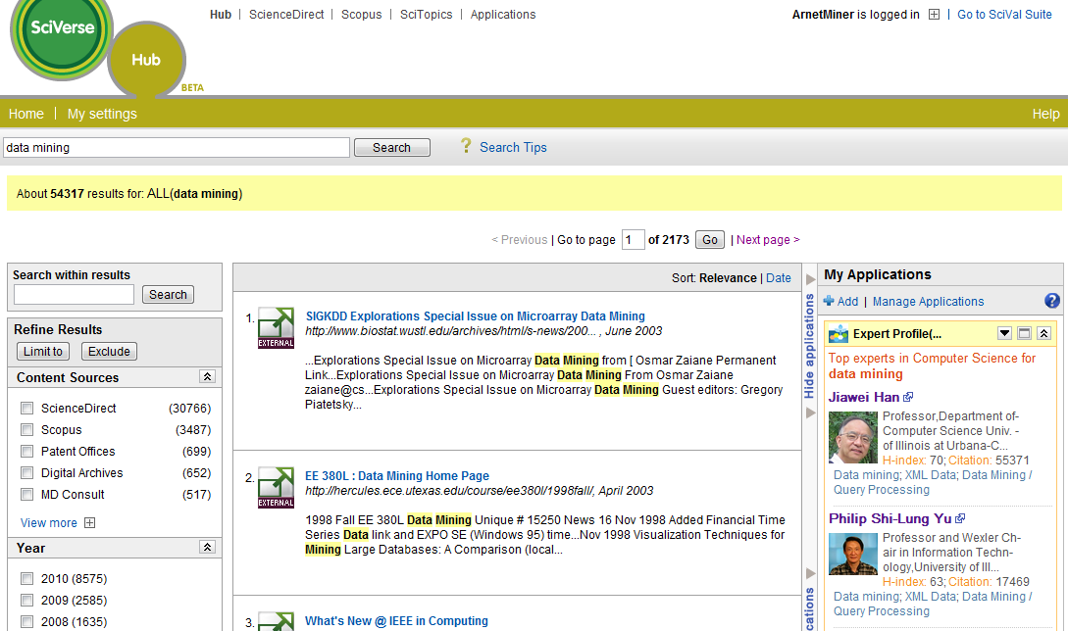
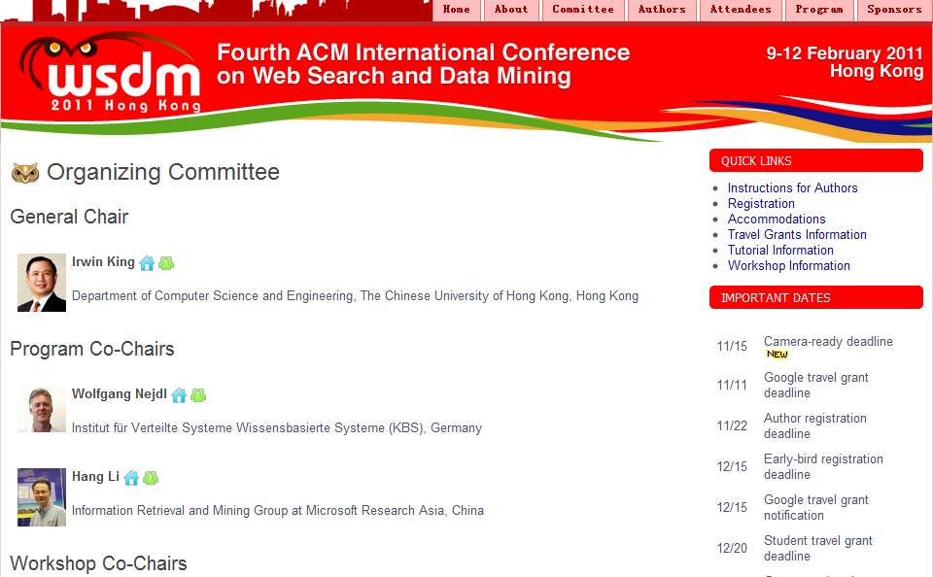
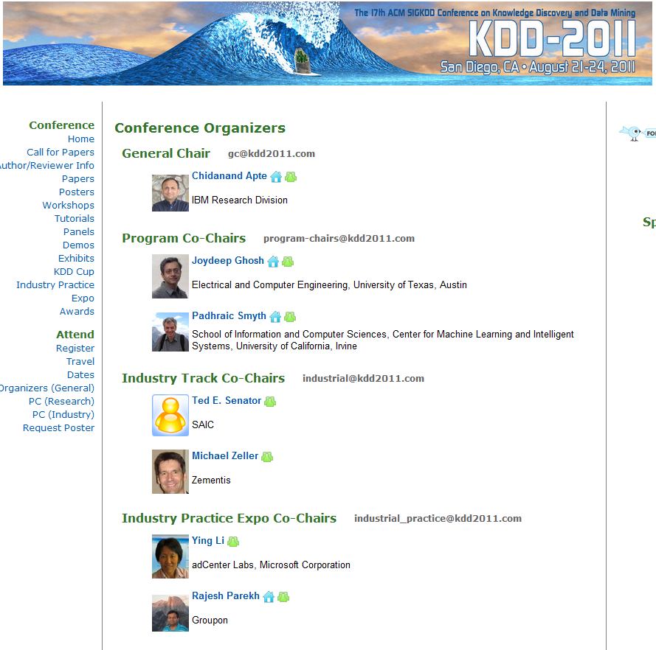
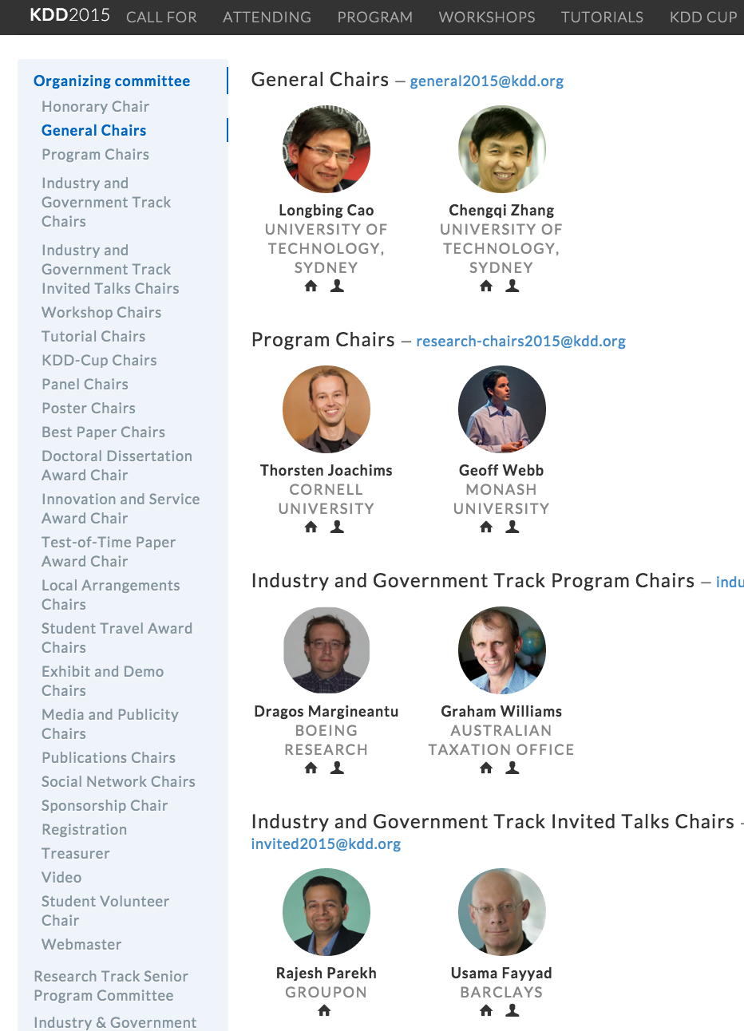


Widely used..
The largest publisher:
Elsevier
Conferences
KDD 2010-15
WSDM 2011
ICDM 2011
ICDM 2012
SocInfo 2011
ICMLA 2011
WAIM 2011
etc.
……

Slide 40
Academic Social Platform

Slide 41


Slide 42


Slide 43


Slide 44


Slide 45
Open Big Scholar Data

Slide 46


Citation
Network
https://aminer.org/citation

Slide 47

Collaboration Network with
Rich Semantics
https://aminer.org/AMinerNetwork

Slide 48
AMiner (ArnetMiner)
—Toward understanding big scholar data http://aminer.org
Semantics
+
Social
+
Open Data
Science of Science!
[1] J. Tang, J. Zhang, L. Yao, J. Li, L. Zhang, and Z. Su. ArnetMiner: Extraction and Mining of Academic Social Networks. KDD’08. pp.990-998.

Slide 49
AMiner (ArnetMiner)
—Toward understanding big scholar data http://aminer.org
Thanks to our partners
[1] J. Tang, J. Zhang, L. Yao, J. Li, L. Zhang, and Z. Su. ArnetMiner: Extraction and Mining of Academic Social Networks. KDD’08. pp.990-998.

Slide 50




AMiner (ArnetMiner)
—Toward understanding big scholar data http://aminer.org
Special thanks to Yuxiao Dong from ND for helping cook the slides!
Notes:
50

Slide 51





Why AMiner.org
“Academic search was treated as document search, but ignored semantics”

