Slide 1


OAG: Toward Linking Large-scale Heterogeneous Entity Graphs
Fanjin Zhang, Xiao Liu, Jie Tang, Yuxiao Dong, Peiran Yao, Jie Zhang, Xiaotao Gu, Yan Wang, Bin Shao, Rui Li and Kuansan Wang.
Tsinghua University Microsoft Research
Notes:
Hello everyone. The title of this talk is
This is a joint work of THU and Microsoft.

Slide 2
OAG overview
Open Academic Graph (OAG) is a large knowledge graph unifying two web-scale academic graphs: Microsoft Academic Graph (MAG) and AMiner.
Linking large-scale heterogeneous academic graphs
Notes:
Open Academic Graph (OAG) is a large knowledge graph unifying two billion-scale academic graphs: Microsoft Academic Graph (or MAG, for short) and AMiner.
MAG is a Web-scale heterogeneous entity graph comprised of different types of entities such as field of study, author, paper and venue.
AMiner is an academic search and mining system developed by Tsinghua University, and it focuses on mining deep knowledge from big scholarly data.

Slide 3
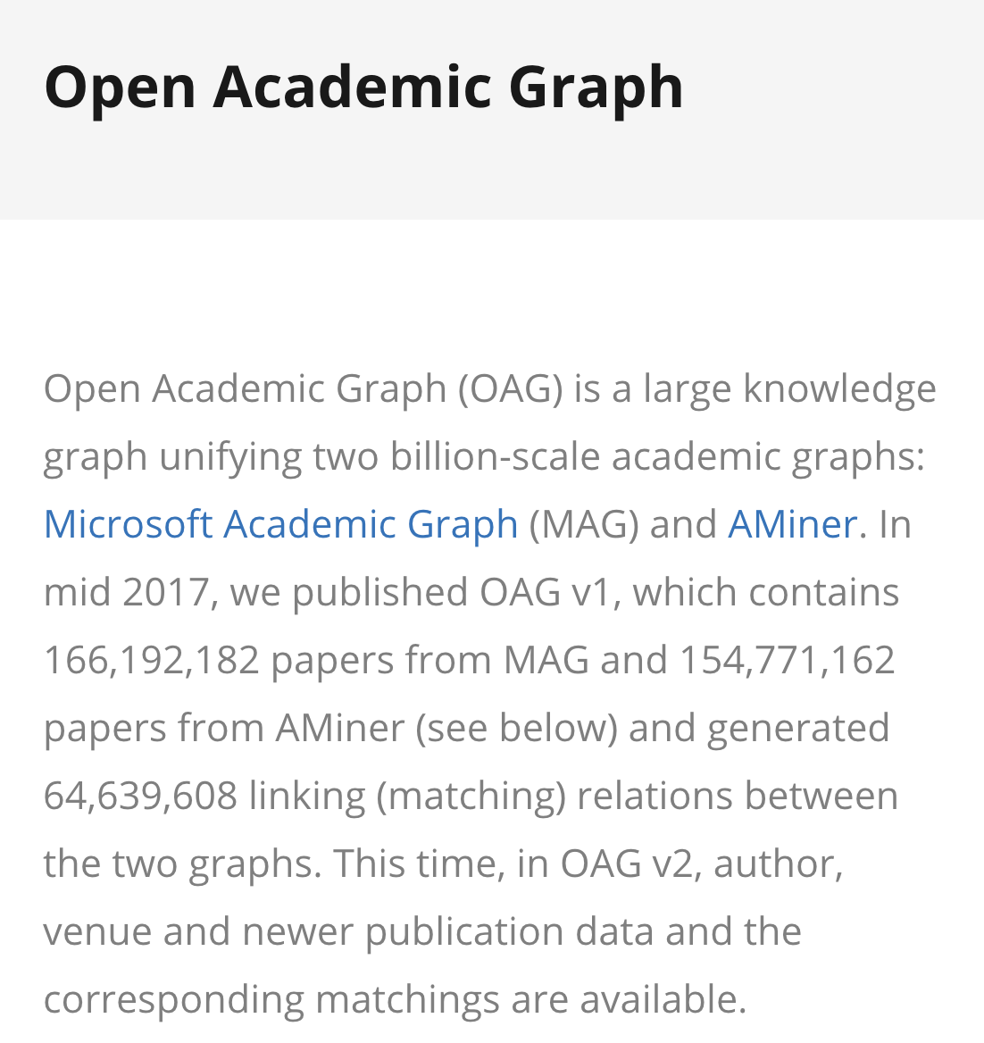
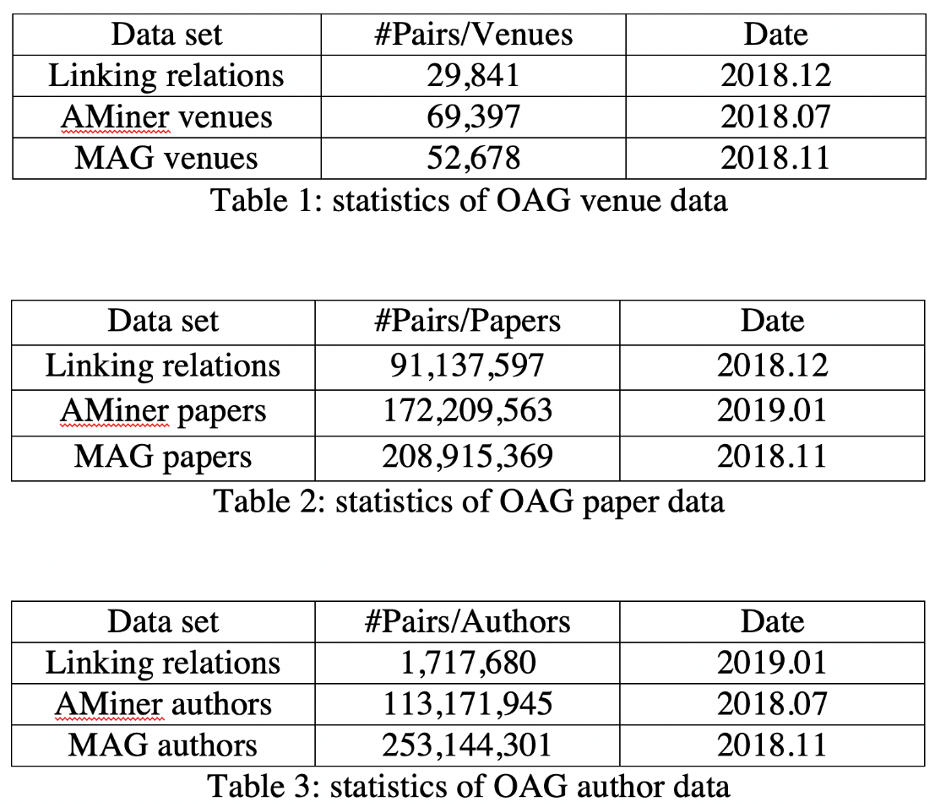
OAG: Open Academic Graph
https://www.openacademic.ai/oag/
Notes:
We have now published OAG dataset, which has venue, paper and author data from each graph and the corresponding matchings.
There are about 30 thousand venue linkings, 90 million paper linkings and 1.7 million author linkings between the two graphs.
OAG now consists of about 700 million entities and 2 billion relationships in total, which is the largest publicly available heterogeneous academic graph until now.

Slide 4
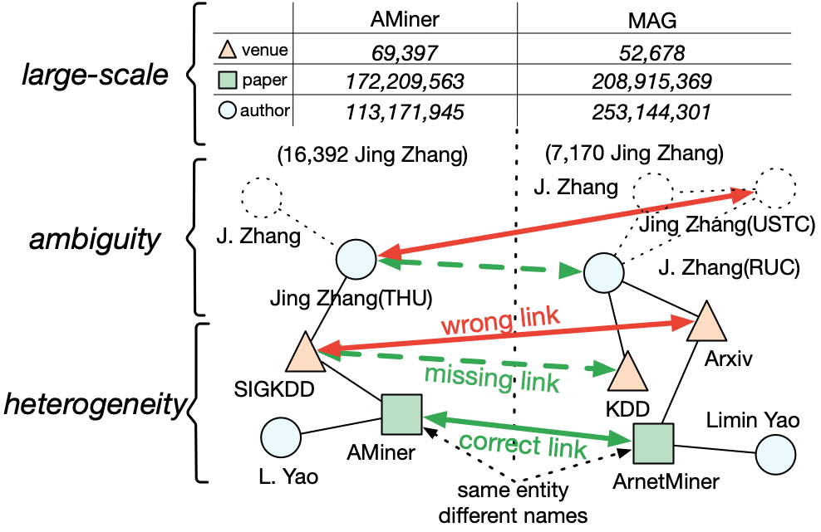
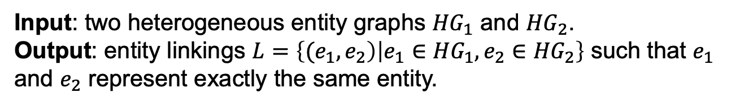
Problem & Challenges
Input: two heterogeneous entity graphs ${HG}_{1}$ and ${HG}_{2}$.
Output: entity linkings $L=\left\{{(e}_{1},e_{2}\right)\left|e_{1}∈{HG}_{1},e_{2}∈{HG}_{2}\right\}$ such that $e_{1}$ and $e_{2}$ represent exactly the same entity.
Notes:
The goal of OAG is to link the same real-world entities from different sources. Given two heterogeneous entity graphs, the output is linked entity pairs.
The challenges of this problem lie in heterogeneity, ambiguity, and large-scale linking.

Slide 5
Challenges
Entity heterogeneity
Different types of entities
Heterogeneous attributes
Entity ambiguity
Long-standing name ambiguity problem
Large-scale entity linking
Hundreds of millions of publications in each source.
Notes:
First, the heterogeneity lies in that there are different types of entities and the entity attributes are also heterogeneous. For example, the author names in papers may have different formats.
The second challenge is entity ambiguity, especially for the long-standing name ambiguity problem.
The third challenge is to perform large-scale entity linking. Taking publication data as an example, there are Hundreds of millions of publications in each source.

Slide 6
Related work
Rule-based method: DiscR [TKDE’15]
Traditional ML method: RiMOM [JWS’06], Rong et al. [ISWC’12], Wang et al. [WWW’12], COSNET [KDD’15].
Embedding-based method: IONE [IJCAI’16], REGAL [CIKM’18], MEgo2Vec [CIKM’18].

Slide 7
Framework: LinKG
Author linking module
Venue linking module
Paper linking module
Notes:
To this end, We propose a unified framework—LinKG—to address the above challenges.
LinKG is coupled with three linking modules, each of which addresses one category of entities.

Slide 8
Framework: LinKG
Venue linking — Sequence-based Entities
An LSTM-based method to capture the dependencies
Paper linking
locality-sensitive hashing and convolutional neural networks for scalable and precise linking.
Author linking
heterogeneous graph attention networks to model different types of entities.
Notes:
To link word-sequence-based entities (e.g., venues), we present an LSTM-based method for capturing the dependencies.
To link large-scale entities (e.g., papers), we leverage locality-sensitive hashing and convolutional neural networks for scalable and precise linking.
To link entities with ambiguity (e.g., authors), we propose heterogeneous graph attention networks to model different types of entities.
Next we present the three modules one by one.

Slide 9
Linking venues — sequence-based entities
Input: venue names in each graph
Output: linked venue pairs
Idea:
Direct name matching
Easy cases
LSTM-based method
Fuzzy-sequence linking
Notes:
For venue linking, we find that using venue names is simple, efficient, and effective.
We first use direct name matching to link easy cases, which takes up 90% of final linking results.

Slide 10
Venue linking characteristics
Word order matters
E.g. ‘Diagnostic and interventional imaging’ and ‘Journal of Diagnostic Imaging and Interventional Radiology’
Fuzzy matching for varied-length venue names.
Extra or missing prefix or suffix
E.g. Proceedings of the Second international conference on Advances in social network mining and analysis.
Notes:
For remaining venues, we find two characteristics. First, the word order in venue names matters. Second, the same venues may have varied-length variants due to extra or missing prefix or suffix.

Slide 11




Venue linking model
Two-layer LSTM layers
Raw word sequence
Input
Similarity
score
Keywords extracted from integral sequences
Notes:
Therefore, we propose an LSTM-based methods to encode venue names for fuzzy linking.
LSTM Can model sequences having variable length.
For venue linking, we model both Integral Sequence and keyword sequence in venue names. We use two LSTM layers to encode each sequence. Finally, sequence embeddings with other features are merged and passed into fully-connected layers to produce the final matching score.

Slide 12
Framework: LinKG
Venue linking — Sequence-based Entities
An LSTM-based method to capture the dependencies
Paper linking
locality-sensitive hashing and convolutional neural networks for scalable and precise linking.
Author linking
heterogeneous graph attention networks to model different types of entities.
Notes:
Next we will introduce paper linking module in our framework.

Slide 13
Linking papers — large-scale entities
Problem setting: To link paper entities, we fully leverage the heterogeneous information, including a paper’s title and authors.
Leverage the hashing technique (LSH) for fast processing
Adopt Doc2Vec to transform titles to real-valued vectors
Use LSH to map real-valued paper features to binary codes.
And the convolutional neural network for effective linking.
Notes:
We utilize papers’ heterogeneous information such as titles and authors.
the overall volume of academic publications in each graph is at the scale of hundreds of millions. Therefore, we first leverage the hashing technique for fast processing.
In detail, we adopt Doc2Vec to transform titles to real-valued vectors and then use LSH to map real-valued features to binary codes. The matching process is just querying binary codes in O(1) time.
For those papers which can not be matched by hashing, we try to use CNN for effective linking.

Slide 14
Paper linking characteristics
Large-scale entities
Hundreds of millions of academic publications for each graph.
Local and hierarchical matching patterns
Paper titles are often truncated if they contain punctuation marks, such as ‘:’ and ‘?’
Different author name formats: Jing Zhang, J., Zhang & Zhang, J.
Notes:
The reason why we use CNN is that we find local and hierarchical matching patterns exist in paper linking. For example, the first name and last name of paper authors can be exchanged but they are actually matched.

Slide 15

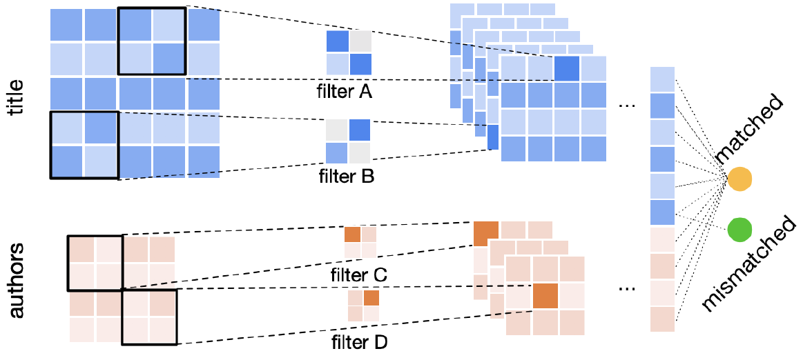
Paper linking model — CNN model
Convolution on input similarity matrix
word-level similarity matrix
MLP layers
Notes:
The input of CNN is word similarity matrix of two papers. If two words are the same, the corresponding entry is 1 and otherwise -1. We first use conv layers and fc to transform similarity matrix to vectors. Then we concatenate the two vectors learned by title and author similarity matrices and use fully-connected layers to produce the final matching score.

Slide 16
Framework: LinKG
Venue linking — Sequence-based Entities
An LSTM-based method to capture the dependencies
Paper linking
locality-sensitive hashing and convolutional neural networks for scalable and precise linking.
Author linking
heterogeneous graph attention networks to model different types of entities.
Notes:
Then, we introduce the author linking module, which is more challenging than linking papers and venues, due to the author name ambiguity issue.

Slide 17
Linking authors — ambiguous entities
Problem setting: To link author entities, we generate a heterogeneous subgraph for each author.
One author’s subgraph is composed of his or her coauthors, papers, and publication venues.
Also incorporate the venue and paper linking results.
Present a heterogeneous graph attention network based technique for author linking.
Notes:
Thus, for author linking problem, we generate a heterogeneous subgraph for each author.
Moreover, we Also incorporate the venue and paper linking results.
Based on the generated subgraph, we Present a heterogeneous graph attention network based technique for linking author entities.

Slide 18
Author linking characteristics
Name ambiguity
16,392 Jing Zhang in AMiner and 7,170 Jing Zhang in MAG
Attribute sparsity
Missing affiliations, homepages…
Already linked papers and venues!
View author linking as a subgraph matching problem
Aggregate needed information from neighbors
Notes:
There are several characteristics for author linking.
The name ambiguity problem is severe in both graphs. For example, there are …
In addition, some author attributes are usually missing, such as affiliations, homepages.
Therefore, we utilized already linked papers and venues to generate subgraph and we want to Aggregate needed information from neighbors for author linking.

Slide 19

Graph neural networks
a
b
v
$$h_{a}=f(h_{a}, h_{b}, h_{c}, h_{d}, h_{e})$$
c
e
d
Neighborhood Aggregation:
Aggregate neighbor information and pass into a neural network
It can be viewed as a center-surround filter in CNN---graph convolutions!
Notes:
Here we briefly introduce some basics of Graph Neural Networks (or GNN). GNN is a powerful method for graph mining problem. The main idea of GNN is to Aggregate neighbor information and pass into a neural network.

Slide 20
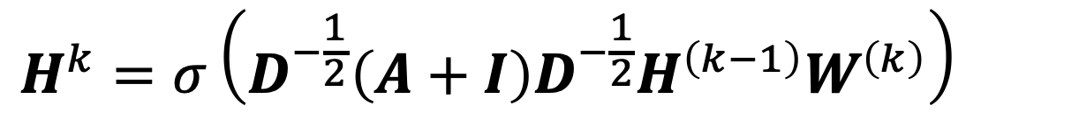
GCN: graph convolutional networks
$$H^{k}=σ\left(D^{−\frac{1}{2}}\left(A+I\right)D^{−\frac{1}{2}}H^{\left(k−1\right)}W^{\left(k\right)}\right)$$
GCN is one way of neighbor aggregations
GraphSage
Graph Attention
… …
Notes:
For example, in GCN, node representation is obtained by taking the average of neighbor representations and then pass into NN.
GCN is one way of neighbor aggregations. In Graph attention networks, the aggregation weight of neighbors are learnt by attention mechanism.

Slide 21
LinKG step 1: paired subgraph construction
Subgraph nodes
direct (heterogeneous) neighbors, including coauthors, papers, and venues
coauthors’ papers and venues (2-hop ego networks)
Merge pre-linked entities (papers or venues)
Construct fixed-size graph
Notes:
In our model, The fist step of author linking is Paired subgraph construction.
One author’s subgraph is composed of her coauthors, papers, and publication venues and alsos her coauthors’ neighbors.
We connect two subgraphs by merging already linked entities.

Slide 22
Step 2: linking based on Heterogeneous Graph Attention Networks (HGAT)
Input node features (in subgraphs)
Semantic embedding: average word embedding of author attributes
Structure embedding: trained network embedding on a large heterogeneous graph (e.g. LINE)
Notes:
The second step is linking based on Heterogeneous Graph Attention Networks.
We pre-train input features for each entity based on both semantic and structure information.

Slide 23

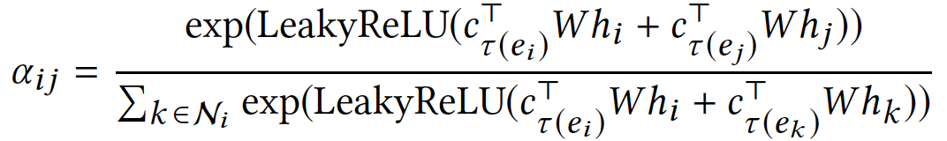
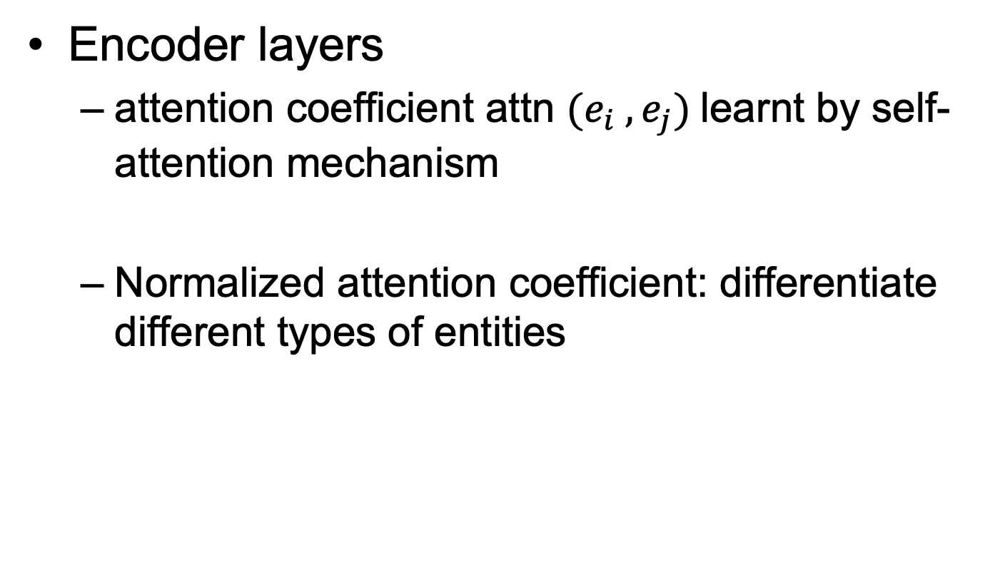
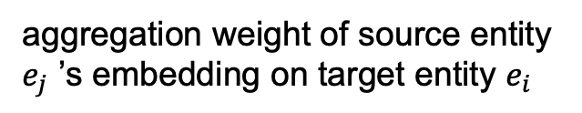
Step 2: linking based on Heterogeneous Graph Attention Networks (HGAT)
Encoder layers
attention coefficient attn $(e_{i} ,e_{j})$learnt by self-attention mechanism
Normalized attention coefficient: differentiate different types of entities
aggregation weight of source entity $e_{j}$ ’s embedding on target entity $e_{i}$
Notes:
In the Heterogeneous Graph Attention Networks , the aggregation weight of source entity 𝑒_𝑗 ’s embedding on target entity 𝑒_𝑖 Is Learnt by self-attention mechanism.
In this model, we differentiate different types of entities by using different parameters to calculate the attention coefficient.

Slide 24
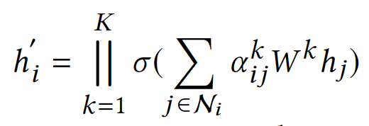

Step 2: linking based on Heterogeneous Graph Attention Networks (HGAT)
Encoder layers (cont.)
Multi-head attention
Two graph attention layers in the encoder
Decoder layers
Fuse embeddings of candidate pairs, and use fully-connected layers to produce the final matching score.
concatenation
Element-wise multiplication
Notes:
We use multi-head attention to enhance the representation. The two hidden embeddings are fused by element-wise multiplication and passed into fc to produce the final matching score.

Slide 25
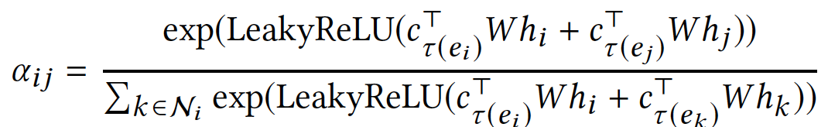
Author linking model — heterogenous graph attention
Heterogeneous subgraph for a candidate author pair
Different attention parameters for
different entity types
Attention coefficient
Notes:
This is the author linking model. The left is paired subgraph construction, and the right presents the Heterogenous Graph Attention networks.

Slide 26
Experiment Setup
Datasets
Baselines
Rule-based method: Keyword
Traditional ML method: SVM & Dedupe
SOTA author linking model
COSNET: based on factor graph model
MEgo2Vec: based on graph neural networks
 | Venue | Paper | Author
Train | 841 | 26,936 | 15,000
Test | 361 | 9,234 | 5,000

Slide 27
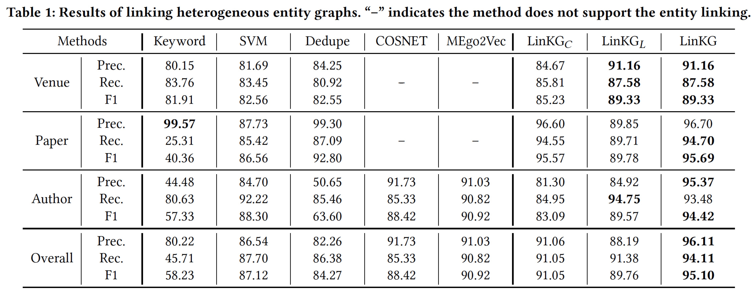
Experimental results
CNN-based method
LSTM-based method
Notes:
We conduct extensive experiments to demonstrate our design choice of each module in the framework.
As shown in table 1, Our method (LinKG) consistently outperforms other baselines.
The best models for venue linking, paper linking and author linking are LSTM-based method, CNN-based method and HGAT-based method respectively.
The overall F1-score is weighted by the number of test samples on different linking problems.

Slide 28
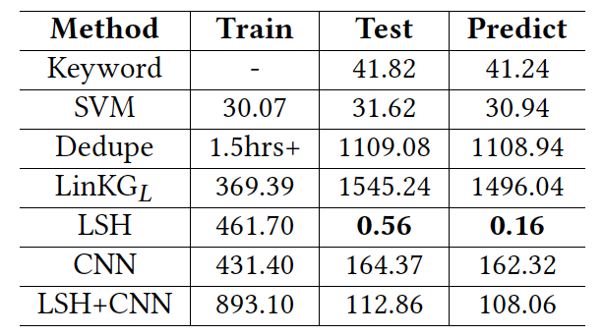
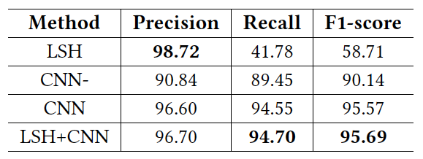
Model variants of paper linking
Table 3: Running time of different methods for paper linking (in second).
Table 2: Paper linking performance
100x prediction
speed-up
Notes:
For detailed paper linking results, we find that combining LSH and CNN is both effective and efficient.

Slide 29
OAG: Open Academic Graph
https://www.openacademic.ai/oag/
Notes:
Based on our proposed framework, we have published Open Academic Graph (OAG), including about 0.7 billion entities and 2 billion relationships, which is the largest publicly available heterogeneous academic graph to date.

Slide 30
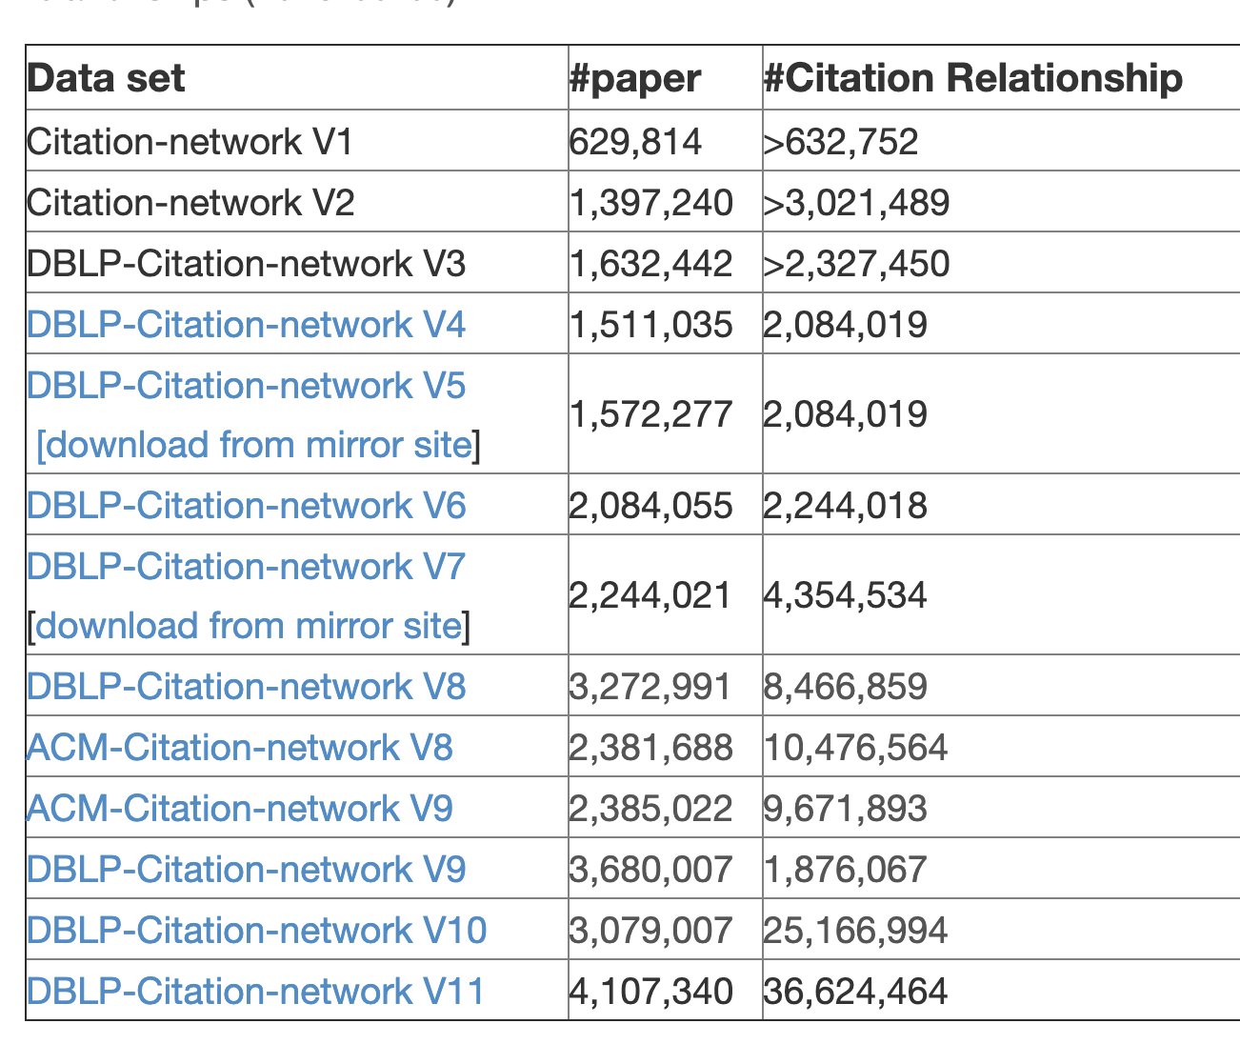
Applications
Data integration
Graph mining
collaboration and citation
Text mining
title and abstract
Science of science …
Citation Network Dataset
https://www.aminer.cn/citation
Notes:
The dataset can be used for various research topics. Such as
We also generated some moderate-size datasets such as dblp citation networks by linking papers from different sources.

Slide 31
Thank You
Code: https://github.com/zfjsail/OAG
Data: https://www.openacademic.ai/oag/

