Slide 1





A Matrix Chernoff Bound for Markov Chains and its Application to Co-occurrence Matrices
Jiezhong Qiu, Chi Wang, Ben Liao, Richard Peng, Jie Tang
Notes:
5sec
Welcome to our paper about Markov Chain Matrix Chernoff Bound and Co-occurrence Matrices
I am jiezhong Qiu from Tsinghua University.

Slide 2
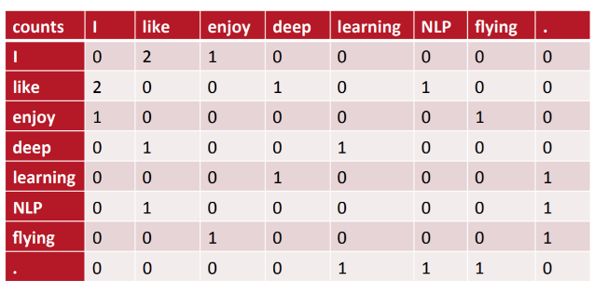
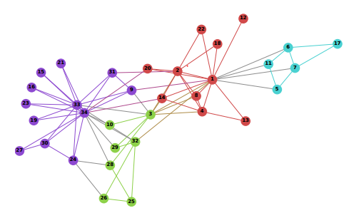
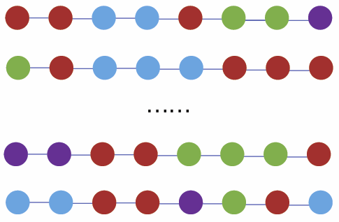
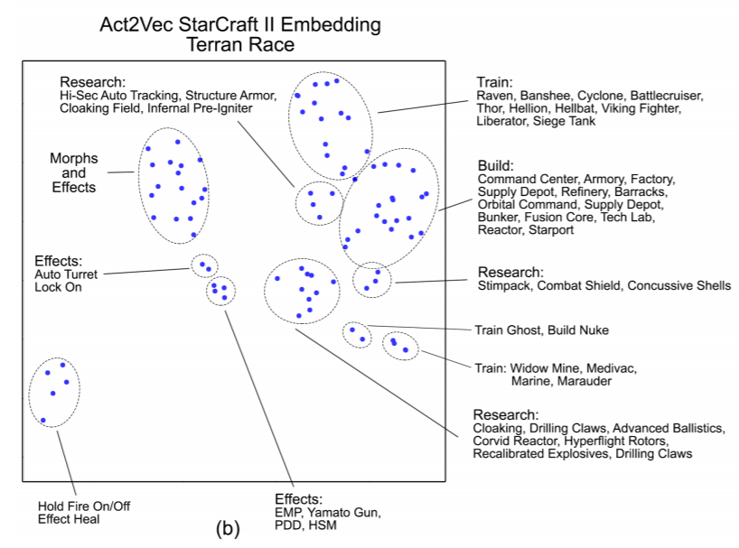
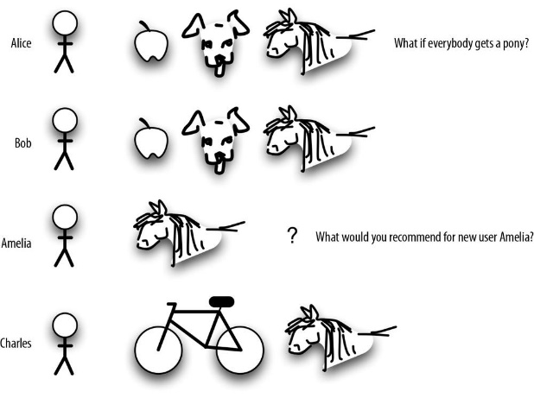
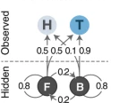

The Application to Co-occurrence Matrices
NLP
(LDA, Word2vec, Glove)
Graph Learning
(DeepWalk, node2vec, metapath2vec)
Recommendation System (Pin2Vec, Item2vec)
Reinforcement Learning
(Act2Vec)
Hidden Markov Models
(Emission Co-occurrence)
Notes:
40 sec
co-occurrence matrices have been common and important data signals in machine learning,
Such as the word co-occurrence in NLP, vertex co-occurrence in Graph Learning, item co-occurrence in Recommendation system, action co-occurrence in Reinforcement Learning,
And Emission co-occurrence in Hidden Markov models.
A common assumption when building such statistics is that there are enough data to provide an accurate estimation,
while the sample efficiency is an open problem.
In this work, we proof a markov chain matrix Chernoff bound, which characterizes the sample efficiency of co-occurrence matrices.

Slide 3
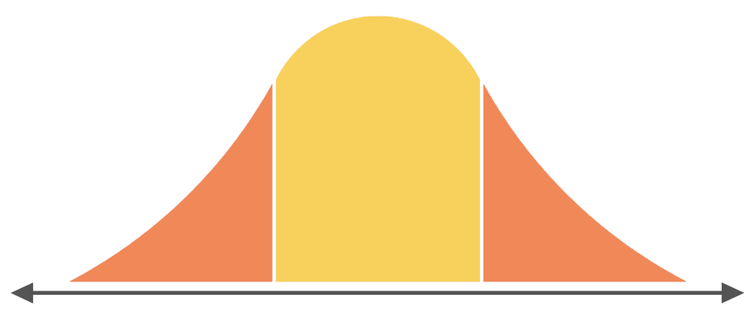
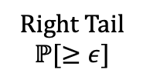
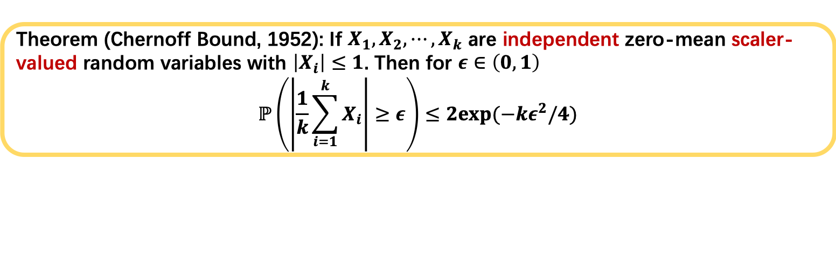



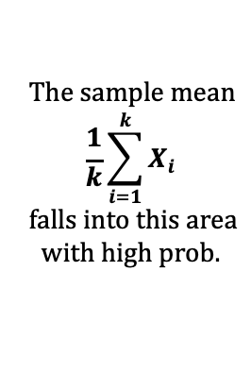
Chernoff Bounds
Theorem (Chernoff Bound, 1952): If $X_{1}, X_{2},⋯,X_{k}$ are independent zero-mean scaler-valued random variables with $\left|X_{i}\right|≤1$. Then for $ε∈\left(0, 1\right)$
$$ℙ\left(\left|\frac{1}{k}\sum_{i=1}^{k}{X_{i}}\right|≥ε\right)≤2exp(−kε^{2}/4)$$
$$The sample mean$$
$$\frac{1}{k}\sum_{i=1}^{k}{X_{i}}$$
$$falls into this area$$
$$with high prob.$$
Left Tail
$$ℙ\left[≤−ε\right]$$
Right Tail
$$ℙ[≥ε]$$
$$−ϵ$$
$$ϵ$$
Notes:
20sec
The Chernoff Bound is one of the most important probabilistic results in computer science.
Suppose there are K independent random variables,
Chernoff bound gives exponentially decreasing bounds on tail distributions of their sample mean.

Slide 4
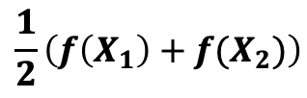





A Matrix Chernoff Bound for Markov Chains
$$P(X_{2}|X_{1})$$
Independence
Markov Dependence
$${ X}_{1}$$
$${ X}_{2}$$
Scalar-valued
Random Variables
Matrix-valued
Random Variables
$$f(X_{1})$$
$$f(X_{2})$$
Sample Mean Matrix
$$\frac{1}{2}\left(f\left(X_{1}\right)+f(X_{2})\right)$$
Notes:
(25sec)
Our work generalize the classical Chernoff bounds in two aspects.
Instead of the independence assumption, we assume that Xi’s are sampled via a Markov chain P.
Instead of the scalar random variables, we assume a function f that maps Xi’s to matrices.
By a random walk on the Markov chain, we compute a a sample mean matrix, and we want to study its behavior.

Slide 5

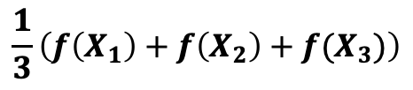


A Matrix Chernoff Bound for Markov Chains
$$P(X_{2}|X_{1})$$
$$P(X_{3}|X_{2})$$
Independence
Markov Dependence
$${ X}_{1}$$
$${ X}_{2}$$
$${ X}_{3}$$
Scalar-valued
Random Variables
Matrix-valued
Random Variables
$$f(X_{1})$$
$$f(X_{2})$$
$$f(X_{3})$$
Sample Mean Matrix
$$\frac{1}{3}\left(f\left(X_{1}\right)+f\left(X_{2}\right)+f(X_{3})\right)$$
Notes:
No script

Slide 6

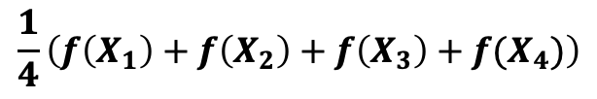
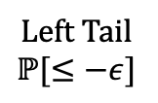


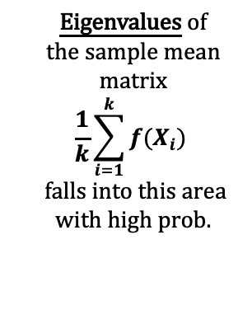
A Matrix Chernoff Bound for Markov Chains
$$P(X_{2}|X_{1})$$
$$P(X_{3}|X_{2})$$
$$P(X_{4}|X_{3})$$
Independence
Markov Dependence
$${ X}_{1}$$
$${ X}_{2}$$
$${ X}_{3}$$
$${ X}_{4}$$
…
Scalar-valued
Random Variables
Matrix-valued
Random Variables
…
$$f(X_{1})$$
$$f(X_{2})$$
$$f(X_{3})$$
$$f(X_{4})$$
Eigenvalues of
$$the sample mean$$
matrix
$$\frac{1}{k}\sum_{i=1}^{k}{f(X_{i})}$$
$$falls into this area$$
$$with high prob.$$
Sample Mean Matrix
$$\frac{1}{4}\left(f\left(X_{1}\right)+f\left(X_{2}\right)+f\left(X_{3}\right)+f(X_{4})\right)$$
Left Tail
$$ℙ[≤−ε]$$
Right Tail
$$ℙ[≥ε]$$
$$−ϵ$$
$$ϵ$$
Notes:
(20sec)
Similar to the classical Chernoff bound, our result shows that
With high probability, the eigenvalues of the sample mean matrix fall into a small area.
More interestingly, the tail distributions of the eigenvalues decrease exponentially in terms of the number of samples from the markov chain.

Slide 7
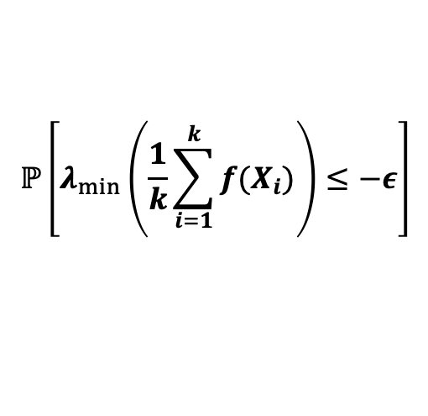
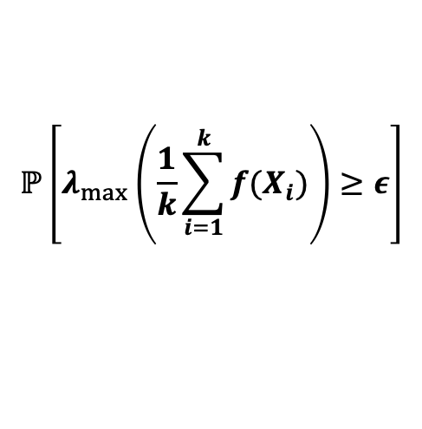
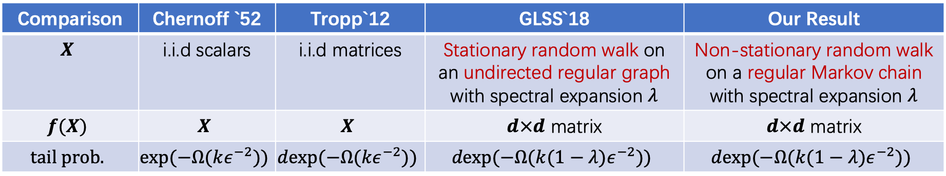
A Matrix Chernoff Bound for Markov Chains
$$ℙ\left[λ_{min}\left(\frac{1}{k}\sum_{i=1}^{k}{f(X_{i})}\right)≤−ε\right]$$
$$ℙ\left[λ_{max}\left(\frac{1}{k}\sum_{i=1}^{k}{f(X_{i})}\right)≥ε\right]$$
and
Comparison | Chernoff `52 | Tropp`12 | GLSS`18 | Our Result
$$X$$ | i.i.d scalars | i.i.d matrices | Stationary random walk on an undirected regular graph with spectral expansion $λ$ | Non-stationary random walk on a regular Markov chain with spectral expansion $λ$
$$f(X)$$ | $$X$$ | $$X$$ | $d×d$ matrix | $d×d$ matrix
$$tail prob.$$ | $$exp(−Ω(kε^{−2}))$$ | $$dexp(−Ω(kε^{−2}))$$ | $$dexp(−Ω(k(1−λ)ε^{−2}))$$ | $$dexp(−Ω(k(1−λ)ε^{−2}))$$
Notes:
(15sec)
Our result improves previous work by extending the regular undirected graph assumption to general markov chains, and
extending the stationary walk assumption to non-stationary one,
It allows for studying more realistic problems, especially the co-occurrence problem.

Slide 8
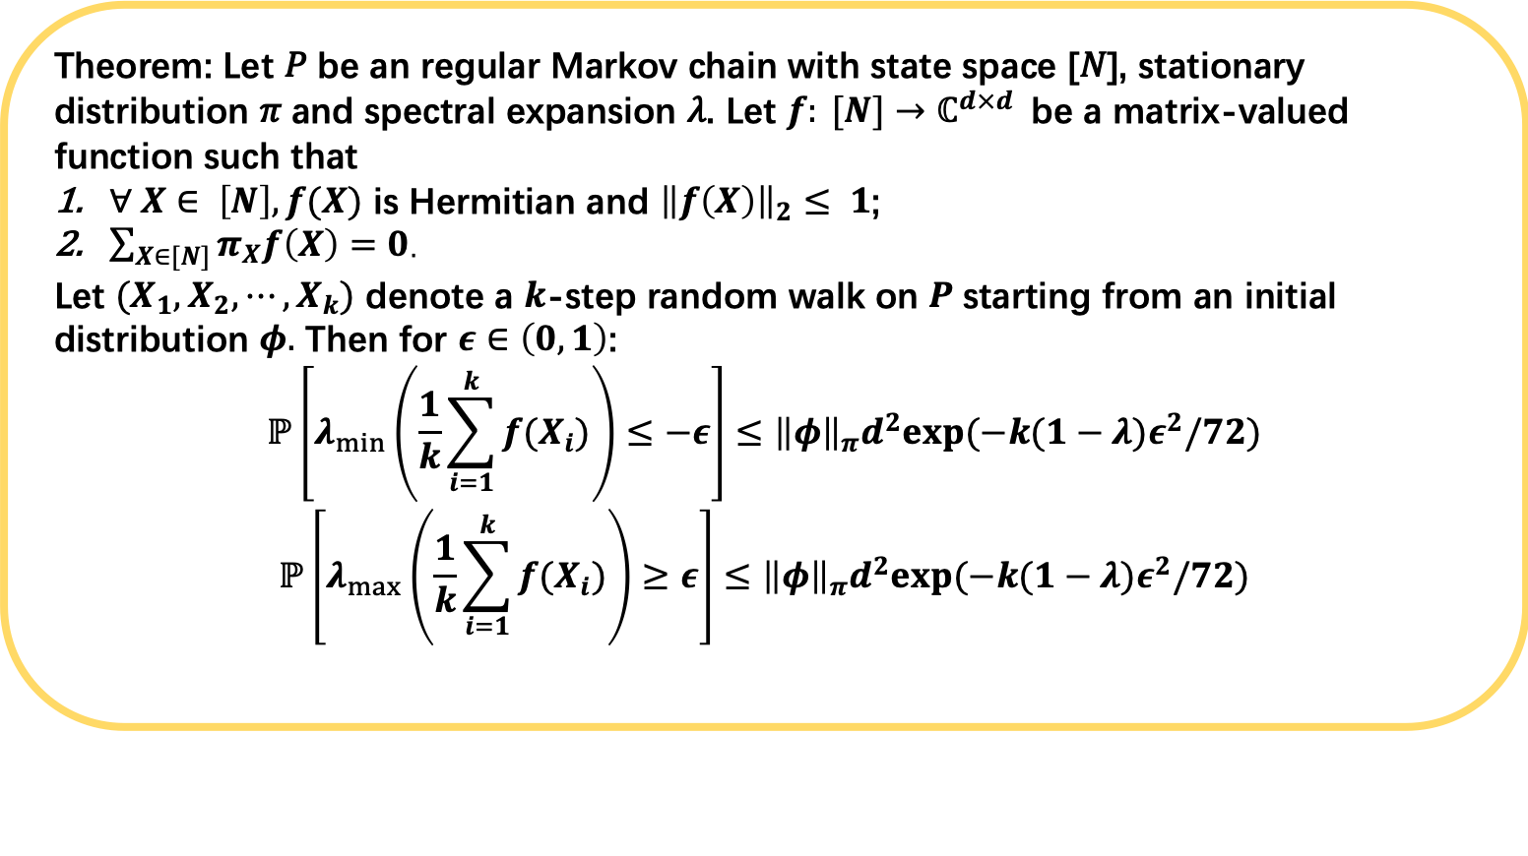
A Matrix Chernoff Bound for Markov Chains
Theorem: Let 𝑃 be an regular Markov chain with state space [𝑁], stationary distribution 𝜋 and spectral expansion 𝜆. Let $f: [N]→ℂ^{d×d}$be a matrix-valued function such that
$∀ X∈ \left[N\right], f(X)$ is Hermitian and ${\left\|f\left(X\right)\right\|}_{2}≤ 1$;
$\sum_{X∈[N]}{π_{X}f\left(X\right)=0}$.
Let $(X_{1},X_{2},⋯, X_{k})$ denote a $k$-step random walk on $P$starting from an initial distribution $φ.$ Then for $ε∈\left(0, 1\right)$:
$$ℙ\left[λ_{min}\left(\frac{1}{k}\sum_{i=1}^{k}{f(X_{i})}\right)≤−ε\right]≤{\left\|φ\right\|}_{π}d^{2}exp(−k(1−λ)ε^{2}/72)$$
$$ℙ\left[λ_{max}\left(\frac{1}{k}\sum_{i=1}^{k}{f(X_{i})}\right)≥ε\right]≤{\left\|φ\right\|}_{π}d^{2}exp(−k(1−λ)ε^{2}/72)$$
Notes:
The formal theorem is shown in this slide,

Slide 9
The Application to Co-occurrence Matrices
NLP
(LDA, Word2vec, Glove)
Graph Representation Learning
(DeepWalk, node2vec, metapath2vec)
Recommendation System (Pin2Vec, Item2vec)
Reinforcement Learning
(Act2Vec)
Hidden Markov Models
(Emission Co-occurrence)
Notes:
Come back to the application to co-occurrence statistics.

Slide 10
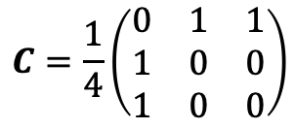
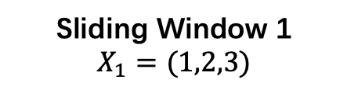
Co-occurrence Matrix of Sequential Data
Sliding Window 1
$$X_{1}=(1,2,3)$$
1
2
3
2
3
1
$$C=\frac{1}{4}\left(\begin{matrix}0 & 1 & 1 \\ 1 & 0 & 0 \\ 1 & 0 & 0\end{matrix}\right)$$
Notes:
(5sec)
Given a sequence of objects,
We move a sliding window through the sequence, and count the co-occurrence in each window.

Slide 11
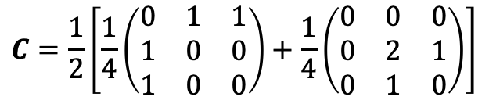
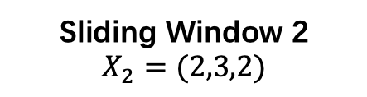
Co-occurrence Matrix of Sequential Data
Sliding Window 2
$$X_{2}=(2,3,2)$$
1
2
3
2
3
1
$$C=\frac{1}{2}\left[\frac{1}{4}\left(\begin{matrix}0 & 1 & 1 \\ 1 & 0 & 0 \\ 1 & 0 & 0\end{matrix}\right)+\frac{1}{4}\left(\begin{matrix}0 & 0 & 0 \\ 0 & 2 & 1 \\ 0 & 1 & 0\end{matrix}\right)\right]$$

Slide 12
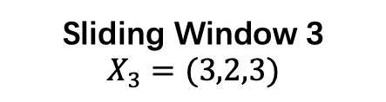
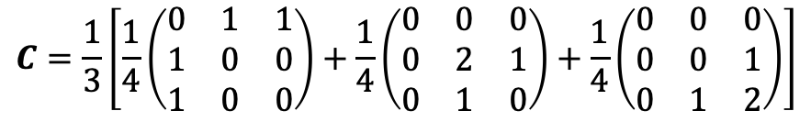
Co-occurrence Matrix of Sequential Data
Sliding Window 3
$$X_{3}=(3,2,3)$$
1
2
3
2
3
1
$$C=\frac{1}{3}\left[\frac{1}{4}\left(\begin{matrix}0 & 1 & 1 \\ 1 & 0 & 0 \\ 1 & 0 & 0\end{matrix}\right)+\frac{1}{4}\left(\begin{matrix}0 & 0 & 0 \\ 0 & 2 & 1 \\ 0 & 1 & 0\end{matrix}\right)+\frac{1}{4}\left(\begin{matrix}0 & 0 & 0 \\ 0 & 0 & 1 \\ 0 & 1 & 2\end{matrix}\right)\right]$$

Slide 13
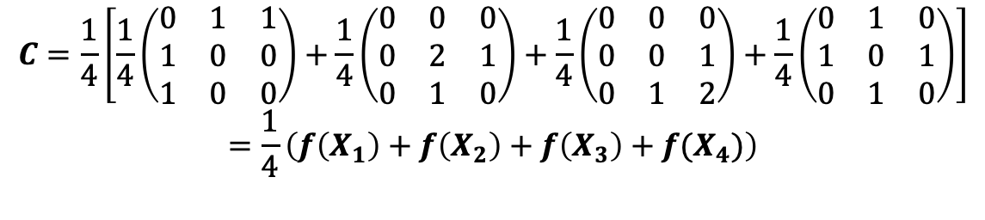
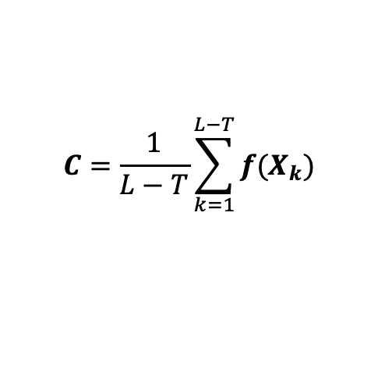
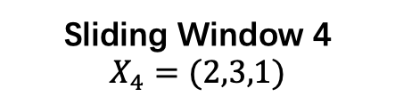
Co-occurrence Matrix of Sequential Data
Markov chain Matrix Chernoff Bound!
Sliding Window 4
$$X_{4}=(2,3,1)$$
1
2
3
2
3
1
$$C=\frac{1}{4}\left[\frac{1}{4}\left(\begin{matrix}0 & 1 & 1 \\ 1 & 0 & 0 \\ 1 & 0 & 0\end{matrix}\right)+\frac{1}{4}\left(\begin{matrix}0 & 0 & 0 \\ 0 & 2 & 1 \\ 0 & 1 & 0\end{matrix}\right)+\frac{1}{4}\left(\begin{matrix}0 & 0 & 0 \\ 0 & 0 & 1 \\ 0 & 1 & 2\end{matrix}\right)+\frac{1}{4}\left(\begin{matrix}0 & 1 & 0 \\ 1 & 0 & 1 \\ 0 & 1 & 0\end{matrix}\right)\right]$$
$$=\frac{1}{4}\left(f\left(X_{1}\right)+f\left(X_{2}\right)+f\left(X_{3}\right)+f(X_{4})\right)$$
Observation 1:
Let $X_{1},X_{2},⋯,X_{L−T}$ be the sequence of sliding windows, and $f$ maps a sliding window to the co-occurrence matrix
within this window. The co-occurrence matrix $C$ can be written as the sample mean of $f(X_{1}),{f(X}_{2}),⋯,{f(X}_{L−T})$:
$$C=\frac{1}{L−T}\sum_{k=1}^{L−T}{f(X_{k})}$$
Observation 2: If the input sequence $v_{1},v_{2},⋯$ is a Markov Chain, then $X_{1},X_{2},⋯$ is a Markov Chain, too.
Notes:
20 sec
The final co-occurrence matrix is simply the sample mean of the co-occurrence matrix in each sliding window.
Moreover, if the input sequence is a Markov chain, the sliding window is also a Markov chain.

Slide 14
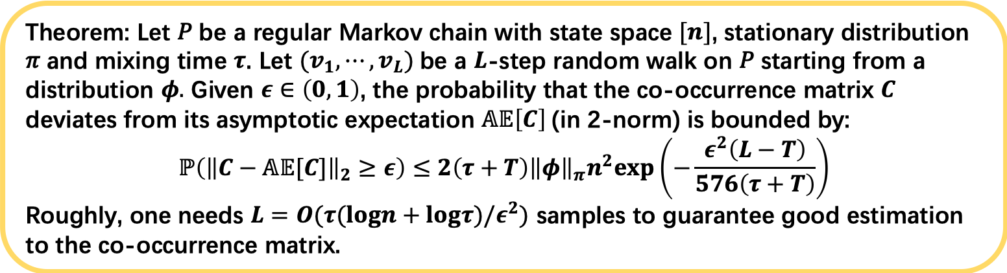
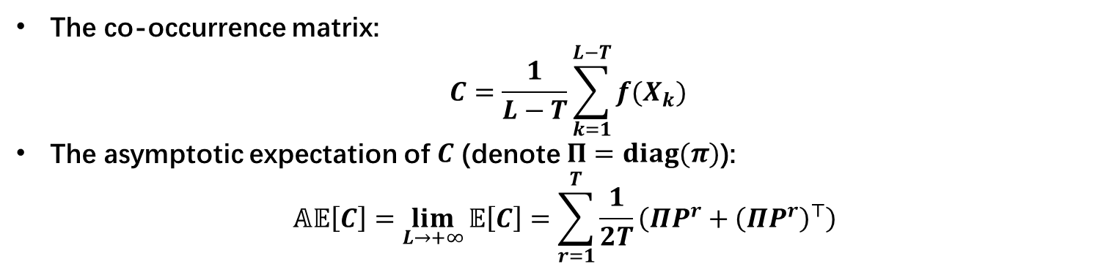
Convergence Rate of Co-occurrence Matrices
The co-occurrence matrix:
$$C=\frac{1}{L−T}\sum_{k=1}^{L−T}{f(X_{k})}$$
The asymptotic expectation of $C$ (denote $Π=diag(π)$):
$$𝔸𝔼\left[C\right]=\lim_{L→+∞}{𝔼\left[C\right]=\sum_{r=1}^{T}{\frac{1}{2T}\left(ΠP^{r}+{\left(ΠP^{r}\right)}^{⊤}\right)} }$$
Theorem: Let 𝑃 be a regular Markov chain with state space $[n]$, stationary distribution 𝜋 and mixing time $τ$. Let $(v_{1},⋯,v_{L})$be a $L$-step random walk on 𝑃 starting from a distribution $φ.$ Given $ε∈\left(0, 1\right)$, the probability that the co-occurrence matrix $C$ deviates from its asymptotic expectation $𝔸𝔼\left[C\right]$(in 2-norm) is bounded by:
$$ℙ\left({\left\|C−𝔸𝔼[C]\right\|}_{2}≥ε\right)≤2\left(τ+T\right){\left\|φ\right\|}_{π}n^{2}exp\left(−\frac{ε^{2}\left(L−T\right)}{576\left(τ+T\right)}\right)$$
Roughly, one needs $L=O(τ(logn+logτ)/ε^{2})$ samples to guarantee good estimation to the co-occurrence matrix.
Notes:
20sec
Built upon our Markov chain Matrix Chernoff Bound, we show that the empirical co-occurrence matrix converges to its expectation exponentially.
Roughly speaking, we need O(t(logn+logt)) samples from the markov chain to provide a good estimation to the Co-occurrence Matrices

Slide 15
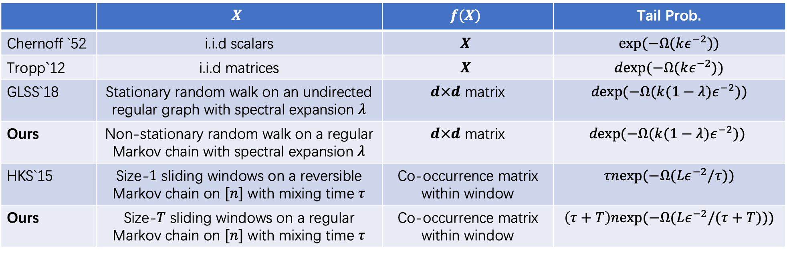
Comparison
 | $$X$$ | $$f(X)$$ | Tail Prob.
Chernoff `52 | i.i.d scalars | $$X$$ | $$exp(−Ω(kε^{−2}))$$
Tropp`12 | i.i.d matrices | $$X$$ | $$dexp(−Ω(kε^{−2}))$$
GLSS`18 | Stationary random walk on an undirected regular graph with spectral expansion $λ$ | $d×d$ matrix | $$dexp(−Ω(k(1−λ)ε^{−2}))$$
Ours | Non-stationary random walk on a regular Markov chain with spectral expansion $λ$ | $d×d$ matrix | $$dexp(−Ω(k(1−λ)ε^{−2}))$$
HKS`15 | Size-$1$ sliding windows on a reversible Markov chain on $[n]$ with mixing time $τ$ | Co-occurrence matrix within window | $$τnexp(−Ω(Lε^{−2}/τ))$$
Ours | Size-$T$ sliding windows on a regular Markov chain on $[n]$ with mixing time $τ$ | Co-occurrence matrix within window | $$\left(τ+T\right)nexp(−Ω(Lε^{−2}/(τ+T)))$$

Slide 16
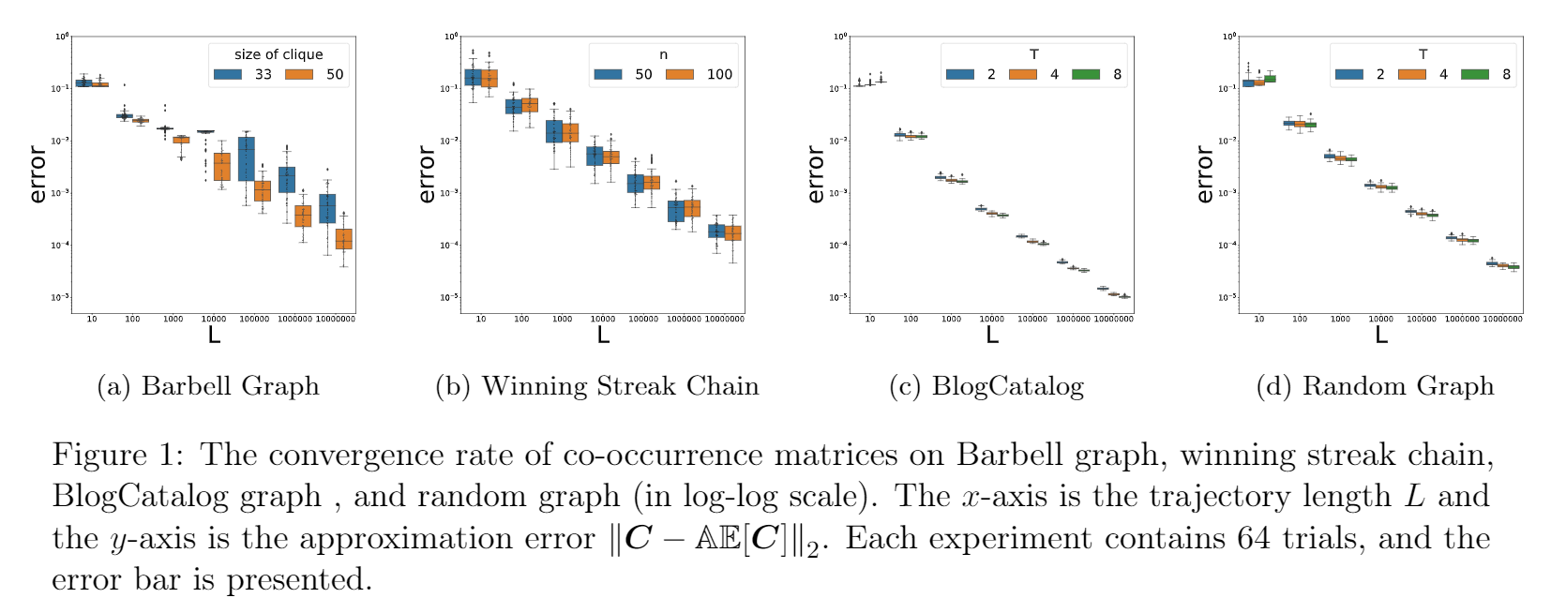
Numerical Experiments

Slide 17
Thanks!
https://arxiv.org/abs/2008.02464
Notes:
Thanks for your listening.

