Slide 1
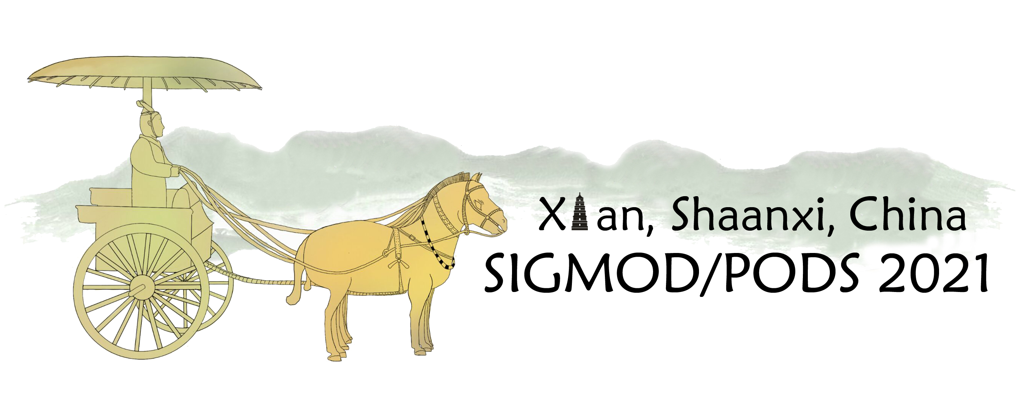





LightNE: A Lightweight Graph Processing System for Network Embedding
Jiezhong Qiu, Laxman Dhulipala, Jie Tang, Richard Peng, Chi Wang
https://github.com/xptree/LightNE.
Notes:
Hi, this is Jiezhong Qiu from Tsinghua University. It is my pleasure to present our work LightNE: A Lightweight Graph Processing System for Network Embedding
in SIGMOD 2021. This is a joint work with Laxman Dhulipala from MIT, Jie Tang from Tsinghua University, Richard Peng from Georgia Tech, and Chi Wang from Microsoft Research.
The code of this work is open-sourced at github.

Slide 2
Roadmap
Introduction to Network Embedding
LightNE: Co-design of Algorithm and System
Experiments on graphs with billions of edges.
Notes:
This talk will start with a gentle introduction to network embedding.
Then I will propose LightNE, including its design goal, and how we meet the goal with algorithm and system co-design.
Finally, we will see some experimental results on very large graphs with billions of edges.

Slide 3


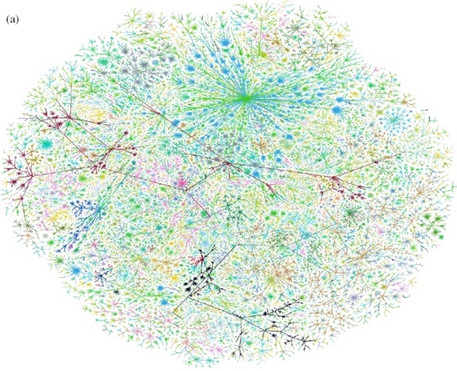
Real-world Graphs
Biological Graph
Question:
How to design machine learning models for large-scale real-world graphs?
Social/Business Graph
Knowledge Graph
Internet Graph
Transportation Graph
figure credit: Web
Notes:
Graphs are everywhere around us, including the social/business graphs, biological graphs, knowledge graphs, internet graphs, and transportation graphs.
Over the past years, the main focus of graph learning research has been on designing models and algorithms for large-scale and real-world graphs.
Among many algorithms, network embedding, exemplified by DeepWalk, Line and node2vec, is one of the most important methods for learning representations for graphs.

Slide 4
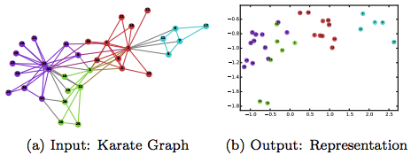

Background: Network Embedding
Given a graph $G=\left(V, E\right)$, aim to learn a function $f:V→R^{d}$ to capture neighborhood similarity and community membership.
A toy example from DeepWalk [1]
[1] Bryan Perozzi, Rami Al-Rfou, and Steven Skiena. 2014. Deepwalk: Online learning of social representations. In KDD ’14. ACM, 701–710.
Notes:
The problem of network embedding is formalized as follows:
Given an input graph, want to learn a mapping function from its node set to low-dimensional vector space, so that the low-dim embeddings
capture neighborhood similarity and community membership of the graph.
Here is a toy example from DeepWalk. You can see that we can almost reconstruct the graph structure form the low-dimensional embeddings.

Slide 5
Background: DeepWalk
Sampling random walk sequences on the input graph
Train a skip-graph model (word2vec) on the sampled sequences
Scalability issue:
  Alibaba embeds a 600-billion-node commodity graph by first partitioning it into 50-million-node subgraphs, and then embedding each subgraph separately with 100 GPUs running DeepWalk [1]
[1] Jizhe Wang, Pipei Huang, Huan Zhao, Zhibo Zhang, Binqiang Zhao, and Dik Lun Lee. 2018. Billion-scale commodity embedding for e-commerce recommendation in alibaba. In KDD ’18. 839–848.
Notes:
The idea of DeepWalk is very simple and smart. It borrows the idea from a popular NLP method, word2vec, by first sampling random walk sequences on the input graph,
And then trainig a word2vec model on the sampled sequences.
However, as a gradient-based learning algorithm, DeepWalk is not scalable.
In the common system design to accelerate DeepWalk, CPUs are designed to conduct graph operations and GPUs are designed to perform optimization.
However, the whole system is bounded by GPU memory, which in most cases is at most 32GB per GPU: embedding graphs with billions of
vertices often require hundreds of Gigabytes of parameter memory.
Actually, Alibaba embeds a 600-billion-node commodity graph by first partitioning it into 50-million-node subgraphs, and then embedding each subgraph separately with 100 GPUs running DeepWalk [1].

Slide 6

Background: Network Embedding as Matrix Factorization
NetMF[1]: DeepWalk is implicitly and asymptotically factorizing:
NetSMF[2]:
  Sparisify r-step random walk matrix ${{(D}^{−1}A)}^{r}$ with PathSampling.
  Need $O(mlogn)$samples
[1] Jiezhong Qiu, Yuxiao Dong, Hao Ma, Jian Li, Kuansan Wang, and Jie Tang. 2018. Network embedding as matrix factorization: Unifying deepwalk, line, pte, and node2vec. In WSDM ’18.
[2] Jiezhong Qiu, Yuxiao Dong, Hao Ma, Jian Li, Chi Wang, Kuansan Wang, and Jie Tang. 2019. Netsmf: Large-scale network embedding as sparse matrix factorization. WWW’ 19.
Notes:
In contrast to the mainstream belief that distributed architecture and GPUs are needed
for large-scale network embedding with good quality, we prove that we can achieve higher quality,
better scalability, lower cost and faster runtime with shared-memory, CPU-only architecture.
To achieve this, we view network embedding from a matrix factorization perspective,instead of treating it as a gradient-based learning problem.
Our previous work named NetMF shows that DeepWalk is implicitly and asymptotically doing matrix factorization, factorizing a random walk matrix polynomial composed with a entry-wise logarithm.
Our another work NetSMF shows that,
although the matrix powers could be very dense, but it can be well approximated by a sparse matrix, using the PathSampling algorithm with O(mlogn) number of samples.
The pathsampling algorithm first sample a uniform ranom edge (u,v) from the graph, and then conduct show random walk from the endpoints u and v, reach u’and v’respectively. And the new edge (u’,v’) contributes to the sparsifier of the r-step random walk matrix power.
We will follow the above matrix factorization framework to design our LightNE system.

Slide 7
Roadmap
Introduction to Network Embedding
LightNE: Co-design of Algorithm and System
Experiments on graphs with billions of edges.
Notes:
Now I will formally introduce LightNE, from both algorithm design and system design perspectives.

Slide 8
LightNE: Design Goal
Scalable: Embed graphs with 1B edges within 1.5 hours.
Lightweight: Occupy hardware costs below 100 dollars measured by cloud rent to process 1B to 100B edges.
Accurate: Achieve the highest accuracy in downstream tasks under the same time budget and similar resources.
Notes:
We have three design goals:
Scalable: Embed graphs with 1B edges within 1.5 hours.
Lightweight: Occupy hardware costs below 100 dollars measured by cloud rent to process 1B to 100B edges.
Accurate: Achieve the highest accuracy in downstream tasks under the same time budget and similar resources.
From a algorithm perspective, LightNE consists of two steps — NetSMF and spectral propagation.
From a system perspective, the NetSMF step can be further decomposed into two sub-steps — parallel sparsifier construction and parallel randomized SVD.
Now we introduce them one by one.

Slide 9
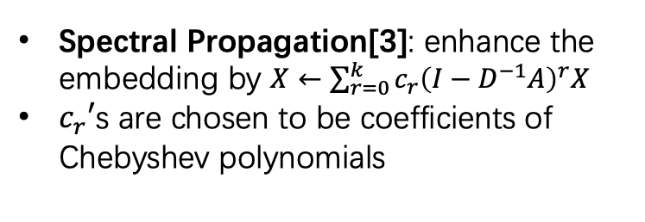
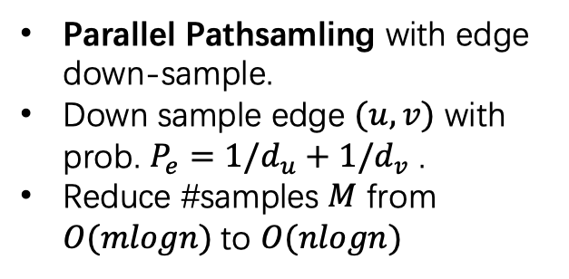
LightNE: Algorithm and System Co-design
Store input graph in GBBS[1] compressed CSR format
Highly optimized parallel graph processing
Parallel Pathsamling with edge down-sample.
Down sample edge $(u, v)$ with prob. $P_{e}=1/d_{u}+1/d_{v}$ .
Reduce #samples $M$ from $O(mlogn)$to $O(nlogn)$
Parallel Randomized SVD implemented by Intel MKL
Spectral Propagation[3]: enhance the embedding by $X←\sum_{r=0}^{k}{c_{r}{\left(I−D^{−1}A\right)}^{r}X}$
$c_{r}′$s are chosen to be coefficients of Chebyshev polynomials
Sparse Parallel Hashing: collect sampled edges in parallel
[2] Jiezhong Qiu, Yuxiao Dong, Hao Ma, Jian Li, Chi Wang, Kuansan Wang, and Jie Tang. 2019. Netsmf: Large-scale network embedding as sparse matrix factorization. WWW’ 19.
[1] Laxman Dhulipala, Guy E. Blelloch, and Julian Shun. 2018. Theoretically Efficient Parallel Graph Algorithms Can Be Fast and Scalable. In ACM Symposium on Parallelism in Algorithms and Architectures (SPAA). 393–404.
[3] Jie Zhang, Yuxiao Dong, Yan Wang, Jie Tang, and Ming Ding. 2019. ProNE: fast and scalable network representation learning. In IJCAI ’19. 4278–4284.
Notes:
The input graph is maintained by a high-performance graph processing system, GBBS, which provides high performance graph operations such as performing
random walks, querying vertex degrees, random accessing a neighbor of a vertex, etc.
In the parallel sparsifier construction step, we run parallel Pathsamling with edge down-sample.
For example, we first sample a uniform random edge (u, v).
With probability p equals to 1/d_u + 1/d_v, we conduct the pathing sampling algothirm and add the sampled edge (u’, v’) to the sparsifier with weight 1/p./
With probability 1-p, we discard this sample.
On can show that, the downsampling (which is in essense an application of importance sampling) reduces #samples from $O(mlogn)$to $O\left(nlogn\right)$
But still preserving the theoretical advantages of sparsification.
Next, we turn to how the sparsifier is constructed and represented in memory. The pathsampling algorithm generates many weighted edges, we need to count the frequency each distinct edge is sampled.
we found that the fastest and most memory-efficient method across all of our inputs was to use sparse parallel hashing.
The construction used in this paper is folklore algorithm in the parallel algorithms literature,
After the construction of the sparsifier, we conduct parallel randomized svd on the sparsifier, implemented by highly-optimized intel mkl library, including efficient sparsem dense matrix multiplication, dense dense matrix multiplication, qr decomposition, singular value decomposition, etc.
The top singular vectors form the initial network embedding matrix.
Combining the above steps together, we get the accelerated NetSMF.
The final step is to perform spectral propagation on the NetSMF embedding. This technique was proposed in the ProNE model, and is able to enhance the quality of existing network embedding. The method applies a filter to each column
of the embedding matrix using a low degree polynomial in the normalized graph Laplacian matrix, and the where coefficients of the polynomial are chosen to be coefficients of Chebyshev polynomials.

Slide 10
Roadmap
Introduction to Network Embedding
LightNE: Co-design of Algorithm and System
Experiments on graphs with billions of edges.
  Baselines: GraphVite, Pytorch-Big-Graph, NetSMF, ProNE
Notes:
We conduct extensive experiments in our paper, comparing LightNE to various baselines such as GraphVite, Pytorch-Big-Graph, NetSMF, ProNE.
Limited by space,in today’s talk. we mainly report the comparison to NetSMF and ProNE.

Slide 11

Comparison to NetSMF and ProNE
Open Academic Graph (67,768,244 nodes, 895,368,962 edges)
LightNE-small (#samples=$m$) and LightNE-large (#samples=200$m$)
LightNE-Large achieves 15x speedup (1.53h v.s. 22.4h) and significant performance gain, comparing to NetSMF.
Not only does LightNE-Small run faster than ProNE+ (20.9 min v.s. 21 min), but also outperforms ProNE+ significantly.
Estimated price of LightNE-Large: 1.53h * 13$/h =20$
Notes:
We conduct experiments on the Open Academic Graph, consists of 67 million nodes and around 1 billion edges.
For LightNE, all experiments are conducted on a server with 88 cores and 1.5 TB memory, a similar server, if rent in Azure, costs 13$ per hour.
We vary the number of samples drawn by LightNE, denote the one with fewer samples as LightNE-small, and the one with more samples as LightNE-Large.
We have third observations:
\pause
Firstly，LightNE-Large achieves 15x speedup (1.53h v.s. 22.4h) and significant performance gain, comparing to NetSMF.
\pause
Secondly, Not only does LightNE-Small runs faster than ProNE (20.9 min v.s. 21 min), but also outperforms ProNE significantly.
\pause
Moreover, it takes LightNE-Large around 20$ to process Open academic graph, meets our design goal to
occupy hardware costs below 100 dollars measured by cloud rent to process 1B to 100B edges.

Slide 12
Comparison to NetSMF and ProNE
Notes:
We use another figure to illustrate the comparison to NetSMF and ProNE as well as the efficiency-effectiveness trade-off curve of LightNE
Overall, LightNE is a Pareto-optimal solution that strictly dominates ProNE+ or NetSMF — for either ProNE+ or NetSMF, one can
find a configuration of LightNE in Figure 2 that is faster and moreaccurate.
Moreover, there is a clear trade-off between efficiency and
effectiveness in LightNE. The more samples LightNE draws, the longer time it takes, but higher F1 score it achieves
That means a user can configure and adjust LightNE flexibly according to his/her time/cost budgets and performance
requirements. Comparing LightNE to NetSMF and ProNE+
also suggests that spectral propagation plays the role of “standing
on the shoulder of giants” — the quality of the enhanced embedding
heavily relies on that of the initial one.

Slide 13
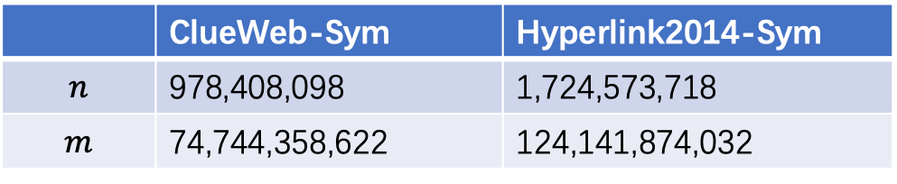
Very Large Graphs
None of the existing network embedding systems can
handle such large graphs in a single machine!
 | ClueWeb-Sym | Hyperlink2014-Sym
$$n$$ | 978,408,098 | 1,724,573,718
$$m$$ | 74,744,358,622 | 124,141,874,032
Notes:
We also conduct experiments on two very large graphs with billions of edges.
Hyperlink2014 graph is one of the largest publicly available graph today, and very few graph processing systems
or graph algorithms have been applied to a graph of this magnitude
\pause
We want to emphasize that None of the existing network embedding systems can handle such large graphs in a single machine!
We gradually increase the number of edge samples until it reaches the memory bottleneck of the single machine.
As we can see, the more samples we draw by edge sampling, the higher accuracy LightNE can achieve.
For each experiment, LightNE needs fewer than two hours for training, again showing the scalability and lightweightness of LightNE.
Moreover, the trend of growth shown in Figure 3 suggests that the performance in these datasets can be further improved if we can overcome the memory bottleneck by,
for example, using a machine with larger memory, or designing compressed hash tables and linear algebra tools.

Slide 14
Conclusion
Propose LightNE, a cost-effective, scalable, and high quality network embedding system that scales to graphs with hundreds of billions of edges on a single machine.
Introduce 4 techniques to network embedding for the first time:
  A new downsampling method to reduce the sample complexity of NetSMF.
  A parallel graph processing stack GBBS for memory efficiency and scalability;
  Sparse parallel hash table to maintain the matrix sparsifier in memory
  Intel MKL for efficient randomized SVD and spectral propagation.

Slide 15
Thanks!
LightNE: A Lightweight Graph Processing System for Network Embedding
Jiezhong Qiu, Laxman Dhulipala, Jie Tang, Richard Peng, Chi Wang
https://github.com/xptree/LightNE.
Notes:
Thanks for your listening. If you are interested in our LightNE paper, please visit our github repo.

